Slide 1
超广角契伦科夫望远镜
和
高能GRB探测
报告人：蔡 晖
中国科学院高能物理研究所
兰州大学
合作者：陈天禄（西藏大学）
张毅，刘成，王振，冯有亮，胡红波（高能所）
第十二届全国粒子物理学术会议，合肥, 2016.8.25
Notes:
从实验观测的角度讨论GRB，介绍一些重要实验在探测GRB时的优势；从而引出目前正在探索的超广角契伦科夫望远镜的研制，以及其探测GRB的潜在优势

Slide 2
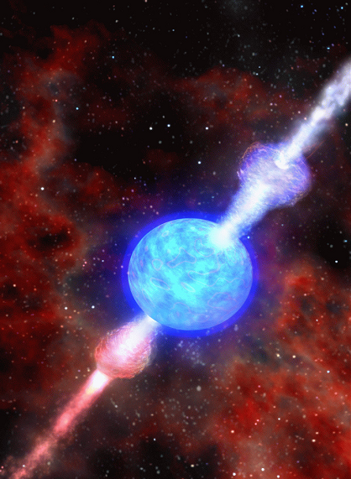
Why Study GRBs at Very High Energy (GeV-subTeV)?
Gamma-ray bursts: the most violent explosions in the universe
Acceleration mechanisms , energetics, and therefore constrain the progenitors and jet feeding mechanism
Understanding progenitor then leads to an understanding of cosmology & stellar evolution required to support progenitor population
Extragalactic background light induced absorption (EBL absorption) of high energy photons
Limits on Lorentz Invariance Violation
Potential ultra high energy cosmic ray sources
Notes:
首先呢，把关注点放在GEV到百GEV能区，这一能区观测点是比较少的，显得比较重要；；宇宙线加速机制；宇宙学和星际演化研究；河外背景光吸收；限制洛伦兹不变性；研究潜在的甚高能宇宙线源

Slide 3
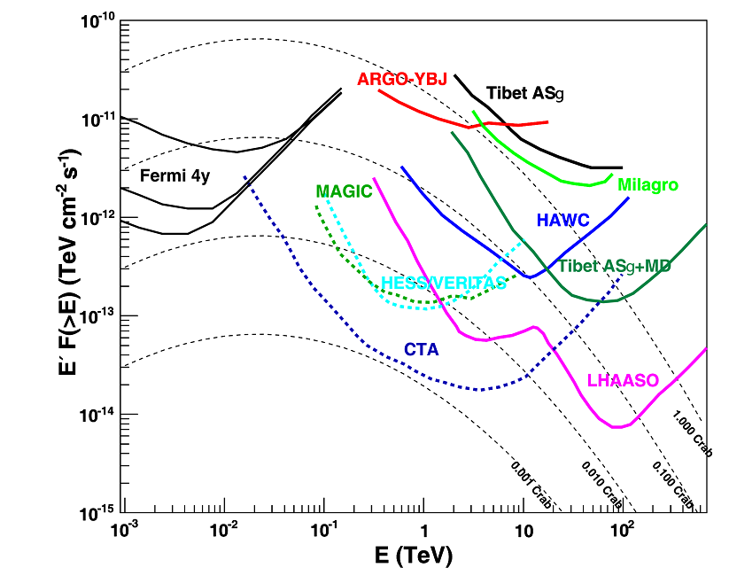
VHE能段γ射线的探测能力
当前探测技术存在薄落区
Chensz, SCIENTIA SINICA Physica, Mechanica & Astronomica,45,119503, 2015
Notes:
图 19 (网络版彩图) 各实验灵敏度, 其中 Fermi 从上至下三
条线分别代表 (l=0◦, b=0◦), (l=0◦, b=30◦), (l=0◦, b=90◦) 位
置处 4 年观测时间,为50 h观测时间(MAGIC为最新的双镜联合观测);
Tibet ASγ(ASγ+MD为12个MD水池和地面阵列全加密
结果), Milagro[34], ARGO-YBJ[32],, HAWC[34], LHAASO[35]
为一年观测时间
蓝色的框框，空间实验和地面实验在这里交接，显示出这是我们探测的薄弱区间。对于寻找伽马射线点源，我们用这张图来描述。每个实验有一条线，实际上对GRB来说，用灵敏度曲线来描述还不是那么全面。所以我们可以分开来看。

Slide 4
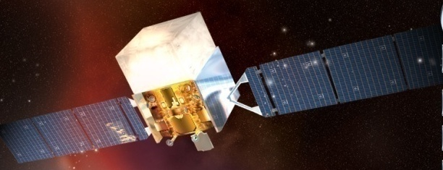
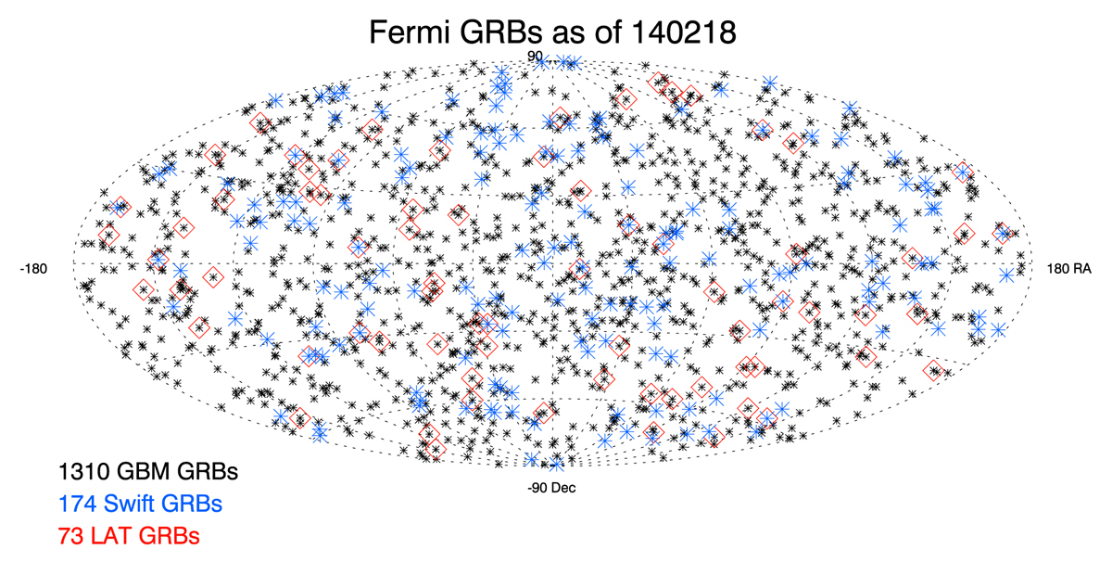
Fermi对高能GRB的探测
空间实验能够覆盖
20 MeV–300GeV
全天候，大视场
能量角度分辨好
但有效面积小约１ｍ^{２}
Notes:
能量分辨6%，有量能器，有track,所以角分辨也很好。

Slide 5
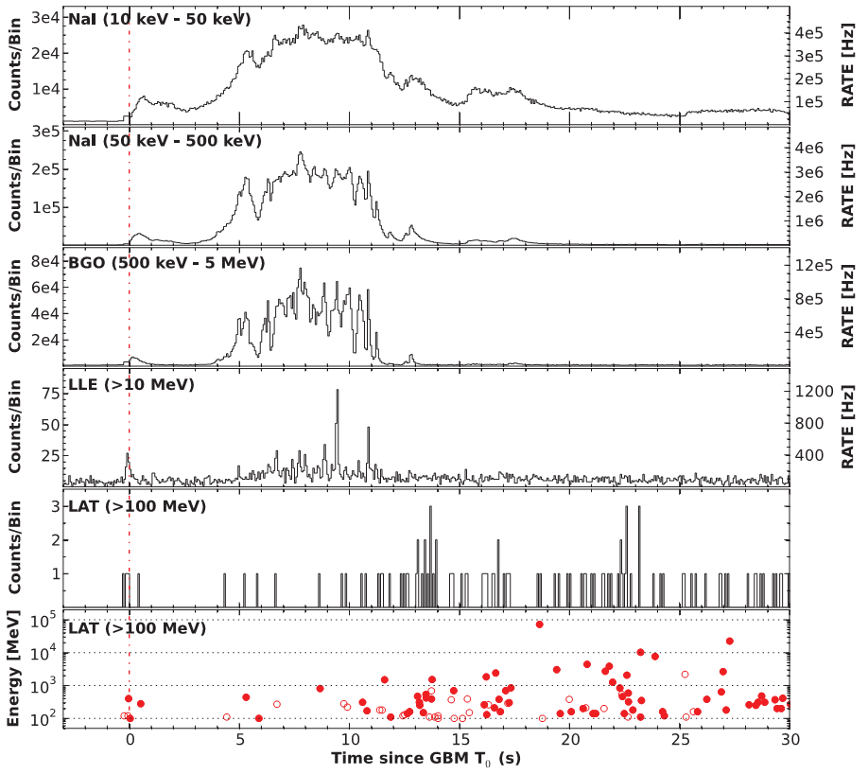
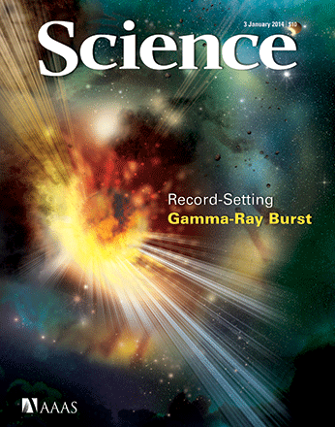
观测到的最高能量的GRB 130427A
GRB Name | Photon E_{max} | Redshift
GRB080916C | 13GeV | 4.35
GRB090510 | 31GeV | 0.903
GRB090902B | 33GeV | 1.822
GRB090926A | 19.6GeV | 2.1
GRB130427A | 95GeV | 0.145
GRB 940217 | 18GeV | /
1. 有效面积1m², 探测GRB光子数少；
2. 高能光子时间延后。
Notes:
目前看到的10GEV以上的GRB有这么几个，fermi看到这些暴的光子极为有限，可能就一个或者两个，因为有效面积小，看光变曲线也能知道高能的比其他能段的要延后，高能光子来的晚，给CTA容易观测，晚10分，

Slide 6
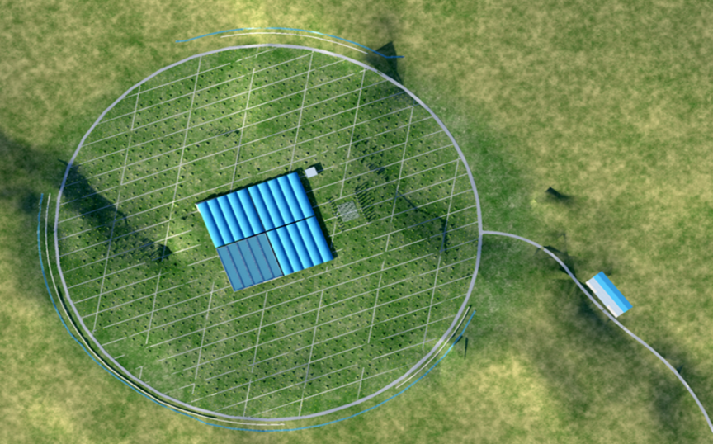
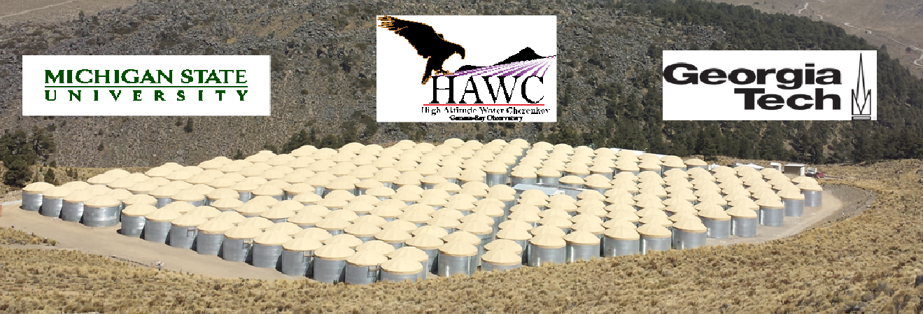
下一代EAS实验对高能GRB的探测能力
γ-ray灵敏度提高20~30倍; 宇宙线能量覆盖范围:100GeV-EeV
大视场，全天候观测；
在阈值100GeV 角分辨以及能量分辨相对较差；
γ-p鉴别能力差导致噪声较多。
GRB 090510,090902B, 130427A
HAWC 1–2 GRBs per year，Lhaaso >2 GRBs per year
Constraining the highest energy of GRB spectra
Notes:
接近阈值，能谱测不好，HAWC 300个水罐子，宇宙线发生shower产生次级粒子，次级粒子在水中产生切伦科夫光，从而被光电倍增光探测到，反推出原初粒子的方向和能量。百GEV基本到达阈值，这一点基本上是由于海拔和shower造成的，shower发展到极大后要被空气吸收掉。第二，这种探测器角分辨就在这个阈值附近变差到1度左右。能量分辨更糟糕，第一次相互作用在大气中的位置不确定，到达观测面次级粒子的数目涨落很大的。能量分辨100%。即使这样，hawc也能看到这几个暴，但是对卫星没看到的，他们也没看到，但是根据灵敏度曲线做了一个预期。即使看不到也可以限制GRB能谱。

Slide 7
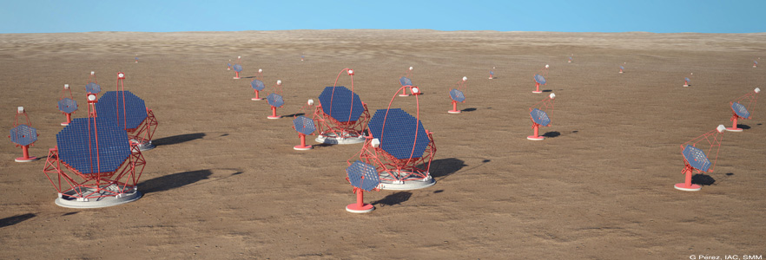
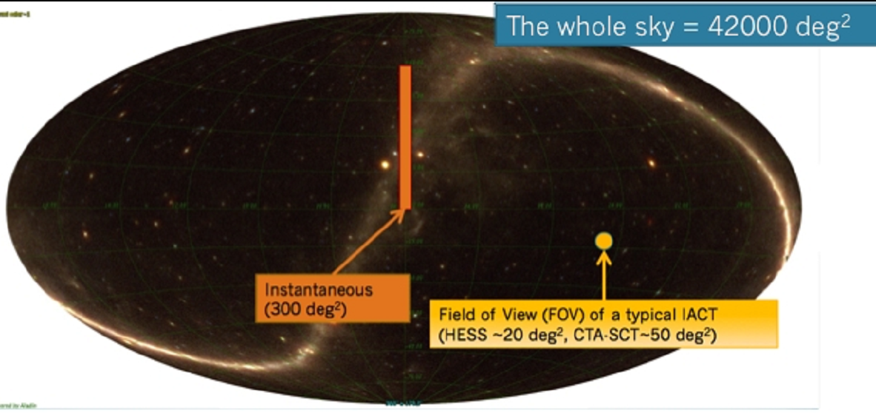
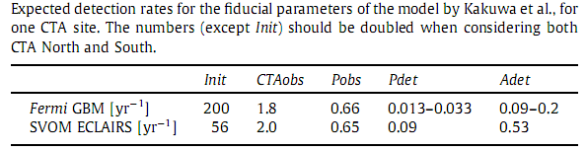
CTA对高能GRB的探测能力
CTA
契仑柯夫望远镜阵列CTA
把阈能100GeV降到20 GeV
有效面积大，光子数多
但低DutyCycle，视场小
Following up alerts mode:
Prompt photons are detected.
Wide-ﬁeld mode: ~2–3 per year
After-glow photons are detected.
S. Inoue et al. / Astroparticle Physics 43 (2013) 252–275
Notes:
0.1时间,a whole sky rate of 600 GRBs/year, a 5 diameter FoV
and a 10% duty cycle, the telescopes will cover a patch of the sky
where a GRB is expected to go off only once every 35 years.
探测原理：宇宙线在大气发展过程中产生其伦科夫光，主要靠探测切伦科夫光来重建能量和角分辨，所以这种仪器只要把镜子做得很大，镜子上的光子可以投到照相机上，阈能就能降到20GeV,有限面积也比较大，shower的其伦科夫光的lightpool可以盖万平米的面积。缺点，10%dutycycle，晴朗无月夜。如果就摆在那看，35年看到一个
所以改进：空间卫星预警；中等尺度探测器对着不同的天空去看，能看到更多

Slide 8
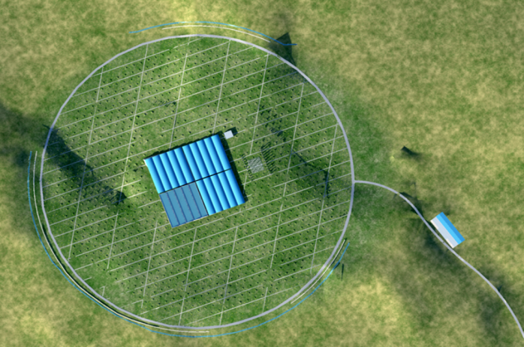
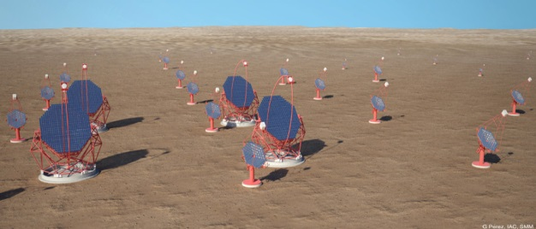
现有GeV-subTeV GRB探测技术
大视场
全天候
？
能量分辨好
角度分辨好
大有效面积
互为补充，各占一边

Slide 9
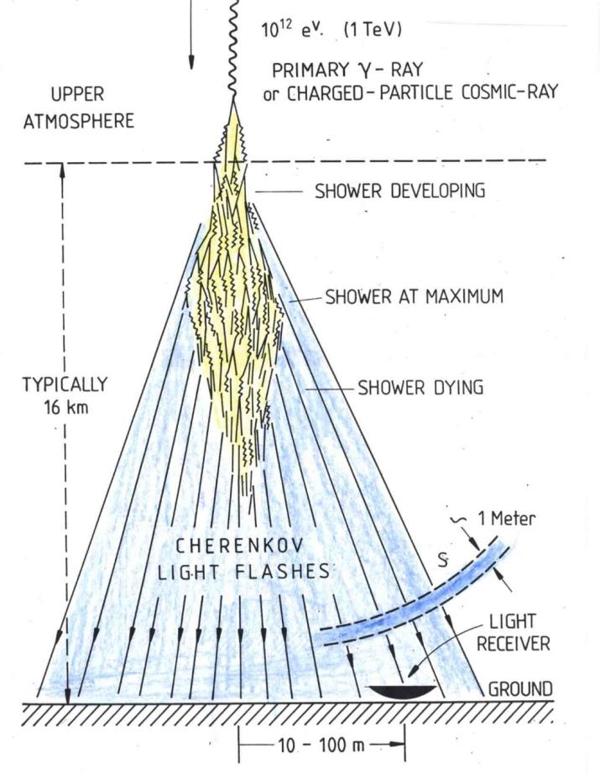
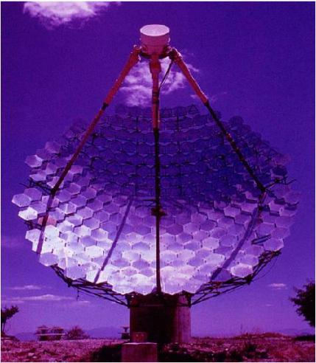
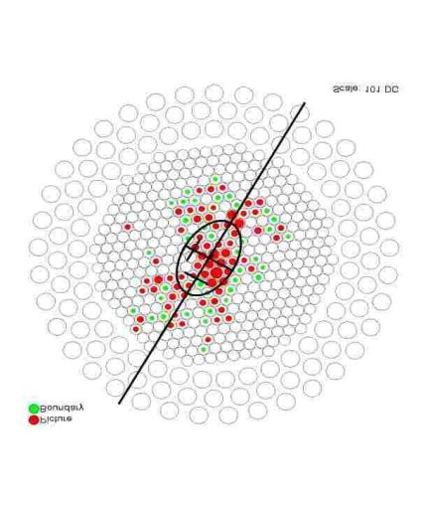
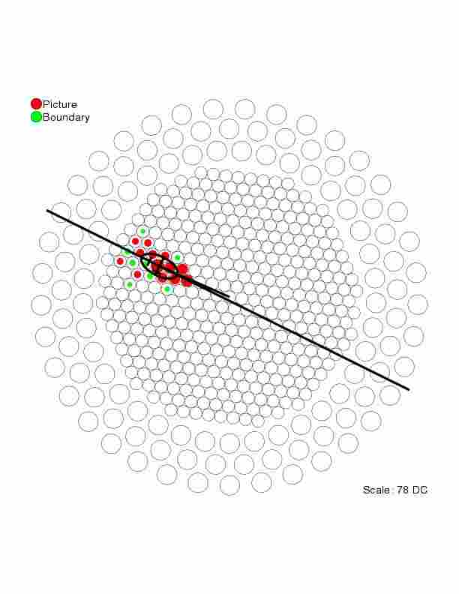
Imaging Atmospheric Cherenkov Telescope (IACT)
Whipple(10m diameter):
1968 - now，490pixels（first generation）
Notes:
The discovery of the Crab Nebula as the first source of TeV gamma rays in 1989, using the technique of ground-based imaging air Cherenkov telescope, has marked the birthday of observational gamma astronomy in very high energy range.
This techique use large diameter mirrors and camera on the focal plane to image of development of air shower. The telescopes with good angular resolution of nearly 0.1 degree and 20% energy resolution. Moreover, they could discriminate the gamma ray and proton well.

Slide 10
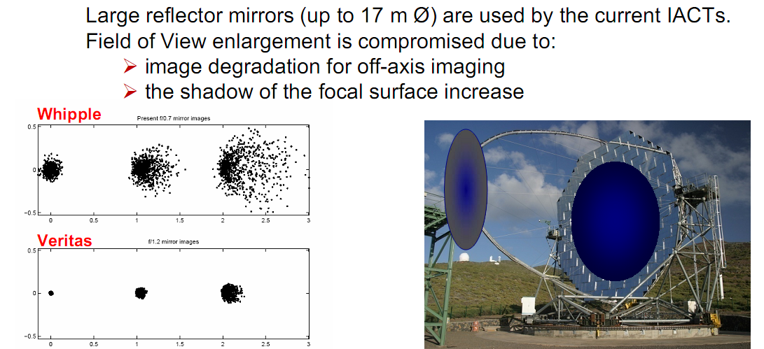
Traditional IACT Technology
Very large reflective mirror （28m H.E.S.S. II）
FoV: 3~5º which is not efficient to detect GRBs
Disadvantage:
  Image distorted for Lange-angle event;
  Enlarge camera will shield the incident particles
Notes:
2002/2004+: HESS (4 telescopes 12m →28m, 5 degree fov)
2005+: MAGIC (1 → 2 telescopes 17m，3.6degree fov)
2007+: VERITAS (4 telescopes 12m, 3.5 degree fov)
Relatively, the FoV is 3~5º which is not effcient go detect tansient source.For the lange-angle event,the image will distorted, and enlarge camera area will shield the incident light.

Slide 11
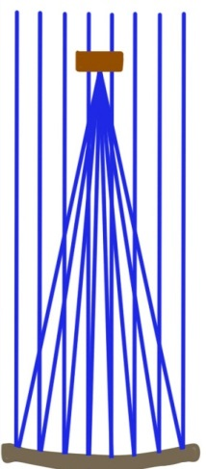
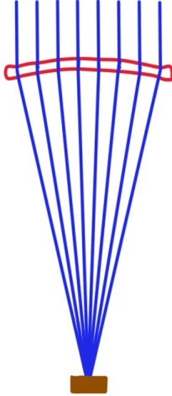
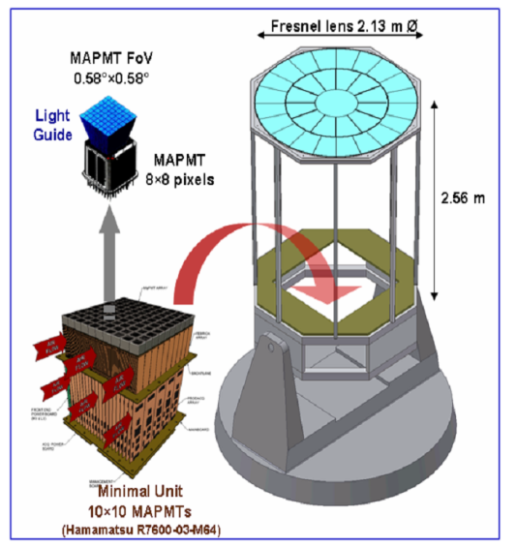
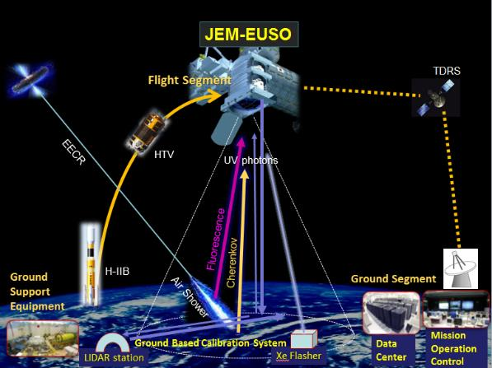
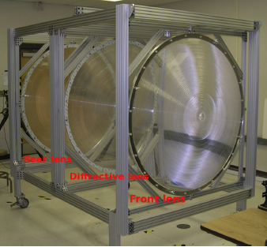
一种尝试：广角大气契伦科夫成像技术
探测器
透镜
反射镜
探测器
GAW
1.5m菲涅尔透镜
Notes:
制作成本可行

Slide 12
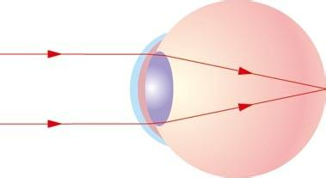
水球透镜的原理
玻璃体 1.336
水球透镜的光学
人眼的光学
光圈
玻璃球壳
玻璃体 1.336
20°和0°入射
晶状体1.406
高纯水1.333
相机
1. 成像质量与入射角度无关。
2. 高纯水对光的吸收小。

Slide 13
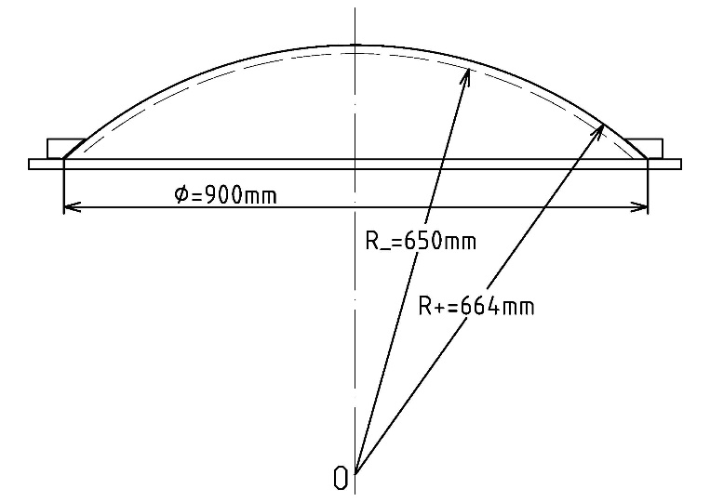
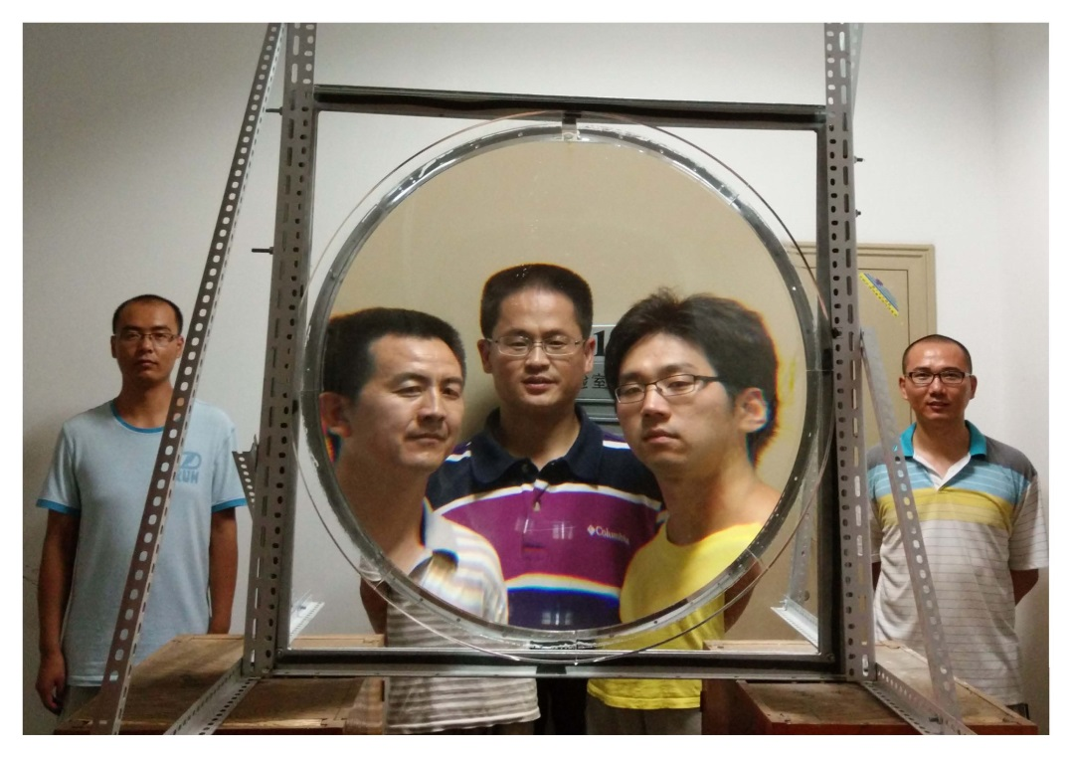
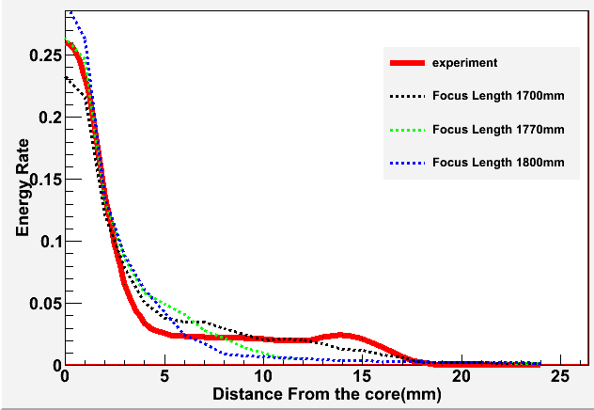
Status and specifications of our prototype
Virtual image formation using
the water lens as a magnifying glass
Notes:
Following slides outline our prototype.
The diameter of the prototype is 0.9 meter, is a plano convex, spherical cap lens. Using the water lens as a magnifying glass, we can see an explicit, amplifying, virtual image.

Slide 14
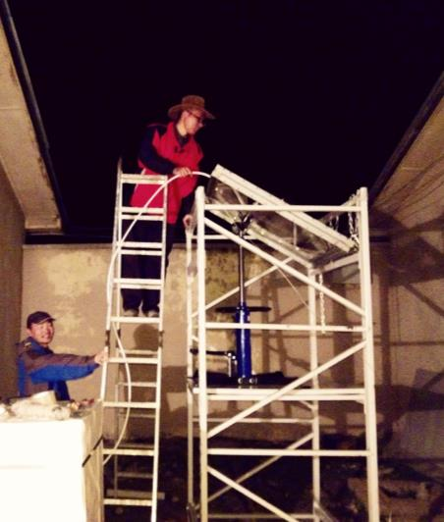
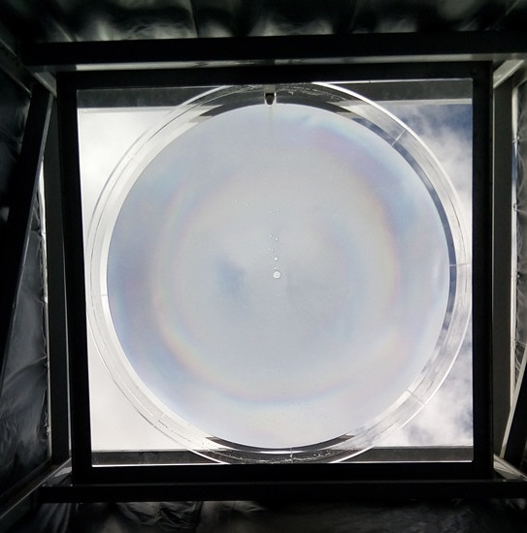
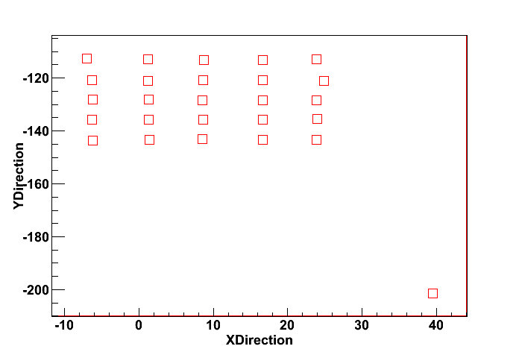
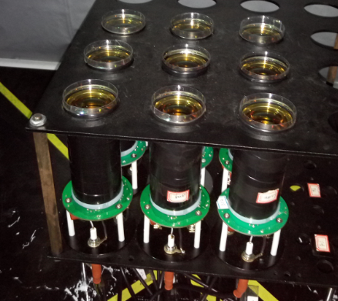
Status and specifications of our prototype
Coincidence measurement of cosmic rays:
  Water lens telescope and Scintillator EAS array
  80m from the center of the scintillator EAS array to Water lens
  3×3 PMT arrays placed at the focal plane of the lens
Scintillator EAS array
~80m
Water lens
Notes:
We do Coincidence measurement of cosmic rays using Water lens telescope and Scintillator EAS array.
The distance from the center of the scintillator EAS array to Water lens is about 80 meters.
The camera is composed of 3×3 PMT arrays, placed at the center of focal plane of the lens.
任何一个新的探测技术及手段都是在摸索中前进的，就像人在会跑之前一定是经历过爬行这样的过程，所以希望大家对我们搭建的望远镜多些包容和理解。

Slide 15
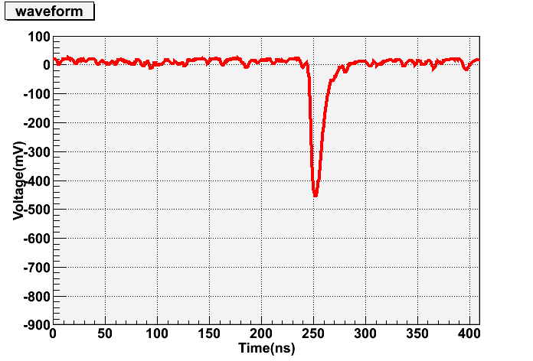
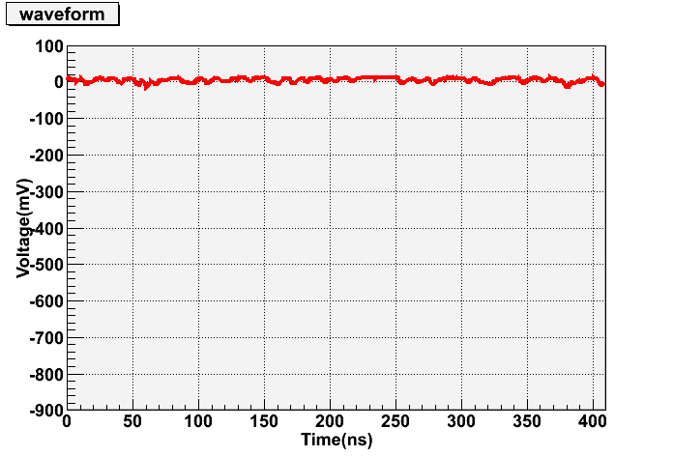
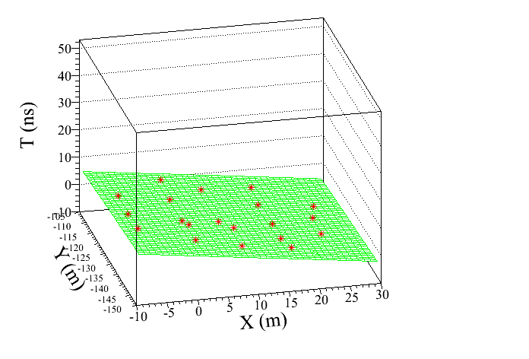
Status and specifications of our prototype
Coincidence measurement of cosmic rays:
  The wave form of any PMT signal above threshold will be recorded by FADC.
Cosmic ray
PMT: 2,3,4,5,6,7,8,9
Zenith: 4.7°
Azimuth: 57.2°
(Due North is 0 degree, rotated by clockwise ）
PMT: 1
VERY PRELIMINARY !
3
6
9
N
2
5
8
1
4
7
Notes:
Here we show a real coincidence cosmic ray event. The left picture is a front plane of the event, the red point is the fired Scintillator detector, and the vertical coordinate is the arrival time of second particles. The zenith angle is 4.7 degree and the azimuth angle is 57.2 degree.
And the same time, the No 1 PMT of the water lens is triggered, it points to the same direction. The picture shows the wave form recorded by FADC. The other PMTs were not fired.

Slide 16
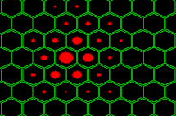
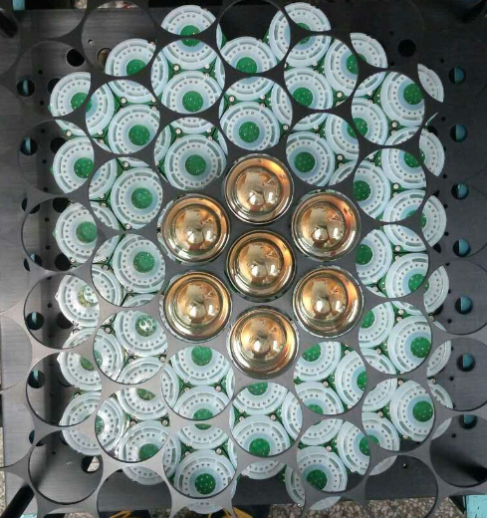
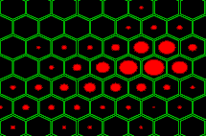
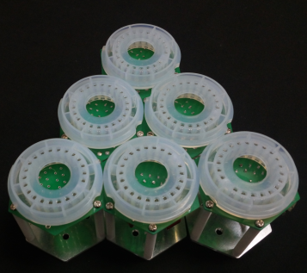
PMT阵列成像系统升级
49支PMT-R7725（2inch）；
Base改进，正六边形排布；
像素间距86mm→58mm；
覆盖7°× 8°天区；
今年9、10月份在
YBJ测试观测

Slide 17
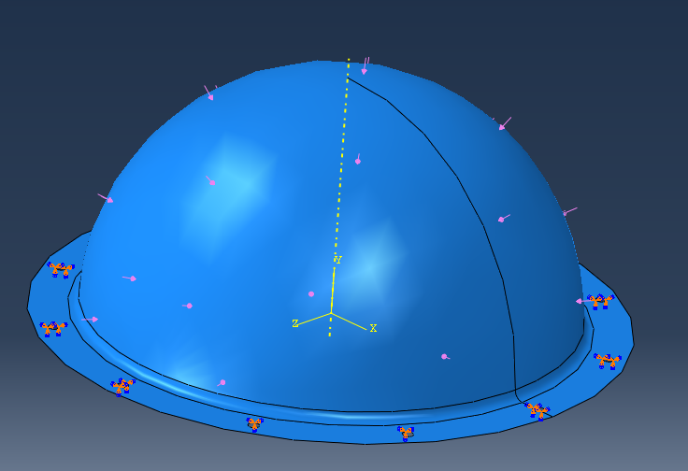
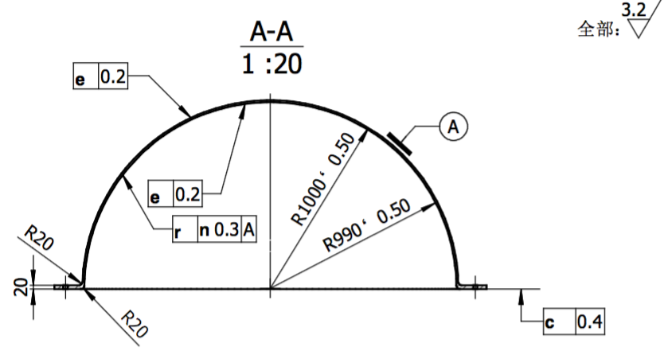
更大口径的样机研制
半球面顶面受全部大气压工况（0.06MPa）
亚克力半球玻璃面规格 | 位移(mm) | 应力（MPa） | 基频(Hz) | 重量（Kg）
pmma-5-1000 | 0.377 | 8.088 | 293.01 | 13.472
pmma-yx-5-1000 | 0.3543 | 3.029 | 324.26 | 16.753
pmma-10-2000 | 0.9854 | 19.1 | 142.06 | 92.864
pmma-yx-10-2000 | 0.692 | 4.564 | 156.86 | 107.582
pmma-15-3000 | 1.136 | 15.58 | 95.66 | 287.549
pmma-yx-15-3000 | 1.037 | 3.059 | 101.42 | 321.582
直径2m的半球透镜今年12月交工，明年进行测试
PMMA材料参数
密度 | 弹性模量 | 泊松比 | 抗拉强度 | 弯曲强度
1.18g/cm^3 | 3140MPa | 0.37 | 69MPa | 117.7MPa

Slide 18
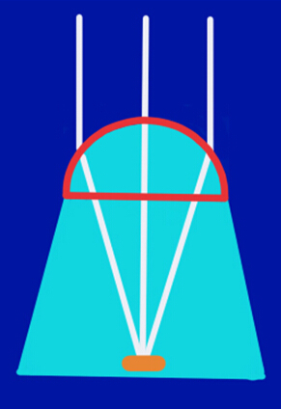
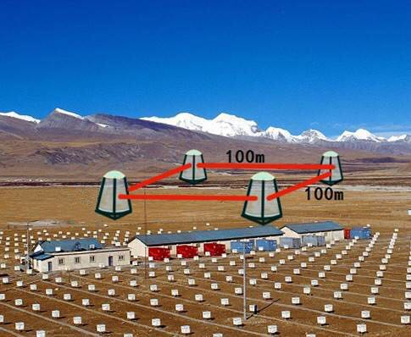
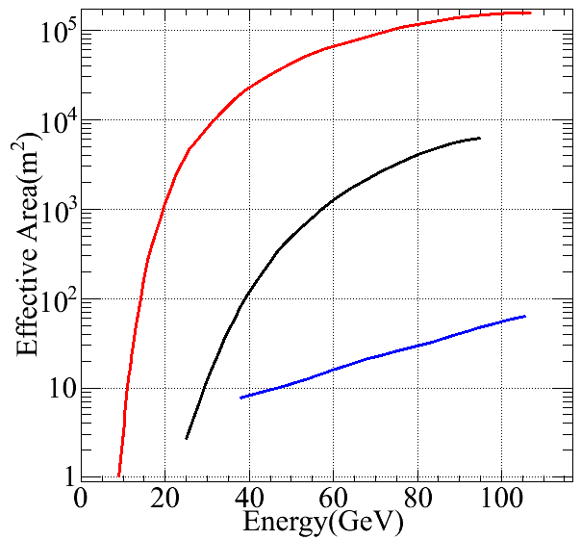
Concept design of water lens telescope array
air
CTA
Waterlens
HAWC
water
VERY PRELIMINARY !
Aperture：6.9m; Effective aperture:5m
Focal length： 14.9m
Field of View： 40º×40º
Notes:
Since the high transmittance of purified water, we propose to use water lens as an economic light collector. The left picture shows concept design of water lens. The material of hemisphere shell is Ultraviolet transparent one, which contains high purified water. Photon multiplier tube array is installed at the focal plane.
The right picture shows a assumed water lens array at Yangbajing observatory.
尽管我们的有效面积没有CTA大，但是仍然要好于hawc,但是设计指标是能够实现广角探测。

Slide 19
Conclusions and Discussions
  GeV-百GeV能区是空间实验和地面实验的连接处，也是γ射线(GRB)观测的薄弱区。
  基于透镜光学的广角大气契伦科夫望远镜是一种可能的下一代IACT技术 。
  球透镜具有成像质量与入射角度无关的优点。研制小型的水球透镜样机，成功观测到了宇宙射线。成像系统和透镜的升级改造也在进行中。模拟研究了水球透镜阵列的性能。
Notes:
水透镜可以更大，探讨菲涅耳透镜实现的可能
the energy range of GeV to sub-TeV is crucial for its important role in filling the gap between space experiments and ground-based
ones.

Slide 20
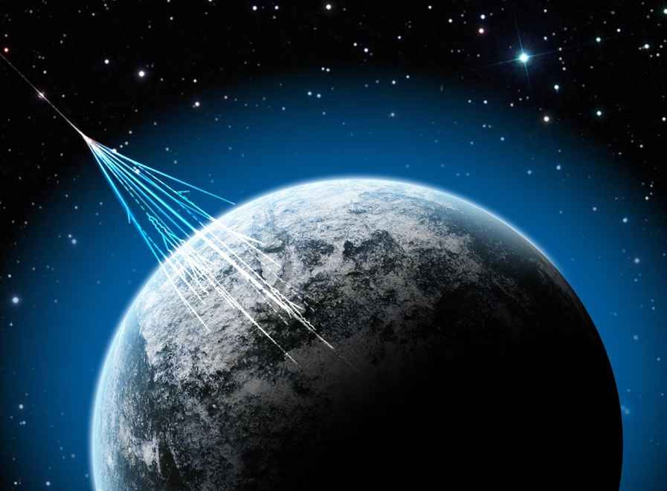
谢谢大家！

