Slide 1
Search for CLFV at COMET experiment muon to electron conversion
Jie Zhang (张杰)
On behalf of COMET Collaboration
Institute of High Energy Physics
中国物理学会高能物理分会
第十二届全国粒子物理学术会议
Aug. 25, 2016
合肥

Slide 2
Outline
Why CLFV?
COMET: Basic Design
Phased Approach
Current Status
Summary

Slide 3
Why Charged Lepton Flavor Violation?

Slide 4
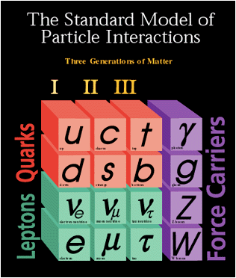
Standard Model
SM almost explain everything except
  Dark matter?
  Anti-matter asymmetry? Need new source(s) of CP violation
  Source of Mass?
  Flavor problem
  …
H
SM is not the end, new physics is needed!

Slide 5
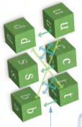
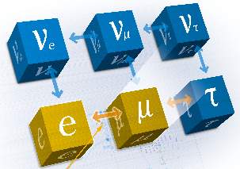
Flavor Transitions on Quarks,
Neutrinos, and Charged Leptons
Quark mixing,
2008 Nobel Prize
Quarks
Neutrino oscillation, 2015 Nobel Prize
Leptons
Not observed, why special?
Charged Lepton Flavor Violation (CLFV)

Slide 6
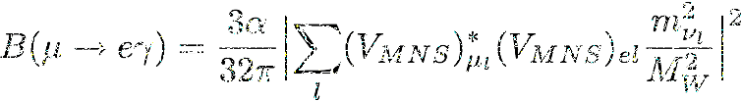
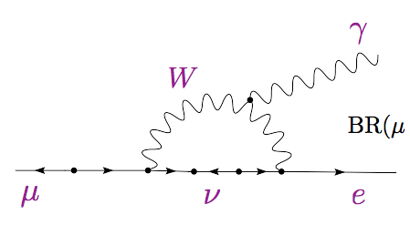
No SM Contribution in Charged Lepton Flavor Violation (CLFV)
GIM suppression
BR~O(10⁻⁵⁴)
Observation of CLFV would indicate a clear signal of
physics beyond the SM with massive neutrinos.

Slide 7
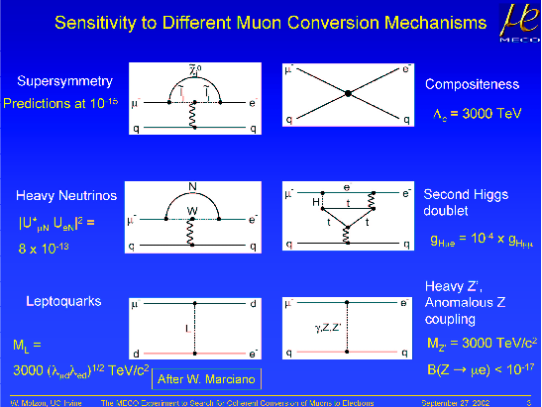
Predicted by many new physics model

Slide 8
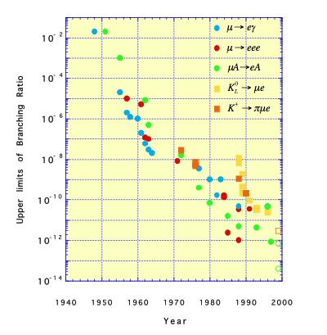
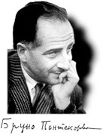
CLFV History
First CLFV search
Pontecorvo,1947

Slide 9
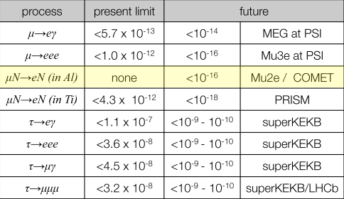
Current limits and expected future
Latest update

Slide 10
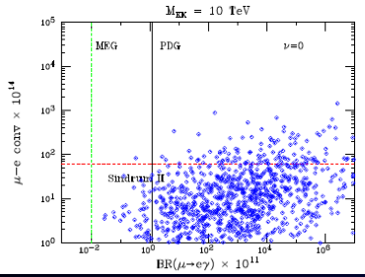
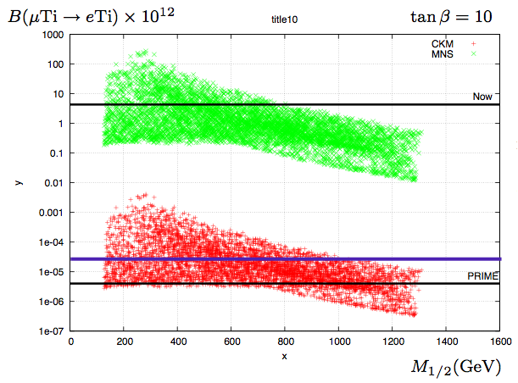
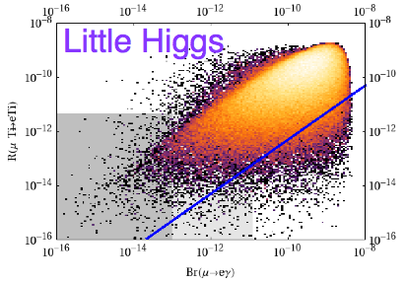
Compare between theory and experiment
extra dimension model
extra dimension model
At the edge of discovery! ？
SUSY model
little Higgs model
10⁴

Slide 11
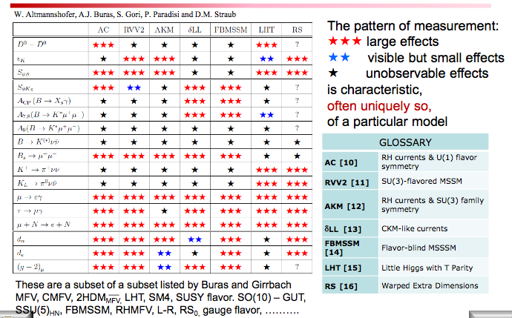
“DNA of New Physics (A.J. Buras)

Slide 12
COMET: Basic Design

Slide 13
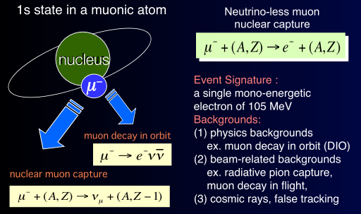
What is Muon to Electron Conversion?

Slide 14
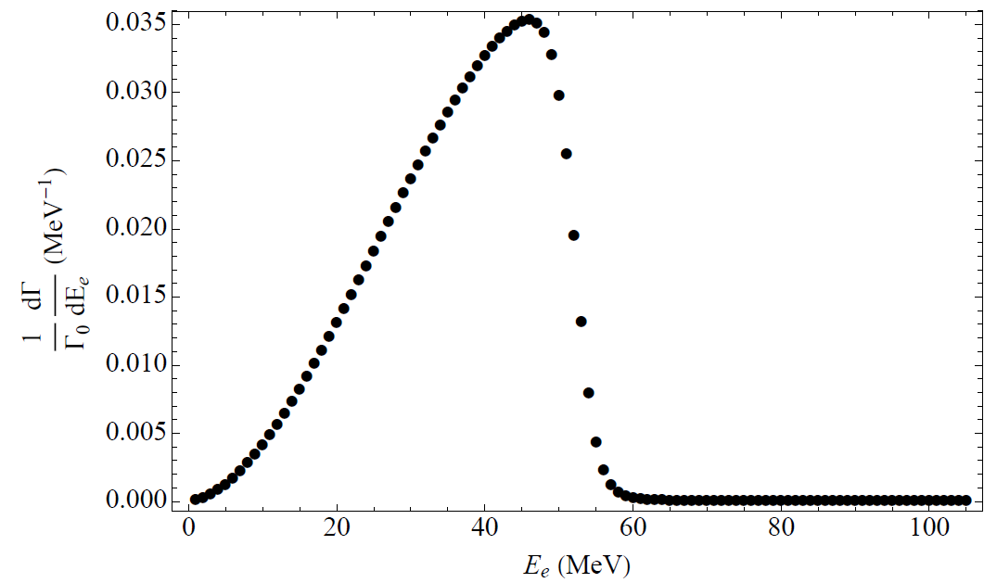
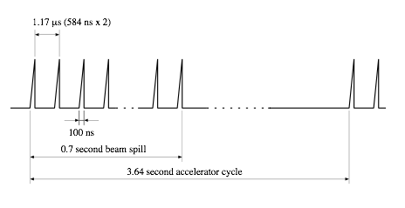
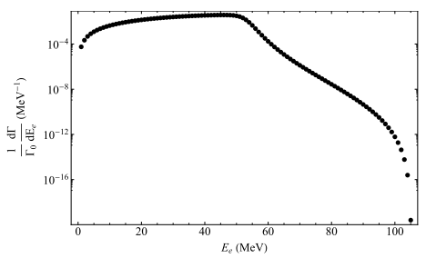
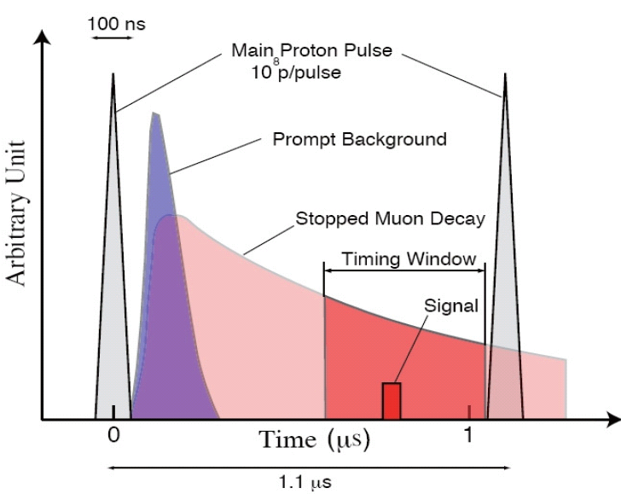
Strategy
DIO
DIO
µ-e conversion
Energy window
logarithmic scale
Require:
Pulsed beam
Excellent proton extinction
High momentum resolution
High intensity beam

Slide 15



µ-e conversion: COMET(E21) at J-PARC
Experimental Goal of COMET
Pulsed proton beam,
10¹¹ muons/stops/sec.for 56kW proton beam power
Curved solenoids for muon charge and momentum selection
C-shape muon beam line and C-shape electron transport followed by electron detection system.
Electron transport with curved solenoid would make momentum and charge selection.
1 T spectrometer Solenoid

Slide 16
Phased Approach

Slide 17
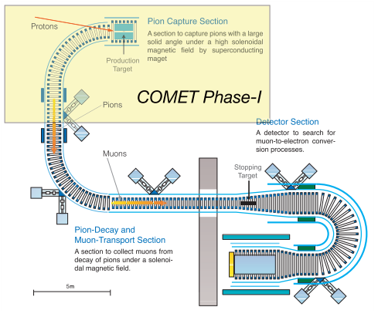
Phased approach

Slide 18
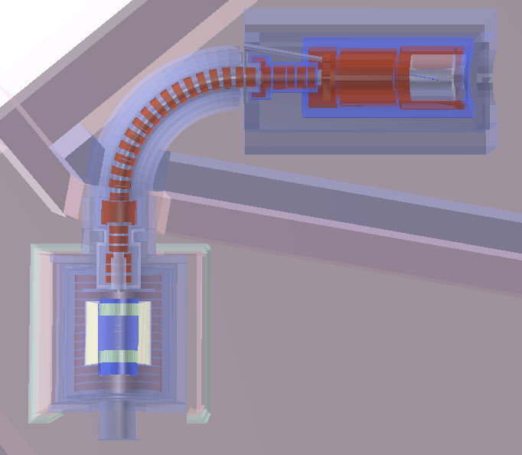
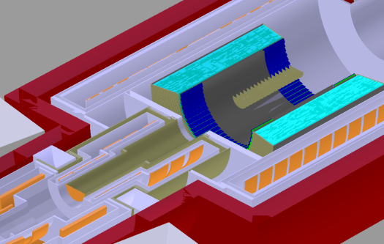
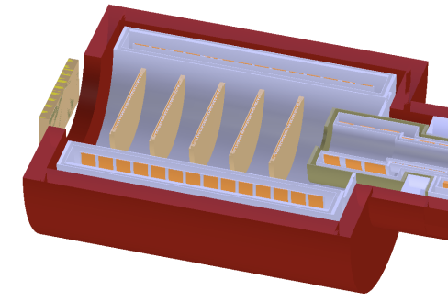
COMET(Phase-I）
Pion Capture Section
Has a high(5T) magnetic field to collect the
low momentum, backwards travelling pions, 3.2KW proton beam
Muon Transport section
Construct to the first 90 degree
Phase-I Detector
A cylindrical drift chamber system(Cydet) for the →e conversion search
A prototype ECAL and straw tube tracker (StrECAL) for beam and background studies
Cydet
StrECAL
Phase-I Goals
Search for →e conversion process with a S.E.S. of 3.1 X 10⁻¹⁵
Beam and background study for Phase-II

Slide 19
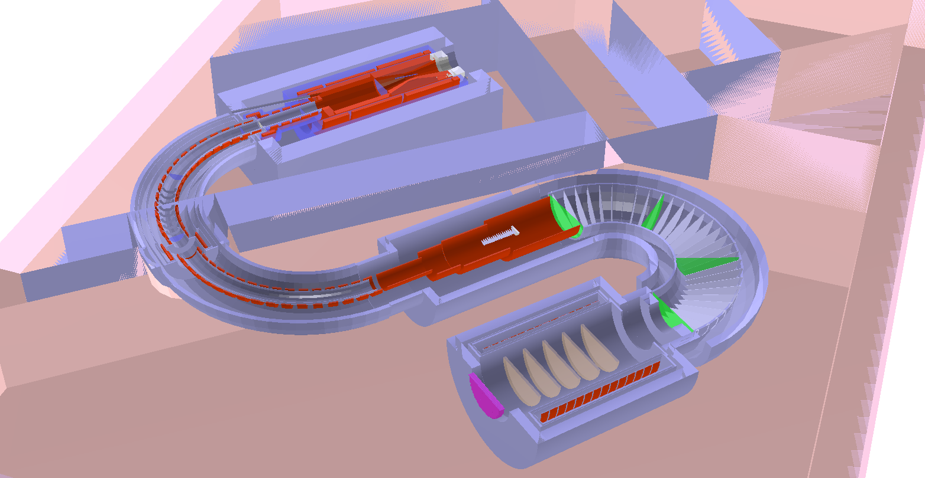
COMET(Phase-II）
Pion Capture Section
Muon stopping target
Electron Spectrometer
Transport Section
Detector
Aiming at 2.6 X 10⁻¹⁷, 10000 times better than the current limit

Slide 20
Current Status

Slide 21

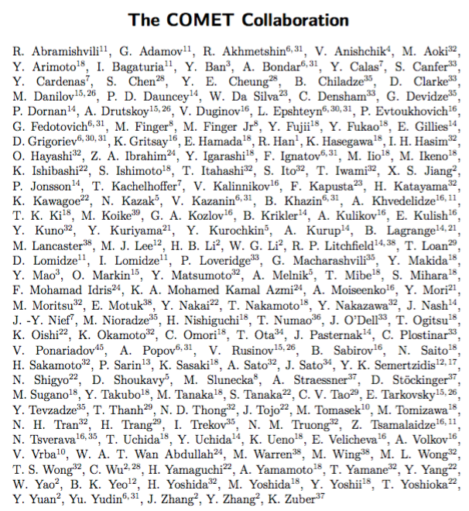
COMET Collaboration
+more
182 collaborators,
32 institutes from 15 countries
国内：高能物理研究所，北京大学，南京大学，华北电力大学

Slide 22
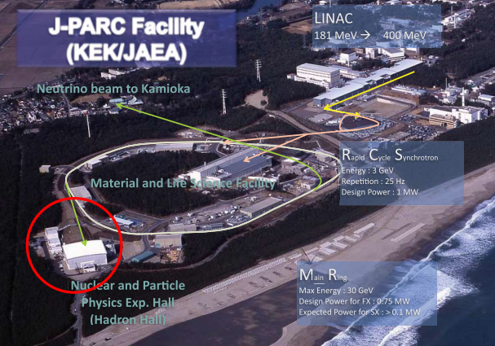
J-PARC layout

Slide 23
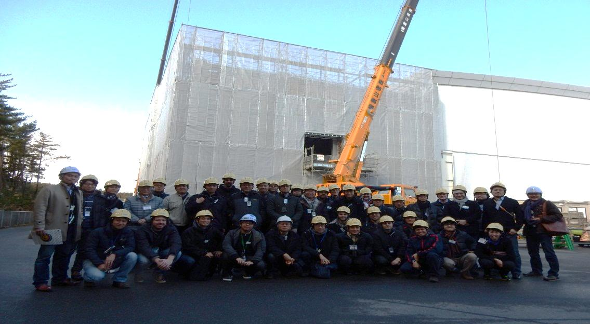
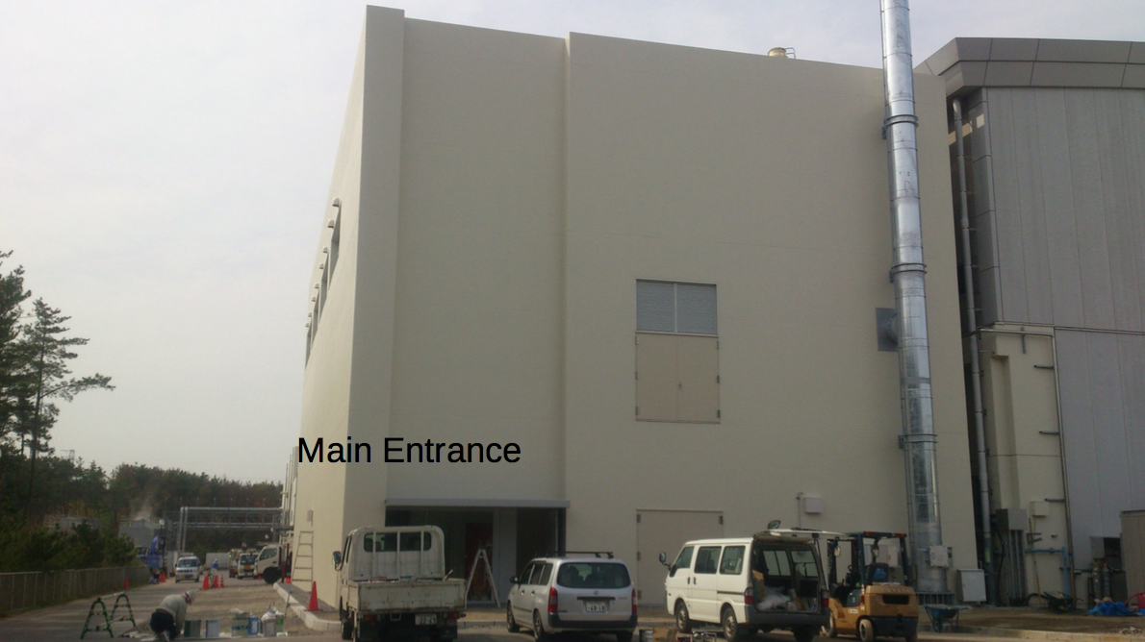
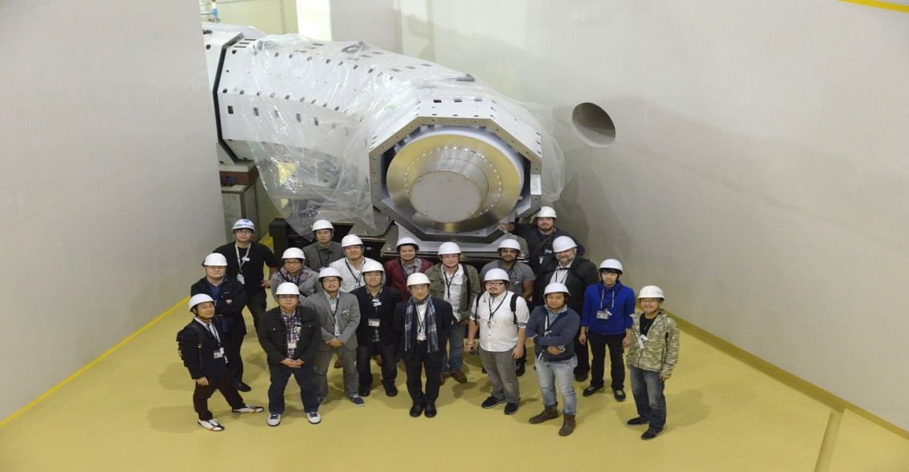
COMET Hall
Dec. 2014
Apr. 2015
Oct. 2015
Hall construct completed;
Beamline under constructing

Slide 24
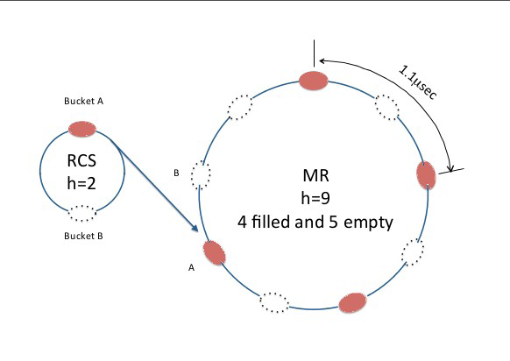
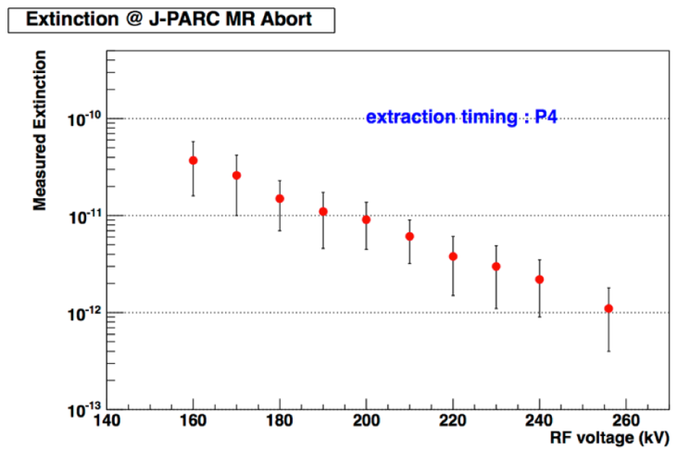
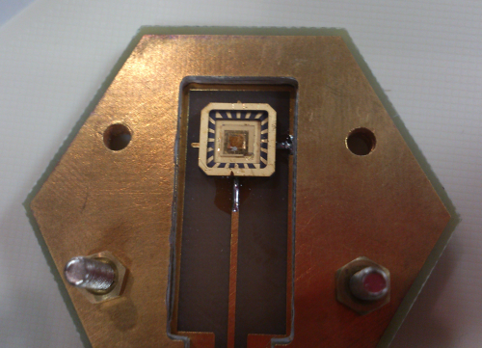
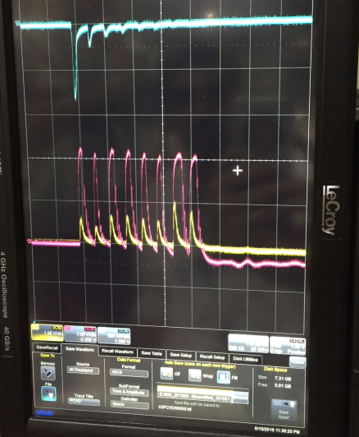
Proton beam
Extinction rate reached 10⁻¹²,
far more better than needed
Proton Beam Monitor:
innovative diamond detector
First beam test for diamond prototype is ongoing @J-PARC MR

Slide 25
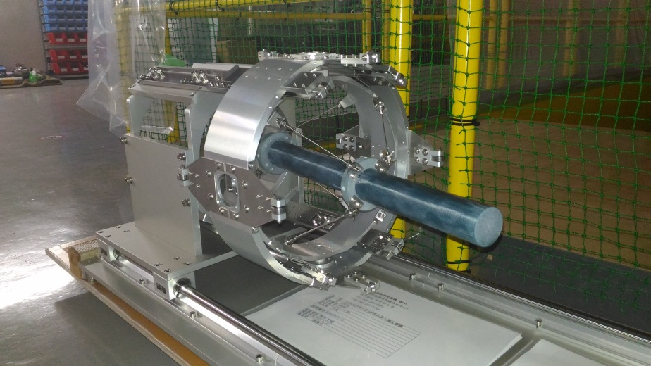
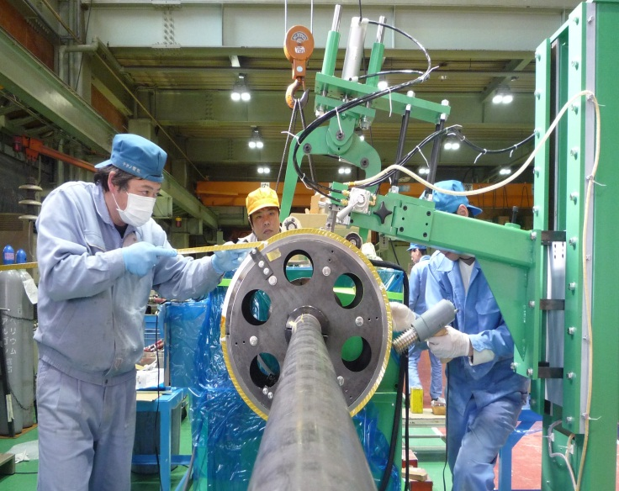
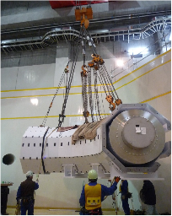
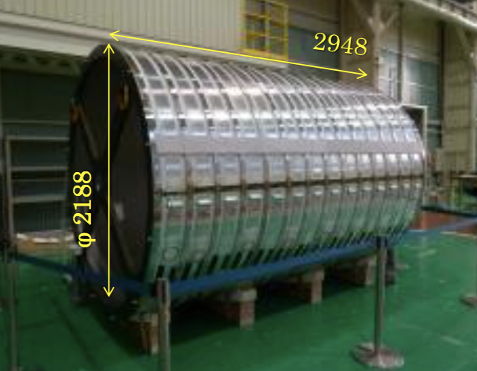
Magnet and target
Proton target: R=13mm, L=700mm,
prototype is made
Pion capture solenoid is under winding
Muon transport solenoid completed
Detector solenoid is assembled

Slide 26
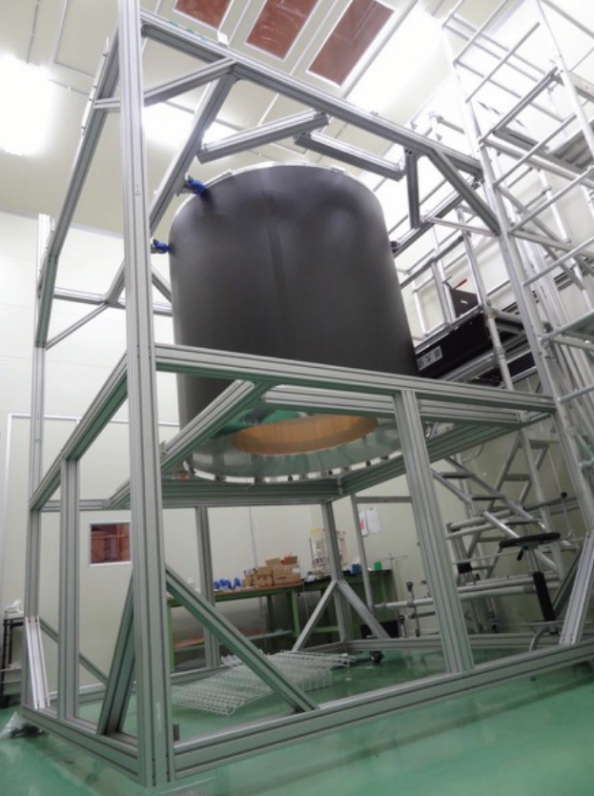
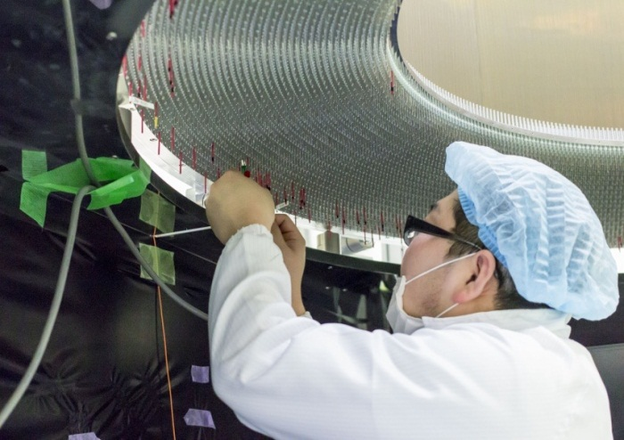
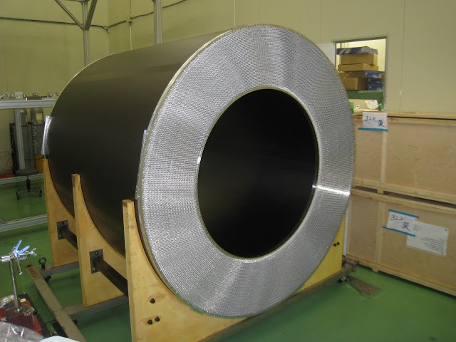
Cylindrical drift chamber (CDC)
All stereo layers
He base gas
19 layers structure
  ~5,000 sense wires
  ~15,000 filed wires
Prototype chamber tests show spatial resolution <200μm, momentum resolution σ_{p} ~200keV/c
Construction started in 2014 and
completed on June 2016

Slide 27
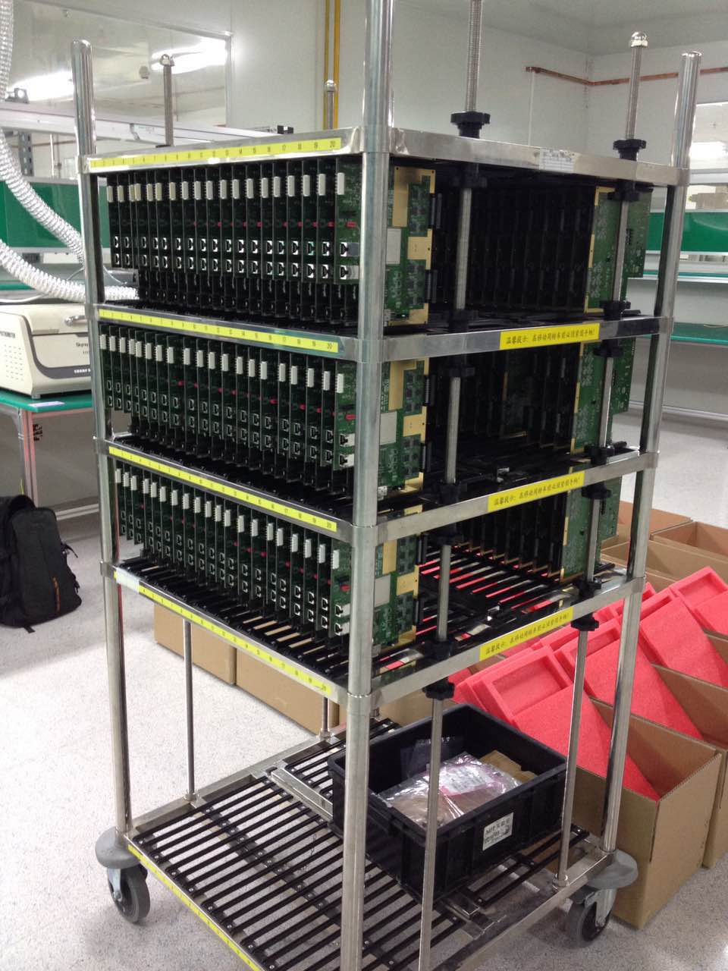
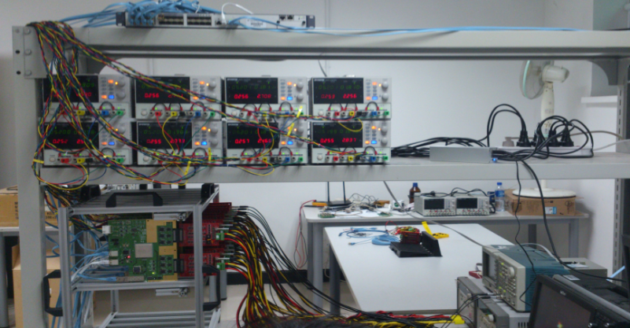
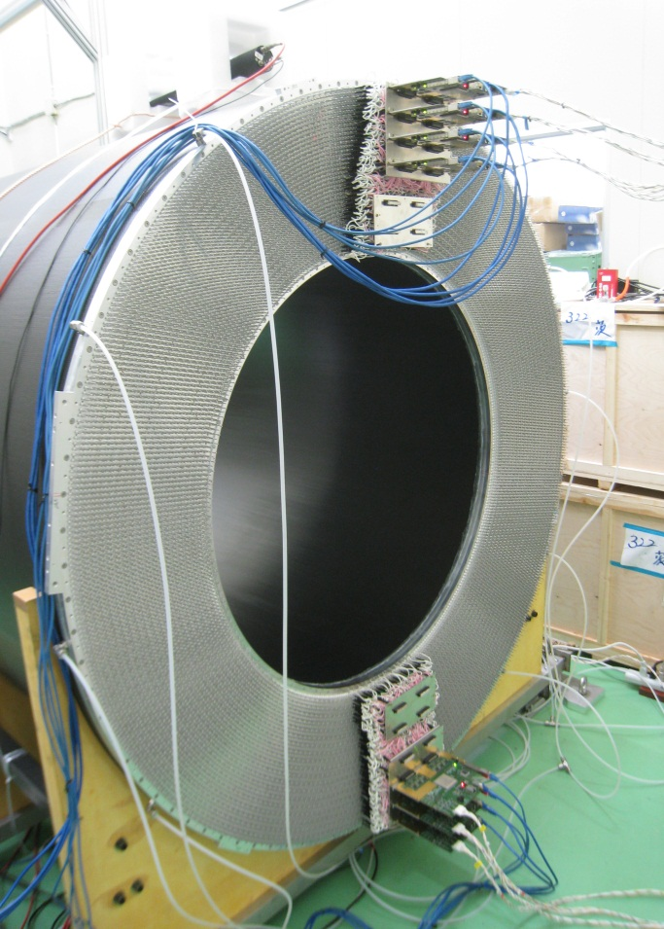
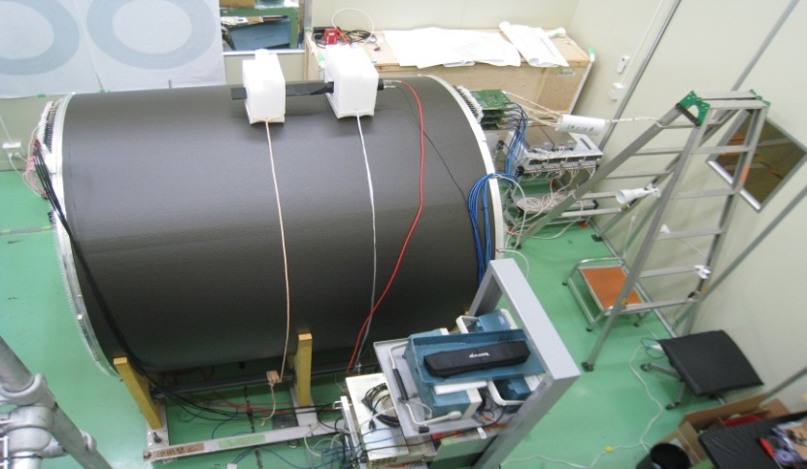
Readout & Cosmic ray test
Mass production/test of readout RECBE boards done.
Cosmic ray test of CDC with RECBE is undergoing.

Slide 28
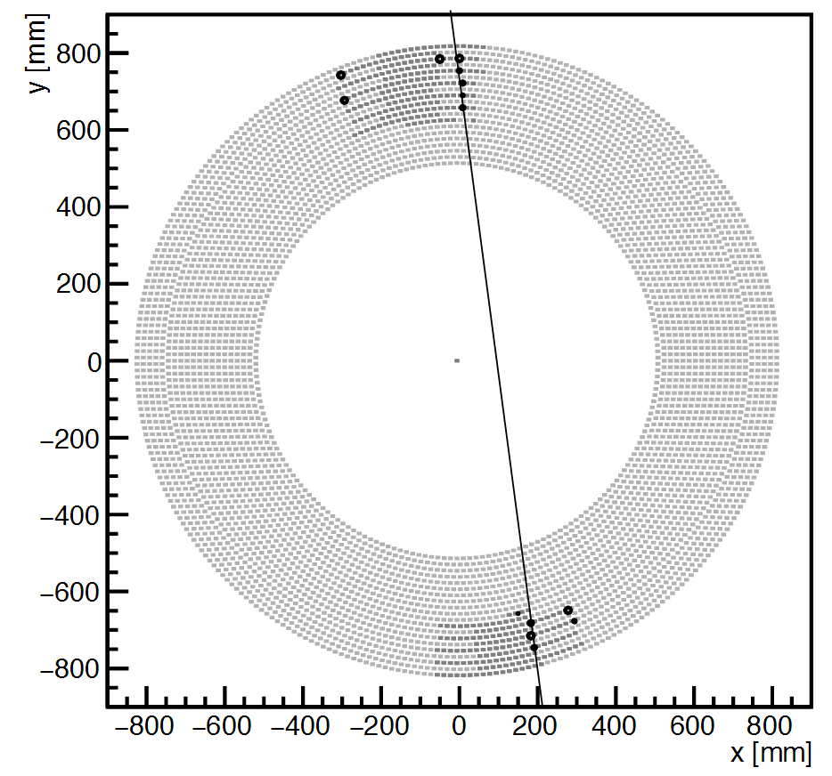
First cosmic-ray event

Slide 29
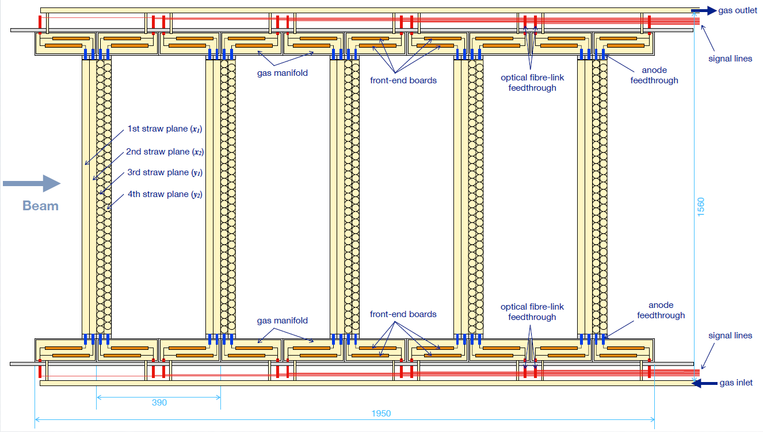
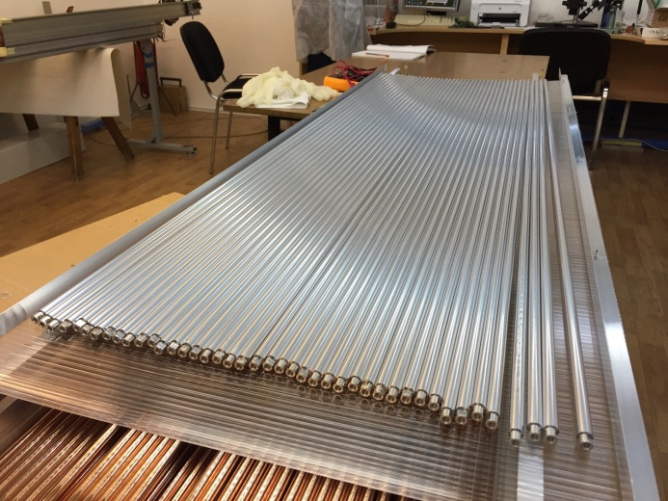
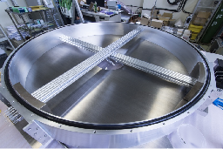
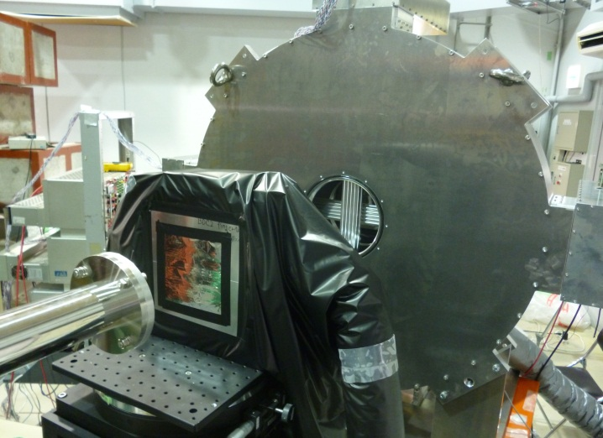
Straw tracker
Mass production of Phase-I straw tube done:
20 μm thick, 9.8mmΦ
Full-scale prototype was maked,
many test are carring on
Operation in vacuum to improve σ_{p}
Beam test w/ 105MeV/c electron was done
σx~150um obtained → σp~180keV/c

Slide 30
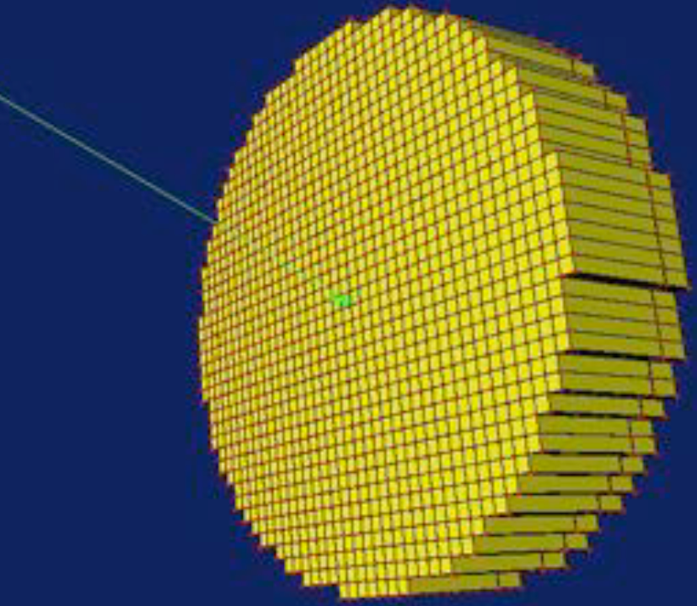
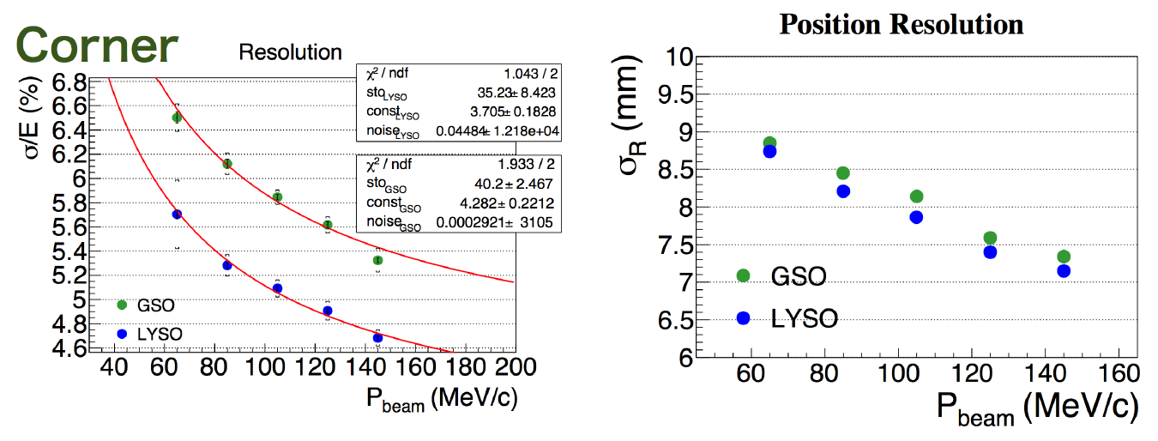


ECAL
GSO and LYSO test at Tohuku Univ.
LYSO was chosen as ECAL crystal
8×8 prototype detector test
is carring on
12x2x2cm

Slide 31

Software framework
The framework has almost been done in 2015
Mass MC events production was performed on March 2016.
Most simulation and analysis are implemented and studied within ICEDUST now.

Slide 32


Overall Background &
Performance Estimate: Phase-I
146 days beam time needed for Phase-I

Slide 33



Studies of Phase-II
Dipole field and Collimator
Optimizations for maximize
signal acceptance and Minimize
Background
250 days beam time estimated

Slide 34

Schedule

Slide 35
Summary
CLFV has SM-free signal for New Physics
at low energy and complementary to other physics.
COMET Phase-II is aiming at S.E. sensitivity of 2.6×10^{－17}.
COMET Phase-I is aiming at S.E. sensitivity of 3.1 ×10^{－15} .
R&D and construction is well underway
More details: COMET Phase-I Technical Design Report
http://comet.kek.jp/Introduction.html

Slide 36
Thanks!

Slide 37
Back up slides

