Slide 1
高能物理2016
高海拔宇宙线观测站
LHAASO
Huihai He, IHEP, CAS
on behalf of the LHAASO collaboration
2016-8-22

Slide 2
Outline
Introduction
LHAASO science
Design of the LHAASO detectors
Engineering arrays at YBJ and activities at the LHAASO site
Summary

Slide 3
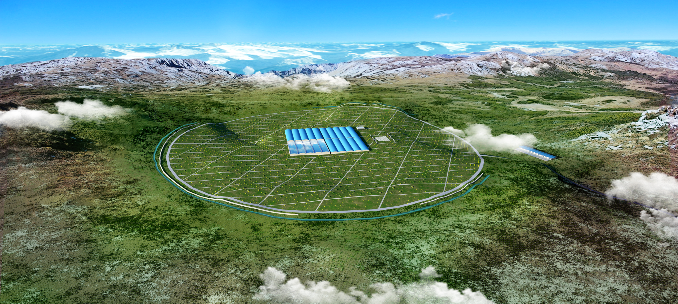
Large High Altitude Air Shower Observatory (LHAASO)
Location: Daochen, Sichuan (29º21’ 31” N, 100º08’15” E, 4410 m a.s.l., 600 g/cm)
Proposal approved on Dec. 31, 2015

Slide 4
Major Scientific Goals
Origin of GCRs
  Searching for GCR sources by measuring SED with an unprecedented sensitivity of 1% Crab unit at 50 TeV
  Energy spectra for individual compositions with energy from 10 TeV to 1 EeV, where the spectrum knees are located
Gamma ray astronomy
  Searching for TeV gamma sources, especially extended and transient ones, with an unprecedented survey sensitivity of 1% Crab unit at 3TeV.
New physics frontier:
  dark matter, Lorentz invariance, new physics beyond LHC energy, etc

Slide 5
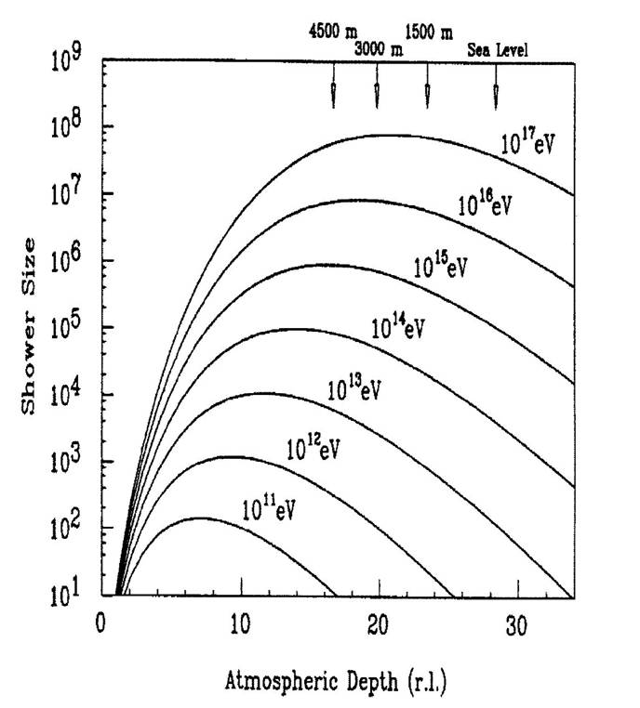
Measurement of air showers at high altitude
HE: near Xmax →lower fluctuation, better σ_{E}
LHAASO
Lower E_{th} →deeper, more sources

Slide 6
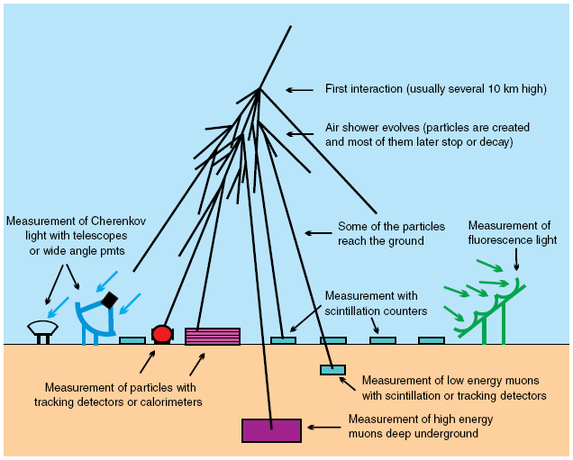
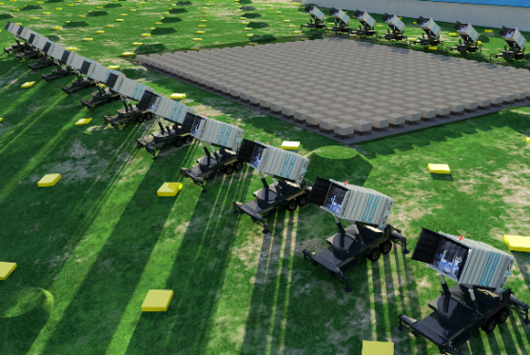
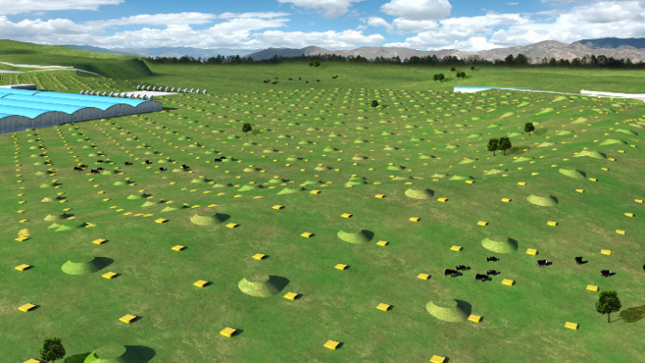
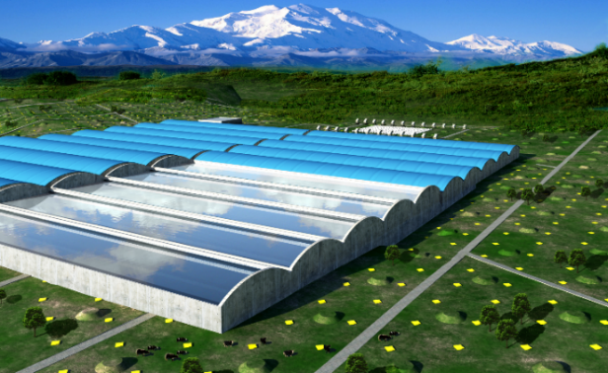
Hybrid Detection of Extensive Air Showers by LHAASO
WFCTA:
12 telescopes
1024 pixels each
WCDA:
3000 cells
KM2A:
5195 EDs
1171 MDs

Slide 7
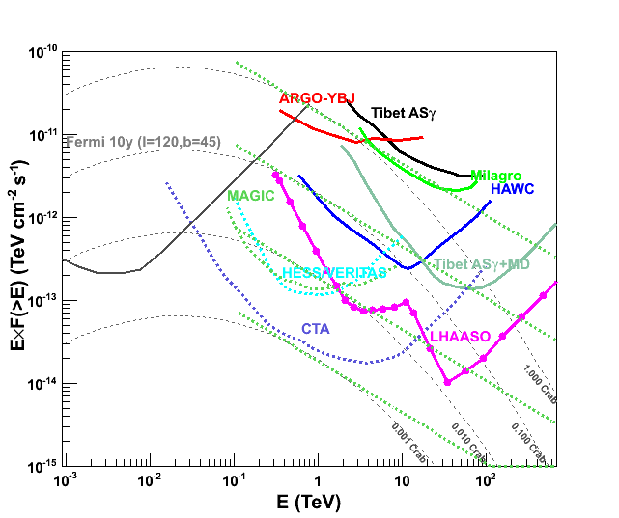
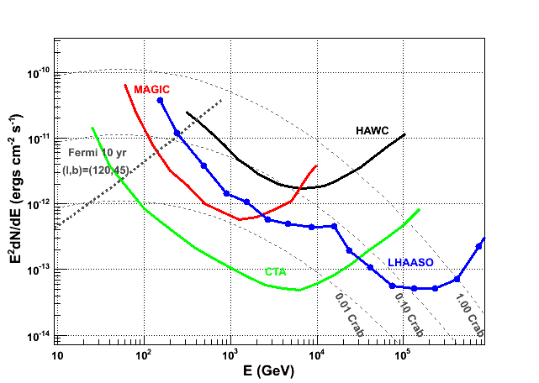
Sensitivity to gamma ray sources
Integral: 1% Crab unit @3TeV & 50TeV
Integral differential

Slide 8
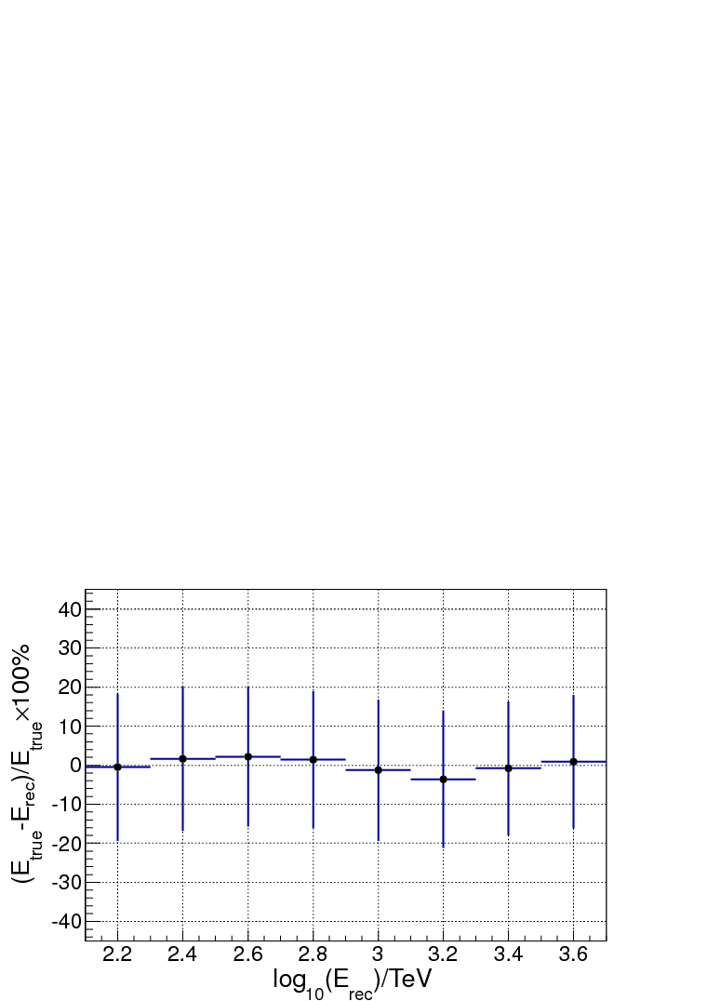
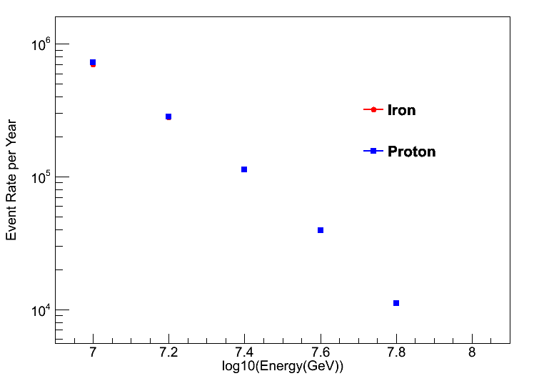
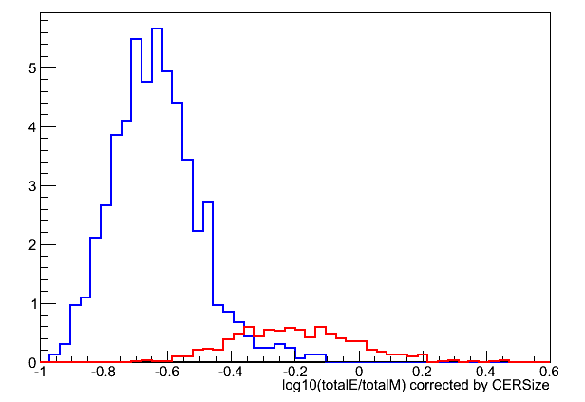
LHAASO performances to cosmic rays
10 TeV to 1 EeV
4000 m²sr @ 100 TeV
Blue: Fe
Red: P

Slide 9
LHAASO Construction Schedule
project | LHAASO Construction period （month）
Capital construction | 24
Detector production | 36
Setup and test |  | 36
Testing run |  |  | 28
Full run |  |  |  |  |  | 2
Duration: 4 years
Different detectors will go parallel
¼ will be finished and start to take data by the end of the 2nd years

Slide 10
Total Budget: ￥1,200 M
Project: 900 M (NDRC)
  Detector and assembly，test，partial operation，etc.
Local Matching: 300 M (Sichuan Province)
  Land, power, road, civil construction, etc.
Local funding:
  100 M (2015)
  150 M (2016)
  50 M (2017)
Operation money:
  1.2 M (2nd)
  4.8 M (3rd)
  6 M (4th)

Slide 11
Origin of GCRs
1 ev/cm³
  Where→ Source
  How → Acceleration
  What → Propagation
  Global vs. local

Slide 12
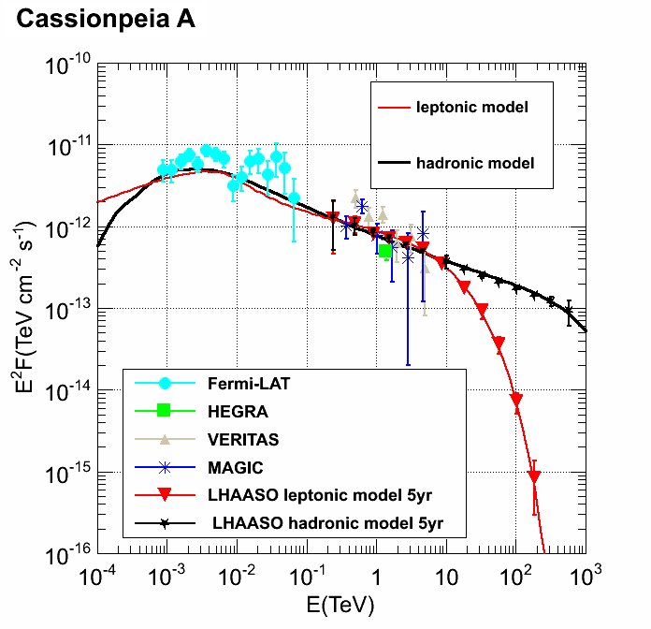
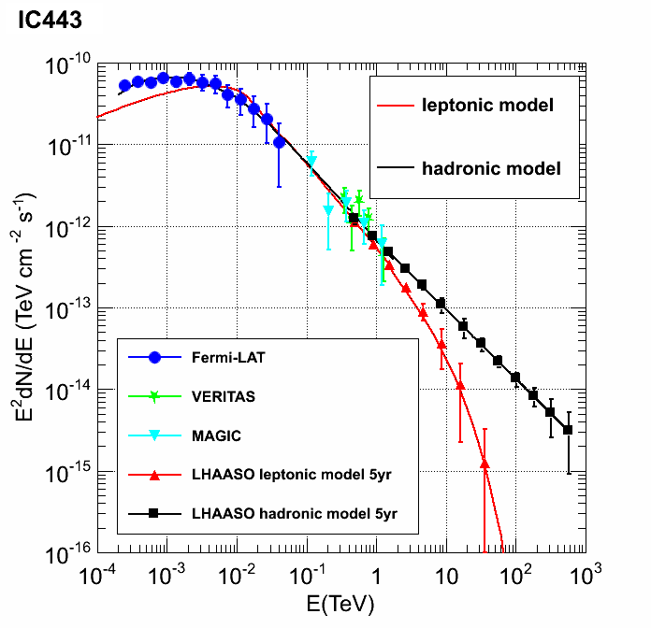
Hadronic vs. Leptonic
Characteristic signatures of π⁰ decay:
  at highest energy by LHAASO
10.1126/science.1231160
Historical SNRs
interacting with molecular clouds

Slide 13
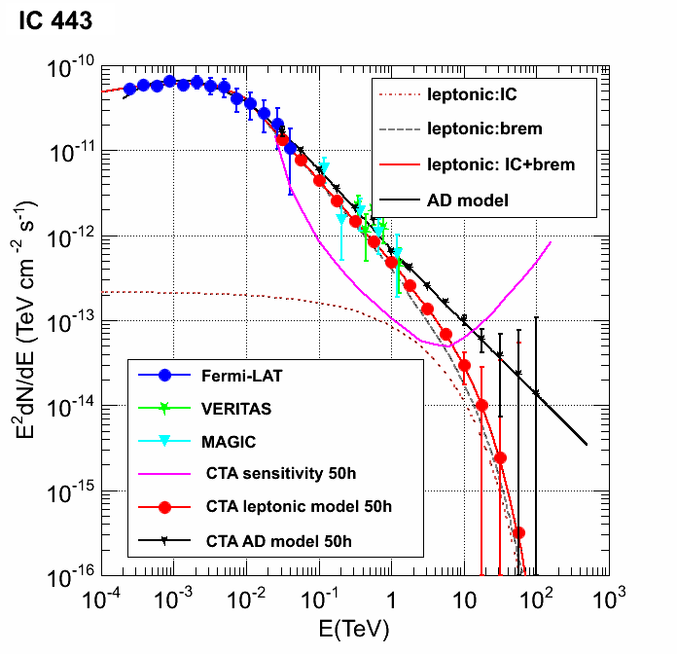
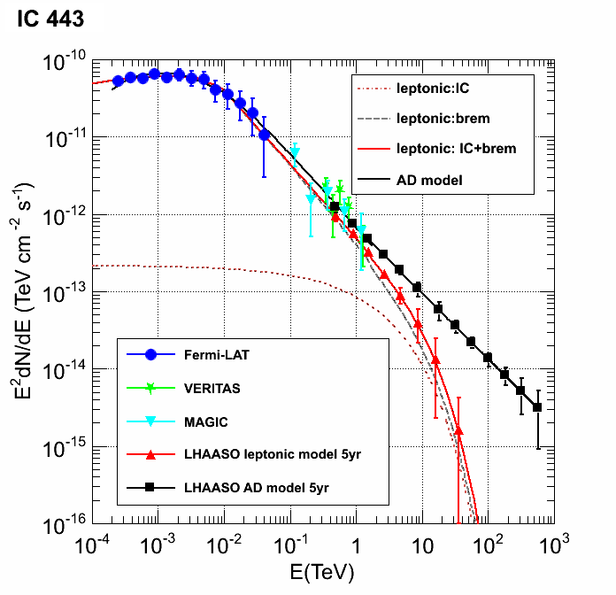
GCR signature @ the highest energies
A LHAASO-like sensitivity is mandatory
@CTA
@LHAASO

Slide 14
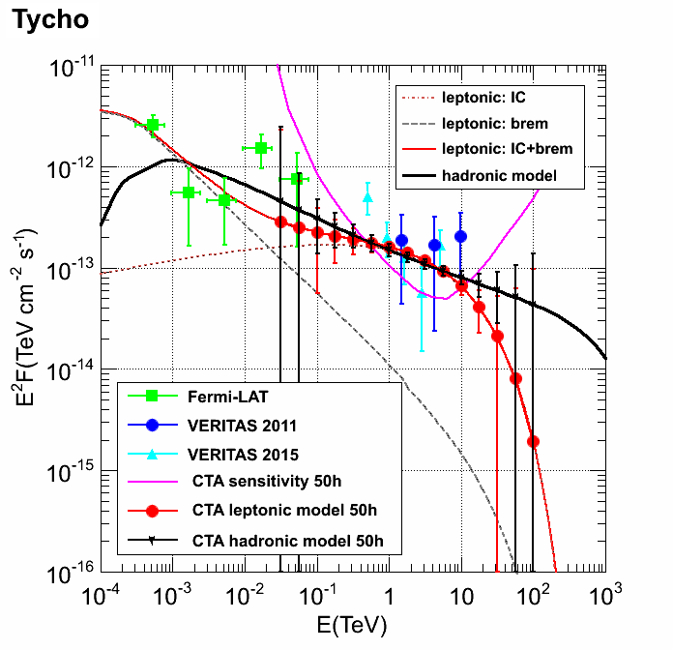
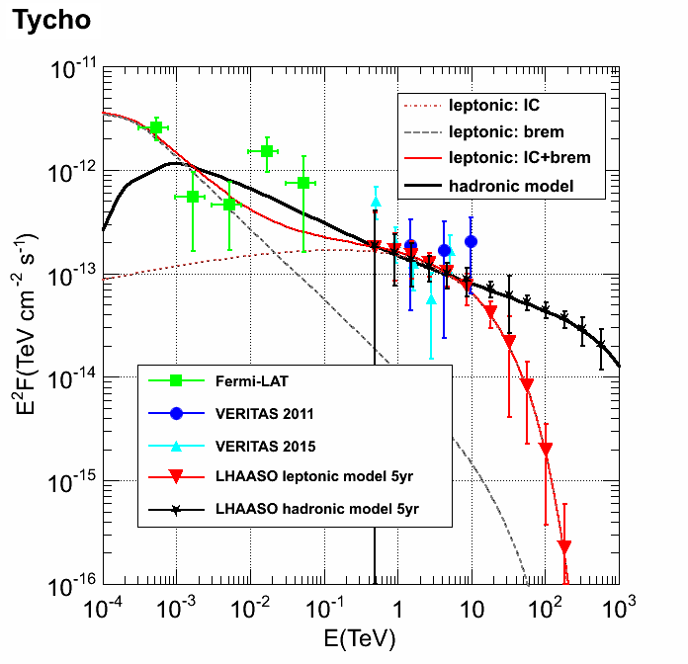
GCR signature @ the highest energies
A LHAASO-like sensitivity is mandatory
@CTA
@LHAASO

Slide 15
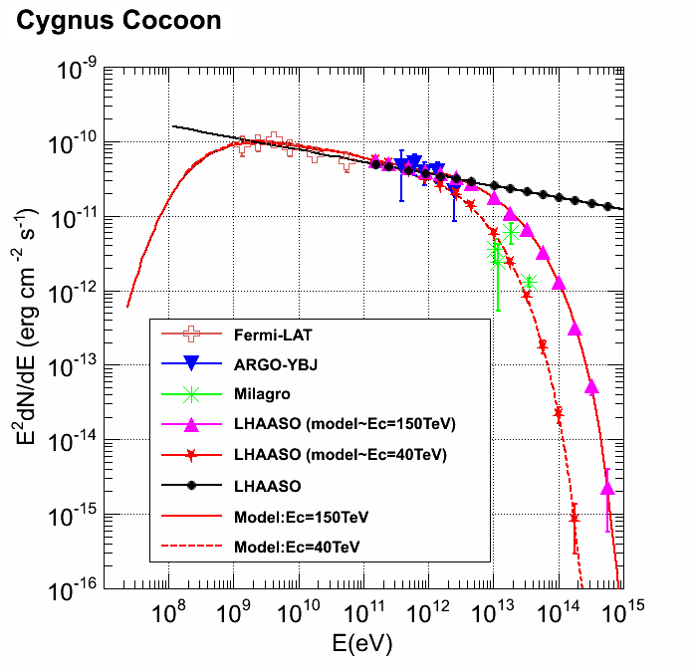
Acceleration limit of GCR sources
An effective probe to the cut-off energy of GCRs (knee)

Slide 16
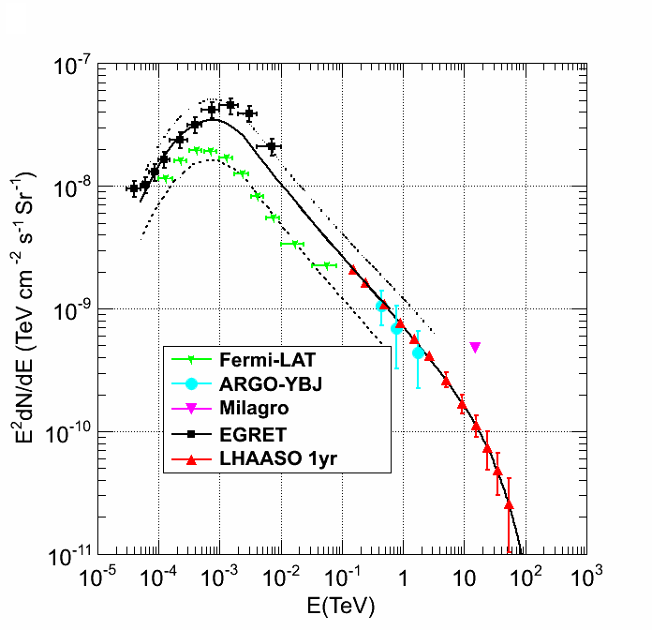
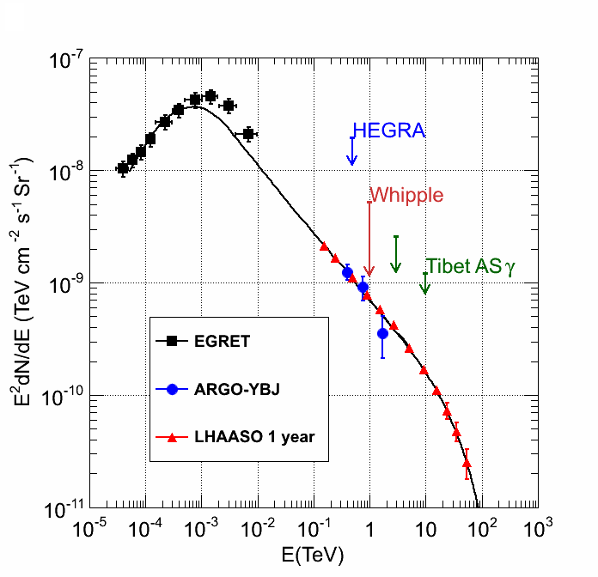
GCR spectrum and density:
global vs. local, diffuse emission as a probe
wide FOV is mandatory
Ec=50TeV
25° < l < 100°, |b|< 5°
Cygnus region

Slide 17
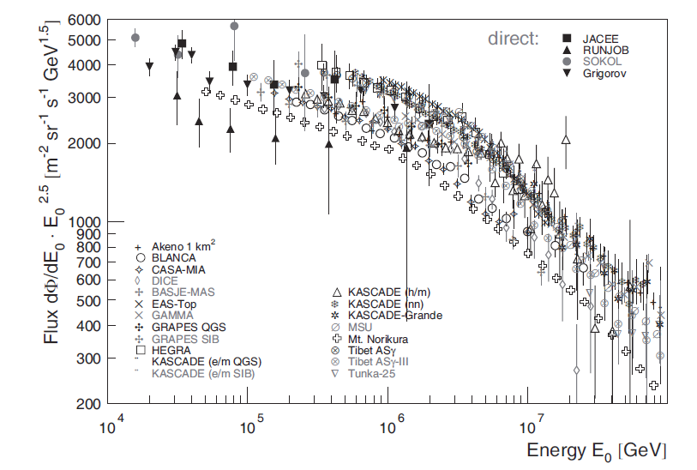
The Knees of GCR spectra:
LHAASO

Slide 18
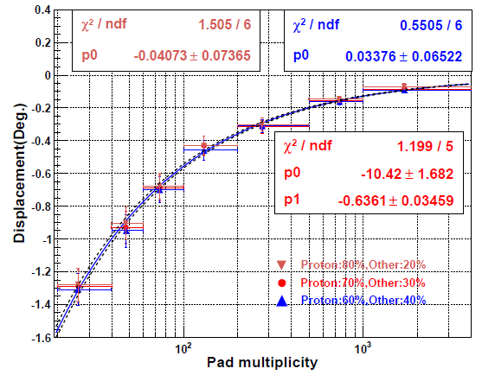
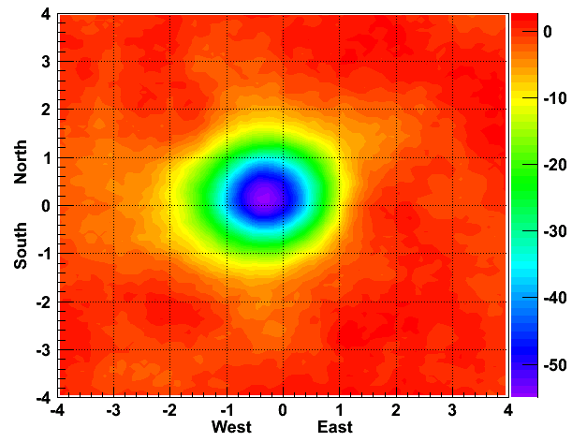
The Knees of GCR spectra:
Blue: Fe
Red: P
Energy scale: magnetic spectrometer
LHAASO prototype +ARGO

Slide 19
Gamma ray astronomy

Slide 20
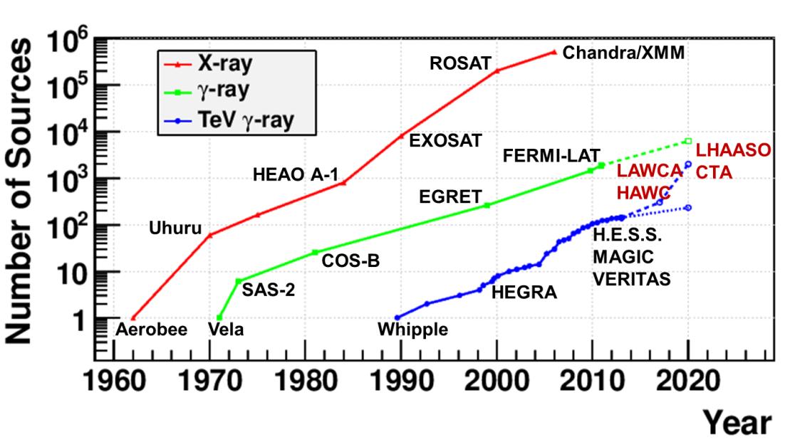
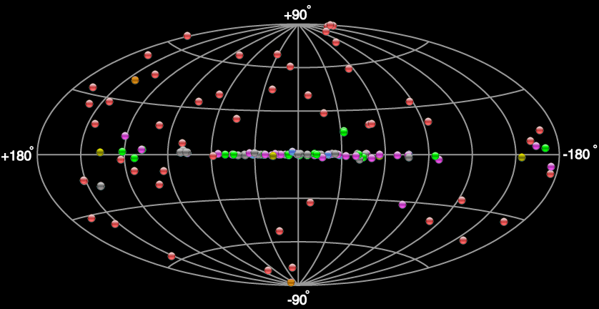
Survey of the γ sky
LHAASO FOV: 60% of the whole sky
Full duty cycle

Slide 21
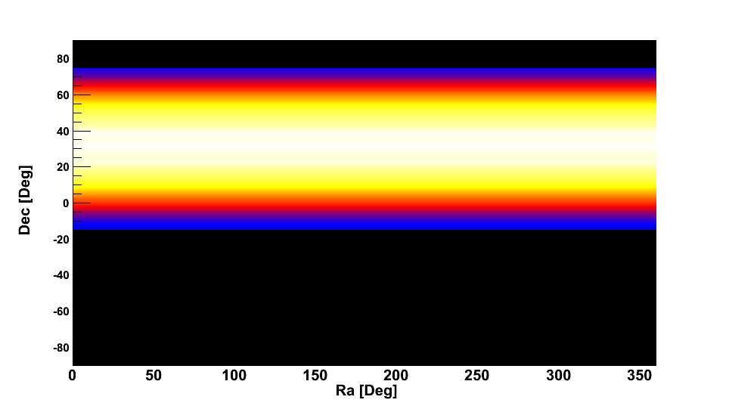
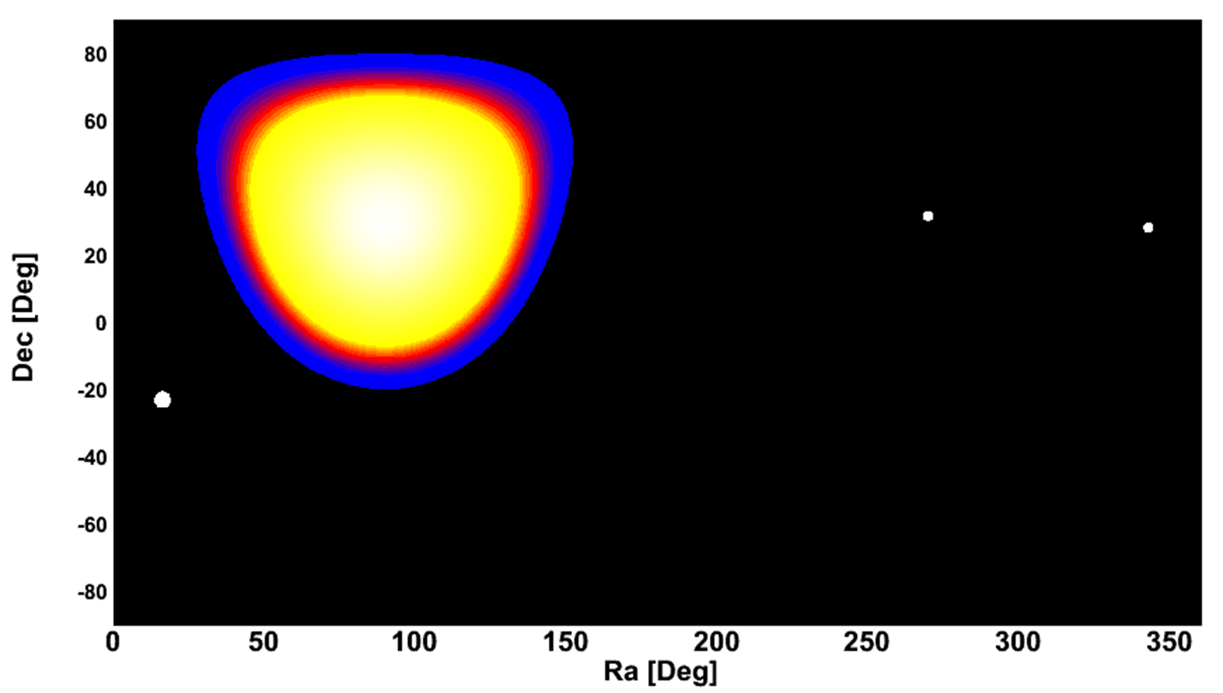
Wide FOV
High sensitivity
Wide FOV:
  1/7 of the sky at each moment
  60% of the sky every day
LHAASO
MAGIC
VERITAS
HESS
每天扫描天区

Slide 22
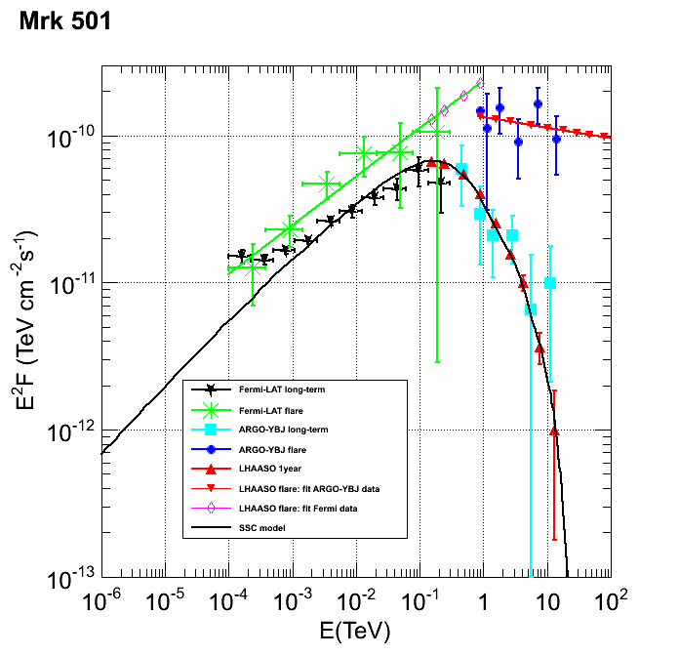
Transient Phenomena: multi-wavelength study

Slide 23
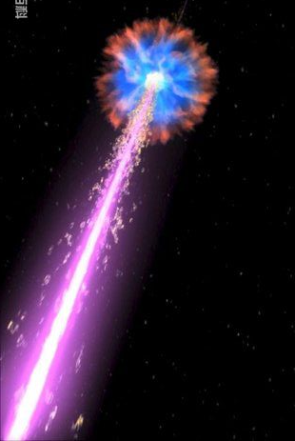
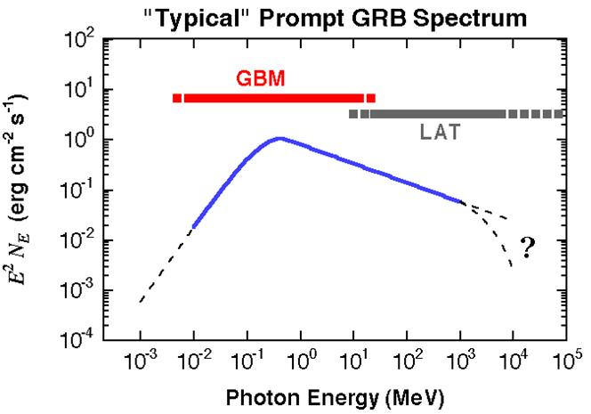

Gamma ray bursts
LHAASO
A_{eff}: ~10⁴ m²@20 GeV

Slide 24
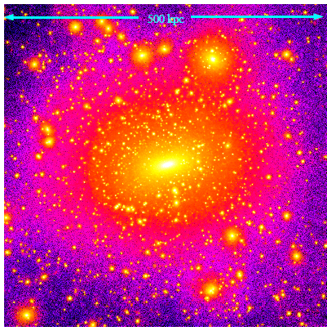
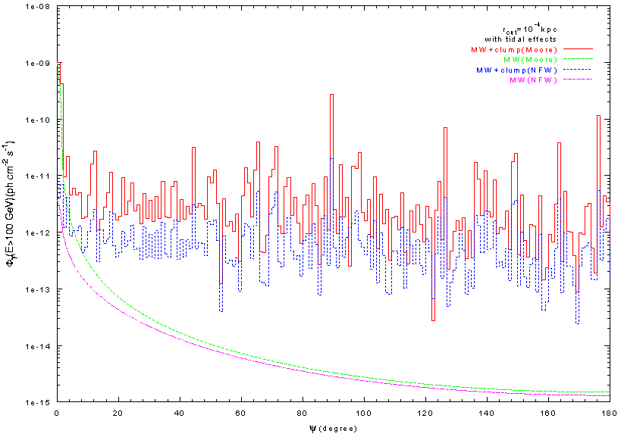
LHAASO@Dark Matter
Decay/annihilation
  dwarf spheroidal galaxies
  clustering
Large FOV、High sensitivity
Identification
  “dark”
  Same γ SED
  extended
Reed et al, MNRAS357,82(2004)
ARGO sensitivity
LHAASO sensitivity
γ-rays from smooth bkg

Slide 25
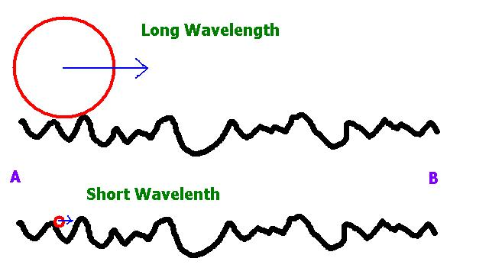
LHAASO@New Physics
Lorentz Invariance, a basic foundation
Quantum gravity, LIV
c varies with energy
Low energy γ
High energy γ

Slide 26
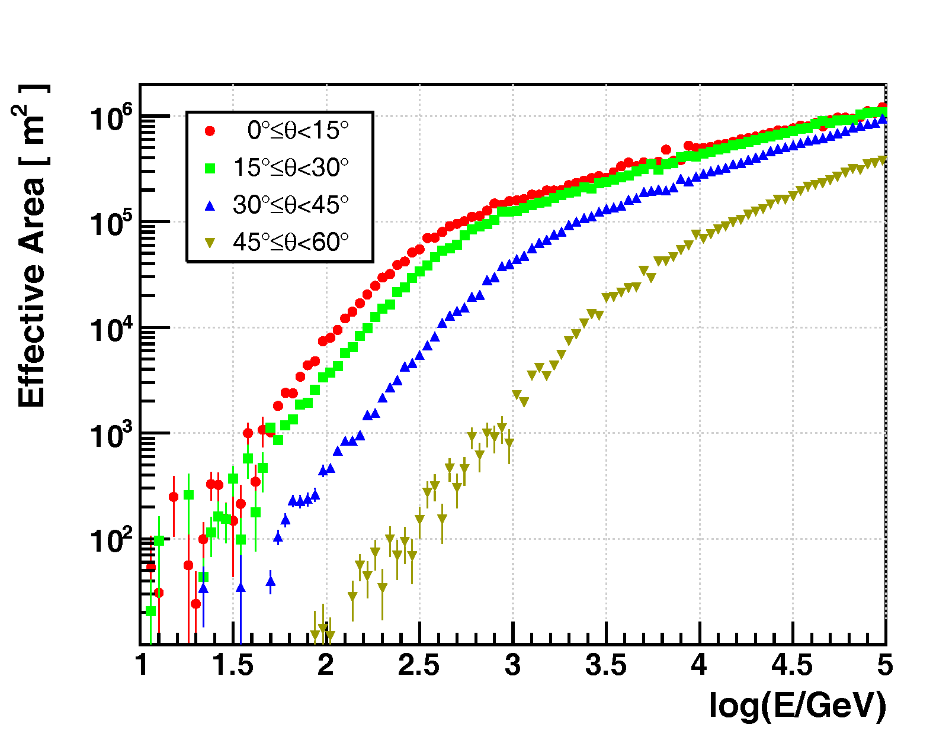
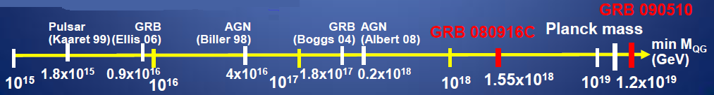
LHAASO@New Physics
GRB/AGN
LHAASO vs. Fermi-LAT
  Aeff@100GeV ×5000
Mass scale ×10
Fermi-LAT: one 31-GeV γ，delay<1s
X.F. Feng

Slide 27
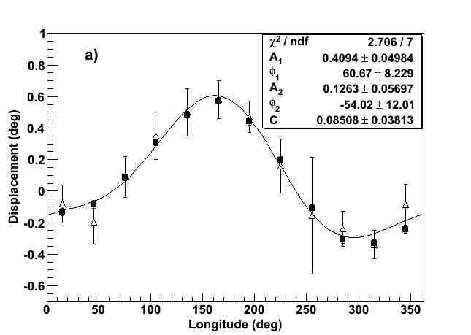
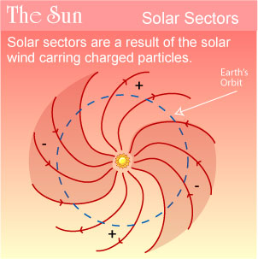
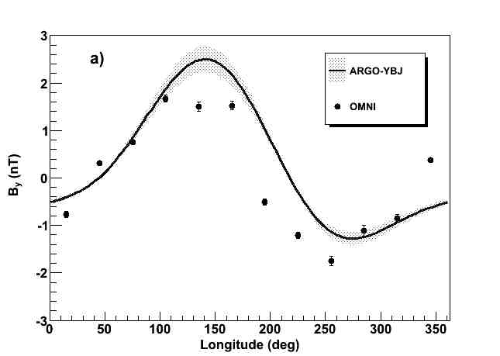
LHAASO@Solar activity
---forecast geomagnetic storms

Slide 28
Design of the LHAASO detectors

Slide 29
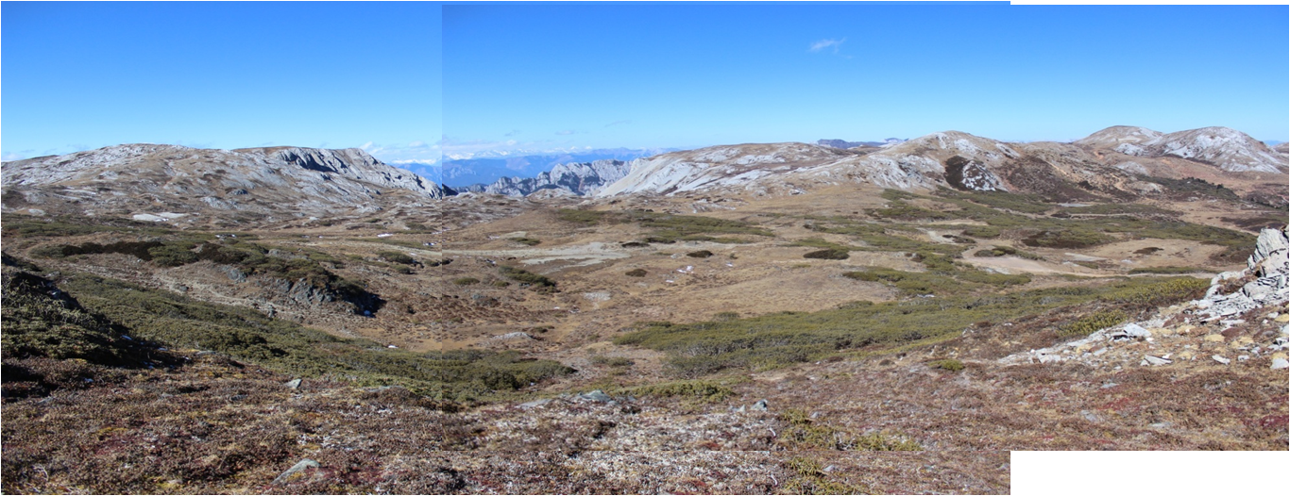
LHAASO: Large High Altitude Air Shower Observatory
Mt. Haizi (4410 m a.s.l.), Sichuan, China
10 km from Yading Airport.
海拔4400米

Slide 30
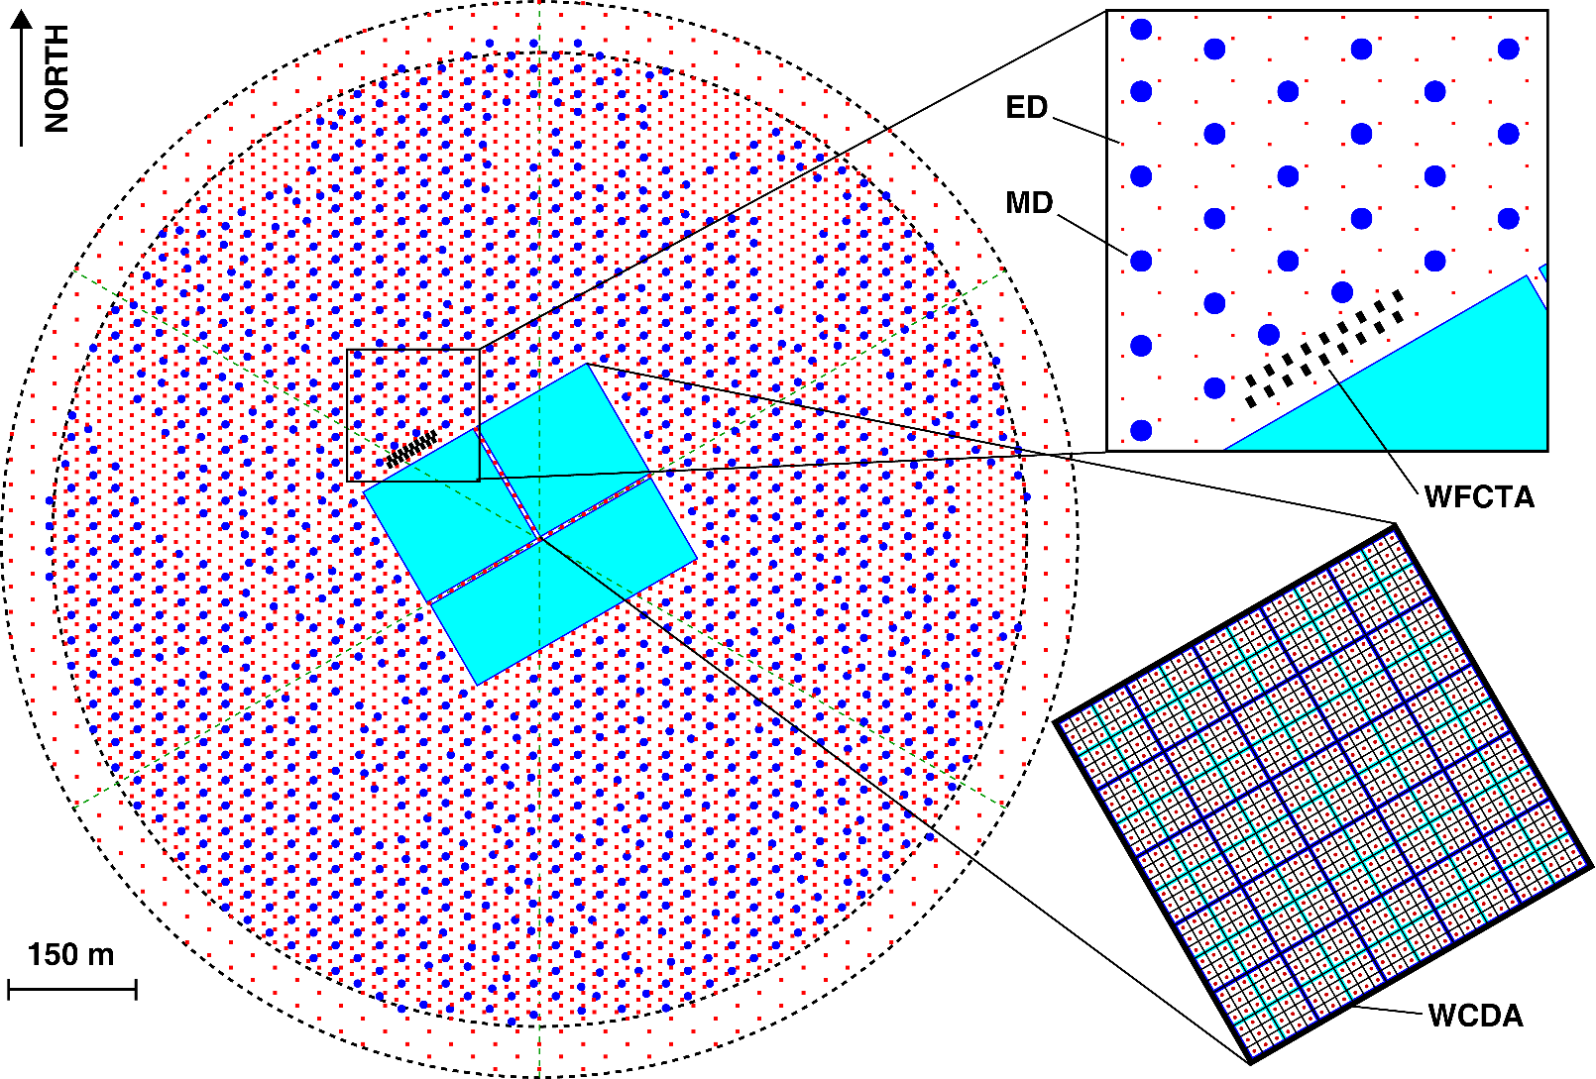
LHAASO layout
5195 EDs
  1 m² each
  15 m spacing
1171 MDs
  36 m2 each
  30 m spacing
3000 WCDs
  25 m² each
12 WFCTs

Slide 31
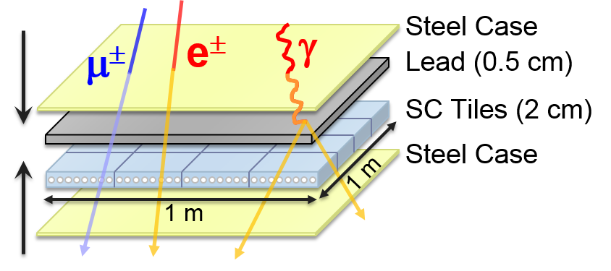
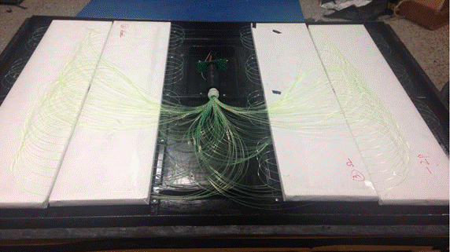
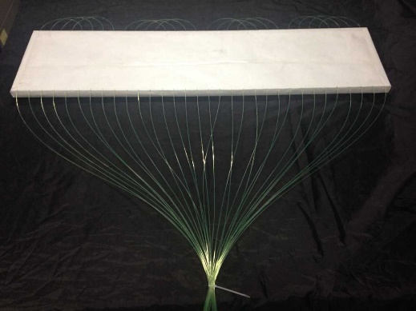
Electromagnetic Particle Detector
Uniformity for 5195 units: < 10%
Stability with ±25ºC: ±5%

Slide 32
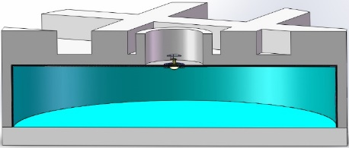
Muon Detector
Water Cherenkov detector underneath soil

Slide 33
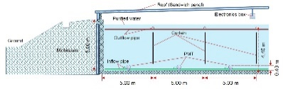
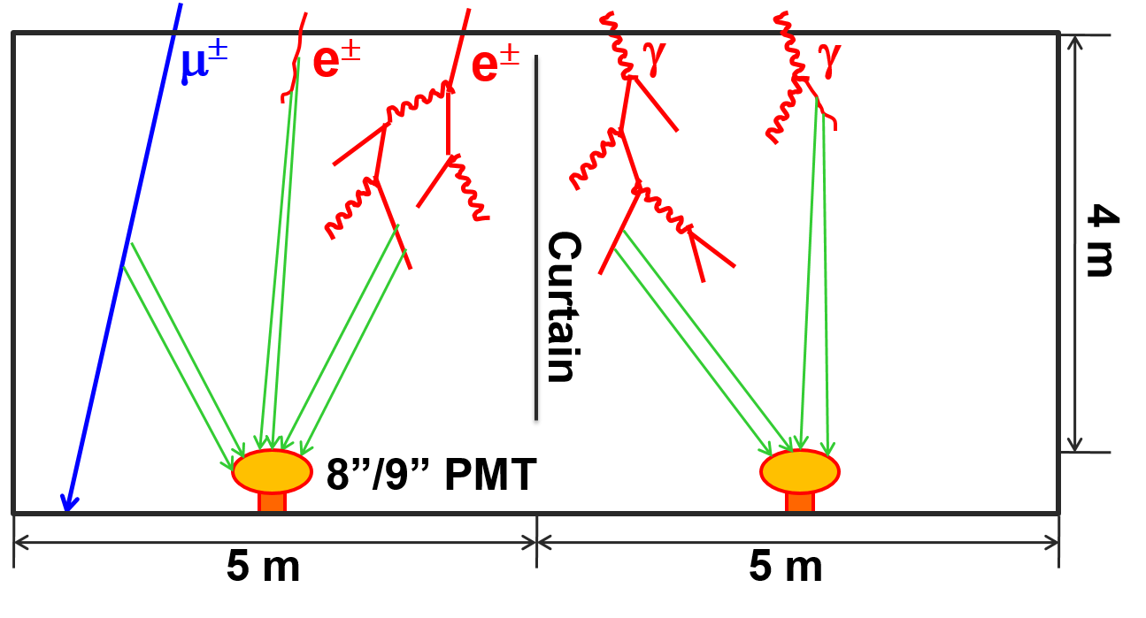
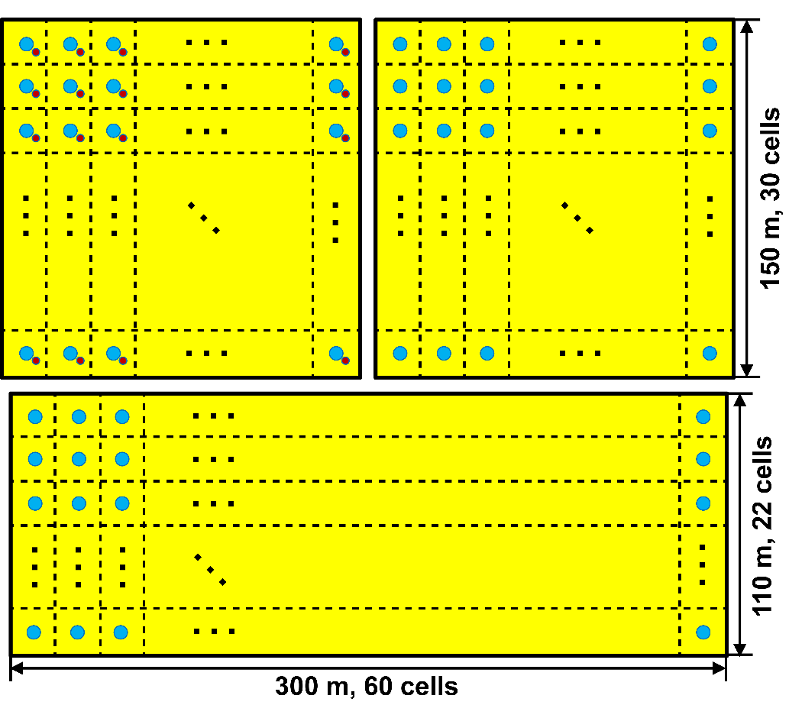
Water Cherenkov Detector Array

Slide 34
Wide FOV Cherenkov Telescope Array
32×32 pixels, 0.5º each
4.7 m² collection area
Energy coverage by different configurations
  <10¹⁶ eV
  10¹⁶-10¹⁷ eV
  10¹⁷-10¹⁸ eV

Slide 35

LHAASO detector timing
Over 7,000 detector units
Spread around 1km² area
0.5°Angular resolution for shower reconstruct from timing of hits TOF
Synchronous timing
among detectors
Time-stamp Synchronization
Time stamps of >7,000 nodes to be aligned <500ps (rms).
Frequency distribution & phase locking
Distribute synchronous ADC clock with <100ps skew.
Traceability & Real-time calibration
Timing delay compensation due to environmental perturbation in hardware in real time.
Notes:
Gamma rays interact in the atmosphere, form particle cascades

Slide 36

“Triggerless” DAQ
---hybrid measurement of showers
Triggering, building, (re-construction) and storage by online computers
WR network & DAQ readout network

Slide 37
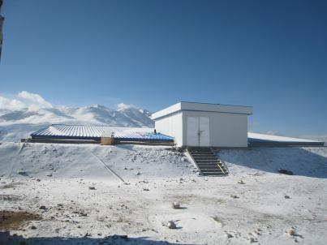
Engineering Array @ YBJ
~1% of LHAASO
  42 EDs, 2 MDs, 9-unit WCDA, 2 telescopes, 100 shower core detectors.
Fully implementing the LHAASO designs, including White-Rabbit-based clock distribution, “triggerless” DAQ, etc
Has been in operation for more than 2 years.

Slide 38
WR performance
WR Switch
Grandmaster
30m
1Km
Cute-WR
WR Switch
30m
Cute-WR
1Km
1Km
Cute-WR
WR Switch
30m
Cute-WR
Cascade topology
2Km
1Km
Cute-WR
WR Switch
30m
WR CERN: 1ns
Cute-WR

Slide 39
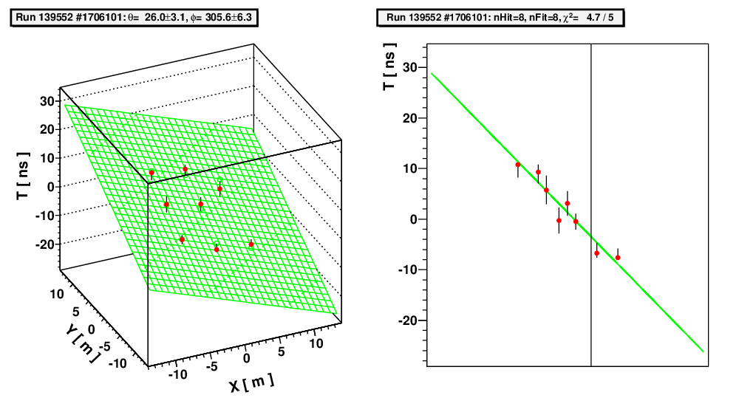
Example Showers

Slide 40
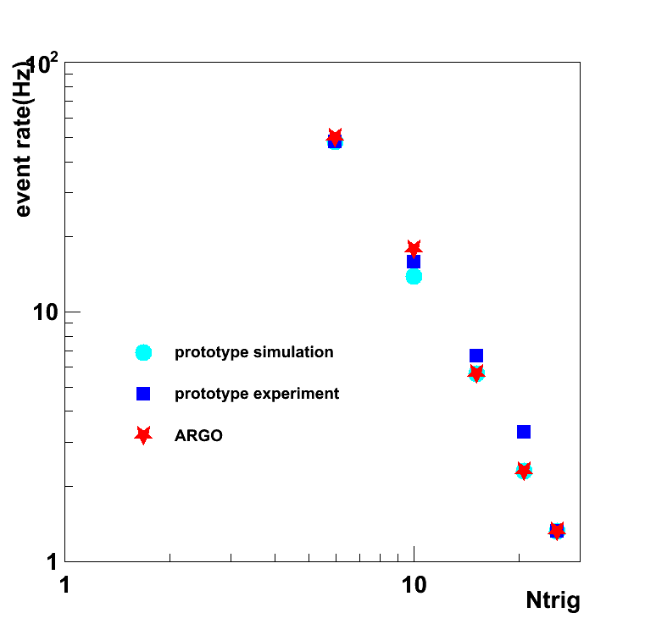
Event Rate and Moon Shadow
Event rate agrees with MC and ARGO-YBJ
Observed moon shadow by 5.8σ in 2 years.

Slide 41



N_{μ} purity > 97%
Soil density 2 g/cm³

Slide 42
Long-term Stability
2%/year→17.8% in 10 years if the signal attenuates exponentially

Slide 43



MD Water Temperature
0-4.2m

Slide 44
P+He Spectrum by WFCTA prototype and ARGO-YBJ

Slide 45








Activities @LHAASO site
Meteo-station
Soil-temperature measurement
MD sites
Site boundary survey
Mt. Haizi (4410 m a.s.l.), Sichuan, China, July 2015
Deep geo-survey, July 2015

Slide 46
Summary and outlook
The LHAASO is designed to fulfill the physical goals in gamma ray astronomy and cosmic ray physics
Prototype arrays of ~1% LHAASO have been in operation at YBJ for more than 2 years
LHAASO infrastructure construction has started at Mt. Haizi, Sichuan, China
¼ LHAASO is expected to produce data in 2018.

Slide 47



LHAASO观测、测控基地施工现场
这里没有宝-马
这里没有奥运
这里是追逐梦想的地方
—LHAASO基建工程师来自前方的报道

