Slide 1
Relativistic Heavy Ion Collisions
相对论重离子碰撞
中国物理学会高能物理分会第十二届全国粒子物理学术会议
王福强
湖州师范学院

Slide 2
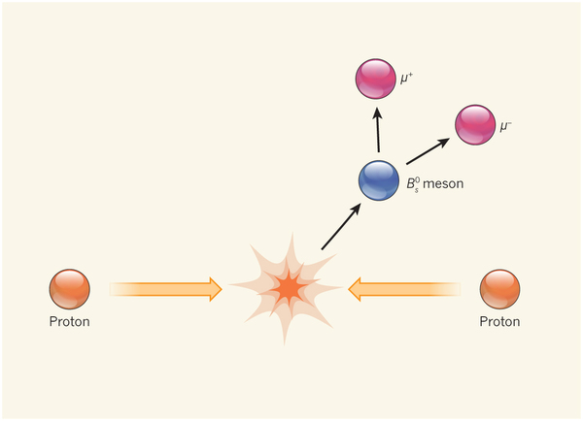

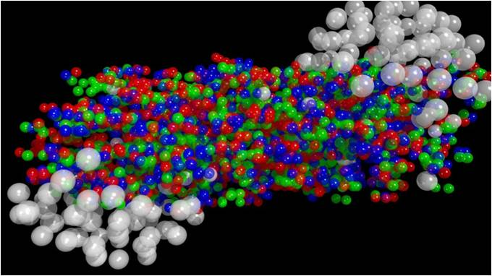
What is relativistic heavy ion collision?
Artist’s view of heavy ion collision
Gold
High energy physics
Proton-proton collisions
Exclusive physics processes
Many (∞) body physics
Condensed matter physics
Mean field approaches
Gold
Physics is known
Complication from ∞
Physics often unknown
Clean environment
High energy nucleus-nucleus collision
Exclusive physics processes
Physics often unknown
Many-body (but not ∞) physics
Nuclear matter
Complication from many-body

Slide 3
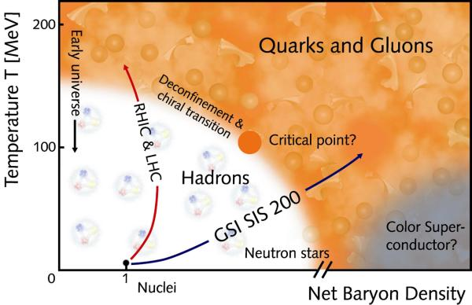
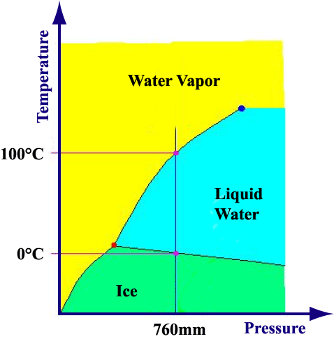
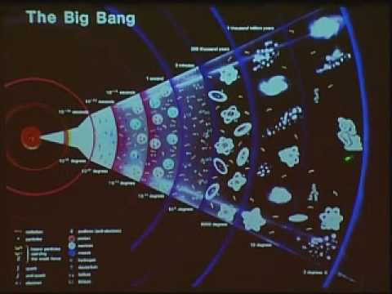
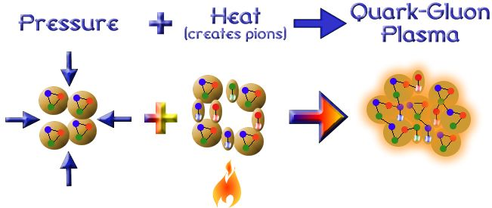
Why relativistic heavy ion collision?
Phase diagram: how matter organizes itself at given degrees of freedom, e.g. water.
QCD under extreme condition
10¹²K
Quark-Gluon Plasma
(QGP)
x5
The QCD phase diagram: structure of matter with quark and gluon (color) degrees of freedom.

Slide 4

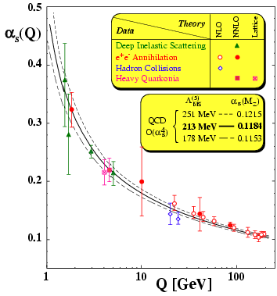
Quantum ChromoDynamics
Q
Complex to calculate:
Lattice QCD
QCD-guided, driven by experiment
Long distance
Short distance
pQCD
Asymptotic freedom
confinement
QCD: the basic theory for strong interaction, DOF well defined at short distances.
Little is known about the dynamical structures of matter, e.g. confinement, nucleon spin, QCD phase structure, strong coupling – QCD at long distances: QCD Matter.

Slide 5
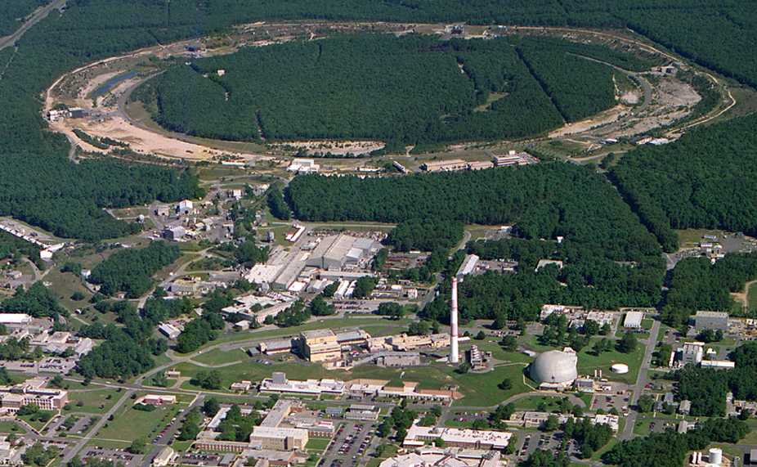
Relativistic Heavy Ion Collider
Brookhaven National Laboratory (BNL), Upton, NY
PHOBOS
RHIC
BRAHMS
PHENIX
STAR
- RHIC: high-energy
heavy-ion collider
(i) Dedicated QCD collider
(ii) √s_{NN} = 5 - 200 GeV
(iii) p, d, Cu, Au, U
AGS
TANDEMS
v = 0.99995⋅c = 186,000 miles/sec
Au + Au at 200 GeV

Slide 6

Large Hadron Collider
- LHC: high-energy particle/heavy-ion collider
√s_{NN} → 5000 GeV
  ~25x of RHIC
(ii) p, Pb
LHCb
ATLAS
ALICE
CMS
LHC

Slide 7

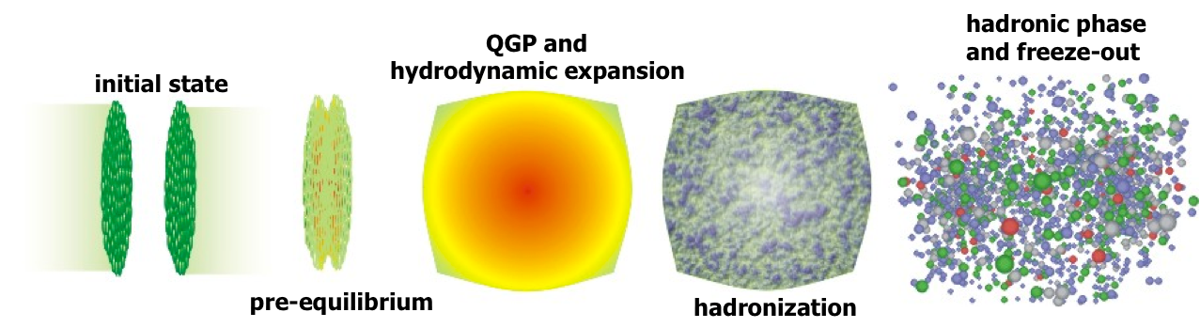
Study QCD by heavy-ion collisions
Outline for the rest of the talk
Hard processes, short distance, rare probes
Soft processes, long distance, bulk particles
Phase boundary, critical point search
One of the challenges is to infer the earlier state QGP through final state hadrons

Slide 8
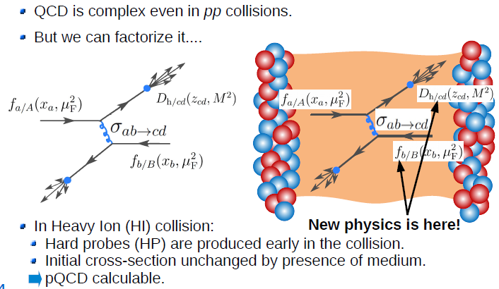
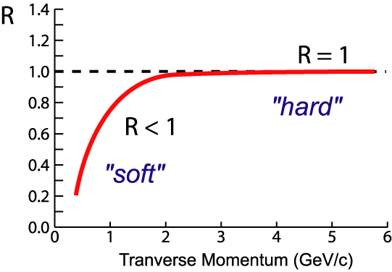
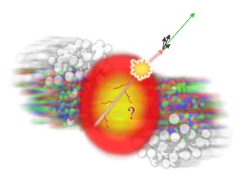
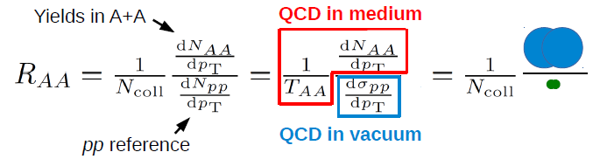

Nuclear modification factor
small
$$R_{AA}$$
Interact with QGP, and changed by QGP
Compare to pp/pQCD leading to knowledge about QGP
Nuclear modification factor:
large

Slide 9
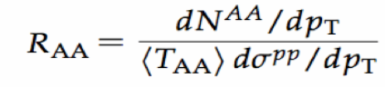
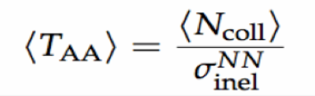
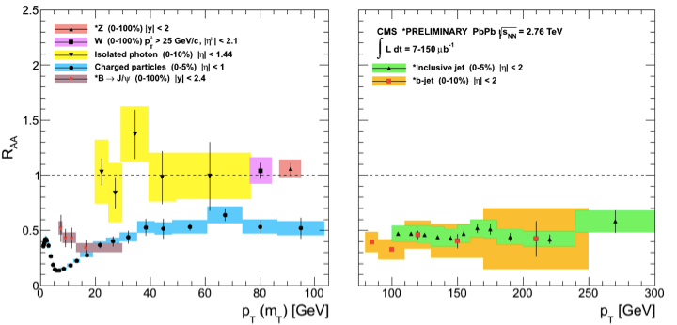
Hadron and (b)jet R_{AA}
Charged Particles
Anti-k_{T} R=0.3 Jets
Ncoll scaling works
No flavor/mass
dependence at high pT
x2 suppression
Flavor/mass dependence
seen at low pT
CMS: EPJC 72 (2012) 1945 , HIN-12-004, PRL 113 (2014) 132301, PLB 715 (2012) 66, JHEP 03 (2015) 022, PLB 710 (2012) 256

Slide 10
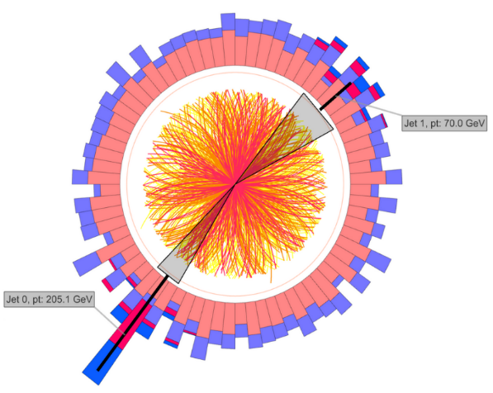
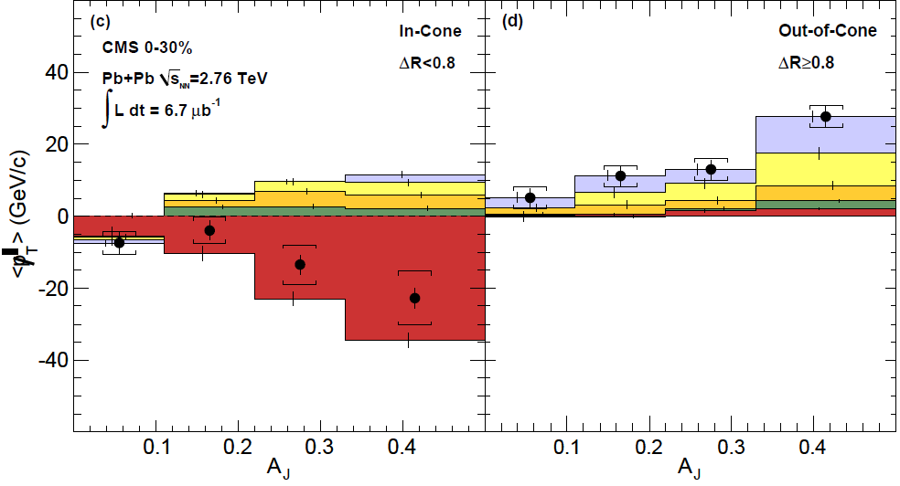
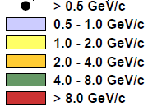

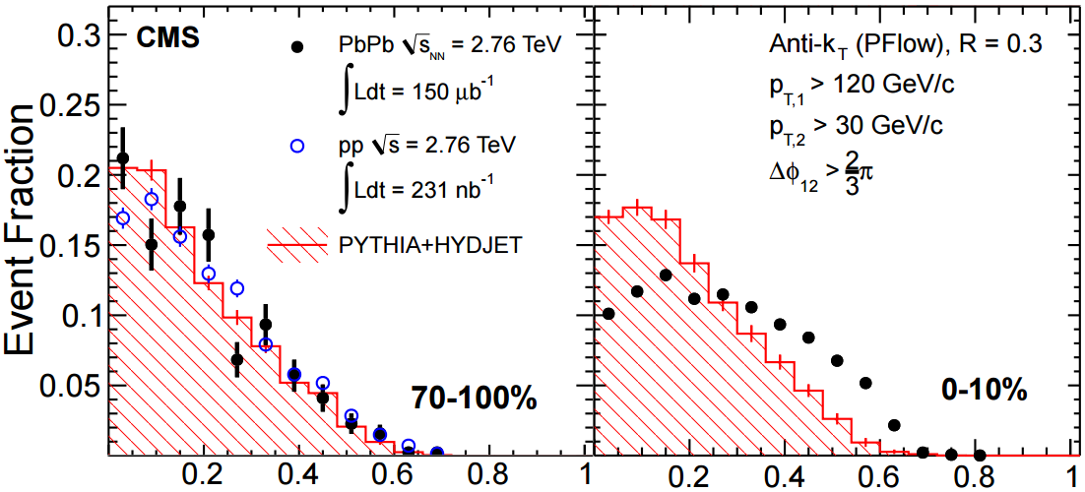
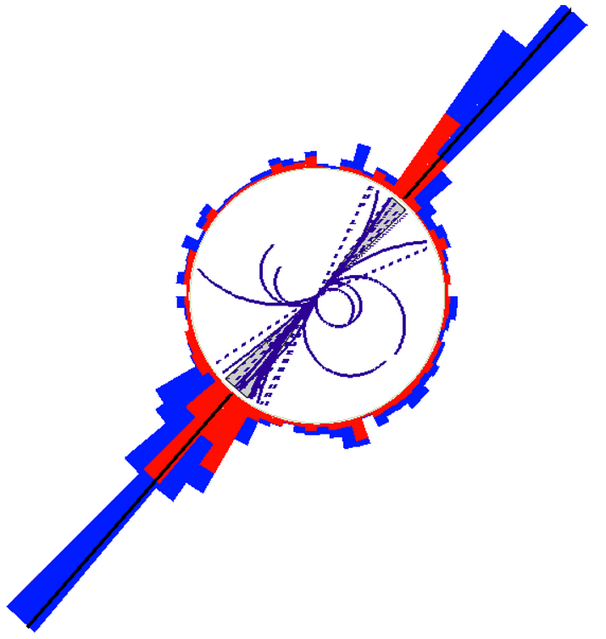
Dijet imbalance @LHC
pp
Large $A_{J}$
Out-of-cone
In-cone
PRC 84, 024906 (2011)
PLB 712, 176 (2012)
Larger fraction of asymmetric dijet events in central PbPb
RPC 84,
024906 (2011)
Many theoretical ideas such as
  Jet collimation, decoherence, hydro, turbulence cascade, third jet, etc.
Further development of jet analysis
  Detailed angular distribution of the quenched energy flow and jet shape

Slide 11
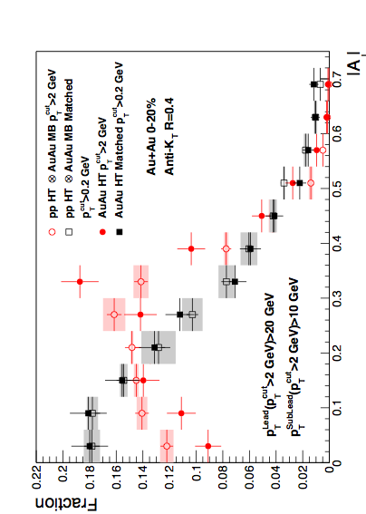
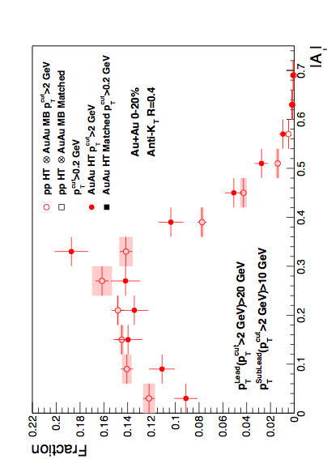
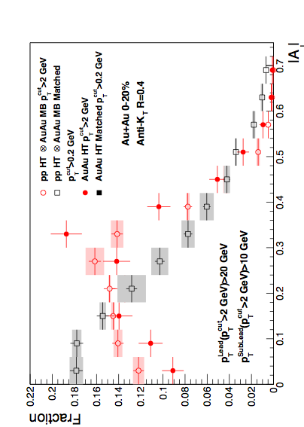
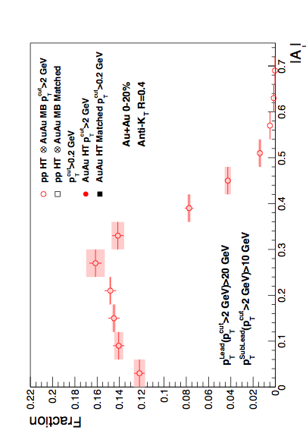

Dijet imbalance @RHIC
Anti-kT R=0.4, pT^{Lead}>20 GeV & pT^{SubLead}>10 GeV with pT^{cut}>2 GeV/c
Sys. Uncertainties:
- tracking eff. 6%
- tower energy scale 2%
Event Fraction
p-value < 10⁻⁴ (stat. error only)
Central Au+Au
anti-k_{T}, R=0.4
p-value = 0.8 (stat. error only)
Preliminary
Au+Au di-jets more imbalanced than p+p for pT^{cut}>2 GeV/c
Au+Au AJ ~ p+p AJ for matched di-jets (R=0.4)
|AJ|
  “Lost” energy seems contained within R=0.4 and low p_{T}
  Imbalance remains for smaller cone or higher constituent cutoff
  → Observed Broadening and Softening jet-by-jet

Slide 12
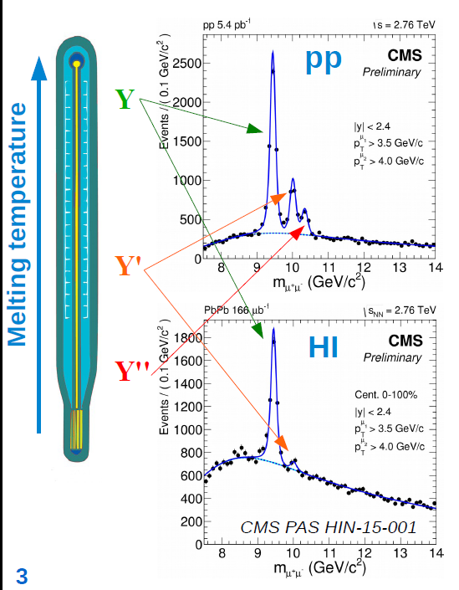
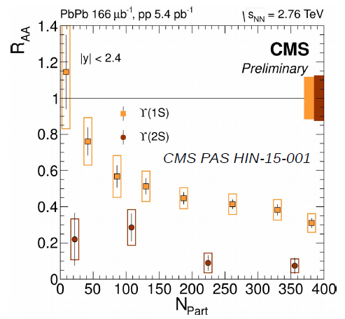
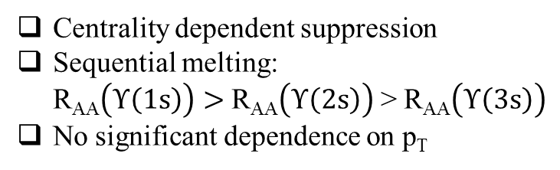
Quarkonia melting
Centrality dependent suppression
Sequential melting:
R_{AA}$\left(Υ\left(1s\right)\right)>$ R_{AA}$\left(Υ\left(2s\right)\right)$ > R_{AA}$\left(Υ\left(3s\right)\right)$
No significant dependence on p_{T}

Slide 13
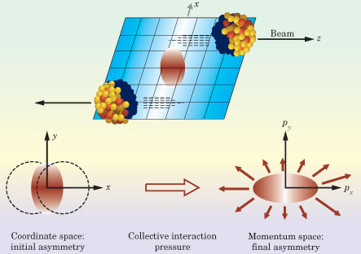
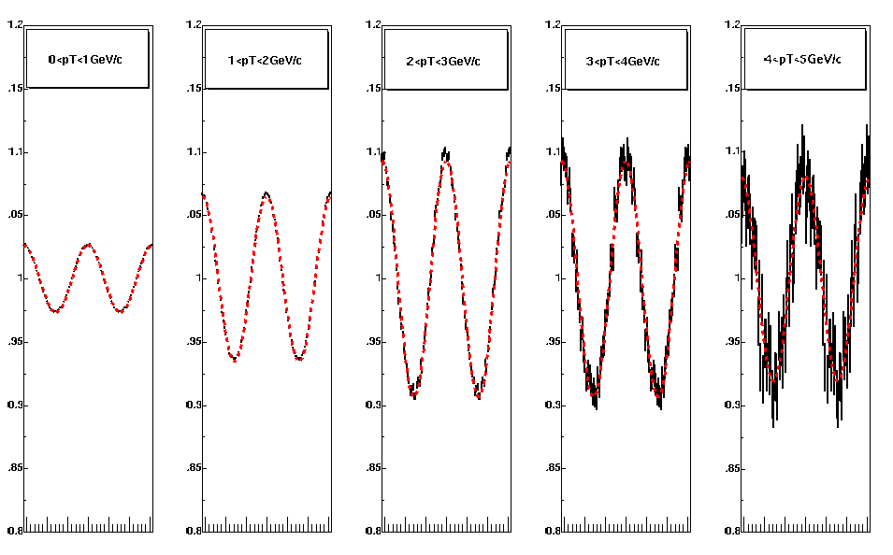
Soft probes: collective phenomena
4v₂
coordinate-space-anisotropy ➔ momentum-space-anisotropy
Pressure gradient

Slide 14
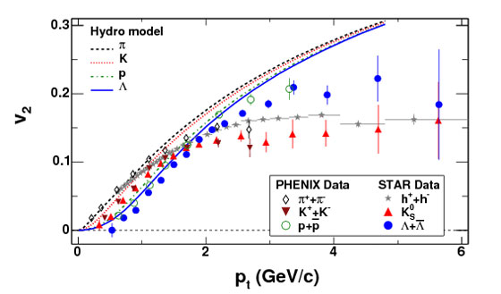

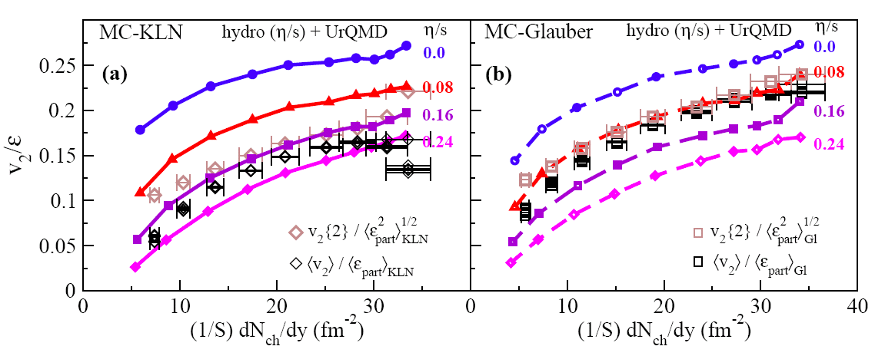
Elliptic flow measurements
RHIC
4v₂
➔ Small value of specific viscosity over entropy η/s
Model: Song et al. arXiv:1011.2783

Slide 15
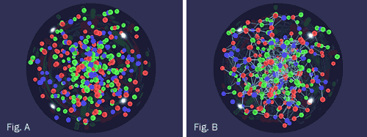
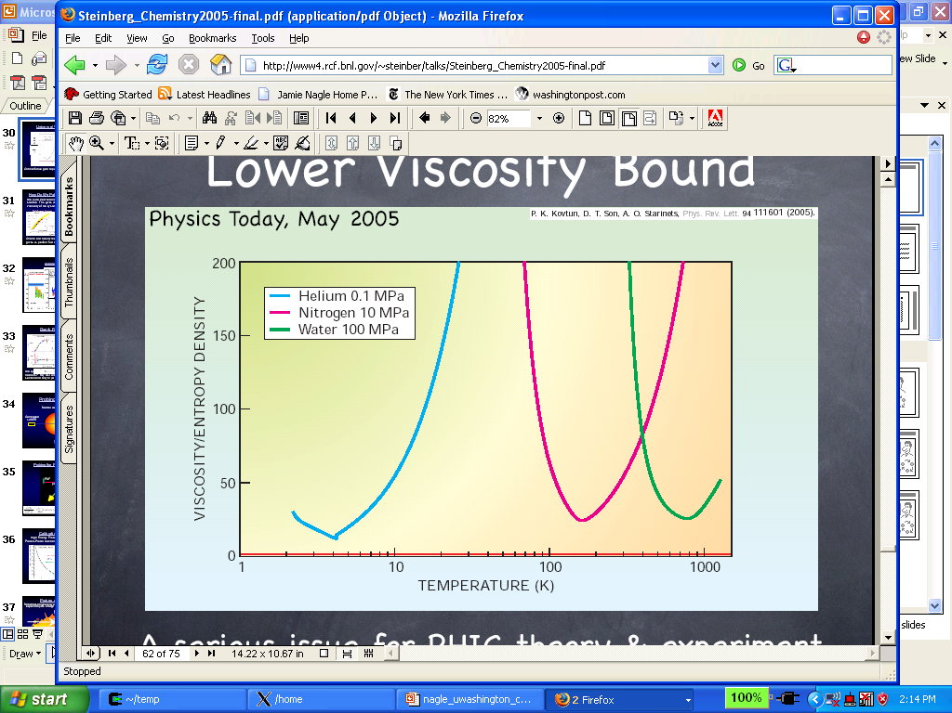
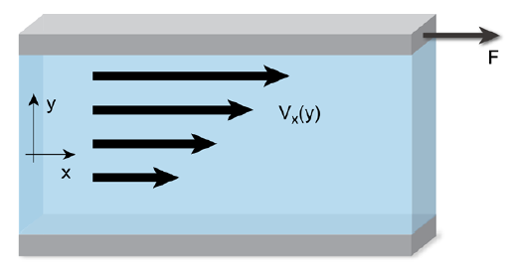



BNL press release 2005
RHIC Scientists Serve Up "Perfect" Liquid
New state of matter more remarkable than predicted -- raising many new questions
http://www.bnl.gov/newsroom/news.php?a=1303
Infinite viscosity
Very low viscosity
η/s ≈ (1-2)/4π
Viscosity quantum limit:
RHIC results

Slide 16
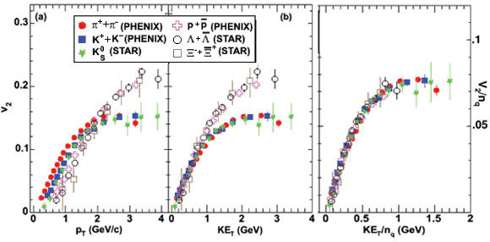
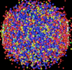
Number of Constituent Quark Scaling
It is the constituent quarks that are flowing

Slide 17
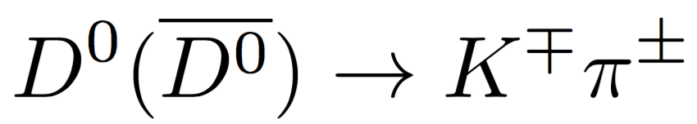
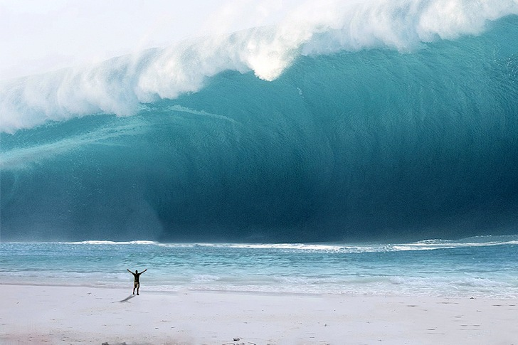
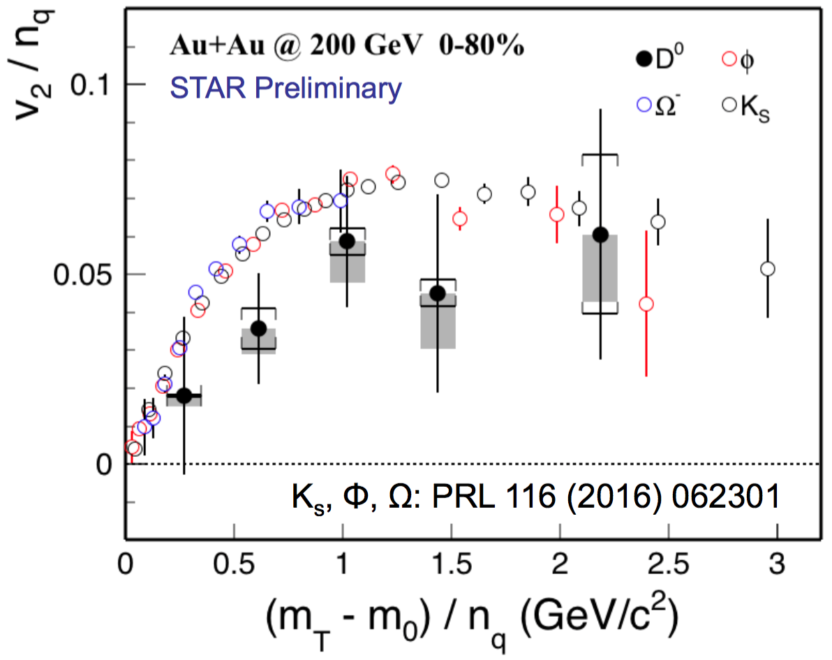

Heavy quarks flow!
Heavy quarks produced early by hard scattering
Heavy, does not easily flow, not easily thermalized
not fully thermalized?
Even heavy quarks flow and nearly thermalized; light quarks must have been thermalized.

Slide 18
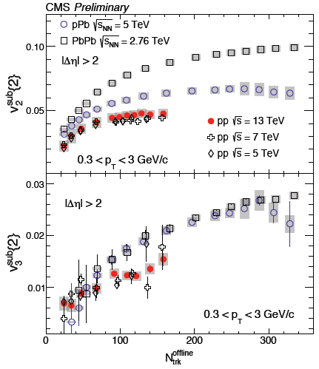

But there may be problems…
proton
LEAD
Yeah…pPb, even pp creates a QGP!
Maybe we need to rethink about the whole paradigm…

Slide 19
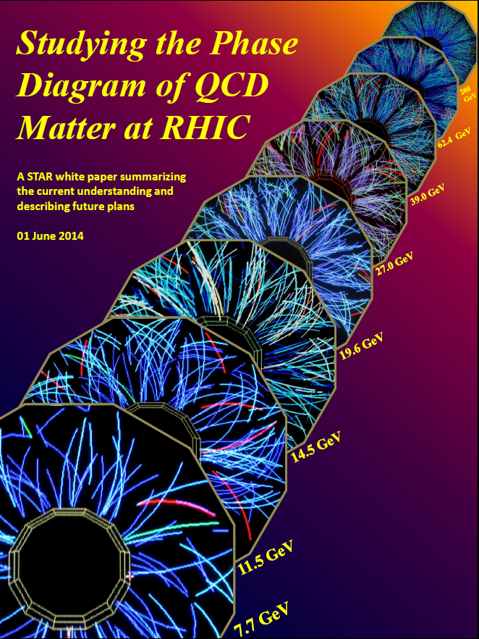
Phase boundary and critical point
Extend RHIC Au+Au measurements down toward SPS energy, search for possible indicators of a rapid transition in measured properties.
Chemical freezeout
Beam
Energy Scan
Phase I
(2010-2014)
NSAC LRP 2007: http://science.energy.gov/np/nsac/
2010: http://arxiv.org/pdf/1007.2613.pdf
2014: https://drupal.star.bnl.gov/STAR/starnotes/public/sn0598

Slide 20
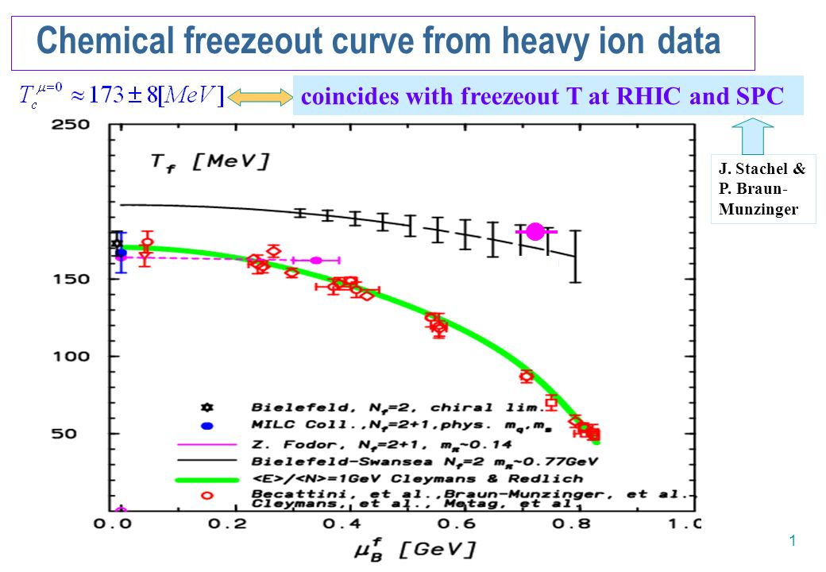
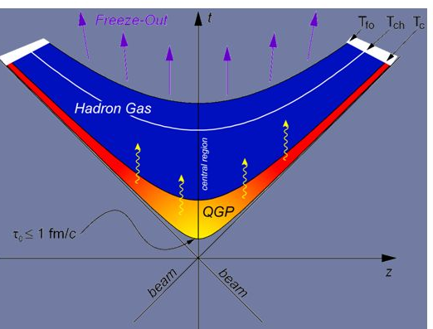
Chemical Freeze-out
Statistical hadronization
Chemical freezeout
Lattice QCD
Chemical freezeout ≈? hadronization transition

Slide 21

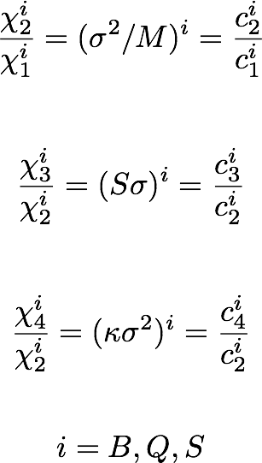
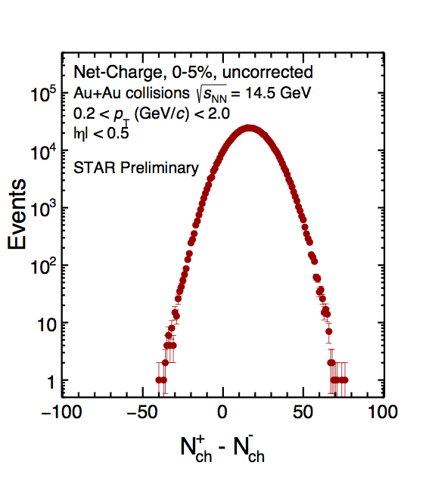

High order moments
Susceptibility ratios of conserved quantities
related to the moments of multiplicity distributions
Comparing first principal Lattice calculations with measured moments of conserved quantities, e.g. net-baryon → extract the chemical freeze out parameters T and μB
Lattice QCD
Experiment
HotQCD, PRL109, 192302 (2012)
WB Group, PRL111, 062005 (2013)
Look for critical behavior

Slide 22
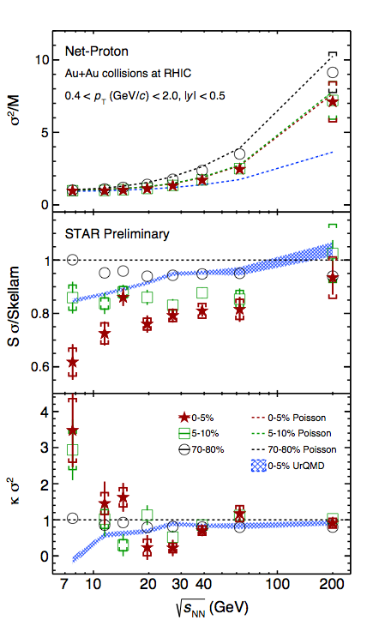
Search for CP via net-proton moments
σ²/M increases with increasing energy, consistent with Poisson expectation
Sσ/Skellam increases with increasing energy
Non-monotonic behavior of net-proton κσ² seen in top 5% central collisions
  5-10% central collisions in between
  → however: smooth trend in centrality
  Peripheral collisions show smooth trend
  Detailed extensive studies have been carried out and are still in progress
UrQMD (no Critical Point), shows suppression at lower energies - due to baryon number conservation

Slide 23
Summary
Relativistic heavy ion physics is a rich and vibrant field. QCD in matter under extremis.
The QCD matter is opaque to hard probes
The QCD matter is fluid/perfect/explosive, but small systems pose challenges
Beam energy scan phase-I searching for the critical point. Phase-II in near future.

