Slide 1

Electromagnetic fields with electric and chiral magnetic conductivities in heavy-ion collisions
Li Hui(李慧)
lihui12@mail.ustc.edu.cn
University of Science and Technology of China
第十二届全国粒子物理学术会议
This work is cooperate with Qun Wang, Xin-Li sheng
2016.8.22

Slide 2
Outline
Introduction and the motivation
The framework of solving the fields
Analytical and numerical results
Summary

Slide 3

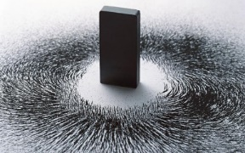
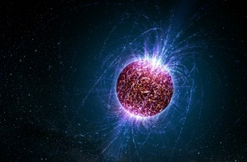
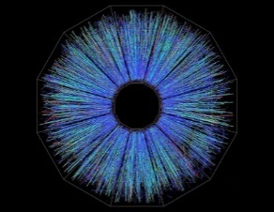



Magnetic strength in HIC
The Earth’s magnetic field (weak)
0.6 G
The strongest steady magnetic fields achieved so far in laboratory
${4.5×10}^{5}$G
The magnetic field existed in the compact stars
${10}^{10}\sim {10}^{16}$G
Heavy ion collisions produce the ever strongest magnetic field in the universe
${10}^{19}$G

Slide 4



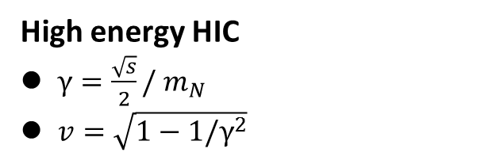
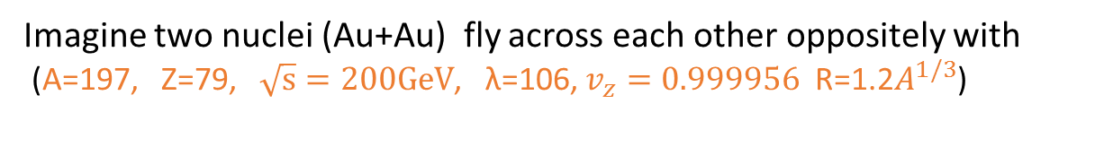
Estimation of EM field in HIC
High energy HIC
$γ=\frac{\sqrt{s}}{2}/{ m}_{N}$
$v=\sqrt{1−1/γ^{2}}$
Electric field in C.M.S frame
Coulomb’s Law
Lorentz transformation to boost into the Lab frame
Strong Interaction
Imagine two nuclei (Au+Au) fly across each other oppositely with
(A=197, Z=79, $\sqrt{s}=200GeV$, λ=106, $v_{z}=0.999956$ R=1.2$A^{1/3}$)
Scaling law
$$B_{LHC}\sim 10B_{RHIC}\sim {10}^{19}Gauss$$
Kharzeev, McLerran, Warringa (2008), Skokov (2009) Deng &Huang (2012)

Slide 5
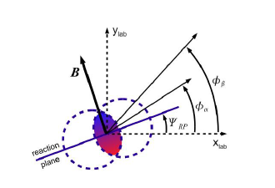
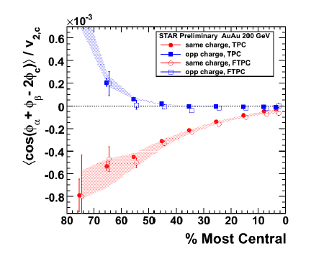


Charge separation effect in HIC
STAR PRL 103, 251601 (2009) ALICE PRL 110, 012301 (2013)
However, the interpretation of chiral magnetic effect is under hot debate due to the background contribution of the elliptic flow.

Slide 6
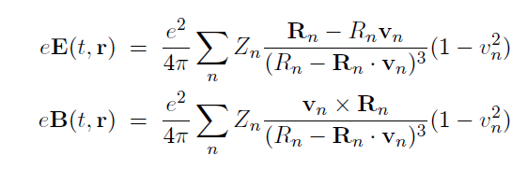
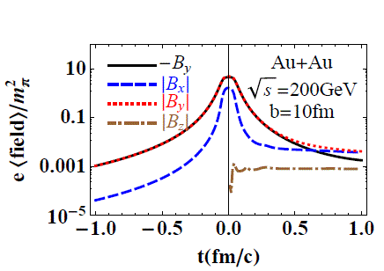


EM fields of charged particle in vacuum
(1)
(2)
Retarded potential
Lienard-Wiechert potentials
$$B\sim \frac{1}{t^{3}}$$
Magnetic field falls rapidly
In non-relativistic frame, $v_{n}≪1$
Eq.1&2 reduce back to Coulomb’s Law and Biot- Savart law

Slide 7
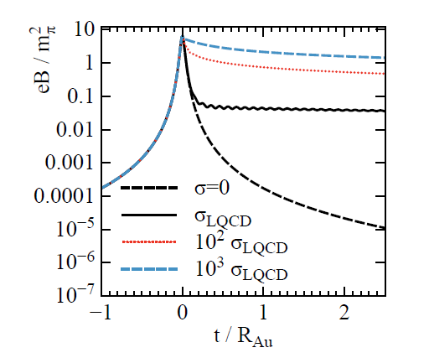

EM fields of charged particle in medium
In conducting medium with constant σ
EM fields can last longer
$$B\sim \frac{1}{t^{2}}$$
Mclerran and Skokov, 2013; Tuchin, 2014

Slide 8
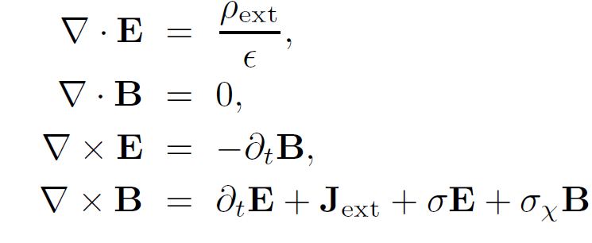



Maxwell-Chen-Simons equations
We start from the
the Ohm current and
the CME current
For simplicity, σ and $σ_{χ}$ are constant.

Slide 9
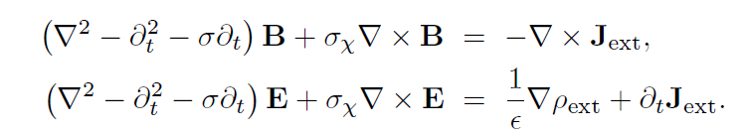



Green function method
represents the related fields
represents the source term

Slide 10
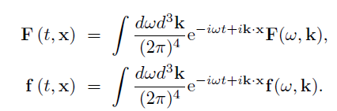
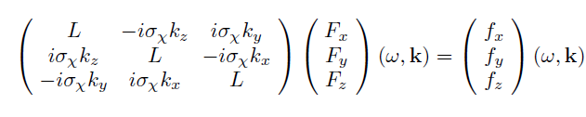


In Momentum space
For convenience, we transform into the momentum space
Fourier transform
The matrix form of eq.(3) in the momentum space
(4)
M as a matrix
We will obtain the form solution of the field

Slide 11




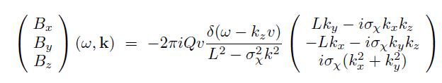
In Momentum space
a charged particle moving along the z direction
 | Coordinate Space | Momentum space
Charge current
Charge density
In momentum space, the magnetic field reads

Slide 12



Magnetic field : algebraic form
Integral over ω is more complicated
Umut Gursoy, Krishna Rajagopal(2014)

Slide 13



Electric field :algebraic form

Slide 14
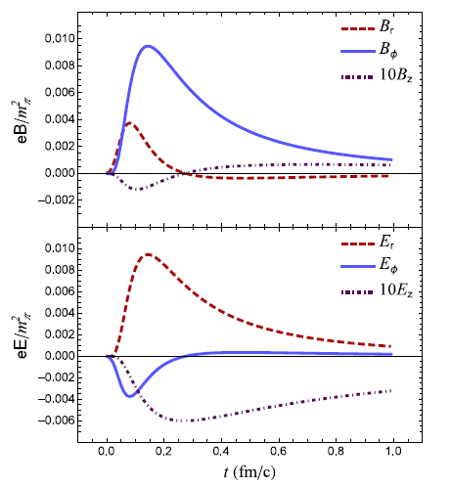
EM field of moving particle

Slide 15
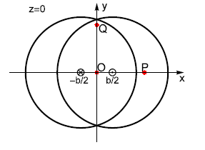
EM field in nuclei collisions
The geometry illustration
UrQMD model
give the configuration of the charged particles
The UrQMD Model is used to calculate the initial state of a heavy ion collision for the hydrodynamical evolution
The parameter b=4, P and Q points are (6,0,0) and (0,6,0) ,respectively.
S. A. Bass et al., Prog. Part. Nucl. Phys. 41, 255 (1998)
M. Bleicher et al., J. Phys. G 25, 1859 (1999)

Slide 16
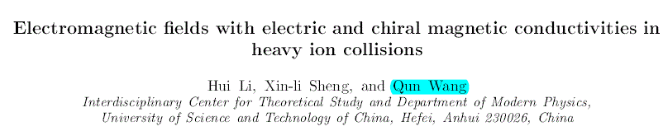
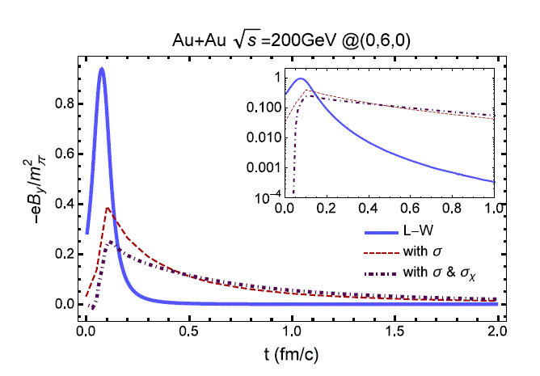
Lifetime of the EM field

Slide 17
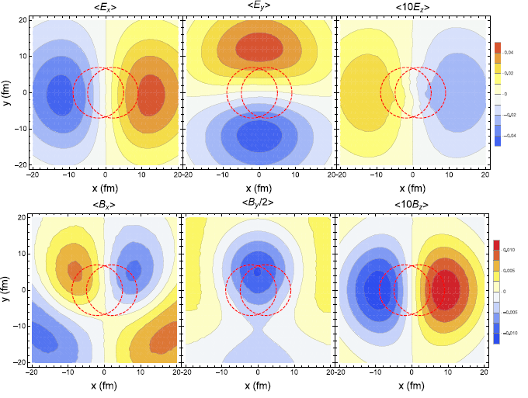
EM field in nuclei collisions
The contour plots for the electric and magnetic field

Slide 18
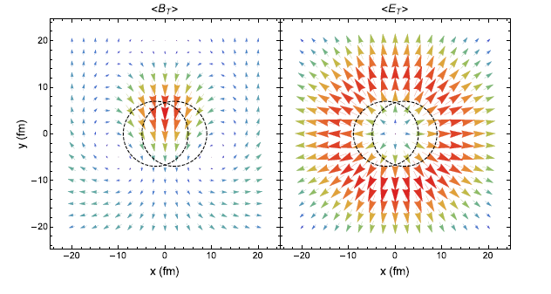
EM field in nuclei collisions
The vector fields for the two transverse components $B_{T}$ and $E_{T}$

Slide 19
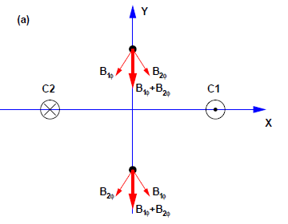
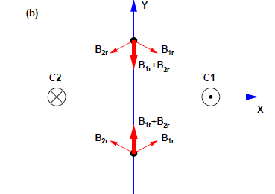
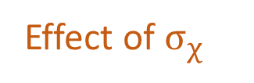
EM field in nuclei collisions
The asymmetry for the magnetic field
Effect of $σ_{χ}$
Radial component opposite sigh
Azimuthal part
same sigh

Slide 20
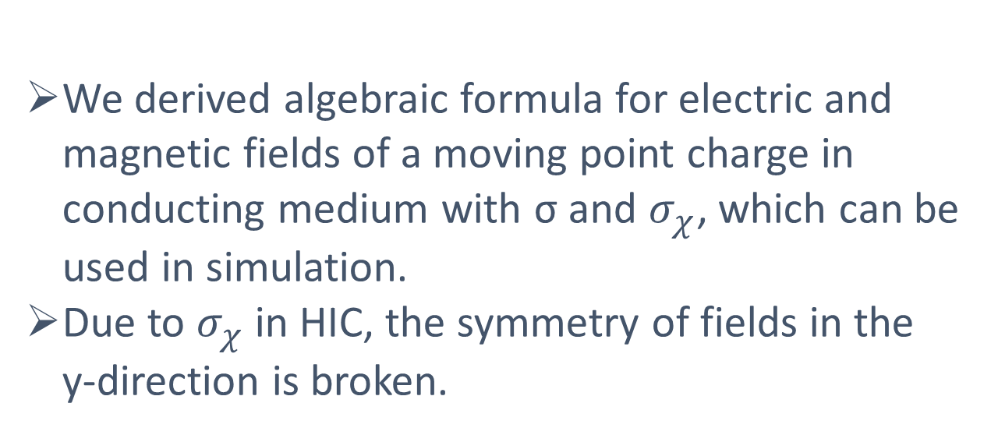
Summary
We derived algebraic formula for electric and magnetic fields of a moving point charge in conducting medium with σ and $σ_{χ}$, which can be used in simulation.
Due to $σ_{χ}$ in HIC, the symmetry of fields in the y-direction is broken.

Slide 21
Thank you !

