Slide 1


Baryon form factor measurement at BESIII
孟召霞 (济南大学)
Zhaoxia Meng (University of Jinan)
on behalf of BESIII Collaboration
第十二届全国粒子物理学术会议
安徽合肥 2016.8.22-8.26

Slide 2
Outline
Motivation
Definition of baryon form factors (FFs)
BESIII detector
Status of baryon FFs measurements
  Proton FFs
  Neutron FFs
  Hyperon FFs
Summary

Slide 3
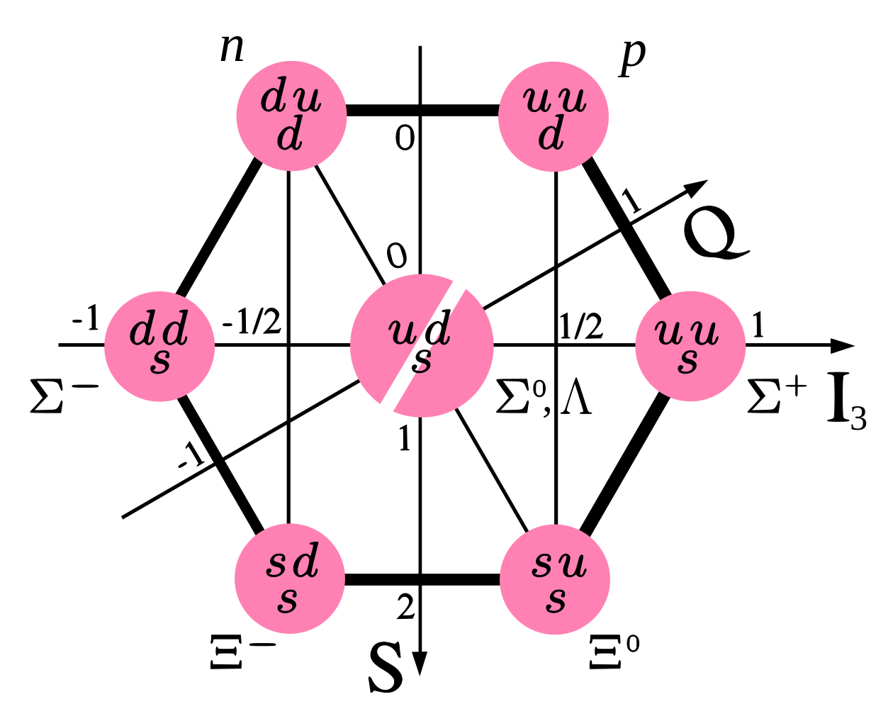
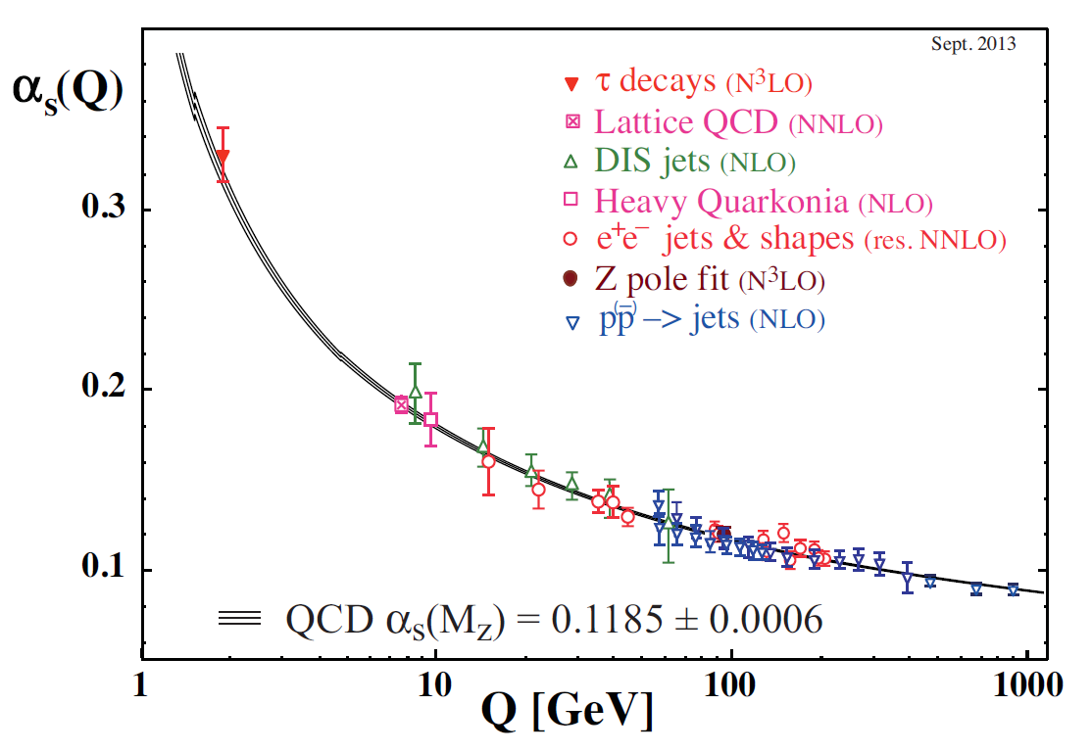
Motivation
1
Baryons have structure
Understanding baryons’ structure helps understand QCD
FFs describe baryons’ internal structure
Spin 1/2
2
Transition region
BESIII energy
FFs help understand strong interaction
Perturbative QCD (pQCD)
Inputs to QCD models
Non-pQCD

Slide 4
Outline
Motivation
Definition of baryon form factors (FFs)
  Dirac and Pauli FFs, Electromagnetic (EM) FFs, ratio of EM FFs, effective (EF) FFs
BESIII detector
Status of baryon FFs measurements
  Proton FFs
  Neutron FFs
  Hyperon FFs
Summary

Slide 5
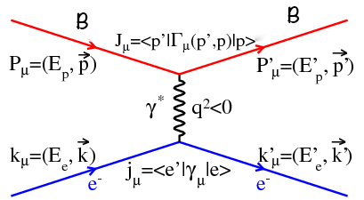
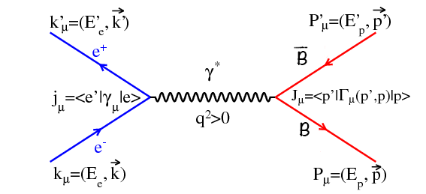
Dirac FF and Pauli FF
Elastic scattering:
Annihilation:
Space-like (SL) region, q² < 0
Time-like (TL) region, q² > 0
Baryon vertex:
: Dirac FF,
: Pauli FF

Slide 6
Dirac FF and Pauli FF
BESIII is in TL region
Elastic scattering:
Annihilation:
Space-like (SL) region, q² < 0
Time-like (TL) region, q² > 0
Baryon vertex:
: Dirac FF,
: Pauli FF

Slide 7
EM FFs and TL angular distribution
Electric
EM FFs:
Magnetic
How to measure them?
Angular analysis
TL:
q²: 4-momentum transferred
by the virtual photon
function of q² and θ:
θ: polar angle of baryon in
CM (center-of-mass system)

Slide 8
Ratio of EM FFs and effective FFs
Angular distribution written as function of EM FFs ratio:
Ratio of EM FFs:
Born cross section:
EF FFs:
Above baryon threshold: ζ=1
All formula valid for spin 1/2

Slide 9
Outline
Motivation
Definition of baryon form factors (FFs)
BESIII detector
Status of baryon FFs measurements
  Proton FFs
  Neutron FFs
  Hyperon FFs
Summary

Slide 10
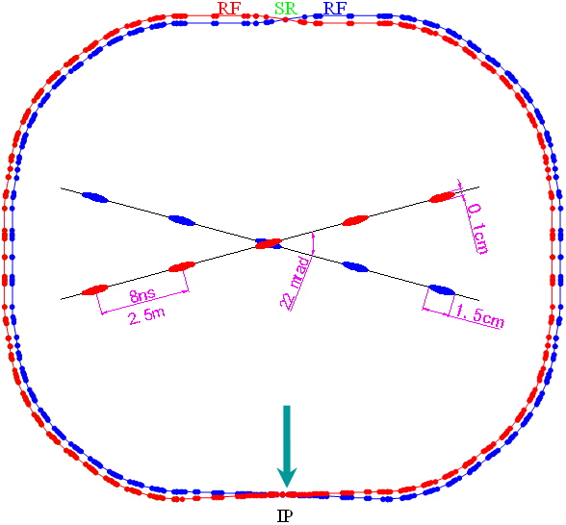
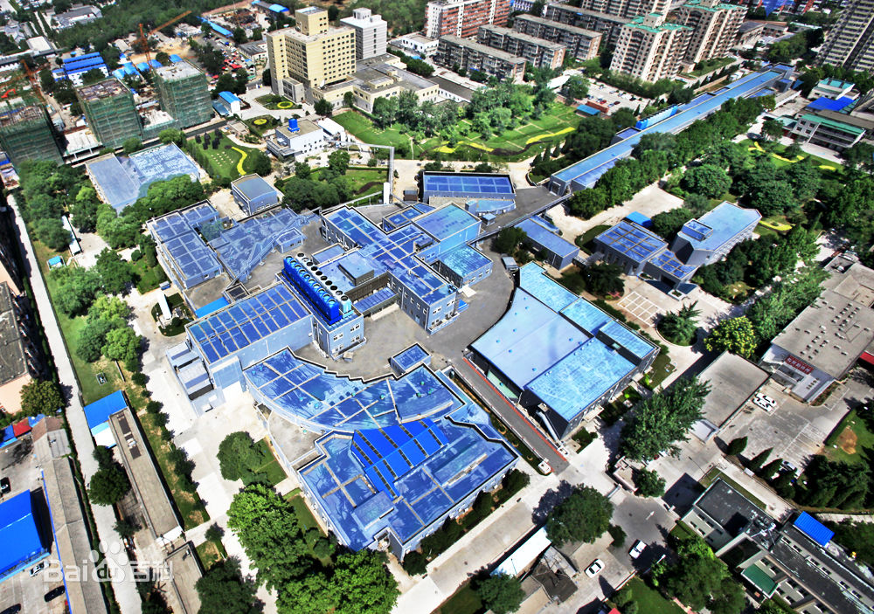
BEPCII
Runs started in 2009
CM energy: 2.0 – 4.6 GeV
“τ-charm factory”
Peak instantaneous luminosity:
  1×10³³ cm⁻²s⁻¹ (designed)
  1×10³³ cm⁻²s⁻¹ (achieved)
Energy spread: 5.16×10⁻⁴ GeV

Slide 11
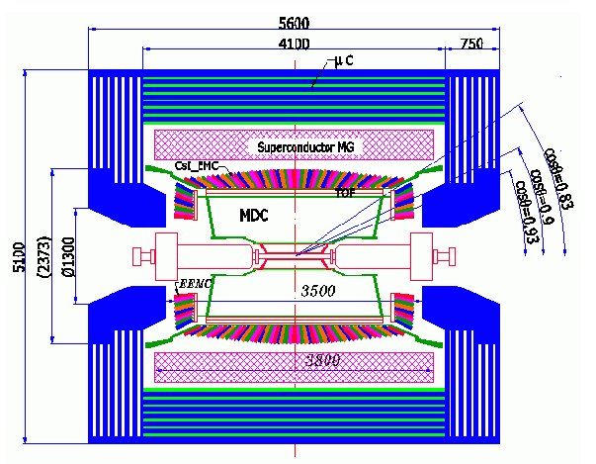
BESIII detector at BEPCII
BEPCII
BESIII
 | MDC | TOF | EMC | MUC
Sub-detectors | Main Drift Chamber | Time of Flight | Electromagnetic Calorimeter | Muon Counter
Resolution | 115μm(wire), < 5% (dE/dx) | 68ps (Barrel), 100ps (Endcap) | 2.3% (energy)

Slide 12
Outline
Motivation
Definition of baryon form factors (FFs)
BESIII detector
Status of baryon FFs measurements
  Proton FFs
    e⁺e⁻→ppbar process
    ISR (Initial State Radiation) process
  Neutron FFs
  Hyperon FFs
Summary

Slide 13
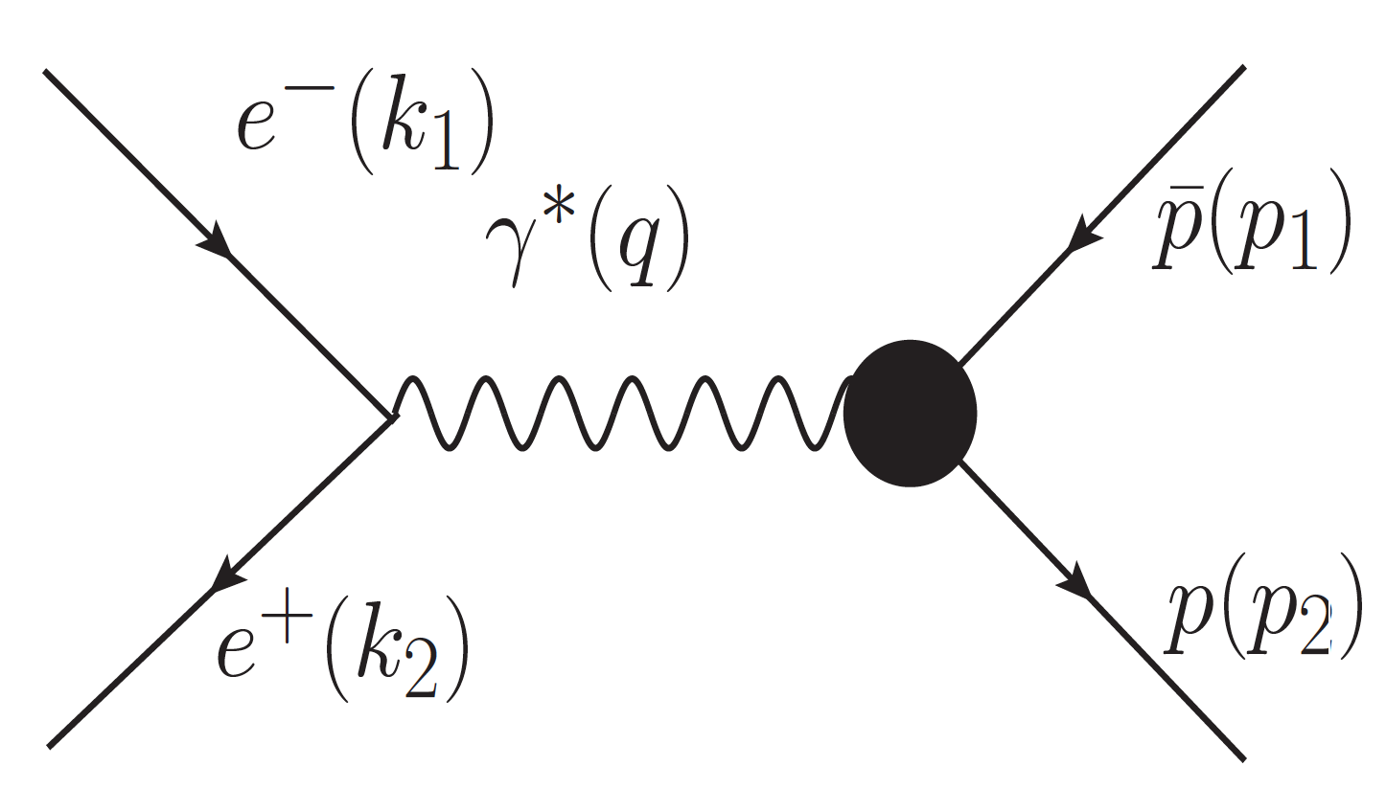
Proton FFs in e⁺e⁻→ppbar
Energy scan method

Slide 14
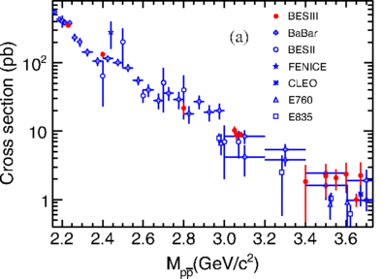

Proton FFs at BESIII in e⁺e⁻→ppbar
Phys. Rev. D 91, 112004 (2015)
Born cross section at 12 CM energies from 2.2324 to 3.671 GeV, integrated luminosity 156.94 pb⁻¹, scanned in 2011 and 2012
EF FFs at 12 CM energy points
Born cross section
EF FF
Inconsistent between Babar and PS170

Slide 15
Proton FFs at BESIII in e⁺e⁻→ppbar
Phys. Rev. D 91, 112004 (2015)
Born cross section at 12 CM energies from 2.2324 to 3.671 GeV, integrated luminosity 156.94 pb⁻¹, scanned in 2011 and 2012.
EF FFs at 12 CM energy points
Consistent with previous measurements
Uncertainty improved by ~ 30% compared to Babar
Born cross section
EF FF
Inconsistent between Babar and PS170

Slide 16
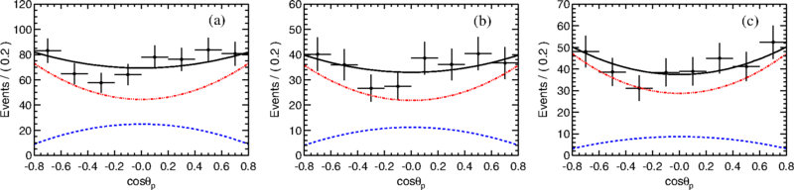
Proton FFs at BESIII in e⁺e⁻→ppbar
Phys. Rev. D 91, 112004 (2015)
R_{EM} at 3 points: 2.2324, 2.4, combined 3.05, 3.06 and 3.08 GeV
2.2324 GeV
2.4 GeV
3.05, 3.06, 3.08 GeV
Dots with error bar: data
Black line: overall fit
Red line: magnetic FF contribution
Blue line: electric FF contribution
E_{cm}(GeV) | χ²/ndf
2.2324 | 1.04
2.4 | 0.74
3.05, 3.06, 3.08 | 0.61
R_{EM}s are extracted from the fit

Slide 17
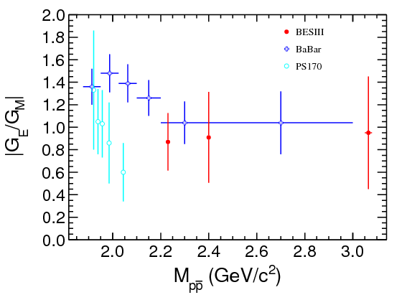
Proton FFs at BESIII in e⁺e⁻→ppbar
R_{EM}
Inconsistent between Babar and PS170
BESIII consistent with Babar in the same q² region
Close to 1

Slide 18
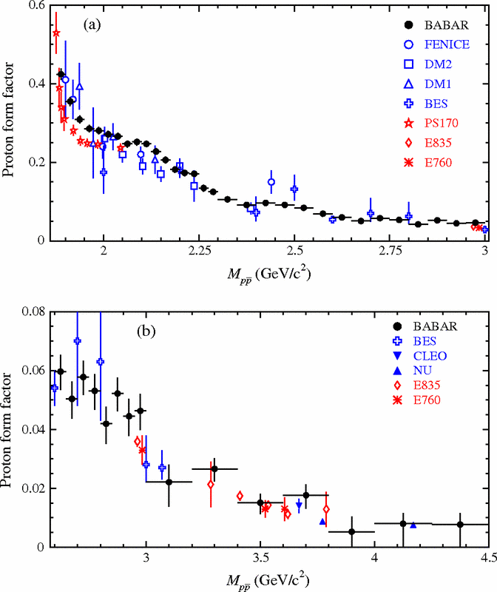
Prospections of proton FFs in e⁺e⁻→ppbar at BESIII
21 energy points between 2-3.08 GeV in 2015, with large statistics.
A trip around 2.2 GeV
More precise measurement
Aim to measure R_{EM} of 10-15% with much narrower q²-bins
E_{cm}(GeV) | Lumi. (pb-1) | Purpose
2.2 | 13.0 | Nucleon FFs & Y(2175)
2.95 | 15.7
2.981 | 15.4
3.0 | 15.3
3.02 | 16.6
A trip around 3 GeV
The 2 trips found by Babar can be studied

Slide 19
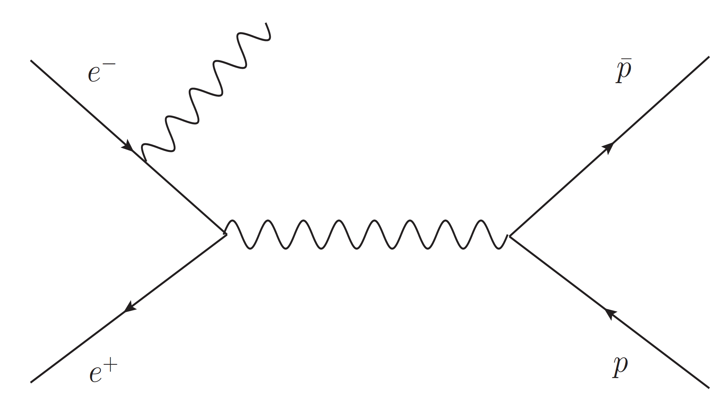
Proton FFs in ISR process
Tagged method (preliminary results)
Untagged method (on going)
Datasets using:
E_{cm} (GeV) | 3.773 | 4.009 | 4.230 | 4.260 | 4.360 | 4.420 | 4.600
Taking time | 2010-2011 | 2011 | 2013 | 2013 | 2013 | 2014 | 2014
Lumi. (pb⁻¹) | 2917.00 | 481.96 | 1047.34 | 825.67 | 539.84 | 1028.89 | 566.93

Slide 20
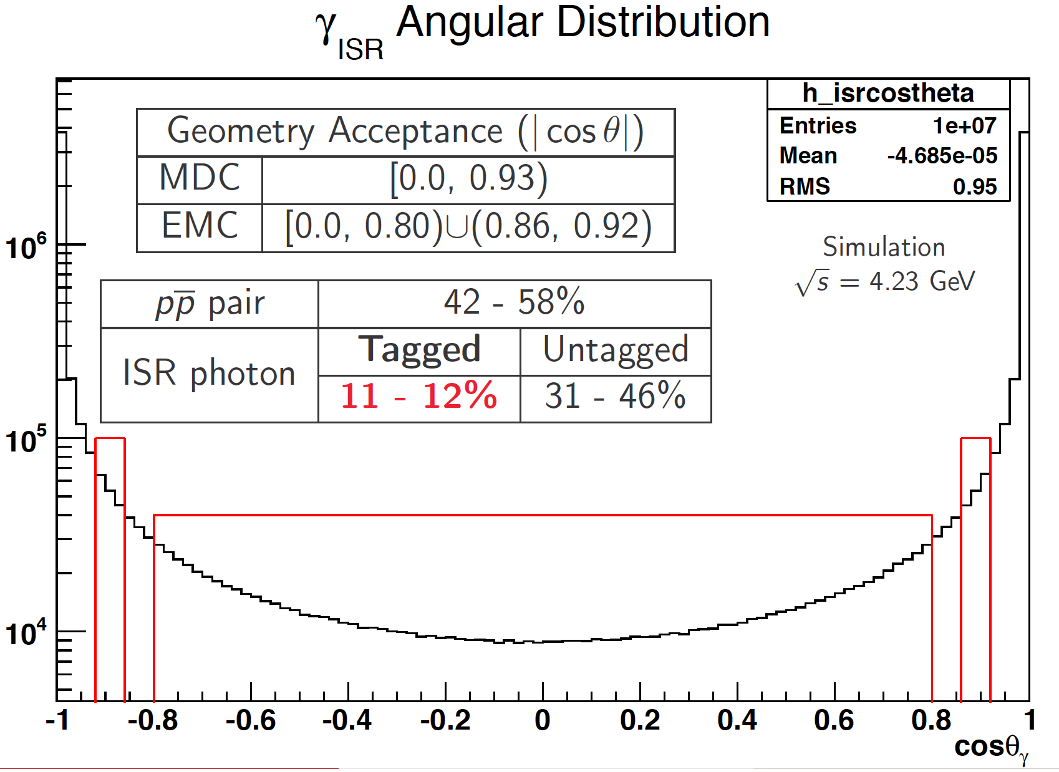
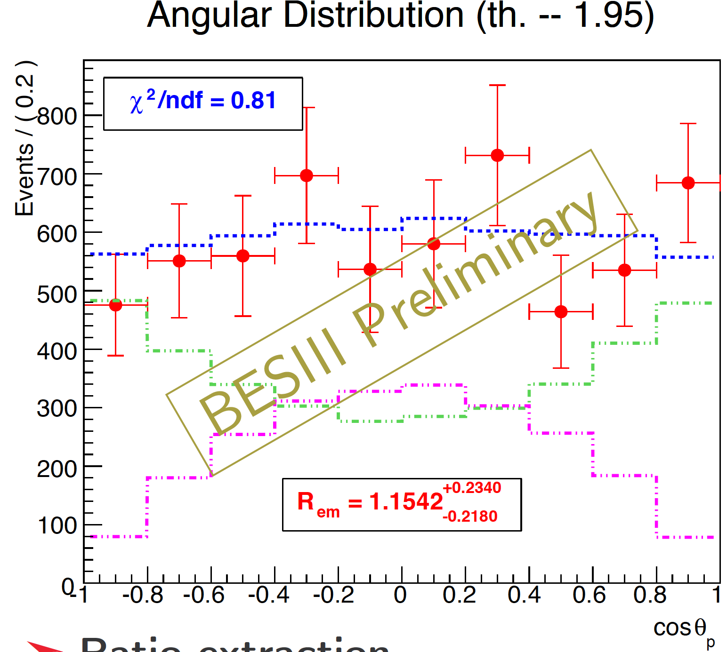

Proton FFs at BESIII with ISR (Tagged)
Angular distribution at ~1.95
Tagged method: γ is detected
Fit is good
Green dashed line: Magnetic FFs contribution
Violet dashed line: Electric FFs contribution
E_{γ} > 25 MeV & |cosθ_{γ}| < 0.8, in the EMC barrel
E_{γ} > 50 MeV & 0.86 < |cosθ_{γ}| < 0.92, in the EMC endcap

Slide 21
Proton FFs at BESIII with ISR (Tagged)
Consistent with Babar and BESIII R scan results
Measured in 31 mass intervals
Consistent with previous results
E_{cm}(GeV) | Stat. | Syst.
δR_{EM}/R_{EM} | 16% - 34% | 5% - 22%
E_{cm}(GeV) | Stat. | Syst.
δG_{Eff}/G_{Eff} | 5% - 32% | 2% - 30%

Slide 22
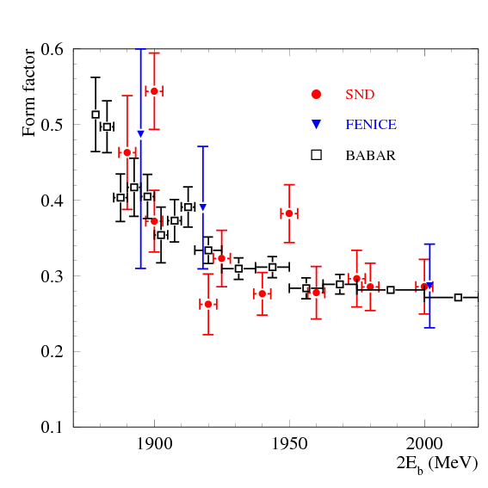
Neutron FFs at BESIII
The first results obtained by FENICE 20 years ago
Confirmed by SND recently in 2014
Compared to the proton FFs from Babar
  Similar distributions of proton and neutron
Babar is proton
Phys. Rev. D90, 112007(2014)
Prospects at BESIII: with data scanned in 2015
First measurement at BESIII
Between 2 and 3.08 GeV
High statistics
Narrow q²-bins (~ 100 MeV)

Slide 23
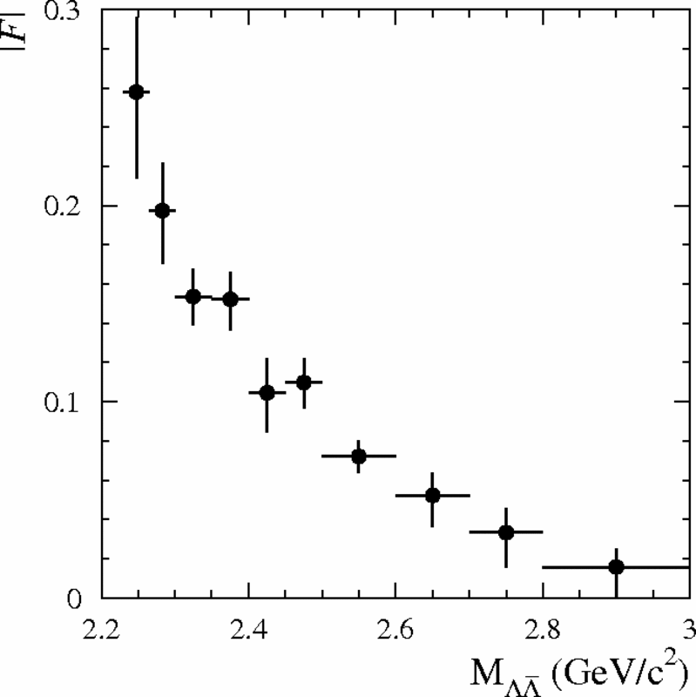
Hyperon FFs at BESIII
Phys. Rev. D76, 092006(2007)
Λ and Σ⁰ FFs were obtained by Babar in processes:
Babar EF FFs for Λ
Preliminary results on Λ FFs at BESIII
  At 4 energy points: 2.2324, 2.4, 2.8, 3.08 GeV with 2015 scan
  2.2324 is 1 MeV above Λ threshold

Slide 24
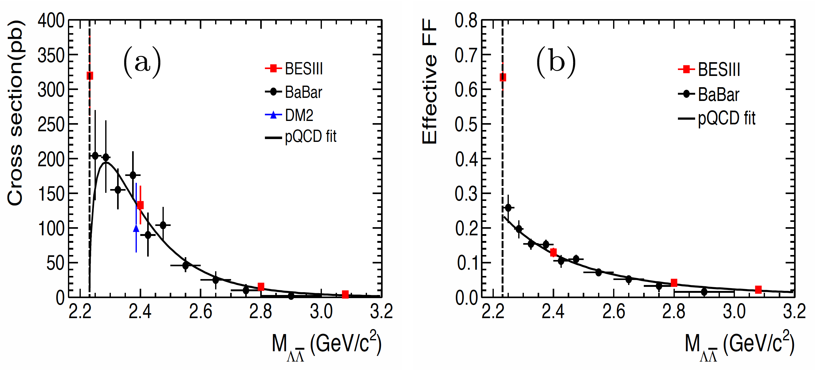
Λ FFs at BESIII
BESIII Preliminary
Do not consider Coulomb interaction in theory
Results consistent with previous measurements
With improved precision
Cross section and EF FFs are measured at threshold
  Helpful in understanding the mechanism of baryon production

Slide 25
Summary
BESIII already had important results on baryon FFs measurements
2012 data scan — proton FFs:
  Born cross section and EF FFs, with uncertainties improved by ~ 30% compared to Babar
  R_{EM} and G_{M}
  Preliminary results of ISR process with tagged method
2015 data scan — more baryon FFs:
  Preliminary results on Λ FFs
  Prospect to improve proton FFs measurements
  Prospect to have first results of neutron FFs at BESIII
  Prospect to have Σ± and Σ⁰ FFs at one energy

Slide 26
Thank you for your attention!

Slide 27
Back-up

Slide 28
Measurements of baryon FFs
Electric
Electromagnetic FFs:
Magnetic
How to measure?
Angular analysis
SL:
TL:

