Slide 1
Development of a new manufacturing method for MicroMegas with resistive anode
Jianxin FENG^{1,2}, Zhiyong ZHANG¹, Binbin QI¹, Libo WU¹, Chengming LIU³
¹State Key Laboratory of Particle Detection and Electronics, University of Science of Technology of China
²Key Laboratory of Quark & Lepton Physics(MOE), Central China Normal University
³Anhui University
第十二届全国粒子物理学术会议 2016.8.25

Slide 2
OUTLINE
Introduction
Manufacturing Method
Test & Results
Summary

Slide 3
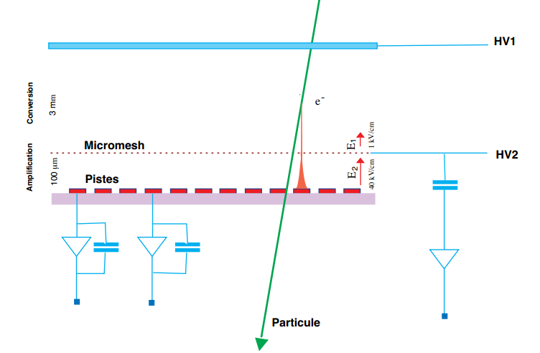
Introduction
MicroMegas (MICRO-Mesh-Gaseous Structure) was first developed by Y.Giomataris et,al. in 1996.
Advantages:
radiation hardness
high count rate(~${{10}^{6}}/{{cm}^{2}∙s}$)
spatial resolution(<100um)
time resolution(<10ns)
T2K, ATLAS small wheel upgrade(2018)
Fig.1 Principle of MicroMegas. Conversion gap is about several millimeters, gap of amplification is about 100um. Particles pass through conversion gap and transfer to electrons and ions. Electrons then amplified in the amplification gap. Electron cluster finally collected by fine strips on PCB.

Slide 4
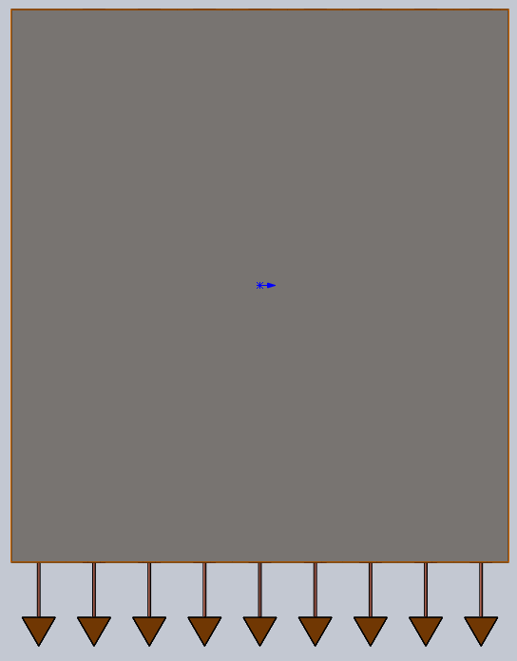
Manufacturing
Thermal adhesive , hot pressing , water soluble film
Resistive anode
FR4
Readout strips
Step1. PCB. The picture below is the lateral view of PCB, which shows that readout strips are buried in two sides.
Step2. Resistive anode. Resistive anode are processed in different method, Ge coating and resistive polymer.
Fig.2_1 Manufacturing

Slide 5
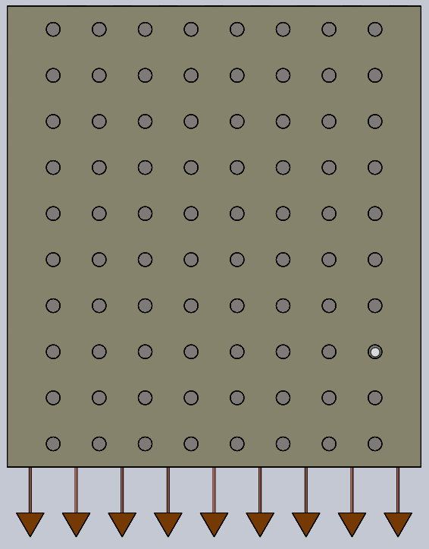
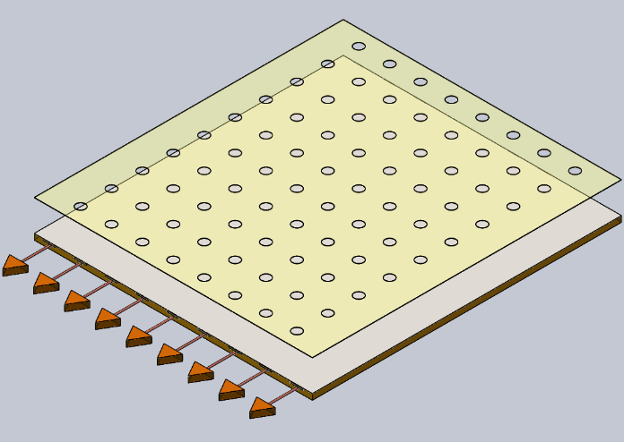
Manufacturing
Thermal adhesive spacer
Step3. Water soluble film. We put a water soluble film on the resistive anode. Holes were bunched on it before. Location & spacer.
Step4. Place thermal adhesive spacer into holes of water soluble film. The radius of spacer is 1mm.
Fig.2_2 Manufacturing

Slide 6
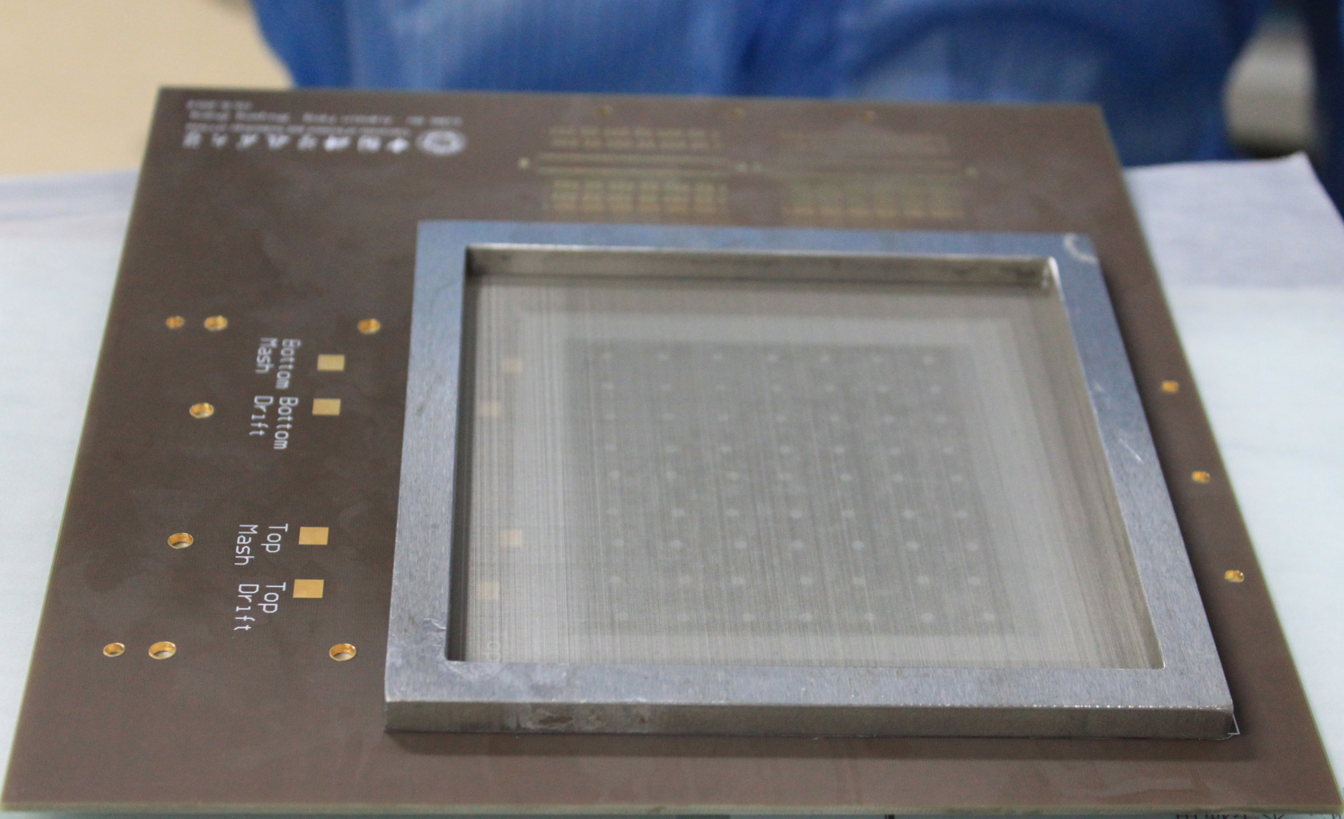
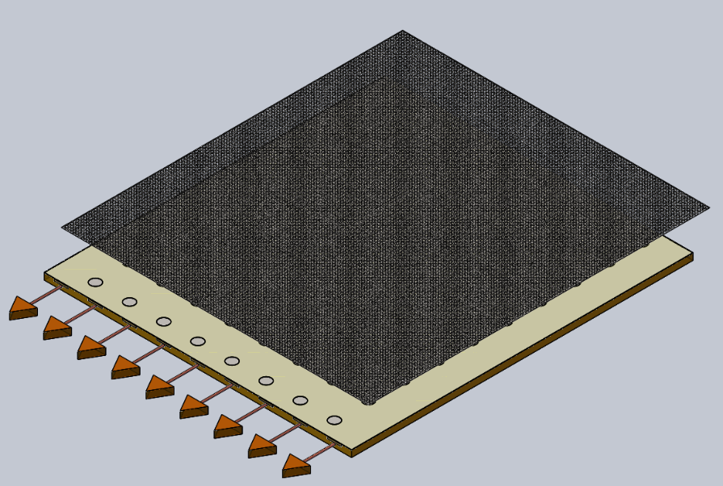
Manufacturing
Step7. Dissolution. Put the semi-finished detector into water. The water soluble film will dissolve in several minutes.
Step8. Drying
Step5. Three-layer structure of mesh, film and PCB.
Step6. Hot pressing.
Fig.2_3 Manufacturing

Slide 7
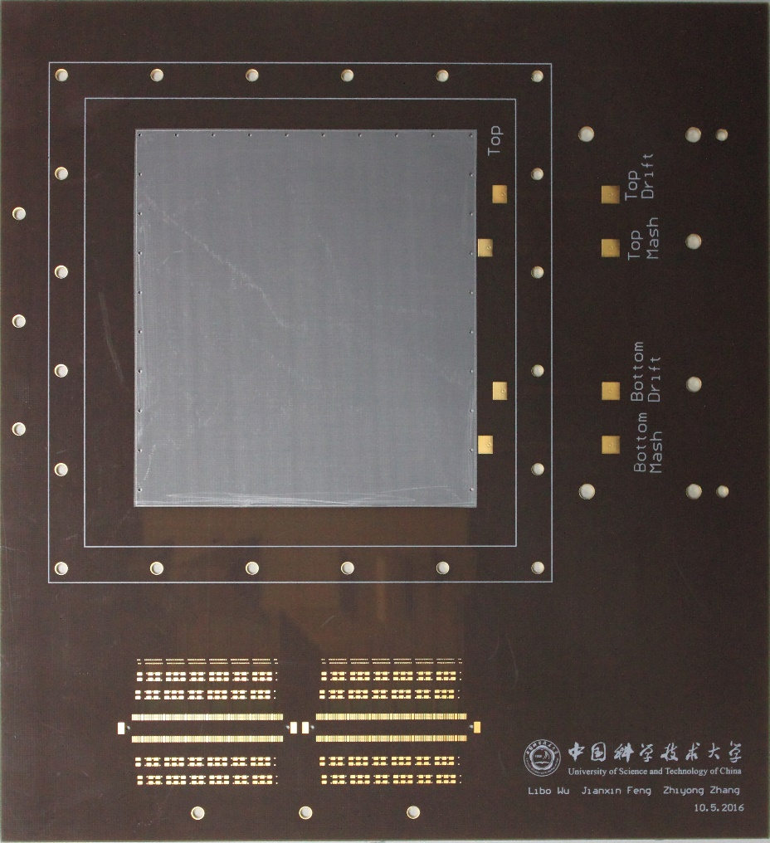
Manufacturing—Resistive anode
Resistive anode reduce sparking, increase gain rate and count rate
Ge Coating
Thickness: 300nm & 500nm(two sides)
Thickness affects the sheet resistance.
Sheet resistance:~10MΩ
Problem: sheet resistance changed a little after thermal pressing or water rinsing ?
Fig.3 PCB, Germanium coated

Slide 8
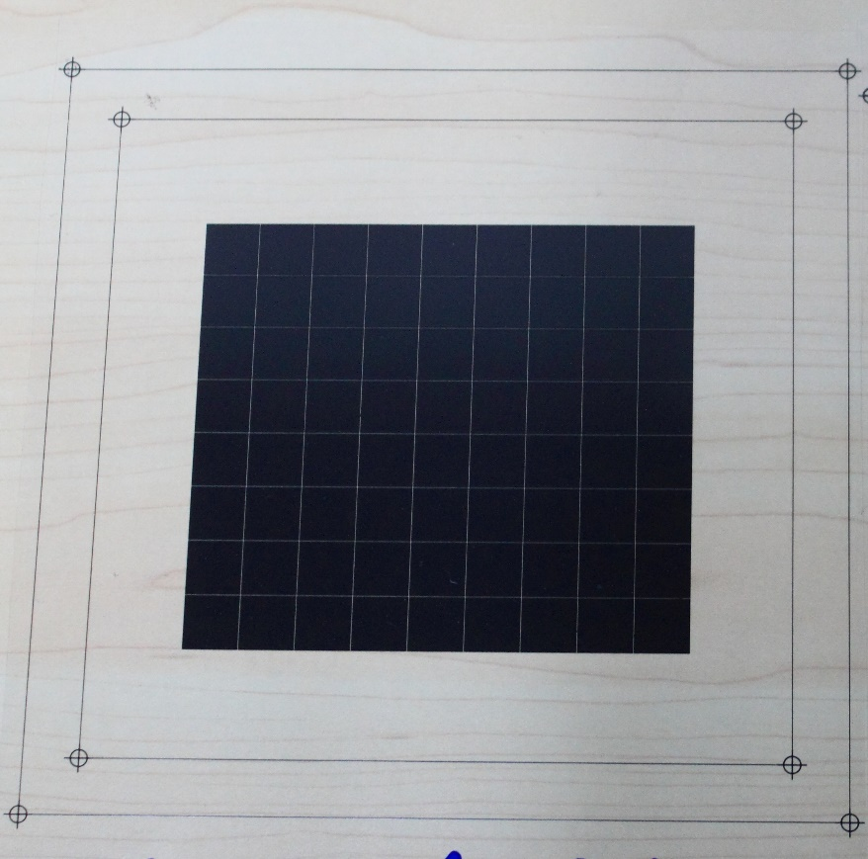
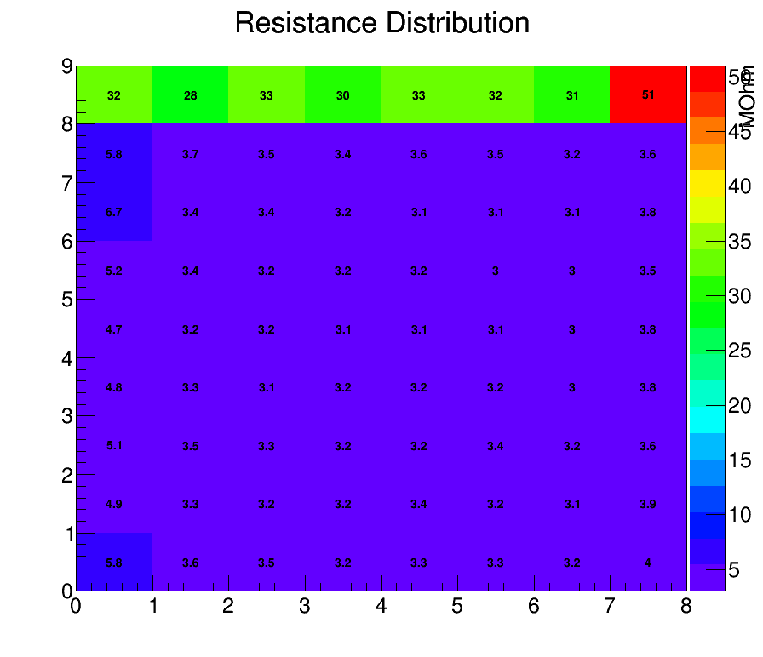
Manufacturing—Resistive anode
Fig.5 Resistive distribution. Resistance squares on the border are not consistent with inner ones.
Fig.4 Resistive polymer.

Slide 9
Manufacturing—water soluble film
Water soluble film is used to locate thermal films & sustain mesh to keep a 100um-gap between PCB and mesh
Thickness: 87um(too thin)
116um(upgrade)
easy to manufacture & used in large area MicroMegas
Environment friendly & cheap：
wastewater disposal: no pollution;
films dissolve completely；
no contamination left;
￥247/kg
Fig.6 A trimming and punched water soluble film is put on PCB and then will be thermal pressed. Thermal pressing will not affect the thickness of water soluble film. Therefore, gas-gap can be well fitted.

Slide 10
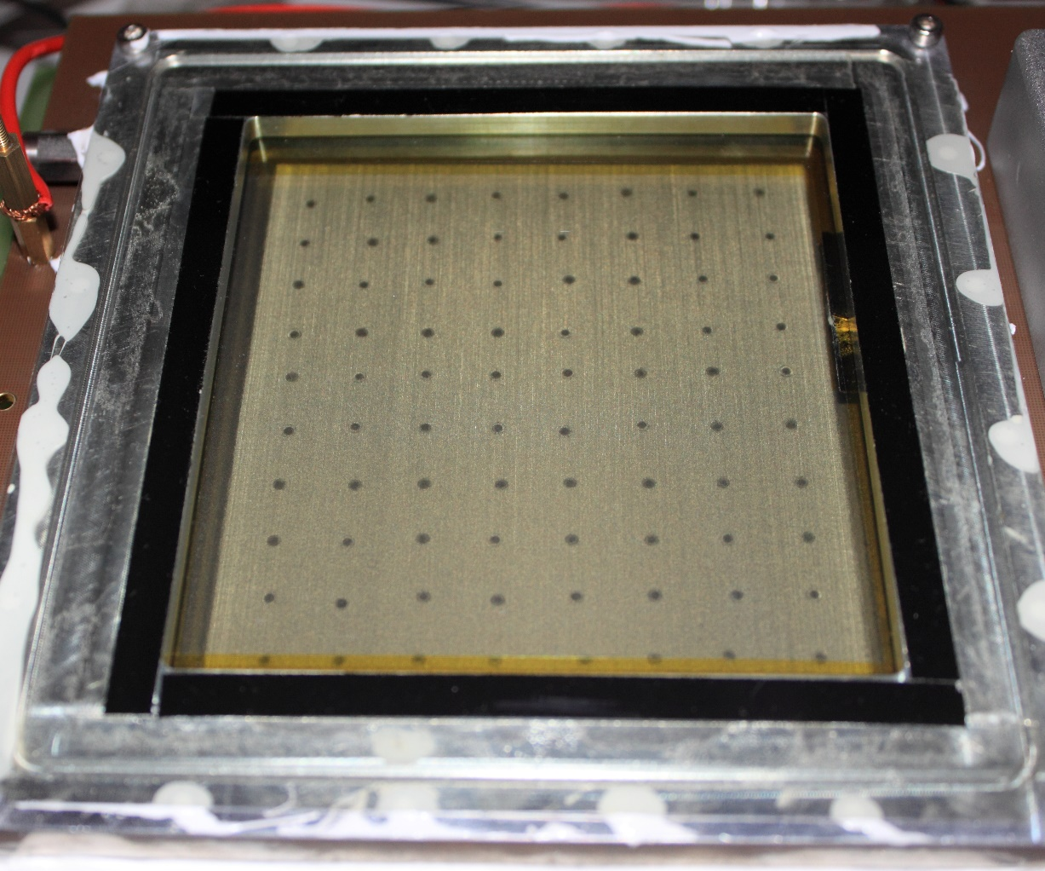
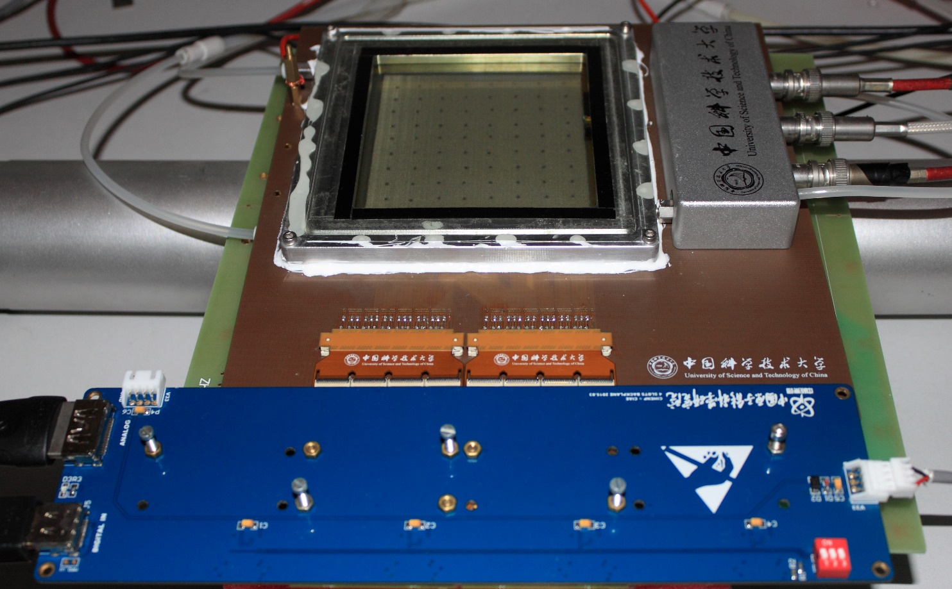
Test setup
Preliminary property:
It is easy to apply a 1000V voltage, comparing to normal anode with 800V voltage.
Holes punched on water soluble film were well arranged in equal pitch. It is necessary to punch holes mechanically. This may effect the uniformity of amplification.
Dead zone: ~3%
Area: 10*9 cm²
Fig.7 MicroMegas assembled by new processing method.

Slide 11
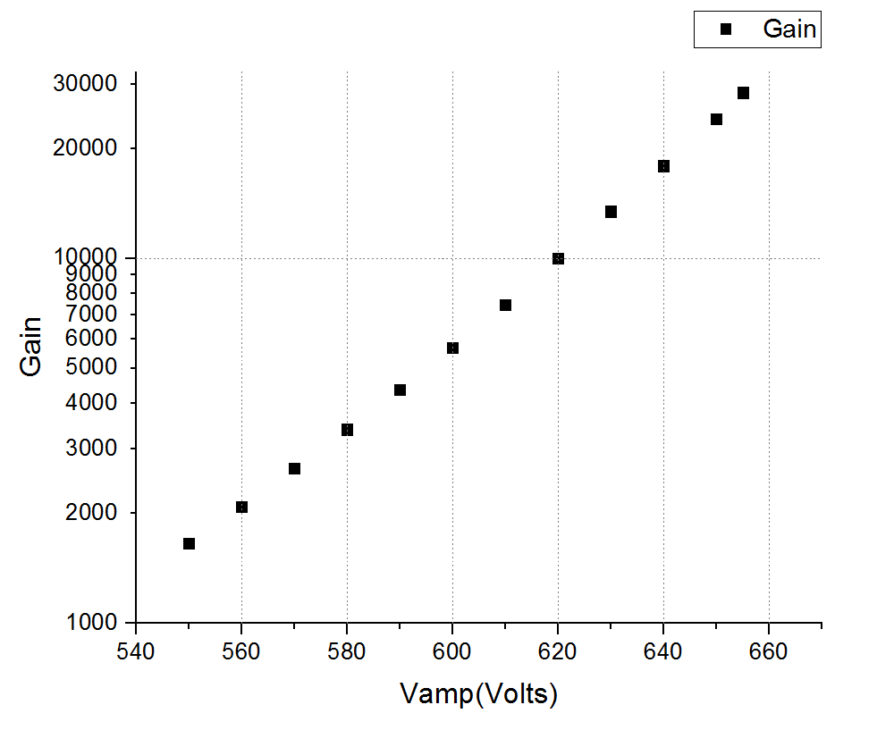
Results
Fig.8 Electron transparency.
$E_{amp}={V_{mesh}}/{d_{amp}}$ ; $E_{drift}={V_{drift}}/{d_{drift}}$ ; $V_{mesh}$ = -600V ; When the ratio is 150, transparency becomes maximum
Fig.9 Gain of MicroMegas. According the result of electron transparency, we fit the ratio at 150 and test gain of the detector. The graph show that its gain is bigger than 2*10^4.

Slide 12
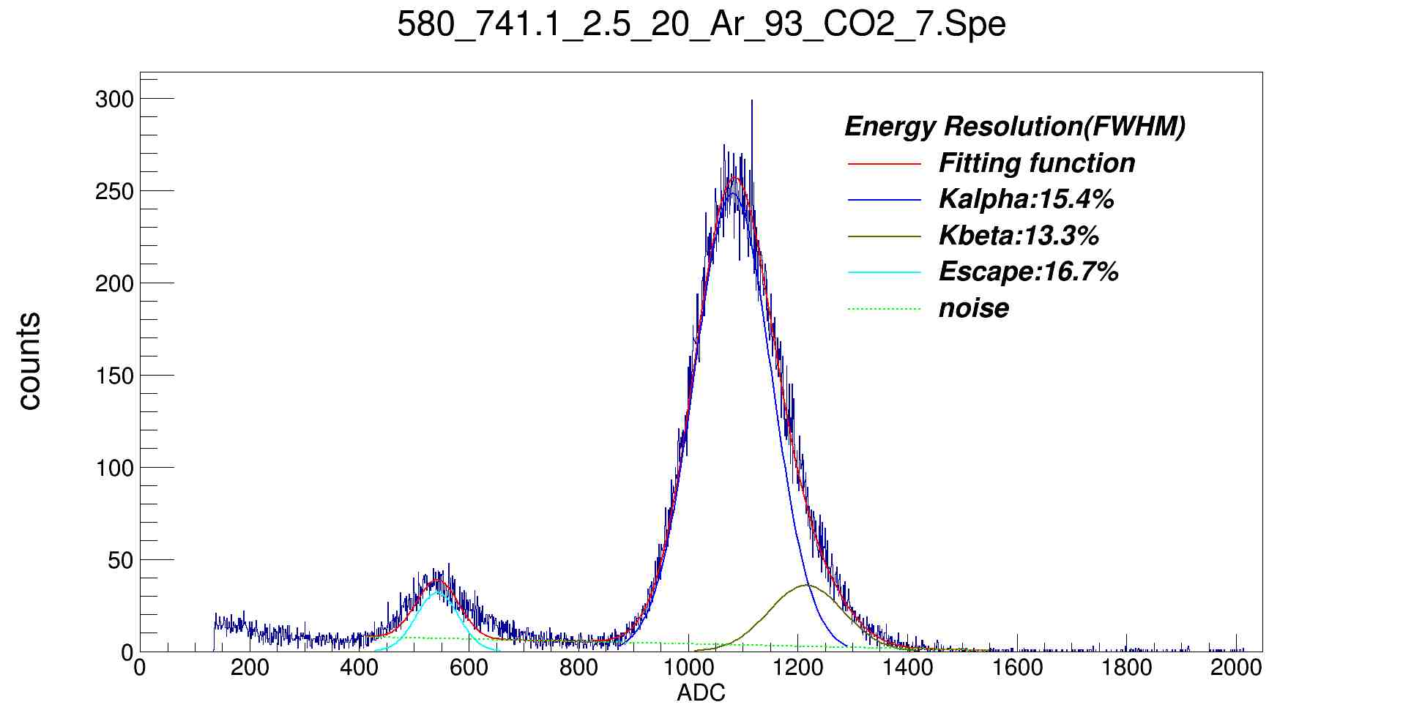
Results
⁵⁵Fe @5.9KeV
Fig.10 Energy resolution of tri-gauss fit. Resolution of $K_{alpha}$is 15.4%.

Slide 13
Results
Fig.11 Muon event. The trigger was given by plastic scintillator(the blue curve). The pink curve and yellow curve were scratched from two meshes. They are all ion signals.

Slide 14
Summary
A new processing method has been used to manufacture MicroMegas. The detector has achieved energy resolution of 15.4%. It’s gain rate is bigger than ${10}^{4}$.
Two-side structure works already. Muon event was recorded by a single MicroMegas. Some new tests should be carried out.
This processing method is not perfect yet. There are some problems such as unstable sheet resistance should be researched.
Thank you!

Slide 15
Manufacturing—Bulk-MicroMegas

