Slide 1
Studies on Nuclear Equation of State with Heavy Ion Collisions Over a Wide Energy Range
中国高能物理学会第十二届全国粒子物理学术会议
2016年8月22日-26日，中国科学技术大学，合肥
肖志刚
清华大学物理系

Slide 2
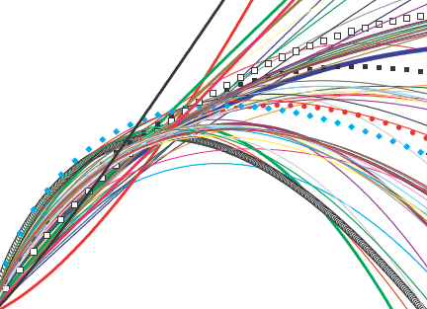
Contents
1 Introduction: Asymmetric nuclear EOS，E_{sym}(ρ)
2 E_{sym}(ρ) at sub-saturation densities
3 E_{sym}(ρ) at supra-saturation densities
4 Summary

Slide 3
Contents
1 Introduction: Asymmetric nuclear EOS，E_{sym}(ρ)
2 E_{sym}(ρ) at sub-saturation densities
3 E_{sym}(ρ) at supra-saturation densities
4 Summary

Slide 4
Femto bang vs Big bang

Slide 5
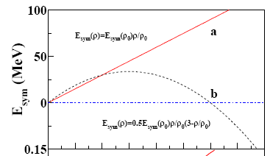
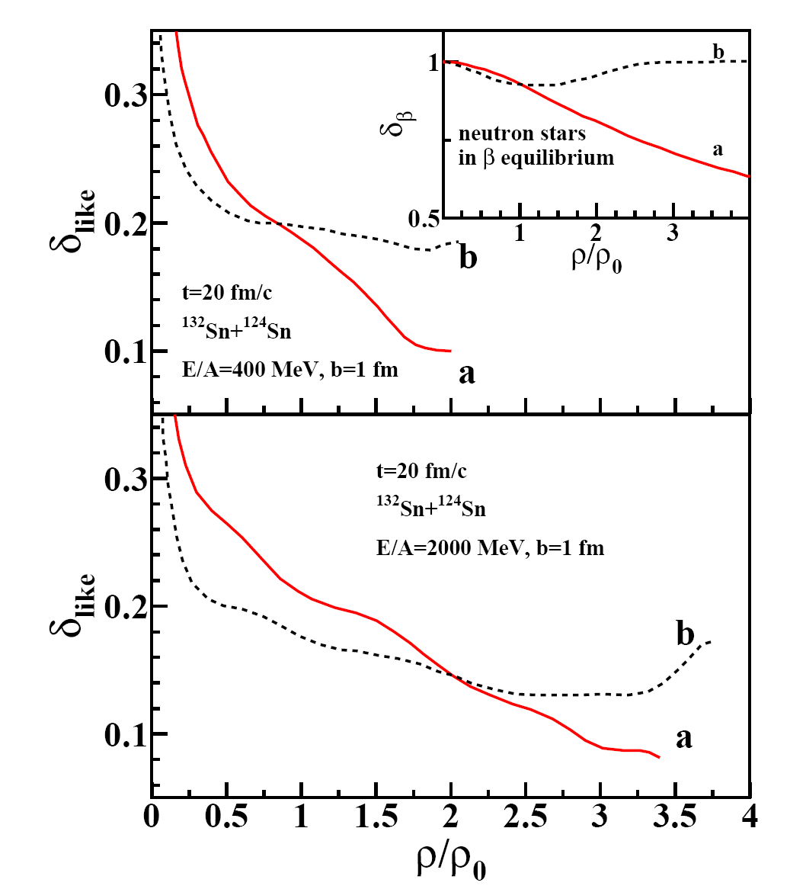

E_{sym}(ρ) 在天体物理和核物理中的重要作用
κ:Compressibility
E_{sym}
Proton fraction
M-R relation
ρ_{c} for D-Urca
Transition density
……
Phy. Rep. 442(2007) 109; NPA777(2006)479
PRC76(2007),015801; PRC75(2007) 015801
PRC74 (2006),035802; Astro. J. 676 (2008) 1170
Phy. Rep. 411(2005) 325; PLB 642, 436 (2006)
......
Astrophysical Connection

Slide 6
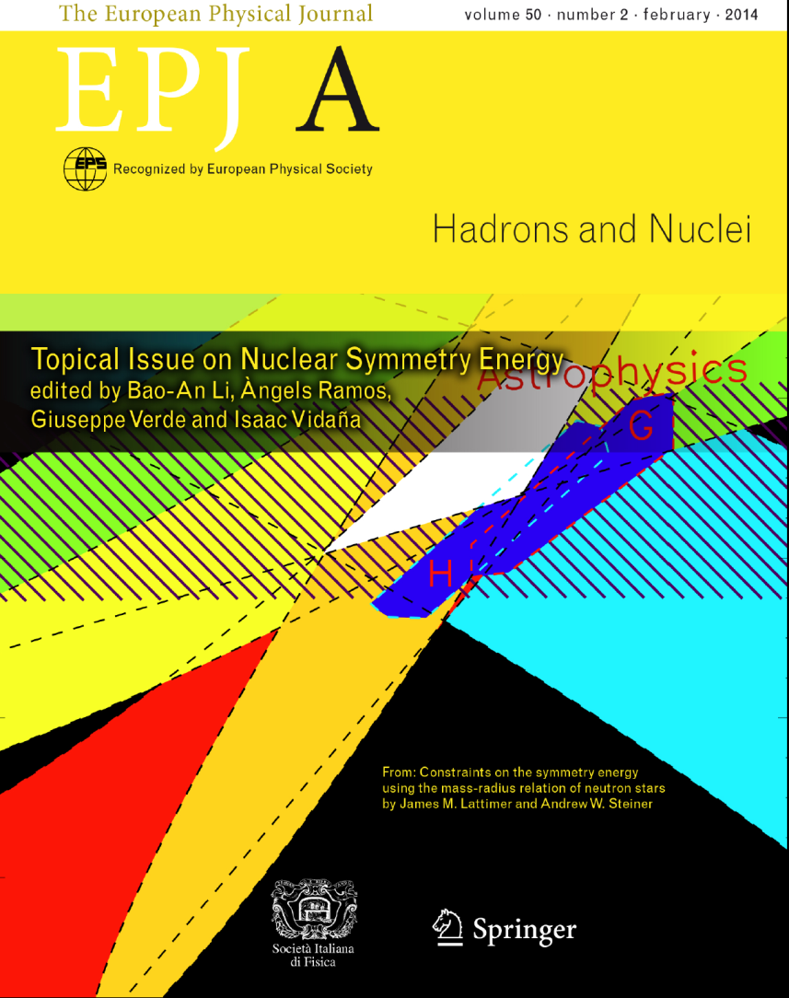
A shopping list for sub-saturation density
E_{sym}(ρ)
At sub-saturation densities
Slope=L
S₀
30
→Isospin diffusion (MSU …)
→ Isospin scalaring and isospin fractionaiton (MSU…)
→ n/p ratio of fast and pre-equilibrium nucleons (MSU …)
→ N/Z of the emitted fragments (LNS, TAMU, MSU, HIRFL …)
GMR strength (ND …)
HBT correlation function (KVI, MSU, HIRFL …)
…. ….
S₀ = 32±3 MeV
L = 55±25 MeV
ρ /ρ₀
0.5
1
To identify a observable in a process where isospin drift is at work? → Long time accumulation
To see isospin drift and the effect persisting to longer time, one need a new “ruler”.

Slide 7
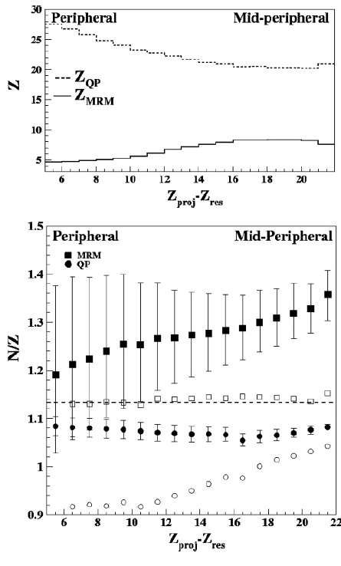
Using fission to study the long time effect of E_{sym}(ρ)
Approaching
Short Contact
Fast Emission (Int. Velo.)
Hot and rotating TLF
CN Emission
Fission
Post-Sciss. Emission
Possible Advantages:
☑ Neck part: Very neutron rich, Low Densities
→ Isospin Drift
☑ Time Scale: Between statistical emission (Q effect) and two body process (very short)
→ Tag the time
L.G. Sobotka, PRC50（1994）R1272
D. Theliault et al., PRC74（2006）051602(R)
D. J. Hinde et al., Phys. Rev. C 39, 2268 (1989).
M. Gui et al., Phys. Rev. C 48, 1791 (1993).

Slide 8
Contents
1 Introduction: Asymmetric nuclear EOS，E_{sym}(ρ)
2 E_{sym}(ρ) at sub-saturation densities
2.1 Isospin dependent hierarchy and long time E_{sym}(ρ) effect
2.2 A new constraint of E_{sym}(ρ) with a new experiment
2.3 A novel probe of E_{sym}(ρ): isospin reorientation effect of Deuteron
3 E_{sym}(ρ) at supra-saturation densities
4 Summary

Slide 9
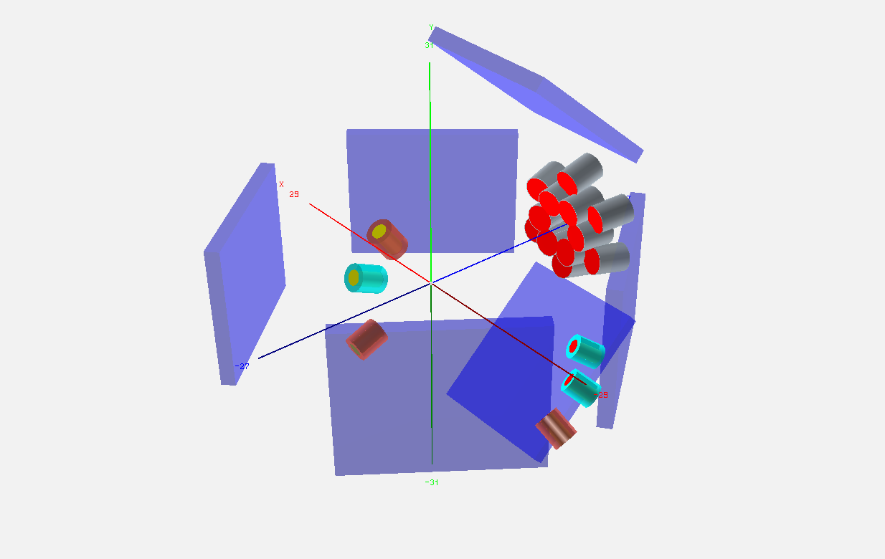
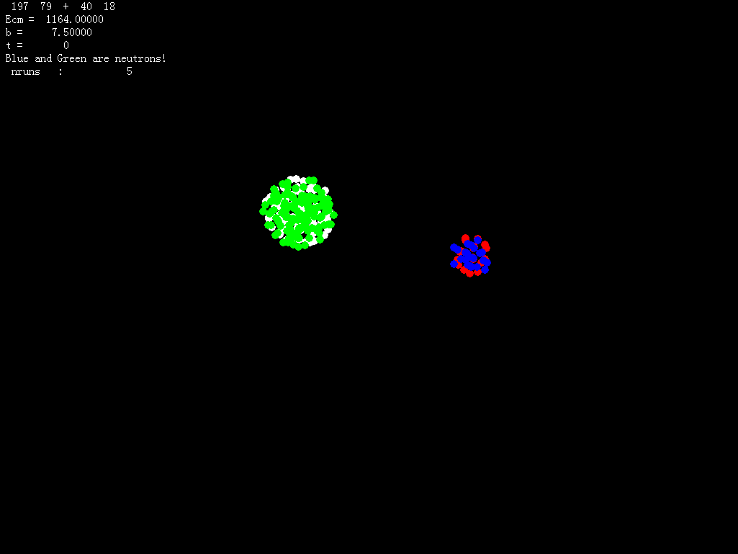
2.1 Isospin dependent hierarchy and long time E_{sym}(ρ) effect
35 MeV/u Ar+ Au.
Trigger: 2 fold fragments .AND. 1 LCP
2 fold fragments .AND. 1 Proj.-like
R. S. Wang, Y. Zhang, XZG et al., PRC89 (2014) 064613

Slide 10
Double angular ratio of particle yield
Model independently, particles emitted at smaller angle are more neutron rich
Smaller angle emitted particles experience more dynamical contribution
R. S. Wang, Y. Zhang, XZG et al., PRC89 (2014) 064613

Slide 11
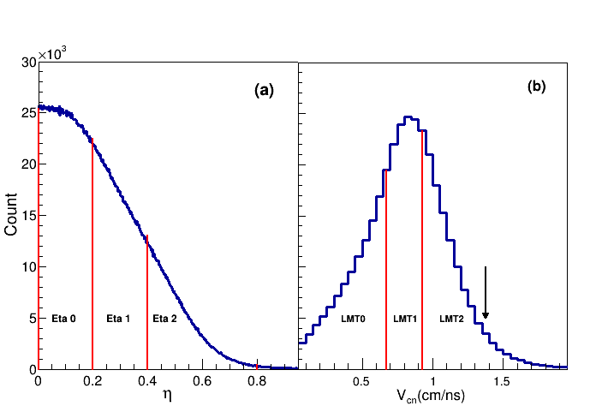
Energy spectra analysis vs mass asymmetry
Three moving source: Int. Velocity, CN, FF
time
Int. Velo.
CN
FF

Slide 12
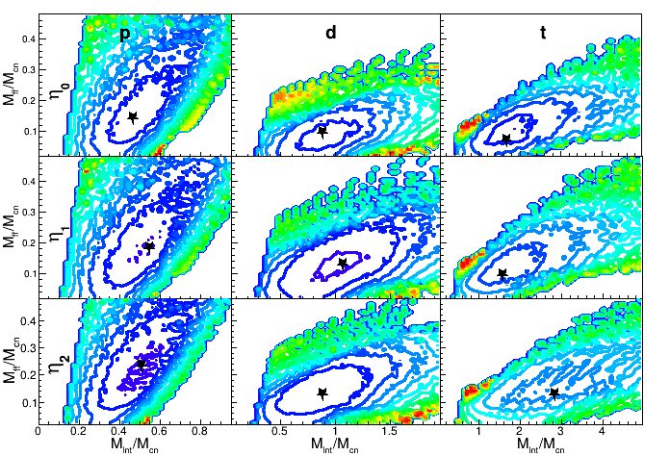
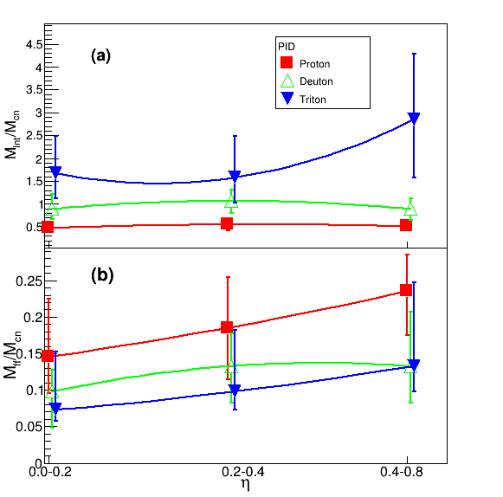
Minimum χ2 analysis
time
Int. Velo.
CN
FF
→ M_{ff}/M_{cn} vs. M_{inv}/M_{cn}
The two ratios show different hierarchy
The particles emitted in early stage are neutron rich!

Slide 13
IQMD calculations (I)
1) <N/Z> decreases with time.
2) <N/Z> depends on E_{sym}(ρ) till very late stage.
3) E_{sym}(ρ) effect equally significant in the fission or non-fission events
R. S. Wang, Y. Zhang, XZG et al., PRC89 (2014) 064613

Slide 14
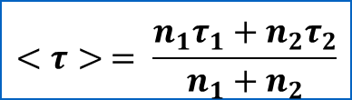
2.2 A new constraint of E_{sym}(ρ) with a new experiment
time
counts
1
2
<τ>
τ₁< τ₂
V₁^{cm}>V₂^{cm}
$$<τ> = \frac{n_{1}τ_{1}+n_{2}τ_{2}}{n_{1}+n_{2}}$$
Time
θ_{LAB}
counts
<N/Z>
1 Angular Distribution Reflects the Average Emission Time
2 Stiffer E_{sym}(ρ) results in faster N/Z fractionation → Stiffer angular distribution
θ_{LAB}
θ_{LAB}
Q. H. Wu, Y. X. Zhang, XZG et al., PRC 91, 014617(2015)

Slide 15
IQMD calculations (II)
Advantage of this observable: changing the stiffness of the symmetry energy yields different trend!
Q. H. Wu, Y. X. Zhang, XZG et al., PRC 91, 014617(2015)

Slide 16
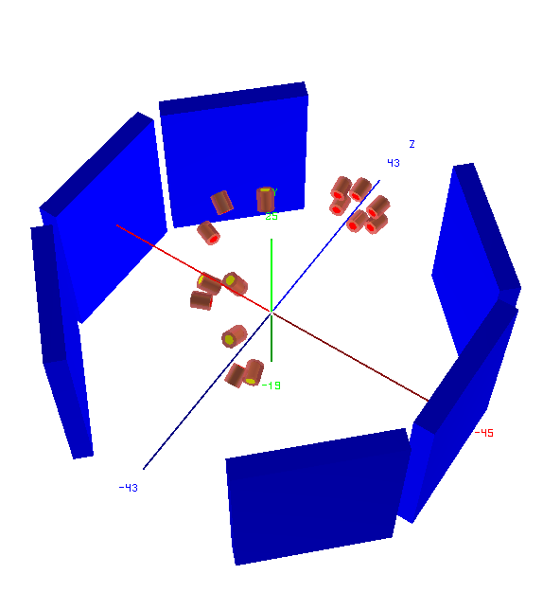
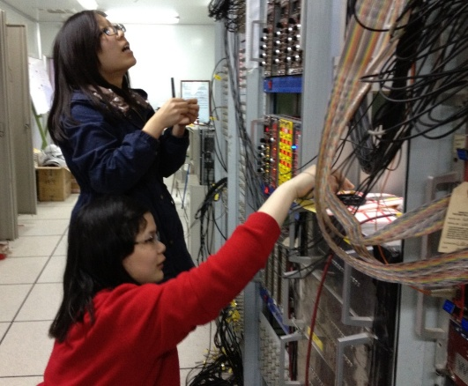
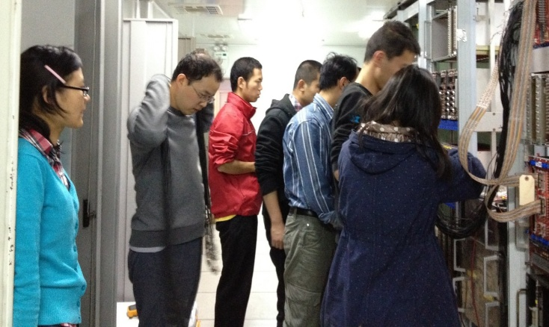
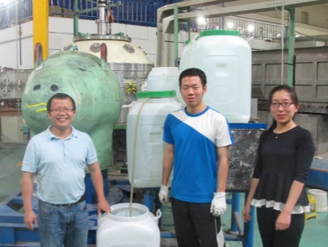
A new constraint to E_{sym}(ρ)
Target
Beam
Complete in June 2014.
Improved PID by using H.Q. telescopes
Lower energy threshold
More Detectors

Slide 17
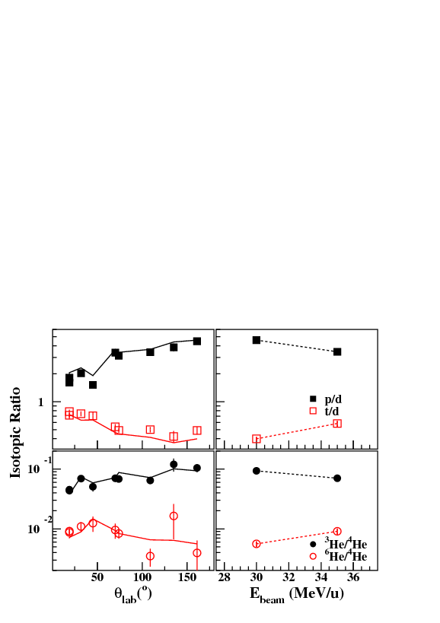
Angular Distribution
Isospin Drift是一个长时标过程。
同位旋自由度的平衡与否，与具体的过程相关！
对于热核蒸发的这一相变过程，气相的中子丰度随着时间推移而降低。
Preliminary

Slide 18
Extracting E_{sym}(ρ)
→Absolute value of the ratios not reproduced quantitatively
→Relative decreasing rate of the neutron richness with angle can differentiate E_{sym}(ρ).
→A soft E_{sym}(ρ) is favored by the data.
Preliminary

Slide 19
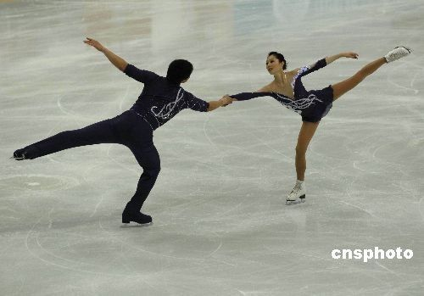
2.3 A novel probe of E_{sym}(ρ): isospin reorientation effect of Deuteron
Oppenheimer proposed first
J. R. Oppenheimer et al., Phys. Rev. 48, 500 (1935)
E. O. Lawrence et al., Phys. Rev. 48, 493(1935)
Favored
p
n
Target
Un-favored
n
p
Target

Slide 20
Results I

Slide 21
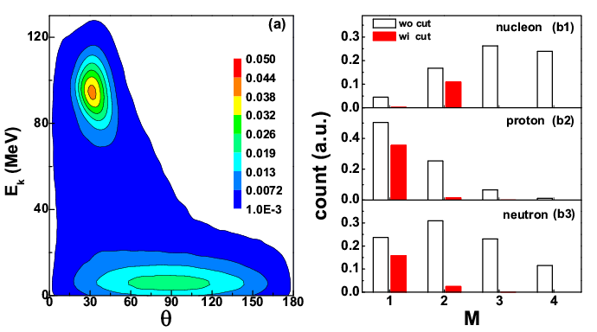
Results II
Li Ou, XZG, Han Yi, Ning Wang, Min Lou and Junlong Tian, PRL 115, 212501, (2015)

Slide 22
Contents
1 Introduction: Asymmetric nuclear EOS，E_{sym}(ρ)
2 E_{sym}(ρ) at sub-saturation densities
3 E_{sym}(ρ) at supra-saturation densities
3.1 π⁻/π⁺ as a probe to E_{sym}(ρ)
3.2 The CSR external Target Experiment
→ Summary

Slide 23

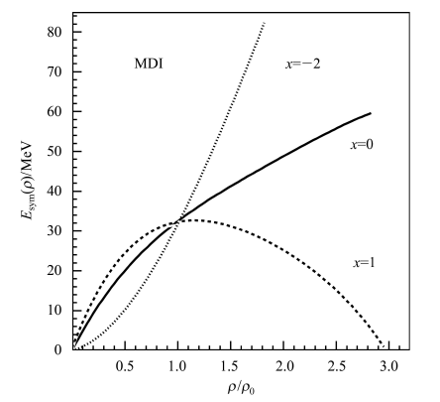
3.1 π⁻/π⁺ as a Promising probe to E_{sym}(ρ) at high density
Probe: π⁻/π⁺ ratio
Isobaric picture
π⁻/π⁺ ≈(N/Z)²
stiff：n tends to LD
Soft：n tends to HD
==> Isospin fractionation
B. A. Li PRC71 (2005)014608
E_{sym}(ρ)
(N/Z)_{dens}
π⁻/π⁺
Note: not direct measurement, one need transport model; sensitivity depends on system mass/beam energy.

Slide 24
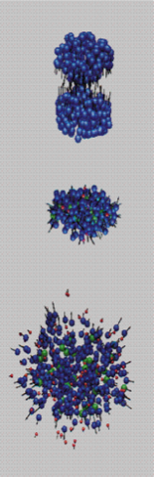
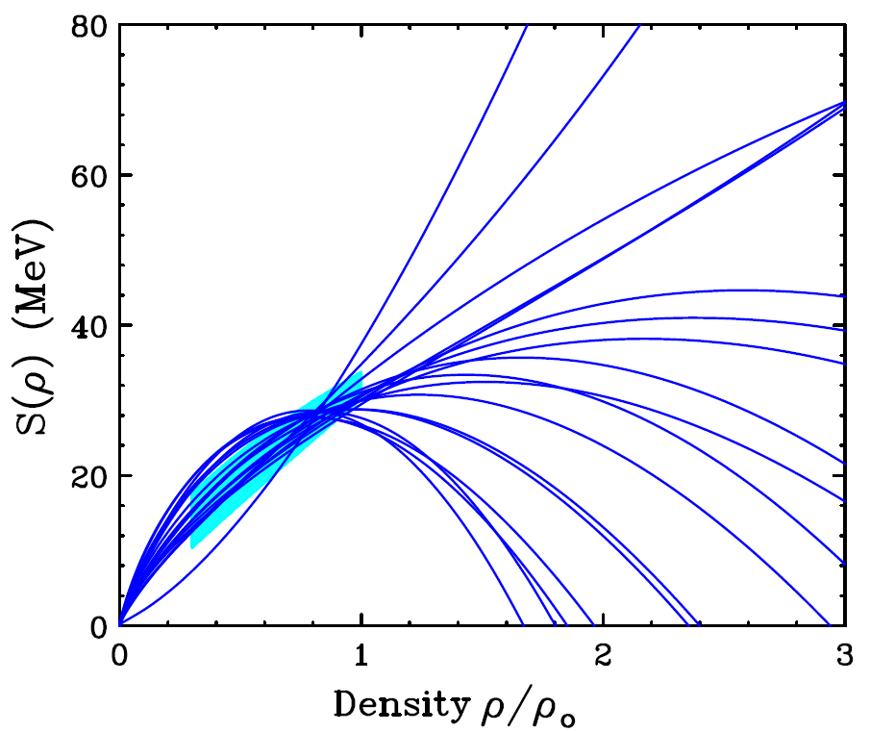
Status of E_{sym}(ρ) above saturation: Very uncertain
→ π⁻/π⁺ 比值, K⁺/K⁰ 比值 ……
→ n/p 微分流
→ n/p 椭圆流
t/³He 微分流
   Stiff
Physics Letters B 683 (2010) 140–144
π⁻/π⁺
PRL 102 (2009) 062502
   Moderate
P. Russotto et al., Phys. Lett. B 697, 471 (2011).
M.D. Cozma, Phys. Lett. B 700, 139 (2011).
P. Russotto et al., EPJA, to be published
  n/p differential flow
   Soft
XZG et al., PRL 102 (2009) 062502
W. J. Xie et al., Physics Letters B 718 (2013) 1510
π⁻/π⁺
   No sensitivity
J. Hong et al. ArXiv: 1307.7654 [nucl-th]
π⁻/π⁺

Slide 25
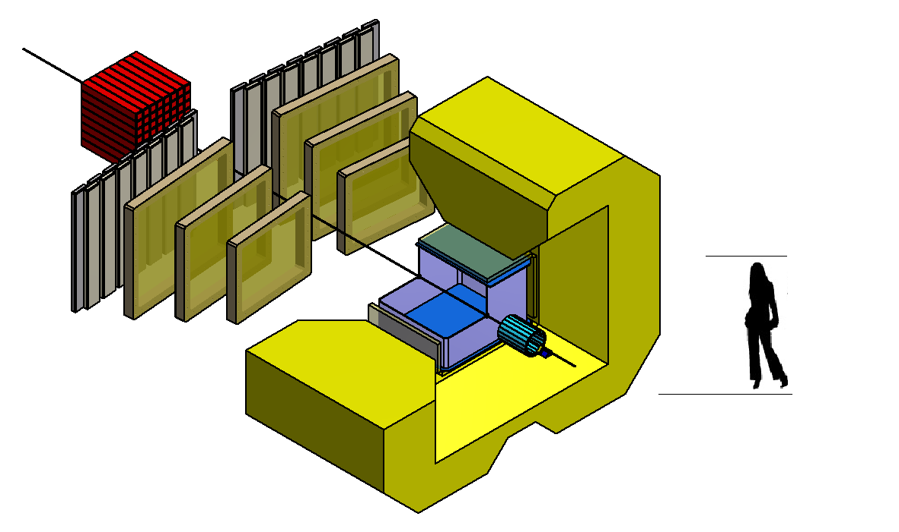
兰州重离子加速器冷却储存环(HIRFL-CSR）
SFC: ≤ 10 AMeV (H.I.), 17~35 MeV (p)
SSC: ≤100 AMeV (H.I.), ≤ 110 MeV (p)
CSRm: ≤1000 AMeV (H.I.), ≤ 2.8 GeV (p)
SSC
SFC
CSRe
RIBLL2
外靶实验装置(CEE)
RIBLL1
CSRm
冷却储存环

Slide 26
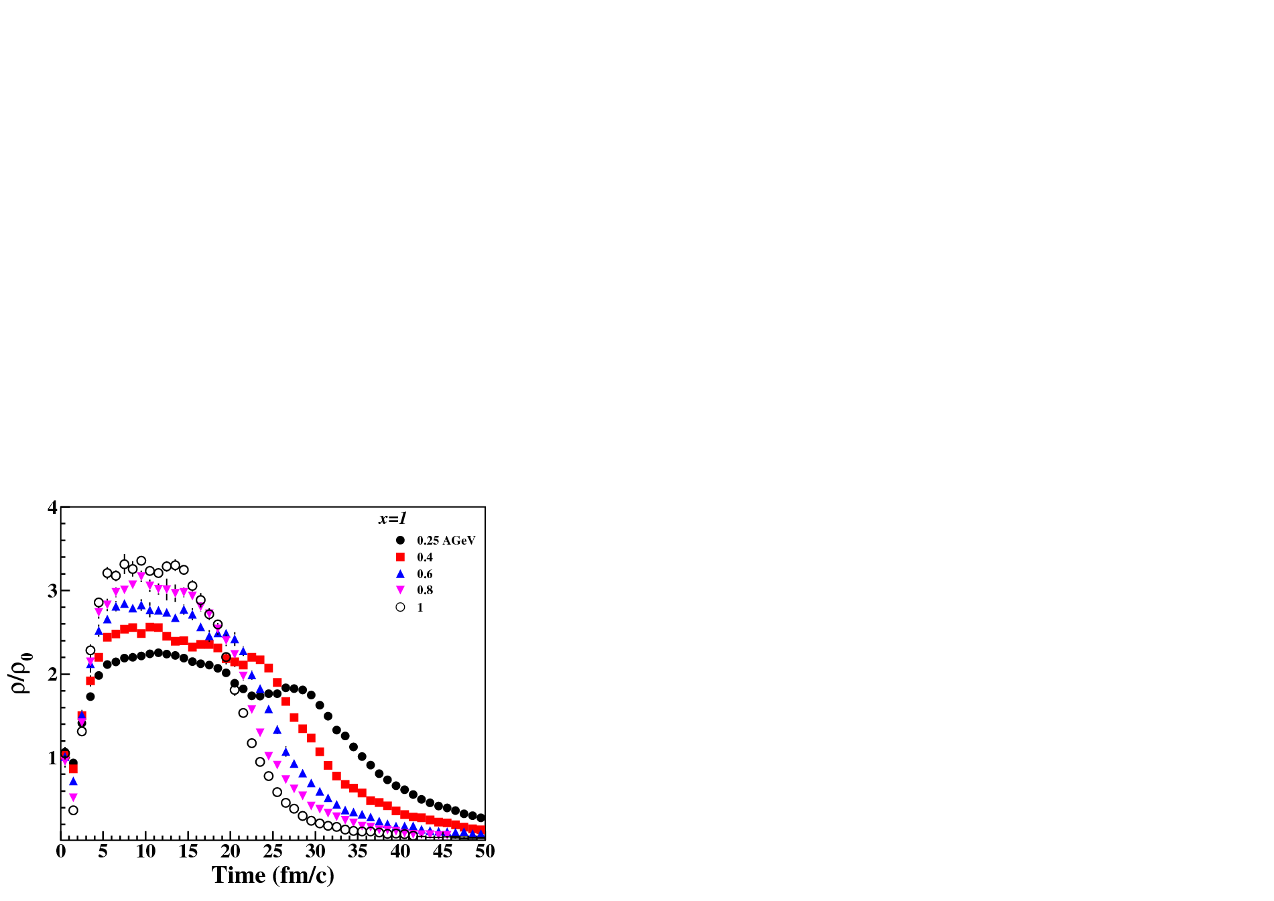
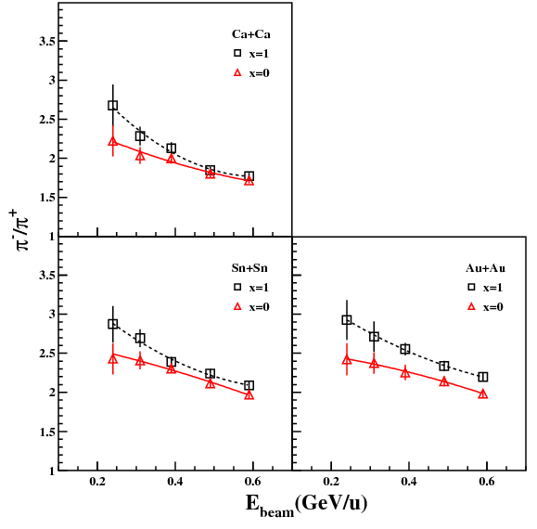
HIRFL-CSR 的优势
理由2：这一能区的观测量对对称能的依赖最为敏感！
(最大的核阻止本领与核物质压缩效应，对应
有最大的同位旋分馏程度)
理由1： 在HIRFL-CSR可致 ρ ~ 2ρ₀ 密度区
⁴⁸Ca+⁴⁸Ca 1.40
¹²⁴Sn+¹²⁴Sn 1.48
¹⁹⁷Au+¹⁹⁷Au 1.49
M. Zhang, XZG et al., Phys. Rev. C 80, 034616 (2009)
F. Fu, XZG et al., Phys. Lett. B 666, 359 (2008)

Slide 27
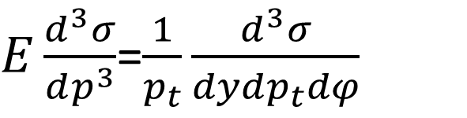
CEE conceptual design
ZDC
eTOF
$E\frac{d^{3}σ}{dp^{3}}$=$\frac{1}{p_{t}}\frac{d^{3}σ}{dydp_{t}dφ}$
MWDC
Si Pixel
T0
Dipole
TPC
iTOF
In this talk: TPC and MWDC
Lyu Liming, Yi Han , XZG et al., 中国科学，submitted (2016)

Slide 28
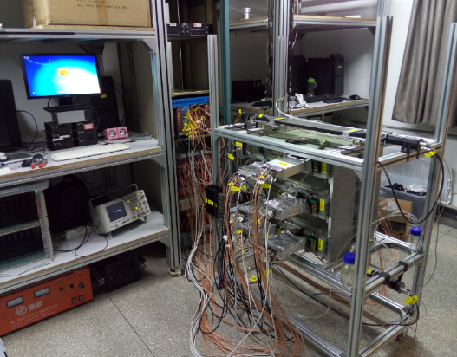
CEE的预研现状
各子系统均开展大量的预研工作

Slide 29
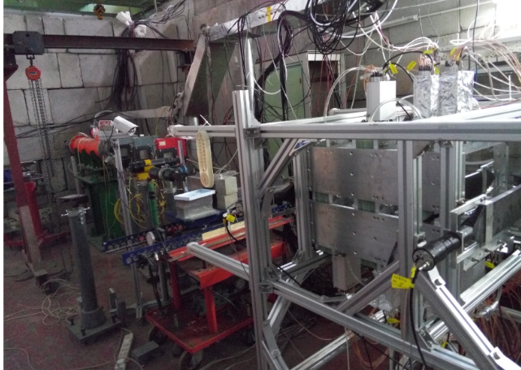
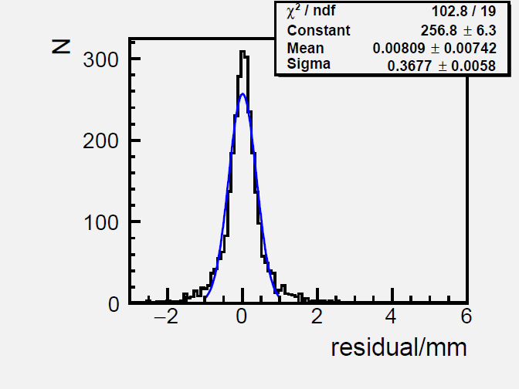
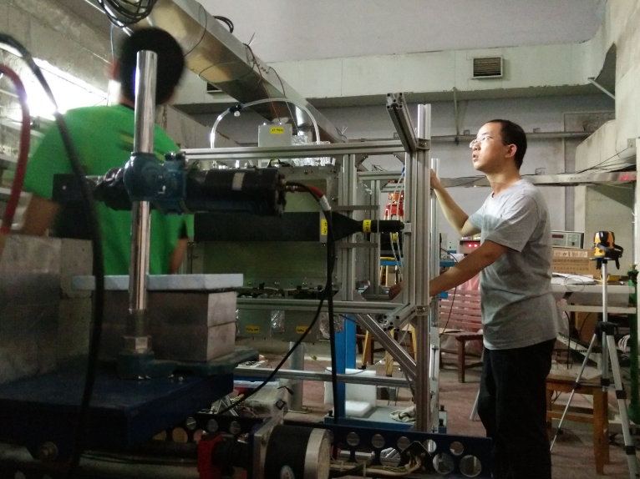
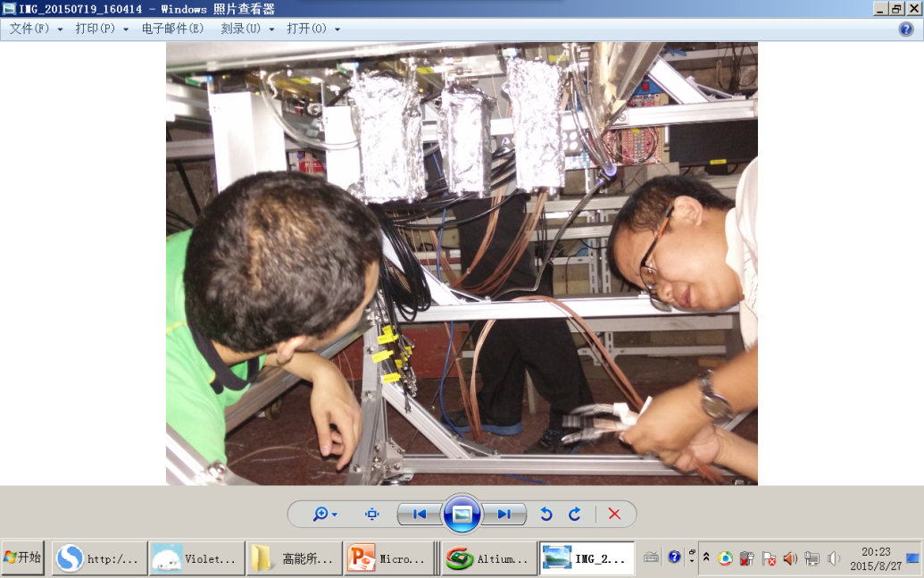
例子1：MWDC 预研 (清华组)
R&D：
→原型研制
→刻度方法
→束流测试
→数据分析
→性能测试
模拟：
→G4全模拟
→径迹查找
→动量重建和PID

Slide 30
例子2： TPC 预研
TPC

Slide 31
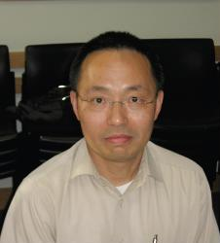

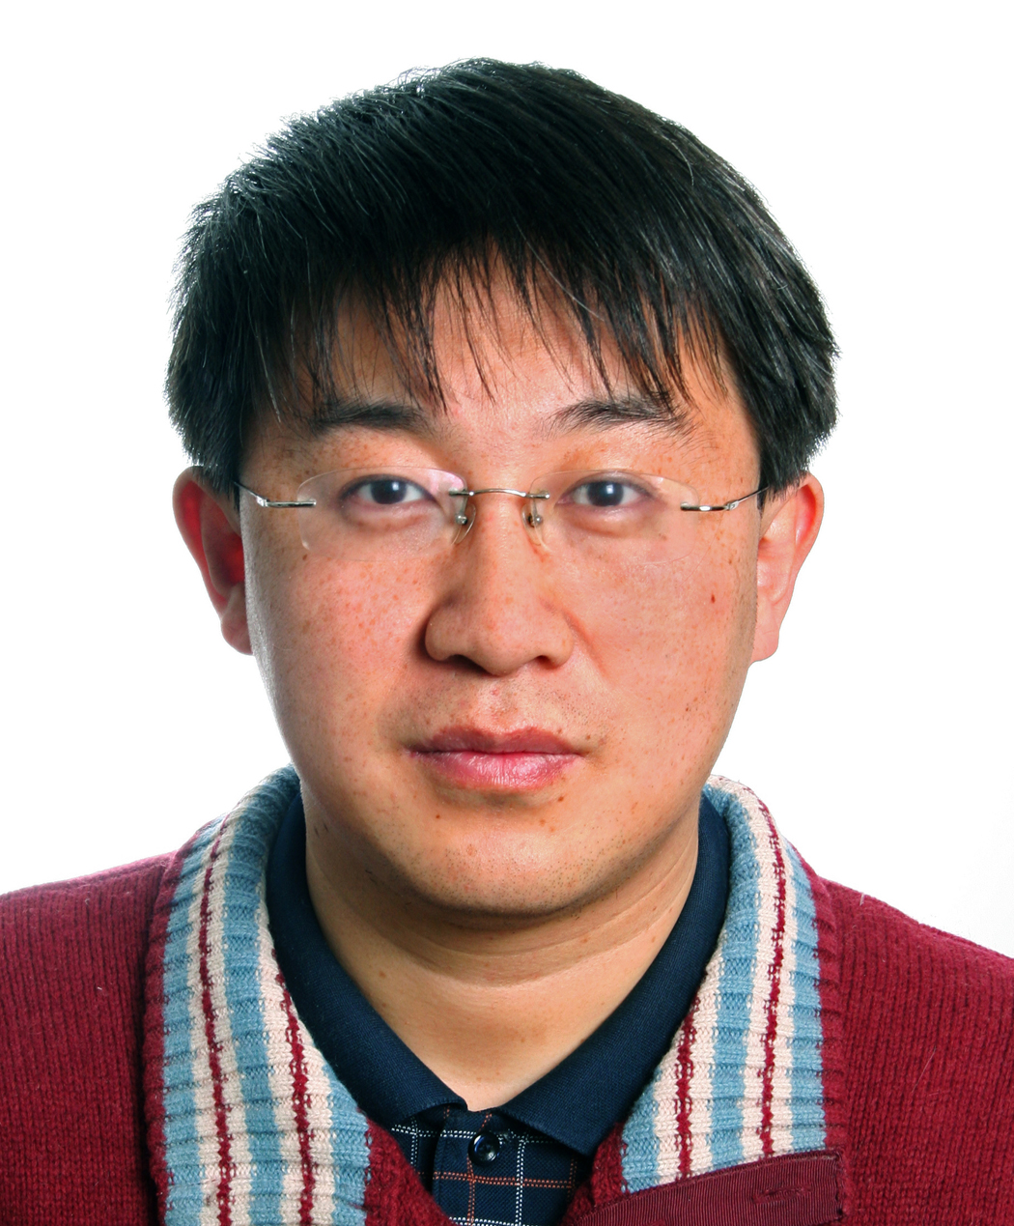
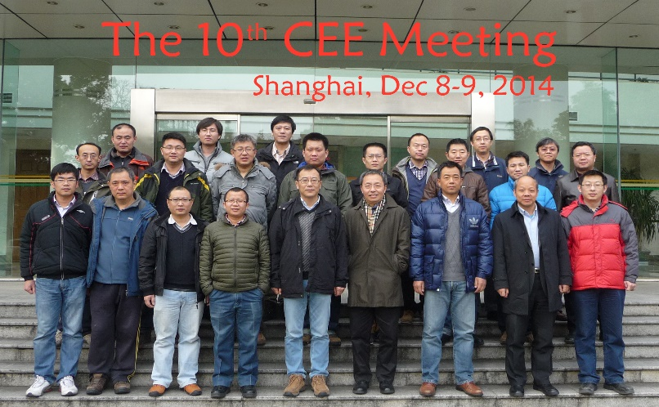
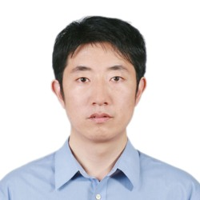
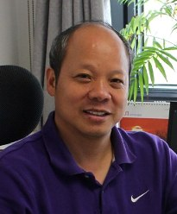
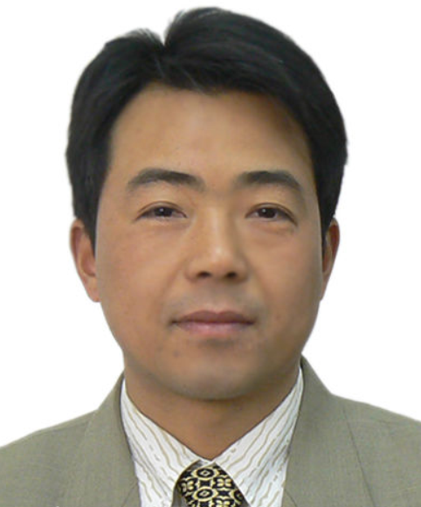

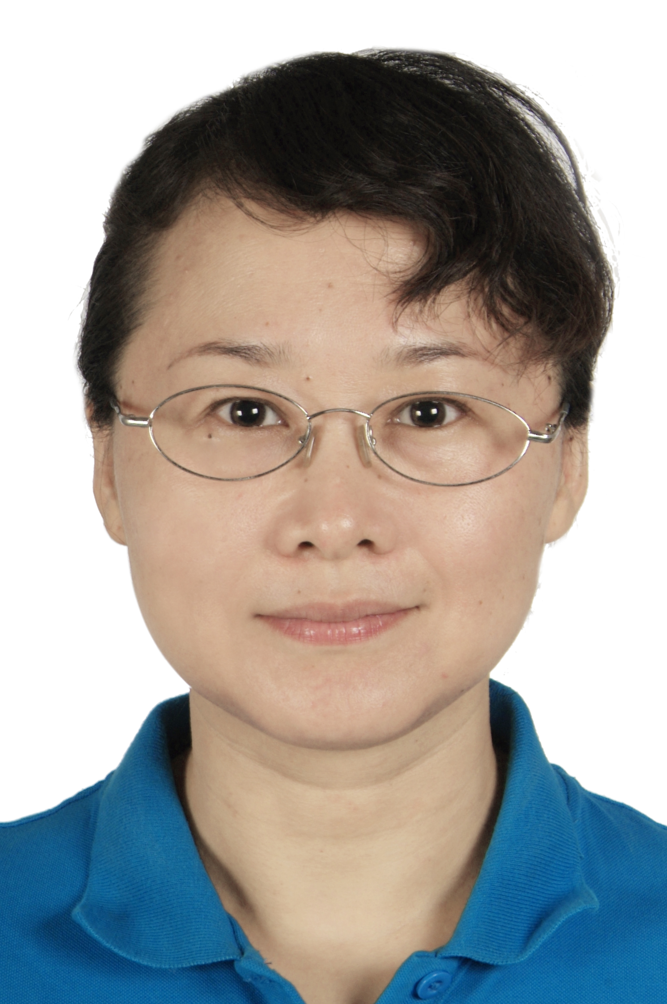
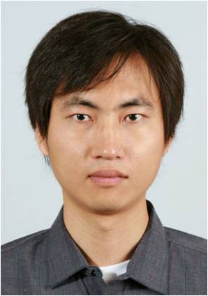
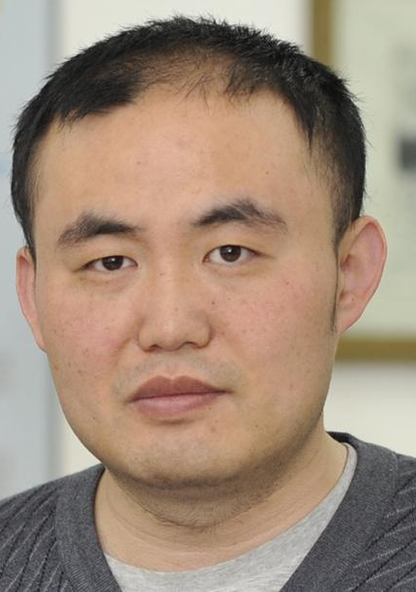
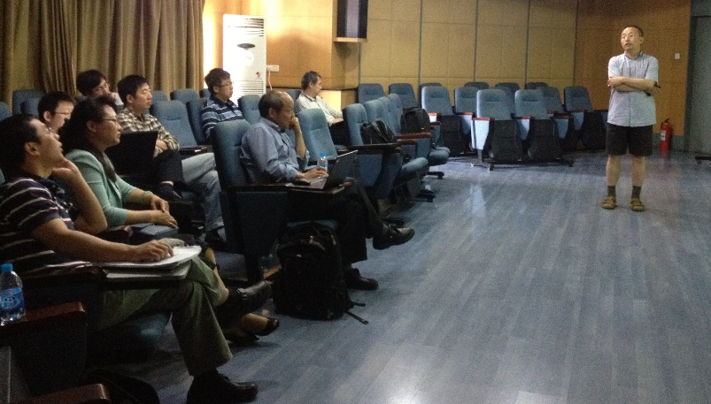
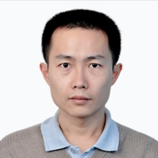
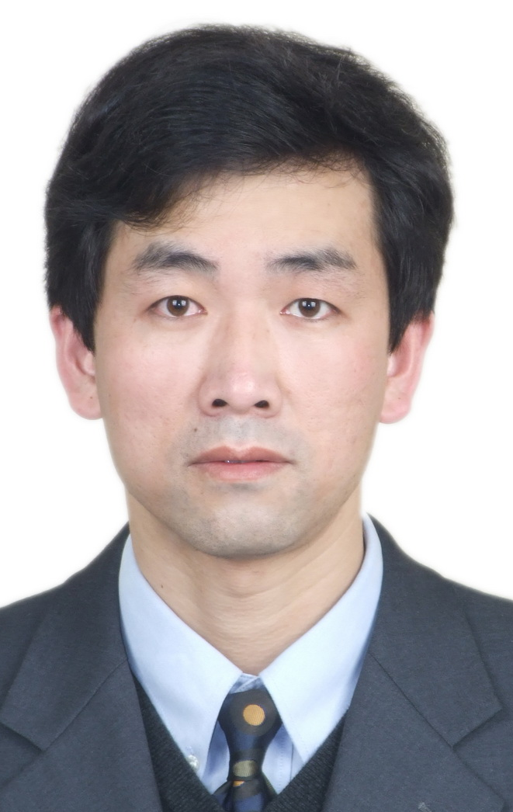
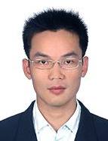
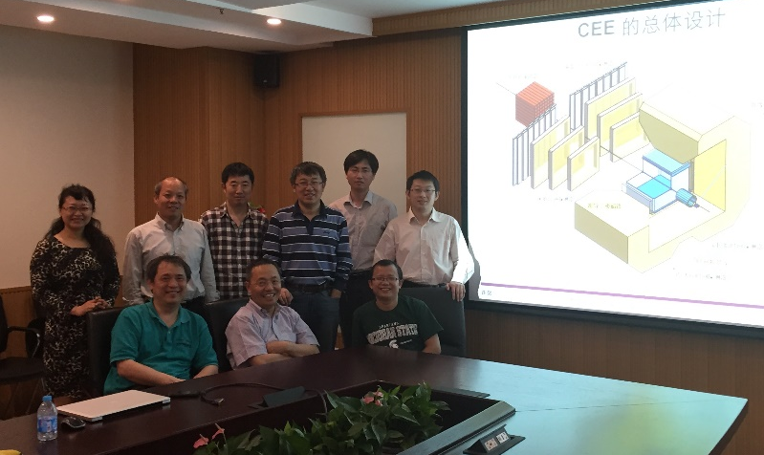
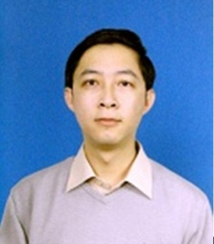
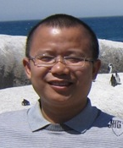
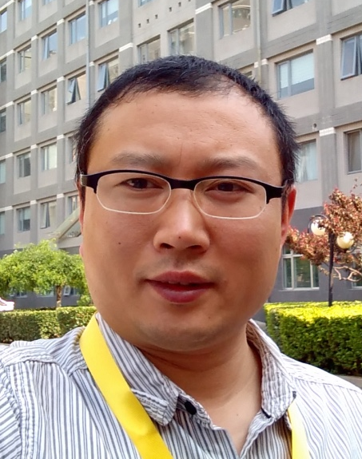
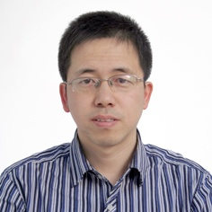
Pre-CEE collaboration

Slide 32
致 谢
合作者（An incomplete list）
清华: S.J. Zhu， Yi Han, Liming Lyu, Zhao Zhang，R. S. Wang，Y. Zhang，Y. Huang，W. J. Cheng，H. J. Li， Y. J. Wang, W. H. Yan, Fenhai Guan，Q. H. Wu
近物所: L. M. Duan’s group，RIBLL (J. S. Wang’s group)，Z. Y. Sun’s group, G. C. Yong
CIAE : Y. X. Zhang，Z.C. Gao， X. G. Wu’s group
华师： N. Xu & Pre-CEE Collab. (CCNU, IMP, SINAP, USTC)
安阳师院: J. L. Tian 广西师大：L. Ou , N. Wang
上海交大：L. W. Chen， Y. Sun 河南师大：C. W. Ma’s group
太原理工：Q. Xu 安徽大学：J. Y. Guo
湖州师院：Y. X. Liu 山大（威海）：S. Y. Wang’s group
北大： J. Meng, S. Q. Zhang, H. Hua, et al.
TAMU-C.：Bao-An Li
MSU： B. Tsang， W. Lynch KTH： Bo. Cederwall， C. Qi
Funding: NSFC, THU Initiative Scientific Program

Slide 33
小结
对于低密区对称能：The effect of E_{sym}(ρ) 效应持续时间很长，发现同位旋依赖的粒子发射次序。越丰中子粒子发射相对越早。在30 MeV/u Ar+Au反应中首次在大角度范围内观察到LCP同位旋分布，并用它来反应时间演化行为，LCP中子丰度随角度减小的趋势，确认长时标的Isospin Drift过程。
与输运模型计算的比较表明，对称能 E_{sym}(ρ)偏软： γ=0.5 or L=50 MeV.
对于高密区对称能：目前的研究未能给其确切的密度依赖，HIRFL-CSR如果配以先进探测谱仪，将会为这一个问题的研究提供机遇。CEE的研发进展良好，但期待资助立项。
谢 谢

Slide 34
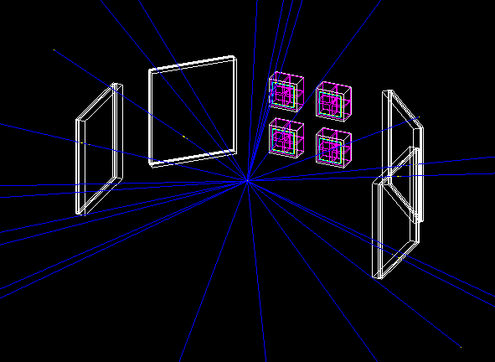
2.3 近期在RIBLL1上的实验计划
HIRA type Telescope
颈部形变与同位旋相关的粒子发射
2016年度束流计划
同位旋相关的粒子发射次序的(HBT) 测量
2018年度束流计划
安装HIRA-type 的粒子望远镜
XZG et al.
PLB 639 (2006) 436
Zhaoqing Feng PRC 94, 014609 (2016).
M. Kaur et al NPA 955, 133 (2016).

Slide 35
“颈部”形变大小如何测量？同位旋相关性？
实验关键：
碎片和轻粒子关联
裂变的Event reconstruction
探测器摆放
足够的统计，足够的统计，足够的统计。
Figure by Junlong Tian
实验准备：
Geant 4 模拟– 优化探测器摆放
Si条望远镜机械加工、装配
Preliminary

Slide 36
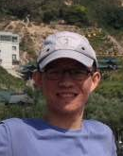













Experimental Nuclear Physics Group @THU
清华大理系学物实验核物理小组
E-mail: xiaozg@tsinghua.edu.cn
主页：http://info.phys.Tsinghua.edu.cn/enpg
1. 费米能区至亚GeV能区核反应与核物质状态方程研究；
PLB 06’, PLB 08’, PRL 09’, JPG 09’, PRC 09’, PRC 10’, NPA10’, CPC 12’，PRC14’, EPJA 14’ , PRC 15’，PRL 15’……
2. 基于CIAE 在束γ阵列的核谱学研究；
¹³⁸Nd (PRC 13’), ⁹⁹Tc(PRC 15’), ¹³⁸Pm(EPJA 15’), ¹²⁹Xe(PRC 16’) …
3. 围绕大科学工程的探测器研发
NIMA13’, NIMA13’, NED14’,CPC13’, CPC14’, CPC16’
4. 国内和国际合作：
IMP/Sπirit TPC/SOLID/FOPI/KTH/iThemba/STAR
EPJA12’, ¹⁰⁶Ag(PRL14’), ¹⁶²W (PRC 15’), ¹⁶⁶Re(PRC15’，PRC16’) , ⁷⁸Br(PRL16’)， NIMA 14’, NIMA 16’ ……

Slide 37
Translate the time evolution into angular distribution
How the neutron and proton immigrate during the process?
1) Coulomb competition exists. When the symmetry effect is smaller (γ=2), Strong coulomb effect in the target source (large Z) leads to a slightly enhanced proton yield.
2) Projectile source always peaks at forward angle, while target source situates at θ<90 at early stage, and moves to θ>90 as time going on.
Q. Wu, Y X Zhang, XZG et al., PRC 91, 014617(2015)

Slide 38
IQMD calculations (III)
Advantage of this observable: changing the stiffness of the symmetry energy yields different trend!
Q. Wu, Y Zhang, Z. Li, XZG et al., PRC 91, 014617(2015)

Slide 39










Tsinghua University
Tsinghua University was founded in 1911.

Slide 40



Department of Physics
→The department of physics was founded in 1926, the first Chair is also the founder of the modern physics in China, Prof. Qi-Sun YE. In 1934, he recommended Prof. You-Xun WU, who had worked with Compton, to be the 2nd Chair.
→1938 ~1946, THU moved to south west China, together with PKU and Nankai due to the WAR. Many famous physicists, including C. N. Yang and T. D. LEE, studied there.
→1952, due to the rearrangement of the institutions in China, the department of Physics was merged to PKU. Department of Engineering Physics was founded in 1955 in THU. A group of theoretic physics was established in 1958.
→1982, the Department of Physics is re-established.
→ Currently, there are about 80 faculty members, ~300 graduate students and ~400 undergraduate students. 4 professors in nuclear physics.

