Slide 1





Study of HV/HR CMOS Sensor for the ATLAS Inner Tracker at the High Luminosity LHC
Jian LIU (刘剑)
Shandong University
liuj@hepg.sdu.edu.cn
24 Aug 2016, Hefei

Slide 2


Outline
HL-LHC environment and HV/HR CMOS introduction
TCAD simulations for various HV/HR technologies
  TCAD simulation purposes and procedures
  Simulations for the LF technology
Prototype characterizations
  Test setup developments
  X-ray and proton tests for the AMS and LF prototypes
  Laboratory test for the LF and the GF prototypes
Conclusions and perspectives

Slide 3
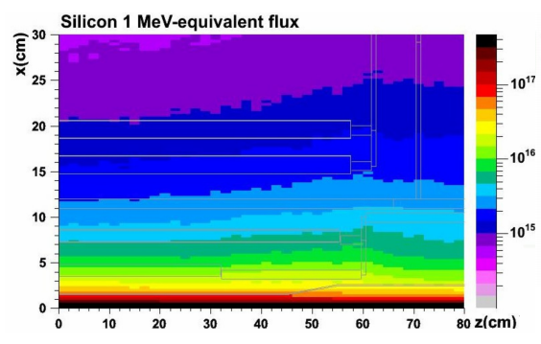
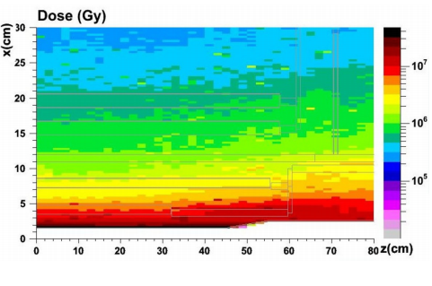
HL-LHC Environment
After the Phase II upgrade ~2024,
The HL-LHC will operate at a levelled instantaneous luminosity of 7.5×10³⁴cm⁻²s⁻¹ .
Total pixel silicon area of ATLAS Inner Tracker (ITk) will be ~8.2m². Strip ~192m².
Fluence at the inner most pixel layer, for an integrated luminosity of 3000 fb⁻¹ over 10 years:
NIEL: ~1.4x10¹⁶ n_{eq} cm⁻²
TID: ~770 MRads
The new Inner Tracker should be rad-hard, cope with high occupancy and lower price.
Presently, one possibility for upgrade is to use a hybrid pixel detector concept:
Sensor: thin silicon planar or 3D (reduce drift distance),diamond…
Readout-Out Chip: deep-submicron rad-hard ICs (65nm)=>high granularity=> high resolution, low occupancy

Slide 4
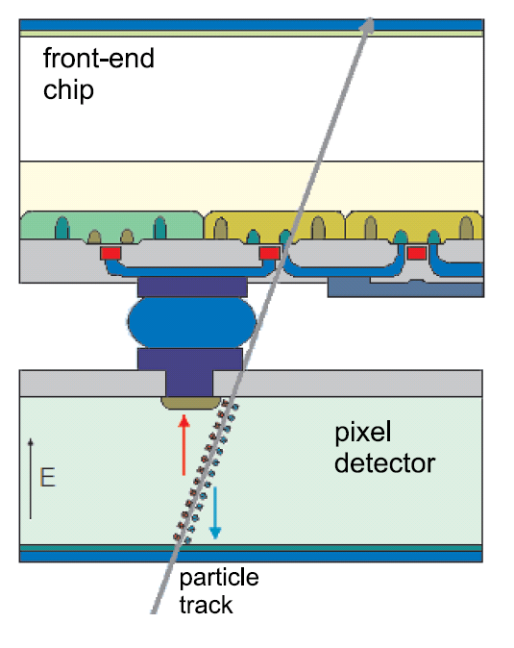
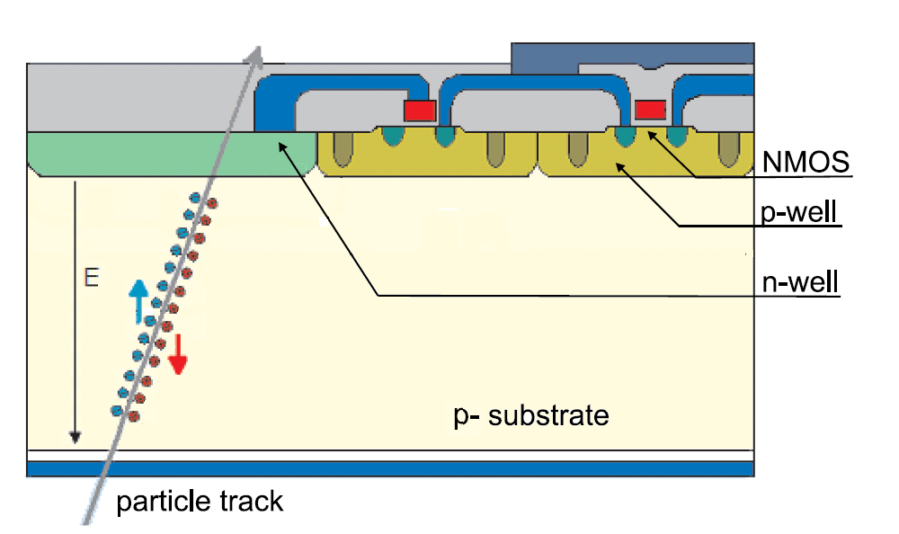
HV/HR CMOS for Phase-II Upgrade
Main advantages:
Commercial CMOS technology→ lower price per unit area.
Can be thinned to tens of µm → material budget reduced.
Pixel size can be reduced → improved single point resolution.
1st amplifier in-sensor → capacitively coupled to a specific digital part by gluing (compatible with ATLAS FE-I4, an readout IC for the ATLAS IBL).
Use cases for the future ITk in 2024:
For inner layers. 25 x 25 µm² pixel size with in-pixel en/de-coding read out by the FE-65 nm (RD53) → higher granularity.
For outer layers. 50 x 50 µm² pixel size, full monolithic chip → ease of assembly, two tracks separation.

Slide 5
HV/HR CMOS architectures
Sensor (can be read out stand alone) bump bonded or capacitively coupled to digital IC:
DC
Bump-bond
Amp
Amp
Discri
Diode
AC
Capacitively coupled pixel detector (CCPD)
Focusing on CCPD in this talk.
Monolithic (depleted CMOS pixel chips including the R/O architecture on-chip, FE-I3 like):
Amp
Discri
Diode

Slide 6
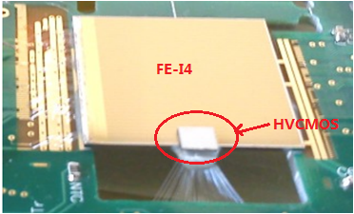
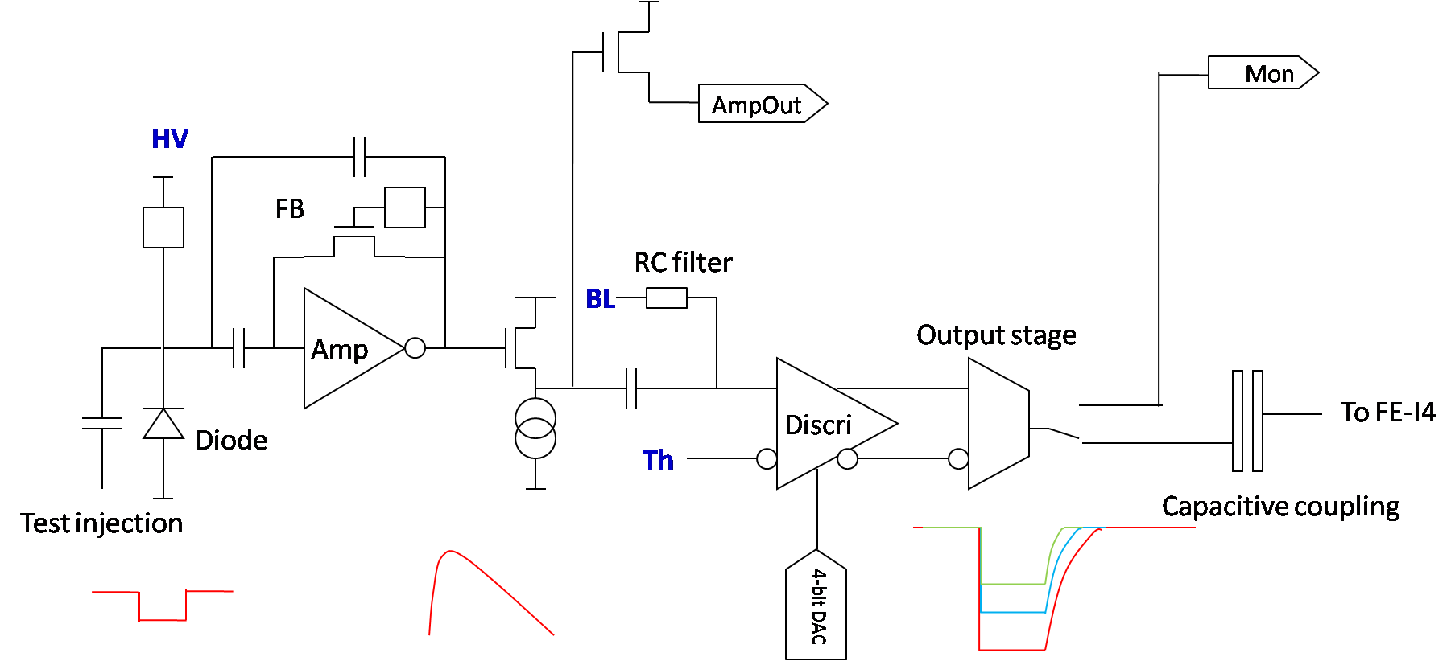
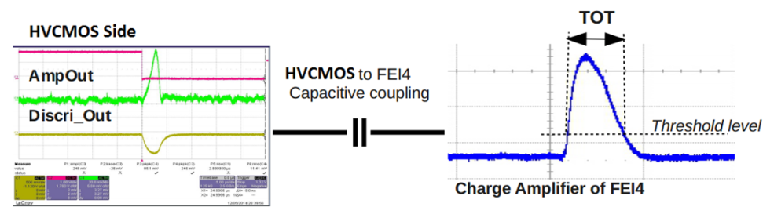
The HV2FEI4 Prototype
The HV CMOS sensor pixels are smaller than the standard ATLAS pixels, in our case 33 μm x 125 μm - so that three such pixels cover the area of the original pixel.
FEI4 Pixels
Signal transmitted capacitively
CCPD Pixels
2
2
3
3
1
1
HV2FEI4 assembly
The pixel chain contains charge sensitive amplifier, comparator and tuning DAC.

Slide 7
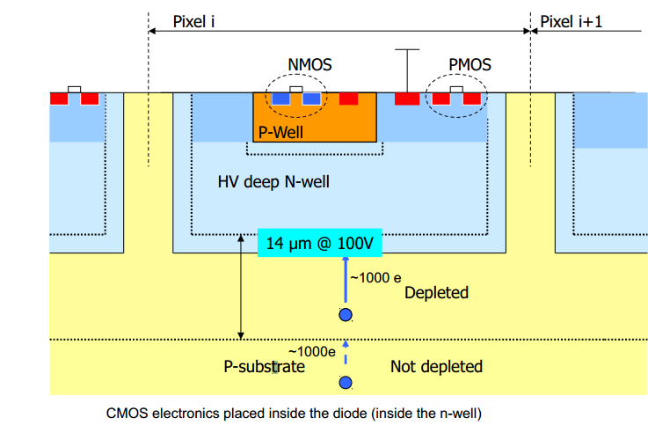
HV/HR CMOS for Phase-II Upgrade
Explore industry standard CMOS processes as sensors:
Exists in many processes, in particular HV/HR CMOS technologies, such as AMS 0.18 µm HV CMOS, GF 0.13 µm BCDlite and LF 150 nm technology…
Basic requirement is Deep N Well(DNW) →high substrate bias voltage→drift→rad-hard
Triple-well technology → shielded electronics with HV.
Depletion width:
DNW: Light doping
In order to verify the feasibility of specific HV CMOS technologies, we need to understand the DNW electrical behavior carefully → 2D/3D TCAD simulations were and are being performed using Sentaurus.
Questions:
Radiation hardness (sensor / transistors).
Signal to Noise Ratio.
Detection efficiency.

Slide 8
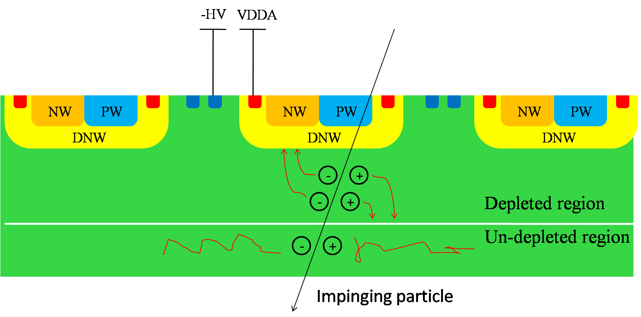
What has been done using TCAD
AC: Input capacitance from the Pwell and DNW.
DC: Breakdown voltage in the critical region.
C_{pw-dnw}
C_{inter}
C_{dnw}
DC: Depletion evaluation depending on the biasing voltage and the resistivity.
DC: Leakage current.
Transient: Charge collection behavior.

Slide 9
LF CCPD sensor layouts
LFoundry CMOS:
150 nm CMOS
2 kΩ.cm p-type bulk
Deep NWell available
HV process
Thinning and back side metallization possible
Version A sensor:
Larger DNW, larger input capacitance, electronics isolated with HV.
Version B sensor:
Smaller DNW, smaller input capacitance.

Slide 10
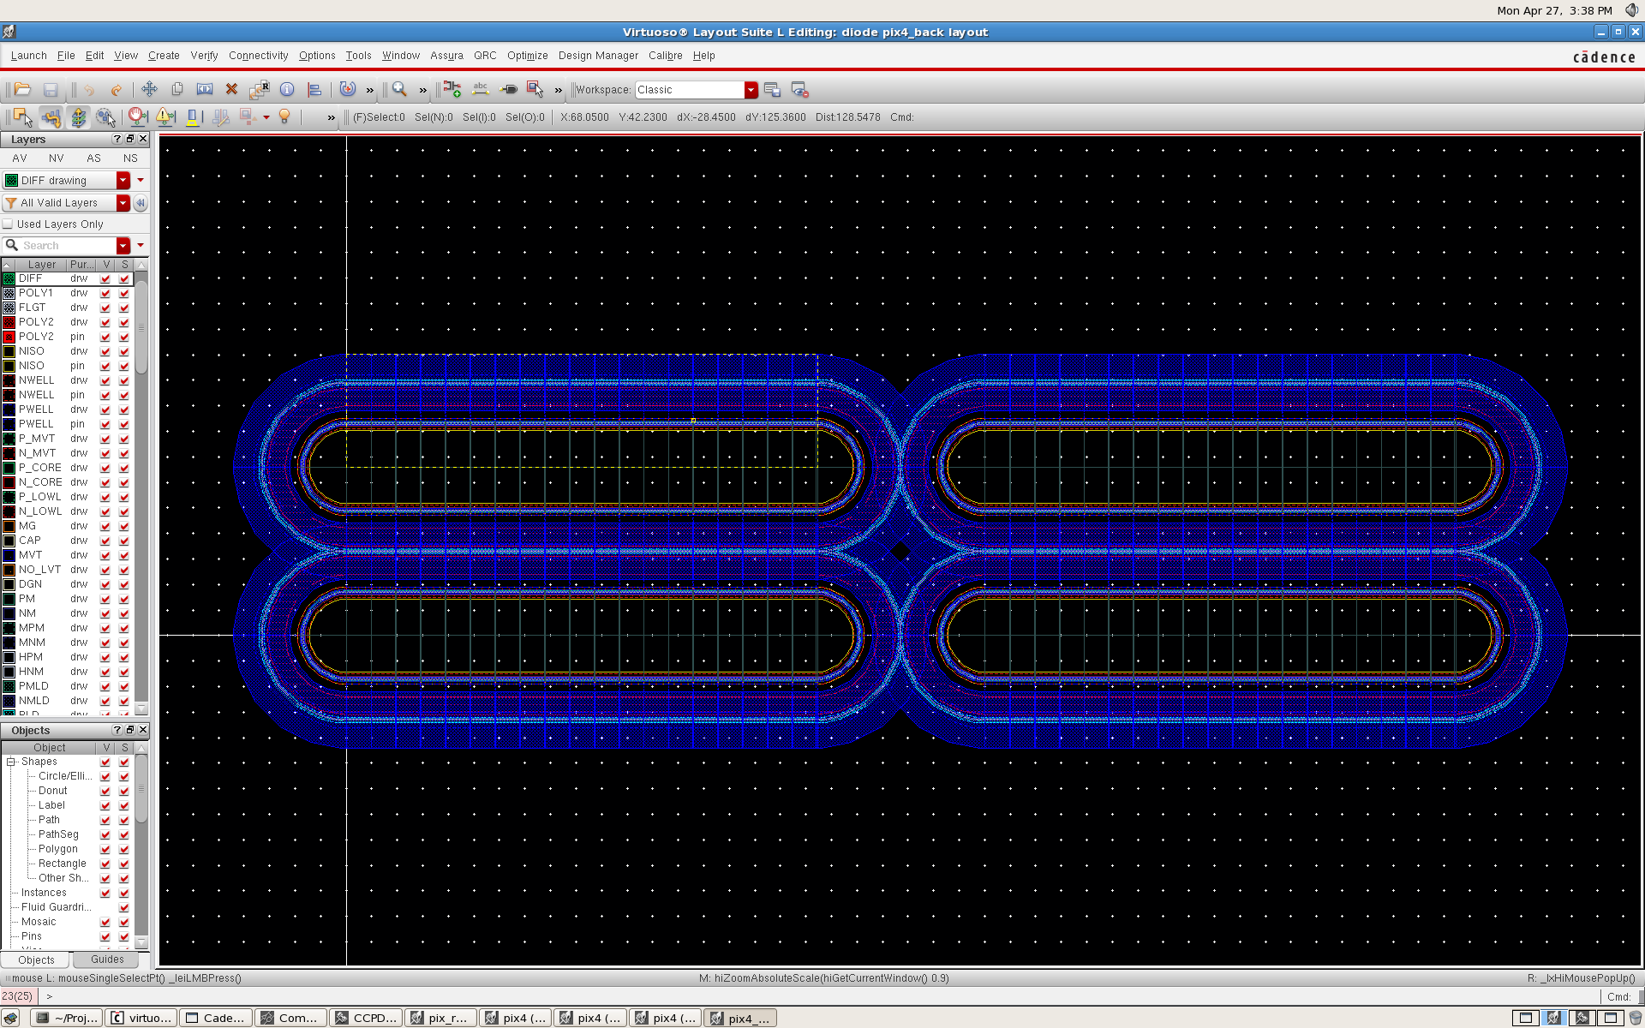
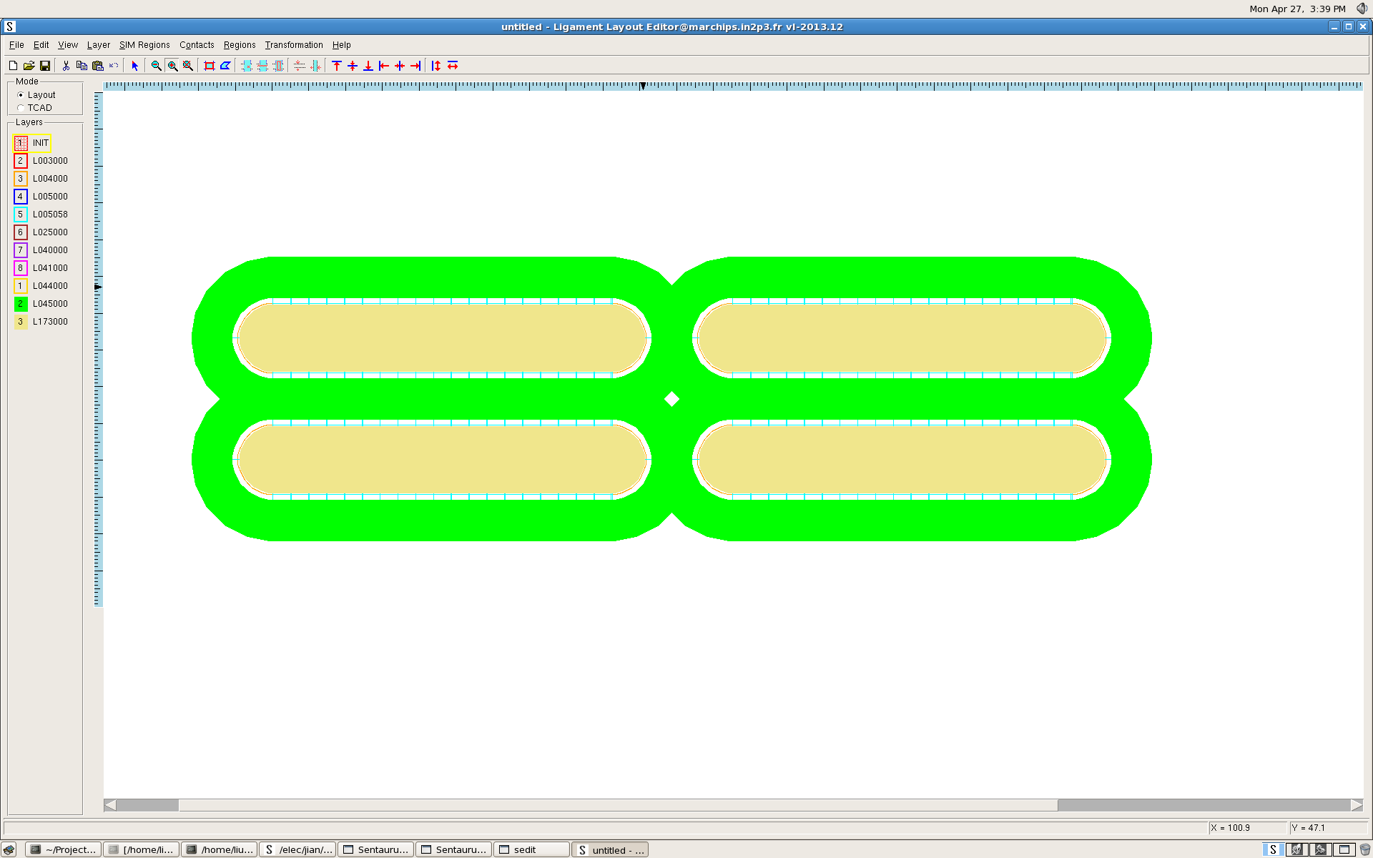
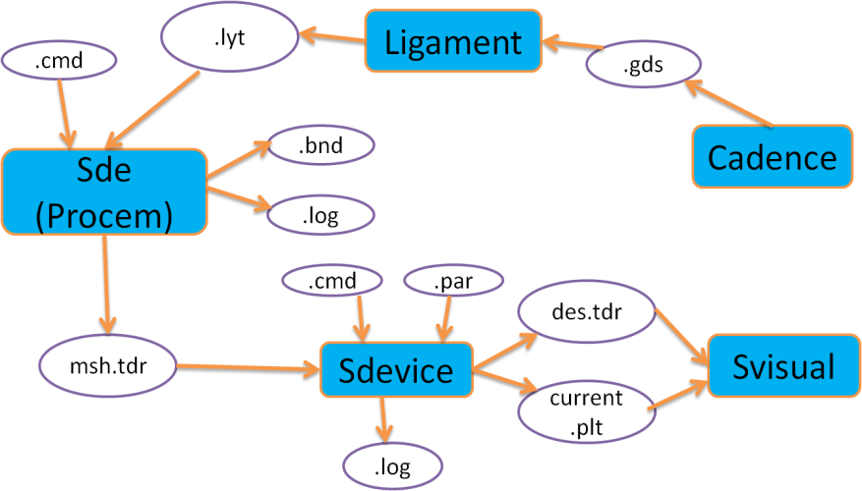
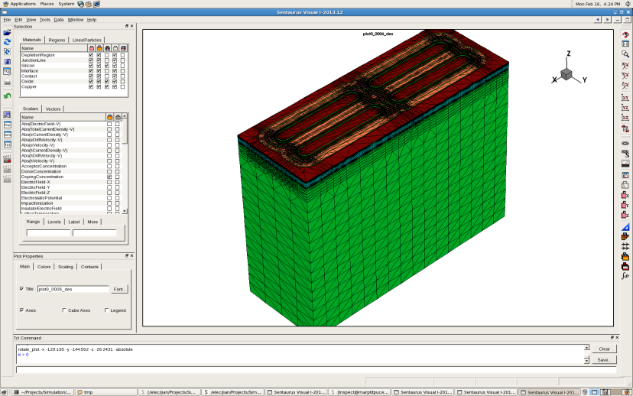
LF simulation procedures
The round corners in .gds are converted to broken lines in .lyt.
Layout in Cadence
Transport to Sentaurus Ligament
2x2 pixel array with standard DNW size.
200 µm substrate ( 2 k Ω.cm).
3D device

Slide 11
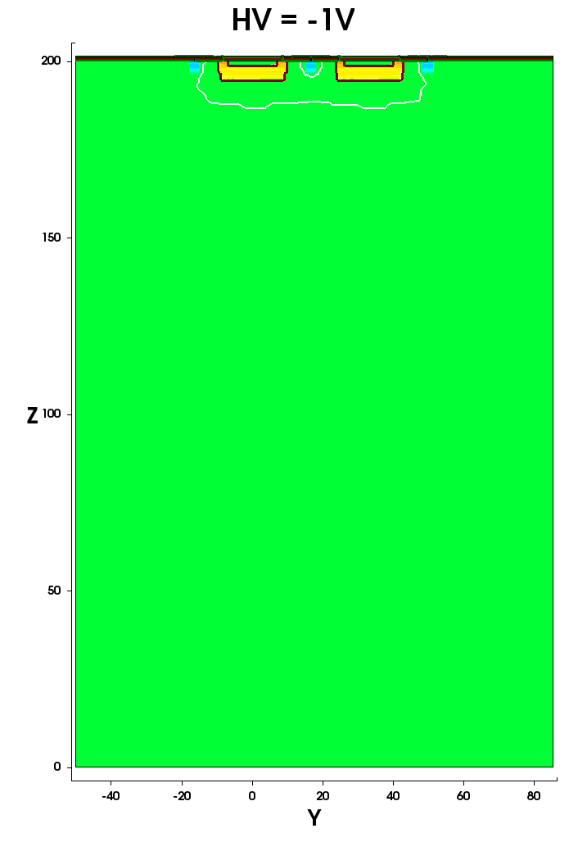
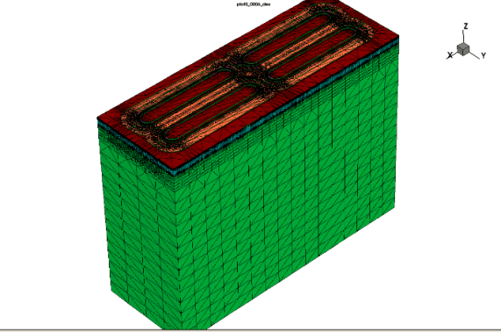
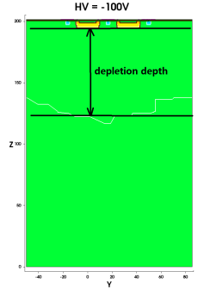
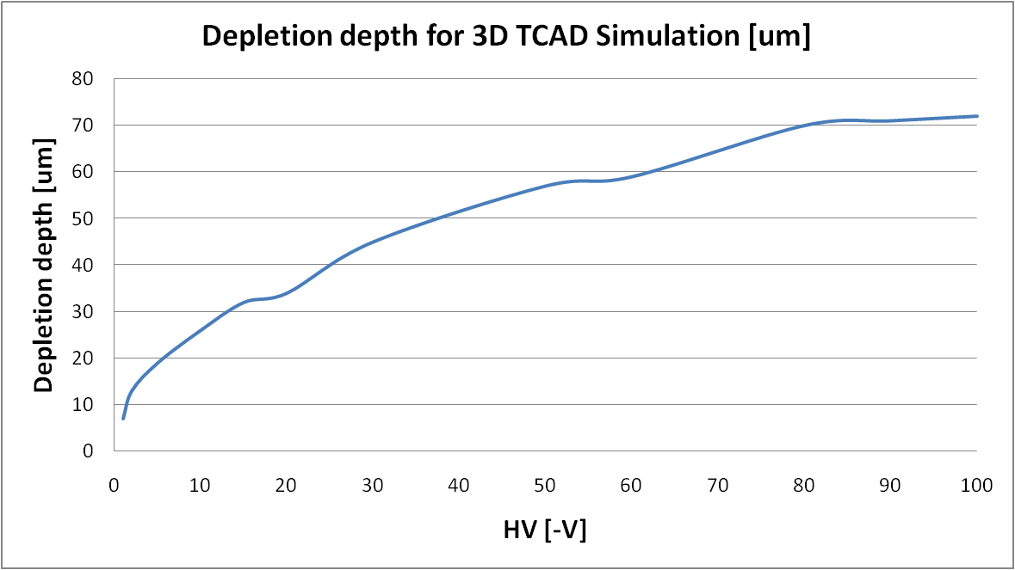
LF VerA depletion
Depletion vs. HV
~70 µm of depletion depth can be obtained @HV=-100 V

Slide 12
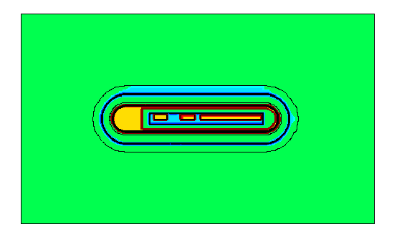
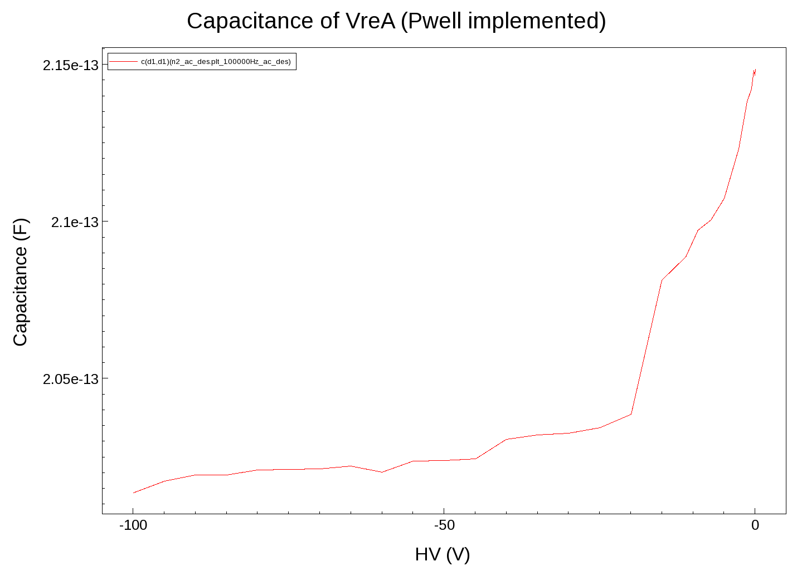
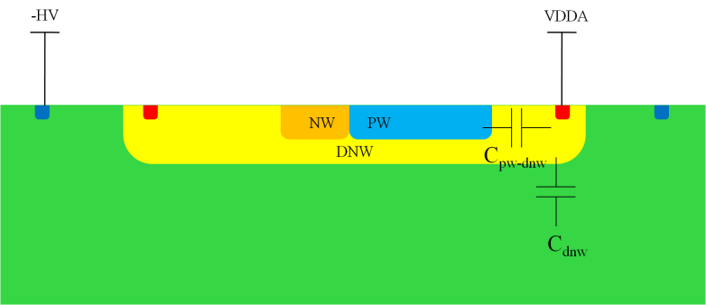
LF VerA capacitance
Top view (PW and NW implemented)
C_{dnw} is ~50 fF @ HV=-50 V
C_{pw-dnw} is ~150 fF @ HV=-50 V
Total capacitance is ~200 fF @ HV=-50 V
The capacitances mainly come from the C_{dnw} (between the DNW and the substrate) and the C_{pw-dnw} (between the PW/PSUB and the DNW)

Slide 13
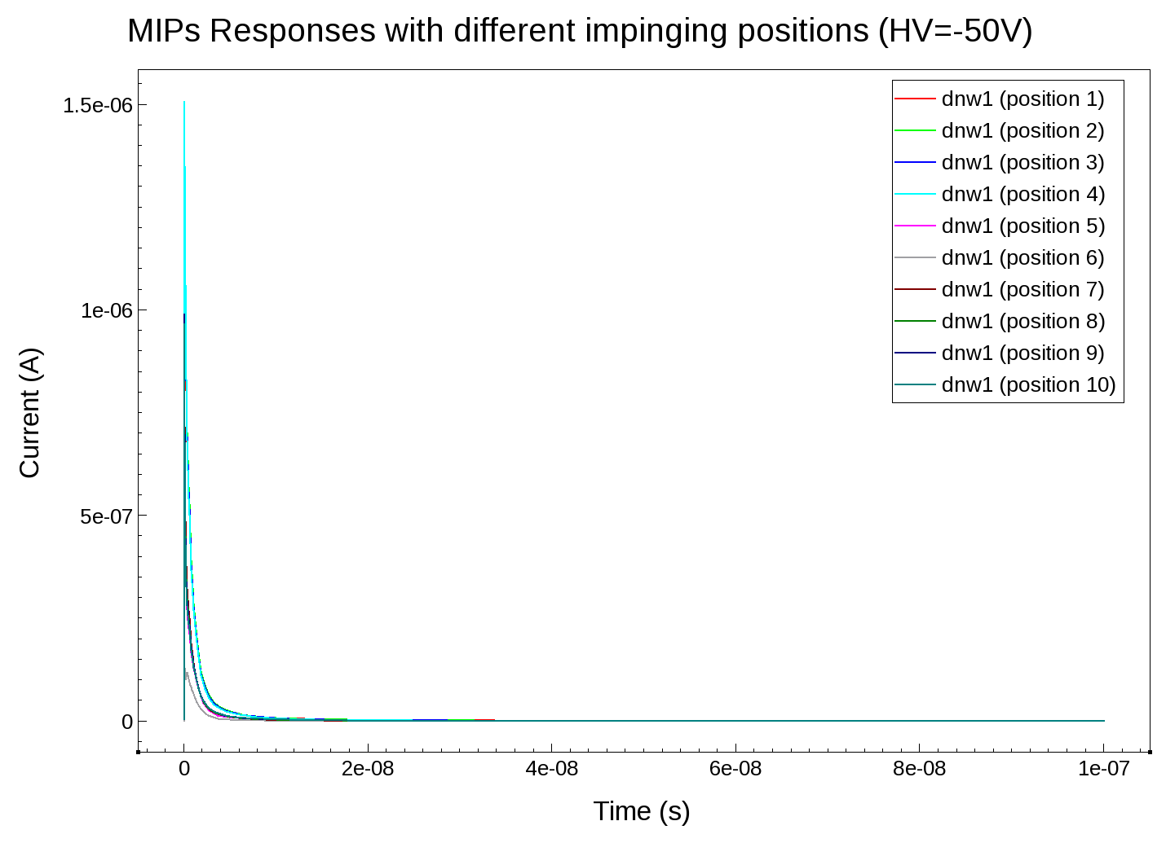
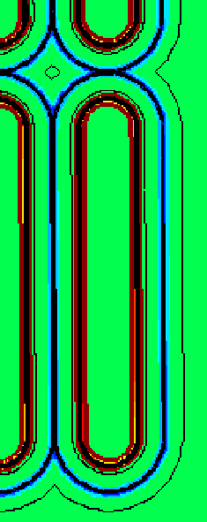
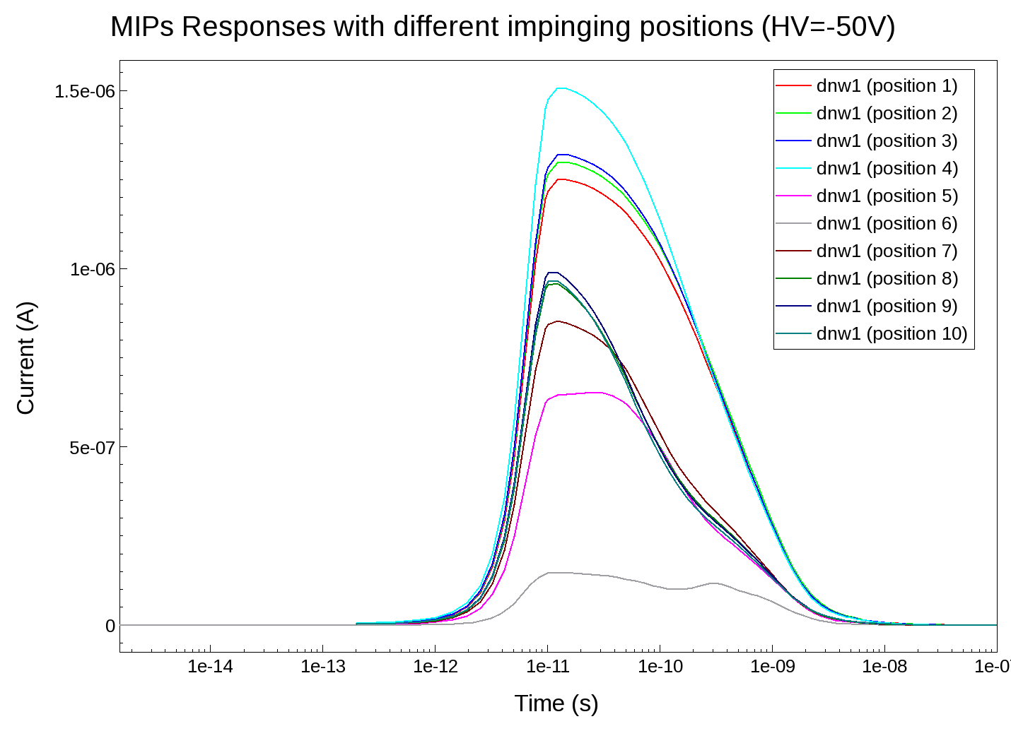
LF VerA transient simulation: charge collection
HV=-50 V
1078
2519
Collected charges within 5 ns.
2848
5625
2758
5668
Linear
2796
5768
2710
5662
HV=-50 V
6687 e- (HV=-100 V)
Log

Slide 14
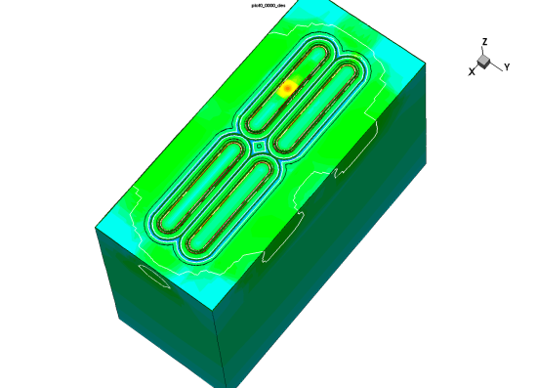
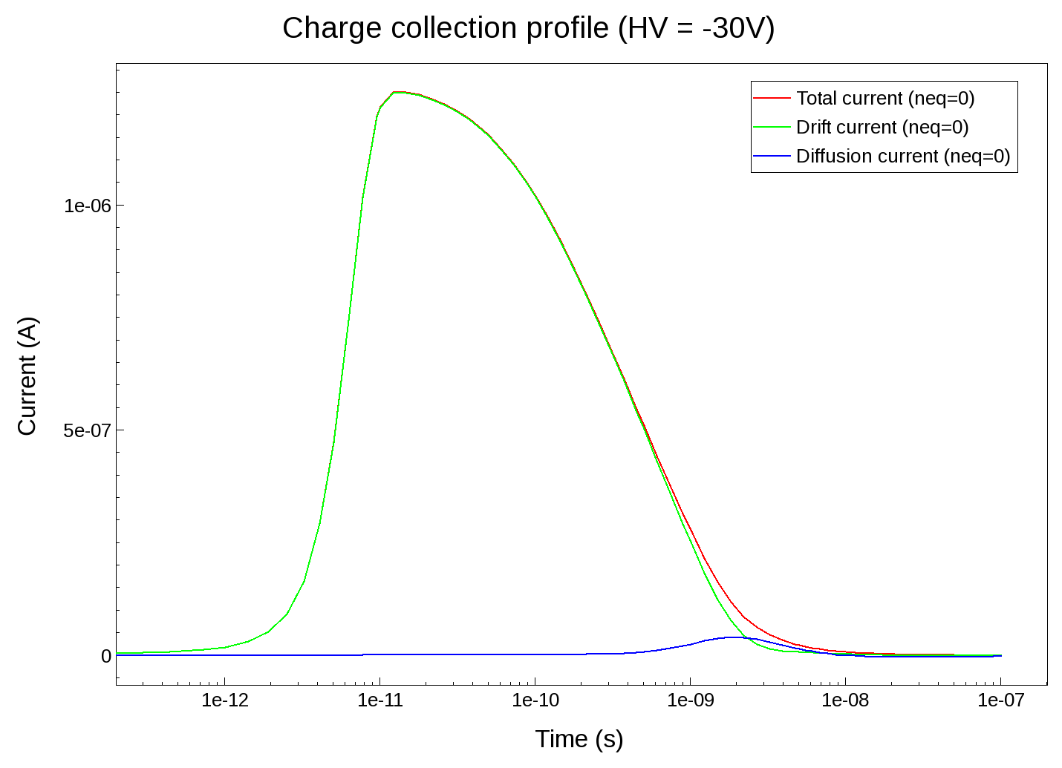
LF VerA transient simulation: charge profile
HV = -50V
Log
Enable the excess carrier generation in specific regions: depleted and un-depleted.
Before irradiation:
Q_{drift}=4812 e- (85%) peaking at ~100 ps.
Q_{diffusion}=850 e- (15%) peaking at ~2 ns.
Fluence (neq.cm⁻²) | Drift(e-) @ -50V | Diffusion(e-) @ -50V
0 | 4812 | 850
1e14 | 4507 | 491
1e15 | 2536 | 188
1e16 | 1081 | 0
43% diffusion charges are lost at approximately 5 MRads.

Slide 15
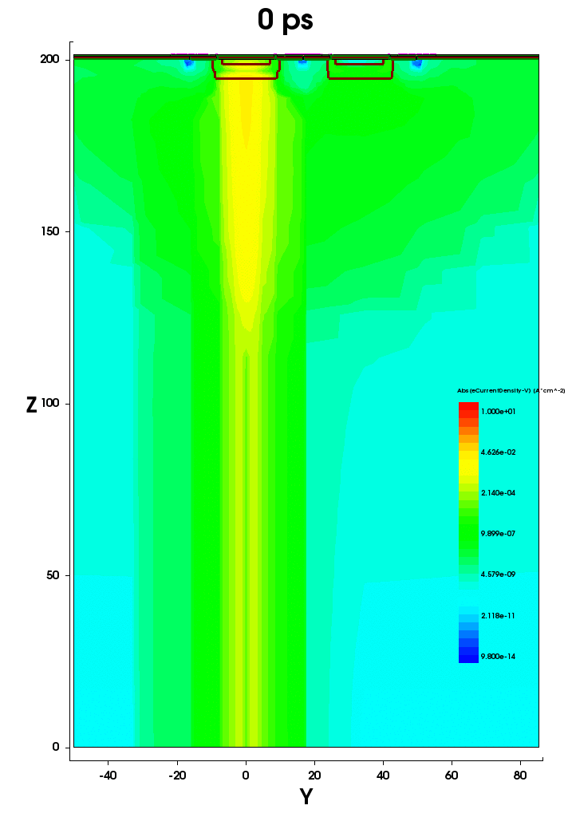
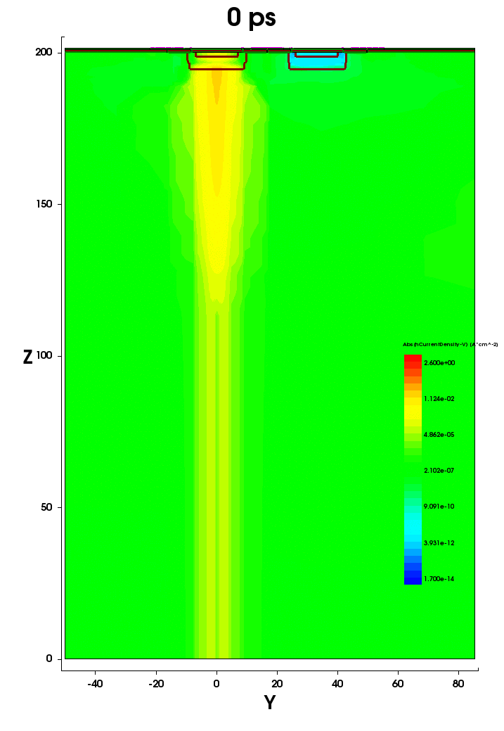
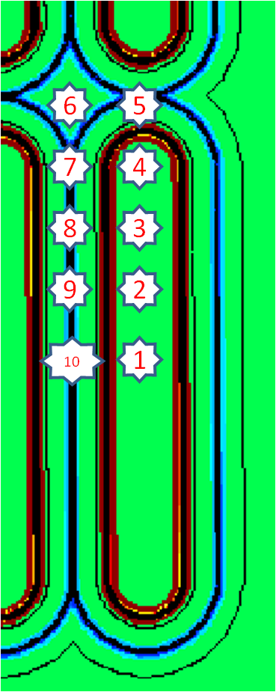
LF VerA transient simulation: e-h current density of position 1
electron
hole
HV = -50 V
Electrons in depletion region drift towards DNW.
Holes in the upper side of depletion region drift towards p+.
Holes in the lower side of depletion region are swept out towards bottom.

Slide 16
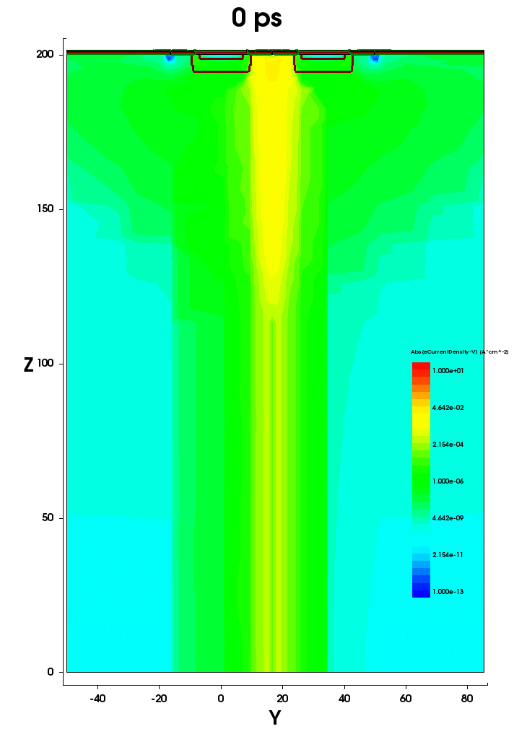
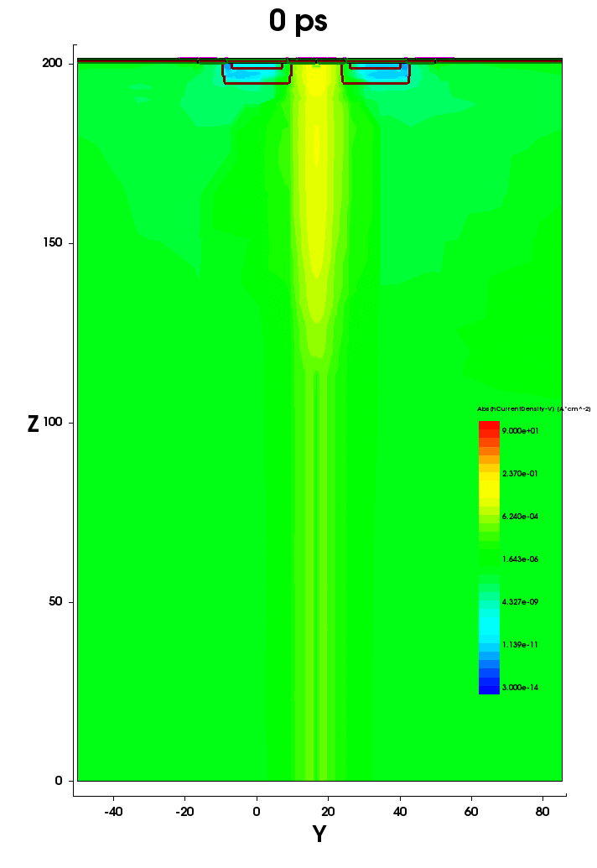
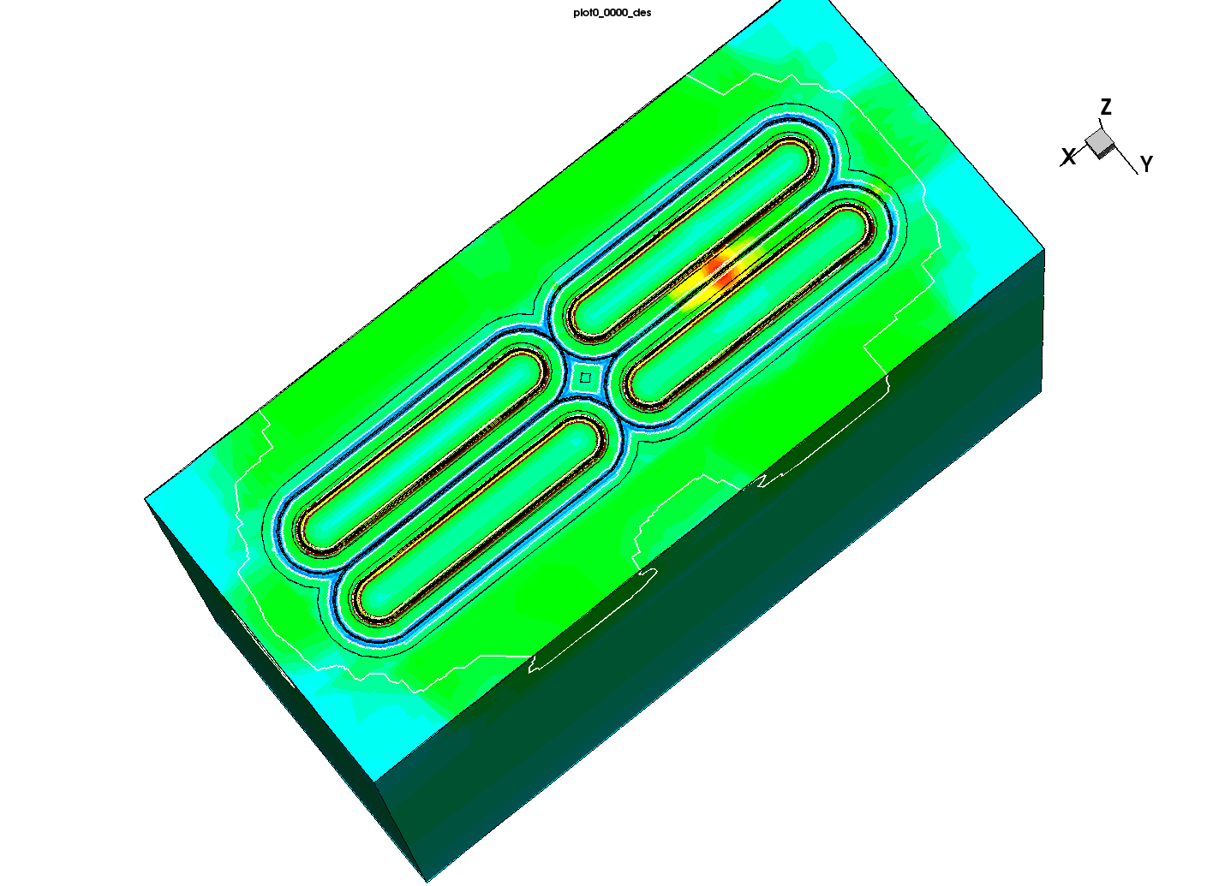
LF VerA transient simulation: e-h current density of position 10
electron
hole
HV = -50 V
Electrons in depletion region drift towards DNW.
Holes in the upper side of depletion region drift towards p+.
Holes in the lower side of depletion region are swept out towards bottom.

Slide 17
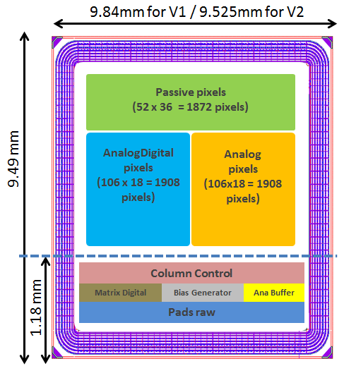
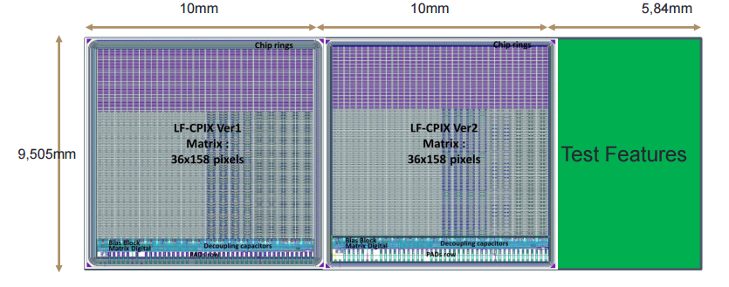
LF CPIX demonstrator
New large demonstrator LF CPIX was submitted on March 2016:
  Pixel size 250 µm × 50 µm (FE-I4 like).
  Consists of three pixel flavors: passive, digital and analog pixel. Some improvements have been brought to them with respect to the characterizations of the LF CCPD prototypes.
  New guard-ring strategy in LF CPIX Ver2 to increase the breakdown voltage and reduce the inactive region.

Slide 18
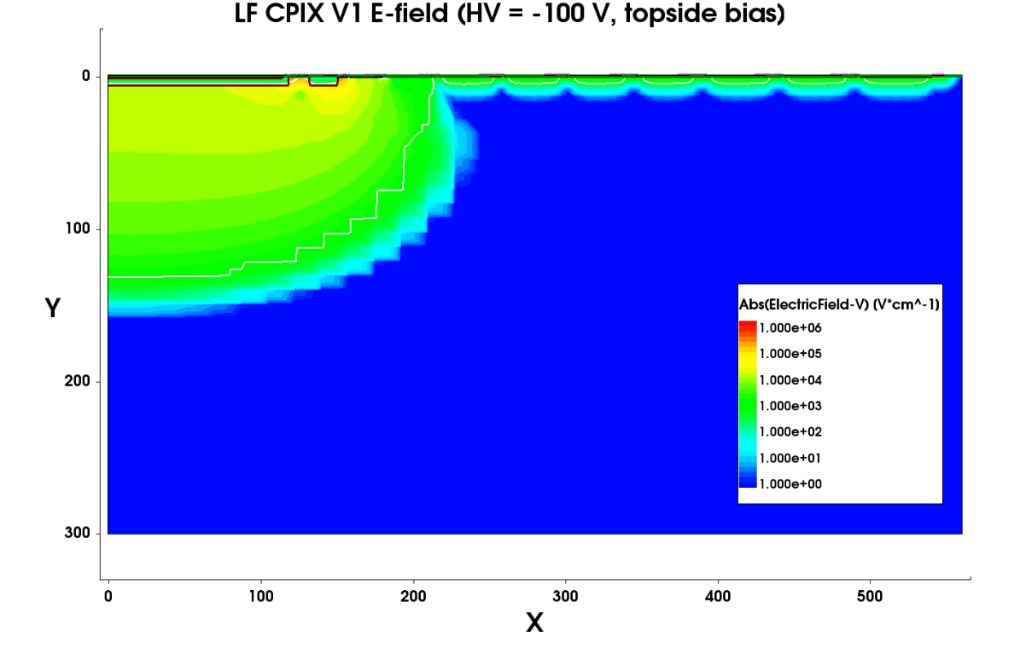
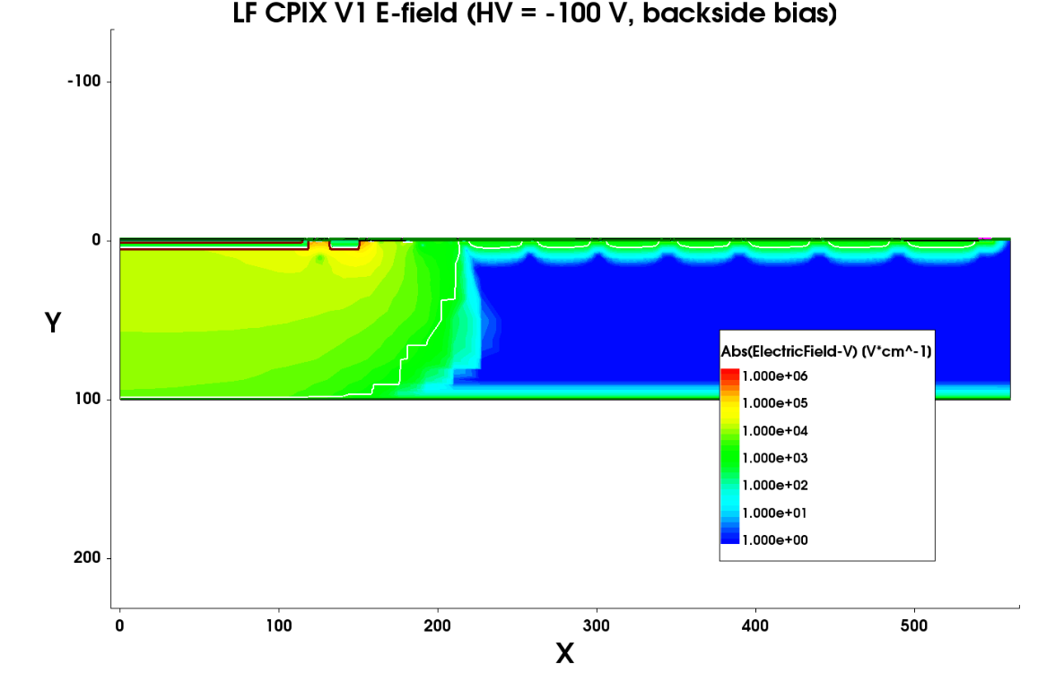
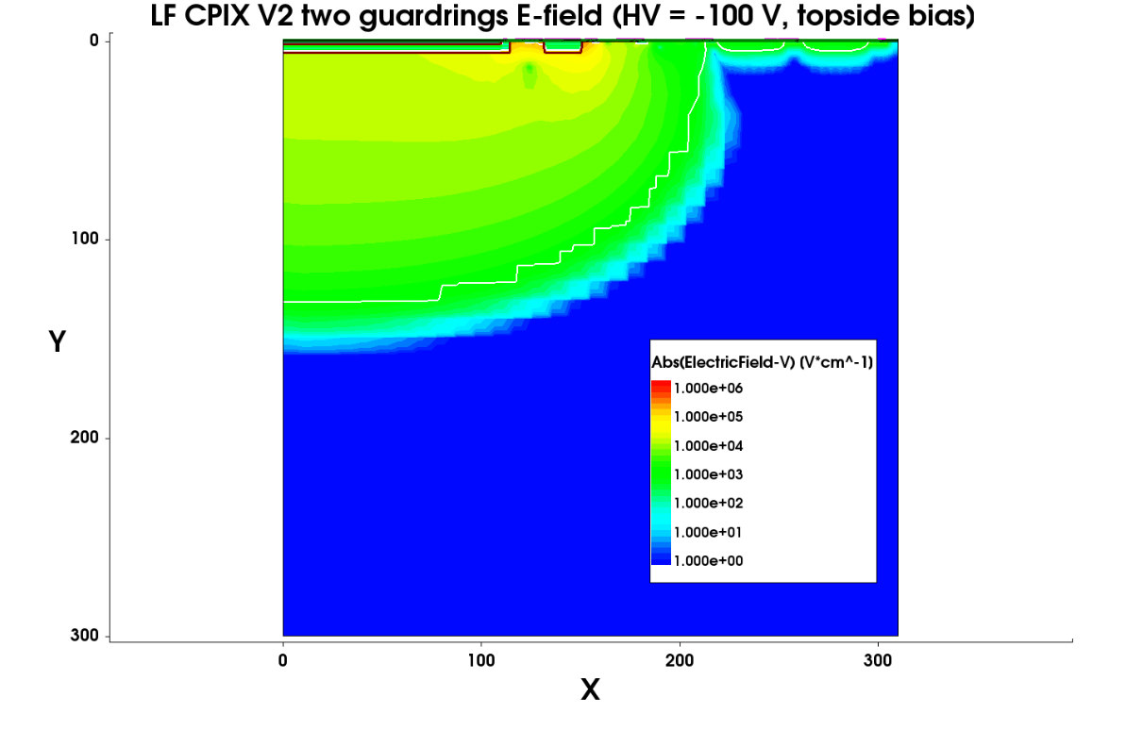
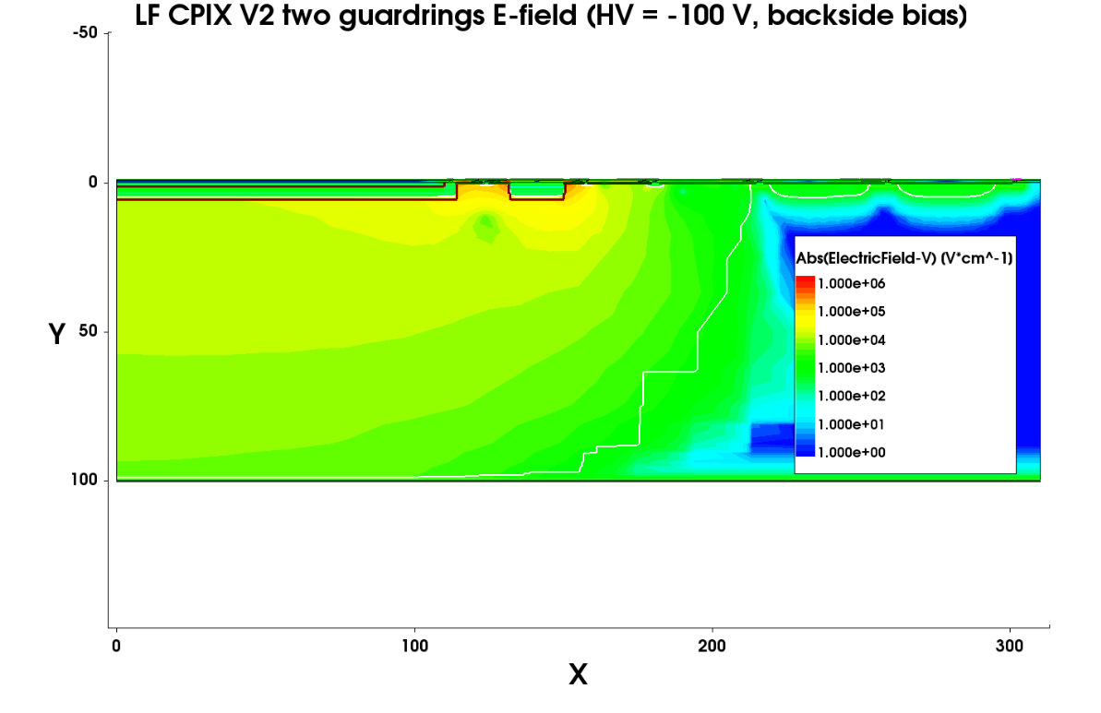
Depletion and e-field of LF CPIX V1 and V2
V1
Big un-depleted area between depleted edge and cutting edge → guard-ring reducing is possible → reduced dead region.
V2
~100 µm
Pwellring + 2 floating guard-rings + backbias + seal-ring.
The depleted region can not reach the chip edge even with removed 5 outer guard-rings.

Slide 19
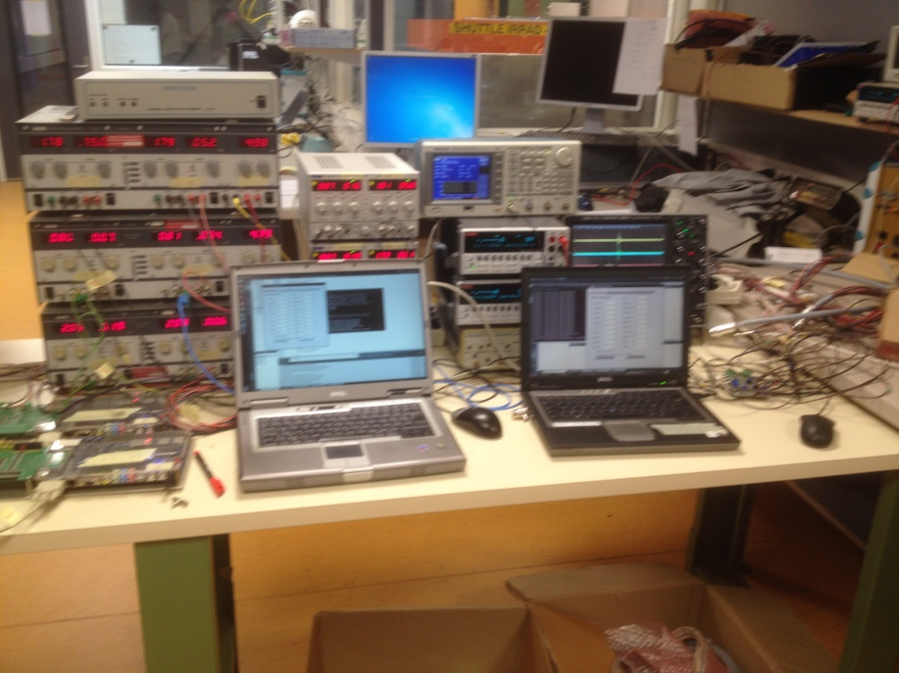
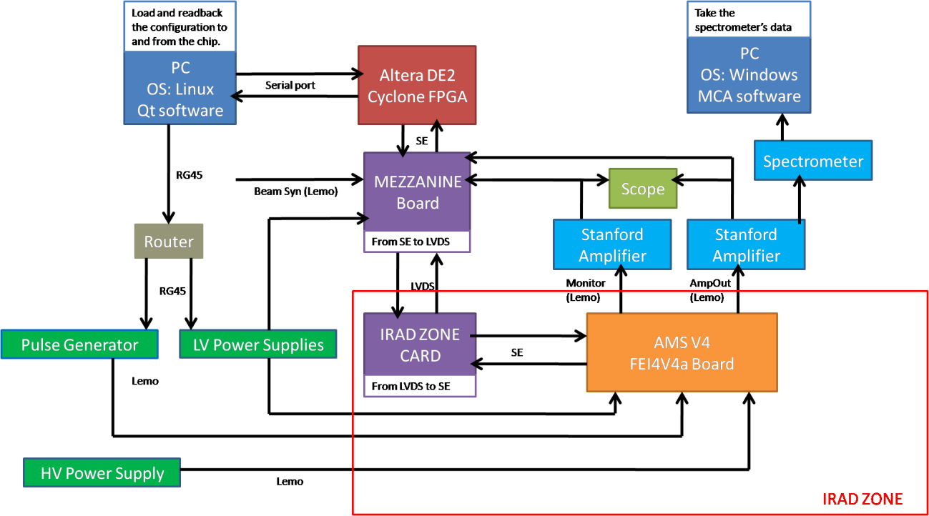
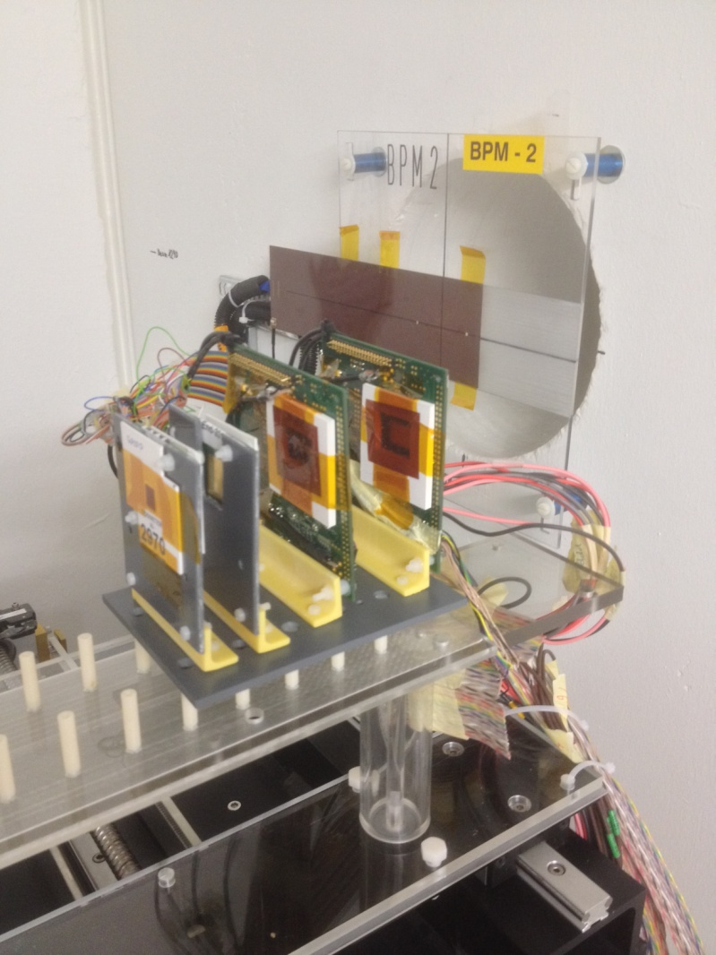
HV/HR sensor test setups (1/2)
A test setup was developed based on the Altera DE2 board. This setup was dedicated to the sensors working in standalone mode.
DAQ based on Altera DE2 Cyclon FPGA
Table IRRAD-9 in Zone-2

Slide 20
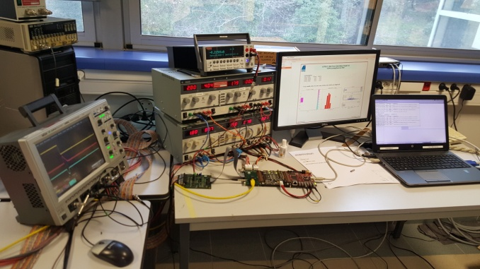
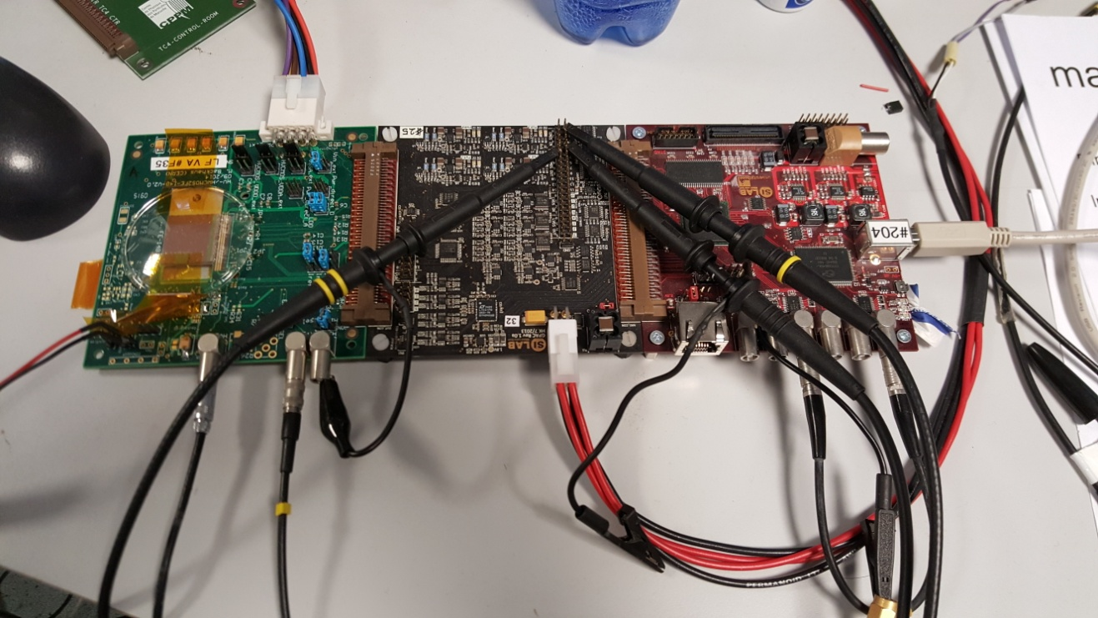
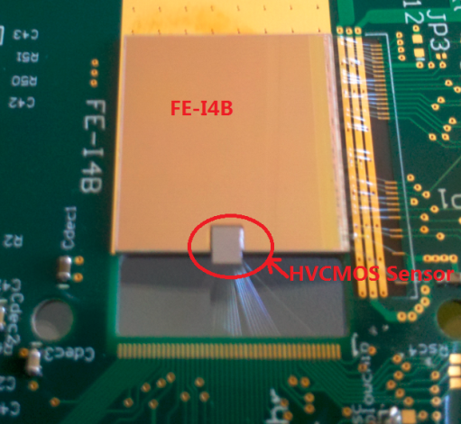
HV/HR sensor test setups (2/2)
A test setup was developed based on the GPAC (Generic Purpose Analog Card) and the Multi-IO board, which was used for the HV/HR sensor to FE-I4 assembly test.
DUT
GPAC
Multi-IO
Test setup based on GPAC and Multi-IO board
HV2FEI4 assembly

Slide 21
HV/HR CMOS characterizations
The characterizations for the HV/HR CMOS sensors are focusing on the radiation damages in both the bulk (NIEL) and the interface (TID).
The NIEL effect could introduce the traps in the bulk which would result in changed effective doping concentration, increased leakage current, reduced charge collection efficiency, etc…
The TID effect could create the fixed charge close to the oxide/silicon interface and the interface traps. For the sensor, they would change the carrier density, electric field around the pn junction, the leakage current, etc… For the transistor, they would change the Vth and the leakage current.
Measurements in proton (NIEL and TID) and X-ray (TID) irradiation:
Leakage current and breakdown voltage
Counting rate for the proton beam halo
The amplitude of the preamplifier
Threshold and noise extracted from the analog scan
SEU rate of the SR
⁵⁵Fe and ⁹⁰Sr spectra
Measurements in the laboratory test:
Matrix scan and tuning
Sub-pixel en/de-coding via FE-I4
Timing measurement via FE-I4

Slide 22
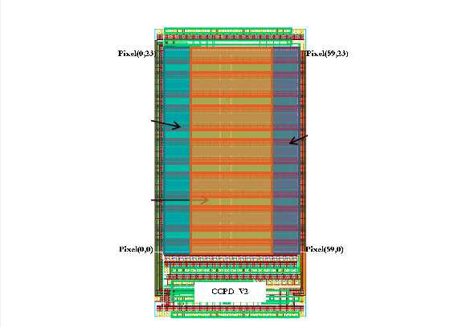
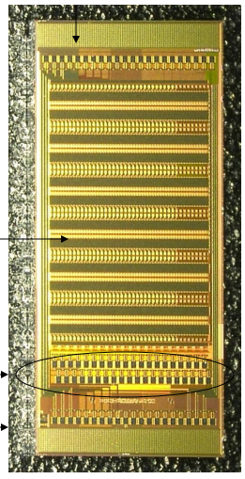
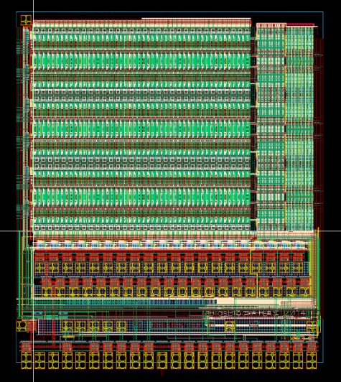
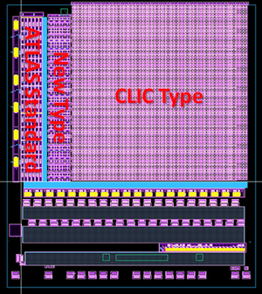
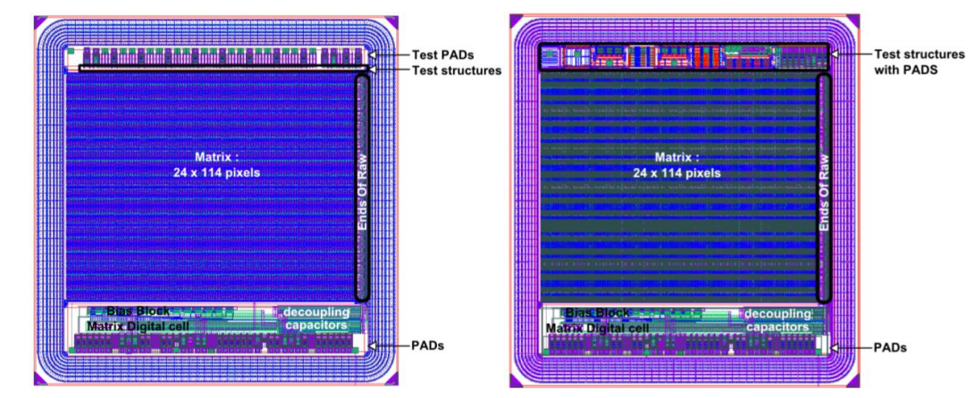
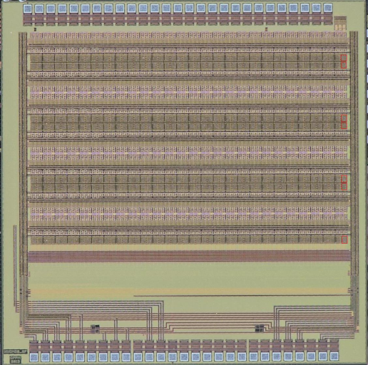
The HV/HR CMOS Prototypes
AMS V1
AMS V2
AMS V3
AMS V4
Prototypes characterized at CPPM:
4 AMS H18 versions (low resistivity)
1 GF 130 nm version (low resistivity)
2 LF 150 nm versions (high resistivity)
GF
LF vA
LF vB

Slide 23
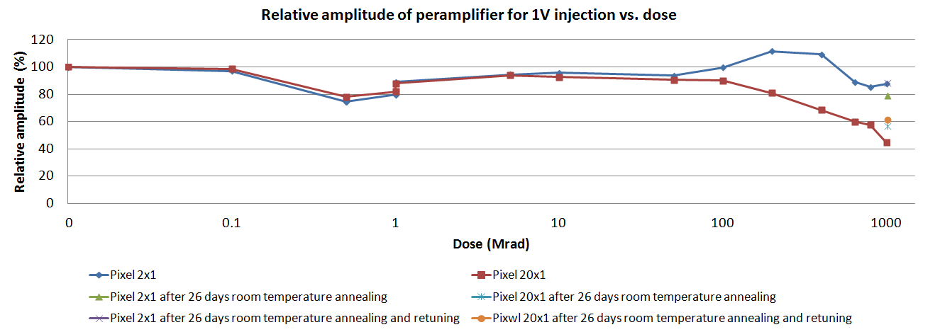
AMS V4: results under X-rays (1/2)
Four iterations has been down for the AMS H18 technology, many characterization efforts on the latest version AMS V4.
Two different pixels were monitored during irradiation: pixel 2x1 (linear feedback transistor) and pixel 20x1 (ELT feedback).
The preamplifiers of both pixels were responsive after 1 GRad. By tuning the corresponding DACs, the amplitude of pixel 2x1 and pixel 20x1 can be recovered to 90% and 60% respectively. The amplitudes were normalized with the values before irradiation.

Slide 24


AMS V4: results under X-rays (2/2)
The pixel 2x1 (linear feedback transistor) became quite noisy after 200 MRads, and the signals of ⁵⁵Fe and ⁹⁰Sr were submerged in the background.
The pixel 20x1 (ELT feedback) kept a very low and stable noise level. Both ⁵⁵Fe and ⁹⁰Sr signals can be observed at 1 GRad.
The SNR (pixel 20x1) was reduced from 60.3 to 27.5 after 1 GRad irradiation.
MPV= 1462 e-

Slide 25
LF VA under protons: leakage current at -20 ℃
80 days -20℃ annealing.
Leakage current at 100 MRads (HV = -70 V):
Board | #24 (25℃) | #55 (-20℃) | #56 (-20℃)
Matrix current (nA) | 21430 | 732 | 565
Guard-ring current (nA) | 76390 | 1568 | 2138
Leakage current reduced approximately by factor of 50.

Slide 26




LF VA under protons: analog scan at -20 ℃
5 MRads
5 MRads
L0.9um
L1.5um
ELT
100 MRads
100 MRads
Both the threshold and noise reduced after 100 MRad. The ELT pixels have bigger threshold level than linear feedback pixels.

Slide 27




LF VA lab test: tuning of LIN feedback pixels
Scan
LSBdacL=63, TDAC=7
TH=0.80V, BL=0.75V
Tuning
LSBdacL=63
TH=0.80V, BL=0.75V
56 pixels (3.1%) were masked.

Slide 28

HV2FEI4_GF lab test
HV2FEI4 assembly
CCPD pixel “2”, “4” and “6” were read with weighted outputs to a single FE-I4 pixel.

Slide 29
Conclusions
TCAD simulations for the GF 130 nm and LF 150 nm technologies have been performed. 3D/2D simulations were carried out for the pixel geometries in order to investigate the depletion, breakdown voltage, leakage current, capacitance as well as the charge collection behaviors.
The simulations show good agreement with measurements before irradiation, for instance the breakdown voltage and capacitance. The increase of the breakdown voltage with increased radiation dose was also reproduced by the TCAD simulation.
Participated to two test setup developments. The data acquisition programs, in particular dedicated to the proton test beams, X-ray sources and threshold tuning, have been implemented into various test setups.
Several HV/HR CMOS prototypes developed in three HV/HR technologies, AMS 0.18 µm HV, GF BCDlite 130 nm and LF 150 nm, have been characterized. The samples show good radiation hardness as high as 864 MRads of protons and up to 1 GRad of X-rays.

Slide 30
Perspectives
Some new behaviors were observed for the p-type substrate prototypes particularly after heavy irradiation, such as the enlarged depleted region at specific irradiation dose ranges (results from the edge-TCT measurements). More efforts should be performed to explore and tune the corresponding physics models.
Improved electronics performance and better charge collection efficiency are expected for the LF CPIX V2.
First CCPD demonstrator (AMS technology) has been received and is under characterization. LF demonstrator will be characterized by July 2016.
First full monolithic chip will be characterized by the end of 2016.
Radiation harness to 100 MRads and 10¹⁵ n_{eq}cm⁻² → an option for the HL-LHC.
CMOS dedicated module concepts are needed.
谢谢！
Thank you!

