Slide 1
Interaction region design for the partial double ring scheme
Yiwei Wang, Xiaohao Cui, Dou Wang, Feng Su,
Sha Bai, Huiping Geng, Yuan Zhang, Jie Gao
CEPC AP meeting, 19 Feb 2016

Slide 2
Introduction
Main parameters
Interaction region lattice
Final doublet
Chromaticity correction section
Matching section
Nonlinear chromaticity correction
Break down of –I (geometric-chromatic aberration)
ARC lattice consideration

Slide 3
Main Parameters of PDR
D. Wang, Jan 2016, HK
 | Pre-CDR | H-high lumi. |  | H-low power |  | Z
Number of IPs | 2 | 2 |  | 2 |  | 2
Energy (GeV) | 120 | 120 |  | 120 |  | 45.5
Circumference (km) | 54 | 54 |  | 54 |  | 54
SR loss/turn (GeV) | 3.1 | 2.96 |  | 2.96 |  | 0.062
Half crossing angle (mrad) | 0 | 14.5 | 8.9 | 11.5 | 8.7 | 16.5
Piwinski angle | 0 | 2 | 3.1 | 2 | 2 | 2.6
N_{e}/bunch (10¹¹) | 3.79 | 3.79 | 1.32 | 2.81 | 2.0 | 0.37
Bunch number | 50 | 50 | 144 | 40 | 57 | 1100
Beam current (mA) | 16.6 | 16.9 | 16.9 | 10.1 | 10.1 | 36.2
SR power /beam (MW) | 51.7 | 50 | 50 | 30 | 30 | 2.2
Bending radius (km) | 6.1 | 6.2 | 6.2 | 6.2 | 6.2 | 6.1
Momentum compaction (10⁻⁵) | 3.4 | 3.0 | 2.3 | 2.6 | 2.5 | 5.4
β_{IP} x/y (m) | 0.8/0.0012 | 0.306/0.0012 | 0.058/0.0016 | 0.22/0.001 | 0.115/0.001 | 0.3/0.001
Emittance x/y (nm) | 6.12/0.018 | 3.34/0.01 | 2.32/0.0058 | 2.67/0.008 | 2.56/0.0078 | 1.18/0.0069
Transverse σ_{IP} (um) | 69.97/0.15 | 32/0.11 | 11.6/0.097 | 24.3/0.09 | 17.6/0.088 | 18.8/0.083
ξ_{x}/IP | 0.118 | 0.04 | 0.01 | 0.04 | 0.028 | 0.02
ξ_{y}/IP | 0.083 | 0.11 | 0.11 | 0.11 | 0.11 | 0.042
V_{RF} (GV) | 6.87 | 3.7 | 3.6 | 3.6 | 3.7 | 0.28
f _{RF} (MHz) | 650 | 650 | 650 | 650 | 650 | 650
Nature σ_{z} (mm) | 2.14 | 3.3 | 3.0 | 3.2 | 3.0 | 3.0
Total σ_{z} (mm) | 2.65 | 4.4 | 4.0 | 4.2 | 4.0 | 3.0
HOM power/cavity (kw) | 3.6 | 3.3 | 1.0 | 1.5 | 0.95 | 0.73
Energy spread (%) | 0.13 | 0.13 | 0.13 | 0.13 | 0.13 | 0.05
Energy acceptance (%) | 2 | 2 | 2 | 2 | 2
Energy acceptance by RF (%) | 6 | 2.2 | 2.2 | 2.2 | 2.4 | 2.0
n_{γ} | 0.23 | 0.49 | 0.46 | 0.47 | 0.46 | 0.08
Life time due to beamstrahlung_cal (minute) | 47 | 53 | 32 | 41 | 32
F (hour glass) | 0.68 | 0.73 | 0.89 | 0.69 | 0.7 | 0.83
L_{max}/IP (10³⁴cm⁻²s⁻¹) | 2.04 | 2.97 | 2.75 | 2.03 | 2.07 | 1.25

Slide 4
Final doublet
constraint R22=0, R44=0 at the exit of QF1
point to pararell image on both x and y planes
get numerical solution with MAD as it’s not easy to get a analytical solution of even with thin-lens model
L*, d, G1, G2
l1, l2
ξy, ξx, R, B1, B2,
βy*, βx*
QD0
QF1
L*
l1
d
l2

Slide 5
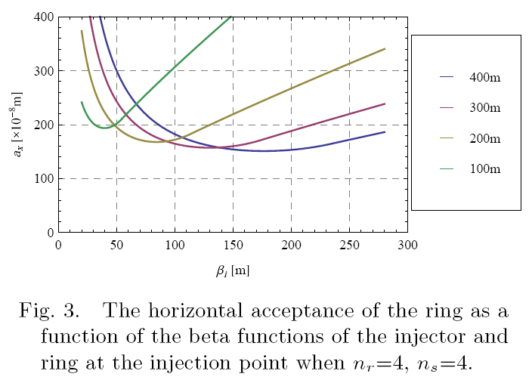
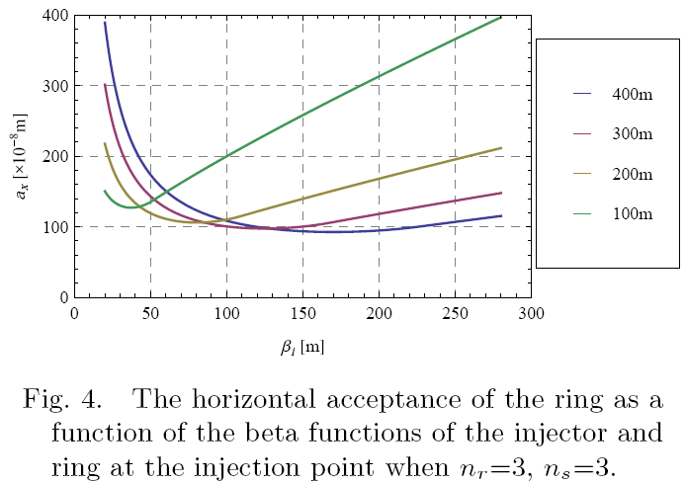
Final doublet
Acceptance can be further reduced with thinner septum magnet or smaller acceptance

Slide 6
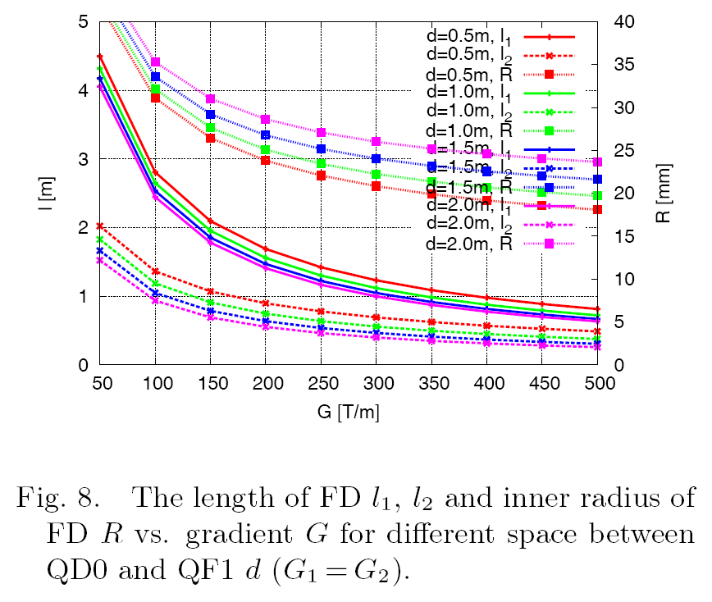
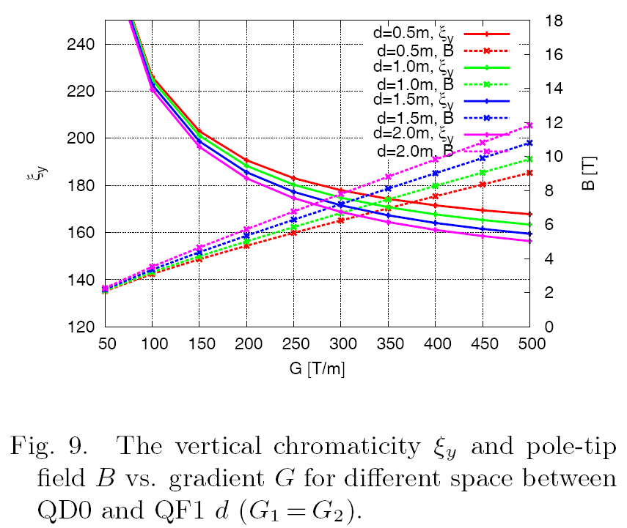
Final doublet
LD1 LD2 G1 G2 LQ1 LQ2 KSIY KSIX B1 B2
1.5 0.5 -200 200 1.68924427 0.8975406954 -190.6883514 -6.165431938 -4.762983257 4.762983257
R Δx
0.025 0.0225*2
RQ1 could be smaller than RQ2 to avoid conflict of Q1,e+ and Q1,e-
R should be re-optimized

Slide 7
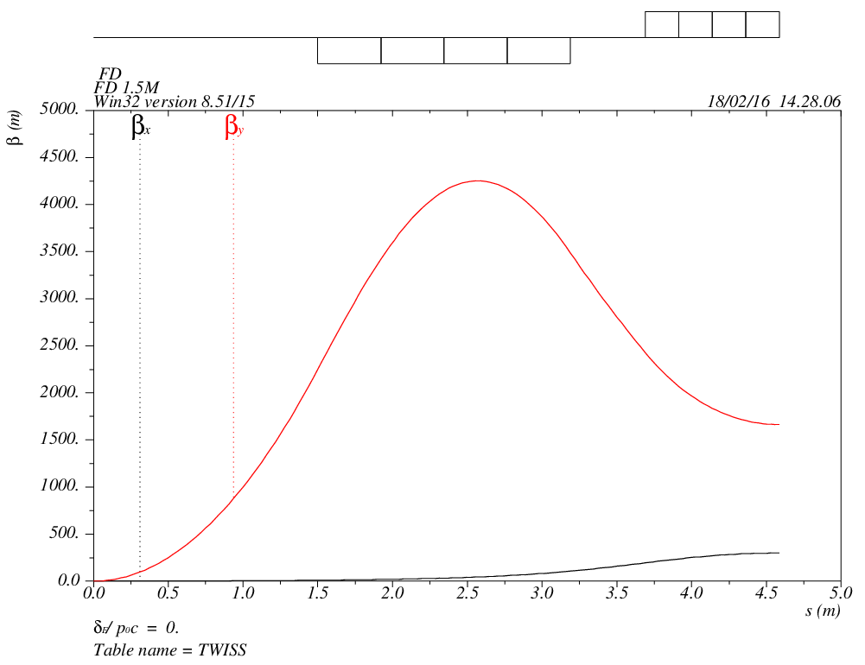
Final doublet
total length = 4.586785 dmux = -0.009271 dmuy = -0.000283
betax(max) = 299.406832 betay(max) = 4169.298422
Dx(max) = 0.000000 Dy(max) = 0.000000
Dx(r.m.s.) = 0.000000 Dy(r.m.s.) = 0.000000

Slide 8
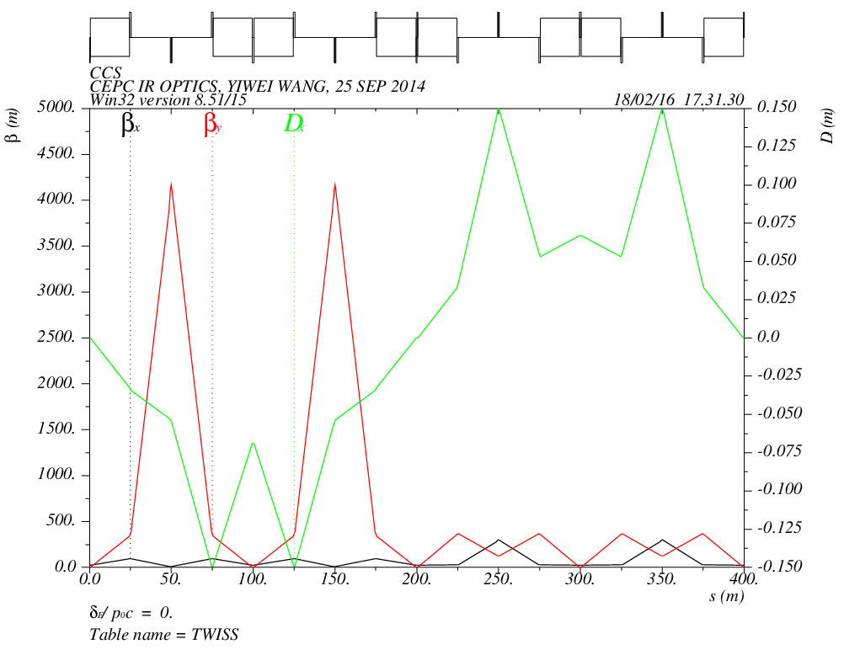
Chromaticity correction section

Slide 9
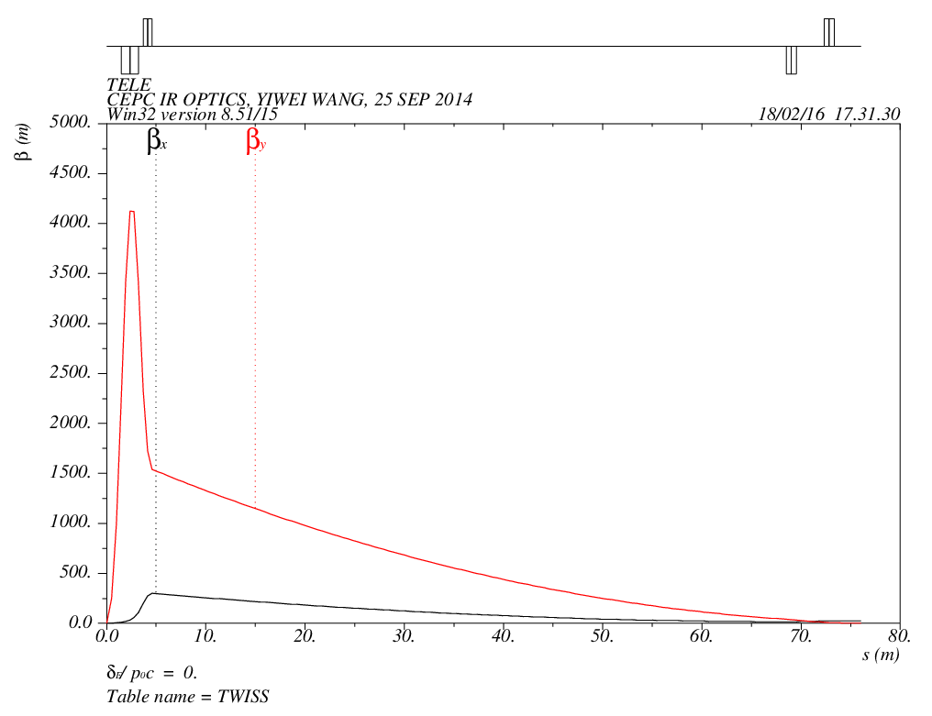
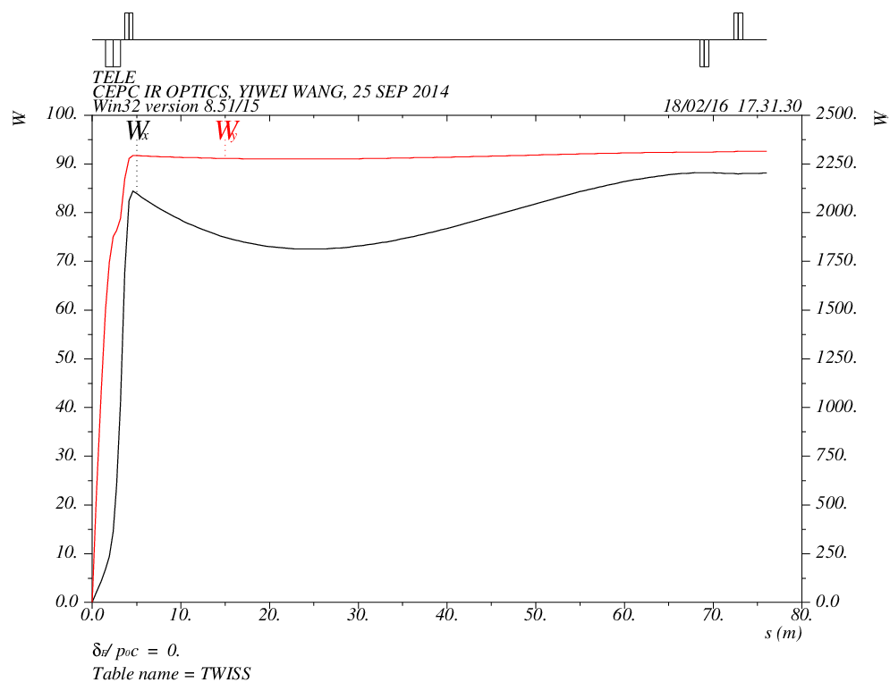
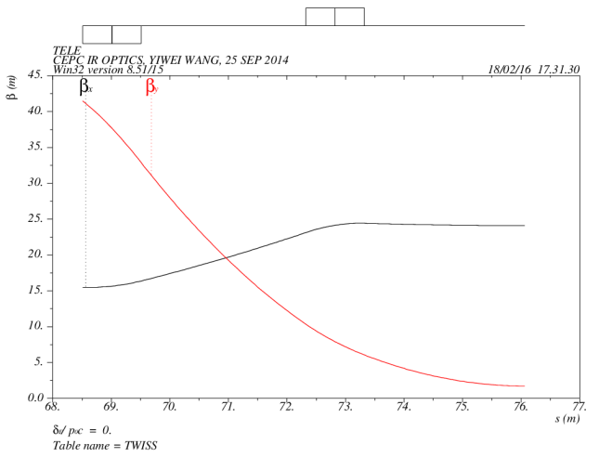
Final transformer

Slide 10
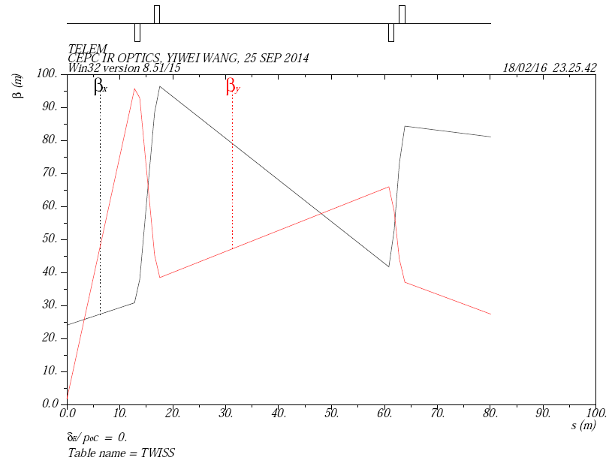
Matching section

Slide 11
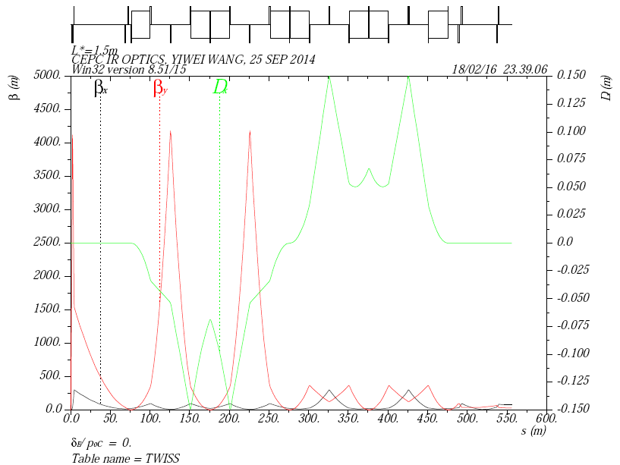
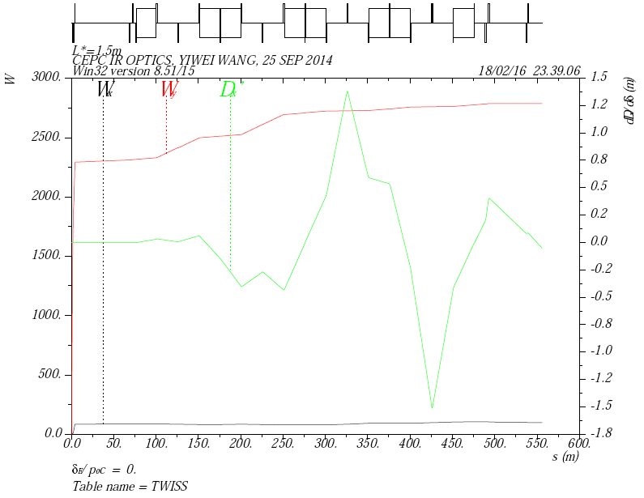
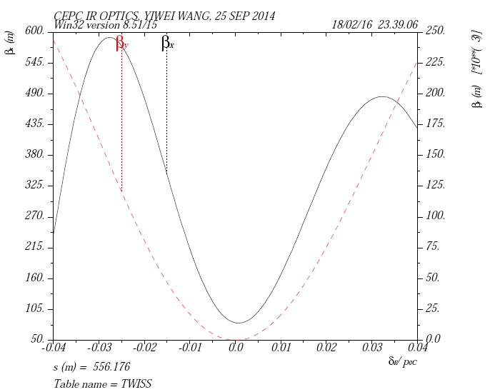
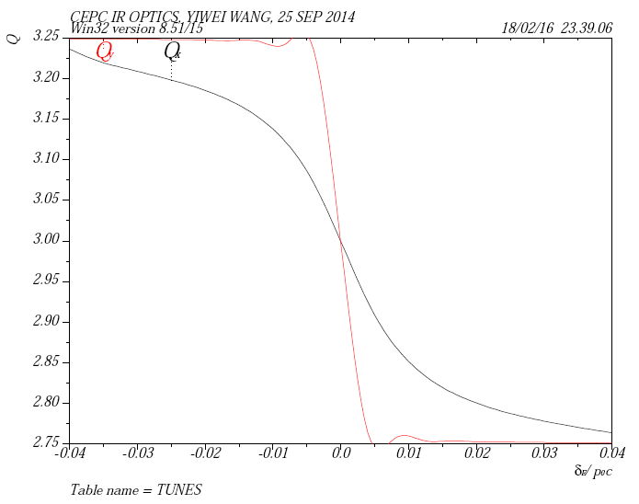
Final focus

Slide 12
Yunhai CAI, 2016, HK

Slide 13
Yunhai CAI, 2016, HK

Slide 14
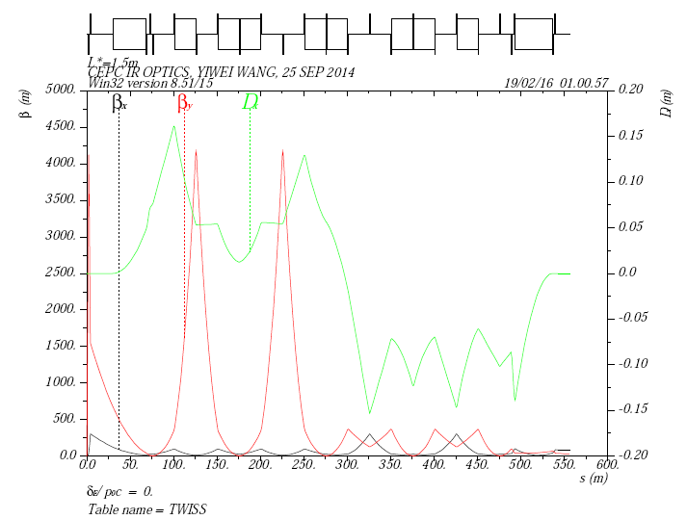
Odd dispersion

Slide 15
Crab sextupole
Dedicated section (for local correction)
Oide’s scheme (for global correction)

Slide 16
ARC
60/60 degree
All the 3rd and 4th order driving term except 2vx-2vy are cancelled in 6 cells
Amplitude-dependent detuning terms need to be corrected
90/90 degree
All the 3rd and 4th order driving term can be cancelled
Global chromaticity correction is complicate
60/90 degree
Check with driving terms along beamline

Slide 17
Summary
For Higgs low-power parameters, a linear lattice has been designed including final doublet optimization, odd dispersion scheme for geometric-chromatic aberration correction.
Nonlinearity correction is going on.
A dedicated section for crab sextupole need to be designed.
ARC optimization is also going on.

