Slide 1
Preliminary Studies on Gamma-Gamma Colliders

Slide 2
Outline:
What is Gamma-Gamma Collider
Photon + Photon=??
Define Gamma-Gamma Collider
Why Gamma-Gamma collider
History of gamma-gamma collider
How can we build a Gamma-Gamma Collider
Conceptual Design of a Gamma-Gamma Collider
Principle of (Inverse) Compton Scattering
How strong/intense gamma we need
Parameter Choice
Technical Challenges in Gamma-Gamma collider
Super Large particle accelerators/colliders
High average power with high repetition Laser facilities
Interaction Region Issues
Optics and optical elements
Summary and prospects
2

Slide 3
What is Gamma-Gamma Collider?
经典电动力学中，把光考虑成电磁波。当两束光在空间某点相遇的时候，一束光对另一束光是没有影响的。
例如，考虑双手各持一个手电筒，照在两边的墙上。上下移动电筒，两束光即使相交时，对彼此也不影响。
如果光强不断增加呢？光子能量不断增加呢？随着光的粒子性在变强，The effect is the scattering of light on light and it is purely a quantum mechanical effect (QED).
Once again, common knowledge is not accurate knowledge
photon和photon之间真的会发生碰撞，散射吗？真的会“无中生有”产生基本粒子吗？（我没找到答案）
3

Slide 4
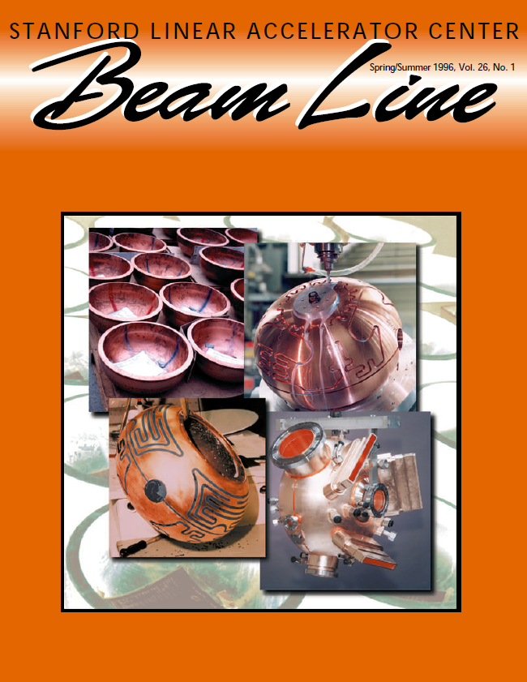
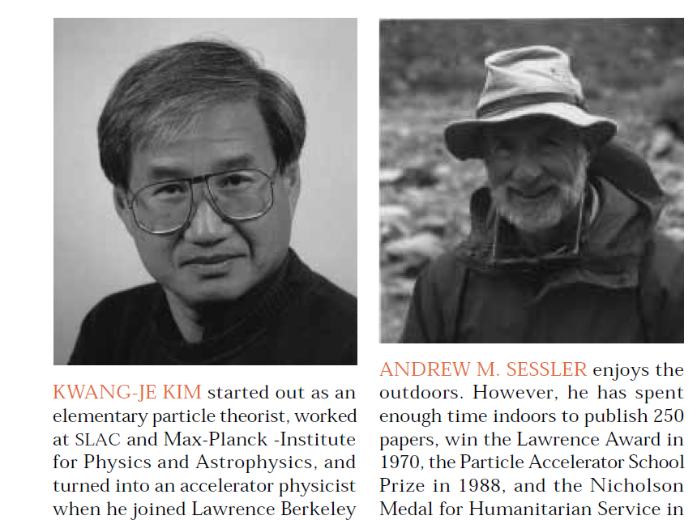
What is Gamma-Gamma Collider?
At first QED effects occur, and pairs of electrons and positrons are produced. Soon quantum chromodynamics (QCD) effects occur, and strange particles are produced.
Gamma-Gamma Colliders are all about what we just describe: namely, making intense beams of gamma rays and having them collide so as to make elementary particles.
QED predicts non-zero cross section of photon-photon scattering. However, the cross section is extremely small for optical photons (~10⁻⁶³ cm²), growing fast with energy (∝ω⁶)
4

Slide 5
Why do we need Gamma-Gamma Collider?
5

Slide 6
6

Slide 7
Why do we need Gamma-Gamma Collider?
和高能正负电子对撞机兼容，可完美寄生于正负电子对撞机中，廉价版一机多用！！
7

Slide 8
History of Gamma-Gamma Collider
最早试图观察到光子（可见光）散射是发生在1930’s，S. Vavilov等人做了实验去测可见光散射后的能谱变化，但是并没有成功，由于截面实在太小了
1980年底（和LPA差不多），第一个关于VLEPP linear collider上面的物理的workshop召开，V. Telnov等人建议将电子转换成光子，从而增加Gamma-Gamma的亮度
1981-1983，I. Ginzburg和V. Telnov等人在JETP（一篇短文）和NIM（两篇长文）发表文章，第一次详细论述了Gamma-Gamma collider的原理，可行性，参数选择等问题
1996-1997，伴随着NLC, TESLA, JLC等大型正负电子对撞机的概念设计，Gamma-Gamma collider逐渐引起高能物理界重视
2001年起，LC & ILC逐渐成为next HEP的重点，与Gamma-Gamma collider发生耦合
2005年，ILC的RDR设计中，摒弃了Gamma-Gamma collider的可能性。主要是因为想要降低预算的原因，所以将IP减少到1个，小角度对撞（14mrad），而Gamma-Gamma要求对撞角至少为25mrad。自此，光子对撞机方面的研究经历了2年多痛苦的岁月（by V. Telnov）
2007年9月, ILC GDE同意将ILC的Engineering Design应该包括photon collider
2008年，”We have now achieved understanding, at a conceptual level , of all critical issues in the design of the photon collider and know how to solve them”
8

Slide 9
Outline:
What is Gamma-Gamma Collider
Photon + Photon=??
Define Gamma-Gamma Collider
Why Gamma-Gamma collider
History of gamma-gamma collider
How can we build a Gamma-Gamma Collider
Conceptual Design of a Gamma-Gamma Collider
Principle of (Inverse) Compton Scattering
How strong/intense gamma we need
Parameter Choice
Technical Challenges in Gamma-Gamma collider (11)
Super Large particle accelerators/colliders (1)
High average power with high repetition Laser facilities (5)
Interaction Region Issues (3)
Optics and optical elements (2)
Summary and prospects
9

Slide 10
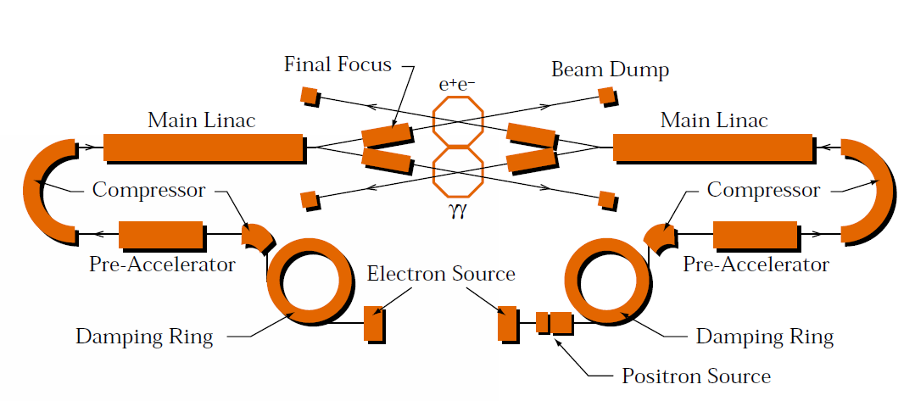
Conceptual Design of a Gamma-Gamma Collider
10

Slide 11
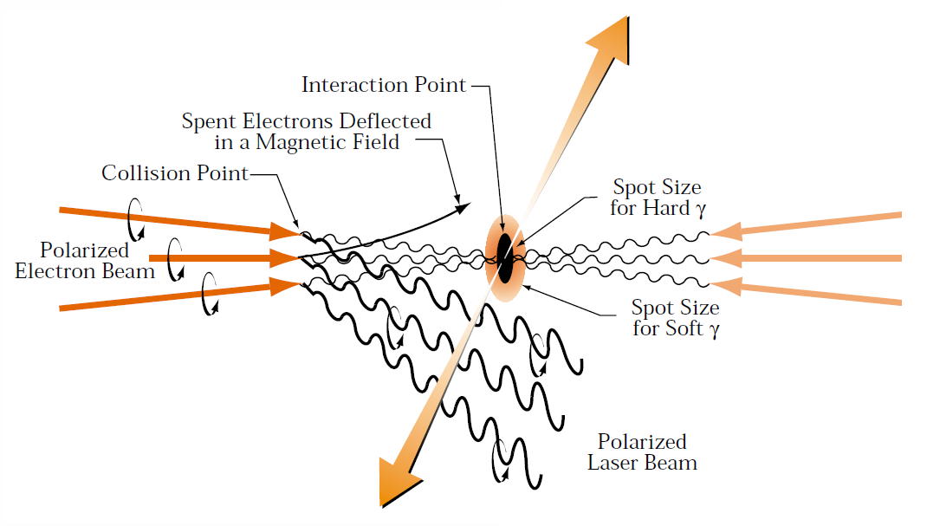
Conceptual Design of a Gamma-Gamma Collider
11

Slide 12
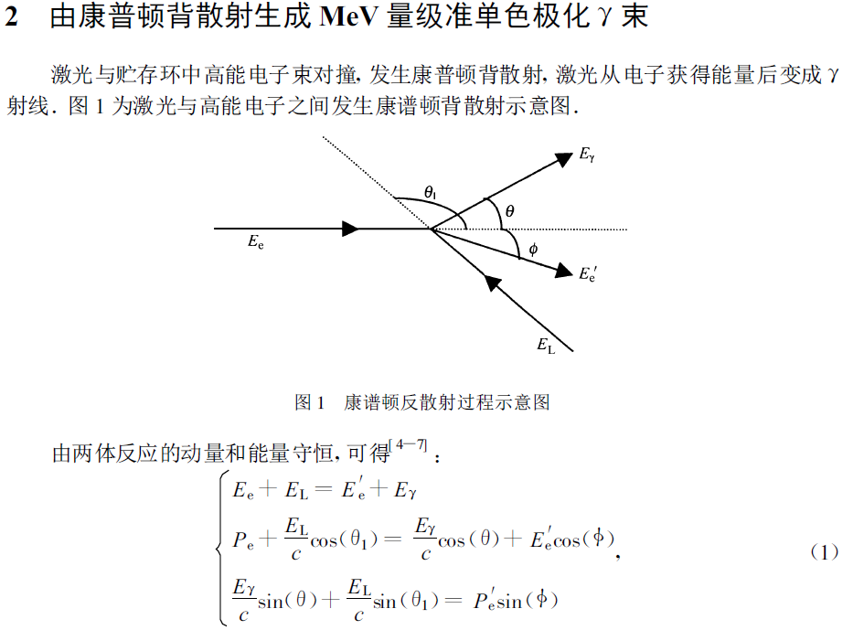
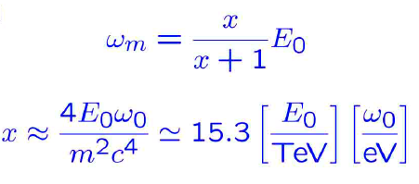
Principle of Compton (Back) Scattering
I. F. Ginzbury et al., JETP Lett. 34, 491 (1982)
《高能物理核物理》 26, 8 (2002)
12

Slide 13
Feasibility of Gamma-Gamma Collider
Q1: How can we focus Gamma-rays??
Conversion Point和Interaction point不能离的很远，否则粒子在偏转磁铁作用下的同步辐射对实际出射的Gamma-ray影响很大。
但是辐射出的gamma ray的单色性又和距离成反比，所以这两个点最好不离的很远
一般来说，Conversion Point与Collision Point相距1 cm左右。即便如此，因为final focus的作用，在conversion point处，电子束团的尺寸要比crossing处大很多，甚至可以达到100倍以上。
Gamma-ray是无法聚焦的，所以我们在相撞的Gamma-ray很大？！
13

Slide 14
Feasibility of Gamma-Gamma Collider
Q1: How can we focus Gamma-rays??
Conversion Point和Interaction point不能离的很远，否则粒子在偏转磁铁作用下的同步辐射对实际出射的Gamma-ray影响很大。
但是辐射出的gamma ray的单色性又和距离成反比，所以这两个点最好不离的很远
一般来说，Conversion Point与Collision Point相距1 cm左右。即便如此，因为final focus的作用，在conversion point处，电子束团的尺寸要比crossing处大很多，甚至可以达到100倍以上。
Gamma-ray是无法聚焦的，所以我们在相撞的Gamma-ray很大？！
Totally wrong!!!
只要电子是聚焦的，那么Compton散射出来的Gamma-ray就是聚焦的！！
只需要做好电子的Final Focus就可以了（这是否是理论上的？）
14

Slide 15
Feasibility of Gamma-Gamma Collider
Q2: How strong laser and how many photons do we need??
How strong photons do we need?
The incident photon cannot be too energetic or else the photons in the incident photon stream can interact with the back-scattered gamma rays and produce electron pairs.
λ₀[μm] ≥ 3.93E₀[TeV], i.e. E₀=250GeV, λ₀ =1μm，每个电子能量为1eV
How many photons per pulse do we need?
显然，和有空间电荷效应等制约的电子束团相比，一个光脉冲中包含的光子数几乎没有限制
在康普顿散射中，一个电子一般只能与一个光子发生反应。所以要想每一个电子都物尽其用，我们需要激光的光子数达到每个电子能碰到光子的几率为1。比如光子-电子的碰撞几率如果是10⁻⁹的话，我们每个脉冲的光子数Np=10⁹Ne，Ne是每个电子束团的电子数目。
一般来说，若Ne=10¹⁰，则Np=10¹⁹，如果假定光子能量为1eV，则一个脉冲的能量约为1J
15

Slide 16
Feasibility of Gamma-Gamma Collider
Q3: What kind of photons can we get??
ω=ω_{m}/[1+(v/v₀)²], ω_{m}=E₀x/(x+1), x=4Eω₀/m²/c⁴cos²(α₀/2)≈19[E₀(TeV)]/[λ(μm)]
当E₀=250GeV，λ=1μm时，x=4.5， ω_{m}=0.8E₀，
从上面的式子可以看出，可以通过减小λ（增加入射光能量）的方法来提升ω_{m}，但如前所述，当入射光子的能量过高时，会和背散射的gamma光子作用，生成正负电子对。因为λ₀[μm] ≥ 3.93E₀[TeV]，所以x的最大值为19/3.93=4.83
16

Slide 17
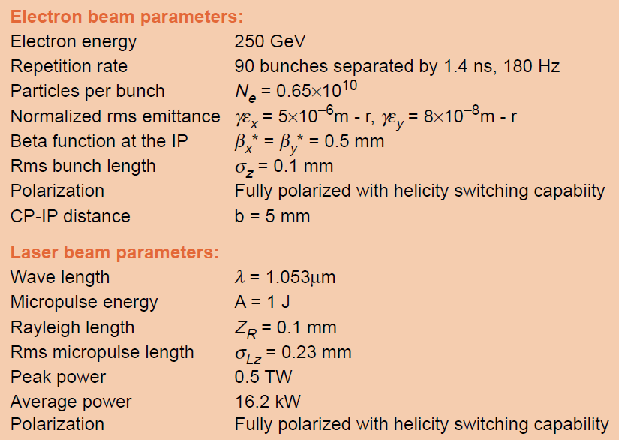
Parameter Choice
Kwang-Je Kim & A. Sessler (1996)
在gamma-gamma的设计参数中，一般说来垂直束团尺寸要比由conversion point到collision point之间的1/γ spreading决定的数值要小一些；
水平方向的束团尺寸则尽可能的小；
一个reasonable的选择是另对撞点处x和y方向的beta函数相等，比如都为0.5mm （？？）
17

Slide 18
Outline:
What is Gamma-Gamma Collider
Photon + Photon=??
Define Gamma-Gamma Collider
Why Gamma-Gamma collider
History of gamma-gamma collider
How can we build a Gamma-Gamma Collider
Conceptual Design of a Gamma-Gamma Collider
Principle of (Inverse) Compton Scattering
How strong/intense gamma we need
Parameter Choice
Technical Challenges in Gamma-Gamma collider
Super Large particle accelerators/colliders
High average power with high repetition Laser facilities
Interaction Region Issues
Optics and optical elements
Summary and prospects
18

Slide 19
Technical Challenge---Accelerator
Kwang-Je Kim & A. Sessler (1996)
19

Slide 20
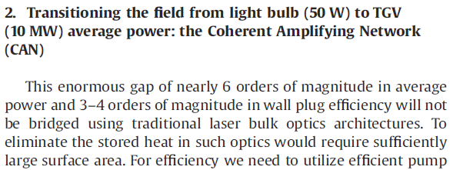
Technical Challenge---Laser Facilities
G. Mourou, T. Tajima et al., NIM A, 740 (2014) 17-20
20

Slide 21
Technical Challenge---Laser Facilities
21

Slide 22
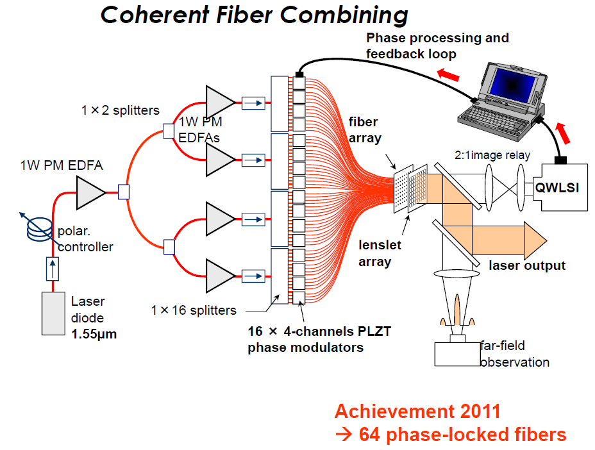
Technical Challenge---Laser Facilities
22

Slide 23
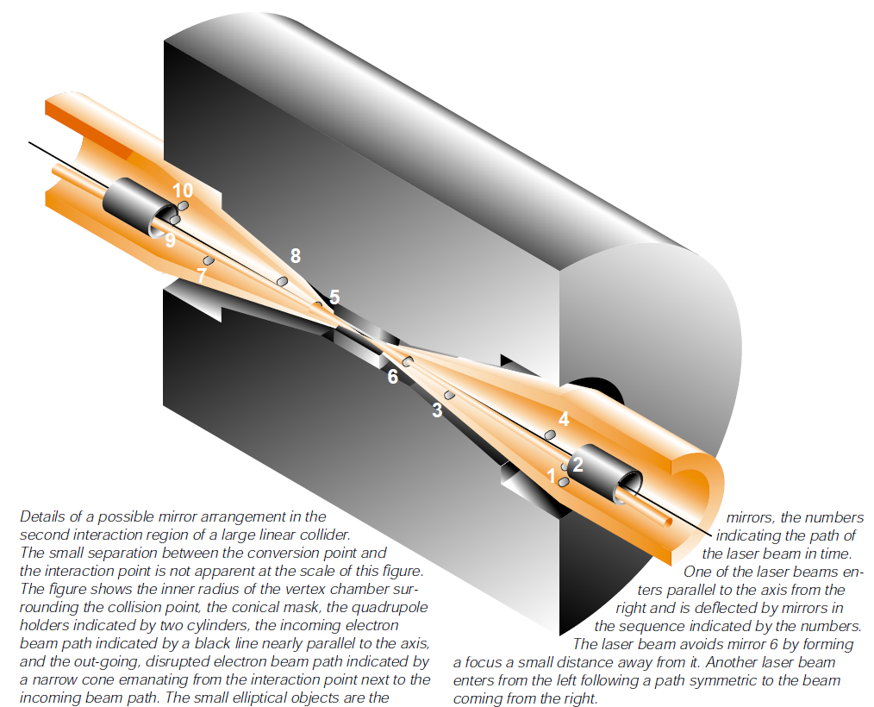
Technical Challenge---Interaction Region
Very crowded @ interaction point
因要移走束流的原因（电子束经过作用后能散很大，0.02~1 E₀），对撞的角度有下限，比如ILC必须不小于25mrad
探测器要求minimum amount of mass is put into this region
bring the opposing laser beam for each e- beam in from the opposite side, and after conversion, depose of laser beam（一种最简单的设计，如左图所示，左边的束流撞右边的光，背向Compton散射出来的gamma和另一侧的gamma相撞，激光脉冲反应后继续向前走，进入beam damp）
必须要在设计之初就考虑到共存的问题，包括对撞角的选择，探测器的设计等！！
23

Slide 24
Technical Challenge---Optics & Optical elements
光学器件必须选用反射式的，不能选用投射式的，防止因平均功率过大打坏设备
激光脉冲和电子束要耦合的很好，光脉冲的瑞利长度要足够长（需要多长？？）
瑞利长度的公式：Z_{R}=2πw₀²/λ
因使用的激光平均功率很高，所以必须要考虑用过的laser的damp问题，外置beam damp装置
正负电子有较小的交叉角，所以从一个方向过来的光将会打到另一个方向的光学器件（如反射镜）上，所以反射镜一定要比较好的定位，使得两束光不会在同一个时刻打在同一个地方。
24

Slide 25
Outline:
What is Gamma-Gamma Collider
Photon + Photon=??
Define Gamma-Gamma Collider
Why Gamma-Gamma collider
History of gamma-gamma collider
How can we build a Gamma-Gamma Collider
Conceptual Design of a Gamma-Gamma Collider
Principle of (Inverse) Compton Scattering
How strong/intense gamma we need
Parameter Choice
Technical Challenges in Gamma-Gamma collider
Super Large particle accelerators/colliders
High average power with high repetition Laser facilities
Interaction Region Issues
Optics and optical elements
Summary and prospects
25

Slide 26
Outline:
What is Gamma-Gamma Collider
Photon + Photon=??
Define Gamma-Gamma Collider
Why Gamma-Gamma collider
History of gamma-gamma collider
How can we build a Gamma-Gamma Collider
Conceptual Design of a Gamma-Gamma Collider
Principle of (Inverse) Compton Scattering
How strong/intense gamma we need
Parameter Choice
Technical Challenges in Gamma-Gamma collider
Super Large particle accelerators/colliders----电子束流参数的选择与确定，反推确定激光参数
High average power with high repetition Laser facilities----如何实现？超出需求后可否降低束流要求？
Interaction Region Issues----必须从一开始就考虑这一问题，比如CEPC的设计，30mrad maybe not enough
Optics and optical elements
Summary and prospects
26

