Slide 1

CEPC Partial Double Ring
Lattice Design
SU Feng WANG Dou WANG Yiwei GAO Jie
BIAN Tianjinan DUAN Zhe GENG Huiping
XU Gang BAI Sha XIAO Ming
Key Laboratory of Particle Acceleration Physics and Technology
Institute of High Energy Physics
Chinese Academy of Sciences
2016.2.19

Slide 2
Out line
ARC FODO cell phase advance： 90/60
ARC + Bypass + PDR + new FFS (test20160115-2-Wamgdou)
DA
Next to do

Slide 3
CEPC Partial Double Ring Layout
1/2RF
1/2RF
IP1_ee
RF
RF
3.2Km
1/2RF
1/2RF
Bypass
about 43.89m
IP4_pp
IP2_pp
Bypass
about 43.89m
1/2RF
1/2RF
IP1_ee/IP3_ee, 3.37Km
IP2_pp/IP4_pp, 892.8m
4 Short Straights, 141.6m?
4 Medium Straights, 466.4m
4 Long Straights, 892.8m
2 Short ARC, 24*FODO, 892.8m
4 Medium ARC, 132*FODO, 4910.4m
4 Long ARC, 144*FODO, 5356.8m
C=56145m
RF
RF
IP3_ee
1/2RF
1/2RF
SU Feng
2016.2.18

Slide 4
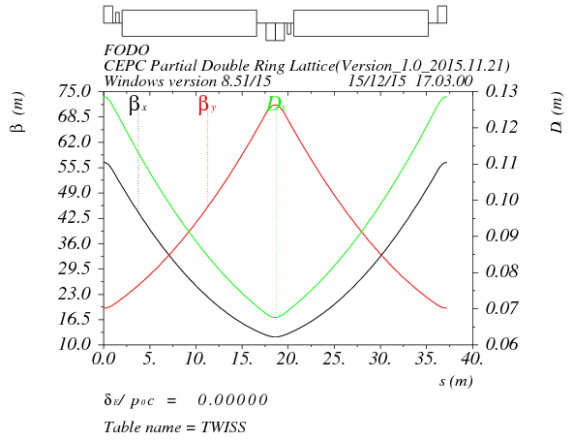
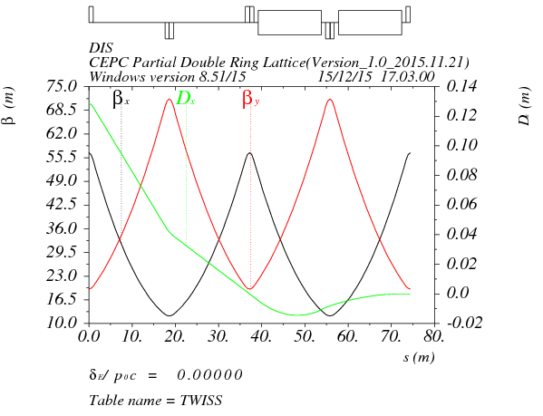
Arc redesign-ultra low emittance
Length of FODO cell: 37.2m
Phase advance of FODO cells: 90/60 degrees
Emittance: 2.52nm, αp=1.05E-5
Bunch length: 1.5168mm
Dispersion supressor:
Angle(BDIS1)=3.5816546264E-3 Angle(BDIS2)=-8.59314326219E-4 Angle(B0)=2.72235074352E-3
BDIS1
BDIS2
B0
B0

Slide 5
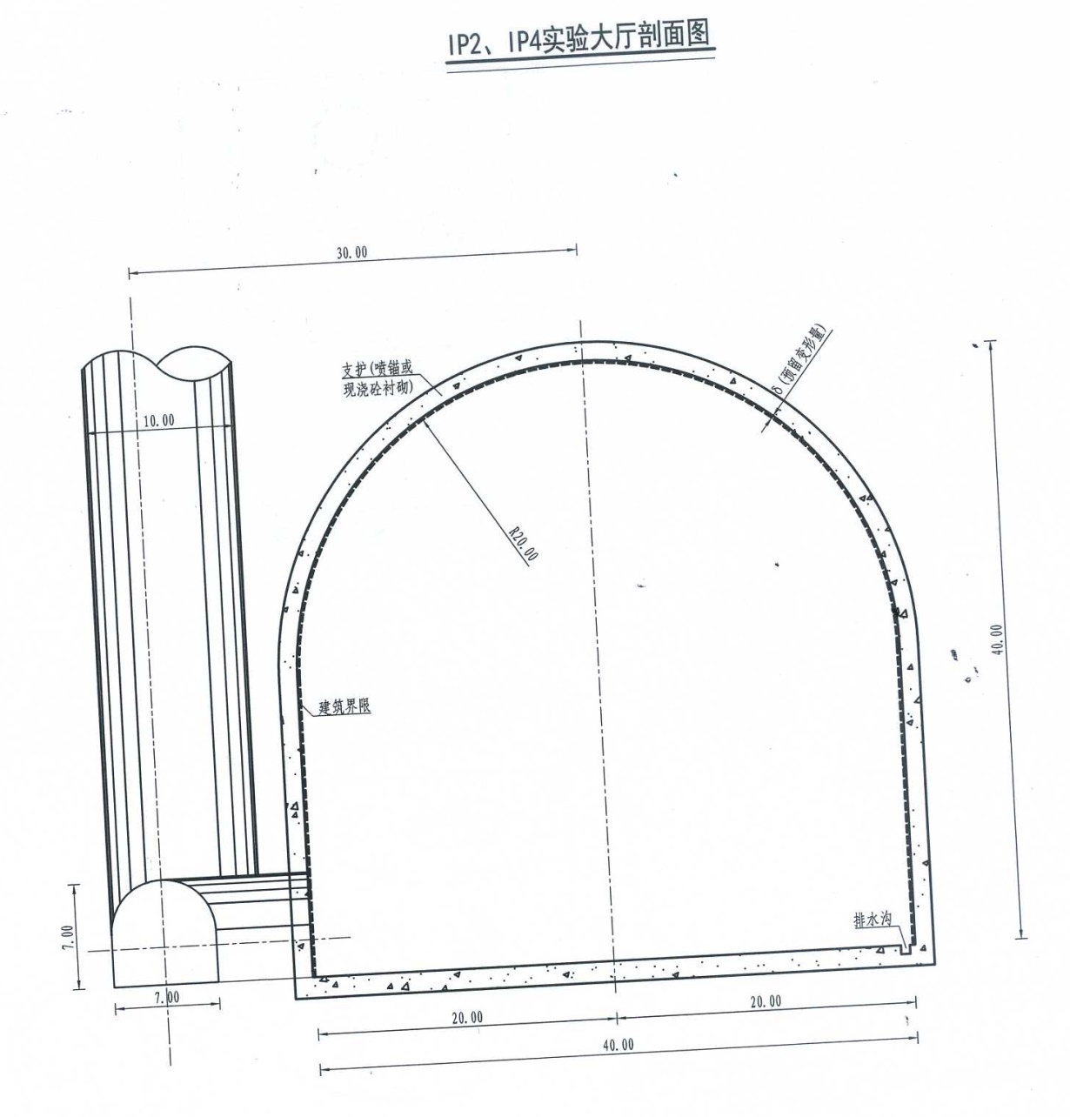
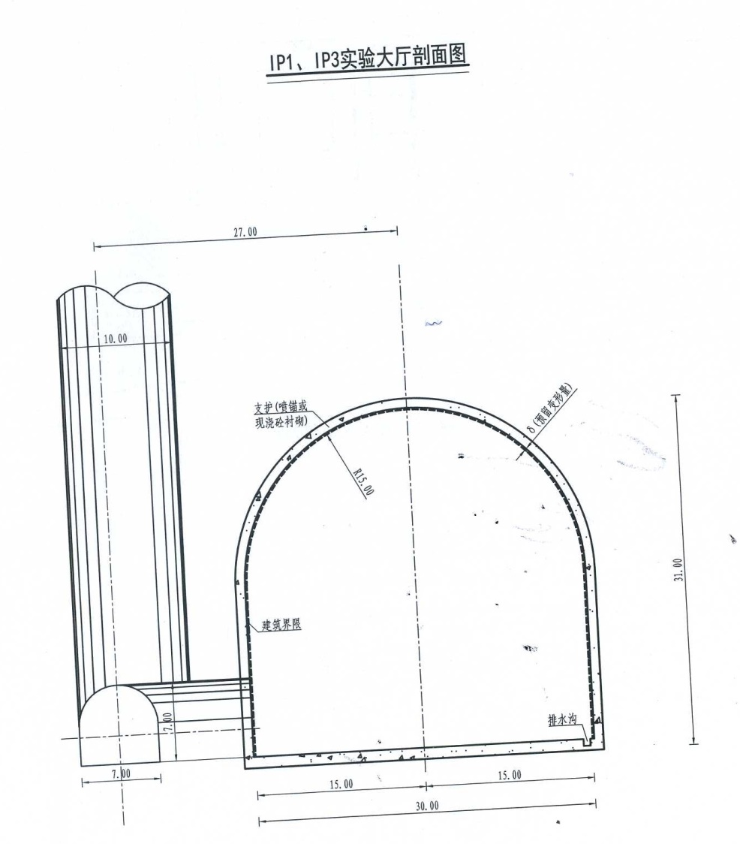
Experiment Hall Size
>20
>30

Slide 6

CEPC Bypass at IP2/4
12L_{c}
12L_{c}
446.4m
12L_{c}
12L_{c}
446.4m
L=29.145m
s
12L_{c}
24L_{c}
892.8m
12L_{c}
446.4m
446.4m
X : 90 4FODO
Y : 60 6FODO
12FODO 24 36 48……
24L_{c}
24L_{c}
446.4m
12L_{c}
12L_{c}
446.4m
L=58.166m
s
24L_{c}
24L_{c}
892.8m
24L_{c}
892.8m
892.8m

Slide 7
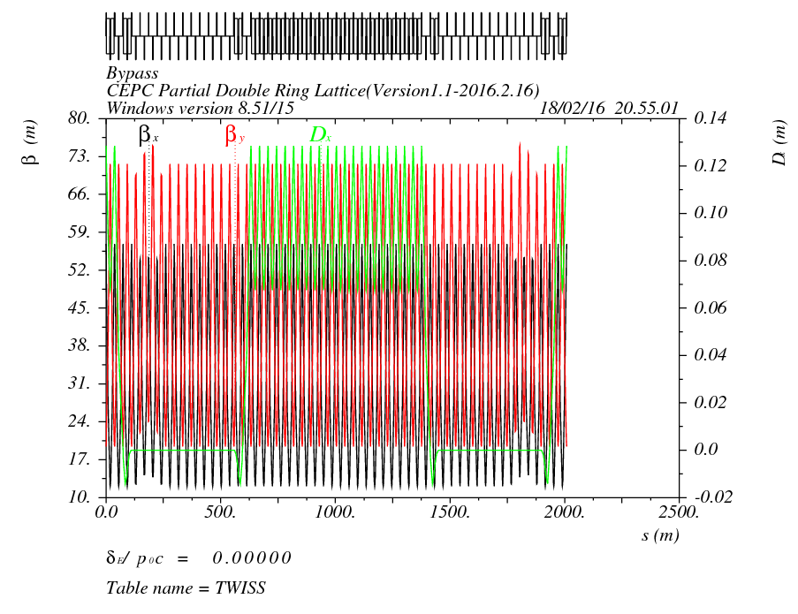
CEPC Bypass at IP2/4
12L_{c}
12L_{c}
446.4m
12L_{c}
12L_{c}
446.4m
L=29.145m
s
s
12L_{c}
24L_{c}
892.8m
12L_{c}
446.4m
446.4m
Cell length=37.2m

Slide 8
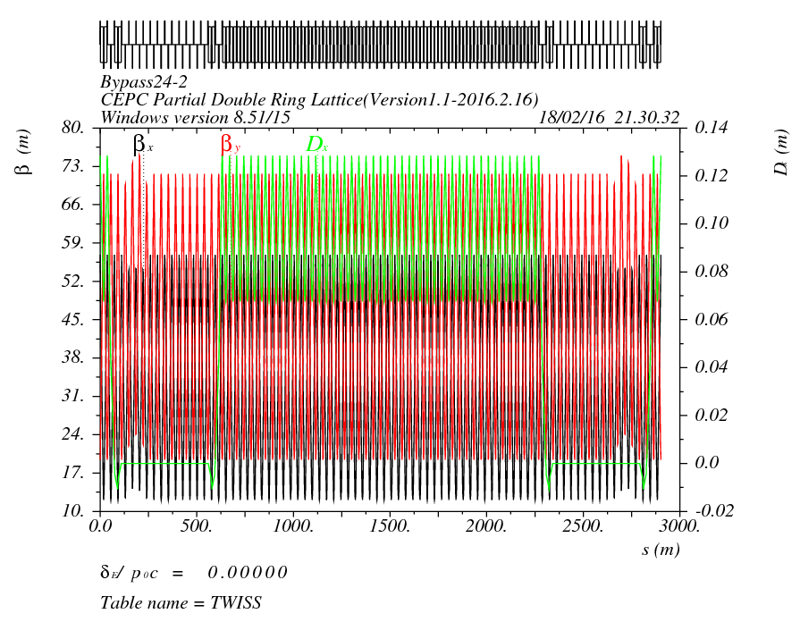
CEPC Bypass at IP2/4
24L_{c}
24L_{c}
446.4m
12L_{c}
12L_{c}
446.4m
L=58.166m
s
24L_{c}
24L_{c}
892.8m
24L_{c}
892.8m
892.8m
Cell length=37.2m

Slide 9
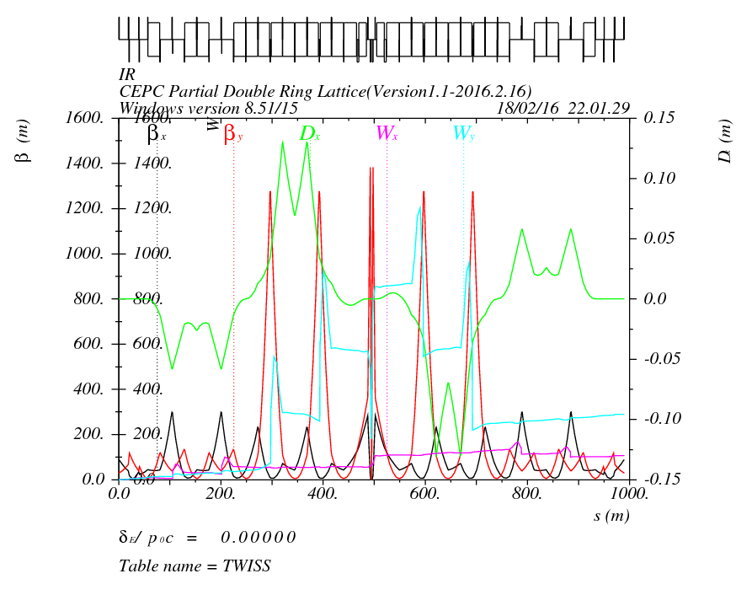
FFS(test20160115-2-Wangdou)
Betx=0.8m
Bety=0.003m

Slide 10
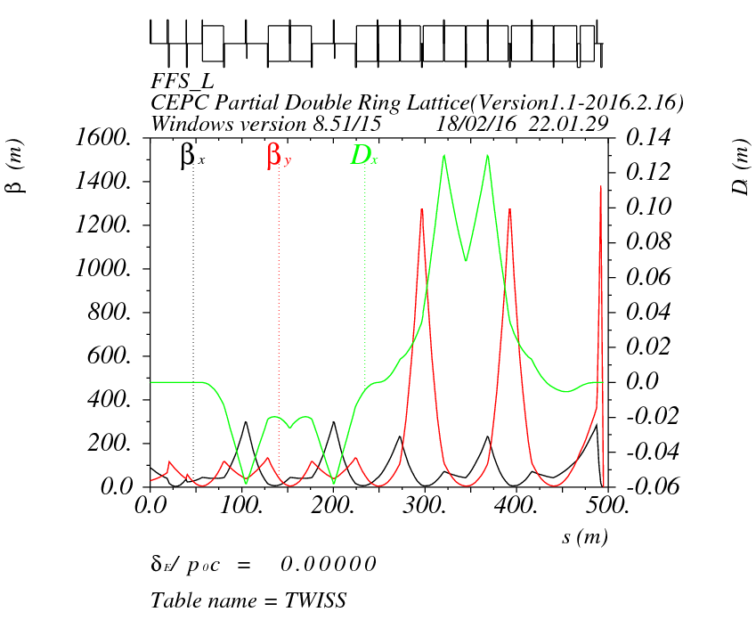
FFS(test20160115-2-Wangdou)
Betx=0.8m
Bety=0.003m
L=494.82m
deltX=0.178m
Angle=4.50608mrad
IP

Slide 11
Comparation of FFS Orbit
version20151126
IP
test20160115-2-Wangdou
IP

Slide 12
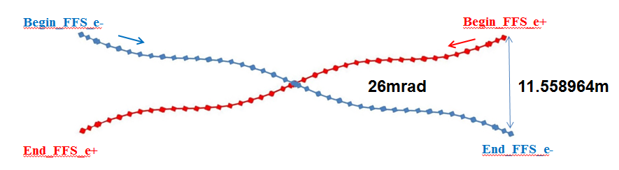
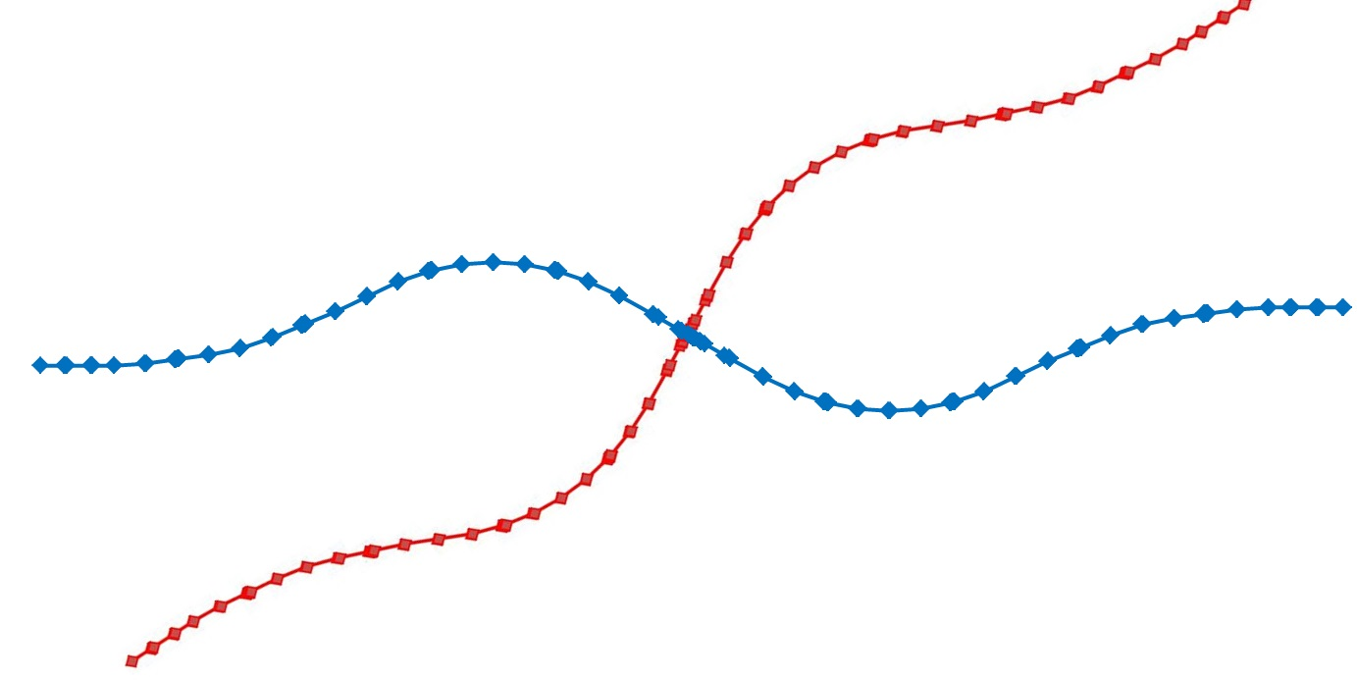
FFS Orbit
version20151126
test20160115-2-Wangdou
30mrad
10.0064m

Slide 13
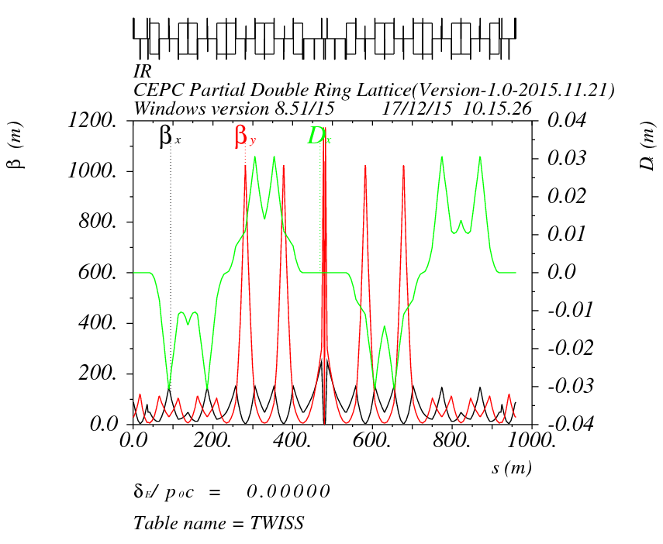
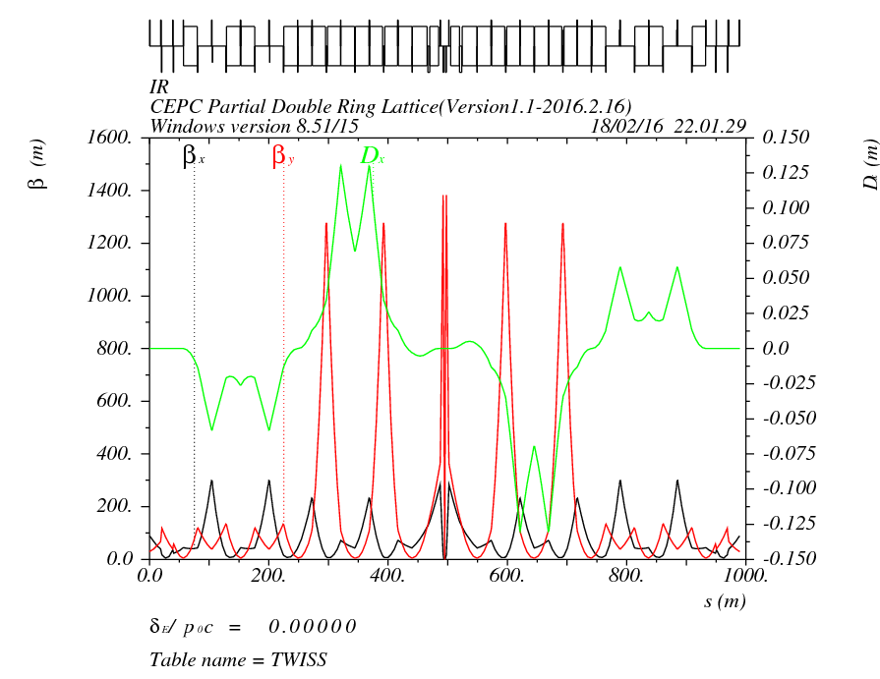
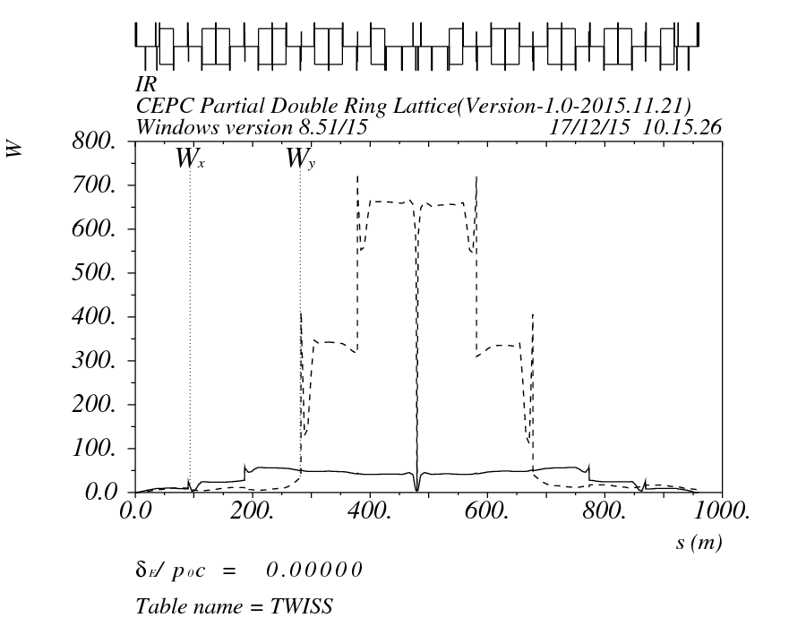
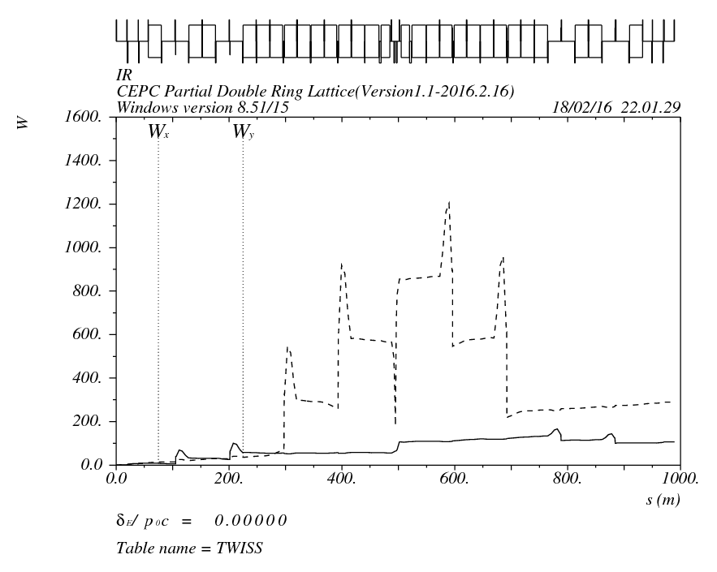
Compare with before
Wangdou-20151126
test20160115-2-Wangdou

Slide 14
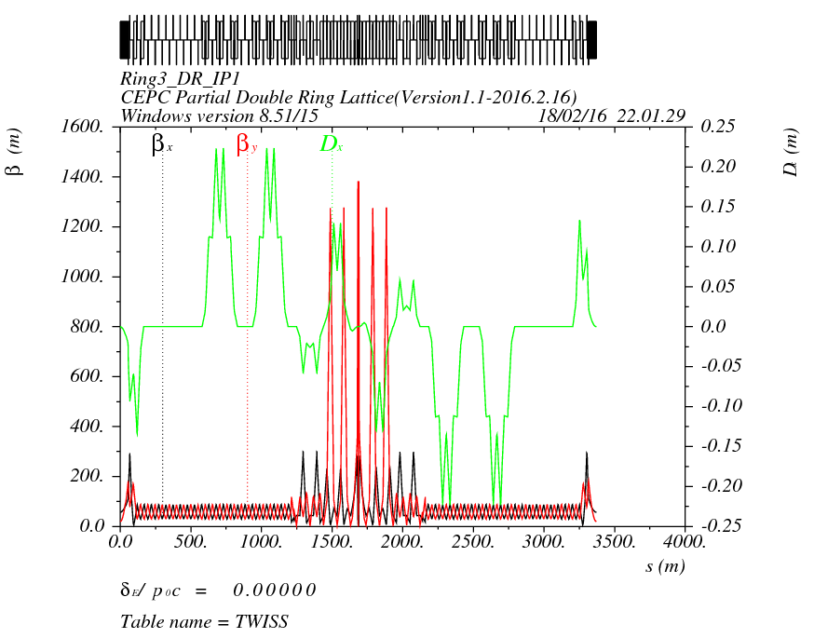
Orbit (RING3_DR_IP1) Version 1.1 + FFS(test20160115-2-Wangdou)
0.0625*12=0.75mrad
+4.25mrad
+5.49302mrad
=10.49302mrad
4.50608+10.49302=15mrad
IP

Slide 15
Dynamic Aperture Version 1.1 + FFS(test20160115-2-Wangdou)
Dp/p=-0.16%
Dp/p=0
Dp/p=0.16%

Slide 16
Compare with before
Version1.0-20160105
Version1.1-20160216
0: 13σx 55σy
0.01：0
0.02：0
-0.8628% and 0.719%
has DA, out is 0.
Dp/p=-0.1605%
Dp/p=0
Dp/p=0.1605%

Slide 17
Next to do
ARC(90/60)+Bypass+PDR+FFS-new(0.8/0.003) Optimise
ARC(90/90)+Bypass+PDR+FFS-new(0.8/0.003->0.22/0.001)
PDR Optimization
DA Optimization

Slide 18
Thank You !

