Slide 1
Update on pretzel orbit design
Huiping Geng
2016.2.19

Slide 2
Contents
Introduction
Matching results with SAD
Primary DA result
Summary

Slide 3
Introduction
Pretzel orbit design stopped at DA tracking with SAD, when it was found that SAD lattice was not consistent with MAD after pretzel orbit was added
Try to match the lattice with SAD
Try to solve the remaining issues in previous version of lattice (Different tunes between each pair of electric separators, and, asymmetric after pretzel orbit correction)

Slide 4
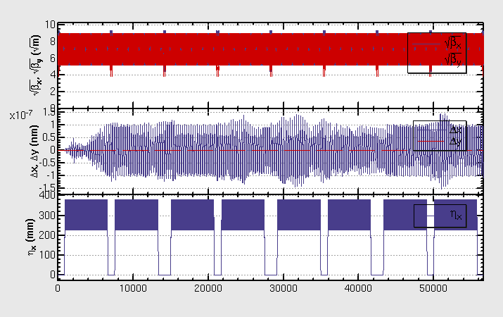
SAD matching results w/o pretzel

Slide 5
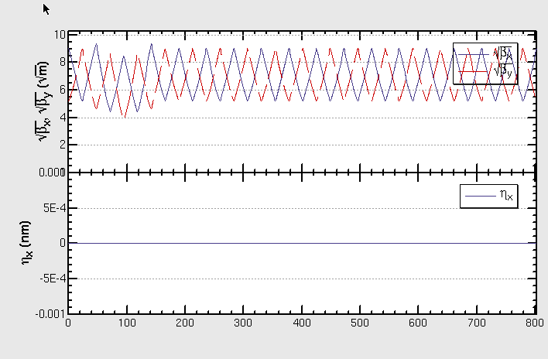
Improvement:
IP, or middle of straight section
+ARC
Same tunes between each pair of electric separators.

Slide 6
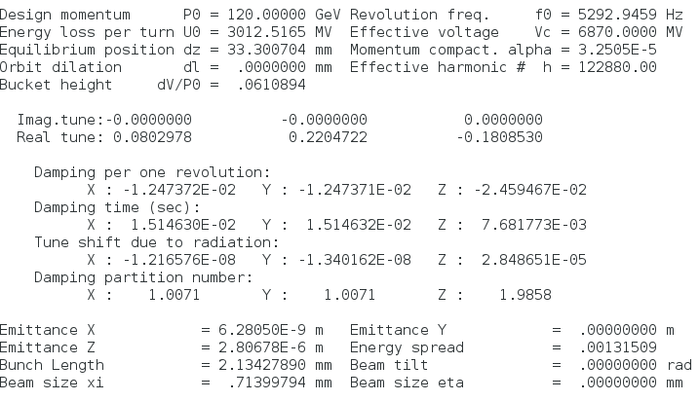
Main output parameters:

Slide 7
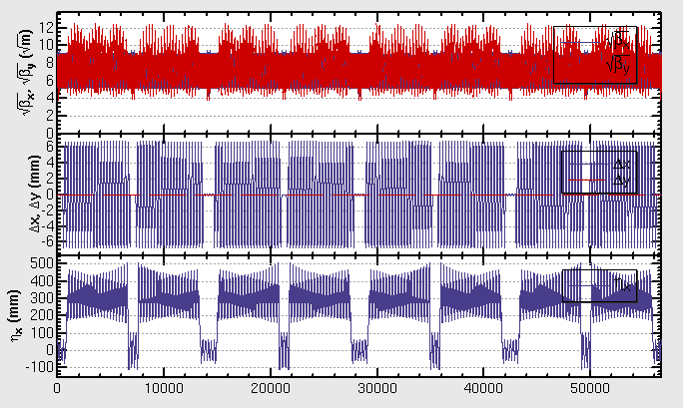
After adding pretzel orbit (with correction) :
Solution need to be improved….

Slide 8
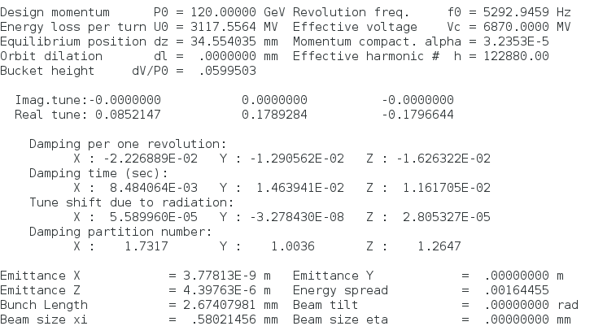
Main output parameters:
Was 3012MV
Was 1.0
Was 6.28nm

Slide 9
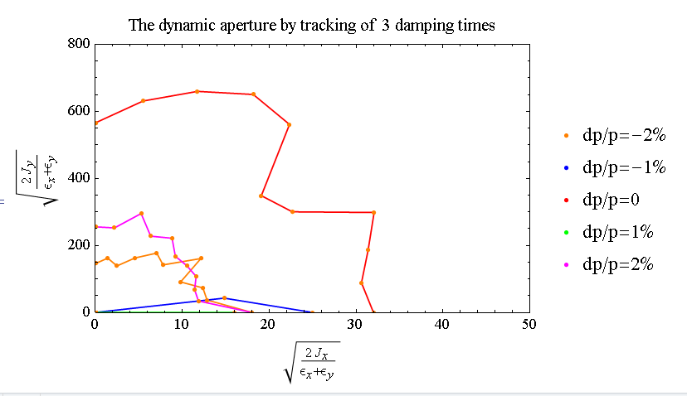
DA (±2%):

Slide 10
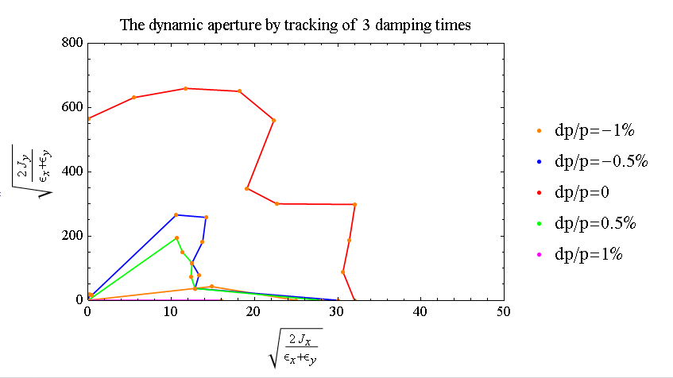
DA (±1%):

Slide 11
Summary and work to do
Pretzel orbit designed by SAD, main parameters being compared before and after adding pretzel orbit
Solved the remaining issues in previous version of lattice (Different tunes between each pair of electric separators, and, asymmetric after pretzel orbit correction)
Primary DA results obtained, has to be checked
Check saw-tooth effect
Add FFS, check DA
Optimize DA

