Slide 1
Beam-Beam Simulations
Zhang Yuan
16-02-19

Slide 2
Primary parameter for CEPC double ring
 | Pre-CDR | H-high lumi. |  | H-low power |  | Z
Number of IPs | 2 | 2 |  | 2 |  | 2
Energy (GeV) | 120 | 120 |  | 120 |  | 45.5
Circumference (km) | 54 | 54 |  | 54 |  | 54
SR loss/turn (GeV) | 3.1 | 2.96 |  | 2.96 |  | 0.062
Half crossing angle (mrad) | 0 | 14.5 | 8.9 | 11.5 | 8.7 | 16.5
Piwinski angle | 0 | 2 | 3.1 | 2 | 2 | 2.6
N_{e}/bunch (10¹¹) | 3.79 | 3.79 | 1.32 | 2.81 | 2.0 | 0.37
Bunch number | 50 | 50 | 144 | 40 | 57 | 1100
Beam current (mA) | 16.6 | 16.9 | 16.9 | 10.1 | 10.1 | 36.2
SR power /beam (MW) | 51.7 | 50 | 50 | 30 | 30 | 2.2
Bending radius (km) | 6.1 | 6.2 | 6.2 | 6.2 | 6.2 | 6.1
Momentum compaction (10⁻⁵) | 3.4 | 3.0 | 2.3 | 2.6 | 2.5 | 5.4
β_{IP} x/y (m) | 0.8/0.0012 | 0.306/0.0012 | 0.058/0.0016 | 0.22/0.001 | 0.115/0.001 | 0.3/0.001
Emittance x/y (nm) | 6.12/0.018 | 3.34/0.01 | 2.32/0.0058 | 2.67/0.008 | 2.56/0.0078 | 1.18/0.0069
Transverse σ_{IP} (um) | 69.97/0.15 | 32/0.11 | 11.6/0.097 | 24.3/0.09 | 17.6/0.088 | 18.8/0.083
ξ_{x}/IP | 0.118 | 0.04 | 0.01 | 0.04 | 0.028 | 0.02
ξ_{y}/IP | 0.083 | 0.11 | 0.11 | 0.11 | 0.11 | 0.042
V_{RF} (GV) | 6.87 | 3.7 | 3.6 | 3.6 | 3.7 | 0.28
f _{RF} (MHz) | 650 | 650 | 650 | 650 | 650 | 650
Nature σ_{z} (mm) | 2.14 | 3.3 | 3.0 | 3.2 | 3.0 | 3.0
Total σ_{z} (mm) | 2.65 | 4.4 | 4.0 | 4.2 | 4.0 | 3.0
HOM power/cavity (kw) | 3.6 | 3.3 | 1.0 | 1.5 | 0.95 | 0.73
Energy spread (%) | 0.13 | 0.13 | 0.13 | 0.13 | 0.13 | 0.05
Energy acceptance (%) | 2 | 2 | 2 | 2 | 2
Energy acceptance by RF (%) | 6 | 2.2 | 2.2 | 2.2 | 2.4 | 2.0
n_{γ} | 0.23 | 0.49 | 0.46 | 0.47 | 0.46 | 0.08
Life time due to beamstrahlung_cal (minute) | 47 | 53 | 32 | 41 | 32
F (hour glass) | 0.68 | 0.73 | 0.89 | 0.69 | 0.7 | 0.83
L_{max}/IP (10³⁴cm⁻²s⁻¹) | 2.04 | 2.97 | 2.75 | 2.03 | 2.07 | 1.25
16-HK

Slide 3
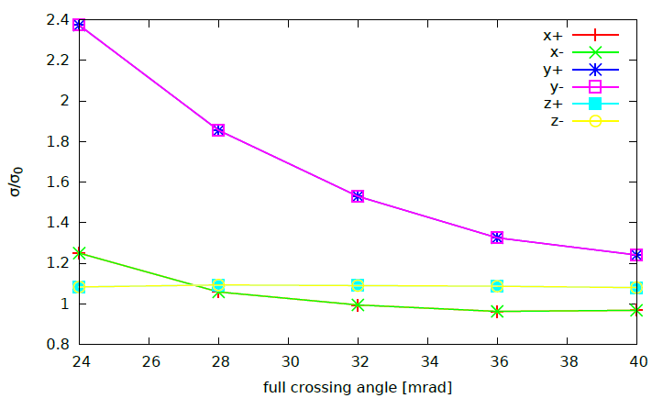
Crossing angle at Z

Slide 4
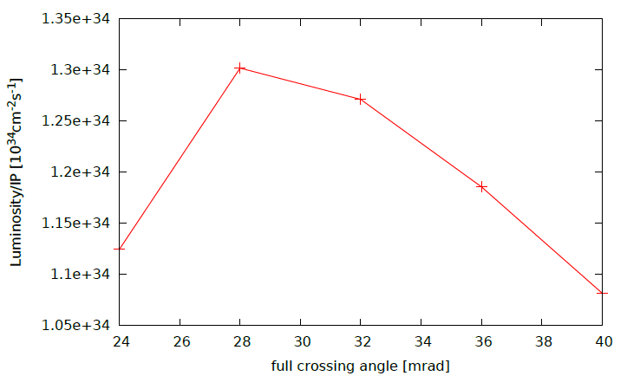
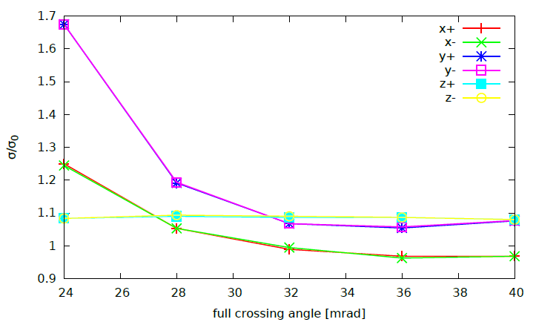
Crossing angle at Z (80% crab-waist strength)

Slide 5
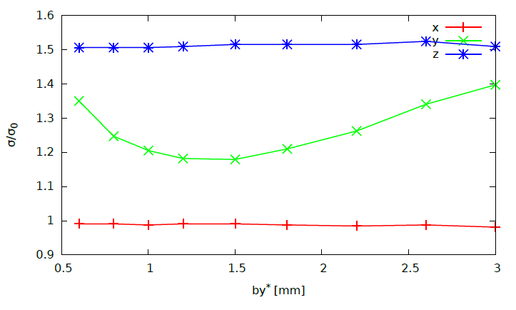
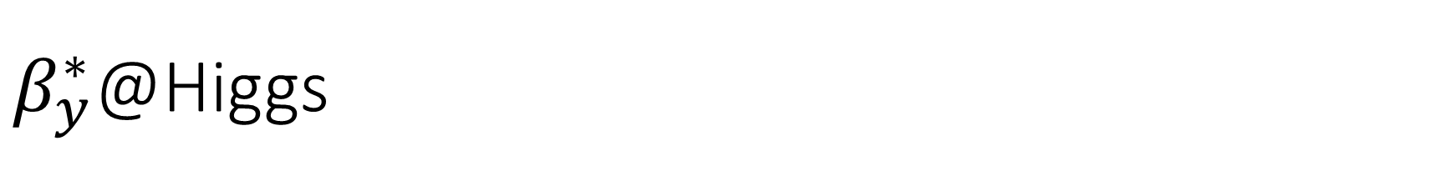
$β_{y}^{∗}$@Higgs

Slide 6
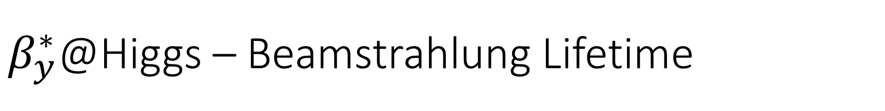
$β_{y}^{∗}$@Higgs – Beamstrahlung Lifetime

Slide 7
Primary parameter for CEPC double ring
 | Pre-CDR | H-high lumi. |  | H-low power |  | Z
Number of IPs | 2 | 2 |  | 2 |  | 2
Energy (GeV) | 120 | 120 |  | 120 |  | 45.5
Circumference (km) | 54 | 54 |  | 54 |  | 54
SR loss/turn (GeV) | 3.1 | 2.96 |  | 2.96 |  | 0.062
Half crossing angle (mrad) | 0 | 14.5 | 8.9 | 11.5 | 8.7 | 15
Piwinski angle | 0 | 2 | 3.1 | 2 | 2 | 8.5
N_{e}/bunch (10¹¹) | 3.79 | 3.79 | 1.32 | 2.81 | 2.0 | 0.46
Bunch number | 50 | 50 | 144 | 40 | 57 | 1100
Beam current (mA) | 16.6 | 16.9 | 16.9 | 10.1 | 10.1 | 45.4
SR power /beam (MW) | 51.7 | 50 | 50 | 30 | 30 | 2.8
Bending radius (km) | 6.1 | 6.2 | 6.2 | 6.2 | 6.2 | 6.1
Momentum compaction (10⁻⁵) | 3.4 | 3.0 | 2.3 | 2.6 | 2.5 | 3.5
β_{IP} x/y (m) | 0.8/0.0012 | 0.306/0.0012 | 0.058/0.0016 | 0.22/0.001 | 0.115/0.001 | 0.08/0.001
Emittance x/y (nm) | 6.12/0.018 | 3.34/0.01 | 2.32/0.0058 | 2.67/0.008 | 2.56/0.0078 | 0.62/0.002
Transverse σ_{IP} (um) | 69.97/0.15 | 32/0.11 | 11.6/0.097 | 24.3/0.09 | 17.6/0.088 | 7/0.046
ξ_{x}/IP | 0.118 | 0.04 | 0.01 | 0.04 | 0.028 | 0.005
ξ_{y}/IP | 0.083 | 0.11 | 0.11 | 0.11 | 0.11 | 0.084
V_{RF} (GV) | 6.87 | 3.7 | 3.6 | 3.6 | 3.7 | 0.12
f _{RF} (MHz) | 650 | 650 | 650 | 650 | 650 | 650
Nature σ_{z} (mm) | 2.14 | 3.3 | 3.0 | 3.2 | 3.0 | 3.9
Total σ_{z} (mm) | 2.65 | 4.4 | 4.0 | 4.2 | 4.0 | 4.0
HOM power/cavity (kw) | 3.6 | 3.3 | 1.0 | 1.5 | 0.95 | 0.99
Energy spread (%) | 0.13 | 0.13 | 0.13 | 0.13 | 0.13 | 0.05
Energy acceptance (%) | 2 | 2 | 2 | 2 | 2
Energy acceptance by RF (%) | 6 | 2.2 | 2.2 | 2.2 | 2.4 | 1.1
n_{γ} | 0.23 | 0.49 | 0.46 | 0.47 | 0.46 | 0.27
Life time due to beamstrahlung_cal (minute) | 47 | 53 | 32 | 41 | 32
F (hour glass) | 0.68 | 0.73 | 0.89 | 0.69 | 0.7 | 0.95
L_{max}/IP (10³⁴cm⁻²s⁻¹) | 2.04 | 2.97 | 2.75 | 2.03 | 2.07 | 3.61
Wangdou-160129

Slide 8
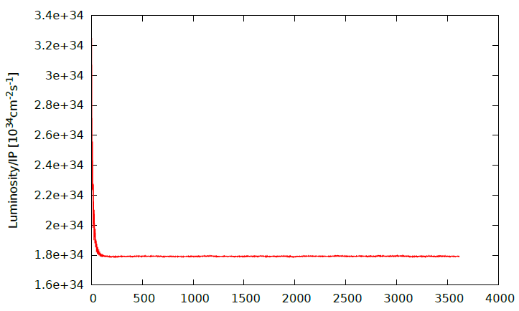
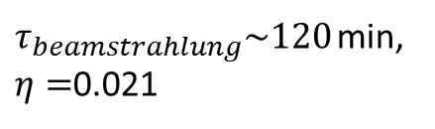
H-low power, Luminosity/IP
$τ_{beamstrahlung}\sim 120$min, $η=$0.021

Slide 9
Z-160129, Luminosity/IP
Z@HK

