Slide 1
Local double ring MDI
Sha Bai
CEPC AP meeting
2016-02-19

Slide 2
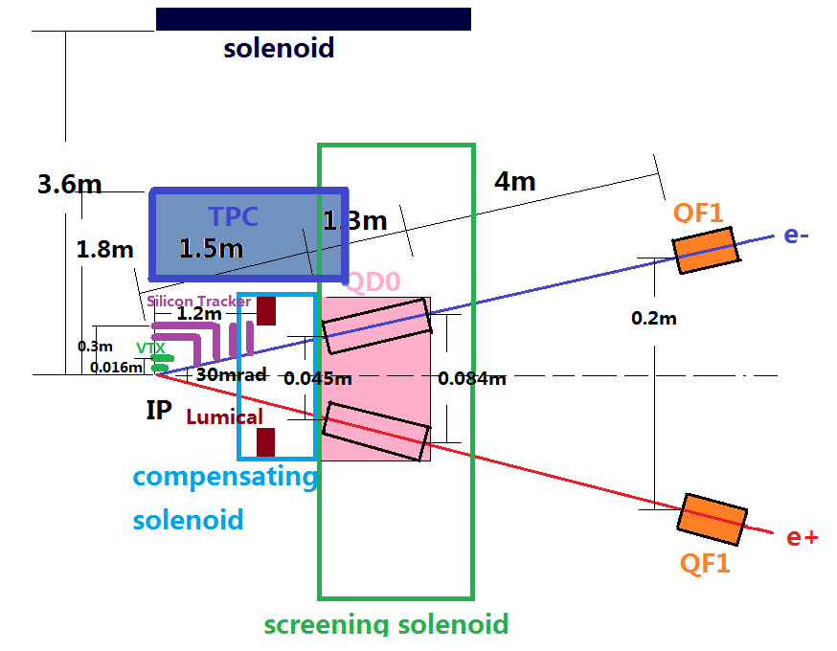
Local double ring MDI layout
Detectors (including silicon tracker, vertex detector, TPC etc on….) which are “far” from this region, should be same as in the single ring.

Slide 3
Tasks and group members
Background (BAI Sha, XIU Qinglei, Yueteng, ZHU Hongbo)
generator and accelerator simulation --- BAI Sha, Yueteng
Detector simulation --- XIU Qinglei
Collimator and Shielding (BAI Sha, XIU Qinglei, Yueteng, ZHU Hongbo)
Physics design and accelerator simulation --- BAI Sha, Yueteng
Detector simulation --- XIU Qinglei
Anti-solenoid (BAI Sha, YAO Weichao, ZHU Yingshun, ZHU Hongbo)
Physics design and accelerator simulation --- BAI Sha
Magnet field calculation/simulation and magnet design --- YAO Weichao
Superconducting magnet (YAO Weichao, ZHU Yingshun, ZHU Hongbo)
IR Design and optimization(WANG Yiwei, WANG Dou, SU Feng, BIAN Tianjian, BAI Sha)
Final doublet physics design(WANG Yiwei)
Lumical(ZHU Kai, ZHU Hongbo)
Radiation protection(MA Zhongjian, ZHU Hongbo, XIU Qinglei)

Slide 4
Background
Generator
Accelerator
part
Accelerator
Simulation
Synchrotron radiation background
a).from the bending magnet
b).from the quadrupole in the IR
Lost particles background
a).radiation Bhabha scattering
b).beamstrahlung
Geant4(Mokka)
Detector
part
Analysis(Marlin)
Cross-section from formula
Monte Carlo method to generate particle energy spread
Bending magnet designed considering synchrotron radiation, in aspect of detector and radiation protection
Collimation system should be redesigned

Slide 5
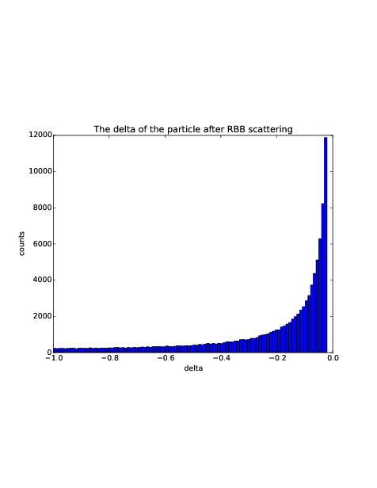
RBB Generator
Radiative Bhabha scattering
Generate 100000 particles
~ energy spread
蒙卡随机投点法
dσ/dp
.
.
.
.
. .
.
.
.
.
.
.
.
0
1
dp
The RBB generator using a Monte-Carlo random point method: randomly
generate a two-dimention coordinate, x/y without any relationship
Energy spread can only be used when point within the function curve

Slide 6
Lost particles statistic RBB generated at IP1, tracking for one turn in SAD
Lattice版本：CEPC-ARC1.0-PDR1.0-FFS(WD1.0)
Gaussian distribution energy spread adding to the 100000 particles generated by RBB generator
Only set aperture in Final doublet ~ 1.7cm in radius
The number of particle lost in the downstream of 1th turn is: 5153
The number of particle lost in the upstream of 1th turn is: 5651

Slide 7
Conclusions and Prospects
Radiative Bhabha scattering events are generated and lost particles information got after tracking in SAD.
With 1.7cm radius beam pipe aperture in final doublet, the lost particles after tracking in one turn upstream of IP1 are much more than in the single ring.
Cross-checked in BBBREM.
Recalculate in new lattice and aperture set in detail.
Put lost particles in the detector and do simulation.

