Slide 1



Experimental Particle Physics
Part 5: Searches Beyond the SM (part II)
Prof. Albert De Roeck
CERN, Geneva, Switzerland
Antwerp University Belgium
UC-Davis California USA
NTU, Singapore
July 29 – August 7 Weihai, China

Slide 2
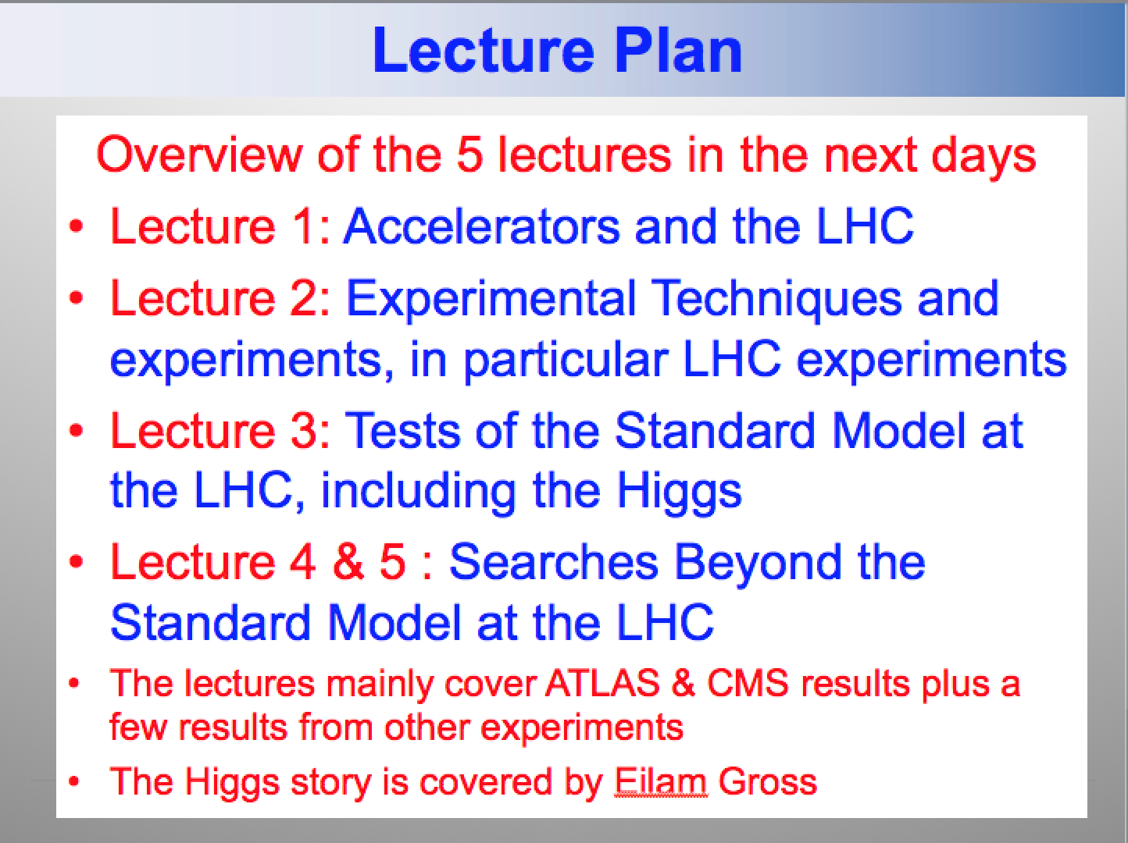
Lecture Plan
Overview of the 5 lectures in the next days
Lecture 1: Accelerators and the LHC
Lecture 2: Experimental Techniques and experiments, in particular LHC experiments
Lecture 3: Tests of the Standard Model at the LHC, including the Higgs
Lecture 4 & 5 : Searches Beyond the Standard Model at the LHC
The lectures mainly cover ATLAS & CMS results plus a few results from other experiment

Slide 3
Lecture Plan
: Searches for Supersymmetry, the connection to dark matter searches and an outlook for the future.

Slide 4
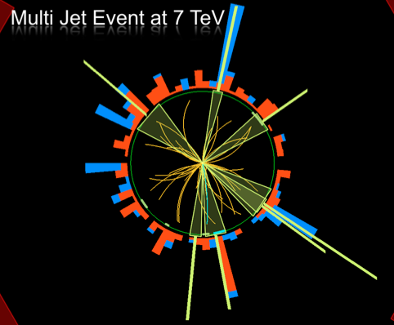
Outline
Search for Supersymmetry
The connection with dark
matter
Outlook for Run-II
Far Future Outlook
Summary

Slide 5
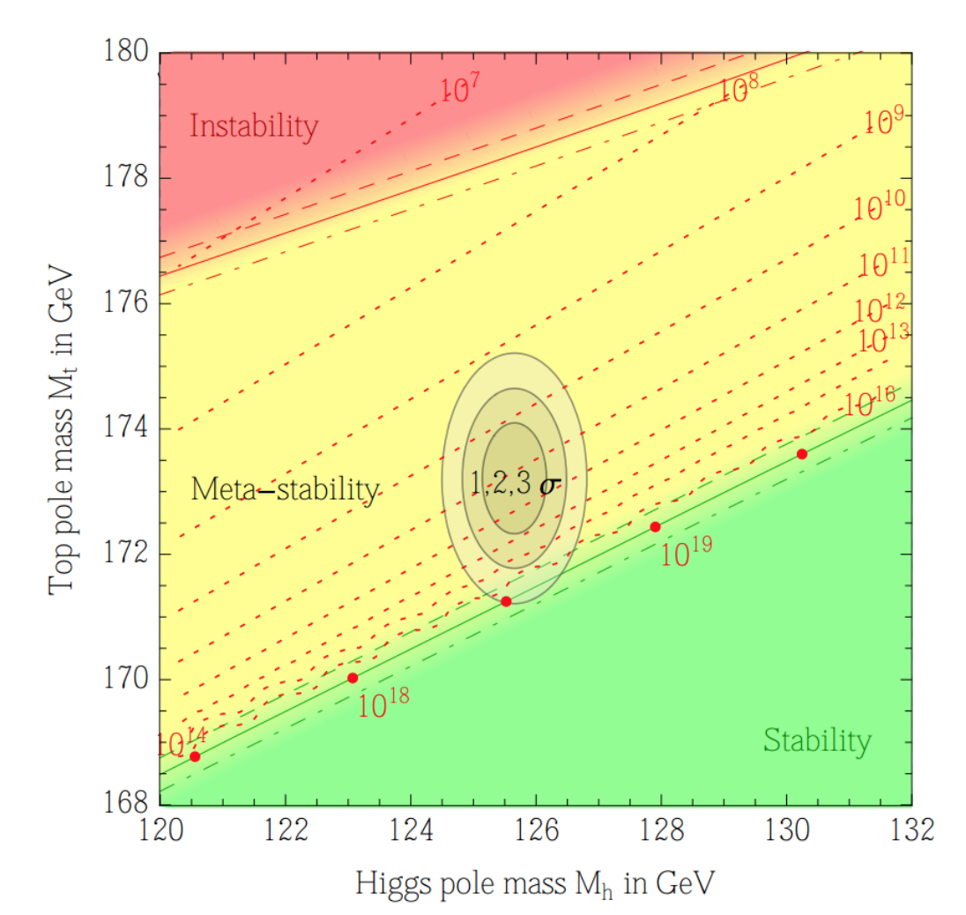

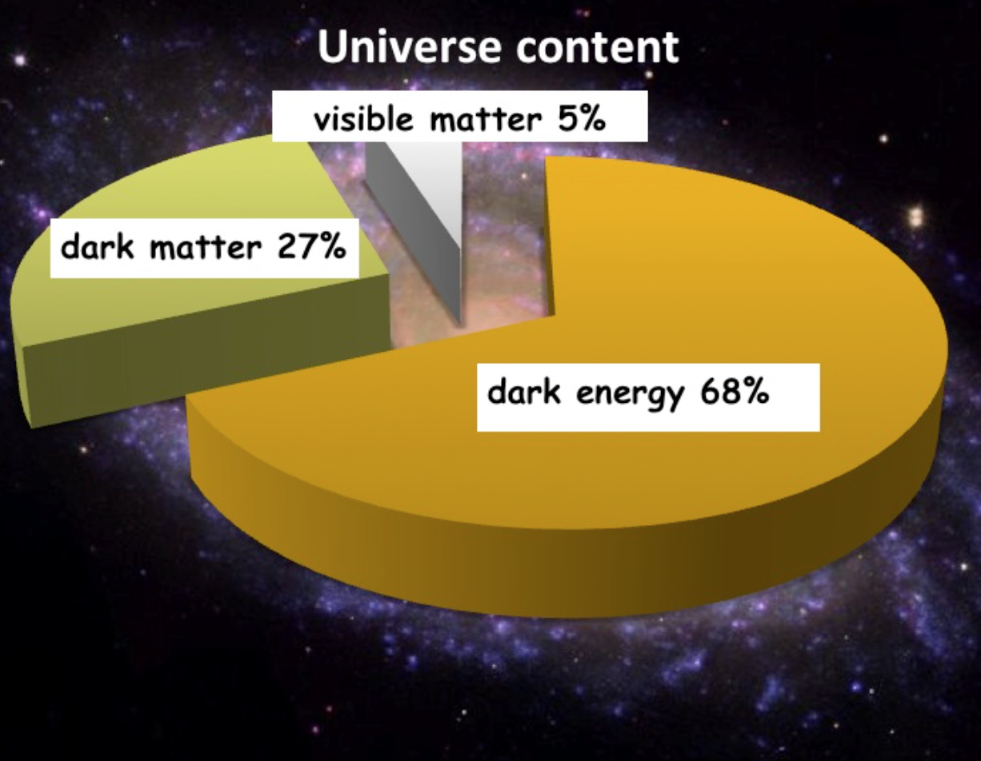

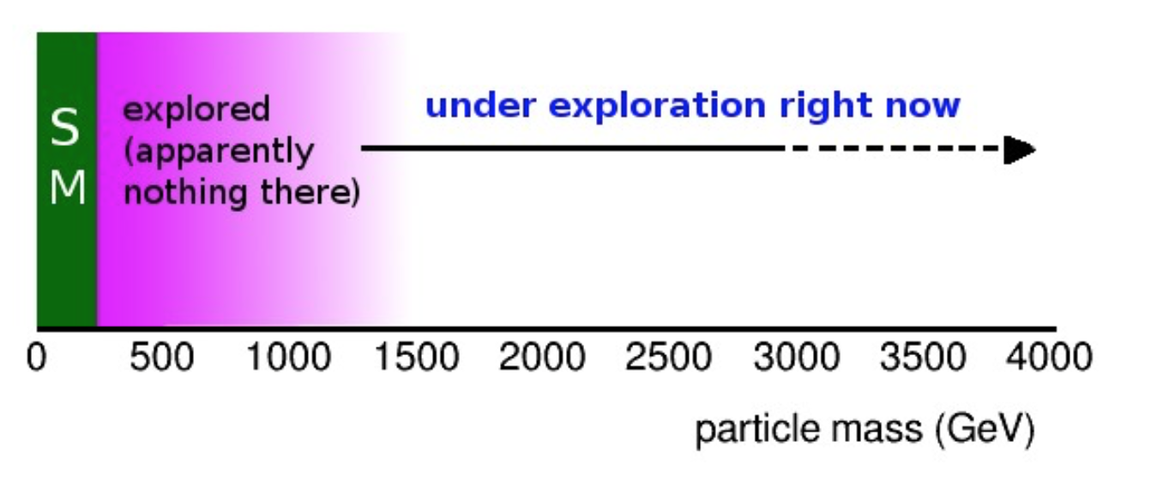
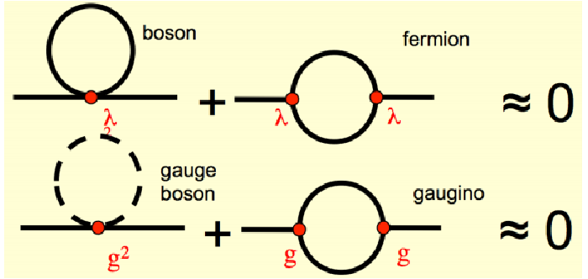
Physics Beyond the Standard Model?
A Higgs at 125 GeV
Precise measurements of the top quark and the Higgs mass
arXiv:1403.6535
We also know that:
New Physics inevitable?
But at which scale/energy?
Searches!!
N. Arkani-Hamed

Slide 6
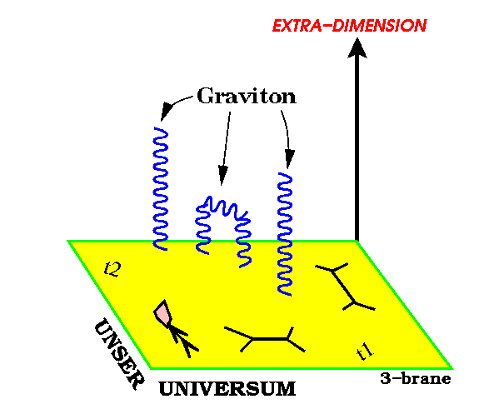
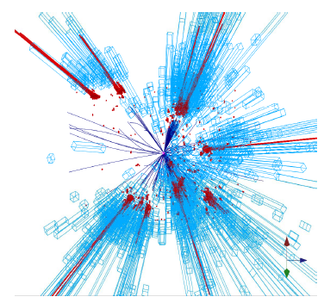
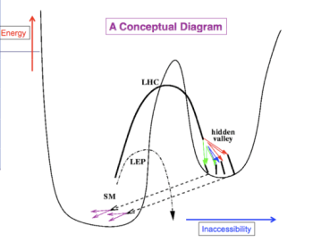
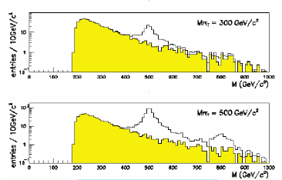
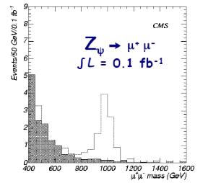
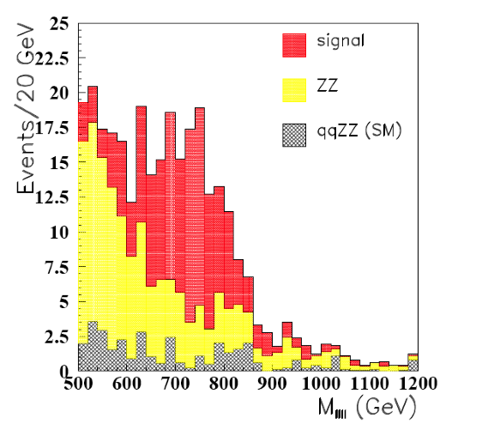
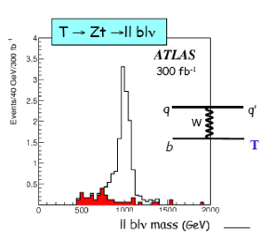
New Physics?
New Gauge Bosons?
Supersymmetry
ZZ/WW resonances?
Technicolor?
Little Higgs?
Extra Dimensions?
Hidden Valleys?
Black Holes???
What stabelizes the Higgs Mass? Many ideas, not all viable any more
A large variety of possible signals. We have to be ready for that
Notes:
5

Slide 7


Run 2
SUSY
« Empty » space is unstable
Dark matter
Origin of matter
Masses of neutrinos
Hierarchy problem
Inflation
Quantum gravity
…
Run 2
SUSY
Run 2
SUSY
Run 2
SUSY
SUSY
SUSY
^{The} Standard Model
John Ellis BUSSTEPP August 2015
Notes:
6

Slide 8

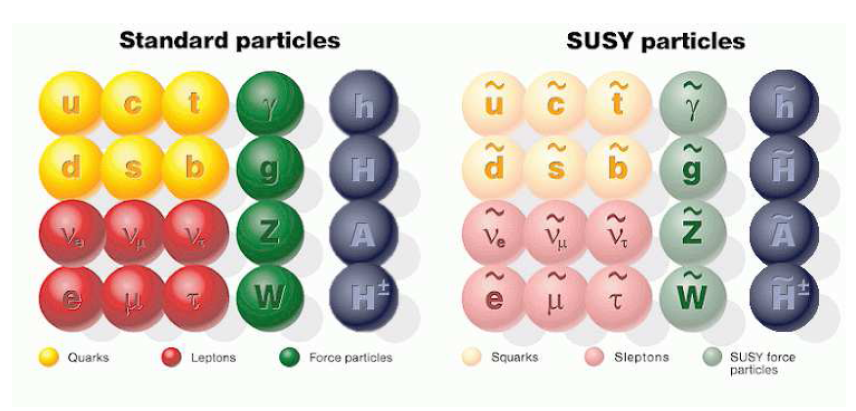
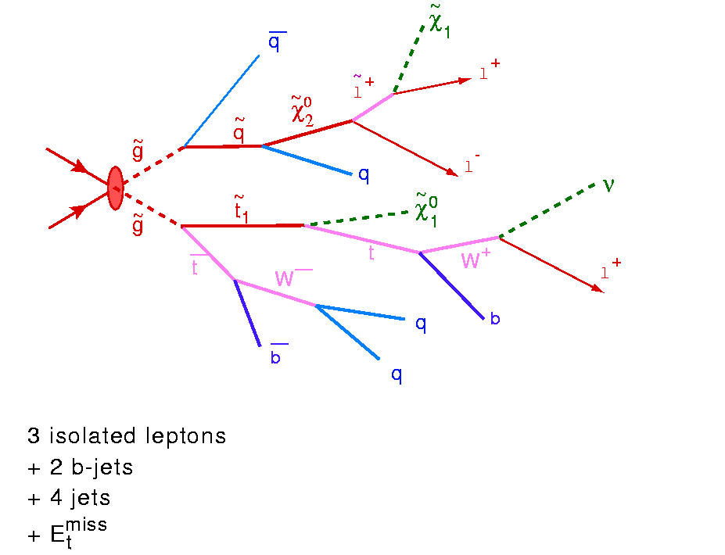

Beyond the Higgs Boson
Supersymmetry: a new symmetry in Nature?
Candidate particles for Dark Matter
⇒ Produce Dark Matter in the lab
“One day all these trees will
be SUSY phenomenology papers”
SUSY particle production at the LHC
Picture from Marusa Bradac

Slide 9
Supersymmetry
Supersymmetry (SUSY) → assumes a new hidden symmetry between the bosons (particles with integer spin) and fermions (particles with half integer spin). Can stabelize the Higgs mass up to the Planck scale
Fermion and boson loops cancel, provided m ≤ TeV.

Slide 10
Why weak-scale SUSY ?
stabilises the EW scale: |m_{F} – m_{B} | < O(1 TeV)
predicts a light Higgs m_{h}< 130 GeV
accomodates gauge unification
accomodates heavy top quark
dark matter candidate: neutralino, sneutrino, gravitino, ...
consistent with EW precision tests
Discovering SUSY – A revolution in particle physics!!

Slide 11
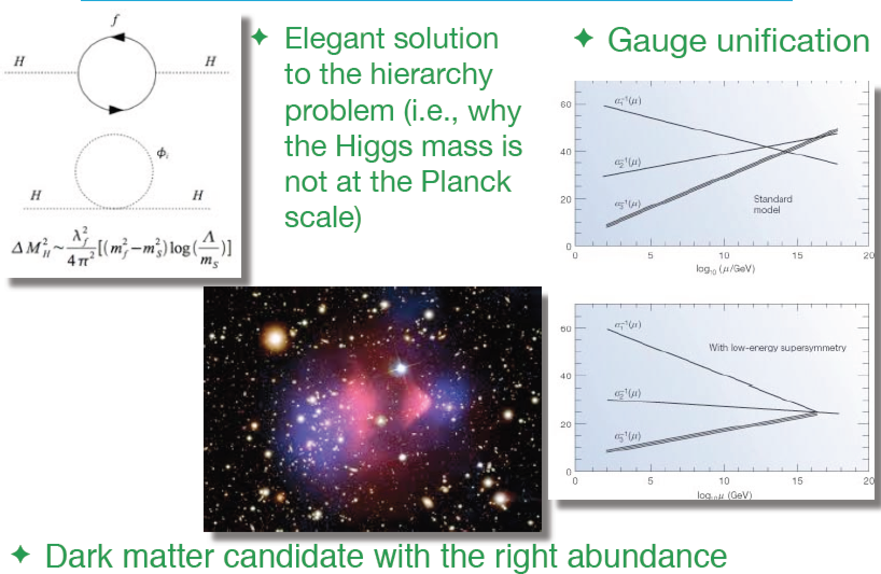
Summary: Why SUSY is good for you!!

Slide 12
Supersymmetry
Supersymmetry (SUSY)  assumes a new hidden symmetry between the bosons (particles with integer spin) and fermions (particles with half integer spin) to explain the Hierarchy problem (Planck  Electro-weak scale)
Lots of new particles (squarks, sleptons,…) predicted with masses in the range from 10’s of GeV’s up to several TeV range
Supersymmetry is broken
We don’t see the superpartners
E.g. Minimal supersymmetric model
⇒ 105 new parameters! :masses, mixing angles…
SUSY breaking mechanisms: reduces # of param.
    Minimal SUSY Gravity (msugra)
    Gauge mediated SUSY breaking
    Anomaly mediated SUSY breaking
    Gravitino mediated SUSY breaking… etc.
LHC is expected to have access to at least some part of the SUSY spectrum!

Slide 13
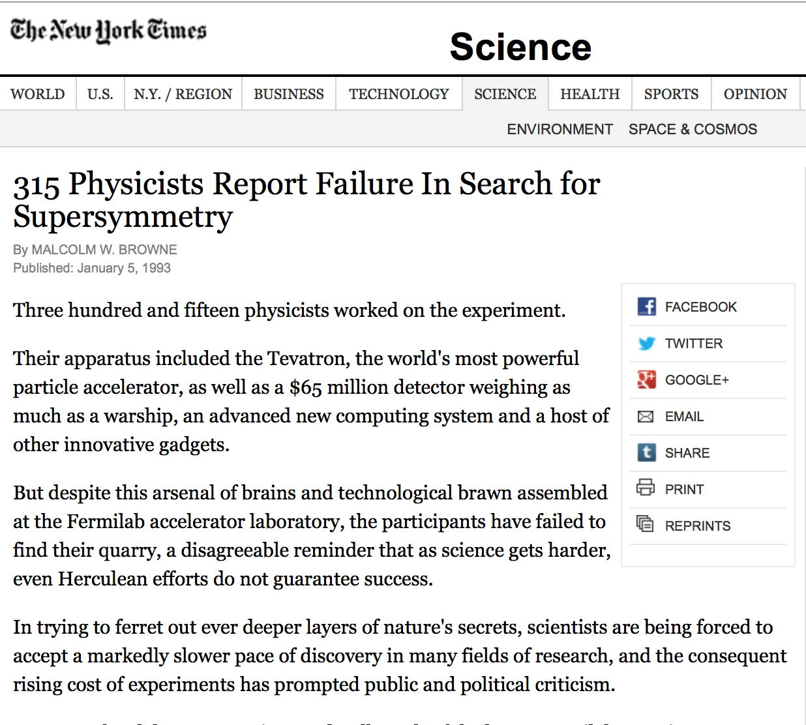
1993: Early Tevatron SUSY Searches
They did not find any…

Slide 14
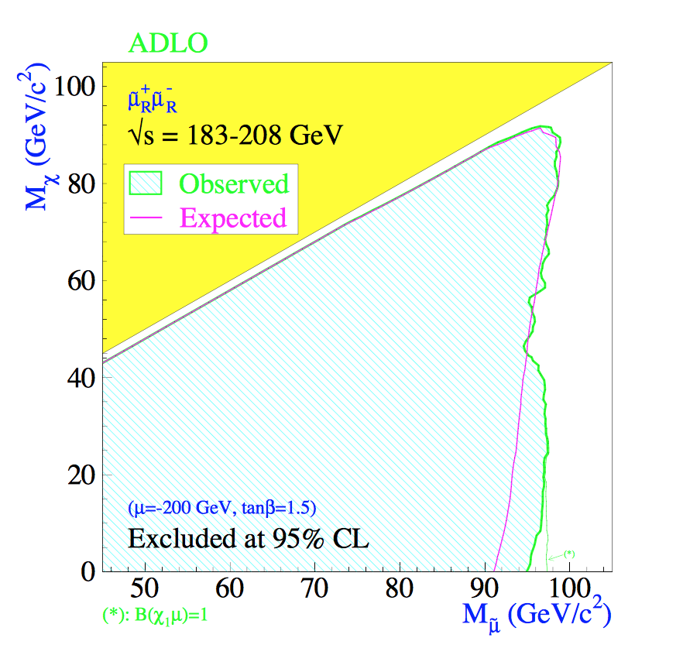
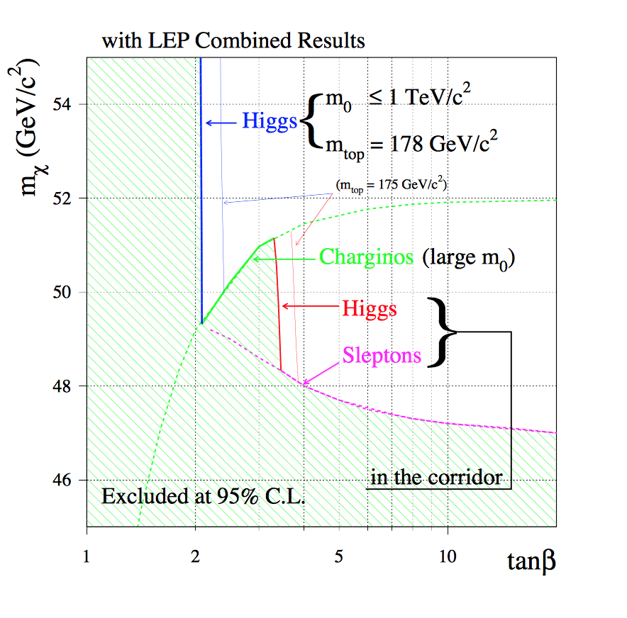
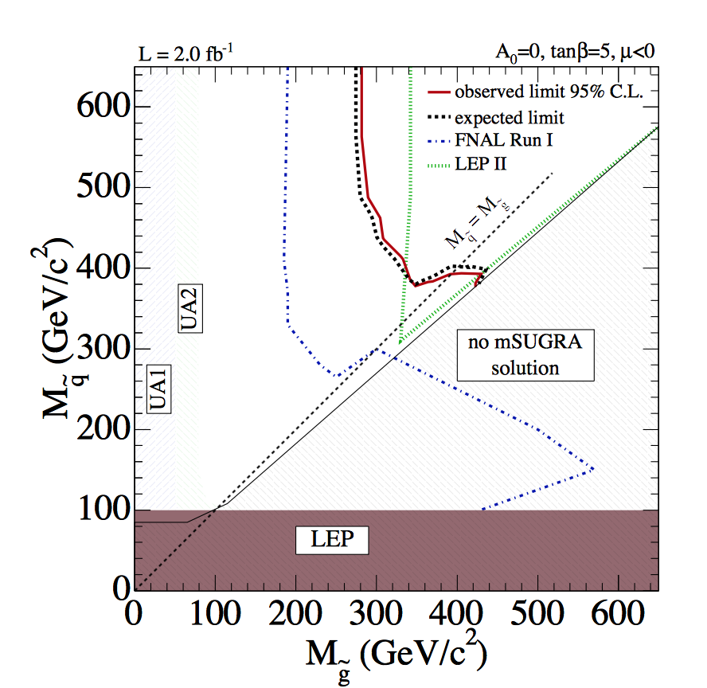
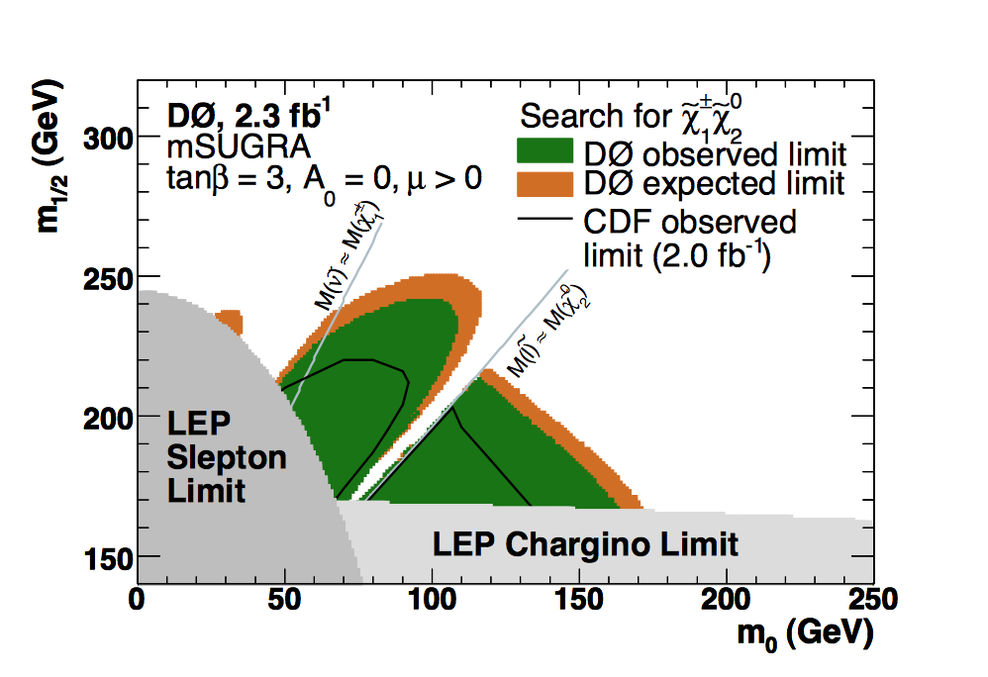
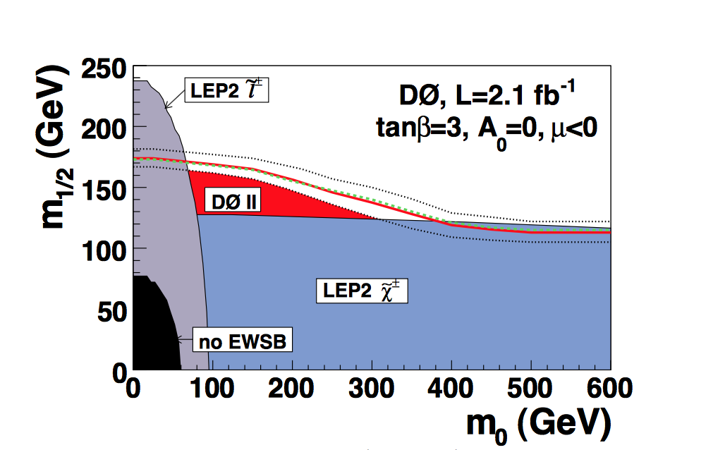
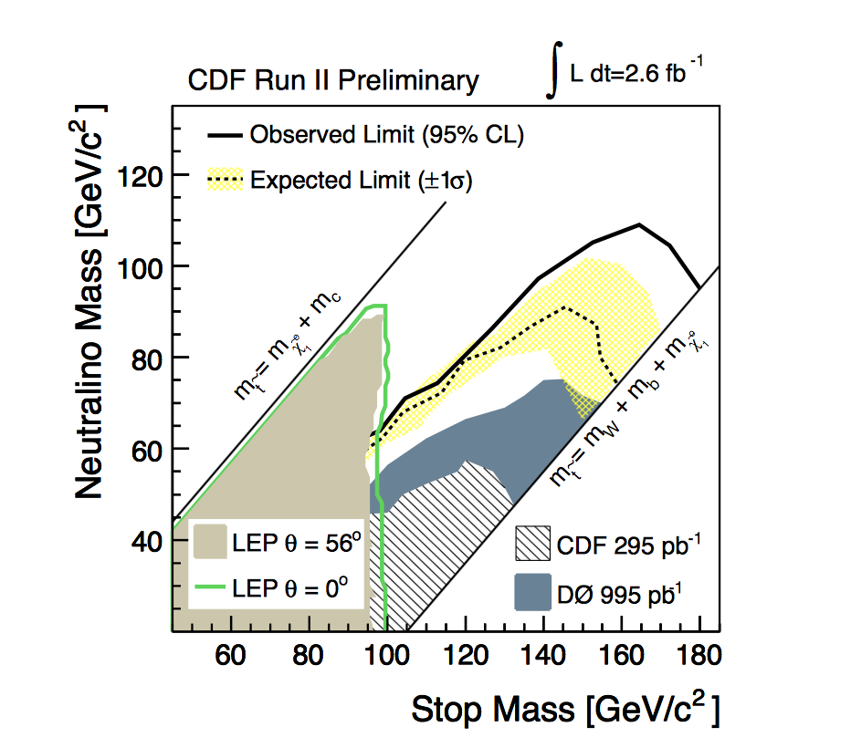
SUSY Searches in 2009: Pre-LHC
PDG 2009
LEP: mostly model
independent
Tevatron: mostly
mSUGRA interpret.
HERA: mostly RPV
Squark/gluino limits: 300-400 GeV
Electroweakinos (except LSP): >100 GeV

Slide 15
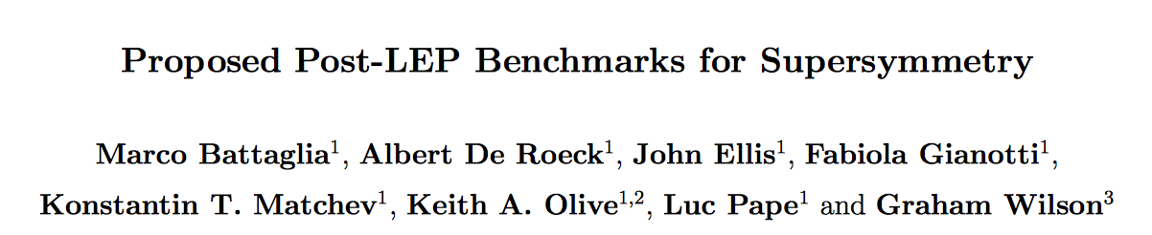
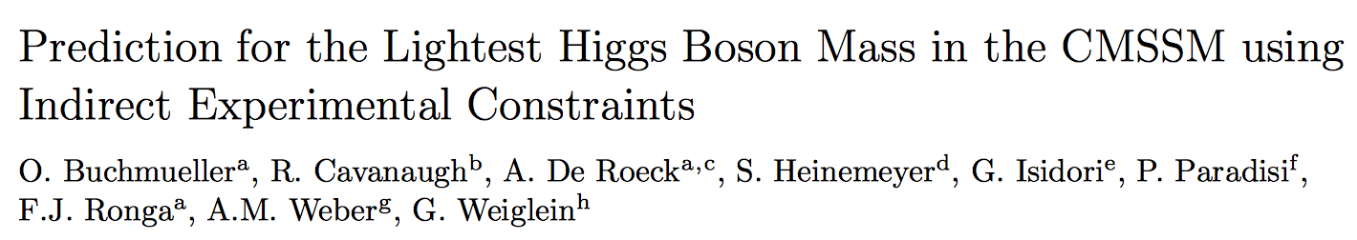
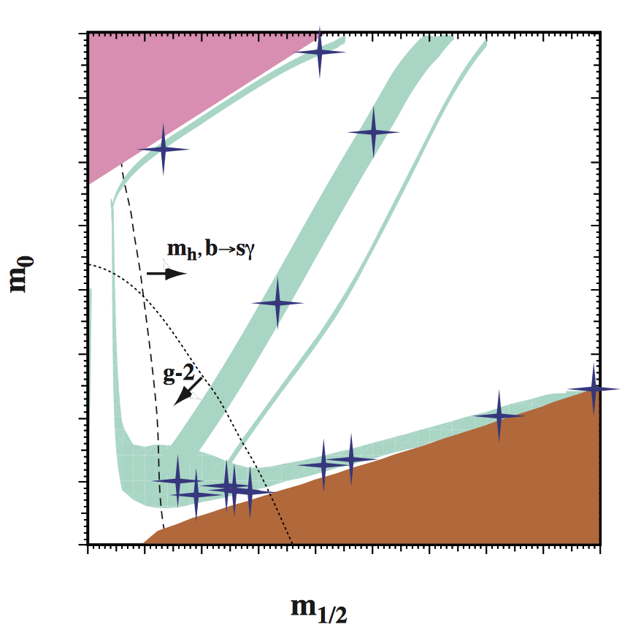
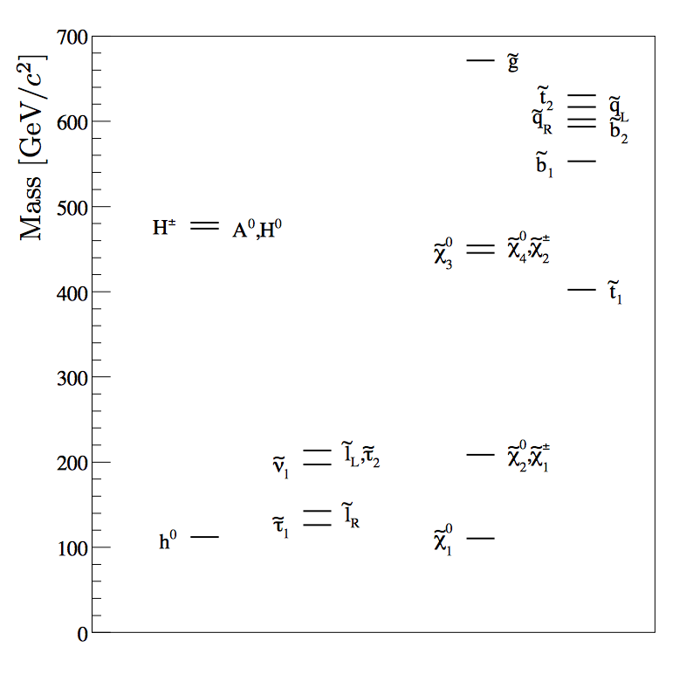
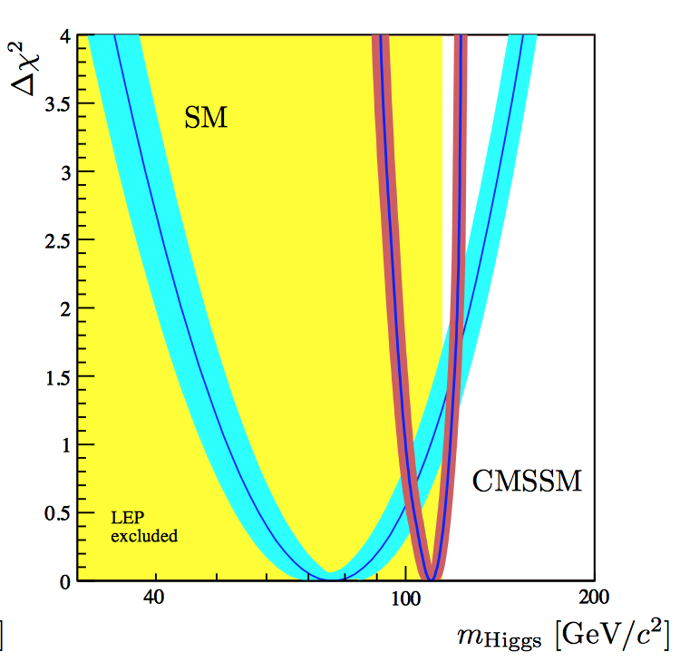
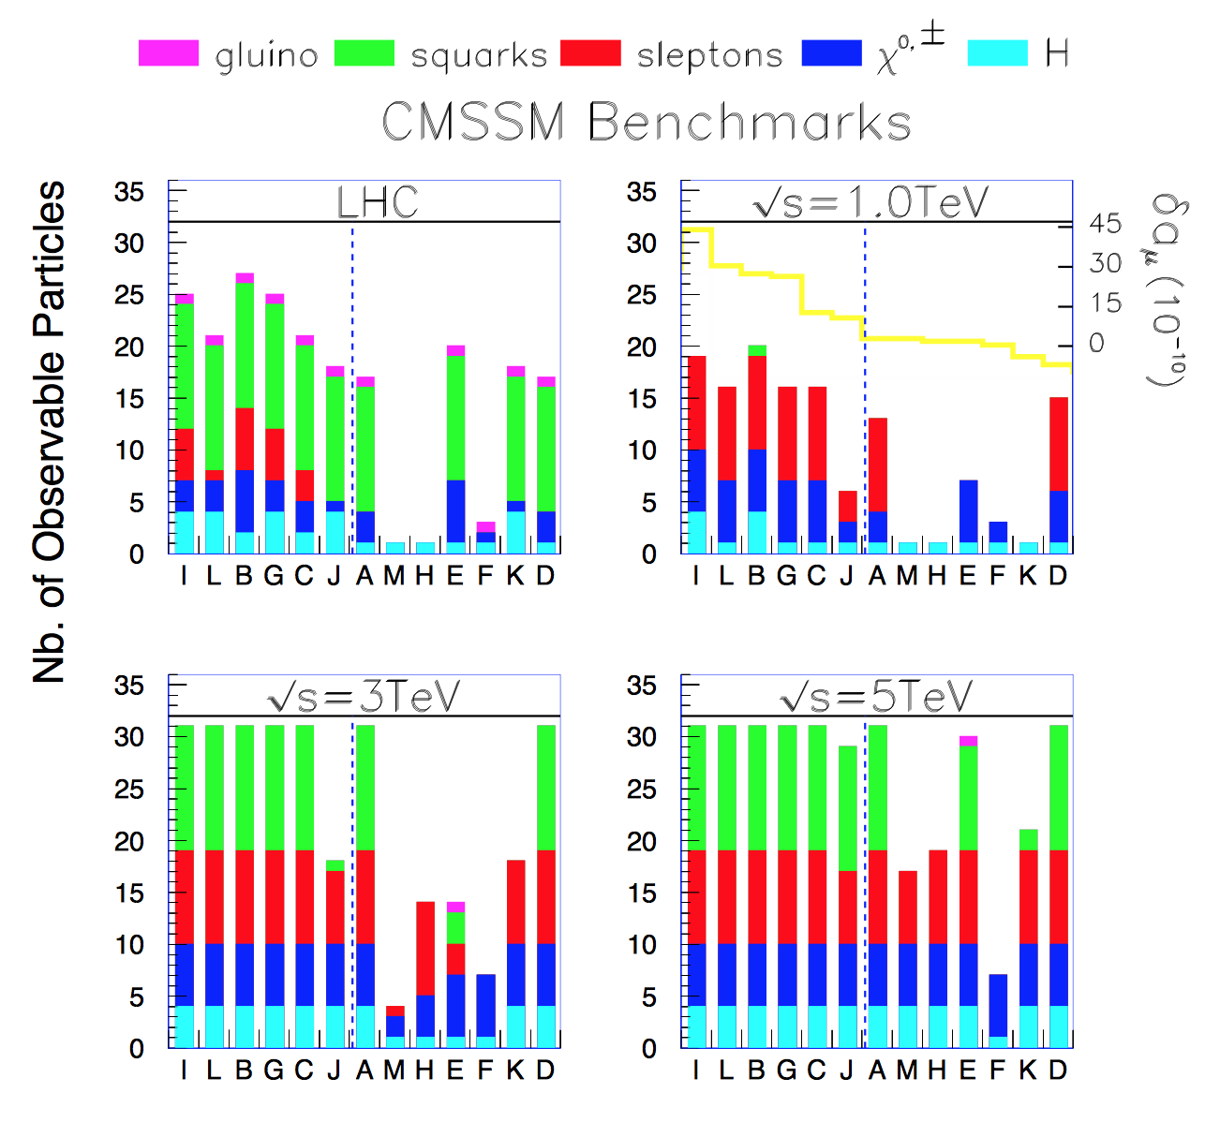

Playing with mSUGRA/CMSSM
hep-ph/0106204
arXiv:0707.3447
Became the Mastercode collaboration
Ok within 2σ ☺
Using constraints
of all available data
(measurements,
limits…)
Is SUSY around the
corner??
Turn on the LHC!

Slide 16

Inclusive SUSY Searches by 2013
Msq = 1800 GeV
Mg = 1400 GeV
CMSSM Landscape in 2013:
Example ATLAS (CMS similar)

Slide 17
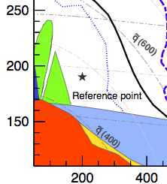
Inclusive SUSY Searches by 2013
Msq = 1800 GeV
Mg = 1400 GeV
Compared
to 2009…
CMSSM Landscape in 2013:
Example ATLAS (CMS similar)
LEP &
Tevatron
The LHC has pushed the mass scale in constraint SUSY models
to a new level!

Slide 18
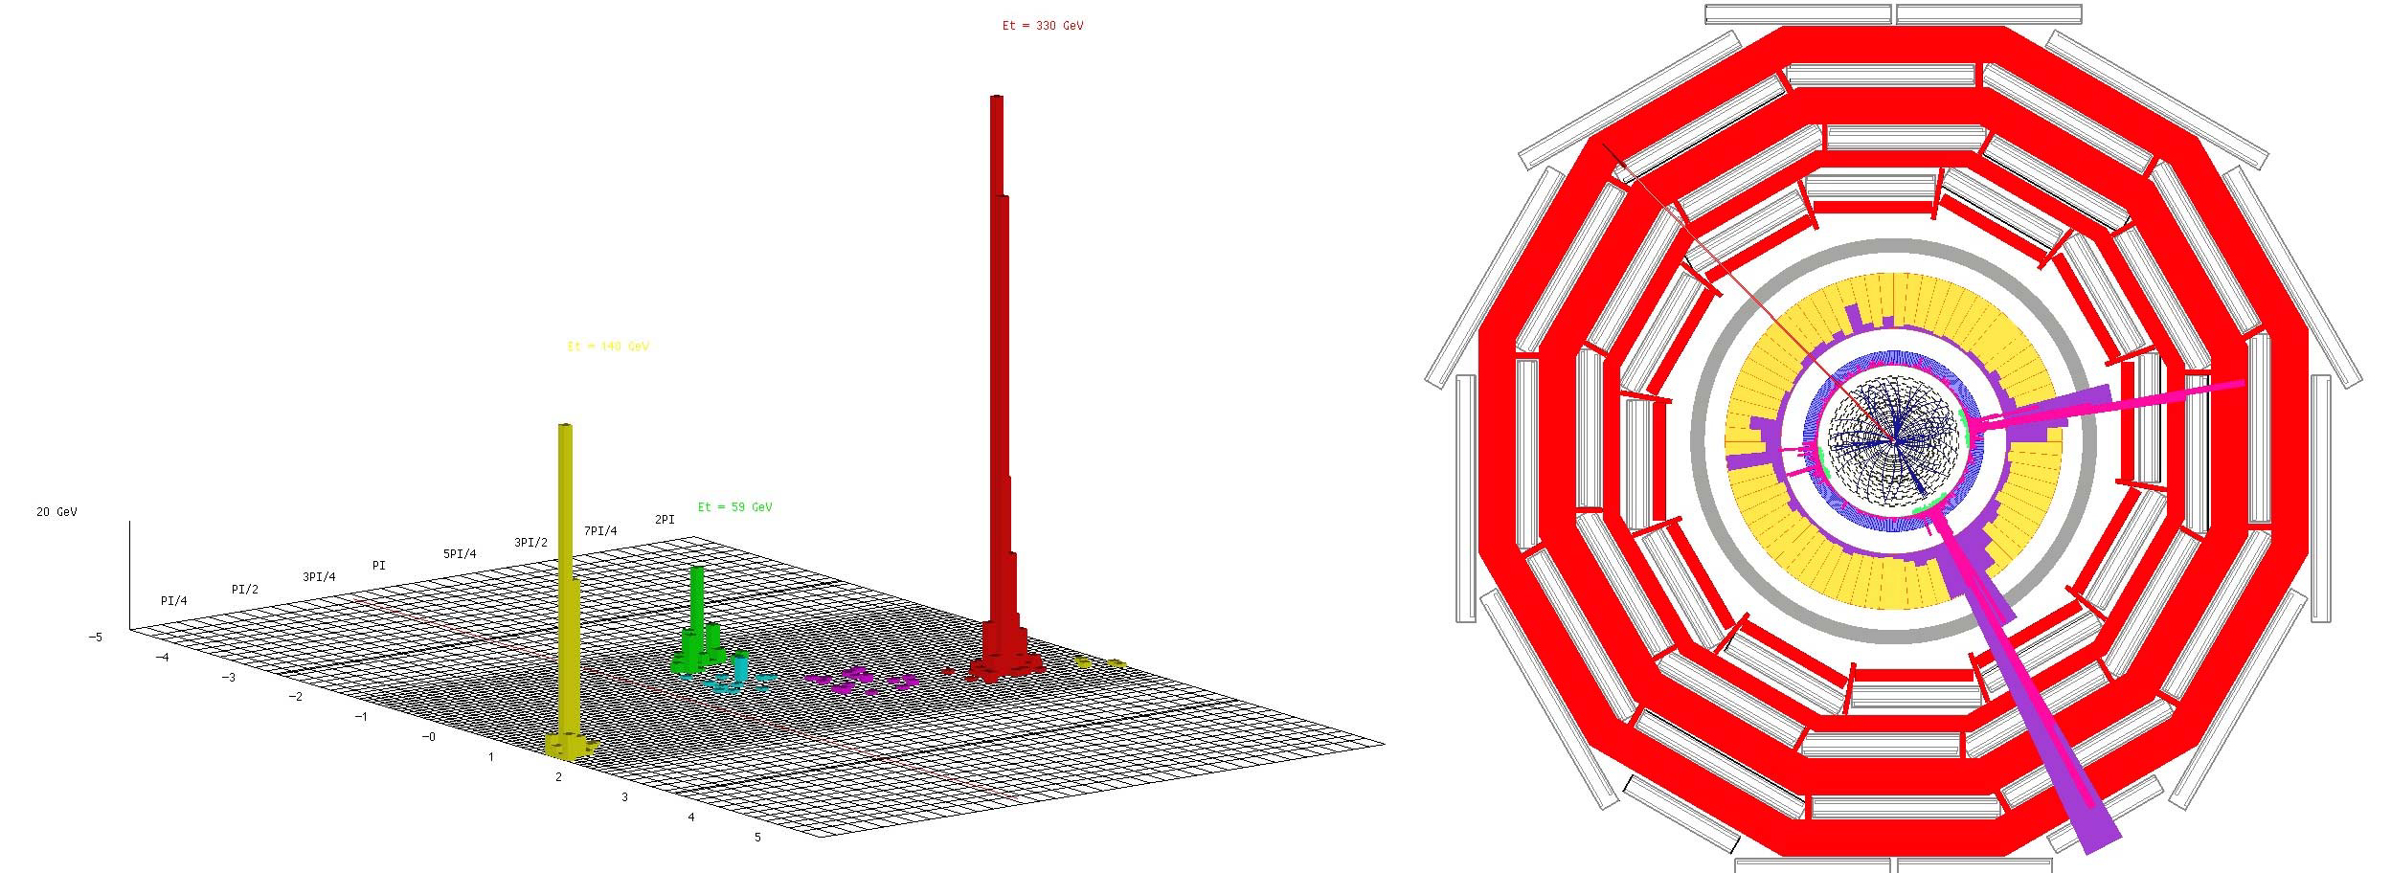
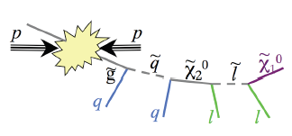
Detecting Supersymmetric Particles
simulation
Energy produced in the detector
θ
φ
Supersymmetric particles decay and produce a cascade of jets, leptons and missing transverse energy (MET) due to escaping ‘dark matter’ particle candidates
Very prominent signatures in CMS and ATLAS

Slide 19
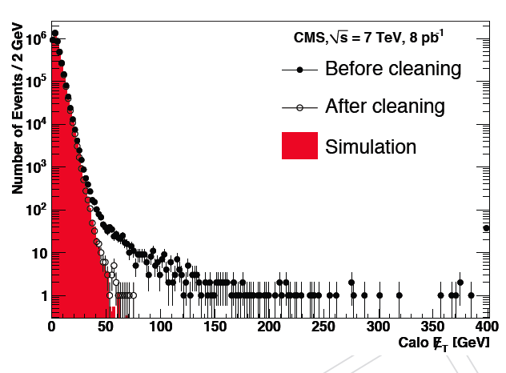
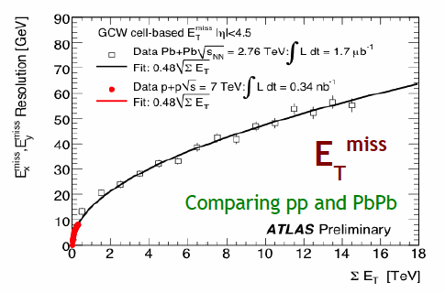
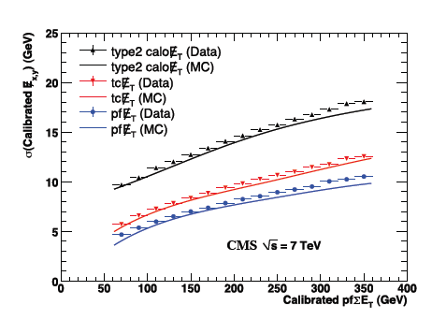
Missing Transverse Energy
Total transverse momentum imbalance
Generally appreciated to be a difficult quantity to measure
Very sensitive to fluctuations, miss-measurements, noise, backgrounds
Minimum bias events
Particle flow
•In practice, rather well under control, from the start (2010)
•Good resolution using ‘particle flow’ ie maximally identifying particles
•More pile-up in future will NOT make this simpler

Slide 20

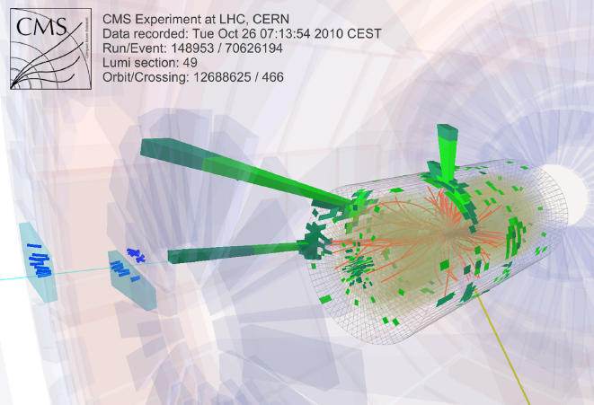
…Some Interesting Collisions…
…already in 2010…
•Events with five jets of particles and large missing energy
which could come from a possible dark matter particle
•But a few events is not enough too prove we have something new
No visible excess has been building up with time…

Slide 21
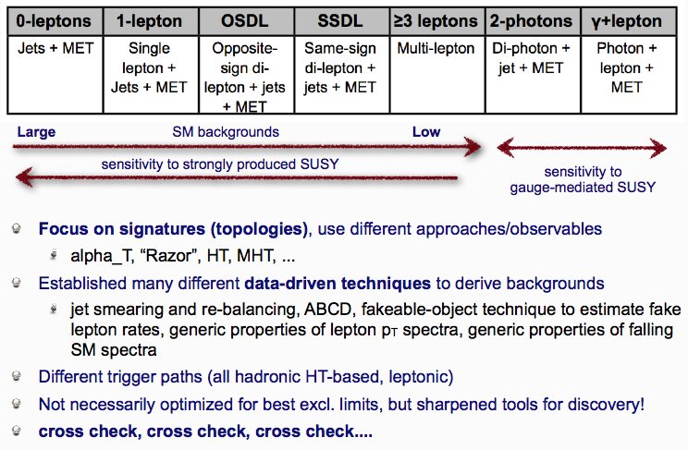
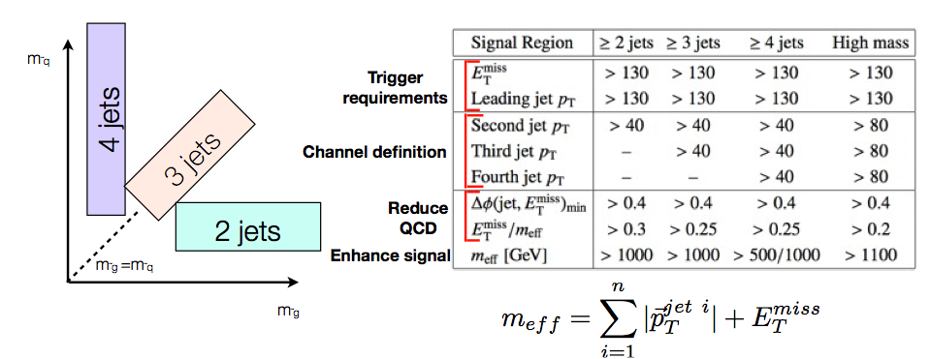
Early SUSY Searches
All Analyses (CMS)
JET+MET (ATLAS)
Note: Strong effort to get background (tail) estimates from data itself

Slide 22
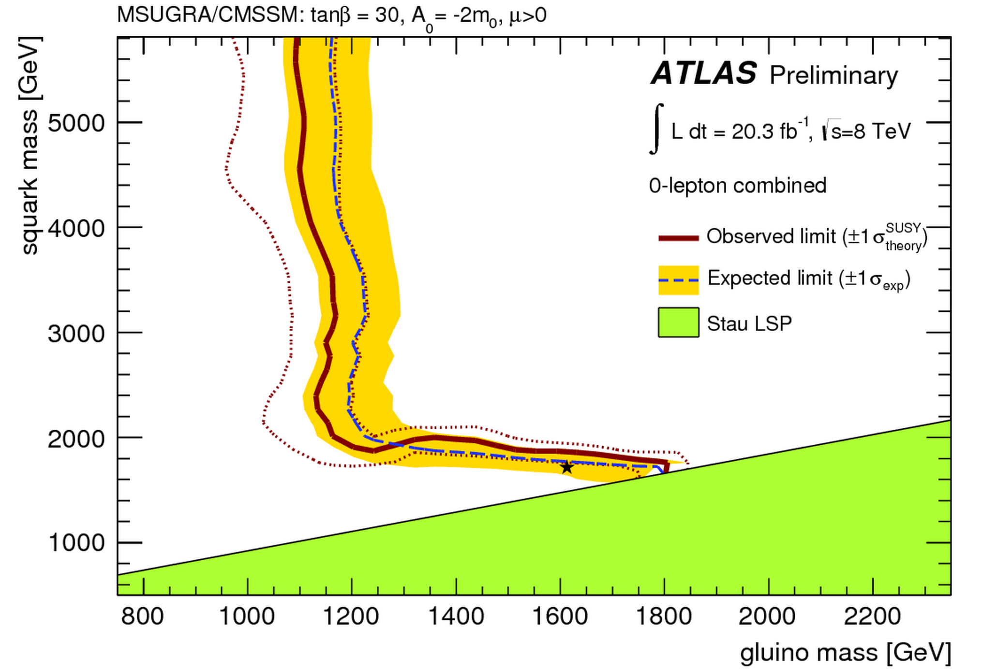
SUSY in Run-1: No Significant Signals
Status with run-1
mSUGRA/CMSSM scenarios
•So far NO clear signal of
supersymmetric particles
has been found
•We can exclude regions
where the new particles
could exist.
•Searches now continue with
the higher energy in Run-2
allowed
excluded
Plenty of searches ongoing: with jets, leptons, photons, W/Z,
top, Higgs, with and without large missing transverse energy
Also special searches for more contrived model regions
CMS-SUS-11-015

Slide 23
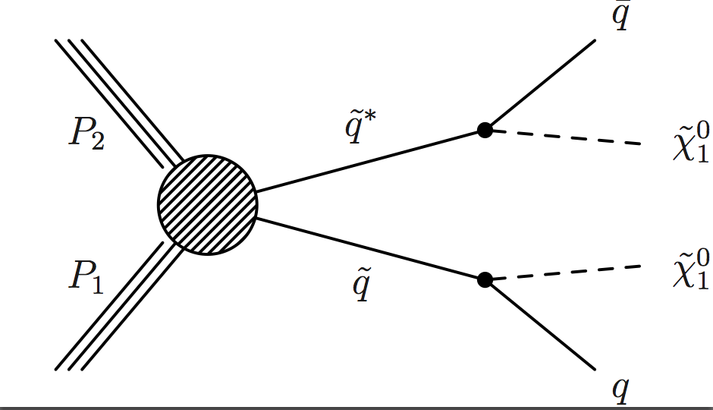
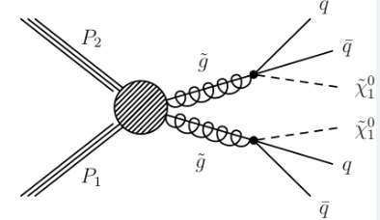
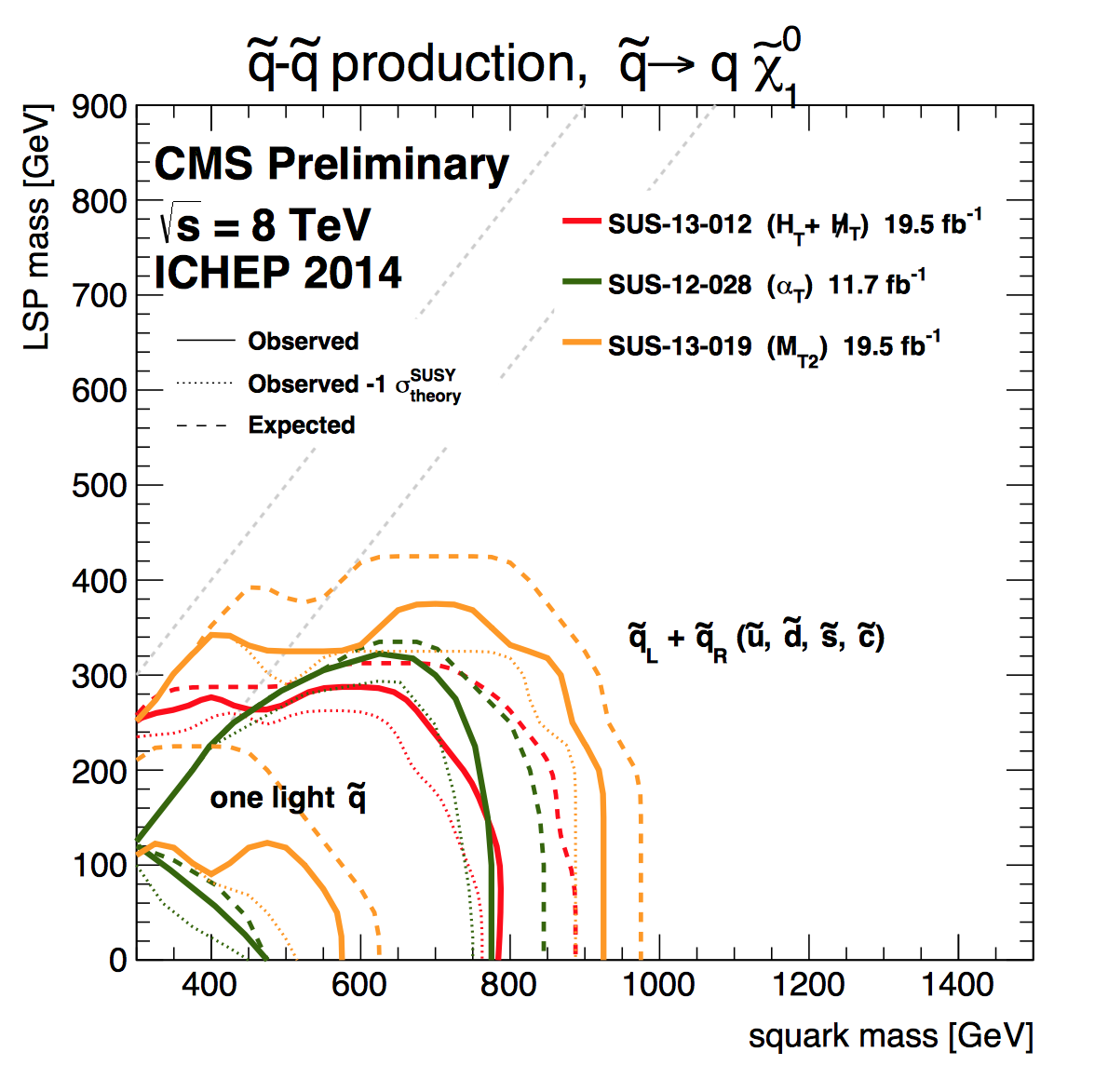
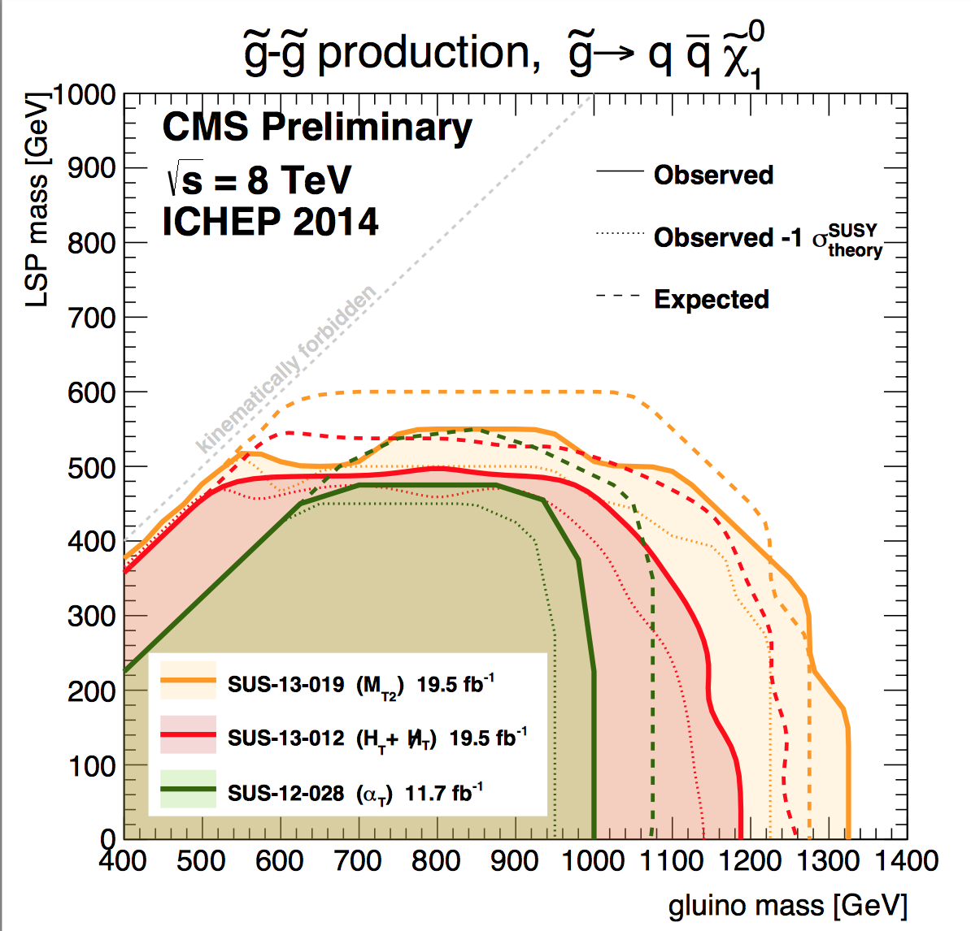
Run-1: Limits on Squarks and Gluinos
Results depend on the topologies studies, assumed mass of the LSP etc.
Popular presentation of data:
Simplified ModelS (SMS)
Examples
Combined limits typically > 1-1.3 TeV on sparticle masses

Slide 24
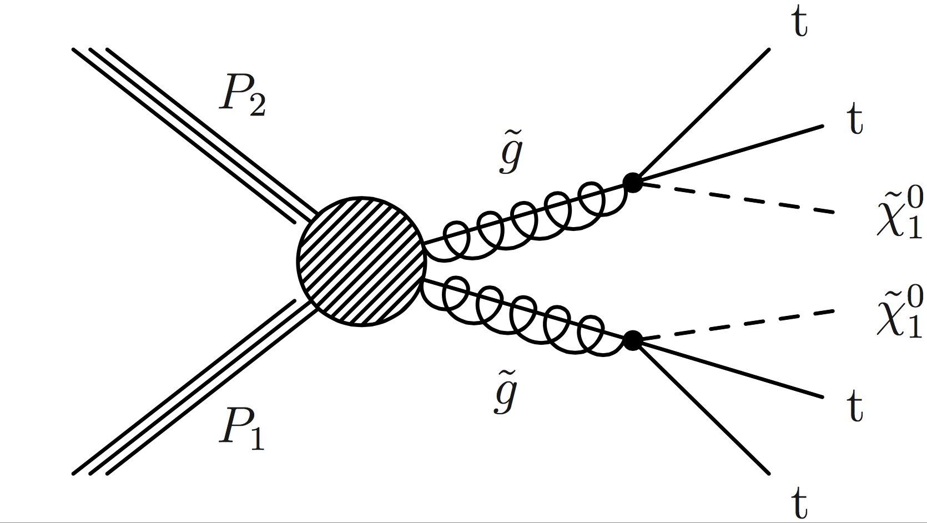
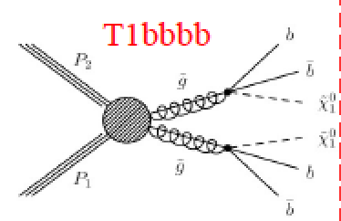
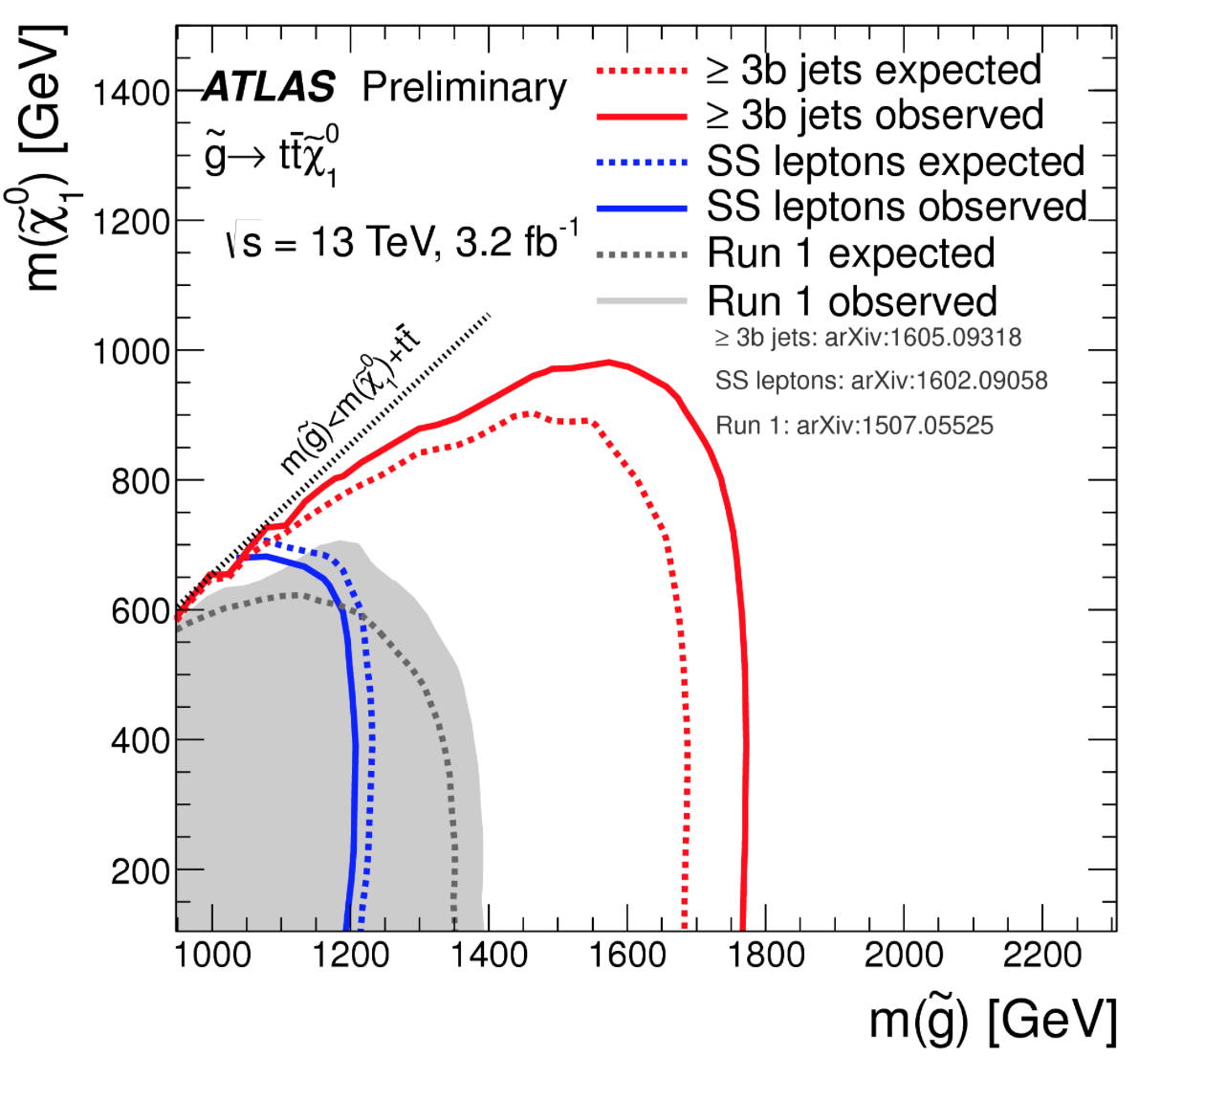
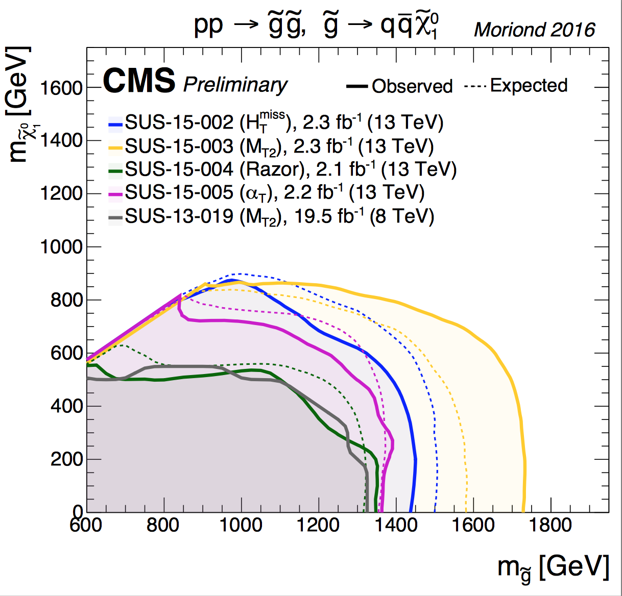
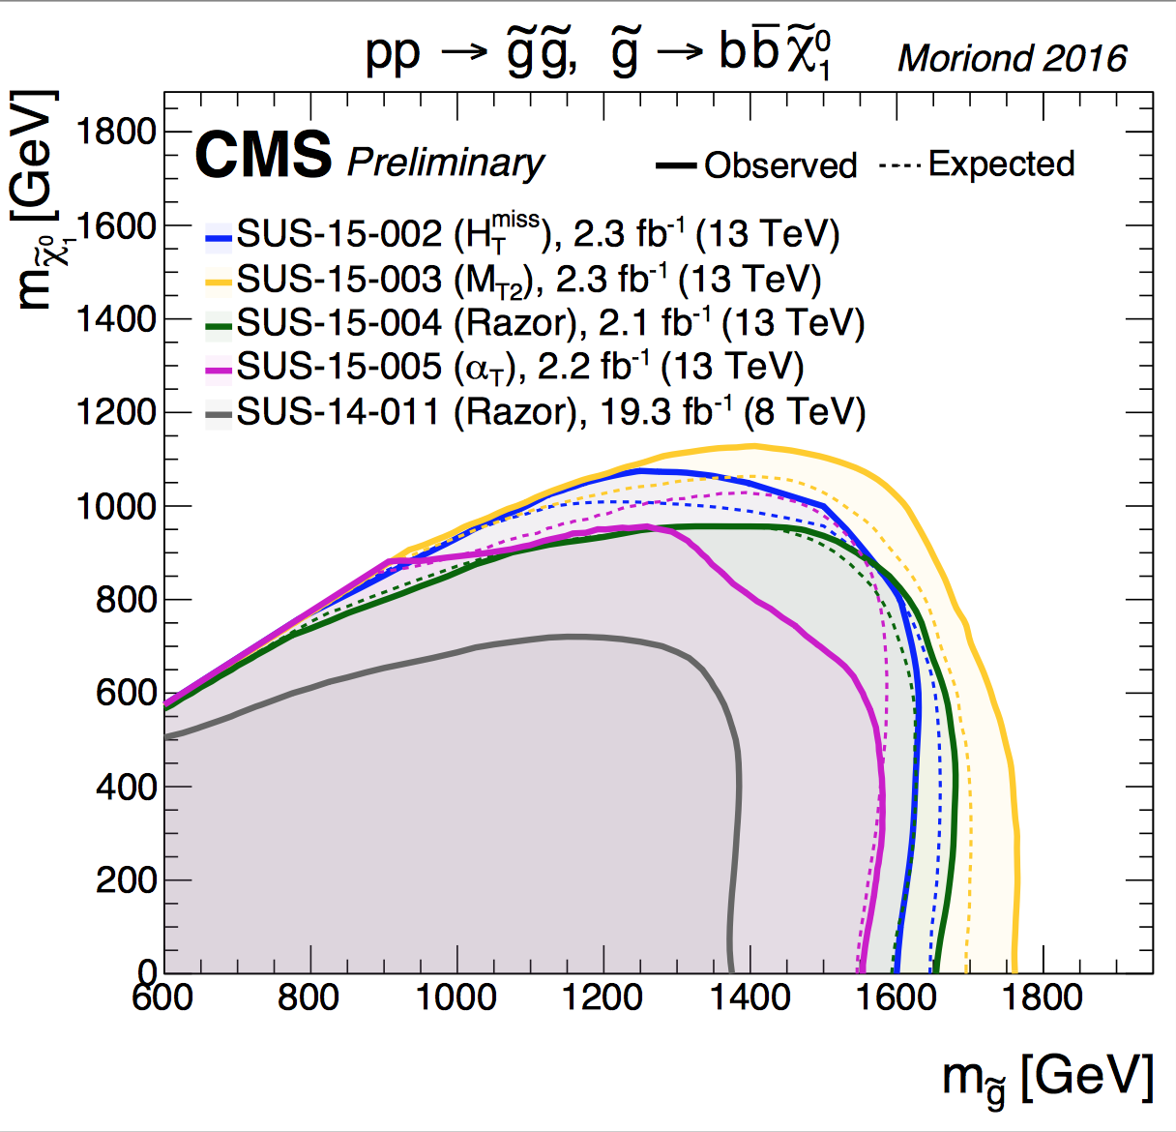
Run-2: All Hadronic Searches
•Gluino searches with all hadronic final states, ie jets + Missing E_{T}
•Several different methods are used, with different background systematics
Popular presentation of data:
Simplified ModelS (SMS)
13 TeV Limits, with 2.3 fb⁻¹ only, are 200-400 GeV better than the 8 TeV ones

Slide 25
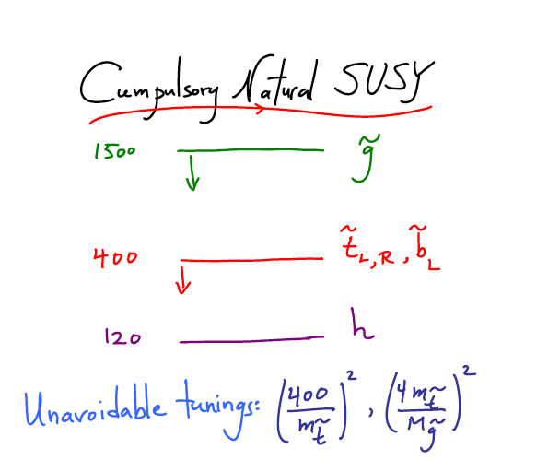
What is really needed from SUSY?
End 2011: Revision!
N. Arkani-Ahmed
CERN Nov 2011
Papucci, Ruderman,
Weiler arXiv:1110.6926
LHC data end 2011
Stops > 200-300 GeV
Gluino > 600-800 GeV
Moving away from
constrained SUSY models
to ‘natural’ models
Natural SUSY survived
LHC so far, but we
are getting close to
push it to its limits!

Slide 26
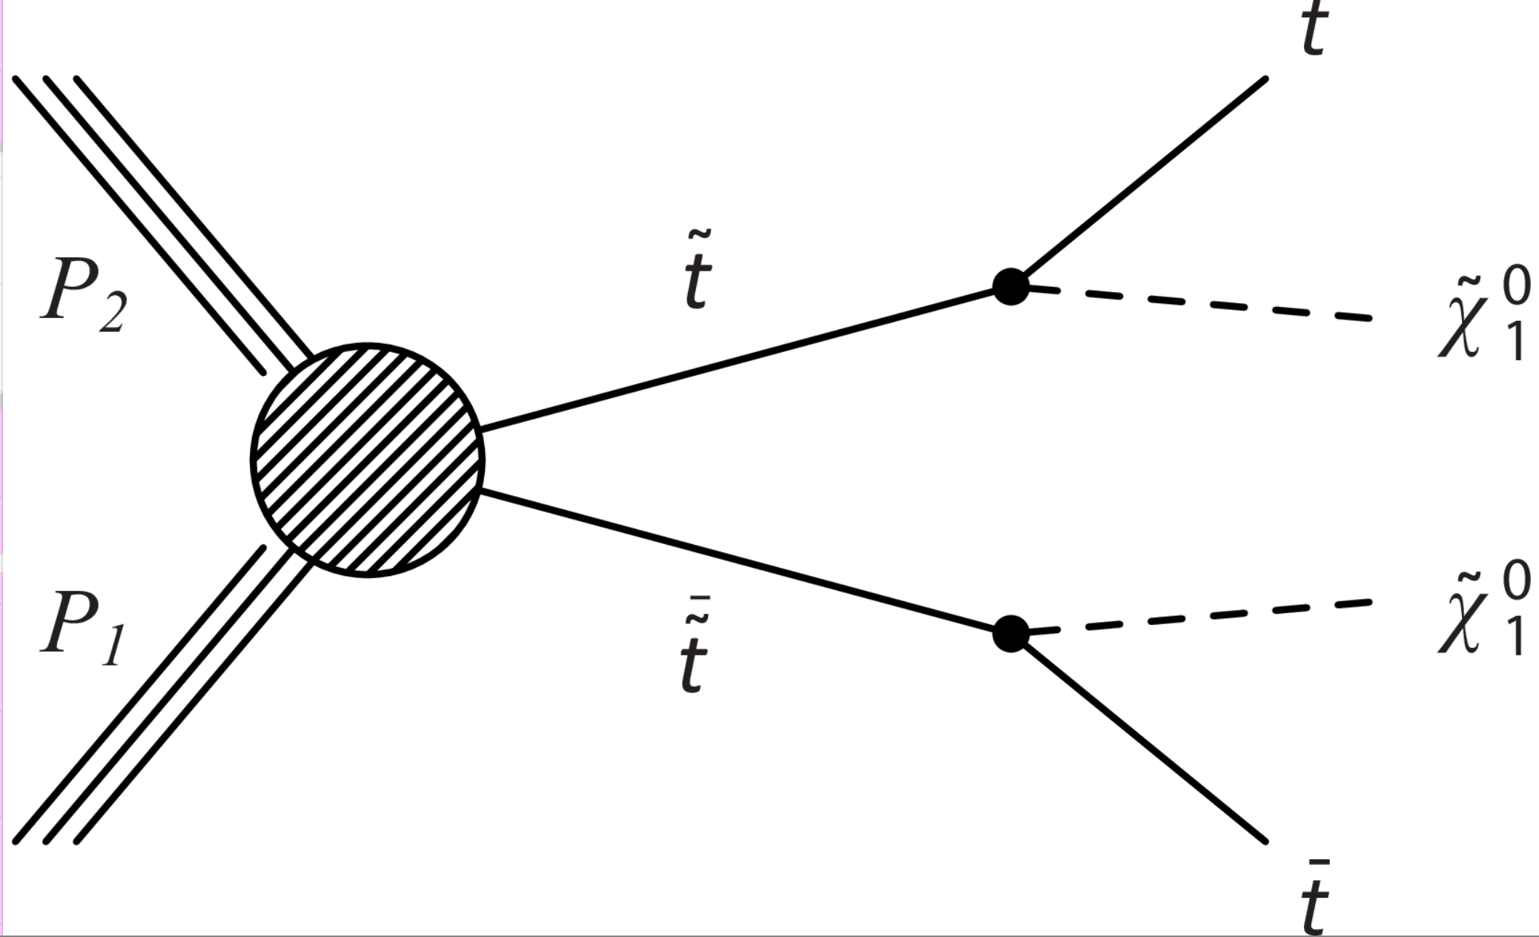



Stop Searches @ 8/13 TeV
The 13 TeV analyses as sensitive
as the higher lumi 8 TeV ones

Slide 27





Phenomenological MSSM analysis
mSUGRA/CMSSM too constraining? SMS don’t always fully cover signatures ?
-> the 19 parameter phenomenological MSSM (pMSSM) analyses
arXiv:1606.03577
ATLAS: arXiv: 1508.06608
gluinos
squarks
stop
10⁸ points sampled: Leads to softer limits on the sparticles masses
Gluinos > 500 GeV, stops > 250 GeV => there is still low mass phase space left!

Slide 28
What about analyses that showed some excess in Run-1?

Slide 29

Search in the Z+Jets+MET Channel
ATLAS-CONF-2015-082
Search for gluino or squark production with Z in decay chain
•In Run-1 ATLAS observed an excess in this
channel: 3 (1.7) σ excess in ee (μμ) channel
•No excess observed in CMS in Run-1
Reproduce the Run-1 analysis in Run-2:

Slide 30

Search in the Z+Jets+MET Channel
Local excess of 2.2σ
Run-2
14
•ATLAS continues to observe
an excess in the 2015 data
•CMS remains consistent with
the background expectation.

Slide 31

Opposite Sign Dilepton Analysis
CMS had “it’s own” mild excess in the run-1 dilepton analysis but in the region
below the Z peak at 8 TeV. The local excess was 3.4σ
The new 2015 data so far does not confirm this excess…

Slide 32
Many Other Searches for SUSY
Searches with many jets (8 or more)
Searches with hard photons
Searches for electroweakinos in multi-lepton final states
Searches with soft leptons
Searches fort sbottoms and staus
Specific analyses for compressed spectra
RPV analyses without missing E_{T} requirement
VBF production of sparticles
SUSY with long lived particles
…
-> So far no outstanding surviving signal!!

Slide 33






Recent New Directions…
Multi-jet (≥6), no MET
VBF EWKino production
Scalar charm quark

Slide 34



Example: SUSY with Long Lived Particles
arXiv:1501.05603
Cross section reach
•Heavy stable charged particles
with de/dx measurements, or
stop-and-decay asynchronous
with the pp collisions.
•Special runs with detector
active and “no-pp collisions”
have been taken.
Gluino > 1580 GeV
Mass reach
arXiv:1606.05129

Slide 35

Summary of SUSY Searches
In short: no sign of SUSY with the data collected so far (similar for CMS)

Slide 36


Slide 37

Dark Matter: Complementary Searches?
After the discovery of the Higgs particle @ the LHC:
Dark matter is the next important physics problems to tackle for the LHC
The search is complementary to other experimental techniques used.

Slide 38





Dark Matter: The Next Challenge !?!
Astronomers found that most of the matter in the Universe must be invisible Dark Matter
‘Supersymmetric’ particles ?
Vera Rubin ~ 1970
F. Zwicky 1898-1974

Slide 39


Particle Dark Matter?
From D. Hooper

Slide 40

WIMPs

Slide 41

Dark Matter @ LHC?
Search for WIMP candidates in events with Missing Transverse Momentum
EG: SUSY searches, monojet and mono-photon searches, W’ searches…
arXiv:1305.1605
+ CAST experiment, searching for axion DM

Slide 42

Direct Searches for Dark Matter
Underground low noise experiments
No non-ambiguous signal yet!!
New 8/9/15: XMASS
experiment (Japan)
does not confirm
the periodical effect
seen by DAMA/LIBRA
New results from
PandaX and LUX

Slide 43






The Generic Dark Matter Connection
Searches for mono-jets and mono-photons etc. can be used to search for
Dark Matter (DM)
Use effective theory or better simplified models to relate measurements to Dark Matter studies

Slide 44



Dark Matter Searches
Convert experimental search results
into limits on DM quantities
Two ways:
Popular in SUSY
Types of interactions chosen
in the studies eg by ATLAS
Discussions on the region of validity ongoing…

Slide 45





Mono-object Searches @ LHC
Mono-jets: Generally the most powerful
Mono-photons: First used for dark matter Searches
Mono-Ws: Distinguish dark matter
couplings to u- and d-type of quarks
Mono-Zs: Clean signature
Mono-Tops: Couplings to tops
Mono-Higgs: Higgs-portals
Higgs Decays?
Effective Field Theories for DM
interpretation are under scrutiny!
Alternatives such as SMS proposed…
arXiv:1407.8257
arXiv:1411.0535
Example Monojets
arXiv:1410.8812
arXiv:1408.3583
Dark Matter?

Slide 46

Some Recent Results (EFTs)

Slide 47

Dark Matter Searches: Evolution
Dark Matter hunt is one of the new main physics goals for the LHC!
•Mono-object searches are not yet giving better sensitivity compared to 8 TeV
•But new developments with Simplified Models, allow including many more
search channels such as dijets (aka “In Search for the Mediator”)
arXiv:1507.00966
A promise for
future studies

Slide 48


Slide 49

Discussions on Dark Matter Interpretation
arXiv:1506.03116
=> Now an ATLAS/CMS +TH working group: arXiv:1603.04156

Slide 50

Dark Matter and the Higgs
“higgs portal models”
Eg: arXiv:1205.3169

Slide 51



Invisible Higgs Decay Channel
CMS-PAS-HIG-13-005
•Possible decay of the Higgs in Dark Matter
particles (if M<M_{H}/2)
•Different searches:
-Direct search
Look for the invisible decay channels
-Indirect search
Make a global fit of all production and
decays (and some modest assumptions)

Slide 52




Invisible Higgs Decay Channel
Search for invisible Higgs decays using
Z+H → 2 leptons + missing E_{T}
VBF H → 2 jets + missing E_{T}
Possible decay in Dark Matter particles
(if M<M_{H}/2): Higgs Portal Models
Combined result from the three channels
BR(H→invisible)<58%(44% exp) at 95% CL.
for a Higgs with a mass of 125 GeV
arXiv1404.1344

Slide 53







Invisible Channels Combination
Recent combination of all channels including also the
mono-jet channel gives for a 125 GeV Higgs a limit
of 36% (30% expected) at 95% CL
Profile
likelihood
scan

Slide 54

New: Invisible Higgs in VBF
VBF process with p_{T} > 35(30) GeV, M_{jj} > 700 GeV and ∆η_{jj} > 3.5 parked dataset with 11 fb⁻¹ in run1
BR(H → inv) = 0.57 (0.40) observed (expected) at 95% CL. Previous CMS limit level in the VBF channels was 0.65 (0.49)
The 95% C.L. observed (expected) limit combining all channels is 47% (35%) for a SM 125 GeV Higgs boson.
HIG-14-038

Slide 55
Searches for BSM Higgses
Exotic Higgs Decays
Search for new Higgses: high and low mass
  2HDM, MSSM, NMSSM…
Charged Higgs searches
Summary
No significant signal to report so far
Exclusions of BSM space

Slide 56




Search for LFV Decays: H →μτ
Background-only
p-value of 0.010 (2.4 σ)
- Best fit
Mild excess giving a 2.4σ effect… To be watched with new data!!!
Not (yet) contradicted by ATLAS … ☺

Slide 57
Looking Forward @ the LHC

Slide 58

Run-I: We Observed Mild Deviations
B. Hooberman

Slide 59




A Global View!
Model independent search
•Divide events into exclusive classes
•Study deviations from SM predictions
in a statistical way
CMS-EXO-10-021
ATLAS-CONF-14-006
ATLAS for 20fb⁻¹
Probability distribution as expected
for 35 pb⁻¹ for CMS
→muons, electrons, photons, (b)jets, MET

Slide 60


Are we leaving no stone unturned?
The LHC BSM searches are indispensable and should be continued in the new energy regime and with increasing statistics.
But if we still do not see more than a 2 sigma at the end of run-III, the HL-LHC will be likely mostly a precision physics machine.
Are we looking at the right place? Time for more effort in thinking of complementary searches?
Are we looking at the right place?
Leave no stone unturned!!

Slide 61


LHCb New Physics in Rare Decays?
Analysis of the B0→K*μ+μ- decay (full run-I data-set)
http://lhcb-public.web.cern.ch/lhcb-public/Welcome.html#P5p
arXiv:1512.04442
Angular
observable
See LHCb
lecture
2.9σ for each point
3.7σ naive combination
Mass of the μμ system

Slide 62




Particles with Milli-Charges?
CMS search for fractional charged particle arXiv:1210.2311
Q=1/3e > 140 GeV; Q=2/3e >310 GeV (95% CL. dE/dx)
A “new” idea -> Hunting for particles with
charges ~ 0.1-0.001e arXiv:1410.6816

Slide 63

How does it feel to be a (BSM) Theorist?
H. Murayama
ICFA Seminar October 2011

Slide 64

Other New Physics Ideas…
Plenty!
  Compositeness/excited quarks & leptons
  Little Higgs Models
  leptoquarks
  String balls/T balls
  Bi-leptons
  RP-Violating SUSY
  SUSY+ Extra dimensions
  Unparticles
  Classicalons
  Dark/Hidden sectors
  Colored resonances
  And more….
Have to keep our eyes open for all possibilities:
Food for MANY PhD theses!!

Slide 65
The Future @ The LHC

Slide 66


The Future: Studying the Higgs…
The Higgs is the new
particle that may give
us crucial insight into
the new physics world
We will have to study it!!
Many questions are still unanswered:
•What explain a Higgs mass ~ 125 GeV?
•What explains the particle mass pattern?
•Connection with Dark Matter?
•Where is the antimatter in the Universe?
•…

Slide 67

LHC Outlook
F. Gianotti, April 2016
7-8 TeV
13-14 TeV
HL-LHC
Run 1
Run 2
Run 3
~3000 fb⁻¹
Splices
fixed
Injectors
upgrade
New
low-β*
quads
~300 fb⁻¹
~100 fb⁻¹
Approved program at CERN to collect 3000 fb⁻¹ with the LHC (HL-LHC)
Maximize the reach for searches and for precision measurements (eg Higgs)

Slide 68


High-Energy LHC??
F. Gianotti
FCC meeting
Rome April 2016
16 TeV vs 14 TeV
28 TeV vs 14 TeV
WG set up to explore technical feasibility of pushing LHC energy to:
design value: 14 TeV
ultimate value: 15 TeV (corresponding to max dipole field of 9 T)
beyond (e.g. by replacing 1/3 of dipoles with 11 T Nb₃Sn magnets)
Identify open risks, needed tests and technical developments, trade-off
between energy and machine efficiency/availability
Report on 1) end 2016, 2) end 2017, 3) end 2018 (in time for ES)
Various options,
with increasing
amount of HW
changes, technical
challenges, cost,
and physics reach
HE-LHC (part of FCC study): ~16 T magnets in LHC tunnel (→ √s~ 30 TeV)
uses existing tunnel and infrastructure; can be built at fixed budget
strong physics case if new physics from LHC/HL-LHC
powerful demonstration of the FCC-hh magnet technology

Slide 69

Example: Searches for New Particles
Searches for pair produced SUSY particles
Energy is key for searches for massive particles!!

Slide 70
Can LHC answer all questions?: Likely not
Some/all New Particles out of mass range?
Need for higher energies at colliders?
Higher precision measurements needed
Need for higher luminosity or e+e-?
Measuring details of the Higgs?
Need for a Higgs factory?
We Expect Answers from the LHC, but
Many ideas are emerging for new accelerators since June 2012
So far only projects being studied, none is approved yet

Slide 71

Summary: The Searches are on!
The LHC has entered a new territory. The ATLAS and CMS experiments are heavily engaged in searches for new physics. The most popular example is Supersymmetry, but many other New Physics model searches are covered.
No sign of new physics yet in the first 20 fb⁻¹ at 8 TeV and the first 13 TeV data… This starts to cut into the ‘preferred regions’ for a large number of models, like SUSY
More exotic channels are now being covered: monopoles, fractional or multiple charged particles, long lived particles… Still many unexplored channels left to explore
The LHC did its part so far with a great run in 2011 and 2012 Collected about 20 fb⁻¹@ 8 TeV by end of 2012
In 2015/206 the energy 13 TeV, excellent for searches
And maybe one day soon:

Slide 72
End of Lecture V

Slide 73


MSSM Neutral Higgs → Tau Tau
arXiv:1408.3316
•Study of the Neutral Higgs h/H/A to tau tau
•Include channels with associated b-quark production
•Upper limits on σ.BR (95% CL)
m_{h}^{max} scenario;
m_{h}^{mod+} and m_{h}^{mod+}
scenarios
with modified
stop mixing

Slide 74

MSSM Neutral Higgs → Tau Tau
arXiv:1408.3316
•Study of the Neutral Higgs
h/H/A to tau tau
•Include channels with associated
b-quark production
•No excess found so far
–> exclusions (95% CL)
m_{h}^{max} scenario;
m_{h}^{mod+} and m_{h}^{mod+}
scenarios
with modified
stop mixing

Slide 75

MSSM Neutral Higgs → Tau Tau
arXiv:1408.3316
•Study of the Neutral
Higgs h/H/A to tau tau
•Include channels with
associated b-quarks
•No excess found so far
–> exclusions (95% CL)
Light stop, light stau,
Tau-phobic and low M_{H}
scenarios

Slide 76


MSSM Neutral Higgs → Tau Tau
NEW: Update of the MSSM results with new tau finder
Reanalysis of the 2011/12 data.
MVA hadronic tau analysis, b-quark categories and
hadronic tau p_{T} categories…
HIG-14-029
Huge gain ~70%!
i.e. like 3x the lumi

Slide 77





MSSM Neutral Higgs → bb
arXiv:1506.08329
Search for H->bb with one or
two b-quarks associated
Exclusion limits for different MSSM scenarios

Slide 78



Charged Higgs Search
Both low and high mass, using full hadronic final states
•Limits now down
to 1.2%-0.16% for
low mass (95%CL)
•Cross section limits
0.38-0.026 pb
at high mass
CMS-PAS-HIG-14-020

Slide 79


Search for LFV Decays: H →μτ
arXiv:1502.07400

Slide 80

Natural SUSY?

Slide 81

Physics Program: Key Topics
Properties of the new Higgs boson, precise determination of its characteristics
High mass reach for new particles and interactions
Precision measurements
Rare process

Slide 82

Prospects for Searches at 14 TeV
0.5-1 fb⁻¹ would be enough for first
analyses entering new territory
We should collect that during summer 2015

Slide 83



High Luminosity LHC Precision
Determine the Higgs couplings to a few % precision…

Slide 84

High Luminosity LHC Precision
Higgs couplings: ….
Determine the Higgs couplings to a few % precision…

