Slide 1
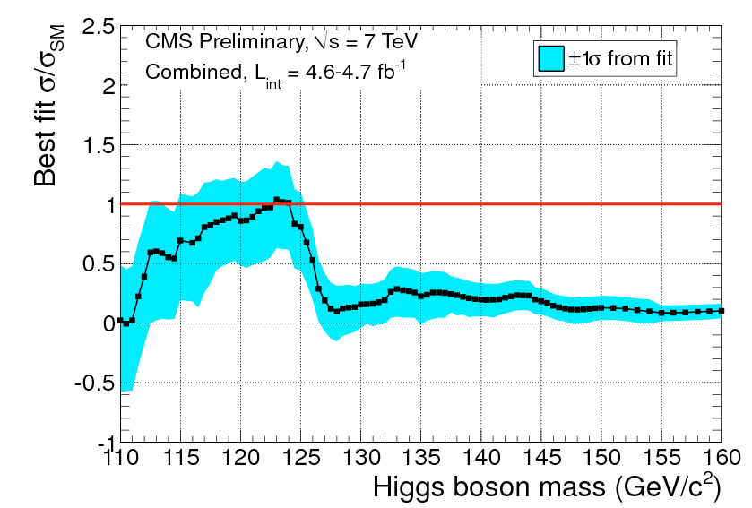
Statistics for HEP Data Analysis
Weihai, July 30th 2016
Tommaso Dorigo
dorigo@pd.infn.it
http.//www.science20.com/quantum_diaries_survivor

Slide 2
About your lecturer
I am a INFN researcher, working in the CMS experiment at CERN since 2002
member of the CMS Statistics Committee, 2009- (and chair, 2012-2015)
Previously (1992-2010) have worked in the CDF experiment at the Tevatron
My interest in statistics dates back to early analyses in CDF. But becoming sapient in statistical matters is a lifelong task, and am still working on it!
Besides research, I do physics outreach in a blog since 2005. The blog is now at http://www.science20.com/quantum_diaries_survivor
Come visit me there!!

Slide 3
Contents of first part (lessons 1 and 2)
Basic concepts: random variables, PDFs, mean and variance, expectation values
An example: why statistics matters, i.e. how knowing the basic statistical distributions saves you from horrible pitfalls
The nuts and bolts of error propagation
how understanding error propagation makes you a better physicist
Estimators and their properties
The χ² method
The Maximum Likelihood method
how knowing the properties of your estimators allows you to not be fooled nor fool yourself
Covariance matrix, error ellipse
A “simple” case: the weighted average of two measurements, in case there is a correlation
Beware, not simple at all!

Slide 4
A suggestion and a few notes
Interrupt often! You might chance to ask a good question…
the answer might show your question was silly → no worry! – you just made sure you understood the matter! Remember, I am here for you…
I do not expect you to follow all the maths – sometimes I will go fast and I will usually neglect to prove the claimed equations
the good thing for you is that you can try to make sense of them by yourself at home; this is a very good way to learn more and ensure you understood the topic
Suggested exercises are (when I remembered to change their color) in green.
we will rather focus on the concepts; the slides are available for offline consumption so you can check the details later
For this reason, the slides contain a lot of text. They are designed to be usable later even if you fell asleep halfway during the lesson, or if our common language barrier made things too hard.

Slide 5
Suggested reading
There are heaps of good books out there about statistics for physicists, statistics for HEP, statistics for data analysis
I can give you my personal advice, but your taste might differ from mine (the way each of us learns is different)
That said, in the following page there are a few suggestions
More bibliographical notes are given after the end of each part

Slide 6
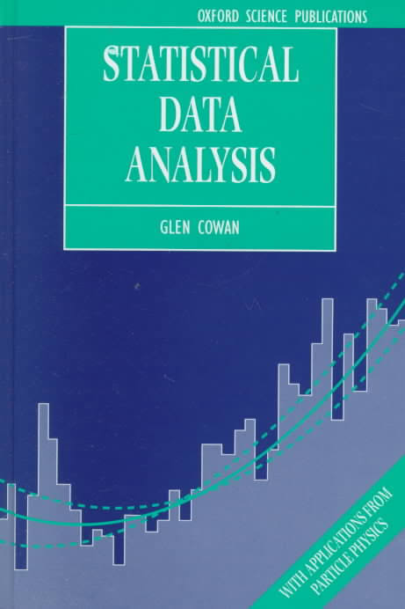
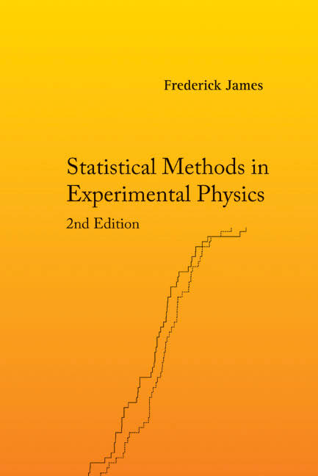
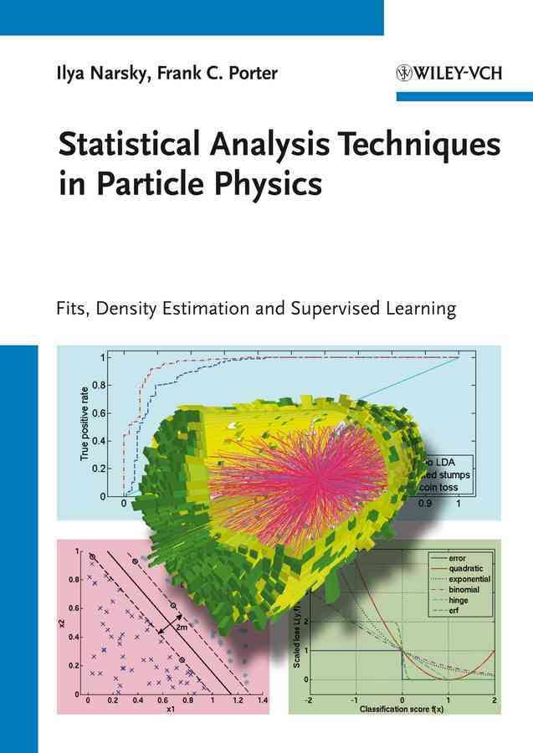
Books
Glen Cowan, "Statistical Data Analysis", Oxford Science Publications 1998
Easy, clear, concise. Provides basic understanding on all the common topics, but lacks in-depth treatment of some advanced material important for HEP (e.g. MVA)
F. James, "Statistical Methods in Experimental Physics", 2nd ed., World Scientific 2002
A serious handbook which contains advanced treatment of many important problems for HEP. Also not complete.
I. Narsky, F. Porter, "Statistical Analysis Techniques in Particle Physics", Wiley 2014
A sharp focus on Multivariate Analysis techniques and their applications to HEP. Aimed at problem solving and extensive, although concise on any given topic.

Slide 7
Statistics matters!
To be a good physicist, one MUST understand Statistics:
“Our results were inconclusive, so we had to use Statistics”
We are quite often in that situation in HEP !
A good knowledge of Statistics allows you to make optimal use of your measurements, obtaining more precise results than your colleagues, other things being equal
It is very easy to draw wrong inferences from your data, if you lack some basic knowledge on Statistics (it is easy regardless!)
Foundational Statistics issues play a role in our measurements, because different statistical approaches provide different results
There is nothing wrong with this: the different results just answer different questions
The problem usually is, what is the question we should be asking ?
Not always trivial to decide!
We also as scientists have a responsibility for the way we communicate our results. Sloppy jargon, imprecise claims, probability-inversion statements are bad. Who talks bad thinks bad ! In the next slide I will make some examples.

Slide 8
Can you recognize anything wrong or smelling fishy in any of the sentences below?
How many of these would you criticize ?
“The measurement is 0.120+-0.003, so the effect is a 40-sigma proof of a non-null value.”
“This is a 3-sigma result. So the probability that the standard model is correct, given the observed data, is 0.0017.”
“I expected 100 +-10 events from backgrounds, but saw 130. The probability that these events are all background ones is thus 0.0017.”
“The article says that the cross section is measured to be σ=1.5+-0.5 pb, so this must be a three-sigma evidence of the process.”
“I tuned my selection by maximizing Q=S/sqrt(B), so it is optimized for discovery.”
“The upper 95% limit is taken as the point where the cumulative of the Likelihood function reaches the value of 0.95.”
The statements are all wrong/misstated/inconsistent. If you learn what is wrong with them during my lectures, you won’t have wasted your time (and I won't have, either).
One additional note: in the country of blindmen, the one-eyed guy is a king!

Slide 9
Chapter 1 - Basic concepts

Slide 10
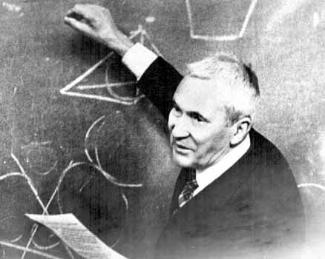
Probability
A mathematical definition of Probability is due to Kolmogorov (1933) with three axioms.
We start by considering a sample space S containing a certain number of elements ("events")
Given the set of all possible events X_{i}, mutually exclusive, we define the probability of occurrence P(X_{i}) as a real-valued function obeying the following three criteria:
P(X_{i})>=0 for all i
P(X_{i} or X_{j}) = P(X_{i}) + P(X_{j})
Σ_{i}P(X_{i})=1
If they are not, they can be broken down
In more elementary ones
A
A&B
Whole
space, S
B

Slide 11
More properties
From the above three axioms we may construct more properties of the probability. For example,
If A and B are non-exclusive sets A={X_{i}}, B={X_{j}} of elementary events, we may define
P(A or B) = P(A) + P(B) – P(A and B)
where “A or B” denotes the fact that an event X_{i} belongs to either set;
and “A and B” that it belongs to both sets.
P(!A) = 1 – P(A)
P(A or !A) = 1
0 <= P(A) <= 1
The conditional probability P(A|B) can then be defined as the probability that an elementary event belonging to set B is also a member of set A:
P(A|B) = P(A and B) / P(B) (read P(A|B) as "p of A given B")
A and B are independent sets if P(A|B)=P(A). In that case, from the above follows that
P(A and B) = P(A) P(B) for A,B independent

Slide 12
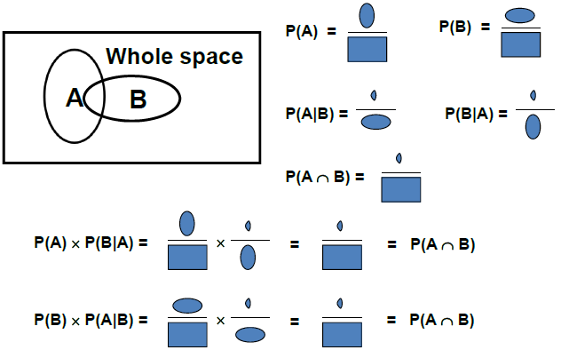
Bayes Theorem
The theorem linking P(A|B) to P(B|A) follows directly from the definition of conditional probability and the previously seen expression of P(A and B):
P(A|B)=P(A and B)/P(B)
P(A and B)=P(B|A) P(A) P(A|B) P(B) = P(B|A) P(A)
If one expresses the sample space as the sum of mutually exclusive, exhaustive sets A_{i} [→law of total probability: P(B)=Σ_{i} P(B|A_{i})P(A_{i}) ], one can rewrite this as follows:
Note: for probabilities to be well-defined, the “whole space” needs to be defined
The “whole space” should be considered conditional on the assumptions going into the model
Restricting the “whole space” to a relevant subspace often improves the quality of statistical inference
(→ conditioning – will discuss later)
(Graph courtesy B. Cousins)

Slide 13
Random variables
Formally, a random variable x is a variable which takes on a specific value for each element of the set S (the "sample space")
X can be single or multi-dimensional (i.e., a vector)
We can omit the separate concept of "elements of S" and "value of the random variable on the element" in the following – x takes values on S; e.g. for continuous, unconstrained variables S is then the real axis; for discrete variables S may e.g. be the set of natural numbers.
Random variables can be independent or dependent on other random variables; we will see later how to formally define this.
The concept of random variable x is tightly intertwined with the one of probability density function f(x) – the function that describes the chance of observing different values of x

Slide 14
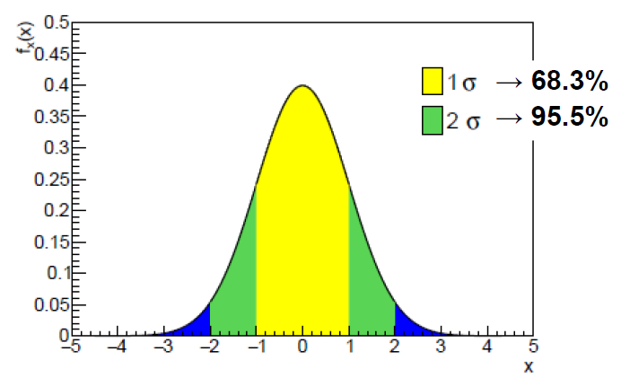
Probability density functions - basics
Often a measurement of some observable quantity results in a continuous random variable. We can consider intervals in the possible values as subsets of the total sample space, and derive the probability that the measurement is included in them
P(x_{meas} in [x, x+dx[) = f(x) dx
Of course this has no meaning unless P(x in S)=1
If x is single-dimensional, we realize that a set of probability values as the one defined above can be effectively drawn as a histogram, if we define the width of the bins to be dx.
By letting dx go to zero, we obtain the continuous function f(x). This is called "probability density function" of x (PDF).

Slide 15
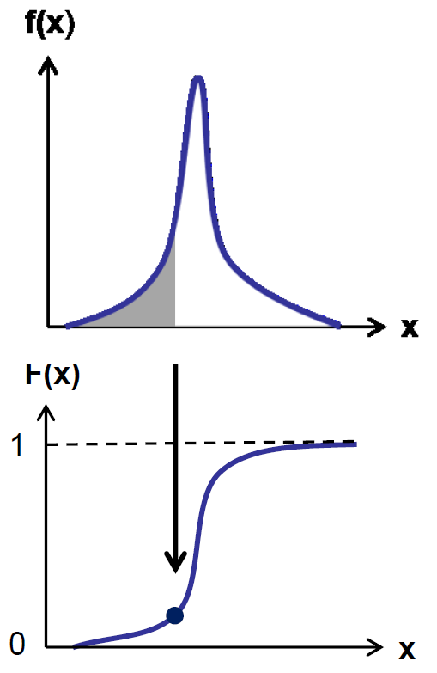
The cumulative distribution
For any single-dimensional PDF f(x) it is straightforward to define the cumulative distribution F(x) as
$$F\left(x\right)=\int_{−∞}^{x}{f\left(x^{′}\right)dx′}$$
The meaning of F(x) is that of the probability to observe x' with a value smaller or equal to x
This leads to the concept of quantile x_{α}, defined as value of x such that F(x_{α})=α.
The special quantile with a name is the median, x_{0.5}.
Other important quantiles: x_{0.05}, x_{0.95}, x_{0.16}, x_{0.84}.
The median, like the mean (see later) but unlike the mode [the most probable value of the distribution f(x)], can be a value not belonging to S
We will use it
When we define
"tail probabilities"

Slide 16
Graphical relation between f(x), F(x), F⁻¹(x), and the quantiles

Slide 17
E[.]: the Mean
The probability density function (pdf) f(x) of a random variable x is a normalized function which describes the probability to find x in a given range: as already written before,
P(x,x+dx) = f(x)dx
This is defined for continuous variables. For discrete ones, e.g. P(n|μ)=e^{-μ}μ^{n}/n! , P is a probability tout-court.
The expectation value of the random variable x is then defined as
E[x], also called population mean , or simply mean, of x, thus depends on the distribution f(x). Note that E[x] is not a function of x, but it is rather a fixed quantity dependent on the form of the PDF f(x).
The formulation of the expectation value is useful to define other properties of the PDF, as shown in the following.
a function of the
parameters of
the model

Slide 18
The variance
Of crucial importance to determine the property of a distribution is the “second central moment” of x,
also called variance. The variance describes the "spread" of the PDF around its expectation value. It enjoys the property that
E[(x-E[x])²] = E[x²]-μ²,
as it is trivial to show.
Also well-known is the standard deviation σ = sqrt(V[x]).

Slide 19
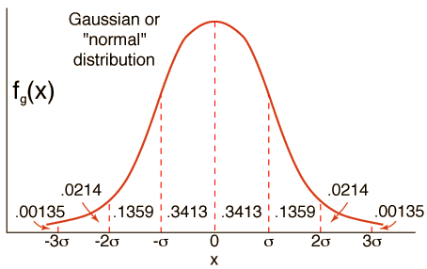
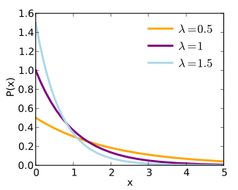
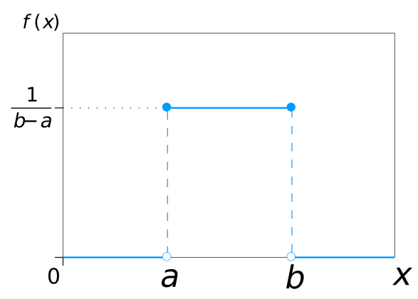
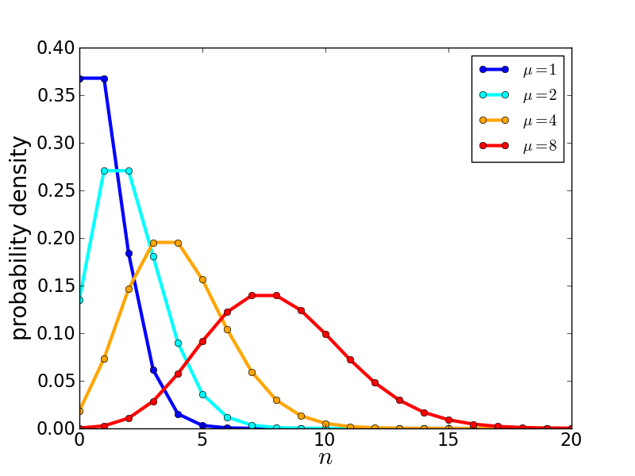
Common PDFs
Let us review quickly the main properties of a few of the statistical distributions you are most likely to work with in data analysis
NB you find all needed info in any textbook (or even the PDG) – this is only a quick a summary
Name | Expression | Mean | Variance | Notable facts
Gaussian f(x;μ,σ)= | e^{-[(x-μ)2/2σ2]}/ (2πσ²)^{1/2} | μ | σ² | Limit of sum of random vars is Gaussian distr.
Negative Exponential f(x;τ)= | e^{-x/τ}/τ | τ | τ² | Useful for particle decays; it is also a common prior in Bayesian calc's
Uniform f(x;α,β)= | (β-α)/2 for α<=x<=β 0 otherwise | (α+β)/2 | (β-α)²/12 | Any continuous r.v. can be easily transformed into uniform (→ MC method !)
Poisson f(x;μ)= | e^{-μ}μ^{N}/N! | μ | Μ | Turns into Gaussian for large μ

Slide 20
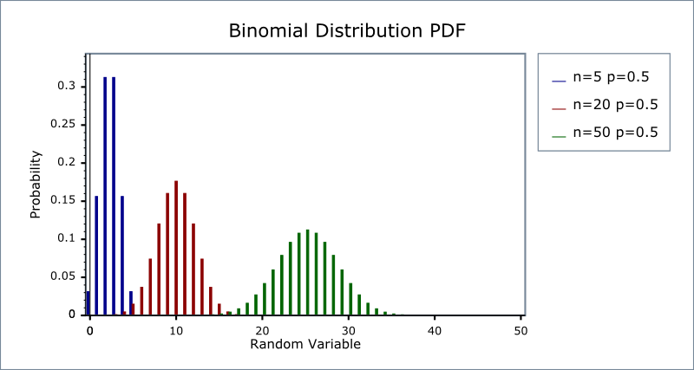
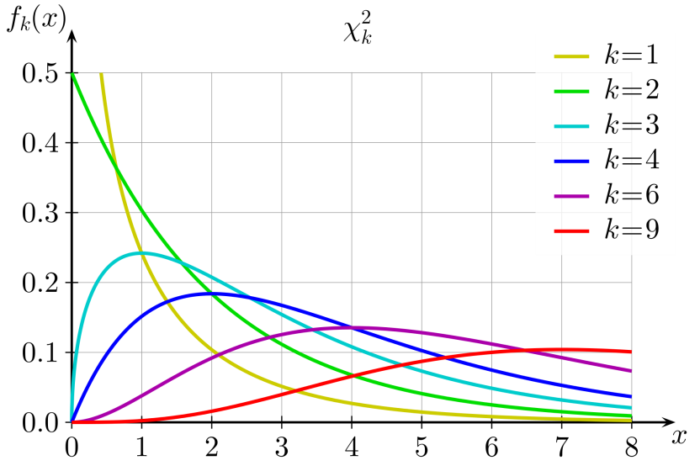
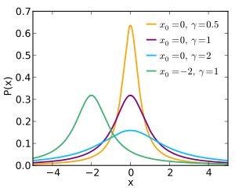
More distributions
Name | Expression: | Mean | Variance | Fun facts
Binomial f(r;N,p)= | N! p^{r}(1-p)^{N-r}/[r!(N-r)!] | Np | Npq | Special case of Multinomial distribution
Chisquare f(x;N)= | e^{-x/2} (x/2)^{N/2-1}/[2Γ(N/2)] | n | 2n | Turns into Gaussian for large n (>30 or so)
Cauchy f(x)= | $[πγ(1+(\frac{x−x0 }{γ})$²]⁻¹ | Undefined! | Infinite | AKA Breit-Wigner. Can be manageable if truncated

Slide 21
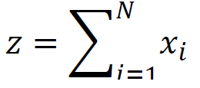
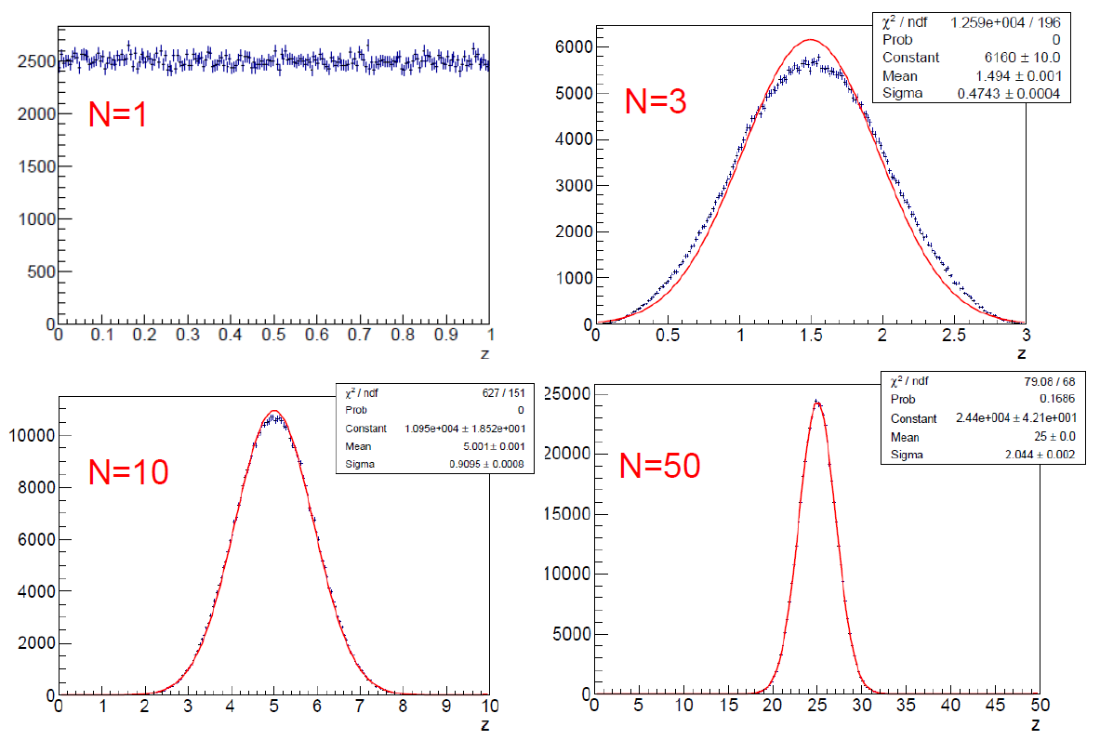
The central limit theorem
The sum of many random variables will tend to a Gaussian distribution!
This is at the basis of MUCH of the statistics practice we do
Here we take x_{i} from a
Uniform distribution and plot z when N becomes large

Slide 22
Warm-up example 1: Why it is crucial to know basic statistical distributions
It is common to know the expression, and at least the basic properties, of the following:
Gaussian (AKA Normal) distribution
Poisson distribution
Exponential distribution
Uniform distribution
Binomial and Multinomial distribution
A mediocre particle physicist can live a comfortable life without having other distributions at his or her fingertips. However, I argue you should at the very least recognize and understand the properties of :
Chisquare distribution
Compound Poisson distribution
Log-Normal distribution
Gamma distribution
Beta distribution
Cauchy distribution (AKA Breit-Wigner)
Laplace distribution
Fisher-Snedecor distribution
There are many other important distributions, but we can stop here…
Most Statistics books discuss the above PDFs carefully, for a good reason.
We can make at least just an example of the pitfalls you may avoid by knowing they exist!

Slide 23
The Poisson distribution
Let us recall again the Poisson PDF:
The expectation value of a Poisson variable with mean μ is E(n) = μ
its variance is V(n) = μ
The Poisson is a discrete distribution. It describes the probability of getting exactly n events in a given time, if these occur independently and randomly at constant rate (in that given time) μ
Other fun facts:
it is a limiting case of the Binomial [ ] for p→0, in the limit of large N
it converges to the Normal for large μ

Slide 24
The Compound Poisson distribution
Less known is the compound Poisson distribution, which describes the sum of N Poisson variables, all of mean μ, when N is also a Poisson variable of mean λ:
Obviously the expectation value is E[n] = λμ
The variance is V(n) = λμ(1+μ)
One seldom has to do with this distribution in practice. Yet I will make the point that it is necessary for a physicist to know it exists, and to recognize it is different from the simple Poisson distribution.
Why ? Should you really care ?
Let me ask before we continue: how many of you knew about the existence of the compound Poisson distribution?
Don't feel forced to raise your hand – typically only 5% of PhDs in Physics know it

Slide 25
PRL 23, 658 (1969)
In 1968 the gentlemen named in the above clip observed four tracks in a Wilson chamber whose apparent ionization was compatible with the one expected for particles of charge ²/₃e.
Successively, they published a paper where they showed a track which could not be anything but a fractionary charge particle!
In fact, it produced 110 counted droplets per unit path length against an expectation of 229 (from the 55,000 observed tracks).
What is the probability to observe such a phenomenon ?
We compute it in the following slide.
Note that if you are strong in nuclear physics and thermodynamics, you may know that a scattering interaction produces on
average about four droplets. The scattering and the
droplet formation are independent Poisson processes.
However, if your knowledge of Statistics is poor, this observation
does not allow you to reach the right conclusion. What is the
difference, after all, between a Poisson process and the
combination of two ?

Slide 26
Significance of the observation
We will get back to this kind of calculations later, so don't worry if you don't get the details now
Case A: single Poisson process, with m=229:
Since they observed 55,000 tracks, seeing at least one track with P=1.6x10⁻¹⁸ has a chance of occurring of 1-(1-P)⁵⁵⁰⁰⁰, or about 10⁻¹³
Case B: compound Poisson process, with λμ=229, μ=4:
One should rather compute
from which one gets that the probability of seeing at least one such track is rather 1-(1-P’)⁵⁵⁰⁰⁰, or 92.5%. Ooops!
Bottomline:
You may know your detector and the underlying physics very well, but only your knowledge of basic Statistics prevents you from being fooled !

Slide 27
Point estimation: Combining Measurements and Fitting
Perceived as two separate topics, but they really are the same thing (the former is a special case of the latter) – I will try to explain what I mean in the rest of this lesson
The problem of combining measurements arises quite commonly in data analysis and we should spend some time on it
We will get eventually to the point of spotting potential issues arising from correlations.
We should all become familiar with these issues, because for HEP physicists combining measurements is day-to-day stuff.
What we call in jargon Data fitting in Statistics is named “parameter estimation” (which should be itself composed of two parts, “point estimation” and “interval estimation”).
One thus realizes that the issue of combining different estimates of the same parameter is a particular case of data fitting, and in fact the tools we use are the same

Slide 28
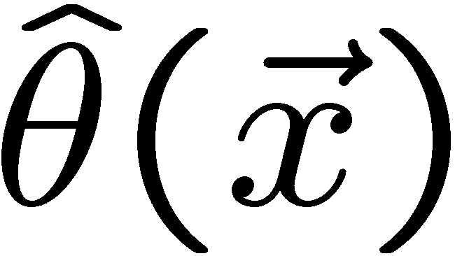
Parameter estimation: definitions
The parameters of a pdf are constants that characterize
its shape, e.g.
x is a random variable, theta is a parameter. If you change theta, you get a different PDF
Suppose we have a sample of observed values:
We often want to find some function of the data to estimate the
parameter(s):
Note: the estimator gets written with a hat
Usually we say ‘estimator’ for the function of x₁, ..., x_{n};
‘estimate’ for the value of the estimator with a particular data set.
Also, note that when we say we "measure" physical quantities, statisticians really talk
about us "estimating" them. An estimate is a measurement. A measurement is an estimate.

Slide 29
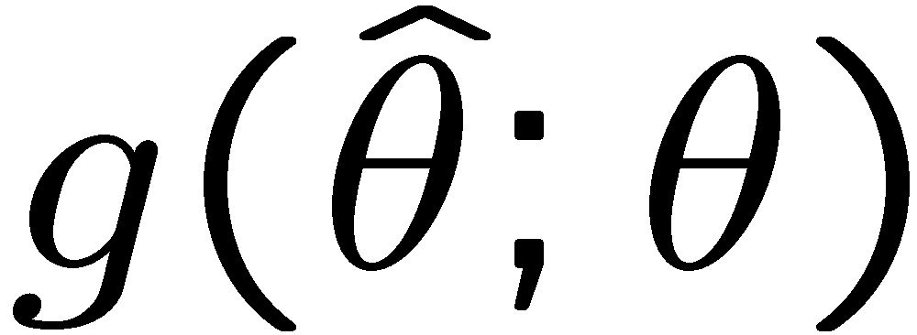
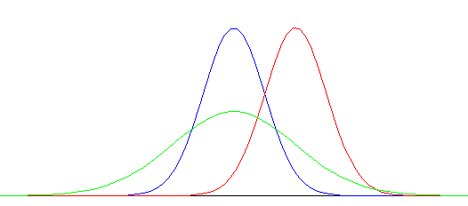
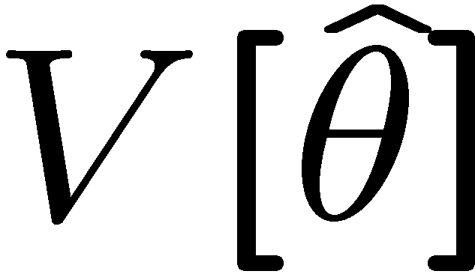
Two properties of estimators
If we were to repeat the entire measurement many times, the estimates we get
from each would follow a pdf:
best
large
variance
biased
We usually (not always!!!) want small (or zero) bias (systematic error):
this way, the average of repeated measurements should tend to the true value.
And we want a small variance (statistical error):
(will define better below)
Note: small bias & small variance are in general conflicting criteria. You know
this from your experimental physics practice, but in Statistics this is a rule

Slide 30
Covariance and correlation
If you have two random variables x,y you can also define their covariance, defined as
This allows us to construct a covariance matrix V, symmetric, and with positive-defined diagonal elements, the individual variances σ_{x}²,σ_{y}²:
A measure of how x and y are correlated is given by the correlation coefficient r:
Note that if two variables are independent, f(x,y) = f_{x}(x) f_{y}(y), then r = V_{xy} = 0 and
E[xy] = E[x]E[y] = μ_{x}μ_{y}.
However, E[xy]=E[x]E[y] is not sufficient for x and y be independent! In everyday usage one speaks of “uncorrelated variables” meaning “independent”. In statistical terms,uncorrelated is much weaker than independent!

Slide 31
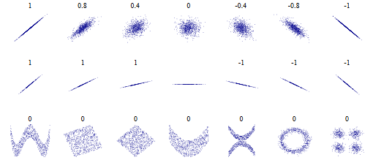
Uncorrelated vs Independent
Uncorrelated << Independent:
r=0 is a very weak condition; r only describes the tendency of the data to “line up” in a certain (any) direction. Many strictly dependent pairs of variables fulfil it. E.g. the abscissa and ordinate of the data points in the last row below.

Slide 32
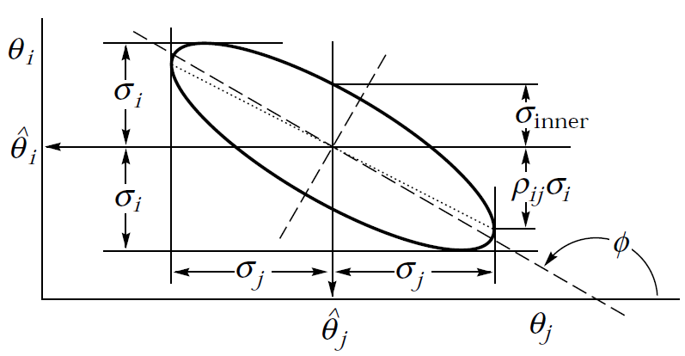
The Error Ellipse
When one measures two correlated parameters θ = (θ₁,θ₂), in the large-sample limit their estimators will be distributed according to a two-dimensional Gaussian centered on θ. One can thus draw an “error ellipse” as the locus of points where the χ² is one unit away from its minimum value (or the log-likelihood equals ln (L_{max})-0.5).
The location of the tangents to the axes provide the standard
deviation of the estimators. The angle φ is given by
Will discuss later (we have not defined chisquare and likelihood)… This is just to say that when one speaks of correlated measurements one will usually end up with error ellipses.
A measurement of one parameter at a given value of the other is determined by the intercept on the line connecting the two tangent points.
The uncertainty of that single measurement, at a fixed value of the other parameter, is
The correlation coefficient ρ is the distance of each axis from the tangent point, in units of the corresponding standard deviation
In that case one may report
and the slope

Slide 33
Error propagation
Imagine you have n variables x_{i}, and you do not know their pdf.
You may compute their mean and covariance matrix. Now say there is a function y of the x_{i} and you wish to determine the pdf of y: you can expand it in a Taylor series around the means, stopping at first order:
From this one can show that the expectation values of y and y² are, to first order,
and the variance of y is then the second term in this expression.
(see backup)
In case you have a set of m functions y_{i}(x), you can build their own covariance matrix
This is often expressed in matrix form once one
defines a matrix of derivatives A,
The above formulas allow one to “propagate” the variances from the x_{i} to the y_{j}, but this is only valid if it is meaningful to expand linearly around the mean!
Beware of routine use of these formulas in non-trivial cases.
remember: E[(x-E[x])²] = E[x²]-μ²

Slide 34
How it works
To see how standard error propagation works, let us use the formula for the variance of a single y(x)
One thus sees that for uncorrelated variables x₁,x₂ (V₁₂=0), the variances of their sum add linearly, while for the product it is the relative variances which add linearly.
and consider the simplest examples with two variables x₁,x₂: their sum and product.
for the sum,
for the product.

Slide 35
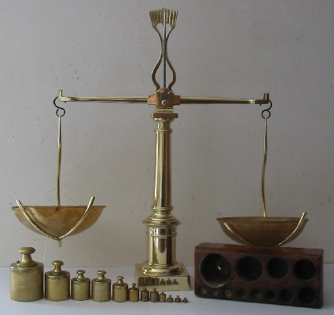
Example 2: why we need to understand error propagation
We have seen how to propagate uncertainties from some measurements (random variables!) x_{i} to a derived quantity y = f(x):
this is just standard error propagation, for uncorrelated random variables x_{i}.
What we neglect to do sometimes is to stop and think
at the consequences of that simple formula, in the
specific cases to which we apply it. That is because we
have not understood well enough what it really means.
Let us take the problem of weighting two objects A and B
with a two-arm scale offering a constant accuracy, say
1 gram. You have time for two weight measurements.
What do you do ?
weight A, then weight B
something else ? Who has a better idea ?

Slide 36
Smart weighting
If you weight separately A and B, your results will be affected by the stated accuracy of the scale: σ_{A} = σ = 1g , σ_{B} = σ = 1g.
But if you instead weighted S=A+B, and then weighted D=B-A by putting them on different dishes, you would be able to obtain
Your uncertainties on A and B have become 1.41 times smaller! This is the result of having made the best out of your measurements, by making optimal use of the information available. When you placed one object on a dish, the other one was left on the table, begging to participate!
= 0.71 grams !

Slide 37
Addendum: fixed % error
What happens to the previous problem if instead of a constant error of 1 gram, the balance provides measurements with accuracy of k% ?
If we do separate weightings, of course we get σ_{A}=kA, σ_{B}=kB. But if we rather weight S = B+A and D = B-A, what we get is (as A=(S-D)/2, B=(D-S)/2)
The procedure has shared democratically the uncertainty in the weight of the two objects. If A=B we do not gain anything from our “trick” of measuring S and D: both σ_{A}=kA and σ_{B}=kB are the same as if you had measured A and B separately. But if they are different, we gain accuracy on the heavier one at expense of the uncertainty on the lighter one!
Of course the limiting case of A>>B corresponds instead to a very inefficient measurement of B, while the uncertainty on A converges to what you would get if you weighted it twice.

Slide 38
Estimators: a few more definitions
Given a sample {x_{i}} of n observations of a random variable x, drawn from a pdf f(x), one may construct a statistic: a function of {x_{i}} containing no unknown parameters. An estimator is a statistic used to estimate some property of a pdf. Using it on a set of data provides an estimate of the parameter.
Estimators are labeled with a hat (will also use the * sign here) to distinguish them from the respective true, unknown value, when they have the same symbol.
Estimators are consistent if they converge to the true value for large n.
The expectation value of an estimator θ* having a sampling distribution H(θ*;θ) is
Simple example of day-to-day estimators: the sample mean and the sample variance
The bias of an estimator is b=E[θ*]-θ. An estimator can be consistent even if biased: the average of an infinite replica of experiments with finite n will not in general converge to the true value, even if E[θ*] will tend to θ as n tends to infinity.
Other important properties of estimators (among which usually there are tradeoffs):
efficiency: an efficient estimator (within some class) is the one with minimum variance
robustness: the estimate is less dependent on the unknown true distribution f(x) for a more robust estimator (see example on OPERA later)
simplicity: a generic property of estimators which produce unbiased, Normally distributed results, uncorrelated with other estimates.
Unbiased estimators of population mean and variance

Slide 39
More properties of estimators and notes
Mean-square error: MSE=V[x*]+b²
it is the sum of variance and bias, and thus gives useful information on the “total” error that one commits in the estimate, by using a biased estimator. Given the usual trade-off between bias and variance of estimators, the MSE is a good choice for the quantity to really try and minimize, by experimental design and by choice of test statistic.
→ later we will show a practical example of this
An equation called RCF bound gives a lower limit to the variance of biased estimators so one can take that into account in choosing an estimator (see next slide)
Consistency is an asymptotic property; e.g. it does not imply that adding some more data will by force an increase the precision! Beware.
Bias and consistency are independent properties – there are inconsistent estimators which are unbiased, and consistent estimators which are biased.
Notable estimators: the MLE and the least-square estimate. We will define them later.
Asymptotically most estimators are unbiased and Normally distributed, but the question is how far is asymptopia. Hints may come from the non-parabolic nature of the Likelihood at minimum, or by the fact that two asymptotically efficient estimators that provide significantly different results.

Slide 40
UMVU, Efficiency, Robustness,
A uniformly minimum variance unbiased estimator (UMVU) for a parameter is the one which has the minimum variance possible, for any value of the unknown parameter it estimates.
The form of the UMVU estimator depends on the distribution of the parameter!
Two related properties of estimators are efficiency and robustness.
Efficiency: the ratio of the variance to the minimum variance bound (defined later).
The smaller the variance of an estimator, the better it is, since we can then expect the estimator to be the closest to the true value of the parameter (if there is no bias)
Robustness: more robust estimators are less dependent on deviations from the assumed underlying pdf
Simple examples:
Sample mean: most used estimator for centre of a distribution - it is the UMVU estimator of the mean, if the distribution is Normal; however, for non-Gaussian distributions it may not be the best choice.
Sample mid-range (definition in next slide): UMVU estimator of the mean of a uniform distribution
Sample mean and sample mid-range are efficient for the quoted distribution (Gaussian and Box, respectively). But for others, they are not.
Robust estimators have efficiency less dependent on distribution

Slide 41
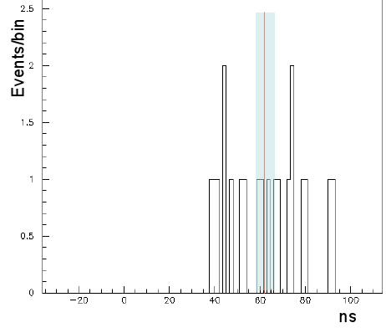
An example from a real experiment
I assume you are all familiar with the OPERA measurement of neutrino velocities
You may also have seen the graph below, which shows the distribution of δt (in nanoseconds) for individual neutrinos sent from narrow bunches at the end of October 2011
Because times are subject to random offset (jitter from GPS clock), you might expect this to be a Box distribution
OPERA quoted its best estimate of the δt as the sample mean of the measurements
This is NOT the best choice of estimator for the location of the center of a square distribution!
OPERA quotes the following result:
<δt> = 62.1 +- 3.7 ns
The UMVU estimator for the Box is the mid-range, δt=(t_{max}+t_{min})/2
You may understand why sample mid-range is better than sample mean: once you pick the extrema, the rest of the data carries no information on the center!!! It only adds noise to the estimate of the average!
The larger N is, the larger the disadvantage of the sample mean.

Slide 42
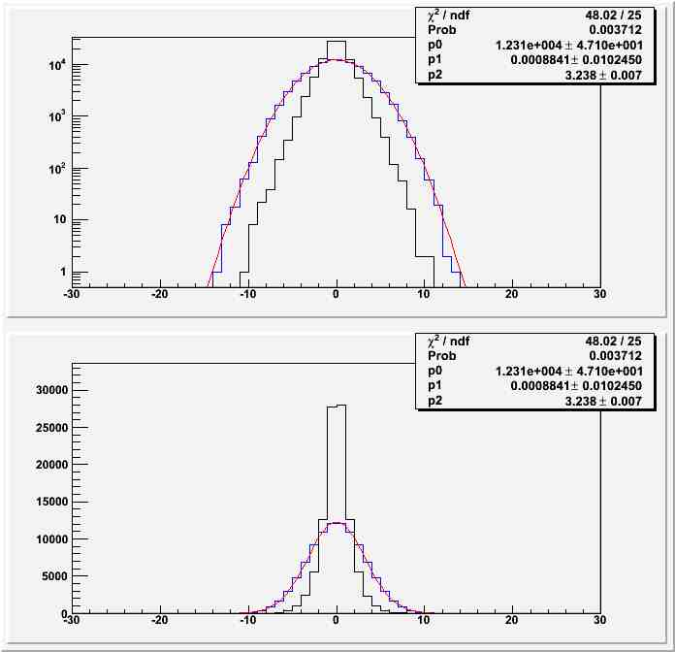
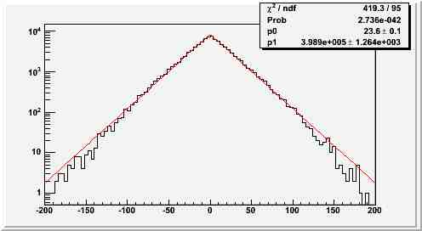
Expected uncertainty on mid-range and average
100,000 n=20-entries histograms, with data distributed uniformly in [-25:25] ns
Average is asymptotically distributed as a Gaussian; for 20 events this is already a good approximation. Expected width is 3.24 ns
Uncertainty on average consistent with Opera result
Mid-point has expected uncertainty of 1.66 ns
if δt=(t_{max}+t_{min})/2, mid-point distribution P(n δt) is asymptotically a Laplace distribution; again 20 events are seen to already be close to asymptotic behaviour (but note departures at large values)
If OPERA had used the mid-point, they would have halved their statistical uncertainty:
<δt> = 62.1 +- 3.7 ns → <δt> = 65.2+-1.7 ns
NB If you were asking yourselves what is a Laplace distribution:
f(x) = 1/2b exp(-|x-μ|/b)

Slide 43
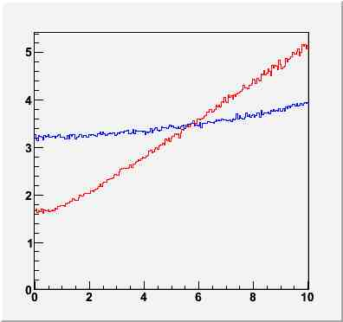
However…
Although the conclusions above are correct if the underlying pdf of the data is exactly a box distribution, things change rapidly if we look at the real problem in more detail
Each timing measurement, before the +-25 ns random offset, is not exactly equal to the others, due to additional random smearings:
the proton bunch has a peaked shape with 3ns FWHM
other effects contribute to smear randomly each timing measurement
of course there may also be biases –fixed offsets due to imprecise corrections made to the delta t determination; these systematic uncertainties do not affect our conclusions, because they do not change the shape of the p.d.f
The random smearings do affect our conclusions regarding the least variance estimator, since they change the p.d.f. !
In conclusion: Opera chose the right estimator. The question of whether they did this by chance or after a very careful study of the statistical properties of the possible estimators is a different one…
One may assume that the smearings are Gaussian. The real p.d.f. from which the 20 timing measurements are drawn is then a convolution of a Gaussian with a Box distribution.
Inserting that modification in the generation of toys one can study the effect: it transpires that, with 20-event samples, a Gaussian smearing with 6ns sigma is enough to make the expected variance equal for the two estimators; for larger smearing, one should use the sample mean!
Timing smearings in Opera are likely larger than 6ns → They did well in using the sample mean after all !
sample mean
Total expected error on mean (ns)
sample midrange
Gaussian smearing (ns)

Slide 44
A robust estimator: Trimmed mean
Often we have a sample of measurements, most of which are drawn from a narrow PDF, but we know that there is some "background" that follows a wider distribution
Simple example: a Z→ee peak from collider data
We might want to quickly estimate the mean of the narrow "signal" PDF using our data
If we take the sample mean, we may err because we do not know the overall distribution and events in the tails ruin the accuracy of our estimate
→ Use a "Trimmed mean": take the sample mean from the central quantiles of the data.
The estimate becomes less dependent on random outliers

Slide 45
Digression: the toy Monte Carlo technique
We often need to check the properties of our estimators in the specific conditions of our experiment – two examples will be given later
For instance, we want to see if they are better than others, or if they depend on a tunable parameter we want to optimize it (→get best M.S.E.)
Usually these details cannot be calculated algebrically, but we can use the Toy Monte Carlo technique:
Simulate experimental data with random generators
Repeat many times, each time extracting properties under study (optionally as a function of parameter to be optimized)
Study properties of estimators as f(tunable parameters)
I give two examples in the next few slides
To generate pseudo-data one may rely on built-in functions in statistics package (root, R, etc.) or work one's way from scratch from pseudo-random generator
We are spoiled by these built-in functions! We need to remember how to do the basic things by ourselves…
One important part is to know how to generate data according to f(x). To do this one needs to find the cumulative F(x) and invert it. See next slide

Slide 46
E.g. How to get data distributed as f(x)=exp(-x) ?
First obtain F(x), the cumulative function:
$F\left(x\right)=\int_{0}^{x}{f\left(x^{′}\right)dx^{′}=\int_{0}^{x}{e^{−x}}}dx=1−e^{−x}=y$
Next, invert it:
$x=−log{(1−y)}$
Finally, account for the range of x you wish to generate, e.g. [0, x_{max}]:
$x=−\log{[1−y\left(1−e^{−x_{max}}\right)]}$
Voila – if y is uniformly distributed in [0,1], x as computed above is distributed as $f\left(x\right)=e^{−x}$ in [0, x_{max}] !
Try it at home: derive recipe to get f(x)=x²

Slide 47
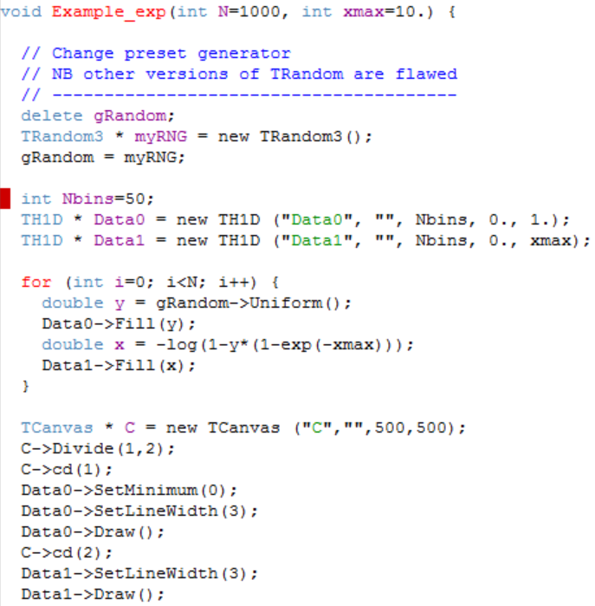
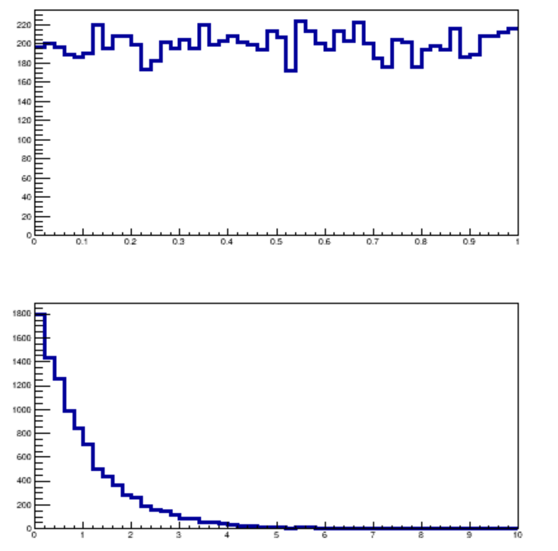
Result
Original distribution of y
From gRandom→Uniform()
Resulting transformed
distribution

Slide 48
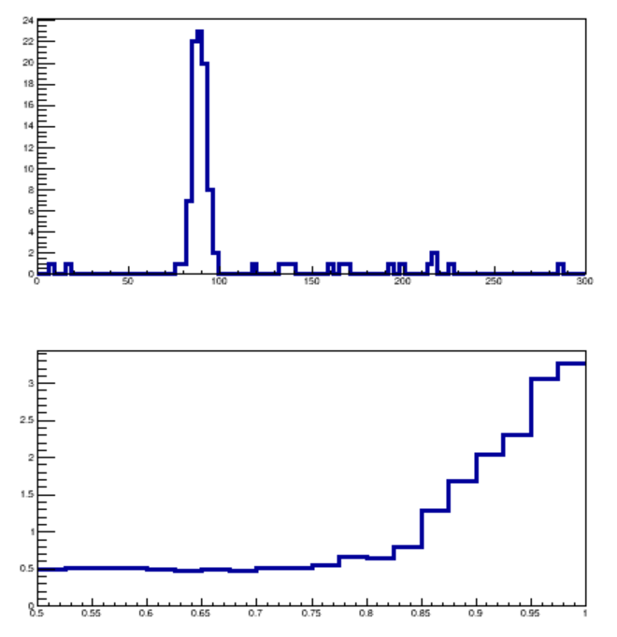
Trimmed mean example: Z→ee mass distribution
Here we have 100 Z→ee candidates, and want a quick-and-dirty check of the energy scale in the EM calorimeter
There is obviously some background, distributed at random values
To get the peak position we could fit the distribution, but a quicker way is to take the trimmed mean.
Average error of estimate indicates we should not average all data
In this case, for r<0.8 we are insensitive to the background noise!
Sample distribution
of 100 mass values
Reconstructed dielectron mass
Study of error on peak location
with toy Monte Carlo
Average error on peak location
One obviously needs to find the proper
working point for one's own problem
→ Use toy MC technique!
Fraction of data considered in average

Slide 49
The method of Maximum Likelihood
Take a pdf for a random variable x, f(x; θ) which is analytically known, but for which the value of m parameters θ is unknown. The method of maximum likelihood allows us to estimate the parameters θ if we have a set of data x_{i} distributed according to f.
The probability of our observed set {x_{i}} depends on the distribution of the pdf. Assuming that the measurements are independent, we have
The likelihood function
is then a function of the parameters θ only. It is written as the joint pdf of the x_{i}, but we treat those as fixed. L is not a pdf! NOTE! The integral under L is MEANINGLESS.
Using L(θ) one can define “maximum likelihood estimators” for the parameters θ as the values which maximize the likelihood, i.e. the solutions of the equation
for j=1…m
to find x_{i} in [x_{i},x_{i}+dx_{i}[
Note: The ML requires (and exploits!)
the full knowledge of the distributions

Slide 50
Variance of the MLE
In the simplest cases, i.e. when one has unbiased estimates and Gaussian distributed data, one can estimate the variance of the maximum likelihood estimate with the simple formula
This is also the default used by Migrad to return the uncertainty of a MLE from a fit.
However, note that this is only a lower limit of the variance in conditions when errors are not Gaussian and when the ML estimator is unbiased. A general formula called the Rao-Cramer-Frechet inequality gives this lower bound as
(b is the bias, E is the expectation value)

Slide 51
Example 3: the loaded die
Imagine you want to test whether a die is loaded. Your hypothesis might be that the probabilities of the six occurrences are not equal, but rather that
Your data comes from N=20 repeated throws of the die, whereupon you get:
The likelihood is the product of probabilities, so to estimate t you write L as
Setting the derivative wrt t to zero of –logL yields a quadratic equation:
This has one solution in the allowed range for t, [-1/6,1/3]: t=0.072. Its uncertainty can be
obtained by the variance, computed as the inverse of the second derivative of the likelihood.
This amounts to +-0.084. The point estimate of the “load”, the MLE, is different from zero,
but compatible with it. We conclude that the data cannot establish the presence of a bias.

Slide 52
Exercise with root
Write a root macro that determines, using the likelihood of the previous slide, the value of the bias, t, and its uncertainty, given a random set of N (unbiased) die throws.
Directions:
Your macro will be called “Die.C” and it will have a function called “void Die(int N) {}”
Produce a set of N throws of the die by looping i=0...N-1 and storing the result of (int)(1+gRandom->Uniform(0.,6.));
Call N₁=number of occurrence of 1; N₃=occurrences of 6; N₂=other results.
With paper and pencil, derive the coefficients of the quadratic equation in t for the likelihood maximum as a function of N₁, N₂, N₃.
Also derive the expression of –d²lnL/dt² as a function of t and N₁,N₂,N₃.
Insert the obtained formulas in the code to compute t* and its uncertainty σ(t*).
Print out the result of t in the allowed range [-1/6,1/3] and its uncertainty. If there are two solutions in that interval, print the result away from the boundary.
How frequently do you get a result for t less than one standard deviation away from 0?

Slide 53
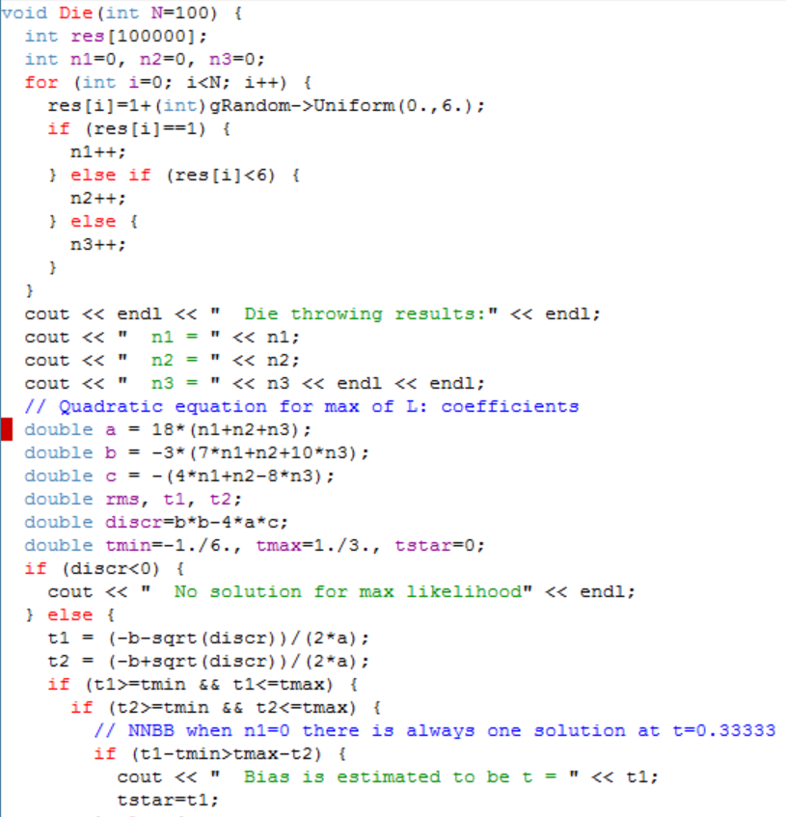
Die.C

Slide 54
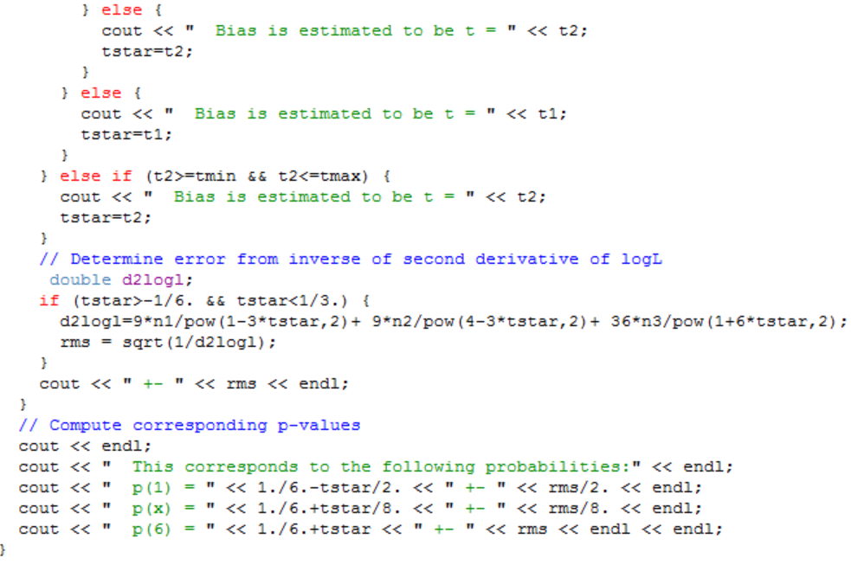

Slide 55
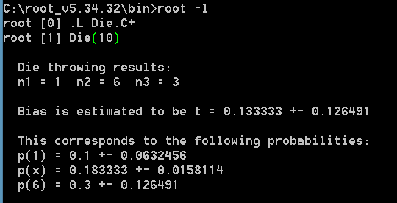
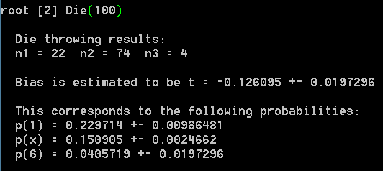
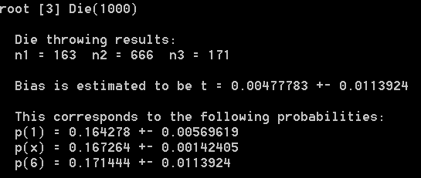
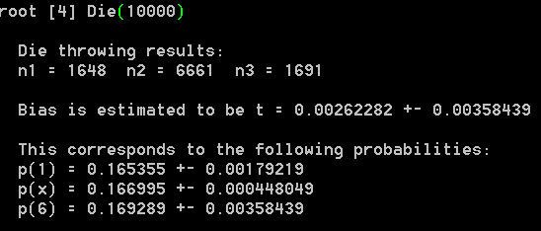
If we had root on this PC…
I had prepared the macro to run with you and play with it – but I cannot connect my PC to the screen!
So here's what we'd be doing

Slide 56
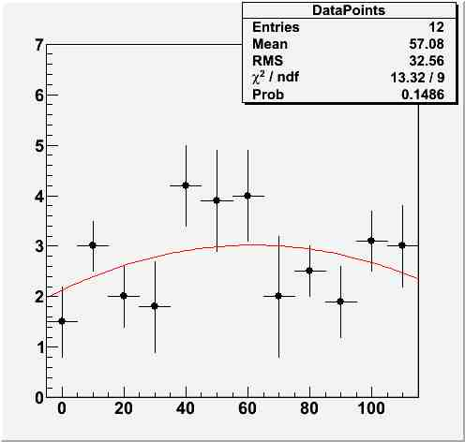
The method of least squares
Imagine you have a set of n independent measurements y_{i} –Gaussian random variables– taken at different x_{i}. Let the y_{i} have different unknown means λ_{i} and known variances σ_{i}². The y_{i} can be considered a vector having a joint pdf which is the product of n Gaussians:
y
λ(x;a,b,c)
Let also λ be a function of x and a set of m parameters θ, λ(x;θ₁…θ_{m}). In other words, λ is the model you want to fit to your data points y(x).
We want to find estimates of θ.
x

Slide 57
If we take the logarithm of the joint pdf we get the log-likelihood function,
which is maximized by finding θ such that the following quantity is minimized:
The expression written above near the minimum follows a χ² distribution only if the function λ(x;θ) is linear in the parameters θ and if it is the true form from which the y_{i} were drawn.
The method of least squares given above “works” also for non-Gaussian errors σ_{i}, as long as the y_{i} are independent. But it may have worse properties than a full likelihood.
If the measurements are not independent, the joint pdf will be a n-dimensional Gaussian. In that case the following generalization holds:
Note that unlike the ML, writing the χ² only requires a unbiased estimate of the variance of a distribution to work! (It makes a Gaussian approximation)
Both a nice and a devaluing property!

Slide 58
Some notes on the chisquare
The chisquare distribution is important as it describes the outcomes of a chisquare fitting to some data, IF the data comes from the fitted model
Later we will discuss the concept of "tail probability" and how this can be used to make inference on the validity of a model. In the case of a chisquare, there is a commodity useful to check whether one's model is appropriate to some data: TMath::Prob(chi2,Ndof)
The function returns the probability that data at least as discrepant with the fitted model is observed, IF the model is correct (i.e. if the data are sampled from it)
Recall: the expectation value of a chisquare, for N degrees of freedom, is N
If you fit some data to a model and get χ²>>N, should you throw your model away ? It depends
Model may be correct but data affected by some additional systematic error
p(χ² ,N) depends not only on χ² /N but also on N

Slide 59
The Error Ellipse
When one measures two correlated parameters θ = (θ₁,θ₂), in the large-sample limit their estimators will be distributed according to a two-dimensional Gaussian centered on θ. One can thus draw an “error ellipse” as the locus of points where the χ² is one unit away from its minimum value (or the log-likelihood equals ln (L_{max})-0.5).
The location of the tangents to the axes provide the standard
deviation of the estimators. The angle φ is given by
A measurement of one parameter at a given value of the other is determined by the intercept on the line connecting the two tangent points.
The uncertainty of that single measurement, at a fixed value of the other parameter, is
The correlation coefficient ρ is the distance of each axis from the tangent point, in units of the corresponding standard deviation
In that case one may report
and the slope

Slide 60
Chapter 2 – Weighted average

Slide 61
Weighted average: the basics
Suppose we need to combine two different, independent measurements with variances σ₁,σ₂ of the same physical quantity x₀:
we denote them with
x₁(x₀,σ₁), x₂(x₀,σ₂) ← the PDFs are G(x₀,σ_{i})
Let us combine them linearly to get the result with the smallest possible variance,
x = cx₁+dx₂
→ What are c, d such that σ_{F} is smallest ?
Let us try this simple
exercise
Answer: we first of all note that d=1-c if we want <x>=x₀ (reason with expectation values to convince yourself of this). Then, we express the variance of x in terms of the variance of x₁ and x₂
, and find c which minimizes the expression. This yields:
The generalization of these formulas to N measurements is trivial

Slide 62
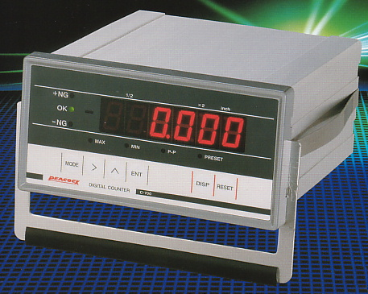
Average of Poisson data
Issues (and errors hard to trace) may arise in the simplest of calculations, if you do not know the properties of the tools you use
Take the simple problem of combining three measurements of the same quantity. Make these be counting rates, i.e. with Poisson uncertainties:
A₁ = 100
A₂ = 90
A₃ = 110
These measurements are fully compatible with each other, given that the estimates of their uncertainties are sqrt(A_{i})={10, 9.5, 10.5} respectively. We may thus proceed to average them, obtaining
<A> = 100.0+-5.77
If they aren’t,
don’t combine!

Slide 63
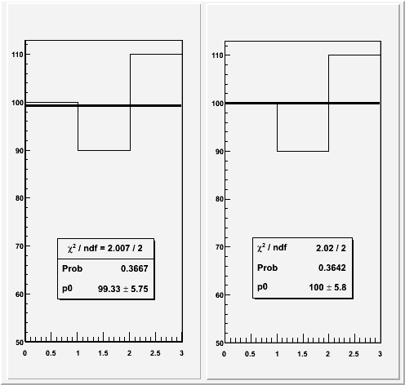
Now imagine, for the sake of argument, that we were on a lazy mood, and rather than do the math we used a χ² fit to evaluate <A>.
Surely we would find the same answer as the simple average of the three numbers, right?
… Wrong!
the χ² fit does not “preserve
the area” of the fitted histogram
What is going on ??
Let us dig a little bit into this matter. This
requires us to study the detailed definition
of the test statistics we employ in our fits.
χ² fit Likelihood fit
In general, a χ² statistic results from a
weighted sum of squares; the weights should be the inverse variances of the true values.
Unfortunately, we do not know the latter!

Slide 64
Two chisquareds and a Likelihood
The “standard” definition is called “Pearson’s χ²”, which for Poisson data we write as
The other (AKA “modified” χ²) is called “Neyman’s χ²”:
While χ²_{P} uses the best-fit variances at the denominator, χ²_{N} uses the individual estimated variances. Although both of these least-square estimators have asymptotically a χ² distribution, and display optimal properties, they use approximated weights.
The result is a pathology: neither definition preserves the area in a fit!
χ²_{P} overestimates the area, χ²_{N} underestimates it. In other words, neither works to make a simple weighted average !
The maximization of the Poisson maximum likelihood,
instead preserves the area, and obtains exactly the result of the simple average.
Proofs in the next slides.
(here n is the best fit value,
N_{i} are the measurements)

Slide 65
Proofs – 1: Pearson’s χ²
Let us compute n from the minimum of χ²_{P}:
n is found to be the square root of the average of squares, and is thus by force an overestimate of the area!
note: a variable weight!

Slide 66
2 – Neyman’s χ²
If we minimize χ²_{N} ,
we have:
the minimum is found for n equal to the harmonic mean of the inputs – which is an underestimate of the arithmetic mean!
again a variable weight
Just developing
the fraction leads to
which implies that
from which we finally get
(ALTERNATIVELY,
just solve for n this one)

Slide 67
3 – The Poisson Likelihood L_{P}
We minimize L_{P} by first taking its logarithm, and find:
As predicted, the result for n is the arithmetic mean. Likelihood fitting preserves the area!

Slide 68
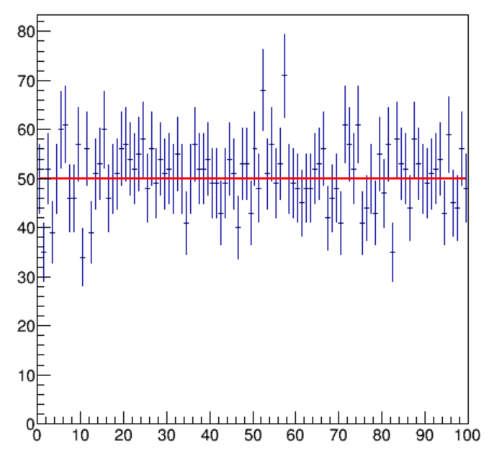
Putting it together
To check the behavior of the three fitting methods (remember: we are just considering them as ways to determine a weighted average here), we study a histogram with 100 bins
Each bin is filled with N sampled from a Poisson(N|μ)
We then fit the histogram to a constant by minimizing χ²_{P} , χ²_{N} , -2ln(L_{P}) in turn
We repeat many times, getting the average result for each fitting method
We can then also study the ratio between the average result and the true μ as a function of μ
By the way, it's four lines of code:
TH1D * A = new TH1D("A","",100, 0., 100.);
For (int i=1; i<101; i++) {
A->SetBinContent(i,gRandom->Poisson(50.));}
A->Fit("pol0"); // for Neyman's chi2

Slide 69
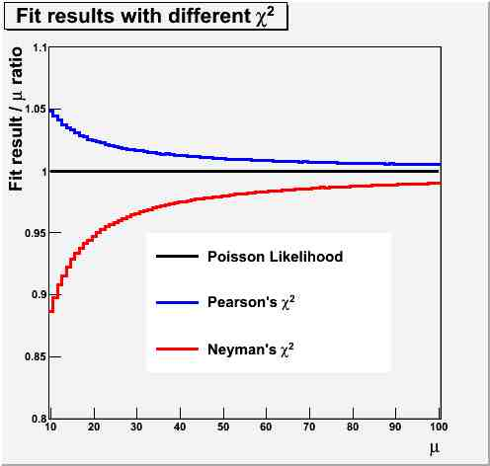
Comparison vs μ
One observes that the convergence is slowest for Neyman’s χ², but the bias is significant also for χ²_{P}
This result depends only marginally on the number of bins
Keep that in mind when you fit a histogram!
Standard ROOT fitting uses V=N_{i} → Neyman’s definition!

Slide 70
Discussion
What we are doing when we fit a constant through a set of k bin contents is to extract the common, unknown, true value μ from which the entries were generated, by combining the k measurements
Whenever possible, use a Likelihood!
We have k Poisson measurement of this true value. Each equivalent measurement should have the same weight in the combination, because each is drawn from a Poisson of mean μ, whose true variance is μ.
But having no μ to start with, we must use estimates of the variance as a (inverse) weight. So the χ²_{N} gives the different observations different weights 1/N_{i}. Since negative fluctuations (N_{i} < μ) have larger weights, the result is downward biased!
What χ²_{P} does is different: it uses a common weight for all measurements, the fit result for the average, μ*. Since we minimize χ²_{P} to find μ*, larger denominators get preferred → positive bias: μ* > μ!
All methods have optimal asymptotic properties: consistency, minimum variance. However, one seldom is in that regime. χ²_{P} and χ²_{N} have problems when N_{i} is small. These drawbacks are solved by grouping bins, at the expense of loss of information.
L_{P} does not have the approximations of the two sums of squares, and it has in general better properties. Cases when the use of a LL yields problems are rare. Whenever possible, use a Likelihood!

Slide 71
Linearization and correlation
In the method of LS the linear approximation in the covariance (Taylor series expansion to first order) may lead to strange results
Let us consider the LS minimization of a combination of two measurements of the same physical quantity k, for which the covariance terms be all known.
In the first case let there be a common offset error σ_{c} . We may combine the two measurements x₁, x₂ with LS by computing the inverse of the covariance matrix:
The minimization of the above expression leads to the following
expressions for the best estimate of k and its standard deviation:
The best fit value does not depend on σ_{c}, and corresponds
to the weighted average of the results when the individual variances σ₁² and σ₂² are used.
This result is what we expected, and all is good here.

Slide 72
Normalization error: Hic sunt leones
In the second case we take two measurements of k having a common scale error.
Try this at home to see
how it works!
This time the minimization produces these results
for the best estimate and its variance:
Before we discuss these formulas, let us test
them on a simple case:
x₁=10+-0.5,
x₂=11+-0.5,
σ_{f}=20%
This yields the following disturbing result:
k = 8.90+-2.92 !
What is going on ???

Slide 73
Shedding some light on the disturbing result
The fact that we get a result outside the range of inputs requires investigation.
Rewrite the result by dividing it by the weighted average result obtained ignoring the scale correlation:
If the two measurements differ, their
squared difference divided by the sum of the individual
variances plays a role in the denominator. In that case the LS fit “squeezes the scale”
by an amount allowed by σ_{f} in order to minimize the χ².
This is because the LS expression uses only first derivatives of the covariance:
the individual variances σ₁, σ₂ do not get rescaled when the normalization factor is lowered,
but the points get closer.
This may be seen as a shortcoming of the linear approximation of the covariance, but it
might also be viewed as a careless definition of the covariance matrix itself instead
(see next slide) !

Slide 74
In fact, let us try again. We had defined earlier the covariance matrix as
The expression above contains the estimates of the true value, not the true value itself. We have learned to beware of this earlier… What happens if we instead try using the following ?
The minimization of the resulting χ²,
produces as result the weighted average
The same would be obtained by maximizing the likelihood
or even minimizing the χ² defined as
Note that the latter corresponds to “averaging first, dealing with the scale later”.

Slide 75
When do results outside bounds make sense ?
Let us now go back to the general case of taking the average of two correlated measurements, when the correlation terms are expressed in the general form :
The LS estimators provide the following result for the weighted average [Cowan 1998]:
whose (inverse) variance is
From the above we see that once we take a measurement of x of variance σ₁², a second measurement of the same quantity will reduce the variance of the average unless ρ=σ₁/σ₂.
But what happens if ρ>σ₁/σ₂ ? In that case the weight w gets negative, and the average goes outside the “psychological” bound [x₁,x₂].
The reason for this behaviour is that with a large positive correlation the two results are likely to lie on the same side of the true value! On which side they are predicted to be by the LS minimization depends on which result has the smallest variance.

Slide 76
How can that be ?
It seems a paradox, but it is not. Again, the reason why we cannot digest the fact that the best estimate of the true value μ be outside of the range of the two measurements is our incapability of understanding intuitively the mechanism of large correlation between our measurements.
John: “I took a measurement, got x₁. I now am going to take a second measurement x₂ which has a larger variance than the first. Do you mean to say I will more likely get x₂>x₁ if μ<x₁, and x₂<x₁ if μ>x₁ ??”
Jane: “That is correct. Your second measurement ‘goes along’ with the first, because your experimental conditions made the two highly correlated and x₁ is more precise.”
John: “But that means my second measurement is utterly useless!”
Jane: “Wrong. It will in general reduce the combined variance. Except for the very special case of ρ=σ₁/σ₂, the weighted average will converge to the true μ. LS estimators are consistent !!”.

Slide 77
Jane vs John, round 1
John: “I still can’t figure out how on
earth the average of two numbers can be ouside of their range. It just fights with my common sense.”
Jane: “You need to think in probabilistic terms. Look at this error ellipse: it is thin and tilted (high correlation, large difference in variances).”
John: “Okay, so ?”
Jane: “Please, would you pick a few points at random within the ellipse?”
John: “Done. Now what ?”
Jane: “Now please tell me whether they are mostly on the same side (orange rectangles) or on different sides (pink rectangles) of the true value.”
John: “Ah! Sure, all but one are on orange areas”.
Jane: “That’s because their correlation makes them likely to “go along” with one another.”

Slide 78
Round 2: a geometric construction
Jane: “And I can actually make it even easier for you. Take a two-dimensional plane, draw axes, draw the bisector: the latter represents the possible values of μ. Now draw the error ellipse around a point of the diagonal. Any point, we’ll move it later.”
John: “Done. Now what ?”
Jane: “Now enter your measurements x=a, y=b. That corresponds to picking a point P(a,b) in the plane. Suppose you got a>b: you are on the lower right triangle of the plane. To find the best estimate of μ, move the ellipse by keeping its center along the diagonal, and try to scale it also, such that you intercept the measurement point P.”
John: “But there’s an infinity of ellipses that fulfil that requirement”.
Jane: “That’s correct. But we are only interested in the smallest ellipse! Its center will give us the best estimate of μ, given (a,b), the ratio of their variances, and their correlation.”
John: “Oooh! Now I see it! It is bound to be outside of the interval!”
Jane: “Well, that is not true: it is outside of the interval only because the ellipse you have drawn is thin and its angle with the diagonal is significant. In general, the result depends on how correlated the measurements are (how thin is the ellipse) as well as on how different the variances are (how big is the angle of its major axis with the diagonal). Note also that in order for the “result outside bounds” to occur, the correlation must be positive!

Slide 79
x₂
x₁=x₂
Tangent in P to
minimum ellipse is
parallel to
bisector
b
P(a,b)
When a large positive correlation
exists between the measurements
and the uncertainties differ, the best
estimate of the unknown μ may lie
outside of the range of the two
measurements [a,b]
a
x₁
LS estimate of μ

Slide 80
Trivia – Try it at home
Here is a simple arrangement with which you can test whether or not a significant correlation between two measurements causes the effect we have been discussing.
d₂
d₁
y
Here we measure y with a ruler shorter than y, by taking d1 and d2 and using the yellow stick
as an offset. The arrangement is such that we set the yellow stick from the edge of the red bar, and the red bar may have an angle error WRT the orthogonal to y. The non-zero angle causes a correlation between the two measurements d1 and d2. It turns out that y1=d1+a and y2=d2+a (a being the length of the yellow stick) will be on the same side of the true value of y, if the angle error is larger than the other uncertainties in the measurements.

Slide 81
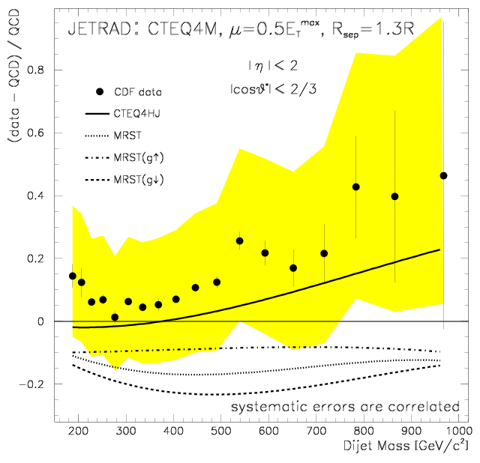
When chi-by-eye fails !
Which of the PDF (parton distribution functions!) models shown in the graph is a best fit to the data:
CTEQ4M (horizontal line at 0.0) or MRST (dotted curve) ?
You cannot tell by eye!!!
The presence of large correlations makes the normalization much less important than the shape.
p-value(χ² CTEQ4M)=1.1E-4,
p-value(χ² MRST) = 3.2E-3 :
The MRST fit has a 30 times higher p-value than the CTEQ4M fit !
Take-home lessons:
- Be careful with LS fits in the presence of large common systematics!
- Do not trust your eye when data points carry significant bin-to-bin correlations!
Source: 1998 CDF measurement of the differential
dijet mass cross section using 85/pb of Run I data,
F. Abe et al., The CDF Collaboration,
Phys. Rev. Lett. 77, 438 (1996)

Slide 82
Drawing home a few lessons
If I managed to thoroughly confuse you, I have reached my goal! There are a number of lessons to take home from this:
Even the simplest problems can be easily mishandled if we do not pay a lot of attention…
Correlations may produce surprising results. The average of highly-correlated measurements is an especially dangerous case, because a small error in the covariance leads to large errors in the point estimate.
Knowing the PDF your data are drawn from is CRUCIAL (but you then have to use that information correctly!)
Statistics is hard! Pay attention to it if you want to get correct results !

Slide 83
Backup and proofs

Slide 84
More notes on the Method of Maximum Likelihood
We discussed the ML method earlier; let's make some further points about it.
Take a random variable x with PDF f(x|θ). We assume we know the form of f() but we do not know θ (a single parameter here, but extension to a vector of parameters is trivial).
Using a sample {x} of measurements of x we want to estimate θ
If measurements are independent, the probability to obtain the set {x} within a given set of small intervals {dx_{i}} is the product
This product formally describes how the set {x} we measure is more or less likely, given f and depending on the value of θ
If we assume that the intervals dx_{i} do not depend on θ, we obtain the maximum likelihood estimate of the parameter, as the one for which the likelihood function
is maximized.
Pretty please, NOTE: L is a function of the parameter θ, NOT OF THE DATA x!
L is not defined until you have terminated your data-taking.

Slide 85
The ML estimate of a parameter θ can be obtained by setting the derivative of L wrt θ equal to zero.
A few notes:
usually one minimizes –lnL instead, obviously equivalent and in most instances simpler
additivity
for Gaussian PDFs one gets sums of square factors
if more local maxima exist, take the one of highest L
L needs to be differentiable in θ (of course!). Also its derivative needs to.
the maximum needs to be away from the boundary of the support, lest results make little sense (more on this later).
It turns out that the ML estimate has in most cases several attractive features. As with any other statistic, the judgement on whether it is the thing to use depends on variance and bias, as well as the other desirable properties.
Among the appealing properties of the maximum likelihood, an important one is its transformation invariance: if G(θ) is a function of the parameter θ, then
which, by setting both members to zero, implies that if θ* is the ML estimate of θ, then the ML estimate of G is G*=G(θ*), unless dG/dθ=0.
This is a very useful property! However, note that even when θ* is a unbiased estimate of θ for any n, G* need not be unbiased.

Slide 86
Maximum Likelihood for Gaussian pdf
Let us take n measurements of a random variable distributed according to a Gaussian PDF with μ, σ unknown parameters. We want to use our data {x_{i}} to estimate the Gaussian parameters with the ML method.
The log-likelihood is
The MLE of μ is the value for which dlnL/dμ=0:
So we see that the ML estimator of the
Gaussian mean is the sample mean.

Slide 87
We can easily prove that the sample mean is a unbiased estimator of the Gaussian μ, since its expectation value is indeed μ:
The same is not true of the ML estimate of σ²,
since one can find (see backup) that
The bias vanishes for large n. Note that a unbiased
estimator of the Gaussian σ exists: it is the sample variance
which is a unbiased estimator of the variance for any pdf. But it is not the ML one.

Slide 88
Expression of covariance matrix of a function y of data x_{i}
We take a function y(x) of n random variables x_{i} and calculate
(Taylor expansion to first order)
(as E[y(x)]=y(μ) )
Now, as E[y(x)]=y(μ), Ε[y(x)²]=y(μ)², it follows:

Slide 89
The sample mean is a unbiased estimator of the population mean μ:
since, for the definition of expectation value, we have
it follows that the sample mean is unbiased:

Slide 90
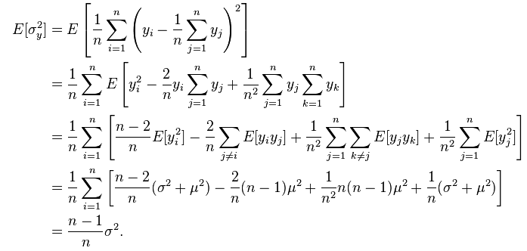
Expectation value of sample variance
That is the reason for the (n-1) factor in the expression of the sample variance,
which is called “Bessel correction”. Note that this makes it unbiased, but there
are other expressions (one which minimizes the MSE for Gaussian data is (n+1)!, but
it is a biased estimator of the population variance!)

Slide 91
Optimization
We all-too-often see analyses blindly optimizing on S/sqrt(B) or S/sqrt(B+S) even in cases when the signal region is going to contain a small number of entries
One real-life example (recently seen): a great cut keeps 20% bgr, 60% signal
at preselection, expect 8 signal, 1 background: S/sqrt(B)=8; S/sqrt(B+S)=0.89
after selection, expect 4.8 signal, 0.2 background: S/sqrt(B)=10.7, S/sqrt(B+S)=0.96
Is it a good idea ?
Median of B-only p-value distribution for observing N=8+1=9 in the first case is p_{m}=1.1*10⁻⁶ , twice smaller than median p-value for observing N = 4.8+0.2 = 5 (p_{m}=2.6*10⁻⁶) → we worsened the expected p-value by a factor of 2 !!!
If you really need a quick-and-dirty answer please use: Q=2[(S+B)^{0.5}-B^{0.5}] which has better properties (case above: Q_{presel}=4; Q_{sel}=3.58)
In general “optimization” is a word used recklessly. A full optimization is seldom seen in HEP analyses. This however should not discourage you from trying!
→When possible, optimize on final result, not on “intermediate step” (systematics may wash out your gain if you disregard them while optimizing); use median H0 p-value.
ANSWER IS HERE

Slide 92
Two more definitions for point estimation: UMVU and RCF bound
A uniformly minimum variance unbiased estimator (UMVU) for a parameter is the one which has the minimum variance possible, for any value of the unknown parameter it estimates.
The form of the UMVU estimator depends on the distribution of the parameter!
Minimum variance bound: it is given by the RCF inequality
A unbiased estimator (b=0) may have a variance as small as the inverse of the second derivative of the likelihood function, but not smaller.

