Slide 1
Statistics for HEP data analysis Part 2, with root exercises
Weihai, August 1st 2016
Tommaso Dorigo
INFN Padova

Slide 2
Contents of lessons 3 and 4
Beyond point estimation: confidence intervals
And the crucial concept of coverage
Hypothesis testing and goodness of fit
Plus some practical examples
Statistical significance and the 5-sigma criterion
The history
The rationale
The drawbacks

Slide 3
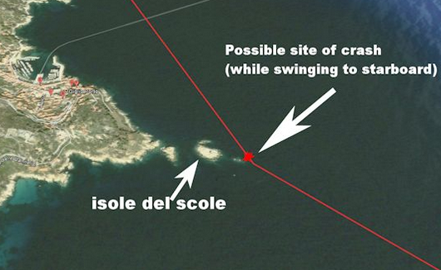
Confidence intervals

Slide 4
The simplest confidence interval: +- 1 standard error
The standard deviation is used in most simple applications as a measure of the uncertainty of a point estimate
For example: N observations {x_{i}} of random variable x with hypothesized pdf f(x;θ), with θ unknown. X={x_{i}} allows to construct an estimator θ*(X)
Using an analytic method, or the RCF bound, or a MC sampling, one can estimate the standard deviation of θ*
The value θ*+- σ*_{θ*} is then reported. What does this mean ?
It means that in repeated estimates based on the same number N of observations of x, θ* would distribute according to a pdf G(θ*) centered around a true value θ with a true standard deviation σ_{θ*}, respectively estimated by θ* and σ*_{θ*}
In the large sample limit G() is a (multi-dimensional) Gaussian function
In most interesting cases for physics G() is not Gaussian, the large sample limit does not hold, 1-sigma intervals do not cover 68.3% of the time the true parameter, and we have better be a bit more tidy in constructing intervals. But we need to have a hunch of the pdf f(x;θ) to start with!
Pay att'n

Slide 5
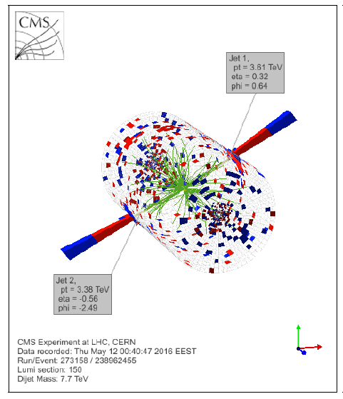
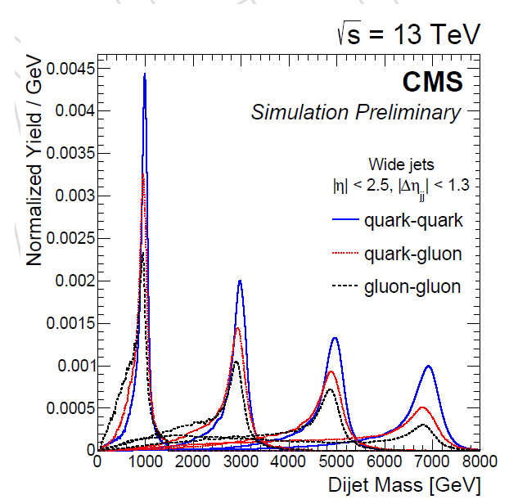
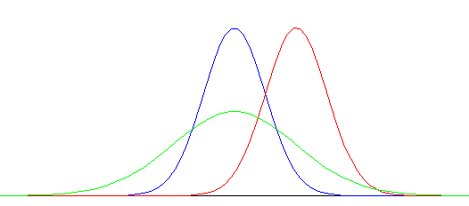
One example to clarify
F(x|M)
Given the importance of the concept just described, let us discuss it with a simple example
A strongly produced resonance of unknown mass in LHC data would result in events with two energetic jets
The PDF f(x;M) depends on M; we may construct an estimate M*+-σ*_{M*} using data x
There is no guarantee that the true value M is within the quoted interval around M*; but asymptotically, our interval covers it 68.3% of the time
Different estimates
have different sampling
distributions
M
The question is how to construct
confidence intervals that "work" in all cases

Slide 6
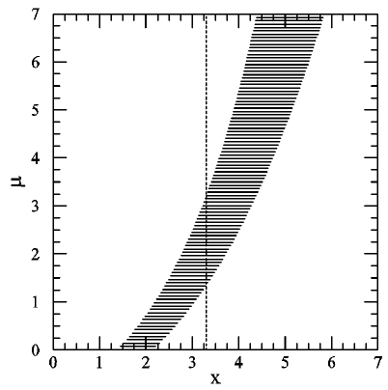
Neyman’s Confidence interval recipe
Specify a model which provides the probability density function of a particular observable x being found, for each value of the unknown parameter of interest: p(x|μ)
Also choose a Type-I error rate α (e.g. 32%, or 5%)
For each μ, draw a horizontal acceptance interval [x₁,x₂] such that
p (x∈[x₁,x₂] | μ) = 1 ‐ α.
There are infinitely many ways of doing this: it all depends on what you want from your data
for upper limits, integrate the pdf from x to infinity
for lower limits do the opposite
might want to choose central intervals
or shortest intervals ?
In general: an ordering principle is needed to well‐define.
Upon performing an experiment, you measure x=x*. You can then draw a vertical line through it.
→ The vertical confidence interval [μ₁,μ₂] (with Confidence Level C.L. = 1 ‐α) is the union of all values of μ for which the corresponding acceptance interval is intercepted by the vertical line.

Slide 7
Important notions on C. I.’s
What is a vector ?
A vector is an element of a vector space (a set with certain properties).
defined to be “an element of a confidence set”, the latter being a set of intervals defined to have the property of frequentist coverage under sampling!
Similarly, a confidence interval is
Let the unknown true value of μ be μ_{t} . In repeated experiments, the confidence intervals obtained will have different endpoints [μ₁, μ₂], depending on the random variable x.
A fraction C.L. = 1 –α of intervals obtained by Neyman’s contruction will contain (“cover”) the fixed but unknown μ_{t} : P( μ_{t}∈[μ₁, μ₂]) = C.L. = 1 -α.
It is important thus to realize two facts:
the random variables in this equation are μ₁and μ₂, and not μ_{t} !
Coverage is a property of the set, not of an individual interval ! For a Frequentist, the interval either covers or does not cover the true value, regardless of α.
→ Classic FALSE statement you should avoid making:
“The probability that the true value is within μ₁ and μ₂ is 68%” !
The confidence interval instead does consist of those values of μ for which the observed x is among the most probable (in sense specified by ordering principle) to be observed.
Also note: “repeated sampling” does not require one to perform the same experiment all
of the times for the confidence interval to have the stated properties. Can even be different
experiments and conditions! A big issue is what is the relevant space of experiments to consider.

Slide 8
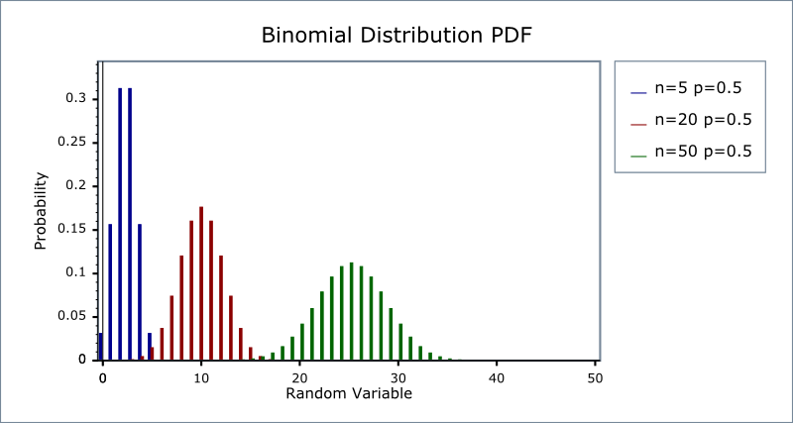
Overcoverage
p
For N=5 trials
0.8
Coverage is usually guaranteed by the frequentist Neyman construction. But this includes overcoverage.
Overcoverage: sometimes the pdf p(x|θ) is discrete → it may not be possible to find exact boundary values x₁, x₂ for each θ; one thus errs conservatively by including x values (according to one’s ordering rule) until Σ_{i}p(x_{i}|θ)>1-α
◊ θ₁ and θ₂ will overcover
Let's make an example with the Binomial
0.5
0.2
0 1 2 3 4 5 x
F(N;r,p) = N! p^{r}(1-p)^{N-r}/[r!(N-r)!]
For N=5, p=0.5:
F(5;0,0.5)=0.5^5=0.031
F(5;1,0.5)=5*0.5^5=0.156
F(5;2,0.5)=10*0.5^5=0.313
F(5;3,0.5)=10*0.5^5=0.313
F(5;4,0.5)=5*0.5^5=0.156
F(5;5,0.5)=0.5^5=0.031
For N=5, p=0.8:
F(5;0,0.8)=0.2^5=0.00032
F(5;1,0.8)=5*0.2^4*0.8=0.0064
F(5;2,0.8)=10*0.2^3*0.8^2=0.0512
F(5;3,0.8)=10*0.2^2*0.8^3=0.2048
F(5;4,0.8)=5*0.2*0.8^4=0.4096
F(5;5,0.8)=0.8^5=0.32768

Slide 9
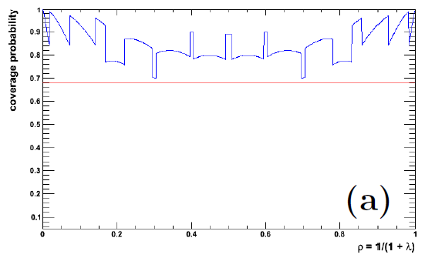
The Binomial error bars for a small number of trials is indeed a complex problem!
The (true) variance is σ=sqrt(ρ(1-ρ)/N) , but its ESTIMATE σ∗=sqrt(ρ∗(1-ρ∗)/N) (with ρ*=S/N) fails badly for small N and ρ∗→0,1
Clopper-Pearson: intervals obtained from Neyman’s construction with a central interval ordering rule. They overcover sizeably for some values of the trials/successes.
Lots of technology to improve properties
N= 10; 68.27% coverage
In HEP (and astro-HEP) the interest is related to the famous on-off problem (determine a expected background from a sideband)

Slide 10
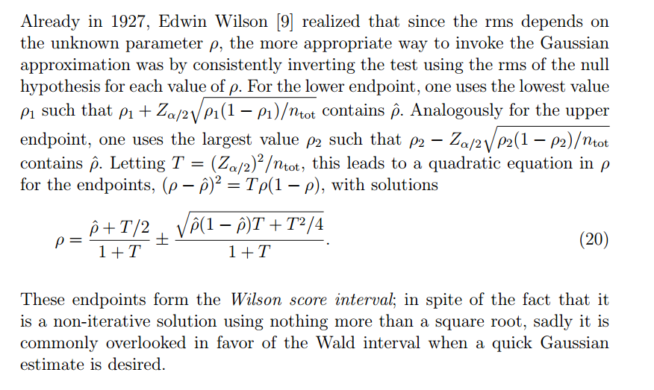
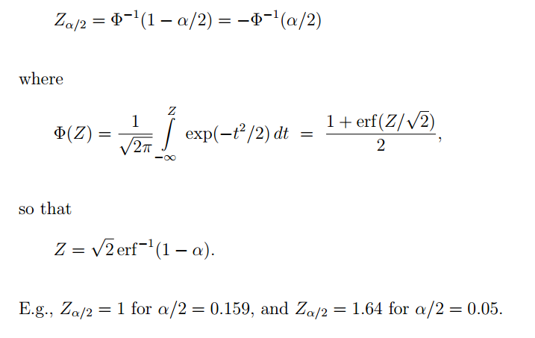
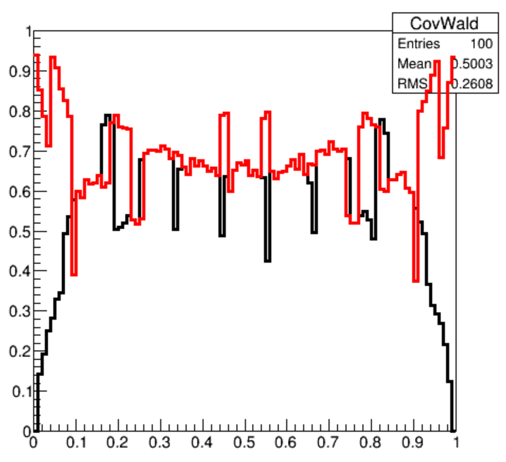
Wilson Score Interval for Binomial
Cousins and Tucker, 0905.3831
N=10; red=Wilson;
Black=Wald

Slide 11
On Undercoverage
It is BAD. A frequentist shouldn’t allow it.
E.g: if you state a limit or an interval at 95% CL and it turns out that, for the true value μ, the coverage is actually 85%, you have underestimated the uncertainty bars of your measurement by a significant factor !!!
Undercoverage results from approximate expressions for the variance, or from other specific aspects of the problem
See example of likelihood of loaded die
Undercoverage can also results from apparently innocuous procedures in the derivation of our results, like
deciding whether to quote a limit or a confidence interval a posteriori
modifying details of analysis “because something does not look right” in your background estimate
Not publishing results that are controversial !

Slide 12
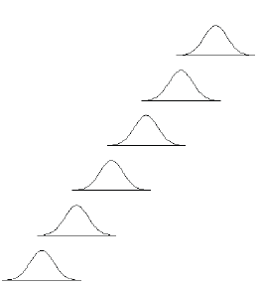
Confidence Intervals and Flip-Flopping
Here we want to understand a couple of issues that the Neyman construction can run into, for a very common case: the measurement of a bounded parameter and the derivation of upper limits on its value
Typical observables falling in this category: cross section for a new phenomenon; or neutrino mass
We take the simplifying assumption that we do
a unbiased Gaussian-resolution measurement;
we also renormalize measured values such that
the variance is 1.0. In that case if μ is the true
value, our experiment will return a value x which
is distributed as
true value μ
Nota bene: x may assume negative values!
observed value x

Slide 13
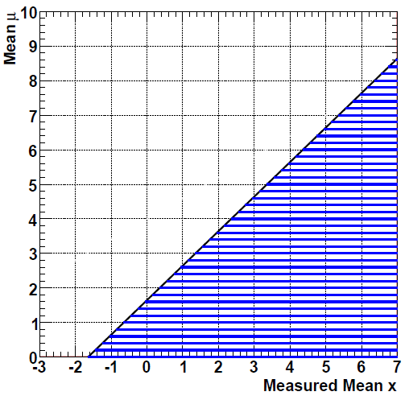
Neyman construction for bounded parameter
Gaussian measurement with known sigma (σ=1 assumed in graph) of bounded parameter μ>=0
Classical method for α=0.05 produces upper limit μ<x+1.64σ (or μ<x+1.28σ for α=0.1) (blue lines)
for x<-1.64 this results in the empty set!
in violation of one of Neyman’s own demands (confidence set does not contains empty sets)
Also note: x<<0 casts doubt on σ=1 hypothesis → rather than telling about value of μ the result could be viewed as a GoF test. Another possibility is to widen the model to allow σ>1
α=0.05
μ = x+1.64σ
Flip-flopping: “since we observe no significant signal, we proceed to derive upper limits…”
As a result, the upper limits undercover ! (Unified approach by Feldman and Cousins solves the issue)

Slide 14
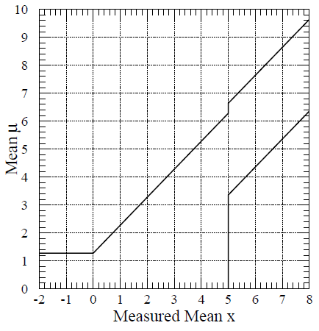
The attitude that one might take, upon measuring, say, a higgs cross section which is negative (say if your backgrounds fluctuated up such that N_{obs}<B_{exp}), is to quote zero, and report an upper limit which, in units of sigma, is
x^{up}=sqrt(2)*ErfInverse(1-2α)
where α is the desired confidence level. X^{up} is such that the integral of the Gaussian from minus infinity to x^{up} is 1-α (one-tailed test).
If, however, one finds x>D, where D is one’s discovery threshold (say, 3-sigma or 5-sigma), one feels entitled to say one has “measured” a non-zero value of the parameter – a discovery of the Higgs, or a measurement of a non-zero neutrino mass. What the physicist will then report is rather an interval: to be consistent with the chosen test size α, he will then quote central intervals which cover at the same level: x_{meas}+-E(α/2), with
E(α) = sqrt(2)*ErfInverse(1-2*α).
The confidence belt may then take the form shown on the graph on the right.
α=0.10,
Z>5 discovery
threshold

Slide 15
Coverage of flip-flopping experiment
We want to write a routine that determines the true coverage of the procedure discussed above for a Gaussian measurement of a bounded parameter:
x_{meas}<0 → quote size-α upper limit as if x_{meas}=0, x^{up}=sqrt(2)*ErfInverse(1-2α)
0<=x_{meas}<D→ quote size-α upper limit, x^{up}=sqrt(2)*ErfInverse(1-2α) + x_{meas}
x_{meas}>=D → quote central value +-α/2 error bars, x_{meas}+-sqrt(2)*ErfInverse(1-α)
Guidelines:
insert proper includes (we want to compile it or it’ll be too slow)
header: pass through it alpha, D, and N_pexp
define useful variables and histogram containing coverage values
loop on x_true values from 0 to 10 in 0.1 steps → i=0...<100 steps, x_true=0.05+0.1*i
for each x_true:
zero a counter C
loop many times (eg. N_pexp, defined in header)
throw x_meas = gRandom->Gaus(x_true,1.)
derive x_down and x_up depending on x_meas:
if x_meas<0 then x_down=0 and x_up = sqrt(2)*ErfInverse(1-2*alpha)
if 0<=x_meas<D then x_down=0 and x_up=x_meas+sqrt(2)*EI(1-2*alpha)
if x_meas>=D then x_down,up = x_meas +- sqrt(2)*EI(1-alpha)
if x_true is in [x_down,x_up] C++
fill histogram of coverage at x_true with C/N_pexp
plot and enjoy

Slide 16
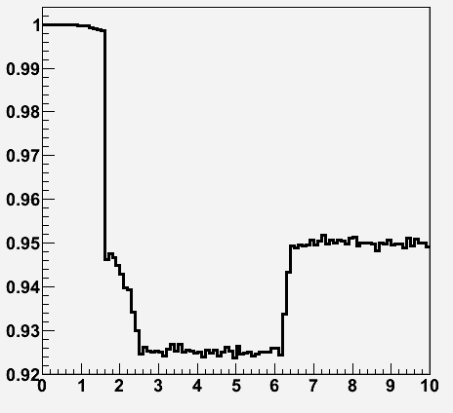
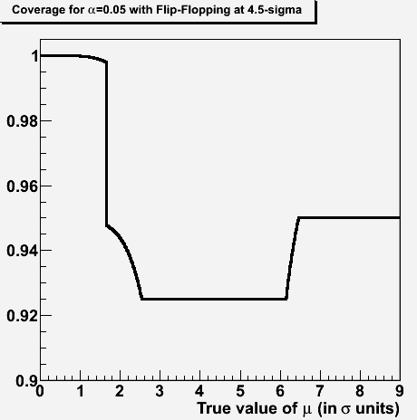
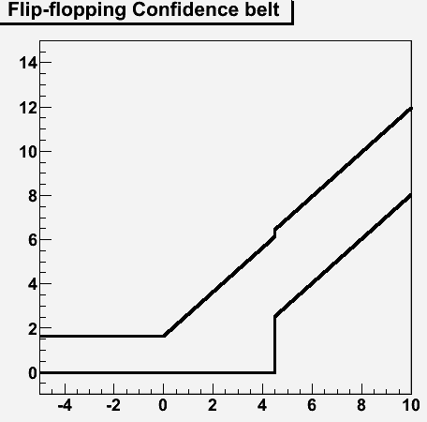
Results
Interesting typical case: alpha=0.05 – 0.1, D=4-5
E.g. alpha=0.05, D=4.5, with N_pexp=100000:
The coverage, for this special
case, can actually be computed
analytically...
Just determine the integral of
the covered area for each region
of the belt – see next slide
Under
coverage!

Slide 17
Coverage.C
if (mu<sqrt(2)*ErfInverse(1.-2*alpha)) { // 1.28, so mu within upper 90% CL
cov = 0.5*(1+TMath::Erf((disc_threshold-mu)/sqrt(2.)));
} else if (mu< disc_threshold-sqrt(2)*ErfInverse(1.-2*alpha/2.)) { // <3.36
cov = 1.-alpha-0.5*(1.-TMath::Erf((disc_threshold-mu)/sqrt(2.)));
} else if (mu<disc_threshold+
sqrt(2)*ErfInverse(1.-2*alpha)) { // 6.28
cov = 1.-1.5*alpha;
} else if (mu<disc_threshold+sqrt(2)*ErfInverse(1.-2*alpha/2.) ) { // 6.64) {
cov = 1.-alpha/2.-0.5*(1+TMath::Erf((disc_threshold-mu)/sqrt(2.)));
} else { cov = 1.-alpha; }
Cov->Fill(mu,cov);
}
char filename[40];
if (alpha>=0.1) {
sprintf(filename,"Coverage_alpha_0.%d_obs_at_%d_sigma.eps", (int)(10.*alpha),idisc_threshold);
} else {
sprintf(filename,"Coverage_alpha_0.0%d_obs_at_%d_sigma.eps", (int)(100.*alpha),idisc_threshold);
}
TCanvas * C = new TCanvas ("C","Coverage", 500,500);
C->cd();
Cov->SetMinimum(1.-2*alpha);
Cov->SetLineWidth(3);
Cov->Draw();
C->Print(filename);
// Now plot confidence belt
// ------------------------
}
(add at the top the #include commands
needed to compile it)
void Coverage (double alpha, double disc_threshold=5.) {
// Only valid for the following:
// -----------------------------
if (disc_threshold-sqrt(2)*ErfInverse(1.-2*alpha/2.)<
sqrt(2)*ErfInverse(1.-2*alpha)) {
cout << "Too low discovery threshold, code not suitable. " << endl;
cout << "Try a larger threshold" << endl;
return;
}
char title[100];
int idisc_threshold=disc_threshold;
int fracdiscthresh =10*(disc_threshold-idisc_threshold);
if (alpha>=0.1) {
sprintf (title, "Coverage for #alpha=0.%d with Flip-Flopping at %d.%d-sigma", (int)(10.*alpha),idisc_threshold, fracdiscthresh);
} else {
sprintf (title, "Coverage for #alpha=0.0%d with Flip-Flopping at %d.%d- sigma", (int)(100.*alpha),idisc_threshold, fracdiscthresh);
}
TH1D * Cov = new TH1D ("Cov", title, 1000, 0., 2.*disc_threshold);
Cov->SetXTitle("True value of #mu (in #sigma units)");
// Int Gaus-1:+1 sigma is TMath::Erf(1./sqrt(2.))
// To get 90% percentile (1.28): sqrt(2)*ErfInverse(1.-2*0.1)
// To get 95% percentile (1.64): sqrt(2)*ErfInverse(1.-2*0.05)
double cov;
for (int i=0; i<1000; i++) {
double mu = (double)i/(1000./(2*disc_threshold))+
0.5*(2*disc_threshold/1000);

Slide 18
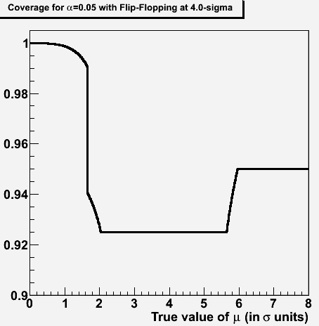
Here is e.g. the exact calculation of coverage for flip-flopping at 4-sigma and a test size alpha=0.05
Can get it by running:
root> .L Coverage.C+;
root> Coverage(0.05,4.);

Slide 19
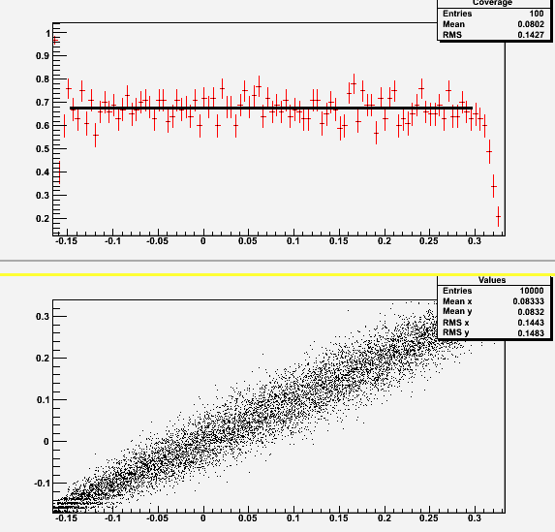
One further example of coverage
Do you remember the program "Die.C" from lesson 2 ?
You may modify it to compute the coverage of the likelihood intervals. → Die3a.C
Just add a TH1D* called “Coverage” and a cycle on the true parameter values, taking
care of simulating the die throws correctly
taking into account the bias t. Then you
count how often the likelihood has the true
value within its interval, as a function of the true value.
By running it you will find that the coverage is only
approximate for small number of throws,
especially when your true value of the
parameter t (the “increase in probability”
of throws giving a 6) lies close to the
boundaries -1/6, 1/3.

Slide 20
Hypothesis Testing and GOF
A few basic definitions
Statistical significance: what is it ?
The Neyman-Pearsons lemma
Goodness-of-Fit tests
Some examples

Slide 21
Hypothesis testing: generalities
We are often concerned with proving or disproving a theory, or comparing and
choosing between different hypotheses.
In general this is a different problem than that of estimating a parameter, but the two
are tightly connected.
If nothing is known a priori about a parameter, naturally one uses the data to estimate it;
if however a theoretical prediction exists on a particular value, the problem is more
proficuously formulated as a test of hypothesis.
Within the idea of hypothesis testing one
must also consider goodness-of-fit tests:
in that case there is only one hypothesis
to test (e.g. a particular value of a parameter
as opposed to any other value), so some of the
possible techniques are not applicable
A hypothesis is simple if it is completely
specified; otherwise (e.g. if depending on
the unknown value of a parameter) it is called composite.

Slide 22
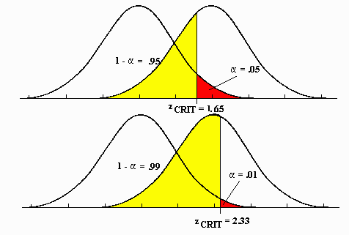
Nuts and bolts of Hypothesis testing
H₀: null hypothesis
H₁: alternate hypothesis
Three main parameters in the game:
α: type-I error rate; probability that H₀ is true although you accept the alternative hypothesis
β: type-II error rate; probability that you fail to claim a discovery (accept H₀) when in fact H₁ is true
θ, parameter of interest (describes a continuous hypothesis, for which H₀ is a particular value). E.g. θ=0 might be a zero cross section for a new particle
Common for H₀ to be nested in H₁
Can compare different methods by plotting α vs β vs the parameter of interest
- Usually there is a tradeoff between α and β; often a subjective decision, involving cost of the two different errors.
- Tests may be more powerful in specific regions of an interval (e.g. a Higgs mass)
There is a 1-to-1 correspondence between hypothesis tests and interval construction
In classical hypothesis testing, test of σ=0 for the Higgs equates to asking whether σ=0 is in the confidence interval.
Above, a smaller α is paid
with a larger type-II error
rate (yellow area)
→ smaller power 1-β

Slide 23
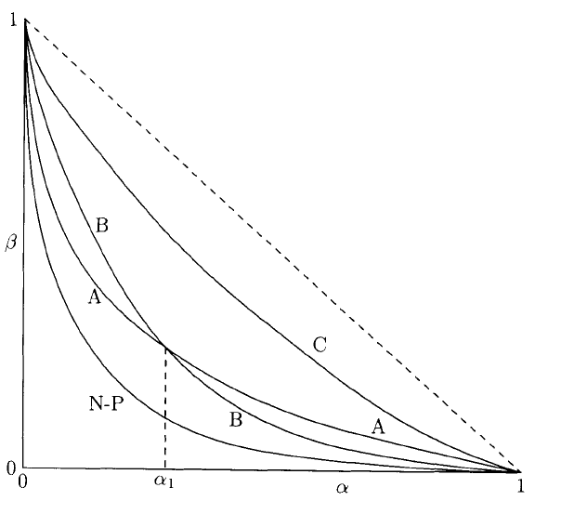
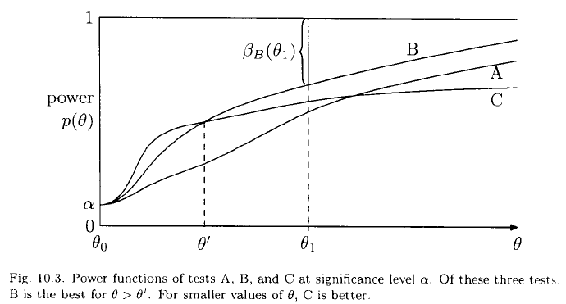
Alpha vs Beta and power graphs
Very general framework of classification
Choice of α and β is conflicting: where to stay in the curve provided by your analysis method highly depends on habits in your field
What makes a difference is the test statistics: note how the N-P likelihood-ratio test outperforms others in the figure [James 2006] – reason is N-P lemma
As data size increases, power curve becomes closer to step function
The power of a test usually also
depends on the parameter of interest: different methods may have better performance in different parameter space points
UMP (uniformly most powerful):
has the highest power for any θ

Slide 24
Statistical significance: What it is
Statistical significance is a way to report the probability that an experiment obtains data at least as discrepant as those actually observed, under a given "null hypothesis“ H₀
In physics H₀ usually describes the currently accepted and established theory (but there are exceptions).
One starts with the p-value, i.e. the probability of obtaining a test statistic (a function of the data) at least as extreme as the one observed, if H₀ is true.
p can be converted into the corresponding number of "sigma," i.e. standard deviation units from a Gaussian mean. This is done by finding x such that the integral from x to infinity of a unit Gaussian G(0,1) equals p:
According to the above recipe, a 15.9% probability is a one-standard-deviation effect; a 0.135% probability is a three-standard-deviation effect; and a 0.0000285% probability corresponds to five standard deviations - "five sigma" for insiders.

Slide 25
Notes
The alert observer will no doubt notice a few facts:
the convention is to use a “one-tailed” Gaussian: we do not consider departures of x from the mean in the uninteresting direction
Hence “negative significances” are mathematically well defined, but not interesting
the conversion of p into σ is fixed and independent of experimental detail. As such, using Νσ rather than p is just a shortcut to avoid handling numbers with many digits:
we prefer to say “5σ” than “0.00000029” just as we prefer to say “a nanometer” instead than “0.000000001 meters” or “a Petabyte” instead than “1000000000000 bytes”
The whole construction rests on a proper definition of the p-value. Any shortcoming of the properties of p (e.g. a tiny non-flatness of its PDF under the null hypothesis) totally invalidates the meaning of the derived Nσ
In particular, using “sigma” units does in no way mean we are espousing some kind of Gaussian approximation for our test statistic or in other parts of our problem.
Beware – this has led many to confusion
The “probability of the data” has no bearing on the concept, and is not used. What is used is the probability of a subset of the possible outcomes of the experiment, defined by the outcome actually observed (as much or more extreme)

Slide 26
The Neyman-Pearson Lemma
For simple hypothesis testing there is a recipe to find the most powerful test. It is based on the likelihood ratio.
Take data X={X₁…X_{N}} and two hypotheses depending on
the values of a discrete parameter: H₀={θ=θ₀} vs H₁{θ=θ₁}.
If we write the expressions of size α and power 1-β we have
The problem is then to find the critical region w_{α} such that 1-β is maximized, given α. We rewrite the expression for power as
which is an expectation value:
This is maximized if we accept in w_{α} all the values for which
So one chooses H₀ if
and H₁ if instead
In order for this to work, the likelihood ratio must be defined in all space; hypotheses must be simple. The test above is called Neyman-Pearson test, and a test with such properties is the most powerful.

Slide 27
Treatment of Systematic Uncertainties
Statisticians call these nuisance parameters
Any measurement in HEP is affected by them: the turning of an observation into a measurement requires assumptions about parameters and other quantities whose exact value is not perfectly known → their uncertainty affects the main measurement
Going from a event count to a cross section requires knowing N_{b}, L, ε_{sel}, ε_{trig} …
measurements which are subsidiary to the main result
Inclusion of effect of nuisances in interval estimation and hypothesis testing introduces complications. Each of the methods has recipes, but not universal nor always applicable
Bayesian treatment: one constructs the multi-dimensional prior pdf p(θ)Π_{i}p(λ_{i}) including all the parameters λ_{i}, multiplies by p(X₀|θ,λ), and integrates all of the nuisances out, remaining with p(θ|X₀)
Classical frequentist treatment: scan the space of nuisance parameters; for each point do Neyman construction, obtaining multi-dimensional confidence region; project on parameter of interest
Likelihood ratio: for each value of the parameter of interest θ*, one finds the value of nuisances that globally maximizes the likelihood, and the corresponding L(θ*). The set of such likelihoods is called the profile likelihood.
Each “method” has problems (B: multi-D priors; C: overcoverage and intractability; L: undercoverage) – will not discuss them here, but note that this is a topic at the forefront of research, for which no general recipe is valid.
Often used are “hybrid” methods for integrating nuisance parameters out: for instance, treat nuisance parameters in a Bayesian way while treating the parameter of interest in a frequentist way, or “profile away” the nuisance parameters and then use any method. Also possible is using Bayesian techniques and then evaluate their coverage properties.

Slide 28
Notes on Goodness-of-fit tests
If H₀ is specified but the alternative H₁ is not, then only the Type I error rate α can be calculated, since the Type II error rate β depends on having specified a particular H₁.
In this case the test is called a test for goodness-of-fit (to H₀).
Hence the question “Which g.o.f. test is best?” is ill-posed, since the power depends on the alternative hypothesis, which is not given.
In spite of the popularity of tests which give a statistic which one may directly connect with the size α (in particular χ² and Kolomogorov tests), their ability to discriminate against variations with respect to H₀ may be poor, i.e. they may have small power (1-β) against relevant alternative hypotheses
χ² throws away information (sign, ordering)
Kolmogorov –Smirnov test only sensitive to biases, not to shape variations, and has terrible performance on tails
It is in general hard to define what is random and what is not. Imagine you get three p-values: would you like to see them evenly spaced in [0,1] ? Would it induce you to doubt of the null if they all came out within 0.01 of 0.5 ? What if they are all close to 0.624 ? Or all close to zero ?

Slide 29
More on GoF
Note the duality with confidence intervals: one might test the hypothesis θ=θ_{test} using θ* as test statistic. If we define the region θ*>=θ*_{obs} as having equal or less agreement with the hypothesis than the result obtained, then the p-value of the test is α.
but for the c.i. the probability α is specified first, and the value θ_{test} is the random variable (depends on data); in a G.o.F. test for θ_{test}, we specify θ_{test} and the p-value is the result.
In HEP, despite their limitations, Goodness-of-Fit tests are useful for a number of applications:
consistency checks
defining a control region
model testing
The job of the experimenter is to find a suitable test statistic, and a region of interest of the latter. An example will clarify matters.

Slide 30
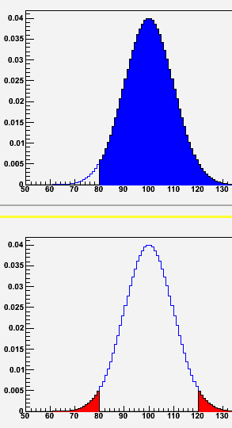
Choosing the region of interest
Feynman’s example:
“Upon walking here this morning, the strangest thing ever happened to me. A car passed by, and I could read the plate: JKZ 0533. How weird is that ??! The probability that I saw such a combination of letters and numbers (assuming they are all used in this country) is one in 10000*26³, or one in eighty-eight millions!”
Correct… The paradox arises from not having defined beforehand the region of interest!
A more common one: you have a counting experiment where background is predicted to be 100 events. You observe 80 events. How rare is that ?
Ill-posed question ! Depends, to say the least, on whether you are interested only in excesses or in absolute departures!
In the first case the region of interest is N>=x, which, for x=80, corresponds to a fractional area p = 0.977.
In the second case, the region of interest is |N-100|>=|x-100| which for x=80 has an integral p = 0.0455.
And one might imagine other ways to answer – a no-brainer being p=e⁻¹⁰⁰ 100⁸⁰/80!

Slide 31
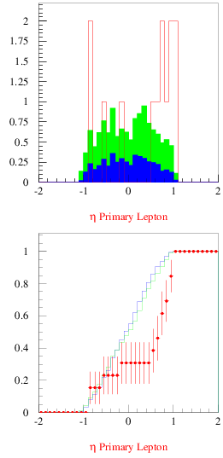
The Kolmogorov Test: an example
CDF, circa 2000: 13 weird events identified in a subset of sample used to extract top quark cross section
contain a “superjet”: a jet with a b-quark tag also containing a soft-lepton tag
expected 4.4 +-0.6 events from background sources
P(>=13|4.4+-0.6)=0.001
Kinematic characteristics found in stark disagreement with expectation from SM sources
Have no alternative model to compare → try a Goodness-of-Fit test
Kolmogorov-Smirnov test: compare cumulative distributions of data and model f(x); find largest difference
Value of d_{KS} can then be used to extract a p-value, given data size.

Slide 32
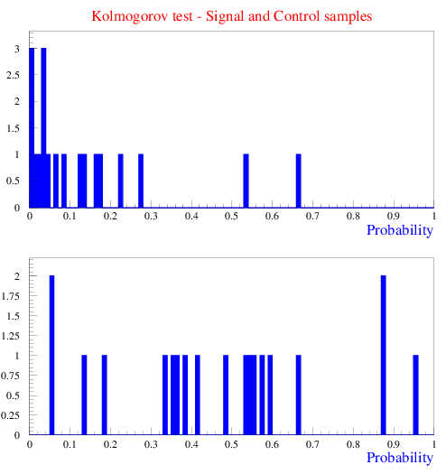
Global P from set of p-values
Authors of CDF “superjet” analysis tested a “complete set” of kinematical quantities; then computed global P of set of KS p-values using
formula of combining p-values (assumed sampled from a Uniform distribution):
→ >6-sigma result!
… But in absence of an alternate model
(really hard to cook given the weird
kinematic properties of the set)
one cannot thus “disprove” the Standard Model…
The real nature of events remained mysterious; at heated meetings, famous physicist argued that it was wrong to draw statistical inferences based on extreme values of some of the kinematical quantities
But the KS test is especially unsuited to spot those! In fact, one can move events in the tails back to center of distribution without p(KS) changing at all !!

Slide 33
Intermezzo: combination of p-values
Suppose you have several p-values, derived from different, independent tests. You may ask yourself several questions with them.
What is the probability that the smallest of them is as small as the one I got ?
What is the probability that the largest one is as small as the largest I observed ?
What is the probability that the product is as small as the one I can compute with these N values ?
Please note! Your inference on the data at hand strongly depends on what test you perform, for a given set of data. In other words, you cannot choose which test to run only upon seeing the data…
Suppose anyway you believe that each p-value tells something about the null hypothesis you are testing, so you do not want to discard any of them. Then the reasonable (not the optimal!) thing to do is to use the product of the N values. The formula providing the cumulative distribution of the density of x=Πx_{i} can be derived by induction (see [Roe 1992], p.129) and is
This accounts for the speed with which the product of N numbers in [0,1] tends to zero as N grows.

Slide 34
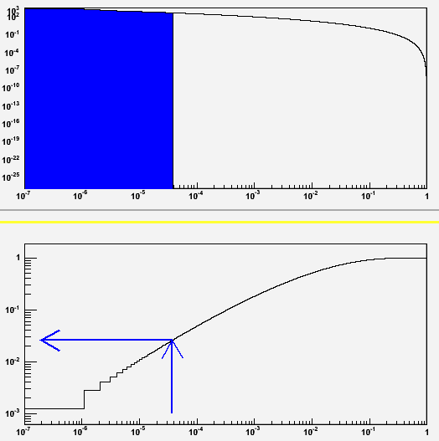
Some examples
To start let us take five really uniformly distributed p-values, x₁=0.1, x₂=0.3, x₃=0.5, x₄=0.7, x₅=0.9. Their product is 0.00945, and with the formula just seen we get P(0.00945)=0.5017. As expected.
And what if instead x₁=0.00001, x₂=0.3, x₃=0.5, x₄=0.7, x₅=0.9 ? The result is P(9.45*10⁻⁷) =0.00123, which is rather large: one might think that the chance of getting one in five numbers as small as 10⁻⁵ must occur only a few times in 10⁻⁵. But we are testing the product, not the smallest of the five numbers !
And if now we let x₁=0.05, x₂=0.10, x₃=0.15, x₄=0.20, x₅=0.25, the test for the product yields P(3.75*10⁻⁵)=0.0258 (see picture on the right).
Also not a compelling rejection of the null…
Compare with what you would get if you had asked “what is the chance that five numbers are all smaller than 0.25 ?”, whose answer is (0.25)⁵=0.00098. This demonstrates that the a-posteriori choice of the test is to be avoided !
pdf of f(Πx_{i})
Cumulative of the pdf f(Πx_{i})

Slide 35
GoF tests with Max Likelihood
The maximum likelihood is a powerful method to estimate parameters, but no measure of GoF is given, because the expected value of L at maximum is not known, even under the hypothesis that the data are indeed sampled from the pdf model used in the fit
The distribution of L_{max} can be studied with toy MC → one derives a p-value that a value as small as the one observed in the data arises, under the given assumptions
Alternatively, one can bin the data, obtaining estimated mean values of entries per bin from the ML fit:
Then one can derive a χ²_{L} statistic using the ratio of likelihoods
and computing
since in this case the latter follows a χ² distribution.
The quantity λ(ν)=L(n|ν)/L(n|n) differs from the likelihood function by a normalization factor, and can thus be used for both parameter estimation and Goodness of fit.

Slide 36
Exercise: probabilities of Poisson data

Slide 37
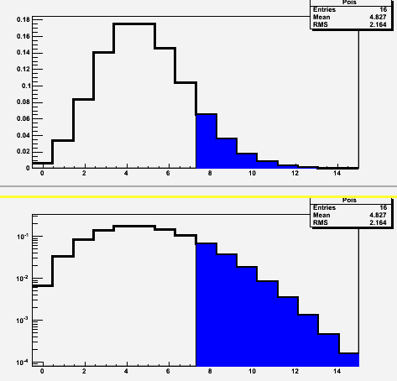
Poisson probabilities
We want to write a root macro that inputs expected background counts B (with no error) and observed events N, and computes the probability of observing at least N, and the corresponding number of sigma Z for a Gaussian one-tailed test.
The p-value calculation should be straightforward: just sum from 0 to N-1 the values of the Poisson (computing the factorial as you go along in the cycle), and derive p as 1-sum.
RECALL:
Deriving the number of sigmas that p corresponds to requires the inverse
error function ErfInverse(x) as
Z = sqrt(2) * ErfInverse(1-2p)
(it should be available as TMath::ErfInverse(double) )
You can also fill two distributions, one with the Poisson(B), the other with only the bins >=N filled (and with SetFillColor(kBlue) or something) and plot
them overimposed, to get something like the graph on the right (top: linear y scale; bottom: log y scale)

Slide 38
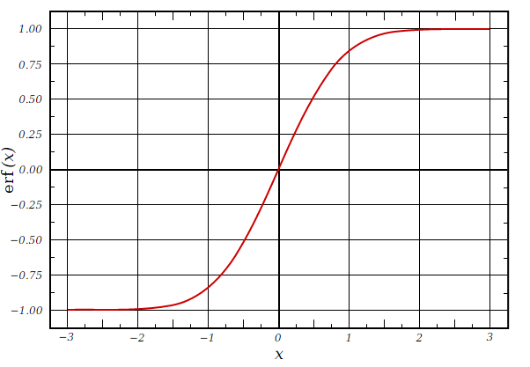
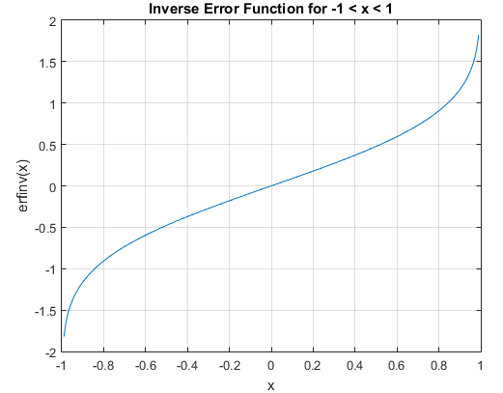
Parenthesis – Erf and ErfInverse
The error function and its inverse are useful tools in statistical calculations – you will encounter them frequently.
The Erf can be used to obtain the integral of a Gaussian as
The erfinverse function is used to convert alpha
values into number of sigmas. We will see examples
of that later on.

Slide 39
One possible implementation
// Macro that computes p-value and Z-value
// of N observed vs B predicted Poisson counts
// --------------------------------------------------------------------
void Poisson_prob_fix (double B, double N) {
int maxN = N*3/2; // extension of x axis
if (N<20) maxN=2*N;
TH1D * Pois = new TH1D ("Pois", "", maxN, -0.5, maxN-0.5);
TH1D * PoisGt = new TH1D ("PoisGt", "", maxN, -0.5, maxN-0.5); // we also fill a “highlighted” portion
double sum=0.;
double fact=1.;
for (int i=0; i<maxN; i++) {
if (i>1) fact*=i; // calculate factorial
poisson = exp(-B)*pow(B,i)/fact;
if (i<N) sum+= poisson; // calculate 1-tail integral
Pois->SetBinContent(i+1,poisson);
if (i>=N) PoisGt->SetBinContent(i+1,poisson);
}
double P=1-sum; // get probability of >=N counts
double Z = sqrt(2) * TMath::ErfInverse(1-2*P);
cout << "P of observing N=" << N << " or more events if B=" << B << " : P= " << 1-sum << endl;
cout << "This corresponds to " << Z << " sigma for a Gaussian one-tailed test." << endl;
Pois->SetLineWidth(3);
PoisGt->SetFillColor(kBlue);
TCanvas* T = new TCanvas ("T","Poisson distribution", 500, 500);
// Plot the stuff
T->Divide(1,2);
T->cd(1);
Pois->Draw();
PoisGt->Draw("SAME");
T->cd(2);
T->GetPad(2)->SetLogy();
Pois->Draw();
PoisGt->Draw("SAME");
}

Slide 40
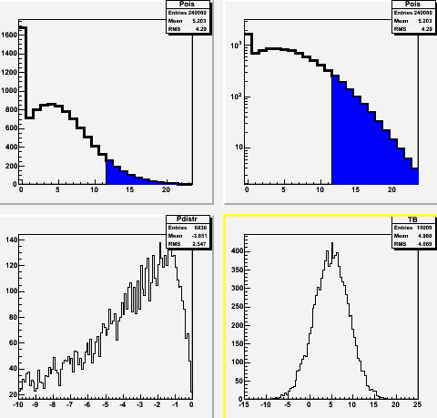
Adding a nuisance
Let us assume now that B’ is not fixed, but known to some accuracy σ_{B}. We want to add that functionality to our macro. We can start with a Gaussian uncertainty.
Example below: B=5+-4, N=12
You just have to throw a random number B=G(B’,σ_{B}) to set B, and collect a large number (say 10k) of p-values as before, then take the average of them.
(why the average ? Would the median be better ?)
Upon testing it, you will discover that you need to enforce that B be non-negative.
What we do with the negative B determines the result we get, so we have to be careful, and ask ourselves what exactly do we mean when we say, e.g., “B=2.0+-1.0”

Slide 41
Possible implementation
void Poisson_prob_fluct (double B, double SB, double N) {
double Niter=10000;
int maxN = N*3/2;
if (N<20) maxN=2*N;
TH1D * Pois = new TH1D ("Pois", "", maxN, -0.5, maxN-0.5);
TH1D * PoisGt = new TH1D ("PoisGt", "", maxN, -0.5, maxN-0.5);
// We throw a random Gaussian smearing SB to B, compute P,
// and iterate Niter times; we then study the distribution
// of p-values, extracting the average
double Psum=0;
TH1D * Pdistr = new TH1D ("Pdistr", "", 100, -10., 0.);
TH1D * TB = new TH1D ("TB", "",100, B-5*SB,B+5*SB);
cout << "Start of cycle" << endl;
for (int iter=0; iter<Niter; iter++) {
// Extract B from G(B,SB)
double thisB = gRandom->Gaus(B,SB);
TB->Fill(thisB); // We keep track of the pdf of the background
if (thisB<=0) thisB=0.; // Note this – what if we had rethrown it ?
double sum=0.;
double fact=1.;
for (int i=0; i<maxN; i++) {
if (i>1) fact*=i;
double poisson = exp(-thisB)*pow(thisB,i)/fact;
if (i<N) sum+= poisson;
Pois->Fill((double)i,poisson);
if (i>=N) PoisGt->Fill((double)i,poisson);
}
double thisP=1-sum;
if (thisP>0) Pdistr->Fill(log(thisP));
Psum+=thisP;
}
double P = Psum/Niter; // we use the average for our inference here
double Z = sqrt(2) * ErfInverse(1-2*P);
cout << "Expected P of observing N=" << N << " or more events if B="
<< B << "+-" << SB << " : P= " << P << endl;
cout << "This corresponds to " << Z << " sigma for a Gaussian one-tailed test." << endl;
// Plot the stuff
Pois->SetLineWidth(3);
PoisGt->SetFillColor(kBlue);
TCanvas* T = new TCanvas ("T","Poisson distribution", 500, 500);
T->Divide(2,2);
T->cd(1);
Pois->DrawClone();
PoisGt->DrawClone("SAME");
T->cd(2);
T->GetPad(2)->SetLogy();
Pois->DrawClone();
PoisGt->DrawClone("SAME");
T->cd(3);
Pdistr->DrawClone();
T->cd(4);
TB->Draw();
}

Slide 42
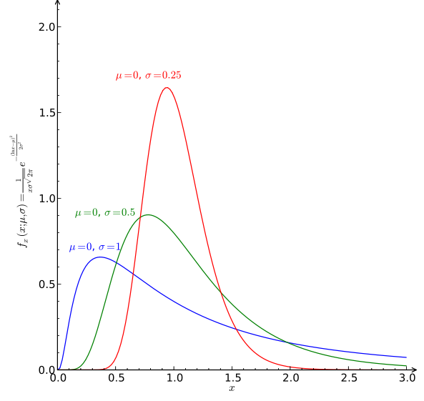
Homework assignment: change to log-normal
Substitute the gRandom->Gaus() call such that you get a B distributed with a log-Normal pdf, being careful to plug in the variance you really want, and check what difference it makes.
It should be intuitive that the LogNormal() is the correct nuisance to use in many common situations. It corresponds to saying “I know B to within a factor of 2”. Or think at a luminosity uncertainty...
This follows from the fact that while the Gaussian is the limit of the sum of many small random contributions , the limit of a product of small factors is a log-normal.
In the web area you find a version of Poisson_prob_fluct.C that does this
To get a logN quickly, just throw y = G(μ,σ) ; then x=exp(y) is what you need.
However, note that with the ansatz “know B to within a certain factor”, we want the median exp(μ) to represent our central value, not the mean e(μ+σ²/2) ! So we set μ=log(B). To know what to set sigma to, we need to consider our ansatz: σ=σ_{B}/B corresponds to it.

Slide 43
The five-sigma criterion
Some history of the five-sigma criterion in HEP
Rosenfeld on exotic baryons
Lynch and the GAME program
Successful and failed applications in recent times
The trouble with it
Ill-quantifiable LEE
Subconscious Bayes factors
Systematics
The Jeffrey-Lindley paradox
How to fix it ?
Lyons’ table
Agreeing on flexible thresholds
Note: numbers within brackets [N] correspond to a bibliographical reference, provided at the end of this section

Slide 44
Some history of 5σ
In 1968 Arthur Rosenfeld wrote a paper titled "Are There Any Far-out Mesons or Baryons?“ [1]. In it, he demonstrated that the number of claims of discovery of such exotic particles published in scientific magazines agreed reasonably well with the number of statistical fluctuations that one would expect in the analyzed datasets. (“Far-out hadrons” are hypothetical particles which can be defined as ones that do not fit in SU(3) multiplets. In 1968 quarks were not yet fully accepted as real entities, and the question of the existence of exotic hadrons was important.)
Rosenfeld examined the literature and pointed his finger at large trial factors coming into play due to the massive use of combinations of observed particles to derive mass spectra containing potential discoveries:
"[...] This reasoning on multiplicities, extended to all combinations of all outgoing particles and to all countries, leads to an estimate of 35 million mass combinations calculated per year. How many histograms are plotted from these 35 million combinations? A glance through the journals shows that a typical mass histogram has about 2,500 entries, so the number we were looking for, h is then 15,000 histograms per year (Our annual surveys also tells you that the U.S. measurement rate tends to double every two years, so things will get worse)."

Slide 45
More Rosenfeld
"[...] Our typical 2,500 entry histogram seems to average 40 bins. This means that therein a physicist could observe 40 different fluctuations one bin wide, 39 two bins wide, 38 three bins wide... This arithmetic is made worse by the fact that when a physicist sees 'something', he then tries to enhance it by making cuts...“
(I will get back to the last issue later)
"In summary of all the discussion above, I conclude that each of our 150,000 annual histograms is capable of generating somewhere between 10 and 100 deceptive upward fluctuations [...]".
That was indeed a problem! A comparison with the literature in fact showed a correspondence of his eyeballed estimate with the number of unconfirmed new particle claims.
Rosenfeld concluded:
“To the theorist or phenomenologist the moral is simple: wait for nearly 5σ effects. For the experimental group who has spent a year of their time and perhaps a million dollars, the problem is harder... go ahead and publish... but they should realize that any bump less than about 5σ calls for a repeat of the experiment.”

Slide 46
Gerry Lynch and GAME
Rosenfeld’s article also cites the half-joking, half-didactical effort of his colleague Gerry Lynch at Berkeley:
"My colleague Gerry Lynch has instead tried to study this problem 'experimentally' using a 'Las Vegas' computer program called Game. Game is played as follows. You wait until a unsuspecting friend comes to show you his latest 4-sigma peak. You draw a smooth curve through his data (based on the hypothesis that the peak is just a fluctuation), and punch this smooth curve as one of the inputs for Game. The other input is his actual data. If you then call for 100 Las Vegas histograms, Game will generate them, with the actual data reproduced for comparison at some random page. You and your friend then go around the halls, asking physicists to pick out the most surprising histogram in the printout. Often it is one of the 100 phoneys, rather than the real "4-sigma" peak. “
Obviously particle physicists in the ‘60s were more “bump-happy” than we are today. The proposal to raise to 5-sigma of the threshold above which a signal could be claimed was an earnest attempt at reducing the flow of claimed discoveries, which distracted theorists and caused confusion.

Slide 47
Let’s play GAME
It is instructive even for a hard-boiled sceptical physicist raised in the years of Standard Model Precision Tests Boredom to play with GAME.
In the following slides are shown a few histograms, each selected by an automated procedure as the one containing “the most striking” peak among a set of 100, all drawn from a smooth distribution.
Details: 1000 entries; 40 bins; the “best” histogram in each set of 100 is the one with most populated adjacent pair of bins (in the first five slides) or triplets of bins (in the second set of five slides)
You are asked to consider what you would tell your student if she came to your office with such a histogram, claiming it is the result of an optimized selection for some doubly charmed baryon, say, that she has been looking for in her research project.

Slide 48
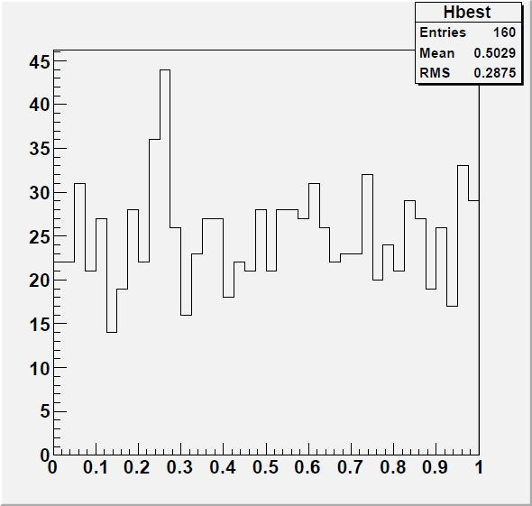
2-bin bumps
Here are the outputs of the most significant 2-bin bumps in five 100-histogram sets: #1

Slide 49
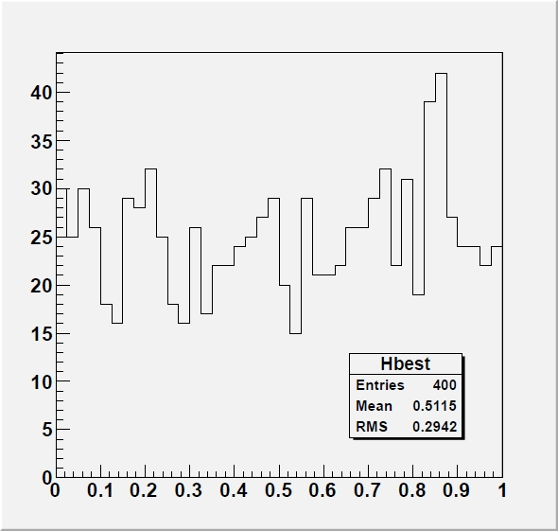
2-bin bumps
Here are the outputs of the most significant 2-bin bumps in five 100-histogram sets: #2

Slide 50
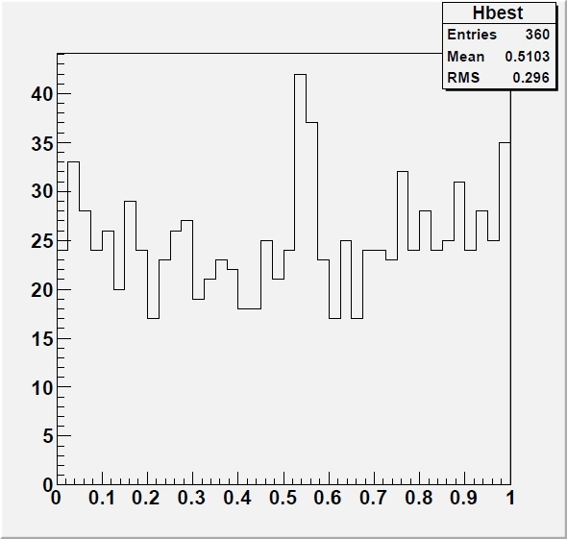
2-bin bumps
Here are the outputs of the most significant 2-bin bumps in five 100-histogram sets: #3

Slide 51
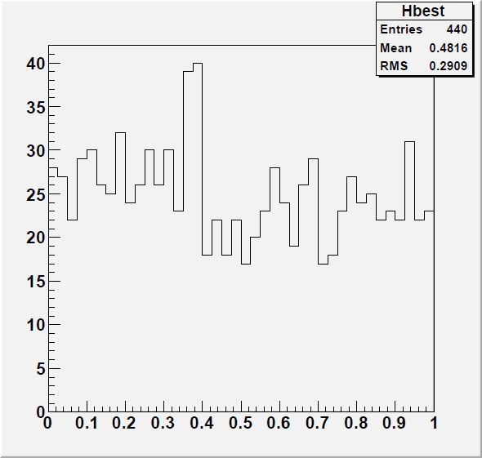
2-bin bumps
Here are the outputs of the most significant 2-bin bumps in five 100-histogram sets: #4

Slide 52
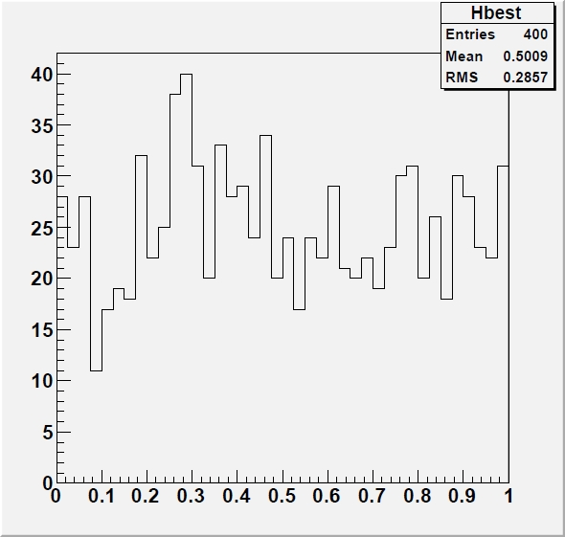
2-bin bumps
Here are the outputs of the most significant 2-bin bumps in five 100-histogram sets: #5

Slide 53
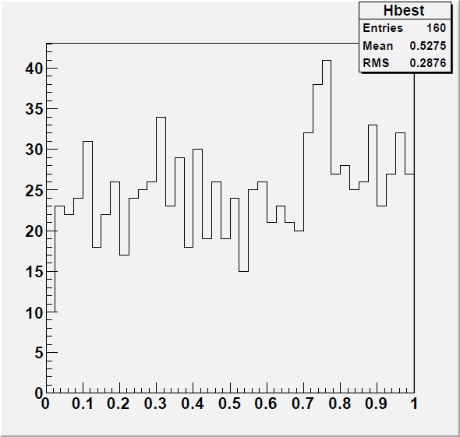
3-bin bumps
Here are the outputs of the most significant 3-bin bumps in five 100-histogram sets: #1

Slide 54
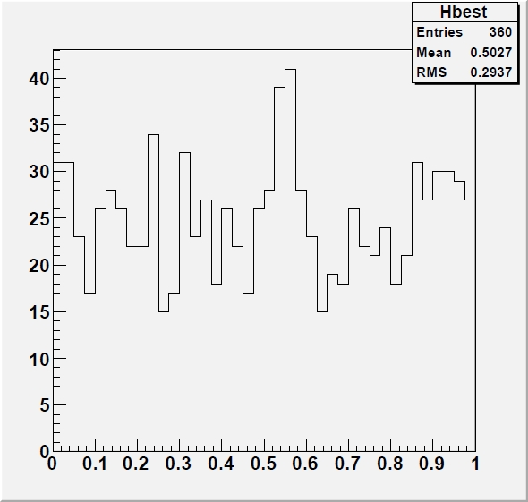
3-bin bumps
Here are the outputs of the most significant 3-bin bumps in five 100-histogram sets: #2

Slide 55
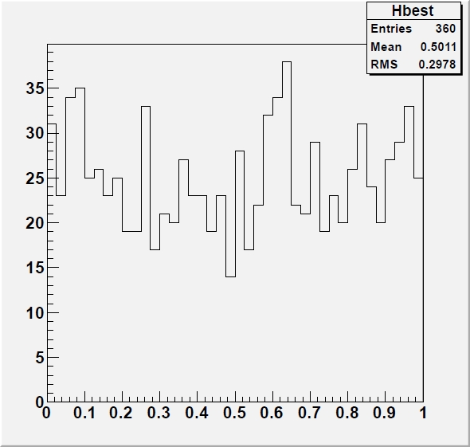
3-bin bumps
Here are the outputs of the most significant 3-bin bumps in five 100-histogram sets: #3

Slide 56
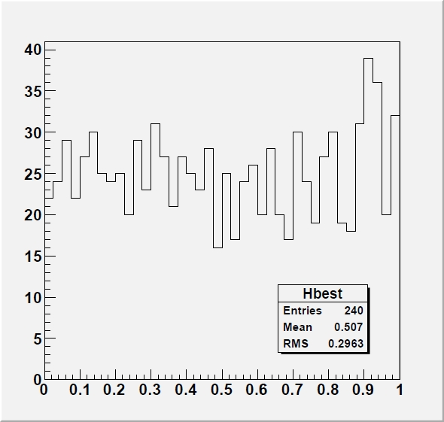
3-bin bumps
Here are the outputs of the most significant 3-bin bumps in five 100-histogram sets: #4

Slide 57
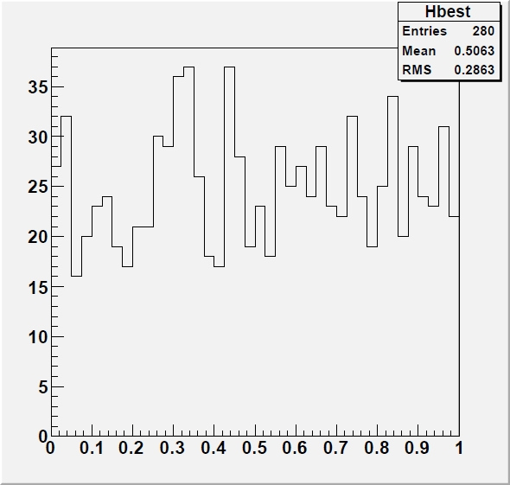
3-bin bumps
Here are the outputs of the most significant 3-bin bumps in five 100-histogram sets: #5

Slide 58
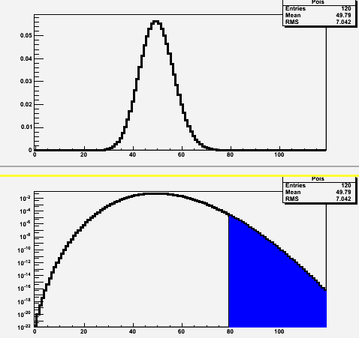
Notes on GAME
Each of the histograms in the previous slides is the best one in a set of a hundred; yet the isolated signals have p-values corresponding to 3.5σ - 4σ effects
E.g. some of the 2-bin bumps contain 80 evts with an expectation of 2*1000/40=50, and
p_{Poisson}(μ=50;N>=80)=5.66*10⁻⁵ → N=3.86σ
Why?
Because the bump can appear anywhere (x39)
in the spectrum – we did not specify beforehand
where we would look because we admit 2- as
well as 3-bin bumps as “interesting” (also, we
could extend the search to wider structures
without penalty)
One should also ponder on the often overlooked fact that researchers finding a promising “bump” will usually modify the selection a posteriori, voluntarily or involuntarily enhancing it. This makes the trials factor quite hard to estimate a priori
P(N|μ=50) in linear (top)
and semi-log scale (bottom)

Slide 59
What 5σ may do for you
Setting the bar at 5σ for a discovery claim undoubtedly removes the large majority of spurious signals due to statistical fluctuations
The trials factor required to reach 10⁻⁷ probabilities is of course very large, but the large number of searches being performed in today’s experiments makes up for that
Nowadays we call this “LEE”, for “look-elsewhere effect”.
50 years after Rosenfeld, we do not need to compute the trials factor by hand: we can estimate a “global” as well as a “local” p-value using brute force computing, or advanced tricks (more later).
The other reason at the roots of the establishment of a high threshold for significance has been the ubiquitous presence in our measurements of unknown, or ill-modeled, systematic uncertainties
To some extent, a 5σ threshold protects systematics-dominated results from being published as discoveries
Protection from trials factor and unknown or ill-modeled systematics are the rationale behind the 5σ criterion
It is to be noted that the criterion has no basis in professional statistics literature, and is considered totally arbitrary by statisticians, no less than the 5% threshold often used for the type-I error rate of research in medicine, biology, cognitive sciences, etcetera. As shown before, the type-1 error rate is an arbitrary choice.

Slide 60
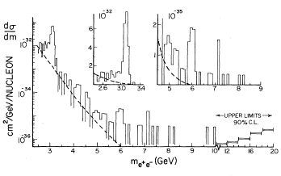
How 5σ became a standard 1: the Seventies
A lot has happened in HEP since 1968. In the seventies, the gradual consolidation of the SM shifted the focus of particle hunts from random bump hunting to more targeted searches
Let’s have a look at a few important searches to understand how the 5σ criterion gradually became a standard
The J/ψ discovery (1974): no question of significance – the bumps were too big for anybody to bother fiddling with statistical tests
The τ discovery (1975-1977): no mention of significances for the excesses of (eμ) events; rather a very long debate on hadron backgrounds.
The Oops-Leon(1976): “Clusters of events as observed occurring anywhere from 5.5 to 10.0 GeV appeared less than 2% of the time⁸. Thus the statistical
case for a narrow (<100 MeV) resonance is
strong although we are aware of the need
for a confirmation.”[2]
In footnote 8 they add: “An equivalent but cruder check is made by noting that the “continuum” background near 6 GeV and within the cluster width is 4 events. The probability of observing 12 events is again <=2%”
... But P(μ=4;N>=12) is 0.00091... so this seems to include
a x20 trials factor. Daniel Kaplan may confirm ?

Slide 61
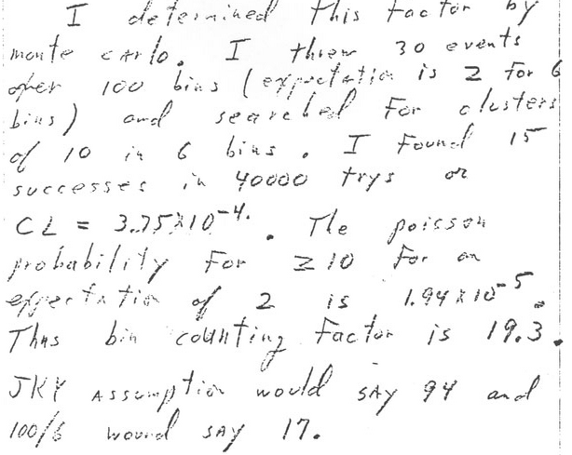
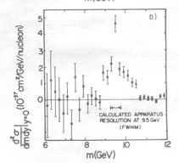
The real Upsilon
Nov 19th 1976
The Upsilon discovery (1977): burned by the Oopsleon, the E288 scientists waited more patiently for more data after seeing a promising 3σ peak at 9.5 GeV
They did statistical tests to account for the trials factor (comparing MC probability to Poisson probability)
Even after obtaining a peak with very large significance (>8σ) they continued to investigate systematical effects
Final announcement claims discovery but does not quote significance, noting however that the signal is “statistically significant”[3]
Nov 21st 1976
June 6th 1977

Slide 62
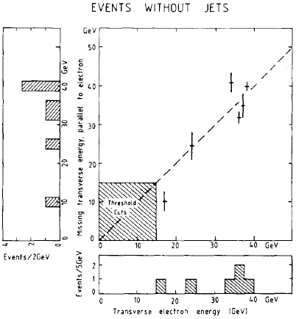
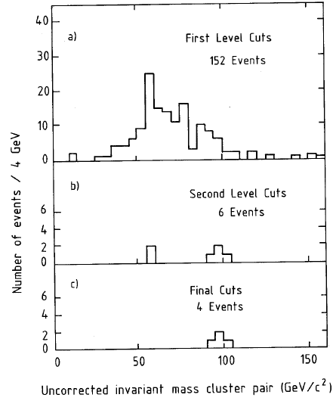
The W and Z bosons
The W discovery was announced on January 25th 1983 based on 6 electron events with missing energy and no jets. No statistical analysis is discussed in the discovery paper[4], which however tidily rules out backgrounds as a source of the signal
Note that in the W search there was no trials factor to account for, as the signature was unique and predetermined; further, the theory prediction for the mass (82+-2 GeV) was matched well by the measurement (81+-5 GeV).
The Z was “discovered” shortly thereafter, with an official CERN announcement made in May 1983 based on 4 events.
Also for the Z no trials factor was applicable
No mention of statistical checks in the paper[5], except notes that the various background sources were negligible.

Slide 63
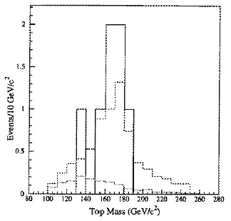
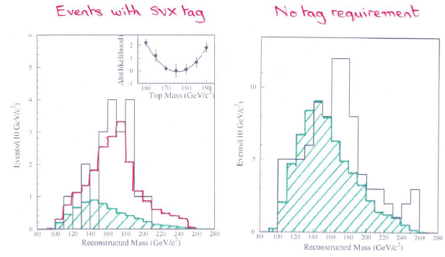
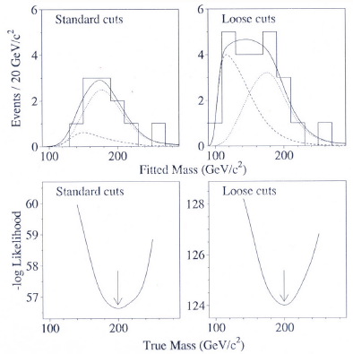
The top quark discovery
In 1994 the CDF experiment had a serious counting excess (2.7σ) in b-tagged single-lepton and dilepton datasets, plus a towering mass peak at a value not far from where indirect EW constraints placed their bets
the mass peak, or corresponding kinematic evidence, was over 3σ by itself;
M=174+-10⁺¹³₋₁₂ GeV (now it’s 173+-0.5!)
Nonetheless the paper describing the analysis (120-pages long) spoke of “evidence” for top quark production[6]
One year later CDF and DZERO[7] both presented 5σ significances based on their counting experiments, obtained by analyzing 3x more data
The top quark was thus the first particle discovered by a willful application of the “5σ” criterion

Slide 64
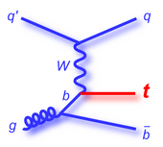
Following the top quark...
Since 1995, the requirement of a p-value below 3*10⁻⁷ slowly but steadily became a standard. Two striking examples of searches that diligently waited for a 5-sigma effect before claiming discovery are:
Single top quark production: the top produced by electroweak processes in hadron-hadron collisions is harder to detect, and took 14 more years from the discovery of top pair production. The CDF and DZERO collaborations competed for almost a decade in the attempt to claim to have observed the process, obtaining 2-sigma, then 3- and 4-sigma effects, and only resolving to claim observation in 2009 [8], when clear 5-sigma effects had been observed.
In 2012 the Higgs boson was claimed by ATLAS and CMS[9]. Note that the two experiments had mass-coincident >3σ evidence in their data 6 months earlier, but the 5σ recipe was followed diligently.
It is precisely the Higgs discovery what brought to the media attention the five-sigma criterion.

Slide 65
Signals that petered out - 1
In April 1995 CDF collected an event that fired four distinct “alarm bells” by the online trigger, Physmon. It featured two clean electrons, two clean photons, large missing transverse energy, and nothing else
It could be nothing! No SM process appeared to come close to explain its presence
Possible backgrounds were estimated below 10⁻⁷, a 6-sigma find
The observation[10] caused a whole institution to dive in a 10-year-long campaign to find “cousins” and search for an exotic explanation; it also caused dozens of theoretical papers and revamping or development of SUSY models
In Run 2 no similar events were found; DZERO did not see anything similar

Slide 66
Signals that petered out - 2
In 1996 CDF found a clear resonance structure of b-quark jet pairs at 110 GeV, produced in association with photons
The signal [11] had almost 4σ significance and looked quite good – but there was no compelling theoretical support for the state, no additional evidence in orthogonal samples, and the significance did not pass the threshold for discovery → archived.
In 1998 CDF observed 13 “superjet” events in the W+2,3-jet sample; a 3σ excess from background expectations (4+-1 events) but weird kinematics
Checking a “complete set” of kinematical variables yielded a significance in the 6σ ballpark
The analysis was published [12]only after a fierce, three-year-long fight within the collaboration; no similar events appeared in the x100 statistics of Run II.

Slide 67
Signals that petered out - 3
1996 was a prolific year for particle ghosts in the 100-110 GeV region. ALEPH also observed a 4σ-ish excess of Higgs-like events at 105 GeV in the 4-jet final state of electron-positron collisions at 130-136 GeV. They published the search[13], which found 9 events in a narrow mass region with a background of 0.7, estimating the effect at the 0.01% level
the paper reports a large number of different statistical tests based on the event numbers and their characteristics. Of course a sort of LEE is at work also when one makes many different tests...
In 2004 H1 published a pentaquark signal at 6 sigma significance[14]. The prominent peak at 3.1 GeV was indeed suggestive, however it was not confirmed by later searches.
In the paper they write that “From the change in maximum log-likelihood when the full distribution is fitted under the null and signal hypotheses, corresponding to the two curves shown in figure 7, the statistical significance is estimated to be p=6.2σ”
Note: H1 worded it “Evidence” in the title !! A wise departure from blind application of the 5-sigma rule...

Slide 68
Signals that petered out - 4
A mention has also to be made of two more recent, striking examples:
In 2011 the OPERA collaboration produced a measurement of neutrino travel times from CERN to Gran Sasso which appeared smaller by 6σ than the travel time of light in vacuum[15]. The effect spurred lively debates, media coverage, checks by the ICARUS experiment and dedicated beam runs. It was finally understood to be due to a large source of systematic uncertainty – a loose cable[16]
Also in 2011 the CDF collaboration showed a large, 4σ signal at 145 GeV in the dijet mass distribution of proton-antiproton collision events producing an associated leptonic W boson decay[17]. The effect grew with data size and was systematical in nature; indeed it was later understood to be due to the combination of two nasty background contaminations[18].

Slide 69
An almost serious table
Given the above information, an intriguing pattern emerges...
Claim | Claimed Significance |  |  |  | Verified or Spurious
Top quark evidence | 3 |  |  |  | True
Top quark observation |  |  | 5 |  | True
CDF bbγ signal |  | 4 |  |  | False
CDF eeggMEt event |  |  |  | 6 | False
CDF superjets |  |  |  | 6 | False
Bs oscillations |  |  | 5 |  | True
Single top observation |  |  | 5 |  | True
HERA pentaquark |  |  |  | 6 | False
ALEPH 4-jets |  | 4 |  |  | False
LHC Higgs evidence | 3 |  |  |  | True
LHC Higgs observation |  |  | 5 |  | True
OPERA v>c neutrinos |  |  |  | 6 | False
CDF Wjj bump |  | 4 |  |  | False

Slide 70
A look into the Look-Elsewhere Effect
From the discussion above, we learned that a compelling reason for enforcing a small test size as a prerequisite for discovery claims is the presence of large trials factors, aka LEE
LEE was a concern 50 years ago, but nowadays we have enormously more CPU power. Nevertheless, the complexity of our analyses has also grown considerably
Take the Higgs discovery: CMS combined dozens of final states with hundreds of nuisance parameters, partly correlated, partly constrained by external datasets, often non-Normal.
→ we still sometimes cannot compute the trials factor satisfactorily by brute force!
A further complication is that in reality the trials factor also depends on the significance of the local fluctuation, adding dimensionality to the problem.
A study by E. Gross and O. Vitells[19] demonstrated how it is possible to estimate the trials factor in most experimental situations

Slide 71
Trials factors
In statistics literature the situation in which one speaks of a trials factor is one of a hypothesis test when a nuisance parameter is present only under the alternative hypothesis. The regularity conditions under which Wilks’ theorem applies are then not satisfied.
Let us consider a particle search when the mass is unknown. The null hypothesis is that the data follow the background-only model b(m), and the alternative hypothesis is that they follow the model b(m)+ μs(m|M), with μ a signal strength parameter and M the particle’s true mass, which here acts as a nuisance only present in the alternative. μ=0 corresponds to the null, μ>0 to the alternative.
One then defines a test statistic encompassing all possible
particle mass values,
This is the maximum of the test statistic defined above for the bgr-only, across the many tests performed at the various possible masses being sought. The problem consists in assigning a p-value to the maximum of q(m) in the entire search range.
One can use an asymptotic “regularity” of the distribution of the above q to get a global p-value by using the technique of Gross and Vitells.

Slide 72
Local minima and upcrossings
One counts the number of “upcrossings” of the distribution of the test statistic, as a function of mass. Its wiggling tells how many independent places one has been searching in.
The number of local minima in the fit to a distribution is closely connected to the freedom of the fit to pick signal-like fluctuations in the investigated range
The number of times that the test statistic (below, the likelihood ratio between H₁ and H₀) crosses some reference line can be used to estimate the trials factor. One estimates the global p-value with the number N₀ of upcrossings from a minimal value of the q₀ test statistic (for which p=p₀) by the formula
The number of upcrossings can be best estimated
using the data themselves at a low value of
significance, as it has been shown that the
dependence on Z is a simple
negative exponential:

Slide 73
Notes about the LEE estimation
Even if we can usually compute the trials factor by brute force or estimate with asymptotic approximations, there is a degree of uncertainty in how to define it
If I look at a mass histogram and I do not know where I try to fit a bump, I may consider:
the location parameter and its freedom to be anywhere in the spectrum
the width of the peak
the fact that I may have tried different selections before settling on the one I actually end up presenting
the fact that I may be looking at several possible final states
My colleagues in the experiment can be doing similar things with different datasets; should I count that in ?
There is ambiguity on the LEE depending who you are (grad student, exp spokesperson, lab director...)
Also note that Rosenfeld considered the whole world’s database of bubble chamber images in deriving a trials factor)
The bottomline is that while we can always compute a local significance, it may not always be clear what the true global significance is.

Slide 74
Systematic uncertainties
Systematic uncertainties affect any physical measurement and it is sometimes quite hard to correctly assess their impact.
Often one sizes up the typical range of variation of an observable due to the imprecise knowledge of a nuisance parameter at the 1-sigma level; then one stops there and assumes that the probability density function of the nuisance be Gaussian.
→ if however the PDF has larger tails, it makes the odd large bias much more frequent than estimated
Indeed, the potential harm of large non-Gaussian tails of systematic effects is one arguable reason for sticking to a 5σ significance level even when we can somehow cope with the LEE. However, the “coverage” that the criterion provides to mistaken systematics is not always sufficient.
One quick example: if a 5σ effect has uncertainty dominated by systematics, and the latter is underestimated by a factor of 2, the 5σ effect is actually a 2.5σ one (a p=0.006 effect): in p-value terms this means that the size of the effect is overestimated by a factor 20,000!

Slide 75
A study of residuals
The distribution of residuals
of 306 measurements in [20]
A study of the residuals of particle properties in the RPP in 1975 revealed that they were not Gaussian in fact. Matts Roos et al. [20] considered residuals in kaon and hyperon mean life and mass measurements, and concluded that these seem to all have a similar shape, well described by a Student distribution S₁₀(h/1.11):
Of course, one cannot extrapolate to 5-sigma the behaviour observed by Roos and collaborators in the bulk of the distribution; however, one may consider this as evidence that the uncertainties evaluated in experimental HEP may have a significant non-Gaussian component
Black: a unit Gaussian;
red: the S₁₀(x/1.11) function
Left: 1-integral distributions of the two functions.
Right: ratio of the 1-integral values as a function of z
x1000!

Slide 76
The “subconscious Bayes factor”
Louis Lyons [21] calls this way the ratio of prior probabilities we subconsciously assign to the two hypotheses
When comparing a “background-only” H₀ hypothesis with a “background+signal” one H₁ one often uses the likelihood ratio λ=L₁/L₀ as a test statistic
The p<0.000027% criterion is applied to the distribution of λ under H₀ to claim a discovery
However, what would be more relevant to the claim would be the ratio of the probabilities:
where p(data|H) are the likelihoods, and π are the priors of the hypotheses
In that case, if our prior belief in the alternative, π₁, were low, we would still favor the null even with a large evidence λ against it.
The above is a Bayesian application of Bayes’ theorem, while HEP physicists prefer to remain in Frequentist territory. Lyons however notes that “this type of reasoning does and should play a role in requiring a high standard of evidence before we reject well-established theories: there is sense to the oft-quoted maxim ‘extraordinary claims require extraordinary evidence’ ”.

Slide 77
A diversion: the “point null” and the Jeffreys-Lindley paradox
All what we have discussed so far makes sense strictly in the context of classical (aka Frequentist) statistics. One might well ask what is the Bayesian view of the problem
The issue revolves around the existence of a null hypothesis, H₀, on which we base a strong belief. It is quite special to physics that we do believe in our “point null” – a theory which works for a specific value of a parameter, known with arbitrary accuracy; in other sciences a true “point null” hardly exists
The fact that we must often compare a null hypothesis (for which a parameter has a very specific value) to an alternative (which has a continuous support for the parameter under test) bears on the definition of a prior belief for the parameter. Bayesians speak of a “probability mass” at θ=θ₀.
The use of probability masses in priors in a simple-vs-composite test throws a monkey wrench in the Bayesian calculation, as it can be proven that no matter how large and precise is the data, Bayesian inference strongly depends on the scale over which the prior is non-null – that is, on the prior belief of the experimenter.
The Jeffreys-Lindley paradox [22] may bring Frequentists and Bayesians to draw opposite conclusions on some data when comparing a point null to a composite alternative. This fact bears relevance to the kind of tests we are discussing, so let us give it a look.

Slide 78
The paradox
Take X₁...X_{n} i.i.d. as X_{i}|θ ~ N(θ,σ²), and a prior belief on θ constituted by a mixture of a point mass p at θ₀ and (1-p) uniformly distributed in [θ₀-I/2,θ₀+I/2].
In classical hypothesis testing the “critical values” of the sample mean delimiting the rejection region of H₀:θ=θ₀ in favor of H₁:θ<>θ₀ at significance level α are
where z_{α/2} is the significance corresponding to test size α for a two-tailed normal distribution
Given the above, it can be proven that the posterior probability that H₀ is true conditional on the data in the critical region (i.e. excluded by a classical α-sized test) approaches 1 as the sample size becomes arbitrarily large.
π(H₀)
X
π(H₁)
θ
θ₀-I/2
θ₀
θ₀+I/2
As evidenced by Bob Cousins[23], the paradox arises
if there are three different scales in the problem,
ε << σ/sqrt(n) << I, i.e. the width of the point mass,
the measurement uncertainty, and the scale I of the
prior for the alternative hypothesis
ε
σ/sqrt(n)
The three scales are usually independent in HEP!!
I

Slide 79
Proof (in case you need it...)
In the first line the posterior probability is written in terms of Bayes’ theorem;
in the second line we insert the actual priors p and (1-p) and the likelihood values in terms
of the stated Normal density of the iid data X;
in the third line we rewrite two of the exponentials using the conditional value of the sample
mean in terms of the corresponding significance z, and remove the normalization factors
sqrt(n)/sqrt(2π)σ;
in the fourth line we maximize the expression by using the integral of the Normal.

Slide 80
Notes on the JL paradox
The paradox is often used by Bayesians to criticize the way inference is drawn by frequentists:
Jeffreys: “What the use of [the p-value] implies, therefore, is that a hypothesis that may be true may be rejected because it has not predicted observable results that have not occurred” [24]
Alternatively, the criticism concerns the fact that no mathematical link between p and P(H|x) exists in classical HT.
On the other hand, the problem with the Bayesian approach is that there is no clear substitute to the Frequentist p-value for reporting experimental results
Bayesians prefer to cast the HT problem as a Decision Theory one, where by specifying the loss function allow a quantitative and well-specified (although subjective) recipe to choose between alternatives
Bayes factors, which describe by how much prior odds are modified by the data, are not factorizing out the subjectivity of the prior belief when the JLP holds: even asymptotically, they retain a dependence on the scale of the prior of H₁.
In their debates on the JL paradox, Bayesian statisticians have blamed the concept of a “point mass”, as well as suggested n-dependent priors. There is a large body of literature on the subject
As assigning to it a non-zero prior is the source of the problem, statisticians tend to argue that “the precise null” is never true. However, we do believe our point nulls in HEP and astro-HEP!!
The JL paradox draws attention to the fact that a fixed level of significance does not cope with a situation where the amount of data increases, which is common in HEP.
In summary, the issue is an active research topic and is not resolved. I have brought it up here to show how the trouble of defining a test size α in classical hypothesis testing is not automatically solved by moving to Bayesian territory.

Slide 81
So what to do with 5σ ?
To summarize the points made above:
the LEE can be estimated analytically as well as computationally; experiments in fact now often produce “global” and “local” p-values and Z-values
What is then the point of protecting from large LEE ?
In any case sometimes the trials factor is 1 and sometimes it is enormous; a one-size-fits-all is then hardly justified – it is illogical to penalize an experiment for the LEE of others
the impact of systematic uncertainties varies widely from case to case; e.g. sometimes one has control samples (e.g. particle searches), sometimes one does not (e.g. OPERA)
The cost of a wrong claim, as image damage or backfiring of media hype, can vary dramatically
Some claims are intrinsically less likely to be true –eg. we have a subconscious Bayes factor at work. It depends if you are discovering an unimportant new meson or a violation of physical laws
So why a fixed discovery threshold ?
One may take the attitude that any claim is anyway subject to criticism and independent verification anyway, and the latter is always more rigorous when the claim is steeper and/or more important; and it is good to just have a “reference value” for the level of significance of the data
It is often held that it is a “tradition” and a useful standard.

Slide 82
Lyons’ Table
My longtime CDF and CMS colleague Louis Lyons considered several known searches in HEP and astro-HEP, and produced a table where for each effect he listed several “inputs”:
the degree of surprise of the potential discovery
the impact for the progress of science
the size of the trials factor at work in the search
the potential impact of unknown or ill-quantifiable systematics
He could then derive a “reasonable” significance level that would account for the different factors at work, for each considered physics effect [21]
The approach is of course only meant to provoke a discussion, and the numbers in the table entirely debatable. The message is however clear: we should beware of a “one-size-fits-all” standard.
I have slightly modified his original table to reflect my personal bias

Slide 83
Table of searches for new phenomena and “reasonable” significance levels
Search | Surprise level | Impact | LEE | Systematics | Z-level
Neutrino osc. | Medium | High | Medium | Low | 4
Bs oscillations | Low | Medium | Medium | Low | 4
Single top | Absent | Low | Absent | Low | 3
B_{s}→μμ | Absent | Medium | Absent | Medium | 3
Higgs search | Medium | Very high | Medium | Medium | 5
SUSY searches | High | Very high | Very high | Medium | 7
Pentaquark | High | High | High | Medium | 7
G-2 anomaly | High | High | Absent | High | 5
H spin >0 | High | High | Absent | Low | 4
4th gen fermions | High | High | High | Low | 6
V>c neutrinos | Huge | Huge | Absent | Very high | THTQ
Direct DM search | Medium | High | Medium | High | 5
Dark energy | High | Very high | Medium | High | 6
Tensor modes | Medium | High | Medium | High | 5
Grav. waves | Low | High | Huge | High | 7

Slide 84
THTQ: one last note about very high Νσ
Recently heard claim from respected astrophysicist “The quantity has been measured to be non-zero at 40σ level”, referring to a measurement quoted as 0.110+-0.0027.
That is a silly statement! As N goes above 7 or so, we are rapidly losing contact with the reality of experimental situations
To claim e.g. a 5σ effect, one has to be reasonably sure to know the p-value PDF to the 10⁻⁷ level
Remember, Nσ is just as femtobarns or or attometers: a useful placeholder for small numbers
Hence before quoting high Nσ blindly, think at what they really mean
In the case of the astrophysicist, it is not even easy
to directly make the conversion, as ErfInverse() breaks
down above 7.5 or so. We resort to a good approximation
by Karagiannidis and Lioumpas [25],
For N=40 my computer still refuses to give anything
above 0, but for N=38 it gives p=2.5*10⁻³¹⁶
so he was basically saying that the data had a probability
of less than a part in 10^316 of being observed if the
null hypothesis held.
That is beyond ridiculous ! We will never be able to know the
tails of our systematic uncertainties to something similar.

Slide 85
Conclusions on the 5-sigma criterion
45 years after the first suggestion of a 5-sigma threshold for discovery claims, and 20 years after the start of its consistent application, the criterion appears inadequate
It did not protect from steep claims that later petered out
It significantly delayed acceptance of some relatively uncontroversial finds
single top is a prime example: DZERO and CDF kept battling to be first to 5σ for 8 years of Run 2, when in fact they could have used their thinning forces better in other directions
It is arbitrary and illogical in many aspects
Bayesian hypothesis testing does not appear ready to offer a robust replacement
JL paradox still active area of debate, no consensual view
A single number never summarizes the situation of a measurement
experiments have started to publish their likelihoods, so combinations and interpretation get easier
My suggestion is that for each considered search the community should seek a consensus on what could be an acceptable significance level for a media-hitting claim
For searches of unknown effects and fishing expeditions, the global p-value is the only real weapon – but in most cases the trials factor is hard to quantify
Probably 5-sigma are insufficient for unpredicted effects, as large experiments look at thousands of distributions, multiple times, and the experiment-wide trials factor is extremely high
One example: CDF lasted 25 years and got one 6-sigma effect (superjet events), plus one unexplainable event. These are roughly on par with the rate at which one would expect similar things to occur

Slide 86
References
[12] D. Acosta et al., “Study of the Heavy Flavor Content of Jets Produced in Association with W Bosons in p anti-p Collisions at s**(1/2) = 1.8 TeV”, Phys. Rev. D65, (2002) 052007.
[13] D. Buskulic et al., “Four-jet final state production in e^e collisions at centre-of-mass energies of 130 and 136 GeV”, Z. Phys. C 71 (1996) 179.
[14] A. Aktas et al., “Evidence for a narrow anti-charm baryon state”, Phys. Lett. B588 (2004) 17.
[15] T. Adam et al., “Measurement of the neutrino velocity with the OPERA detector in the CNGS beam”, JHEP 10 (2012) 093.
[16] T. Adam et al., “Measurement of the neutrino velocity with the OPERA detector in the CNGS beam using the 2012 dedicated data”, JHEP 01 (2013) 153.
[17] T. Aaltonen et al., “Invariant Mass Distribution of Jet Pairs Produced in Association with a W Boson in p anti-p Collisions at s**(1/2) =1.96 TeV”, Phys. Rev. Lett. 106 (2011) 71801.
[18] T. Aaltonen et al., “Invariant-mass distribution of jet pairs produced in association with a W boson in p pbar collisions at sqrt(s) = 1.96 TeV using the full CDF Run II data set”, Phys. Rev. D 89 (2014) 092001.
[19] E. Gross and O. Vitells, “Trials factors for the Look-Elsewhere Effect in High-Energy Physics”, arxiv:1005.1891v3, Oct 7th 2010
[20] M. Roos, M. Hietanen, and M.Luoma, “A new procedure for averaging particle properties”, Phys.Fenn. 10:21, 1975
[21] L. Lyons, “Discovering the significance of 5σ”, arxiv:1310.1284v1, Oct 4th 2013
[22] D.V. Lindley, ”A statistical paradox”, Biometrika, 44 (1957) 187-192.
[23] R. D. Cousins, “The Jeffreys-Lindley Paradox and Discovery Criteria in High-Energy Physics”, arxiv:1310.3791v4, June 28th 2014, to appear in a special issue of Synthese on the Higgs boson
[24] H. Jeffreys, “Theory of Probability”, 3rd edition Oxford University Press, Oxford, p.385.
[25] G. K. Karagiannidis and A. S. Lioumpas, A. S., “An improved approximation for the Gaussian Q-function.” Communications Letters, IEEE, 11(8), (2007), 644
[1] A. H. Rosenfeld, “Are there any far-out mesons and baryons?,” In: C.Baltay, AH Rosenfeld (eds) Meson Spectroscopy: A collection of articles, W.A. Benjamin, New York, p.455-483.
[2] D. C. Hom et al., “Observation of High-Mass Dilepton Pairs in Hadron Collisions at 400 GeV”, Phys. Rev. Lett. 36, 21 (1976) 1236
[3] S. W. Herb et al., “Observation of a Dimuon Resonance at 9.5-GeV in 400-GeV Proton-Nucleus Collisions”, Phys. Rev. Lett 39 (1977) 252.
[4] G. Arnison et al., “Experimental Observation of Isolated Large Transverse Energy Electrons with Associated Missing Energy at sqrt(s)=540 GeV, Phys. Lett. 122B, 1 (1983) 103.
[5] G. Arnison et al., “Experimental Observation of Lepton Pairs of Invariant Mass Around 95 GeV/c2 at the CERN SpS Collider”, Phys. Lett. 126B, 5 (1983) 398.
[6] F. Abe et al., “Evidence for Top Quark Production in p anti-p Collisions at s**(1/2) = 1.8 TeV”, Phys. Rev. D50 (1994) 2966.
[7] F. Abe et al., “Observation of Top Quark Production in p anti-p Collisions with the Collider Detector at Fermilab”, Phys. Rev. Lett. 74 (1995) 2626; S. Abachi et al., “Observation of the Top Quark”, Phys. Rev. Lett. 74 (1995) 2632.
[8] V.M. Abazov et al., “Observation of Single Top-Quark Production”, Phys. Rev. Lett. 103 (2009) 092001; T. Aaltonen et al., “Observation of Electroweak Single Top Quark Production”, Phys. Rev. Lett. 103 (2009) 092002.
[9] J. Incandela and F. Gianotti, “Latest update in the search for the Higgs boson”, public seminar at CERN. Video: http://cds.cern.ch/record/1459565; slides: http://indico.cern.ch/conferenceDisplay.py?confId=197461.
[10] S. Park, “Searches for New Phenomena in CDF: Z’, W’ and leptoquarks”, Fermilab-Conf-95/155-E, July 1995.
[11] J. Berryhill et al., “Search for new physics in events with a photon, b-tag, and missing Et”, CDF/ANAL/EXOTIC/CDFR/3572, May 17th 1996.

Slide 87
Practical exercises
You can find the code used for many of the examples of this course in the links below
Code for exercises in:
http://www.pd.infn.it/%7Edorigo/Poisson_prob_fix.C
http://www.pd.infn.it/%7Edorigo/Poisson_prob_fluct.C
http://www.pd.infn.it/%7Edorigo/F_test_commented_exercise.C
http://www.pd.infn.it/%7Edorigo/F_test_commented.C
http://www.pd.infn.it/%7Edorigo/FlipFlop_exercise.C
http://www.pd.infn.it/%7Edorigo/FlipFlop.C
http://www.pd.infn.it/%7Edorigo/Coverage.C
http://www.pd.infn.ig/%7Edorigo/Die3a.C (and Die.C and Die2.C)
Mind the underscores →
they are where you
see a space in the name

Slide 88
Possible solutions

Slide 89
Log-normal nuisance in Poisson test
// Macro that computes p-value and Z-value of N observed vs B predicted
// Poisson counts
// --------------------------------------------------------------------
void Poisson_prob_fluct (double B, double SB, double N, int opt=1) {
double Niter=10000;
if (opt!=0 && opt!=1) {
cout << "Please put fourth argument either =0 (Gaussian nuisance)" << endl;
cout << "or =1 (LogNormal nuisance)" << endl;
return;
}
int maxN = N*2;
TH1D * Pois = new TH1D ("Pois", "", maxN, -0.5, maxN-0.5);
TH1D * PoisGt = new TH1D ("PoisGt", "", maxN, -0.5, maxN-0.5);
// We throw a random Gaussian smearing SB to B, compute P,
// and iterate Niter times; we then study the distribution
// of p-values, extracting the average
double Psum=0;
TH1D * Pdistr = new TH1D ("Pdistr", "", 100, -10., 0.);
TH1D * TB = new TH1D ("TB", "",100, B-5*SB,B+5*SB);
if (opt==0) { // nornal
mu = B;
sigma = SB;
} else { // lognormal
mu = log(B); // median! omitting the convexity correction -sigma*sigma/2;
sigma = SB/B;
}
for (int iter=0; iter<Niter; iter++) {
// Extract B from G(B,SB)
double thisB = gRandom->Gaus(mu,sigma); // normal
if (opt==1) thisB = exp(thisB); // lognormal
TB->Fill(thisB);
if (thisB<=0) thisB=0.;
double sum=0.;
double fact=1.;
for (int i=0; i<maxN || (opt==0 && i<B+6*SB) || (opt==1 && i<mu+10*sigma); i++) {
if (i>1) fact*=i;
double poisson = exp(-thisB)*pow(thisB,i)/fact;
if (i<N) sum+= poisson;
Pois->Fill((double)i,poisson);
if (i>=N) PoisGt->Fill((double)i,poisson);
}
double thisP=1-sum;
if (thisP>0) Pdistr->Fill(log(thisP));
Psum+=thisP;
}
double P = Psum/Niter;
double Z = sqrt(2) * ErfInverse(1-2*P);
cout << "Expected P of observing N=" << N << " or more events if B="
<< B << "+-" << SB << " : P= " << P << endl;
cout << "This corresponds to " << Z << " sigma for a Gaussian one-tailed test." << endl;
}

Slide 90
Exponential model in F-test
double y = gRandom->Uniform(0.,1.);
// Generate histogram of data according to different pdfs
// ------------------------------------------------------
if (option==0) {
// int(0:x) dt = x
// quindi genero y=uniform(0:1) e prendo
// x=y*xmax
Data0->Fill(y*xmax);
Data1->Fill(y*xmax);
Data2->Fill(y*xmax);
Data3->Fill(y*xmax);
} else if (option==1) {
// int(0:x) t dt = x^2/2
// quindi genero y=uniform(0:1) e prendo
// x=sqrt(2*y*xmax^2/2)
Data0->Fill(sqrt(y*xmax*xmax));
Data1->Fill(sqrt(y*xmax*xmax));
Data2->Fill(sqrt(y*xmax*xmax));
Data3->Fill(sqrt(y*xmax*xmax));
} else if (option==2) {
// int(0:x) t^2 dt = x^3/3
// quindi genero y=uniform(0:1) e prendo
// x=pow(y,1/3)*xmax
Data0->Fill(pow(y,0.33333)*xmax);
Data1->Fill(pow(y,0.33333)*xmax);
Data2->Fill(pow(y,0.33333)*xmax);
Data3->Fill(pow(y,0.33333)*xmax);
} else if (option==3) {
// int(0:x) e(-t) dt = (1-e^-x)
// quindi genero y=uniform e prendo
// x=-log(1-y*(1-exp(-xmax)))
Data0->Fill(-log(1-y*(1-exp(-xmax))));
Data1->Fill(-log(1-y*(1-exp(-xmax))));
Data2->Fill(-log(1-y*(1-exp(-xmax))));
Data3->Fill(-log(1-y*(1-exp(-xmax))));
}
}
For full code, see
http://www.pd.infn.it/%7Edorigo/F_test_commented.C
Piece to be added to former version of code

Slide 91
Coverage of Flip-flopping measurement
void FlipFlop (double alpha=0.05, double D=4.5, double Npexp=1000) {
double x_true;
double x_meas;
double sigma = 1;
double x_down;
double x_up;
double covers=0.;
double EIa = sqrt(2)*TMath::ErfInverse(1-alpha);
double EI2a= sqrt(2)*TMath::ErfInverse(1-2*alpha);
TH1D * Coverage_vs_xtrue = new TH1D("Coverage_vs_xtrue", "Coverage vs x_true", 100, 0., 10.);
TH1D * BeltUp = new TH1D ("BeltUp", "Flip-flopping Confidence belt", 15000, -5.,10.);
TH1D * BeltDo = new TH1D ("BeltDo", "Flip-flopping Confidence belt", 15000, -5.,10.);
cout << "Critical values: " << endl;
cout << "For xmeas < 0 : 0 < xtrue < " << EI2a*sigma << endl;
cout << "For 0<xmeas<" << D << " : 0 < xtrue < xmeas+"
<< EI2a*sigma << endl;
cout << "For xmeas>=D : xmeas-" << EIa*sigma << " < xtrue < xmeas+"
<< EIa*sigma << endl;
cout << endl;
for (int ix=0; ix<100; ix++) {
x_true = 0.05 + 0.1*ix;
covers=0;
for (int pexp=0; pexp<Npexp; pexp++) {
// A Gaussian measurement with uncertainty sigma
x_meas = gRandom->Gaus(x_true,sigma);
if (x_meas<D) { // Not significantly different from zero, will report upper limit
x_down = 0;
x_up = EI2a*sigma;
if (x_meas>0) x_up = x_meas + x_up;
} else { // will report an interval
x_down = x_meas-EIa*sigma;
x_up = x_meas+EIa*sigma;
}
// compute coverage
if (x_true>=x_down && x_true<x_up) covers++;
}
Coverage_vs_xtrue->Fill(x_true,covers/Npexp);
}
// Belt plot
for (int i=0; i<15000; i++) {
x_meas = -4.9995 + i*0.001;
if (x_meas<0) {
BeltUp->Fill(x_meas,EI2a);
BeltDo->Fill(x_meas,0.);
} else if (x_meas<D) {
BeltUp->Fill(x_meas,x_meas+EI2a);
BeltDo->Fill(x_meas,0.);
} else {
BeltUp->Fill(x_meas,x_meas+EIa);
BeltDo->Fill(x_meas,x_meas-EIa);
}
}
gStyle->SetOptStat(0);
TCanvas * W2 = new TCanvas ("W2", "Coverage of flip-flopping NP construction", 500, 500);
W2->cd();
Coverage_vs_xtrue->SetLineWidth(3);
Coverage_vs_xtrue->Draw();
TCanvas * W = new TCanvas ("W", "Confidence belt", 500, 500);
W->cd();
BeltUp->SetMinimum(-1);
BeltUp->SetMaximum(15);
BeltUp->SetLineWidth(3);
BeltDo->SetLineWidth(3);
BeltUp->Draw();
BeltDo->Draw("SAME");
}

Slide 92
Exact calculation of coverage
void Coverage (double alpha, double disc_threshold=5.) {
gStyle->SetOptStat(0);
// Only valid for the following:
// -----------------------------
if (disc_threshold-sqrt(2)*ErfInverse(1.-2*alpha/2.)<
sqrt(2)*ErfInverse(1.-2*alpha)) {
cout << "Too low discovery threshold, code not suitable. " << endl;
cout << "Try a larger threshold" << endl;
return;
}
char title[100];
int idisc_threshold=disc_threshold;
int fracdiscthresh =10*(disc_threshold-idisc_threshold);
if (alpha>=0.1) {
sprintf (title, "Coverage for #alpha=0.%d with Flip-Flopping at %d.%d-sigma",
(int)(10.*alpha),idisc_threshold, fracdiscthresh);
} else {
sprintf (title, "Coverage for #alpha=0.0%d with Flip-Flopping at %d.%d-sigma",
(int)(100.*alpha),idisc_threshold, fracdiscthresh);
}
TH1D * Cov = new TH1D ("Cov", title,
1000, 0., 2.*disc_threshold);
Cov->SetXTitle("True value of #mu (in #sigma units)");
// Int Gaus-1:+1 sigma is TMath::Erf(1./sqrt(2.))
// To get 90% percentile (1.28): sqrt(2)*ErfInverse(1.-2*0.1)
// To get 95% percentile (1.64): sqrt(2)*ErfInverse(1.-2*0.05)
double cov;
for (int i=0; i<1000; i++) {
double mu = (double)i/(1000./(2*disc_threshold))+
0.5*(2*disc_threshold/1000);
if (mu<sqrt(2)*ErfInverse(1.-2*alpha)) { // 1.28, so mu within upper 90% CL
cov = 0.5*(1+TMath::Erf((disc_threshold-mu)/sqrt(2.)));
} else if (mu< disc_threshold-sqrt(2)*ErfInverse(1.-2*alpha/2.)) { // <3.36
cov = 1.-alpha-0.5*(1.-TMath::Erf((disc_threshold-mu)/sqrt(2.)));
} else if (mu<disc_threshold+
sqrt(2)*ErfInverse(1.-2*alpha)) { // 6.28
cov = 1.-1.5*alpha;
} else if (mu<disc_threshold+sqrt(2)*ErfInverse(1.-2*alpha/2.) ) { // 6.64) {
cov = 1.-alpha/2.-0.5*(1+TMath::Erf((disc_threshold-mu)/sqrt(2.)));
} else {
cov = 1.-alpha;
}
Cov->Fill(mu,cov);
}
char filename[40];
if (alpha>=0.1) {
sprintf(filename,"Coverage_alpha_0.%d_obs_at_%d_sigma.eps", (int)(10.*alpha),idisc_threshold);
} else {
sprintf(filename,"Coverage_alpha_0.0%d_obs_at_%d_sigma.eps", (int)(100.*alpha),idisc_threshold);
}
TCanvas * C = new TCanvas ("C","Coverage", 500,500);
C->cd();
Cov->SetMinimum(1.-2*alpha);
Cov->SetLineWidth(3);
Cov->Draw();
C->Print(filename);

