Slide 1

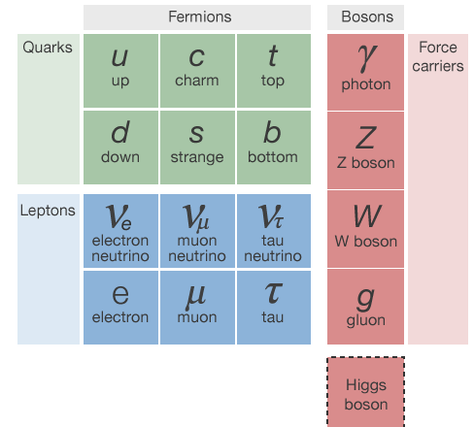

Slide 2




History

Slide 4
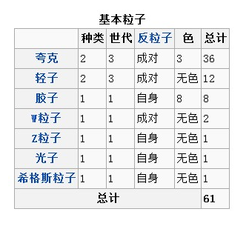

Slide 5
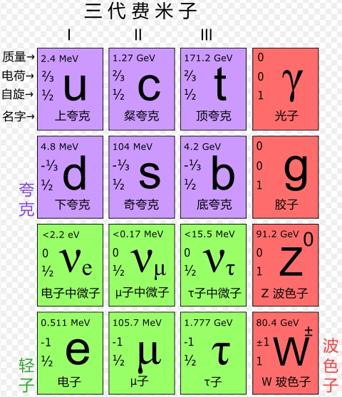

Slide 7



Slide 8


Slide 9
对称性自发破缺

Slide 10

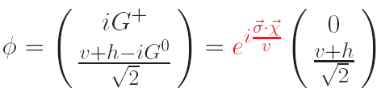

Slide 11



Slide 12





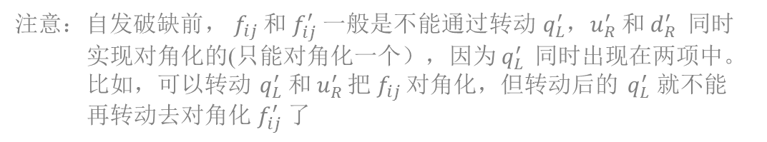

$i,j generation$ indices
arbitrary matrix
not hermitian

Slide 13


$i,j generation$ indices
$$not diagonal$$

Slide 14













Unitary rotations:
matrix$in generation$ space
not mass eigenstates
mass eigenstates

Slide 15




matrix$in generation$ space
$$′$$
simultaneously diagonalized
黑格斯没有树图的 FCNC Yukawa couplings

Slide 16

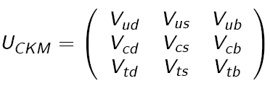

Fermions’ unitary rotations
have impact in charged current coupling
Charged current coupling:
matrix$in generation$ space
generation blind
generation diagonal
also unitary

Slide 17




For example:
top decay
t → W d ~ |V_{td}|²
t → W s ~ |V_{ts}|²
distinguishable
e.g., b-tagging
t → W b ~ |V_{tb}|²

Slide 18

neutral current couplings:
after fermions’ unitary rotations
they are still diagonal
matrix$in generation$ space
product=1 (unit matrix)
flavor diagonal
flavor diagonal
generation blind
generation blind

Slide 19

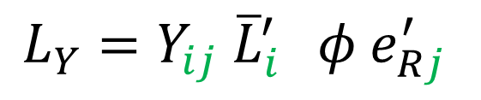


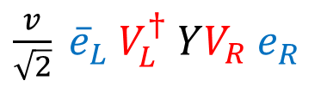
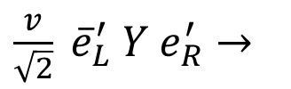





lepton flavor rotation
In SM, no right-handed neutrinos (massless neutrinos)
$$e_{Rj}^{′}={e_{R}^{′}}_{ } {μ_{R}^{′}}_{ } {τ_{R}^{′}}_{ }$$
mass term:
$\frac{v}{\sqrt{2}} {\overline{e}}_{L}^{′} Y e_{R}^{′}$
matrix$in generation$ space
$$e_{R}^{′}=({e_{R}^{′}}_{ } {μ_{R}^{′}}_{ } {τ_{R}^{′})}_{ }$$
rotations to diagonalize Y:
$$e_{L}^{′}→V_{L}{ e}_{L}$$
$$e_{R}^{′}→V_{R}{ e}_{R}$$
$\frac{v}{\sqrt{2}} {\overline{e}}_{L}^{′} Y e_{R}^{′}→$
$\frac{v}{\sqrt{2}} {\overline{e}}_{L}^{ } {V_{L}^{†}}_{ }YV_{R} e_{R}^{ }$
diagonal

Slide 20

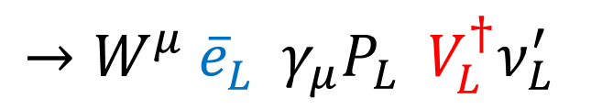

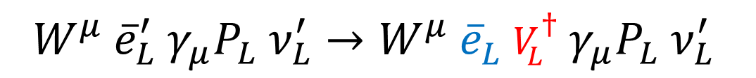


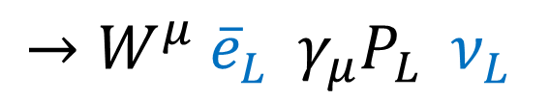

charged current coupling:
matrix$in generation$ space
$${W^{μ} \overline{e}}_{L}^{′} γ_{μ}P_{L} ν_{L}^{′}→{W^{μ} \overline{e}}_{L}^{ } {{V_{L}^{†}}_{ }γ}_{μ}P_{L} {ν_{L}^{′}}_{ }^{ }$$
$$→{W^{μ} \overline{e}}_{L}^{ } { γ}_{μ}P_{L} {{V_{L}^{†}ν}_{L}^{′}}_{ }^{ }$$
$$→{W^{μ} \overline{e}}_{L}^{ } { γ}_{μ}P_{L} {ν_{L}^{ }}_{ }^{ }$$
$${e_{L}^{′} }_{ }^{ }$$
$$ν_{L}^{′}$$
$${e_{L}^{ } }_{ }^{ }$$
$$ν_{L}^{ }$$
generation blind
generation blind
generation diagonal
generation diagonal

Slide 21
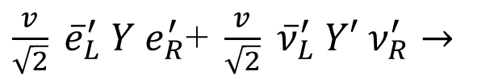
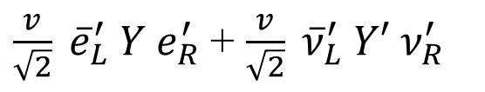






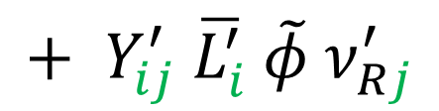

With right-handed neutrinos (massive neutrinos)
$$+ Y_{ij}^{′} \overline{L_{i}^{′}}{ \tilde{φ} ν}_{Rj}^{′}$$
mass terms:
$\frac{v}{\sqrt{2}} {\overline{e}}_{L}^{′} Y e_{R}^{′}$ + $\frac{v}{\sqrt{2}} {\overline{ν}}_{L}^{′} Y′ ν_{R}^{′}$
rotations to diagonalize $Y,Y′$:
matrix$in generation$ space
$$e_{L}^{′}→V_{L}{ e}_{L}$$
$$e_{R}^{′}→V_{R}{ e}_{R}$$
$$ν_{L}^{′}→U_{L}{ ν}_{L}$$
$$ν_{R}^{′}→U_{R}{ ν}_{R}$$
$\frac{v}{\sqrt{2}} {\overline{e}}_{L}^{′} Y e_{R}^{′}\text{+ }\frac{v}{\sqrt{2}} {\overline{ν}}_{L}^{′} Y′ ν_{R}^{′}→$
$\frac{v}{\sqrt{2}} {\overline{e}}_{L}^{ } {V_{L}^{†}}_{ }YV_{R} e_{R }^{ }$+ $\frac{v}{\sqrt{2}} {\overline{ν}}_{L}^{ } {U_{L}^{†}}_{ }Y′U_{R} ν_{R}^{ }$
diagonal
diagonal

Slide 22

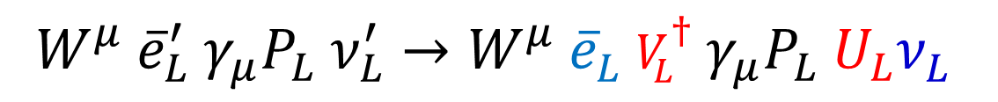

$${W^{μ} \overline{e}}_{L}^{′} γ_{μ}P_{L} ν_{L}^{′}→{W^{μ} \overline{e}}_{L}^{ } {{V_{L}^{†}}_{ }γ}_{μ}P_{L} {{U_{L}ν}_{L}^{ }}_{ }^{ }$$
$$V (similar to CKM)$$
$${e_{L}^{′} }_{ }^{ }$$
$$ν_{L}^{′}$$
$${e_{L}^{ } }_{ }^{ }$$
$${ν_{L}^{1} ,ν_{L }^{2},ν_{L}^{3}}_{ }^{ }$$

Slide 23

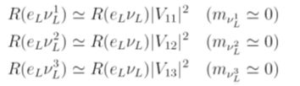


Slide 24
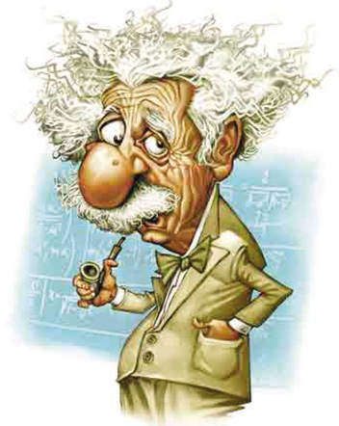




lepton flavor rotations
have only one phenomenology：neutrino oscillation
$$ν_{L}^{ }→U_{L}{ ν}_{L}$$
interaction eigenstates
mass eigenstates
source
propagation
detection
mass eigenstates
interaction
eigenstates
interaction
eigenstates

Slide 25





Slide 26
QCD interactions:

Slide 27
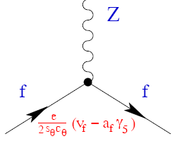
EW gauge interactions:

Slide 28
Higgs gauge+Yukawa interactions:

Slide 29
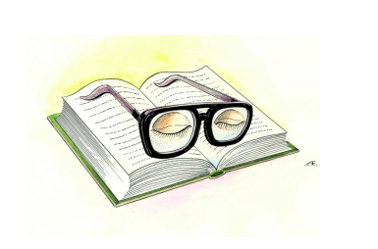
休息一会儿

