Slide 1
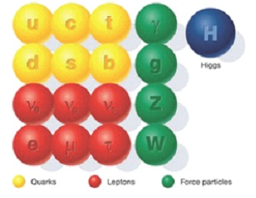
Lecture 5 Some Discussions of SM

Slide 2

(1) Chiral fermions

Slide 3



(2) Global flavor symmetry
approximate symmetry
broken by instanton effects (very small)

Slide 5
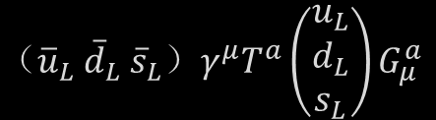





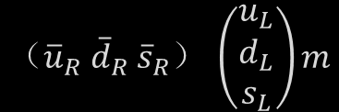

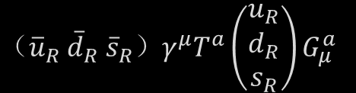

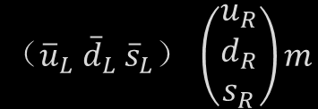
${（{\overline{u}}_{L} {\overline{d}}_{L} {\overline{s}}_{L}）γ}^{μ}T^{a}\left(\begin{matrix}u_{L} \\ d_{L} \\ s_{L}\end{matrix}\right)G_{μ}^{a}$
$${（{\overline{u}}_{L} {\overline{d}}_{L} {\overline{s}}_{L}）}^{ }\left(\begin{matrix}u_{R} \\ d_{R} \\ s_{R}\end{matrix}\right)m$$
${（{\overline{u}}_{R} {\overline{d}}_{R} {\overline{s}}_{R}）γ}^{μ}T^{a}\left(\begin{matrix}u_{R} \\ d_{R} \\ s_{R}\end{matrix}\right)G_{μ}^{a}$
$${（{\overline{u}}_{R} {\overline{d}}_{R} {\overline{s}}_{R}）}^{ }\left(\begin{matrix}u_{L} \\ d_{L} \\ s_{L}\end{matrix}\right)m$$
SU_{L}(3) × SU_{R}(3)
$$SUV(3)$$
(if $mu=md=ms=0$)
(if $mu=md=ms =m  0$)
SU_{L}(2) × SU_{R}(2)
$$SUV(2)$$
QCD
(if $mu=md=0$)
(if $mu=md$ $=m  0$)
U_{A}(1)
$$ψ_{L,R}→e^{iθ} ψ_{L, R}$$
broken by anomaly
(classical level)
(quantum level)
C, P
broken by θ-term

Slide 6
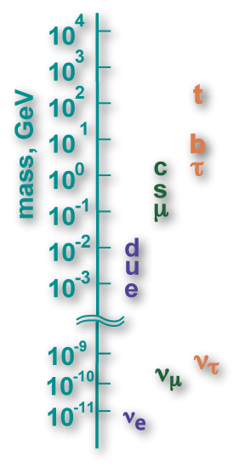

(3) Scale of the SM

Slide 7
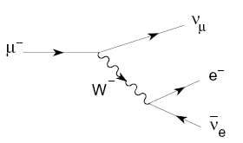
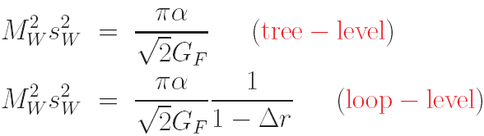
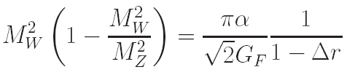
(4)

Slide 9
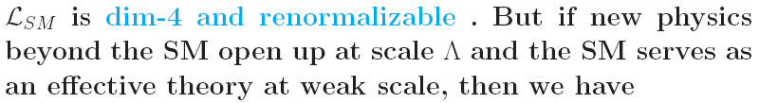

(5) High dimensional operators

Slide 10
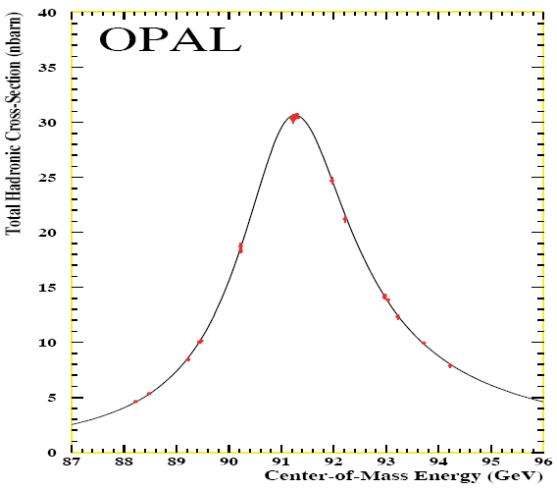
(6)

Slide 13

(7) Problems or Crisis ?
(from particle expt )
A_{FB} at LEP:
Cosmic dark matter
(a real crisis ? )

Slide 14
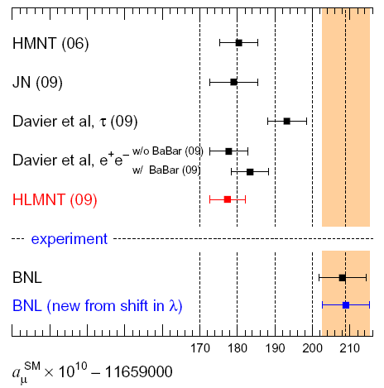

Slide 15
A_{FB} at LEP:

Slide 16
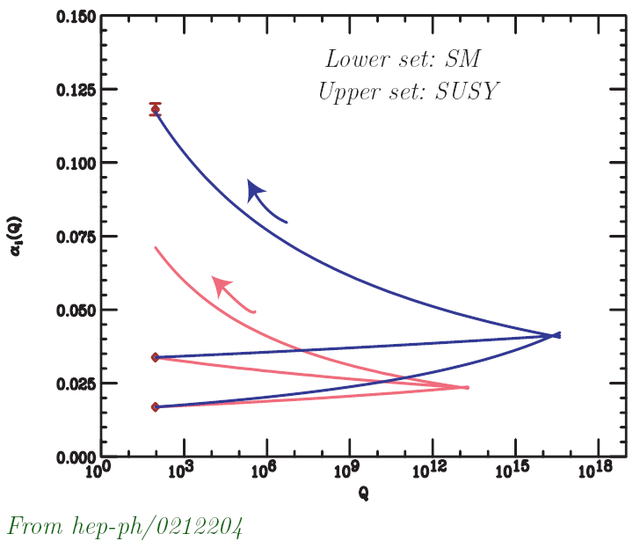

Slide 17

休息一会儿

