Slide 1



Experimental Particle Physics
Part 3: SM measurements at the LHC
Prof. Albert De Roeck
CERN, Geneva, Switzerland
Antwerp University Belgium
UC-Davis California USA
NTU, Singapore
July 29 – August 7 Weihai, China

Slide 2
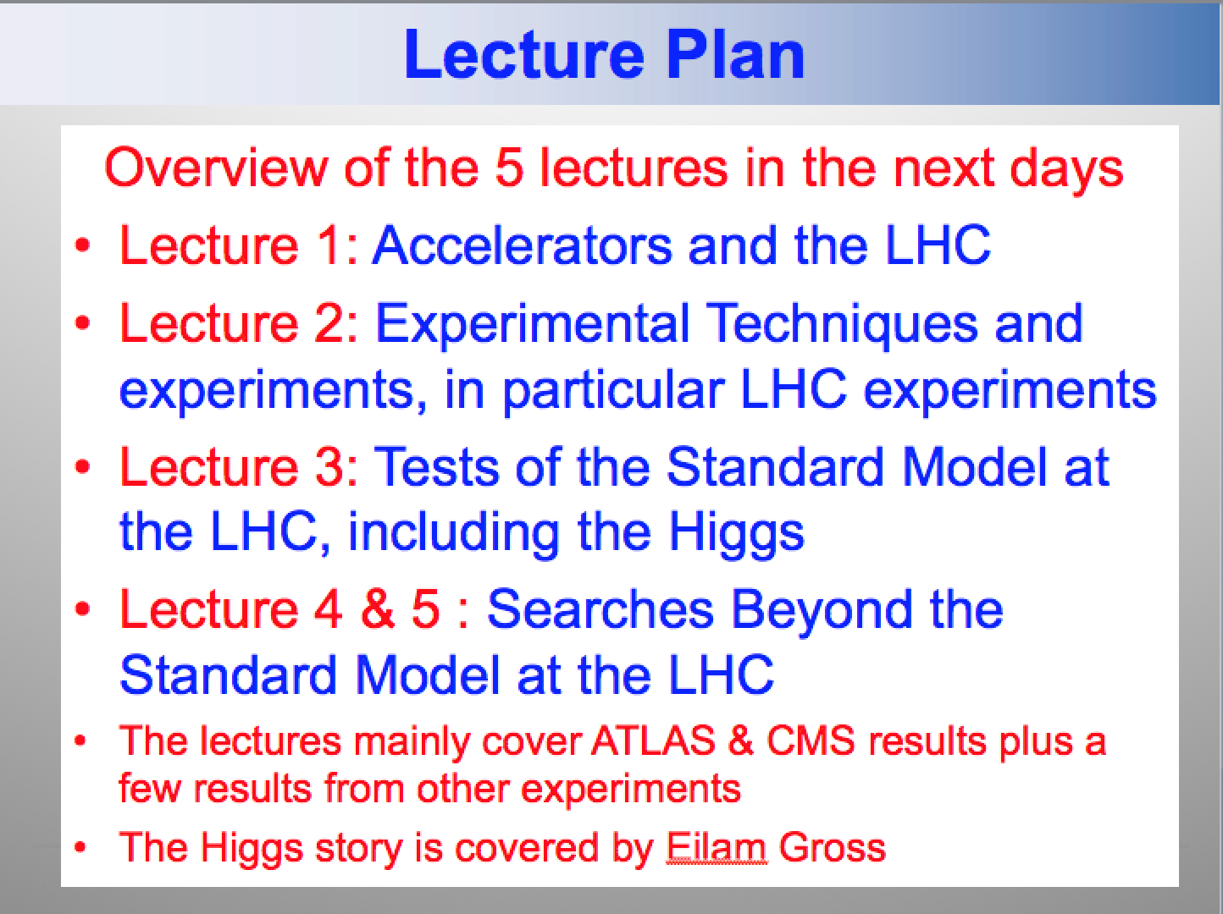
Lecture Plan
Overview of the 5 lectures in the next days
Lecture 1: Accelerators and the LHC
Lecture 2: Experimental Techniques and experiments, in particular LHC experiments
Lecture 3: Tests of the Standard Model at the LHC, including the Higgs
Lecture 4 & 5 : Searches Beyond the Standard Model at the LHC
The lectures mainly cover ATLAS & CMS results plus a few results from other experiment

Slide 3
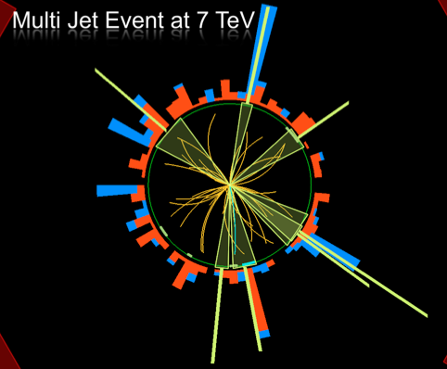
Outline Lecture III
pp collisions at the LHC
Soft pp collisions and multi-
particle production
QCD hard scattering
Electroweak processes
Top production
B-physics
Summary

Slide 4

The “Standard Model”
Over the last 100 years: combination of
Quantum Mechanics and Special Theory of relativity
along with all new particles discovered has led to the
Standard Model of Particle Physics.
The new (final?) “Periodic Table” of fundamental elements:
Fermions
Bosons
The most basic mechanism of the SM, that of granting mass to particles remained a mystery for a long time
A major step forward was made in July 2012 with the discovery of what could be the long-sought Higgs boson!!
Matter particles
Force particles
Fermions: particles with spin ½
Bosons: particles with integer spin

Slide 5
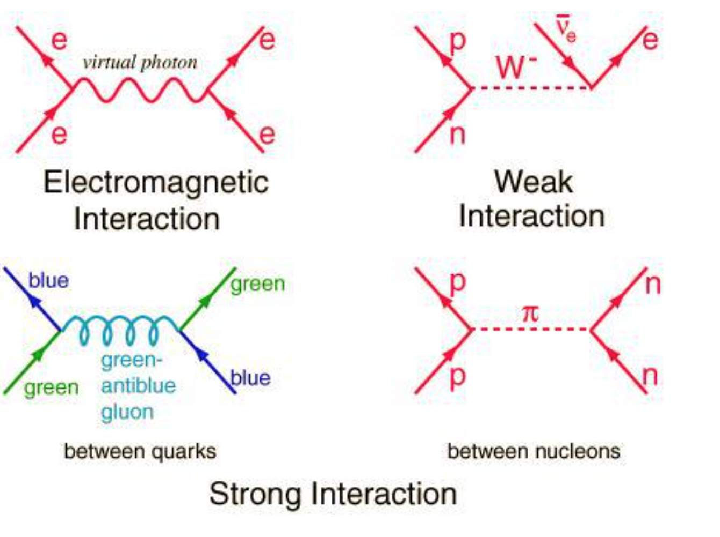
The Fundamental Forces of Nature

Slide 6
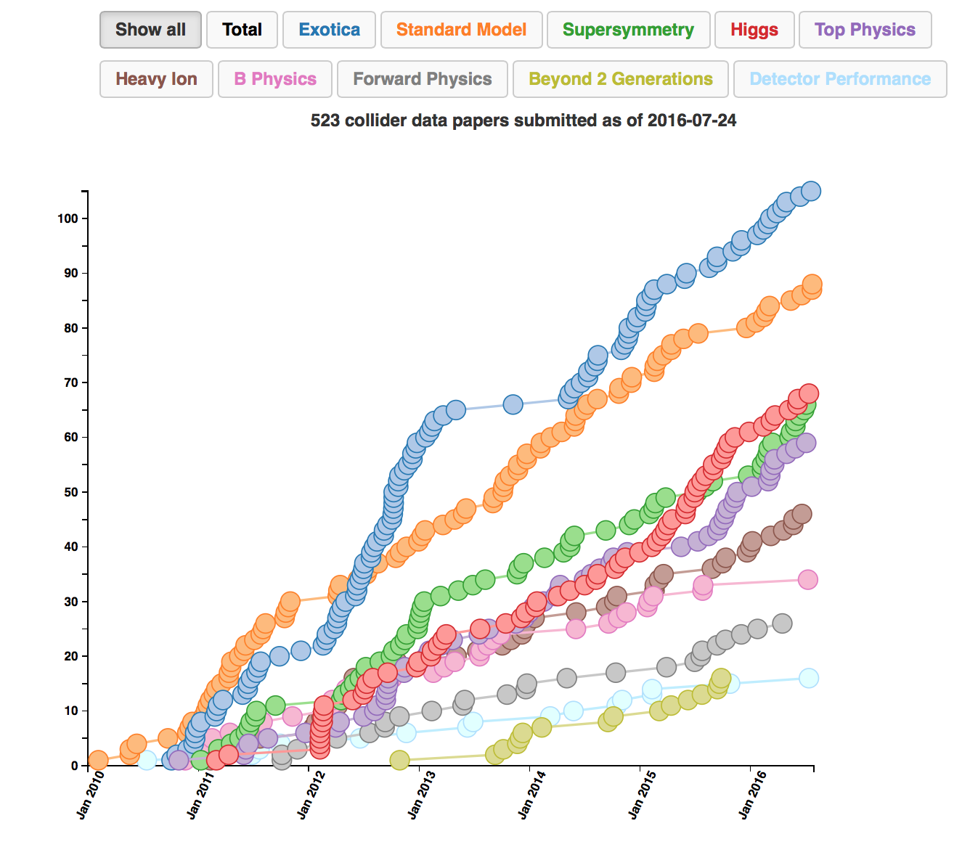
LHC Publications: Example CMS
> 500 publications on
pp (and pPb/PbPb)
physics since 1/2010
(1/2/2016)
About 60 papers on
Higgs studies!!
Paper 16 was the
discovery paper!
http://cms-results.web.cern.ch/cms-results/public-results/publications-vs-time/
>6000 citations

Slide 7
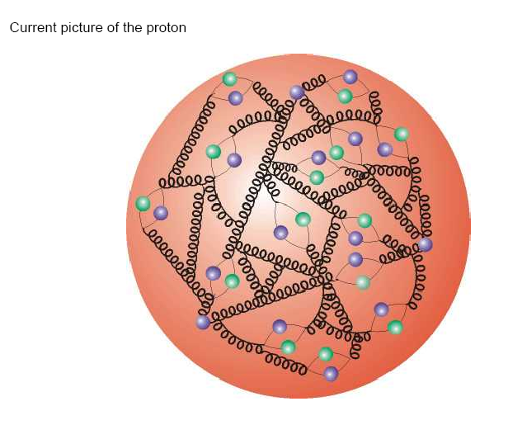
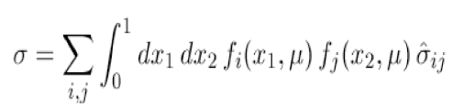
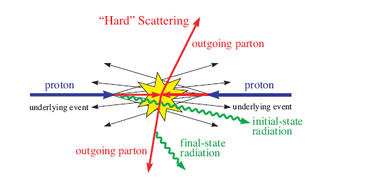
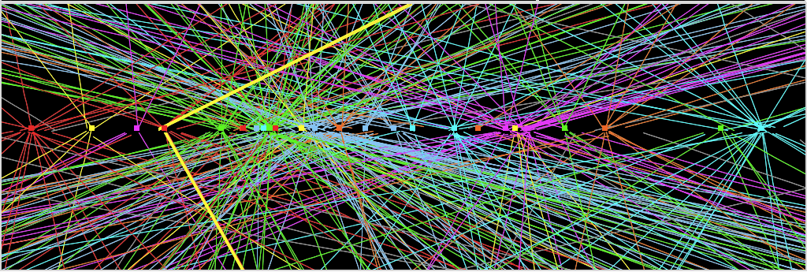
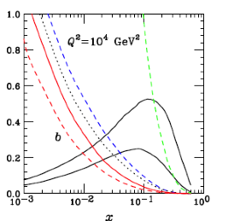
pp-Collisions : Complications
Protons have structure
Parton
distributions
Underlying event
Pile-up: approximate 20 collisions per
bunch crossing in 2012 (more in future)
Pile-up 2012!!
Much more in 2015+
Z→ μμ event with ~20 reconstructed vertices (2012)

Slide 8
Proton-proton Collisions
Most interactions due to collisions at large distance between incoming
protons where protons interact as “ a whole ”
→ small momentum transfer (Δp ≈  /Δx )
particles in final state have large longitudinal momentum but small
transverse momentum (scattering at large angle is small)
< p_{T} > ≈ 500 MeV of charged particles in final state
Most energy escapes down the beam pipe.
These are called soft events…
A minimum bias data event sample is dominated by soft events

Slide 9
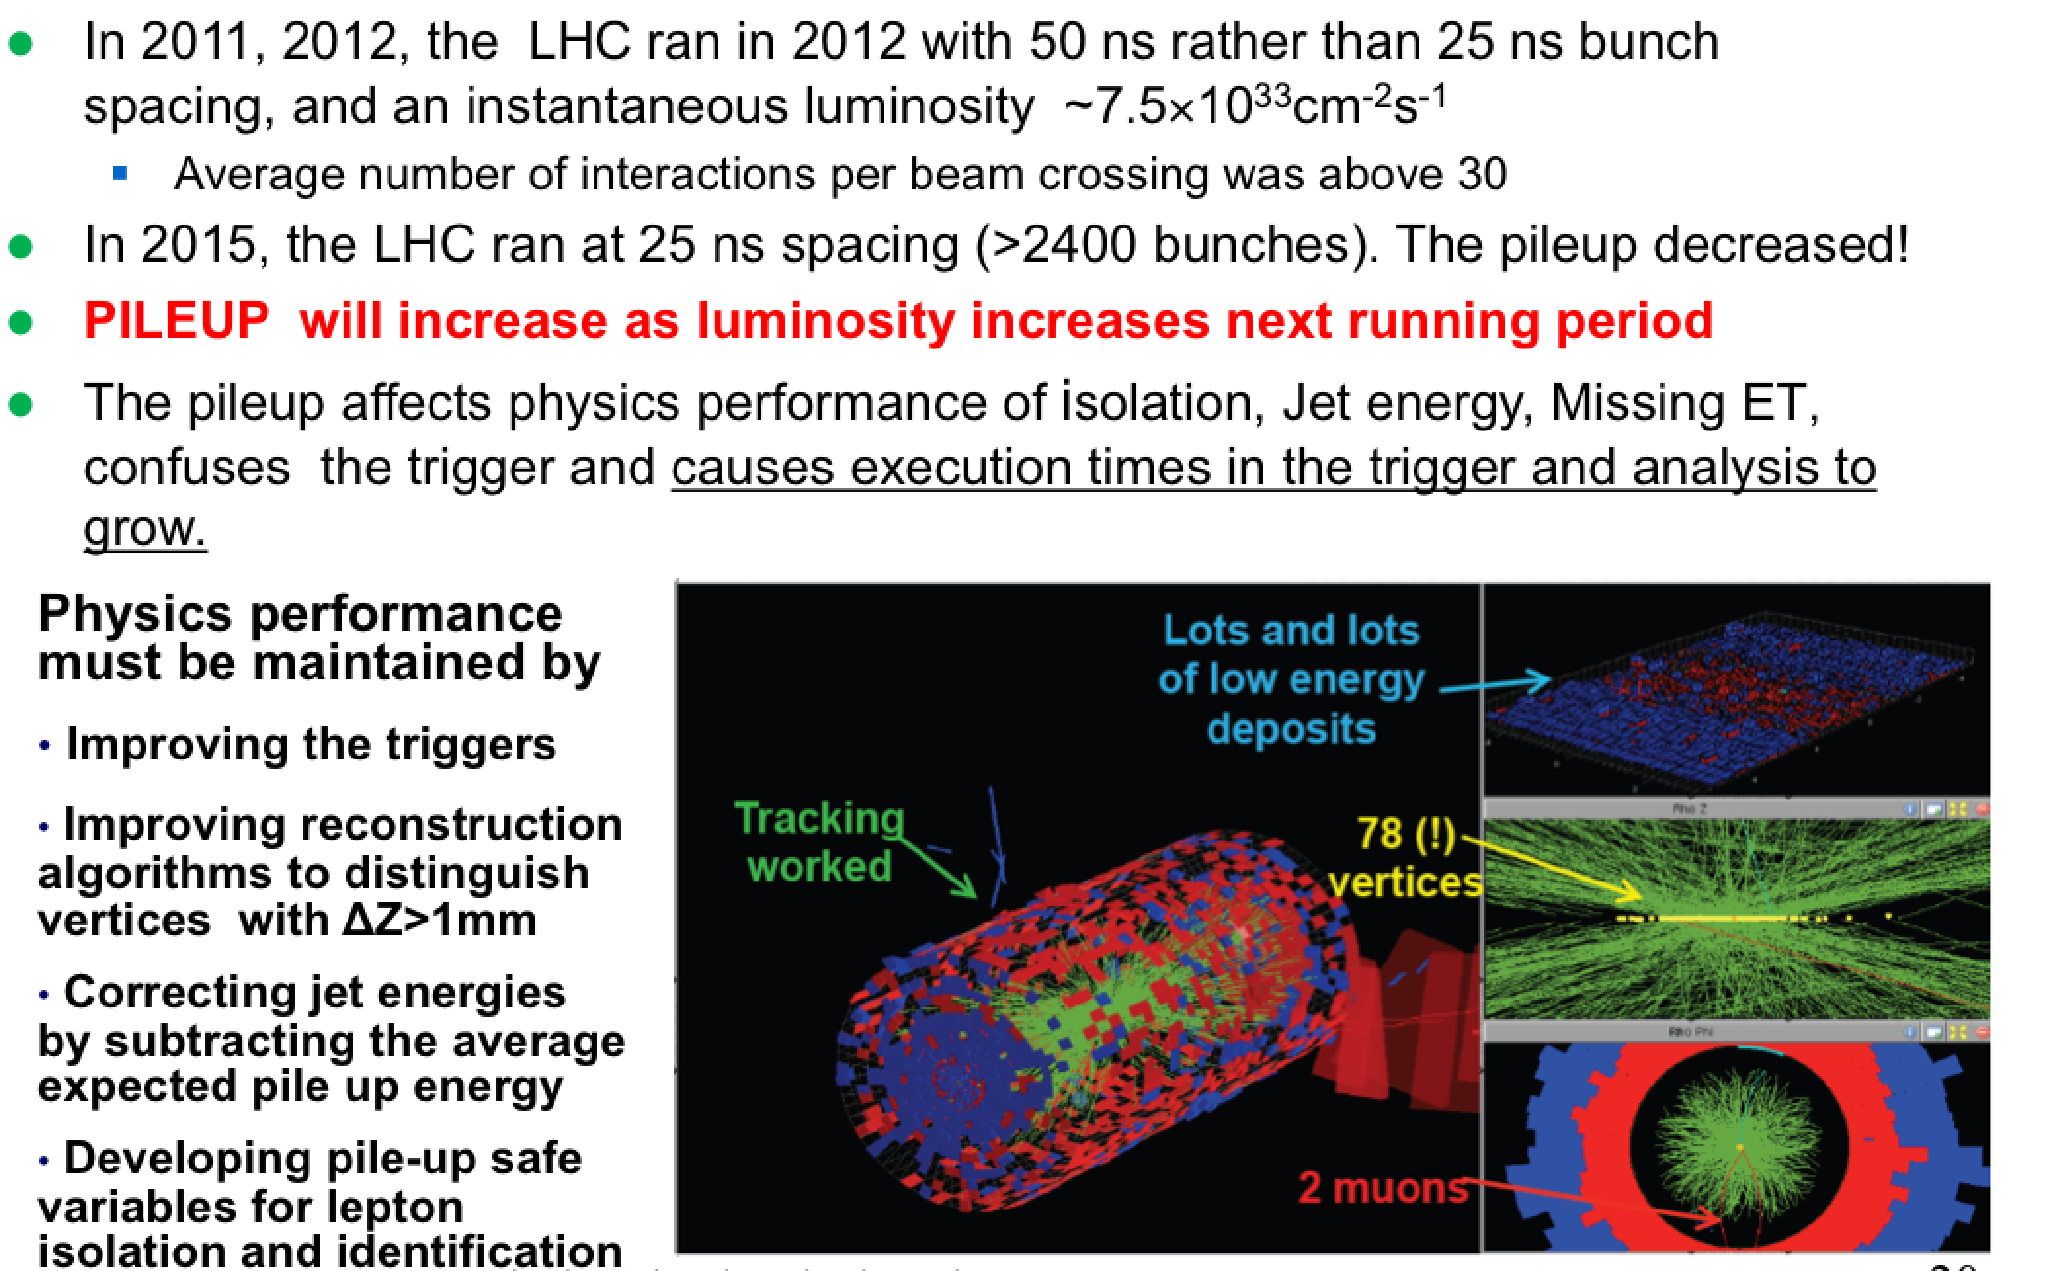
The Pile-up Issue @ LHC
above 20
to ~ 50

Slide 10
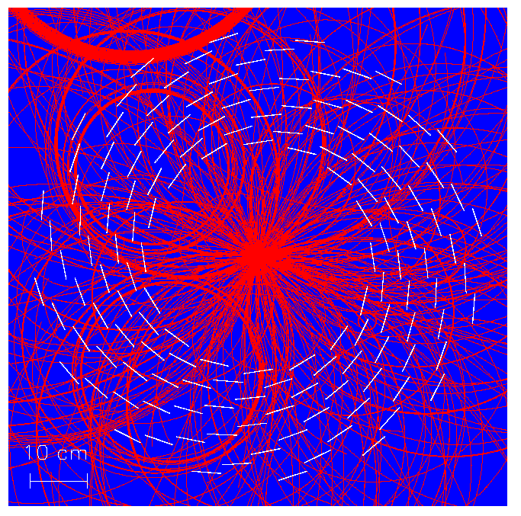
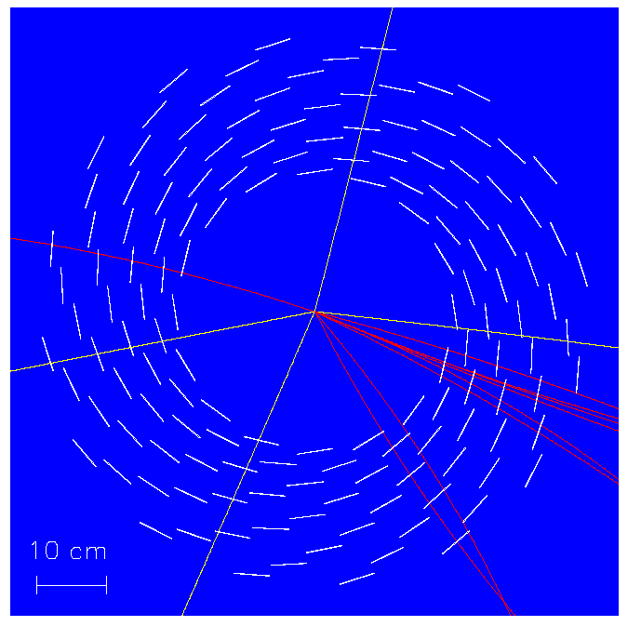
How to find the interesting signals
This event contains pp →H+X, with H→ZZ→μμμμ
X ~ 100 charged particles
All tracks shown
Only tracks with transverse
momentum > 2 GeV shown

Slide 11
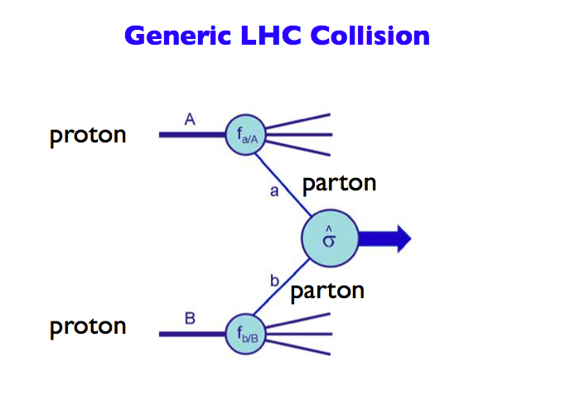
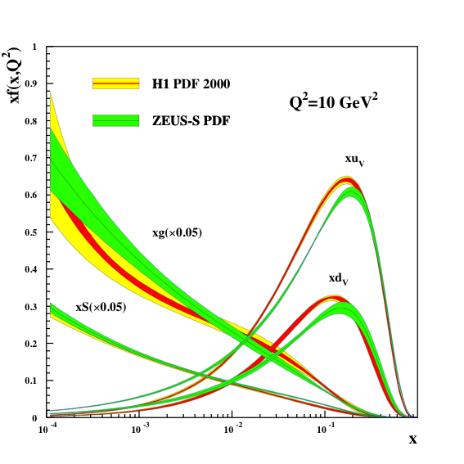
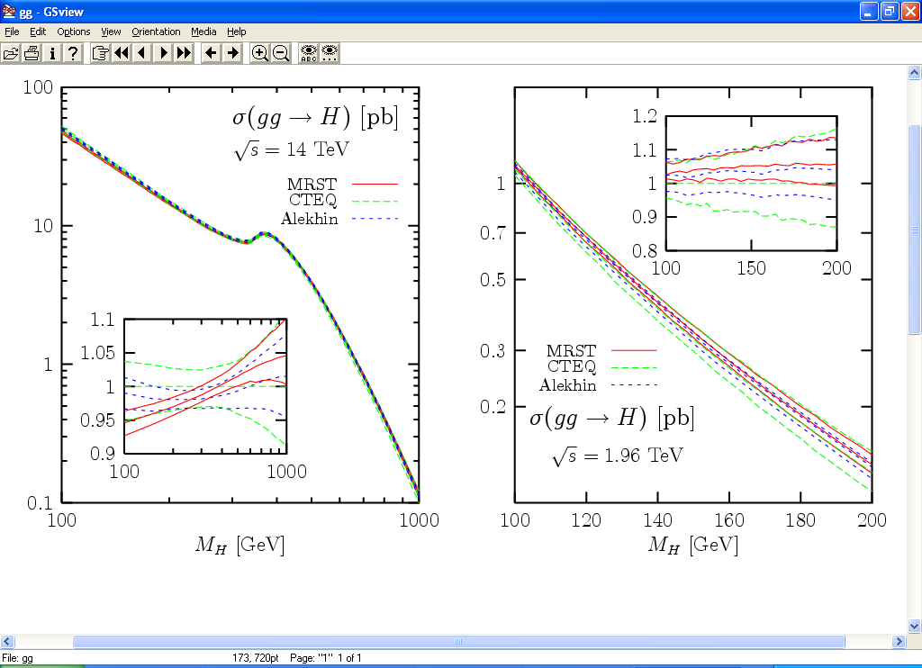
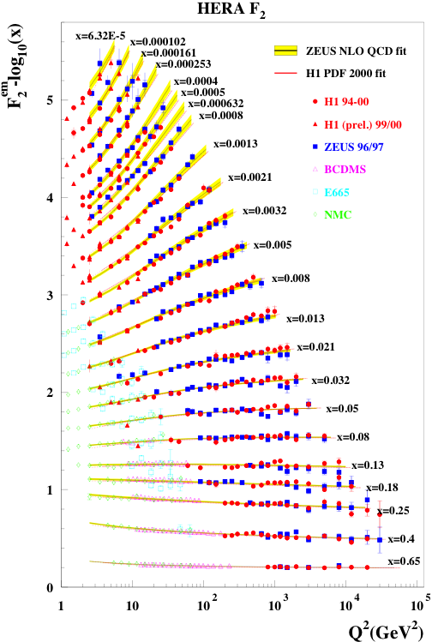
Proton-proton collisions and PDFs
Parton Distribution Functions: the probability of finding
a parton with momentum fraction x in the proton
Structure function
measurements eg
from HERA (ep)
Simple spread of existing PDFs gives
up to 10% uncertainty on Higgs cross
section. Possible gain ~ factor of 2
with final HERA data (PDF4LHC)
Now also LHC pp
data used to
constrain PDFs

Slide 12
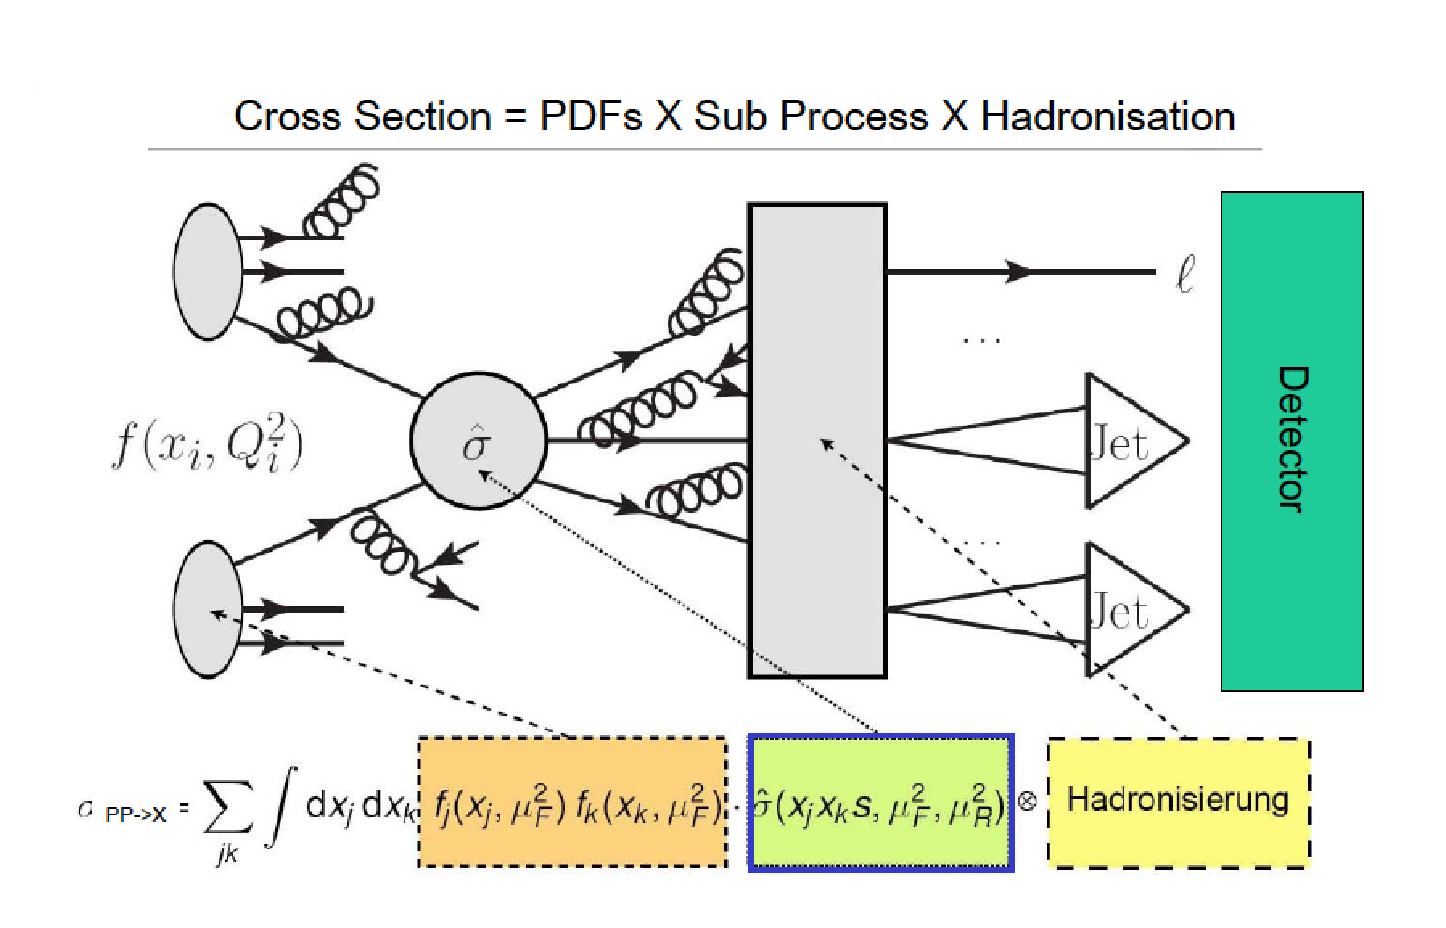
Proton-Proton Collisions

Slide 13
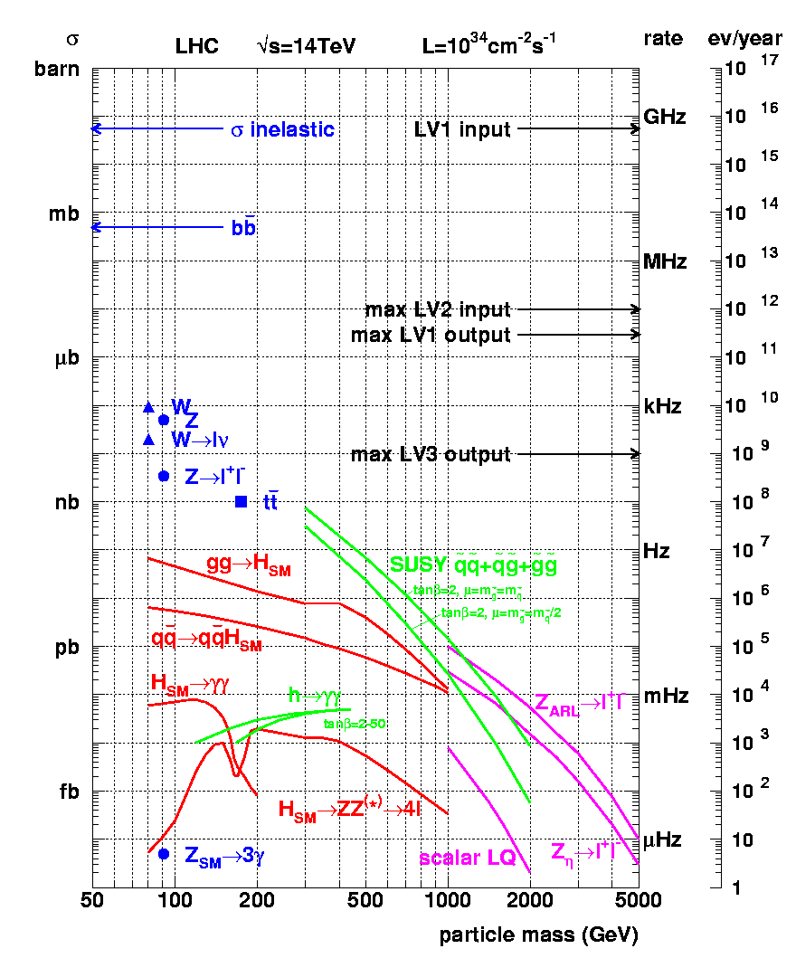
Cross sections at the LHC
“Well known” processes, don’t need to keep all of them …
New Physics!!
This we want to keep!!

Slide 14
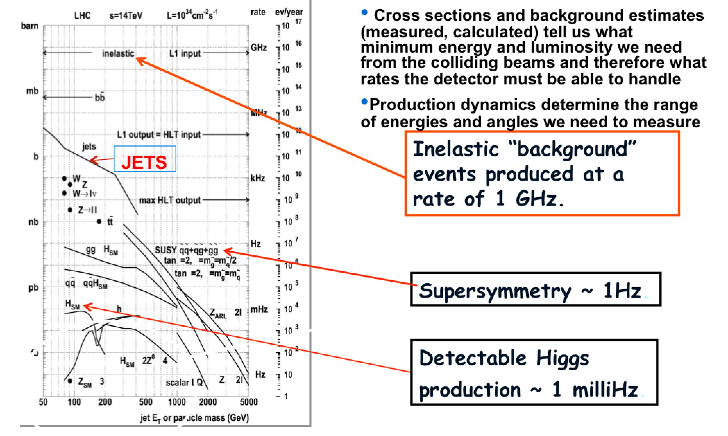
Cross Sections at the LHC

Slide 15
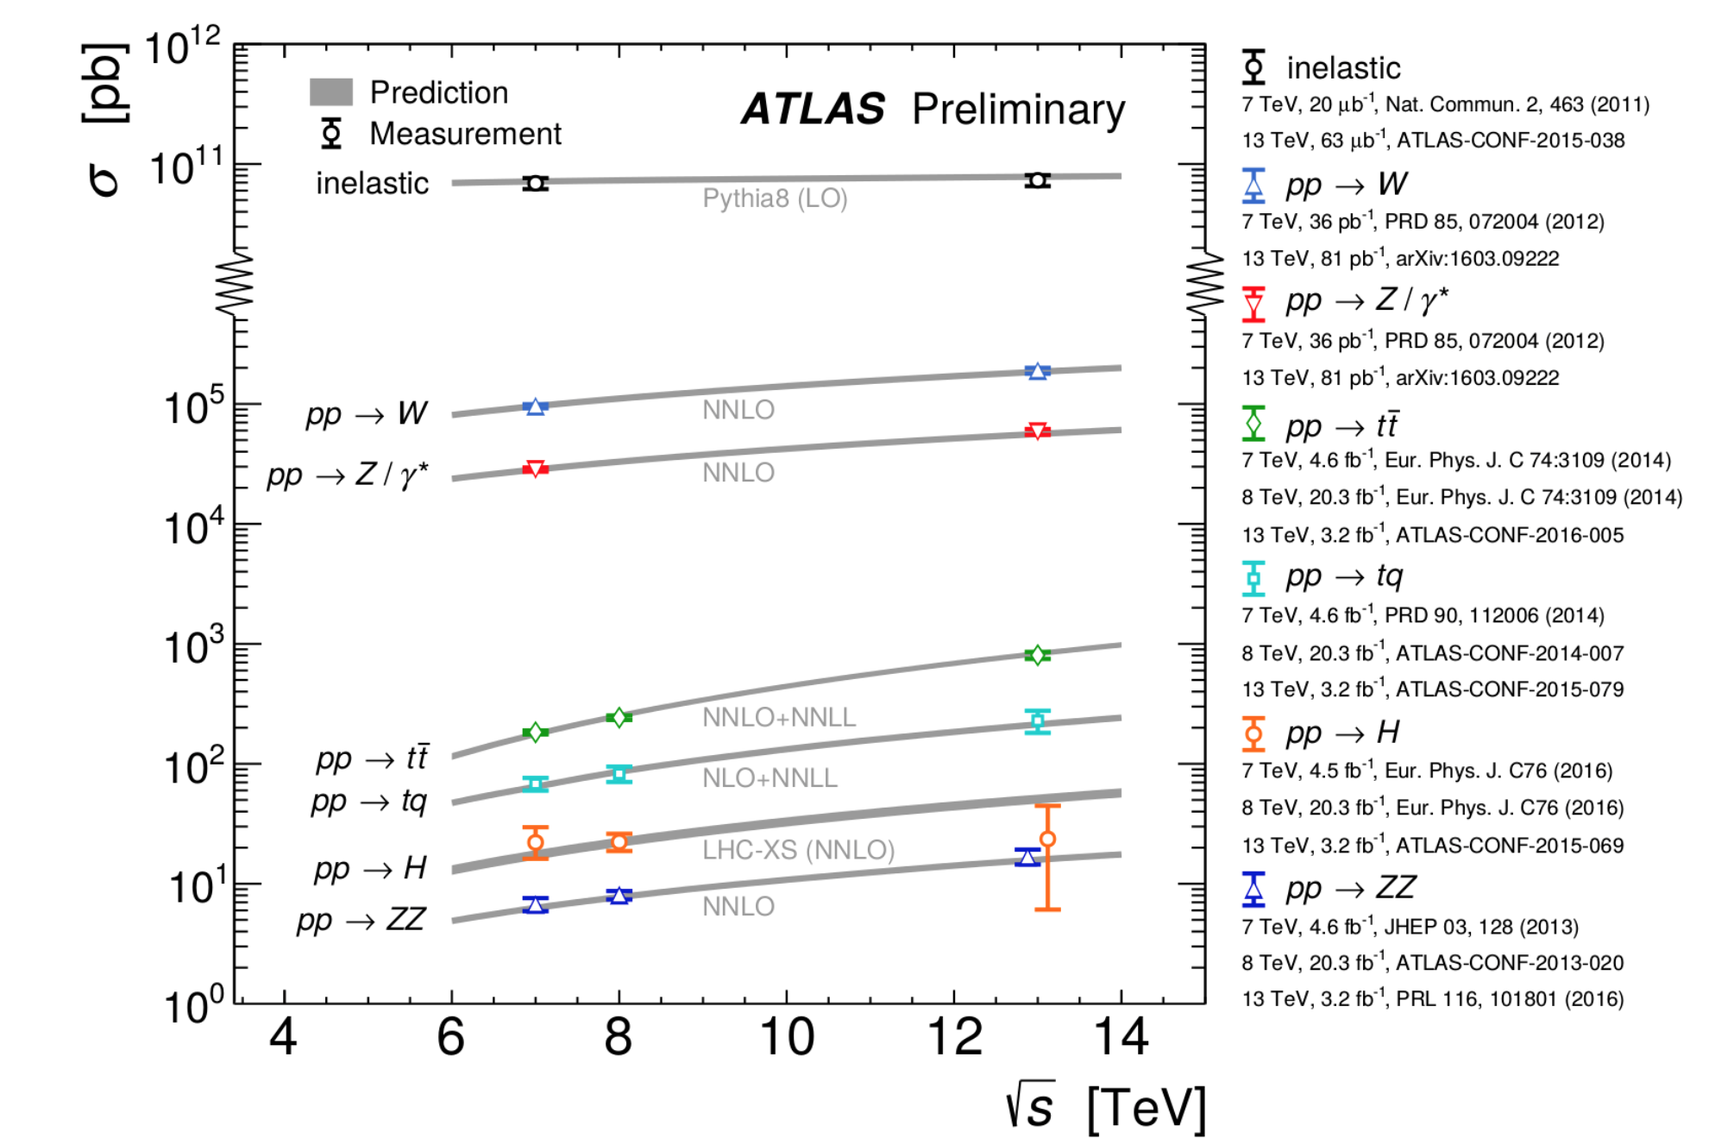
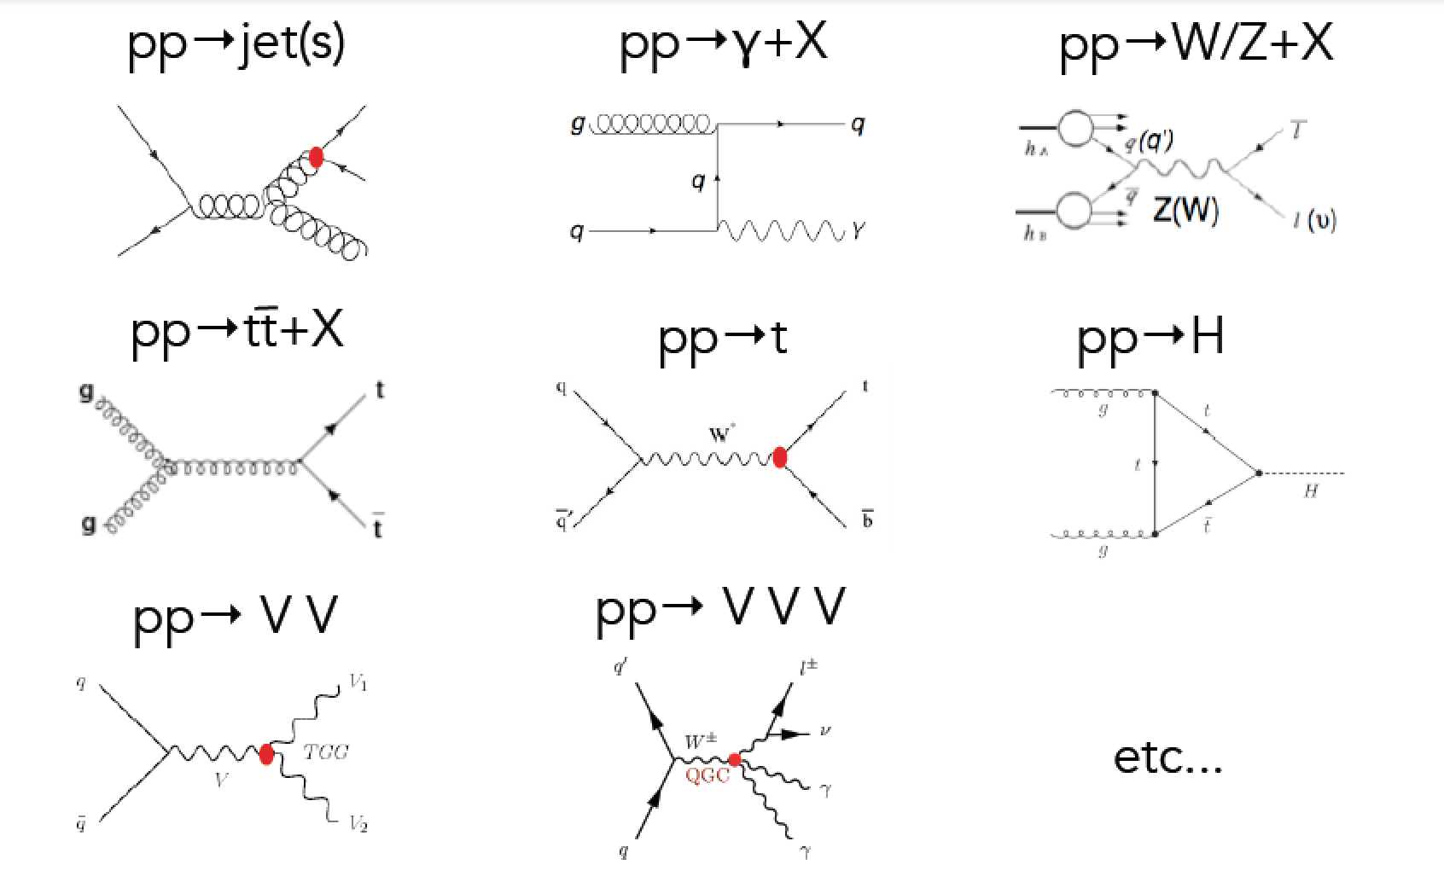
Standard Model Measurements
Standard Model measurements form an integer part of the physics program of the LHC
Precision measurements allow test for a wide range of SM predictions, and extract fundamental parameters (eg α_{s})
  Requires matching precision at theory prediction side
Important to understand backgrounds for searches for new physics
Cross Sections
Many processes studied: Examples

Slide 16
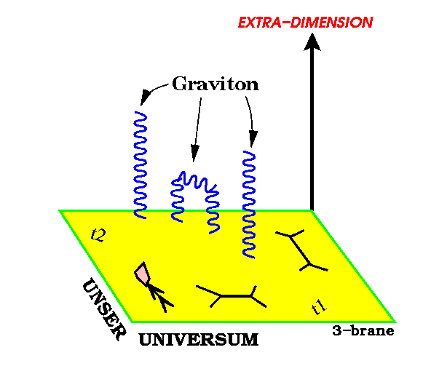
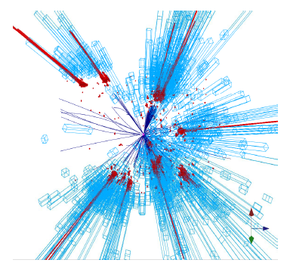
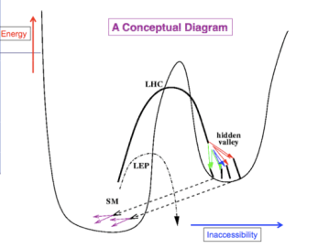
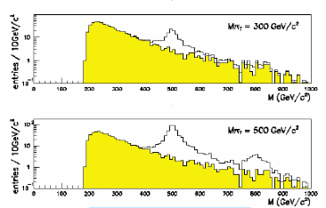
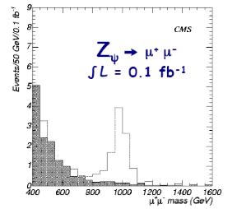
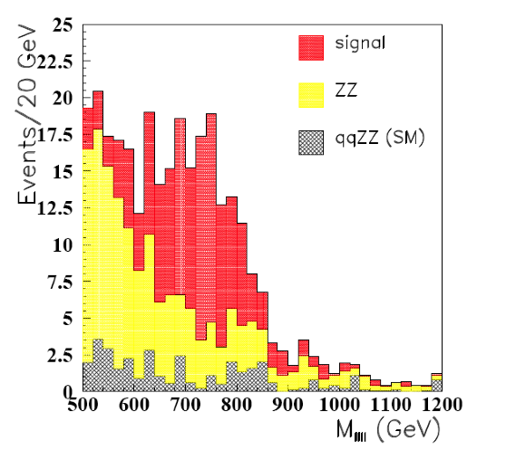
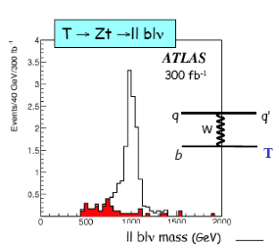
Search for New Physics?
New Gauge Bosons?
Supersymmetry
ZZ/WW resonances?
Technicolor?
Little Higgs?
Extra Dimensions?
Hidden Valleys?
Black Holes???
What stabelizes the Higgs Mass? Many ideas, not all viable any more
A large variety of possible signals. We have to be ready for that
Notes:
15

Slide 17
QCD Process

Slide 18
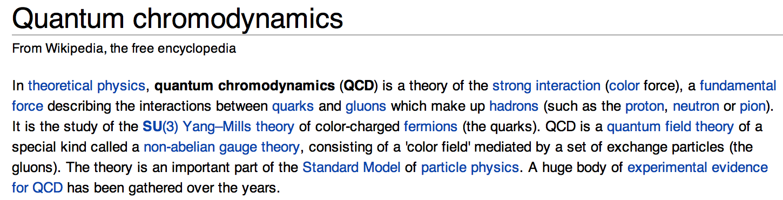
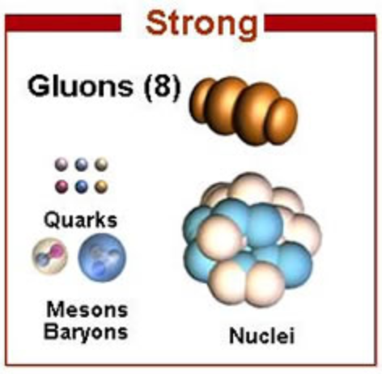
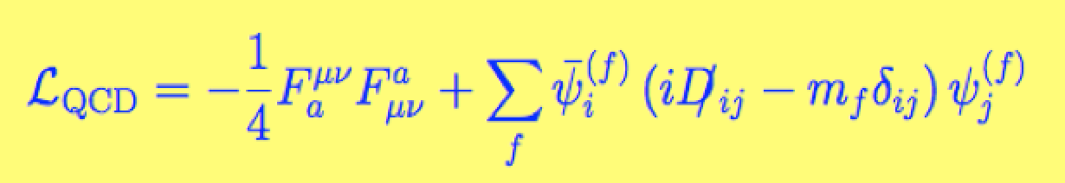
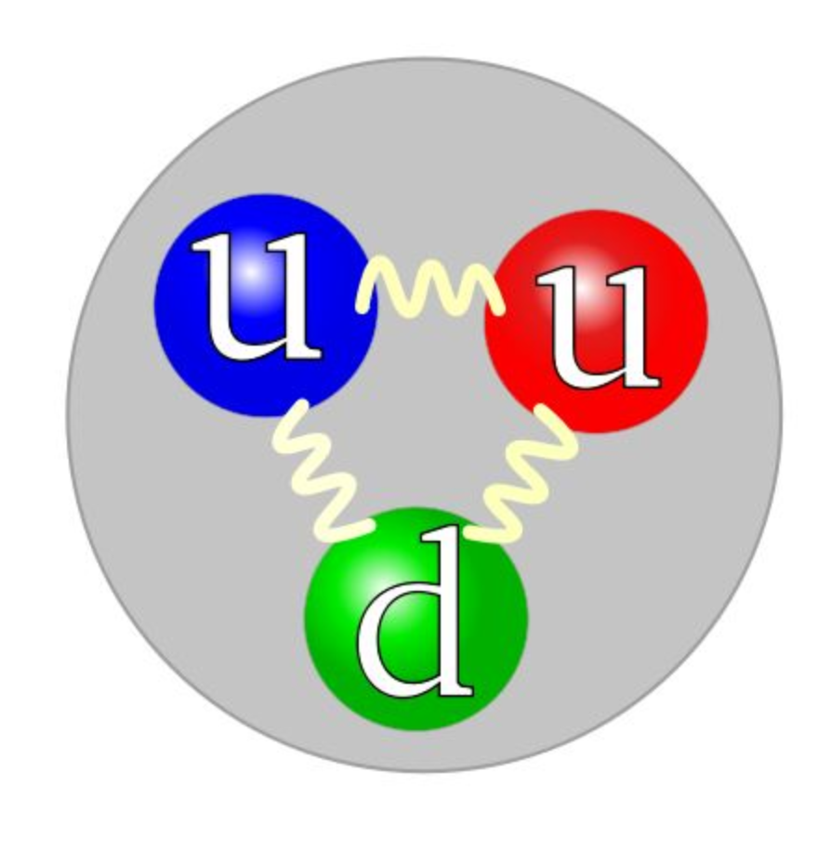

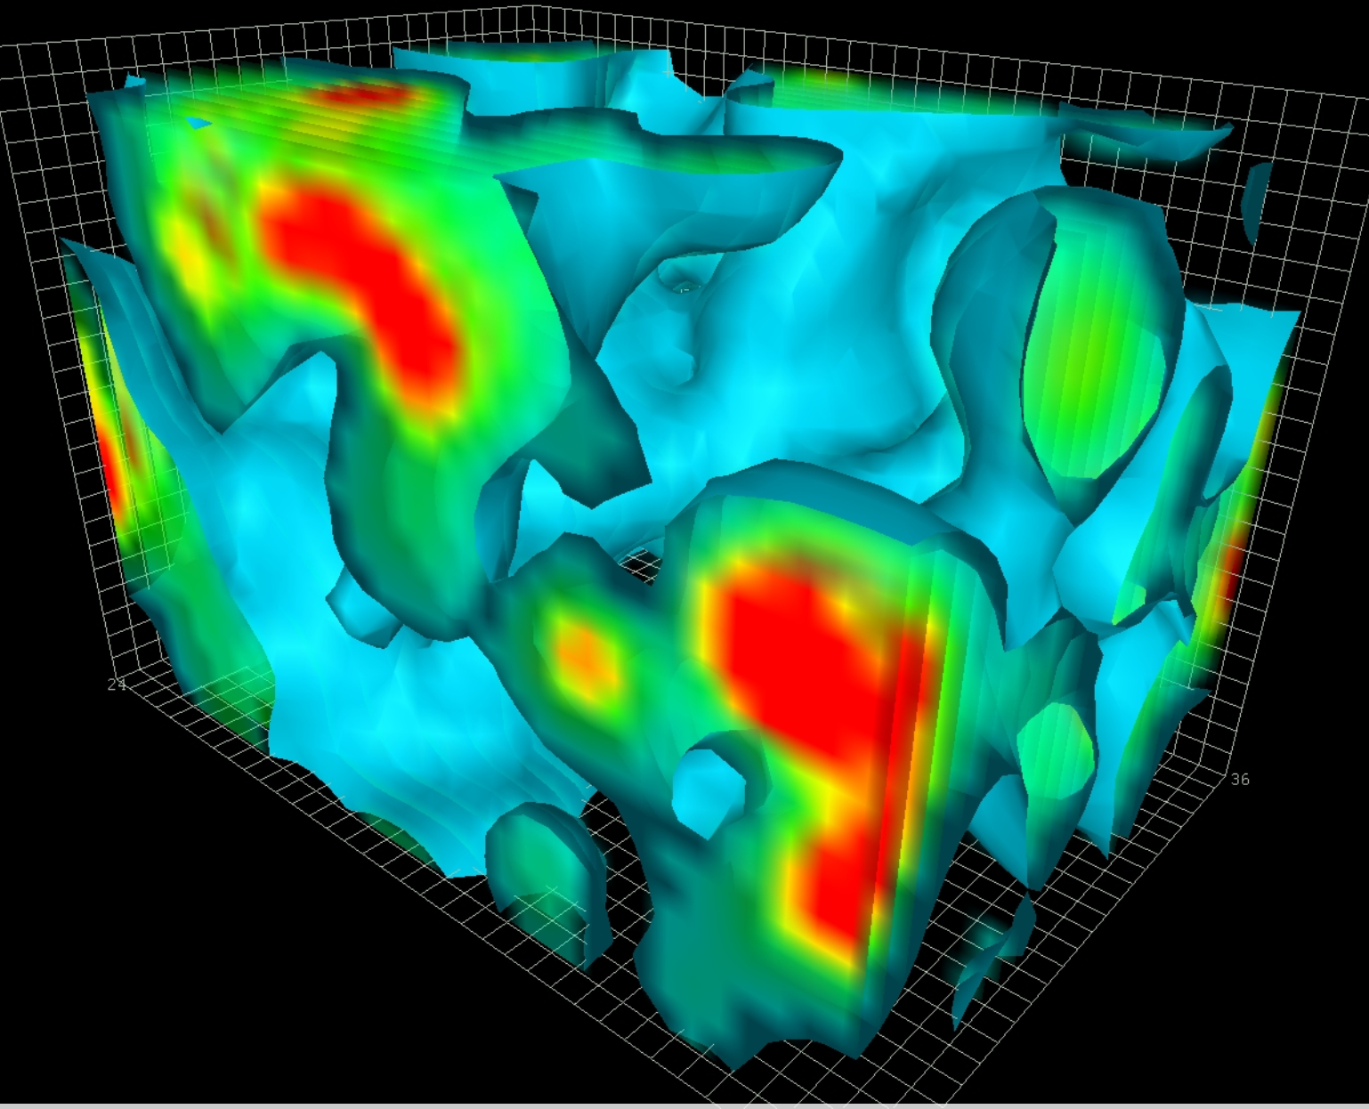

The Strong Force: QCD
QCD plays a major role in basically every topic under discussion in this
school. For precision physics, or discovery physics we need to
understand the role of QCD corrections: QCD is all around us at the LHC

Slide 19
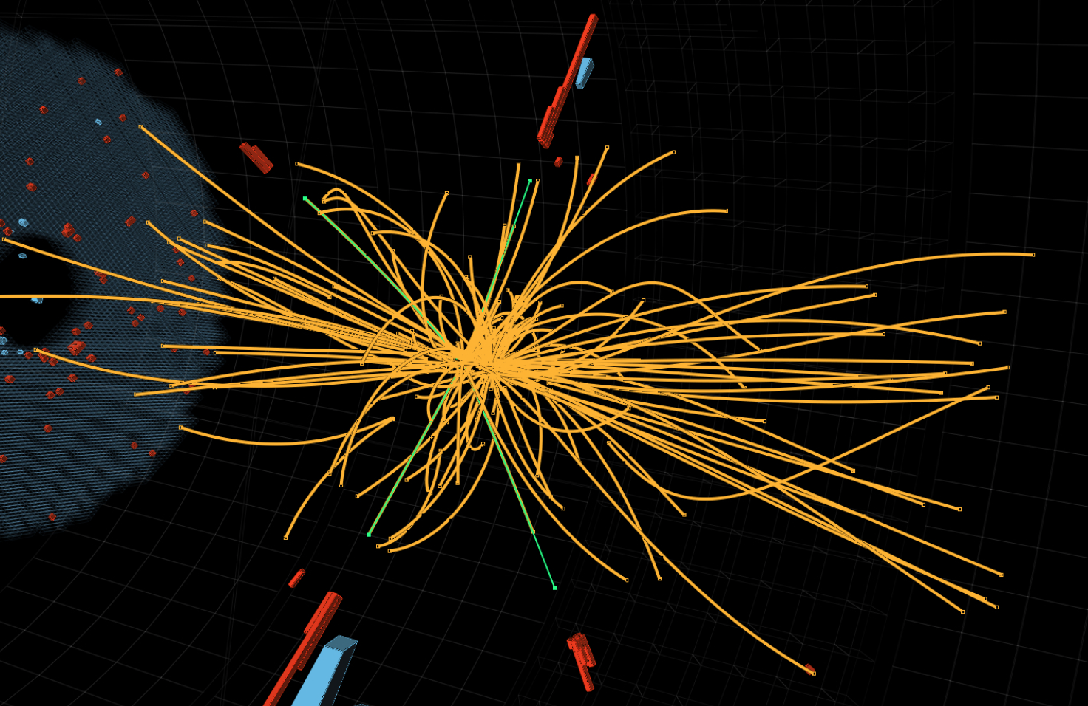
Soft pp Collisions

Slide 20

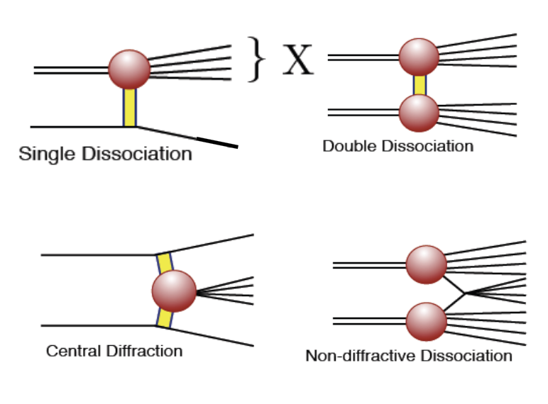
The Total Cross Section
Diffractive and non-Diffractive Processes
The total cross section
consists of different
contributions:
•Elastic pp-> pp
•Diffractive
•Non-Diffractive
First measurement:
The total cross section

Slide 21
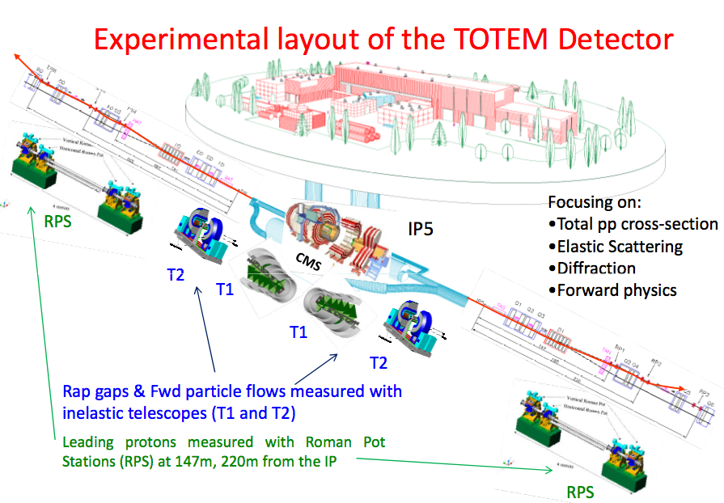
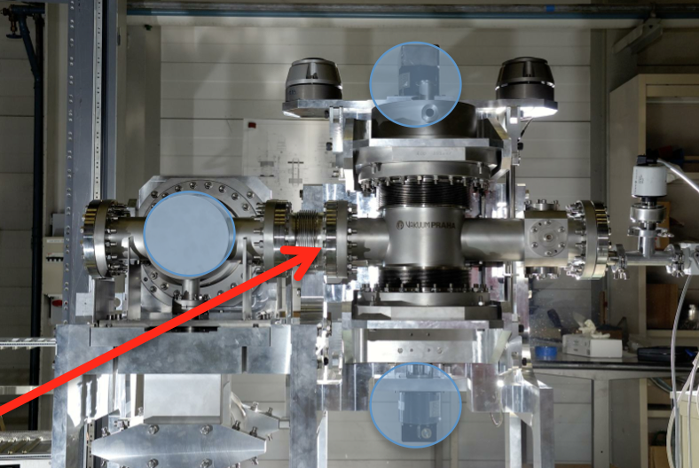
The TOTEM Experiment

Slide 22
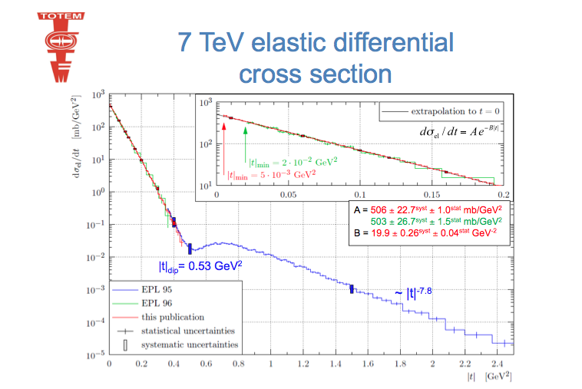
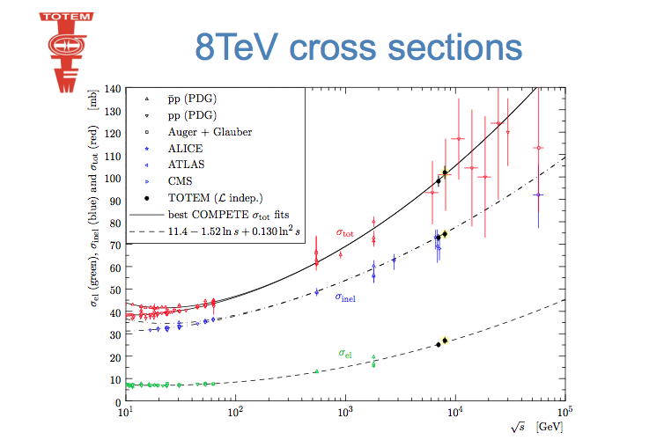
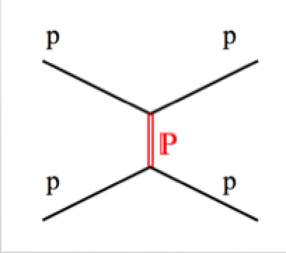

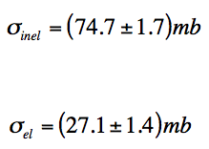

Elastic/Total pp Cross Section
TOTEM = Roman Pots + Forward Detectors
TOTEM uses the same IP as CMS (IP5)
EPL 101 21004 (2003)
Future: •High beta measurements for Coulomb-Nuclear interference

Slide 23
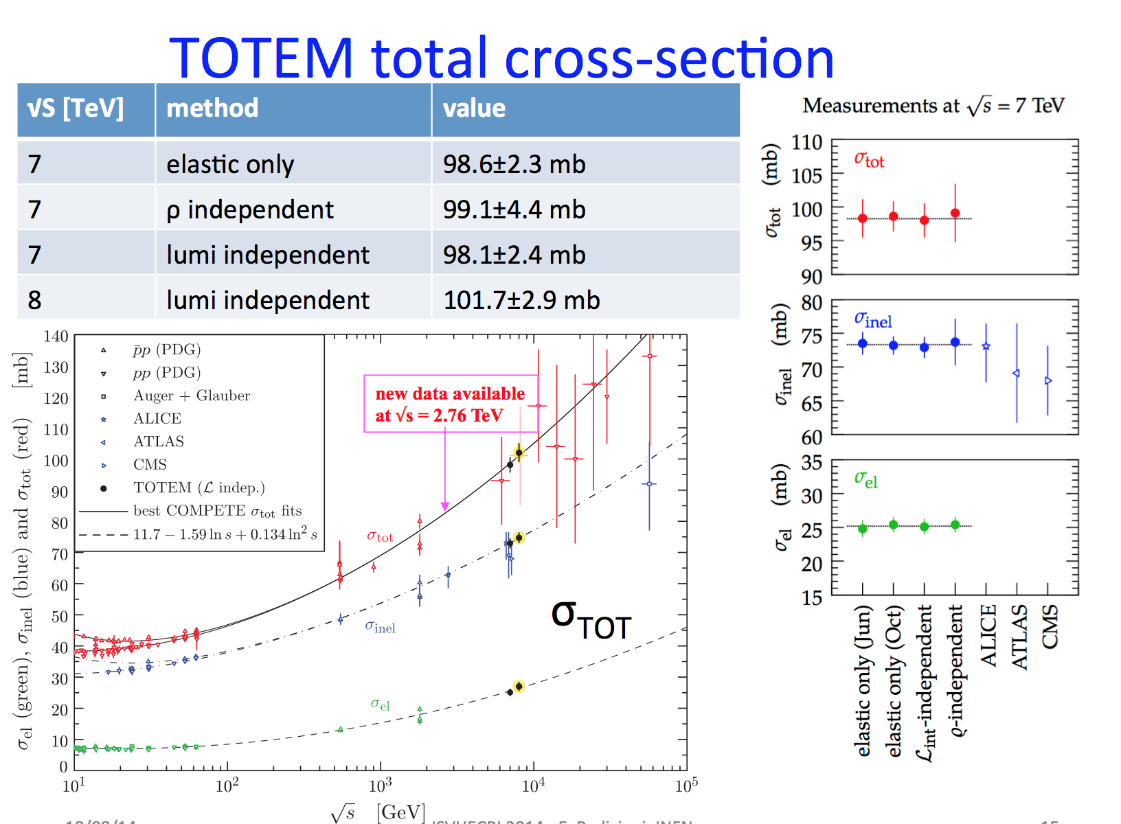
Elastic/Total pp Cross Section
Alfa result

Slide 24
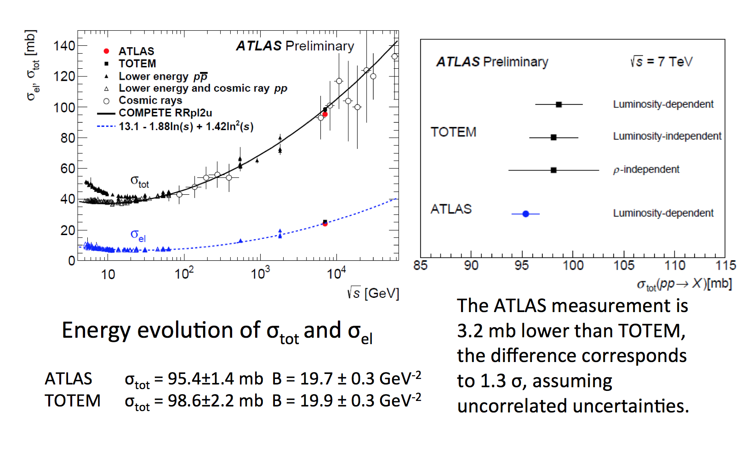
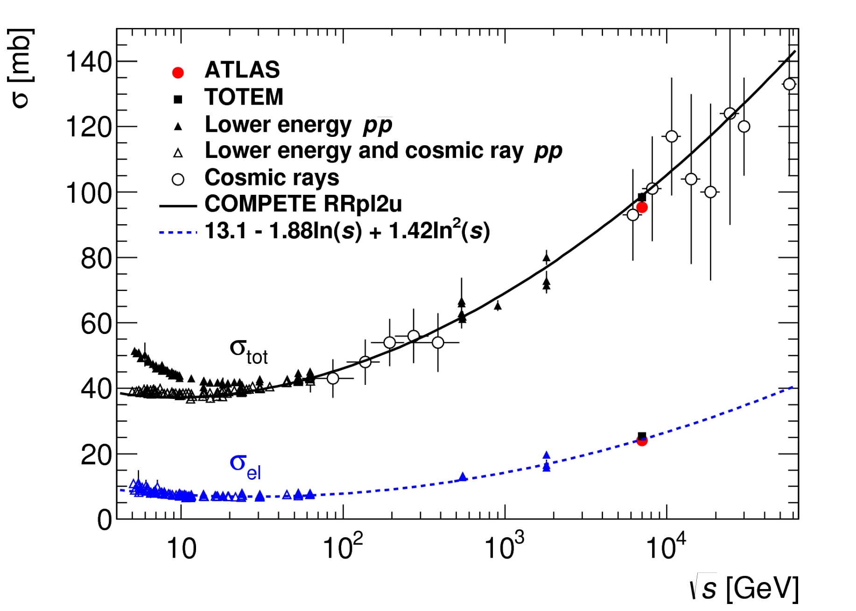
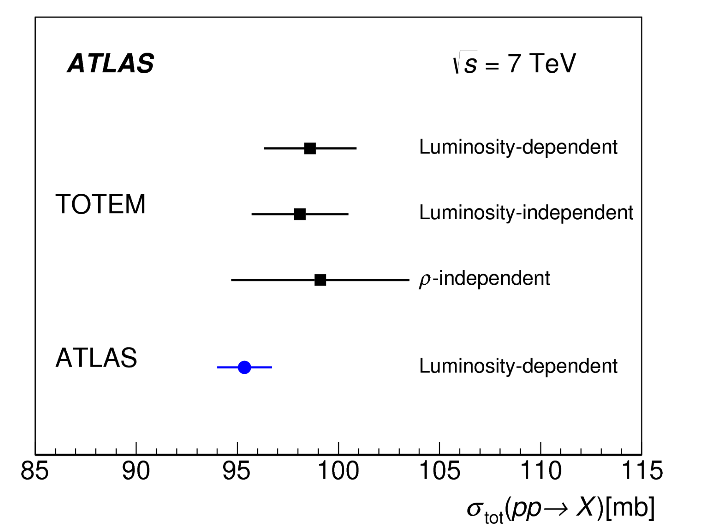
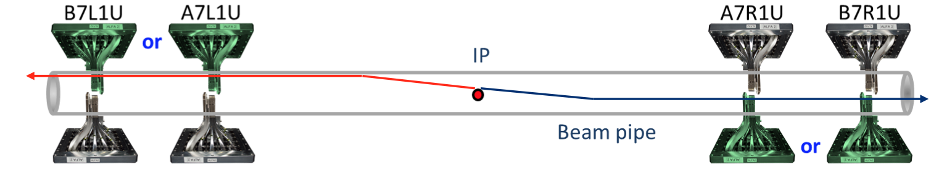
Elastic/Total pp Cross Section
Alfa result
arXiv:1408.5778

Slide 25
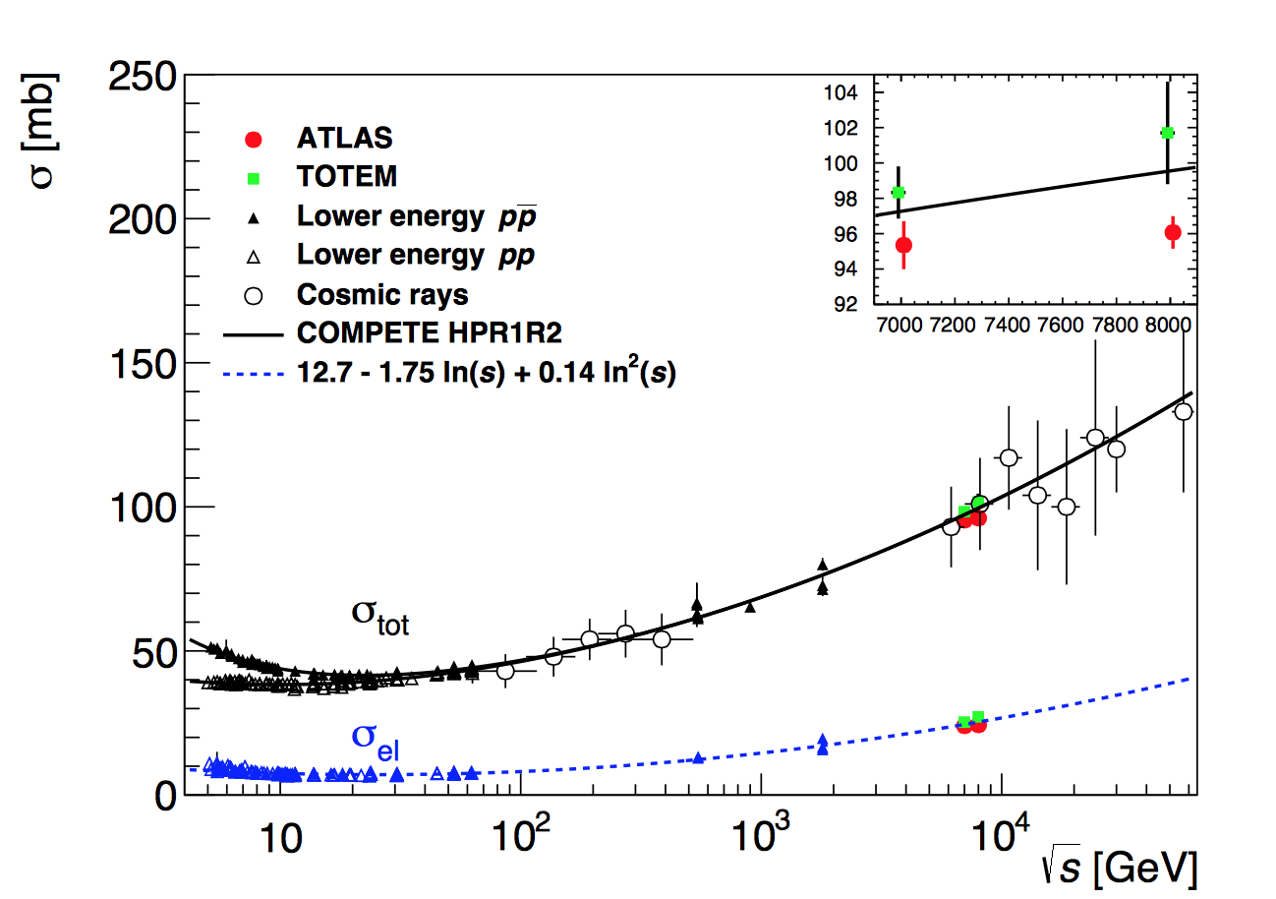
Total Inelastic Cross Section @ 8 TeV
A new measurement from ATLAS using their ALFA spectrometer
using the optical theorem
arXiv:1607.06605
Value at 8 TeV
is 1.9σ lower
compared to TOTEM!

Slide 26
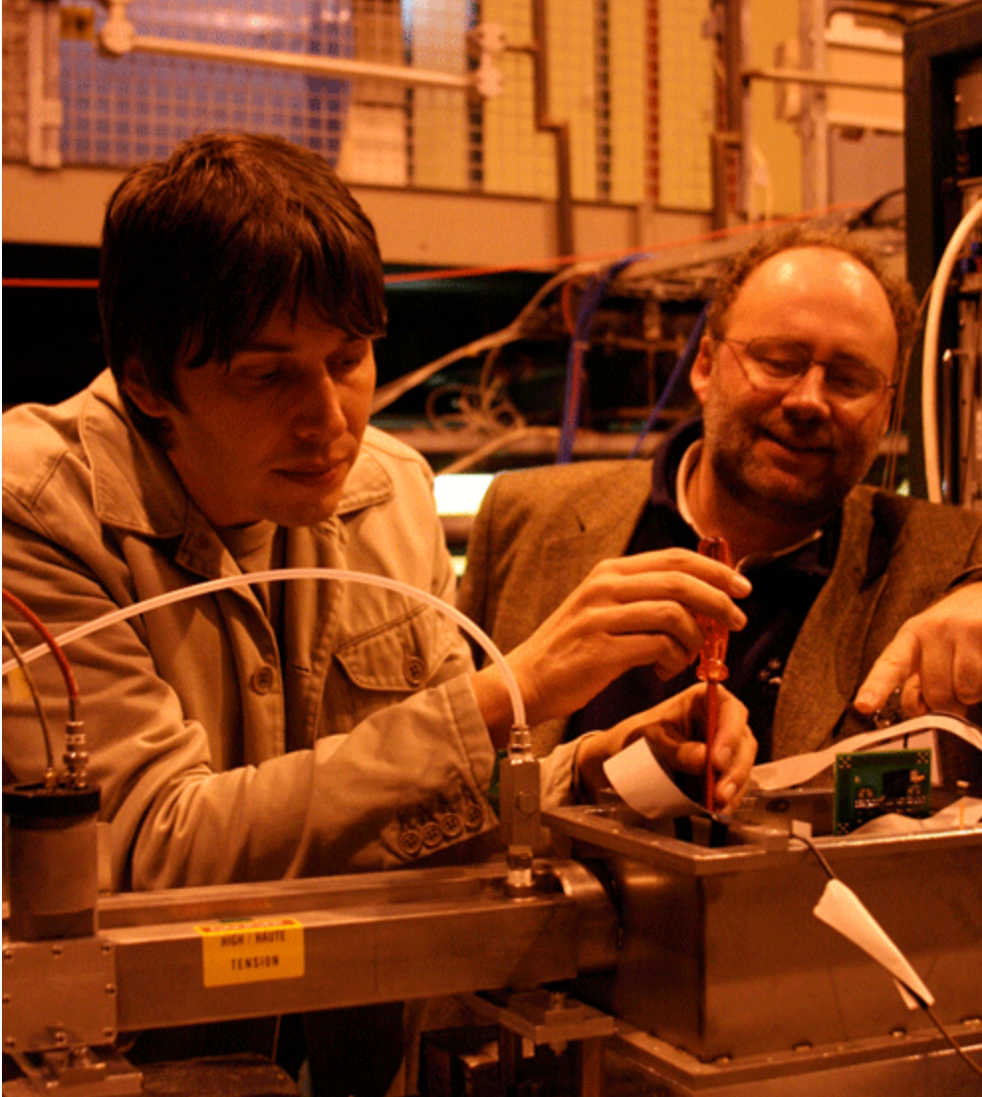
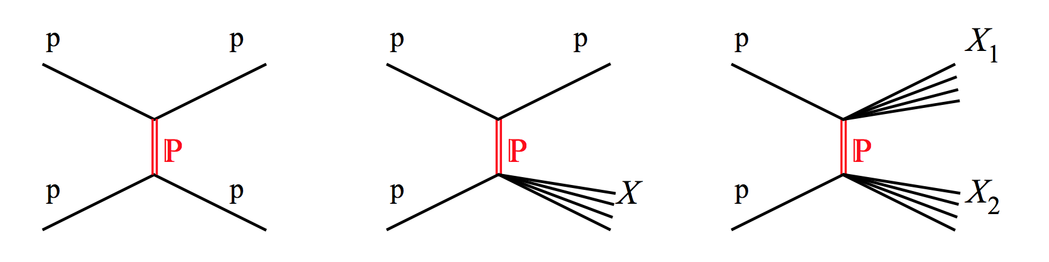

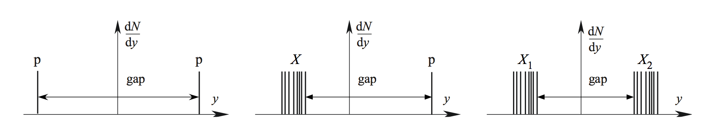


Diffractive Cross Sections
Single diffraction
Double diffraction
arXiv:1208.4968
LHC detector acceptance typically -5<η<5

Slide 27




Total Inelastic Cross Section @ 13 TeV
First very rough measurement from ATLAS counting inelastic events
Measured with single side events in the detector to constrain diffraction
arXiv:1606.02625

Slide 28


Total Inelastic Cross Section @ 13 TeV
First very rough measurement from CMS counting inelastic events
CMS-PAS-FSQ-15-005
Forward calorimeters
•Negative Z: CASTOR+HF
•Positive Z: only HF
Cross sections as function
of ξ = Μ_{X}²/s , with Μ_{X}² the
Mass of the diffractive system
Total inelastic cross section

Slide 29





Brian Cox…
Now a popular TV personality and Science program presenter in the UK

Slide 30





Diffraction at the LHC
arXiv:1503.08689
Analysis based on rapidity
gaps as defined here:
Run-II+ detectors:
FSCs, TOTEM-CMS, ALFA, upgrades…
-> Many future opportunities…
Low mass extrapolation?

Slide 31
Understanding Particle Production
Proton-Proton Collisions:
What particles are produced and with what energies and angles?

Slide 32





First Publication with 13 TeV Data!
Using the
pixel detector

Slide 33



LHC @ 13 TeV Results
arXiv:1602.01633
arXiv:1507.05915
arXiv:1602.01633
•Among the first papers @ 13 TeV!!: dN_{charged}/dη of min. bias events…

Slide 34







Particle Production @ 7 and 8 TeV
•Single particles, multiplicities etc. vs phenomenological models…
•LHC detectors are excellent and complementary for such studies
p/pbar
Φ/ρ+
Φ/ρ+ω
Multiplicities
Density at η=0
Λ/Λbar
Φ

Slide 35




Underlying Event Studies
The underlying event is everything except the hard scattering and its radiation
An important systematic effect for precision measurements, eg top mass
All central detectors have made measurements in the ‘transverse’ region:
Measure the particle
flow in transverse
region as function
of the hard scale
7 TeV
900 GeV

Slide 36

Underlying Event Studies @ 13 TeV
CMS-PAS-FSQ-15-007
Leading jet p_{T}
Measure the particle
flow in transverse
region as function
of the hard scale
The activity keeps increasing with
increasing CM energy!!

Slide 37




Double Parton Scattering
Two independent parton collisions within one proton collision!!
Example: angular correlations study of W+ 2jet events: The fraction of the
cross section attributed to DPS= 0.08 ± 0.01 (stat.) ± 0.02 (sys.)
arXiv:1301.6872
Basic process
Difference between the transverse momenta
of the two jets (p_{T} > 20 GeV)
DPS
DPS can be important for searches where after cuts only a few events remain…
•How well do we control DPS at the LHC energies?
•Expect increase of DPS for pp collisions at 13 TeV

Slide 38



Correlations Between Produced Particles
•Select high multiplicity events
•Study the correlation between
two charged particles in the
angles φ (transverse):
Δφ and θ (longitudinal): Δθ
η= -ln tanθ/2
All events
High multiplicity events
A new phenomenon
in the ‘stronge force’?
•Multiple interactions?
•Glass condensates?
•Hydrodynamic models?
…
JHEP 1009 (2010) 091
•Understanding the “Ridge” in pp collisions? New measurements at 13 TeV!
•Was first seen in AA, then pp (unexpected) and now also pA (~unexpected)

Slide 39


The Ridge at 13 TeV
Analysis with the first 13 TeV data
ATLAS-CONF-2015-027
The ridge is still there at 13 TeV!
Does it get stronger at 13 TeV?
What does it mean?

Slide 40

Correlations Between Produced Particles
Effect the same at both CMS energies
Effect in pp collisions: a new phenomenon in the ‘stronge force’?
Multiple interactions? Glass condensates? Hydrodynamic models?
Still a bit of a mystery!!

Slide 41




Forward Particles Measurements
•LHCf uses the same Interaction Point as ATLAS (IP1)
•LHCf has forward detectors at zero degrees seen from the IP (140 away
from the IP): Measure the forward photons/pions for cosmic ray studies
PLB 703 (2011) 128
Forward gamma measurement compared
to Monte Carlos for Cosmic Ray studies
No model reproduces the data well !!
Important for understanding of cosmic ray data

Slide 42
Hard Scattering
Perturbative QCD

Slide 43




Inclusive Jet Production (8 TeV)
CMS-PAS-SMP-14-001
Agreement with NLO calculations over the full range, up to and beyond
2 TeV p_{T} jets… QCD predictions work well…

Slide 44

Most commonly used algorithm: Anti-k_{T}

Slide 45



Inclusive Jet Production (13 TeV)
ATLAS-CONF-2015-034
CMS-PAS-SMP-15-007
Differential cross sections with R=0.7 and R=0.4
Jet p_{T} spectrum consistent with predictions
from NLOJET++
Ratio measurements show
R= 0.7: a good overall agreement
R= 0.4 5-10% overestimation
This was already observed at lower CM energies

Slide 46

Jet Studies
Plenty of studies with jets
The highest mass dijet events
recorded so far in run-II
Examples of ongoing studies
•Azimuthal correlations
•Multi-jet production
•Jet substructure and
boosted jet analyses
•Forward jet production
•Strong coupling constant
α_{s} determination → later
•PDF sensitivity and
extraction → later
…
Dijet invariant mass = 7.9 TeV

Slide 47


Early Measurements of Multi-jets
Early 2010 data…
Jet Multiplicity distribution
Eur.Phys.J. C71 (2011) 1763
A six jet event
Multi-jet distribution in good agreement with theory - LO matrix elements plus
matched parton showers - apart from normalization

Slide 48




New Directions: Boosted Jets & Substructure
Analyse boosted/merged jets
arXiv:0802.2470
•Start from Cambridge-Aachen FAT jets and apply jet “pruning” to find sub-jets
•Many methods being developed to analyse the jet substructure: grooming->
mass drop filtering, trimming, pruning…
Example: Boosted top events with b-jet and two merged jets from the W

Slide 49




Extracting the Strong Coupling Constant
Measure the ratio of 3-jet to 2-jet events
This measurement is sensitive to the fundamental QCD parameter α_{s}
Di-jets within the range of 420 - 1390 GeV, p_{T} of all jets larger than 150 GeV
World average
arXiv:1304.7498

Slide 50



Determination of α_{s}
Several processes
used to extract α_{s}
•7 TeV analysis
•NLO extractions
•Theory uncert.
dominate
arXiv:1304.7498
arXiv:1412.1633
arXiv:1410.6765
arXiv:1307.1907
→R32 jet ratios
→Inclusive jets
For CTNLO PDFs
→Top production
NNLO & Assuming 173.2 top poles mass

Slide 51


Determination of α_{s}
Transverse energy-energy correlations between jets
arXiv:1508.01579

Slide 52






PDF Information@ LHC
Many process are sensitive to the parton distributions functions (PDFs)
Some are already included in the global PDF fits by the fitter groups
top/Z
global fits
jets
top
W
photons

Slide 53


Low-x Studies at the LHC
High energy of the LHC allows to
access regions of low Bjorken-x
Detector coverage to large |η| is
important! Typical measurements:
• Low mass Drell-Yan, Jpsi…
Prompt photon production
Jet production with large rapidity
QCD Dynamics studies:
DGLAP: Dokshitzer, Gribov, Lipatov, Altarelli Parisi
BFKL: Balitskii, Fadin, Kuraev, Lipatov

Slide 54








Low-x: Mueller-Navelet Jet Studies
•Look at correlations between jets -with p_{T}> 35 GeV- at large rapidity distance
•Proposed in the early ‘90’s to as sensitivity test to BFKL and DGLAP evolution
CMS-PAS-FSQ-12-002
central + forward jet
azimuthal correlation vs Δy
Δy
No model describes all
these measurements
very well

Slide 55
Heavy Ion Collisions

Slide 56


Heavy Ion Collisions
Lead-lead collisions at the LHC to study the primordial plasma,
a state of matter in the early moments of the Universe
Hundreds of particles
in the detector
Study the phase transition
of a state of quark gluon
plasma created at the time
of the early Universe to
the baryonic matter we
observe today
A recorded lead lead collision in the CMS detector

Slide 57



Heavy Ion Collisions
•A new state of matter: observed at
SPS and RHIC
•Further studied at the LHC
- larger temperature, volume, energy
density and lifetime…
- large cross section for hard probes
•ALICE especially designed for HIC
CMS, ATLAS and LHCb take and analyse
pPb & PbPb data too

Slide 58

Highlights from the LHC
J. Schukraft, Kruger 2014

Slide 59

W, Z Production

Slide 60

A

Slide 61



W and Z Boson Production
Select final states with leptons
arXiv:1603.09222
CMS-PAS-SMP-15-011
Missing transverse energy
from the W → μ+ν decays
Z peak (di-muon pair
mass distributions)

Slide 62

W and Z Boson Production
Contains a new measurements at 13 TeV!
with about 5% precision (~lumi uncert.)
CMS-PAS-SMP-15-004
Many detailed EWK studies possible –and done-- with the large Z,W samples

Slide 63


W and Z Production at 13 TeV
arXiv:1603.09222
W⁺/W⁻ ratio: uncertainty: 0.8%
W/Z ratio: uncertainty: 2%

Slide 64


Comparison with NLO Calculations
Differential distributions
CMS-PAS-SMP-15-011
arXiv:1512.02192
Data more precise than predictions!
Theory comparisons
p_{T} of the Z → μμ
Theory comparisons
p_{T} of the Z → ll

Slide 65




Multi-Boson Production
…and examples of anomalous
triple gauge coupling limits

Slide 66

W Boson Production

Slide 67

W Boson Production
PDF precision will be crucial for EWK measurements M_{W}, sin²θ etc…

Slide 68

Top Production

Slide 69




Top Quark Physics
•The heaviest known elementary particle: ~173 GeV
•Coupling to the Higgs ~1 → Special role in EWK symmetry breaking?
•Special sector to searches for new physics

Slide 70


Candidate Event for Top Production

Slide 71


LHC as a Top Factory
Cross section ~ 250 pb (8 TeV)
->• ~5.10⁶ produced tt-pairs (2012)
•a few 10⁵ used in the analyses
Top mass determination (2014)
Spring 2014
Using Tevatron and
LHC combination of the
mass measurements
Meanwhile:
CMS update: 172.38±0.10 (stat)±0.65 (syst) GeV
Tevatron update: 174.34 ± 0.64 GeV

Slide 72

Top Quark Cross Sections
Good agreement with the SM predictions up to the new 13 TeV

Slide 73


Cross Sections at 13 TeV
A more detailed look at 13 TeV…
New: CMS dilepton measurement
CMS-PAS-TOP-16-005
Most precise individual
measurements now
already at the level
of 5-7% !

Slide 74

Top Mass Determination
Steady improvements over the
last years in run-1
Precision now is ~0.3%, similar
to the theoretical uncertainty
Hadronization model uncertainties
one of the main limitations
Many alternative methods have
been and are being explored
using J/psi, secondary vertices,…
This is not the last word yet
Experiment combination under way
Note: the average value LHC
somewhat lower than Tevatron
one: 174.34 ± 0.64 GeV

Slide 75



Top Differential Cross Sections
Run-I showed a difference in the p_{T} spectrum of the top in data compared
to ME+PS predictions
Better agreement with the recent NNLO calculations!
Run 2 results coming up

Slide 76


Vector Boson+Jets and Top+Jets
arXiv:1304.7098
High statistics and precision at the LHC
allows for W/Z+jets and top+jets studies
arXiv:1404.3171
top+jets
Z+jets
Good description by (most of) theory for both processes
Important backgrounds for searches, eg for SUSY searches

Slide 77




Single Top Production
•All single top processes have been studied
in run one by CMS and ATLAS including
differential cross sections and angular
measurements
•First t-channel measurements at
13 TeV by both experiments

Slide 78

Summary: Cross Sections at 7/8 TeV
Measurements in good agreement with the Standard Model predictions

Slide 79

B physics
•Dedicated experiment at the LHC is LHCb
•Not discussed in these lectures

Slide 80

Example 13 TeV Results
The inclusive di-muon spectrum in pp at 13 TeV
We find back all our usual suspects!
?

Slide 81

bb Jet Cross Sections at 7 TeV
arXiv:1607.08430
At least one b-jet with pT> 270 GeV

Slide 82




Pentaquarks?
In QCD we have color-white states: tri-q’s (baryons) and q anti-q (mesons)
What about pure gluon states (glueballs) and other exotic quark states
LHCb reported the observation of penta-quarks ie: 4 quarks+ an antiquark
Penta-quarks have a checkered history:
They have been discovered in two waves
•In the 1970’s
•In the last decade (2003-2006)
2006
Do the pentaquarks rise from the ashes?

Slide 83





Study of the Λ_{b} Decays
Mixture of all known Λ_{b} states
Add two pentaquark states
arXiv:1507.03414

Slide 84

Pentaquarks?
arXiv:1507.03414

Slide 85






Precision Measurements: B_{s(d)} →μμ
•A B_{s} particle is a particle consisting of a beauty-quark
and strangeness-quark, with a mass of ~ 5.4 GeV
•Three B_{s} particles in a billion will decay into two
muons. This decay has been chased since 30 years.
•New physics modifies these Standard Models predictions
PRL 111 (2013) 101804

Slide 86

Precision Measurements: B_{s(d)} →μμ
Combined CMS+LHCb analysis submitted to Nature Dec 2014
V. Chiochia
But no sign of New Physics …☹

Slide 87






Measurements of B_{s(d)} →μμ
arXiv:1411.4413
Published in Nature
New: ATLAS measurements
arXiv:1604.04263

Slide 88







Evidence for New Processes at LHC
Examples
EWK WWjj production
Wγγ production
ttZ production
arXiv:1405.6241
CMS-PAS-SMP-15-008
ATLAS-CONF-2016-003
Many other processes eg in top sector: ttW, ttγγ, ttbb,…

Slide 89



Summary: Cross Sections 7/8/13 TeV
Measurements in good agreement with the Standard Model predictions!!

Slide 90
Summary
Run-I delivered many measurements of Standard Model processes, eg on the top quark, EWK and in QCD. Some features of multi-particle production are not understood.
Electroweak measurements show agreement with the data in general.
The LHC is a top-factory. Very detailed study of the top quarks ongoing. No surprises yet!
A prime target of the LHC was the discovery of “a” or “the” Higgs particle. Particle found/Mission accomplished! ☺
-> See Eilam Gros’ lectures
However this does create some issues for the SM and we would be expecting to see new particles !
But where is everybody else? → Next Lectures

