Slide 1
Statistics for HEP data analysis Part 3: advanced inference
Weihai, August 2nd 2016
Tommaso Dorigo
INFN Padova

Slide 2
Contents of lecture 5
Frequentists and Bayesians
nuts and bolts
The likelihood principle
Conditioning
Statistical significance
Finding the right model: the F-test

Slide 3
Frequentist and Bayesian schools

Slide 4
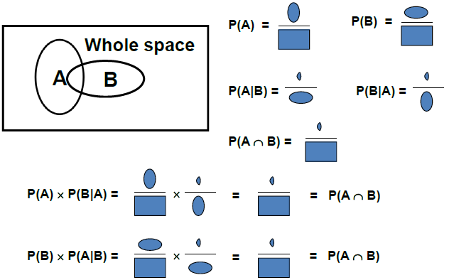
Recall Bayes Theorem
(Graph courtesy B. Cousins, http://indico.cern.ch/getFile.py/access?contribId=1&resId=0&materialId=slides&confId=44587)

Slide 5
Probability: Operational Definitions
Frequentist definition: empirical limit of the frequency ratio between the number of successes S and trials T in a repeated experiment,
P(X)=lim_{n→inf}(S/T)
Definition as a limit is fine –can always imagine to continue sampling to obtain any required accuracy
compare to definition of electric field as ratio between force on test charge and magnitude of charge
But can be applied only to repeatable experiments
this not usually a restriction for relevant experiments in HEP, but must be kept in mind –cannot define frequentist P that you die if you jump out of 3rd floor window
Bayesian framework: to solve problem of unrepeatable experiments we replace frequency with degree of belief
Best operational definition of degree of belief: coherent bet. Determine the maximum odds at which you are willing to bet that X occurs:
P(X) = max[expense/return]
Of course this depends on the observer as much as on the system: it is a subjective Bayesian probability
Huge literature exists on the subject (short mentions below)
→ In science we would like our results to be coherent, in the sense that if we determine a probability of a parameter having a certain range, we would like it to be impossible for somebody knowing the procedure by means of which we got our result to put together a betting strategy against our results whereby they can on average win money !
We will see how this is the heart of the matter for the use of Bayesian techniques in HEP

Slide 6
Frequentist use of Bayes Theorem
Bayes theorem is true for any P satisfying Kolmogorov axioms (using it does not make you a Bayesian; always using it does!), so let us see how it works when no degree of belief is involved
A b-tagging method is developed and one measures:
P ( b-tag| b-jet ) = 0.5 : the efficiency to identify b-quark-originated jets
P ( b-tag| ! b-jet ) = 0.02 : the efficiency of the method on light-quark jets
From the above we also get :
P ( ! b-tag| b-jet ) = 1 – P ( b-tag | b-jet ) = 0.5 ,
P ( ! b-tag| ! b-jet ) = 1 – P ( b-tag | ! b-jet ) = 0.98 .
Question: Given a selection of b-tagged jets, what fraction of them are b-jets ? Id est, what is P ( b-jet | b-tag ) ?
b-tag |!b-jet
!b-tag | !b-jet
Answer: Cannot be determined from the given information!
We need, in addition to the above, the true fraction of jets that do contain b-quarks, P(b-jet). Take that to be P(b-jet) = 0.05 ; then Bayes’ Theorem inverts the conditionality:
P ( b-jet | b-tag ) ∝ P ( b-tag | b-jet ) P ( b-jet )
If you then calculate the normalization factor,
P(b-tag) = P(bt|bj) P(bj) + P(bt|!bj) P(!bj) = 0.5*0.05 + 0.02*0.95 = 0.044
you finally get P(b-jet | b-tag) = [0.5*0.05] / 0.044 = 0.568.
!b-tag |b-jet
b-tag |b-jet

Slide 7
Bayesian use of Bayes Theorem
When we are dealing with hypotheses, Bayesian and Frequentist schools part. Subjective probability deals with the probability of hypotheses: one may then talk of the probability of a constant of nature having a particular value, and can use Bayes theorem
for a Frequentist, P(m_{ν}=0) makes no sense; for a Bayesian it does, so it can be used as a factor in Bayes theorem
If f(X_{i}|θ) is the p.d.f. of a random variable X, and θ is a variable representing the possible values of a unknown physical parameter, then from N observations {X_{i}}_{i=1,..,N} one gets the joint density function as
p({X}| θ) = Π_{i=1,…,N} f(X_{i}|θ)
From a Frequentist standpoint, θ has a true, unknown, fixed value; one cannot use Bayes theorem to get p(θ|X) from p(X|θ) – it does not make sense to speak of p(θ).
The inference Bayesians do using a particular set of data {X₀} starts from the opposite viewpoint. p(θ) is a degree of belief of the parameter assuming a specific value. They can thus obtain
Note that there is one (and only one) probability density in θ on each side of the equation, again consistent with the likelihood not being a density.

Slide 8
A Bayesian example
In a background-free experiment, a theorist uses a “model” to predict a signal with Poisson mean of 3 events. From the formula of the Poisson distribution, and from B=0, we get:
P(0 events | model true) = 3⁰e⁻³/0! = 0.05
P(0 events | model false) = 1.0
P(>0 events | model true) = 0.95
P(>0 events | model false) = 0.0
Imagine that the experiment is performed and zero events are observed.
Question: Given the result of the experiment, what is the probability that the model is true? What is P(model true | 0 events) ?
Answer: Cannot be determined from the given information!
We need, in addition to the above, to state our degree of belief in the model prior to the experiment, P(model true). Need a prior!
Then Bayes’ Theorem inverts the conditionality:
P(model true|0 events) ∝ P(0 events | model true) P(model true)
If the model tested is the Standard Model, then still very high degree of belief after experiment, unlike typical claims “there is 5% chance the S.M. is true”
If it is instead Large Extra Dimensions or something similar, then the low prior belief becomes even lower.

Slide 9
Bayesian decision making
It is useful at this point to note that while in HEP we usually stop upon determining the posterior P(model|data), this is not what happens in the real world !
Suppose you determine that P(new physics model true|data)=99%, and you want to use that information to decide whether to take an action, e.g. call a press release or submit a proposal for a new experiment, based on the model being true. What should you decide ?
You cannot tell ! You need also a cost function, which describes the relative costs (to You) of a Type I error (declaring background-only model false when it is true) and a Type II error (not declaring the background-only model false when it is false).
Thus, Your decision, such as where to invest your time or money, requires two subjective inputs: Your prior probabilities, and the relative costs to You of the various outcomes.
→ Classical hypothesis testing is not a complete decision making theory, regardless of the language (“the model is excluded”, etc.)

Slide 10
Probability, Probability Density, and Likelihood
For a discrete distribution like the Poisson, one has a probability P(n|μ) = μ^{n}e^{-μ}/n!
For a continuous pdf, e.g. a Gaussian pdf p(x|μ,σ)=(2πσ²)^{-0.5}e^{- (x-μ)2/2σ2}, one has p(x|μ,σ)dx as the differential of probability dP
In the Poisson case, suppose one observes n=3. Substituting it into P(n|μ) yields the likelihood function L(μ) = μ³e^{-μ}/3!
The key point is that L(μ) is not a probability density in μ.The term “likelihood” was invented for this function of the unknowns, to distinguish it from a function of the observables.
For a pdf p(x|θ) and a one-to-one change of variable from x to y(x), one can write
p(y(x)|θ) = p(x|θ) / |dy/dx|.
The Jacobian at the denominator modifies the density, guaranteeing that
P ( y(x1) < y < y(x2) ) = P ( x1 < x < x2 )
so that probabilities (and not their d.f.s) are invariant under changes of variable.
E.g. the mode of a probability density is not invariant (so, e.g., the criterion of maximum probability density is ill-defined). Instead, the likelihood ratio is invariant under a change of variable x (the Jacobians in numerator and denominator cancel).
For the likelihood L(θ) and reparametrization from θ to u(θ): L(θ) = L(u(θ))
→ it is invariant under a reparametrization!, reinforcing the fact that L is not a pdf in θ.

Slide 11
On HEP use of Bayesian methods
There are compelling arguments that Bayesian reasoning with subjective P is the uniquely “coherent” way (e.g. in the sense of our betting criterion) of updating personal beliefs upon obtaining new data.
The question is whether the Bayesian formalism can be used by scientists to report the results of their experiments in a “objective” way (however one defines “objective”), and whether the result can still be coherent if we replace subjective probability with some other recipe.
A bright idea of physicist Harold Jeffreys in the mid-20th century: Can one define a prior p(μ) which contains as little information as possible, so that the posterior pdf is dominated by the likelihood?
What is unfortunately common in HEP: choose p(μ) uniform in whatever metric you are using (“Laplace’s insufficient reason”). This is a bad idea!
Jeffreys’ work resulted in what are today called ”reference priors”
the probability integral transform assures us that we can find a metric under which the pdf is uniform → choosing the prior is equivalent to choosing the metric in which the pdf is uniform

Slide 12
Jeffreys chooses the metric according to the Fisher information. This results in different priors depending on the problem at hand:
Poisson with no background → p(μ) = μ^{-0.5} ;
Poisson with background → p(μ) = (μ+b) ^{-0.5}; ! note: prior belief on μ depends on b !?
Gaussian with unknown mean → p(μ) = flat
Note that what we (in HEP) call “flat priors” is not what statisticians mean: flat priors for them are Jeffreys priors (flat in information metric)
In general, a sensitivity analysis (effect of prior assumption on the result) should always be ran, especially in HEP.
In more than one dimension, the problem of finding suitable priors becomes even harder. It is a notoriously hard problem: you start with a prior, change variables → get a Jacobian, which creates structure out of nothing. A uniform prior in high dimensions pushes all the probability away from the origin.
Not even clear how to define subjective priors there; human intuition fails in high dimensions. Lots of arbitrariness remains. Some have even used flat priors in high dimensions for SUSY searches → beware!
In summary, despite the flourishing of Bayesian techniques in the last thirty years (particularly for decision making), in HEP their use is still limited

Slide 13
Classical statistics inference: no priors
Most of what we do is based on use classical statistics, developed in the early XXth century
it gives you answers, but does not provide a complete answer to what you’d like to know: it does not allow to make decisions
it does not give you the probability of a constant of nature having a certain value
With the tools of classical statistics, and without using priors we can still derive confidence intervals (Neyman 1934-37) for parameter values
An ingenious construction, but often misinterpreted
Important to keep in mind: confidence intervals do not give you any confidence that a unknown parameter is contained within an interval ! This is something only a Bayesian method may provide.
In Bayesian inference in fact one rather speaks of “credible intervals”
Likelihood ratios, also constructed from the Frequentist definition of probability, are the basis for a large set of techniques addressing point and interval estimation, and hypothesis testing. They also do not need a prior to be constructed. Will see an example below.

Slide 14
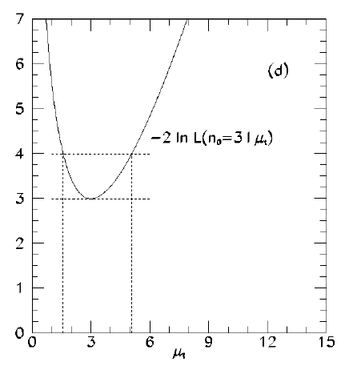
Likelihood ratio tests
Because of the invariance properties of the likelihood under reparametrization, a ratio of likelihood values can be used to find the most likely values of a parameter θ, given the data X
a reparametrization from θ to f(θ) will not modify our inference: if [θ₁, θ₂] is the interval containing the most likely values of θ, [f(θ₁),f(θ₂)] will contain the most likely values of f(θ)
log-likelihood differences also invariant
One may find the interval by selecting all the values of θ such that
-2 [ ln L(θ) – ln L(θ_{max}) ] <= Z²
The interval approaches asymptotically a central confidence interval with C.L. corresponding to ±Z Gaussian standard deviations. E.g. if we want 68% CL intervals, choose Z=1; for five-sigma, Z²=25, etc.
It is an approximation! Sometimes it undercovers (e.g. Poisson case)
But a very good one in typical cases. The property depends on Wilks’ theorem and is
based on a few regularity conditions.
LR tests are popular because it is what MINUIT MINOS gives
Problems arise when θ approaches boundary of definition
Example: likelihood-ratio interval for Poisson process with n=3 observed: L (μ) = μ³e^{-μ}/3! has a maximum at μ= 3.
Δ(2lnL)= 1² yields approximate ±1 Gaussian standard deviation interval : [1.58, 5.08]
For comparison: Bayesian central with flat prior
yields [2.09,5.92]; NP central yields [1.37,5.92]
R. Cousins, Am. J. Phys. 63 398 (1995)

Slide 15
The likelihood principle
In both Bayesian methods and likelihood-ratio based methods, only the probability (density) for obtaining the data at hand is used: it is contained in the likelihood function. Probabilities for obtaining other data are not used
In contrast, in typical frequentist calculations (e.g., a p-value which is the probability of obtaining a value as extreme or more extreme than that observed), one uses probabilities of data not seen.
This difference is captured by the Likelihood Principle:
If two experiments yield likelihood functions which are proportional,
then Your inferences from the two experiments should be identical.
The likelihood Principle is built into Bayesian inference (except special cases).
It is instead violated (sometimes badly) by p-values and confidence intervals.
You cannot have both the likelihood principle fulfilled and guaranteed coverage.
Although practical experience indicates that the Likelihood Principle may be too restrictive, it is useful to keep it in mind.

Slide 16
Example of the Likelihood Principle
Imagine you expect background events sampled from a Poisson mean b, assumed known precisely.
For signal mean μ, the total number of events n is then sampled from Poisson mean μ+b. Thus,
P(n) = (μ+b)^{n}e^{-(μ+b)}/n!
Upon performing the experiment, you see no events at all, n=0. You then write the likelihood as
L(μ) = (μ+b)⁰e^{-(μ+b)}/0! = exp(-μ) exp(-b)
Note that changing b from 0 to any b*>0, L(μ) only changes by the constant factor exp(-b*). This gets renormalized away in any Bayesian calculation, and is a fortiori irrelevant for likelihood ratios. So for zero events observed, likelihood-based inference about signal mean μ is independent of expected b.
You immediately see the difference with the Frequentist inference: in the confidence interval constructions, the fact that n=0 is less likely for b>0 than for b=0 results in narrower confidence intervals for μ as b increases.

Slide 17
Conditioning and ancillary statistics
An “ancillary statistic” is a function of the data which carries information about the precision of the measurement of the parameter of interest, but no information about the parameter’s value.
Most typical case in HEP: branching fraction measurement. With N_{A}, N_{B} event counts in two channels one finds that
P(N_{A},N_{B}) = Poisson (N_{A}) x Poisson (N_{B}) = Poisson (N_{A}+N_{B}) x Binomial (N_{A}|N_{A}+N_{B})
By using the expression on the right, one may ignore the ancillary statistics N_{A}+N_{B}, since all the information on the BR is in the conditional binomial factor → by restricting the sample space, the problem is simplified. This is relevant when one designs toy Monte Carlo experiments e.g. to evaluate uncertainties
And it gets even more intriguing in the famous example by Cox (1958): flip a coin to decide whether to use a 10% scale (if you get tails) or a 1% scale (if you get head) to measure a weight. Which error do you quote for your measurement, upon getting a head ?
Of course the knowledge of your measuring device allows you to estimate that your precision is 1%
but a full NP construction (which seeks the highest power for a chosen α, unconditional on the outcomes) would require you to include the coin flipping in the procedure!
The quality of your inference depends on the breadth of the “whole space” you are considering. The more you can restrict it, the better (i.e. the more relevant) your inference; but ancillary statistics are not easy to find
The likelihood principle can be thought of as an extreme form of conditioning: you only consider the data you have !

Slide 18
Food for thought: relevant subsets
Neyman’s method for the Gaussian measurement with known sigma of parameter with unknown positive mean yields upper limits at 95% CL in the form μ_{UL}=x+1.64σ
This lends itself to a pointed criticism best highlighted by a hypothetical betting game
The procedure is guaranteed to cover the unknown true value in 95% of experiments by the math of Neyman’s construction
Yet one can devise a betting strategy against it at 1/20 odds, using no more information than the observed x, and be guaranteed to win in the long run!
How ? Just choose a real constant k: bet that the interval does not cover when x<k, pass otherwise.
For k<-1.64 this wins EVERY bet! For larger k, advantage is smaller but is still >0.
Surely then, the procedure is not making the best inference on the data ?
Another example:
Find μ using x₁, x₂ sampled from p(x|μ)=Uniform [μ-1/2, μ+1/2]:
A: {0.99,1.01} ; B: {0.51,1.49}
N-P procedures maximizing power in the unconditional space yield the same confidence interval for both data sets A and B; however, B clearly restricts the set of possible μ to [0.99,1.01] while A only restricts it to [0.51,1.49] !
There exists in fact a ancillary statistics |x₁-x₂| which carries no information on μ, yet can be used to divide the sample space in subsets where inference can be different.
See R. Cousins, Arxiv:1109.2023 for more discussion

Slide 19
Comparing methods to compute intervals
Bayesian credible intervals:
need a prior (can be a good thing –allows a means to put in your personal prior belief)
random variable in construction is true value
usually obey the likelihood principle
can be basis for decision theory (provides p(θ|data) )
do not guarantee coverage
Frequentist confidence intervals:
do not need a prior (can do inference reporting the result of your data keeping it objective)
random variables are extrema of intervals
do not obey the likelihood principle
guarantee coverage
use p(data not obtained) for inference about θ
Likelihood ratio intervals:
do not need a prior
random variables are extrema of intervals
obey the likelihood principle
they do not always cover

Slide 20
The three methods at work
Let us take the classical example of a zero-background counting experiment, N_{obs}=3 case (as above): determine upper limit on signal. This boils down to three different recipes:
1. Bayesian upper limit at 90% credibility: determine posterior p(μ|N);
find μ_{u} such that posterior probability P(μ>μ_{u}) = 0.1.
2. Likelihood ratio method for approximate 90% C.L. upper limit: find μ_{u} such
that L(μ_{u}) / L(3) has prescribed value
3. Frequentist one-sided 90% C.L. upper limit: find μ_{u} such that
P(n≤3 |μ_{u}) = 0.1.
They give different answers ! That is because they ask different questions.
Which method is best ? Not decidable – and certainly the answer cannot be given by HEP physicists !
Several factors contribute to the practical choices made
Frequentist vs Bayesian preconceptions
Technical problems (eg. with the integration of the nuisance parameters in the Bayesian case → until MCMC tools became available, the problem was intractable in all but the easiest cases)
Peculiarities of the problem at hand. For instance, small statistics causes the Likelihood intervals, which rest on asymptotic properties of the form of L (Wilks’ theorem) to have poor properties

Slide 21
Treatment of Systematic Uncertainties
Statisticians call these nuisance parameters
Any measurement in HEP is affected by them: the turning of an observation into a measurement requires assumptions about parameters and other quantities whose exact value is not perfectly known → their uncertainty affects the main measurement
Going from a event count to a cross section requires knowing N_{b}, L, ε_{sel}, ε_{trig} …
measurements which are subsidiary to the main result
Inclusion of effect of nuisances in interval estimation and hypothesis testing introduces complications. Each of the methods has recipes, but not universal nor always applicable
Bayesian treatment: one constructs the multi-dimensional prior pdf p(θ)Π_{i}p(λ_{i}) including all the parameters λ_{i}, multiplies by p(X₀|θ,λ), and integrates all of the nuisances out, remaining with p(θ|X₀)
Classical frequentist treatment: scan the space of nuisance parameters; for each point do Neyman construction, obtaining multi-dimensional confidence region; project on parameter of interest
Likelihood ratio: for each value of the parameter of interest θ*, one finds the value of nuisances that globally maximizes the likelihood, and the corresponding L(θ*). The set of such likelihoods is called the profile likelihood.
Each “method” has problems (B: multi-D priors; C: overcoverage and intractability; L: undercoverage) – will not discuss them here, but note that this is a topic at the forefront of research, for which no general recipe is valid.
Often used are “hybrid” methods for integrating nuisance parameters out: for instance, treat nuisance parameters in a Bayesian way while treating the parameter of interest in a frequentist way, or “profile away” the nuisance parameters and then use any method. Also possible is using Bayesian techniques and then evaluate their coverage properties.

Slide 22
Finding the right model

Slide 23
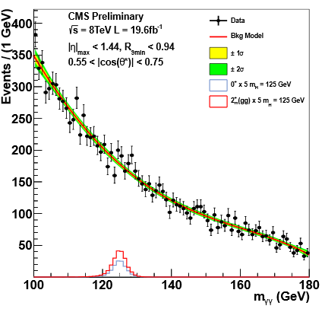
Finding the right model
Often in HEP, astro-hep etc. we do not know what is the true functional form the data are drawn from
Can in specific cases use MC simulations; not always
Extracting inference from a spectrum is thus limited:
“I see a deformation in the spectrum”
“A deformation from what ?”
Nonetheless, we routinely use e.g. mass spectra to search for new particles and we “guess” the data shape
EG: LHC searches for Z’, jet-jet resonances, jet extinction, quantum black holes, ttbar resonances, compositeness...
Also, e.g., the Higgs H→γγ searches in ATLAS and CMS !
All these searches have trouble simulating the reconstructed mass spectrum so families of possible “background shapes” are used
The modeling of the background shape is thus a difficult problem

Slide 24
Fisher’s F-test
Suppose you have no clue of the real functional form followed by your data (n points)
or even suppose you know only its general form (e.g. polynomial, but do not know the degree)
You may try a function f₁(x;{p₁}) and find it produces a good fit (→goodness-of-fit); however, you are unsatisfied about some additional feature of the data that appear to be systematically missed by the model
You may be tempted to try a more complex function –usually by adding one or more parameters to f₁
this ALWAYS improves the absolute χ², as long as the new model “embeds” the old one (the latter means that given any choice of {p₁}, there exists a set {p₂} such that f₁(x;{p₁})==f₂(x;{p₂})
How to decide whether f₂ is more motivated than f₁ , or rather, that the added parameters are doing something of value to your model ?
Don’t use your eye! Doing so may result in choosing more complicated functions than necessary to model your data, with the result that your statistical uncertainty (e.g. on an extrapolation or interpolation of the function) may abnormally shrink, at the expense of a modeling systematics which you have little hope to estimate correctly.
Use the F-test: the function F
has a Fisher distribution if the
added parameter is not improving
the model.

Slide 25
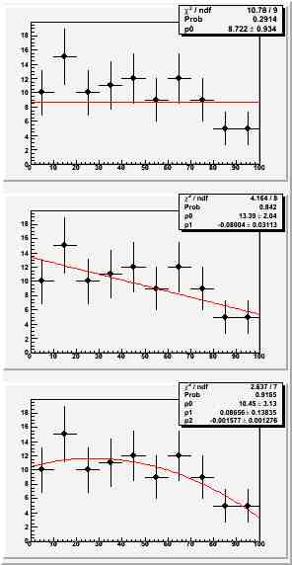
Example of F-test
Imagine you have the data shown on the right, and need to pick a functional form to model the underlying p.d.f.
At first sight, any of the three choices shown produces a meaningful fit. P-values of the respective χ² are all reasonable (0.29, 0.84, 0.92)
The F-test allows us to pick the right choice, by determining whether the additional parameter in going from a constant to a line, or from a line to a quadratic, is really needed.
We need to pre-define a size α of our test: we will reject the “null hypothesis” that the additional parameter is useless if p<α. Let us pick α=0.05 (ARBITRARY CHOICE!).
We define p as the probability that we observe a F value at least as extreme as the one in the data, if it is drawn from a Fisher distribution with the corresponding degrees of freedom.
Note that we are implicitly also selecting a “region of interest” (large values of F)!
How many of you would pick the constant model ? The linear ? The quadratic ?
Would your choice change if α=0.318 (1-sigma)?

Slide 26
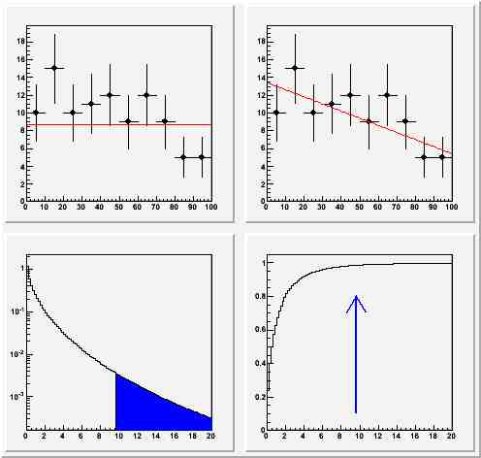
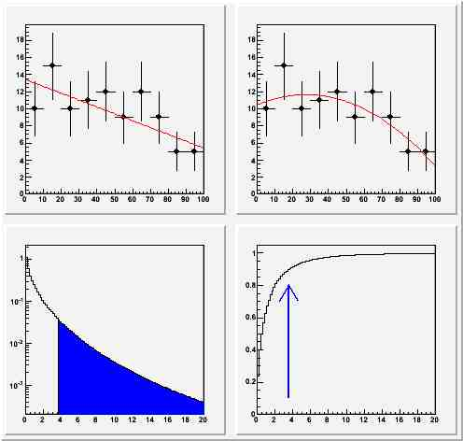
The test between constant and line yields p=0.0146: there is evidence (according to our choice of α) against the null hypothesis (that the additional parameter is useless), so we reject the constant pdf and take the linear fit
The test between linear and quadratic fit yields p=0.1020: there is no evidence against the null hypothesis (that the additional parameter is useless). We therefore keep the linear model.

Slide 27
Playing with the F test
The provided code can be used to get familiar with the use of the F test.
Simple exercise: add functionality to generate exponentially falling data; check when linear model breaks down, when quadratic model also breaks down, etcetera, as a function of
number of events in histogram
number of bins in histogram
size of the test
What you need:
understand what the code does
understand how to generate exponentially falling data
code it
choose suitable upper range of histogram
In particular, you need to use the integral function of the pdf (we assume gRandom
only provides uniformly-distributed random numbers!)

Slide 28
Machine learning and multivariate techniques
In the following I will only give a very quick and dirty survey of the field – very rich and in constant development
A detailed discussion would require several lectures
Will not focus on the most "a' la mode" tools (eg. Bdt, NN), but rather give an overview of the various classes of tools
One can live a decent life as a physicist even these days without knowing the gory details, but one must
(1) understand the basic issues and
(2) know how to use the common tools (eg. TMVA)
I can only try to work at the first issue today!

Slide 29
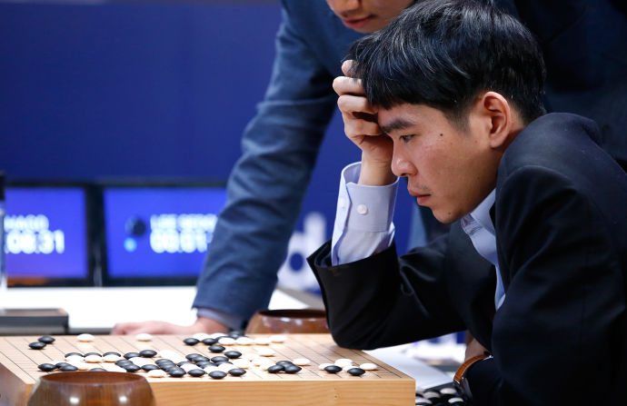
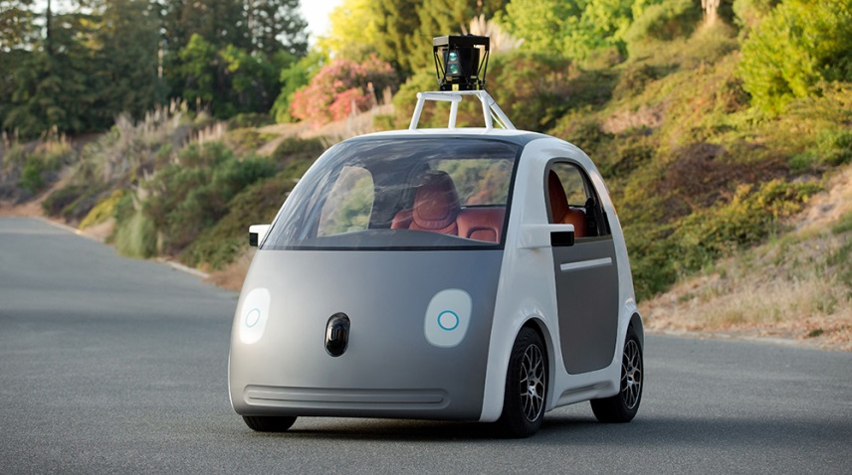
Machine Learning is ubiquitous

Slide 30
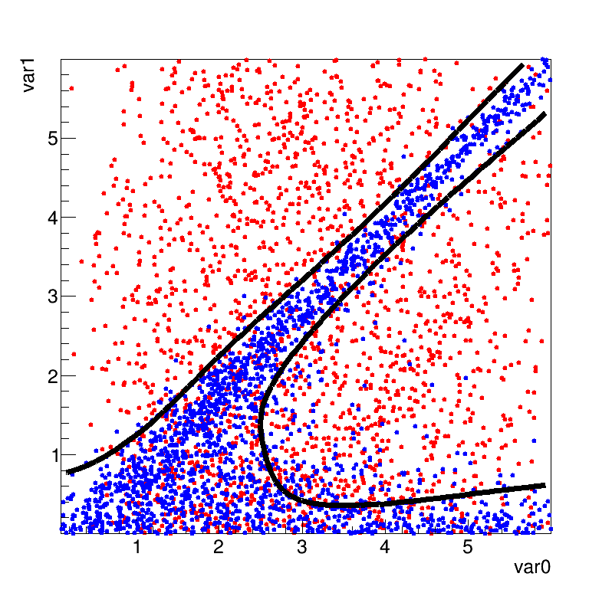
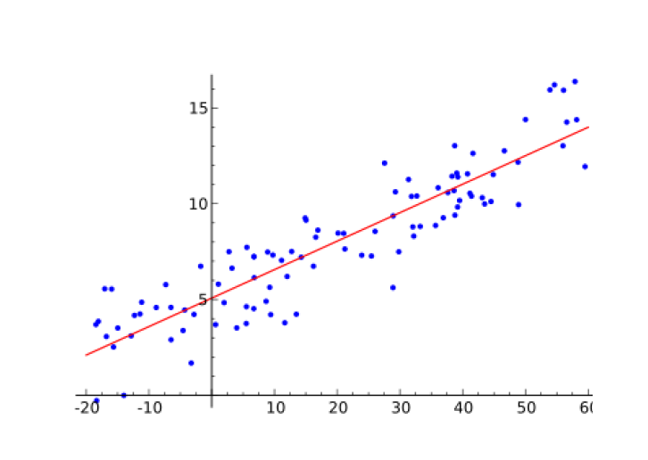
What is Machine Learning
“[Machine Learning is the] field of study that gives computers the ability to learn without being explicitly programmed.” Arthur Samuel (1959)
“A computer program is said to learn from experience E with respect to some task T and some performance measure P, if its performance on T, as measured by P, improves with experience E.” Tom Mitchell, Carnegie Mellon University (1997)
And multivariate techniques ?
Many things … starting from “linear regression” to event classification
x₂
Background
Signal
f(x)
x
x₁

Slide 31
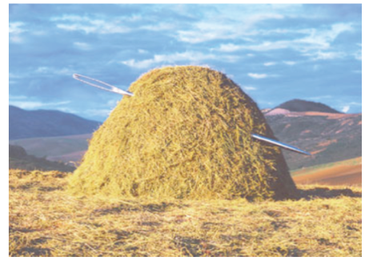
Event Classification
Signal and Background
discriminating observed variables x₁, x₂, …
→ decision boundary ?
Rectangular cuts?
A linear boundary?
A nonlinear one?
x₂
S
x₂
S
x₂
S
B
B
B
x₁
x₁
x₁
Low variance (stable), high bias methods
High variance, small bias methods

Slide 32
Regression
‘known measurements” → model “functional behaviour”
constant ?
linear?
non - linear?
f(x)
f(x)
f(x)
x
x
x
known analytic model (i.e. nth -order polynomial) → Maximum Likelihood Fit)
no model ?
“draw any kind of curve” and parameterize it?
seems trivial ?
seems trivial ? → human brain has very good pattern recognition capabilities!
what if you have many input variables?

Slide 33
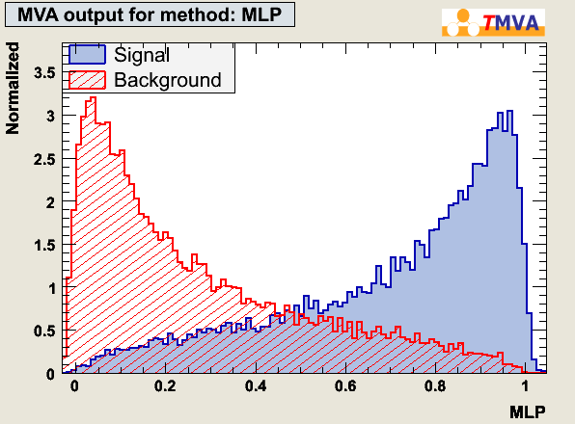
Event Classification
Each event, if Signal or Background, has “D” measured variables.
most general form
y = y(x); x ^{D}
x={x₁,….,x_{D}}: input variables
^{D}
“feature
space”
Test statistic:
y(x): R^{D}→R:

Find a mapping from D-dimensional input-observable (”feature” space)
to one dimensional output → class label
plotting (histogramming) the resulting y(x) values:
y(x)

Slide 34
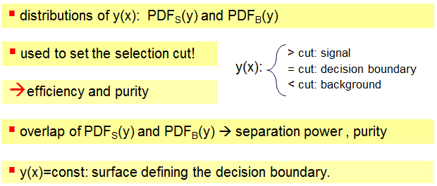
Generalities on discriminators use
y(x)
y(B) → 0, y(S) → 1

Slide 35
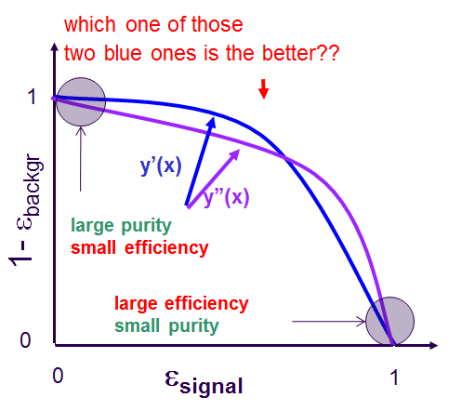
The receiver operation characteristic (ROC)
Increase purity
y(x)
Cut tighter
Decrease efficiency

Slide 36
How to build your classifier
$y\left(x\right)=\frac{PDF(x|S)}{PDF(x|B)}$ is the best possible classifier
but p(x|S), p(x|B) are typically unknown
→ Neyman-Pearsons lemma doesn’t really help us directly
So we can try and estimate p(x|S) and p(x|B): (e.g. the differential cross section folded with the detector influences) and use the likelihood ratio
E.g. D-dimensional histogram, Kernel density estimators, kNN algorithm
These are called generative algorithms
OR
Approximate the “likelihood ratio” (or a monotonic transformation thereof).
Find a y(x) whose hyperplanes in the “feature space”
(y(x) = const) optimally separate signal from background
E.g. Linear Discriminator, Neural Networks, …
These are called discriminative algorithms

Slide 37
Different classes of ML algorithms
supervised: - if we know the PDFs, or at least we can estimate them
→ E.g. use training “events” with known type (Signal or Background)
un-supervised: - if there is no prior notion of “Signal” or “Background”
→ cluster analysis: if different “groups” are found → class labels
reinforcement-learning:
- learn from “success” or “failure” of some “action policy”
→ E.g. a robot achieves his goal or does not / falls or does not fall/ wins or loses the game)

Slide 38
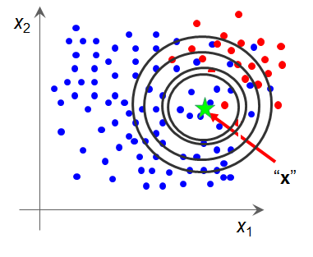
Estimating the PDF: the K-Nearest Neighbor
A brute-force attempt at determining the
density of the data (either S or B) by
finding how many events are contained in
a hyperball of given size
Or better, keep N fixed and determine local density
from size of the ball
One may weight the events by their distance, using
a "kernel function" (typically a Gaussian of the
multi-dimensional distance)
But how to define the distance in the feature space ?
Can try to weight each coordinate by inverse of its variance
Some variables are more discriminating than others → use a weight → hyperellipsoid
Can try to adapt the size of the hyperellipsoid to the point of space, by studying how
rapidly the local density varies (gradient of PDF)
A drawback of kNN and other similar methods (eg. Kernel density):
evaluation for any test events involves ALL TRAINING DATA → high CPU demand

Slide 39
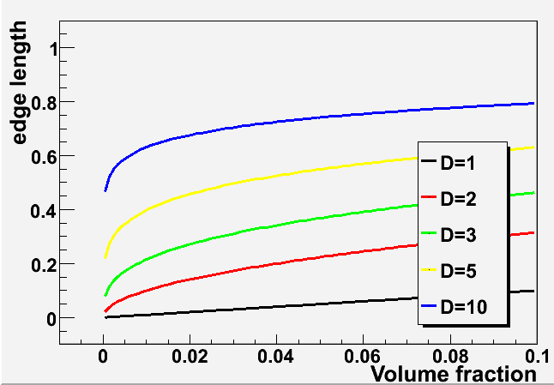
The main drawback of generative algorithms: the curse of dimensionality
Filling a D-dimensional histogram to get a mapping of the PDF is typically unfeasable due to lack of Monte Carlo events.
In high-dimensional cases, the k "closest events often are not in a small “vicinity” of the space point anymore:
This limits the possible dimensionality to 10 or so
In 10 dimensions, if a hyperball captures 1% of the phase space, 63% of range in each variable
Is necessary → that’s not “local” anymore !

Slide 40
What if we ignore correlations ?
Multivariate Likelihood (k-Nearest Neighbour) tries to estimate the full D-dimensional joint probability density. This cannot work for high D.
A "Naïve Bayesian" approach is to ignore the correlations.
Use the "marginals":
product of marginal PDFs
(1-dim “histograms”)
One can get the P_{i} by smoothing the marginal distributions
The P(x) thus obtained can be used as a
discriminant: the class label is assigned to the
class that has highest p(x)
The method works well if the correlations are
small → one can try to eliminate them by
applying "decorrelation" techniques

Slide 41
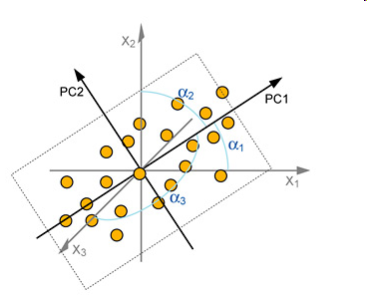
Decorrelation
To make the feature variables more usable by a method ignoring the correlations, one
may "rotate" the variables.
One finds a transformation that diagonalizes the covariance matrix of the inputs
The eigenvectors of the covariance matrix are the principal components → by rotating the
Variables to match the largest eigenvectors, one decorrelates the inputs.
A large eigenvalue means a large variance
along that component
This however works only for linear correlations…

Slide 42
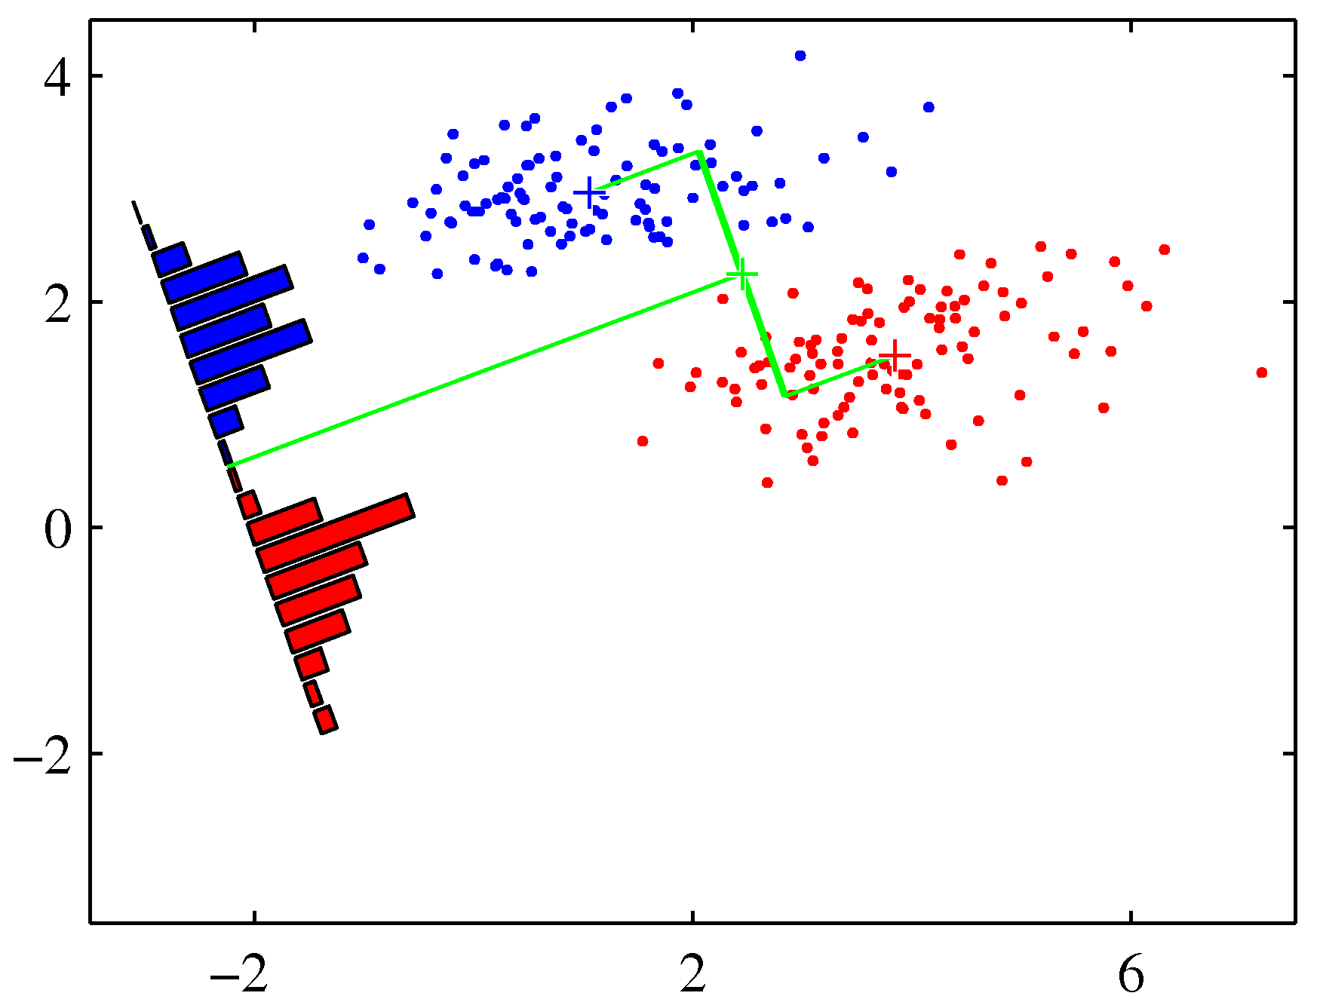
Discriminative methods: e.g. the Fisher linear discriminant
$$y\left(x=\left\{x_{1},…,x_{D}\right\}\right)=w_{0}+ \sum_{i=1}^{D}{w_{i}x_{i}}$$
The method finds a linear boundary
in the D-dimensional space which
best separates signal and background events
The problem corresponds to
finding the best weights W_{i}

Slide 43
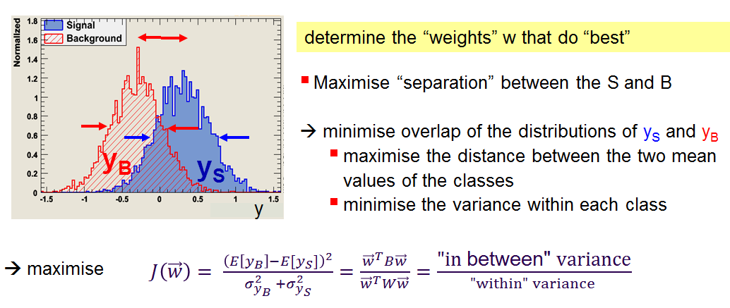
How it works
Of course, this works well if the two classes have features subjected to
linear correlations. If there are subtler dependencies, the method is not powerful
… but there are workarounds: transform the coordinates.

Slide 44
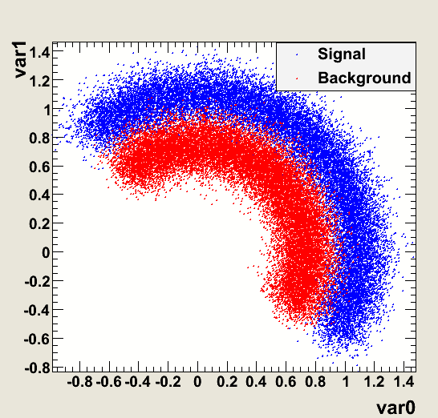
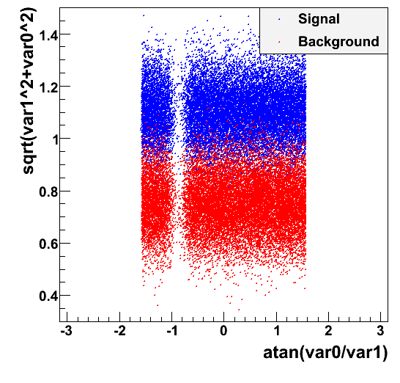
Find and apply useful transformations before computing the discriminant!
Some preprocessing of your data can hugely improve the performance of even
smart classification algorithms – leave alone the dumbest of all.
By transforming the two initial variables into polar coordinates, in the example below the discriminant acquires almost perfect power, which no linear boundary could do before

Slide 45
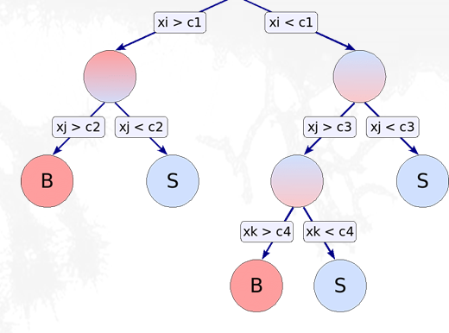
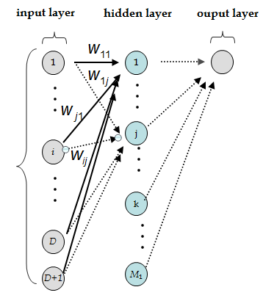
Some common discriminative classifiers
There exist a large number of algorithms for classification that are based on the
construction of a decision boundary, however complex. I will just mention them briefly
Decision tree:
Construct a tree of selection cuts
Easy to interpret, but sensitive to fluctuations
in training data
Boosted Decision Trees:
combine a whole forest of Decision Trees, derived from the same sample, e.g. using different event weights
boosting: reweighting misclassified events can dramatically improve performances
Neural networks:
Multi-layer architectures of non-linear decision boundaries, that act as firing neurons, activating in turn other nodes

Slide 46
Watch out for overtraining
If your classifier is too flexible, or if
you give it a chance to learn too much from the training data, it can produce suboptimal performances
x₂
S
classificaion error
True performance (independent test sample)
B
training sample
training cycles
x₁
x₂
Any of the tunable parameters of a classifier may be affected by overtraining
It is thus necessary to verify the performance of the classifier on an independent test sample
S
B
One usually divides MC in three parts. Use the first part
for training, the second for testing, and the third for the
actual application
x₁

Slide 47
Some common advice on MVA
MVA methods are not AI-powered: there is only some model with fitting decision boundaries, and a lot of technology to stabilize the output and improve performances
The main job is in your hands – find good observables to feed the classifiers. A good
classifier has good separation power between S and B, and has "new information" with respect to already considered variables.
Eliminating correlations can help the classifiers, but correlations are not bad per se.
However, some features (e.g. the curved one shown earlier) are hard to discover by the algorithm – help it!
Apply pre-selection cuts, avoid "sharp features" or integer variables → better create subsets and train independently

Slide 48
Conclusions
Statistics is NOT trivial. Not even in the simplest applications!
A understanding of the different methods to derive results (eg. for upper limits) is crucial to make sense of the often conflicting results one obtains even in simple problems
The key in HEP is to try and derive results with different methods –if they do not agree, we get wary of the results, plus we learn something
Making the right choices for what method to use is an expert-only decision, so…
You should become an expert in Statistics, if you want to be a good particle physicist (or even if you want to make money in the financial market)
The slide of this course are nothing but an appetizer. To really learn the techniques, you must put them to work
Be careful about what statements you make based on your data! You should now know how to avoid:
Probability inversion statements: “The probability that the SM is correct given that I see such a departure is less than x%”
Wrong inference on true parameter values: “The top mass has a probability of 68.3% of being in the 171-174 GeV range”
Apologetic sentences in your papers: “Since we observe no significant departure from the background, we proceed to set upper limits”
Improper uses of the Likelihood: “the upper limit can be obtained as the 95% quantile of the likelihood function”
Bad use of figures of merit: "We chose the cut that maximized S/sqrt(B+S), so it's optimized for discovery"

Slide 49
References
[James 2006] F. James, Statistical Methods in Experimental Physics (IInd ed.), World Scientific (2006)
[Cowan 1998] G. Cowan, Statistical Data Analysis, Clarendon Press (1998)
[Cousins 2009] R. Cousins, HCPSS lectures (2009)
[D’Agostini 1999] G. D’Agostini, Bayesian Reasoning in High-Energy Physics: Principles and Applications, CERN Yellow Report 99/03 (1999)
[Stuart 1999] A. Stuart, K. Ord, S. Arnold, Kendall’s Advanced Theory of Statistics, Vol. 2A, 6th edition (1999)
[Cox 2006] D. Cox, Principles of Statistical Inference, Cambridge UP (2006)
[Roe 1992] B. P. Roe, Probability and Statistics in Experimental Physics, Springer-Verlag (1992)
[Tucker 2009] R. Cousins and J. Tucker, 0905.3831 (2009)
[Cousins 2011] R. Cousins, Arxiv:1109.2023 (2011)
[Cousins 1995] R. Cousins, “Why Isn’t Every Physicist a Bayesian ?”, Am. J. Phys. 63, n.5, pp. 398-410 (1995)
[Gross 2010] E. Gross, “Look Elsewhere Effect”, Banff (2010) (see p.19)
[Vitells 2010] E. Gross and O. Vitells, “Trials factors for the look elsewhere effects in High-Energy Physics”, Eur.Phys.J.C70:525-530 (2010)
[Dorigo 2000] T. Dorigo and M. Schmitt,“On the significance of the dimuon mass bump and the greedy bump bias”, CDF-5239 (2000)
[ATLAS 2011] ATLAS and CMS Collaborations, ATLAS-CONF-2011-157 (2011); CMS PAS HIG-11-023 (2011)
[CMS 2011] ATLAS Collaboration, CMS Collaboration, and LHC Higgs Combination Group, “Procedure for the LHC Higgs boson search combination in summer 2011”, ATL-PHYS-PUB-2011-818, CMS NOTE-2011/005 (2011).
Also cited (but not on statistics):
[McCusker 1969] C.McCusker, I.Cairns, PRL 23, 658 (1969)
[MINOS 2011] P. Adamson et al., Arxiv:1201.2631 (2011)

