Slide 1


PandaX-III 原型探测器进展
上海交通大学
林横
2016.11.11
上海交通大学PandaX-III 探测器项目组：Karl.L.Giboni 韩柯 Hiroki Kusano 林横 任祥祥 王少博 赵立
PandaX-III collaborating institutions：Shanghai Jiao Tong University, China Central Normal University, CEA Saclay (France), Lawrence Berkeley National Laboratory(USA), China Institute of Atomic Energy, Moscow Engineering Physics Institute(Russia), Peking University, Shandong University, Sun Yat-Sen University, Universidad de Zaragoza(Spain), University of Science and Technology of China
2016.11.11 Beijing Heng Lin (SJTU) 第六届全国微结构气体探测器会议

Slide 2
Outline
Overview
Prototype
· Field cage
· Micromegas on the readout plane
· high voltage feedtrough
· gas system
Data and result
Future plan
2016.11.11 Beijing Heng Lin (SJTU) 2

Slide 3
Overview
Neutrinoless double-beta decay (0νββ) is an extremely rare decay process of half-life on the order of 10²⁴ years.
·If if neutrinos are their own anti-particle, i.e., Majorana particles?
· Lepton number conservation?
In experiments, we measure the energies of two emitting electrons from 0νββ.
2016.11.11 Beijing Heng Lin (SJTU) 3

Slide 4
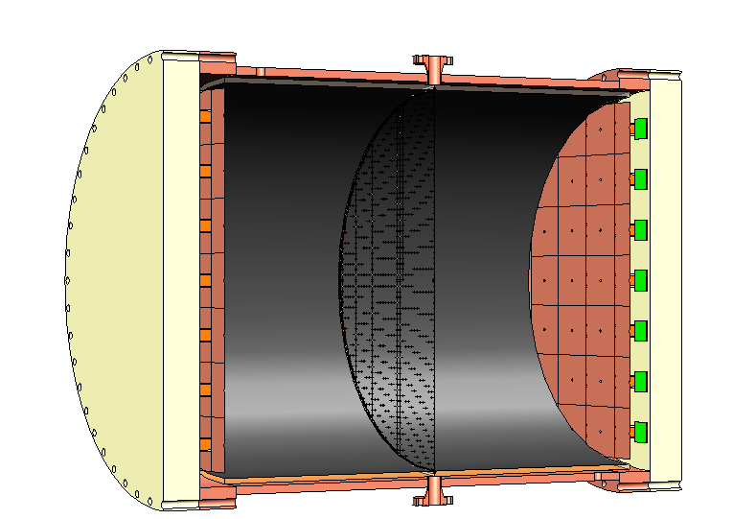
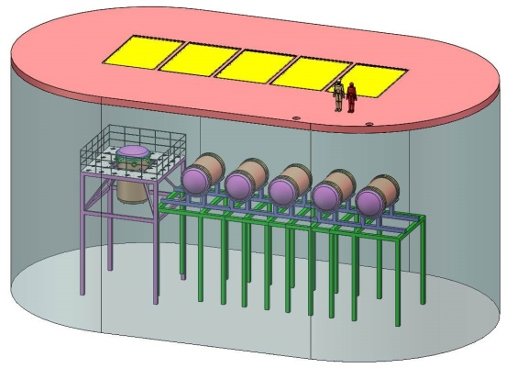
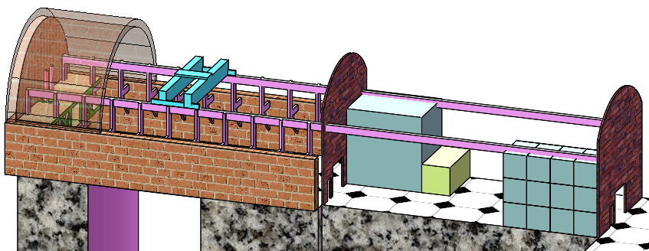
Overview-PandaX-III
The PandaX-III project searches for the possible 0νββ of ¹³⁶Xe: ¹³⁶Xe→¹³⁶Ba+2e⁻ with 200 kg to one ton of 90% enriched ¹³⁶Xe as the source
High pressure and high voltage time projection chamber
Water shielding
In China Jin Ping underground Laboratory (CJPL-II)
2016.11.11 Beijing Heng Lin (SJTU) 4

Slide 5
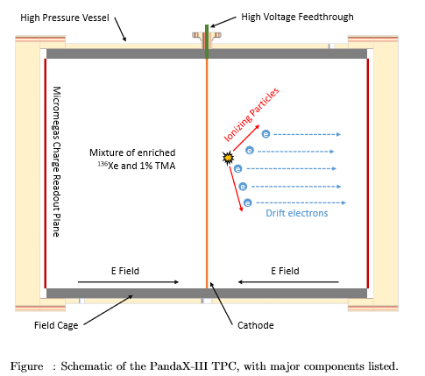
TPC
A Time Projection Chamber (TPC)
2016.11.11 Beijing Heng Lin (SJTU) 5

Slide 6
electronics
Prototype
Readout plane
Testing gas system
Testing High pressure
Testing High Voltage
Testing readout
Gas system
TPC
HV feedthrough
vessel
2016.11.11 Beijing Heng Lin (SJTU) 6

Slide 7
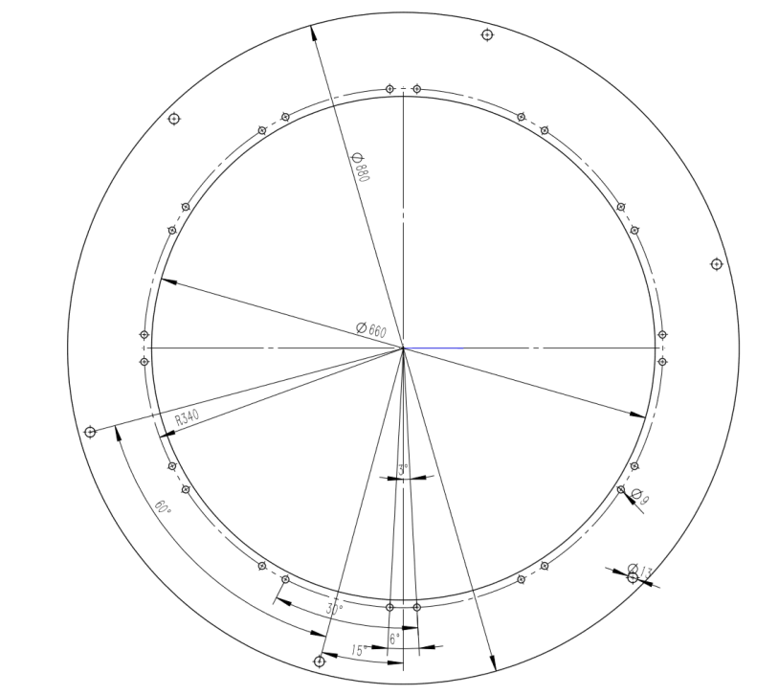
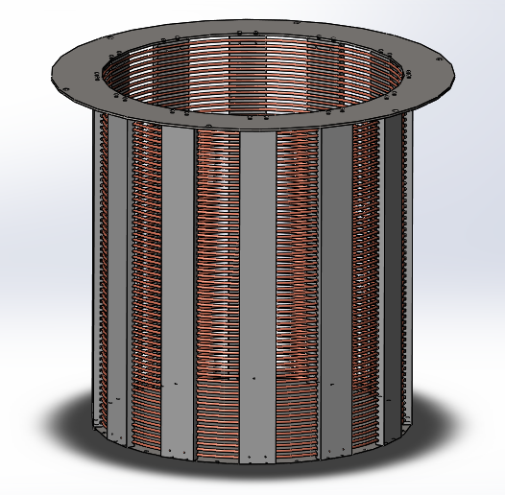
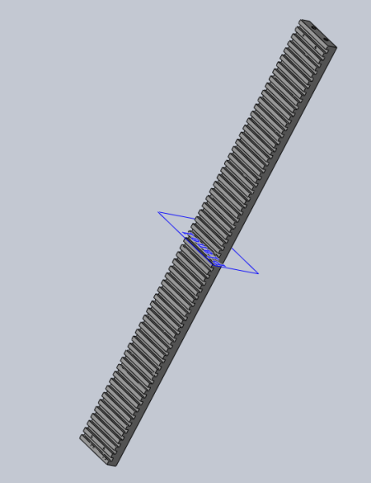
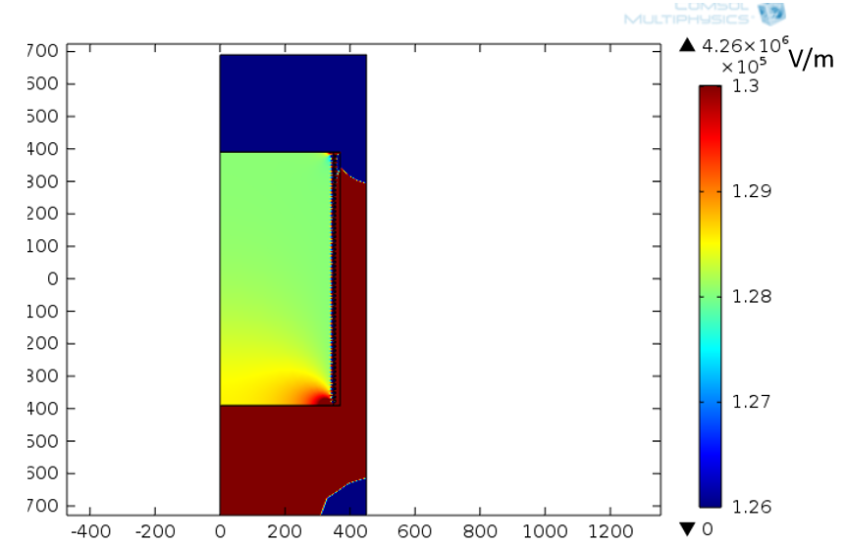
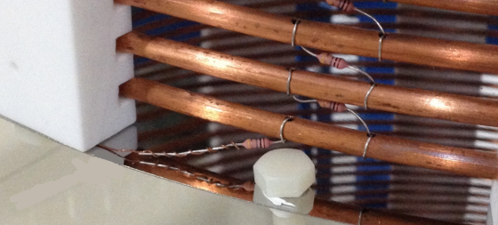
Prototype-field cage
59 copper rings and 2 resistor (1G ohm)chains to shape the field
Stainless steel Mounting ring
ID:660mm
12 Tyflon sporting bars
Height:780mm;
Resistors fixed between shaping rings
2016.11.11 Beijing Heng Lin (SJTU) 7

Slide 8
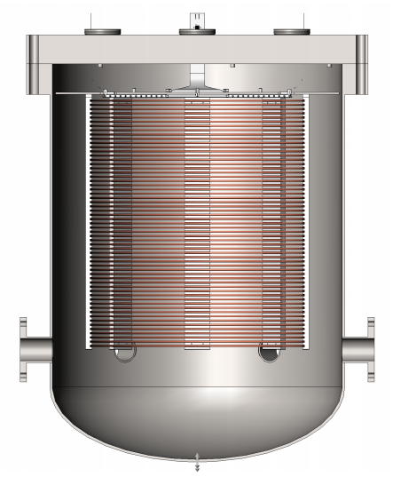
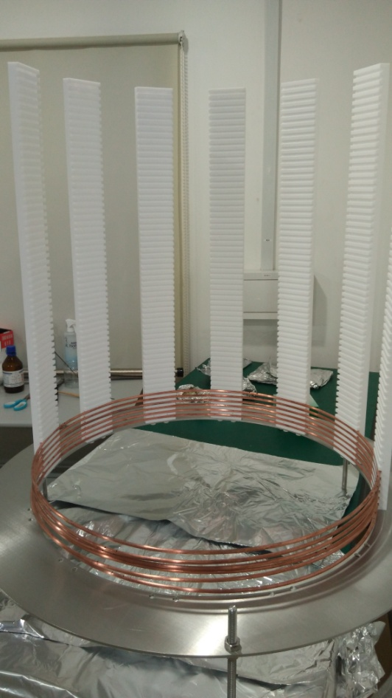
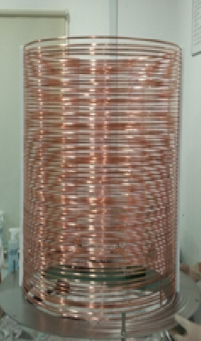
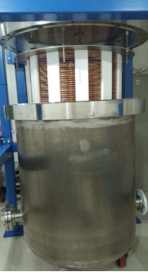
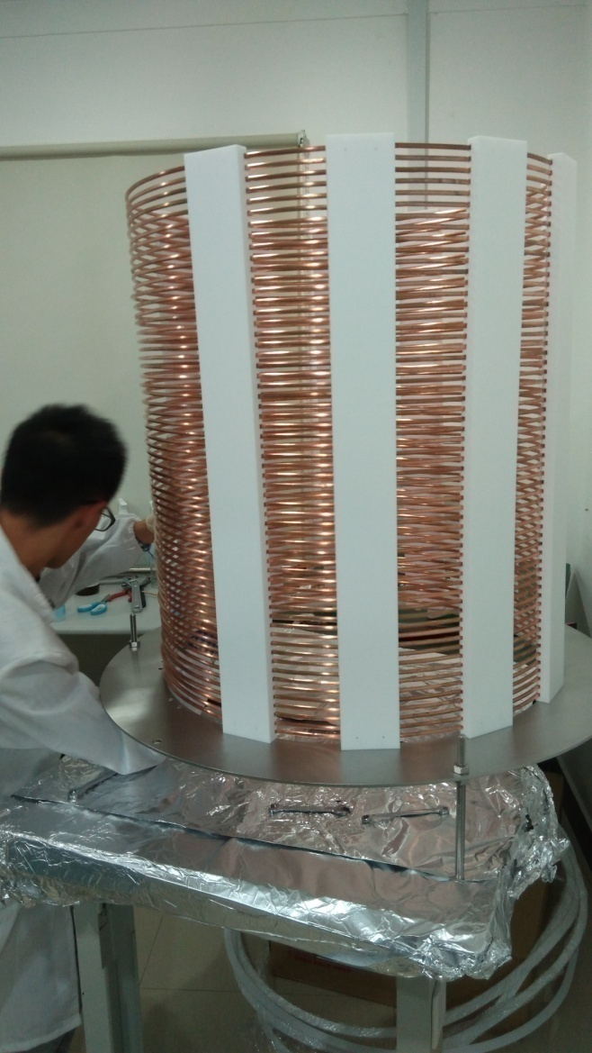
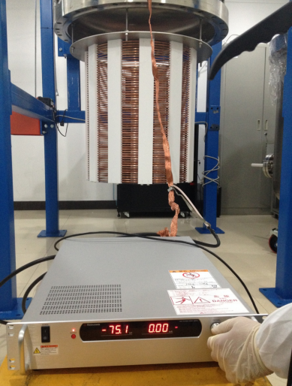
Prototype-field cage
Remove half of supporting bars
Shape rings + resistor
Rest Supporting bars
Current Test
2016.11.11 Beijing Heng Lin (SJTU) 8

Slide 9
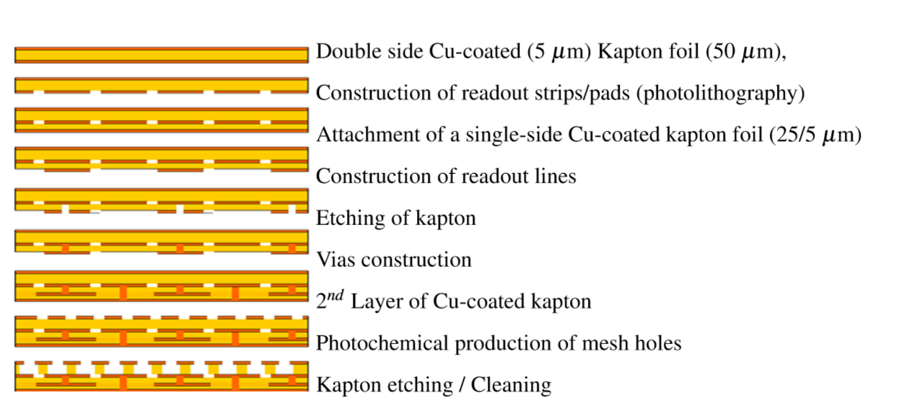
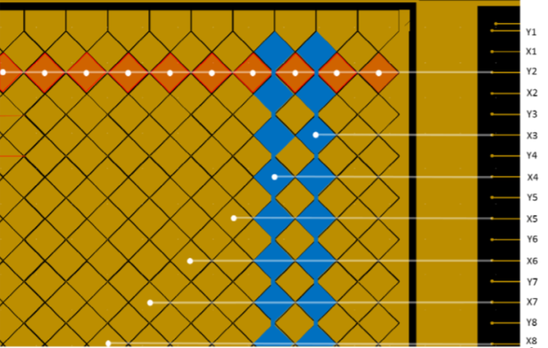
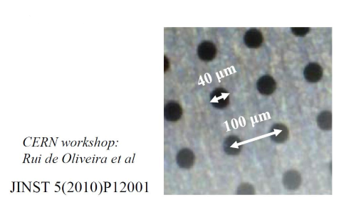
Prototype-Micromegas
Micro Mesh Gas Amplifier
Micromegas：
gas amplification through very thin layers 50µm
Mesh shaped to get the X-Y information of signal
Made of copper and capton
Amplification ~1000
2016.11.11 Beijing Heng Lin (SJTU) 9

Slide 10
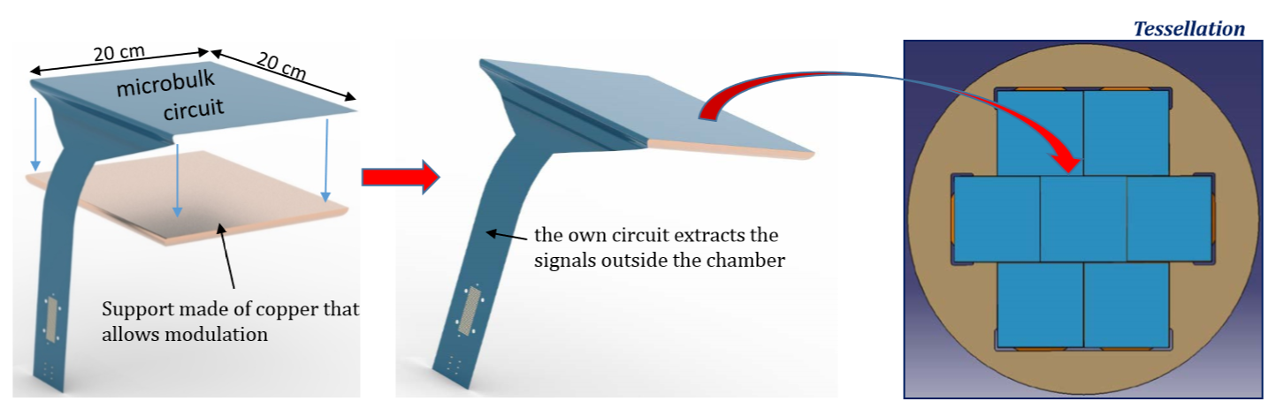
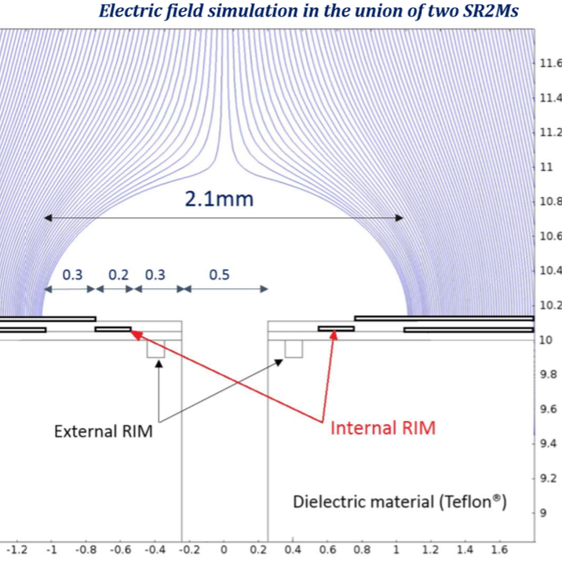
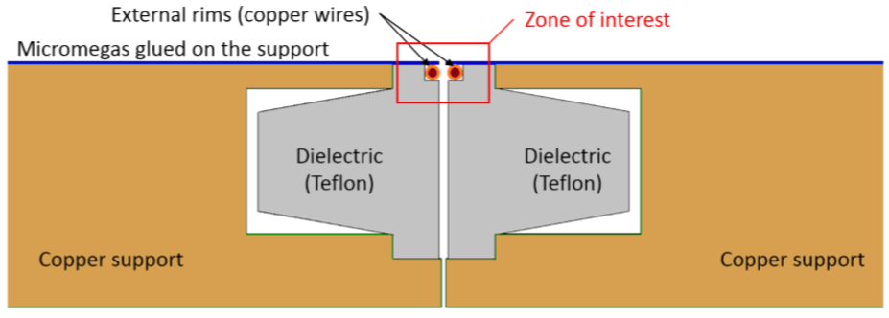
Scalable Radio-pure Readout Module (SR2M)
Prototype-Micromegas
SR2M
Dead-zone-less arrangement
2016.11.11 Beijing Heng Lin (SJTU) 10

Slide 11
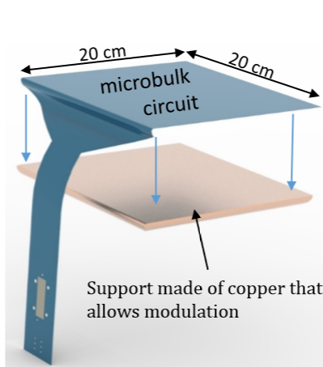
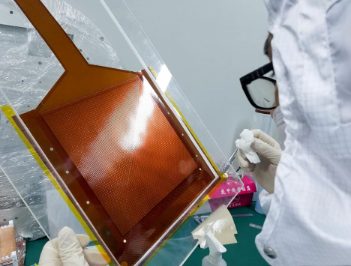
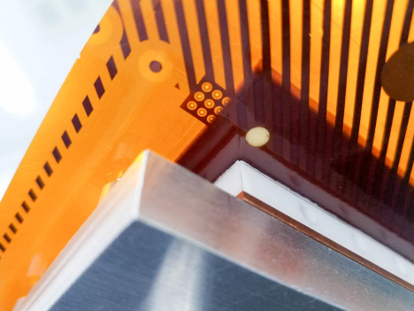
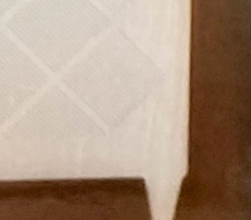
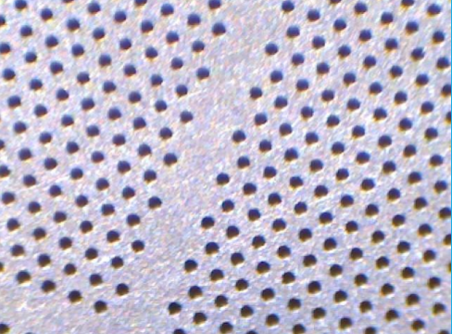
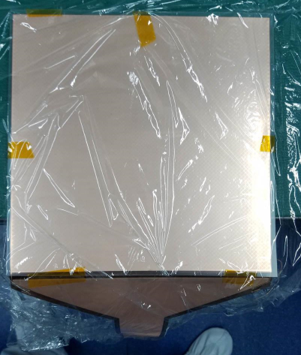
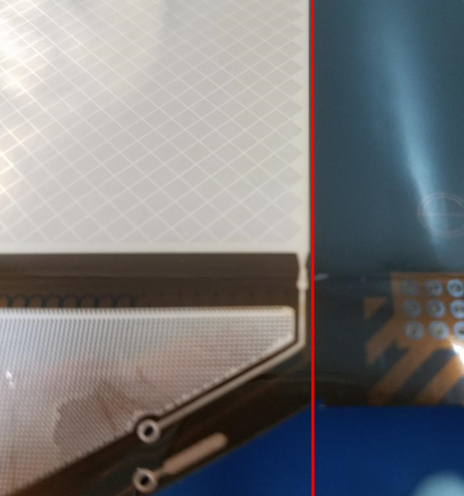
Micromegas gluing
Prototype-Micromegas
Glue on a plastic board
positioning
cut
2016.11.11 Beijing Heng Lin (SJTU) 11

Slide 12
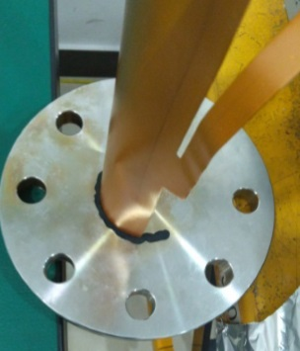
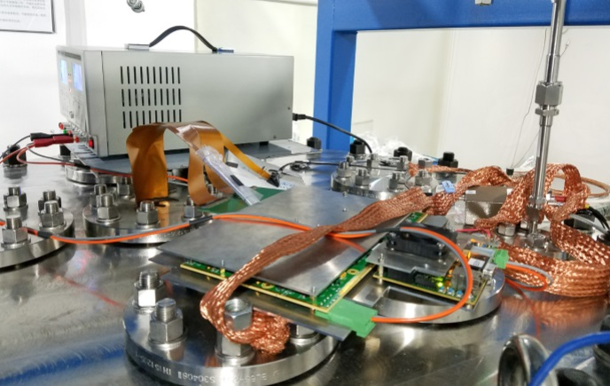
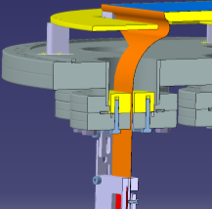
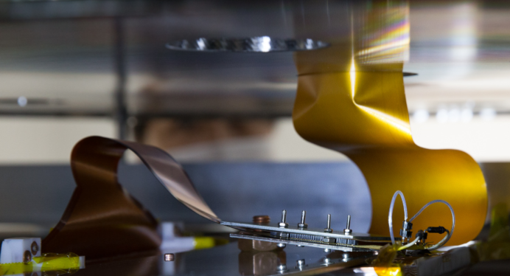
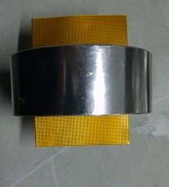
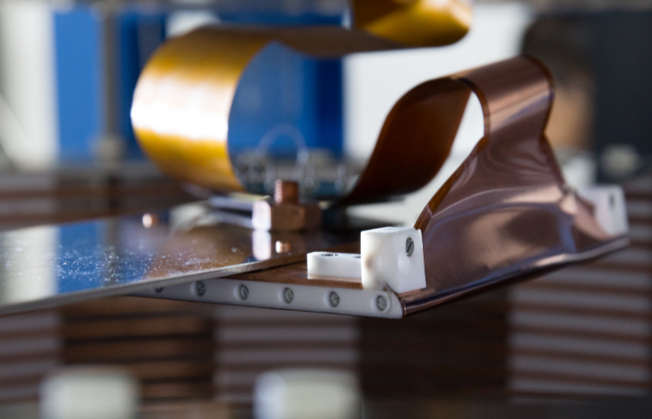
Prototype-Micromegas
MM on the detector
Sealed with epoxy
Connect to electronics
Leak rate~3*10e-6 mbar*l/s:
0.6g of Xenon lost every year per feedthrough
2016.11.11 Beijing Heng Lin (SJTU) 12

Slide 13
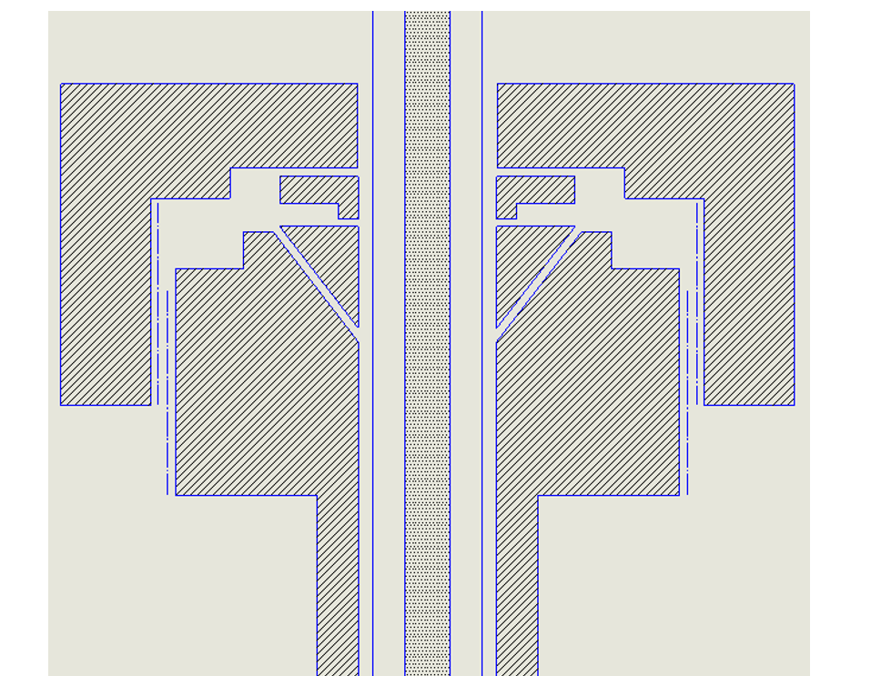
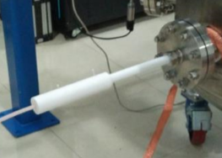
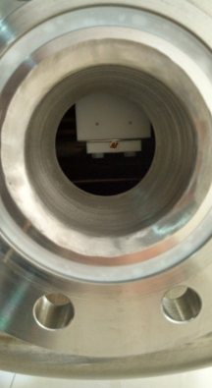
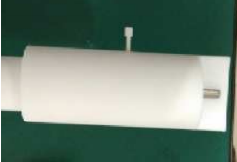
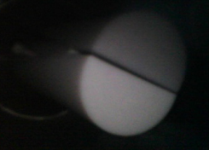
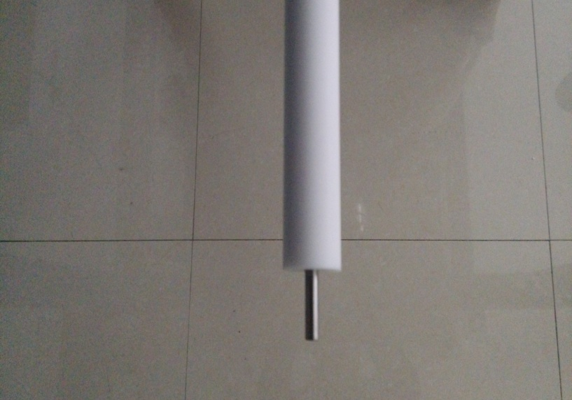
1.Steel rod soldered with tyflon
2.Steel rod plug into a tyflon
Prototype-High voltage feedthrough
Rod outside
feedtrough
Connector inside
Vacuum Pressure held at 1.2 *10^-5barG)
High Voltage test: N2 (10~12BarG) gas:
a) HV: -46KV, creepage: 0.01mA;
b) HV: -100KV, creepage: 0.2mA;
2016.11.11 Beijing Heng Lin (SJTU) 13
Notes:
t

Slide 14
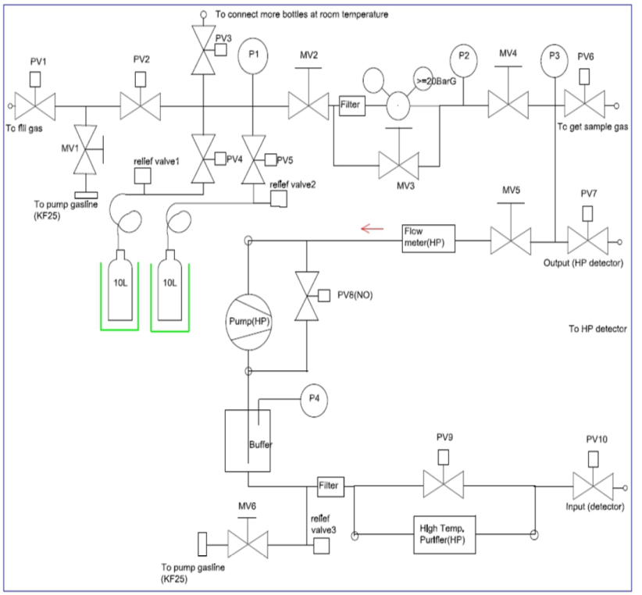
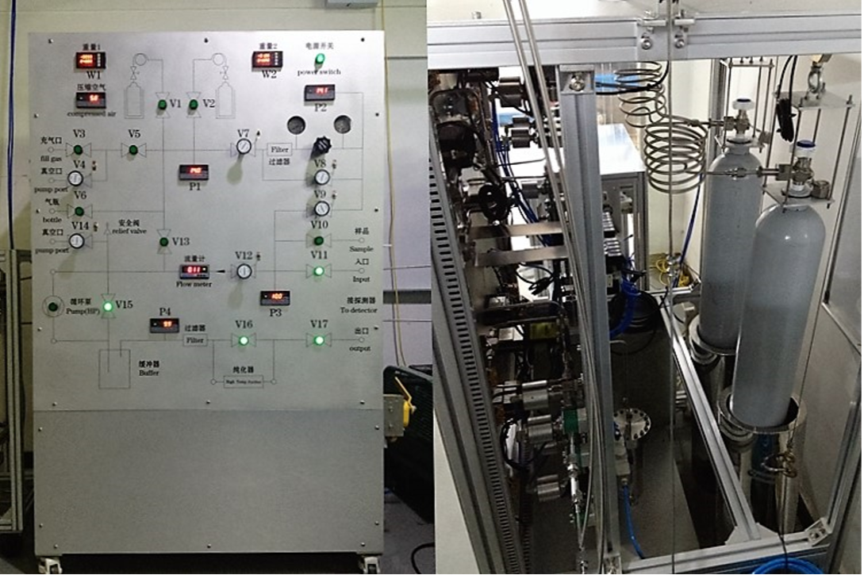
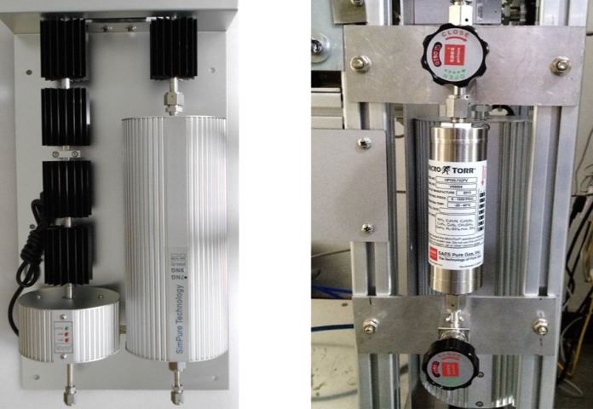
Prototype-gas system
Used for:
· Circlation and purification
· Recuperation and filling
· Mixing different typies of gas
2016.11.11 Beijing Heng Lin (SJTU) 14

Slide 15
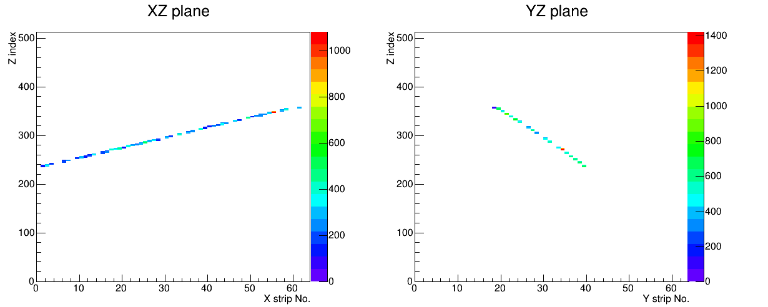
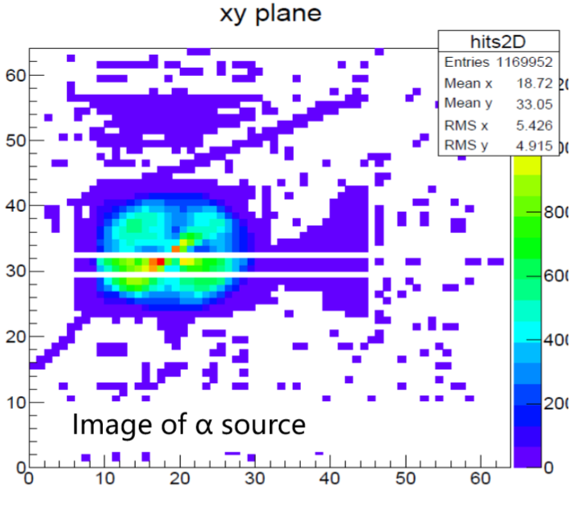
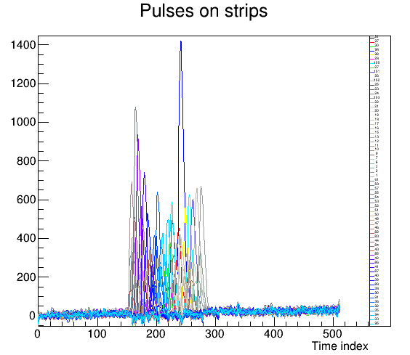
Data and result
The detector was test in Argon+CO2,Argon+isobutane under different pressure ,with an Am241 source inside
Muon across the detector(70%Ar+30%CO2)
Hit map of α source
Strip signals
2016.11.11 Beijing Heng Lin (SJTU) 15

Slide 16
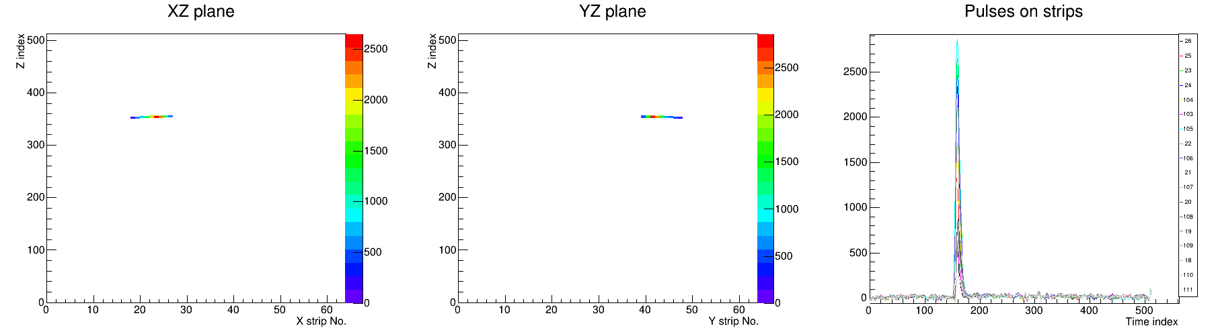
Gamma track
Data and result
2016.11.11 Beijing Heng Lin (SJTU) 16

Slide 17
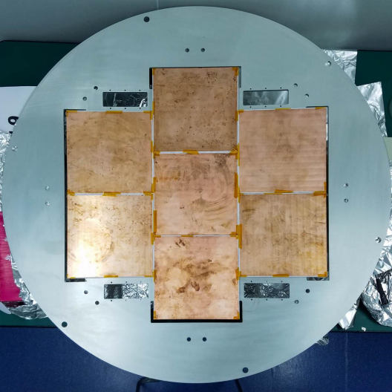
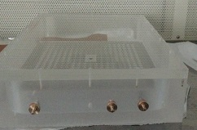
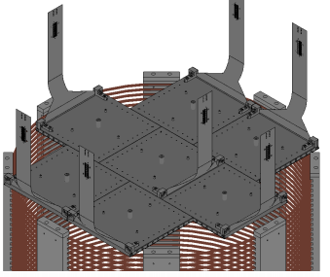

Future plan
testing and assembling 7 micromegas
Micromegas test box
Solve problem of leakage and high voltage
R&D on the new TPC design
2016.11.11 Beijing Heng Lin (SJTU) 17

Slide 18
Thanks!
2016.11.11 Beijing Heng Lin (SJTU)

