Slide 1
RHIC/STAR iTPC 升级样机的制作与初步测试
沈付旺
UCAS, Beijing
November 12, 2016

Slide 2
Outline
Upgrade motivation of STAR-iTPC
Upgrade contents of STAR-iTPC
iTPC MWPC prototyping
iTPC MWPC test with ⁵⁵Fe X-ray
Summary

Slide 3
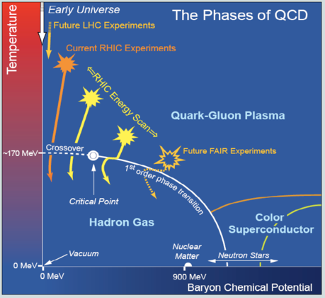
RHIC STAR beam energy scan (RHIC-BES)
STAR key objective
Mapping the features of QCD matter phase diagram.
Physical mechanism
Heavy ion collisions allow to explore the QCD phase structure by varying the collision energy.
RHIC-BES program (I->II)
Goals
Turn-off of QGP signatures
Search critical point
First order phase transition
Schedule
BES-I completed 2010~2014
Have some good but conclusive results.
BES-II in 2019~2020
Need detailed study of the key region.
Need detector upgrade: The improvement of iTPC capability is essential.

Slide 4
STAR detector upgrade

Slide 5
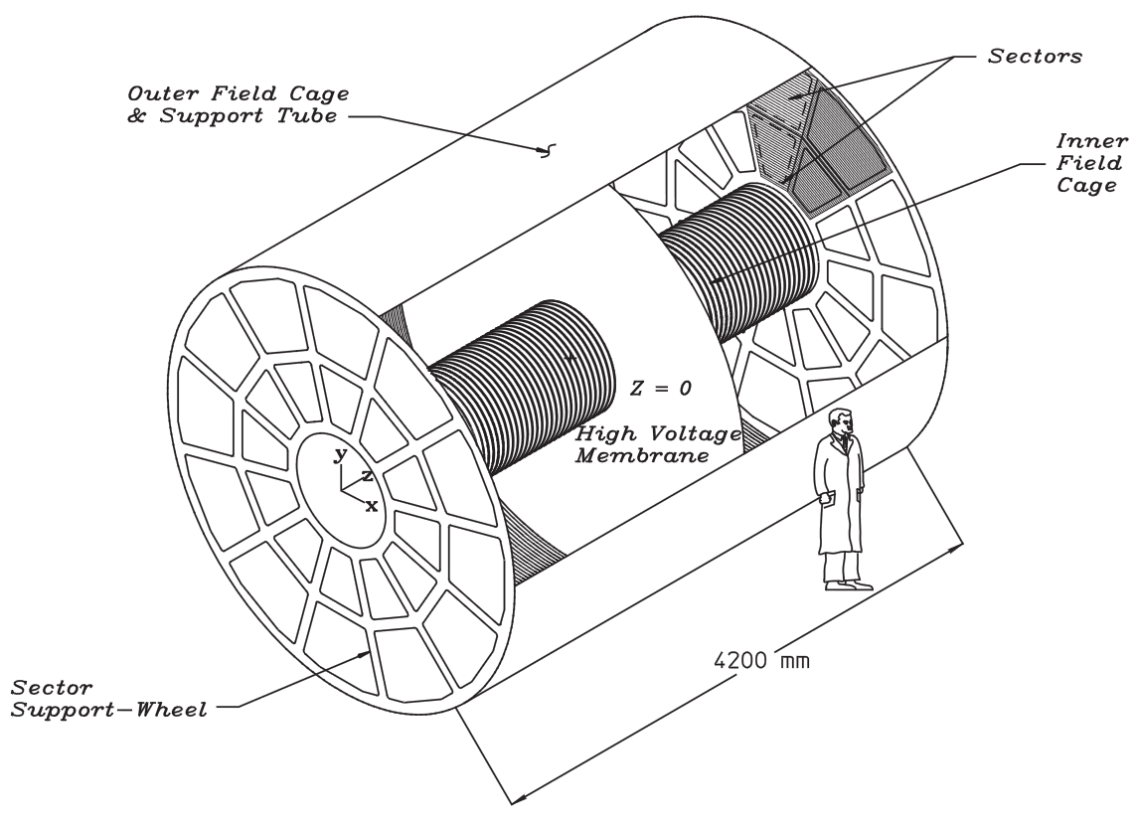
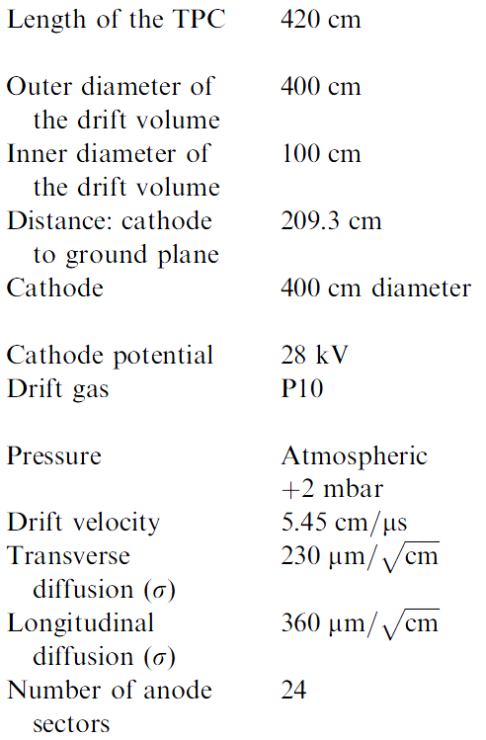
STAR TPC geometry
Outer Sector
Inner Sector

Slide 6
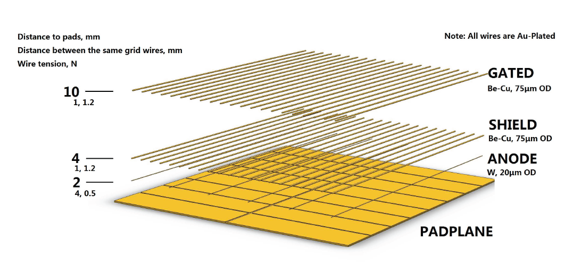
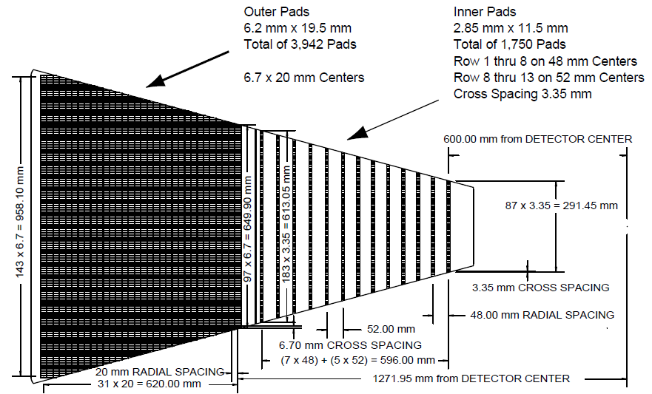
iTPC MWPC upgrade
Produce and replace all 24 inner sectors
Increase readout channels
Renew all three wire grids
New electronics for inner sectors
Pad coverage 20%->100%
Gain uniformity >90%
Detection efficiency >92%
Gas gain VS anode voltage :
2000 @1120V

Slide 7
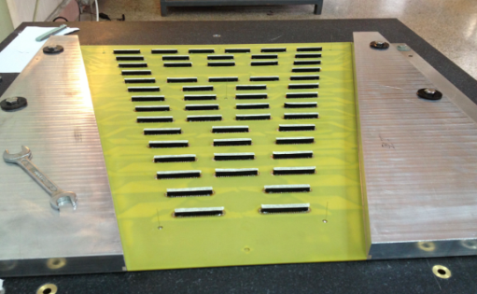
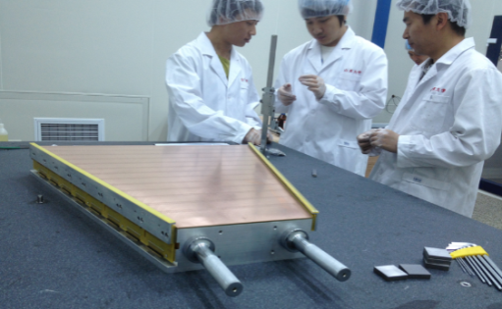
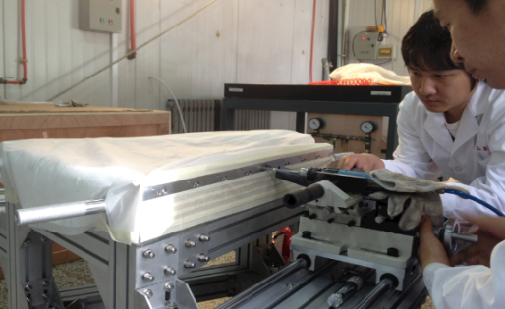
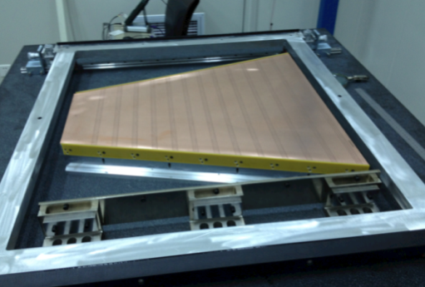
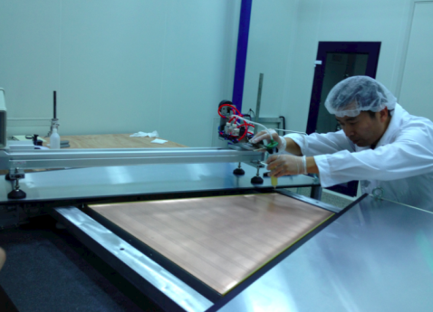
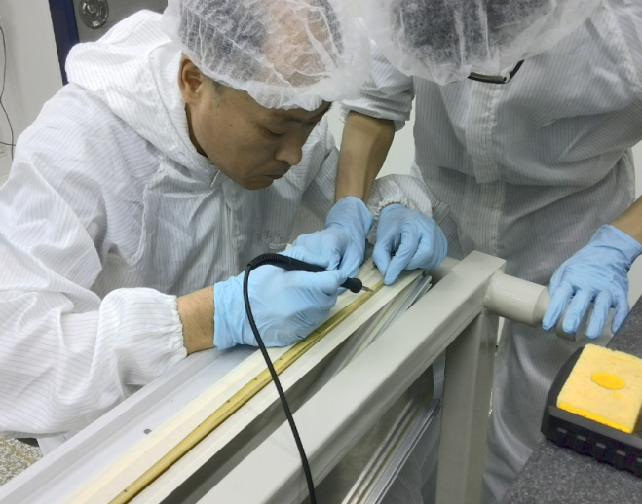
Construction of iTPC MWPC prototype
PCB bonding
Wire mounts installing
Pining wire mounts
Mounting wires
Epoxying wires
Soldering wires

Slide 8
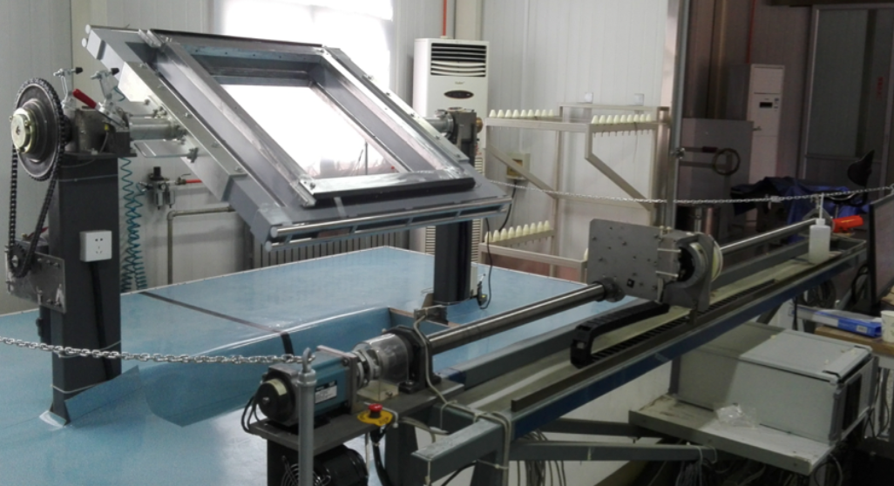
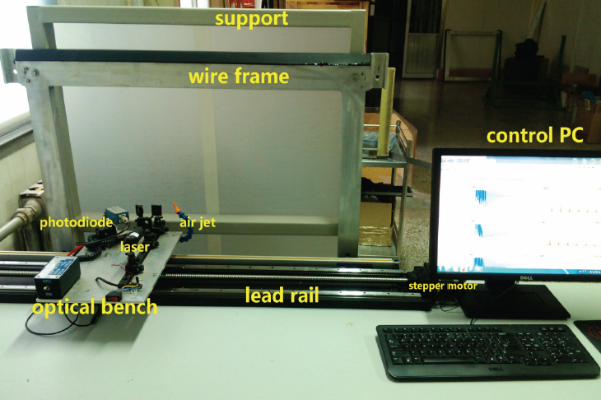
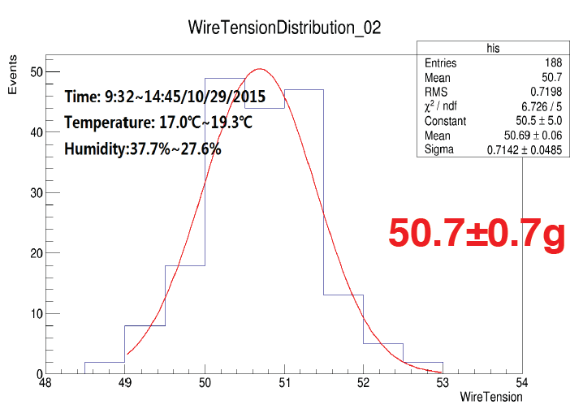
Wire winding and tension measurement
Wire winding system
Control wire tension and pitch
Wire tension measurement system
Measure each wire tension
Required to be
51$±3g$

Slide 9
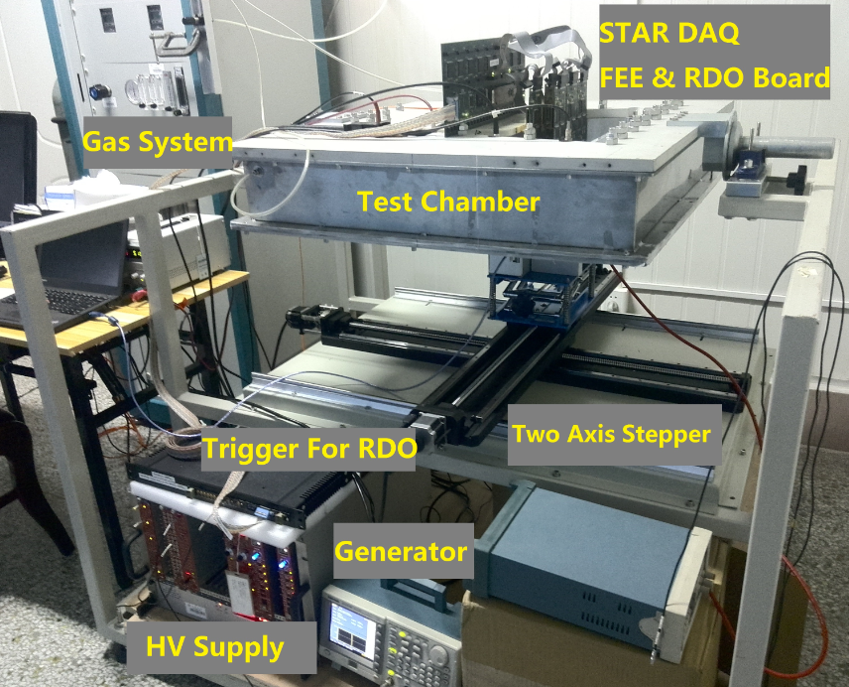
Test system setup with ⁵⁵Fe X-ray
⁵⁵Fe Φ 5mm
Anode Wires
5.9 KeV X-ray
Inner Sector Pad
DAQ setup
6 FEEs so far
Trigger: 2kHz
Anode voltage:
1070-1320V
⁵⁵Fe source
Activity ~1mCi
Φ 5mm

Slide 10
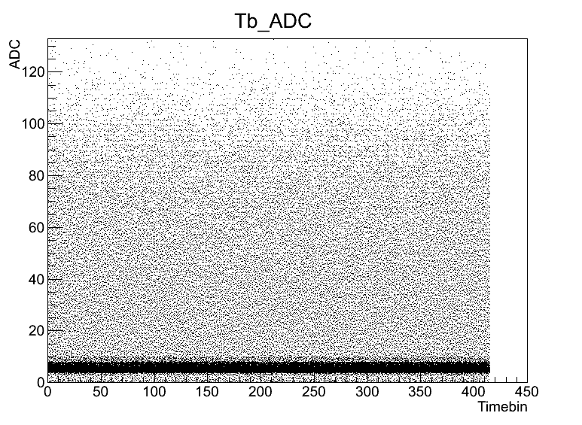
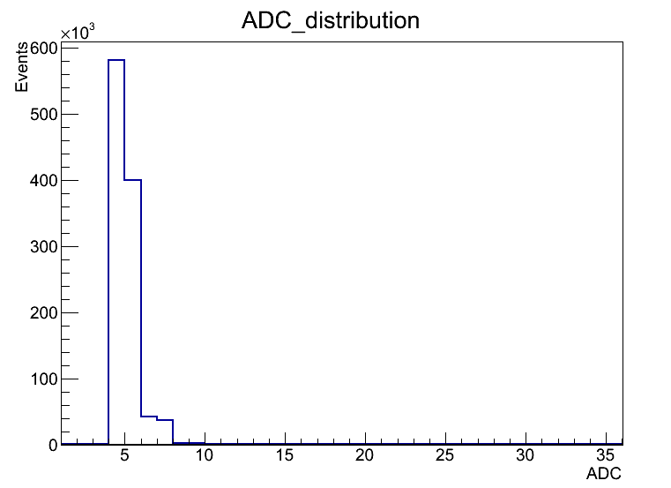
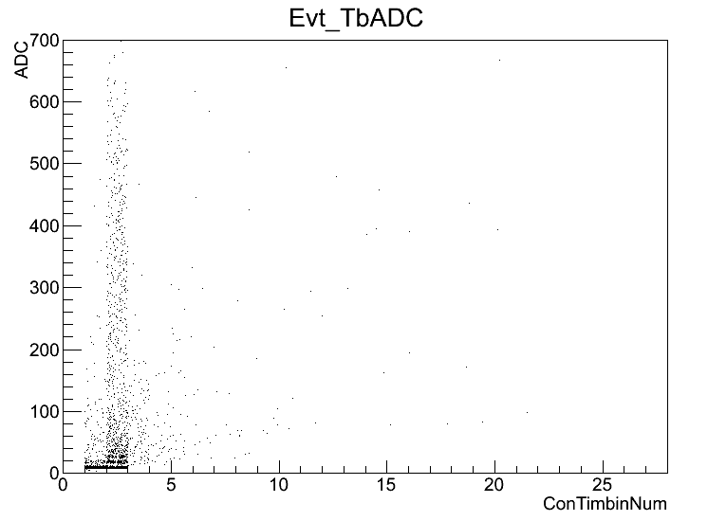
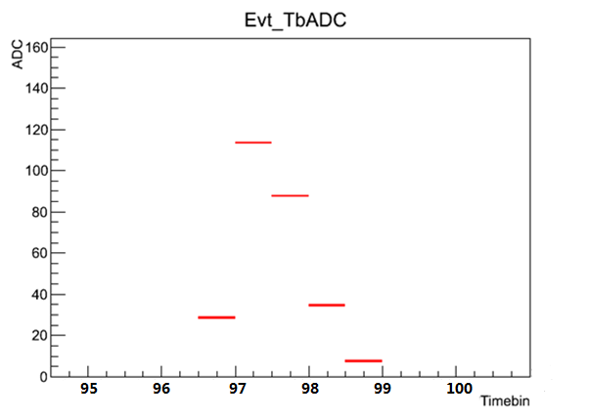
Pad Signal selection
Single pad & Single Time Bin
ADC Counts Distribution
Time bin VS ADC
1070V Data
With X-ray
1070V Data
Without X-ray
Anode Wire Voltage - 1070 V
Without X-ray
2 Time Bins
The STAR DAQ algorithm
Read out versus time bin (100ns each, 400 in total)
2 time bins ADC in a row >3 counts
Pad signal selection
A noise band with ADC <5 -> cut 1: ADC>5
The noise continued time bins <3 -> cut2: ConTb> 2
⁵⁵Fe X-ray signal pulse
signal ADC obtained from pulse integral ADC .
Sum over the pads
1070 V
A Typical Pulse

Slide 11
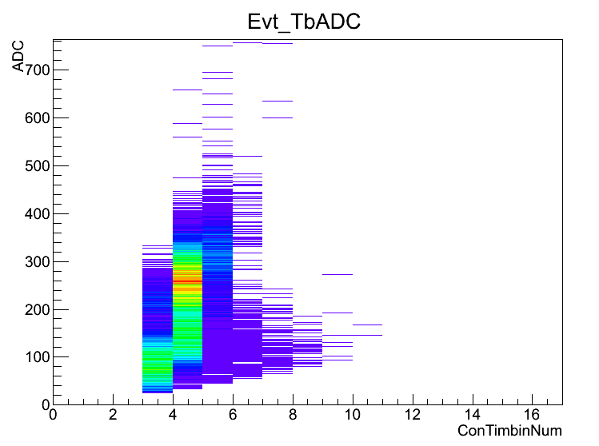
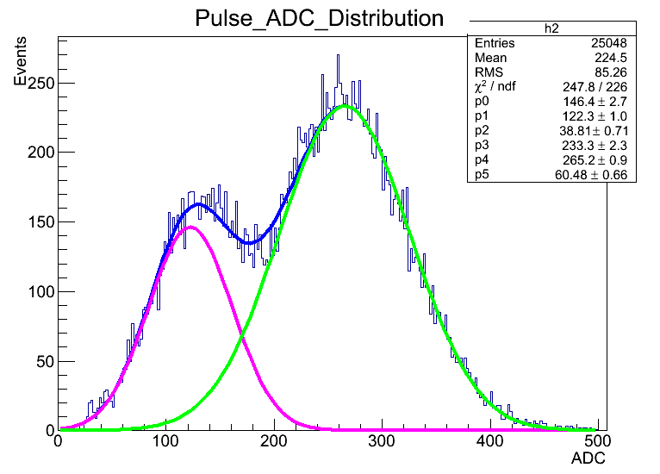
Signal ADC distribution
1070 V
5.9KeV Peak
Escape Peak
1070 V
Pulse continued time bins VS pulse integral ADC
Two bright regions which indicate high statistics.
⁵⁵Fe X-ray spectrum in P10 gas
There are two clear peaks after 2 cuts.

Slide 12
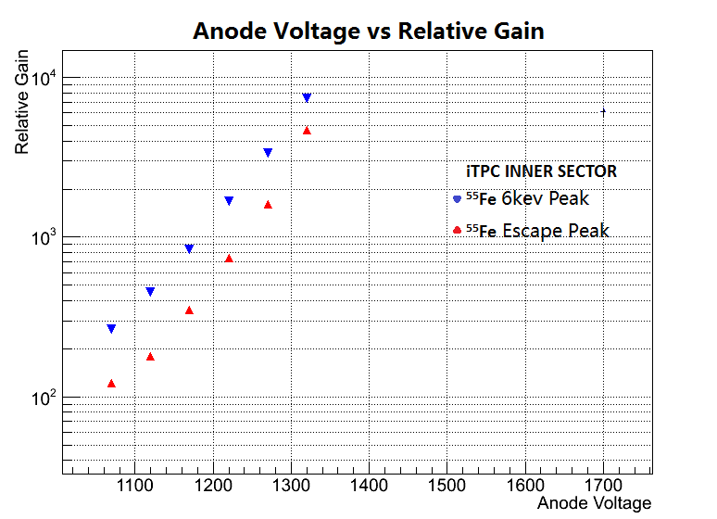
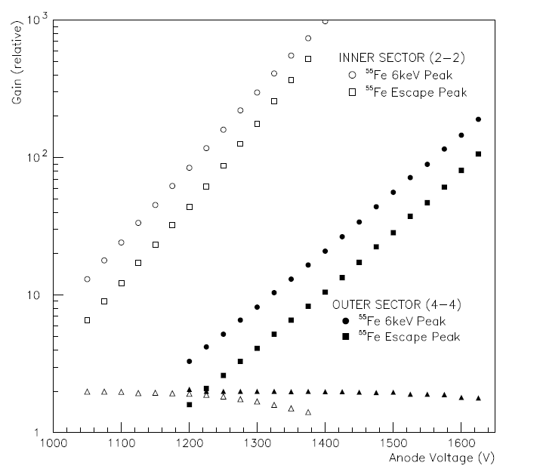
Anode HV versus relative gain
STAR note 263
ADC of main and escape peaks
The ADC of peaks increase exponentially with increasing anode voltage
STAR note 263
Same shape for relative gain versus anode HV in previous STAR measurements

Slide 13
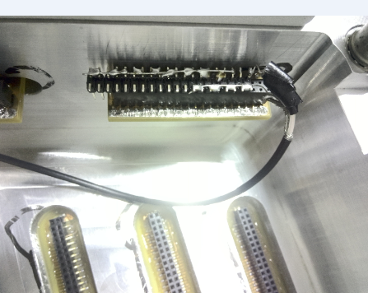
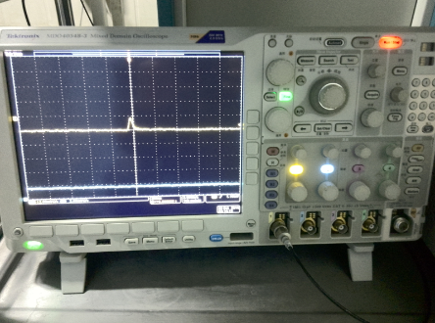
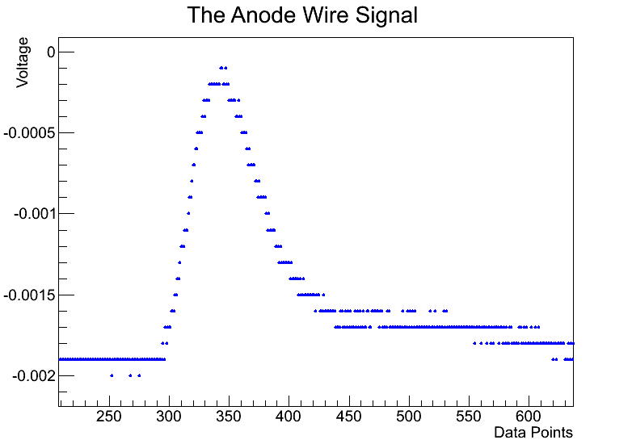
Anode wire readout with ⁵⁵Fe X-ray
Data readout
Plug the stitch into feed through board, then connected to oscilloscope. Read out with Labview.
(QDC in purchase, to be used next step)
Charge integration
Record data above the pedestal and continued at least 40 ns.
Can not see the signal below 1290V without preamplifier.
One anode wire
Feed through board
Oscilloscope(50Ω)
PC
Start Point
Pedestal

Slide 14
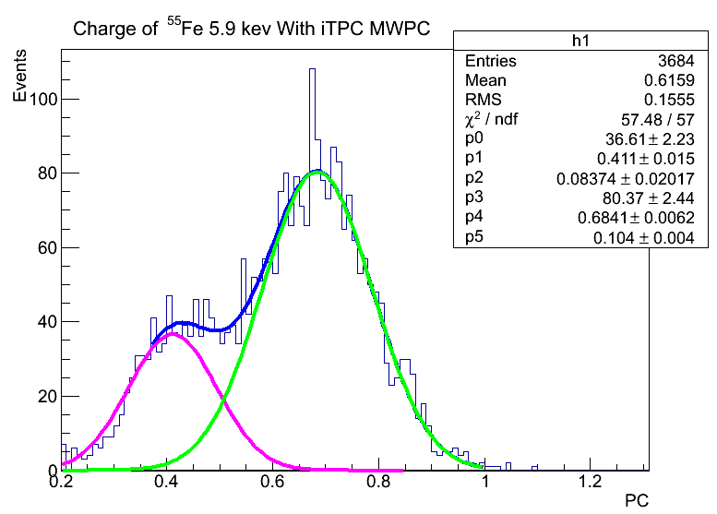
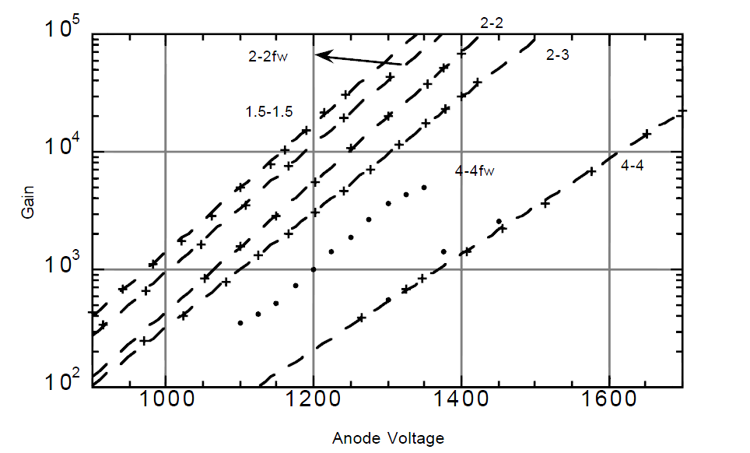
Charge distribution from one anode wire
⁵⁵Fe
Anode Wires
5.9 KeV X-ray
Inner Sector Pad
1295 V
⁵⁵Fe 5.9 KeV charge
Charge : 0.68PC (1295V)
Gain = 0.68 * 6.24 * 10⁶/225 = 18977
The ratio of main peak charge to escape peak charge is 1.66
Energy resolution 35%
STAR note 263 voltage versus gas gain
Gain = e^{b*(V-V0)} = 18360
0.411PC
0.684PC
STAR note 263

Slide 15
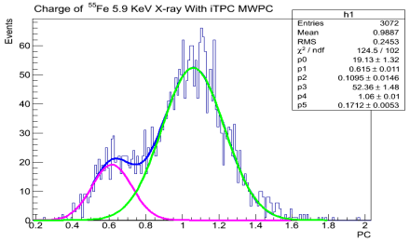
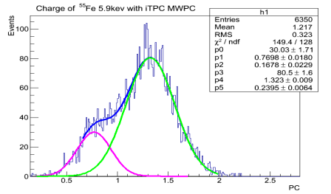
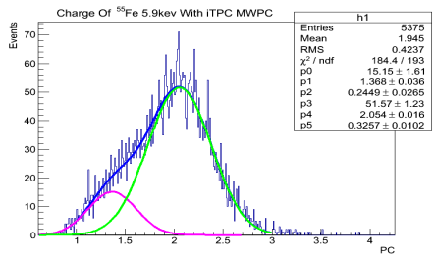
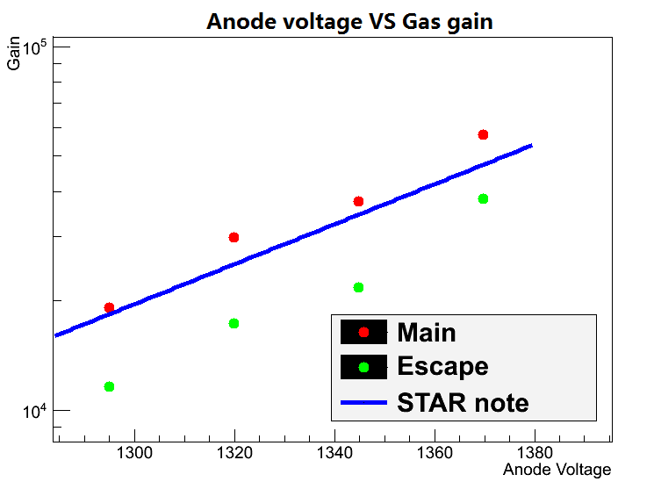
Charge distribution at other voltages
1320V
1345V
1370V
Gain and ratio of main/escape peak are in reasonable agreement with note 263

Slide 16
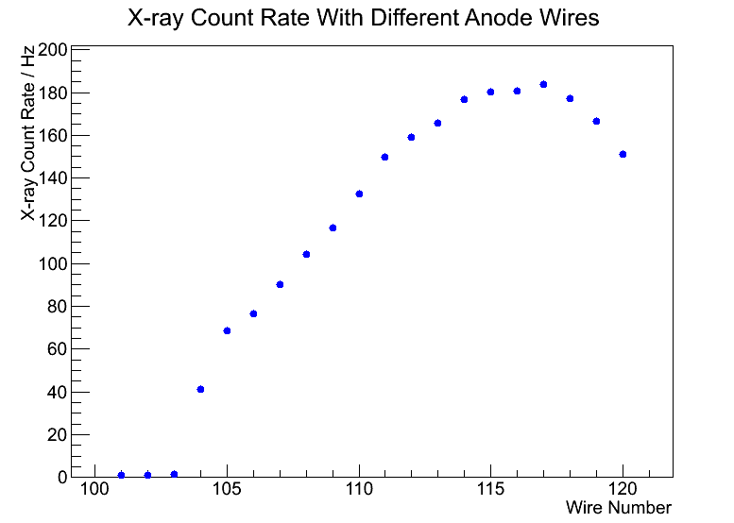
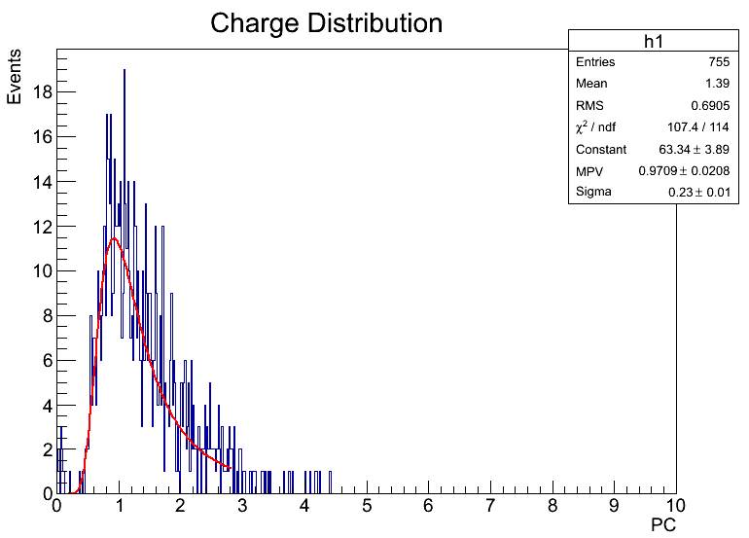
⁵⁵Fe X-ray and cosmic ray count rate
Signal
Discriminator
Counter
X-Ray count rate
~200hz
Cosmic Ray Charge
23℃
1320V
755 Events
90 min
Cosmic ray count rate: 0.14Hz
X-ray rate: ~200Hz
Background/Signal ~ 0.07%

Slide 17
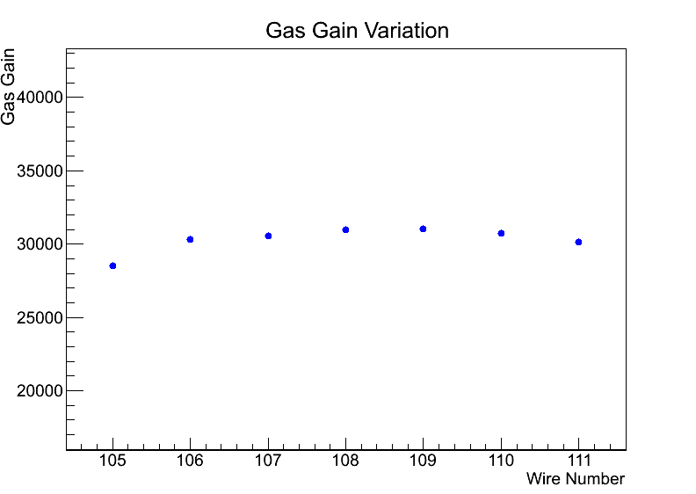
Gain measurements with different wires
Wire Num | Anode Vol | Temperature | Main Peak(PC) | Escape Peak(PC) | Ratio(M/E) | Gas Gain | Energy Resolution
105 | 1320 V | 20.7 ℃ | 1.028 | 0.6065 | 1.69 | 28516 | 35.5%
106 |  | 21.2 ℃ | 1.092 | 0.6387 | 1.71 | 30292 | 33.9%
107 |  | 21.6 ℃ | 1.101 | 0.6448 | 1.71 | 30541 | 34.4%
108 |  | 21.7 ℃ | 1.116 | 0.6505 | 1.72 | 30957 | 35.3%
109 |  | 21.8 ℃ | 1.118 | 0.6571 | 1.70 | 31013 | 34.1%
110 |  | 21.4 ℃ | 1.109 | 0.6632 | 1.67 | 30763 | 37.9%
111 |  | 20.5 ℃ | 1.086 | 0.6124 | 1.77 | 30125 | 38.8%
The difference between maximum and minimum is ~ 8.7%
The effects of temperature needs further investigation. 2~3% effects from previous STAR measurements.
Gas Gain Variation

Slide 18
Summary
The 1st pre-prototype was made.
First test results from pad and anode wire test with ⁵⁵Fe source
The test results are in reasonable agreement with STAR note
Mass production will be ready by March 2017.
Planed detailed testing for mass production next step:
For mass production with ⁵⁵Fe source:
(1) check the gain of all the anode wires, with QDC readout
(2) 3 point gain test over pads on each anode wire
General test:
(3) HV burn-in with 10% above operating voltage
(4) breakdown check with hot X-ray source
Thanks !

