Slide 1
AWS Integration in Distributed Computing
Xianghu Zhao
IHEP Computing Center
2016 BESIIICGEM Cloud Computing Summer School

Slide 2
Content
Why use AWS in HEP experiments
How to use AWS
AWS integration in distributed computing

Slide 3
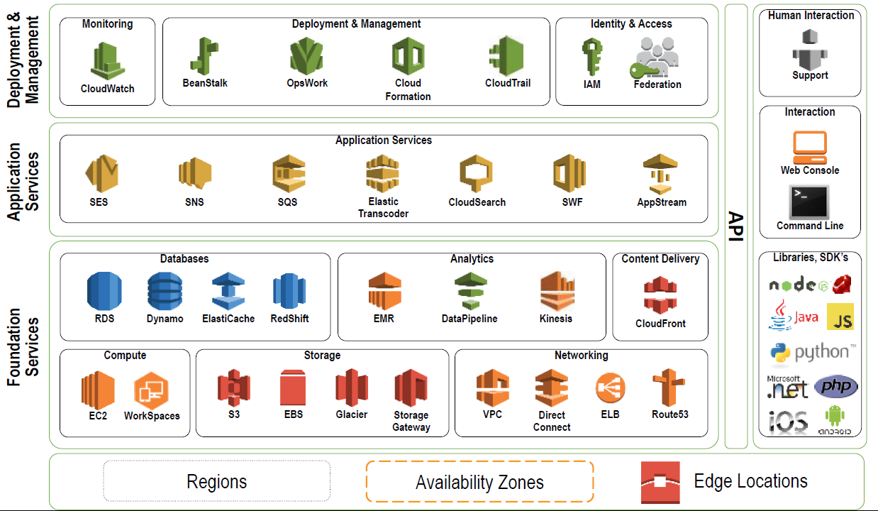
Amazon Web Services (AWS)

Slide 4
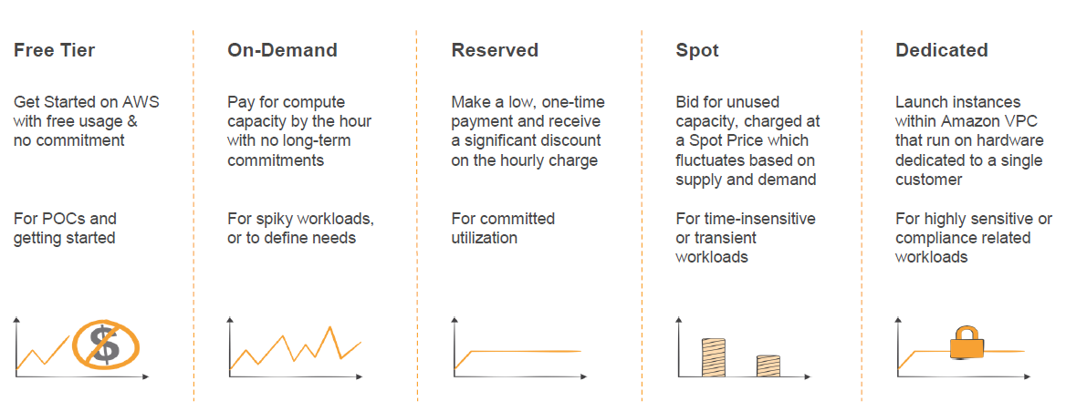
Pricing Models

Slide 5
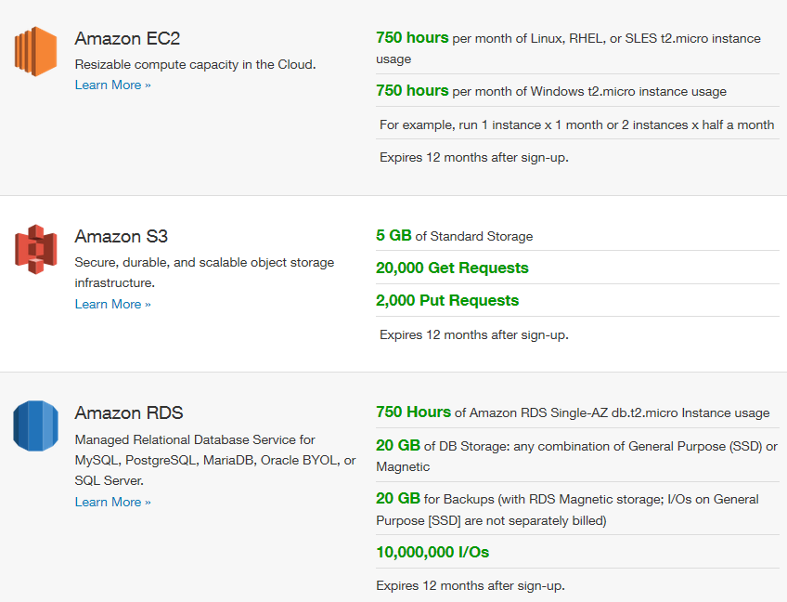
Free Tier for 12 Months
New registers could test AWS for free in 12 months

Slide 6
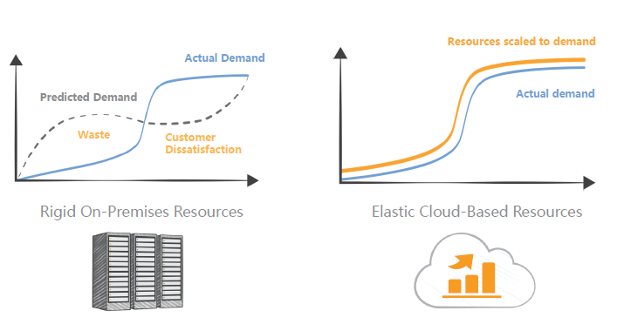
Flexible Resource Usage

Slide 7
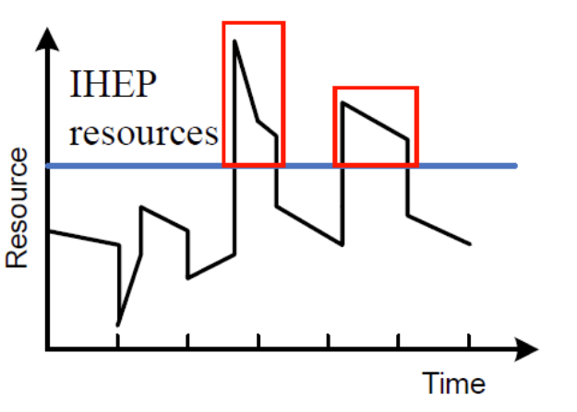
Situation for HEP Experiments
Computing requirements fluctuate a lot
Increase before some meeting
Get the analysis results faster than competitors
Deploy of local resources need time and manpower
Local
resources

Slide 8
Why Use Commercial Cloud
Relatively limitless resources
Mature and stable
Reduce the task of maintaining a local site
AWS as the first choice
AWS is the largest and most popular one
CERN has researched and tested on AWS a lot

Slide 9
How to Use AWS

Slide 10
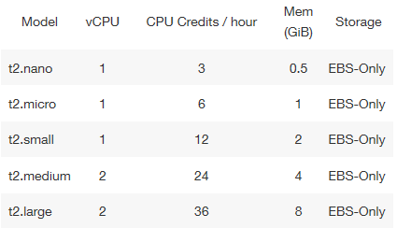
AWS EC2 Instance Types
Predefined by AWS
General Purpose
T2 (Burstable Performance Instances)
M4, M3
Compute Optimized
C4, C3
Memory Optimized
X1, R3
GPU Instances
G2

Slide 11
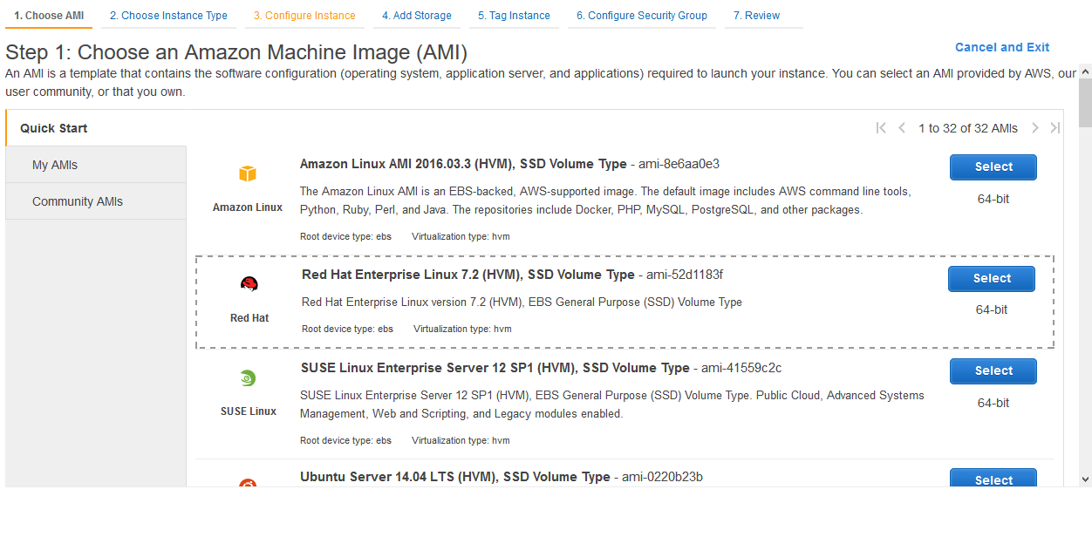
Create Instance on Web Panel
Log in to AWS EC2 panel

Slide 12
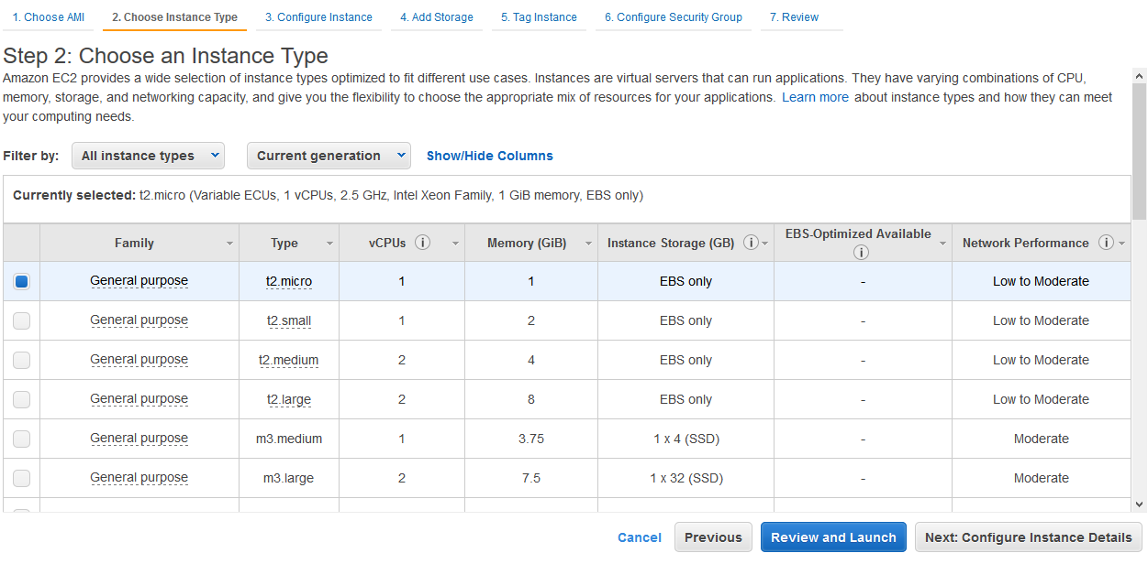
Create Instance on Web Panel

Slide 13
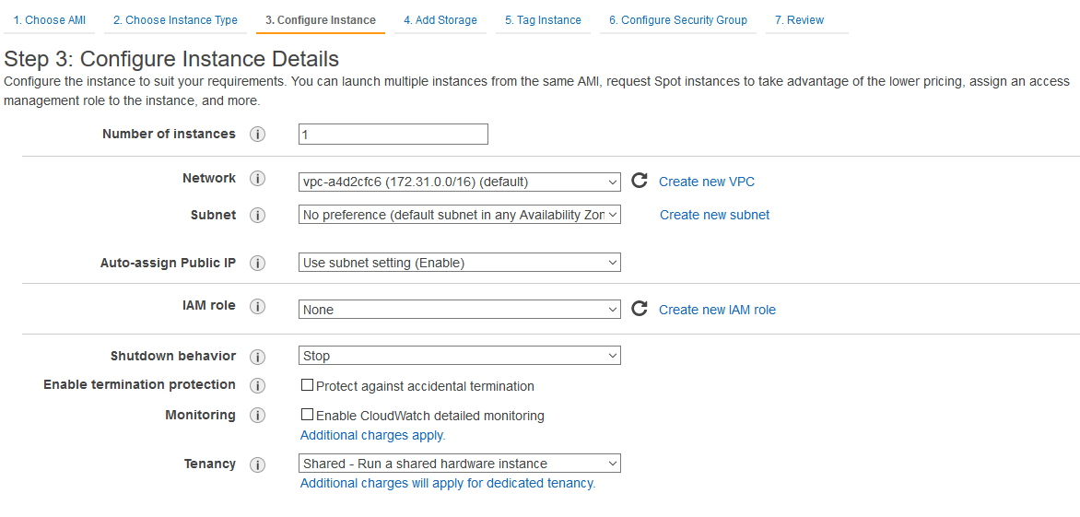
Create Instance on Web Panel

Slide 14
Create Instance on Web Panel
Storage located on EBS (Elastic Block Storage)
Disks used by instance
SSD or Magnetic

Slide 15
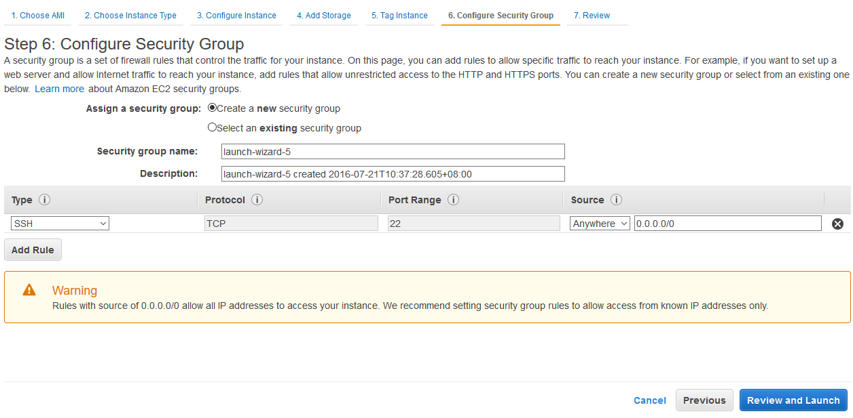
Create Instance on Web Panel
Configure the firewall rules

Slide 16
Manage The Access Key
Create access key in IAM panel
Get access key and secret key for AWS command and API

Slide 17
Command Tools for AWS
AWS Command Line Interface
AWS official full-featured cli
Install with pip
pip install awscli
Amazon EC2 API Tools
ec2-api-tools
EC2 official tools written in java
euca2ools
Compatible with Amazon EC2 and IAM APIs

Slide 18
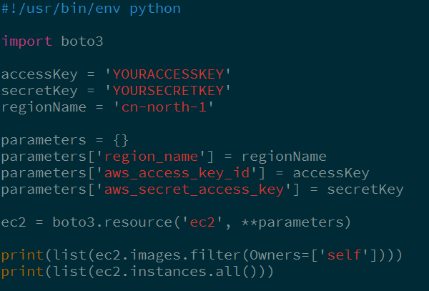
EC2 SDK Example
boto is the official SDK for AWS with full functionalities
Here is a simple example using boto3 SDK to access AWS EC2
List all private images and instances

Slide 19
AWS Integration in Distributed Computing

Slide 20
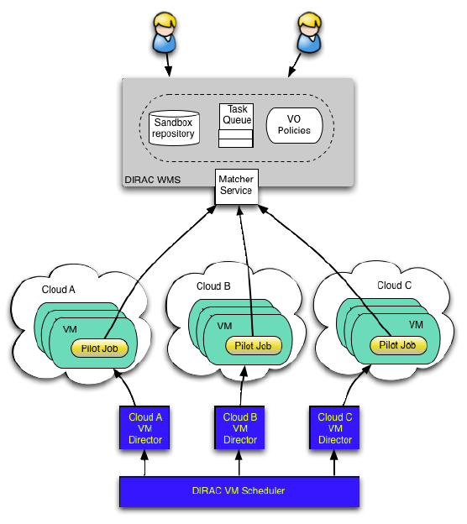
Virtual Machine Scheduler
DIRAC provide job scheduler
VMDIRAC provide virtual machine scheduler
Support AWS EC2 with boto SDK

Slide 21
Detailed Configuration
Import image
No public image suitable for BESIII software environment
Import with ec2-api-tools (ec2-import-instance)
Test the image and network
Create a squid instance for caching http request
Python boto SDK test
Create access and secret key
Configuration in VMDIRAC and add new site
Add simple support for multi-core instance

Slide 22
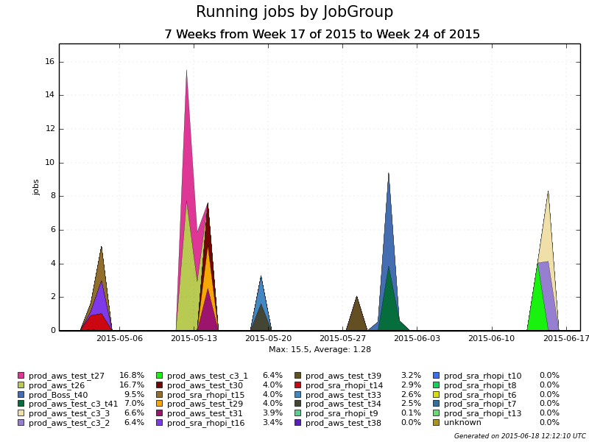
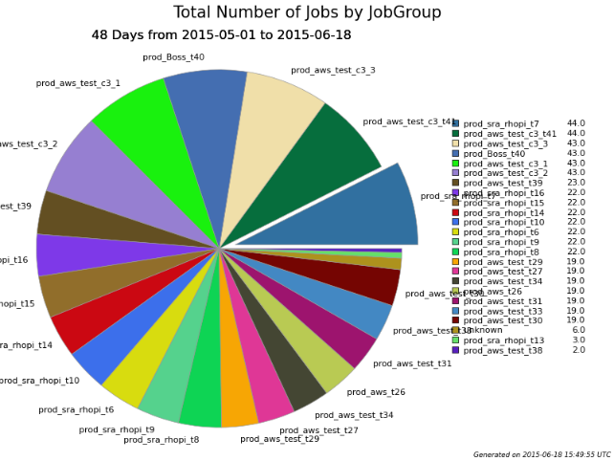
AWS Test with BESIII Software
Using AWS EC2 to do the computing task. Output data transferred back to IHEP grid storage
Test with BESIII simulation, reconstruction and analysis jobs
600 jobs finished, 10 GB data transferred back to IHEP
High success rate close to 100%
Computing efficiency and data transfer are reliable
Job Number
Jobs
in several submissions

Slide 23
AWS Performance Test
Comparison between different instance types
c3 instances are best for BESIII computing
Higher computing efficiency
Comparable lower price
Computing efficiency is comparative with local physics server
Local server CPU E5-2630 v3
 | Simulation (s/event) | Reconstruction (s/event) | Analysis (s/event) | CPU Usage
t2.micro | 4.08 | 1.61 | 0.0357 | 86.5%
m3.medium | 1.03 | 0.32 | 0.0073 | 95.7%
c3.large | 0.64 | 0.21 | 0.0044 | 95.6%
Local Server | 0.40 | 0.13 | 0.0028 | 99.5%

Slide 24
AWS Billing Analysis
Enable the billing report in web panel to get the detailed billing information in S3
Test with c3.large instance. Running about 4 hours
EC2 holds most part of the billing
Consider BESIII MC job (sim+rec+ana) as example, 1000 rhopi events need to pay 0.20 RMB
 | Billing (CNY) | Percentage
Data Transfer | 1.60 | 2 %
EC2 c3.large Instance | 73.60 | 92 %
EBS I/O Requests | 2.40 | 3 %
EBS Storage | 2.40 | 3 %
Other | - | -

Slide 25
Possible Usage in Future
A good complement to the local resources
Spot instance
Get computing resources with much lower price
Adjust the virtual machine and job scheduling policy
It could also require the physics software to change the computing model
Storage
Storage data on S3/Glacier
Not used in the previous test
High price and security consideration

Slide 26
Thanks!

