Slide 1
Introduction to Virtualization Technology
Jianhai Chen (陈建海)
chenjh919@zju.edu.cn
+86 13958011808
Intelligence Computing and System Lab (InCas-lab, http://vm.zju.edu.cn), College of Computer Science, Zhejiang University,
Hangzhou, Zhejiang, P.R. China
2016/07/18
Notes:
Good morning everyone! I am glad to be here. Thanks very much prof. huang xingtao, zhangxiaomei, and everyone of summer school for giving me this opportunity to talk about virtualization technology. My name is Jianhai Chen. I am a computer teacher from InCAS-lab, college of computer science of Zhejiang university. Our lab includes two research groups or directions, data mining technology group and virtualization research group. We have been doing research at virtualization technology for nearly 10 years. We have completed many projects. Begin from last year, we have built a good cooperation with IHEP about virtualization application in high energy physics area.
I will share some of my views and experience in using virtualization technology. I hope we can make more communication and discussion each other about virtualization in future.

Slide 2
Agenda
Introduction
Virtualization Technologies
  CPU
  Memory
  IO
Commercial virtualization tools
Problems in using virtualization
  How to create and handle VM images
  Virtual network concepts and configuration
Summary
Notes:
In last class we see that a cloud computing system is a platform system which manages a large amount of virtual machines for running application services. The virtual machine is exactly realized by virtualization technology.
In this class we will focus on discussing virtualization technology including some concepts, some key techniques for the design and implementation of virtualization, some commercial virtualization tools and some key problems in using virtualization.
首先，介绍一些虚拟化技术有关的概念与架构。
其次，介绍一下虚拟化实现的关键技术，CPU，内存和IO是如何实现的。
再次，介绍一下常用的虚拟化工具。
最后，介绍关于镜像方面的制作管理方法和网络配置问题。
BESIII scientific application can run within a VM.
Stefano.bagnasco@to.infn.it

Slide 3

1.What is virtualization
Virtualization is a term that (wikipedia)
  refers to the abstraction of computer resources, or the act of creating a virtual (rather than actual) version of something, including virtual computer hardware platforms, operating systems, storage devices, and computer network resources.
Virtualized computer resources
abstraction
virtualization
Physical computer resources
https://en.wikipedia.org/wiki/Virtualization
Notes:
We introduce the definition of Wikipedia.
In Wikipedia, virtualization is a term that refers to the abstraction of computer resources, or the act of creating a virtual (rather than actual) version of something in computing, including virtual computer hardware platforms, operating systems, storage devices, and computer network resources.
Actually, in our computer system, CPU, memory, disk, network IO are all resources and will be abstracted and virtualized.
虚拟化技术最早出现在1960年代，IBM 主机。然而，之后的30多年来没有大规模研究和应用。
后来2000年之后，随着硬件规模的发展扩大，数据中心资源浪费严重，虚拟化再次引起注意。各种虚拟化产品依次出现。
1999年VMWARE,2003年XEN,2007年KVM
2007年，INTEL CPU 支持VT, AMD CPU支持 VT
…
今天的VMM
多大数十种

Slide 4
Why virtualize？
Virtualization adds flexibility, allows heterogeneity, and improves manageability of the computing infrastructure
Virtualization allows resource sharing:
  Reduced number of equipment devices
  Higher availability
  Reduced time needed for deployments using virtualized infrastructure
  Lower cost of ownership
  More resilient and simpler to manage
Notes:
Data center can achieve higher availability, reduced time …, lower cost of ownership, and more resilient and simpler to manage.

Slide 5
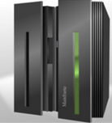

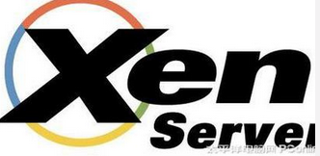
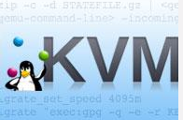
2. History
Virtualization conception
  Firstly appeared in IBM mainframe computer OS in the 1960s.
  Used as a method of logically dividing system resources between different applications
Since then, about 30 years before 1999
  The interest was decreased and the development of virtualization was almost stop.
1999-, the development ->climax
  Vmware, the first virtual platform for Intel x86-32 architecture computers.
  2003, UCCL, Xen, the first open-source, drive more academia research on virtualization.
  2007, KVM, a linux OS kernel-based VM, hardware support: Intel VT, AMD-V
  Now ~50 virtualization tools or types
Notes:
Virtualization conceptions has a history about 50 years. It firstly appeared in IBM mainframe computer OS in the 1960s, used as a method of logically dividing the system resources of mainframe computers between different applications. Since then, the meaning of the term virtualization has broadened.
About 30 years before 1999, the interest to virtualization was decreased and the development of virtualization almost stop because the computer system resources at that time are very expensive.
Until in 1999 VMware Inc. presented Vmware virtual platform for x86-32 architecture, a common architecture used in most current computers.
In 2003, the University of Cambridge Computer Laboratory designed Xen, an open-source virtualization, causing the climax of academia research on virtualization.
Afterwards, more virtualization productions have been developed, such as KVM, Linux OS supports virtualization, Kernel-based VM(KVM) in 2007. At the same time, Intel and AMD provided the hardware support to virtualization technology, such as Intel (VT): VT-x,VT-d, VT-I; and AMD: AMD-V, Pacifica. Nowadays, the commercial virtualization tools has been about 50 types. And the virtualization has become a crucial technology in cloud computing.

Slide 6
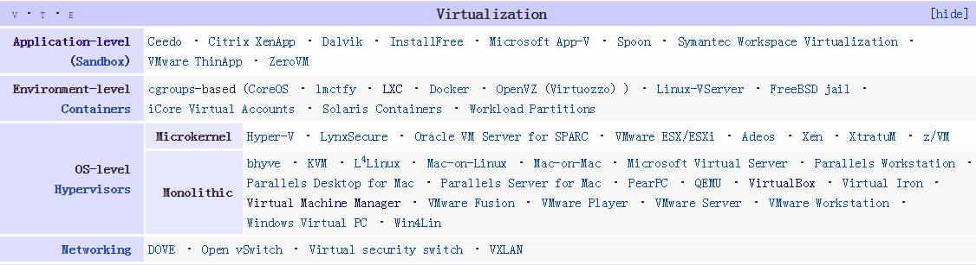
2. History
In the 1960s
  Firstly appeared in IBM mainframe computer OS.
  Used as a method of dividing system resources between different applications.
Since then, before 1999
  the development of virtualization was almost at a standstill about 30 years.
1999-, the development runs to climax
  Vmware, the first virtual platform for Intel x86-32 architecture computers.
  2003, UCCL, Xen, the first open-source, drive more academia research on virtualization.
  2007, KVM, a linux OS kernel-based VM
  2007, hardware support: Intel VT, AMD-V
  Now ~50 virtualization tools or types
Notes:
Here’s a quick overview of virtualization development history. Virtualization conceptions has a history with about 50 years. It firstly appeared in IBM mainframe computer OS in the 1960s, used as a method of logically dividing the system resources of mainframe computers between different applications. Since then, the meaning of the term virtualization has broadened.
About 30 years before 1999, the interest to virtualization was decreased and the development of virtualization almost stop. Until in 1999 VMware Inc. presented Vmware virtual platform for x86-32 architecture, a common architecture used in most computers.
In 2003, the University of Cambridge Computer Laboratory designed Xen, an open-source virtualization, causing the climax of academia research on virtualization.
Afterwards, more virtualization productions are developed, such as KVM, Linux OS supports virtualization, Kernel-based VM(KVM) in 2007. At the same time, Intel and AMD provided the hardware support to virtualization technology, such as Intel (VT): VT-x,VT-d, VT-I; and AMD: AMD-V, Pacifica. Nowadays, the commercial virtualization tools has been about 50 types. Now the virtualization has become a crucial technology in cloud computing.

Slide 7
3. Virtualization types
Basic types
  Hardware virtualization
  Software virtualization
Other special types
  Desktop virtualization
  Nested virtualization
  …...
Notes:
There are two main types of virtualization, hardware and software.
Besides, there also emerges some other special virtualization types in practical application.
Now I make a brief introduction about them.

Slide 8
1) Hardware virtualization
Hardware virtualization (most fundamental)
  or platform virtualization refers to the creation of a virtual machine (VM) that acts like a real computer with an operating system (OS).
  Software executed on these VMs is separated from the underlying hardware resources.
    Host with Microsoft Windows → VM → Ubuntu linux OS;
Concepts
  Host/guest
  Hypervisor or Virtual Machine Manager (VMM)
Notes:
hardware virtualization is also called platform virtualization. It is the most fundamental type of virtualization.
It refers to the creation of a virtual machine (VM) that acts like a real computer with an operating system (OS).
Software executed on these VMs is separated from the underlying hardware resources.
For example, a computer that is running Microsoft Windows may host a virtual machine that looks like a computer with the Ubuntu Linux operating system; Ubuntu-based software can be run on the virtual machine.
In hardware virtualization, the host machine is the actual machine on which the virtualization takes place, and the guest machine is virtual machine.
The words host and guest are used to distinguish the software that runs on the physical machine from the software that runs on the virtual machine.
The software that creates or manages a virtual machine on the host hardware is called a hypervisor or Virtual Machine Manager or Monitor.

Slide 9
1) Hardware virtualization
Hardware virtualization (most fundamental)
  or platform virtualization refers to the creation of a virtual machine (VM) that acts like a real computer with an operating system (OS).
  Software executed on these VMs is separated from the underlying hardware resources.
    Host with Microsoft Windows → VM → Ubuntu linux OS;
Guest machine
Concepts
  Host/guest
  Hypervisor or Virtual Machine Manager (VMM)
Hypervisor
Host machine
Notes:
hardware virtualization is also called platform virtualization. It is the most fundamental type of virtualization.
It refers to the creation of a virtual machine (VM) that acts like a real computer with an operating system (OS).
Software executed on these VMs is separated from the underlying hardware resources.
For example, a computer that is running Microsoft Windows may host a virtual machine that looks like a computer with the Ubuntu Linux operating system; Ubuntu-based software can be run on the virtual machine.
In hardware virtualization, the host machine is the actual machine on which the virtualization takes place, and the guest machine is virtual machine.
The words host and guest are used to distinguish the software that runs on the physical machine from the software that runs on the virtual machine.
The software that creates or manages a virtual machine on the host hardware is called a hypervisor or Virtual Machine Manager or Monitor.

Slide 10
Virtual machine monitor (VMM)
VMM transforms the single machine interface into the illusion of many interfaces. Each of these interfaces (virtual machines) is an efficient replica of the original computer system, complete with all of the processor instructions.
Robert P. Goldberg.
Notes:
In virtualization, a virtual machine monitor (VMM), also called as Hypervisor, is added to the traditional computer architecture. VMM transforms the single machine interface into the illusion of many. Each of these interfaces (virtual machines) is an efficient replica of the original computer system, complete with all of the processor instructions.

Slide 11
Two types of VMM implementation
Vmware Esx server
Xen ctrix server
VMware Esx workstation
Xenserver
Notes:
According to the layer of computer architecture VMM located, there are two VMM types.
In type I, VMM is directly deployed among hardware without an OS, Vmware Esx server and Xen ctrix server are examples.
While in Hypervisor type II, VMM can be deployed among an OS. E.g VMware Esx workstation.

Slide 12
What does a VM look like
Without VMs: Single OS owns all hardware resources
With VMs: Multi-OSes share hardware resources
A virtual machine is implemented by adding software to an execution platform to give it the appearance of a different platform, or for that matter, to give the appearance of multiple platforms.
Notes:
Without VMs: single OS owns all hardware resources while with VMs: Multi-OSes share hardware resources through VMM.
A virtual machine is implemented by adding software to an execution platform to give it the appearance of a different platform, or for that matter, to give the appearance of multiple platforms.

Slide 13
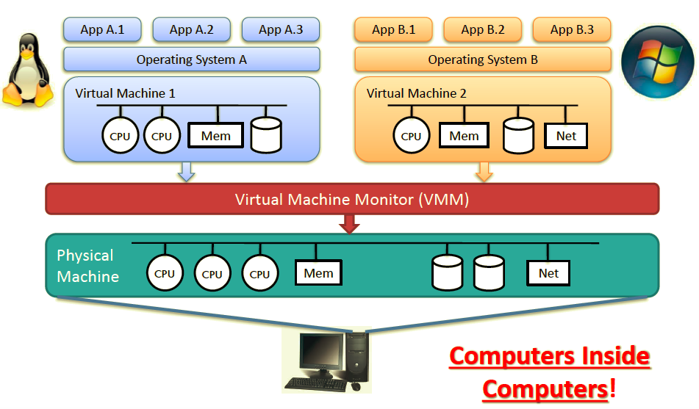
Example: Virtualization in computers: Virtual Machine

Slide 14
Essential characteristics of VMM
Equivalence
  Essentially identical virtual platform, except
    Differences caused by the availability of system resources
      E.g. amount of memory available to VM
    Differences caused by timing dependencies.
Isolation, or resource control
  VMM is in complete control of system resources
    VM can’t access any resources not explicitly allocated to it
    VMM may regain control of resources already allocated
Efficiency
  At worst only minor decreases in speed
  Rules out traditional emulators and complete software interpreters (simulators)
Source from Gerald J. Popek & Robert P. Goldberg, “Formal Requirements for Virtualizable Third Generation Architectures”
Notes:
From the perspective of design, three essential characteristics of VMM: equivalence, isolation and efficiency should be taken into consideration.
Equivalence: the virtual platform must be equivalent to the physical platform except …
2)The isolation or resource control must guarantee that VMM is in complete control of system resources: VM can’t access any resources not explicitly allocated to it. VMM may regain control of resources already allocated.
3)The efficiency depends on only minor decreases in speed at worst and rules out traditional emulators and complete software interpreters(simulators).

Slide 15
Hardware virtualization types
Full virtualization
  almost complete simulation of the actual hardware to allow software to run an unmodified guest OS (VM).
  implementation methods
    Binary Translation ….....software
    Hardware-assisted virtualization etc.
Partial virtualization
  some but not all of the target environment attributes are simulated.
    As a result, some guest programs may need modifications to run in such virtual environments.
Paravirtualization
  Modify guest OS to cooperatively work with hypervisor to solve virtualization issues or for performance.
Notes:
Full virtualization: presents almost complete simulation of the actual hardware to allow software to run an unmodified guest OS.
Partial virtualization: some but not all of the target environment attributes are simulated.
As a result, some guest programs may need modifications to run in such virtual environments.
Paravirtualization: a hardware environment is not simulated and modify the guest specifically to enable that the guest programs are executed in their own isolated domains, as if they are running on a separate system.
Hardware-assisted virtualization: is a way of improving overall efficiency of virtualization.
It involves CPUs that provide support for virtualization in hardware and other hardware components that help improve the performance of a guest environment.

Slide 16
2)Software virtualization
Operating system-level virtualization
  hosting of multiple virtualized environments within a single OS instance.
  An OS allows for multiple isolated user-space instances (based on cgroup)
  Often called containers, E.g. Docker
Application virtualization and workspace virtualization
  hosting of individual applications in an environment separated from the underlying OS.
  Application virtualization is closely associated with the concept of portable applications.
  E.g. Java Virtual Machine
Notes:
Operating system-level virtualization is hosting of multiple virtualized environments within a single OS instance.
Application virtualization and workspace virtualization is the hosting of individual applications in an environment separated from the underlying OS. Application virtualization is closely associated with the concept of portable applications.
Service virtualization is a scenario emulating the behavior of dependent (e.g., third-party, evolving, or not implemented) system components that are needed to exercise an application under test (AUT) for development or testing purposes.

Slide 17
3)Desktop/Nested virtualization
Desktop virtualization(DV)
  is the concept of separating the logical desktop from the physical machine.
    One form is virtual desktop infrastructure (VDI).
    thought of as a more advanced form of hardware virtualization.
  generally used to support desktop office.
Nested virtualization (NV)
  refers to the ability of running a VM within another, having this general concept extendable to an arbitrary depth.
  E.g. be used to deploy a cloud platform in VMs, such as openstack.
VM
VM
Notes:
Desktop virtualization is the concept of separating the logical desktop from the physical machine.
One form of desktop virtualization, is virtual desktop infrastructure (VDI), can be thought of as a more advanced form of hardware virtualization. Rather than interacting with a host computer directly via a keyboard, mouse, and monitor, the user interacts with the host computer using another desktop computer or a mobile device by means of a network connection, such as a LAN, Wireless LAN or even the Internet. In addition, the host computer in this scenario becomes a server computer capable of hosting multiple virtual machines at the same time for multiple users.^{[4]}
If you want to practice deploying, and operating a cloud platform in VM then it needs nested virtualization.
如果你要在虚拟机中练习搭建云平台的实践，则需要虚拟机中能够安装虚拟机。

Slide 18
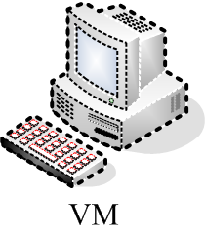
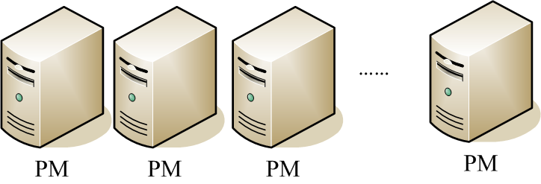
4. Virtualization benefits
Server consolidation and live migration
Server consolidation
Live migration

Slide 19
Agenda
Introduction
Virtualization Technologies
  CPU
  Memory
  IO
Commercial virtualization tools
Problems in using virtualization
  How to create and handle VM images
  Virtual network concepts and configuration
Summary
Notes:
How to realize the virtualization technologies?
The purpose of virtualization technology is to virtualize everything of computer resources.
We mainly introduce the hardware resource virtualization including CPU, memory and IO virtualization technologies.
i.e. how to realize the virtualization of CPU, memory and IO?

Slide 20
Virtual Platform
Simulates hardware platform and all its software platforms.
Hardware platform
  CPU, Memory, I/O
Software platforms/components layer
  BIOS
  OS
  Run time library
  Applications
Notes:
After virtualization, we assume we have a virtualized platform. Then, the virtual platform should simulate its hardware and all its software platforms. The hardware mainly includes CPU, memory and IO. The software targets to virtualize all software component layers, including BIOS, OS, runtime library and applications. We mainly talk about how to realize the hardware virtualization.
一个虚拟平台必须模拟一个硬件平台和所有相关的软件平台。
模拟硬件需要实现CPU、MEM、IO。
软件模拟需要实现BIOS，OS， Run time library和application.

Slide 21
Agenda
Introduction
Virtualization Technologies
  CPU
  Memory
  IO
Commercial virtualization tools
Problems in using virtualization
  How to create and handle VM images
  Virtual network concepts and configuration
Summary
Notes:
How to realize the virtualization technologies?
The purpose of virtualization technology is to virtualize everything of computer resources.
We mainly talk about the hardware resource virtualization for CPU, memory and IO virtualization technologies.
i.e. how to realize the virtualization of CPU, memory and IO?

Slide 22
Instruction and application program
Applications run by CPU with an instruction set system
An instruction
  is a basic command of CPU operation, e.g., one time of single logical computation: plus two numbers, subtract two numbers.
One application program
  commonly compiled from source code into binary
  consists of a set of sequence instructions.
The running of application equals to that
  A set of sequence ordered instructions run by CPU.
Notes:
What is CPU?
Before virtualization，in general an application program is firstly compiled into a binary code which consists of a set of sequence instructions.
The running of application denotes CPU run a set of instructions according to a special order.

Slide 23
For Example：2+3=5
Memory
2
2
3
3
Write
Write
Input
Read
Read
Output
2
ALU
3
+
5
CPU
command：input 3
Add
command：Input 2
Controller
Out
Notes:
This is an example of application program to complete a computing task with 2+3.
To show how to realize a simple computing task with 2+3 for a computer.
The 2+3 program will have a set of instructions ordered.
The instruction simulation or virtualization is the most central work of virtualization.

Slide 24
Program with instructions
Input 2
Write 2 to memory
Input 3
Write 3 to memory
Read 2
Read 3
Add 2 and 3
Output 5
Input 2
A=2
Input 3
B=3
Read A
Read B
Add A, B TO C
Output C

Slide 25
CPU virtualization
How to virtualize CPU resource?
  VM is set one or more vCPUs and each vCPU is allocated to run applications of Guest OS.
  Each application program is denoted by an ordered set of instructions and finally executed by physical CPU.
  During the running of application, app instructions will firstly submitted to vCPU, then the vCPUs are allocated to physical CPU to run instructions through VMM scheduling.
    Some sensitive instructions only be executed by root user
    Non-privileged instruction can be executed in Guest OS
VM₀
VM_{n}
APP (Instructions )
APP (Instructions )
vCPU
vCPU
…...
vCPU
VMs
scheduling
allocate
VMM
pCPU
pCPU
……
pCPU
PM
Notes:
So questions are:
How to simulate the cpu instructions. How to schedule PCPU to execute the Vcpu instructions.
Let’s start getting the instruction system of CPU because all hardware resource management is implemented by the instruction.
The operating system controls and manages resources by executing some instructions to complete the application program tasks. One application program denotes a set of instructions. The guest OS running an application by running these instructions by CPU. Some instructions can only be executed by root user. These instructions are privileged instructions. We call some privileged instructions as sensitive instructions. The ISA virtualization must control sensitive instructions.
The non-privileged instruction can be directly executed in guest OS and some sensitive instructions can not be executed in GOS. And the GOS will send the process of sensitive instructions to VMM and VMM sends to the PCPU to run.
虚拟机CPU称为vCPU。
CPU是一个执行程序指令的部件。在操作系统中，一个程序就是一组指令的有序集合， 因此CPU执行程序就是执行一组有序的指令。
在客户机OS中，程序的执行就是将一组有序指令交给了vCPU执行，VCPU又不是真的CPU，需要VMM调度具体的CPU来执行。
CPU虚拟化需要解决由各个VCPU提交过来的指令请求，如何调度CPU来执行。
CPU is a component of executing program instructions. In OS, one program is an ordered set of instructions. So the program execution of CPU is equal to executing a set of ordered instructions.

Slide 26
CPU virtualization approaches
Binary Translation (BT)
  Translate guest OS binary on the fly to solve virtualization issue
Paravirtualization (PV)
  Modify guest OS to directly access some special CPU instruction.
Hardware-assisted virtualization
  Some virtualized instructions directly executed by physical CPU
Notes:
In CPU virtualization, the key problem is how to virtualize the instruction.
There are three relation approaches, Binary Translation, Paravirtualization, Hardware-assisted virtualization.
Intel® VT for Intel® 64 (VT-x) and AMD-V technology
VMX Transitions.

Slide 27
1)Binary Translation (BT)
Translate guest OS binary
  OS binary is still visible to guest, but the executed guest code is actually in translation cache.
  Need to steal guest address space to hold the translated cache.
    be able to run unmodified guest OS
All the instructions are virtualized for translation.
  Frequent translations impact on performance
  Benefit: not modify guest OS
  VMWare, Qemu
Guest Operating System
binary
Translated by VMM
Physical instructions
Notes:
整个操作系统看做一个应用程序的二进制，所有的代码指令被翻译成物理CPU可识别的指令。
The guest OS is viewed as an application program binary. The all program codes denote a set of virtual instructions and are translated into real instructions of PCPU by VMM in runtime.
所有的操作指令必须先翻译再被执行，造成很大开销.
All the virtualized instructions must be translated for execution. The large quantity of translation operations reduce performance.

Slide 28
2)Paravirtualization (PV)
Modify guest OS source to cooperatively work with hypervisor for performance, simplicity etc.
  Hypercall to request for hypervisor service
    Share the global resource
  Event channel to receive asynchronous notification from hypervisor
  Share memory for massive information communication
  Virtio for directly access IO device
Widely used in device driver by commercial VMMs
  Vmware
  Xen/KVM
  Hyper-V
Notes:
Modifying guest OS source to cooperatively work with hypervisor for performance, simplicity etc.
The implementation approaches include hypercall, event channel, share memory and virtio.
通过修改VM的OS内核，增加一些特殊支持超级调用，使得一些特殊指令能够直接被PM操作系统运行而不进入VMM。比如，IO访问支持。
virtio技术

Slide 29
3)Hardware-assisted virtualization
Hardware extension
  Intel® Virtualization Technology (Intel® VT)
  AMD-V
Hardware support to enable that
  Guest OS runs in de-privileged mode to execute instructions
  Guest access to privileged resources triggers exit from VM to VMM
The purpose is to run unmodified guest OS
Notes:
Some sensitive instructions can be directly captured and executed by hardware extension.
This needs to improve hardware support that VM can.
The hardware can directly access some instructions of guest OS.
is a way of improving overall efficiency of virtualization.
CPUs provide support for virtualization in hardware
other hardware components that help improve the performance of a guest environment.

Slide 30
Agenda
Introduction
Virtualization Technologies
  CPU
  Memory
  IO
Commercial virtualization tools
Problems in using virtualization
  How to create and handle VM images
  Virtual network concepts and configuration
Summary
Notes:
内存是如何被虚拟化的？首先需要了解操作系统内存工作原理。
操作系统中的MMU，是负责内存管理的部件。
计算机的内存被分段和分页进行管理，每个页标识为一个地址，所有地址构成一个地址空间。操作系统访问数据要遍历内存空间。
为了保证访问效率，操作系统设计要求一些内存地址是连续的。
虚拟化之后，虚拟机GuestOS看到的连续内存是虚拟化的内存（vMemory），会对应到实际的物理机实际内存，是不连续的。
这要求管理一张虚拟机OS的内存地址（逻辑地址）和物理机实际内存地址的对照表。

Slide 31
Memory virtualization
In OS, memory management follows some rules:
  OS expect to see physical memory starting from 0
    BIOS/Legacy OS are designed to boot from address low 1M
  OS expect to see contiguous memory in address space
    OS kernel requires minimal contiguous low memory
      OS, such as Linux, requires minimal contiguous low memory
    OS components may require certain level of contiguous memory
      For example, DMA pages, identical mapped kernel data structure…
    Efficient page frame management
      Less management overhead
    Efficient TLB (Translation lookaside buffer)
      Super page TLB
Notes:
Now, let’s see that how to realize the memory virtualization.
As a guest OS, it must ensure that
In general, all the linux OS expect to see physical memory starting from 0. The BIOS OS are designed to boot from address low 1M (mega byte).
OS expect to see contiguous memory in address space.
So VMM has to remap guest physical address to host physical address.
A translation lookaside buffer (TLB) is a cache that memory management hardware uses to improve virtual address translation speed.^{[1]} The majority of desktop, laptop, and server processors includes one or more TLBs in the memory management hardware, and it is nearly always present in any hardware that utilizes paged orsegmented virtual memory.

Slide 32
Physical page frame redirection
contiguous
MAP
noncontiguous
Notes:
For example, we consider four VMs run in one PM. VM1 has five pages with contiguous memory page address.
By virtualization, memory pages are redirected. Each page with a logical address is corresponding to a PM page address.
After the redirection, the VM guest memory pages are remapped to real PM memory with noncontiguous address.

Slide 33
Page frame allocation
Partitioning
  Simple and high performance
  $ to buy more memory
Contents based sharing
  Pages with same contents can share the physical frame
    Such as zero page, guest code pages etc.
    Can improve memory usage
Ballooning
  A VMM-aware balloon driver running in guest OS to dynamically allocate memory from OS and release them to VMM, and vice versa
Host swapping
  The physical frames for guest pages may be swapped out
Shadow page table
  Guest memory <--→ physical machine memory
Notes:
Page frame allocation is an important problem of memory virtualization. The main solutions are as follows.
At first, we can do memory partition and allocate a special amount of memory pages for each VM. This requires more $ to buy more memory.
At second, contents based sharing, pages with same contents can share the physical frame such as zero page, guest code pages etc.
Ballooning solution is used in many VMMs. A VMM-aware balloon driver running in guest OS to dynamically allocate memory from OS and release them to VMM, and vice versa.
The last solution is host swaping. The physical frames for guest pages may be swapped out.
Another conception is the shadow page table.
It is a memory address mapping table, a mapping from guest page address to the physical page address.
When a guest OS requires to access a special page, it firstly has a page address based on the guest OS. It is a virtual address.
Not a physical memory address. It firstly access the shadow page table to determine the real physical address. If the mapping is not in the shadow page table, then trigger a page miss interrupt to look for the real address from the physical memory.

Slide 34
Ballooning
Notes:
The ballooning method implements VMM a dynamical memory allocation solution by a balloon driver program.
The allocation operation is like a balloon which can become big or small. Zoom in or out.
All VMs initially are allocated with a special size of memory. When a VM running application needs more memory, the VM will do “ballooning in” method to obtain some idle memory pages from other adjacent VMs. Then, the size of memory of this VM becomes bigger. Conversely, when the other VMs need more memory pages, the VM can also do “ballooning out” method to release some memory pages for other VMs. All memory allocation operations are completed dynamically.
每个VM首先分配指定大小的内存，随着应用的运行，内存需求会变大，在用完本地分配的内存之后，气泡就会变大，从其他VM中获取有用的内存。
当内存用完后，通过balloon out会释放内存使自己变小。

Slide 35
Agenda
Introduction
Virtualization Technologies
  CPU
  Memory
  IO
Commercial virtualization tools
Two problems in using virtualization
  How to create and handle VM images
  Virtual network concepts and configuration
Summary
Notes:
IO虚拟化是怎么做到的？操作系统管理IO设备是通过管理IO设备驱动程序进行的。

Slide 36
Device interface
Driver program
Interaction between device and driver:
  Driver programs device through register access
  Device notifies driver through interrupt
  Device could DMA for massive data movement
I/O Virtualization requires the hypervisor to present guest a complete device interface
  Presenting an existing interface
    Software Emulation
    Direct assignment
  Presenting a brand new interface
    Paravirtualization
Notes:
IO虚拟化是怎么做到的？操作系统管理IO设备是通过管理IO设备驱动程序进行的。
OS has a device interface model. For each device, there is a device driver program.
CPU controls, manages and interacts all devices in OS by the driver program.
1)Driver programs drive device operation through register access
2)Device notifies driver through interrupt
3)Device could DMA for massive data movement through shared memory.
IO virt. Requres the vmm to present guest a complete device interface.
The following three approaches can be used to implement the IO virtualization.
Presenting an existing interface
Software Emulation
Direct assignment
2)Presenting a brand new interface
Paravirtualization
In OS, CPU与设备之间的交互接口如图所示。所有IO设备通过设备驱动与CPU交互。
驱动程序通过寄存器访问来驱动设备。
设备通过中断通知驱动。
设备也可以直接通过DMA共享内存实现较大的数据移动。

Slide 37
Software Emulation
Guest runs native device driver, e.g. NE2000
  I/O access is trap-and-emulated by device model in hypervisor
    Translation of virtual interrupt
  Virtual Interrupt is signaled by device model per semantics
Excessive trap and emulation
Guest
VM
VMM
Notes:
In this approach, the guest OS has a native device driver, e.g. NE2000. The hypervisor has a device model.
I/O access is trap-and-emulated by device model. Virtual interrupt is signaled by device model per semantics.
When app sends an IO operation request to native driver, the request will be trap, then exit VM and be emulated by the device model.
The model generates an IRQ which is sent back to the VM as a virtual interrupt. And complete the IO operation.
So each IO access operation will intervene the hypervisor one time, and obviously excessive trap and emulation will seriously impact the IO performance.
In running data intensive applications, there are usually excessive hypervisor intervention for performance data movement.
软件模拟方法：在虚拟机的OS中具有一个原始的设备驱动，在VMM中有一个设备模型对驱动进行仿真模拟。
每一次IO访问，应用程序向驱动发出一次IO操作请求，会从VM中出来陷入到VMM，被设备模型仿真模拟，
并产生一个中断请求，返回到VM, (VMM-in)，完成具体的IO操作。因此，每一次IO操作总是会干扰VMM一次。
如果IO操作很频繁，则会过度干扰VMM造成性能下降。

Slide 38
Paravirtualization
Modify guest OS
A new front-end driver (FE driver) is run in guest
  Optimized request through hypercall
Hypervisor runs a back-end driver (BE driver) to service request from FE driver
  Notify guest for processing
Shared memory is used for massive data communication
  To reduce guest/hypervisor boundary crossing
  E.g. Xen VNIF, KVM Virtio-Net
Notes:
The Paravirtualization aims at reducing the runtime hypervisor intervention.
It modifies the guest OS to present a new device model. The guest OS runs a new front-end driver optimizing IO request through hypercall.
The Hypervisor runs a back-end driver corresponding to FE. The front-end driver communicates with the back-end driver and use shared memory for massive data communication. Then the runtime hypervisor intervention is largely reduced.
通过超级调用直接进行IO操作交互处理。不用陷入到VMM，然后返回。

Slide 39
Direct assignment
Guest runs native driver
I/O is written through
  Translation for MMIO is presented
Interrupt
  Physical interrupt is captured by hypervisor (pIRQ)
  Virtual interrupt is signaled for guest (vIRQ)
  Remapping from pIRQ->vIRQ in hypervisor
Special hardware device is directly allocated to a special VM
Notes:
通过虚拟机直接访问IO设备。
The direct assignment is implemented by hardware that enables that guest runs native driver and IO operation is written through.
It uses a new method to process interrupt: Physical interrupt is captured by hypervisor (pIRQ). Virtual interrupt is signaled for guest (vIRQ). Remapping from pIRQ->vIRQin hypervisor.

Slide 40
Agenda
Introduction
Virtualization Technologies
  CPU
  Memory
  IO
Commercial virtualization tools
Problems in using virtualization
  How to create and handle VM images
  Virtual network concepts and configuration
Summary

Slide 41
Commercial virtualization tools
Xen
KVM/Qemu
Vmware
virtualbox
LXC & Docker
……
Notes:
We focus on the following five virtualization tools.

Slide 42
Xen
Emerge in 2003.
Open-source virtualization tool
Firstly (First version)developed by the University of Cambridge Computer Laboratory
Xen is currently available for the IA-32, x86-64 and ARM instruction sets.
Xen supports five different approaches to running the guest operating system:
  HVM (hardware virtual machine),
  HVM with ParaVirtualization drivers,
  PVHVM (HVM with PVHVM drivers),
  PVH (PV in an HVM container) and PV (paravirtualization)

Slide 43
KVM
Produced in 2007.
KVM (Kernel-based Virtual Machine)
  is a virtualization infrastructure for the Linux kernel that turns it into a hypervisor.
  supports x86 processors
Paravirtualization supports for certain devices
  Be available for Linux, OpenBSD, FreeBSD, NetBSD, Plan 9 and Windows guests using the Virt-IO API.
  Supports
    a para virtual Ethernet card,
    a para virtual disk I/O controller,
    a balloon device for adjusting guest memory usage,
    and a VGA graphics interface using SPICE or VMware drivers.

Slide 44
Qemu
QEMU (short for Quick Emulator)
  a free and open-source hosted hypervisor that performs hardware virtualization (not to be confused with hardware-assisted virtualization).
QEMU is a hosted virtual machine monitor
  It emulates CPUs through dynamic binary translation and provides a set of device models, enabling it to run a variety of unmodified guest operating systems.
  It also can be used together with KVM in order to run virtual machines at near-native speed (requiring hardware virtualization extensions (VT-x) on x86 machines).
  QEMU can also be used purely for CPU emulation for user-level processes, allowing applications compiled for one architecture to be run on another.

Slide 45
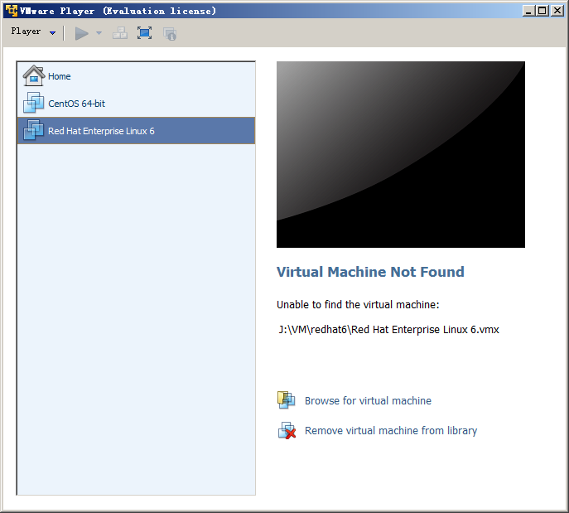
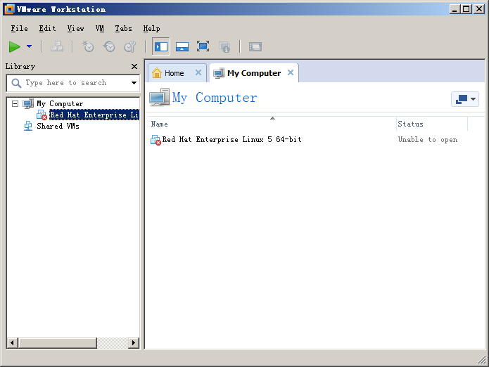
VMware
Produced in 1999. VMware Inc. product. It is non-open source.
  VMware's desktop software runs on Microsoft Windows, Linux, and Mac OS X.
  Its enterprise software hypervisors for servers, VMware ESX and VMware ESXi, are bare-metal hypervisors that run directly on server hardware without requiring an additional underlying operating system.
Desktop software
  VMware workstation, VMware Fusion
  VMware player: is freeware for non-commercial use
Server software
  VMware vSphere
  VMware server

Slide 46
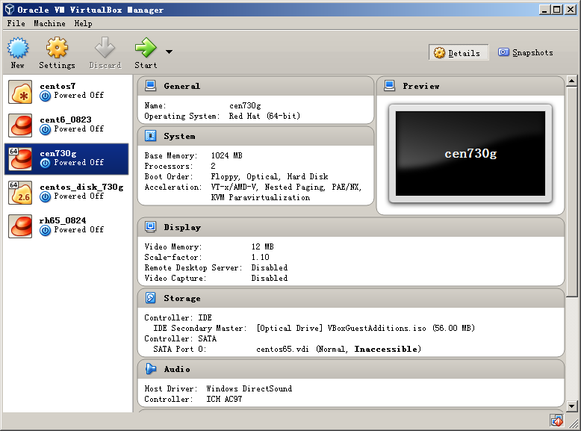
virtualbox
is a hypervisor for x86 computers from Oracle Corporation.
VirtualBox may be installed on a number of host operating systems, including: Linux, OS X, Windows Vista, Solaris, and OpenSolaris.
Support Software-based virtualization and Hardware-assisted virtualization

Slide 47
LXC (linux container) and Docker
LXC (Linux Containers)
  is an operating-system-level virtualization environment for running multiple isolated Linux systems (containers) on a single Linux control host.
  The Linux kernel provides the cgroups functionality that allows limitation and prioritization of resources (CPU, memory, block I/O, network, etc.)
Docker
  a project automating deployment of applications inside software containers
  can also use LXC as one of its execution drivers, enabling image management and providing deployment services.
  More and more incorporations use docker to deploy their business applications, e.g. Google.

Slide 48
Agenda
Introduction
Virtualization Technologies
  CPU
  Memory
  IO
Commercial virtualization tools
Problems in using virtualization
  How to create and handle VM images
  Virtual network concepts and configuration
Summary
Notes:
Use the virtualization tools to create and handle VM images.

Slide 49
Libvirt – API for managing VMs
is an open source API, daemon and management tool for managing platform virtualization.
  itself is a C library.
  Others, Python, Perl, OCaml, Ruby, Java, and PHP.
  widely used in the orchestration layer of hypervisors in the development of a cloud-based solution.
can be used to manage
  KVM, Xen, VMware ESX, QEMU and other virtualization technologies.
  Two user interfaces developed based on libvirt
  Graphical Interface: virt-manager
  Command line interface: virsh
Warnke, Robert; Ritzau, Thomas. qemu-kvm & libvirt (in German)
https://en.wikipedia.org/wiki/Libvirt
Notes:
The most important tool is libvirt. It is an open source API, daemon and management tool for managing platform virtualization.
itself is a C library. Others, Python, Perl, OCaml, Ruby, Java, and PHP. Is widely used in the orchestration layer of hypervisors in the development of a cloud-based solution.
Can be used to manage images of KVM, Xen, VMware ESX, QEMU and other virtualization technologies.
There two user interfaces. Graphical interface: virt-manager and command line interface: virsh.

Slide 50
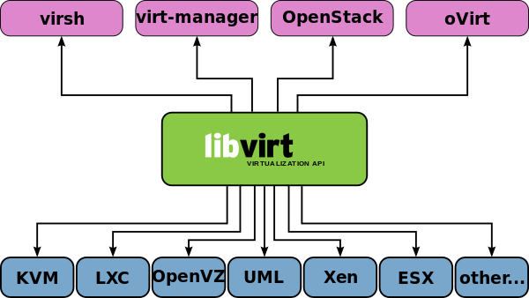
libvirt
Libvirt
  is a common API for uniformly managing VMs
  supports several Hypervisors and is supported by several management solutions
Notes:
Libvirt is a common application program interface. It presents a unified interface for managing virtual machines.
公共的API，提供了统一管理虚拟机的接口。API。
libvirt supports several Hypervisors and is supported by several management solutions

Slide 51
virt-manager
http://virt-manager.org/
Virtual Machine Manager
  is a desktop-driven virtual machine manager with which users can manage virtual machines (VMs)
Functions
  create, destroy, edit, start and stop VMs
virt-manager’s supporting tools
  virt-install tool: provision os to virtual machines
  virt-clone tool: copy disk images
  virt-viewer application: interact with VM in graphical display
Notes:
A tool which is very easy to learn used to manage virtual machines. We can create VMs, destroy VMs and monitor the running states of VMs.
About virt-manager’s supporting tools
The virt-install tool is a command line tool which provides an easy way to provision operating systems into virtual machines.
The virt-clone tool is a command line tool for cloning existing inactive guests. It copies the disk images, and defines a config with new name, UUID and MAC address pointing to the copied disks.
The virt-viewer application is a lightweight interface for interacting with the graphical display of virtualized guest OS. It can display VNC or SPICE, and uses libvirt to lookup the graphical connection details.

Slide 52
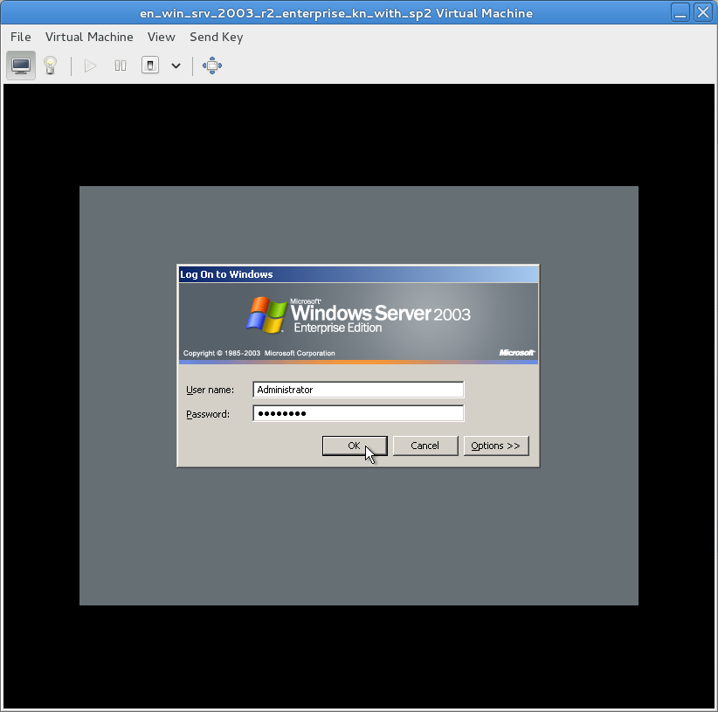
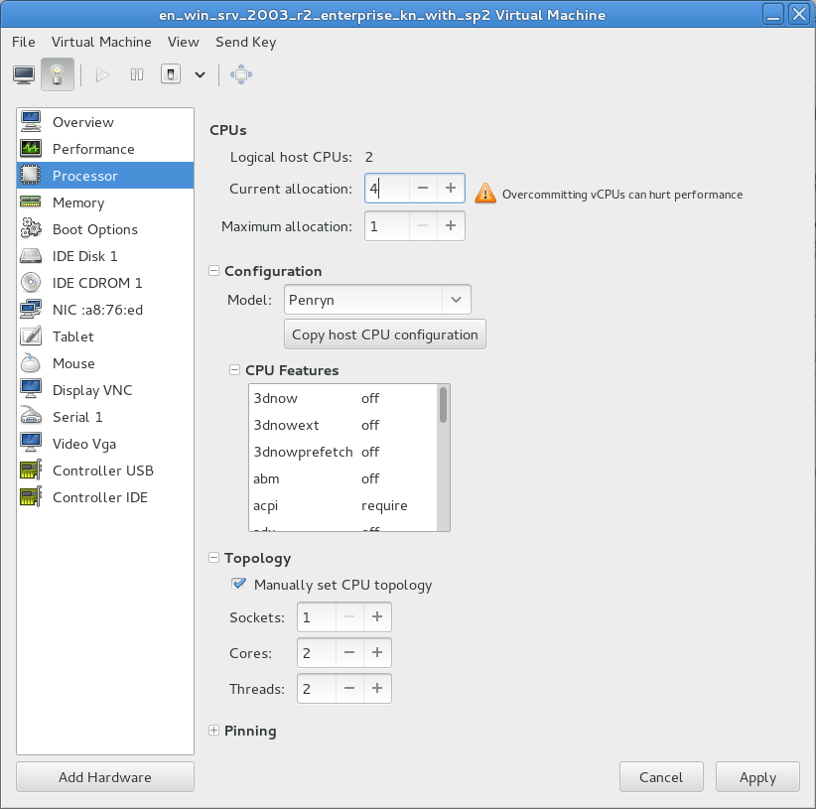
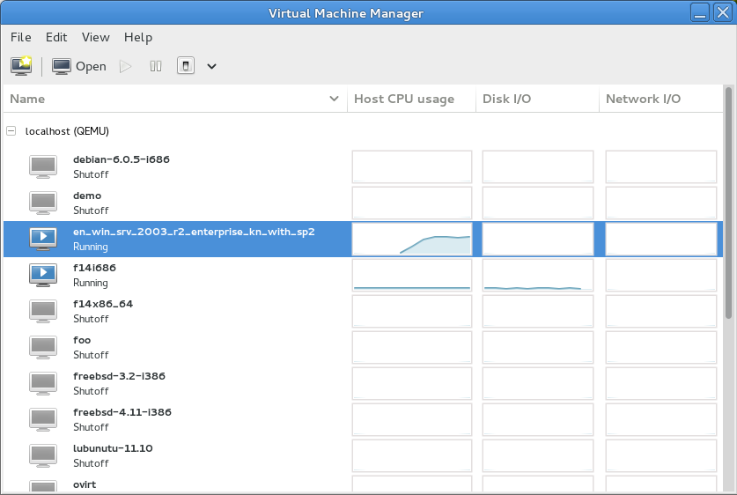
virt-manager
http://virt-manager.org/
Notes:
A tool which is very easy to learn used to manage virtual machines. We can create VMs, destroy VMs and monitor the running states of VMs.
About virt-manager’s supporting tools
The virt-install tool is a command line tool which provides an easy way to provision operating systems into virtual machines.
The virt-clone tool is a command line tool for cloning existing inactive guests. It copies the disk images, and defines a config with new name, UUID and MAC address pointing to the copied disks.
The virt-viewer application is a lightweight interface for interacting with the graphical display of virtualized guest OS. It can display VNC or SPICE, and uses libvirt to lookup the graphical connection details.

Slide 53
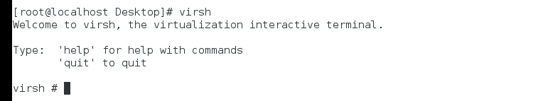
virsh
http://blog.csdn.net/bravezhe/article/details/8465678
The virsh is used to manage domains.
  You must run the commands as the root user or by assuming the appropriate role account on the host operating system.
  The commands cannot be run in the guest domain.
Commonly used commands:
  virsh create #1: start a VM
    virsh create vm01.xml
  virsh destroy #1
  virsh list
    list all the running VMs
  virsh console: connect to a VM
  virsh reboot #1
  virsh shutdown #1
  …
Notes:
The virsh is used to manage domains. You must run the commands as the root user or by assuming the appropriate role account on the host operating system. The commands cannot be run in the guest domain.

Slide 54
VM image file
VM Image file stores all contents of a VM.
Two modes: mirror and sparse mode
  The mirror mode image stores all byte data, includes invalid data for users. Raw format is a mirror mode image.
  The sparse mode image stores the user or system valid data, only occupy a special necessary size of storage space. The qcow2 and vmdk are sparse mode file formats.
File format
  Conventional image: qcow, qcow2 & raw
  Commercial virtualization image: vmdk, vdi, …
    Each commercial virtualization has its own image format.

Slide 55
Choosing Image format
raw format (KVM/Xen)
  (linux default) the raw format is a plain binary image of the disc image, and is very portable.
  On file systems that support sparse files, images in this format only use the space actually used by the data recorded in them.
qcow2 (QEMU copy-on-write)
  QEMU copy-on-write format with a range of special features, includes the ability to take multiple snapshots, smaller images on file-systems that don’t support sparse files, optional AES encryption, and optional zlib compression.
Other
  vmdk: VMWare file format
  vdi: virtualbox file format
Image File format convert
  Generally a commercial VMM can convert its format file to the raw formant
Notes:
raw format (KVM/Xen):
(linux default) the raw format is a plain binary image of the disc image, and is very portable.
On file systems that support sparse files, images in this format only use the space actually used by the data recorded in them.
raw format (KVM/Xen)
(linux default) the raw format is a plain binary image of the disc image, and is very portable.
On file systems that support sparse files, images in this format only use the space actually used by the data recorded in them.
Other
vmdk: VMWare file format
vdi: virtualbox file format
Image File format convert
A commercial VMM can convert its format file to the standard raw formant.

Slide 56
Agenda
Introduction
Virtualization Technologies
  CPU
  Memory
  IO
Commercial virtualization tools
Problems in using virtualization
  How to create and handle VM images
  Virtual network concepts and configuration
Summary
Notes:
Virtualization has been widely used in modern data centers, grids and clouds.
This lesson convers some general concepts about virtualization, a simple introduction of the design and implementation challenges of virtualization technology, some commonly used virtualization tools and some difficulties in practical using virtualization. I have made much communication and discussion with professor zhangxiaomei about the lesson content during the period of preparation.

Slide 57
Network Communication between VMs
Application
Application
Communication
VM1
VM2
VM1
VM2
Disperse placement (DP)
Colocation-placement (CP)
PM1
HW
PM2
HW
VM1
VM2
PM
Hardware(HW)
VM1
VM2
VMM
VMM
VMM
Virtual Network
Network
Pass through vNIC
but not NIC
Through NIC
Notes:
The network communication between VM1 and VM2 which are disperse placed onto distinct PMs will pass through the network interface card of PMs.
The network communication between VM1 and VM2 which are colocation placed onto the same PM will not pass through the network interface card of PMs but vNIC.

Slide 58
Virtual network concepts
Physical network
  NIC, switch
Virtual Network
  vNIC, vSwitch
Virtual network devices
  TAP/TUN
  Linux Bridge
http://www.ibm.com/developerworks/cn/linux/1310_xiawc_networkdevice/
https://www.vmware.com/support/ws55/doc/ws_net_basics.html
http://blog.csdn.net/tantexian/article/details/45395075
Notes:
参考资料：
http://www.ibm.com/developerworks/cn/linux/1310_xiawc_networkdevice/
网络设备虚拟化
https://www.vmware.com/support/ws55/doc/ws_net_basics.html
3种虚拟网络模式
http://blog.csdn.net/tantexian/article/details/45395075
Neutron的网络拓扑图

Slide 59
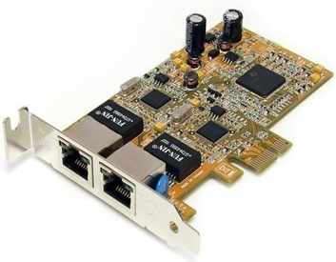
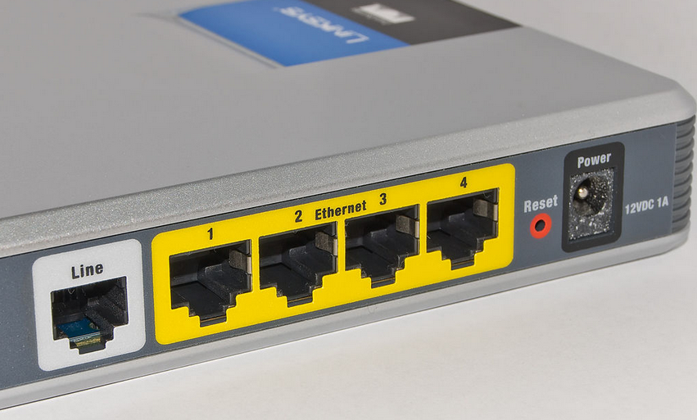
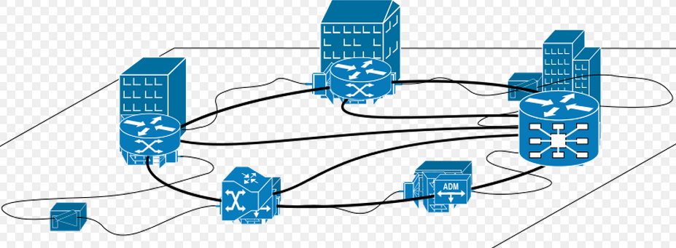
Physical network
Many computers with distinct geolocations are connected together, creating a physical network.
Network connection needs network devices.
  Network interface controller(NIC)
    A computer or server must be network-capable with a working NIC or a network card installed.
    The NIC enables the computer to interact with a network.
  Switch and local area network (LAN)
    Computers are usually connected to a device called a switch, which creates a local area network (LAN).
    Switches are responsible for intelligently routing this network traffic to the appropriate destination.
  Network protocol: TCP/IP
Notes:
To connect to a network, a computer must be network-capable, namely, must installed a working network interface controller (NIC), also known as a network card or network adapter. The NIC enables the computer to interact with a network.
Many computers must use switch to connect together.
Multiple computers interconnecting requires a network device, called switch.
In most business environments, computers are usually connected to a device called a switch, which creates a local area network (LAN).
Switches are responsible for intelligently routing this network traffic to the appropriate destination.
The network communication must need protocols such as TCP/IP.

Slide 60
Virtual network
In virtualization network devices are virtualized, such as vNIC and vSwitch.
Many VMs connected together with virtual network devices create a virtual network.
  Virtual network interface card (vNIC)
    Hypervisor can create one or more vNICs for each VM.
    The vNIC provides the networking capabilities of the VM.
    Each vNIC is identical to a physical NIC.
  Virtual Switch(vSwitch)
    Switch also can be virtualized as a virtual switch.
    Each vNIC is connected to the vSwitch port, and these vSwitch access external physical network through the physical NIC of Physical Server.
  e.g., TAP/TUN
Notes:
1)Similar as physical network, many VMs can be connected together by virtual network devices, creating a virtual network
2)For each VM, the connection to network is by the virtual network card. Hypervisor can create one or more vNICs for each VM and each vNIC is identical to a physical NIC.
3)Switch can also be virtualized as a virtual switch. Each vNIC is connected to the vSwitch port, and these vSwitch access external physical network through the physical NIC of Physical Server.
虚拟机的网络功能由虚拟网卡(vNIC)提供，Hypervisor可以为每个虚拟机创建一个或多个vNIC，站在虚拟机的角度，这些vNIC等同于物理的网卡。为了实现与传统物理网络等同的网络结构，与NIC一样Switch也被虚拟化为虚拟交换机(vSwitch)，各个vNIC链接在vSwitch的端口上，最后这些vSwitch通过物理Server的物理网卡访问外部的物理网络。

Slide 61
TAP/TUN
TAP / TUN
  is a pair of virtual network devices based on Linux kernel implementation.
  is widely used to realize the connection between the VM and PM.
TAP
  is equivalent to an Ethernet device, which operates the second-layer packets such as Ethernet data frames. (can see in linux by ifconfig)
TUN
  simulates the network layer devices, and operate the third layer packet such as IP data packets. ➔router or switch (vSwitch)
Notes:
In order to realize the connection between the VM and PM, it is required a virtual network device to connect.
These virtual network devices are all implemented in software and provide the software on operating system with the same function as hardware on the network.
网络设备的虚拟化
TAP/TUN是Linux内核实现的一对虚拟网络设备，这些虚拟的网络设备全部用软件实现，并向运行于操作系统上的软件提供与硬件的网络设备完全相同的功能。
TAP 等同于一个以太网设备，它操作第二层数据包如以太网数据帧。TUN模拟了网络层设备，操作第三层数据包比如IP数据封包。Linux内核通过TUN/TAP设备向绑定该设备的用户空间的程序发送数据，反之，用户空间的程序也可以像操作硬件网络设备那样，通过TUN/TAP设备发送数据。
基于TAP驱动，即可以实现虚拟网卡的功能，虚拟机的每个vNIC都与Hypervisor中的一个TAP设备相连。当一个TAP设备被创建时，在Linux设备文件目录下将会生成一个对应的字符设备文件，用户程序可以像打开普通文件一样打开这个文件进行读写。

Slide 62
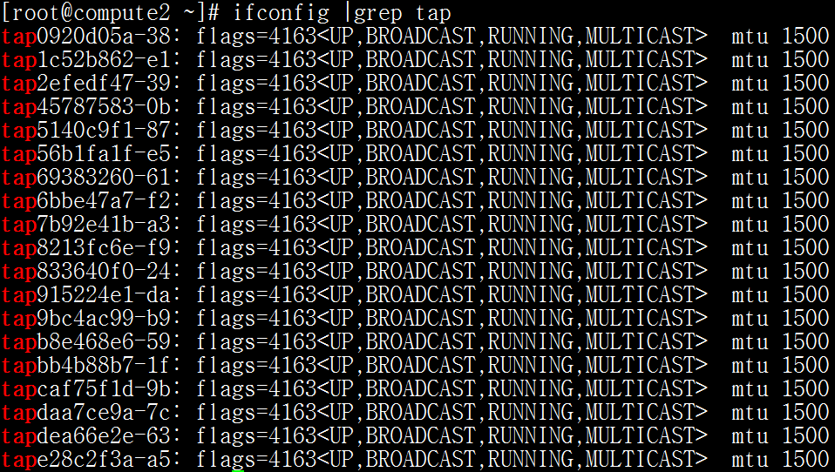
Tap devices in KVM machine
One VM has a tap device

Slide 63
Linux bridge
Linux Bridge
  is a virtual network device working on the second layer
  has the functions similar to the physical switches.
Bridge can
  bind other Linux network device as a slave device, and virtualize the slave device as a port.
VM
OS
vNIC
bridge
PM(host)
NIC
Notes:
网络设备的虚拟化
Linux Bridge(网桥)是工作于二层的虚拟网络设备，功能类似与物理的交换价。
Bridge可以绑定其他Linux网络设备作为从设备，并将这些从设备虚拟化为端口，当一个从设备被绑定到Bridge上时，就相当于真实网络中的交换机端口插入了一个连接有终端的网线。

Slide 64
Network configuration
Networking modes
Example of virtual network configuration

Slide 65
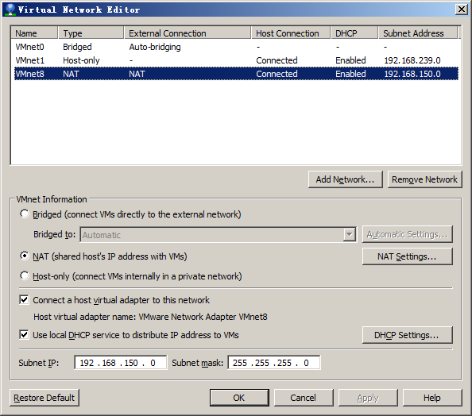
Networking modes
Network address translation (NAT) configures your VM to share the IP and MAC addresses of the host.
  The VM and the host share a single network identity that is not visible outside the network.
  NAT can be useful when you are allowed a single IP address or MAC address by your network administrator.
  You might also use NAT to configure separate VMs for handling http and ftp requests, with both VMs running off the same IP address or domain.
Host-only networking configures your VM to allow network access only to the host.
  This can be useful when you want a secure VM that is connected to the host network, but available only through the host machine.
Bridged networking configures your VM as a unique identity on the network, separate and unrelated to its host.
Notes:
There are three modes you can configure a VM for virtual networking.
The first is NAT. It configures your VM to share the IP and MAC address of the host.
So if the host can link to an outside network, then the VM can also link to an outside network.
在实际使用中，经常需要让一个虚拟机作为一个单独的服务器，拥有一个能被外网访问的IP地址，这时，需要将虚拟机网络连接模式设置为网桥模式。
In practical application, we usually need a VM as a special server machine with a special IP address which can be accessed by outer network.
Then we should use the bridge networking mode to configure the VM network.
Next, I present an example to show how to configure the network with bridge networking mode.

Slide 66
Example： bridge networking
Hardware environment: （centos）
  A host is running centos with virtualization KVM.
    A VM is required to configure the virtual network in bridge mode.
    The host is required to configure a bridge and bind the NIC to this bridge.
Configuration steps
  Step1. modify ifcfg-ethX in host
  Step2. create a new bridge in host
  Step3. modify VM configure file (.xml) in host
  Step4. Connect VM and configure VM network

Slide 67
Step1: modify ifcfg-ethX
1. Modify /etc/sysconfig/network-scripts/ifcfg-ethX. e.g.
  vi /etc/sysconfig/network-scripts/ifcfg-eth0
  -----------------------------------------------------------
  DEVICE=“eth0”
  NM_CONTROLLED=“no”
  ONBOOT=“yes”
  TYPE=Ethernet
  BOOTPROTO=none
  BRIDGE=“br0” #Add this line bind br0
  NAME="System eth0"
  HWADDR=44:37:E6:4A:62:AD
-------------------------------------------
(In host machine)

Slide 68
Step2: create a new bridge in host
Add a new file, /etc/sysconfig/network-scripts/ifcfg-br0.
#---------------------------------------------
DEVICE=“br0”
ONBOOT=“yes”
TYPE=“Bridge” #it’s bridge
BOOTPROTO=static
IPADDR=10.0.112.39 #ip addr.
NETMASK=255.255.255.0 #netmask
GATEWAY=10.0.112.1 #gateway
DEFROUTE=yes
#------------------------------------------------------------------
And restart network device and check bridge interface info.
#service network restart #restart network service
#brctl show #show bridge list
bridge name bridge id STP enabled interfaces
br0 8000.4437e64a62ad no eth0 #bind eth0
Notes:
添加/etc/sysconfig/network-scripts/ifcfg-br0的配置文件，比如
DEVICE=“br0”
ONBOOT=“yes”
TYPE=“Bridge”
BOOTPROTO=static
IPADDR=10.0.112.39 #ip 地址
NETMASK=255.255.255.0 #掩码
GATEWAY=10.0.112.1 #网管
DEFROUTE=yes
重启网络，校验桥接接口
#service network restart
#brctl show
bridge name bridge id STP enabled interfaces
br0 8000.4437e64a62ad no eth0

Slide 69
Step3. Modify VM configure file (.xml)
Add the following code to VM configure file XXX.xml:（XXX is filename）
<devices>
<interface type='bridge'>
<source bridge='br0'/>
<target dev='vnet0'/>
<mac address="00:11:22:33:44:55"/>
</interface>
</device>
Boot the VM to check network link valid or not.
#virsh create XXX.xml
#brctl show
bridge name bridge id STP enabled interfaces
br0 0.4437e64a62ad no eth0 vnet0
Notes:
虚拟网络模式
2.修改虚拟机配置文件，增加如下内容
<devices>
<interface type='bridge'>
<source bridge='br0'/>
<target dev='vnet0'/>
<mac address="00:11:22:33:44:55"/>
</interface>
</device>
启动虚拟机，验证网口接口是否正常
#virsh create XXX.xml
#brctl show
bridge name bridge id STP enabled interfaces
br0 0.4437e64a62ad no eth0 vnet0

Slide 70
Step4. Connect VM and configure VM network
Use vnc to connect VM. Firstly use virsh dumpxml to view the vnc interface number. Then use virt-viewer to connect to the VM.
virt-viewer localhost:5901
Login the VM and complete the network configuration. The operation in VM is the same as physical machine.
Notes:
虚拟网络模式
3.使用vnc连接虚拟机，进行网络配置
使用virt-viewer通过vnc端口连接虚拟机，如果在配置文件中虚拟机使用自动分配vnc端口，则可以使用virsh dumpxml查看虚拟机运行时vnc端口号
#virt-viewer localhost:5901
登陆后进行虚拟机的网络配置(和物理机的网络配置相同)

Slide 71
Summary
What is virtualization
Virtualization technology implementation principles
  CPU, Memory, IO virtualization
Virtualization tools
  KVM, Xen, Docker
Two problems in practical application
  Manage VM images
  Virtual network concepts

Slide 72
End
Thank You!

