Slide 1
Managing OpenNebula
OpenNebula Interfaces
Stefano Lusso – INFN Torino

Slide 2
Managing OpenNebula
Hypervisor
Sunstone
CLI (one* command)
virsh
Orchestrator
Be careful of consistency

Slide 3
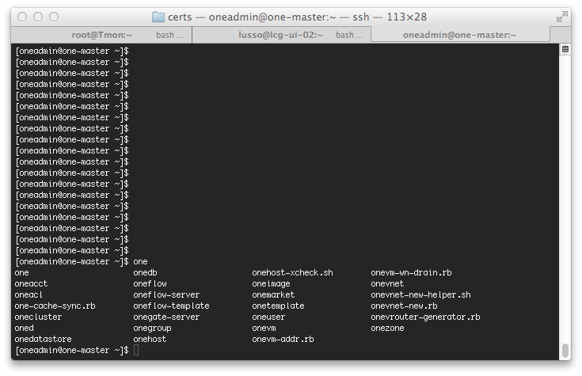
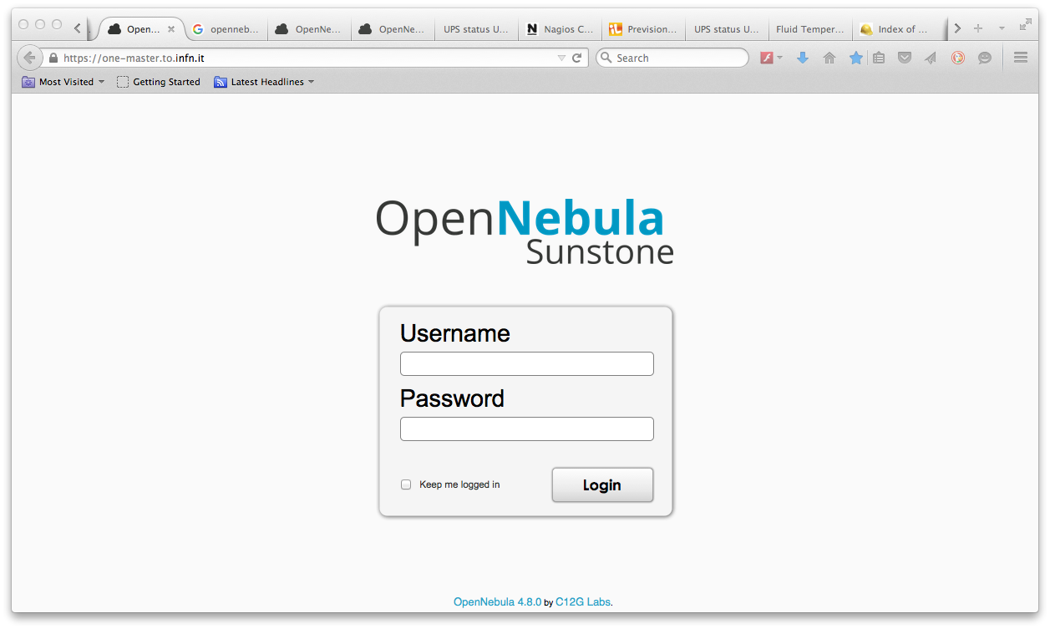
CLI and Sunstone

Slide 4
Managing the infrastructure
OpenNebula Infrastructure
Cluster
Host
Datastores
Virtual Network

Slide 5
Managing the virtual resource
OpenNebula Virtual resource
Virtual Machine
Template
Images
Template + Image + Network -> Virtual Machine
$ onetemplate instantiate “MyNode”

Slide 6
Managing hosts
$ onehost list
ID | NAME | CLUSTER | RVM | ALLOCATED_CPU | ALLOCATED_MEM | STAT
97 | one-kvm-01 | Workers | 1 | 600 / 2400 (25%) | 15G / 62.9G (23%) | on
98 | one-kvm-02 | Workers | 1 | 600 / 2400 (25%) | 15.1G / 62.9G (24%) | on
100 | one-kvm-04 | Workers | 1 | 800 / 2400 (33%) | 20G / 62.9G (31%) | update
240 | one-kvm-71 | Workers | 1 | 700 / 3200 (21%) | 15.5G / 126G (12%) | update
266 | one-kvm-82 | Workers | 2 | 1600 / 4000 (40%) | 40G / 157.4G (25%) | on
DEFAULT_SCHED = [ Policy = 1 ]
Striping: Maximize resources available for the VMs by spreading the VMs in the hosts

Slide 7
Managing hosts

Slide 8
Managing hosts
Adding host

Slide 9
Managing hosts
enabling host
$ onehost show one-kvm-69
HOST 203
INFORMATION ID : 203
NAME : one-kvm-69
CLUSTER : Workers
STATE : DISABLED
IM_MAD : im_kvm
VM_MAD : vmm_kvm
VN_MAD : ebtables
LAST MONITORING TIME : 09/03 11:25:07
$ onehost list | grep one-kvm-69
ID NAME CLUSTER RVM ALLOCATED_CPU ALLOCATED_MEM STAT
203 one-kvm-69 Workers 0 - - off
$ onehost enable one-kvm-69
$ onehost list | grep one-kvm-69
203 one-kvm-69 Workers 0 - - init
$ onehost list | grep one-kvm-69
203 one-kvm-69 Workers 0 0 / 3200 (0%) 0K / 126G (0%) on

Slide 10
Managing VM
VM listing
$onevm list
ID USER GROUP NAME STAT UCPU UMEM HOST TIME
18243 compass ec2 ec2-m1-large runn 303 15G one-kvm-34 0d 19h09
18252 oneadmin oneadmin WN-EC2-8slots runn 601 20.1G one-kvm-44 0d 18h43
18259 oneadmin oneadmin WN-EC2-8slots runn 799 20.1G one-kvm-43 0d 16h38
18260 oneadmin oneadmin WN-EC2-8slots runn 502 20.2G one-kvm-45 0d 16h16
18261 oneadmin oneadmin WN-EC2-8slots runn 613 20.2G one-kvm-46 0d 15h49
18262 oneadmin oneadmin WN-EC2-8slots runn 601 20.1G one-kvm-55 0d 15h27
18263 oneadmin oneadmin WN-EC2-8slots runn 671 20G one-kvm-64 0d 01h57
18265 ebes oneadmin BESIII-WN runn 0 15G one-kvm-49 0d 00h34
18266 oneadmin oneadmin WN-EC2-8slots runn 55 20G one-kvm-45 0d 00h23

Slide 11
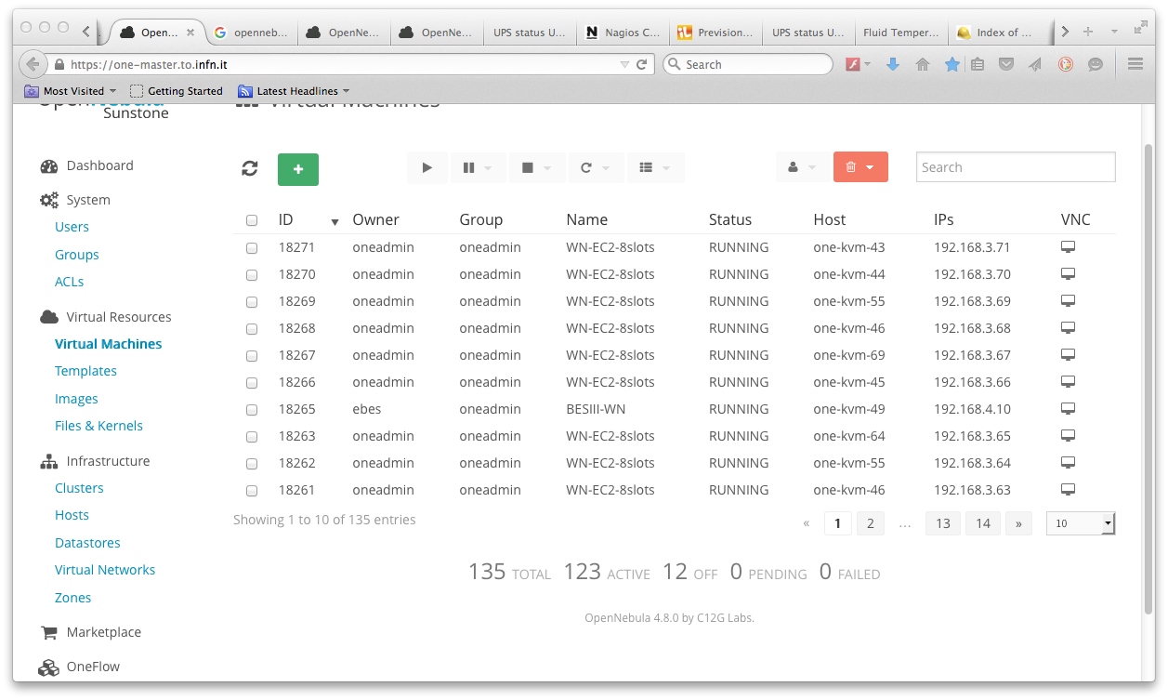
Managing VM
VM listing

Slide 12
Managing VM
VM suspend
$ onevm list
ID USER GROUP NAME STAT UCPU UMEM HOST TIME
18272 oneadmin oneadmin WN-EC2-8slots runn 34 20G one-kvm-57 0d 00h21
[root@one-kvm-57 ~]# virsh list
Id Name State
----------------------------------------------------
3 one-18200 running
7 one-18272 running
$ onevm suspend 18272
$ onevm list
18272 oneadmin oneadmin WN-EC2-8slots save 1 20G one-kvm-57 0d 00h22
[root@one-kvm-57 ~]# virsh list
Id Name State
----------------------------------------------------
one-18200 running
7 one-18272 paused
$ onevm list
18272 oneadmin oneadmin WN-EC2-8slots susp 0 0K one-kvm-57 0d 00h23

Slide 13
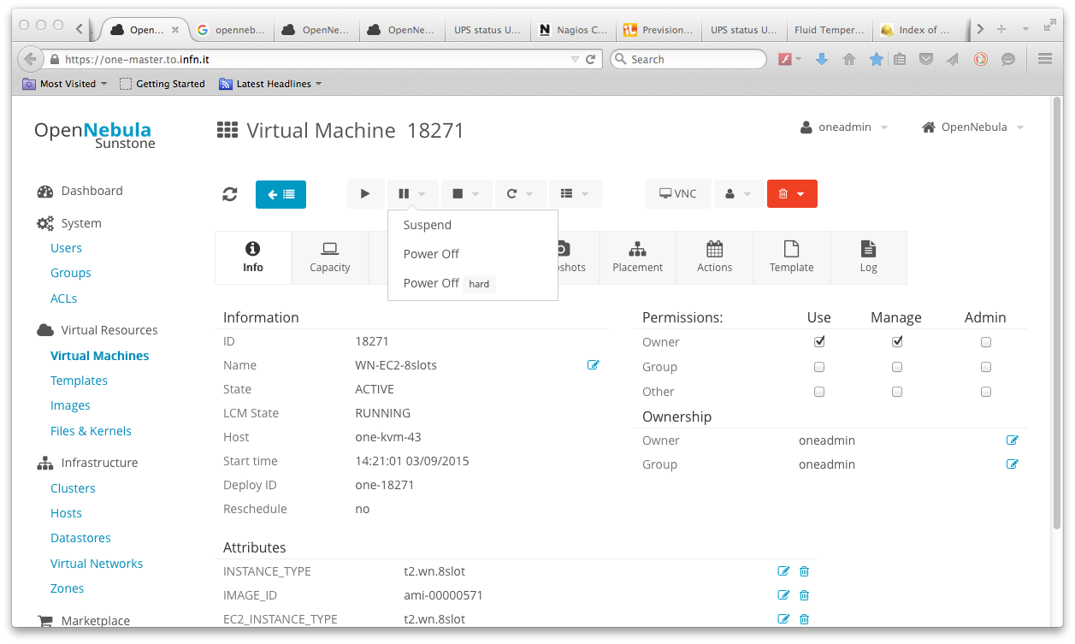
Managing VM
VM suspend

Slide 14
Managing VM
VM suspend - checkpoint
[root@one-kvm-57 18272]# ls –alh /var/lib/one/datastores/0/18272
total 5.3G
-rw-rw-rw- 1 oneadmin oneadmin 3.2G Sep 3 15:25 checkpoint
-rw-rw-r-- 1 oneadmin oneadmin 1.2K Sep 3 15:02 deployment.0
-rw-r--r-- 1 oneadmin oneadmin 1.9G Sep 3 15:24 disk.0
-rw-rw-r-- 1 oneadmin oneadmin 157G Sep 3 15:24 disk.1
-rw-r--r-- 1 oneadmin oneadmin 384K Sep 3 15:02 disk.2
lrwxrwxrwx 1 oneadmin oneadmin 40 Sep 3 15:02 disk.2.iso -> /var/lib/one/datastores/109/18272/disk.2
$ onehost show one-kvm-57 | tail
VIRTUAL MACHINES
ID USER GROUP NAME STAT UCPU UMEM HOST TIME
18200 compass ec2 ec2-m1-large runn 599 15G one-kvm-57 2d 03h26
18272 oneadmin oneadmin WN-EC2-8slots susp 0 0K one-kvm-57 0d 00h24

Slide 15
Managing VM
VM resume
$ onevm resume 18272
[root@one-kvm-57 18272]# virsh list
Id Name State ----------------------------------------------------
one-18200 running
8 one-18272 shut off
running

Slide 16
Managing VM
hypervisor reboot (may happen)
$ onevm list | grep one-kvm-41
ID USER GROUP NAME STAT UCPU UMEM HOST TIME
23993 ebes bes BESIII-WN unkn 0 15G one-kvm-41 108d 22h48
24287 oneadmin oneadmin WN-EC2-8slots unkn 799 20G one-kvm-41 28d 00h17
24333 fermi ec2 ec2-m1-small unkn 0 2.5G one-kvm-41 17d 22h29
[root@one-kvm-41 24287]# ls –al /mnt/VirtualMachines/running/24287
-rw-rw-r-- 1 oneadmin oneadmin 1217 May 9 09:45 deployment.0
-rw-r--r-- 1 oneadmin oneadmin 2309357568 Jun 3 15:55 disk.0
-rw-rw-r-- 1 oneadmin oneadmin 167772160001 Jun 3 15:55 disk.1
-rw-r--r-- 1 oneadmin oneadmin 393216 May 9 09:45 disk.2
lrwxrwxrwx 1 oneadmin oneadmin 40 May 9 09:45 disk.2.iso -> /var/lib/one/datastores/109/24287/disk.2
[
root@one-kvm-41 24287]# virsh create deployment.0
Domain one-24287 created from deployment.0
[root@one-kvm-41 24287]# virsh list
Id Name State
----------------------------------------------------
1 one-24287 running
$ onevm list | grep 24287
24287 oneadmin oneadmin WN-EC2-8slots runn 111 20G one-kvm-41 28d 00h25
$ onevm list | grep one-kvm-41
23993 ebes bes BESIII-WN runn 10 15G one-kvm-41 108d 23h24
24287 oneadmin oneadmin WN-EC2-8slots runn 32 20G one-kvm-41 28d 00h54
24333 fermi ec2 ec2-m1-small runn 0 2.5G one-kvm-41 17d 23h05
The orchestrator has no
info about VMs
May cause inconsistency!

Slide 17
Managing VM
VM live migration
$ onevm migrate --live 18296 one-kvm-srv-01
$ onevm list| grep 18296
18296 oneadmin oneadmin EC2-TEST-SERVIC migr 0 8G one-kvm-srv-01 0d 00h16
$ onevm list | grep 18296
18296 oneadmin oneadmin EC2-TEST-SERVIC unkn 1 8G one-kvm-srv-01 0d 00h18
$ onevm list | grep 18296
18296 oneadmin oneadmin EC2-TEST-SERVIC runn 1 8G one-kvm-srv-05 0d 00h18
KVM-01
KVM-05

Slide 18
Managing users
users listing
$ oneuser list
ID NAME GROUP AUTH VMS MEMORY CPU
0 oneadmin oneadmin core - - -
[…]
53 compass ec2 core 18 / 18 257.5G / - 103.0 / 103
54 giunti ec2 core 8 / 10 120G / 125G 48.0 / 48.0
59 saletta ec2 core 0 / 18 0M / 46.9G 0.0 / 18.0
61 rdh ec2 core 3 / 18 41.7G / - 18.0 / 48.0

Slide 19
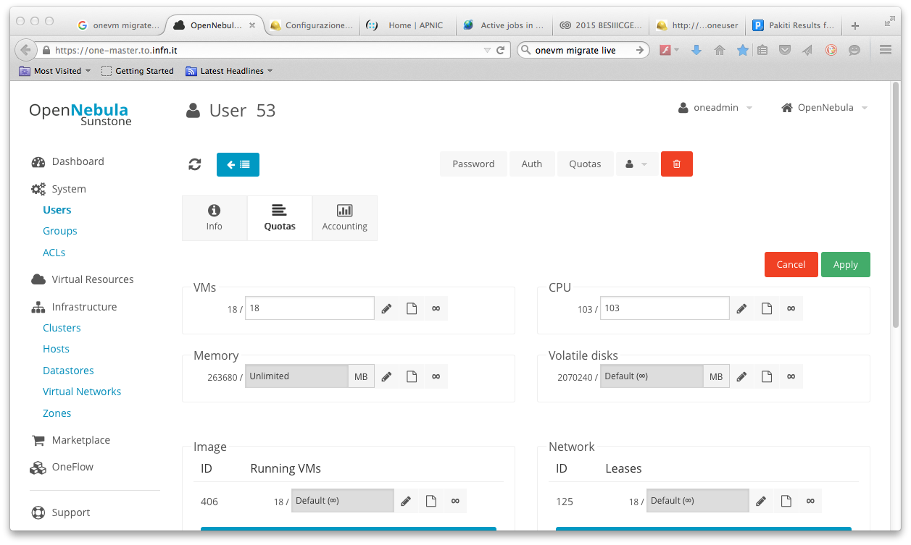
Managing users
user quota

Slide 20
Managing users
user show
$ oneuser show compass
USER 53 INFORMATION
ID : 53
NAME : compass
GROUP : ec2
RESOURCE USAGE & QUOTAS
NUMBER OF VMS MEMORY CPU VOLATILE_SIZE
18 / 18 257.5G / - 103.00 / 103.00 2T / -
DATASTORE ID IMAGES SIZE
104 1 / - 4.9G / -
106 1 / - 1.9T / -
100 1 / - 2.2G / -
NETWORK ID LEASES
125 18 / -
IMAGE ID RUNNING VMS
406 18 / -
$ oneuser quota compass =======> edit

Slide 21
Managing datastores
Datastores types and Transfer Manager
OpenNebula has 3 different datastore types:
System, to hold images for running VMs: copies of the original image, qcow deltas or simple filesystem links.
Images, stores the disk images repository. Disk images are moved, or cloned to/from the System datastore when the VMs are deployed or shutdown; or when disks are attached or snapshoted.
Files, a special datastore used to store plain files and not disk images (kernels, ramdisks or context files)
OpenNebula has different ways to distribute datastore images to the hosts (Transfer Manager):
shared, the datastore is exported in a shared filesystem to the hosts.
ssh, datastore images are copied to the remote hosts using the ssh protocol (scp)
vmfs, image copies are done using the vmkfstools (VMware filesystem tools)
qcow, a driver specialized to handle qemu-qcow format and take advantage
of its snapshoting capabilities
ceph, a driver that delegates to libvirt/KVM the management of Ceph RBDs.
lvm, images are stored as LVs in a cLVM volume (cluster).

Slide 22
Managing datastores
datastores listing
$ onedatastore list
ID NAME SIZE AVAIL CLUSTER IMAGES TYPE DS TM
0 system_servic 1.8T 90% Services 0 sys - shared
1 default 2T 68% - 48 img fs shared
2 files 115.1G 22% - 15 fil fs ssh
100 cached_qcow 2T 68% Workers 12 img fs qcow2
101 cached_raw 2T 68% Workers 2 img fs shared
103 persistent_da.. 115.1G 22% - 3 img fs ssh
104 persistent_da.. 2.2T 45% - 6 img fs ssh
105 persistent_da.. 2.1T 34% - 19 img iscsi iscsi
106 persistent_da.. 0M - - 7 img iscsi iscsi
109 system_worker - - Workers 0 sys - ssh
Iscsi datastores are neither shared nor transferred.
A symlink is created by iscsi tool on the hypervisor in /dev tree

Slide 23
Managing datastores
datastores on hypervisor
$ ssh one-kvm-69 "ls -al /var/lib/one/datastores"
total 32
drwxr-xr-x 6 oneadmin oneadmin 4096 Jan 27 2015 .
drwx------ 4 oneadmin oneadmin 4096 Jan 27 2015 ..
drwxr-xr-x 3 oneadmin oneadmin 4096 Sep 3 11:30 0
drwxr-x--- 5 oneadmin oneadmin 8192 Sep 2 13:53 1
drwxr-xr-x 2 oneadmin oneadmin 4096 Jul 21 18:08 100
drwxr-xr-x 2 oneadmin oneadmin 4096 Jul 16 11:13 101
lrwxrwxrwx 1 oneadmin oneadmin 25 Jan 27 2015 109 -> /var/lib/one/datastores/0
$ ssh one-kvm-69 "ls -alh /var/lib/one/datastores/0/18267”
-rw-rw-r-- 1 oneadmin oneadmin 1.2K Sep 3 11:30 deployment.0
-rw-r--r-- 1 oneadmin oneadmin 2.0G Sep 4 17:40 disk.0
-rw-rw-r-- 1 oneadmin oneadmin 157G Sep 4 17:40 disk.1
-rw-r--r-- 1 oneadmin oneadmin 384K Sep 3 11:30 disk.2
$ ssh one-kvm-69 "virsh list"
Id Name State
----------------------------------------------------
1 one-18267 running
Running VM system datastore
images datastore

Slide 24
Managing datastores
datastore show
$ onedatastore show 100
DATASTORE 100 INFORMATION
ID : 100
NAME : cached_qcow
USER : oneadmin
GROUP : oneadmin
CLUSTER : Workers
TYPE : IMAGE
DS_MAD : fs
TM_MAD : qcow2
BASE PATH : /var/lib/one/datastores/100
[…]
IMAGES
179
344
370
406
560
571
606
[…]

Slide 25
Managing datastores
datastores on Hypervisor
[root@one-kvm-69 ~]# ls -alh /var/lib/one/datastores/100
total 36G
drwxr-xr-x 2 oneadmin oneadmin 4.0K Jul 21 18:08 .
drwxr-xr-x 6 oneadmin oneadmin 4.0K Jan 27 2015 ..
-rw-r--r-- 1 oneadmin oneadmin 2.4G Dec 23 2014 301366810110b9d0d38a567608276d18
-rw-r--r-- 1 oneadmin oneadmin 1.1G Jul 17 17:45 36a5c526f085e08ad76a8e33b20f5e68
-rw-r--r-- 1 oneadmin oneadmin 3.9G Jun 16 15:49 37e84acd3f209bacad7cef0981294770
-rw-r--r-- 1 oneadmin oneadmin 4.0G Mar 23 10:39 415cc735930d89d44e786d16d13953ca
-rw-r--r-- 1 oneadmin oneadmin 1.6G Mar 18 16:55 575e3d39ce965436375e6b1b762bcd91
-rw-r--r-- 1 oneadmin oneadmin 4.5G Jul 8 10:42 63f3d63f089c6448942b8e281312971e
-rw-r----- 1 oneadmin oneadmin 4.2G Jan 24 2014 9216c7d53b8e77c72c62a4f47d1b9c28
-rw-r--r-- 1 oneadmin oneadmin 2.8G Jul 21 18:05 9f074f4bd1a8531cbff6a012b5bc2844
-rw-r--r-- 1 oneadmin oneadmin 2.5G Jan 30 2015 abcf34d68eb440fe1d08acae11fcc038
-rw-rw---- 1 oneadmin oneadmin 1.4G Mar 19 2014 c224ac762be10303cfc23959387d42df
-rw-r--r-- 1 oneadmin oneadmin 2.8G Jul 21 17:46 df10ca879f32624873f27cf5020272cb
-rw-rw---- 1 oneadmin oneadmin 2.2G May 21 2014 ede7f7f37ff49f144e1e7860c6fffa01
-rw-rw---- 1 oneadmin oneadmin 2.3G Jun 4 2014 f403170329468977ee7c406a57d2ed3b

Slide 26
Managing datastores
Image file in datastore
$ oneimage show 571
IMAGE 571 INFORMATION
ID : 571
NAME : WN-CentOS6-CloudInit-v11
DATASTORE : cached_qcow
TYPE : OS
PERSISTENT : No
SOURCE : /var/lib/one/datastores/100/abcf34d68eb440fe1d08acae11fcc038
FSTYPE : save_as
STATE : used
RUNNING_VMS : 49
[…]
]$ qemu-img info /var/lib/one/datastores/100/abcf34d68eb440fe1d08acae11fcc038
file format: qcow2
virtual size: 80G (85899345920 bytes)
disk size: 2.5G
VIRTUAL MACHINES
ID USER GROUP NAME STAT UCPU UMEM HOST TIME
11812 jlab12 ec2 ec2-m1-medium runn 0 7.5G one-kvm-06 208d 18h30
$ onevm list | grep one-kvm-06
11812 jlab12 ec2 ec2-m1-medium runn 0 7.5G one-kvm-06 213d 09h48
16129 sfarm ec2 ec2-m1-large poff 0 0K one-kvm-06 69d
[root@one-kvm-06 ~]# ls -alh /var/lib/one/datastores/100
[…]
-rw-r--r-- 1 oneadmin oneadmin 2.5G Jan 30 2015 abcf34d68eb440fe1d08acae11fcc038

Slide 27
Managing network
vnet listing
$ onevnet list
ID USER GROUP NAME CLUSTER BRIDGE LEASES
20 oneadmin oneadmin Grid-Services-Priva - br0 13
21 oneadmin oneadmin Grid-Services-Publi - br1 15
32 oneadmin oneadmin VRouter-Pub - br1 16
35 oneadmin oneadmin T2-Dummy-Prv - br0 6
36 oneadmin oneadmin T2-PROOF-Prv - br0 64
37 oneadmin oneadmin T2-VWN-Prv - br0 60

Slide 28
Managing network
vnet show
$ onevnet show 37
VIRTUAL NETWORK 37 INFORMATION
ID : 37
NAME : T2-VWN-Prv
USER : oneadmin
GROUP : oneadmin
CLUSTER : -
BRIDGE : br0
VLAN : No
USED LEASES : 60
VIRTUAL NETWORK TEMPLATE
BRIDGE="br0"
NETWORK_MASK="255.255.255.0”
ADDRESS RANGE POOL
AR TYPE SIZE LEASES MAC IP GLOBAL_PREFIX
0 IP4 254 60 02:00:c0:a8:03:01 192.168.3.1 -
LEASES
AR OWNER MAC IP IP6_GLOBAL
0 VM : 18102 02:00:c0:a8:03:15 192.168.3.21 -
[…]
0 VM : 18302 02:00:c0:a8:03:52 192.168.3.82 -

