Slide 1
Introduction to CVMFS A way to distribute HEP software on cloud
Tian Yan
(IHEP Computing Center, yant@ihep.ac.cn)
2016 BESIIICGEM Cloud Computing Summer School
2016/07/21, Shandong University, Jinan

Slide 2
Outline
Overview
How does CVMFS work?
Install and configure CVMFS server and client
Debugging
Summary

Slide 3
OVERVIEW
Part I

Slide 4
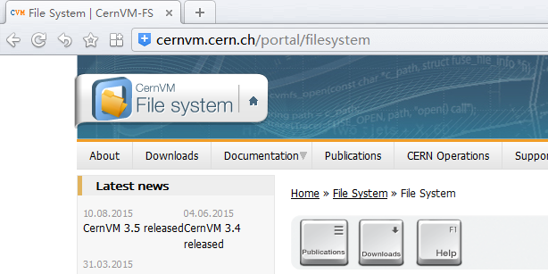
What is CVMFS?
CVMFS = CERNVM File System
POSIX read-only network file system based on HTTP
designed and optimized for HEP software distribution
official site: http://cernvm.cern.ch/portal/filesystem

Slide 5
Why we use it?
Widely used in HEP community
developed in CERN and widely used in WLCG
Fast
based on HTTP, allow exploitation of web caches (e.g. squid, commercial content delivery networks)
aggressively cached to reduce latency
transfer data and metadata on demand
Flexible
filesystem versioning and hotpatching file-by-file
software in VM/Docker image need further packaged

Slide 6
Why we use it?
Scalable
stratum 0 (release manager machine), stratum 1(mirror)
automatic mirror server selection based on geographic proximity
use web/local cache to reduce direct access to server
Reliable
it verifies data integrity by cryptographic hashes
Easy to install, configure and maintain
based on HTTP, firewall friendly
can be installed by one shell script
it’s stable

Slide 7
How does it work?
Part II

Slide 8
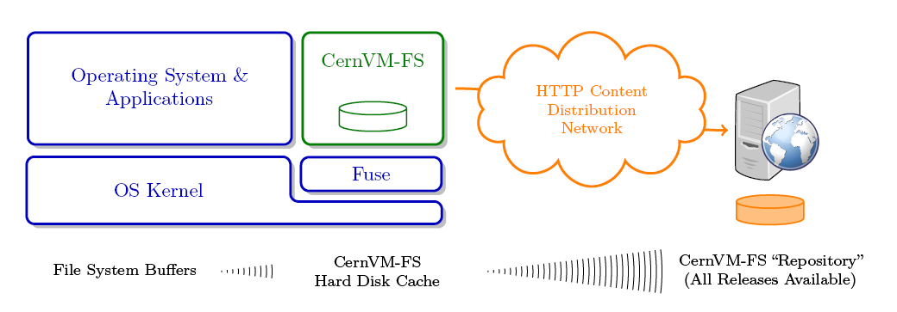
A glance
left side is client; right side is server with http interface
virtual filesystem based on FUSE in user space
load data only on access

Slide 9
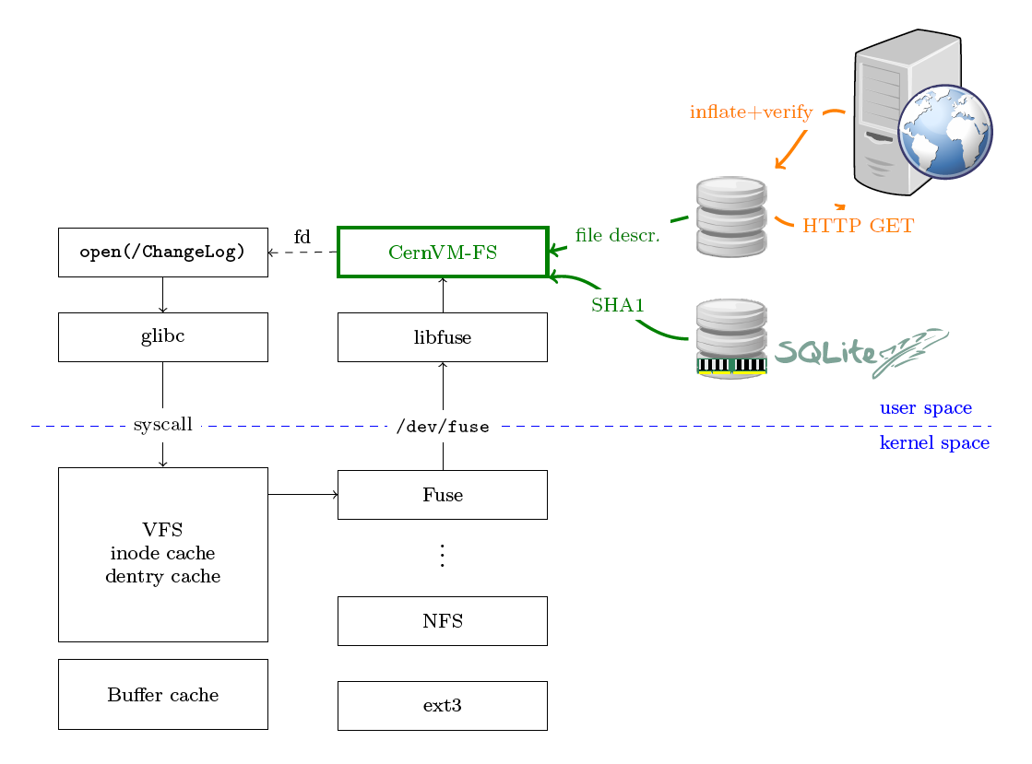
Openning a file on CVMFS
FUSE: filesystem in user space
metadata stored in SQLite DB

Slide 10
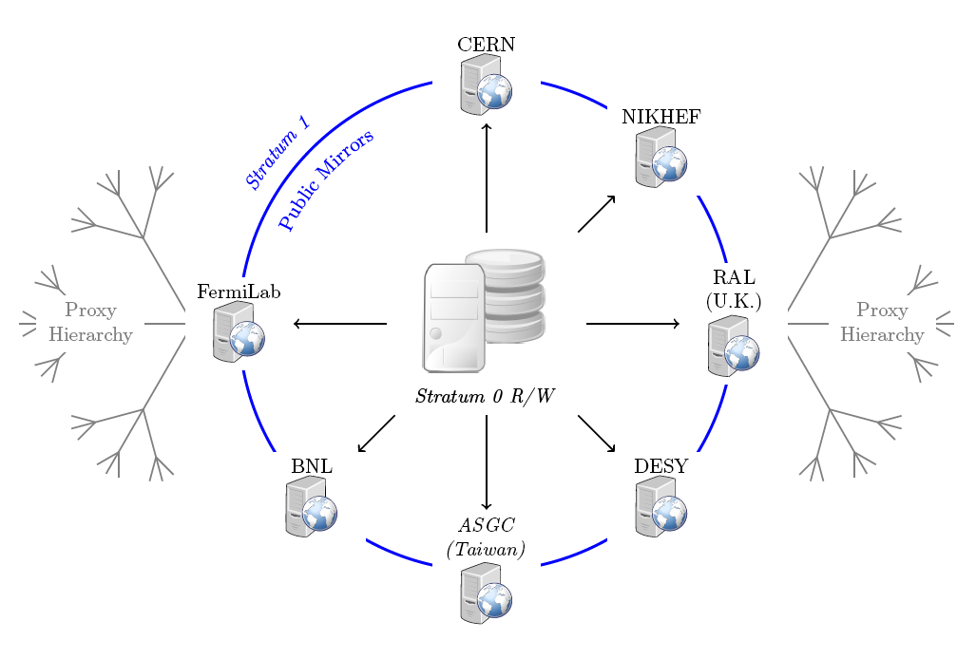
CVMFS server stratums
for cern.ch dormain

Slide 11
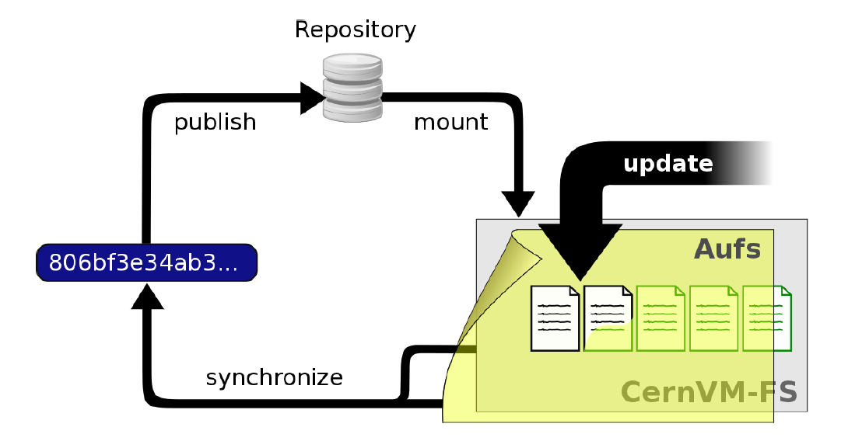
CVMFS repository
CVMFS repository is a form of content-addressable storage
publish: create file catalog, compress data, calculate hash

Slide 12
How to install, configure and debug it?
Part III

Slide 13
Install stratum 0 server
Install AUFS-enabled kernel on SL6
# wget https://ecsft.cern.ch/dist/cvmfs/cvmfs-release/cvmfs-release-latest.noarch.rpm
# yum install cvmfs-release*.rpm
# yum –disablerepo=“*” –enablerepo=“cernvm-kernel” install kernel
# yum –enablerepo=“cernvm-kernel” install aufs2-util
# reboot
Install cvmfs packages
# yum install cvmfs cvmfs-server

Slide 14
Creating a repository
create a repository (bes3.ihep.ac.cn)
# cvmfs_server mkfs bes3.ihep.ac.cn
update the repository
# cvmfs_server transaction bes3.ihep.ac.cn
add/edit/delete files/directories in /cvmfs/bes3.ihep.ac.cn
publish the repository
# cvmfs_server publish bes3.ihep.ac.cn
if you want to clear all changes and start over again:
# cvmfs_server abort bes3.ihep.ac.cn

Slide 15
Paths in CVMFS server
Some notable file paths in cvmfs server
/srv/cvmfs, /srv/cvmfs/<fqrn>, /var/spool/cvmfs can be symlinked to another location before creating the repository
Path | Description
/cvmfs | repository mount point, read-only AUFS mountpoints
/srv/cvmfs | central repo. storage location
/srv/cvmfs/<fqrn> | storage location of a specific repo.
/var/spool/cvmfs | internal states of the repo.
/etc/cvmfs | configuration files and keychains

Slide 16
Install client
Install cvmfs packages:
# yum install cvmfs cvmfs-config-default
create a file /etc/cvmfs/default.local with content:
CVMFS_REPOSITORIES=bes3.ihep.ac.cn
CVMFS_HTTP_PROXY=DIRECT
CVMFS_CACHE_BASE=/path/to/your/cache/dir
CVMFS_QUOTA_LIMIT=10240
create file /etc/cvmfs/config.d/bes3.ihep.ac.cn with content:
CVMFS_SERVER_URL=http://your.server/cvmfs/bes3.ihep.ac.cn
CVMFS_PUBLIC_KEY=/etc/cvmfs/keys/bes3.ihep.ac.cn.pub

Slide 17
Install client
copy the key in CVMFS server to the same dir in client:
/etc/cvmfs/keys/bes3.ihep.ac.cn.pub
setup
# setenforce 0
# cvmfs_config setup
# service autofs restart
check if it can be mounted
# cvmfs_config probe

Slide 18
Debugging
Check if misconfiguration exist
# cvmfs_config chksetup
show all the configuration parameters
# cvmfs_config showconfig bes3.ihep.ac.cn
to exclude autofs/automount as a source of problem, try to mount repo. manually
# mount –t cvmfs bes3.ihep.ac.cn /mnt/cvmfs
to exclude SELinux as a source of problem, disable it by
# setenforce 0

Slide 19
Summary
CVMFS is a widely used filesystem to distributed HEP software in grid, cloud, and cluster sites over WAN
It’s a POSIX read-only network filesystem based on FUSE, HTTP, AUFS etc.
You can try setting up a server and client on VMs.
Thank you!

