Slide 1

SPPC High Field Magnets -
Preliminary Design Study and R&D Steps
Qingjin XU
On behalf of the SPPC magnet working group
Institute of High Energy Physics (IHEP)
Chinese Academy of Sciences (CAS)
2016.4.28

Slide 2
Requirements of the SPPC Magnets
SPPC
50/100 km in circumference
C.M. energy 70 TeV or higher
Timeline
Pre-study: 2013-2020
R&D: 2020-2030
Eng. Design: 2030-2035
Construction: 2035-2042
Main dipoles
Field strength: 20 Tesla
Aperture diameter: 40~50 mm
Field quality: 10⁻⁴ at the 2/3 aperture radius
Outer diameter: 900 mm in a 1.5 m cryostat
Tunnel cross section: 6 m wide and 5.4 m high
Qinhuangdao
The CEPC-SPPC ring sited in Qinhuangdao,
50 km and 100 km options .
SPPC accelerator complex
6-m Tunnel for CEPC-SPPC. Left: SPPC collider. Right: CEPC collider (bottom) and Booster (top)
Refer to CEPC-SPPC Pre-CDR, Mar. 2015: http://cepc.ihep.ac.cn/preCDR/volume.html

Slide 3
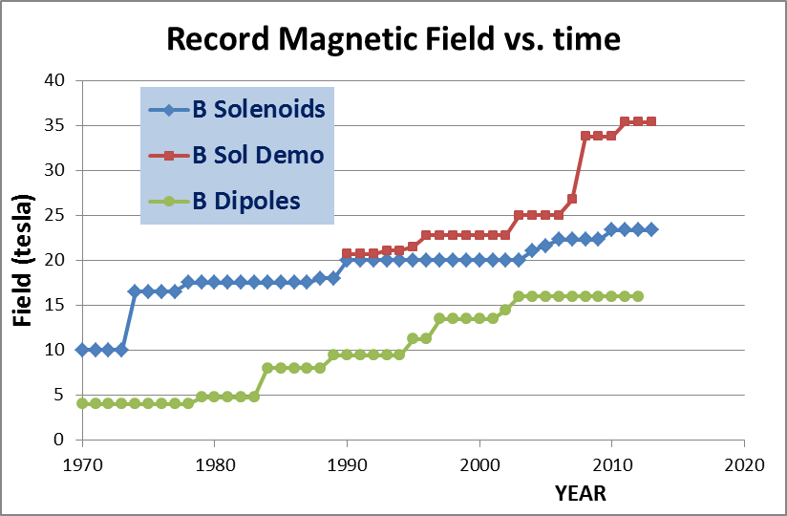
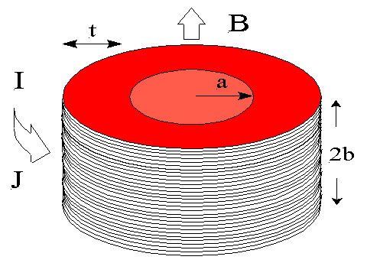
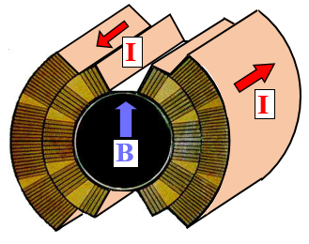
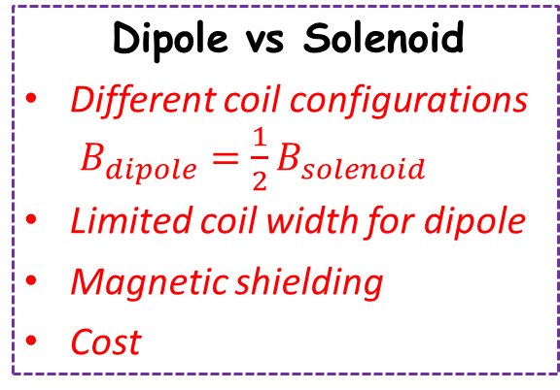
Why 20-T Dipole Is Difficult ?
Dipole vs Solenoid
Different coil configurations
$B_{dipole}=\frac{1}{2}B_{solenoid}$
Limited coil width for dipole
Magnetic shielding
Cost
Dipole
Solenoid
J_{e} – Current density
t – Coil thickness
J_{e} – Current density
t – Coil thickness
LHC dipole
Martin Wilson
Lucio Rossi

Slide 4
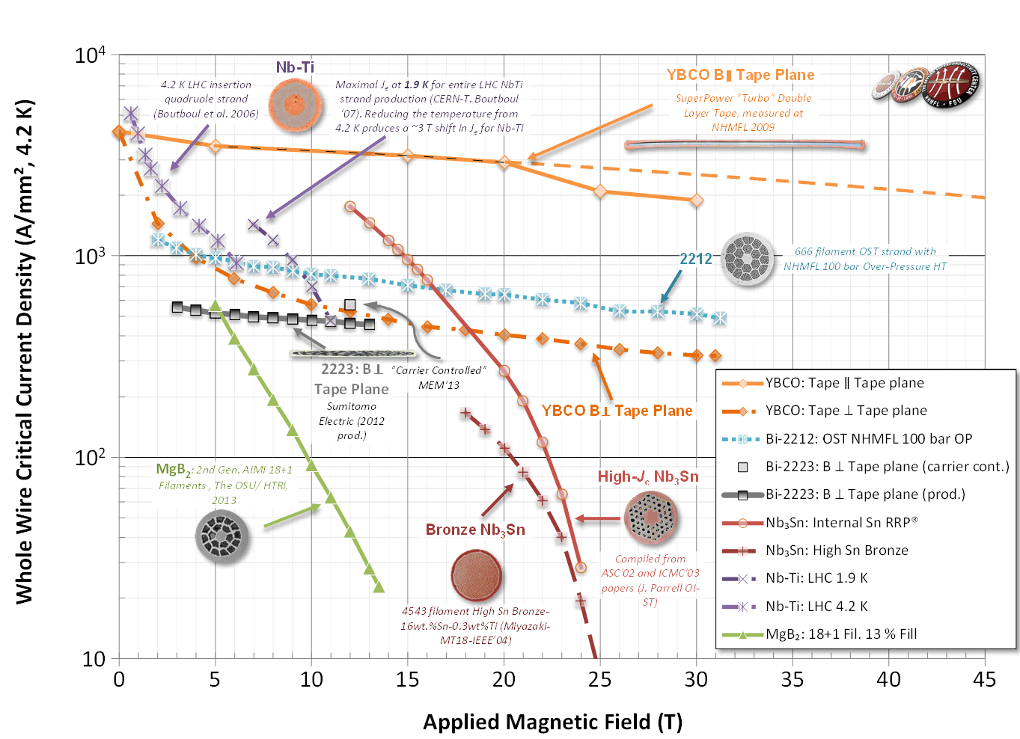
Performance of Superconductors
WHOLE WIRE critical current density of main superconductors @ 4.2 K
Peter Lee
500 A/mm²
NbTi:
11 T @ 1.9K
Nb₃Sn (Nb₃Al)
17 T @ 4.2 K

Slide 5
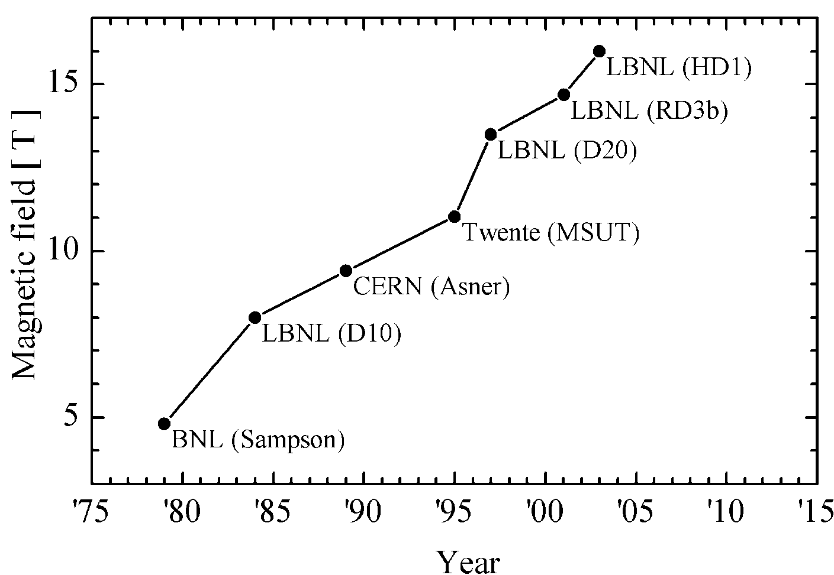
R&D History of Nb₃Sn Dipole Magnets
Results achieved with Nb₃Sn dipole technology test
16 T achieved with block type configuration (HD1 @ LBNL, 2003)
15 T achieved with common coil configuration (RD3 @ LBNL, 2001)
Results achieved with accelerator level field quality and bore
14 T achieved with block type configuration (HD2 @ LBNL, 2007)
13 T achieved with Cos-theta configuration (D20 @LBNL, 1997)
20 T
HTS
D.R. Dietderich, A. Godeke, Cryogenics 48, (2008)
Nb₃Sn
(no bore)
(no bore)
IHEP
(Single bore)
LBNL(RD3C)
(Two 35 mm bore)
NbTi
(LHC NbTi dipole 8.3 T)

Slide 6
Challenges and R&D Focus of the 20-T Accelerator Magnets
J_{c} and cost of Superconductors: Based on the present J_{c} level, thousands of tons of Nb₃Sn and HTS superconductors are needed to fabricate SPPC magnets. Significant increase of J_{c} and reduction of cost of superconductors are expected.
HTS coils for accelerator magnets, especially tape conductors: field quality (current distribution, magnetization effect,…), quench protection and fabrication method.
Magnetic force in superconducting coils at 20 T: F ̴ B². And both Nb₃Sn and HTS superconductors are strain sensitive! Needs innovative strain management for superconducting coils.

Slide 7
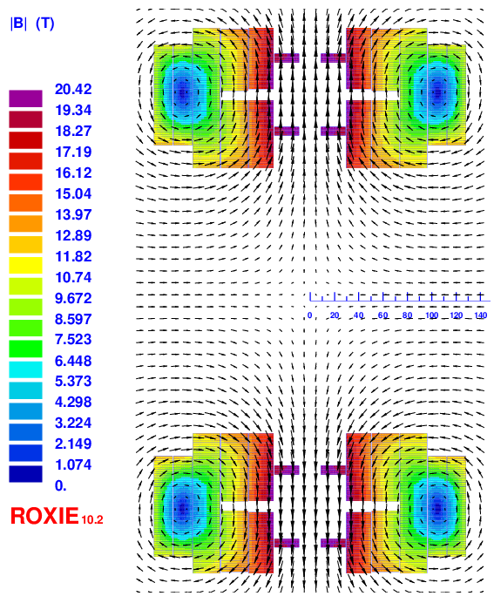
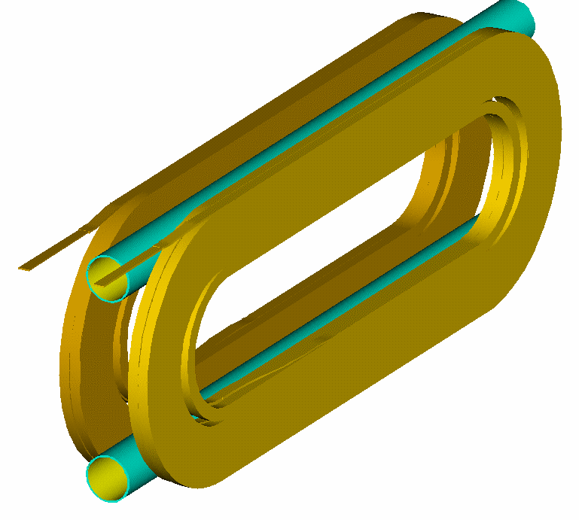
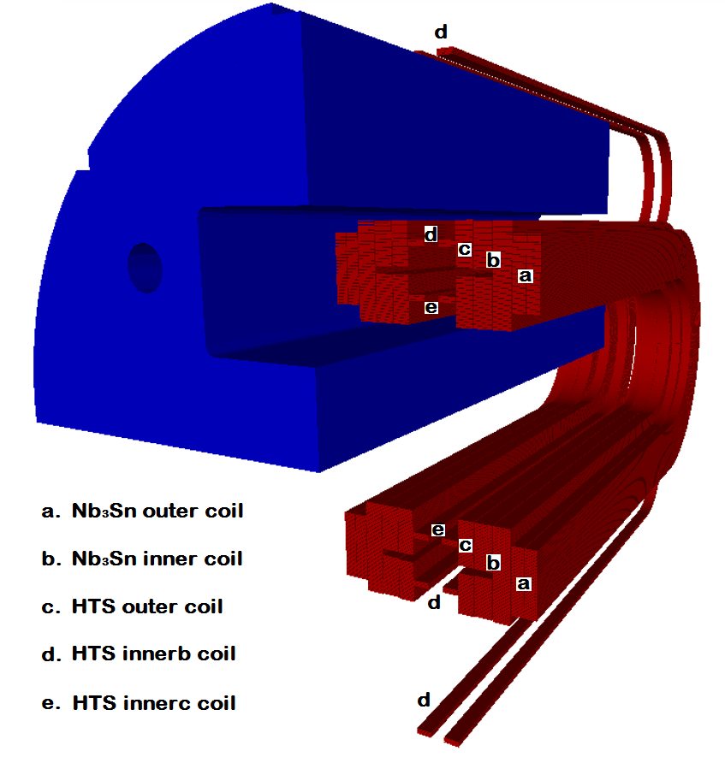
Design Study of SPPC Dipole Magnets
Q. Xu, K. Zhang, C. Wang et al.
With common coil configuration
20-T dipole magnet with common coil configuration two Φ50 mm beam pipes; load line 80% @ 1.9 K
Integrated b_{n}/a_{n} | Value (10⁻⁴)
b3 | 0.14
b5 | 1.42
b7 | -0.40
a2 | -0.29
a4 | -1.81
a6 | 0.03
Q. Xu, K. Zhang, C. Wang et. al., 20-T Dipole Magnet with Common Coil Configuration: Main Characteristics and Challenges, IEEE Trans. Appl. Supercond., VOL. 26, NO. 4, 2016，4000404

Slide 8
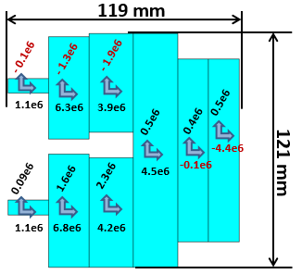
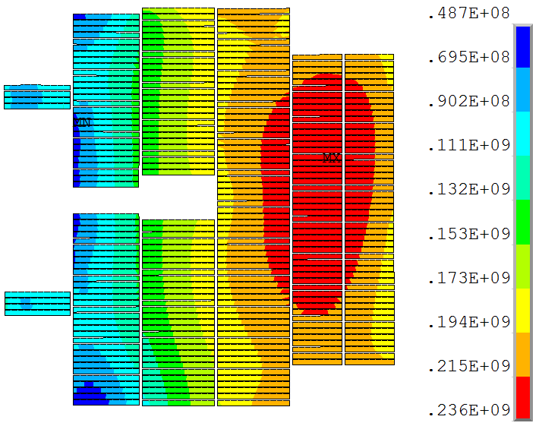
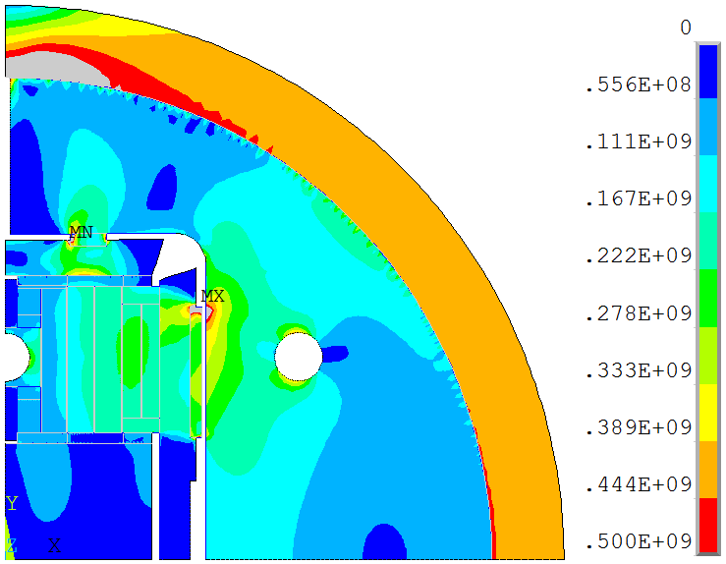
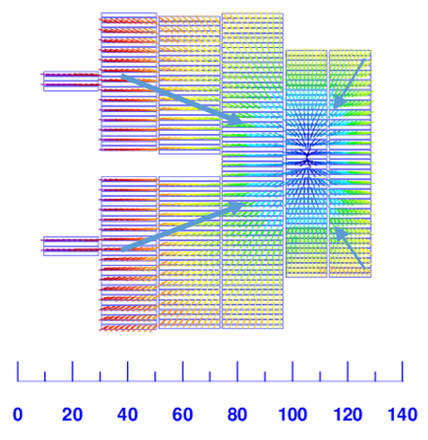
Design Study of SPPC Dipole Magnets
K. Zhang, Q. Xu, C. Wang et al.
With common coil configuration
D.R. Dietderich, A. Godeke / Cryogenics 48 (2008) 331–340
Lorentz force per aperture:
Fmag_x=23.4 MN/m
Fmag_y=2.38 MN/m
Stress in coil after excitation
Direction of Magnetic force
Stress in shell after excitation
K. Zhang et. al., 2-D Mechanical Design Study of a 20-T Two-in-One Common-Coil Dipole Magnet for High-Energy Accelerators, IEEE Trans. Appl. Supercond., VOL. 26, NO. 4, 2016, 4003705

Slide 9
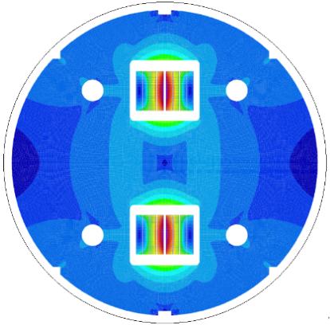
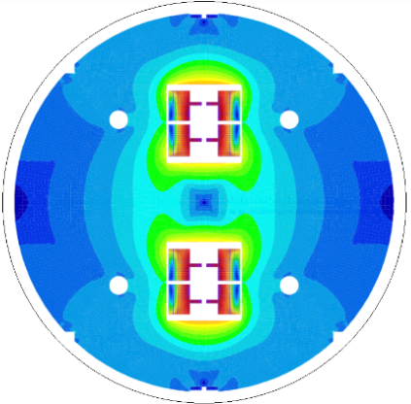
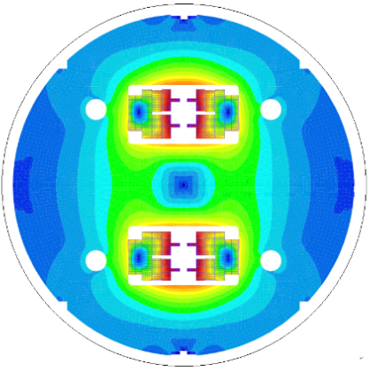
R&D Steps for SPPC Dipole Magnets
Q. Xu, K. Zhang, C. Wang et al.
With common coil configuration
a
b
c
1st step ongoing
Fabrication of 15-T Nb₃Sn and Nb₃Sn+HTS subscale magnets, to test the stress management method for Nb₃Sn & HTS coils and the quench protection method for HTS coils;
By the end of 2018.
2nd step
Fabrication of 15-T Nb₃Sn and Nb₃Sn+HTS operational field dipole magnet with two Φ50 mm beam pipes and 10⁻⁴ field quality, to test the field optimization method for HTS coils;
To be funded.
3rd step
Fabrication of the 20-T magnet with Nb₃Sn+HTS or only one of them, if we can get significant progress on the performance of Nb₃Sn or HTS superconductors, i.e., their Jc level is 3~6 times increased or even more, and the cost is significantly reduced.
Q. Xu, K. Zhang, C. Wang et. al., 20-T Dipole Magnet with Common Coil Configuration: Main Characteristics and Challenges, IEEE Trans. Appl. Supercond., VOL. 26, NO. 4, 2016，4000404

Slide 10
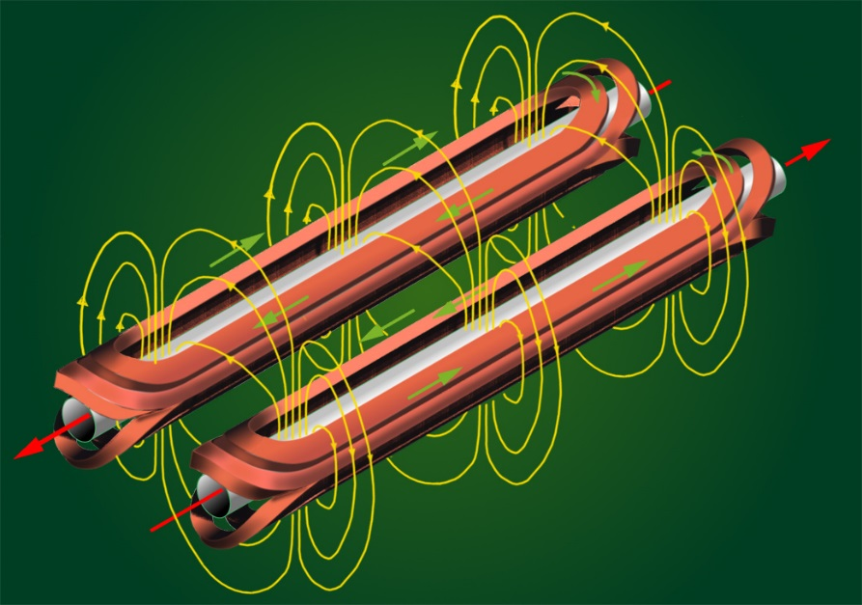
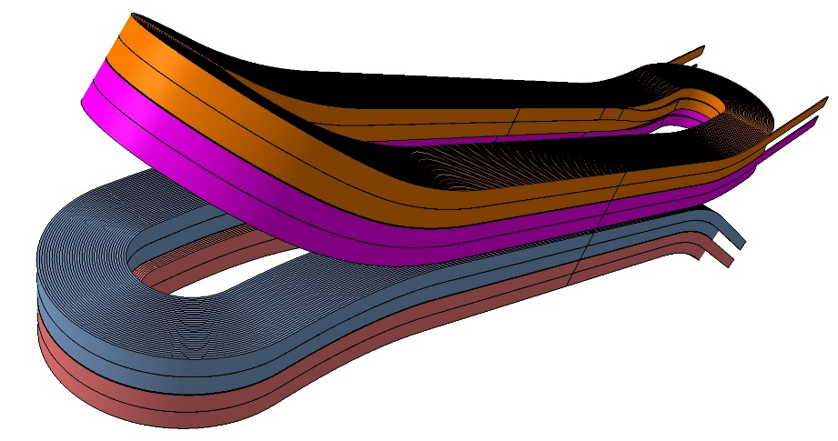
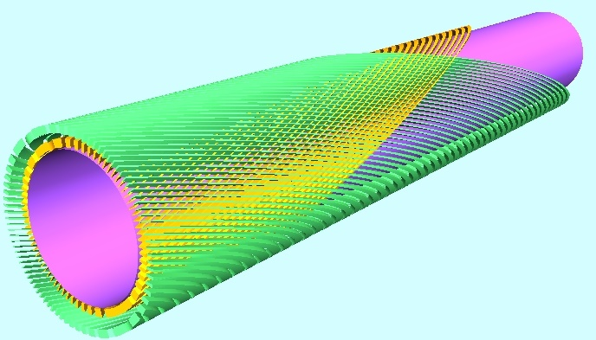
R&D Steps for SPPC Dipole Magnets
Comparison of different coil configurations
Efficiency, field quality, stress management, fabrication method…
Cos-theta dipole
Highest efficiency, complicated ends with hard-way bending
Common coil dipole
Simplest structure with large bending radius, lower efficiency
Block type dipole
Simpler structure with hard-way bending, lower efficiency
Canted cos-theta dipole
Lowest stress level in coil, lowest efficiency

Slide 11
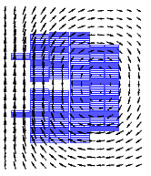
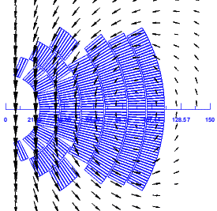
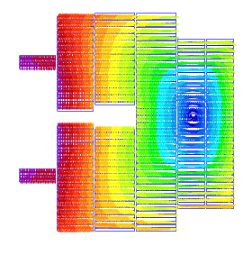
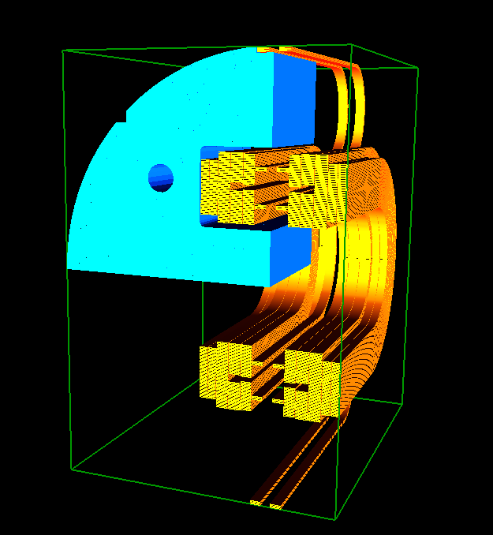
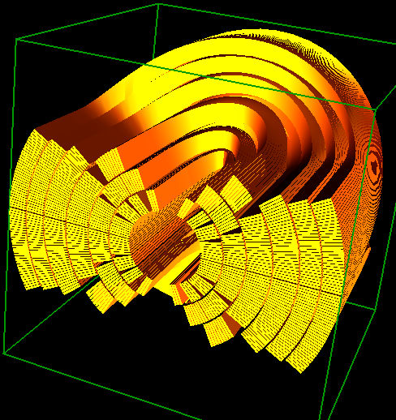
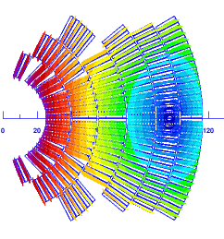
R&D Steps for SPPC Dipole Magnets
Comparison of different coil configurations
Common coil vs Cos-theta
Different coil configurations for 20-T dipole magnet
Left: Common coil
Right: Cos-theta
C. Wang et al.
Common coil
Common coil
Coil ends
Cos-theta
Cos-theta

Slide 12
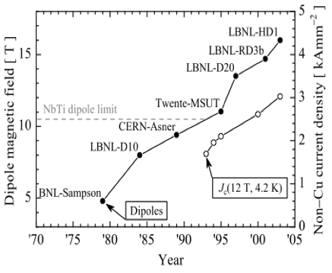
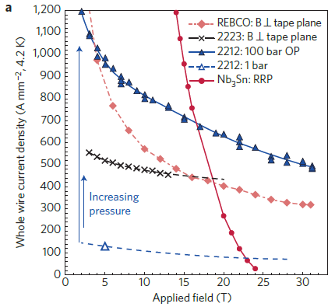


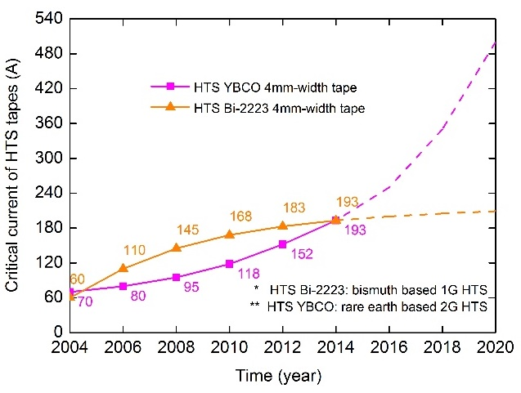
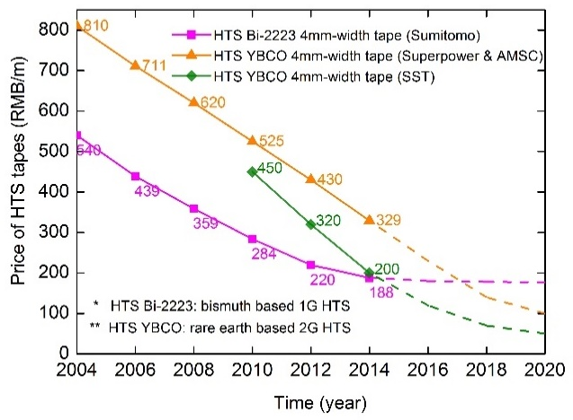

R&D Steps for SPPC Dipole Magnets
R&D of advanced superconductors: Nb₃Sn & HTS
Super High J_{c} Nb₃Sn
Magnet field Vs. Conductor J_{c}
Over-pressure HTS Bi-2212
Principle: increase of Nb₃Sn pinning force at high field through grain refinement: J_{c}(12 T, 4.2K) from 3.5 kA/mm² @ 100+ nm to 9.6 kA/mm² @ 35 nm !
X. Xu et al, Appl. Phys. Lett. 104 082602 & ASC14
D.R. Dietderich, A. Godeke, Cryogenics
48 (2008) 331–340
D. C. Larbalestier et al, NATURE MATERIALS DOI: 10.1038/NMAT3887, 2014
And, other materials
like …
Iron-based superconductor?
HTS YBCO J_{c} estimation
HTS YBCO cost estimation

Slide 13
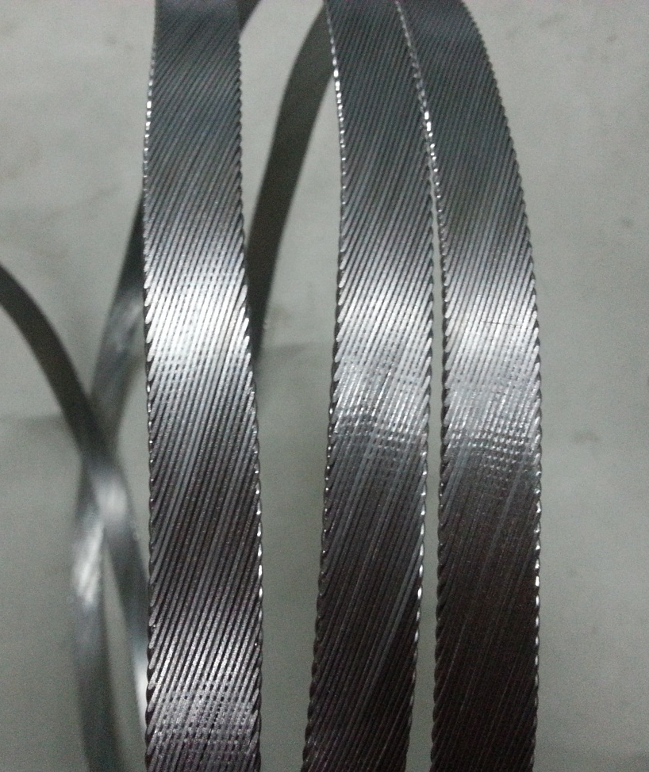
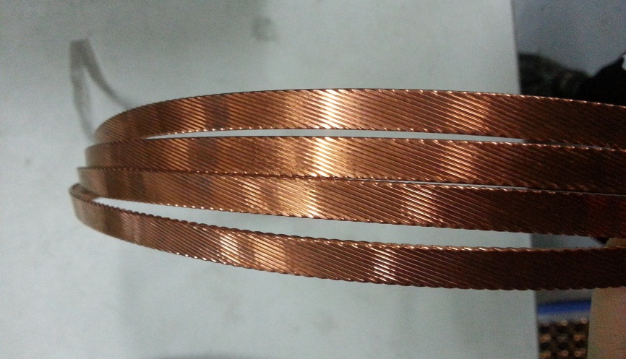
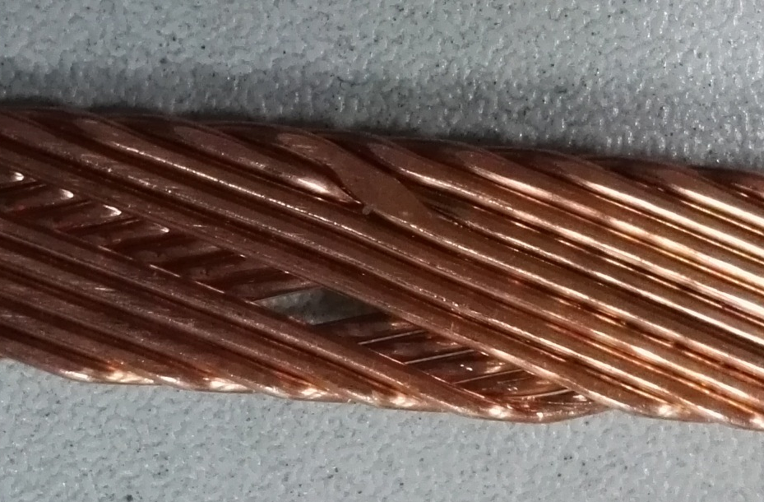
Development of Nb₃Sn Rutherford Cable
Y. Zhu (WST) et al.
Collaboration between WST, Changtong Electric, Toly Electric, and IHEP
Superconducting Rutherford Cable fabricated by Changtong Electric with WST ITER type Nb₃Sn strand
Superconducting Rutherford Cable fabricated by Toly Electric with WST ITER type Nb₃Sn strand

Slide 14
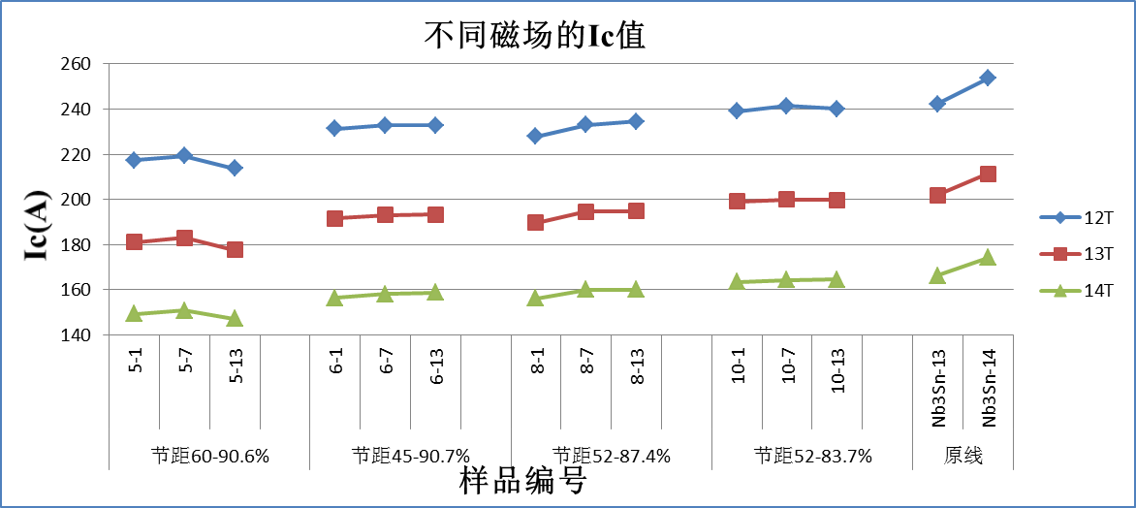
Development of Nb₃Sn Rutherford Cable
Y. Zhu (WST) et al.
Collaboration between WST, Toly Electric, Changtong Electric and IHEP
Pitch length | Filling factor (%) | Ic degradation(%) | Average Ic degradation(%) | 备注
60 | 90.6 | 9.39~16.04 | 12.48~12.67 | 损降最大
45 | 90.7 | 3.84~10.33 | 6.31~7.42 | 损降性能相当
52 | 87.4 | 3.18~10.39 | 6.51~6.76
52 | 83.7 | 0.33~6.2 | 3.13~3.60 | 损降最小

Slide 15
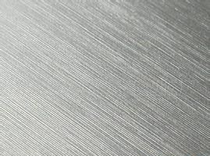

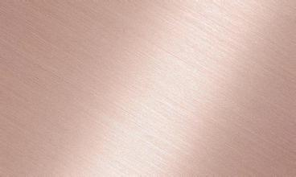


R&D of High Field ReBCO Tape by SSTC
SSTC
Al₂O₃
Y₂O₃
MgO
Seed Layer
CeO₂
Cap Layer
(Y,Gd)BCO
Superconducting Layer
Ag
Overlayer
Hastelloy
Substrate
Amorphous Layer
Architecture of type II superconductor from SSTC
3.3mm tape Ic:
>300A @ 12T, 4.2K
Improved performance of SSTC tape at 4.2K
Performance of SSTC tape at 4.2K and 12T

Slide 16
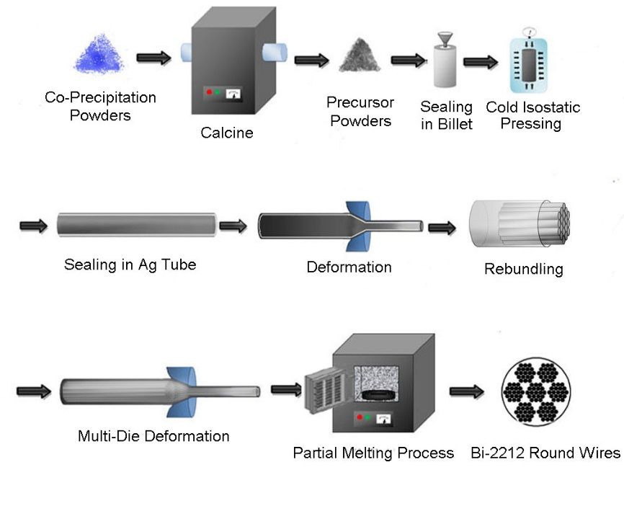
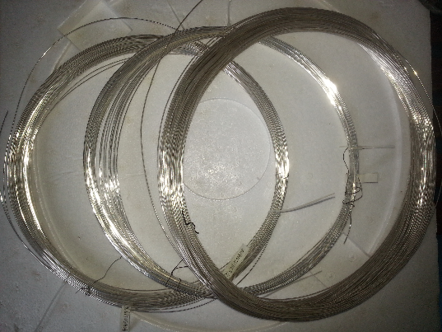
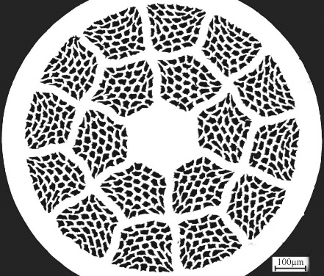
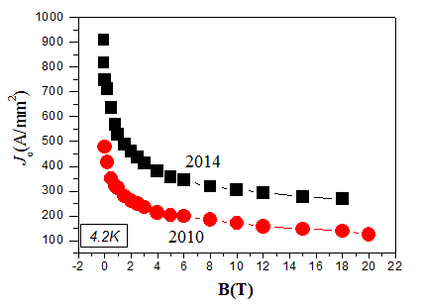
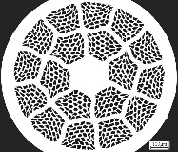
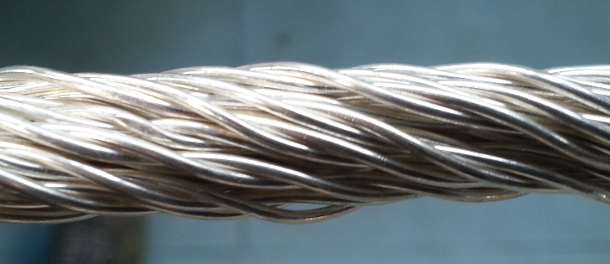
R&D of Bi-2212 Superconductor by NIN
NIN
Fabrication of hundred meter level Ф1.0mm strands
4.2K、0T：Jce 920A/mm²，Jc 4400A/mm²。
4.2K、20T:Jce 270A/mm²，Jc 1200A/mm²。
An Over-pressure furnace is ready for heat treatment of strands
（a）
PIT制备Bi-2212线材
（a）
Bi-2212 stands and CICC conductor under development

Slide 17
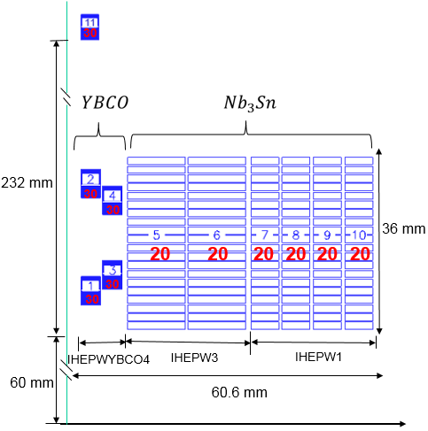
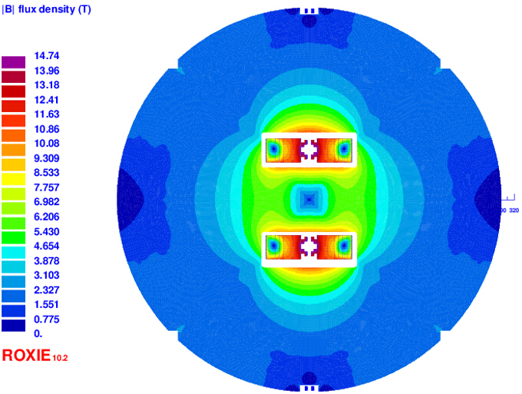



Model Magnet Development (2016-2018)
C. Wang, K. Zhang, Q. Xu et al.
To fabricate a 14-T dipole magnet (with two apertures) with HTS and Nb₃Sn superconductors, to test the field optimization method of HTS & Nb₃Sn coils.
Clear bore diameter 15mm Inter-aperture spacing 156 mm
I=358A (YBCO)
I=9930A(Nb₃Sn)
Main field: 14.6T
Iron yoke OD:
600mm
YBCO B_{peak}
14.7T @4.2K
Nb₃Sn B_{peak}
14.5T @4.2K
Field distribution in the cross section of the magnet
Main parameters of the cables
Cable | Hight | Width-i | Width-o | Ns | Strand | Filament | Insulation
IHEPW1 | 5.8 | 1.5 | 1.5 | 14 | IHEPWCJC | Nb3Sn | 0.15
IHEPW3 | 12 | 1.5 | 1.5 | 29 | IHEPWCJC | Nb3Sn | 0.15
IHEPWYBCO4 | 4 | 0.2 | 0.2 | 1 | IHEPWYBCO | YBCO | 0
Coil configuration in the 1st quadrant
Main parameters of the strands
For per meter of such magnet, the required length of the strand: YBCO: 0.6 Km; Nb₃Sn in total: 9.12 Km
Strand | diam. | cu/sc | RRR | Tref | Bref | Jc@ BrTr | dJc/dB
IHEPWCJC | 0.82 | 1 | 100 | 4.2 | 12 | 2400 | 400
IHEPWYBCO | - | - | - | 4.2 | 12 | 1020 | 40

Slide 18
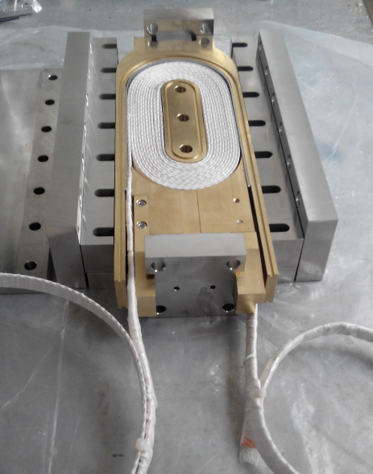
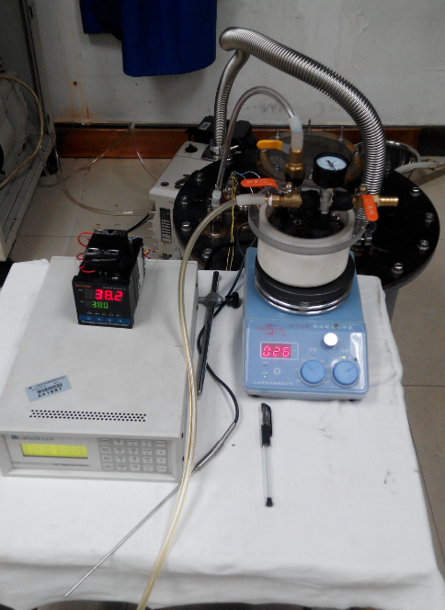
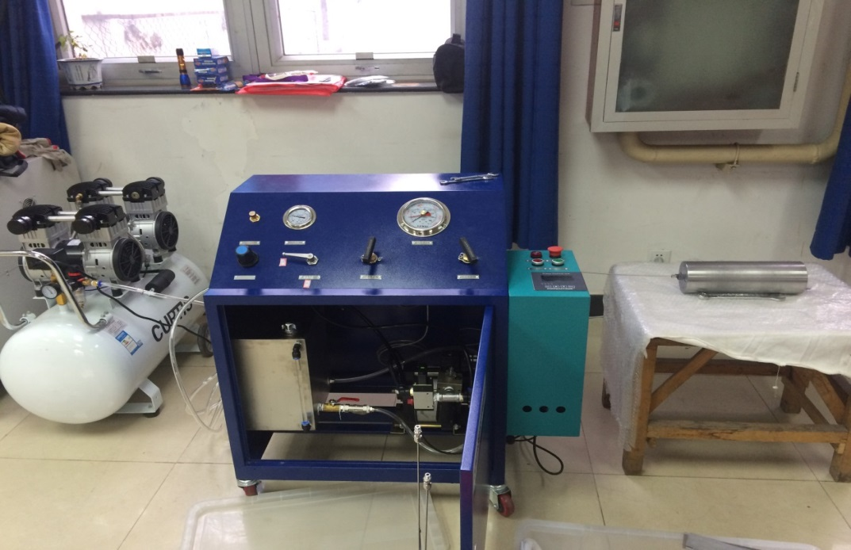
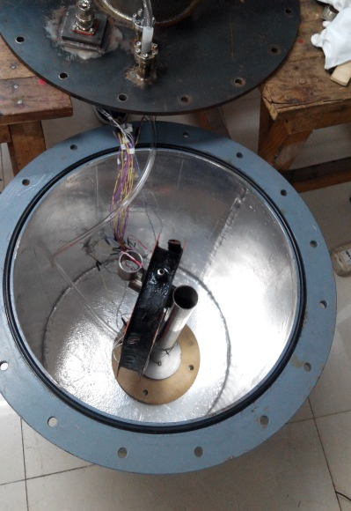
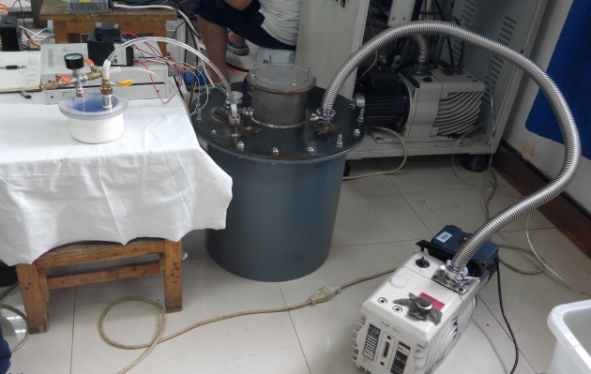
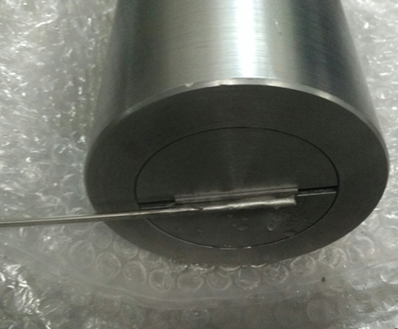
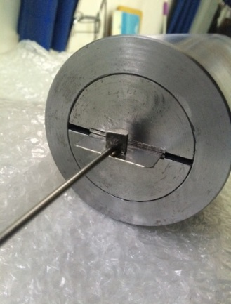



Preparation for Model Magnet Development
Kai Zhang, Chengtao Wang et al.
Air compressor
Booster pump
Shell
support
Epoxy tank
Heating Magnetic Stirrer
Bladder
Racetrack coil
Bladder
Container
Epoxy tank
Container
Vacuum pump
Strain
sensor
Temperature controller

Slide 19
Summary
SPPC needs thousands of 20-T level magnets to bend and focus the high energy proton beams .
Present status of the accelerator magnet technology: highest 16 T achieved to demonstrate the Nb₃Sn technology but without accelerator level bore and field quality. Present highest operational field for accelerators 8.3 T.
To achieve the challenging 20-T accelerator magnets, a 10~15 years long term R&D is necessary.
A working group is being organized for the 20-T magnet R&D in China, and expecting international collaboration with worldwide labs.
R&D of advanced superconductors and model magnets for SPPC study have been started. Welcome more collaborators to join us!
Much more funding is necessary to carry out the R&D of this critical technology for CEPC-SPPC project.

Slide 20


Thanks

