Slide 1
铁基高温超导研究进展
陈仙辉
中国科学技术大学

Slide 2
报告内容
铁基超导新材料进展
  FeSe衍生体系
  FeAs基超导材料
  其他
物性与机理研究进展
  门电压技术调控超导电性
  Electronic nematicity
  强关联效应
  C₄-symmetry reentrance
潜在强电应用探索

Slide 3
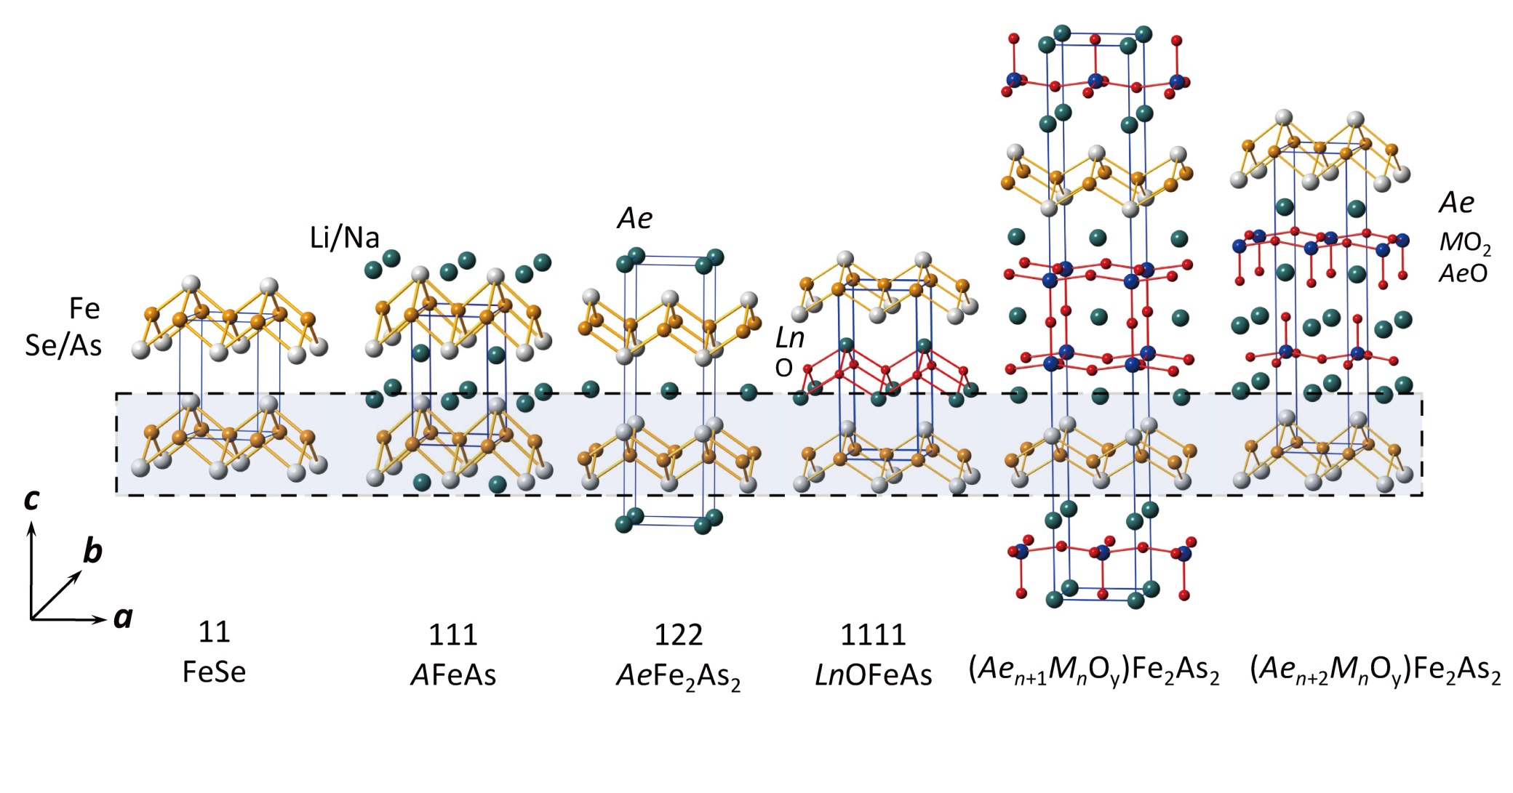
Some typical crystal structure of iron-based SCs
Iron-based superconductors: two categories
FeAs-based and FeSe-based
Fe²⁺ As³⁻ Fe²⁺Se²⁻
Tc=8 K Tc=25 K Tc=38 K Tc=55 K Tc=33-42 K
Highest T_{c} (~55 K) in SmO_{1-x}FeAs
是否还能获得更高超导转变温度？

Slide 4
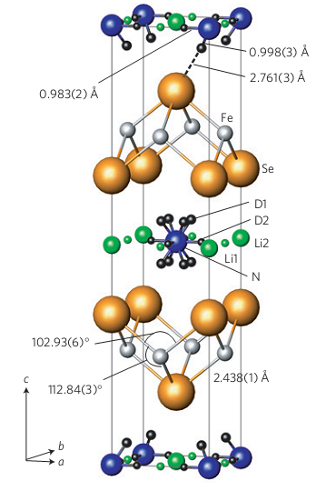
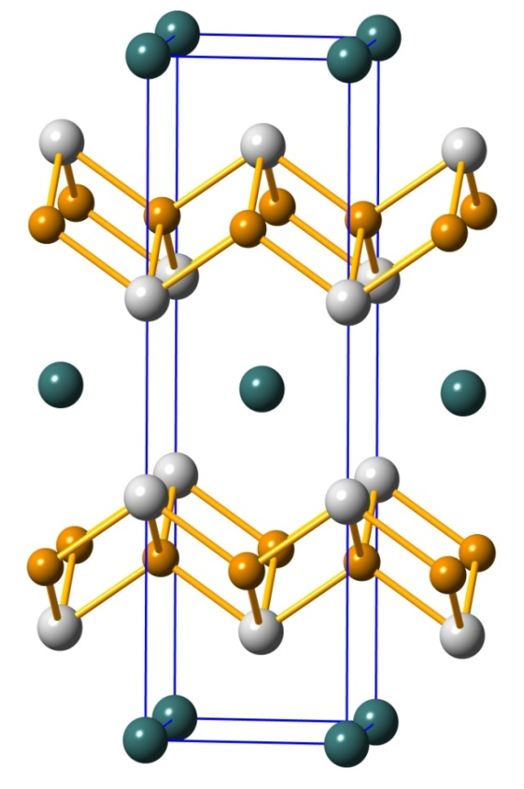
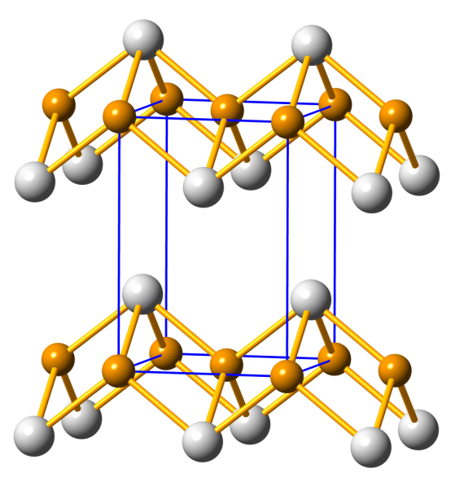
Crystallography of Iron-selenides
Se
Fe
K
Fe_{1+x}Se
T_{c} = 8 K
Tc=37
(under pressure)
K_{x}Fe_{2-y}Se₂ T_{c} = 31 K
with 245 phase
Solid-state reaction method
Li_{x}(NH₂)_{y}(NH₃)_{1-y}Fe₂Se₂
T_{c} = 43 K
Liquid ammonia method

Slide 5
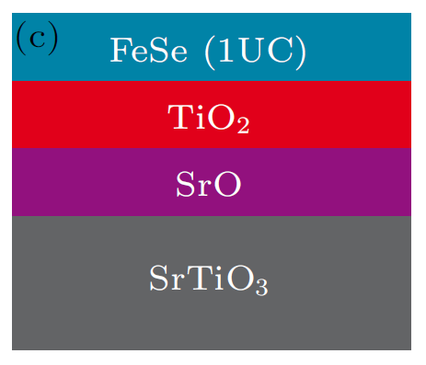
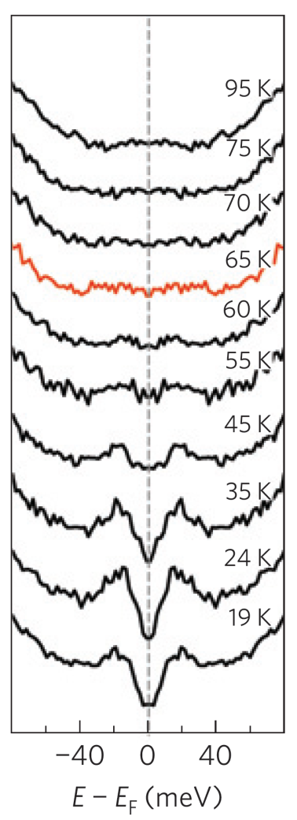
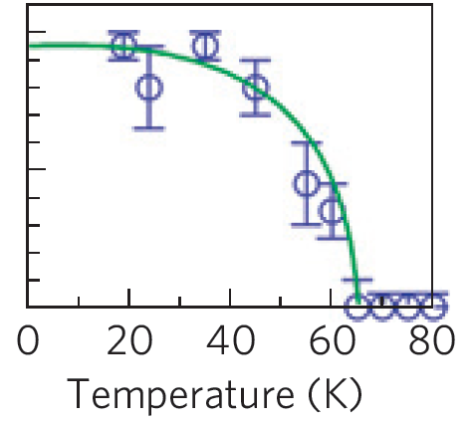
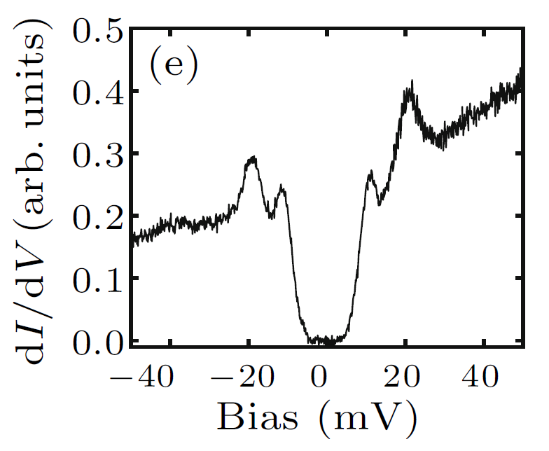
FeSe衍生体系——Single Unit-Cell FeSe film
T_{c} ~ 65K
With possibility of Tc >100K
20.1meV
9.5meV
Q. Y. Wang et al., Chin. Phys. Lett. 29, 037402 (2012)
S. L. He et al., Nature Materials 12, 605(2013)
S. Tan et al., Nature Materials 12,634(2013).

Slide 6
Unique behaviors in FeSe-derived superconductors:
In the heavily electron-doped FeSe-derived SCs: interband scattering or Fermi surface nesting is not a necessary ingredient for the unconventional SC.
T_{c} in the one-unit-cell FeSe on SrTiO₃ substrate can reach as high as ~65 K, largely transcending the bulk T_{c} of all known iron-based superconductors.
FeSe layer is nearly neutral
Problems for studying in FeSe-derived superconductors
Extra Fe and intergrowth of tetragonal and hexagonal phases for Fe_{1+x}Se
In the case of A_{x}Fe₂Se₂, the inter-grown antiferromagnetic insulating phase makes it difficult to study the underlying physics. Superconductors of alkali metal ions and NH₃ molecules or organic-molecules intercalated FeSe and single layer or thin film FeSe on SrTiO₃ substrate are extremely air-sensitive, which prevents the further investigation of their physical properties.
Therefore, it is urgent to find a stable and accessible FeSe-derived superconductor for physical property measurements so as to study the underlying mechanism of superconductivity, and for understanding
High-Tc SC in single-layer FeSe/SrTiO₃

Slide 7
Hydrothermal synthesis: new method
Mild condition synthesis for avoiding Fe vacancy in FeSe layers
for heavily electron-doped FeSe-derived superconductors
LiOH·H₂O+Fe+Selenourea
Steel autoclave
Stir and dissolve
Seal and heat
Teflon
10ml H₂O
Reaction at 160 ºC
X. F. Lu and X. H. Chen* et al. PRB (2013)
X. F. Lu and X. H. Chen* et al. Nat. Mater. (2015)

Slide 8
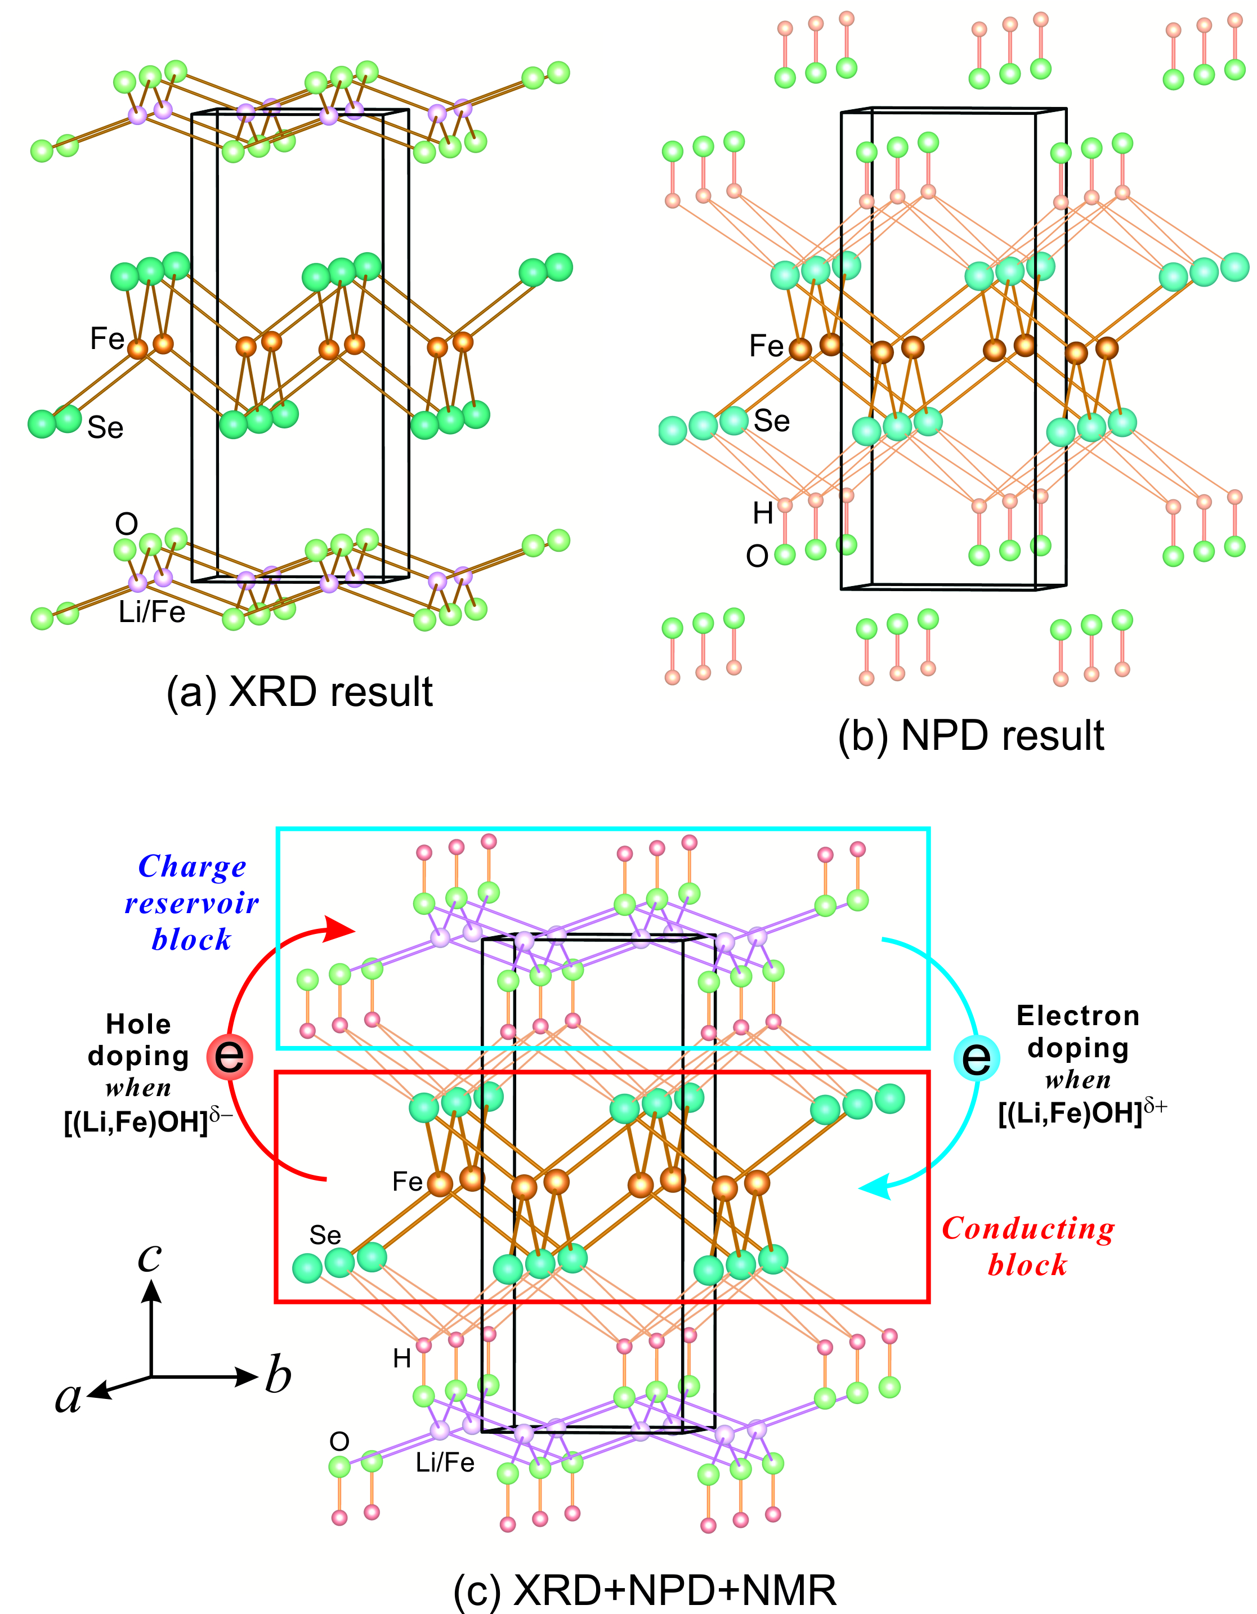
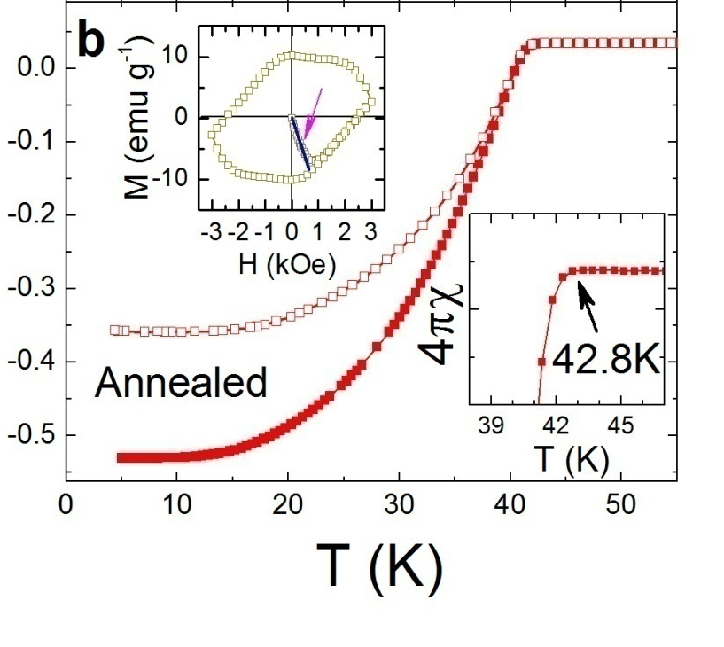
FeSe衍生体系——Li_{0.8}Fe_{0.2}OHFeSe
High stability in air and homogeneity in FeSe layer provide an outstanding platform for studying superconductivity in FeSe-derived materials.
Superconductivity with T_{c} ≈ 43 K can be observed after annealing under 5 GPa and 150 ºC.
X. F. Lu and X. H. Chen* et al. PRB (2013)
X. F. Lu and X. H. Chen* et al. Nat. Mater.(2015)

Slide 9
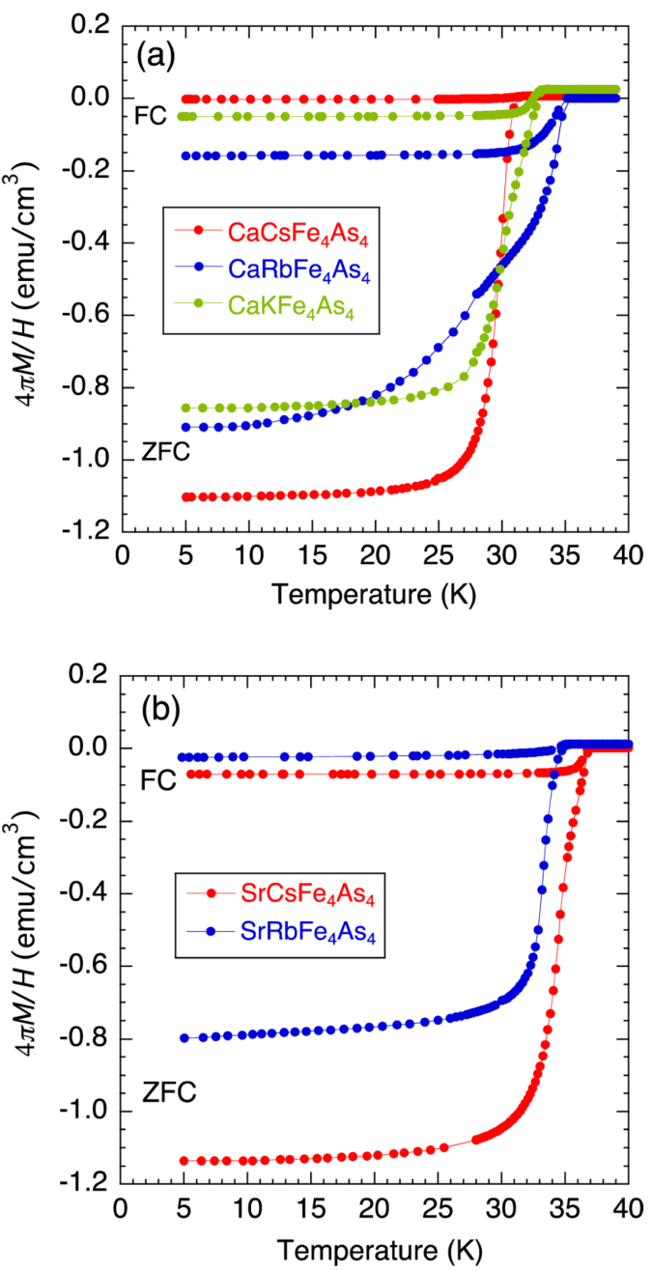
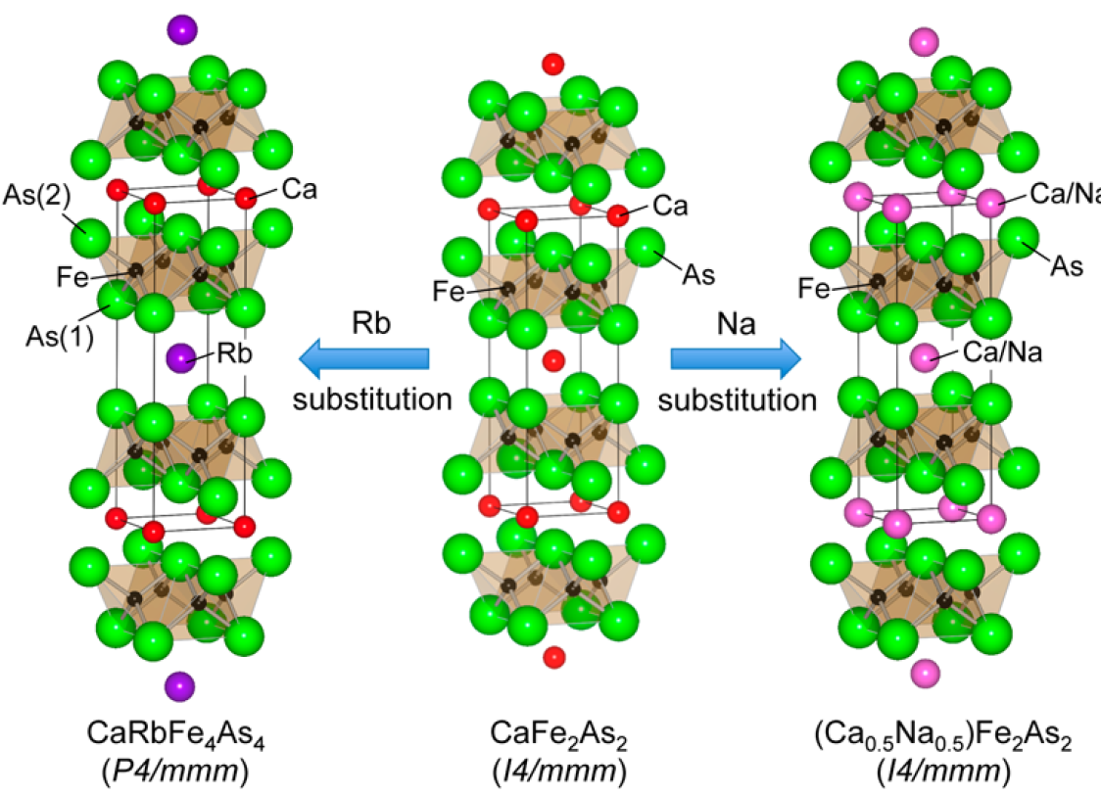
FeAs基超导材料——1144-phase
A. Iyo et al, J. Am. Chem. Soc. 138, 3410 (2016)

Slide 10
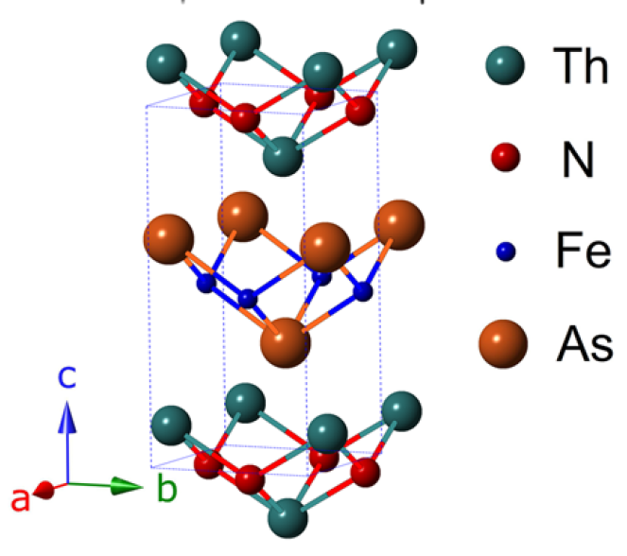
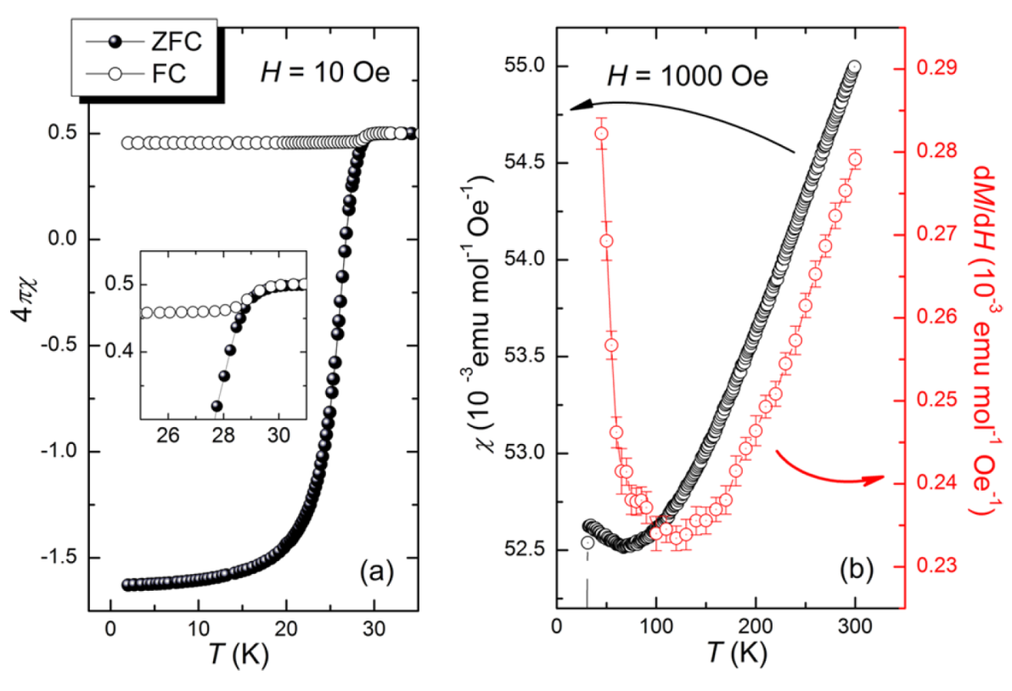
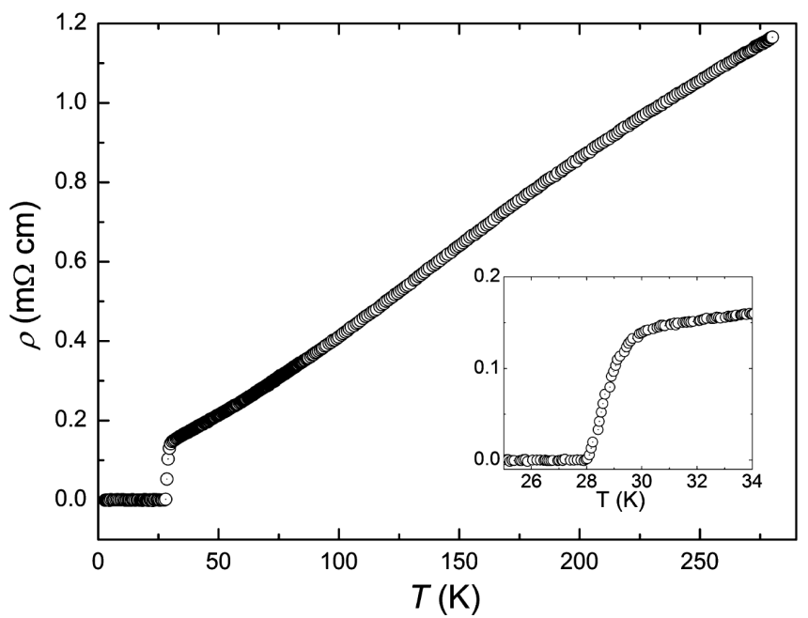
FeAs基超导材料——ThNFeAs
A New ZrCuSiAs-Type Superconductor
C. Wang et al, J. Am. Chem. Soc 138, 2170 (2016)

Slide 11
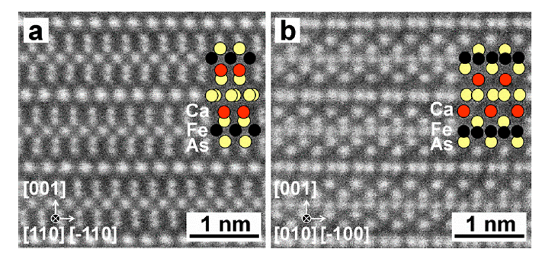
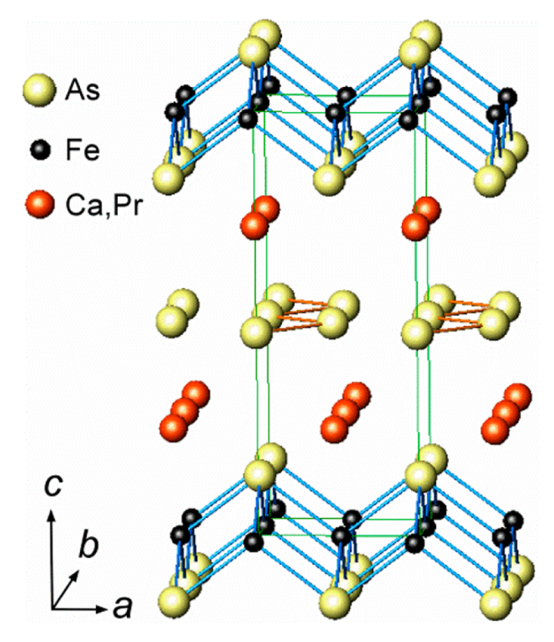
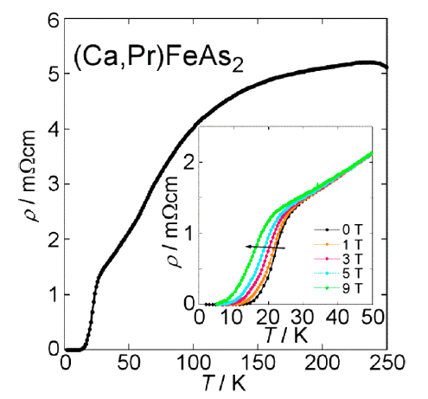
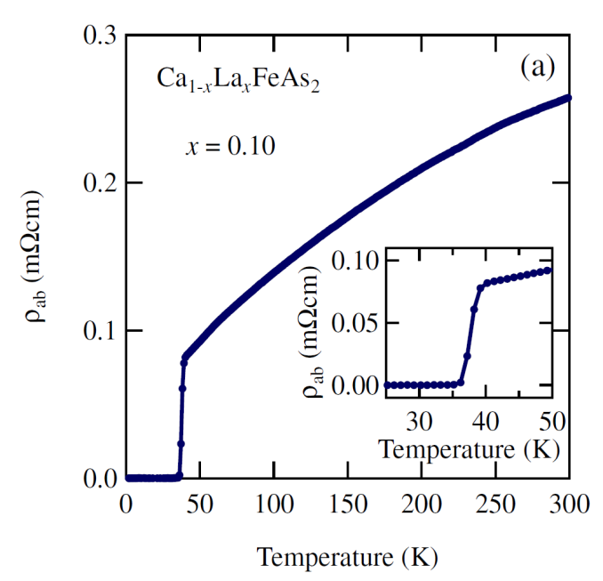
FeAs基超导材料——(Ca,Pr)/(Ca,La)AsFeAs
H. Yakita et al. JACS 136, 846 (2014)
N. Katayama et al. JPSJ 82, 123702 (2013)

Slide 12
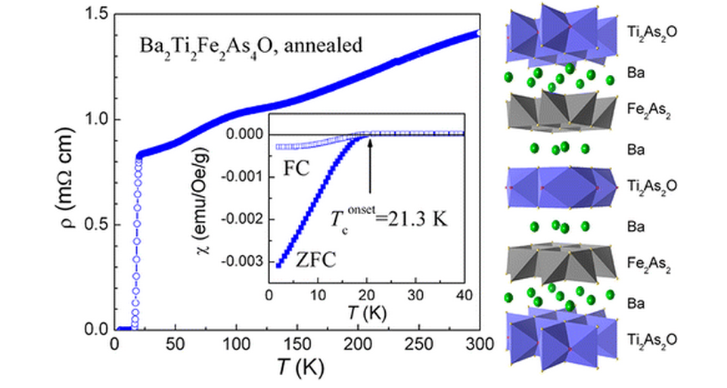
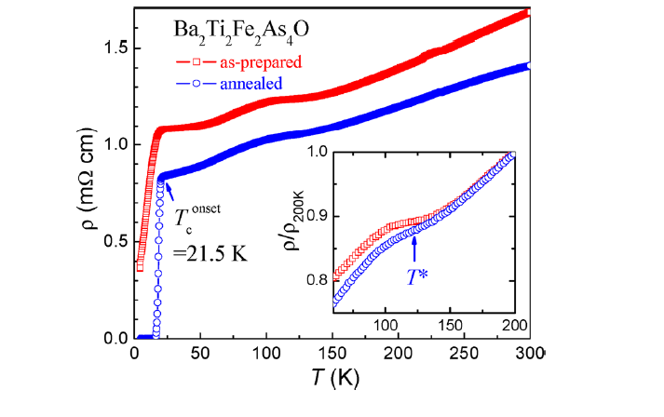
FeAs基超导材料——Bi₂Ti₂Fe₂As₄O
Y. L. Sun et al, J. Am. Chem. Soc. 134, 12893 (2012)

Slide 13
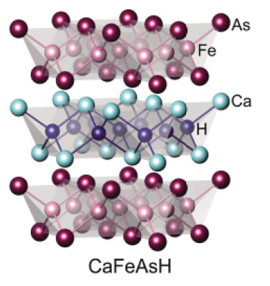
FeAs基超导材料——Hydrogen in layered iron arsenides
LaFeAsO_{1−x}H_{x}
/Sm/Ce/La
T. Hanna et al. PRB 84, 024521 (2011)
S. Matsuishi et al. PRB 85, 014512 (2012)
S. Limura et al. Nature Commun. 3: 943 (2013)
M. Hiraishi et al. Nat. Phys. 10, 300 (2014)

Slide 14
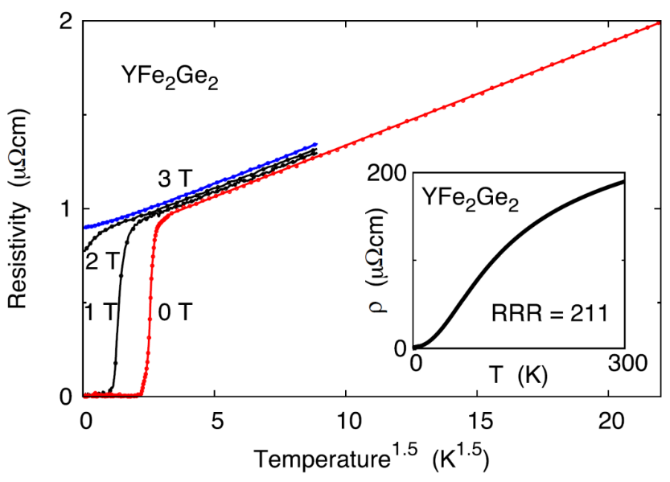
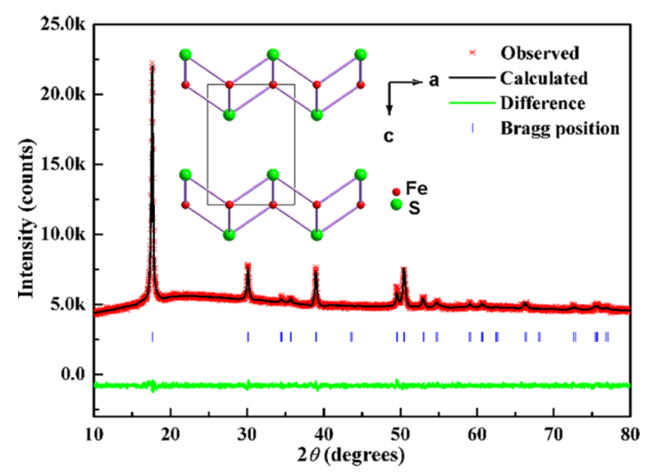
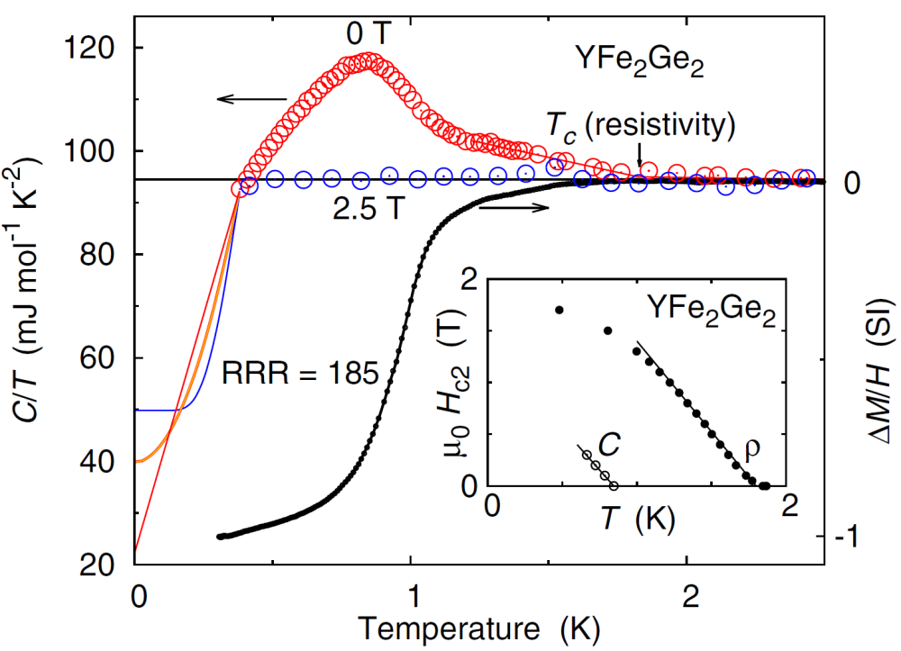
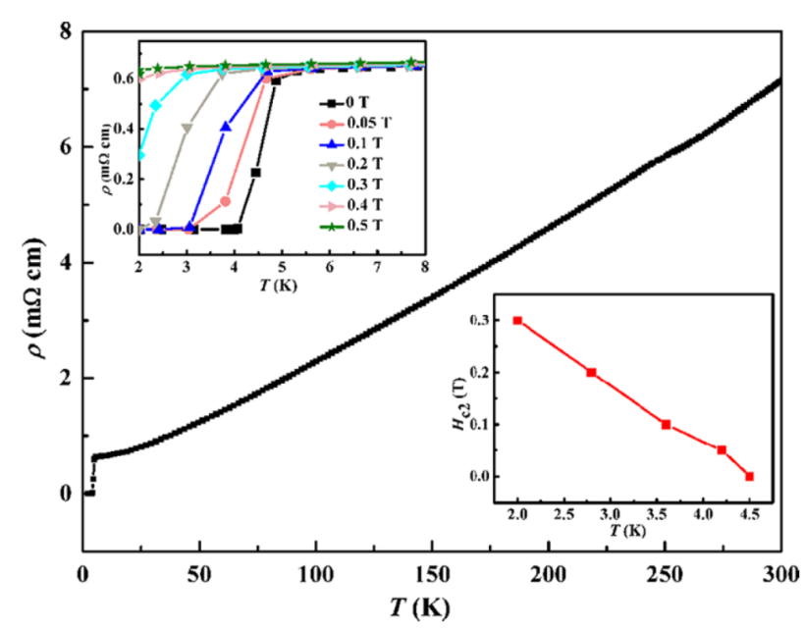
铁基超导新材料： YFe₂Ge₂ 和 FeS
YFe₂Ge₂
FeS
J. S. Chen et al, PRL 116, 127001 (2016)
X. F. Lai et al., J. Am. Chem. Soc. 137, 10148 (2015)

Slide 15
报告内容
铁基超导新材料进展
  FeSe衍生体系
  FeAs基超导材料
  其他
物性与机理研究进展
  门电压技术调控超导电性
  Electronic nematicity
  强关联效应
  C₄-symmetry reentrance
潜在强电应用探索

Slide 16
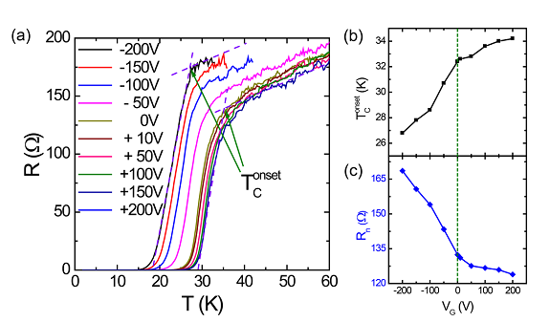
Electric-field-tuned superconducting transition of 1-UC FeSe
传统门电压技术很难大幅度改变载流子浓度
back gate
T_{C} increases when electrons are injected into the 1-uc FeSe films by the field effect
The insulating STO substrate was used as a back gate.
Qi-Kun Xue et al. PRB 89, 060506(R) (2014)

Slide 17
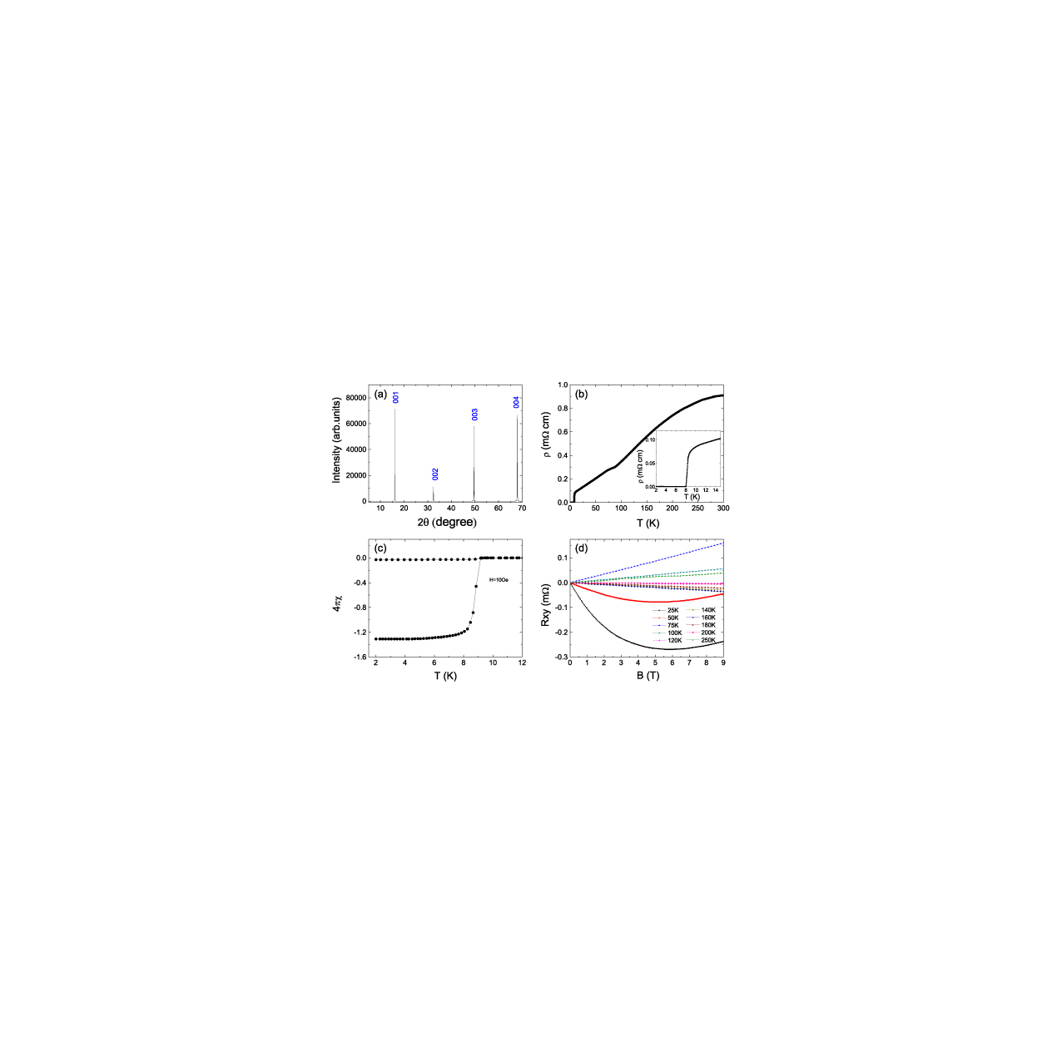
Bulk FeSe
T_{c} ~ 8 K

Slide 18
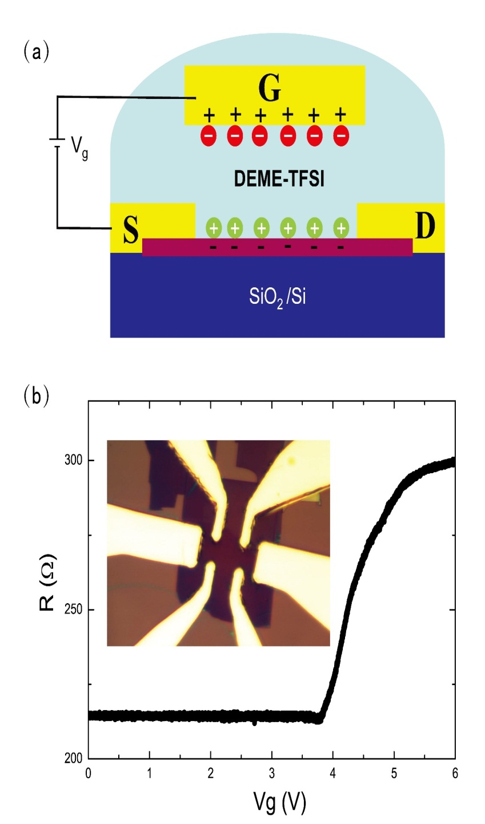
Liquid gating technology
DEME-TFSI@220 K
Thickness: 8 nm
离子液体门电压调控技术
B. Lei and X. H. Chen* et al, PRL (2016)

Slide 19
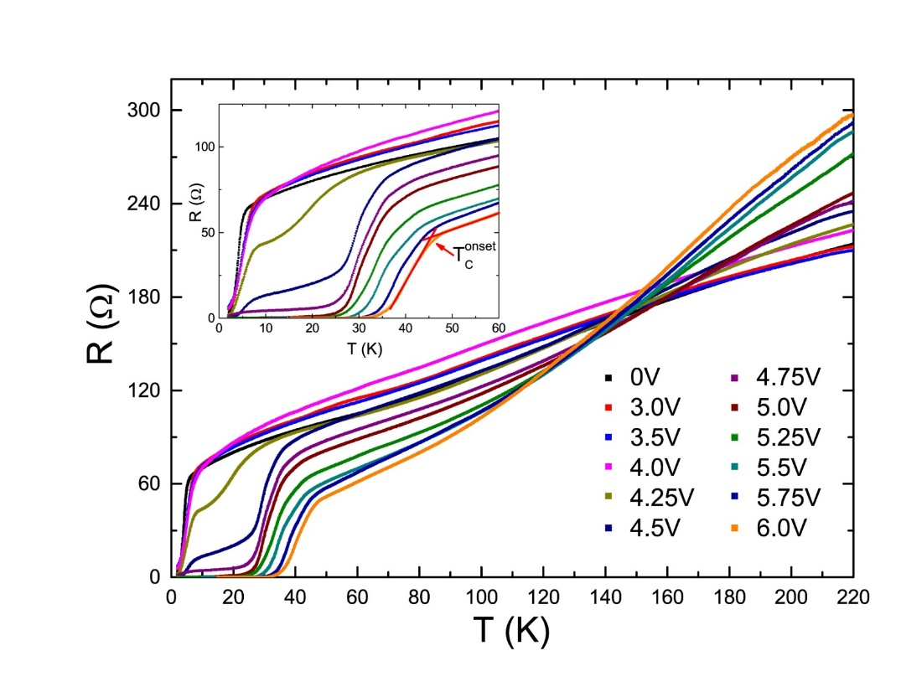
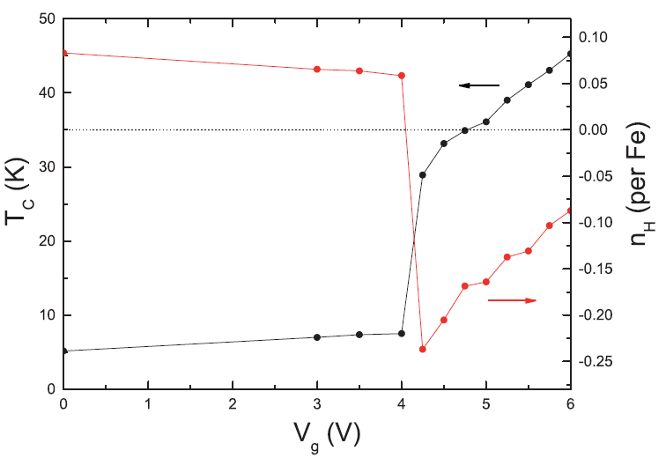
Liquid gating control——High-Tc superconductivity in FeSe flakes
From low-Tc phase to High-Tc phase with a Lifshitz transition
and disappearance of hole pocket
Pairing symmetry is different
B. Lei and X. H. Chen* et al, PRL (2016)

Slide 20
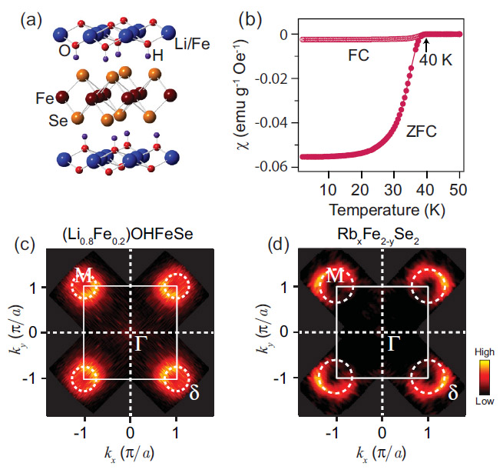
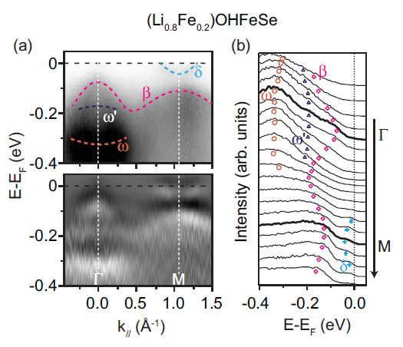
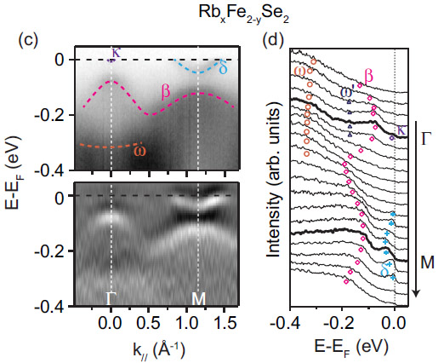
Similarity between highly electron-doped FeSe compounds
What will happen with further increasing electron doping?
X. H. Niu et al., PRB 92, 060504(R) (2015)

Slide 21
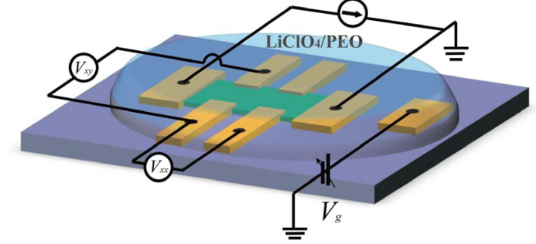
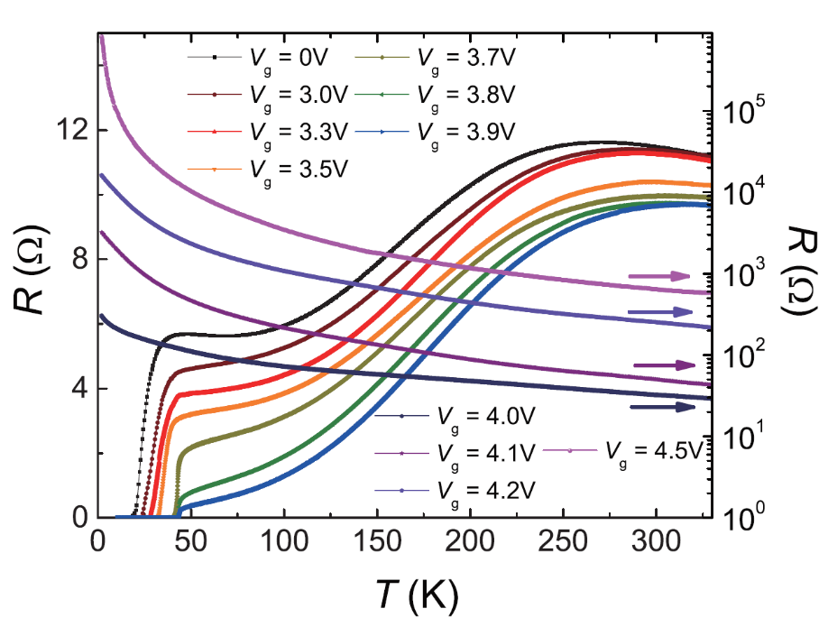
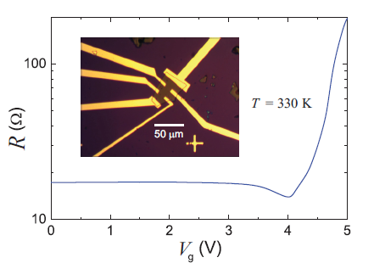
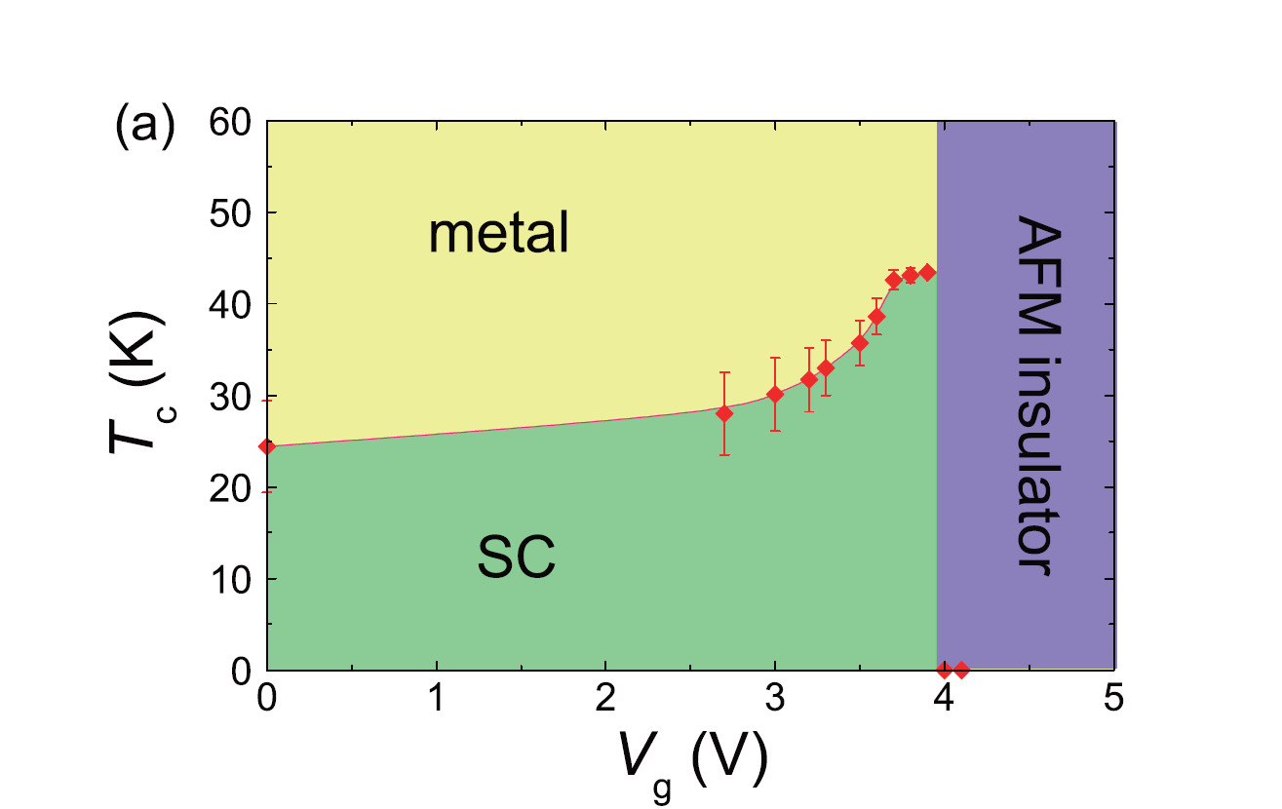
Liquid gating control—— SC-insulator transition in (Li,Fe)OHFeSe
LiClO₄/PEO@330 K
Thickness: ~200 nm
B. Lei and X. H. Chen* et al. PRB (2016)

Slide 22
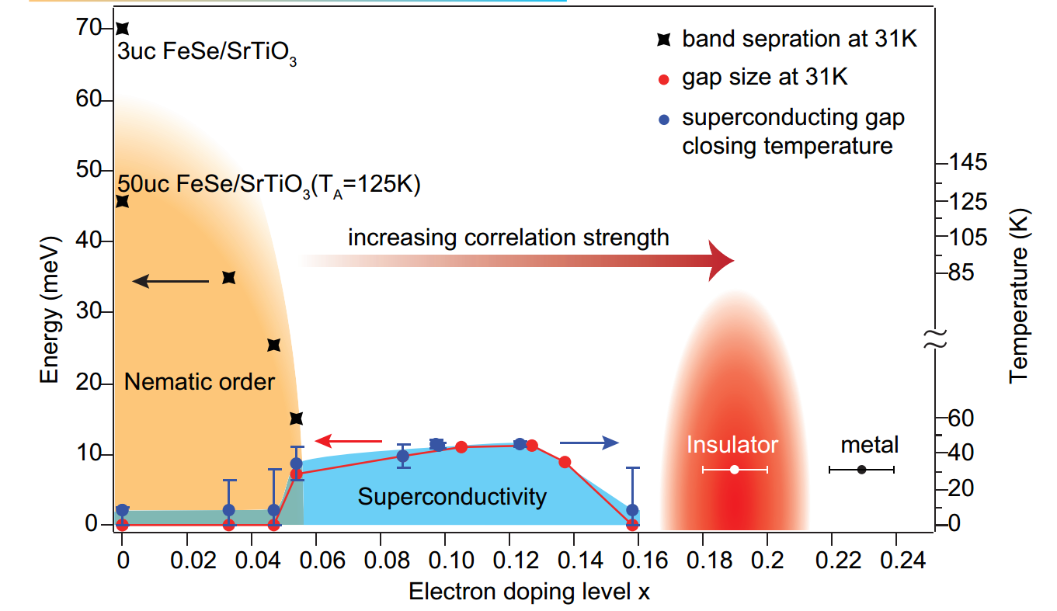
Similar SC-insulator transition in K-doped FeSe Thin films
FeSe thin layer ARPES results
Wen, C. H. P., et al. Nat. Commun. 7:10840 (2016)

Slide 23
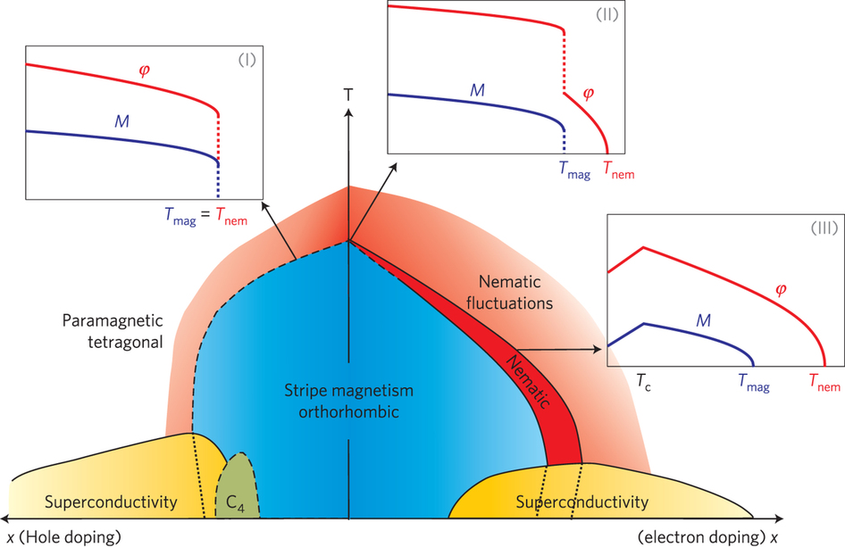
Phase diagram
反常物性：
Nematic phase
Strong correlation
C4 magnetic phase
. . .
理解反常物理性质将有助于我们进一步理解高温超导电性

Slide 24
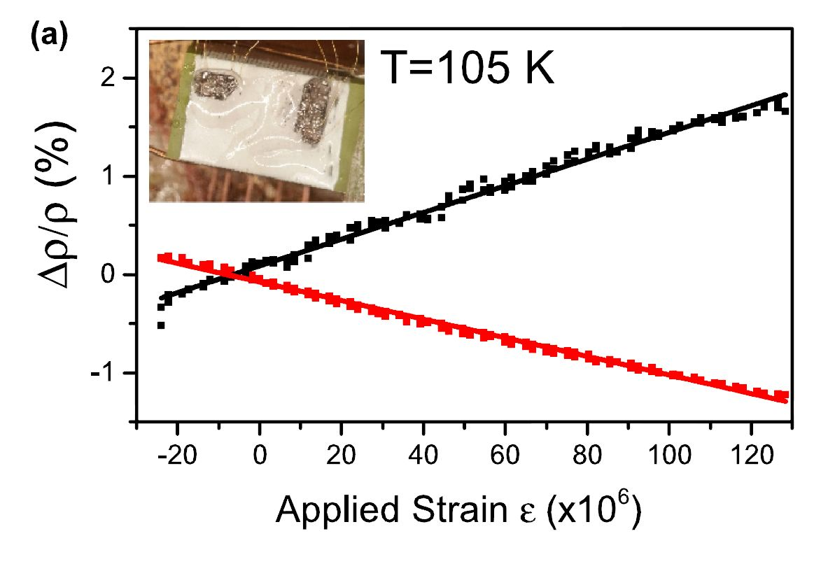
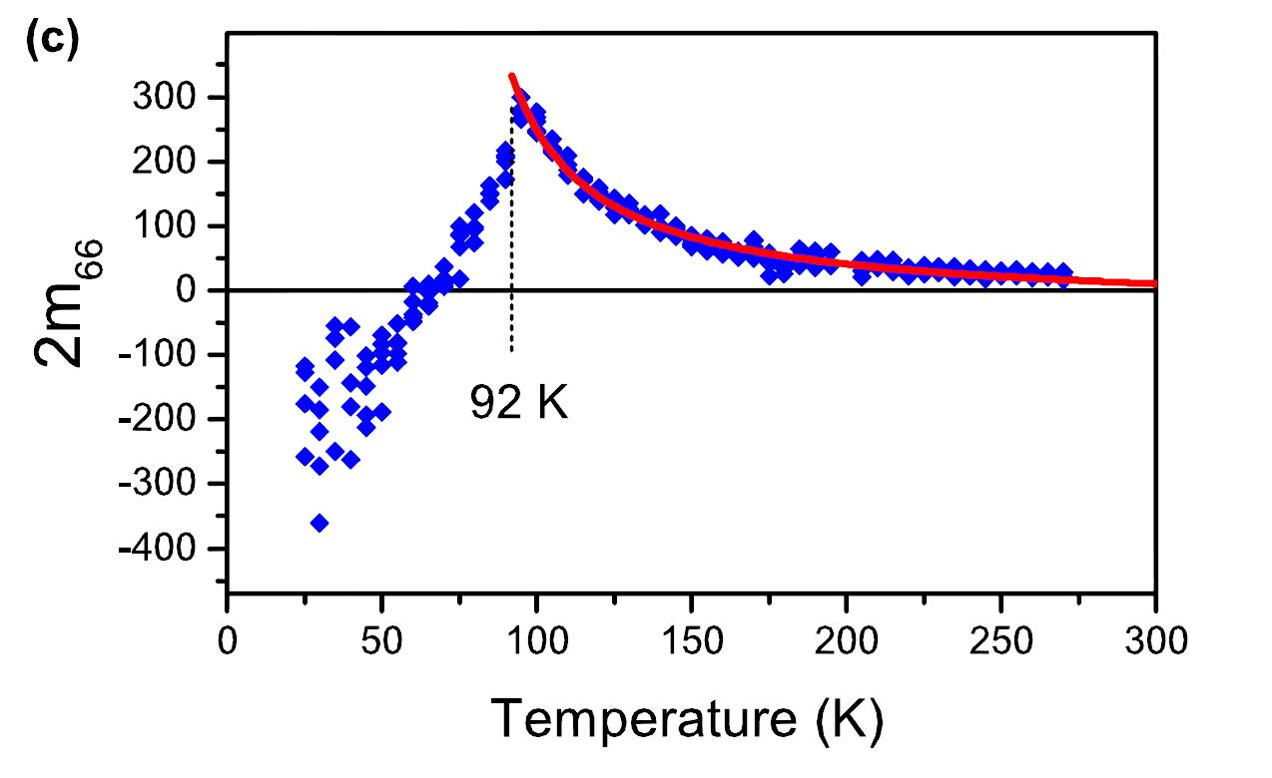
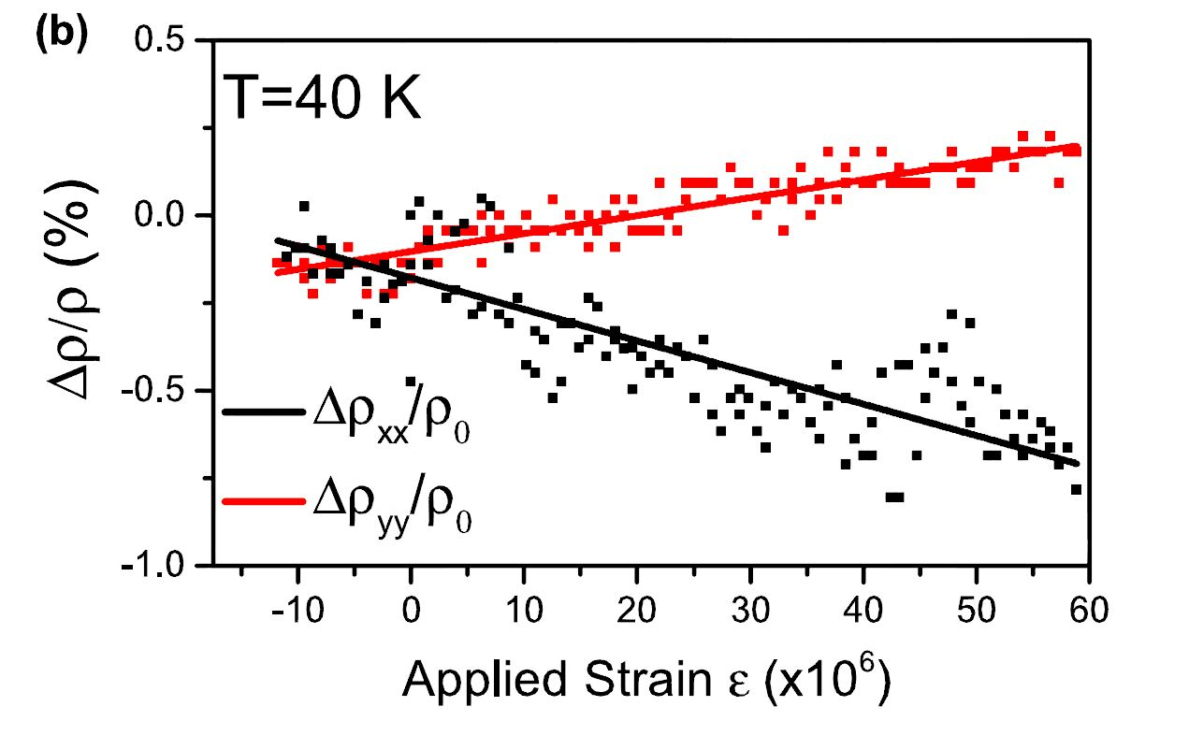
Electronic nematicity——Nematic Phase in FeSe
2m₆₆ = ( ρ_{xx} /ρ₀ − ρ_{yy} /ρ₀)/(ε_{xx} − ε_{yy} )
In-plane resistivity anisotropy with applied uniaxial pressure
Watson, M. D., et al. PRB 91.155106 (2015).

Slide 25
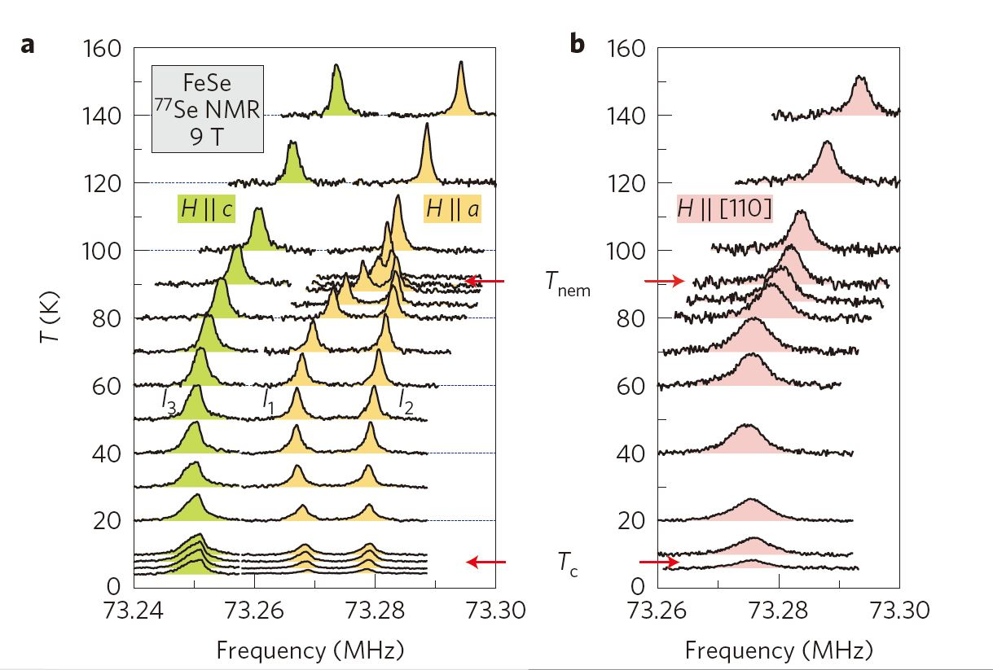
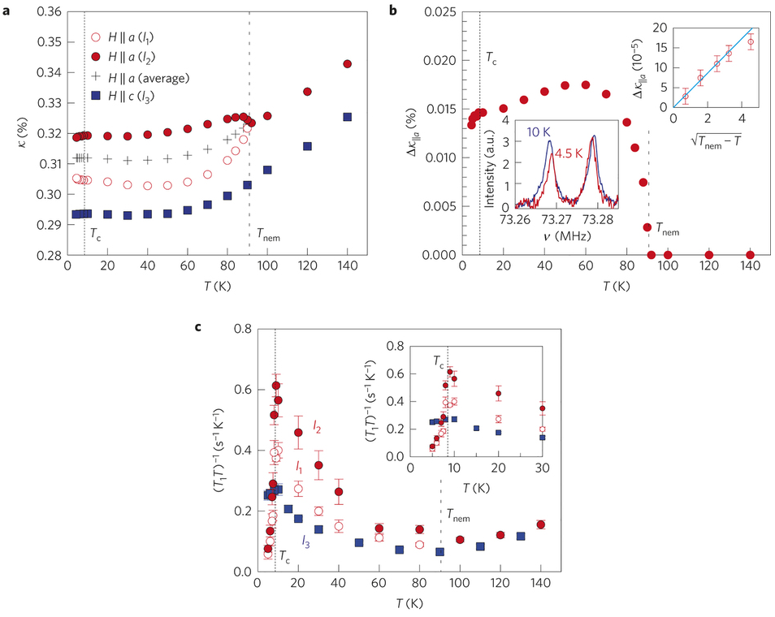
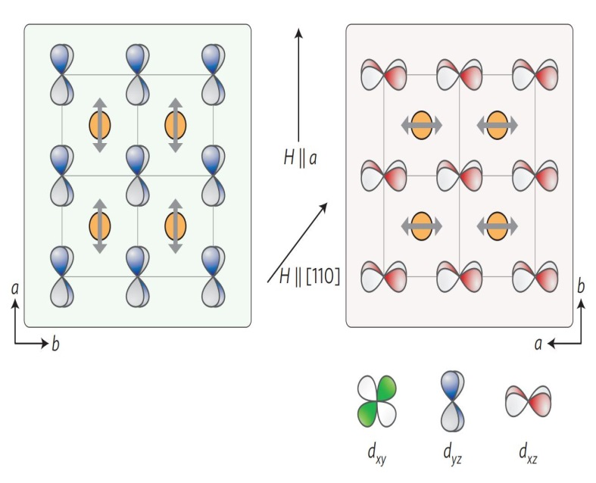
Electronic nematicity——Orbital order in FeSe
S. H. Baek, et al. Nat. Mater. 14, 210 (2015)
Observation of orbital order suggests a orbital-driven nematic state in ​FeSe.
Orbital-driven vs Spin driven

Slide 26
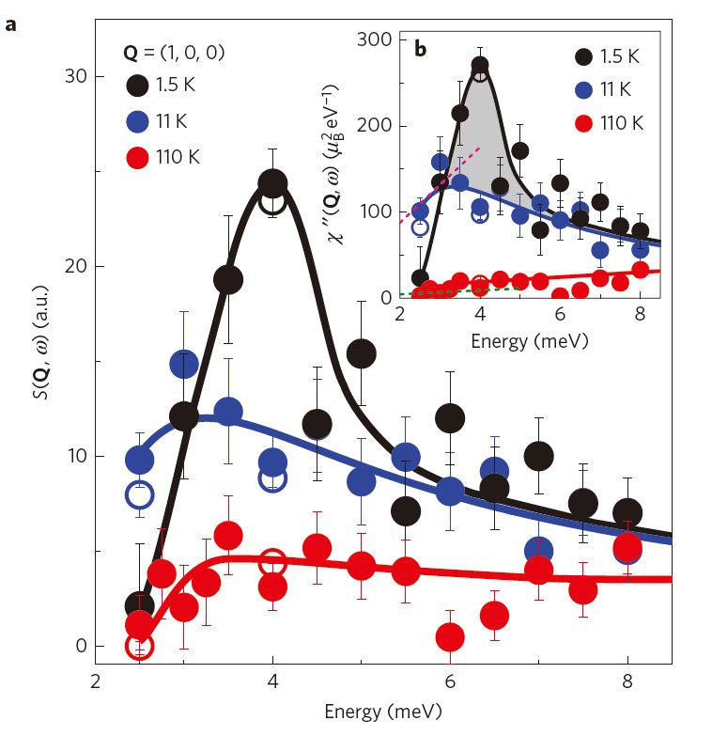
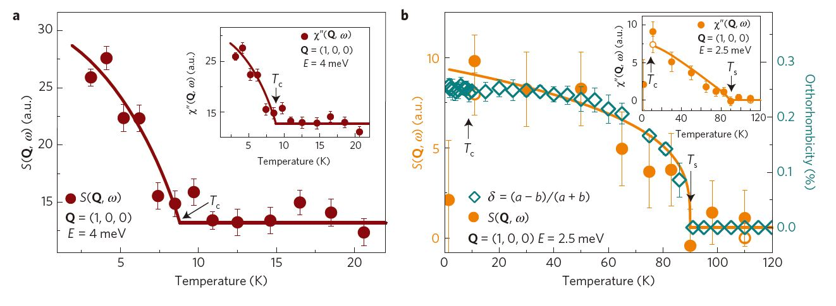
The nematic spin fluctuation at high energy scale probed by INS
Electronic nematicity——A neutron study in FeSe
Support spin driven picture!
Q. S. Wang, et al. Nature materials (2015).

Slide 27
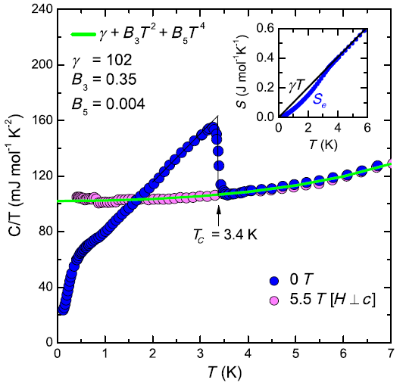
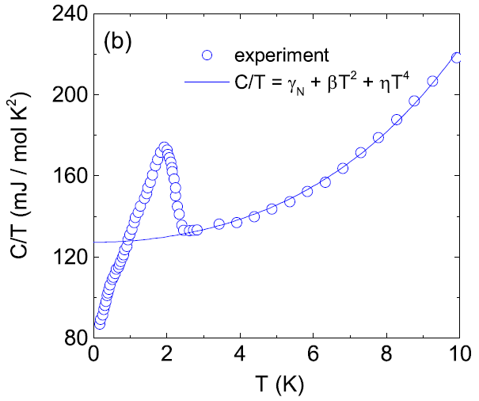


Electron correlation——heavily hole-doped AFe₂As₂ (A = K, Rb, Cs)
Large Sommerfeld coefficients
KFe₂As₂
RbFe₂As₂
γ_{N}=98 mJ·mol·K²
γ_{N}=127 mJ·mol·K²
F. Hardy et al.,
PRL 111,027002 (2013)
Z. Zhang et al.,
PRB 91, 024502 (2015)
CsFe₂As₂
A. F. Wang et al.,
PRB 87, 214509(2013)
γ_{N}=184 mJ·mol·K²

Slide 28

Heavy fermion behavior in AFe₂As₂ (A = K, Rb, Cs)
d-electron heavy fermion superconductors
NMR experiment suggests that AFe₂As₂ (A = K, Rb, Cs) are d-electron heavy fermion superconductors
Y. P. Wu et al., PRL (2016)

Slide 29


Electron correlation ——Searching for Mott phase

Slide 30


Electron correlation——similarity between insulating FeAs
compound and lightly doped cuprates
NaFe_{1-x}Cu_{x}As, x = 0.30
The overall line shape and strong spatial variations of the spectra are strikingly similar to those of lightly doped cuprates close to the parent Mott insulator.
C. Ye et al., PRX 5, 021013 (2015)

Slide 31



Electron correlation ——Searching for Mott phase
arXiv:1504.05116

Slide 32


C₄-symmetry reentrance in Ba_{1-x}Na_{x}Fe₂As₂
S. Avci et al. Nat. Commun. 5: 3845 (2015)

Slide 33


orthorhombic-distortion reentrance in Ba_{1-x}K_{x}Fe₂As₂
A. E. Bohmer et al. Nat. Commun. 6: 7911 (2015)

Slide 34


Complex phase diagram in Ba_{1-x}Na_{x}Fe₂As₂
L. Wang et al. PRB 93, 014514 (2016)

Slide 35
报告内容
铁基超导新材料进展
  FeSe衍生体系
  FeAs基超导材料
  其他
物性与机理研究进展
  门电压技术调控超导电性
  Electronic nematicity
  强关联效应
  C₄-symmetry reentrance
潜在强电应用探索

Slide 36


Critical current in iron-based superconductors
Irradiated SmFeAsO_{0.8}F_{0.15}
single crystal
SmFeAsO_{0.7}F_{0.25} single crystal
J_{c} ~ 2×10⁶ A/cm²
J_{c} ~ 2×10⁷ A/cm²
P. J. W. Moll et al. Nat. Mater. (2010)
L. Fang et al. Nat. Commun. (2013)

Slide 37


Critical current in iron-based superconductors
Pristine and Irradiated
Ba_{0.6}K_{0.4}Fe₂As₂ single crystal
FeSe_{0.5}Te_{0.5}-coated conductors
J_{c} > 10⁶ A/cm²
铁基超导薄膜带材(FeSe_{0.5}Te_{0.5} ),在4.2 K 下，30 特斯拉磁场下，超导临界电流仍然高达1×10⁵ A/cm²。 很有潜力用于高磁场 MRI和储能等方面。
Pristine, J_{c} ~ 2×10⁶ A/cm²
Irradiated, J_{c} ~ 5×10⁷ A/cm²
L. Fang et al. APL (2012)
W. D. Si et al. Nat. Commun. (2012)

Slide 38
FeSe衍生体系——Li_{0.8}Fe_{0.2}OHFeSe
High stability in air and homogeneity in FeSe layer provide an outstanding platform for studying superconductivity in FeSe-derived materials.
Superconductivity with T_{c} ≈ 43 K can be observed after annealing under 5 GPa and 150 ºC.
X. F. Lu and X. H. Chen* et al. PRB (2013)
X. F. Lu and X. H. Chen* et al. Nat. Mater.(2015)

Slide 39
A summary of ongoing studies
New iron-based superconducting materials:
new FeSe-derived materials
new spacing layer in FeAs-based materials
controllable approaches for higher T_{c}
…
Physics of correlated electrons:
exploring new phases by liquid gating technique
studying electronic nematicity with multiple probes
understanding complicated electron correlation effect
…
Potential applications:
increasing critical current for power applications
…

Slide 40
Thank you for your attention!

Slide 41



FeSe衍生体系——Single Unit-Cell FeSe film
电子掺杂 + 界面电-声子相互作用

Slide 42

Electronic nematicity——Band structure in FeSe
Lifting of the d_{xz}/d_{yz} orbital degenerance caused by the electronic nematicity
Nakayama, K., et al. PRL 113, 237001(2014):.

Slide 43


Electronic nematicity——Band structure in FeSe
Strong orbital anisotropy detected by ARPES
T. Shimojima, et al. PRB 90,121111 (2014).

Slide 44




Superconductors can transform the power grid to deliver abundant, reliable, high-quality power for the 21st century
current state future needs
Performance
10× increase in J_{c}
→ 10× reduction in ac loss
Cost
10-100× improvement needed
Materials
Increase operating temperature 2×-5×

Slide 45



Liquid gating control——induced SC in insulating FeSe thin film
35 K
K. Hanzawa et al., PNAS113, 3986 (2016)

Slide 46


Electric-field-induced superconductivity in electrochemically etched
ultrathin FeSe films on SrTiO3 and MgO
J. Shiogai et al. Nature Physics 12, 42 (2016)

Slide 47



Superconductors: aimed for a Major Role in Energy Delivery
superconductivity
lighting. heating
refrigeration
hydro
wind
solar
coal
gas
transportation
mechanical
motion
power grid
heat
electricity
motors
industry
nuclear
fission
fuel cells
information
technology
production
delivery
use
High power density
1/2 size
1/2 weight
1/2 losses
Increased capacity
Enhanced reliability
Smart distribution

Slide 48
Key issues for power applications
Overall current density J_{e} of conductor, not just of superconductor
Performance in field
Multiple filaments for AC applications
Anisotropy of J_{c} with respect to field direction
Cost!
  Conductor itself
  Cooling (AC losses)
Scalability of fabrication
Mechanical
  Strength, bend radius

