Slide 1


高场用铁基超导材料的研究进展
马衍伟
中国科学院电工研究所

Slide 2
汇 报 提 纲
铁基超导材料简介
高性能122铁基线带材的制备研究
122铁基线带材的实用化制备进展
结论
1
2
3
4

Slide 3
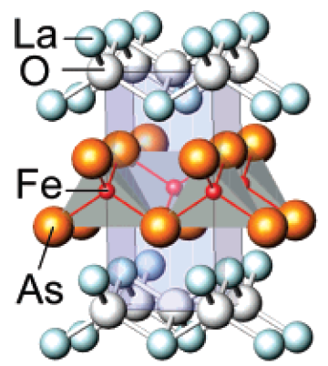
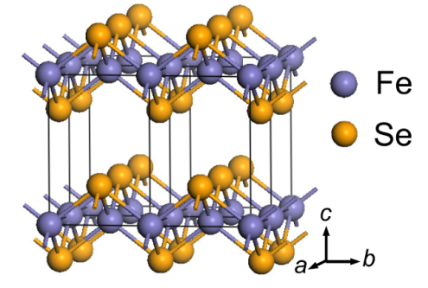
Main known Fe-based superconductors
Among them, the three phases most relevant for wire applications are 1111, 122, and 11 types with a T_{c} of 55, 38 and 8 K, respectively.
122 phase AFe₂As₂
(A=Ba, Sr, Ca)
1111 Phase LnOFeAs
111 phase LiFeAs
11 phase FeSe
T_{c} ~55 K
T_{c} ~38 K
T_{c} ~18 K
T_{c} ~8 K
Z. A. Ren et al., Chin. Phys. Lett. 25, 2215 (2008)
M. Rotter, et al., Phys. Rev. Lett. 101, 107006 (2008)
X. C. Wang, et al., Solid State Commun. 148, 538 (2008).
F. C. Hsu, et al., Proc. Natl. Acad. Sci. U.S.A. 105, 14262 (2008).

Slide 4
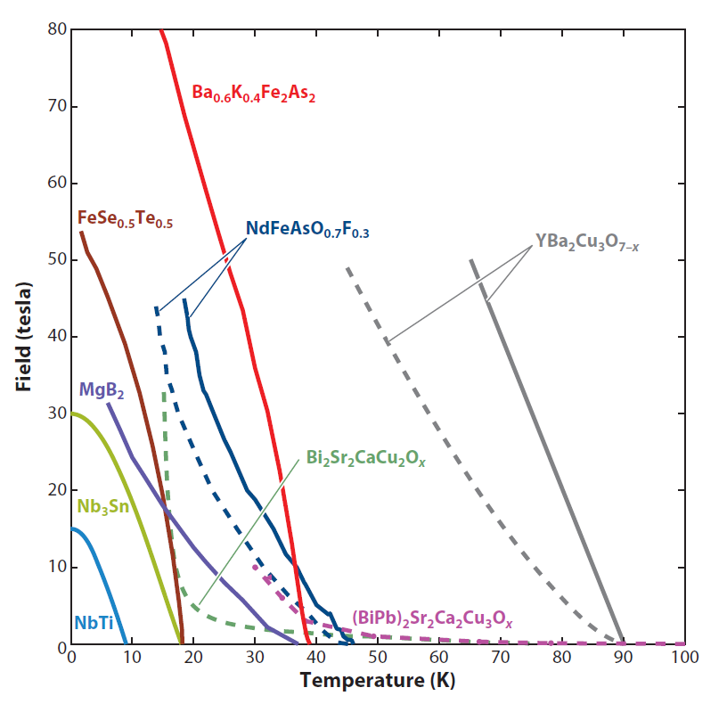
铁基超导材料具有很高的上临界场(H_{c2})
Material | Tc (K)
Nb47wt%Ti | 9 K
Nb₃Sn | 18 K
MgB₂ | 33-39 K
Bi-2212 | 75-90 K
Bi-2223 | 108-111 K
REBCO | 90-92 K
Gurevich, Nature Mater. 10 (2011) 255
Interesting FBS have T_{c}: 38-55 K >> Nb-Ti and Nb₃Sn
Operation at 4K >20T or 10-30 K at >10 T would be very valuable
FBS have H_{c2} > 30-70 T at 20-30 K where FBS outperform both MgB₂ and Bi-2223.
外推 H_{c2}( 0 K) 可以超过 200 T, 在20 K可产生 ~ 70 T，在高场磁体方面具有重要潜在应用前景。

Slide 5
Comparison between different superconductors
 | LTS (NbTi, Nb₃Sn) | Cuprates | MgB₂ | Iron-based
T_{c} | 18 K | 110 K | 39 K | 55 K
H_{c2} | ~30 T | ~100 T | ~40 T | >100 T
γ | 1 | 5-7 (YBCO) 50-90 (BSCCO) | ~3.5 | 1-2
Critical current density of iron-based single crystals J_{c}>1 MA/cm²

Slide 6
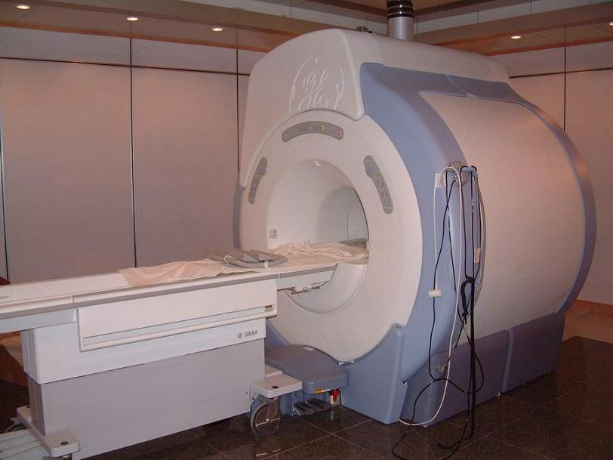
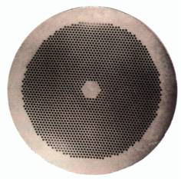
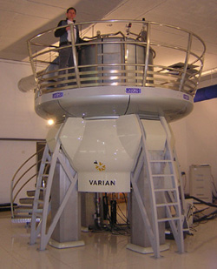
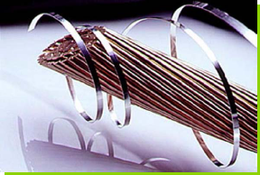
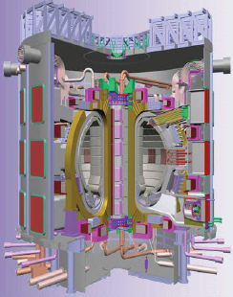
Fe-based wires potential for high-field applications
To apply superconducting materials to technologies related to magnets, they must be transformed into wires
MRI
Merits:
High H_{c2} (70T@20K),
Low γ (<2)
NMR
ITER
Development of high-performance wire conductors is essential

Slide 7
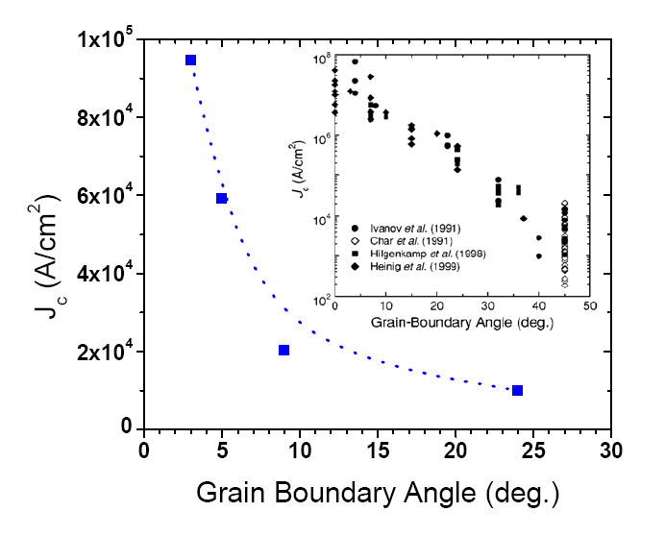
Grain boundary behavior in 122-type pnictides
Co doped Ba-122 thin films on bicrystals
Lee et al., APL 95, 212505 (2009).
Katase et al., Nat. Commun. 2, 409 (2011)
YBCO 4.2 K
YBCO 77 K
J_{c} decreases exponentially with GB angle, however, the critical angle GBs of pnictides is θ_{c} = 9º, larger than YBCO (θ_{c}~5º) .
Weak link effect, the GBs do not degrade the J_{c} as heavily as YBCO.
Advantageous GB over cuprates! This is the reason why we can use the PIT method to
make the pnictide wire and tapes, but PIT can not work for YBCO.

Slide 8
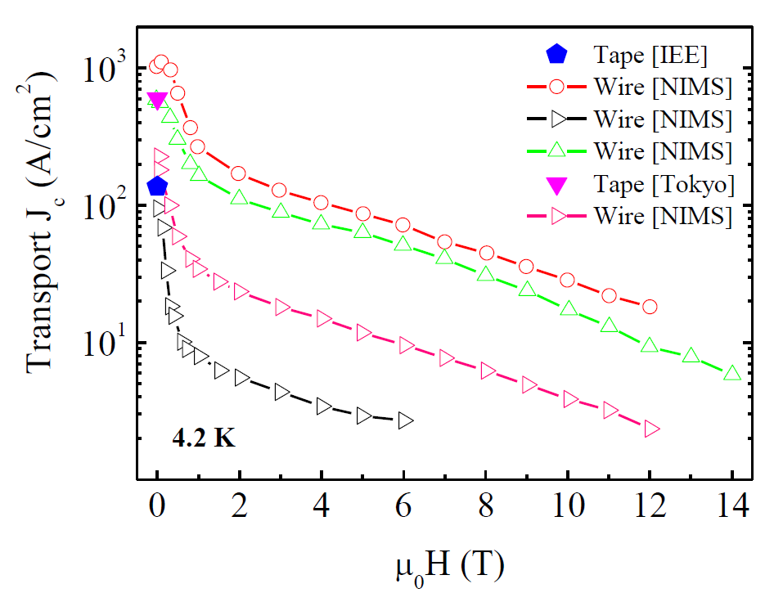
Compared to 122 tapes: 10⁵ A/cm² @ 10 T
1111 and 11 wire and tapes: J_{c} ~ 200 A/cm² in high fields
1111 type - Sm[O_{1-x}F_{x}]FeAs
11 type - FeTe_{1-x}Se_{x}
The J_{c} values obtained are still two to three orders of magnitude lower than for the 122 tapes.
1111 wires: how to control fluorine content during sintering.
11 wires: hard to remove excess Fe.

Slide 9
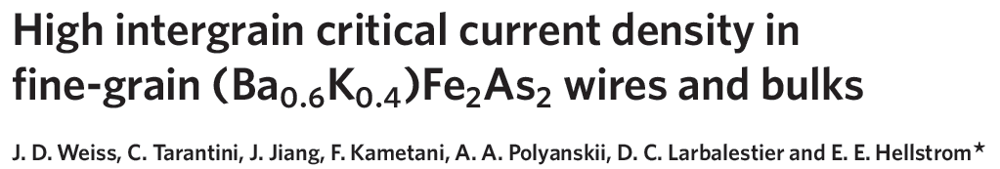
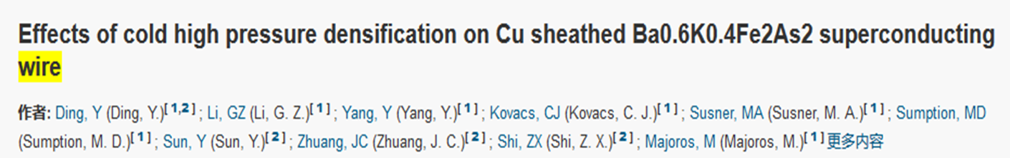
国外制备铁基超导线的情况 122体系
美国弗罗里达强磁场实验室： HIP 4.2K、10T时Jc = ~10⁴ A/cm²
美国橡树岭国家实验室：铜包套、冷压， 4.2K、0T时Jc=2.8 × 10⁴ A/cm²
日本AIST：银包套，冷压
4.2K、0T时, Jc~10⁵ A/cm²,
20 K, 2.5T, ~10⁴ A/cm²

Slide 10
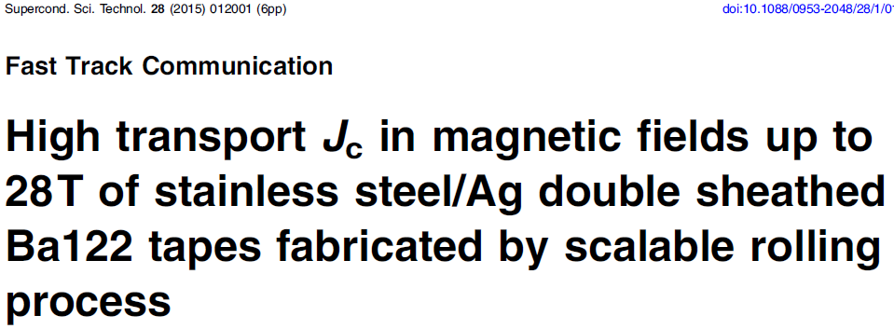
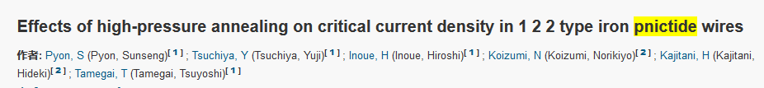
国外制备铁基超导线的情况 122体系
日本国立材料研究所：Ag包套、冷压；4.2K、10T时, Jc = 8.9 × 10⁴ A/cm²
日本东京大学： Ag包套, HIP合成；4.2K，0T时 Jc= 4.8 × 10⁴ A/cm²

Slide 11
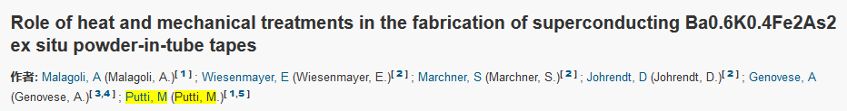
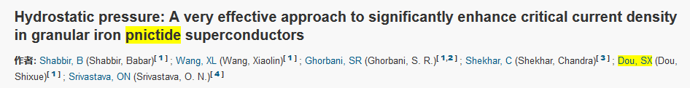
国外制备铁基超导线的情况 11/122 体系
意大利Genova大学：
4.2K, 0T时 Jc=3 × 10⁴ A/cm²
4.2K, 0T时 Jc 400 A/cm²
澳大利亚Wollongong大学：
仅有磁化Jc

Slide 12
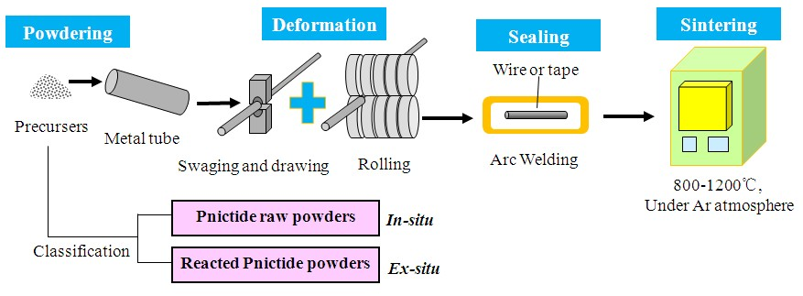
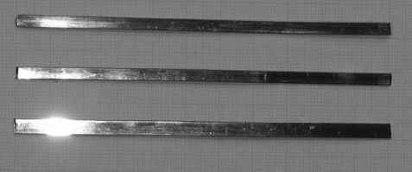
Fabrication process for Sr(Ba)_{1-x}K_{x}Fe₂As₂ wires
(Powder-in-tube method )
－ Simple and scalable process, low cost
800-900ºC
Final Product
122 PIT wires:
1. The single phase can easily be obtained.
2. The sintering temperature is low.
Iron-based superconducting tapes

Slide 13
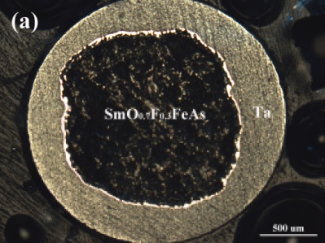
2008年4月，采用传统的粉末装管法，首次研制出新型铁基超导体线材
铁基线材临界电流密度非常低
主要是存在反应层、许多杂相、裂纹等
早期线带材
LaOFeAs
Tc＝25K
SmOFeAs
Supercond. Sci. Technol. 21 (2008) 105024

Slide 14
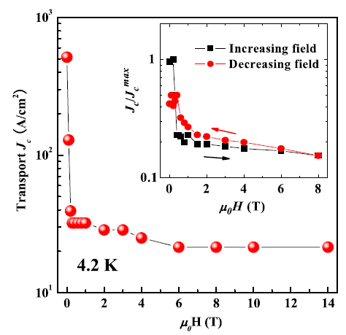
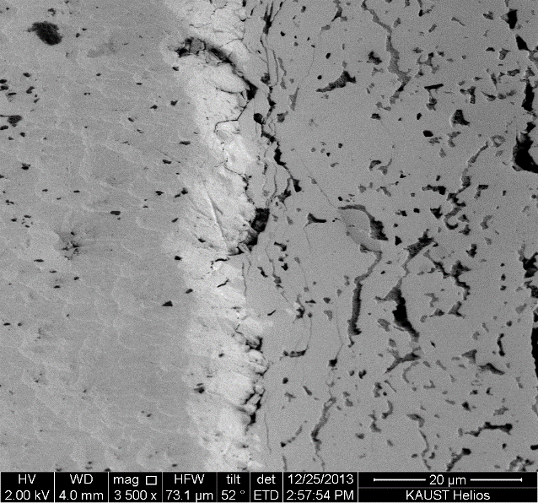
Key problems for PIT wires: Low density and weak link
Good connectivity is desirable!
Crack
Pore
Ag
Low density: cracks and porosity
Hysteresis in transport J_{c}: signature of weak links
Residual cracks and porosity always lead to poor grain connection, so suppress J_{c} in polycrystalline wires!
A hysteretic phenomenon observed for transport J_{c} in an increasing and a decreasing field indicated a weak-linked behavior, similar to that of the cuprates.

Slide 15
Solutions
Add Sn to improve the grain connectivity. (APL2011)
Large reduction rolling to increase texture. (Physica C 2011, APL 2011)
Hot pressing is effective to enhance the superconducting core density as well as grain alignment. (APL2014)
Tape axis
Rolled
Planar view
Longitudinal section
Hot pressed
Tape axis

Slide 16
Zn and In additions are effective to enhance the J_{c}-B of 122/Ag tapes
Chemical addition has been confirmed as a simple and readily scalable technique for enhancing Jc.
The additions do not significantly affect the temperature transition Tc, and the Tc decreased only 0.4 K.
the Jc enhancement in In or Zn-added samples may be attributed to the improved phase uniformity as well as the good grain connectivity
Lin et al., Scripta Mater. 112 (2016) 128

Slide 17
Optimized rolling process for 122/Ag tapes: 3-pass deformation is best
Ag
The width of the tapes and the area of superconducting cores increase with decreasing the rolling pass, but the transport J_{c} seems close.
We can fabricate tapes with 3 rolling passes to get the uniform and high-J_{c} 122 tapes.
Huang, Physica C, 2016

Slide 18
Breakthrough work
Very High transport J_{c} were achieved in 122/Ag tapes: J_{c} > 10⁵ A/cm² (4.2 K, 10 T)－by hot pressing
The threshold for practical application:
J_{c}=10⁵ A/cm²@10 T
First to reach practical level J_{c}!
Even for hot pressed multifilamentary 122 wires
At 4.2 K, 10 T
7-core, J_{c}= 6.1×10⁴ A/cm²,
19-core, J_{c}= 3.5×10⁴ A/cm².
The superior J_{c} can be attributed to higher grain texture and improved densification.
Zhang et al., APL 104 (2014) 202601

Slide 19
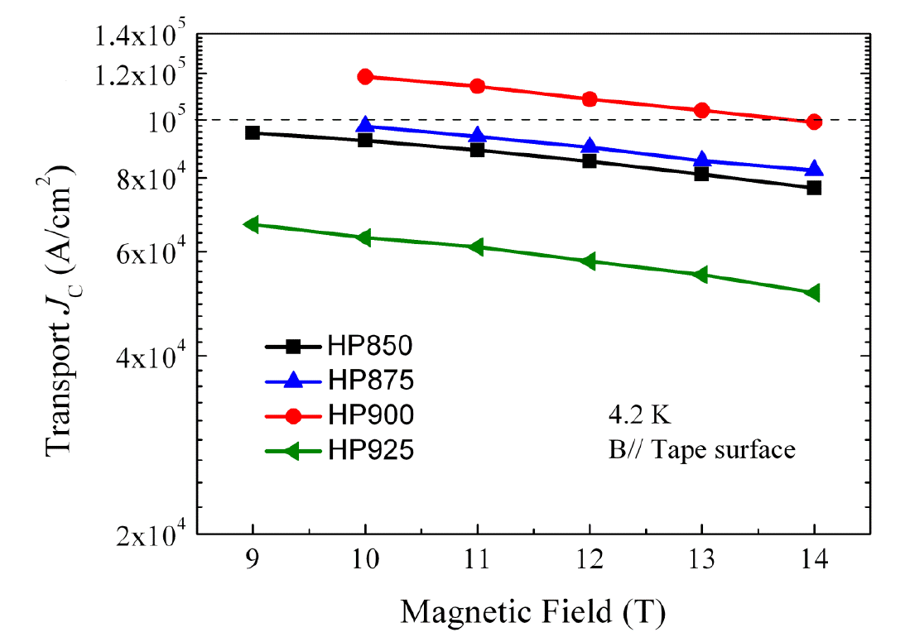
突破性进展
New record transport J_{c} values were achieved in 122/Ag tapes: J_{c} ~ 1.0×10⁵ A/cm² (4.2 K, 14 T)
--继续保持国际领先优势
--文献报道最高值
At 4.2 K and 10 T:
J_{c} = 1.2×10⁵ A/cm²
Main challenge:
How to transfer the already achieved high J_{c} to the large scale required for application.
高性能短样制备是制备均匀长线的基础
Lin et al., Sci. Rep. 4 (2014) 6944

Slide 20
热压提高机制研究
--高的织构度和致密度
About 154.0
Nearly constant !
The variation tendency of J_{c} values was qualitatively similar to those of F and RRR values.
The hardness was almost saturated as soon as the hot pressing was applied.
The J_{c} increase for HP900 tapes was mainly attributed to higher degree of c-axis texture and enhanced grain connectivity (high density).

Slide 21
EBSD images: the orientation mapping of grains
A useful tool to clarify the grain size, local orientation of the grains and misorientation angles between grains.
Upper: HP850
Inhomogeneous distribution of grain size
Lower: HP900
A room for the J_{c} improvement
The dominant orientation is (001) as the expected red color for both tapes, but there is a small (100) orientation for HP850 tapes as the green color.
The large fraction of small misorientation angles between 2–10ºC (HP850 tapes 23.3%, HP900 tapes 26.2%).

Slide 22
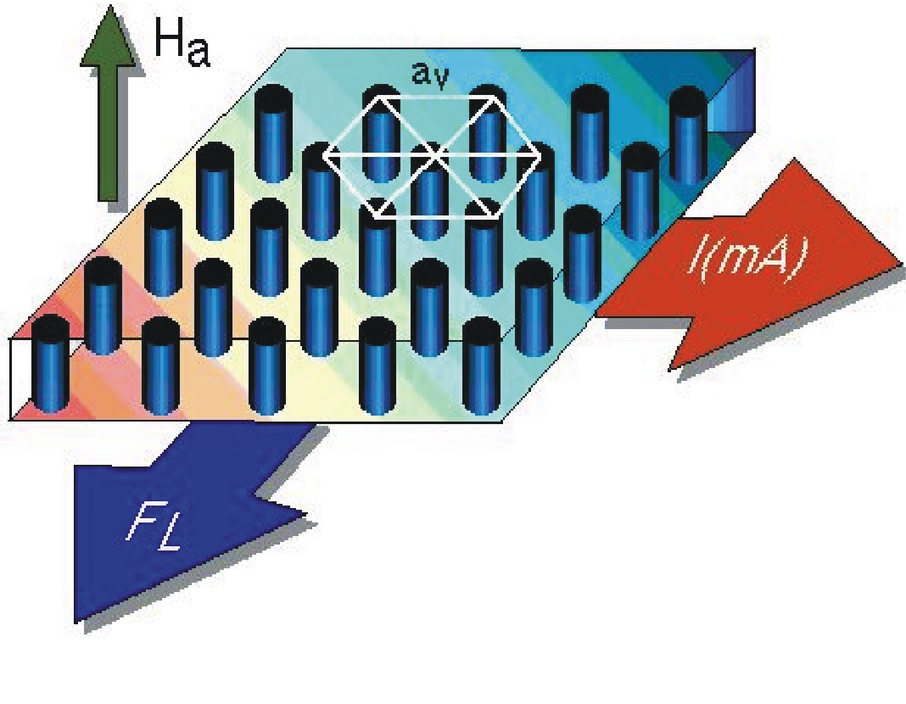
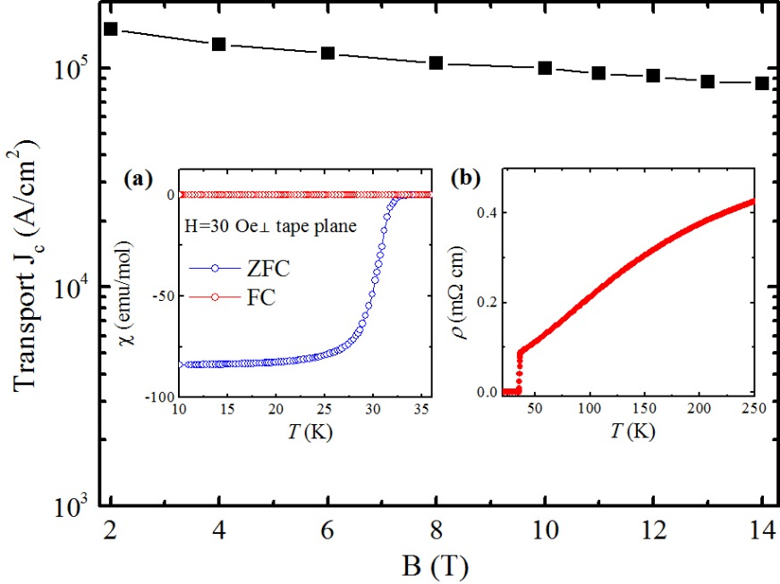
高性能热压122带材的磁通钉扎机制与动力学
磁通线
钉扎中心: 晶格缺陷，位错，掺杂纳米粒子
J_{c} (4.2 K, 10 T)~10⁵ A/cm²，I_{c}(4.2 K, 10 T)~300 A。
T_{c}~35 K, 超导转变宽度小。
剩余电阻率：RRR=ρ(250 K)/ρ(37 K)=4.81, 表明晶粒连接性较好
没有钉扎中心，则没有超导电流。
即使磁通线被钉扎住，热激活，磁通量子隧穿和机械振动会导致磁通线重新分布，从而导致样品的磁化强度发生弛豫。
磁通线的钉扎与运动是影响J_{c}的重要因素！

Slide 23
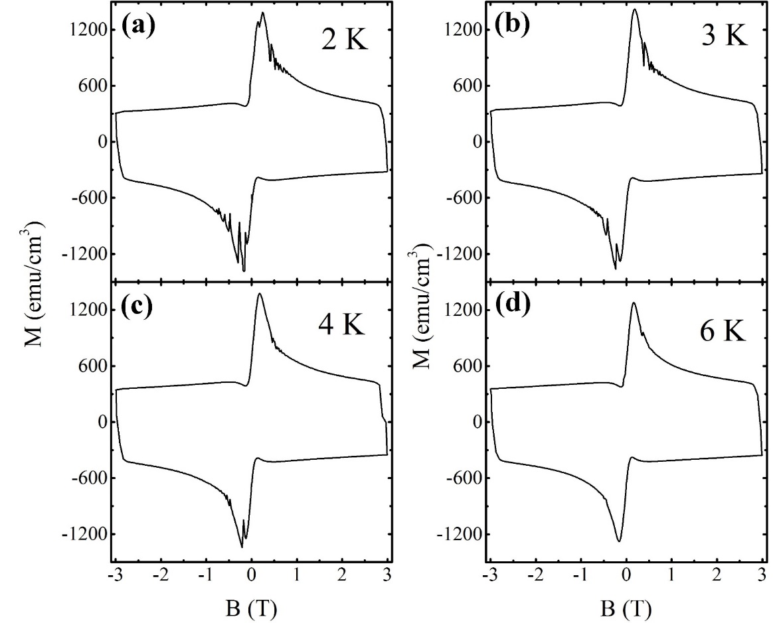
磁通跳跃（<6 K, <1 T）-- 高J_{c}！
首次在铁基超导线带材中发现磁通跳跃行为。
Ba_{0.65}Na_{0.35}Fe₂Fe₂As₂，Ba_{0.78}K_{0.28}Fe₂As₂，LiFeAs单晶中同样存在磁通跳跃现象。

Slide 24
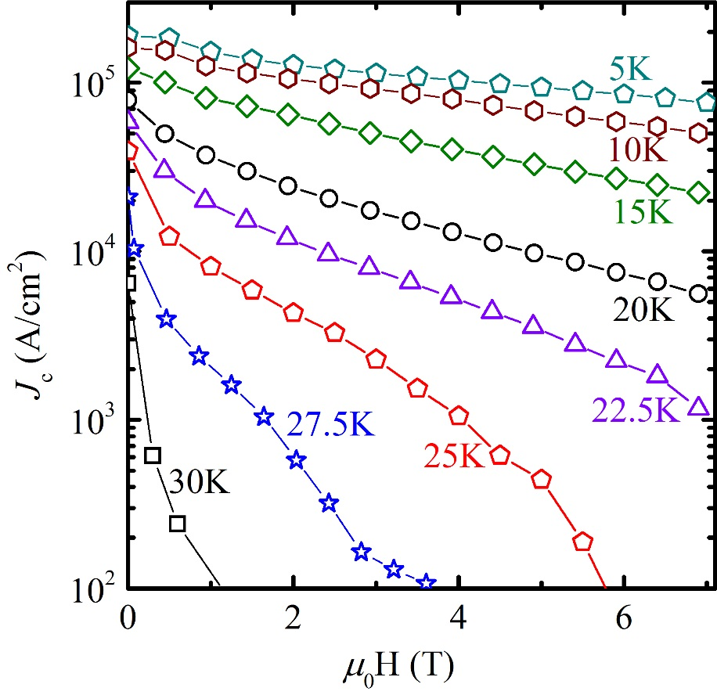
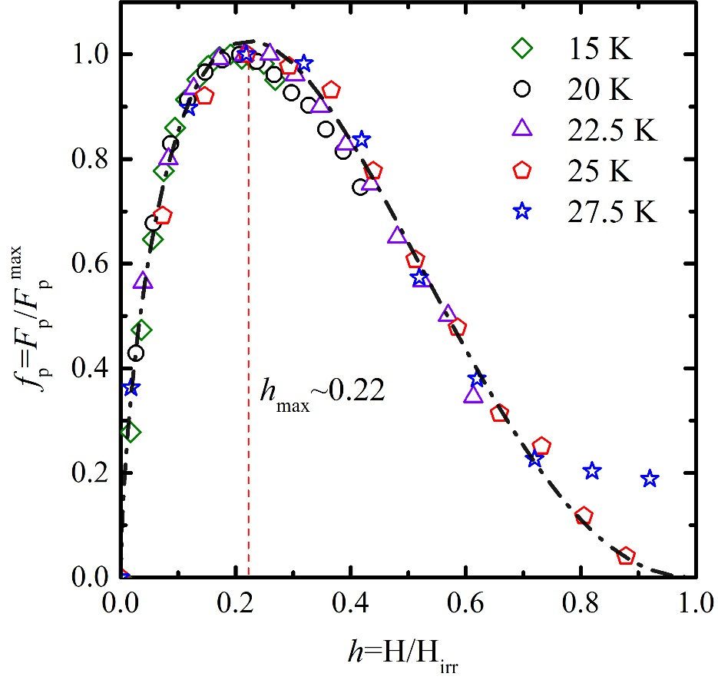
磁通钉扎机制
磁化电流密度非常接近于传输电流密度，表明带材的晶粒性可以忽略。
根据Dew-Hughes模型，约化钉扎力：f_{p}=Ah^{p}(1-h)^{q}，峰值位置：h_{max}=p/(p+q)=0.22，
表明晶界和位错是主要的钉扎中心，点钉扎也可能起到一定作用。
δl型钉扎, 由于平均自由程的涨落而引起的钉扎。

Slide 25
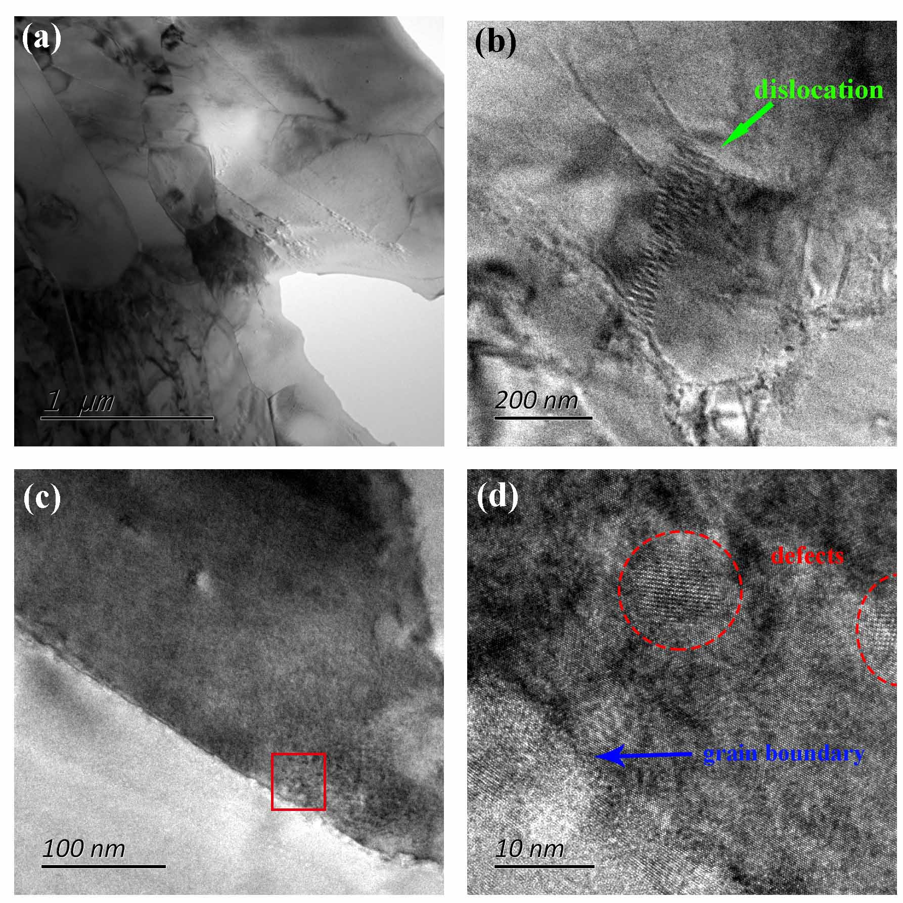
高性能Sr122带材超导芯的微观结构（TEM）
高密度位错
晶格缺陷
大量的晶界
大量的晶界和位错作为有效钉扎中心起主要钉扎作用。
Nb-Ti, Nb₃Sn和MgB₂线材中，晶界有利于钉扎磁通，而且不会阻碍晶间电流，这与热压Sr122带材非常相似。
一些点状晶格缺陷作为点钉扎中心也起到一定的钉扎作用。

Slide 26
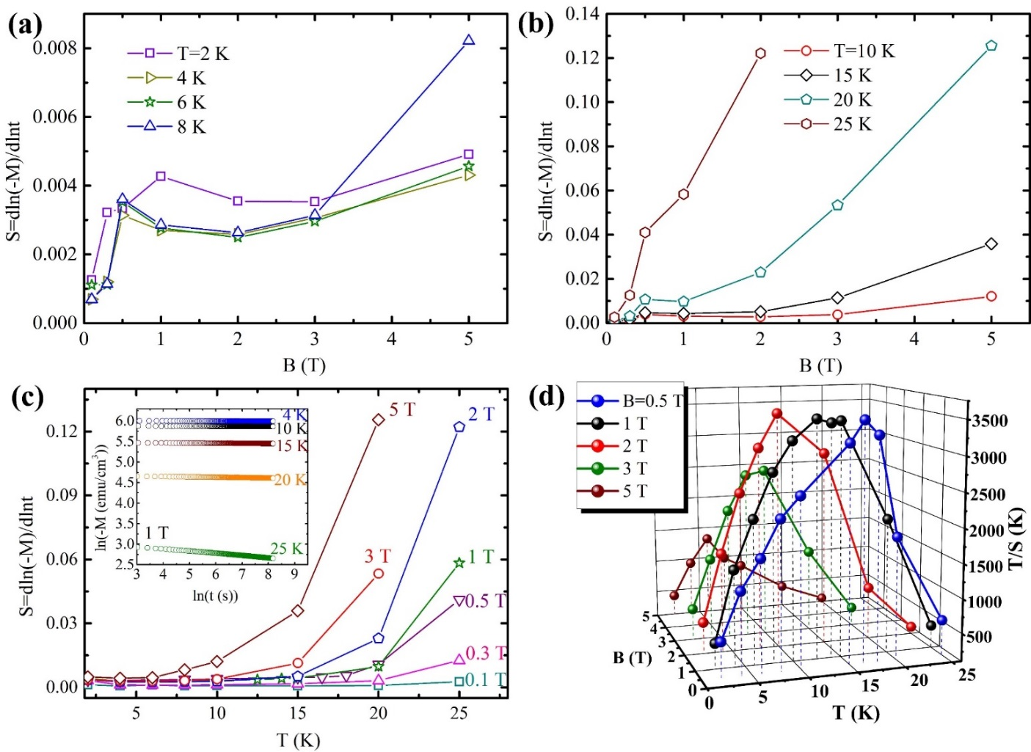
磁弛豫——磁通蠕动行为
磁通弛豫率：
磁化强度M和时间t为对数函数关系——热助磁通蠕动。
磁弛豫率很小且随磁场、温度变化不大表明热压Sr122带材的钉扎能力很强，而且J_{c}随磁场变化不大。
发生从磁通弹性蠕动到塑性蠕动的转变。
Dong et al., JAP 119 (2016) 143906

Slide 27
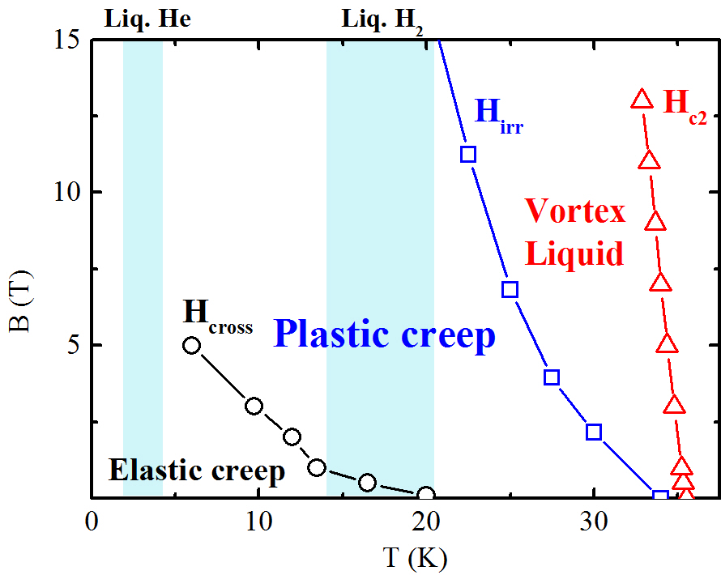
高J_{c}热压Sr122带材磁通相图
Dong et al., JAP, 2016
H_{cross} 定义为磁通弹性蠕动到塑性蠕动的转变磁场
磁通弹性蠕动区域的临界电流密度随磁场变化不大。
在液氦温区，临界电流密度随磁场变化不大，但临界电流密度在液氢温区随磁场升高而迅速减小。
进一步增加钉扎力：i) 减小晶粒大小以增加晶界，ii) 增加点钉扎中心，例如：辐照或纳米粒子掺杂。

Slide 28
Conductor requirements for practical applications
Overall current density J_{cE} of conductor, not just of superconductor
Performance in field
Filamentary architecture essential for AC applications
Anisotropy of J_{cE} with respect to field direction
Cost
  Conductor itself
  Cooling
Scaleability of fabrication
Mechanical
  Strength, bend radius, …..
Conductor shape
  tape or wire
Larbalestier, Nature 414 (2001) 368

Slide 29
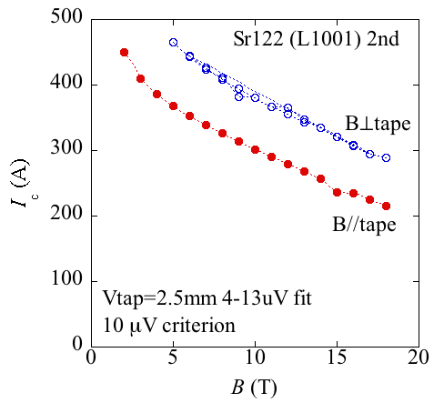
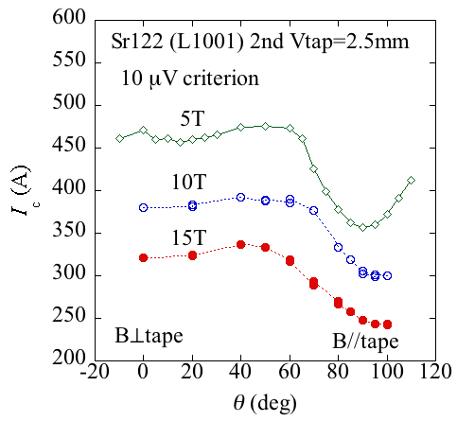
J_{c} properties at 4.2 K for HP Sr-122/Ag tapes
Small anisotropy
-- Measured by Dr. S. Awaji
HFLSM, Tohoku Univ.
4.2 K
4.2 K
The I_{c} in applied magnetic fields is slightly higher in the perpendicular field (I_{c}┴) than in the parallel field (I_{c}//).
The anisotropy ratio (Г= I_{c}⊥/I_{c}∥) is less than 1.5, quite small, very promising for applications.

Slide 30
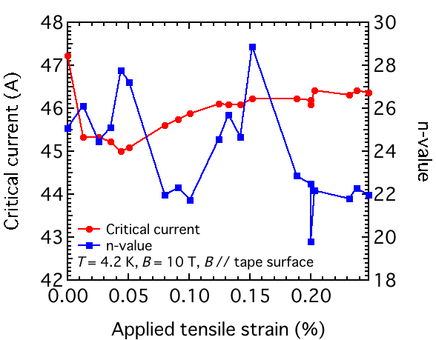
Temperature dependence of n value for Sr-122 tapes
n value
-- Measured by Prof. Yang
Univ. of Southampton, UK
-- Measured by Dr. Oguro
HFLSM, Tohoku Univ., JP
Ag-sheathed
Fe-sheathed
At 20 K, the n value was over 30
At 4.2 K, the n value was over 20

Slide 31
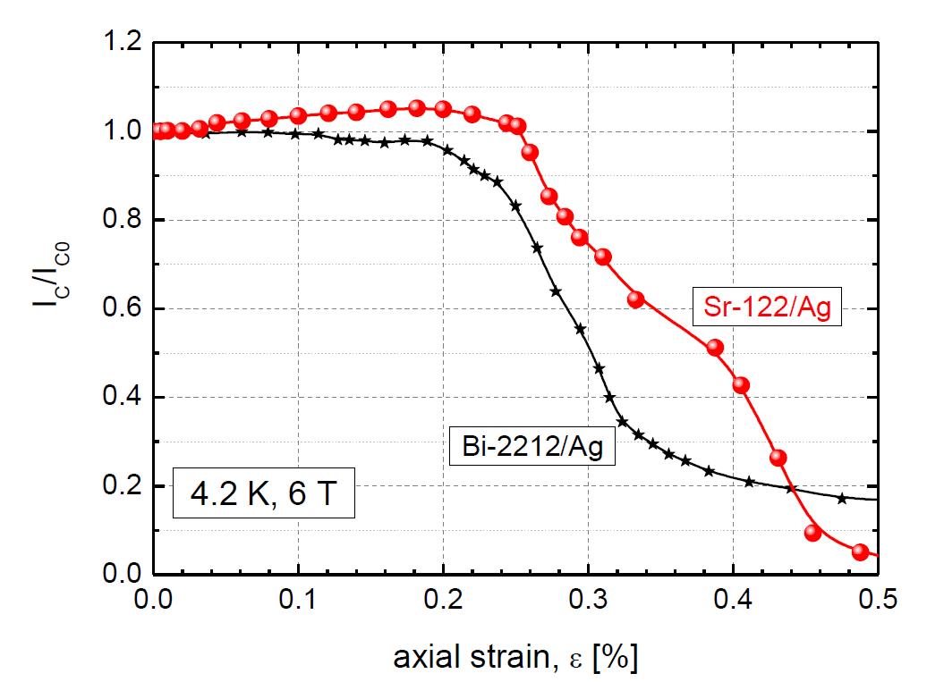
The first strain measurements of Sr-122/Ag tapes
Strain property
Kovac et al., SuST 28 (2015) 035007
-- Measured by Dr. Kovac
Slovak Academy of Sciences
At 4.2 K, 10 T: I_{c} >125A
Irreversible strains:
ε = 0.25%
which seems better than that of Bi-2212/Ag
The first observation of strain effects on the critical current of 122 wires
Next step:
Improvement of mechanical property of pnictide wires will be one of the major challenges for high field applications

Slide 32
Fabrication of stainless steel/Ag double sheathed Ba122 tapes
Highly mechanical property is expected!
High J_{c}, but show lower J_{e}
NIMS group, Supercond. Sci. Technol. 28 (2015) 012001

Slide 33
So far, all high-J_{c} pnictide wires and tapes were made by using Ag as sheath material
Ag is very expensive
We should find other cheap materials, in order to reduce the cost!
Ag
Ag
IEECAS, 2014
Ag
Ag
Florida, 2012
NIMS, 2014

Slide 34
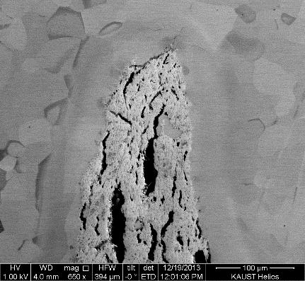
Fe sheath material
Ma , Physica C 516 (2015) 17
Fabrication of Fe-cladded 122 tapes
-- tape thickness=0.6 mm
-- by the scalable rolling
At 4.2 K and 14 T:
J_{c} = 2.4×10⁴ A/cm²
Fe
From an economic point of view, the Fe sheath is more attractive than the Ag sheath in fabricating Sr122/Ba122 tapes for practical applications.

Slide 35
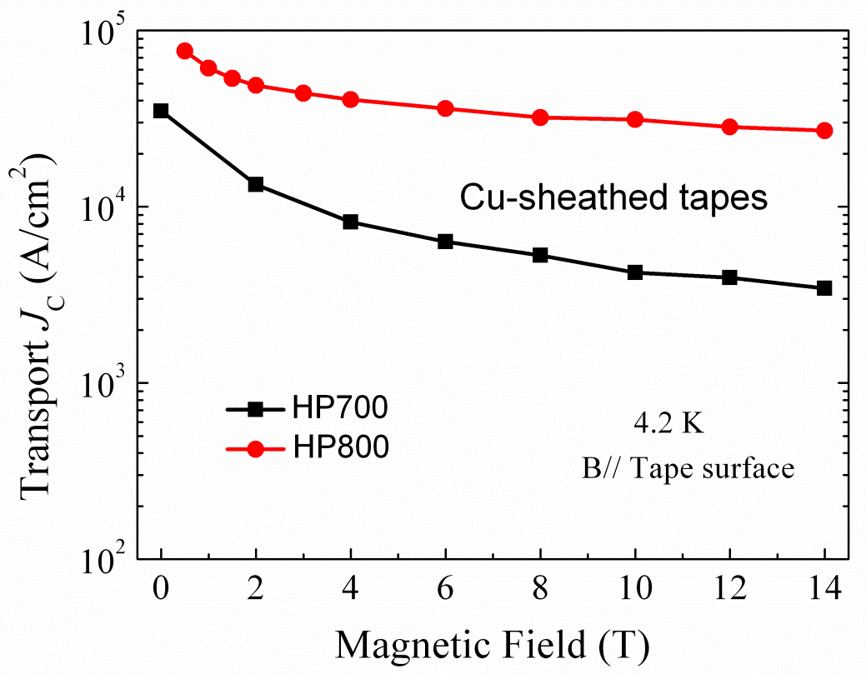
铜包套
首次成功制备高性能Cu包套铁基超导带材
--对进一步促进铁基超导材料的实际应用具有重要意义
At 4.2 K, 10 T
Transport J_{c}:
3.1×10⁴ A/cm²
Engineering J_{e}:
>10⁴ A/cm²
800ºC/30分钟
优点：既可以降低铁基线带材的制造成本，同时还可保证线带材在使用时的热稳定性。
Lin, et al., Sci. Rep. 5 (2015) 11506

Slide 36
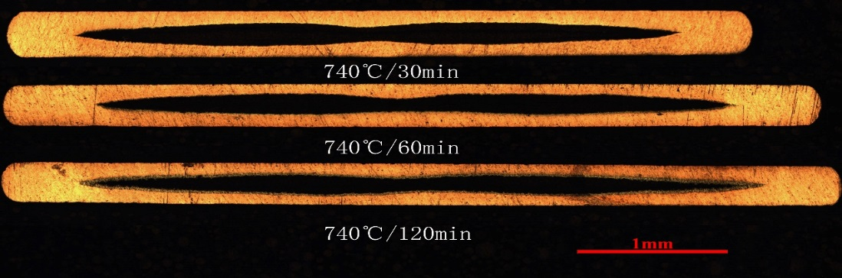
Latest result
High J_{c} in Cu-sheathed Sr-122 tapes at low temperature 740ºC
At 26 T:
J_{c} = 1.6×10⁴ A/cm²
Je >10⁴ A/cm²
Cu
The HP740/60 tape has a uniform and well connective superconducting phase and only a small amount of diffusion of Cu.
The best transport J_{c} reaches 3.5×10⁴ A/cm² at 10 T and keeps 1.6×10⁴ A/cm² at 26 T.
Cu
Cu
Lin, to be published

Slide 37
率先成功制备了高性能122型铁基超导19和114芯线带材
多芯样品具有更高的磁场特性和较低的交流损耗，对实际应用具有重要意义。
Fe
Fe
Ag
Ag
114 filament
Ag
Fe
At 4.2 K, 10 T:
114-core round wires: J_{c}=800 A/cm².
When they are flat rolled into tapes, the J_{c} grows with the reduction of tape thickness. the J_{c} =6.3×10³ A cm⁻² in 0.6 mm thick tapes.
7-core tapes: J_{c}= 1.5×10⁴ A/cm².
This J_{c} degradation can be ascribed to the sausage effect.
Yao et al., JAP 118 (2015) 203909

Slide 38
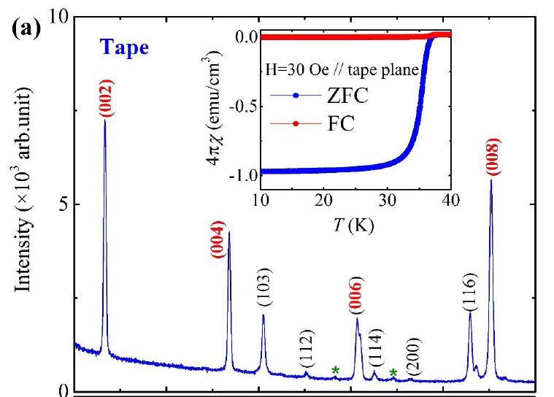
Higher J_{c} in Ba-122/Ag tapes was achieved by scalable rolling process
-- thickness=0.3 mm
One cycle of ﬂat Rolling + Sintering process
At 4.2 K and 10 T:
Transport J_{c} = 5.4×10⁴ A/cm²
The highest among the rolled iron-based superconducting tapes
The degree of texturing F: ~0.69
Average Hv: ~135
Such high J_{c} value is believed to stem in part from an improvement of grain connectivity by reducing weak links.
Dong et al., Scripta Mater. 99 (2015) 33

Slide 39
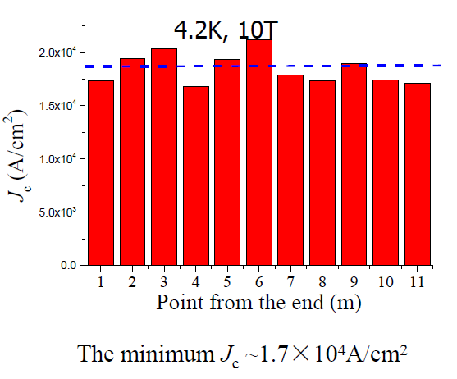
Significant breakthrough!
Ma , Physica C 516 (2015) 17
The first 11m long Sr-122 tape
-- by the scalable rolling process
Uniform wires can be fabricated
The first long wire-- 11 m
The average J_{c} of this long Sr122/Ag wire is ~ 18400A/cm²
The fluctuations of the J_{c} is ~5%

Slide 40
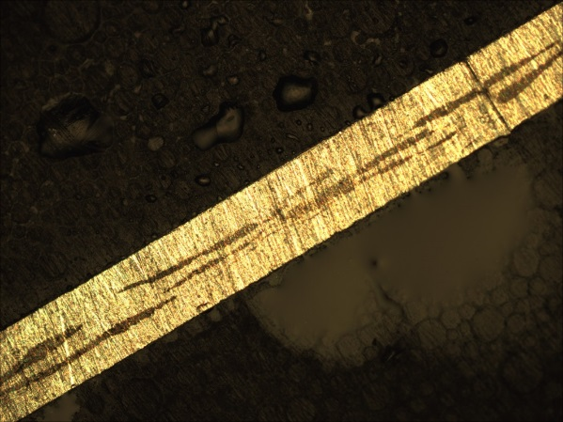
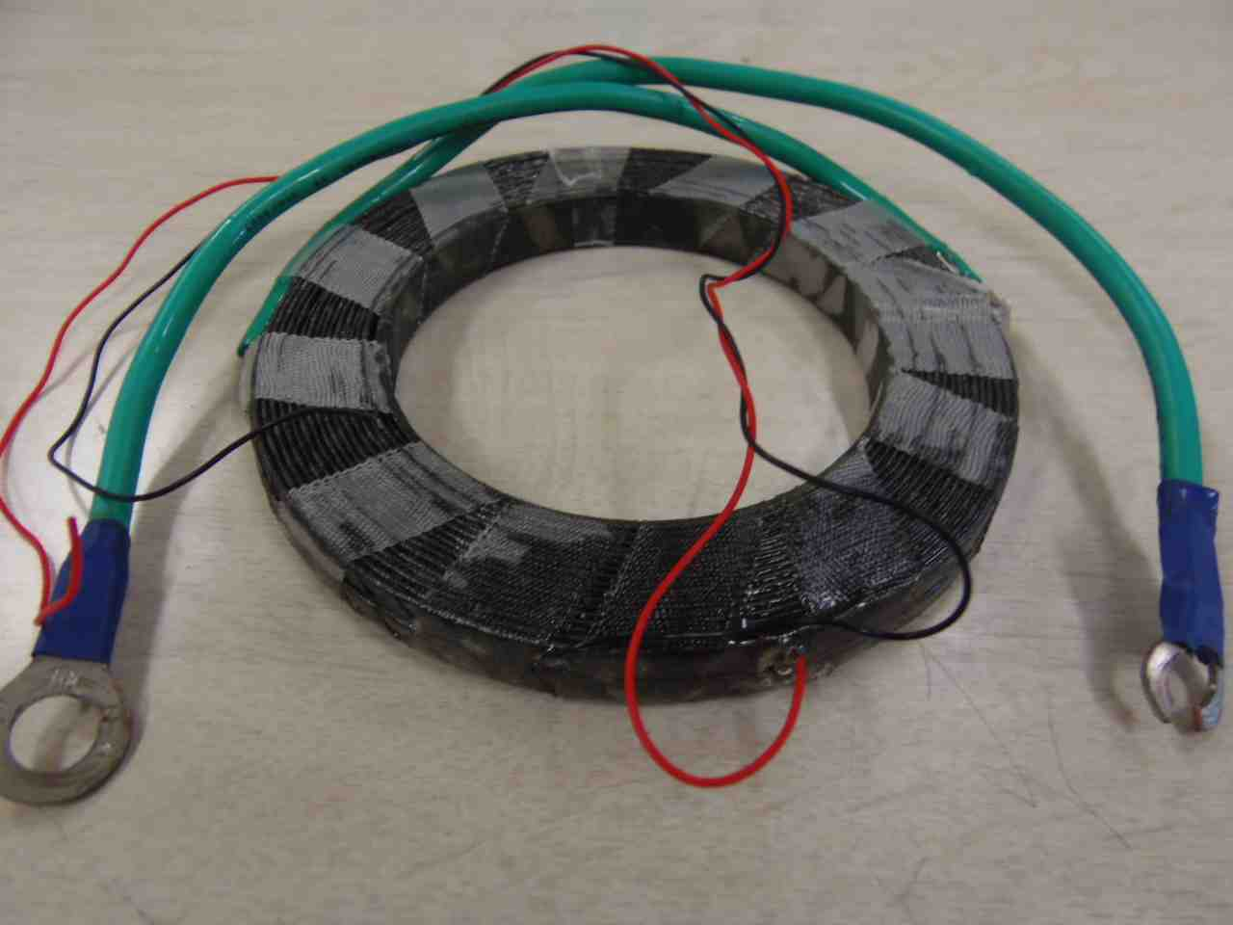
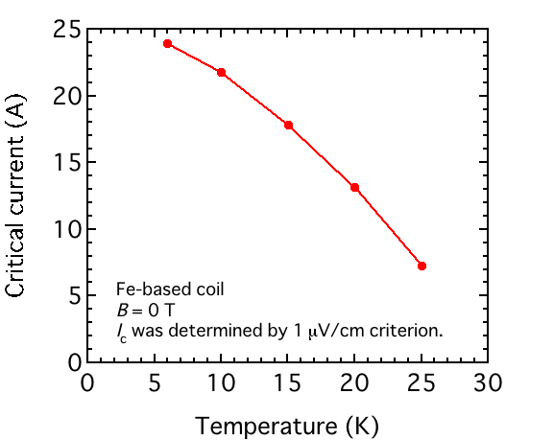
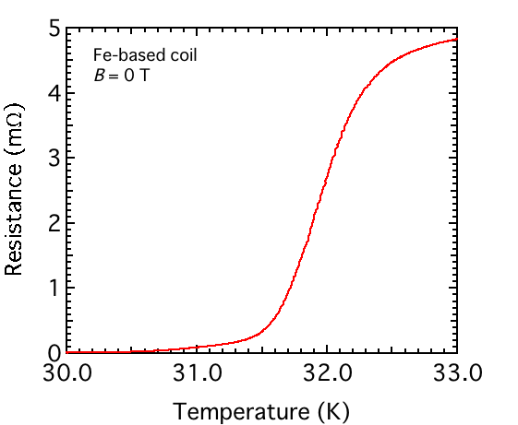
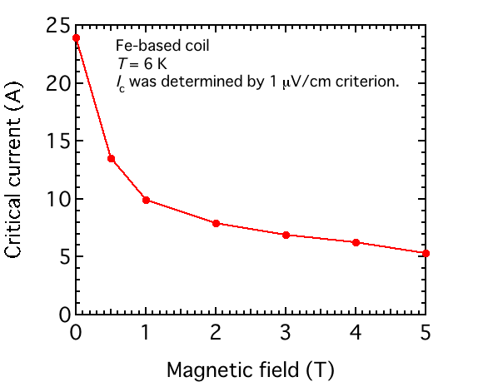
Fabrication of Sr122 coil using 10 m long Ag-sheathed tape
Superconducting ratio：9%
OD: 110 mm
ID: 71.5 mm
Turns:15×2
Next step:
1) Increase S ratio;
2) Ag is too soft for winding, to use high strength tape.
7-filamentary
Length：10 m
Thickness：0.44 mm
Width：3.7 mm
Short tape I_{c}: ~100 A (4.2 K, 0 T)

Slide 41
Prospects
Breakthrough work
Already reached practical level J_{c} at 10 T
+
Realization of the first 11 m long-length tape
Strong promising for high-field applications !
122 PIT tapes have achieved the practical level J_{c}, increasing it further is challenging. Still we are below the film J_{c}, so there is room for improvement.
We believe that PIT process can be applied industrially to fabricate pnictide wires and tapes, as already demonstrated by the production of Bi-2223 and MgB₂ wires.

Slide 42
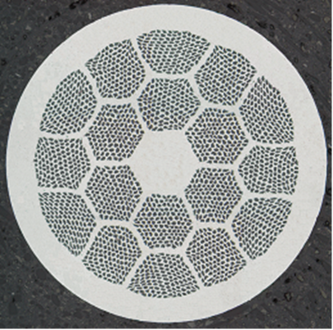
Summary: Challenges for the next stage R&D
Ultra High In-Field Critical Currents: I_{c, min} – B
→ e.g. J_{c} > 2×10⁵ A/cm² @ 4.2 K, 10 T
Correspondingly, J_{c} > 10⁵ A/cm² @ 4.2K, 28 T
High J_{c} Round Wires:
→ Like Bi-2212, round wire is ideal for high homogeneity magnets – NMR
Low Cost Wires:
→ e.g. Cu- or Fe-sheathed wire fabrication, instead of using Ag
High Mechanical Strength Long Wires:
→ Tensile, Bending

Slide 43
Thank you for your attention !

Slide 44
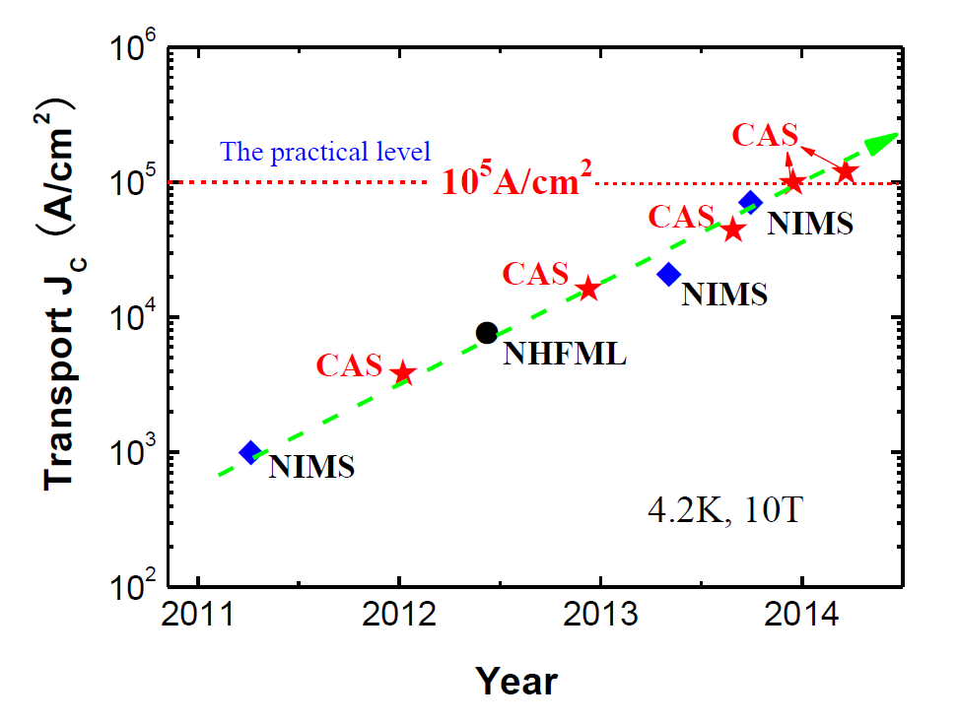
铁基超导体线材的传输性能最新进展
电工所
4.2K, 10 T
J_{c}=1.2×10⁵ A/cm²
Latest
Next goal: 10⁵A/cm² at 20-30T

