Slide 1
BESIII data processing
邓子艳 2016-06-06
高能物理计算与软件会议，广东东莞

Slide 2
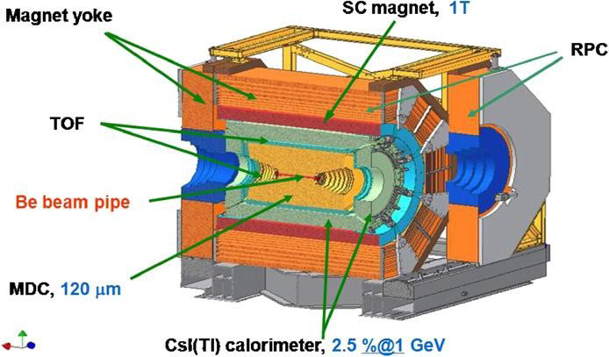
BESIII dataflow
Raw data on disk
(All, Bhabha, Dimu., Random trigger ……)
Raw data on tapes
Detector Calibration
Detector Simulation
Offline Reconstruction (DST Production)
Background Mixing
(with random trigger events)
Physics Skimming(nprong, DTag, …)
Reconstruction
User Analysis

Slide 3
Key components for data processing
Raw data from detector
Data management system
Offline software system
Data quality system
Database server
Computing resources

Slide 4
BESIII data volume
Resonance | Raw files | Data volume(RAW) | Data volume(DST)
psip | 32000 | 80T | 27T
jpsi | 45600 | 85T | 29T
Psipp | 90000 | 170T | 56T
4040 | 9500 | 18T | 6T
XYZdata | 60000 | 120T | 40T
Rscan | 43000 | 80T | 21T
tauscan | 2000 | 8T | 2.6T
2175 | 12000 | 22T | 5T
4180
Total size of random trigger data: 40T
~100 TB raw data(Physics+ Random+CAL) per year

Slide 5
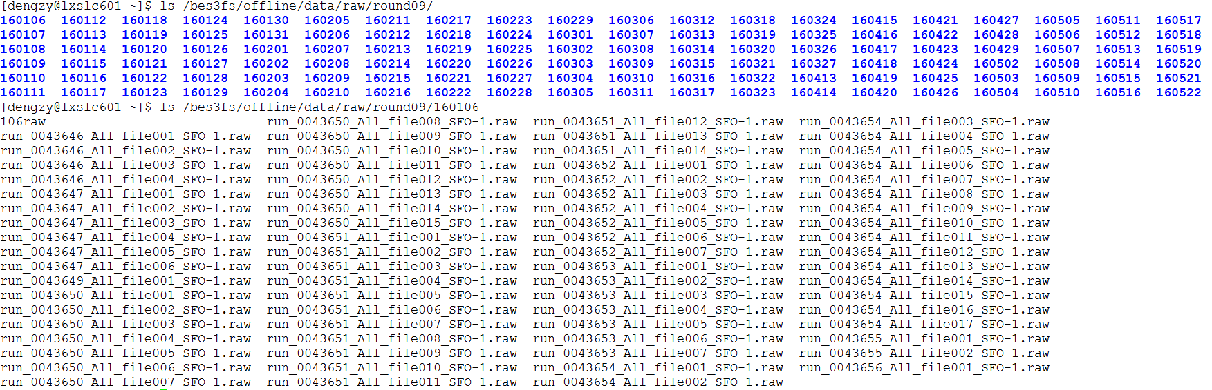
Raw data on Lustre file system
~2GB per raw data file
Hundreds of raw files per day
including : All, dimu, bhabha, diphoton, random trigger data

Slide 6
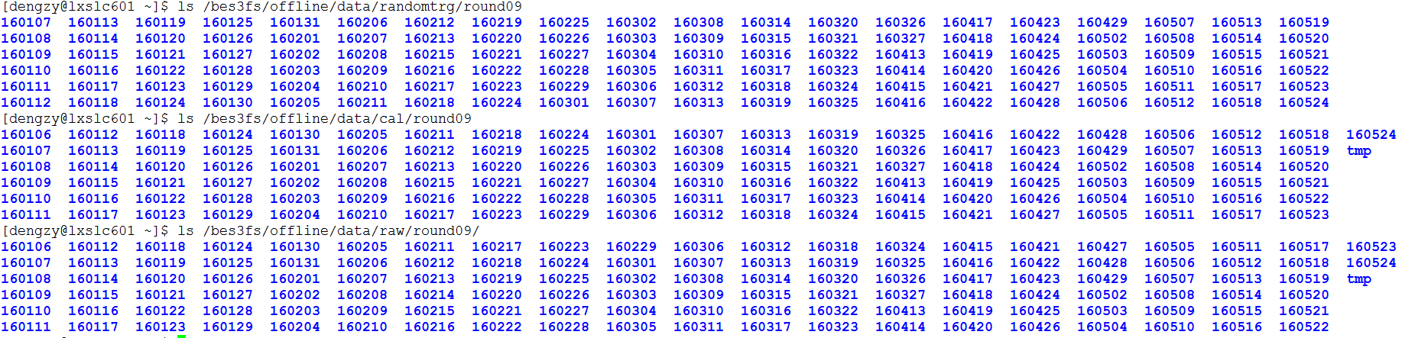
Raw data on Lustre file system
Random trigger data
Data for calibration
Raw data

Slide 7
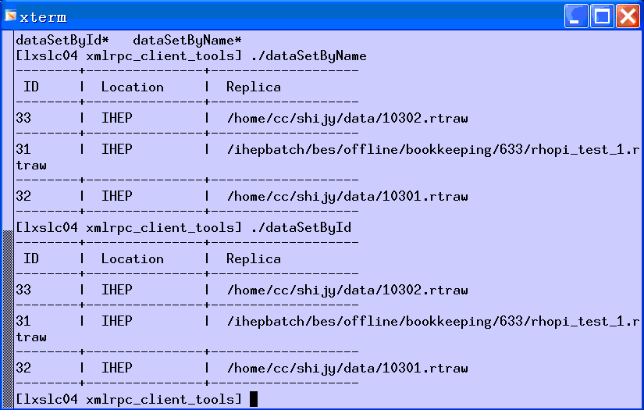
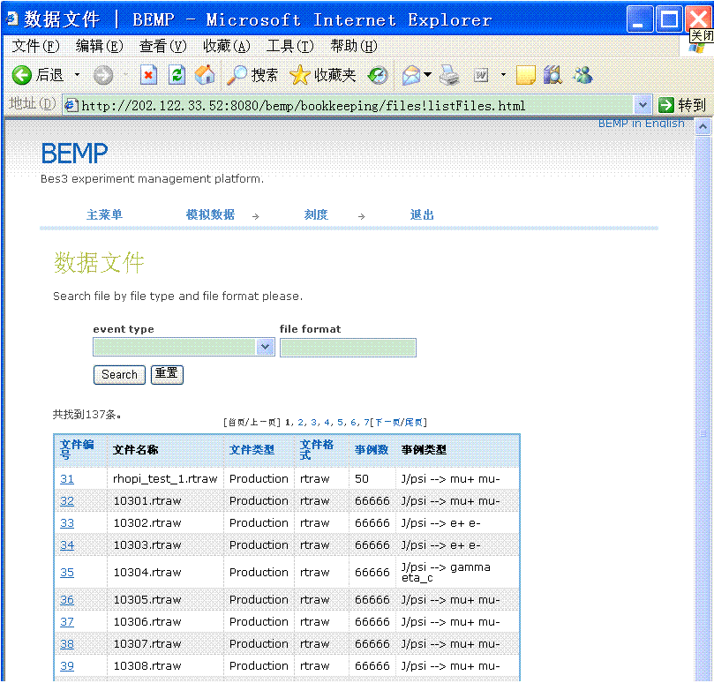
The architecture of Bookkeeping
XML-rpc
XML-rpc service
DB
JDBC
BookkeepingSvc
Bookkeeping Server
MySQL
JSP
(Javs Server Page)
HTTP
Database
Server Side
Client Side
Notes:
Bookkeeping is mainly consists of 3 parts:
A database to keep all the data information that the physicists may be interested in.
A bookkeeping server that provides services to access the database.
Bookkeeping client tools for ordinary users to query data.
The bkk services are hosted by a central server that deals both with web pages and xmlrpc services.

Slide 8
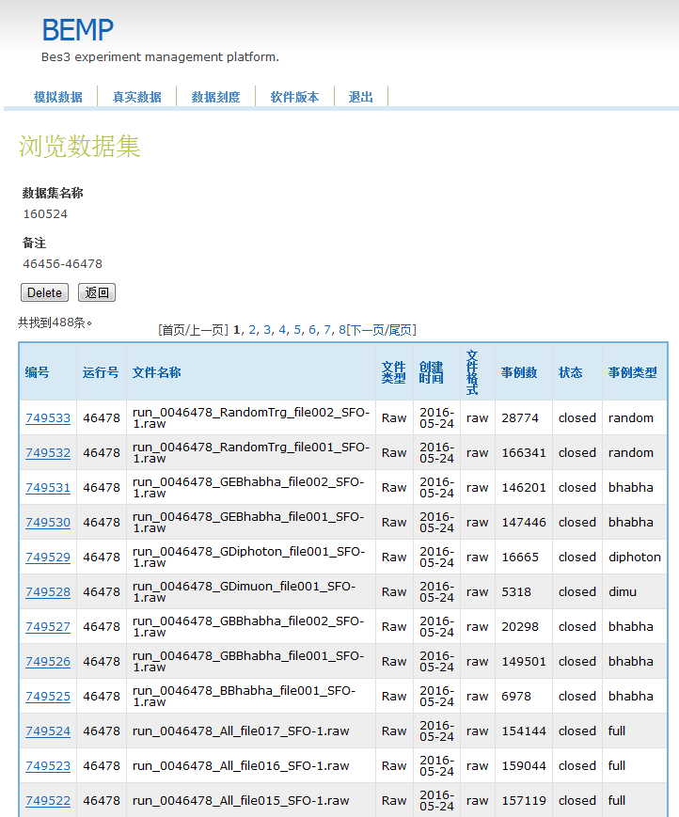
Data management
Management of raw data
  Import information of raw data files from online database
  File and dataset management: provide interface for dataset access

Slide 9
Data management
Copy raw data from castor to disk(Lustre)
  Get information of raw data from Bookkeeping
    position in castor, runID,……
  Create a dataset:
    runFrom, runTo, dataset name
  Dataset name is input of a data migration job script
  Submit the job
  After the job finished, check the consistency of raw data files
  cd /bes3fs/offline/data/cpfromcastor/round09
  mkdir date
  cd date
  /afs/ihep.ac.cn/soft/common/sysgroup/offline/bin/CpFromCastor -c ~/bin/TypeConfig.cfg -d date dataset REAL
  q2n
  chkcopy SeqNo

Slide 10
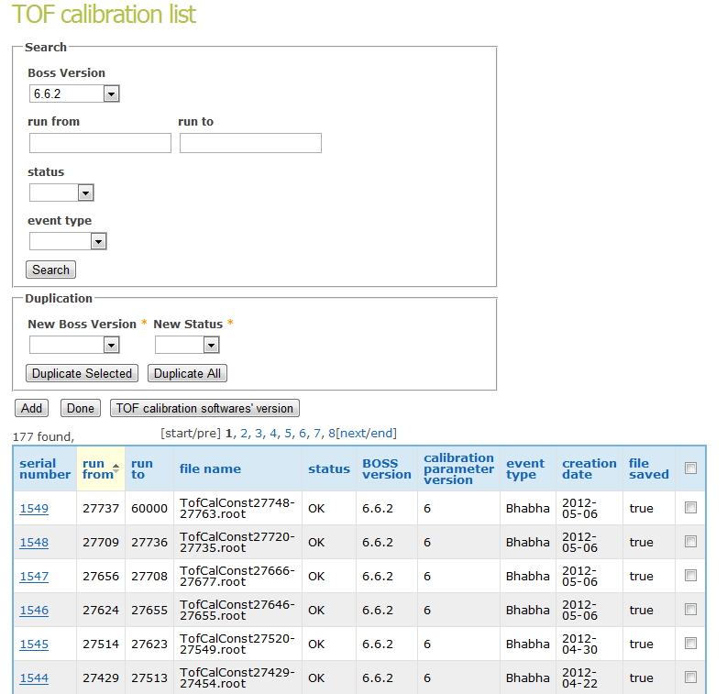
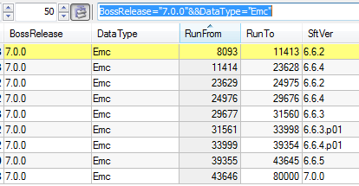
Calibration constants version control
Management of calibration constants
  Save calibration constants for specific sub-detector, software version, run range
  Interface for users to search specific constants
  Permission control for different users

Slide 11
BESIII Offline Software System (BOSS)
BESIII Offline Software System (BOSS), is a new offline data processing software system which is developed based on GAUDI framework
External Libs: Geant4, ROOT, GDML, MySQL……
OS: Scientific Linux 6, GCC 4.6.3
Simulation, calibration, reconstruction, and analysis algorithms are core software for data processing and physics analysis, software framework provides these algorithms event data service and constants data service
Detector geometry service
Simulation
Raw data Converter
Raw data
Event Data Service
BESIII
Offline Database
Calibration
Reconstruction
Calibration constant service
REC data converter
Rec data
Physics
constant
service
Physics Analysis
DST data converter
DST data

Slide 12
Reading calibration constants
Calibration
root file
bemp put root file to db
~bemp/SqlTest/CalConstSqlHelper.cxx
offlinedb
MdcCalConst
Read from root file
$CALIBROOTCNVROOT/src/cnv/
RootMdcCalibDataCnv.cxx
TCDS
Read db sql
$CALIBUTILROOT/src/Metadata.cxx
getter setter
$CALIBDATAROOT/src/Mdc/MdcCalibData.cxx
Read TTree from sql results
$CALIBTREECNVROOT/src/cnv/
TreeMdcCalibDataCnv.cxx
MdcCalibFunSvc

Slide 13
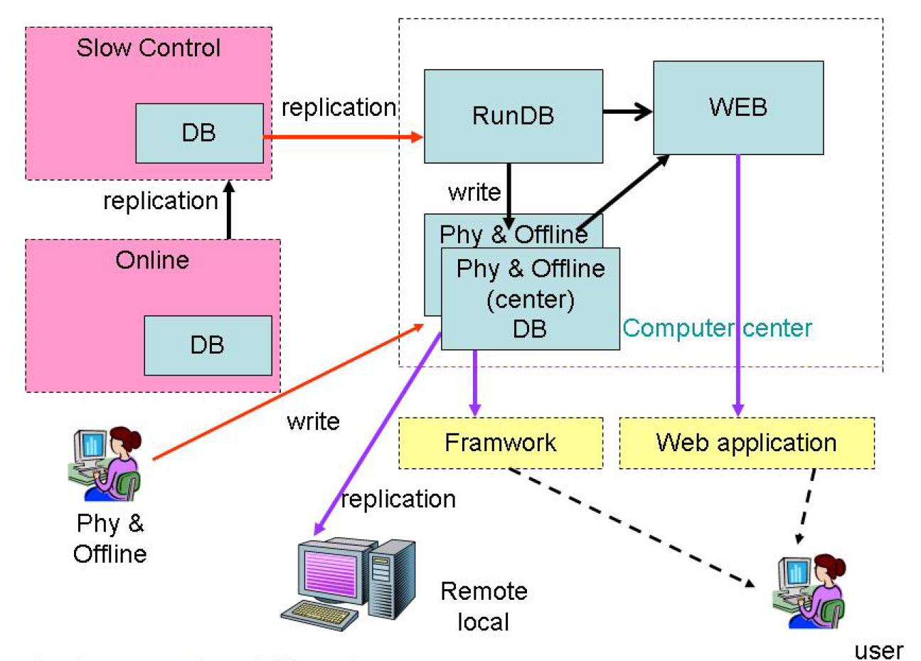
Database architecture

Slide 14
Database performance
Servers:
  Replication of DAQ and DCS Database
  Web server for data quality and bemp
  Central Database servers:1 master and 5 slaves at IHEP, other slaves at other groups
  Bookkeeping database and web server
Central database servers:
  Size：35G（database files、logs）
  Throughput：2 connections per second , more than 200 queries per second (The statistics only from one slave)
    Connections | 636619
    Innodb_data_read | 437587968
    Uptime | 2933932
Replication of DAQ and DCS:
  Size: 970G
BEMP database server
  Size: 11G

Slide 15
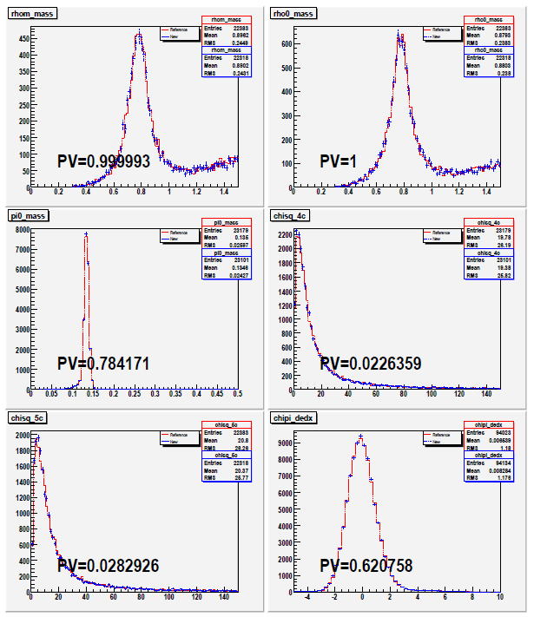
Data Quality Assurance
Several kinds of MC samples generated and reconstructed
  J/psi->e+e-, mu+mu-, rhopi, KsKpi, PPbar
Part of real data reconstructed to check the software performance and MC/data consistency

Slide 16
Data Production
Data production uses the validated offline software release
Physics production takes place 1 or 2 times per year, ~ 5 months processing time for each production
Data reconstruction for newly taken data will last from the begin to the end of each data taking round
  Depending on when the calibration constants of sub-detectors are ready

Slide 17
BESIII data processing
Computing Resources in IHEP
  CPU cores
    ~5000 cores
  Tape space (Castor)
    4PB, 3PB available
  Local file system(Lustre)
    ~2800TB, ~300TB available
CPU time of production jobs (with 2000 cores)
  Produce 1 billion jpsi inclusive mc DST events: 8 days
  Reconstruct 1 billion jpsi raw data: 7 days
  Reconstruct 0.1 billion psip raw data: 1 days
  Reconstruct 2.9fb⁻¹ psipp raw data: 13 days

Slide 18
Tag based analysis
TAG describe basic infor for each event
Location of DST file saved in TAG file
Save much disk space compared with skimming
Analysis speed is same as skimming

Slide 19
Multi-input data analysis
Retrieve dst and raw data in the same job
Raw data of each sub-detector can be retrieved independently

Slide 20
Summary
Large scale data samples from BESIII have been successfully processed
Data management and offline software system provide quick and stable data processing for BESIII

