Slide 1
中国高能物理发展战略研讨（第5次）
中国高能物理分会
中国科学院粒子物理卓越中心
粒子和相互作用协同创新中心
中国科学技术大学承办
赵政国

Slide 2
提纲
粒子物理重大科学问题和装置
基于加速器高能物理现状
发展战略

Slide 3
Key Science Questions
1. What interaction does Higgs particle reflects? Are there any other Higgs particles?
2. What are dark matter and dark energy?
3. How did the universe begins?
4. What are the property of neutrinos?
6. What information do cosmic rays bring us?
Does proton decay?
Are there any new forms of matter?
How are the elements from iron to uranium made?
Do all the forces become one?

Slide 4
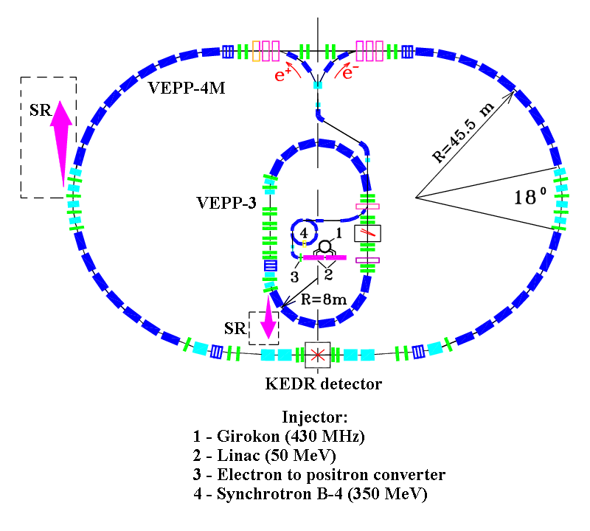
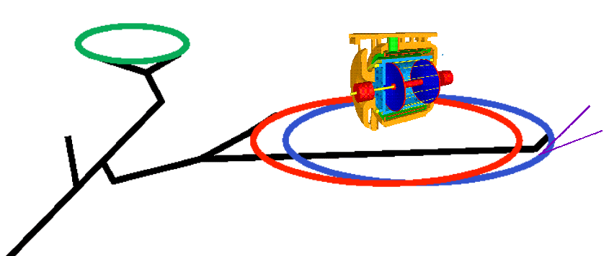
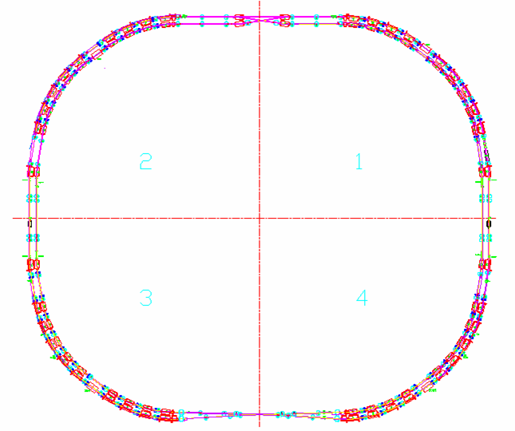
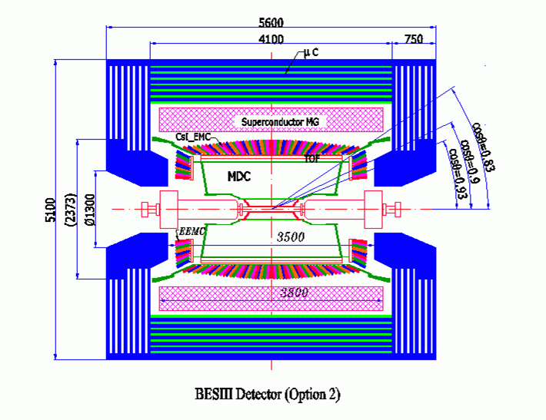
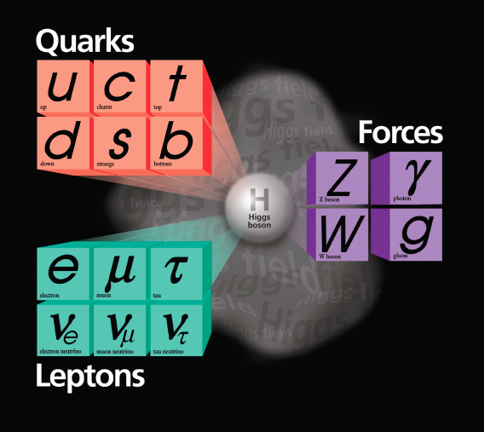

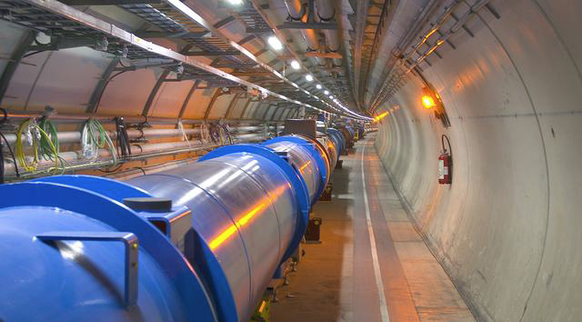
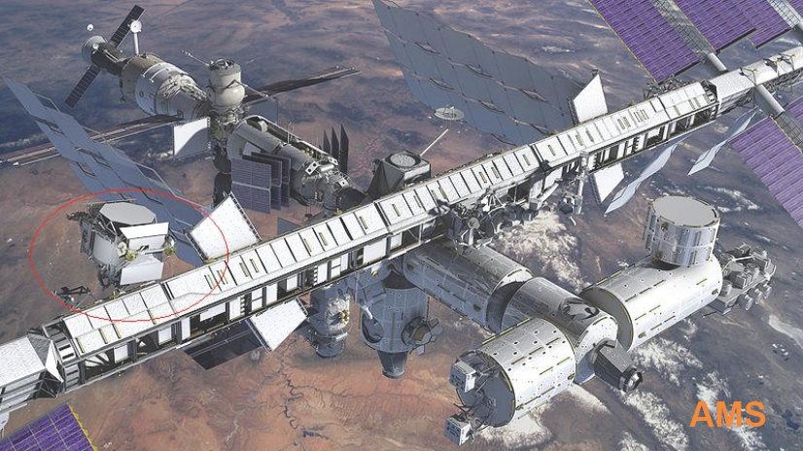
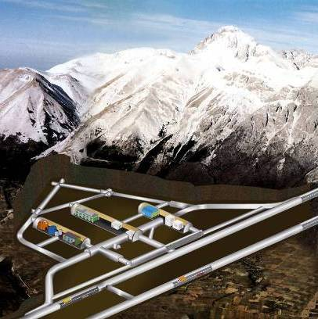
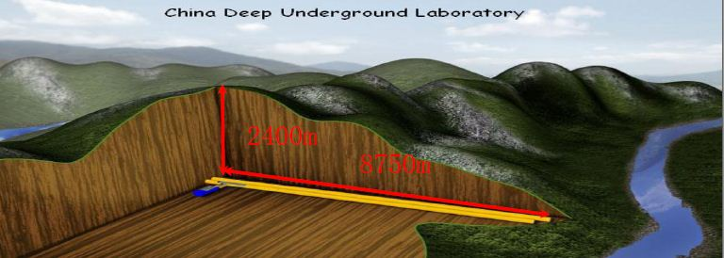
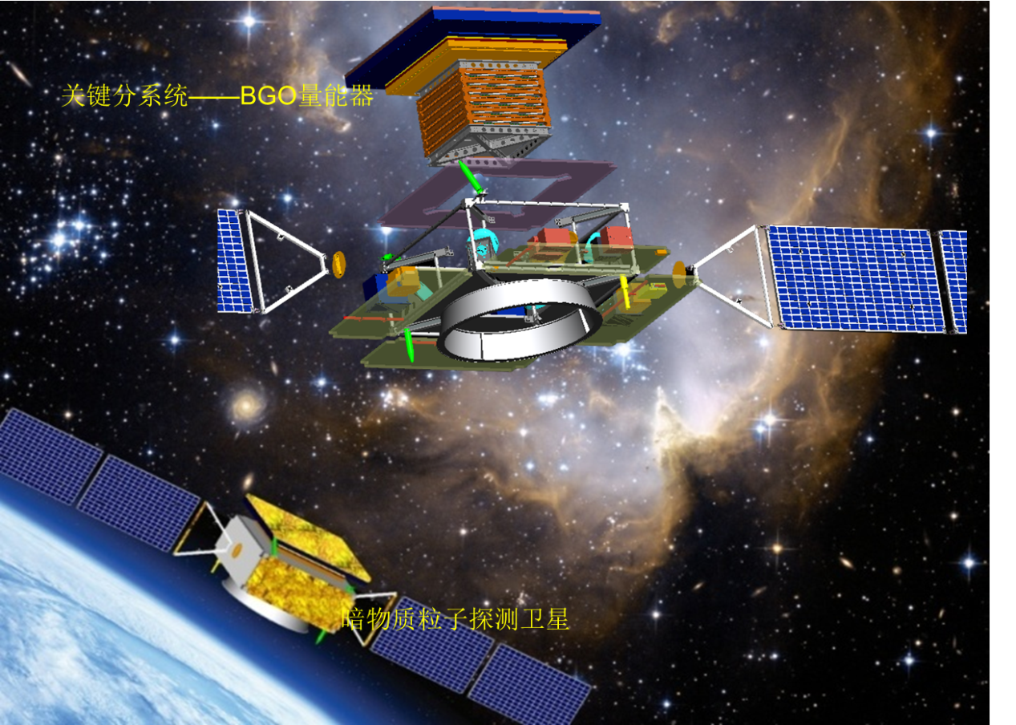
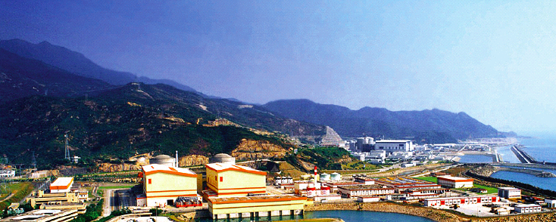
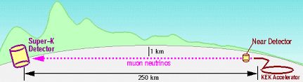
粒子物理研究的大科学装置
DAFNE
BEPCII
Graviton?
Dark matter
Anti-matter
SKEKB
DAMPE
CJPL
AMS

Slide 5
粒子物理前沿
ATLAS
高能量前沿
Higgs
超对称
新相互作用
CMS
Higgs 工厂?
下一代超级对撞机?
Star
ALICE
BelleII
LHCb
暗物质
BESIII
Panda
高亮度／精度前沿
新强子
禁戒／稀有衰变
中微子
Yangba Jing
宇宙前沿
宇宙线源
成份
加速机制
GlueX
LHAASO
Z Factory
HIEPA
IceCube
AUGER
Da Yabay ν
Juno
CTA
PandaX
CEDX
0ν2β
DUNE

Slide 6

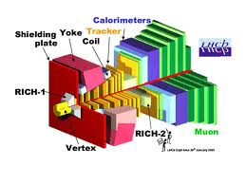


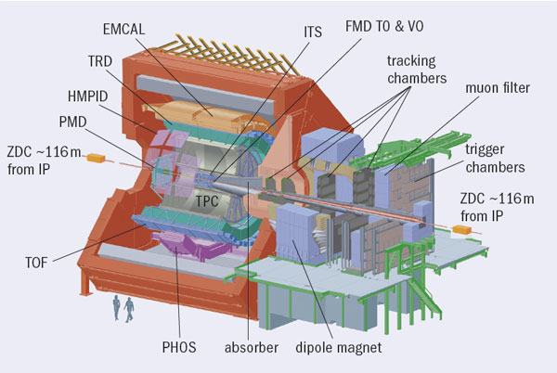
大型强子对撞机－世界最高能量前沿
ATLAS
3000 Physicists
180 Institutions
40 countries
550 MCHF
CMS
2900 Physicists
184 Institutions
38 countries
550 MCHF
LHCb
1160 Physicists
69 Institutions
16 countries
75 MCHF
ALICE
1550 Physicists
151 Institutions
37 countries
150 MCHF
CMS
Experiment # of authors from China
ATLAS 51
CMS 32
LHCb 16
ALICE 9
Tunnel circumference: 27 km
Diameter: 3.8 m
Depth: 70 – 140 m
6
ATLAS
Notes:
Experiment Number of authors from China
ATLAS 51
CMS 32
LHCb 16
ALICE 9

Slide 7
Physics at LHC
Search for Higgs bosons and alternative schemes for the spontaneous symmetry-breaking mechanism. Found it!→study of its properties
Search for super-symmetric particles, new gauge bosons, leptonquarks and quark and lepton compositeness beyond SM.
Test of the Standard Model and high-precision measurement of the 2nd and 3rd quark family (m_{t,} t decay properties, rare decays and spectroscopy of B-hadrons; B⁰_{s}-mixing), explore the source of CPV.
QCD studies (proton structure, hard diffractive scattering, physics of jet, photon and heavy flavor…).
Physics with Heavy ion collision, Quark gluon plasma (QGP).

Slide 8




The Fundamental Interactions: Boson Exchange
Strong
Electromagnetic
Weak
Gravitation
A new interaction that we don’t understand yet!
γ, Z, W, τ, μ, e
H
?
γ, Z, W, τ, μ, e

Slide 9
Higgs 粒子发现后高能物理的主要物理目标
Higgs 粒子物理
Higgs粒子性质研究: m, 宽度，J^{PC} , 产生和 衰变模式；
与其它粒子的耦合。
Higgs粒子为新物理的探索提供新的窗口。
超出标准模型新物理
寻找其它Higgs粒子，超对称粒子，暗物质粒子，奇异强子和极端条件下物质形态;
直接寻找－高能量，高统计量数据. Look for unusual signatures and rare final states;
间接寻找－高统计量，高精度. Precision measurements of
the known processes.

Slide 10
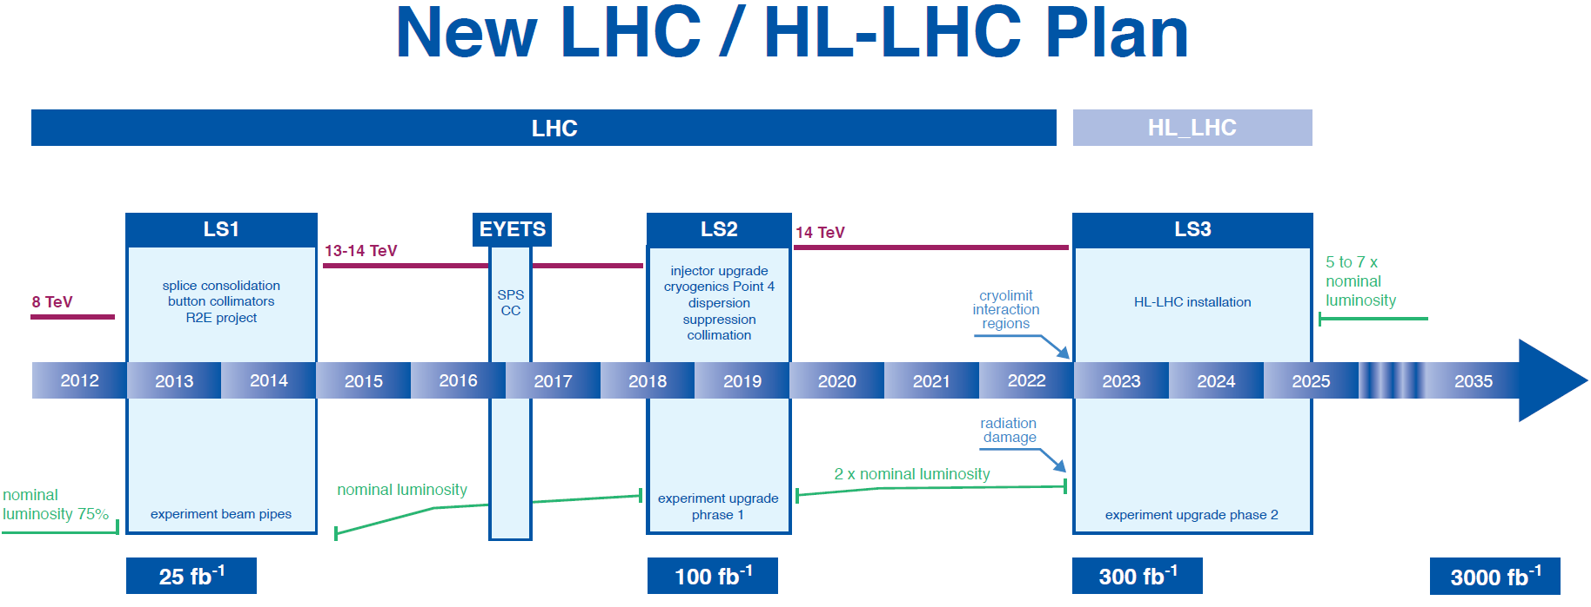
需要高统计量数据研究Higgs性质，寻找新物理
Unique frontier for tackling key science questions,
training world first class scientists and develop cutting
edge technology.

Slide 11
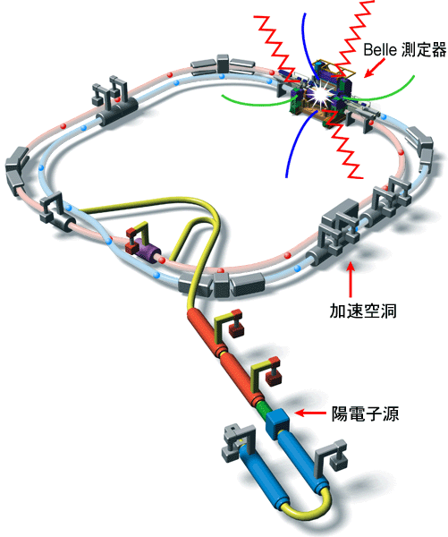

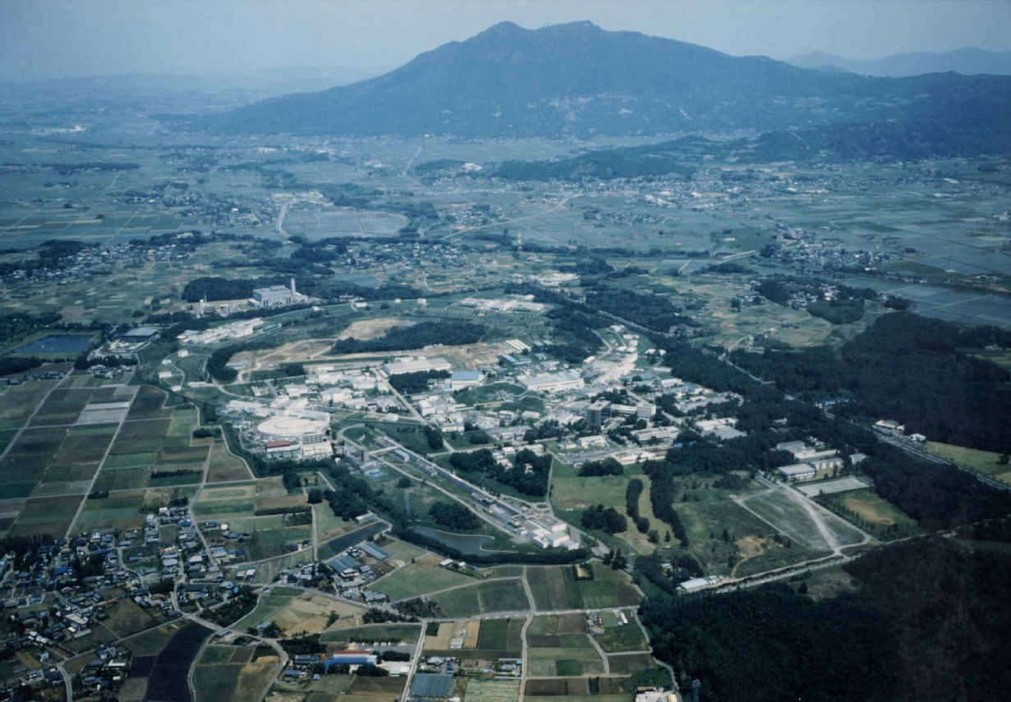
The Belle Experiment at KEKB
SCC RF(HER)
Belle detector
World record:
L = 2.1 x 10³⁴/cm²/sec
ARES(LER)
Mt. Tsukuba
Ares RF
cavity
8 x 3.5 GeV
22 mrad crossing
KEKB
Belle
e⁺ source
1999-2010
1014/fb
The KEKB Collider
~ 1 km in diameter

Slide 12
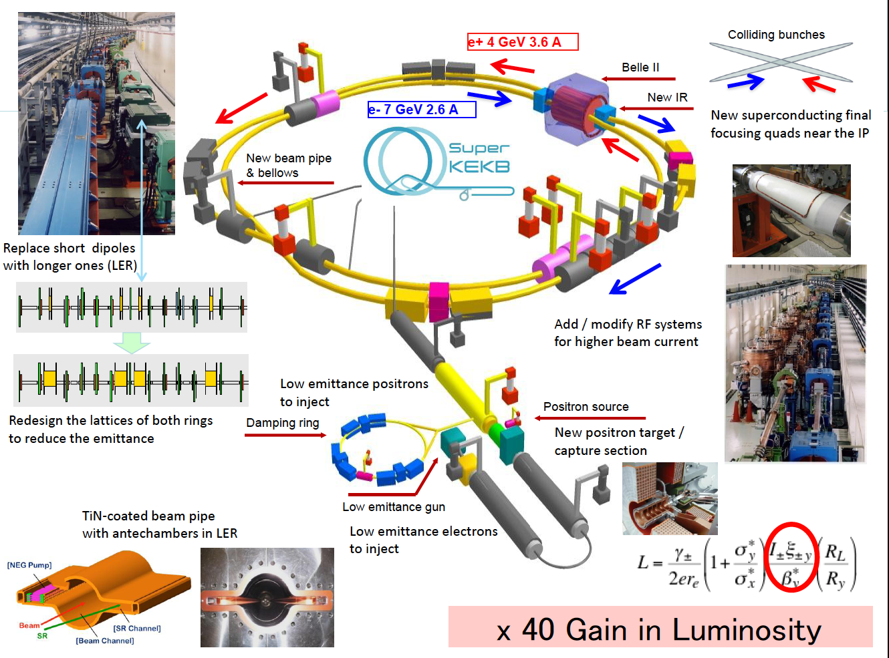

Slide 13
Belle II Detector
BEAST (Background commissioning detector)
KL and muon detector:
Resistive Plate Counter (barrel outer layers)
Scintillator + WLSF + MPPC (end-caps , inner 2 barrel layers)
EM Calorimeter:
CsI(Tl), waveform sampling (barrel)
Pure CsI + waveform sampling (end-caps)
Particle Identification
Time-of-Propagation counter (barrel)
Prox. focusing Aerogel RICH (fwd)
electrons (7GeV)
Beryllium beam pipe
2cm diameter
Vertex Detector
2 layers DEPFET + 4 layers DSSD
positrons (4GeV)
Central Drift Chamber
He(50%):C2H6(50%), small cells, long lever arm, fast electronics
Notes:
Reuses the structure, solenoid and CsI(Tl) crystals and part of the barrel RPCs. Most other components are new.
We must prepare for backgrounds a factor of 10-20 higher. Hence the use of DEPFET pixels for inner vertexing and a new silicon vertex detector with the APV2.5 readout chip from CMS. The PID is based on Cherenkov counters. For the barrel, the Cerenkov light is totally internally reflected to an array of pixelated PMTs. High precision timing and position information is used to distinguish kaons from pions.

Slide 14
Physics at SuperB Factory—Precision Frontier
Search and understand new form of hadron.
Search for new phenomena:
– CPV from the new physics (non KM), and in charm sector.
– Lepton flavor violations (LFV) in τ decays.
Provide data to diagnose (if found) or constrain (if not found) new physics models.
Probe the charged Higgs in large tanβ region through pure leptonic decay, B→τν,D_{τν}.
Search for new physics (independently from LHC)
– If LHC finds NP, precision flavor physics is compulsory.
– If LHC finds no NP, high statistics B/τ decays would be a
unique way to search for the >TeV scale physics [very
probably if M_{h}~125 GeV].

Slide 15
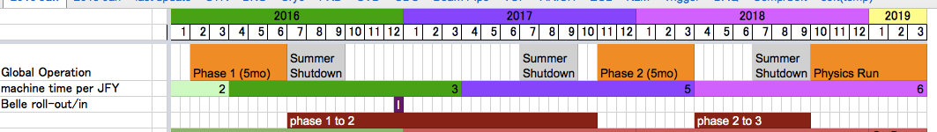
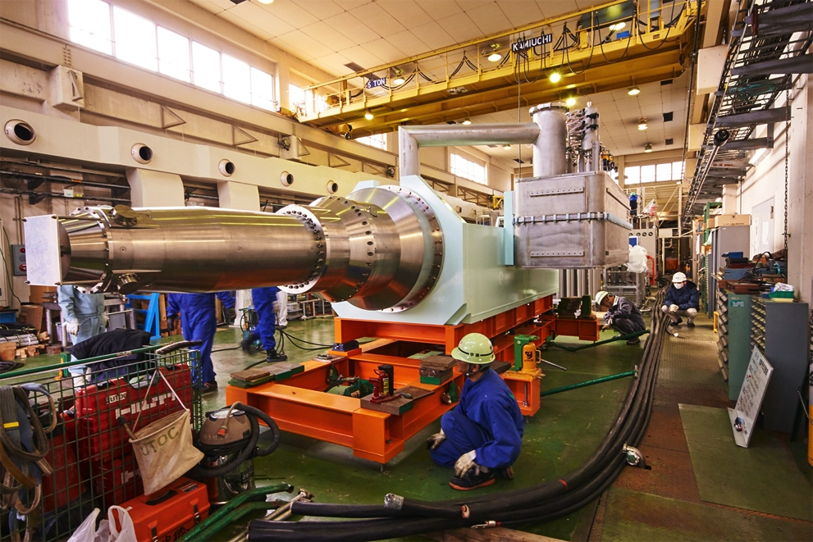
Belle II Schedule
BEAST PHASE I:
Started Feb 2016 (Belle II roll-in at the end of the year)
BEAST PHASE II:
Starts Nov 2017 [first collisions, limited physics without vertex detectors]
Belle II Physics Running:
Fall 2018 [vertex detectors in]
QCSL at KEK, Dec 2015

Slide 16
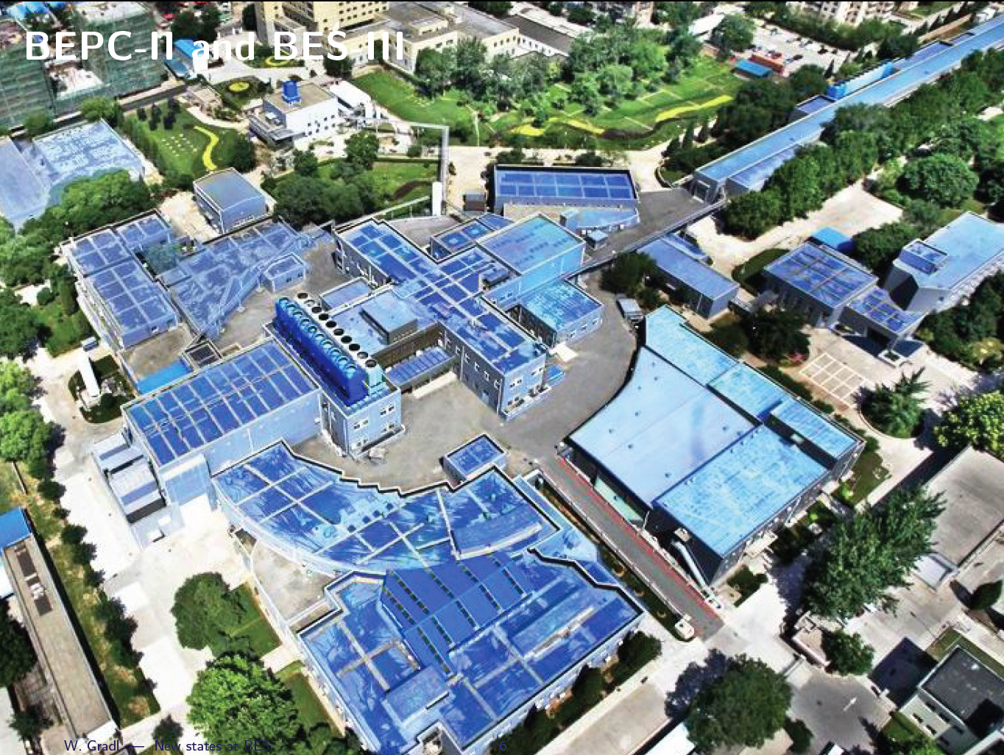
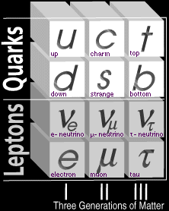
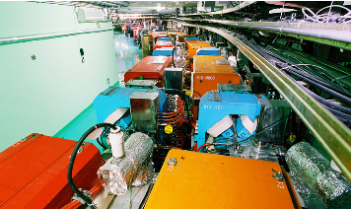
E_{cm}: 2.0-4.6 GeV
σ_{Ε}: 5.16×10⁻⁴
L: 0.65×10³³ cm⁻²s⁻¹@3770
北京正负电子对撞机
11 countries, 52 institutions, 351 authors
LINAC
BESIII
detector
Storage ring
16
Notes:
Major physics: physics with c quark and tau lepton; search for exotic hadron; study of QCD and CPV; new physics with LNV, LFV and forbidden process

Slide 17
Physics at tau-charm sector
Light hadron spectroscopy
Physics with charm quark, tau-lepton, charmonium
QCD in the transition region between pQCD and non pQCD
Searches for glueball, exotic hadrons, rare decays, LVP, new physics beyond SM

Slide 18
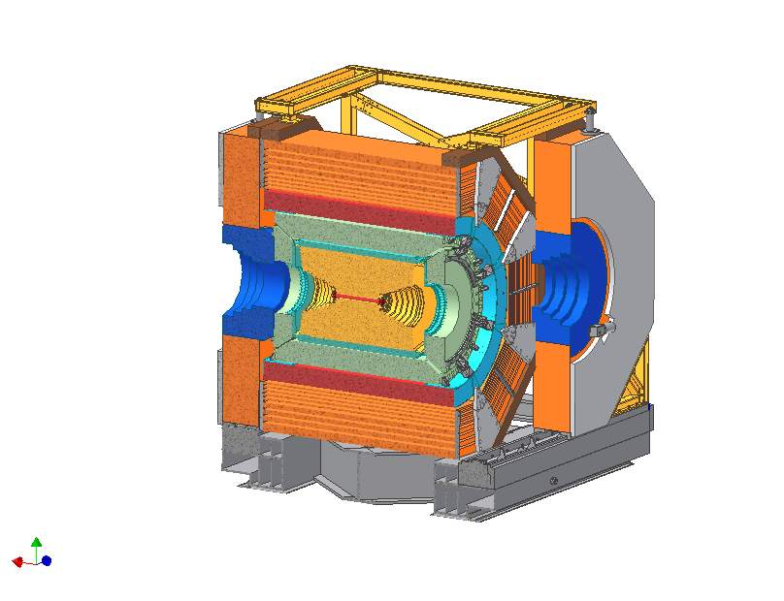
北京谱仪 (BESIII Detector)
Drift chamber (MDC)
Small cell, 43 layer
Gas He/C₃H₈=40/60
σ_{xy}=130 μm, dE/dx~6%
σ_{p}/p = 0.6% at 1 GeV
1 T Super conducting magnet
Muon counter
Resistive plate chamber
Barrel: 9 layers
Endcaps: 8 layers
σ_{spatial}: 1.48 cm
Time-of-flight (TOF)
Plastic scintillator
σ_{Τ}(barrel): 105 ps
σ_{Τ}(endcap): 125 ps
5.1 m
ECAL calorimeter
CsI(Tl): L=28 cm (15X₀)
Energy range: 0.02-2GeV
At 1 GeV σ_{E} (%) σ_{l}(mm)
Barrel: 2.5 6.1
Endcap: 5 9
RO channels: 10⁴
Cost: 200 M RMB
5.6 m
Data acquisition
Event rate: 4 kHz
Data size: 50 MB/s
Grid computing
CPU: 3200 core
Storage: 2.2 pB

Slide 19
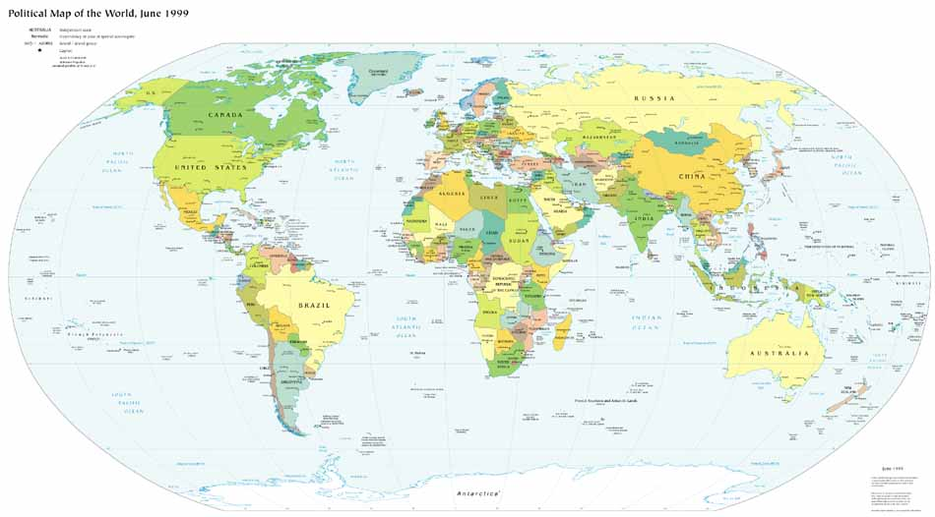
北京谱仪国际合作实验
11 国家, 52 单位, 351 作者
Europe (12)
Germany: Univ. of Bochum,
Univ. of Giessen, GSI
Univ. of Johannes Gutenberg
Helmholtz Ins. In Mainz
Russia: JINR Dubna; BINP Novosibirsk
Italy: Univ. of Torino，Frascati Lab
Netherland：KVI/Univ. of Groningen
Sweden: Uppsala Univ.
Turkey: Turkey Accelerator Center
US (6)
Univ. of Hawaii
Univ. of Washington
Carnegie Mellon Univ.
Univ. of Minnesota
Univ. of Rochester
Univ. of Indiana
Korea (1)
Seoul Nat. Univ.
China(30)
IHEP, CCAST, GUCAS, Shandong Univ.,
Univ. of Sci. and Tech. of China
Zhejiang Univ., Huangshan Coll.
Huazhong Normal Univ., Wuhan Univ.
Zhengzhou Univ., Henan Normal Univ.
Peking Univ., Tsinghua Univ. ,
Zhongshan Univ.,Nankai Univ.
Shanxi Univ., Sichuan Univ., Univ. of South China
Hunan Univ., Liaoning Univ.
Nanjing Univ., Nanjing Normal Univ.
Guangxi Normal Univ., Guangxi Univ.
Suzhou Univ., Hangzhou Normal Univ.
Lanzhou Univ., Henan Sci. and Tech. Univ.
Hong Kong Univ., Hong Kong Chinese Univ.
Japan (1)
Tokyo Univ.
Pakistan (2)
Univ. of Punjab
COMSAT CIIT
19

Slide 20
北京正负电子对撞机和北京谱仪
正确选项，中国高能由此真正起步，几代人的奋斗和贡献，巨大成功。
从一席之地到前引领→国际高能物理重要基地
为我国粒子物理的发展，及其他大科学工程项目(如大亚湾中微子)的发展和成功奠定了坚实的基础。
为我国粒子物理发展及高校培养了大批人才。
下一步如何发展？还可运行多少年？升级改进？超级tau-c 工厂？

Slide 21
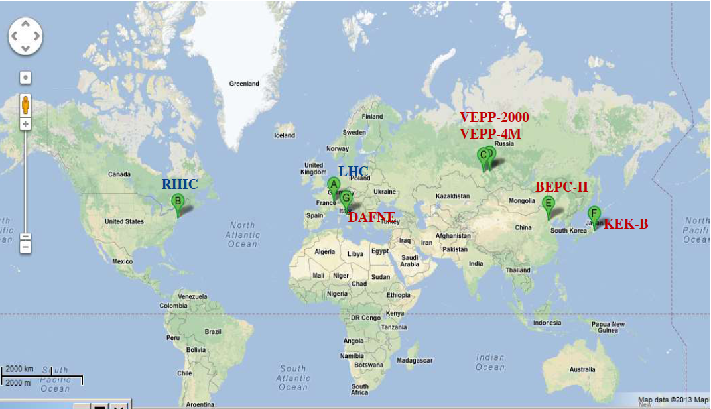
人类共建27个粒子加速器，尚有7个在运行
中国
CEPC, ZF
HIEPA ?
欧洲
HLHC
CLIC, F_{CC} ?
Russia
STCF ?
美国
EIC ?
日本
SKEK-B
ILC ?
世界下一代加速器实验的布局处在关键时刻。
大国行为，反映一个国家甚至人类的经济、科学技术和教育的综合实力。中国在此领域应该有与大国地位相称的作为。

Slide 22
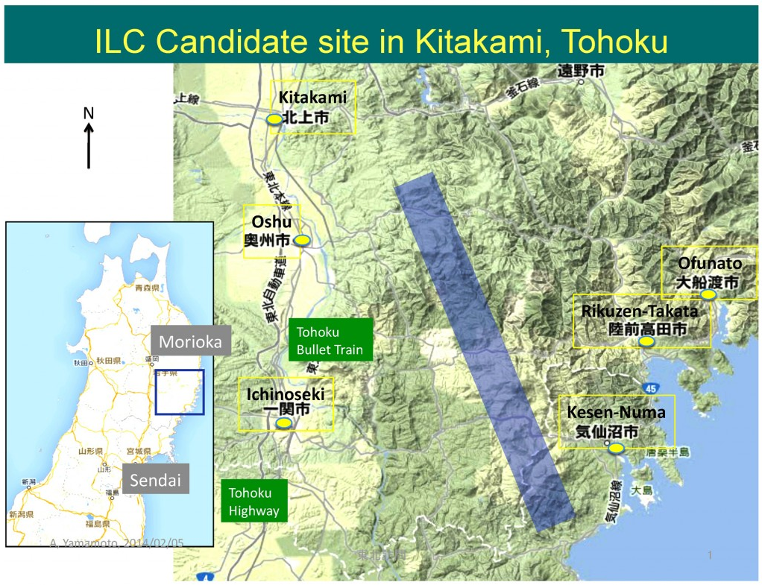
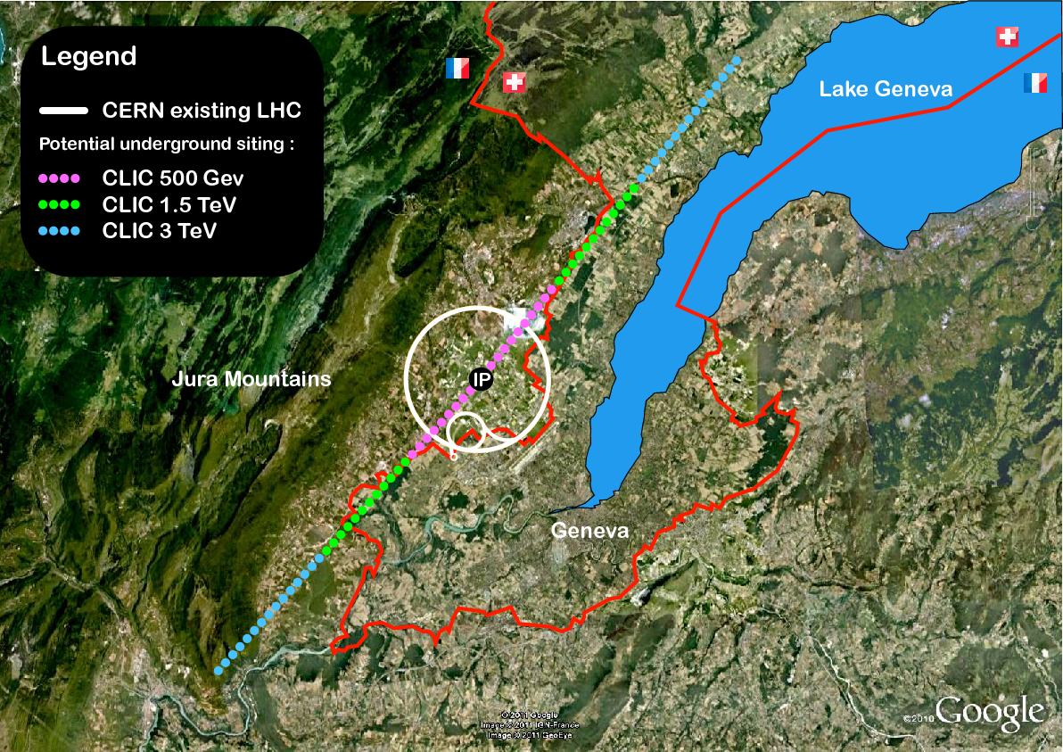

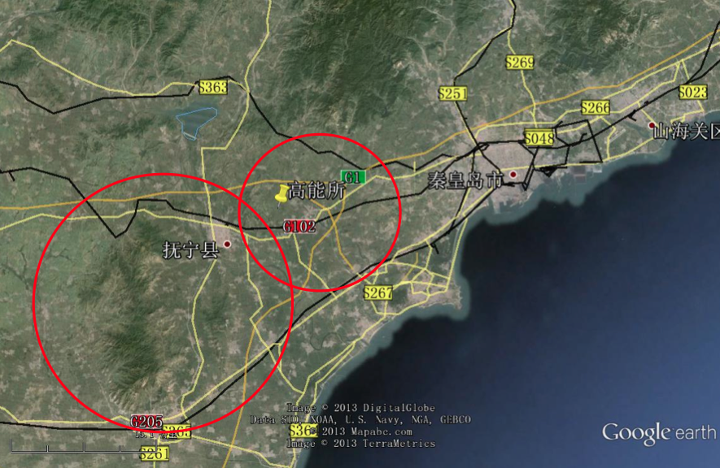
Future High Energy Frontiers
ILC
CLIC
F_{CC}:
e⁺e⁻
pp
e⁻ ion
CEPC+SppC

Slide 23
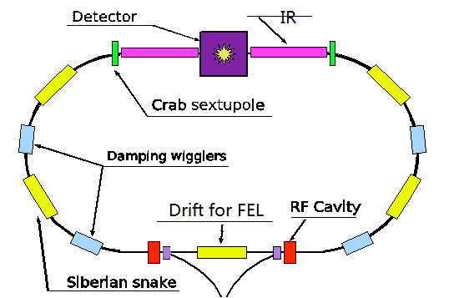
我国高能物理可能的选项
e+
IP1
e-
High Energy Booster(7.2Km)
Medium Energy Booster(4.5Km)
e+ e- Linac
(240m)
CPC
Proton Linac
(100m)
HIEPA
Low Energy Booster(0.4Km)
Booster(50Km)
CEPC Collider Ring(50Km)
IP2
SppC Collider Ring(50Km)
~40 亿?
~400亿?
Notes:
Add SBF, CEPC, HIEPA, DAMPE

Slide 24
中国高能物理的未来？
高能量前沿: 大型环型正负电子对撞机(CEPC, ZF, 250 GeV)
重大关键科学问题，丰富的物理课题，最先进的技术和方法，极具挑战。
国际项目，聚集世界一流科学家和高技术人才，与大国地位相称的大型国际研究中心。
如何战略布署，建立国际合作，得到国内外科技界支持？
如何填补人才和关键技术的极大缺口？
充分认识其长期性和复杂艰巨性。
高精度前沿：高亮度正负电子加速器(HIEPA 2-7 GeV)
重大科学问题，丰富的τ-c 物理；具挑战性的新技术和方法。
世界几大国际研究中心之一，引领τ-c物理和奇异物质研究
中国有成熟的队伍和主要相关技术。

Slide 25
十三五，十四五的规划？
十三五期间充分发挥科技部重点研发课题的经费进行R&D
- 完成 HIEPA R&D ?
- 完成 CEPC R&D ?
十四五如何申报项目？
- CEPC
- HIEPA
- CEPC+HIEPA
如何相互兼容，支持？怎样的战略安排才能保证高能物理
健康，持续发展？

Slide 26
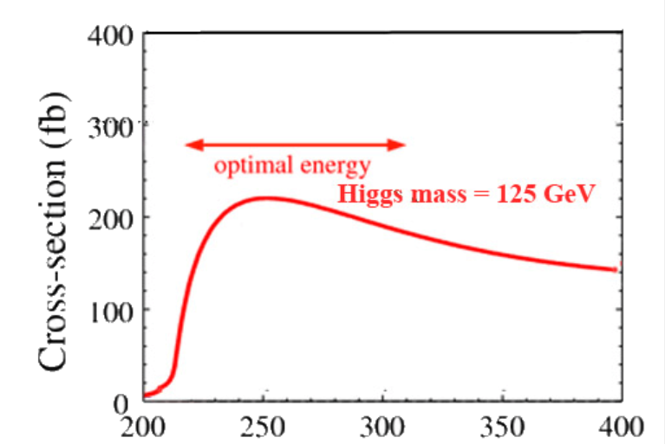
CEPC-SppC (CPC: Circular Particle Collider)
Phase 1: e⁺e⁻ Higgs (Z) factory two detectors, 1M ZH events in ~10yrs
Circular Electron Positron Collider (CEPC)
E_{cm}≈240GeV, luminosity ~2×10³⁴ cm⁻²s⁻¹, can also run at the Z-pole
Precision measurement of the Higgs boson (and the Z boson)
Phase 2: a discovery machine; pp collision with E_{cm} ≈ 50-100 TeV; ep, HI options
Super proton-proton Collider (SppC)
e⁺e⁻ → ZH
e+
IP1
e-
LTB
High Energy Booster(7.2Km)
BTC
BTC
Medium Energy Booster(4.5Km)
e+ e- Linac
(240m)
Low Energy Booster(0.4Km)
Proton Linac
(100m)
IP3
IP4
Booster(50Km)
CEPC Collider Ring(50Km)
IP2
LTB : Linac to Booster
BTC : Booster to Collider Ring
SppC Collider Ring(50Km)
E_{cm}(GeV)

Slide 27
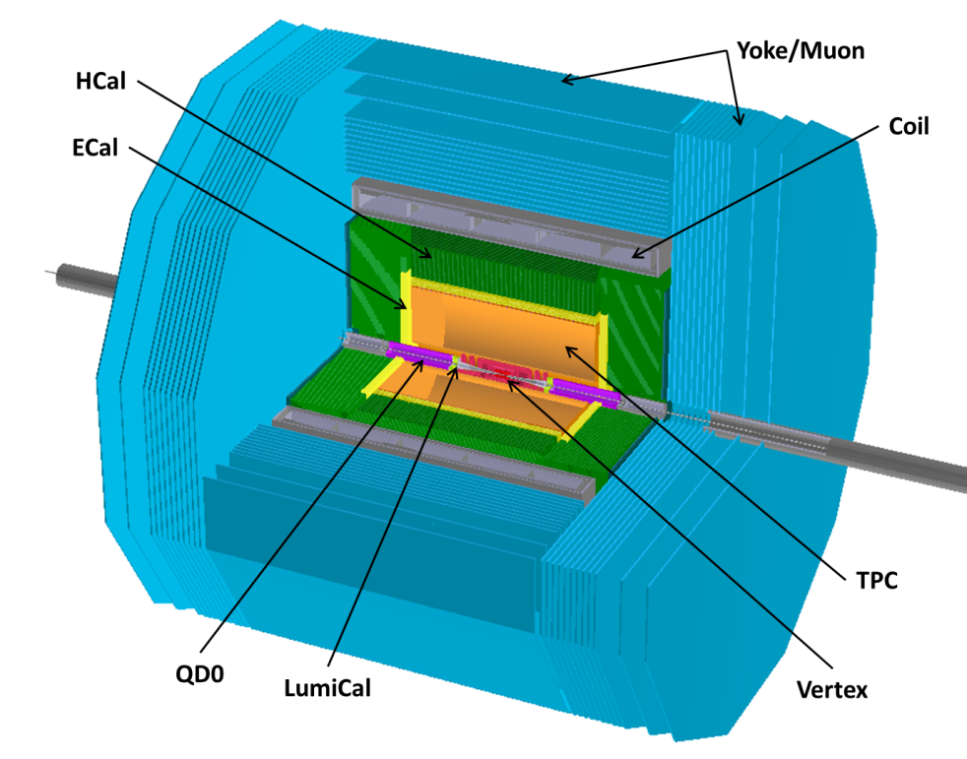
CEPC Detector
ILD-like detector with additional considerations.
Similar performance requirements to ILC detectors
Challenges:
Momentum:
Impact parameter:
Jet energy:

Slide 28
HIEPA (High Intensity Electron Positron Accelerator )
E_{cm} = 2-7 GeV; L = (0.5-1)x10³⁵ cm⁻²s⁻¹ at 4 GeV, and single beam polarization
Advanced synchrotron radiation facility (SRF)
Circumference:
~ 700m

Slide 29
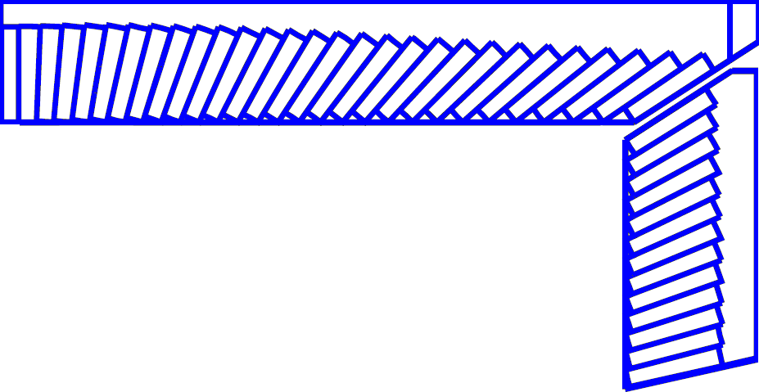
Detector
245 cm
PXD
Material budget ~0.15%X₀ / layer
σ_{xy}=50 μm
York/Muon
185 cm
MDC
σ_{xy}=130 μm
dE/dx<7%, σ_{p}/p =0.5% at 1 GeV
Superconducting magnet
(0.7-1 T)
York/Muon
135 cm
EMC
PID
π/K (and K/p) 3-4σ separation up to 2GeV/c
105 cm
PID-barrel
85 cm
20°
PID-endcap
EMC
Energy range: 0.02-2GeV
At 1 GeV σ_{E} (%)
Barrel(Cs(I): 2
Endcap (Cs): 4
MDC
15 cm
PXD/SSD
10 cm
MUD
μ/π suppression power >10
3~6 cm
IP
120 cm
140 cm
190 cm
240 cm
300 cm

Slide 30
Accelerator-based Experiments
 | 2016 | 2017 | 2018 | 2019 | 2020 | 2021 | 2022 | 2023 | 2014 | 2025 | 2026 | 2027 | 2028 | 2029 | 2030 | 2031 | 2032 | 2033 | 2034 | 2035
LHC
Fcc
CEPC
ZF
SppC
ILC | T | D | R
SKEK-B
BEPCII |  |  |  |  |  | ?
HIEPA
~10 years gap
Notes:
!0 years gap is not a problem if CEPC were approved and under construction, but if CEPC were not going to be approved, 10 years gap means the broken of the line of HEP in China

Slide 31
中国高能物理走向何方？
Options:
一步到位：CPC(CEPC+SppC)→至少全世界半世纪
的高能物理
分步走： HIEPA → ZF → CPC
C. 国际合作: LHC, Fcc, ILC…
中国还需要有自己的加速器研究基地吗？
中国应该有一明确,共识的高能物理发展路线图。

Slide 32
全球性科学的理念
集中“最好”（experts, methods and technology..), 协同合作，共同攻克关键科学问题，共同分享成果和技术。
在一些关键技术和方法及相关人才培养方面起领导作用，并做出重要贡献。
共同协商，相互支持建立“以我为主”的重大科学装置→你中有我，我中有你。以“最好”攻克难关，从“最好”中共赢。
USA, Japan → LHC (Europe)
Europe, Japan → DUNE, space experiments (USA)
USA, Europe → ILC (Japan)
要在中国成功建造CPC，我们必须有以上理念
Notes:
For CEPC, we must build up momentum of having support from international high energy community

Slide 33
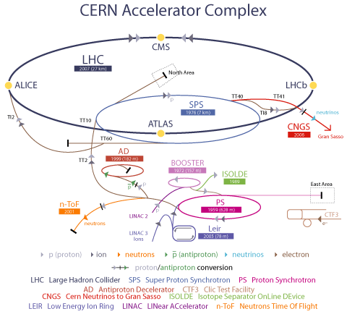
LEP: 1988-2000
E_{cm}(e⁺e⁻) = 200-209 GeV
LHC: Construction 1998-2007
Commission 2007
E(p+p) = 14 TeV
2007
Discover W, Z
450 GeV
ν_{τ}–ν_{μ}
Produce >1000 different
isotopes
1969
25 GeV
1959, 678 m
Over 60 years!

Slide 34
What Can Be Learnt From CERN?
Successful for over 60 years. Leads the HEP since SPS
Site that can accommodate continuous development and expansion
Sustainable development
Multiformity
p, pbar, n, e⁺⁻ , ion, ν, >1000 isotopes, nuclear
physics, high energy physics, neutrino physics,
anti-matter, application…..

Slide 35
Extra Slides

Slide 36
粒子物理重大科学前沿问题
ATLAS, CMS
CEPC, ILC, Fee
标准模型的Higgs粒子反映什么样的相互
作用, 是否有超出标准模型的新物理？
暗物质
暗能量
中微子的属性
引力量子化
宇宙起源及铁以上重元素的形成
宇宙线粒子给我们带来的信息
极端条件下的物质形态及奇异物质
宇宙中正反物质不对称
万有引力与弱电及强相互作用的统一
PandaX, CEDX, DAMPE
LUX, AMSII
ATLAS, CMS
Dayabay, JUNO, T2K, SK…DUNE
CSR, CJPL
Yangbajing,
CTA, LHASSO
STAR, ALICE, LHCb, BELLE, BESIII, ATLAS, CMS, AMSII, CBM, CEE

Slide 37
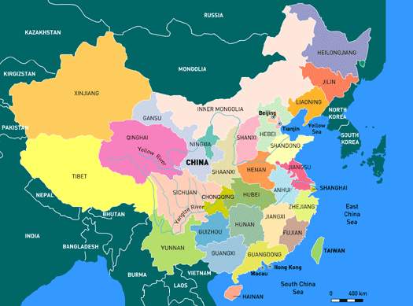
Facilities for Particle Physics in China
Existing
Under construction/planning

Slide 38
Features of Accelerator-based Experiment
Frontier of high energy, precision and intensity
Condition controlled experiment
Rich physics topics with broad spectrum
Cutting edge technologies, driven force for high tech.
Unique base for training experts and work force for industry, college of modern society
High cost, large collaboration → global science

Slide 39
Features of Non Accelerator-based Experiment
Frontier of high energy (cosmic ray), moving to precision
Physics motivation usual single purpose
Weak signal, low signal rate, extremely low background
Relatively smaller scale (cost, size, collaboration)
Long project period, less “publication”
Different frontiers are complementary. For exploring these key science questions, multi-experiments with different technologies are need.

Slide 40
Remarks
Infrastructures based in China is crucial – We should have our own facilities
Frontiers based abroad and in China are complementary
HEP has been going global, international collaborations is not spending money for others, but spending money affordable to have the opportunity for standing at the frontier with discovery potential(LHC, AMS is a typical example), train world first class scientists, master cutting edge technology……
Our community is too small, it needs to be significantly expanded with projects and recruiting/cultivate experts Except for IHEP+IMP, dream for having ~30 groups from universities, each has faculties, PD and graduate students

Slide 41
基本粒子物理研究的特点
极端条件
最小尺寸： 1/100,000,000 原子；
最快速度：近光速
最高温度：1,000,000,000,000,000 ⁰C；
最前沿的高新技术，高投入，大规模、长周期；
多学科和技术的综合，多国家甚至全球合作→Global science；
由该领域发展的方法、手段和设备极大地推动了其它学科发展，并对国家安全、能源、医疗、信息等有广泛的应用。粒子物理的研究水平反映一个国家甚至人类的经济、科学技术和教育的综合实力。

Slide 42
问题和思考
受国外资助，学习→自带经费参与，贡献→建立与大国地位相称的国际合作。
已有相当的基础和实力，在一些课题和方向上取得最大成果，但总体实力，关键技术和方法及相关核心专家尚待大幅提高。
队伍太小，得到的资助太少，与国家地位远不相称。
没有专门的国家机构对粒子物理在规划，布局和资助上整体负责(USA: DOE)。
没有形成规范的，国际标准的研究和制定规划，确定大装置建造项目的体系。
建立正确，开阔心胸的国际合作，全球科学的理念。

Slide 43
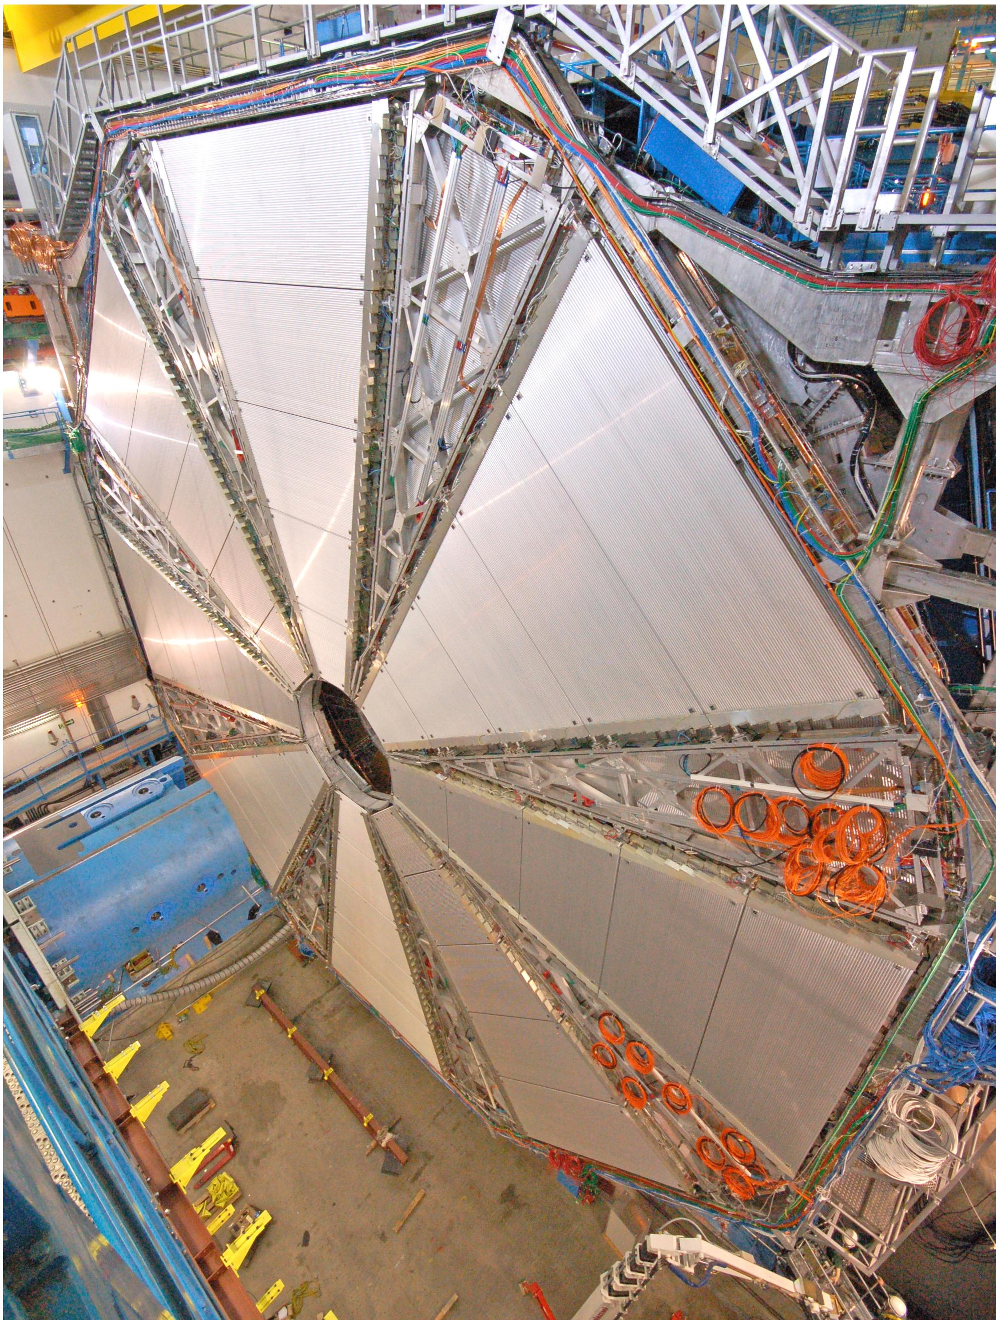
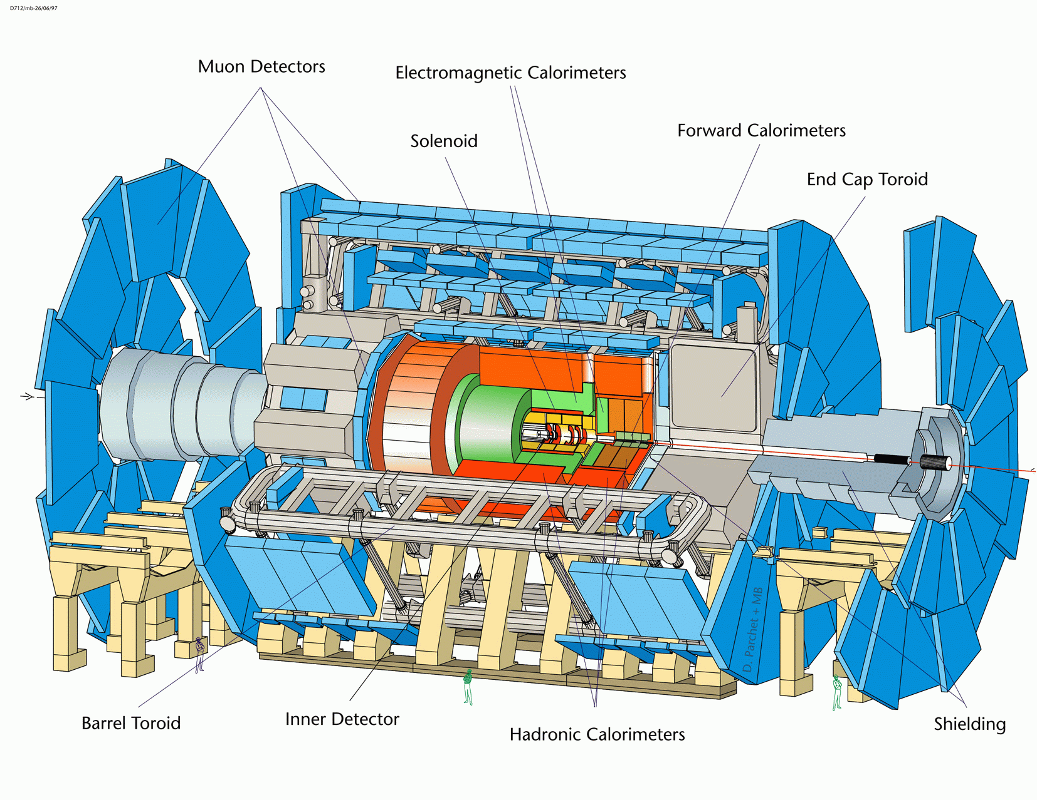
Put all the best together
Notes:
No single country is able to build the Muon Spectrometer alone
It assembled all the best in the world available (tube from Switzerland, alignment to 2 few micro from Germany and

Slide 44
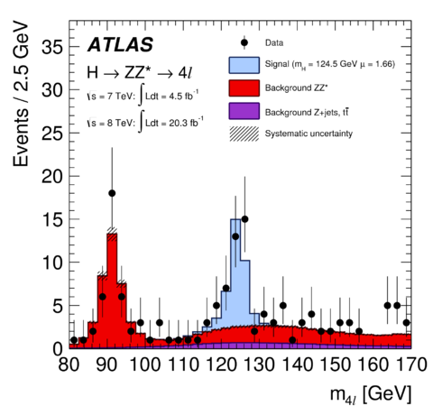
Demanding of global science
→ Put all the best together
H→ZZ→4μ
Al tube
L: 6 m; φ: 30 mm
Thickness: 200 mm
Switzerland
University of Michigan,
Tuffs Univ.
Boston U.
Washington U.
MIT
Harvard U.
BNL, US
ANL, US
Saclay, France
IMP, Germany
NIKHEF, Nederland
INFN, Italy
IHEP, JINR (Russia)
Weizmann Institute,
IHEP, USTC, SDU,
Tokyo U.
Rome U.
U. of Freiburg
……..
3D B sensor
Saclay, France
～11 米
Alignment bar (10 μm)
U. of Freiburg, Brandeis U.
RO electronics
BNL, UM, Harvad U.
Tokyo U., Weizmann,
Position monitor system 10 mm
NIKHEF

Slide 45
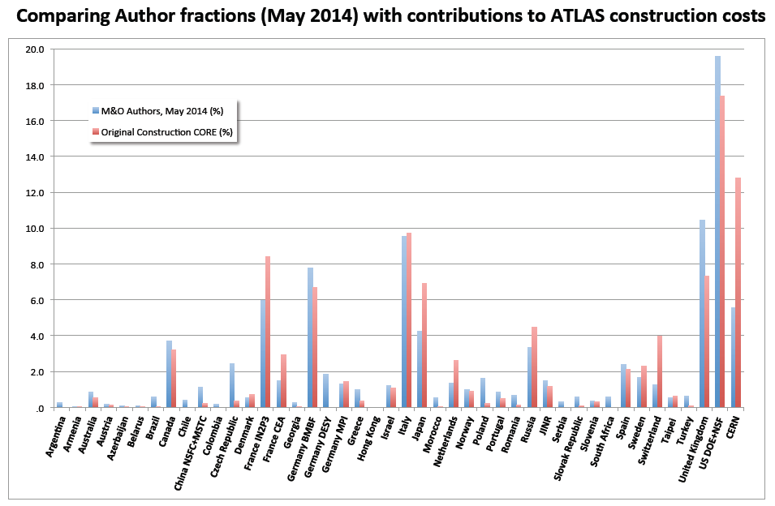
作者和建造贡献
USA
France
Italy
CERN
Germany
Japan
UK
Russia
China
Taiwan
Israel
Switzerland

Slide 46
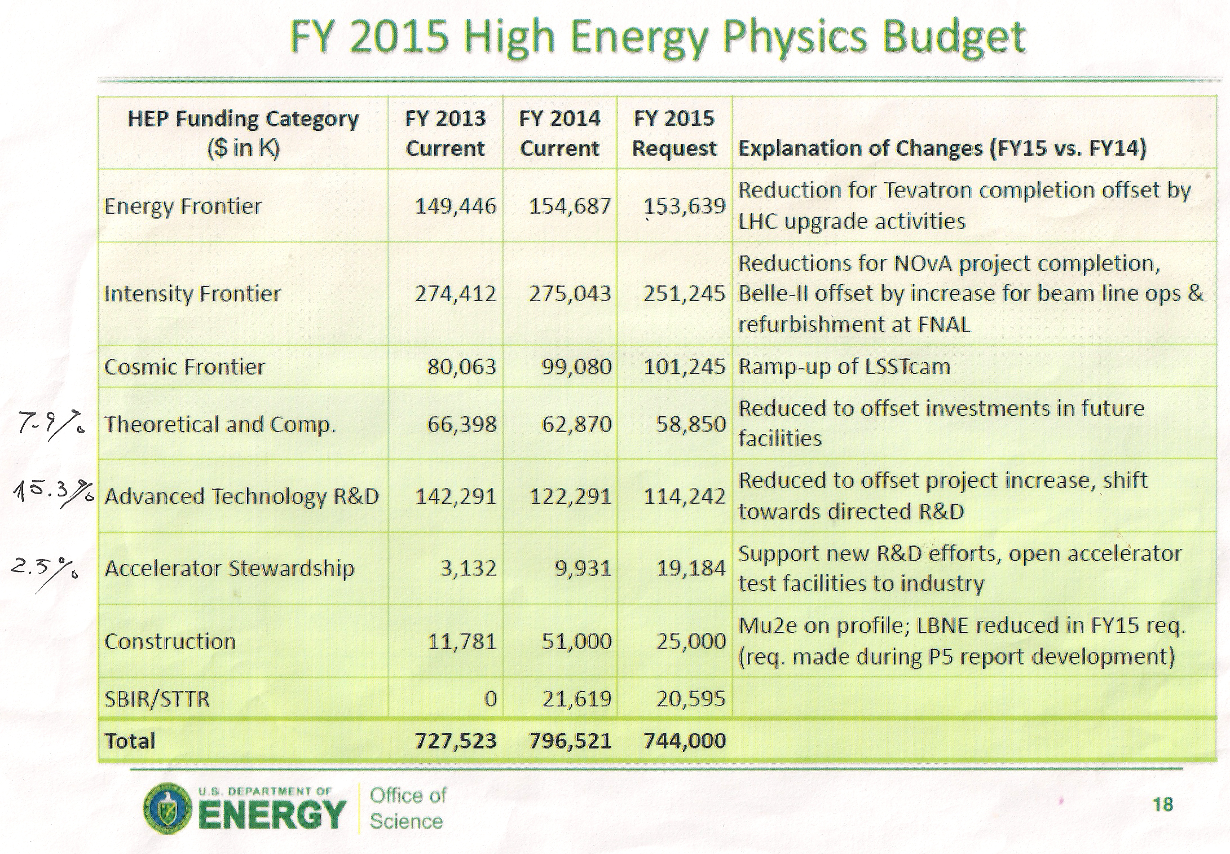
人民币（亿） 1$ = 6.45¥ | 2013 | 2014 | 2015
总计 | 46.93 | 51.38 | 47.99
大学 | 7.8 | 7.68 | 7.74
高能量前沿（LHC） | 9.64 | 9.98 | 9.91

Slide 47
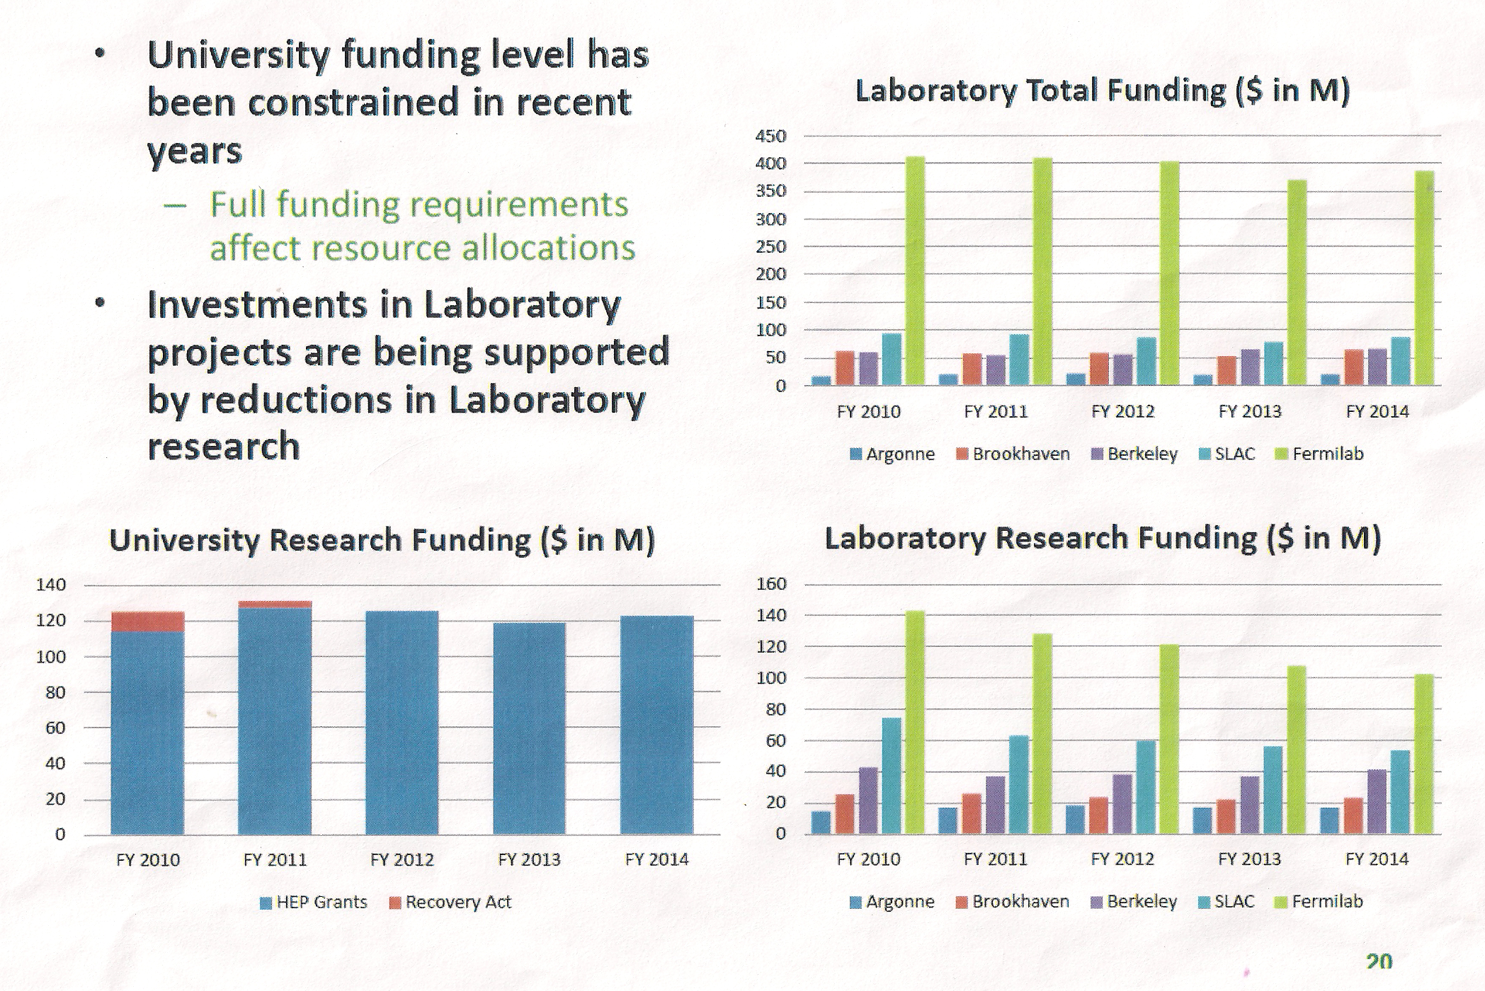
DOE Funding to National Labs and Universities

