Slide 1
Zprime Searches at 13TeV pp Collider
黄迁明 北京大学
史静远 东南大学 吕 游 中国科学技术大学 岳远方 河南师范大学
惠 文 郑州大学

Slide 2
OUTLINE
Standard Model
Sequential Standard Model
Search strategy and result
Summary and prediction
2

Slide 3
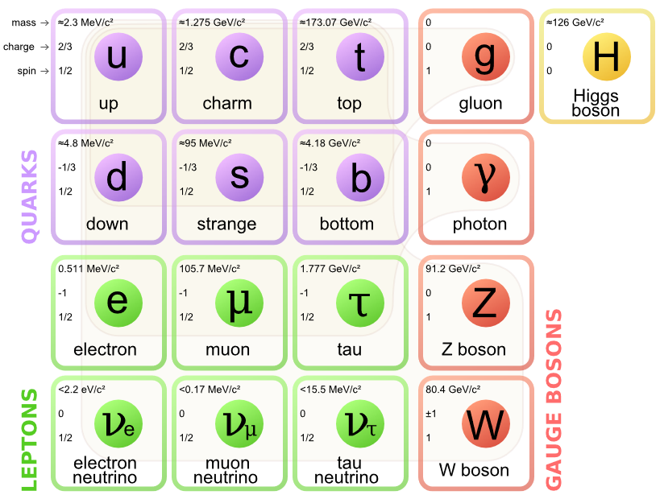
Standard Model
$$SU{\left(3\right)}_{C}×SU{\left(2\right)}_{L}×U{\left(1\right)}_{Y}$$
Theory of almost everything
3

Slide 4
Sequential Standard Model
1.Electroweak symmetry breaking.
$Large group→SMGroup×U{\left(1\right)}_{Y}^{′}$
2.Predicts the existence of dilepton resonance model.
3.Leads to an additional bosons : Z’
Same coupling constants as Z, heavier mass
4

Slide 5
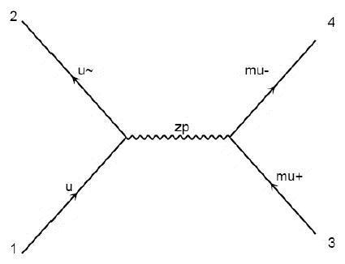
Signal process
$$p p→Z^{′}→μ^{+} μ^{−}$$
5

Slide 6
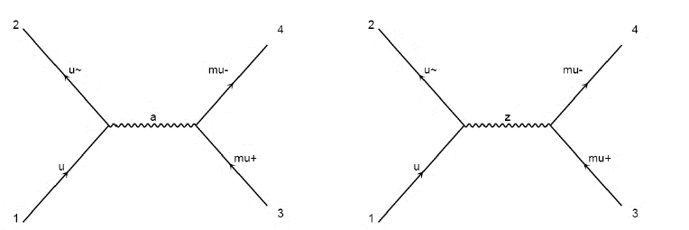
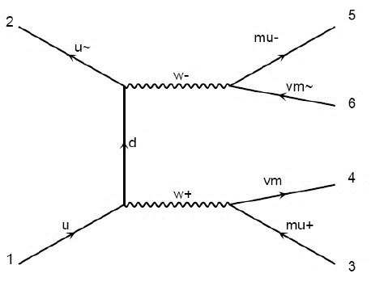
Background
↑DY
←TTbar
↙WW ↓ST
6

Slide 7
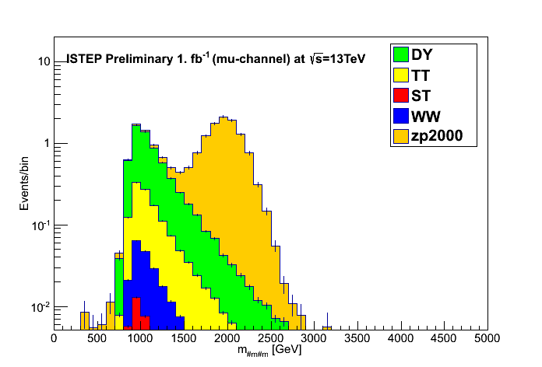
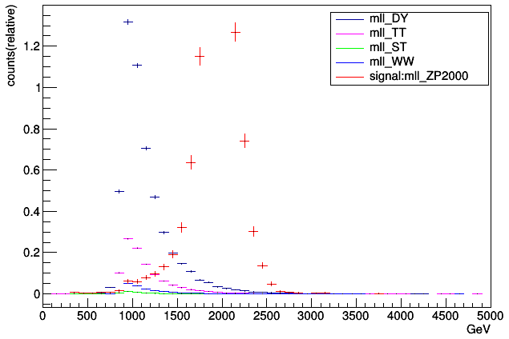
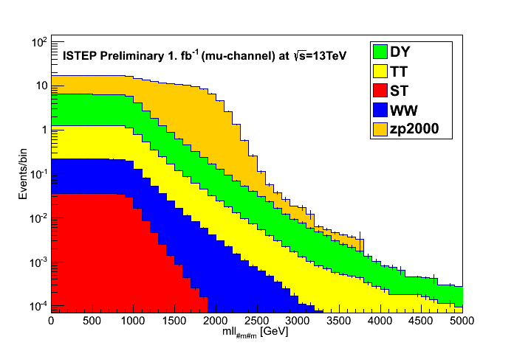
Search strategy and result
1.Generate background and signal events
out.root
outdata.root
zprimetraining.root
2.Distribution of histograms and ntuples
7

Slide 8
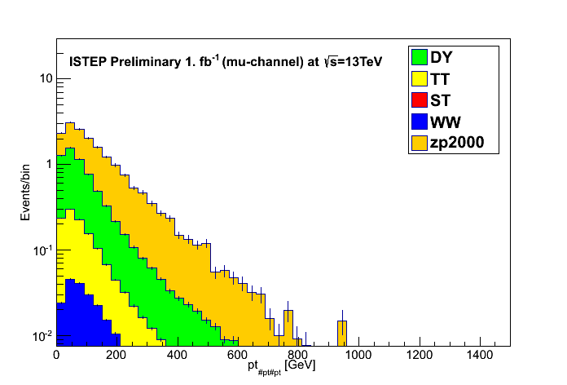
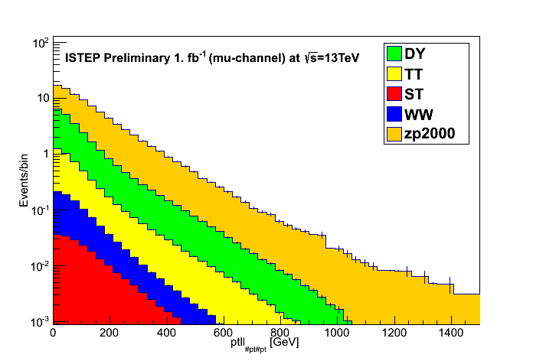
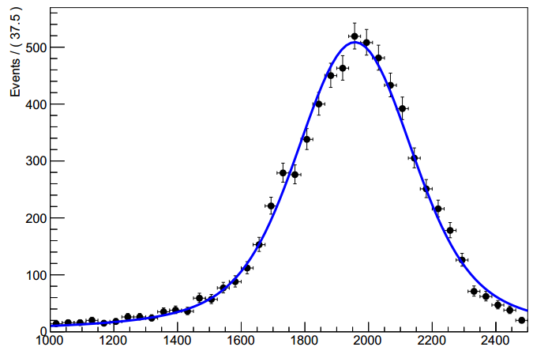
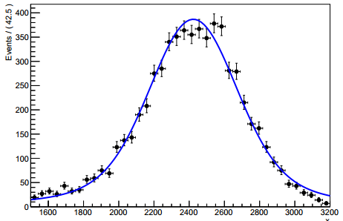
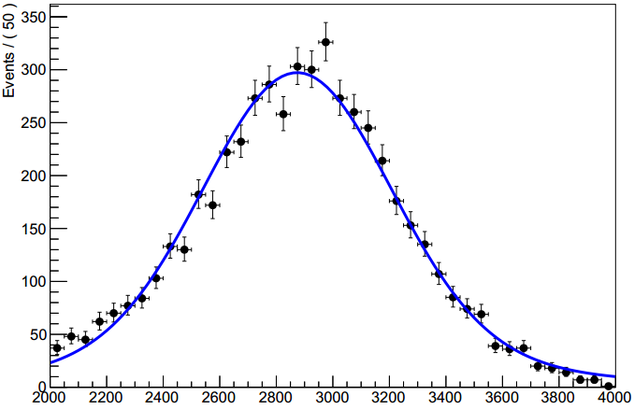
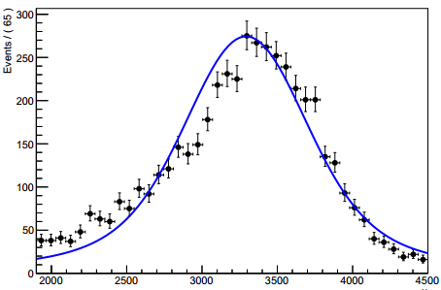
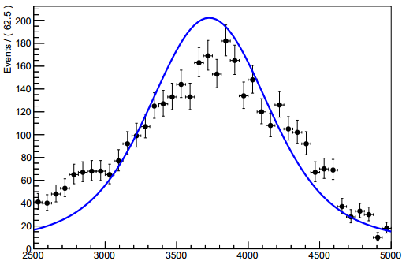
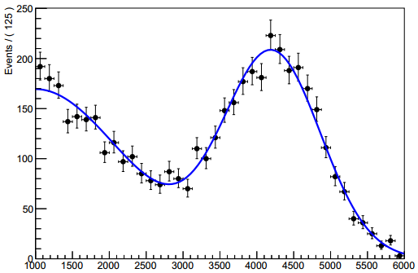
8

Slide 9
Significance
$$\sqrt{−2\ln{\frac{L(0)}{L(\hat{S})}}}$$
$$\sqrt{2(n\ln{\frac{n}{b}}+b−n)}$$
$$\sqrt{q_{0}}$$
9

Slide 10
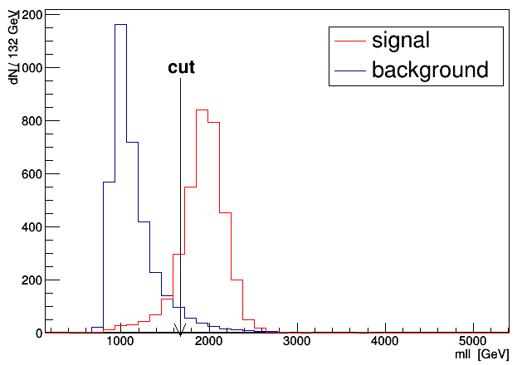
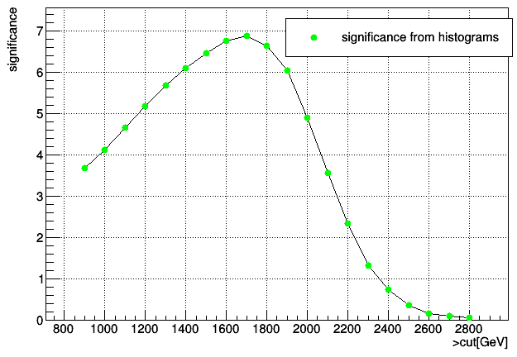
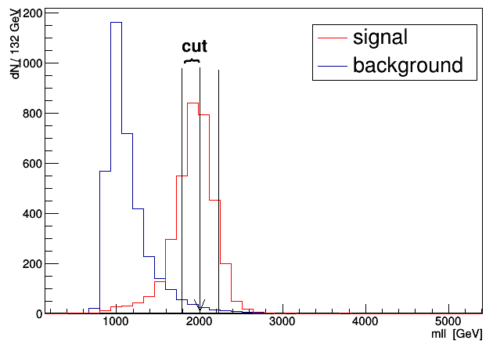
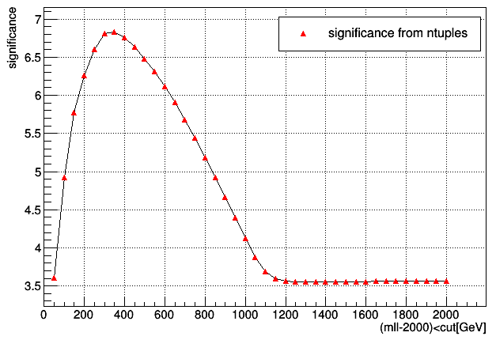
3.Apply the cut on the histograms
4.Apply the cut on the ntuples

Slide 11
5.Use TMVA to select the data
BDT
BDTG
Fisher
LikelihoodD
MLP
11

Slide 12
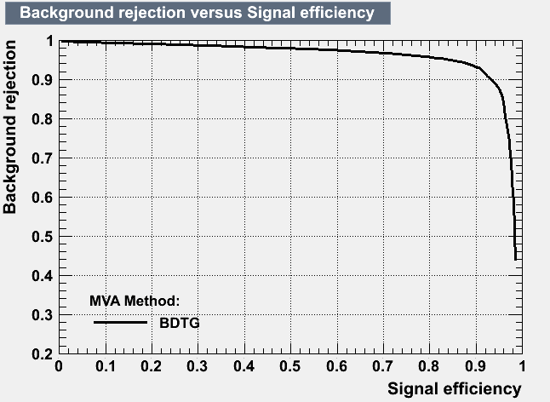
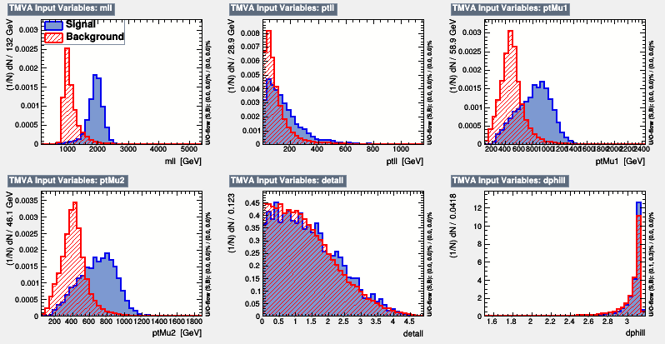
BDTG
Origin data is in the TMVA.root, half of the data for training and the rest for test
Apply the cut on the result.root
Before training,the data in the TMVA.root is like this
12
11

Slide 13
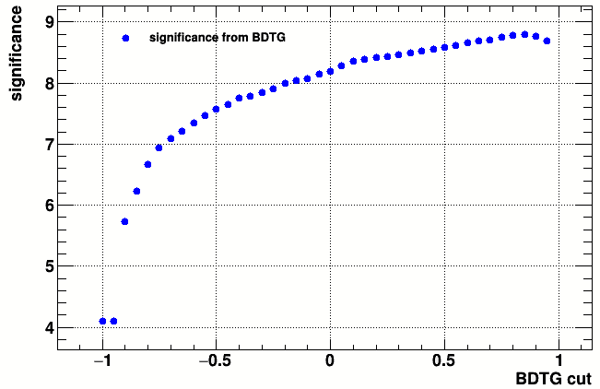
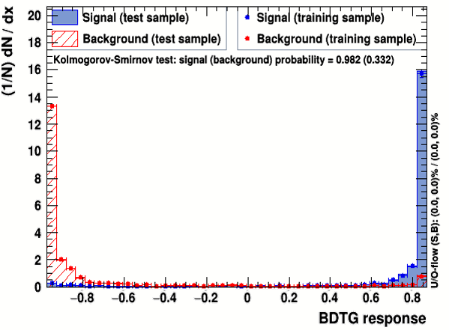
If we calculate the significance, the result will be like this, but it is wrong.
The training result, test sample accord with the training sample perfectly.
13

Slide 14
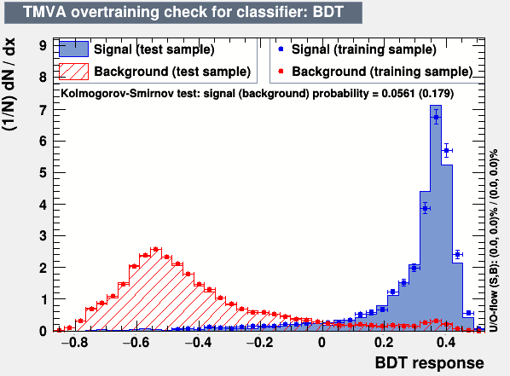
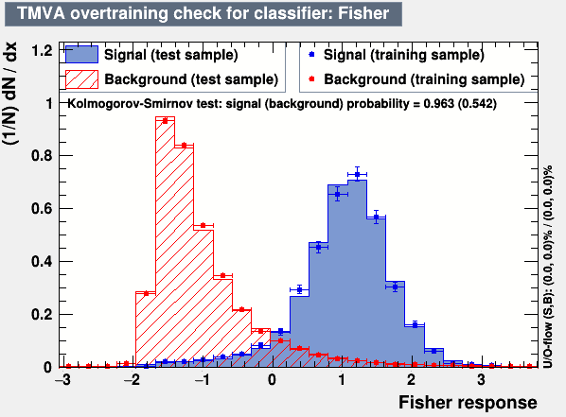
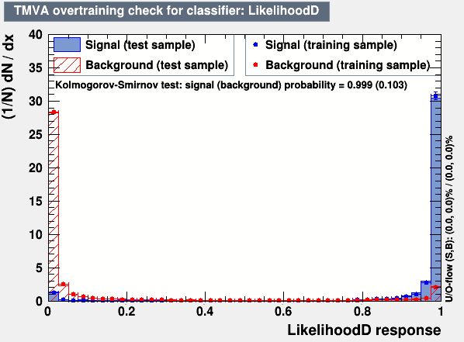
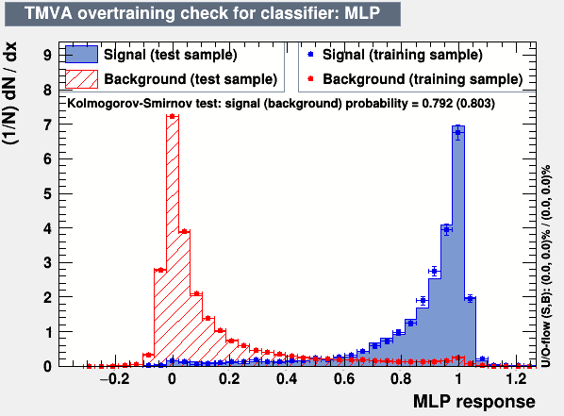

Slide 15
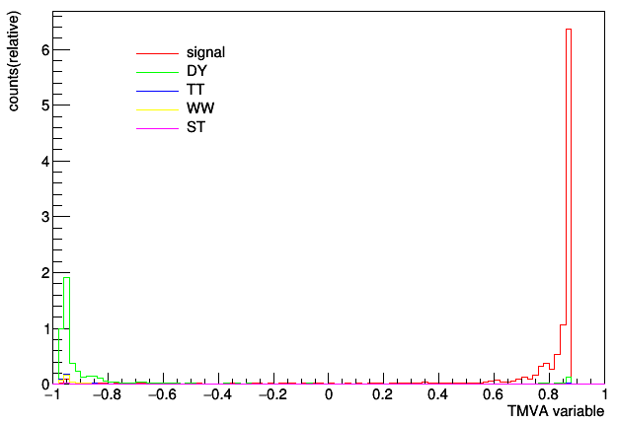
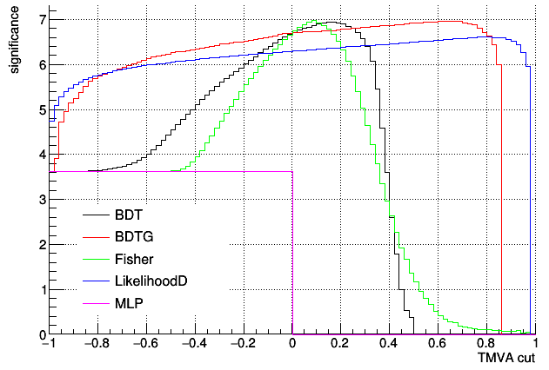
After training, the output is like this, all variables turn into one, the signal and background also have some change.
Now we can calculate the significance ,and in similar way,we can get the output of BDT、Fisher、LikelihoodD、MLP, the significance of them is like this
15

Slide 16
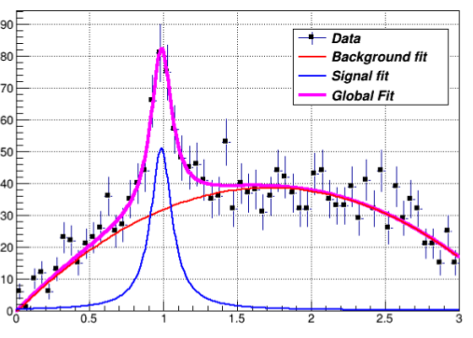
We can use fitting or shape analysis
Like this, signal is buried in the background, we can predict the function of signal and background and then apply them together on the data, by doing this we can get the parameters of function of signal and background, we can rebuild the signal and the background.
16

Slide 17
Summary
In the Sequential Standard Model (SSM), The SSM Z’ is a carbon copy of SM Z boson with the same couplings, but only with a heavier mass. There are various decay channels and many kinds of backgrounds, we use cuts on histograms, ntuples and TMVA to find the significance and compare with each other, different way has different performance. We also predict that we can use shape or fitting methods to analyze the data.
17

Slide 18
Thank you

