Slide 1
CEPC partial double ring scheme and crab-waist parameters
Dou Wang, Jie Gao, Feng Su, Ming Xiao, Yuan Zhang, Jiyuan Zhai, Yiwei Wang, Bai Sha, Huiping Geng, Tianjian Bian, Xiaohao Cui, Yuanyuan Guo
CEPC AP meeting, 2016.03.25

Slide 2
Primary parameter for CEPC double ring （wangdou20160325）
 | Pre-CDR | H-high lumi. | H-low power | W | Z
Number of IPs | 2 | 2 | 2 | 2 | 2 | 2
Energy (GeV) | 120 | 120 | 120 | 80 | 45.5 | 45.5
Circumference (km) | 54 | 54 | 54 | 54 | 54 | 54
SR loss/turn (GeV) | 3.1 | 2.96 | 2.96 | 0.59 | 0.062 | 0.062
Half crossing angle (mrad) | 0 | 15 | 15 | 15 | 15 | 15
Piwinski angle | 0 | 2.5 | 2.6 | 5 | 8.5 | 7.6
N_{e}/bunch (10¹¹) | 3.79 | 2.85 | 2.67 | 0.74 | 0.46 | 0.46
Bunch number | 50 | 67 | 44 | 400 | 1100 | 1100
Beam current (mA) | 16.6 | 16.9 | 10.5 | 26.2 | 45.4 | 45.4
SR power /beam (MW) | 51.7 | 50 | 31.2 | 15.6 | 2.8 | 2.8
Bending radius (km) | 6.1 | 6.2 | 6.2 | 6.1 | 6.1 | 6.1
Momentum compaction (10⁻⁵) | 3.4 | 2.5 | 2.2 | 2.4 | 3.5 | 3.5
β_{IP} x/y (m) | 0.8/0.0012 | 0.25/0.00136 | 0.268 /0.00124 | 0.1/0.001 | 0.08/0.001 | 0.1/0.001
Emittance x/y (nm) | 6.12/0.018 | 2.45/0.0074 | 2.06 /0.0062 | 1.02/0.003 | 0.62/0.002 | 0.62/0.0028
Transverse σ_{IP} (um) | 69.97/0.15 | 24.8/0.1 | 23.5/0.088 | 10.1/0.056 | 7/0.046 | 7.9/0.053
ξ_{x}/IP | 0.118 | 0.03 | 0.032 | 0.008 | 0.005 | 0.006
ξ_{y}/IP | 0.083 | 0.11 | 0.11 | 0.074 | 0.084 (Fl=3) | 0.073 (Fl=2.6)
V_{RF} (GV) | 6.87 | 3.62 | 3.53 | 0.81 | 0.12 | 0.12
f _{RF} (MHz) | 650 | 650 | 650 | 650 | 650 | 650
Nature σ_{z} (mm) | 2.14 | 3.1 | 3.0 | 3.25 | 3.9 | 3.9
Total σ_{z} (mm) | 2.65 | 4.1 | 4.0 | 3.35 | 4.0 | 4.0
HOM power/cavity (kw) | 3.6 | 2.2 | 1.3 | 0.99 | 0.99 | 0.99
Energy spread (%) | 0.13 | 0.13 | 0.13 | 0.09 | 0.05 | 0.05
Energy acceptance (%) | 2 | 2 | 2
Energy acceptance by RF (%) | 6 | 2.2 | 2.1 | 1.7 | 1.1 | 1.1
n_{γ} | 0.23 | 0.47 | 0.47 | 0.3 | 0.27 | 0.24
Life time due to beamstrahlung_cal (minute) | 47 | 36 | 32
F (hour glass) | 0.68 | 0.82 | 0.81 | 0.92 | 0.95 | 0.95
L_{max}/IP (10³⁴cm⁻²s⁻¹) | 2.04 | 2.96 | 2.01 | 3.09 | 3.61 | 3.09

Slide 3
parameter for CEPC double ring-88km （wangdou20160318）
 | Pre-CDR | H-high lumi. | H-low power
Number of IPs | 2 | 2 | 2
Energy (GeV) | 120 | 120 | 120
Circumference (km) | 54 | 88 | 88
SR loss/turn (GeV) | 3.1 | 2.0 | 2.0
Half crossing angle (mrad) | 0 | 15 | 15
Piwinski angle | 0 | 2.0 | 2.6
N_{e}/bunch (10¹¹) | 3.79 | 1.75 | 1.53
Bunch number | 50 | 257 | 176
Beam current (mA) | 16.6 | 24.5 | 14.7
SR power /beam (MW) | 51.7 | 50 | 30
Bending radius (km) | 6.1 | 9.0 | 9.0
Momentum compaction (10⁻⁵) | 3.4 | 1.9 | 1.5
β_{IP} x/y (m) | 0.8/0.0012 | 0.36/0.0011 | 0.36/0.0011
Emittance x/y (nm) | 6.12/0.018 | 1.63/0.005 | 1.15 /0.0035
Transverse σ_{IP} (um) | 69.97/0.15 | 24.4/0.074 | 20.5/0.062
ξ_{x}/IP | 0.118 | 0.04 | 0.033
ξ_{y}/IP | 0.083 | 0.091 | 0.091
V_{RF} (GV) | 6.87 | 3.1 | 2.57
f _{RF} (MHz) | 650 | 650 | 650
Nature σ_{z} (mm) | 2.14 | 2.7 | 2.94
Total σ_{z} (mm) | 2.65 | 3.25 | 3.53
HOM power/cavity (kw) | 3.6 | 2.2 | 1.1
Energy spread (%) | 0.13 | 0.1 | 0.1
Energy acceptance (%) | 2 | 1.5 | 1.4
Energy acceptance by RF (%) | 6 | 3 | 2.1
n_{γ} | 0.23 | 0.29 | 0.31
Life time due to beamstrahlung_cal (minute) | 47 | 32 | 40
F (hour glass) | 0.68 | 0.78 | 0.82
L_{max}/IP (10³⁴cm⁻²s⁻¹) | 2.04 | 4.18 | 2.63

Slide 4
parameter for CEPC double ring-100km （wangdou20160318）
 | Pre-CDR | H-high lumi. | H-low power
Number of IPs | 2 | 2 | 2
Energy (GeV) | 120 | 120 | 120
Circumference (km) | 54 | 100 | 100
SR loss/turn (GeV) | 3.1 | 1.7 | 1.7
Half crossing angle (mrad) | 0 | 15 | 15
Piwinski angle | 0 | 2.0 | 2.83
N_{e}/bunch (10¹¹) | 3.79 | 1.43 | 1.22
Bunch number | 50 | 436 | 307
Beam current (mA) | 16.6 | 30 | 18
SR power /beam (MW) | 51.7 | 50 | 30
Bending radius (km) | 6.1 | 11 | 11
Momentum compaction (10⁻⁵) | 3.4 | 1.8 | 1.4
β_{IP} x/y (m) | 0.8/0.0012 | 0.297/0.0011 | 0.3/0.0011
Emittance x/y (nm) | 6.12/0.018 | 1.63/0.0049 | 1.03/0.003
Transverse σ_{IP} (um) | 69.97/0.15 | 22/0.074 | 17.6/0.59
ξ_{x}/IP | 0.118 | 0.033 | 0.025
ξ_{y}/IP | 0.083 | 0.083 | 0.083
V_{RF} (GV) | 6.87 | 3.1 | 2.25
f _{RF} (MHz) | 650 | 650 | 650
Nature σ_{z} (mm) | 2.14 | 2.45 | 2.77
Total σ_{z} (mm) | 2.65 | 2.94 | 3.33
HOM power/cavity (kw) | 3.6 | 2.3 | 1.1
Energy spread (%) | 0.13 | 0.1 | 0.1
Energy acceptance (%) | 2 | 1.46 | 1.4
Energy acceptance by RF (%) | 6 | 3.5 | 2.2
n_{γ} | 0.23 | 0.27 | 0.28
Life time due to beamstrahlung_cal (minute) | 47 | 40 | 49
F (hour glass) | 0.68 | 0.8 | 0.85
L_{max}/IP (10³⁴cm⁻²s⁻¹) | 2.04 | 4.75 | 3.01

Slide 5
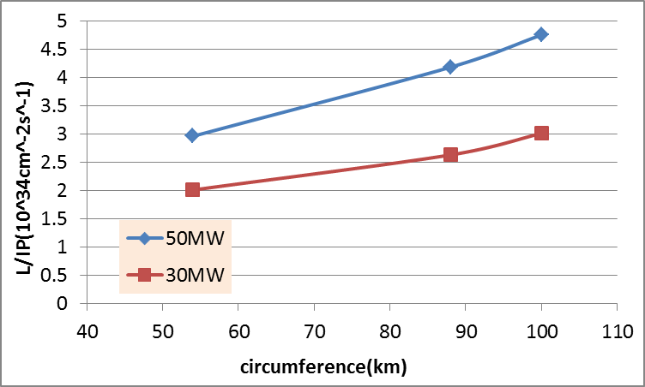
Luminosity vs circumference (Higgs)

Slide 6
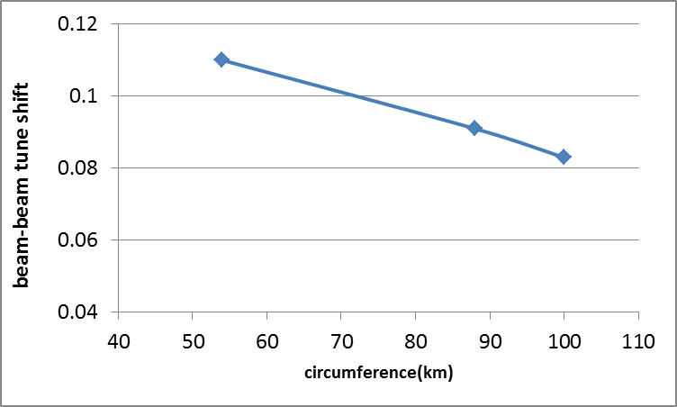
ξ_{y} vs circumference (Higgs)

Slide 7
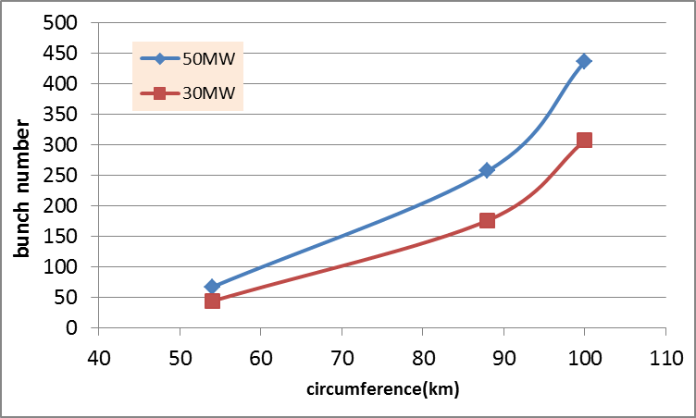
Bunch number vs circumference (Higgs)

Slide 8
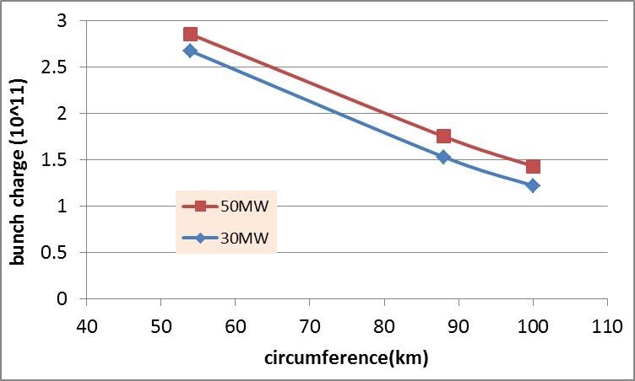
Bunch charge vs circumference (Higgs)

Slide 9
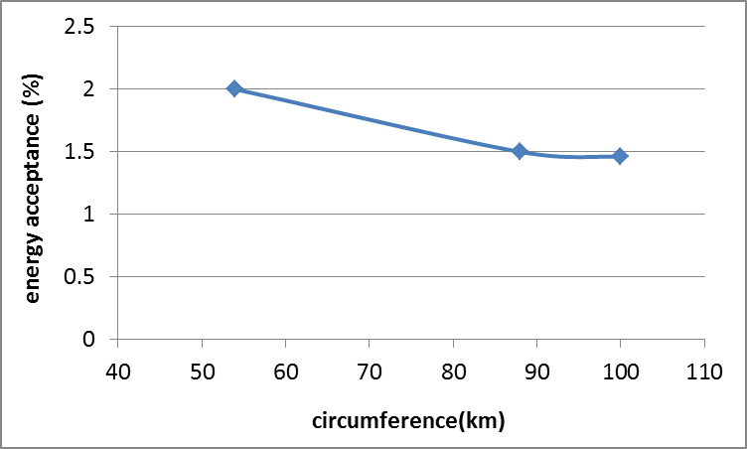
Energy acceptance vs circumference (Higgs)

Slide 10
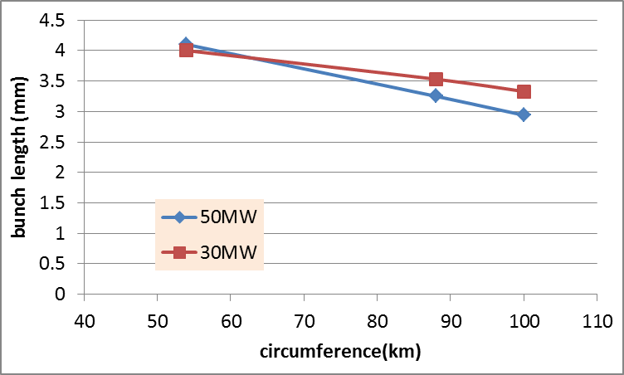
Bunch length vs circumference (Higgs)

Slide 11
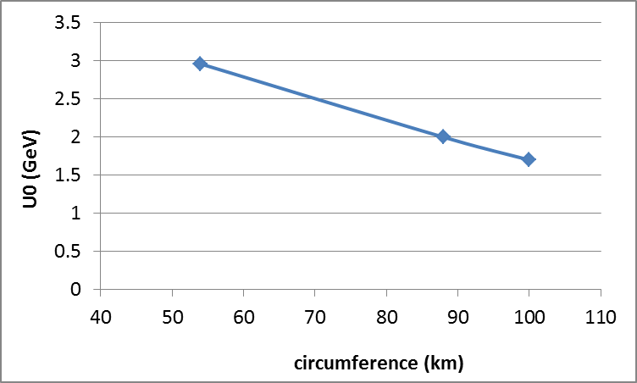
SR loss vs circumference (Higgs)

Slide 12
Double ring FFS design with crab sextupoles
Betax=0.25m
Betay=0.00136m
K2hs=23.3 m⁻³
K2vs=-32.8 m⁻³
Crab sextupole
IP
Critical energy: Ec=190 keV
Dipole strength: B=0.019 T
As Oide said, the second FFS sextupoles of the CCS-Y section can work as the crab sextupoles, if their strengths and phases to the IP are properly chosen.

Slide 13
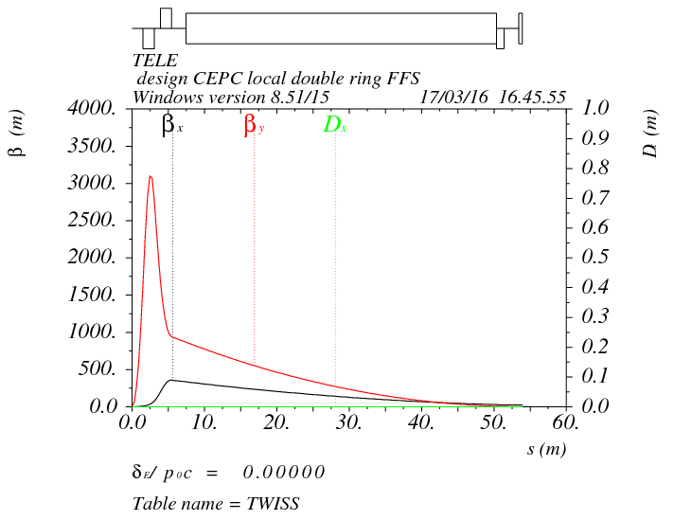
Final doublet
IP
L*=1.5m
L(QD0)=1.56m, G(QD0)=-200T/m
L(QF1)=1.53m, G(QF1)=98T/m
L₀=0.85m

Slide 14
Crab sextupole strength
Δϕ_{x}=2π, Δϕ_{y}=2.5π
The crab sextupole should be placed on both sides of the IP in phase with the IP in the horizontal plane and at π/2 in the vertical one.
13% strength of main sextupoles

Slide 15
Thanks！

