Slide 1
Interaction region design for the partial double ring scheme
Yiwei Wang, Xiaohao Cui, Dou Wang, Feng Su,
Sha Bai, Huiping Geng, Yuan Zhang, Jie Gao
CEPC AP meeting, 19 Feb 2016

Slide 2
Primary parameter for CEPC double ring （wangdou20160325）
 | Pre-CDR | H-high lumi. | H-low power | W | Z
Number of IPs | 2 | 2 | 2 | 2 | 2
Energy (GeV) | 120 | 120 | 120 | 80 | 45.5
Circumference (km) | 54 | 54 | 54 | 54 | 54
SR loss/turn (GeV) | 3.1 | 2.96 | 2.96 | 0.59 | 0.062
Half crossing angle (mrad) | 0 | 15 | 15 | 15 | 15
Piwinski angle | 0 | 2.5 | 2.6 | 5 | 7.6
N_{e}/bunch (10¹¹) | 3.79 | 2.85 | 2.67 | 0.74 | 0.46
Bunch number | 50 | 67 | 44 | 400 | 1100
Beam current (mA) | 16.6 | 16.9 | 10.5 | 26.2 | 45.4
SR power /beam (MW) | 51.7 | 50 | 31.2 | 15.6 | 2.8
Bending radius (km) | 6.1 | 6.2 | 6.2 | 6.1 | 6.1
Momentum compaction (10⁻⁵) | 3.4 | 2.5 | 2.2 | 2.4 | 3.5
β_{IP} x/y (m) | 0.8/0.0012 | 0.25/0.00136 | 0.268 /0.00124 | 0.1/0.001 | 0.1/0.001
Emittance x/y (nm) | 6.12/0.018 | 2.45/0.0074 | 2.06 /0.0062 | 1.02/0.003 | 0.62/0.0028
Transverse σ_{IP} (um) | 69.97/0.15 | 24.8/0.1 | 23.5/0.088 | 10.1/0.056 | 7.9/0.053
ξ_{x}/IP | 0.118 | 0.03 | 0.032 | 0.008 | 0.006
ξ_{y}/IP | 0.083 | 0.11 | 0.11 | 0.074 | 0.073
V_{RF} (GV) | 6.87 | 3.62 | 3.53 | 0.81 | 0.12
f _{RF} (MHz) | 650 | 650 | 650 | 650 | 650
Nature σ_{z} (mm) | 2.14 | 3.1 | 3.0 | 3.25 | 3.9
Total σ_{z} (mm) | 2.65 | 4.1 | 4.0 | 3.35 | 4.0
HOM power/cavity (kw) | 3.6 | 2.2 | 1.3 | 0.99 | 0.99
Energy spread (%) | 0.13 | 0.13 | 0.13 | 0.09 | 0.05
Energy acceptance (%) | 2 | 2 | 2
Energy acceptance by RF (%) | 6 | 2.2 | 2.1 | 1.7 | 1.1
n_{γ} | 0.23 | 0.47 | 0.47 | 0.3 | 0.24
Life time due to beamstrahlung_cal (minute) | 47 | 36 | 32
F (hour glass) | 0.68 | 0.82 | 0.81 | 0.92 | 0.95
L_{max}/IP (10³⁴cm⁻²s⁻¹) | 2.04 | 2.96 | 2.01 | 3.09 | 3.09

Slide 3
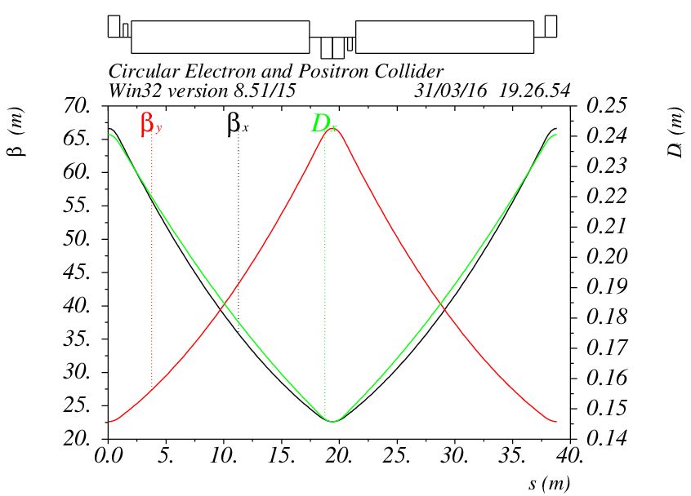
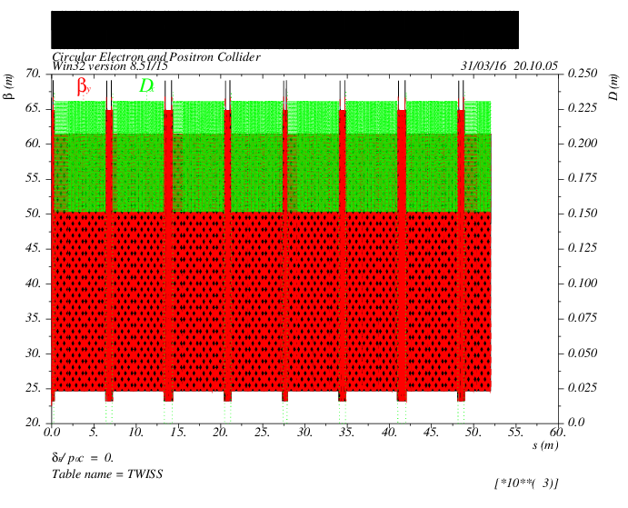
ARC lattice
60/60 degree
156 cells in each section
55km

Slide 4
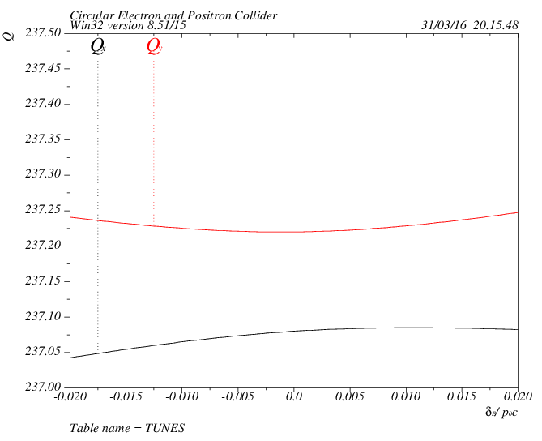
Tune shift
tune vs. dP/P
Second order chromaiticity arise due to stronger focusing
2 families in ARC

Slide 5
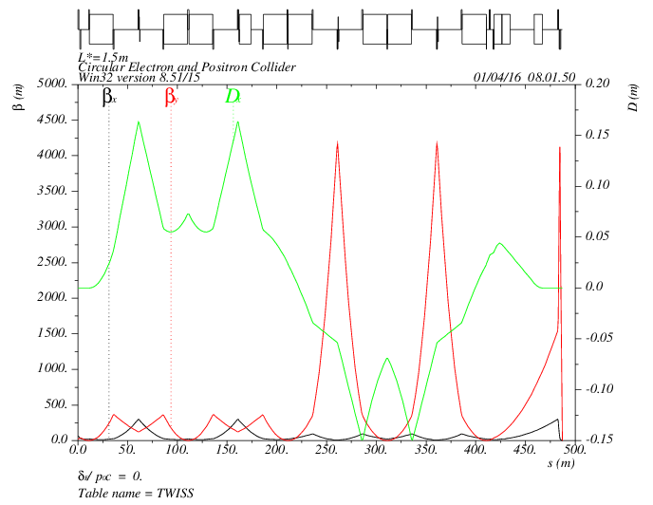
IR lattice
Additional sextupole for 3rd order chromaticity

Slide 6
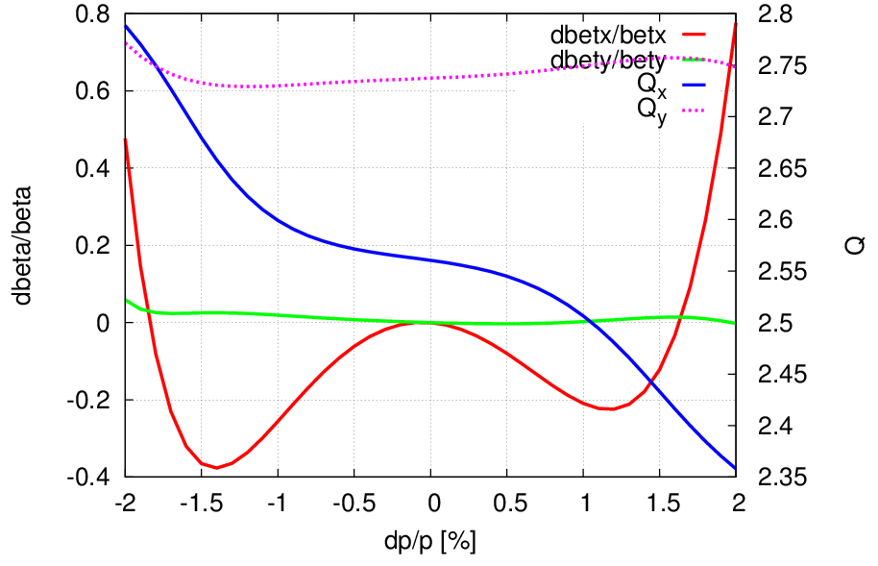
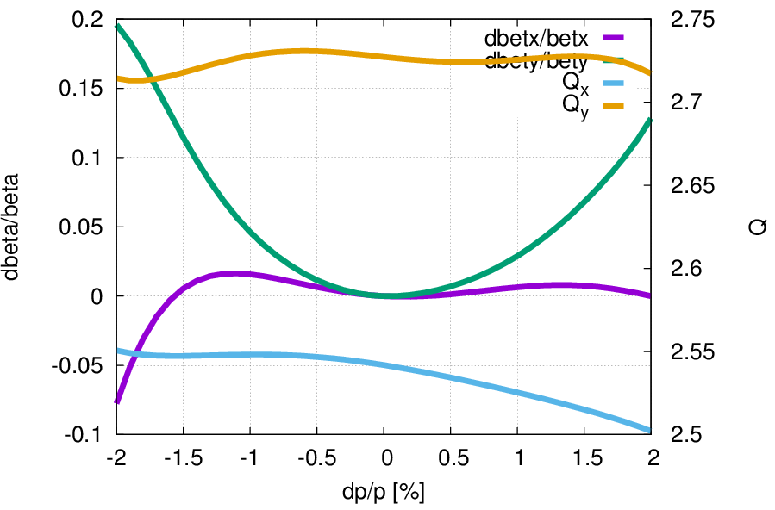
Chromaticity correction
3rd order vertical chromaticity
3rd order vertical and horizontal chromaticity
Preliminary result
to be further optimized with whole ring

Slide 7
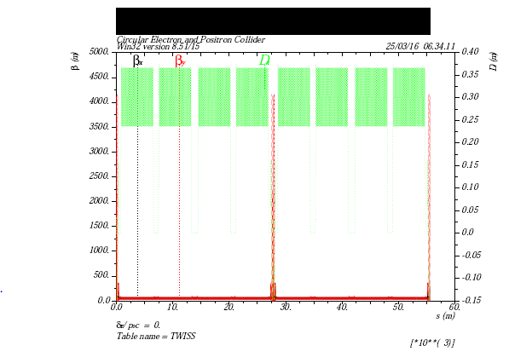
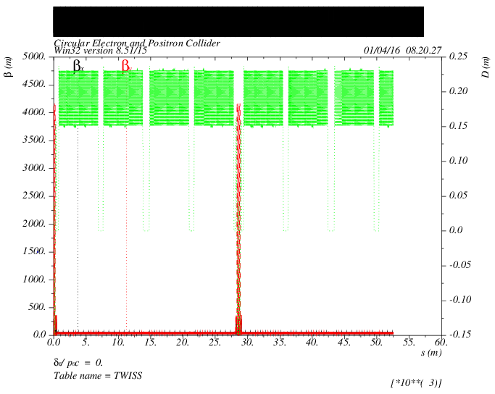
ARC+IR
ARC 6.28nm
3rd order vertical chromaticity
ARC 2.9nm
3rd order vertical and horizontal chromaticity

Slide 8
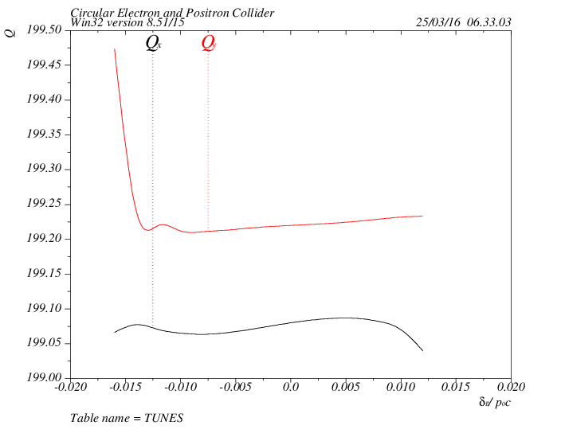
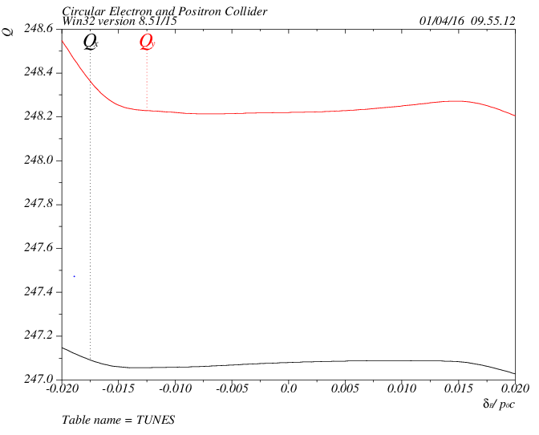
ARC+IR
ARC 6.28nm
3rd order vertical chromaticity
ARC 2.9nm
3rd order vertical and horizontal chromaticity
4 families in IR
2 families in ARC
Preliminary result
to be further optimized with whole ring

Slide 9
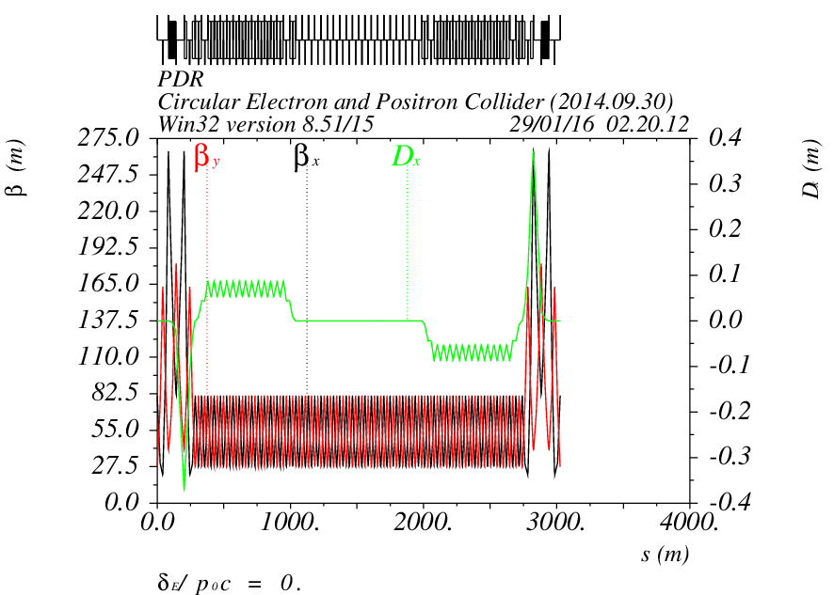
PDR lattice
The bending angle in PDR is small compare with its length
If scale bending angle with (6km/54km)*2π/4=175 mrad
Actually: Left PDR 0.75mrad+14.25mrad-15mrad-15mrad
Actually: Right PDR +15mrad +15mrad-14.25mrad-0.75mrad
Present PDR almost doesn’t contribute to the emittance
The PDR should be included into the ARC, otherwise
the total length will be 55km+6km!!!

