Slide 1
Orbit correction and error analysis in CEPC partial double ring
Sha Bai, Dengjie Xiao,
Yiwei Wang, Feng Su, Huiping Geng, Dou Wang
2016-04-01
CEPC AP meeting

Slide 2
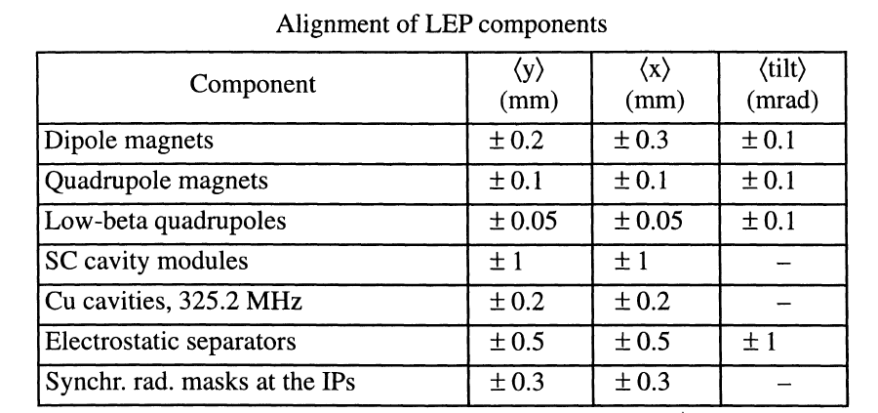
LEP Alignment parameters
From: LEP Design Report---------LEP2 P177

Slide 3
Magnet Field error 1
From: LEP Design Report---------LEP P18

Slide 4
Magnet Field error 2
From: LEP Design Report---------LEP P19

Slide 5
Magnet Field error 3

Slide 6
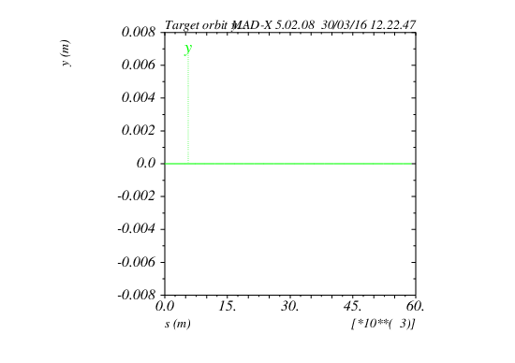
Target orbit no error
Lattice版本：CEPC-ARC1.0-PDR1.0-FFS (WD1.0)

Slide 7
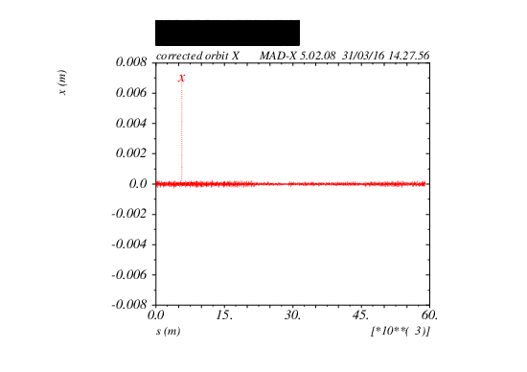
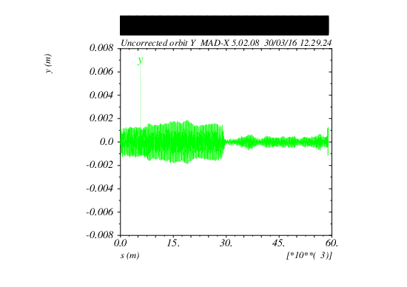
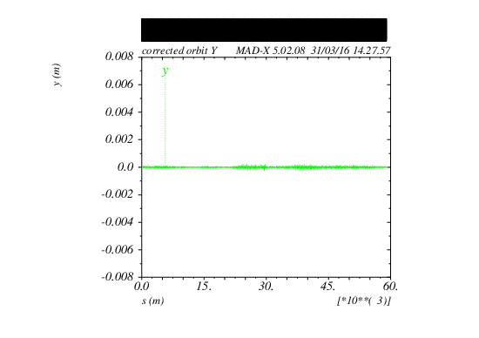
Orbit correction result
Before correction
After correction

Slide 8
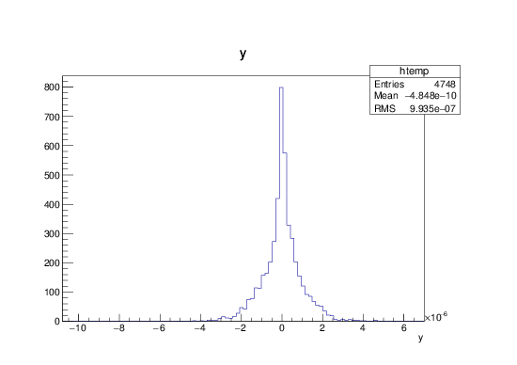
BPM readings statistic
X CORRECTION
SUMMARY:
RMS before correction
2.127 mm
RMS after correction
0.0009987 mm
Y CORRECTION
SUMMARY:
RMS before correction
0.6423 mm
RMS after correction
0.0009935 mm

Slide 9
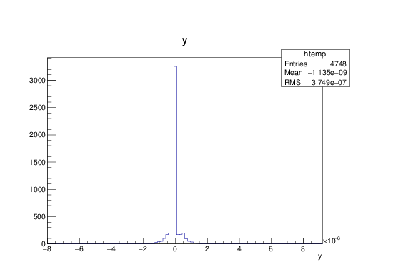
Correctors strength statistics
X CORRECTION:
about 1700 correctors used
Max strength ~ 23urad
RMS ~ 0.77urad
Y CORRECTION:
about 1700 correctors used
Max strength ~ 6.7urad
RMS ~ 0.37urad

Slide 10
Multipole errors effect on DA
Multipole errors of all magnets
Multipole errors of bend
Multipole errors of quadurpoles
Multipole errors of sextupoles
Multipole errors reduce DA a little bit , but not much. It seems to have not much effect on DA, especially of off-momentum DA.
Orbit has no change due to multipole errors.

Slide 11
Conclusions and Prospects
The LEP misalignment errors (bending magnets and quadrupoles) are used for the CEPC partial double ring.
Orbit correction in CEPC partial double ring are executed using MICADO method, using about 1700 correctors. Correctors strength statistic are done and maximum strength of correctors are got.
Dengjie is working with Yiwei on the DA program to calculate DA from MADX tracking, and will be given the DA after orbit correction in the near future.
Multipole errors are introduced to CEPC partial double ring, but may have not much effect on dynamic aperture.

