Slide 1
CEPC partial double ring scheme and crab-waist parameters
Dou Wang, Jie Gao, Feng Su, Ming Xiao, Yuan Zhang, Jiyuan Zhai, Yiwei Wang, Bai Sha, Huiping Geng, Tianjian Bian, Xiaohao Cui, Yuanyuan Guo
CEPC AP meeting, 2016.04.01

Slide 2
Primary parameter for CEPC double ring
（wangdou20160325）
 | Pre-CDR | H-high lumi. | H-low power | W | Z
Number of IPs | 2 | 2 | 2 | 2 | 2
Energy (GeV) | 120 | 120 | 120 | 80 | 45.5
Circumference (km) | 54 | 54 | 54 | 54 | 54
SR loss/turn (GeV) | 3.1 | 2.96 | 2.96 | 0.59 | 0.062
Half crossing angle (mrad) | 0 | 15 | 15 | 15 | 15
Piwinski angle | 0 | 2.5 | 2.6 | 5 | 7.6
N_{e}/bunch (10¹¹) | 3.79 | 2.85 | 2.67 | 0.74 | 0.46
Bunch number | 50 | 67 | 44 | 400 | 1100
Beam current (mA) | 16.6 | 16.9 | 10.5 | 26.2 | 45.4
SR power /beam (MW) | 51.7 | 50 | 31.2 | 15.6 | 2.8
Bending radius (km) | 6.1 | 6.2 | 6.2 | 6.1 | 6.1
Momentum compaction (10⁻⁵) | 3.4 | 2.5 | 2.2 | 2.4 | 3.5
β_{IP} x/y (m) | 0.8/0.0012 | 0.25/0.00136 | 0.268 /0.00124 | 0.1/0.001 | 0.1/0.001
Emittance x/y (nm) | 6.12/0.018 | 2.45/0.0074 | 2.06 /0.0062 | 1.02/0.003 | 0.62/0.0028
Transverse σ_{IP} (um) | 69.97/0.15 | 24.8/0.1 | 23.5/0.088 | 10.1/0.056 | 7.9/0.053
ξ_{x}/IP | 0.118 | 0.03 | 0.032 | 0.008 | 0.006
ξ_{y}/IP | 0.083 | 0.11 | 0.11 | 0.074 | 0.073
V_{RF} (GV) | 6.87 | 3.62 | 3.53 | 0.81 | 0.12
f _{RF} (MHz) | 650 | 650 | 650 | 650 | 650
Nature σ_{z} (mm) | 2.14 | 3.1 | 3.0 | 3.25 | 3.9
Total σ_{z} (mm) | 2.65 | 4.1 | 4.0 | 3.35 | 4.0
HOM power/cavity (kw) | 3.6 | 2.2 | 1.3 | 0.99 | 0.99
Energy spread (%) | 0.13 | 0.13 | 0.13 | 0.09 | 0.05
Energy acceptance (%) | 2 | 2 | 2
Energy acceptance by RF (%) | 6 | 2.2 | 2.1 | 1.7 | 1.1
n_{γ} | 0.23 | 0.47 | 0.47 | 0.3 | 0.24
Life time due to beamstrahlung_cal (minute) | 47 | 36 | 32
F (hour glass) | 0.68 | 0.82 | 0.81 | 0.92 | 0.95
L_{max}/IP (10³⁴cm⁻²s⁻¹) | 2.04 | 2.96 | 2.01 | 3.09 | 3.09

Slide 3
parameter for CEPC double ring-88km
（wangdou20160329）
 | H-high lumi. | H-low power | W | Z
Number of IPs | 2 | 2 | 2 | 2
Energy (GeV) | 120 | 120 | 80 | 45.5
Circumference (km) | 88 | 88 | 88 | 88
SR loss/turn (GeV) | 2.0 | 2.0 | 0.4 | 0.04
Half crossing angle (mrad) | 15 | 15 | 15 | 15
Piwinski angle | 2.0 | 2.6 | 6.3 | 12.1
N_{e}/bunch (10¹¹) | 1.75 | 1.53 | 0.565 | 0.24
Bunch number | 257 | 176 | 1150 | 6600
Beam current (mA) | 24.5 | 14.7 | 35.5 | 86.5
SR power /beam (MW) | 50 | 30 | 14.3 | 3.6
Bending radius (km) | 9.0 | 9.0 | 9.0 | 9.0
Momentum compaction (10⁻⁵) | 1.9 | 1.5 | 1.9 | 1.9
β_{IP} x/y (m) | 0.36/0.0011 | 0.36/0.0011 | 0.1/0.001 | 0.1/0.001
Emittance x/y (nm) | 1.63/0.005 | 1.15 /0.0035 | 0.76/0.0023 | 0.24/0.0011
Transverse σ_{IP} (um) | 24.4/0.074 | 20.5/0.062 | 8.7/0.048 | 4.9/0.033
ξ_{x}/IP | 0.04 | 0.033 | 0.0053 | 0.0033
ξ_{y}/IP | 0.091 | 0.091 | 0.061 | 0.06
V_{RF} (GV) | 3.1 | 2.57 | 0.57 | 0.074
f _{RF} (MHz) | 650 | 650 | 650 | 650
Nature σ_{z} (mm) | 2.7 | 2.94 | 3.55 | 3.93
Total σ_{z} (mm) | 3.25 | 3.53 | 3.65 | 4.0
HOM power/cavity (kw) | 2.2 | 1.1 | 0.99 | 0.97
Energy spread (%) | 0.1 | 0.1 | 0.07 | 0.04
Energy acceptance (%) | 1.5 | 1.4
Energy acceptance by RF (%) | 3 | 2.1 | 1.4 | 0.9
n_{γ} | 0.29 | 0.31 | 0.27 | 0.2
Life time due to beamstrahlung_cal (minute) | 32 | 40
F (hour glass) | 0.78 | 0.82 | 0.94 | 0.97
L_{max}/IP (10³⁴cm⁻²s⁻¹) | 4.18 | 2.63 | 3.52 | 5.02

Slide 4
parameter for CEPC double ring-100km
（wangdou20160329）
 | H-high lumi. | H-low power | W | Z
Number of IPs | 2 | 2 | 2 | 2
Energy (GeV) | 120 | 120 | 80 | 45.5
Circumference (km) | 100 | 100 | 100 | 100
SR loss/turn (GeV) | 1.7 | 1.7 | 0.33 | 0.034
Half crossing angle (mrad) | 15 | 15 | 15 | 15
Piwinski angle | 2.0 | 2.83 | 8.65 | 15.8
N_{e}/bunch (10¹¹) | 1.43 | 1.22 | 0.42 | 0.165
Bunch number | 436 | 307 | 2400 | 15800 | 182260
Beam current (mA) | 30 | 18 | 48.7 | 125.3 | 1449.7
SR power /beam (MW) | 50 | 30 | 16.0 | 4.3 | 50
Bending radius (km) | 11 | 11 | 11 | 11
Momentum compaction (10⁻⁵) | 1.8 | 1.4 | 1.4 | 1.3
β_{IP} x/y (m) | 0.297/0.0011 | 0.3/0.0011 | 0.1/0.001 | 0.1/0.001
Emittance x/y (nm) | 1.63/0.0049 | 1.03/0.003 | 0.46/0.0014 | 0.14/0.00065
Transverse σ_{IP} (um) | 22/0.074 | 17.6/0.59 | 6.8/0.037 | 3.8/0.026
ξ_{x}/IP | 0.033 | 0.025 | 0.003 | 0.002
ξ_{y}/IP | 0.083 | 0.083 | 0.055 | 0.054
V_{RF} (GV) | 3.1 | 2.25 | 0.41 | 0.053
f _{RF} (MHz) | 650 | 650 | 650 | 650
Nature σ_{z} (mm) | 2.45 | 2.77 | 3.8 | 3.94
Total σ_{z} (mm) | 2.94 | 3.33 | 3.9 | 4.0
HOM power/cavity (kw) | 2.3 | 1.1 | 0.98 | 0.97 | 11.3
Energy spread (%) | 0.1 | 0.1 | 0.065 | 0.037
Energy acceptance (%) | 1.46 | 1.4
Energy acceptance by RF (%) | 3.5 | 2.2 | 0.9 | 0.7
n_{γ} | 0.27 | 0.28 | 0.26 | 0.18
Life time due to beamstrahlung_cal (minute) | 40 | 49
F (hour glass) | 0.8 | 0.85 | 0.96 | 0.985
L_{max}/IP (10³⁴cm⁻²s⁻¹) | 4.75 | 3.01 | 4.46 | 6.59 | 76.4

Slide 5
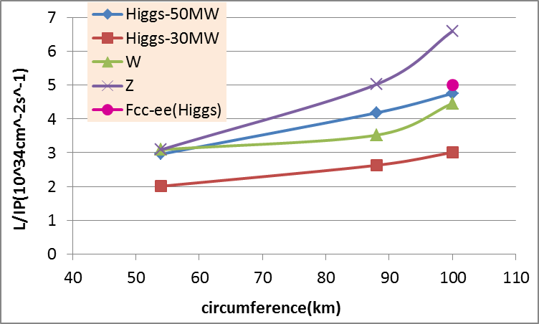
CEPC Luminosity vs circumference

Slide 6
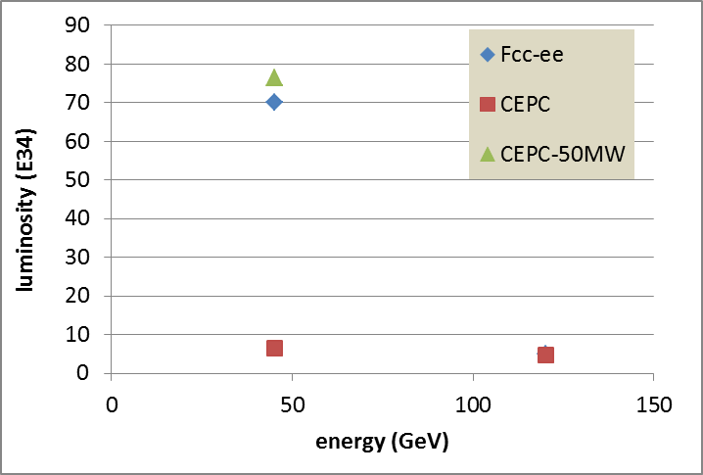
100km CEPC vs Fcc-ee
P_{HOM}=11.3 kw
P_{HOM}=29.1 kw
Fcc-ee did not include the constraint for HOM power.

Slide 7
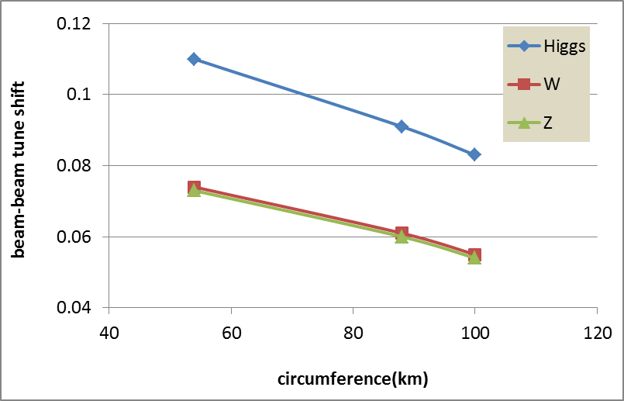
ξ_{y} vs circumference (Higgs)

Slide 8
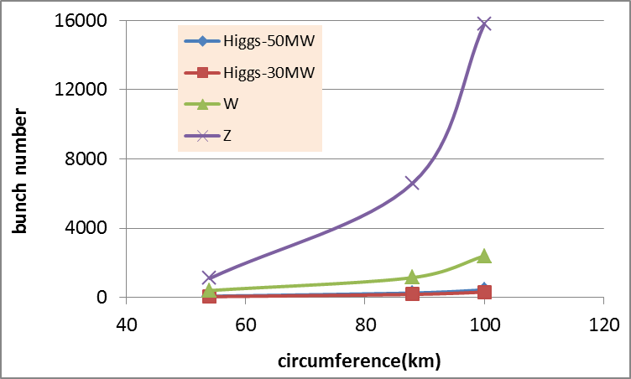
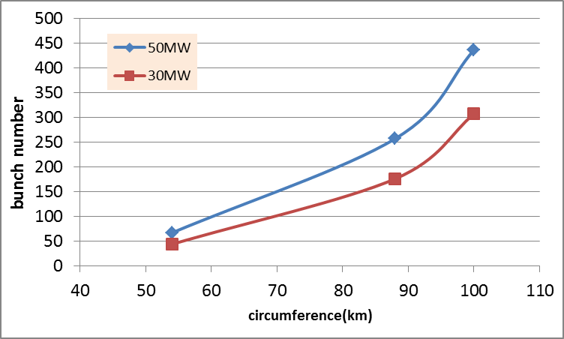
Bunch number vs circumference
Higgs

Slide 9
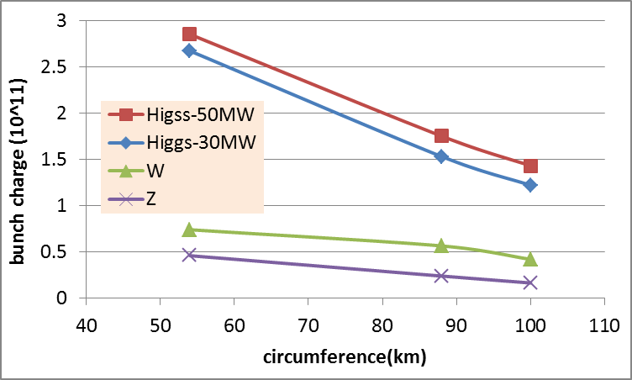
Bunch charge vs circumference

Slide 10
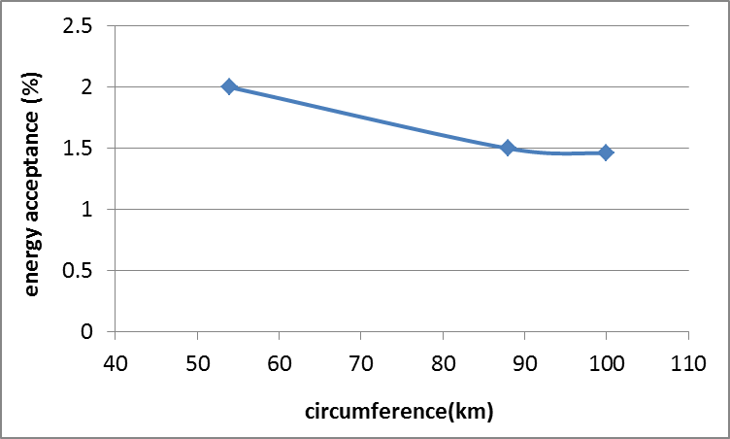
Energy acceptance vs circumference (Higgs)

Slide 11
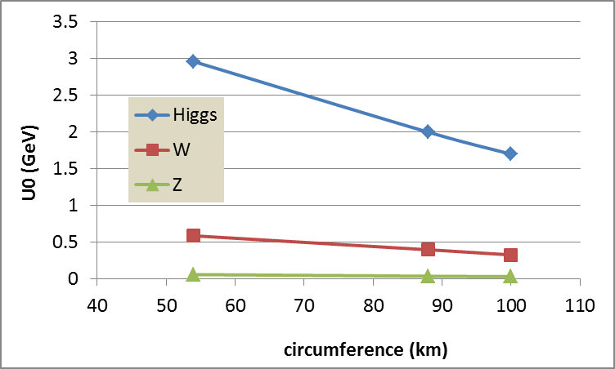
SR loss vs circumference

Slide 12
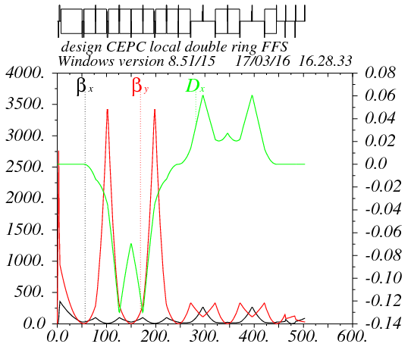
Double ring FFS design with crab sextupoles
Betax=0.25m
Betay=0.00136m
K2hs=26.8 m⁻³
K2vs=32.2 m⁻³
Crab sextupole
IP
Critical energy: Ec=190 keV
Dipole strength: B=0.019 T
As Oide said, the second FFS sextupoles of the CCS-Y section can work as the crab sextupoles, if their strengths and phases to the IP are properly chosen.

Slide 13
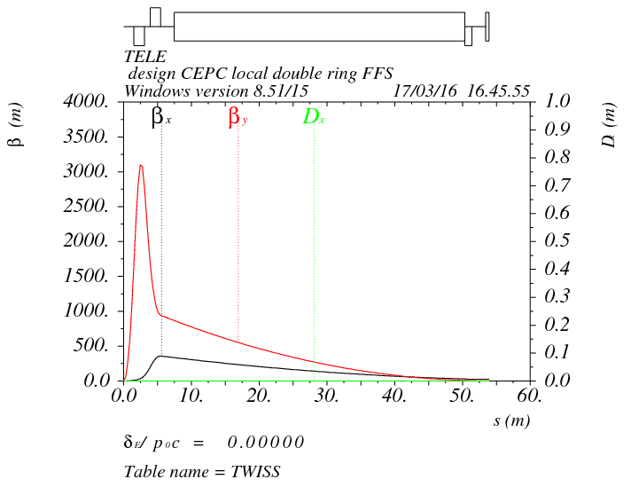
Final doublet
IP
L*=1.5m
L(QD0)=1.46m, G(QD0)=-200T/m
L(QF1)=1.29m, G(QF1)=97T/m
L₀=1.5m

Slide 14
Crab sextupole strength
Δϕ_{x}=2π, Δϕ_{y}=2.5π
The crab sextupole should be placed on both sides of the IP in phase with the IP in the horizontal plane and at π/2 in the vertical one.
13% strength of main sextupoles

Slide 15
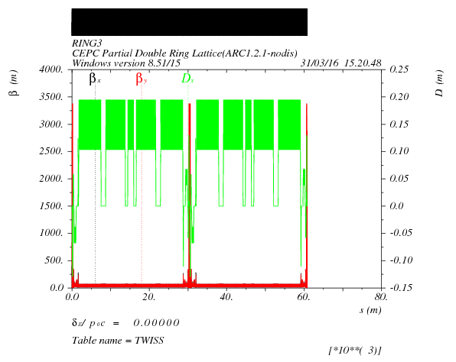
Insert FFS in PDR

Slide 16
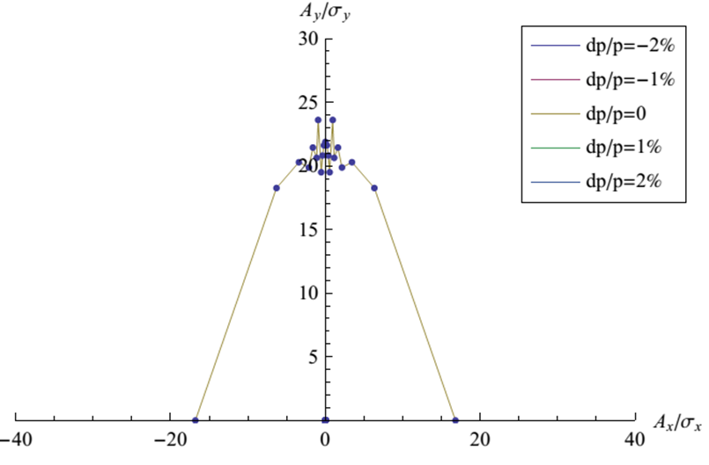
DA of the whole ring
Su Feng 2016.03.31
Sextupole: 2组

Slide 17
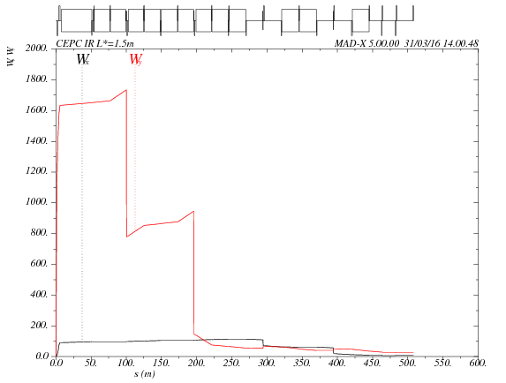
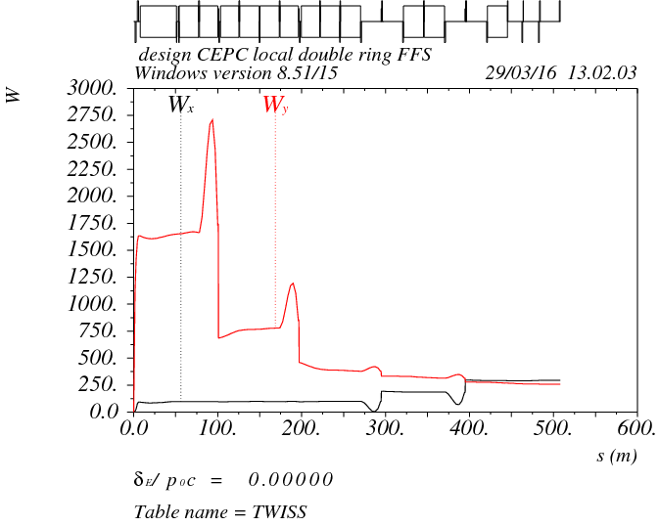
Chromaticity correction in FFS
Fine tuning the phase of main sextupoles.
Weak sextupoles are -10% of main sextupoles to correct the sextupoles’ length effect
K2hs=-6.99 m-3
K2vs=32.16 m-3

Slide 18
DA after chromaticity correction
Sextupole: 2组

Slide 19
Thanks！

