Slide 1
Update on pretzel scheme
Huiping Geng
2016.04.01

Slide 2
Contents
Lattice re-matching
Insertion of FFS
DA with FFS

Slide 3
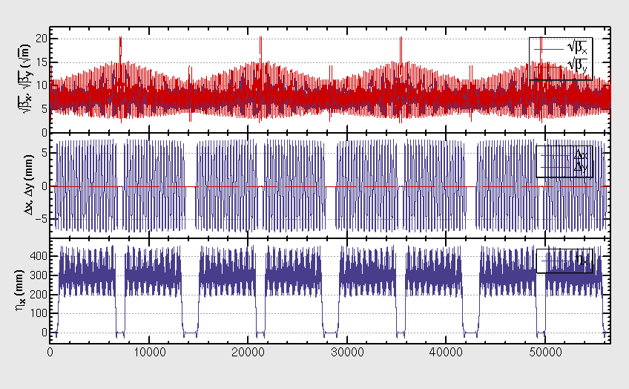
Lattice (w/o FFS) re-matching result

Slide 4
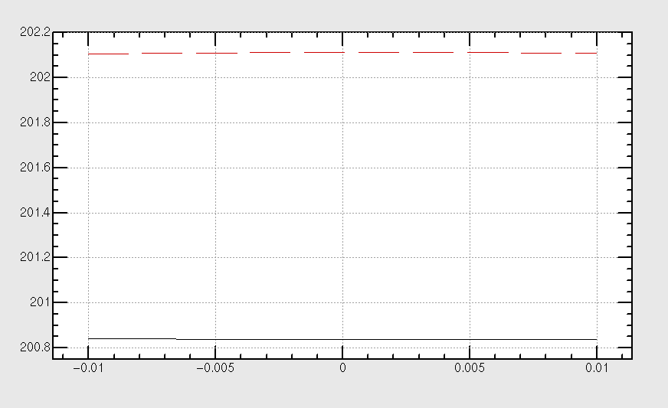
Tune chromaticity

Slide 5
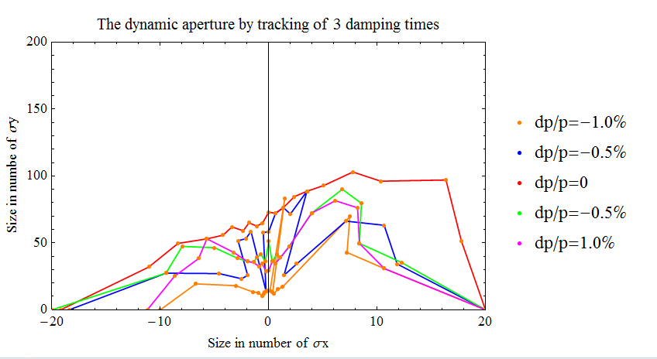
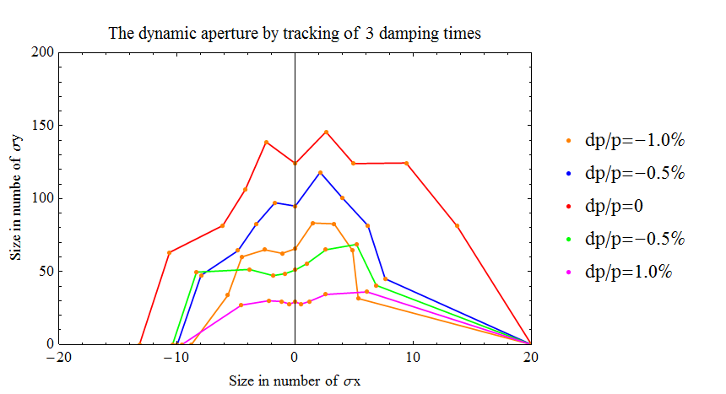
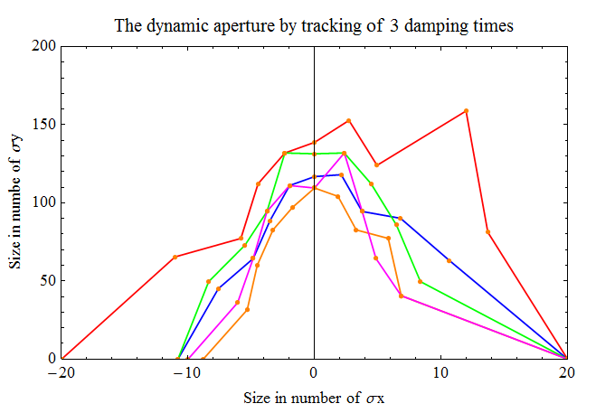
DA @ different tune
.85/.11
.79/.14
.79/.15

Slide 6
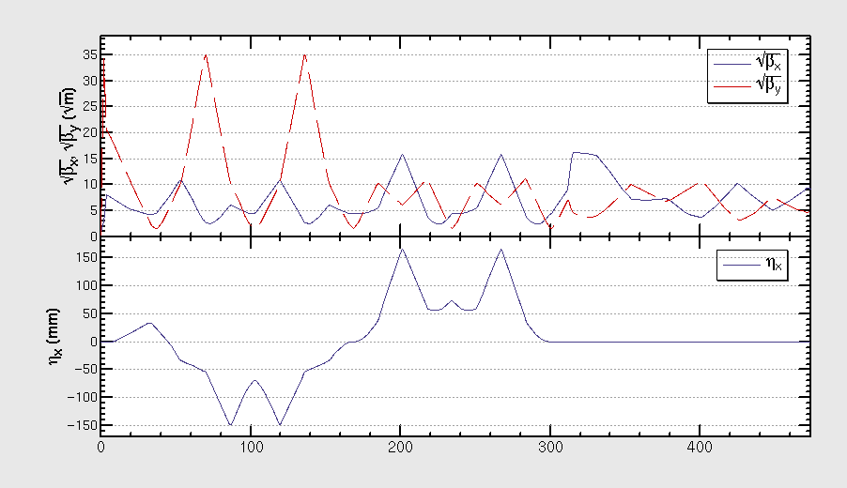
Insertion of FFS
From Yiwei, 3mm

Slide 7
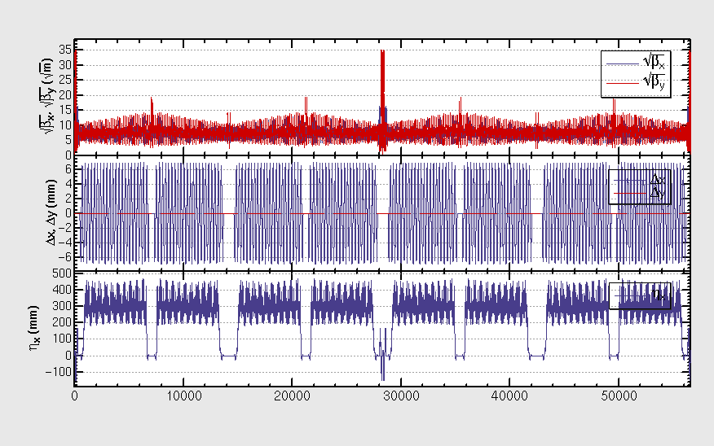
Ring lattice with FFS

Slide 8
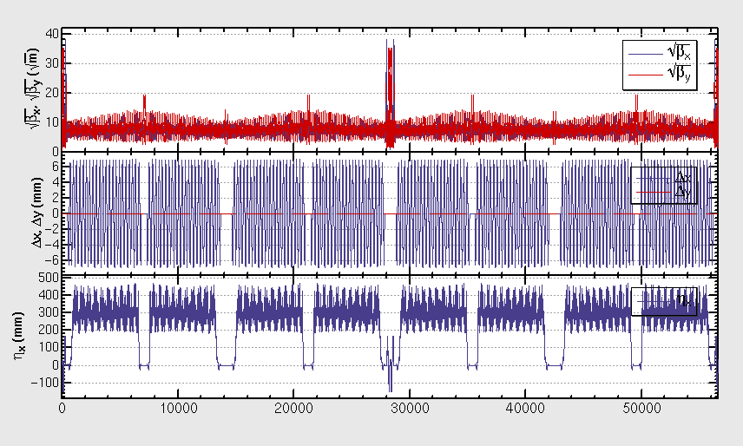
After tune adjustment

Slide 9
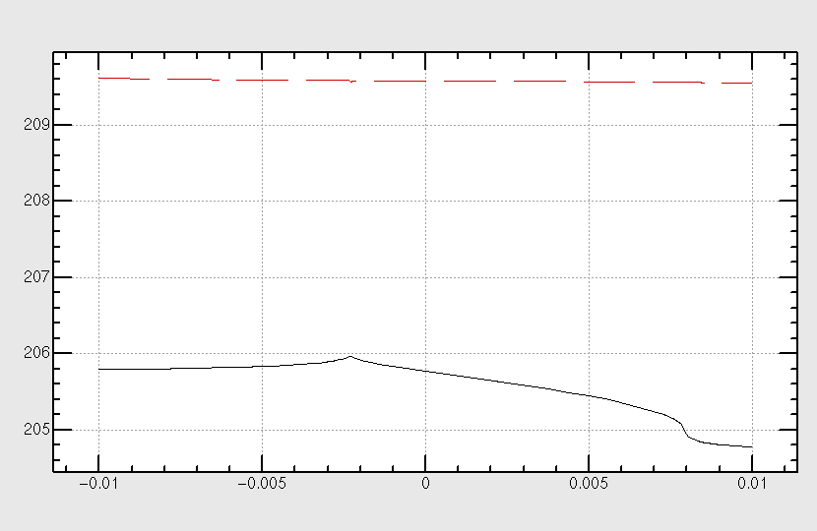
Tune chromaticity

Slide 10
Tune chromaticity after correction

Slide 11
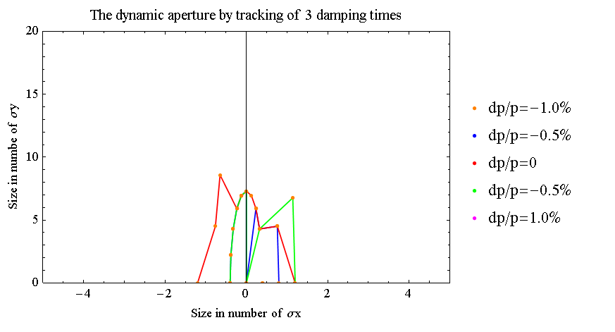
DA with FFS

Slide 12
Summary
DA need to be optimized ….

