Slide 1
Primary Radiation Calculation for Sun Yat-Sen Proton Hospital
GHMT R&D Center
Accelerator Physics Department
Zhangmin LI
2016-9-23

Slide 2
Abstract
Sun Yat-Sen Hospital is under construction, which is a cyclotron based proton therapy facility. In order to evaluate the dose level and impacts to environment, a primary understanding of the various radiation sources is needed for shielding design. The goal of this work is to get the dose distribution of the whole facility and verify whether the wall can shield the radiation to the limit value.

Slide 3
Contents
Introduction
Design Objective of Radiation Safety
General Method
Cyclotron room
Gantry Treatment Room
Fixed Beam Treatment Room
Total Dose
Summary

Slide 4
Introduction
Sun Yat-Sen Hospital consists of a cyclotron provided by IBA, 3 gantry treatment rooms and 2 fixed beam treatment rooms. The cyclotron generates proton beams with a fixed energy of 230 MeV. The max current extracted from the cyclotron is usually limited to 300 nA. The material of the wall is standard concrete. The annual workload in a treatment room is 211.76 nA.h. But we adopt 500nA.h for a conservative calculation.
This work is a primary calculation based on IBA’s original design.

Slide 5
Design Objective of Radiation Safety
Table. Dose limit
International recommendations | National Standards
ICRP Pub.107(2008) | GB 18871-2002
Occupational exposure Annual effective dose < 20 mSv Exposure for the public Annual effective dose < 1 mSv | Occupational exposure Annual effective dose < 20 mSv Exposure for the public Annual effective dose < 1 mSv
For a conservative design, the objective of radiation safety :
Occupational exposure: 10mSv (1/2 of the National Standards)
Exposure for the public: 0.1mSv (1/10 of the National Standards)
Standard GBZ/T 201-2007 limits the dose rate outside the treatment room: ≤2.5 μSv/h.

Slide 6
General Method
A simple analytical model provides a first estimate before going into complex Monte Carlo simulations.
The wall thickness at 0°direction of 230MeV for controlled area is 3.94m.
Monte Carlo simulations:
In this work we choose FLUKA because of its friendly interface FLAIR and can also cooperate with SimpleGEO.

Slide 7
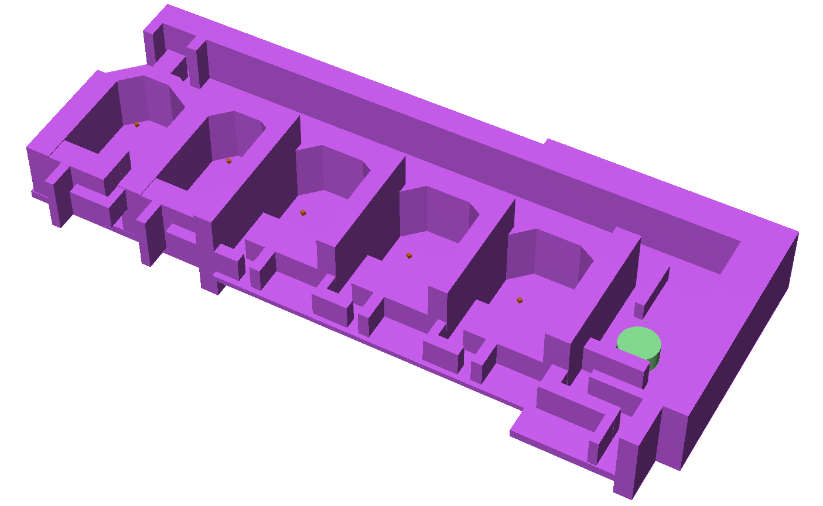
General Method
3D geometry of proton therapy facility

Slide 8
General Method
FLUKA settings
5 energy points (130 MeV, 160 MeV, 180 MeV, 210 MeV, and 230 MeV) will take an independent simulation.
the gantry treatment room will have 4 direction’s (0°, 90°, 180°, and 270°) simulation with 5 energy points. Every direction has the same weight of ¼.
USRBIN and AUXSCORE card are used to score the dose equivalent.

Slide 9
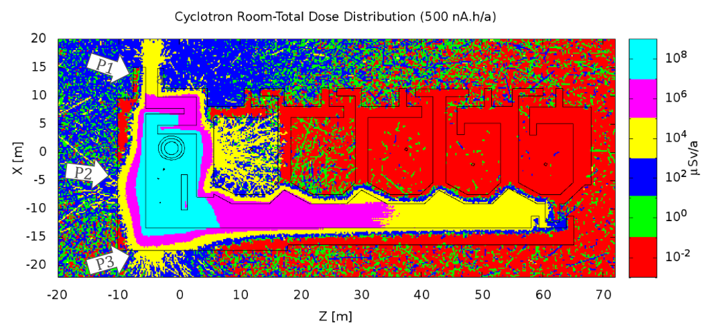
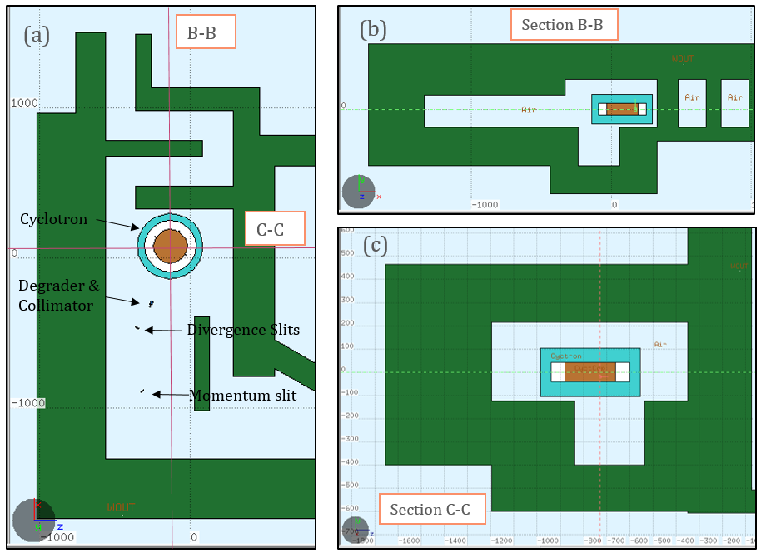
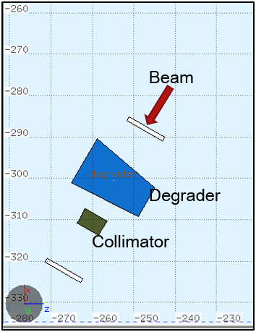
Cyclotron Room

Slide 10
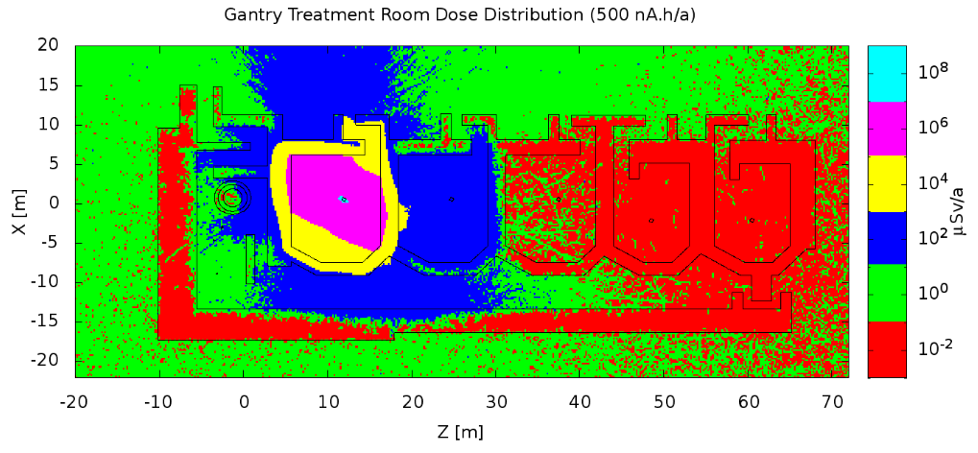
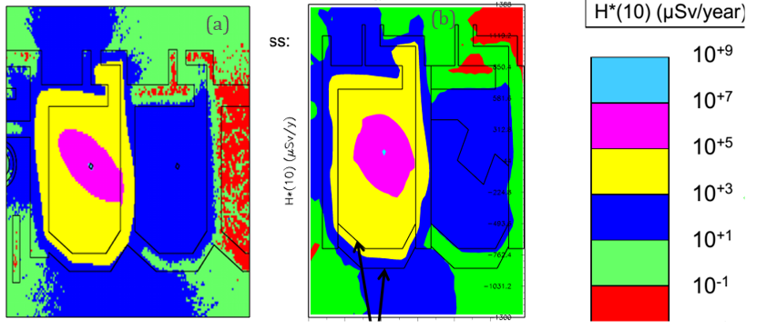
Gantry Treatment Room
The boundary of 1mSv/a is inside the building for 500 nA.h
(a) Dose for 211.76nA.h
(b) Dose of Frederic's work

Slide 11
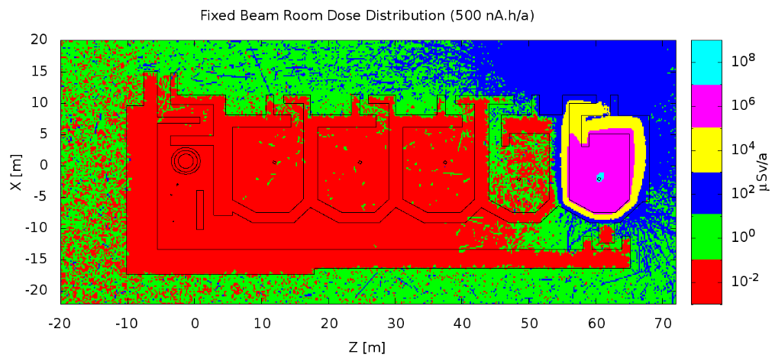
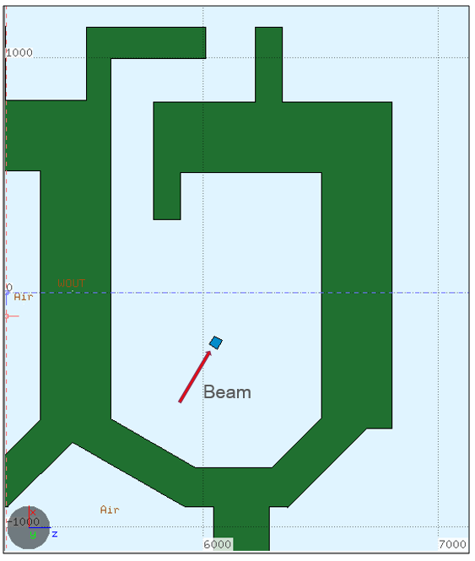
Fixed Beam Treatment Room
The 1mSv/a boundary is inside the wall.

Slide 12
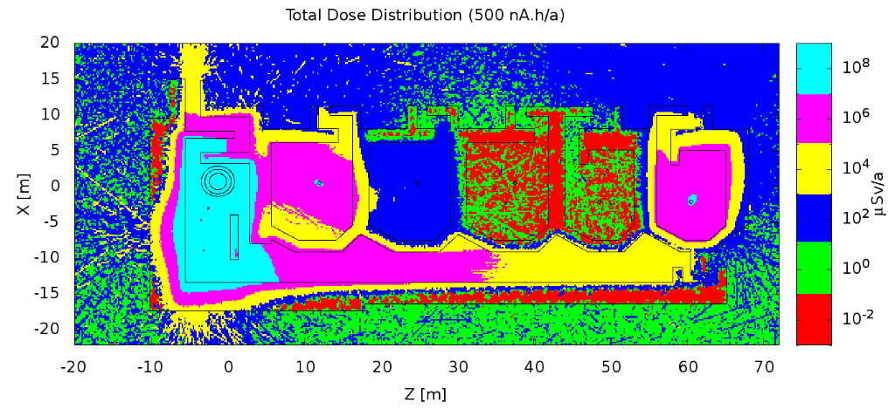
Total Dose
The 1 mSv/a boundary is quite clear, almost inside the wall, but the 0.1 mSv/a is obscure and mostly outside the wall.

Slide 13
Summary
The dose outside the building is higher than the objective limit value (0.1 mSv/a) with IBA orignial thickness and 500 nA.h workload. The most dangerous point is at the outside of cyclotron room and exit of its maze.
However, the hospital can rezone the controlled & supervised area. What’s more the treatment level will be underground, the soil can also shield some radiation.
This report just finish the simulation part, a full radiation shielding design for Sun Yat-Sen Proton Hospital please refer to “Qing Biao Wu et al. Radiation Shielding Design Report for Guangdong Hengjian proton therapy facility. 2015.”

Slide 14
Thanks for your attention!

