Slide 1
Fast Radiation Simulation and Visualized Data Processing Method
GHMT R&D Center
Accelerator Physics Department
Jinlong Wang
2016-9-23

Slide 2
Abstract
Typical FLUKA simulation time for a primary number 10⁶ is 1~2 hours on a standalone computer, in order to get a better statistics, the general way is to increase the primary, for a complicated shielding case the primary number is up to 10⁹. Thus a fast radiation simulation method is introduced which is called Multicore FLUKA. Flair and SimpGEO are good additional tools for FLUKA, they are helpful to geometry model, compile an input file and visualize the standard FLUKA output. What more, Gun plot is powerful to merge multi data to figures. Full beam line radiation is also discussed.

Slide 3
Contents
Introduction
Fast Radiation Simulation
Complicated Model
Visualized Data Processing
Data Merge Method
Full Beam Line Simulation
Summary

Slide 4
1.Introduction

Slide 5
Purpose
Purpose 1:
Reduce the simulation time for high primary number (up to 10^{8~9}).
Multicore FLUKA
Purpose 2:
Make the modeling and input file compiling faster and easier.
Flair
Purpose 3:
Visualize the FLUKA output data.
SimpleGEO+DaVis3D
Purpose 4:
Merge multi data to figures.
Gun plot
Purpose 5:
Increase the accuracy.
Full Beam Line Simulation

Slide 6
2. Fast Radiation Simulation

Slide 7
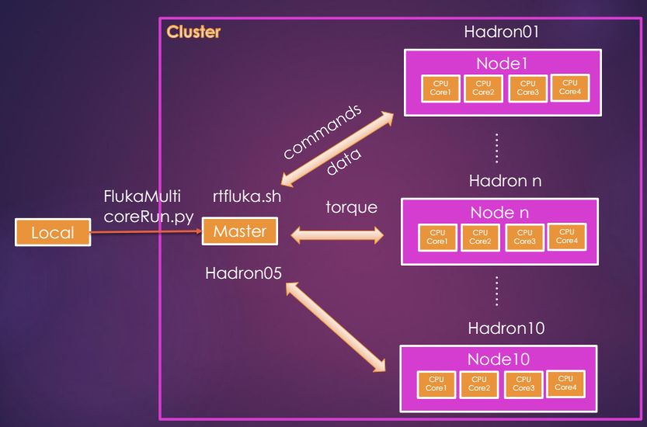
Work flow of Multicore FLUKA
T_Multicore = T0/(4*Node number)

Slide 8
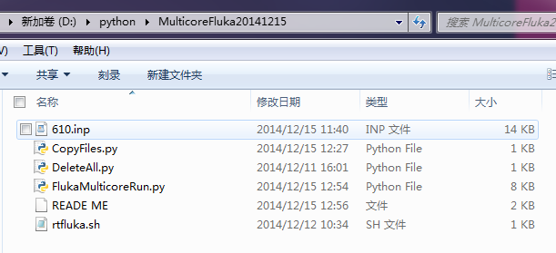
Coding
Python+shell scripts
**.inp: input file
FlukaMulticoreRun.py: The main program
rtfluka.sh: shell scrip, change the random number
CopyFiles.py DeleteAll.py: Auxiliary functions deal with files

Slide 9
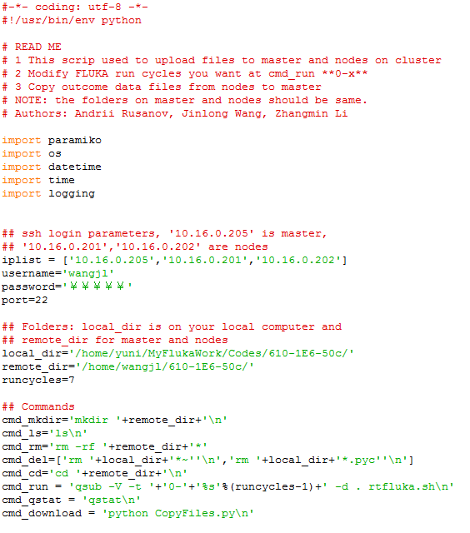
Specification of FlukaMulticoreRun.py
Coding
Variables in rectangle should be changed to your settings

Slide 10
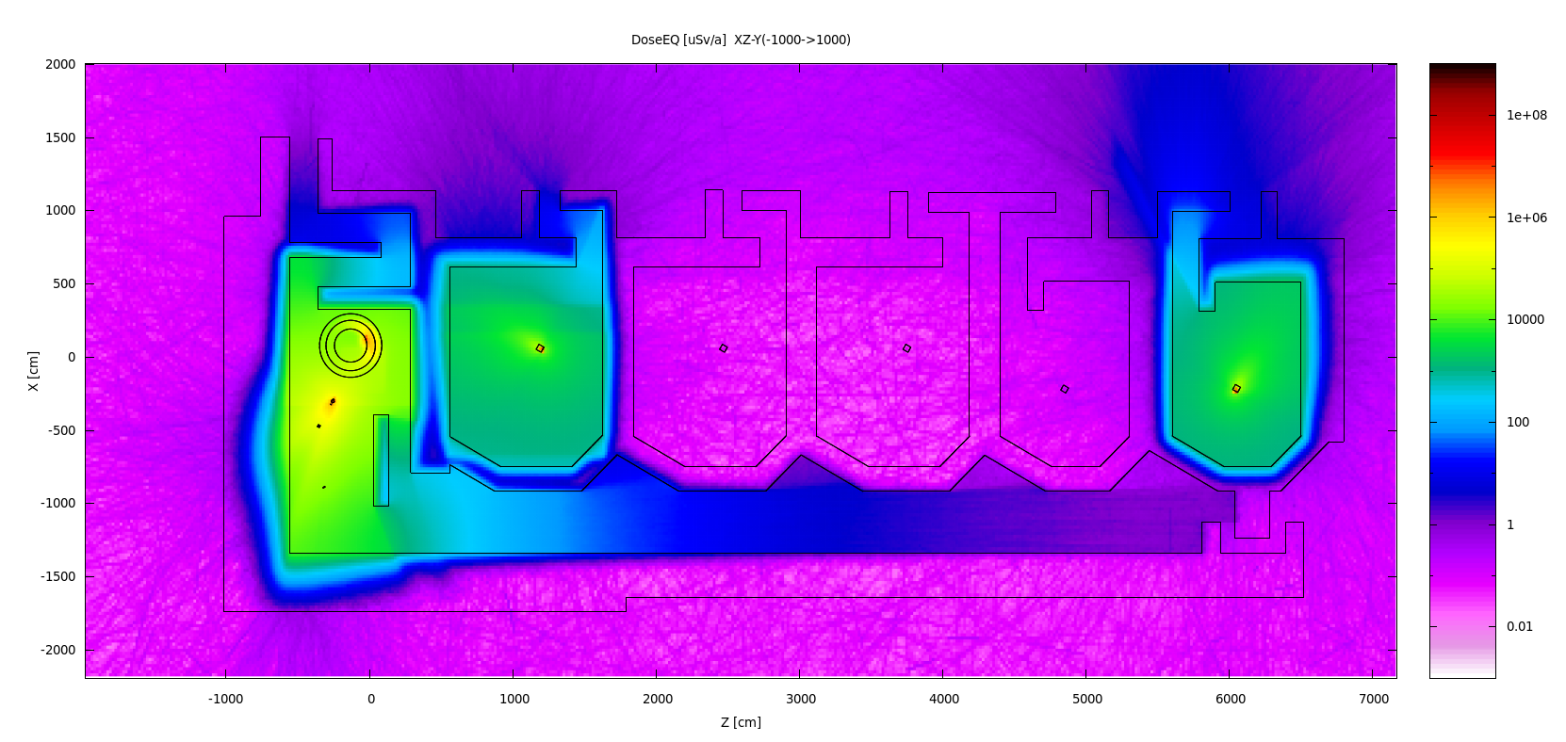
Verification
Multicore FLUKA is proved to be powerful in the radiation work of Sun Yat-Sen Proton Hospital. Dose distribution is smooth and clear. The primary number is 9×10^8 for every source simulation. However, we only spent 1~2 months in total.

Slide 11
3. Complicated model

Slide 12
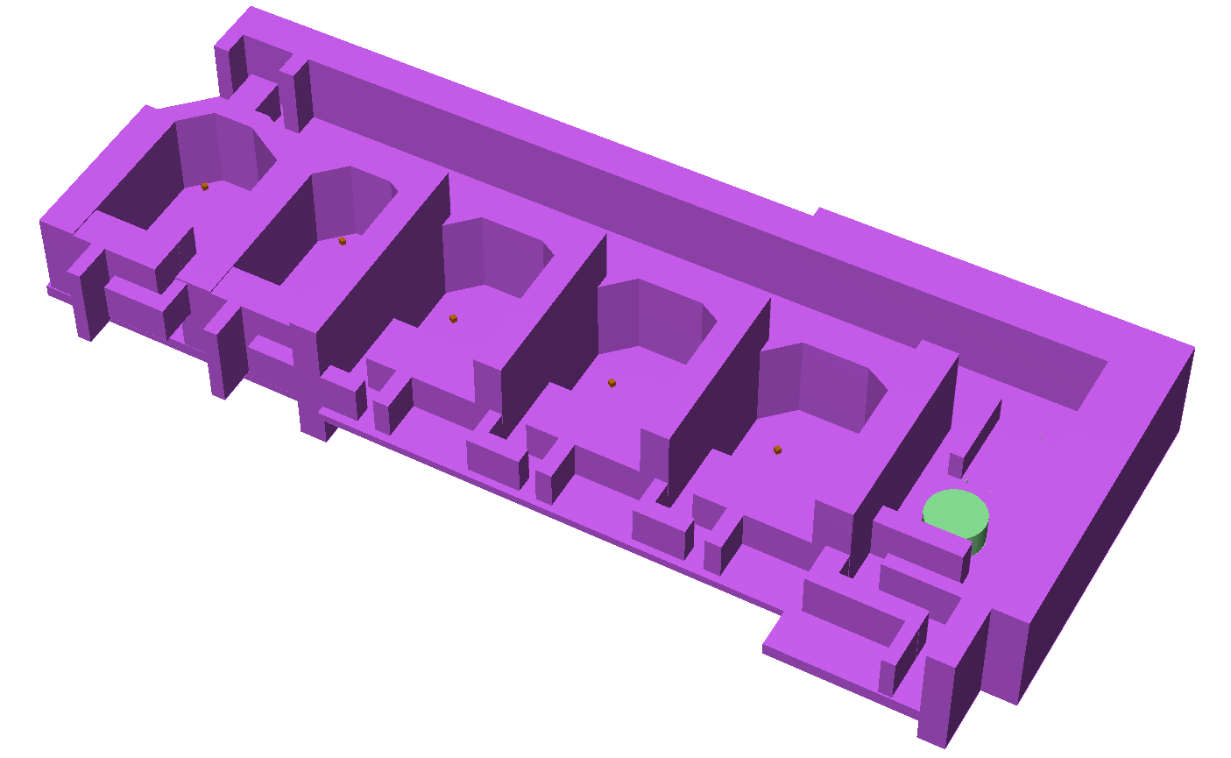
3D SimpleGEO geometry of proton therapy facility
GEO modeling directly by FLUKA is difficult, and the 3D model from CAD software such as NX, Solid works, etc. is different format from FLUKA.
SimpleGEO Advantages:
Like CAD
Easy to create bodies and can rotated to any angle easily
SimpleGEO Disadvantages:
Low accuracy
Directly import complicated SimpleGEO model always cause errors and difficult to figure out the reason.
SimpleGEO model is always used for data visualize

Slide 13
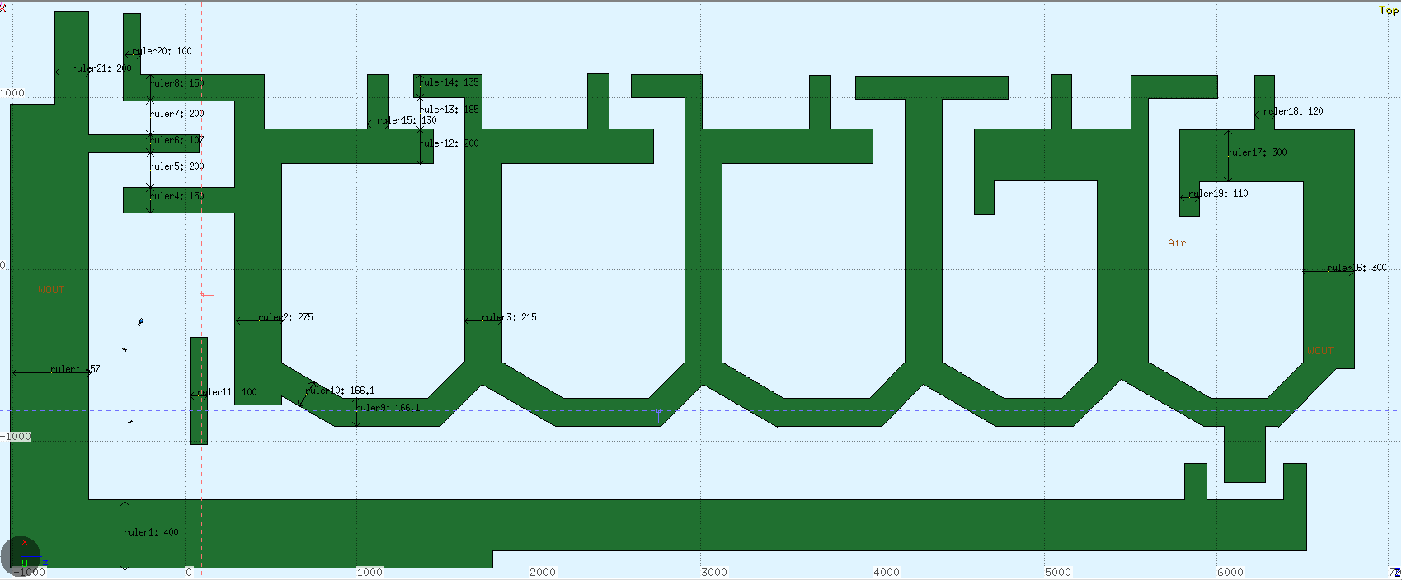
FLAIR geometry of proton therapy facility
FLAIR Advantages:
Higher accuracy
Easy debug
Directly used for FLUKA
SimpleGEO Disadvantages:
More like program
Difficult to create complicated model
Few bodies to choose
Edit FLUKA simulation input file

Slide 14
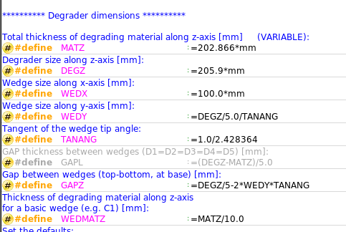
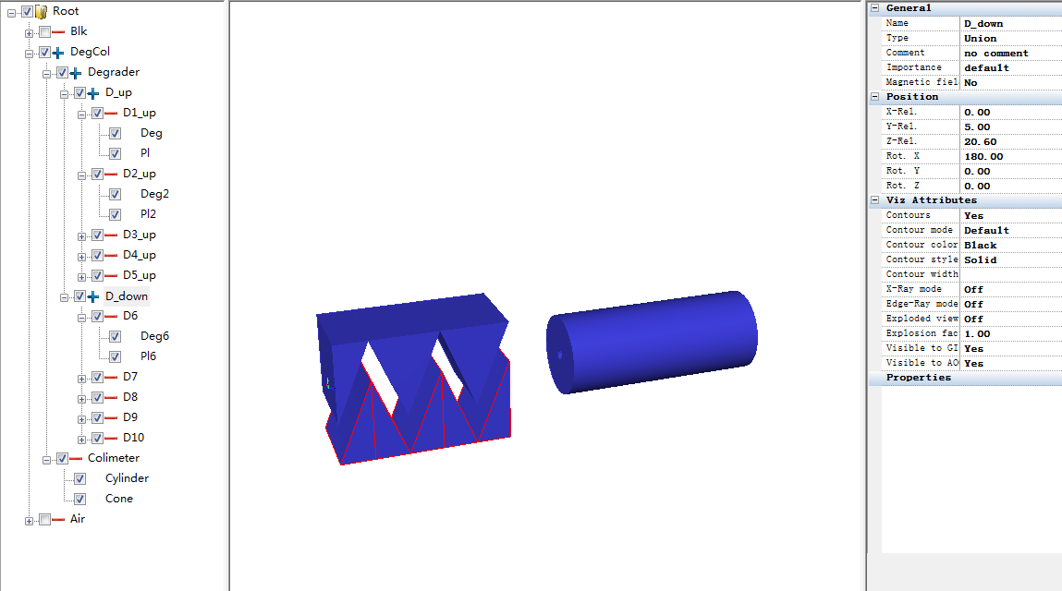
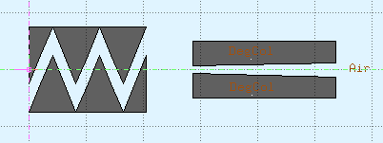
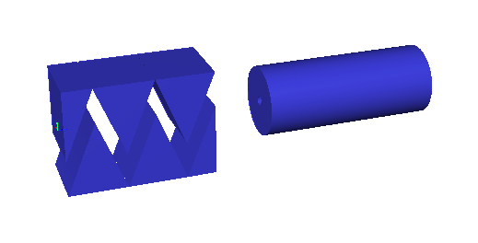
The Degrader Model
FLAIR
Slow but accurate
Many parameters
Simple GEO
Fast but almost can not work in fluka
Easy to rotate
Less parameters

Slide 15
4. Visualized Data Processing

Slide 16
The video display of DaVis3D
DaVis3D is one plugin tools of SimpleGEO, it’s a novel post processing tool for FLUKA output data.

Slide 17
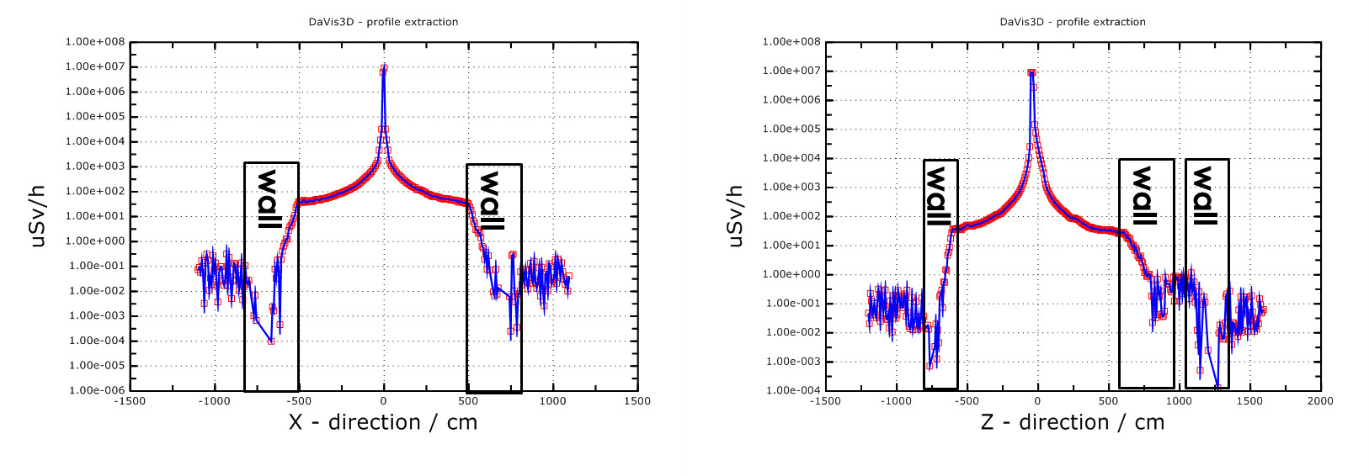
Profiles
Obviously, the shielding wall stop particles
Statistics outside the wall is not as good as inside.
Thus the primary should be increased.

Slide 18
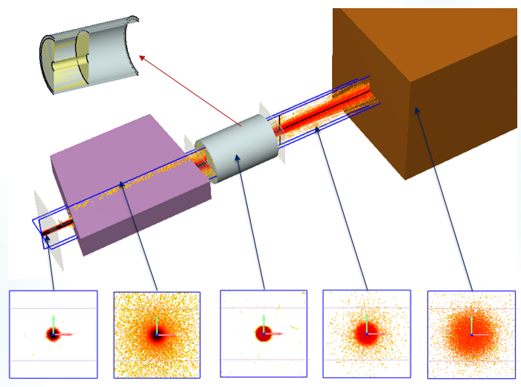
Degrader & collimator and beam shape
Beam size will increase in graphite degrader and decrease after tantalum collimator, increase in target again.

Slide 19
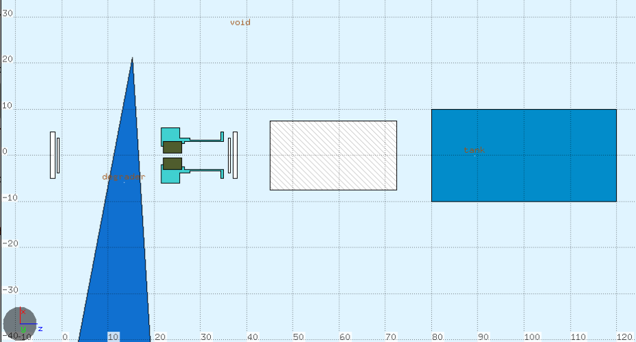
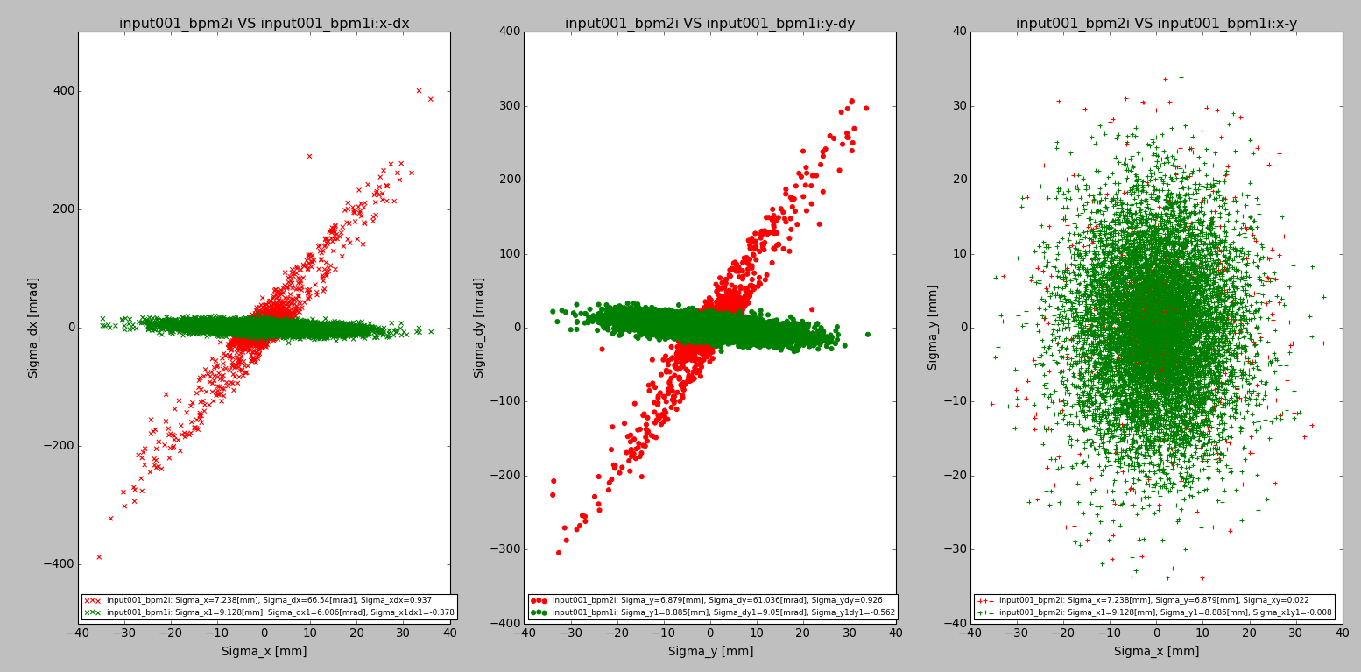
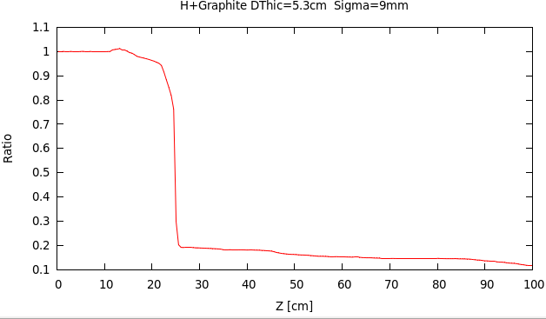
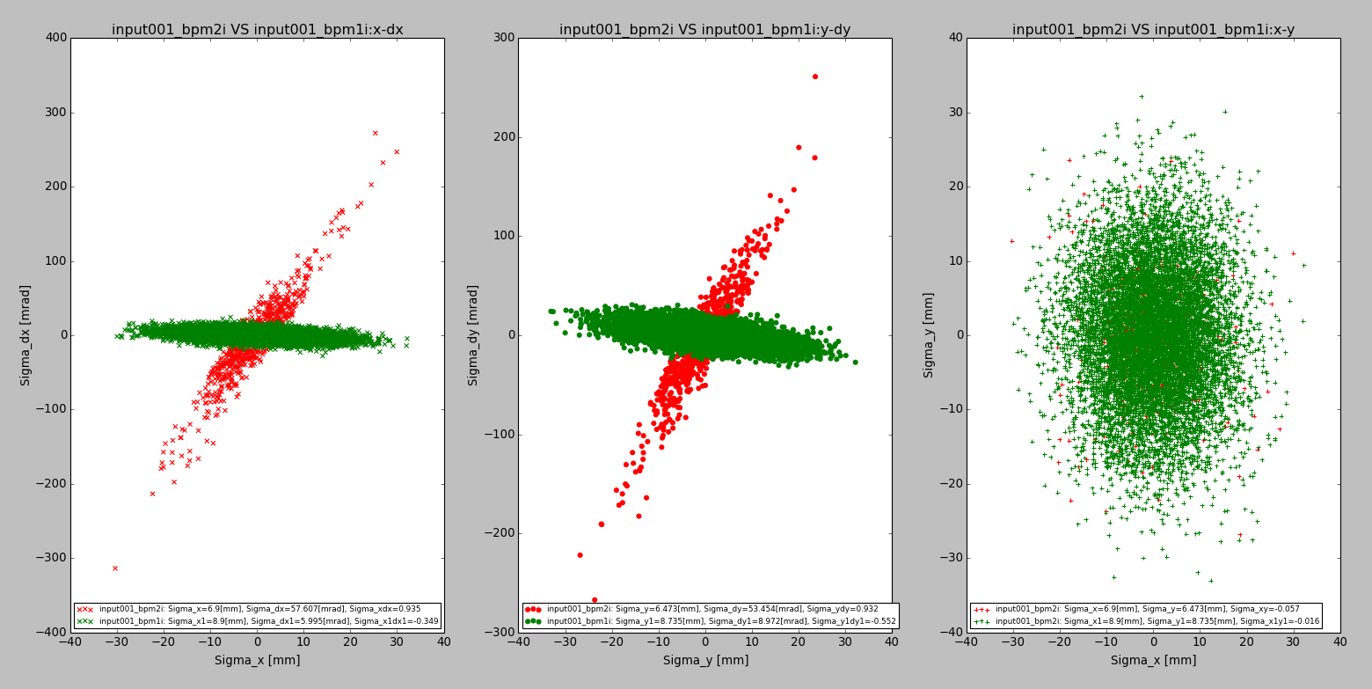
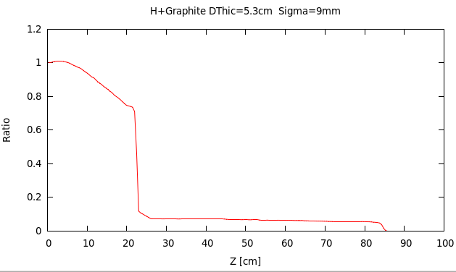
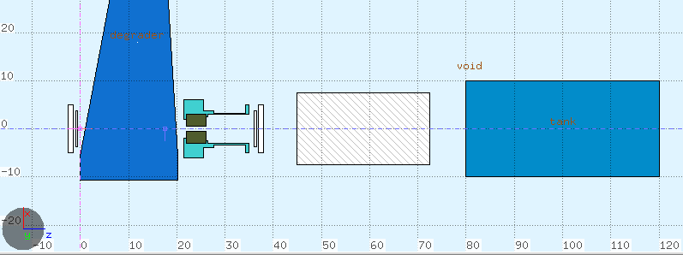
Degrader & collimator and beam shape
DThic=5.3cm
BPM1
BPM2
Energy≈195MeV Efficiency(T2T3) ≈18.26%
Energy≈75MeV Efficiency(T2T3) ≈7.08%
DThic=18.8cm

Slide 20
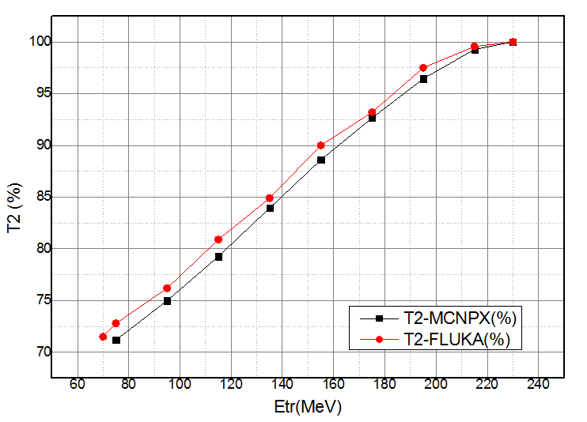
Efficiency
Etr(MeV) | Thick(cm) | T2-MCNPX(%) | T2-FLUKA(%)
230 | 0 | 100.00 | 100.00
215 | 2.3 | 99.28 | 99.56
195 | 5.3 | 96.44 | 97.50
175 | 8.2 | 92.65 | 93.20
155 | 10.8 | 88.60 | 90.00
135 | 13.2 | 83.93 | 84.90
115 | 15.3 | 79.26 | 80.90
95 | 17.15 | 75.00 | 76.20
75 | 18.8 | 71.19 | 72.80
70 | 19 | - | 71.50
T2 simulated by Fluka can consists with MCNP data.

Slide 21
Simple GEO + DaVis3D

Slide 22
5. Data Merge

Slide 23
Fix beam treatment room
Energy(MeV | Weight
230 | 0.176
210 | 0.140
180 | 0.123
160 | 0.313
130 | 0.248
Total | 1.000
Flair can merge data directly from the output for one simulation. But for different sources we need flexible merge tool which can set the weight of source, set color palette, and contour plot. Thus Gun plot is a good choice.

Slide 24
set palette defined ( 1 "grey",2 "magenta", 3 "blue",4 "green",5 "yellow", 6 "red", 7 "cyan")

Slide 25
set palette defined ( 1 "red",2 "green", 3 "dark-blue",4 "blue",5 "honeydew", 6 "dark-pink", 7 "cyan")

Slide 26
There are 16 sources in this work and every source have 5 energy point.

Slide 27
6. Full Beam Line Simulation

Slide 28
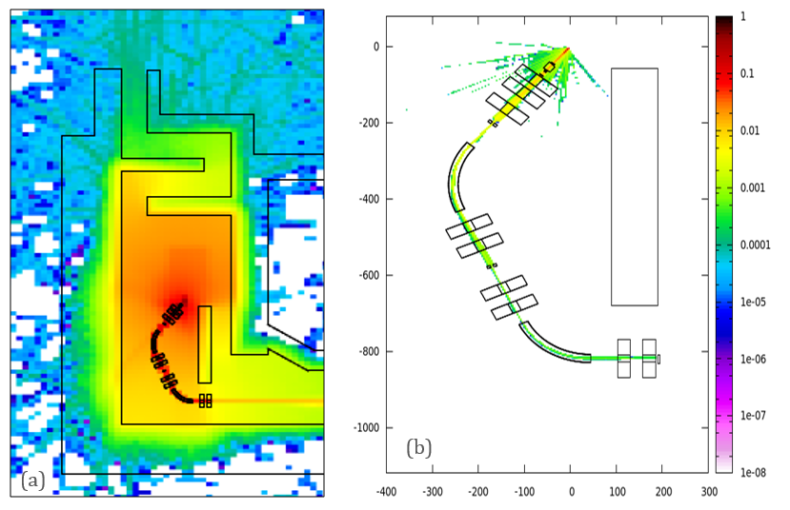
(a) Dose Distribution, (b) Proton Flux Beam Line
The most ideal simulation is to have a full beam line with magnet field in dipole and quadruple, and all the slits are adjusted to the correct efficiency. This method can get an accurate dose distribution

Slide 29
7. Summary

Slide 30
Multicore FLUKA, Flair, SimpleGEO and full beam line are important tool or method for radiation shielding.
Multicore FLUKA can save simulation time and liberate the researcher to focus on physics, it is flexible and can satisfy the user requirement.
Flair and SimpleGEO are used for modeling and visualized data processing.
Full beam line is an ideal method which can present the most accurate radiation distribution, but need more investigation in the future.

