Slide 1
Radiation Protection Aspects for
LCLS-II High Power Electron Accelerator
James C. Liu, Ph.D. and CHP
Deputy Department Head,
Radiation Protection Department
SLAC National Accelerator Laboratory
Menlo Park, CA, USA 94025
Sept. 22-23, 2016 at CSNS, China

Slide 2
Outline
2
  Introduction to LCLS-II Layout and Beam Parameters
  U.S. Regulations and SLAC Requirements
  LCLS-II Safety Aspects (Use EBDs as an Example):
        Prompt Radiation
        Residual Dose Rates
        Groundwater
        Radioactive Air (Concentration and Effluent)
        LCW Heat Exchanger System
  Protection from SCRF Cavity
  Conclusions
  EBD: Electron Beam Dump LCW: Low Conductivity Water

Slide 3
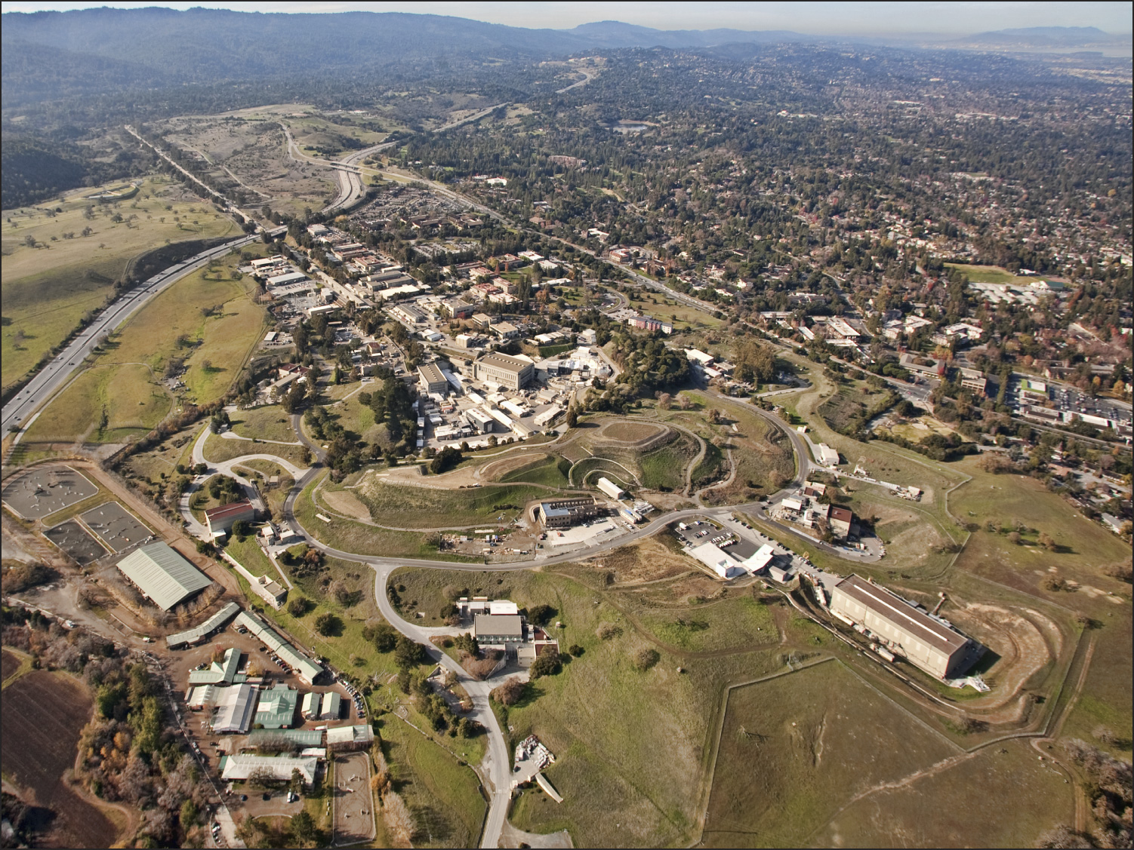



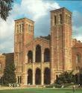
Linac Coherent Light Source (LCLS)
3
First Hard FEL Machine April 2009
Injector at
2-km point
Existing Linac (1 km)
(with modifications)
UCLA
e– Transfer Line (340 m)
Undulator (130 m)
Near Experiment Hall
X-ray Transport Line (200 m)
Far Experiment Hall
Notes:
Since October 2009 LCLS has provided x-rays to users
Electron source is the original SLAC linac
One fixed gap undulator
X-ray energy, pulse length, is set by electron beam
Six experimental stations
One or two experiments scheduled at a time

Slide 4

New Injector and
New Superconducting Linac
4
New Cryo Plant
Linac Coherent Light Source
Existing Bypass Line
LCLS 2009
LCLS-II 2020
New Transport Line
Two New Undulators
Replacing the Existing One
Near Experiment Hall
Repurpose Existing Experimental Stations
Far Experiment Hall

Slide 5
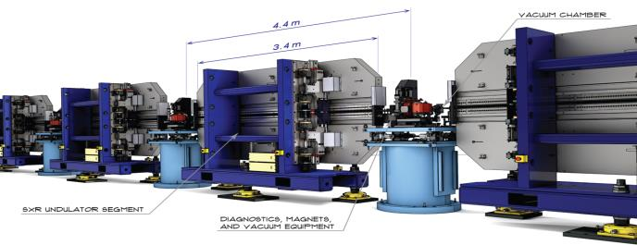
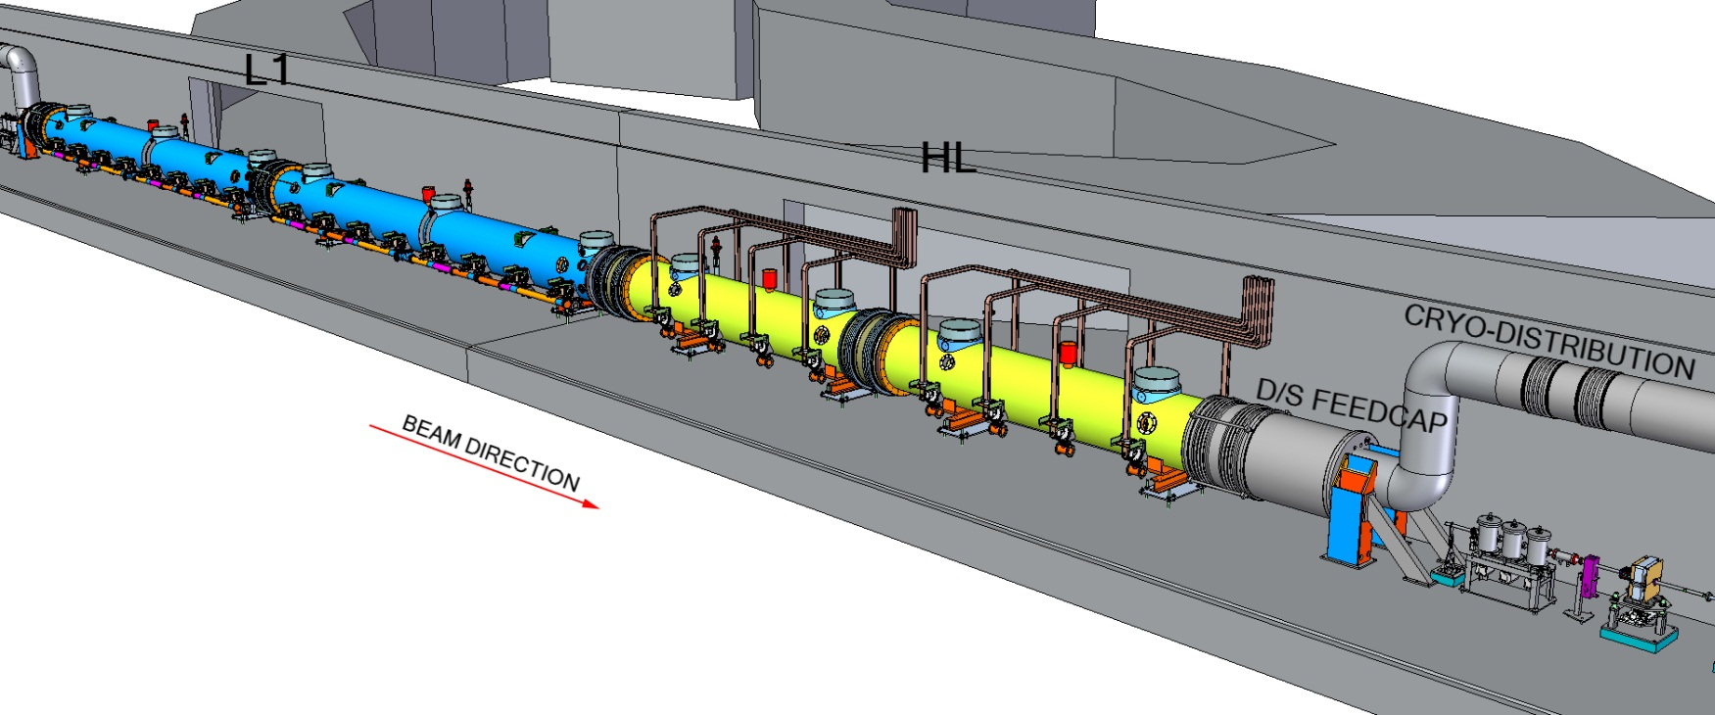
LCLS-II Layout and Beam Parameters
5
LCLS-I Linac
3-15 GeV
1 kW
0.2-1.3 keV (1 MHz)
LCLS-II Injector &
3 SCRF Sections
proposed
FACET-II
0.1-20 keV* (120 Hz)
Sec. 11-20
Sec. 21-30
SXU
L2
L3
HXU
0.25 GeV
1.6 GeV
4.0 GeV
1 MW, 1 MHz
BSY
(Beam Switch Yard)
1-25 keV (120 Hz)
250 kW Dump
1-5 keV (1 MHz)
4 Beamlines
LCLS Cu Linac
LCLS-II Hard
LCLS-II Soft
LCLS-II Dump
Kickers
Septums
BEAM DIRECTION
Beam Split by Kickers and Septums

Slide 6
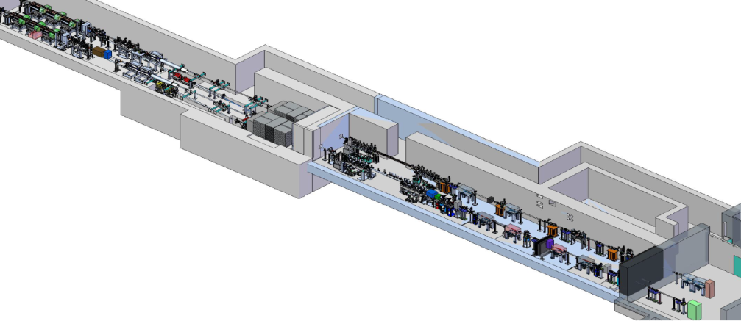
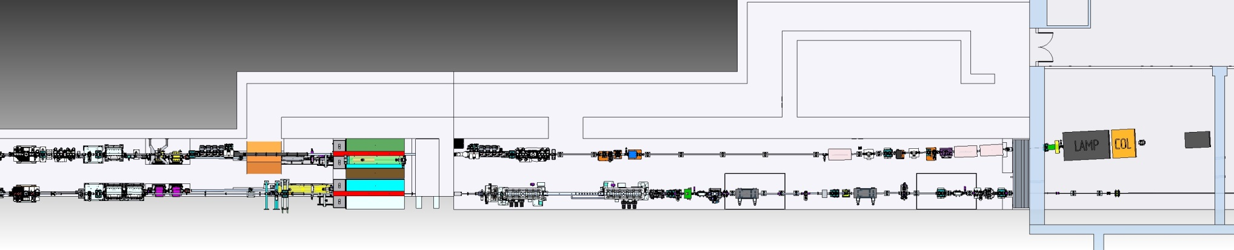
LCLS-II Layout: EBD, FEE and NEH
6
FEL Stopper Sets
2 Electron Beam Dumps
(2 EBDs, 2x120 kW)
FEE
NEH
undulators
FEE HALLWAY AND FEE MAZE
SXR
HXR
EBD
FEE
NEH HUTCH 1

Slide 7
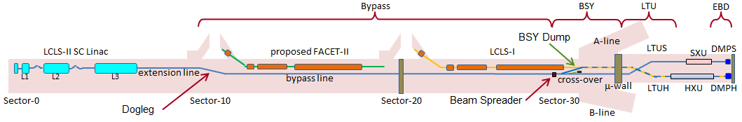
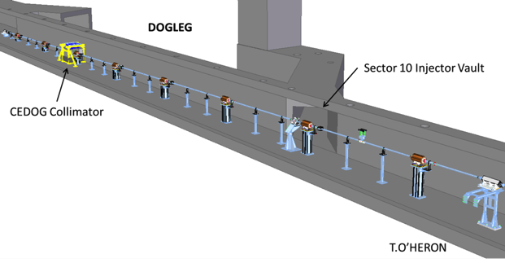
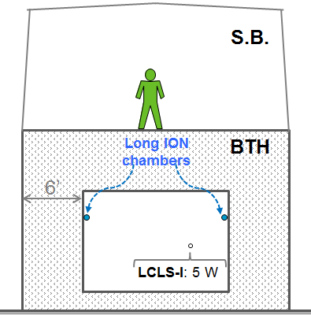
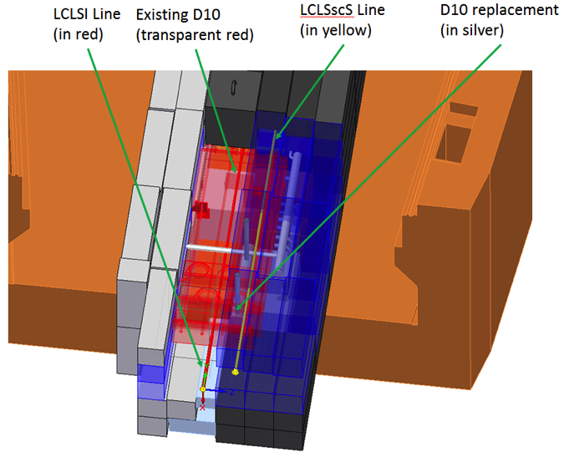
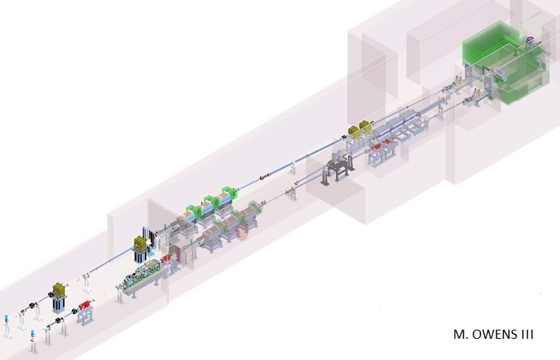
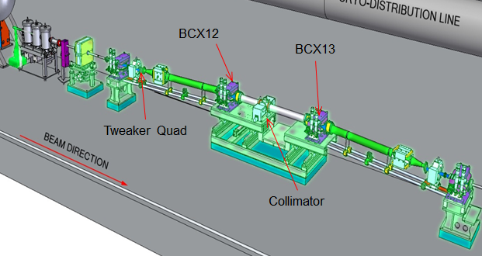
LCLS-II Main Radiation Source Terms
7
250-kW BSY Dump inside Muon Shield
Aboveground BTH
Halo Collimators & SCRF along Linac
Two 120-kW EBDs
BYD

Slide 8
LCLS-II Electron Normal Beam Losses
8
LCLS-II-2.7-PR-0079-R1 by J. Welch; RSC16-02 June 2016
Area | Linac-BSY | BSY | BTH | Dump Lines
Beamline Component | Halo Collimators R1 estimate* | Dump | Two 225-m-long beam lines | BYD (0.1% of EBDs | Two EBDs
Maximum Power for worker dose impacts | 310 W (32 max.) | 250 kW | 450 W (1 W/m) | 2x120 W | 2x120 kW
Average Power (5000 h/y with use factor) for public/environmental impacts | 70 W (13 max.) | 90 kW | 450 W (1 W/m) | 75 W | 27 kW + 48 kW
* R0 estimates: average power 3000 W along ~30 halo collimators of SC Linac
LCLS-II 1 MW versus LCLS-I 1 kW
LCLS-II radiation protection for public, environment and workers is more challenging, considering now that there are less safety margin and the constraints of building LCLS-II on existing LCLS-I configuration (Monte Carlo calculations and optimization are very important)

Slide 9
9
Radiological Requirements for Worker Protection
 | Prompt Radiation | Residual Dose Rates | Radioactive Air Concentration | Ozone
Federal Limit | Department of Energy (DOE) 10 CFR 835 DOE Order 420.2c Radiation Worker (RWT): 50 mSv/y General Employee (GERT): 1 mSv/y ALARA |  |  | OSHA 29 CFR 1910.1000 PEL = 0.1 ppm
SLAC Design Limit | Shielding Design RWT ≤ 5 µSv/h GERT ≤ 0.5 µSy/h | Non-Radiation Area ≤ 50 µSv/h | Air Immersion ≤ 1 DAC (25 µSv/h) | PEL 0.1 ppm
 | 1) ES&H Manual, Chapter 9 “Radiological Safety” 2) Radiation Protection Program Manual and Procedures 3) Radiation Safety Systems: Technical Basis Documents
For ¹¹C, ¹³N and ¹⁵O, DOE Immersion 1 DAC = 0.22 MBq/m³
For ⁴¹Ar, DOE Immersion 1 DAC = 0.11 MBq/m³
Notes:
1DAC-h= 2.5 mrem
2 DAC-h- RA limit

Slide 10
10
Radiological Requirements for Public/Environment Protection
 | General Program | Direct Radiation | Radioactive Air Effluent | Ground Water | Waste Water
Federal |  |  | 40 CFR 61H (NESHAPs) | 40 CFR 141 (NPDWR) | 10 CFR 20K
State & Local |  |  | BAAQMD | RWQCB Order | CCR17, SBSA Permit
DOE Order 458.1 Limit | 1 mSv/y to MEI ALARA |  | 0.1 mSv/y to MEI (Maximum Exposed Individual of the Public) | MCL for ³H: 740 Bq/L | ³H: 185 GBq/y All other radionuclides: 37 GBq/y to sewer
SLAC Design Limit |  | 50 µSv/y to MEI | 1 µSv/y MEI for each air release point so that no continuous monitoring is needed | EPA Detection Limit of 37 Bq/L ³H | LCW discharge
 | 1) ES&H Manual, Chapter 9 “Radiological Safety” 2) Radiological Environmental Protection Program Manuals and Procedures 3) Radiation Safety Systems: Technical Basis Documents

Slide 11
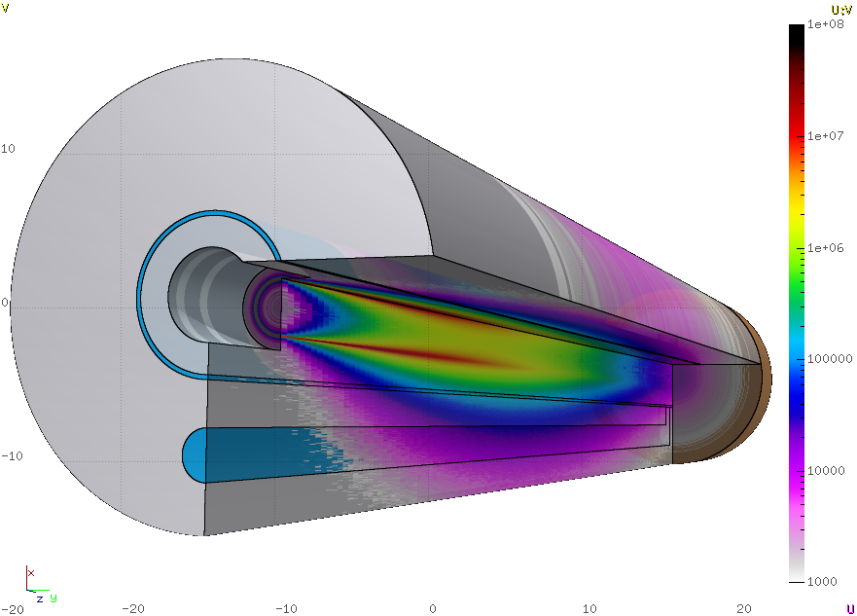
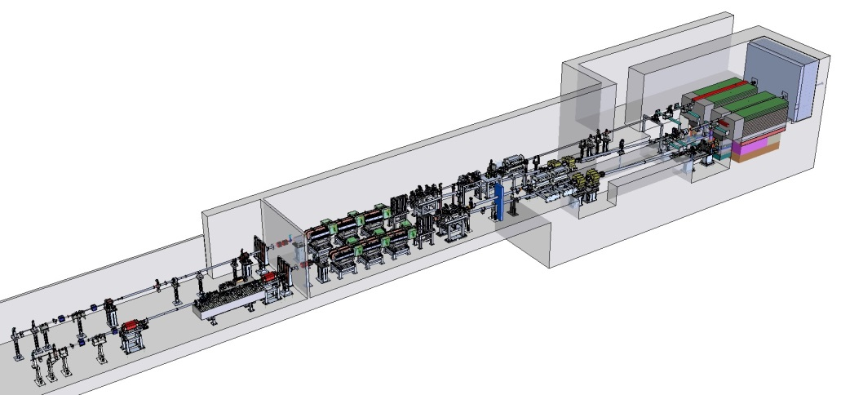
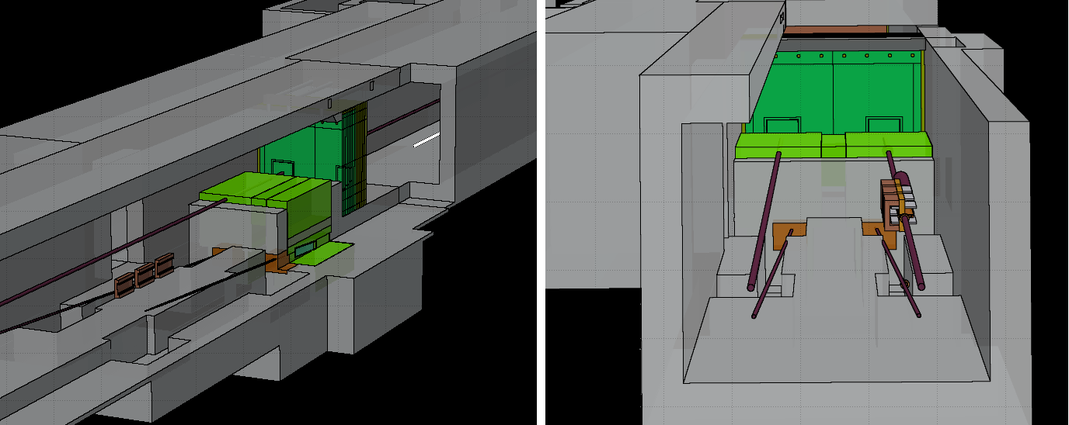
  LCLS-II Safety Aspects: Example of 2 EBDs
11
2 EBDs
FEE & NEH
Prompt Radiation in NEH
East End of Undulator Hall
Residual Dose Rate
Groundwater
Radioactive Air IN/OUT
Extensive Dump Shielding (dictated by GW, which also address other hazards)
LCW for EBDs
Bend Magnets
(BYDs)
FLUKA used for this complex geometry

Slide 12
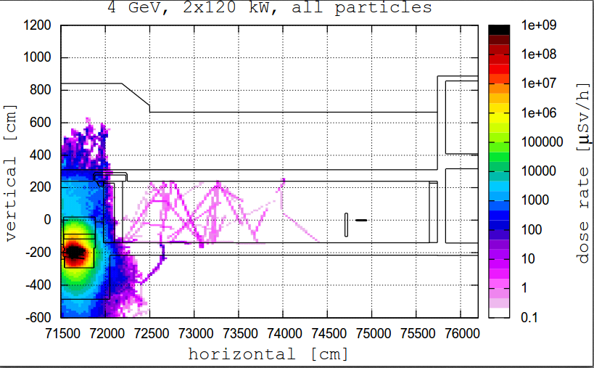
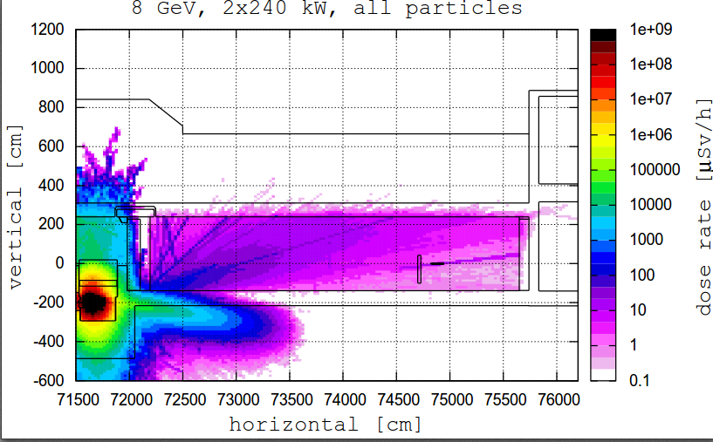

Prompt Radiation to FEE and NEH
12
2 x 120 kW at 4 GeV
2 x 240 kW at 8 GeV
NEH
FEE
Dump shielding for groundwater protection helps reduce prompt
FLUKA-calculated prompt radiation in NEH within the limit of 0.5 µSv/h (1 mSv/y) for users
  FEE is not occupiable
Muon radiation dominant in 8 GeV upgrade case
Very high radiation level around dump creates material damage issue

Slide 13
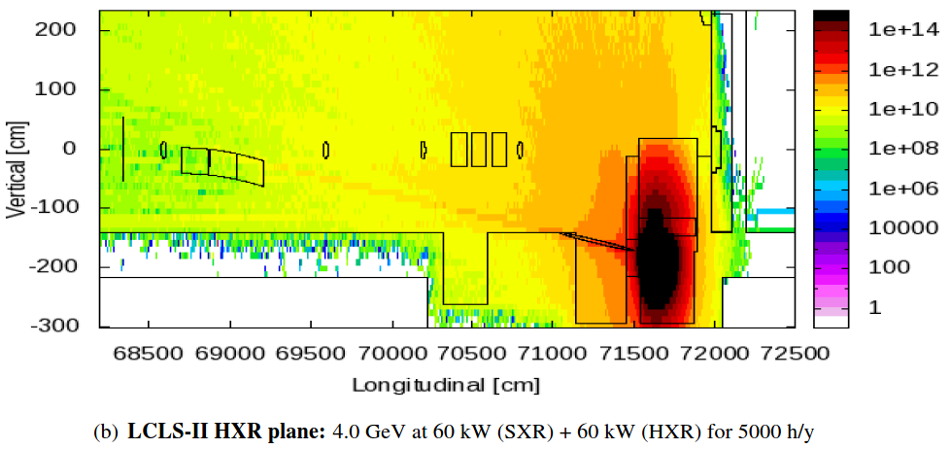
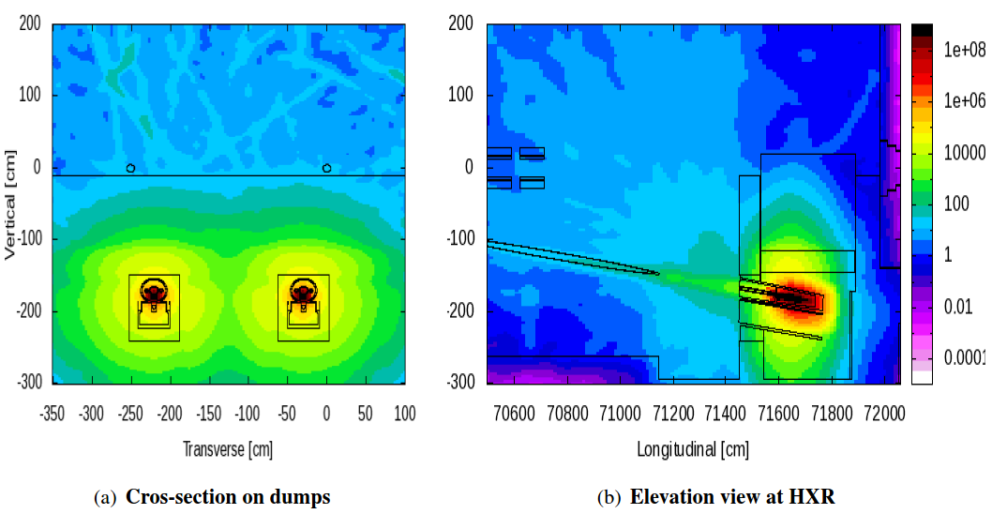
  Radiation Damage to Materials near EBDs
13
1-MeV Equivalent Neutron Fluence
Electronics are of concern:
Limit: 1E13 n/cm²
Limit: 100 Gy
Absorbed Dose

Slide 14
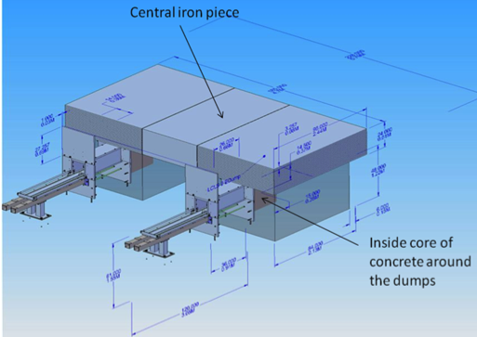
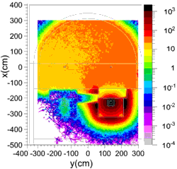
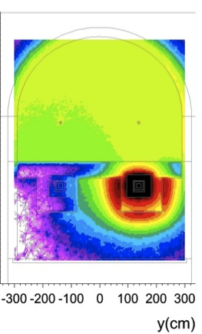
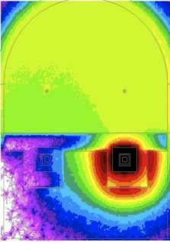

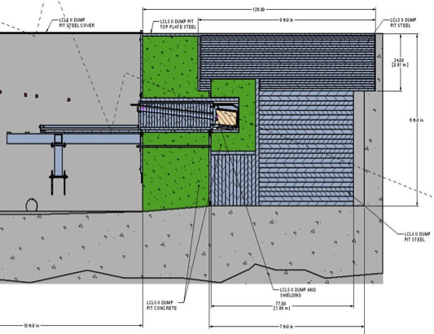
EBD Shielding for Residual Dose Rate
14
Changes required to dump pit design (3D view and elevation view)
Residual dose rates above one dump for T_{i}=30 days, T_{c}=1h, 5kW
Before Changes
After Changes
[μSv/h]
50
  Reduce residual dose rate from 500 μSv/h to 50 μSv/h (Non-Radiation Area) by Inserting a 20 cm concrete shell around the dump to absorb neutrons in the core lowering activation of the concrete tunnel
  Service of dumps that are highly activated!

Slide 15
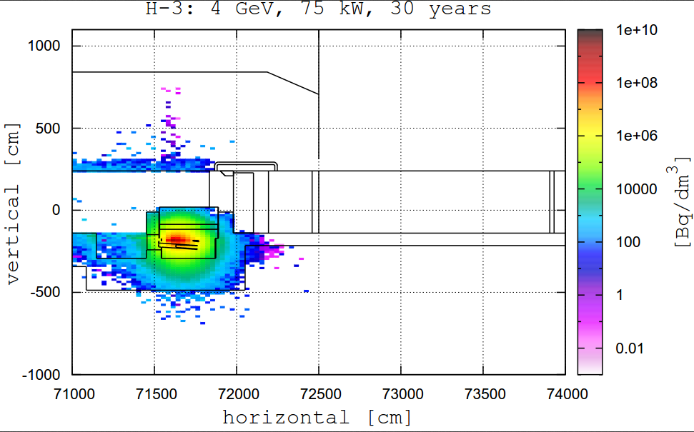
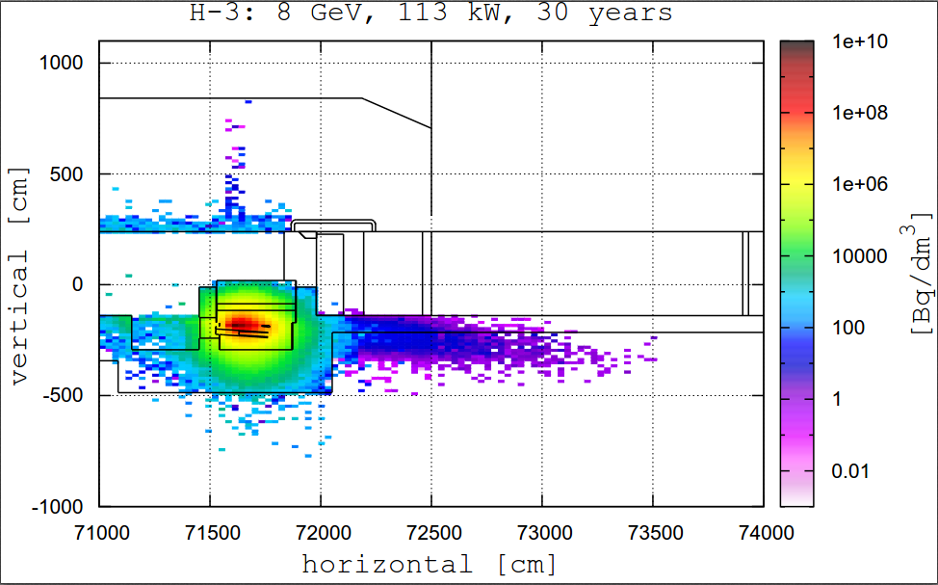
  Groundwater Protection: Tritium Production in Soil around EBD Enclosure
15
75 kW at 4 GeV
113 kW at 8 GeV
4 GeV baseline: saturation activity of 40 Bq/dm³ of ³H in soil
8 GeV upgrade:
  4 times higher H-3 production in soil in forward direction
  2 times higher H-3 production in soil on side of the dumps

Slide 16
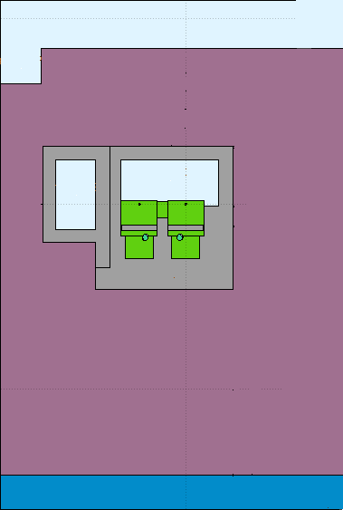
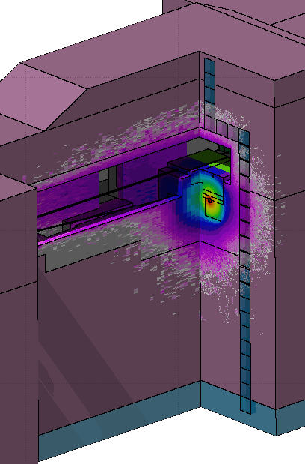
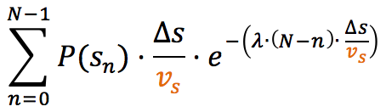
Groundwater Protection for 2 EBDs
16
membrane
  ³H is the main concern due to high leachability from soil to water
  For 43 kW over a year, most irradiated 1 m³ rainwater path, worst drift speed, no diffusion and no dilution → 44 Bq/L of ³H (EPA MCL = 740 Bq/L)
  Geomembrane will reduce rainwater flux
10 m
  ³H in ground water is expected to be below EPA detection limit of 37 Bq/L.
Groundwater table 10 m below dump enclosure
Minimal direct activation
Notes:
Activation from direct path is negligible

Slide 17
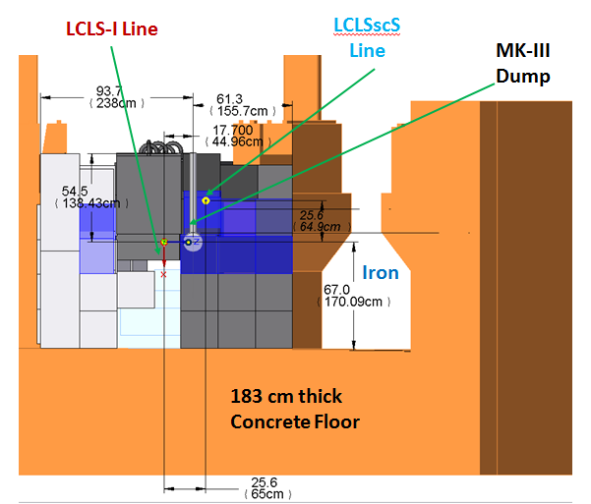
Groundwater Protection for 2 EBDs and BSY Dump
17
  BSY Dump with 1.7 m iron and 1.8 m concrete floor (52 kW)
  2 EBDs (43 kW)
Groundwater table below dump enclosure
Small direct activation
Saturation Activity ³H (Bq/L) | BSY Dump | 2 EBDs
Direct Activation in GW | 4 | 0
Indirect Rain Path to GW | 22 | 44
Geomembrane | Recommended | Required

Slide 18
18
LCLS-II Radioactive Air and Ozone Concentrations
1-day irradiation and no decay | Linac Halo Collimators | BSY Dump | BYD Magnets | Two EBDs | half-life (min)
Beam Power (kW) | 0.001 (reference) | 240 | 0.24 | 2x120
Local Shielding | No | Yes | No | Yes
¹¹C (Bq/m³) | 1.28E+02 | 6.94E+05 | 4.08E+03 | 3.40E+04 | 20.4
¹³N (Bq/m³) | 2.24E+02 | 1.53E+06 | 5.52E+03 | 1.02E+05 | 10.0
¹⁵O (Bq/m³) | 2.40E+02 | 1.00E+06 | 5.90E+03 | 4.53E+04 | 2.0
⁴¹Ar (Bq/m³) | 1.03E+02 | 1.65E+06 | 1.21E+04 | 6.07E+03 | 109.3
Sum (Bq/m³) | 6.94E+02 | 4.88E+06 | 2.76E+04 | 1.88E+05
Ozone (ppm) | 0.0007 | 0.38 | 0.046 | 0.0005 | 34.7
Calculated with FLUKA (dominated by air gaps between dump and shielding)
For ¹¹C, ¹³N and ¹⁵O, DOE Immersion 1 DAC = 0.22 MBq/m³
Ozone G value = 10, OSHA ozone PEL = 0.1 ppm

Slide 19
19
Dose to Public MEI from Radioactive Air Effluent
 | Linac Halo Collimators | BSY Dump | BYD | 2 EBDs
Average Power (kW) | 0.001 (reference case) | 90 with shielding | 0.075 | 75 with shielding
Air Exchange per Day | 1 | 8 | 1 | 1
MEI Location | MEI #02 (Sand Hill Rd.) | MEI #16 (SLAC Guest House) | MEI #08 (East End close to SLC) | MEI #08 (East End close to SLC)
Distance to MEI | 790 m North West from S4 | 420 m North East | 550 m East | 550 m East
¹¹C (µSv/y) | 9.3E-6 | 6.4E-2 | 1.0E-4 | 5.7E-4
¹³N (µSv/y) | 1.3E-5 | 1.1E-1 | 1.1E-4 | 1.4E-3
¹⁵O (µSv/y) | 3.9E-6 | 2.2E-2 | 5.4E-5 | 2.7E-4
⁴¹Ar (µSv/y) | 1.4E-5 | 1.9E-1 | 5.2E-4 | 1.7E-4
Total (µSv/y) | 3.9E-5 | 3.9E-1 | 7.9E-4 | 2.4E-3
Calculated with EPA-approved CAP88 code (annual NESHAPs report):
DOE/EPA dose limit: 100 µSv/y to public MEI
1 µSv/y to public MEI from each air release point so that no continuous air monitoring is required

Slide 20
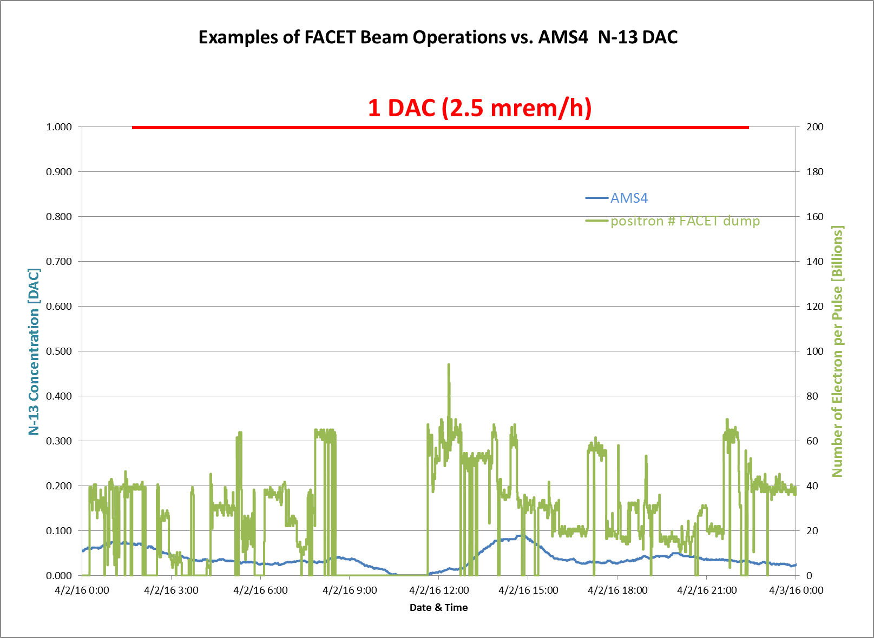
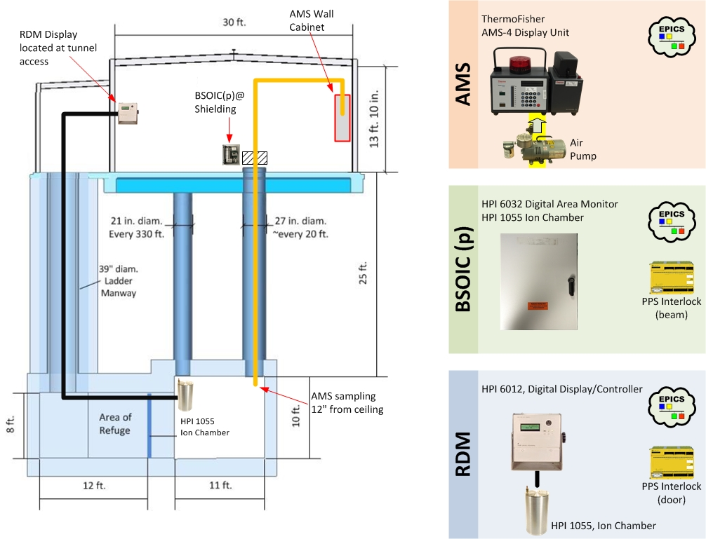
Deployment of AMS, RDM and Interlocked Detector in Linac
20
AMS
BSOIC
Eberline AMS-4 field-tested in Linac
AMS-4 detection limit is 0.02 DAC for ¹³N
Equivalent to MEI dose of 0.07 µSv/y for BSY dump (the worst case)
RDM

Slide 21
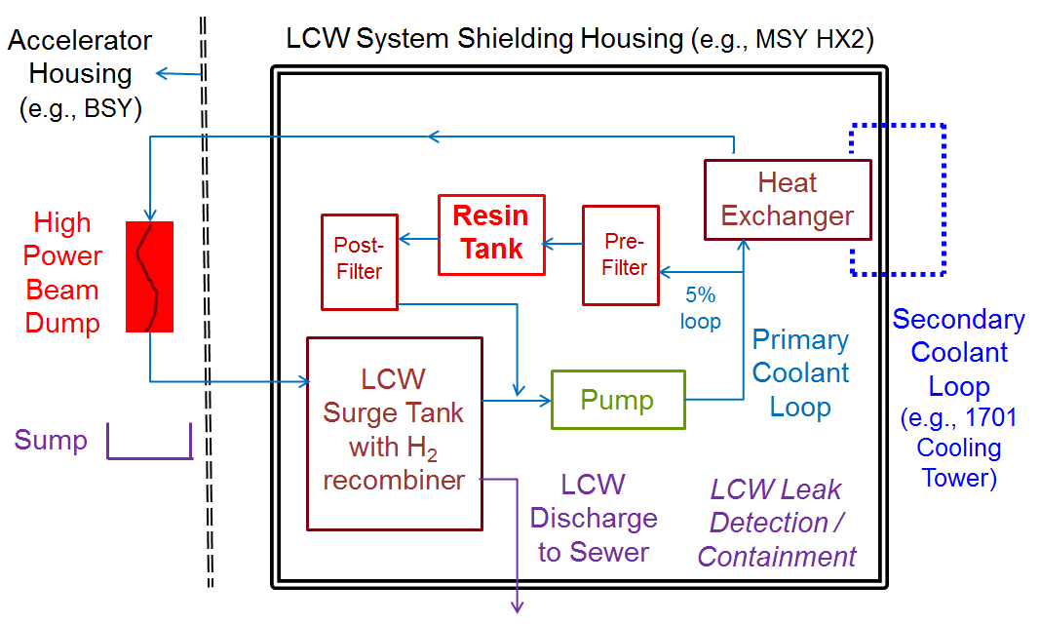
    LCW Heat Exchanger System for High Power Dumps
21
LCLS-II-1.2-PR-0211-R0
by J. Liu
  Radiological Hazards:
        ¹⁵O (2-min half-life) and ¹¹C (20-min half-life) in LCW; decay after beam off
        ³H (12.3-yr half-life, beta emitter) remained in LCW
        Erosion/corrosion products (²²Na, ⁵⁴Mn, ⁶⁰Co, ⁶⁵Zn, etc.) and ⁷Be in resin/filters
        Potential leakage of radioactive LCW
        Explosion from H₂ build-up in surge tank and release of radionuclides
Notes:
There are over 150 site –wide separate LCW systems cooling various components: magnets, halo and protection collimators, dumps (80-100)
BAS-II, BSY Collimators (HX1), SL10, SL30 (HX2), BDE, NFF, SFF systems
Historically, during high power operations (A-line, SLC), ~35 systems have been radioactive
Require RP coverage –
All resin bottles, filters need to be monitored
Plans are to use HX2 for LCW for a new high power BSY dump and the two EBD
LCLS-I operations,
Historically

Slide 22
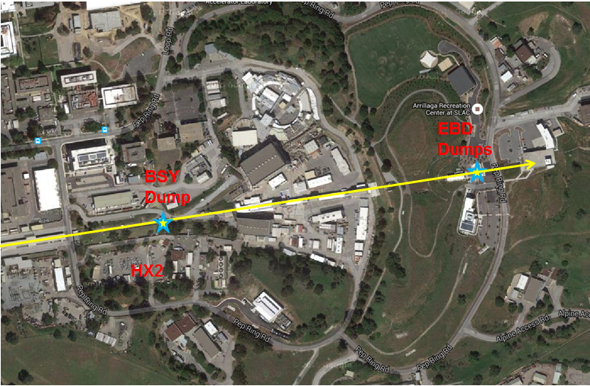
LCW HX2 System for BSY Dump and 2 EBDs
22

Slide 23
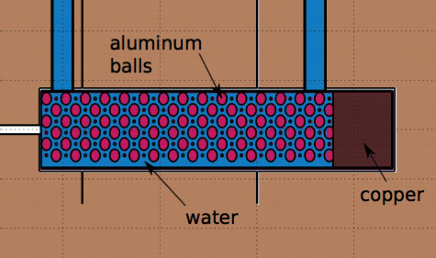
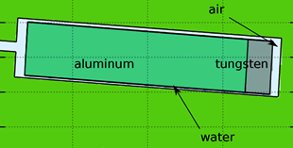
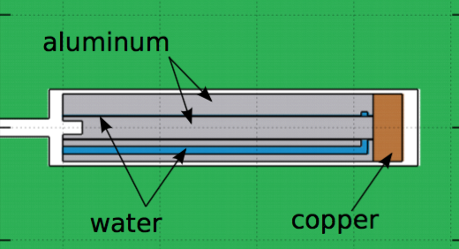
Induced Activity in LCW for LCLS-II Dumps
23
Induced Activity and Impact on LCW System Design for Three Types of Dumps | BSY Dump (volume-cooled) | 2 EBD Dumps (surface-cooled) | 3 CEBAF Dumps (internally-cooled)
³H saturation activity (185 GBq/y discharge limit to sewer) | 510 GBq @ 90 kW average power | 3,3 GBq @ 76 kW average power | EBDs: 11 GBq @76kW BSY: 18.5 GBq @90kW
⁷Be saturation activity @ average power | 74 GBq @ 90 kW | 0.44 GBq @ 76 kW | EBDs: 1,5 GBq @76kW BSY: 2.4 GBq @90kW
¹⁵O, ¹¹C, ¹³N saturation activity @ 240 or 250 kW maximum power; 1 TVL = 17 cm concrete | 2850 GBq ¹⁵O, 703 GBq ¹¹C & 0.56 Sv/h at 1 m | 18.5 GBq ¹⁵O, 3.7 GBq ¹¹C & 3.5 mSv/h at 1 m | 222 GBq ¹⁵O, 48 GBq ¹¹C & 42 mSv/h at 1 m
²²Na, ⁵⁴Mn, ⁶⁰Co, ⁶⁵Zn Maximum activities estimated from historical data 1 TVL = 23 cm concrete | 5 mSv/h at 1 m from two 400-L resin tanks (= 15 GBq ⁶⁰Co) | 0.05 mSv/h at 1 m from two 400-L resin tanks (= 0.15 GBq ⁶⁰Co) | 0.4 mSv/h at 1 m from two 400-L resin tanks (= 1.2 GBq ⁶⁰Co)

Slide 24
Radiological Controls of HX2 LCW for Dumps
24
Concrete (cm) |  | 3 CEBAF Dumps
¹⁵O/¹¹C In LCW | Wall | 48
 | Ceiling | 60
Resin Activity | Wall | 50
 | Ceiling | 50
0.4 mSv/h
@ 1 m resin tanks
42 mSv/h @ 1 m ¹⁵O/¹¹C in
surge tanks
Shielding Limit: 5 µSvh
  Radiological Controls:
      Concrete housing and shielding for underground piping
      Access controls to housing with interlocked detectors
      High capacity resin tanks with efficient exchange and disposal features
      Hydrogen recombiner to eliminate H₂ explosion
      Containment of LCW leakage and management of LCW discharge with ³H

Slide 25
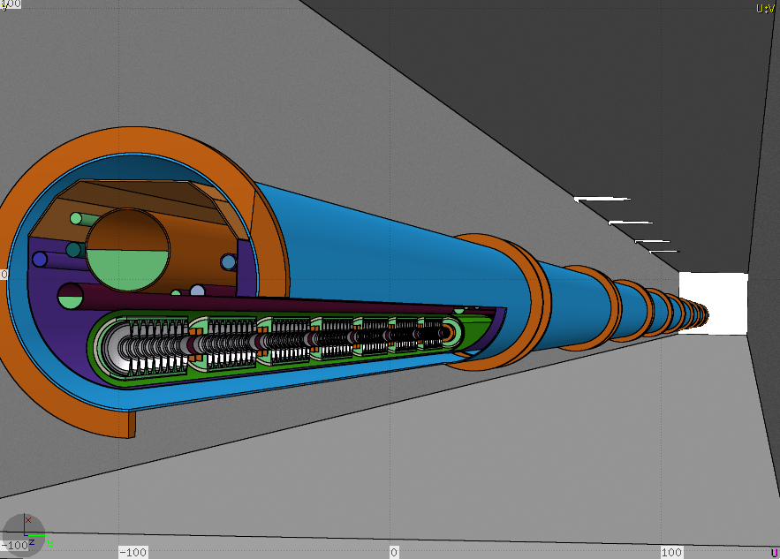
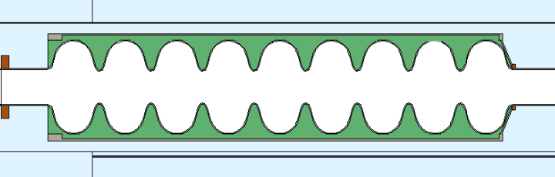
Radiation from Superconducting RF Cavities (SCRF)
25
3D Rendering of FLUKA input model
Quadrupole between 2 Cryomodules (16 MV/m)
SCRF Cavity
8 Cavities with nine cells each
M. Santana et Al. "Studies of Radiation Fields from LCLS-II Super Conducting RF Cavities”, Int. J. of Modern Physics, TBP 2015

Slide 26
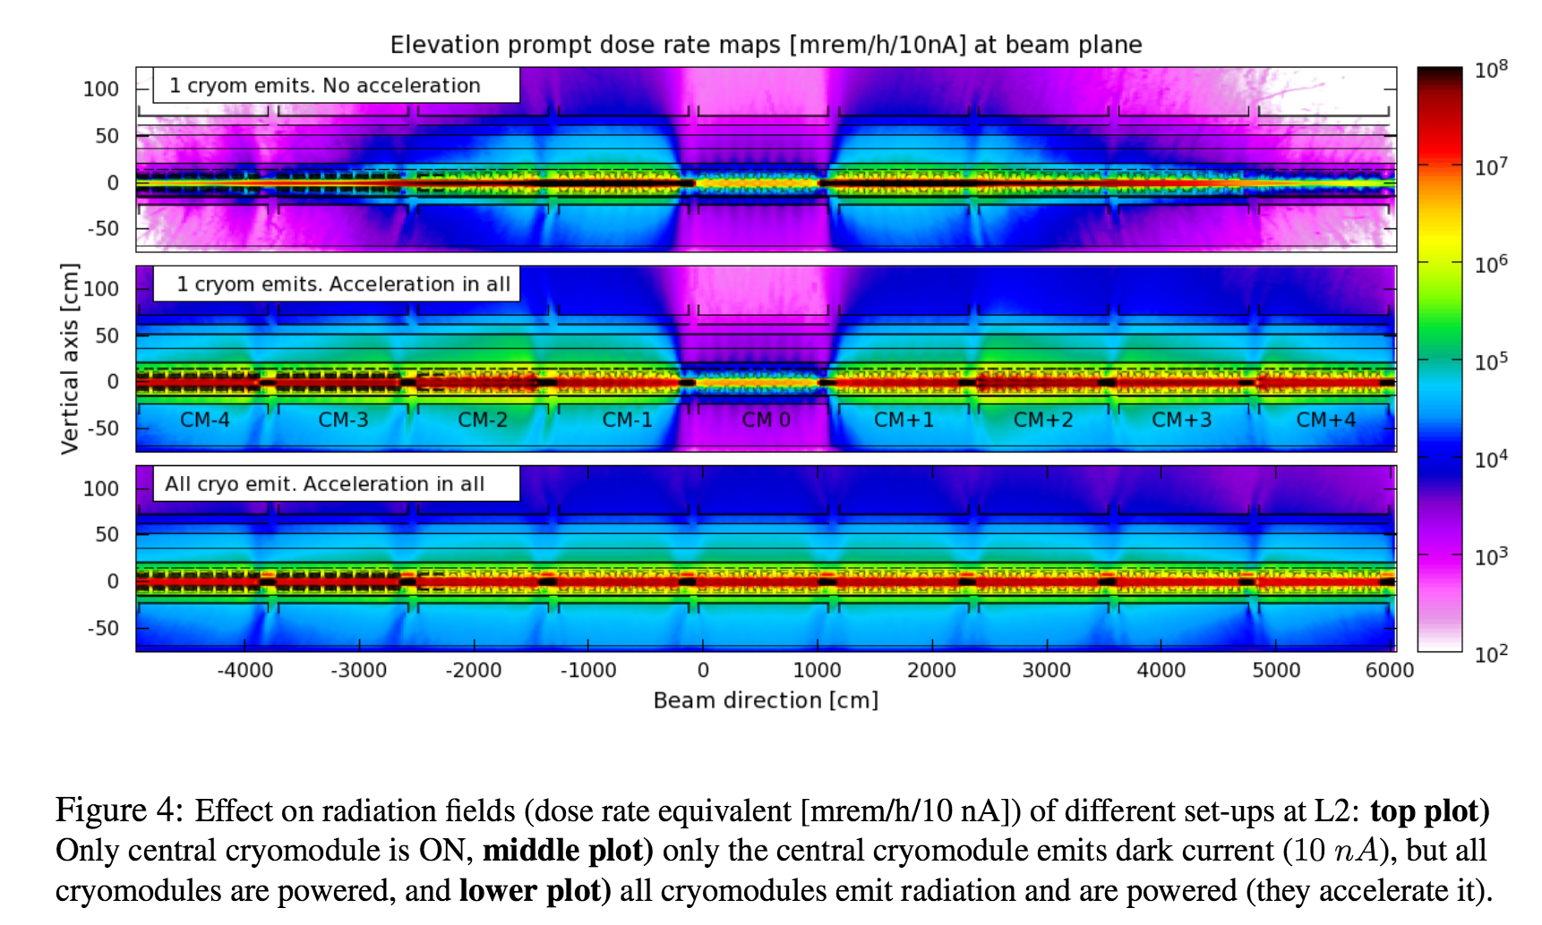
Studies of Radiation from SCRF
26
  Radiation from field emission including capture current effects have been simulated via ‘soft’ coupling Track3P (X. Chen, L. Ge, Z. Li) and FLUKA (Nuclear Data Sheets 120, 211-214, 2014) using extensive customized code and a detailed geometry of up to 9 cryomodules.
  Results are normalized to the captured field emission, which (at 16 MV/m) should be limited to: < 10 nA/cryomodule
Longitudinal [cm]
Vertical [cm]
Longitudinal [cm]
  Tracking of field emission showers allows studies for MP/RP purposes:
  Radiation fields inside the tunnel and streaming through linac penetrations
  Radiation damage of cryomodule components, wiring, instrumentation, electronics, …
  Activation of Helium, cryomodule, tunnel
  Activation of air (equivalent to electron losses in collimators)

Slide 27
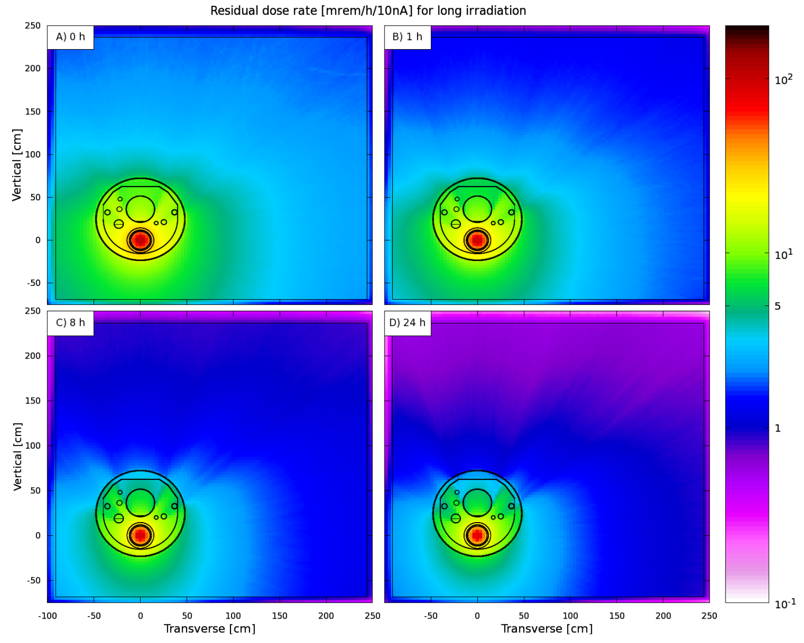
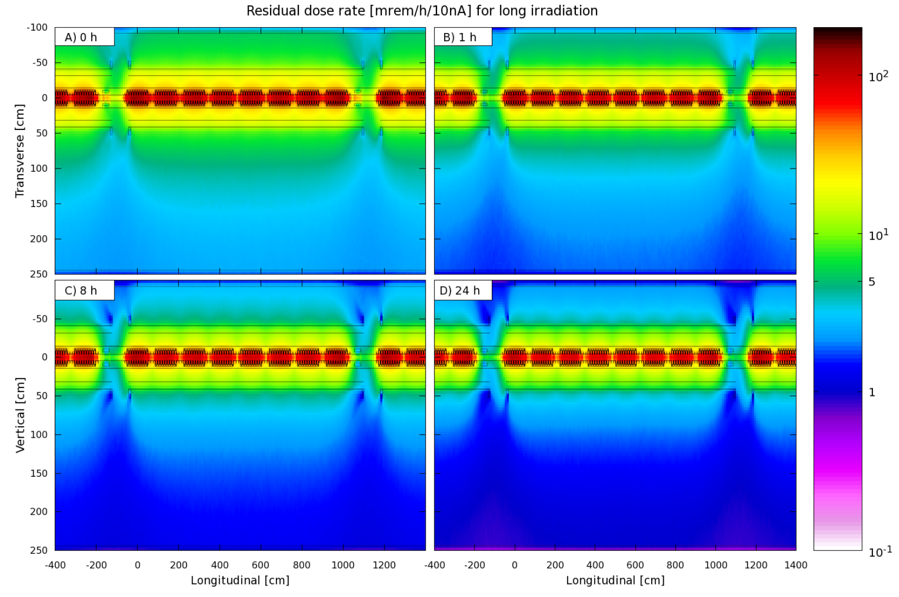
Residual Dose Rate near Cryomodules
27
Maps of residual dose rate [mrem/h] in L2 after very long operation and 4 cool-down times
  Less than RA in general area after 1 h
10 nA field emission and 16 MV/m gradient

Slide 28
Conclusions
28
Evaluated the hazards and developed mitigation/controls and monitoring to protect workers, public and environment for LCLS-II (MW, MHz, SCRF accelerator):
  Prompt radiation and radiation from SCRF field emission
  Activation of dumps, collimators, shielding, components, cooling water, cables
  Environmental impact to air, soil, groundwater,
  Monte Carlo codes such as FLUKA need to be used for activation and shielding calculations and optimization
  Subjects not covered, but important:
      Forward-peaked bremsstrahlung from BYD-EBD to FEE and NEH
      Radiation damage to undulators, devices and components
      Containment of electron beam: no passively-safe MW dump (rely on adequate cooling, distribute power in several lines, interlocks with fast response time, etc.)
      Containment of FEL:
        High energy density per pulse (eV/atom) can ablate any solid!
        High average power density (up to 600 watts at MHz)

Slide 29
LCLS-II RP Team
29
Project Leader
Mario Santana
RSO
Sayed Rokni
  Core team members: Mario Santana (Lead), J. Bauer, Jan Blaha, James Liu, Ludovic Nicolas, Stan Mao, Shanjie Xiao
  RPD team members: Olga Ligeti, Ryan Ford
  Team profile: RP staff has experience in design and operation of large-scale of similar projects including LCLS, SSRL/SPEAR3, LCLS-II (prev. version), FACET or LHC, as well as WFO consulting
  The team gathers proficiency in the most important radiation transport simulation codes,
Areas
Functions
Injector
Jan Blaha
BCS / PPS
Stan Mao
J. Bauer
LINAC
Mario Santana
Jan Blaha
Simulations
Mario Santana
Ludovic Nicolas
Shanjie Xiao
BSY / BTH / UH
Mario Santana
Ludovic Nicolas
Environmental
James Liu
Jan Blaha
Dumps
Mario Santana Ludovic Nicolas
XTOD – NEH,
FEL Beamlines
Shanjie Xiao
James Liu
Magnet damage
Stan Mao
James Liu
Maranda Cimeno
Mario Santana
Other Areas
Mario Santana
Ludovic Nicolas
  RP-LCLS2 org chart

Slide 30
Thank You

Slide 31
SLAC Radiation Safety Systems
31
Radiation Safety System
Access Control System
(keep people away from radiation)
Beam Containment System
(keep radiation away from people)
Beam Parameter Monitors
Beam Loss Monitors
Beam
Shut-Off Ion Chambers
(BSOIC)
Outside Shielding
Shielding
Dump
Collimator
Protection of Safety Devices

Slide 32
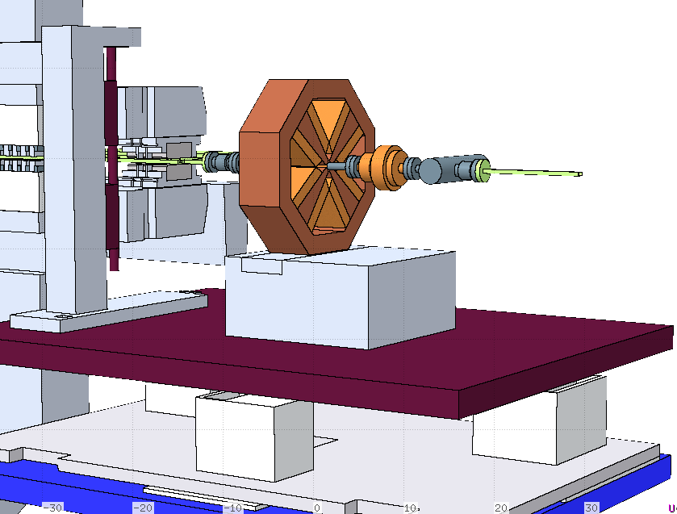
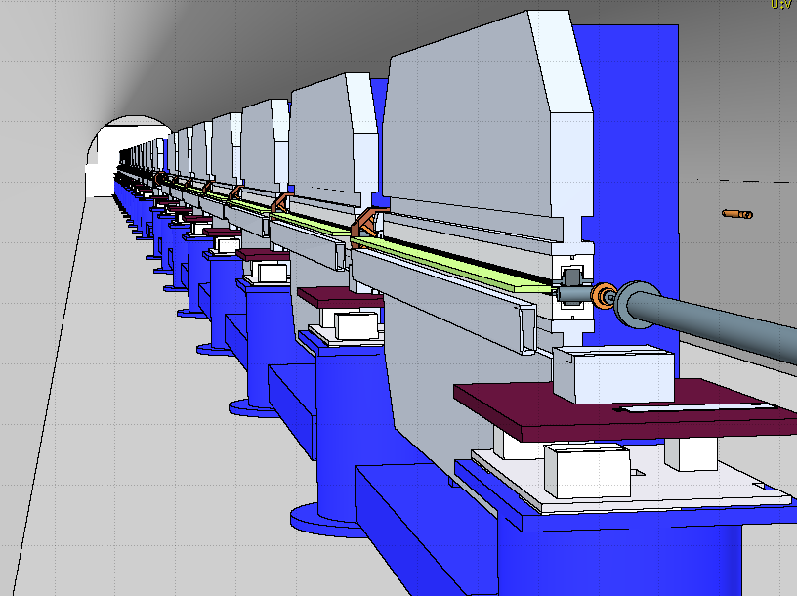
Radiation Fields within Undulators
32
SXR components & optics implemented in FLUKA per MAD files
High detail level near beam path, based on CAD drawings

Slide 33
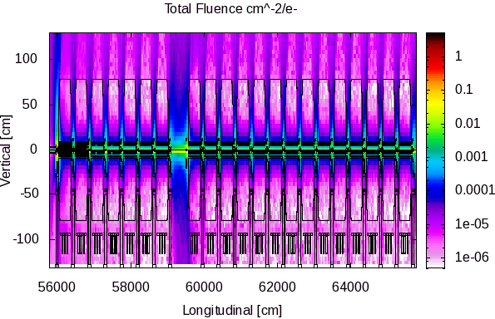
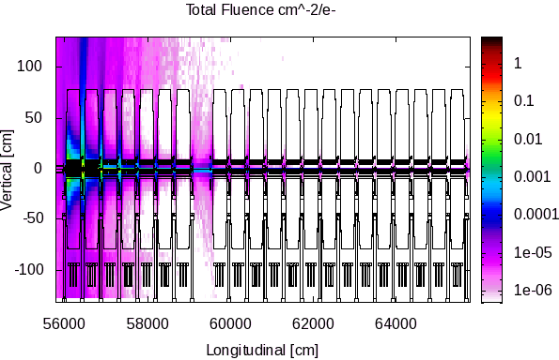
Radiation Fields within Undulators
33
Fluence maps used to decide detector type, settings, placement and also for calibration
Fluence [cm²/e⁻]
Normal loss ~ line source @ 1 mradian/2π
Mis-steering 1 mradian up magnet #1

Slide 34
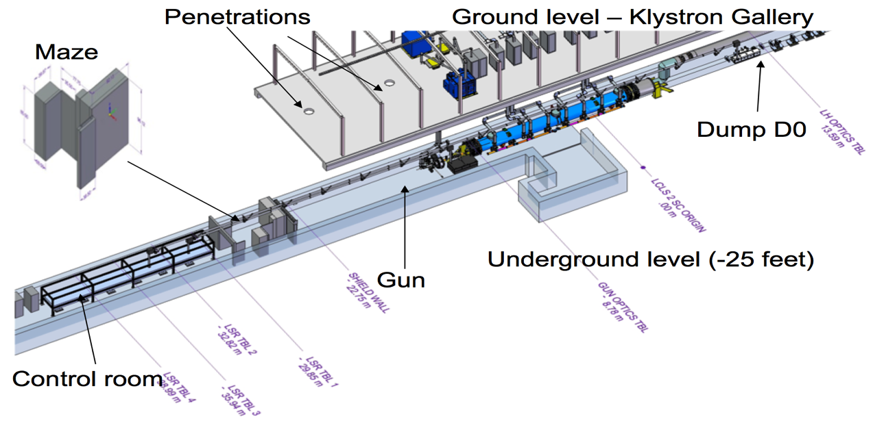
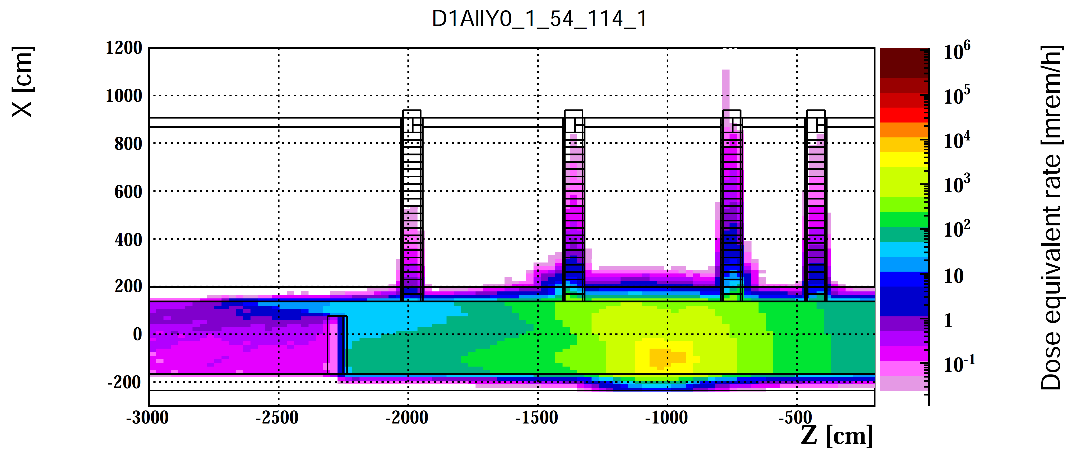
LINAC \ Gun & Injector
  Additional shielding on the maze has been designed according to preliminary dark current (P~1 W, <E>~20 MeV) average energy. Source models + other terms are being refined and shielding will be reviewed accordingly
Courtersy H. Alvarez
Elevation view of the dose rate [mrem/h]
  Mitigation needed for penetration above maze
  Penetrations to Klystron Gallery are OK

Slide 35
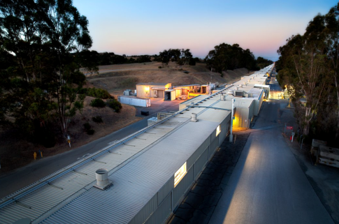
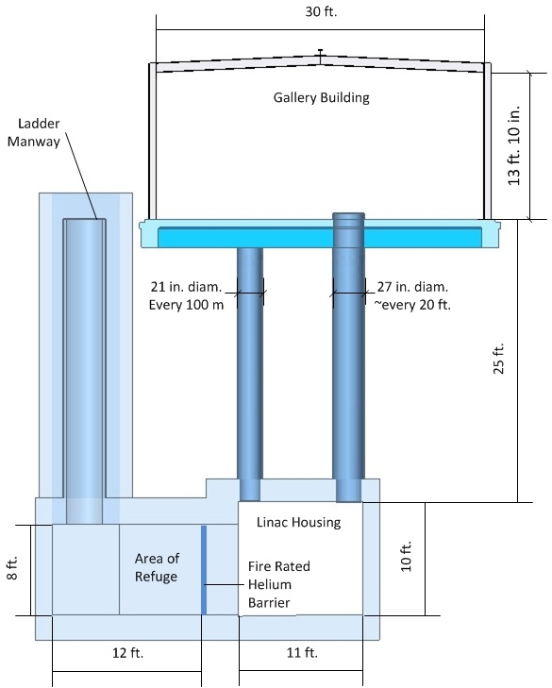

Penetrations to Klystron Gallery
There are over 450 penetrations from the Linac to the upper accessible Klystron Gallery!!
170 penetrations have Line-of-sight
Penetrations for waveguides/cables are 60% open
Penetration for helium supply/return or helium release are 100% open
Multiple configurations source/penetration were studied
35

Slide 36
Radiation Streaming Through Penetrations
South
North
250 mSv/h
There is a line-of-sight for north penetrations.
Shielding and/or exclusion area is required.
2 MW loss @ 4 GeV

Slide 37

Solution to the Penetration Issue

Slide 38

Direct Radiation (Skyshine) to Public
Head House
BTH
ESB
Dominated by skyshine from high-energy neutrons penetrating 4’-6’ concrete roofs of Head House and BTH
4 GeV, 48 W (limited by 7 LION pairs)
Estimated with SKYSHINE code
0.4 mrem/y at 500 m (site boundary) & 1.7 mrem/y at 350 m (guest house) from 24 h/d and 250 d/y operation
  SLAC RSS: 5 mrem/y per facility, 10 mrem/year for all facilities
If without LIONs, 1 W/m ×225 m ×2 = 450 W, 15.7 mrem/y at 350 m
RP-RPG-131105-MEM-01 by S. Mao
LCLS-II-2.7-PR-0079-R0 by J. Welch
Notes:
-Baseline design does not allow access to BTH and downstream areas during LCLS-II beam Operations
-damping ring enclosures at Sector 1 (SC LINAC L1 beamline) are personnel exclusion zones (not shown)

Slide 39





PMS for Direct/Skyshine Radiation Monitoring
39
  Shielding design goal: 5 mrem/y to public MEI
  0.4 mrem/y at site boundary & 1.7 mrem/y at guest house from 24 h/d and 250 d/y operation and 48 W loss at BTH limited by BCS-LIONs
  8 upgraded PMS near site boundary
  One prototype purchased and to be tested in FY17
  All to be purchased in FY18 and installed in FY19
    New PMS Neutron Detector
    Thermo WENDI2 (2 bar ³He)
    0.1 µrem/h to 10 rem/h of ²⁵²Cf
    $17K M&S
Existing PMS at SLAC
    New PMS Photon Detector
    Canberra EgoGamma GM
    1 µR/h – 1000 R/h
    $6K M&S

Slide 40

Protection and Monitoring for Groundwater
40
EPA/DOE requirements: no impacts to groundwater
Design goal: shielding for BSY dump, 2 EBDs, and some halo collimators to be < EPA detection limit of 1000 pCi/L of ³H and ALARA (e.g., geomembrane)
4 new wells next to high loss points:
  South of S4
  South of S10
  In MSY, south of BSY dump
  South of 2 EBDs
Periodic sampling (part of the existing 100 wells on site)
To be installed by FY18 for pre-operation monitoring
$25K each well
Dump Lines
LCLS-II-1.2-PR-0160-R0 by J. Liu

Slide 41


AMS, RDM and PMS Locations
41
6 AMS Locations (1 movable, 13 additional sampling heads)
8 RDM Locations (2 movable)
8 PMS Locations (1 movable)

Slide 42

LCW Systems for LCLS-II Dumps and Spreader Line
42
SC-Linac Spreader Line
(Cu)
Cu-LinacD2
(Cu)
BSY Dump (Al)
2 EBDs
(Al dump and SS piping)
HX1
(no upgrades for RP)
SL10
SL30
HX2
(upgrades needed)
HX2 and HX1 including piping to BSY are all SS316L
BSY dump LCW to HX2 West Surge Tank (SL10)
EBD LCW to HX2 East Surge Tank (SL30) after disconnect all Cu lines and de-Cu cleaning
D2 (Cu) and spreader line septa and collimators (Cu) to HX1

Slide 43




Benchmark of LCW System with JLAB
43
Hall C dump LCW housing with gate alarm interlocked to beam
3 resin tanks, 2 filter tanks, drip pan (left), sealed concrete floor for contamination control
three 100-gallon resin tanks
Vented surge tank with hydrogen recombiner with H sensor (T shape on top)

Slide 44
44
Design Criteria, Mitigation, Controls and Monitoring
 | Linac Halo Collimators | BSY Dump | BTH | BYD and 2 EBDs
Groundwater (no impact: < EPA detection limit of 1000 pCi/L ³H) | Shielding for Some collimators 2 Wells | Dump shielding 1 Well |  | Dump shielding geomembrane 1 Well
Direct Radiation (5 mrem/y, 8 PMS site-boundary) | >20’ earth | >20’ earth | 4’-6’ concrete roof | >20’ earth
Radioactive Air (10 mrem/y & 0.1 mrem/y to MEI, 1-DAC to worker) | Cryo FE monitoring 3 AMS | Dump shielding Vent for access 1 AMS | 1 AMS | Dump shielding 1 AMS
Residual Dose Rate (5 mrem/h non-RA, 1-h delay access) | Shielding for some collimators 2 RDM | Dump shielding 2 RDM | 1 RDM | Dump shielding 2 RDM
LCW System (housing, resin tanks, filter tanks, leak controls, Locked door interlocked to detector, H₂ recombiner) | 4 new LCW systems for S0-S10 & HX1 | HX2 upgrades |  | HX2 upgrades

Slide 45



Dump Activation - Serviceability
45
  Residual dose rate [mSv/h] for the extracted main dump stopper at 30 cm from its cylindrical surface
The dump is being designed for no service, and removal at end of life
At least one spare dump will be available
Extraction of the dump would not occur before 1 week cool-down
The dump should be extracted into a ‘fresh’ shielding container

Slide 46
Radiation Sources to XTES
Undulator & Dump Hall
FEE
NEH
e-
FEL
Spontaneous
Bremsstrahlung
Collimator
FEL
Spontaneous
Secondaries from e- loss
Mirror
Collimator
BYD Magnets
Collimator
e- loss at BYD
Dump Shielding
Mirror
  FEL
    SXR (0.2-1.25 keV): can be contained by beampipes and chambers
    HXR (1-25 keV): hutch shielding needs be revisited (off-project)
e-
    Spontaneous Synchrotron
    SXR: mostly cut by mirrors due to the low cut-off energy
    HXR: higher cut-off, hutch shielding needs be revisited (off-project)
    Gas bremsstrahlung is negligible
    No insertion device is allowed at high rep-rate (via interlock) to limit bremsstrahlung
Main Dump
Main radiation source is from e⁻ losses on BYD magnets (4 GeV, 120 W on each of SXR and HXR)

Slide 47

Main radiation sources in LCLS
Beam Transport Hall (BTH)
Undulator Hall (UH)
Near Experimental Hall (NEH)
3 beam dumps
Collimators & other losses
Front End Enclosure
(FEE)
X ray tunnel
(XRT)
Far experimental Hall
(FEH)
Failure modes. Configuration controls…
MULTIPLE RADIATION SOURCES
Collimators & other
Single Beam Dumper
(TDKIK)
Tune-up Dump
(TDUND)
Main Dump
(MDUMP)
Electrons
Bremsstrahlung
X-Rays

Slide 48


BCS Requirements
Cu
GUN1
6 MeV
SC
BEGGUNB
0.75 MeV
50 W PIC, 1 pair
100 W LION, 2 pair
30 kW PIC, 1 pair, fast, protect stopper
375 W - 50 kW MCB
6 kW at max Allowed Beam Bower (ABP)
IM01
FCG1
6 MeV
Injector
L0
FCDG0DU
100 MeV
DIAG0
BXG
GSPEC1
6 MeV
STC0
IMBCSC0
L0
SPEC1
135 MeV
1 kW LION, 2 pair (along bypass)
100 W LION, 5 pair
5% ACM comparator to protect personnel in gallery
50 kW - 2 MW MCB
250 kW max ABP
L1
BX01
Linac
S1-S27
IM11B
L1
L2
TD11
250 MeV
IM21B
L3
L2
Comparator
IMBCSDOG
BC2
5 GeV
IMSP0S
IMBP28
IMSP0H
L3
S28-BSY
No BCS to limit losses
2 MW MCB
250 kW max ABP Dump line
120 kW max ABP per undulator line
IMSP0D
STSP6HA*
STSP6HB
STSP6HC
STSP6HD
(BYKIKC)
IMBSY1
(TDKICKC)
15 GeV
IMSP1D
IMBSY2
STSP5S
IMSP2D
IMBSY3
IMSP1S
IMBSY34
D10
IMSP1H
BXSP1H
D2B, 4 GeV
Comparator
D2, 4 or 15 GeV
STBP34A
STBP34BSTBP34C
Comparator
ST60
ST61
100 W PICs, 9x, fast, protect S BTMs
100 W PICs, 9x, fast, protect H BTMs
35 W LIONs, 7 pair
2 MW MCB
120 kW max ABP per beam
MUON WALL
DUMPBSY 4 GeV
IM31
BTHW
BTH
IMBCS1
IMBCS2
BYKIK
TDUNDB
4 GeV
20 W LION, 5 pair
20 W PIC, 2x, fast protect BTM
2 MW MCB, 120 kW max ABP per beam
IM36
TDKIK
IMUNDI
Undulator
TDUND15 GeV
SXR
HXR
KEY
IMUNDOB
5% ACM Comparator 2x, purpose?
100 W LION, 3 pair
100 W PICs, 10x, fast, protect coll. and safety dump
2 MW MCB, 120 kW max ABP per beam
BCS ACM
IMBCS4B
Dump
IMUNDO
Calibration ICT
ENDDMPS
4 GeV
(DUMPS)
IMBCS3
LCLS toroid
IMDUMP
SXR
XPP
IMBCS4
e- Dump
ENDDMPH
4 or 15 GeV
(DUMPH)
e- Stopper
CXI
Xray Stopper
XCS
MEC

Slide 49

Estimated Beam Loss by Area (J. Welch)
See PRD: LCLSII-2.7-PR-0079

