Slide 1
Study on patient-induced radioactivity during proton treatment in hengjian proton medical facility
Dr. Qingbiao Wu
a. China Spallation Neutron Source (CSNS)，Institute of High Energy Physics (IHEP), Chinese Academy of Sciences (CAS), Dongguan 523803, People's Republic of China
b. Dongguan Institute of Neutron Science (DINS), Dongguan 523808, People's Republic of China
2016.9.23
Email: qbwu@ihep.ac.cn

Slide 2
Note to the report
The report is based on the same article published in Applied Radiation and Isotopes recently.
For the consideration of copyright and comprehension, it is suggested to download the full article from the links:
  http://www.sciencedirect.com/science/article/pii/S0969804316303141
  http://dx.doi.org/10.1016/j.apradiso.2016.06.029

Slide 3
Highlights
A detailed study on patient-induced radioactivity was conducted by adopting Monte Carlo code FLUKA and activation formula.
New formulas for calculating the activity build-up process of periodic irradiation were derived and extensively studied.
Patient induced radioactivity, which has been ignored for years, is confirmed as a vital factor for radiation protection.
The induced radioactivity from single short-time treatment and long-time running (saturation) were studied and compared.
Some suggestions on how to reduce the hazard of patient’s induced radioactivity were given.

Slide 4
1. Introduction
Hengjian Proton Medical Facility (HJPMF) has 5 treatment rooms: 3 gantry + 2 fixed-beam.
The proton beam extracted from C230 cyclotron (bought from IBA) has a fixed energy of 230 MeV.
The proton energy is degraded to 130~230 MeV by ESS before transporting to the treatment room.
Only pencil beam scanning (PBS) mode will be adopted for treatment in HJPMF.
Only two source terms need to be considered from beam-transporting line (BTL) to patient:
  (1) beam line loss at beam pipe with most 0.106 nA at 230 MeV;
  (2) beam point loss at patient with most 1.66 nA at 230 MeV.

Slide 5
1. Introduction
HJPMF’s annual workload is obtained by referring to IBA.
  350 patients/year/room, and 4800 h/year for treatment (16 h/day, 6 days/week, 50 weeks/year).
Source terms obtained by combining workload with transporting efficiency.

Slide 6
1. Introduction
The dose-governed target values:
  5 mSv/a – for the radiation worker,
  0.1 mSv/a – for the public.
The dose rate limit for shielding design :
  < 2.5 μSv/h in the working place.

Slide 7
2. Calculation and analysis
2.1. Geometrical model and calculation method
  FLUKA was used (SimpleGeo for geometrical model built)
  Detailed as far as possible:
  true building structure (walls, beam pipes, etc.),
  patient represented by a water phantom (30×30×70 cm),
  two situations of with and without couch were considered,
  concrete wall of with and without Na were considered (which influences the product of Na-24 and Na-22).

Slide 8
2. Calculation and analysis
2.2. Number of treatment rooms, patients per day, and time per patient
  The beam hits the patient for only 2 min in each 32-min treatment.

Slide 9
2. Calculation and analysis
2.3. Simulation techniques
  To patient and air:
  Single short-time irradiation profile of 2-min treatment with different cooling time was simulated.
  air dose coefficient from ICRP68 and fgr12 used to get air inhalation and air submersion dose;
  specific gamma-ray dose constant used to convert each nuclide’s activity to dose (Bq/cm³ → Sv/h);
  linear source (for beam pipe) or point source (for patient, nozzle and couch), with ½ self-shielding factor, assumed.
  To long-time saturation:
  Long-time irradiation profile of 30-year continuous irradiation was simulated.
  To convert the result of 30-year continuous treatment into real (nested) periodic irradiation result, new buildup formulas were deduced.
  To distinguish the residual dose rate of each component:
  “two-step simulation” method adopted.

Slide 10
2. Calculation and analysis
2.4. Induced dose rate distribution and its decay with time
Single 2-min irradiation
30-year continuous irradiation

Slide 11
2. Calculation and analysis
2.4. Induced dose rate distribution and its decay with time
Key points:
Induced radioactivity in the treatment room comes mainly from the patient after the single short-time treatment is completed.
The residual dose rate near patient can reach 200 μSv/h at the cooling time of 1 min.
Residual dose rate from concrete, beam pipe, and nozzle, all < 0.5 μSv/h in most space of the treatment room.
The residual dose rate declines quickly in the 30-min cooling time between two treatments.
After 30-year continuous treatment, the residual dose rate from concrete, beam pipe, and nozzle all will build up to 5–10 times, but still < 2.5 μSv/h in most space of the treatment room.
The irradiation profile of 30-year continuous treatment is overestimated and need to be corrected by taking the cooling process into consideration. Monte Carlo simulation can’t do this job, traditional activation formula only deal with one time irradiation. → New formulas needed !

Slide 12
2. Calculation and analysis
2.5. Air- and patient-induced radionuclides and dose rates from a single short-time treatment
Key points:
The residual dose rate is dominated by the patient activation, in which O-15 dominates in the first 10 min of cooling, both O-15 and C-11 dominate in the cooling time between 10 and 15 min, and C-11 dominates after 15 min of cooling.

Slide 13
2. Calculation and analysis
2.5. Air- and patient-induced radionuclides and dose rates from a single short-time treatment
Key points:
The O-15 is produced through ¹⁶O(p,pn)¹⁵O reaction during treatment, while proton reaches the patient (water phantom).
The activity concentration after 2-min treatment and 1-min cooling can be verified using activation formula:
Take O-15 for example:
Agrees with FLUKA’s simulation result in Table 5 completely !

Slide 14
2. Calculation and analysis
2.6. The components’ radionuclides and dose rates from long-time treatment
2.6.1. Buildup formulas of periodic irradiation
  The nested periodic irradiation profile of HJPMF:
  1st day irradiation: t_{i1} = 2 min, t_{c1} = 30 min, the first- layer period t₁ = 32 min.
  n₁ = 30 cycles, t_{i2} = 32 min×30 = 16 h, t_{c2} = 8 h, the second-layer period t₂ = t_{i2} + t_{c2} = 24 h =1 d.
  1st week irradiation: n₂ = 6 cycles, t_{i3} = 1 d×6 = 6 days, t_{c3} = 1 d, the third-layer period t₃ = t_{i3} + t_{c3} = 1 week.
  1st year irradiation: n₃ = 50 cycles, t_{i4} = 1 week×50 = 50 weeks = 350 days, t_{c4} = (365 - 350) days = 15 days, t₄ = 1 year = 365 days.
  30 years irradiation: n₄ = 30 cycles.
  After the kth-layer n_{k} cycle treatment is completed, the activity been built up reaches a maximum value and minimum value at the last treatment-ending moment and cooling-ending moment, respectively:
buildup formulas of periodic irradiation

Slide 15
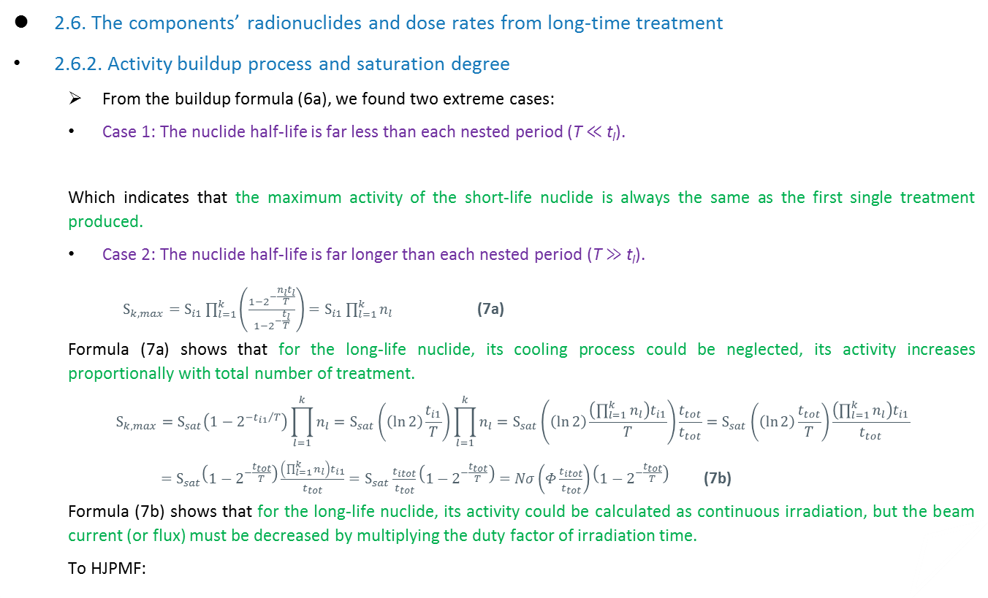
2. Calculation and analysis
2.6. The components’ radionuclides and dose rates from long-time treatment
2.6.2. Activity buildup process and saturation degree
  From the buildup formula (6a), we found two extreme cases:
  Case 1: The nuclide half-life is far less than each nested period (T ≪ t_{l}).
  Which indicates that the maximum activity of the short-life nuclide is always the same as the first single treatment produced.
  Case 2: The nuclide half-life is far longer than each nested period (T ≫ t_{l}).
    $S_{k,max}=S_{i1}\prod_{l=1}^{k}{\left(\frac{1−2^{−\frac{{n_{l}t}_{l}}{T}}}{1−2^{−\frac{t_{l}}{T}}}\right)}=S_{i1}\prod_{l=1}^{k}{n_{l}}$ (7a)
  Formula (7a) shows that for the long-life nuclide, its cooling process could be neglected, its activity increases proportionally with total number of treatment.
    $$S_{k,max}=S_{sat}\left(1−2^{{−t_{i1}}/T}\right)\prod_{l=1}^{k}{n_{l}}=S_{sat}\left(\left(\ln{2}\right)\frac{t_{i1}}{T}\right)\prod_{l=1}^{k}{n_{l}}=S_{sat}\left(\left(\ln{2}\right)\frac{\left(\prod_{l=1}^{k}{n_{l}}\right)t_{i1}}{T}\right)\frac{t_{tot}}{t_{tot}}=S_{sat}\left(\left(\ln{2}\right)\frac{t_{tot}}{T}\right)\frac{\left(\prod_{l=1}^{k}{n_{l}}\right)t_{i1}}{t_{tot}}$$
    $=S_{sat}\left(1−2^{−\frac{t_{tot}}{T}}\right)\frac{\left(\prod_{l=1}^{k}{n_{l}}\right)t_{i1}}{t_{tot}}=S_{sat}\frac{t_{itot}}{t_{tot}}\left(1−2^{−\frac{t_{tot}}{T}}\right)=Nσ\left(Φ\frac{t_{itot}}{t_{tot}}\right)\left(1−2^{−\frac{t_{tot}}{T}}\right)$ (7b)
  Formula (7b) shows that for the long-life nuclide, its activity could be calculated as continuous irradiation, but the beam current (or flux) must be decreased by multiplying the duty factor of irradiation time.
  To HJPMF:
Utilizing the limitation of${ 2}^{−x}=1+\frac{−1×\ln{2}}{1!}x+⋯=1−\left(\ln{2}\right)x \left(x→0\right)$

Slide 16
2. Calculation and analysis
2.6. The components’ radionuclides and dose rates from long-time treatment
2.6.2. Activity buildup process and saturation degree
  The direct way of finding the activity build-up process is adding up the activity produced by each of the former irradiation. To HJPMF, it is programmed and shown in Fig. 8.
  It is very important to determine theoretically what saturation degree of each nuclide can reach during the accelerator’s life-time, and how fast it does. For this purpose, formula (6a) can be used to define and calculate the saturation degree at different running times. The saturation degrees are functions of the nuclide half-life, as plotted in Fig. 9.
  From Fig. 9, it can be found that: With the increase of half-life, the nuclide not only needs longer time to reach saturation, but also decreases its saturation degree.

Slide 17
2. Calculation and analysis
2.6. The components’ radionuclides and dose rates from long-time treatment
2.6.2. Activity buildup process and saturation degree
  Formula (6a) and Fig. 9 are important to find the activity buildup process of a known nuclide.
  Example, ²⁴Na : T = 15 h.
  The single-treatment saturation degree is 0.03; → ²⁴Na will build 33 times when reach saturation !
  its 1-week saturation degree is 1; → ²⁴Na will reach saturation in the 1st week !
  its 30-year saturation degree is 0.05. → ²⁴Na’s activity is only 1/20 of the ideal saturation when reaches
  saturation !
²⁴Na

Slide 18
2. Calculation and analysis
2.6. The components’ radionuclides and dose rates from long-time treatment
2.6.3. Fixed components’ radionuclides and dose rates from long-time treatment

Slide 19
2. Calculation and analysis
2.6. The components’ radionuclides and dose rates from long-time treatment
2.6.3. Fixed components’ radionuclides and dose rates from long-time treatment

Slide 20
2. Calculation and analysis
2.6. The components’ radionuclides and dose rates from long-time treatment
2.6.3. Fixed components’ radionuclides and dose rates from long-time treatment
Key points:
The fixed components’ dose rate at 1-min cooling from 30-year periodic treatment are at most 2.2 times of that of 2 min single short-time treatment, lower than ever expected.
Even after long-time treatment, the residual dose rate at a distance of 1 m from the isocenter is still dominated by the patient in the cooling time of 30 min.
The second contributor to dose rate is concrete wall or couch. Both of them contribute 0.2–0.5 μSv/h at 1-min cooling at a distance of 1 m from the isocenter.
The dose rate at1-min cooling from couch at the isocenter will be approximately 5 μSv/h after a single short-time treatment, and will buildup to approximately 80 μSv/h after 30-year continuous treatment. However, by adopting the buildup formulas to correct, after 30-years periodic treatment, it will buildup to approximately 8 μSv/h, which is one-tenth of that after 30-year continuous treatment, and is still much less than the dose rate from patient. .
Al-28 and Na-24 are the two main radionuclides produced in concrete after long-time treatment and in the 30-min cooling time. Na-24 produced by concrete without sodium decreases to approximately 1/17 of concrete with sodium.

Slide 21
2. Calculation and analysis
2.7. Radiation protection for the patient escort
Key points:
In order to evaluate the radiation influence of patient-induced activity to his/her surrounding environment, we calculated the residual dose rate produced by the patient at different distances and cooling times, and the integral dose at these cooling time intervals.
For simple and conservative calculation, we assumed the patient could be cured in 1 year, the escort began to contact the patient at 1 or 5 min after the treatment is completed, the average contact distance is 30 cm, 60 cm, or 1 m.
From Table 8, we found that the annual dose received by the escort is 0.464 mSv/a, at the contact distance and cooling time of 30 cm and 1 min, respectively.
In practice, the begin contact time maybe 5 min after the treatment finished or later, and the average contact distance maybe 60 cm or farther. In that case, the annual dose received by the escort will be at most 0.058 mSv/a, less than HJPMF’s govern target value (0.1 mSv/a) for the public.

Slide 22
2. Calculation and analysis
2.8. Radiation protection for the positioning technician
2.8.1. Dose received from removing the irradiated patient
  We assumed the following: each treatment room allocated one positioning technician, the average contact time needed to remove the patient from couch is 1 min, the average contact distance was 60 cm or 1 m, and the begin contact time after completion of treatment was 1, 5, or 10 min.
  The positioning technician will receive an annual dose of 4 mSv/a from removing the irradiated patient at the average contact distance of 1 m and begin contact time of 1 min; this annual dose can be decreased to 1.1 mSv/a or even 0.319 mSv/ a if the begin contact time postpones to 5 or 10 min after treatment is complete.
  Longer wait is unnecessary and unrealistic !

Slide 23
2. Calculation and analysis
2.8. Radiation protection for the positioning technician
2.8.2. Dose received from position the next patient
  We assumed that the time needed for the position process is 10 min and the patient began to enter the treatment room at 1-min cooling time.
  The annual dose received by the technician from positioning is no more than 0.91 mSv/a.
  Where very close to the couch, which dominates the dose rate from fixed components in the distance of < 1 m, and may reach 8 μSv/h at the isocenter and the saturation state. →The distance to the couch should be carefully monitored during the positioning process.

Slide 24
3. Conclusions and suggestions
The patient-induced radioactivity is a vital factor for radiation protection to patient escort and positioning technician, but has been ignored for years.
More articles on treatment room and nozzle induced radioactivity,
seldom articles on patient-induced radioactivity.
→ Business consideration? (guess…)
The results can be adopted to other proton medical facilities.
The dose rate at 1-mincooling produced by fixed components from long-time treatment is at most 2.2 times of that from single short-time treatment, lower than expected.
The buildup formulas and results are valuable and suitable to other accelerators too, as long as the irradiation profile is periodic (nested or not) or can be approximated as periodic.
To the patient, since his/her induced radioactivity may reach tens of micro-Sievert per hour to 200 μSv/h, it is advised that at least 5-min cooling time for the main short-lifetime nuclide O-15 in the patient to decay, before the positioning technician enters the treatment room to remove the patient.
To the patient escort, the patient-induced radioactivity is not a serious problem, as the escort begins to contact the irradiated patient usually at 5 min after treatment finished or later, and the number of treatments for a patient is limited.

Slide 25
3. Conclusions and suggestions
To the positioning technician, it is advised to pay attention to the contact distance and contact time of the irradiated patient, so as to reduce the dose received from removing the irradiated patient. It is also advised to pay attention to the induced radioactivity from couch (or other components), which is located near the isocenter and downside the beam direction, although its residual dose rate is one order of magnitude lower than patient, but more time is needed to position the next patient than to remove the irradiated patient. It is advised to have sufficient number of positioning technicians to reduce their average dose. Furthermore, it is notable that the dose from prompt radiation will make the acceptable dose from induced radioactivity lower than the annual dose limit. Therefore, regular monitoring of personal dose is very important.
It can be found that our results agree with Thomadsen’s review paper (Thomadsen, 2014). It is advised to refer to this review paper for a comprehensive understanding of the induced radioactivity produced in various particle medical therapy facilities.

Slide 26
Recent articles on patient-induced radioactivity:
Thomadsen’s review paper (Thomadsen, 2014).
  Thomadsen, B., 2014. Potential hazard due to induced radioactivity secondary to radiotherapy: the report of task group 136 of the american association of physicists in medicine. Health Phys. 107 (5), 442-60.
Yung-Cheng Hsu’s article (from Taiwan), 2016.
  Yung-Cheng Hsu, et al.,2016. Neutron yield and
  induced radioactivity: a study of 235-MeV proton
  and 3-GeV electron accelerators. Radiation Protection
  Dosimetry. Vol. 168, No. 1, pp. 124–133.
Not enough for ¹⁵O decay !
At least 5 min advised !

Slide 27
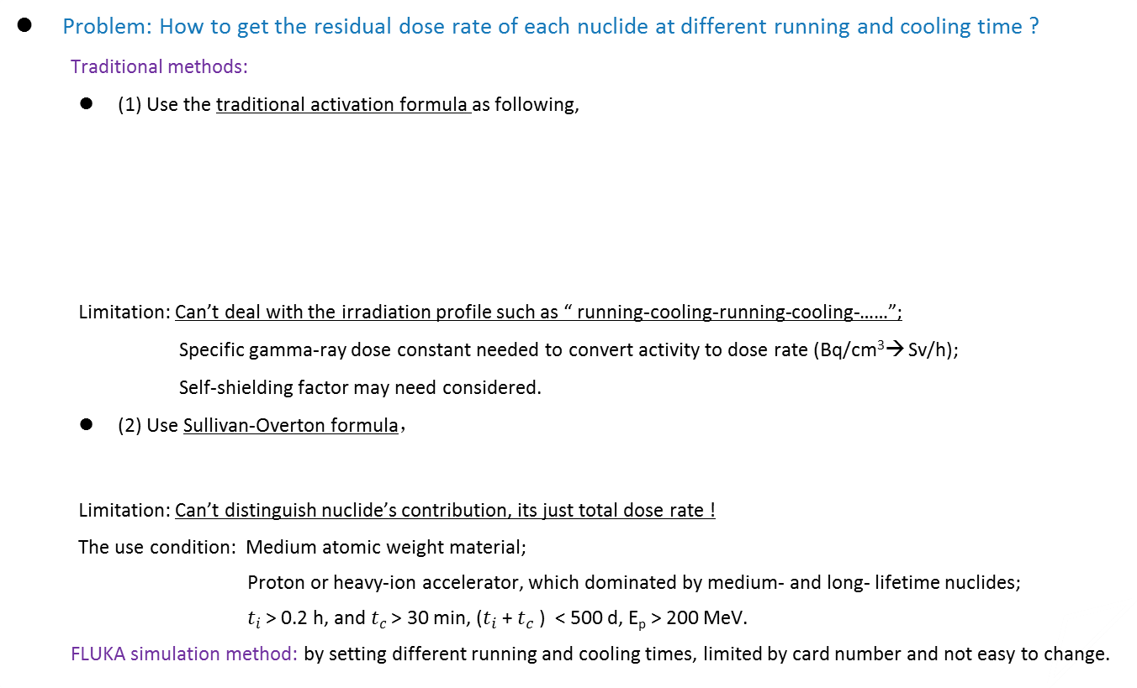
Use buildup method
Problem: How to get the residual dose rate of each nuclide at different running and cooling time ?
  Traditional methods:
  (1) Use the traditional activation formula as following,
  Limitation: Can’t deal with the irradiation profile such as “ running-cooling-running-cooling-……”;
  Specific gamma-ray dose constant needed to convert activity to dose rate (Bq/cm³→ Sv/h);
  Self-shielding factor may need considered.
  (2) Use Sullivan-Overton formula，
  Limitation: Can’t distinguish nuclide’s contribution, its just total dose rate !
  The use condition: Medium atomic weight material;
  Proton or heavy-ion accelerator, which dominated by medium- and long- lifetime nuclides;
  $t_{i}$ > 0.2 h, and $t_{c}$ > 30 min, ($t_{i}$ + $t_{c}$ ) < 500 d, E_{p} > 200 MeV.
  FLUKA simulation method: by setting different running and cooling times, limited by card number and not easy to change.

Slide 28

Use buildup method
Problem: How to get the residual dose rate of each nuclide at different running and cooling time ?
  The buildup method (combining activation formulas with FLUKA’s simulation), described in the article:
  Advantages:
  Need only one-time FLUKA simulation, “running-cooling-running-cooling-…” irradiation profile can be derived;
  (vs. traditional activation formula)
  (2) Each nuclide’s buildup process and contribution can be studied in detail and in figure; (vs. Sullivan-Overton formula)
  (3) Applicable to short-lifetime radionuclide, and no limitation for $t_{i}$ and $t_{c}$. (vs. Sullivan-Overton formula)
  Limitation:
  To the nuclide from second activation (such as Mn-52, which comes from Mn-52m), since it’s not produced by prompt radiation, the delay effect may need consider !
Saturation degree is vitally important to study the buildup process of
induced radioactivity !

Slide 29
Thanks for your attention !
&
Eager for your discussion !

