Slide 1

CEPC parameter choice and partial double ring design
Dou Wang, Jie Gao, Feng Su, Yuan Zhang, Jiyuan Zhai, Yiwei Wang, Bai Sha, Huiping Geng, Tianjian Bian, Na Wang, Xiaohao Cui
CEPC AP meeting, 2016.04.22

Slide 2
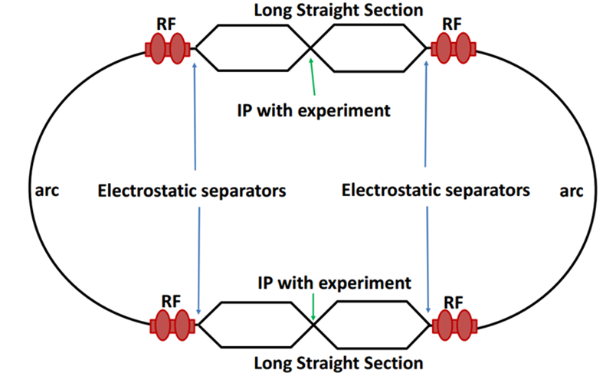
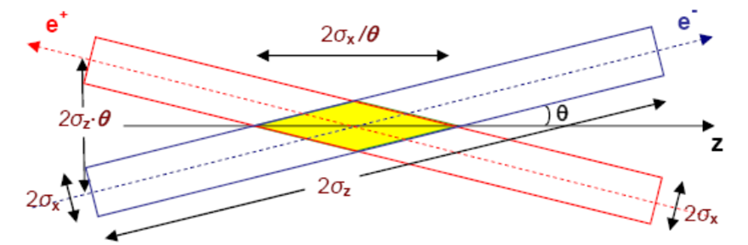
Machine constraints / given parameters
Energy E₀
Circumference C₀
N_{IP}
Beam power P₀
β_{y}*
Emittance coupling factor κ_{ε}
Bending radius ρ
Piwinski angle Φ
ξy enhancement by crab waist F_{l} ~1.5 (2.6)
Energy acceptance (DA)
Phase advance per cell (FODO)

Slide 3
Constraints for parameter choice
Limit of Beam-beam tune shift
F_{l}: ξy enhancement by crab waist
Beam lifetime due to beamstrahlung
BS life time: 30 min
V.I. Telnov
Beamstrahlung energy spread
A=δ₀/δ_{BS} (A≥3)
HOM power per cavity
*J. Gao, emittance growth and beam lifetime limitations due to beam-beam effects in e+e- storage rings, Nucl. Instr. and methods A533（2004）p. 270-274.

Slide 4
parameter for CEPC partial double ring
（wangdou20160420）
 | Pre-CDR | H-high lumi. | H-low power | H-20MW | W | Z
Number of IPs | 2 | 2 | 2 | 2 | 2 | 2
Energy (GeV) | 120 | 120 | 120 | 120 | 80 | 45.5
Circumference (km) | 54 | 54 | 54 | 54 | 54 | 54
SR loss/turn (GeV) | 3.1 | 2.96 | 2.96 | 2.96 | 0.59 | 0.062
Half crossing angle (mrad) | 0 | 15 | 15 | 15 | 15 | 15
Piwinski angle | 0 | 2.5 | 2.6 | 2.6 | 5 | 7.6
N_{e}/bunch (10¹¹) | 3.79 | 2.85 | 2.67 | 2.66 | 0.74 | 0.46
Bunch number | 50 | 67 | 44 | 29 | 400 | 1100
Beam current (mA) | 16.6 | 16.9 | 10.5 | 6.8 | 26.2 | 45.4
SR power /beam (MW) | 51.7 | 50 | 31.2 | 20 | 15.6 | 2.8
Bending radius (km) | 6.1 | 6.2 | 6.2 | 6.2 | 6.1 | 6.1
Momentum compaction (10⁻⁵) | 3.4 | 2.5 | 2.2 | 2.2 | 2.4 | 3.5
β_{IP} x/y (m) | 0.8/0.0012 | 0.25/0.00136 | 0.268 /0.00124 | 0.267/0.00124 | 0.1/0.001 | 0.1/0.001
Emittance x/y (nm) | 6.12/0.018 | 2.45/0.0074 | 2.06 /0.0062 | 2.06/0.0062 | 1.02/0.003 | 0.62/0.0028
Transverse σ_{IP} (um) | 69.97/0.15 | 24.8/0.1 | 23.5/0.088 | 23.4/0.088 | 10.1/0.056 | 7.9/0.053
ξ_{x}/IP | 0.118 | 0.03 | 0.032 | 0.032 | 0.008 | 0.006
ξ_{y}/IP | 0.083 | 0.11 | 0.11 | 0.11 | 0.074 | 0.073
V_{RF} (GV) | 6.87 | 3.62 | 3.53 | 3.53 | 0.81 | 0.12
f _{RF} (MHz) | 650 | 650 | 650 | 650 | 650 | 650
Nature σ_{z} (mm) | 2.14 | 3.1 | 3.0 | 3.0 | 3.25 | 3.9
Total σ_{z} (mm) | 2.65 | 4.1 | 4.0 | 4.0 | 3.35 | 4.0
HOM power/cavity (kw) | 3.6 | 2.2 | 1.3 | 0.84 | 0.99 | 0.99
Energy spread (%) | 0.13 | 0.13 | 0.13 | 0.13 | 0.09 | 0.05
Energy acceptance (%) | 2 | 2 | 2 | 2
Energy acceptance by RF (%) | 6 | 2.2 | 2.1 | 2.1 | 1.7 | 1.1
n_{γ} | 0.23 | 0.47 | 0.47 | 0.47 | 0.3 | 0.24
Life time due to beamstrahlung_cal (minute) | 47 | 36 | 32 | 32
F (hour glass) | 0.68 | 0.82 | 0.81 | 0.81 | 0.92 | 0.95
L_{max}/IP (10³⁴cm⁻²s⁻¹) | 2.04 | 2.96 | 2.01 | 1.29 | 3.09 | 3.09

Slide 5
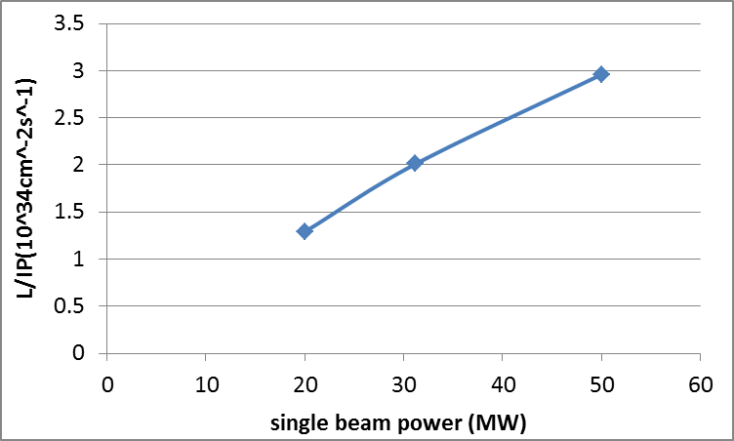
CEPC Higgs Luminosity vs beam power

Slide 6
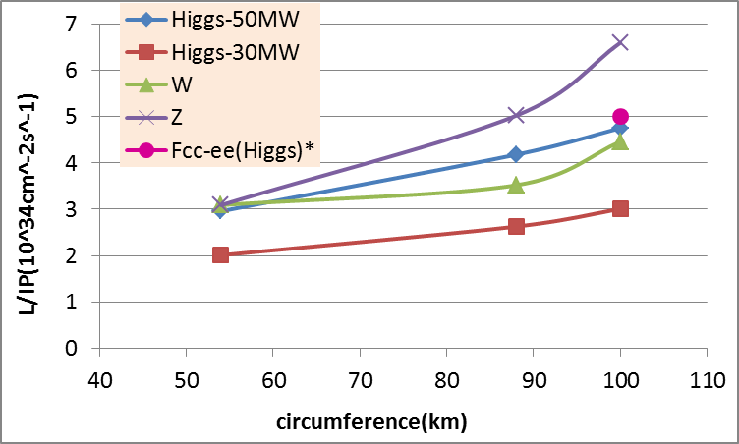
CEPC PDR Luminosity vs circumference
* Fabiola Gianotti, Future Circular ColliderDesign Study, ICFA meeting, J-PARC, 25-2-2016.

Slide 7
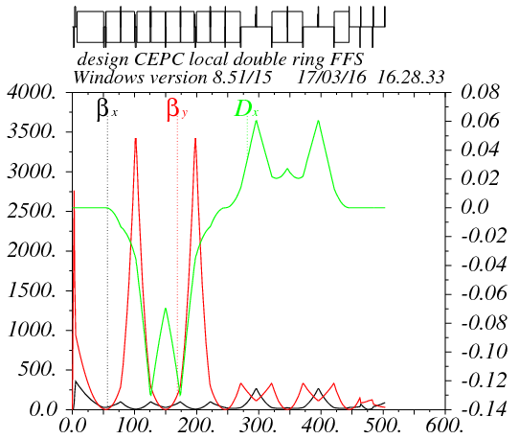
Partial double ring FFS design with crab sextupoles
Betax=0.25m
Betay=0.00136m
K2hs=26.8 m⁻³
K2vs=32.2 m⁻³
Crab sextupole
IP
Critical energy: Ec=190 keV
Dipole strength: B=0.019 T
The second FFS sextupoles of the CCS-Y section work as the crab sextupoles.

Slide 8
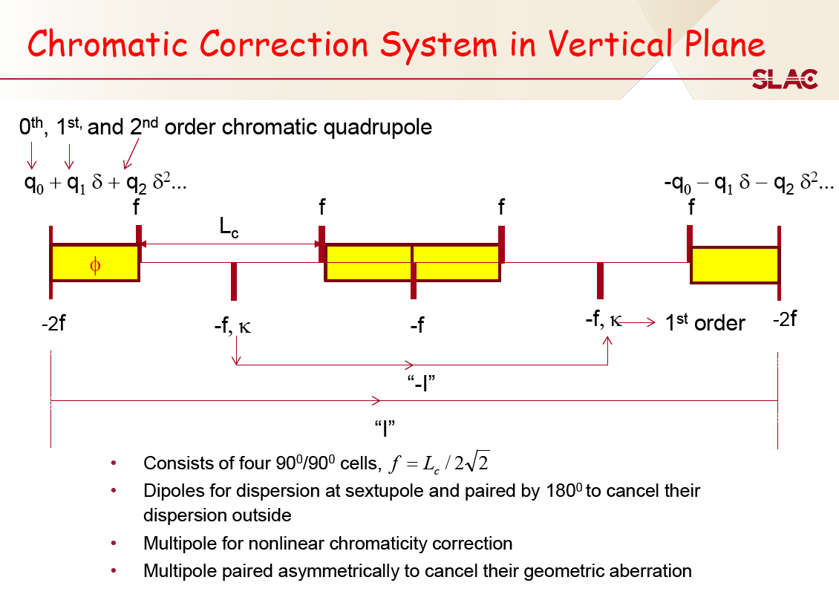

Slide 9
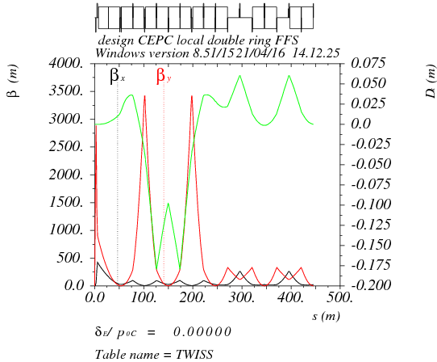
Higher order chromaticity correction in FFS
Quadrupole pair, sextupole pair, octupole pair.

Slide 10
Thanks！

