Slide 1
Update on pretzel scheme design
Huiping Geng
2016.04.22

Slide 2
Contents
Revisit of main ring DA results
Comparison of DA results with different straight section length combination
Summary

Slide 3
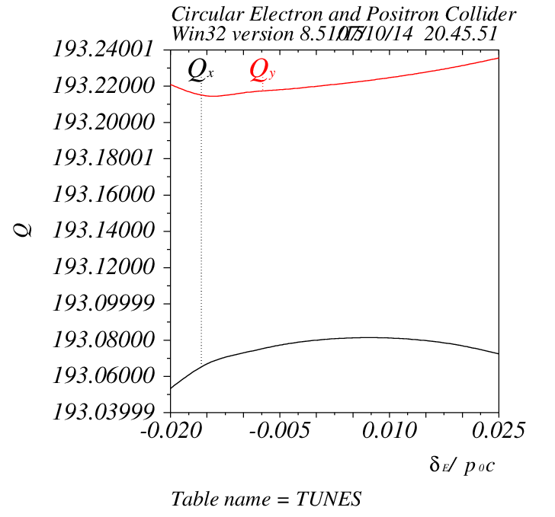
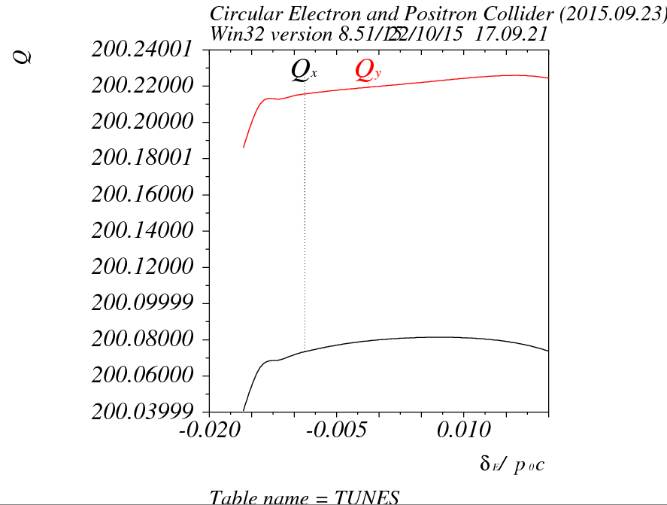
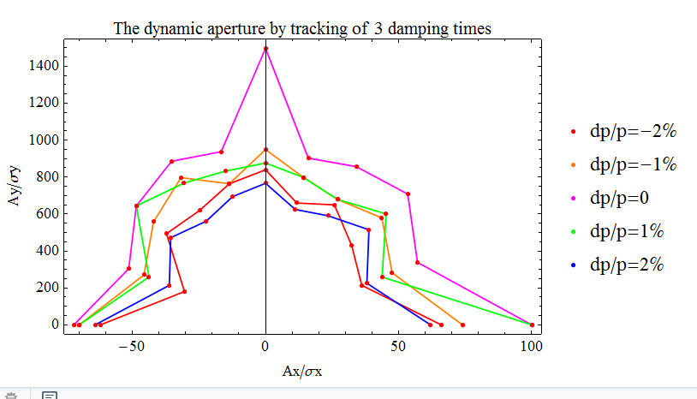
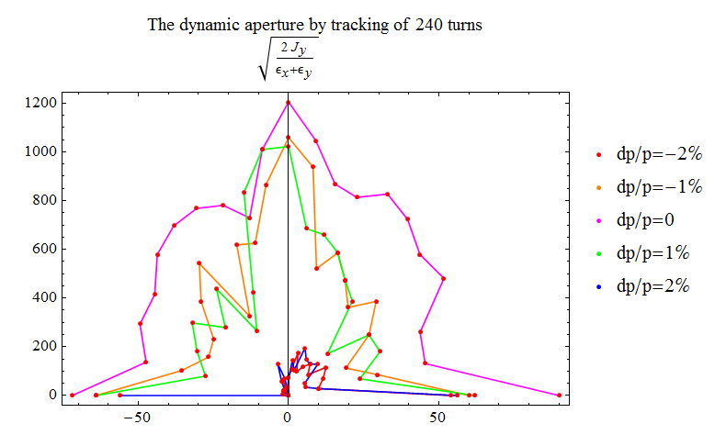
Revisit of previous main ring DA results
MAD matching results
New version
v20150923
With same working point and chromatic correction scheme
Dramatic drop of DA at ±2% momentum spread

Slide 4
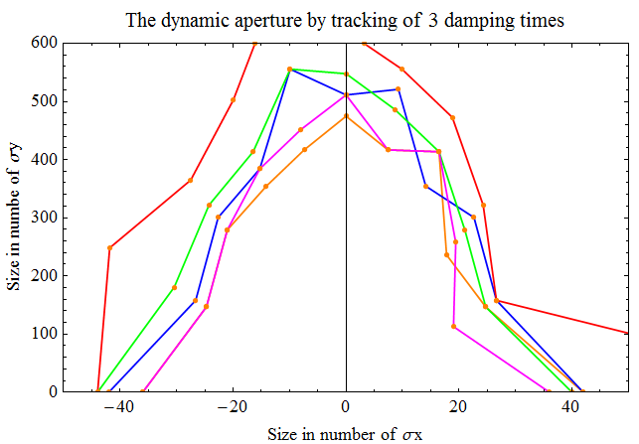
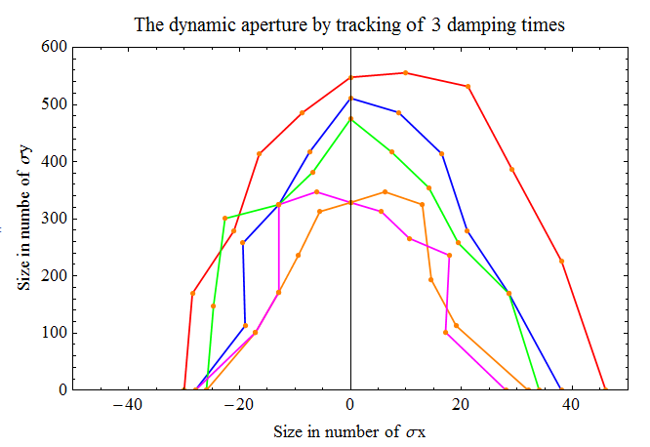
Revisit of previous main ring DA results
（18+34）结构
（14+38）结构

Slide 5
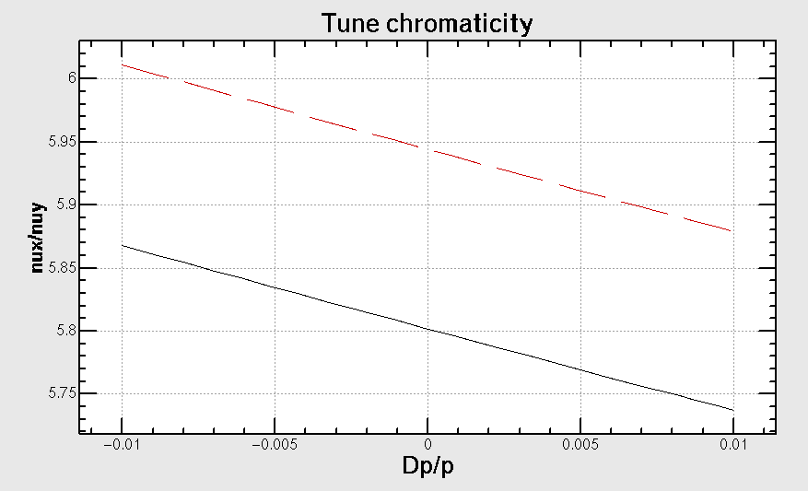
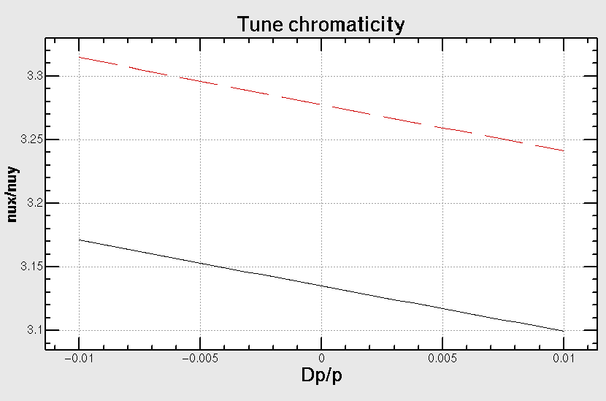
长短直线节的局部色品
Revisit of previous main ring DA results
长直线节，1604.8m
Tune 变化了0.13
短直线节，849.6m
Tune变化了0.07

Slide 6
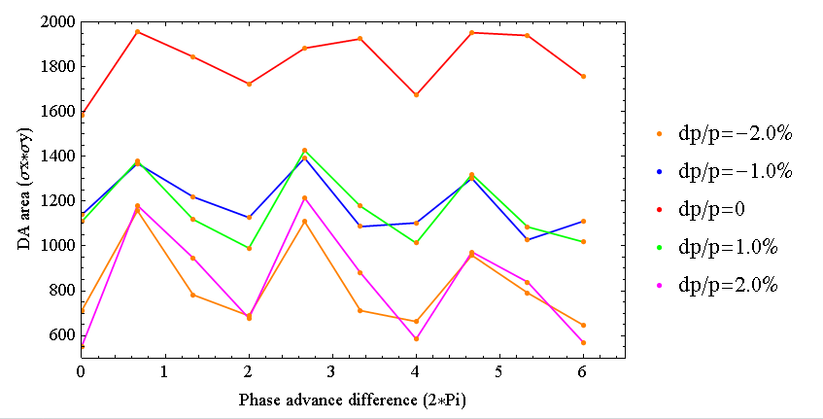
改变最长直线节的长度，保持周长不变，工作点不变
从左到右，长短直线节长度差逐步加大，最右边的点，短直线节最短为8个FODO cell长度。

Slide 7
Summary/ work to do
Try to optimize main ring DA
Tune scan
FMA

