Slide 1

CEPC parameter choice and partial double ring design
Dou Wang, Jie Gao, Feng Su, Yuan Zhang, Jiyuan Zhai, Yiwei Wang, Bai Sha, Huiping Geng, Tianjian Bian, Na Wang, Xiaohao Cui, Zhe Duan, Yuanyuan Guo

Slide 2
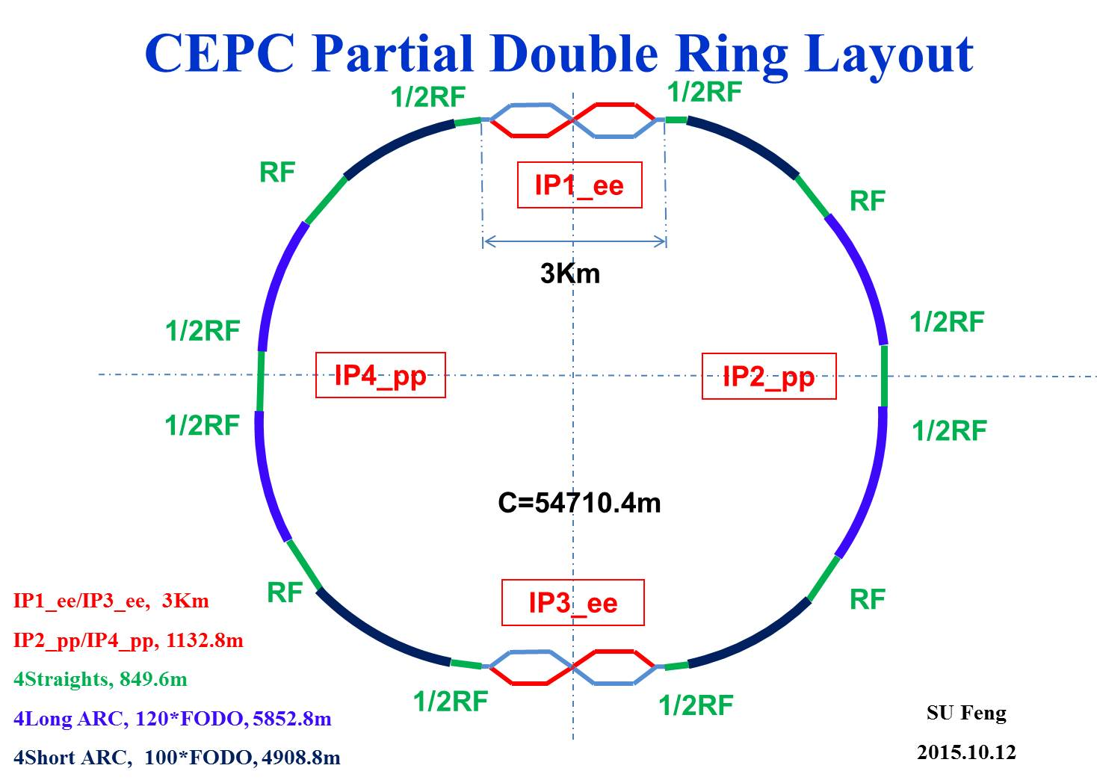
Advantage:
Avoid pretzel orbit
Accommodate more bunches at Z/W energy
Increase luminosity and reduce beam power with crab waist collision
bypass (pp)
bypass (pp)

Slide 3
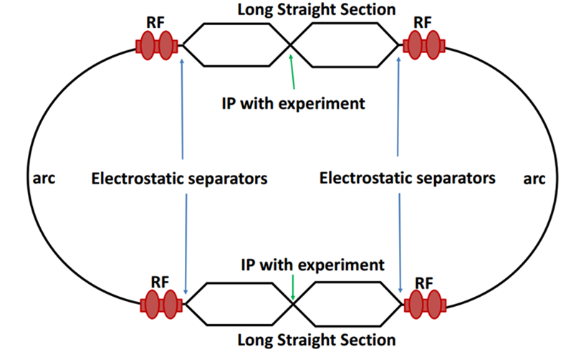
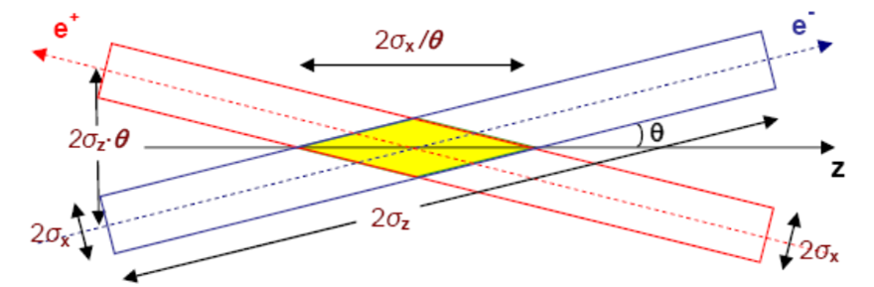
Machine constraints / given parameters
Energy E₀
Circumference C₀
N_{IP}
Beam power P₀
β_{y}*
Emittance coupling factor κ_{ε}
Bending radius ρ
Piwinski angle Φ
ξy enhancement by crab waist F_{l} ~1.5 (2.6)
Energy acceptance (DA)
Phase advance per cell (FODO)

Slide 4
Constraints for parameter choice
Limit of Beam-beam tune shift
F_{l}: ξy enhancement by crab waist
Beam lifetime due to beamstrahlung
BS life time: 30 min
V.I. Telnov
Beamstrahlung energy spread
A=δ₀/δ_{BS} (A≥3)
HOM power per cavity
*J. Gao, emittance growth and beam lifetime limitations due to beam-beam effects in e+e- storage rings, Nucl. Instr. and methods A533（2004）p. 270-274.

Slide 5
Parameter choice – step 1
Beam-beam limit:
F_{l}: ξy enhancement by crab waist, ~ 1.5.

Slide 6
Parameter choice – step 2

Slide 7
Parameter choice – step 3
BS life time: 30 min
ξy:
μ-- phase advance/cell, ϕ-- bending angle/cell.
Estimate :

Slide 8
Parameter choice – step 4

Slide 9
Parameter choice – step 5
Effective bunch length: overlap area of colliding bunches
Hour glass effect:

Slide 10
Parameter choice – step 6
V_{rf} , φ_{s}
Energy acceptance from RF:

Slide 11
Parameter choice – step 7
Beam lifetime due to radiative Bhabha scattering
Beam lifetime due to Beamstrahlung
HOM power per cavity
HOM loss factor:
*V.I. Telnov, "Issues with current designs for e+e- and gammagamma colliders“, PoS Photon2013 (2013) 070. https://inspirehep.net/record/1298149/files/Photon%202013_070.pdf

Slide 12
parameter for CEPC partial double ring
（wangdou20160420）
 | Pre-CDR | H-high lumi. | H-low power | H-20MW | W | Z
Number of IPs | 2 | 2 | 2 | 2 | 2 | 2
Energy (GeV) | 120 | 120 | 120 | 120 | 80 | 45.5
Circumference (km) | 54 | 54 | 54 | 54 | 54 | 54
SR loss/turn (GeV) | 3.1 | 2.96 | 2.96 | 2.96 | 0.59 | 0.062
Half crossing angle (mrad) | 0 | 15 | 15 | 15 | 15 | 15
Piwinski angle | 0 | 2.5 | 2.6 | 2.6 | 5 | 7.6
N_{e}/bunch (10¹¹) | 3.79 | 2.85 | 2.67 | 2.66 | 0.74 | 0.46
Bunch number | 50 | 67 | 44 | 29 | 400 | 1100
Beam current (mA) | 16.6 | 16.9 | 10.5 | 6.8 | 26.2 | 45.4
SR power /beam (MW) | 51.7 | 50 | 31.2 | 20 | 15.6 | 2.8
Bending radius (km) | 6.1 | 6.2 | 6.2 | 6.2 | 6.1 | 6.1
Momentum compaction (10⁻⁵) | 3.4 | 2.5 | 2.2 | 2.2 | 2.4 | 3.5
β_{IP} x/y (m) | 0.8/0.0012 | 0.25/0.00136 | 0.268 /0.00124 | 0.267/0.00124 | 0.1/0.001 | 0.1/0.001
Emittance x/y (nm) | 6.12/0.018 | 2.45/0.0074 | 2.06 /0.0062 | 2.06/0.0062 | 1.02/0.003 | 0.62/0.0028
Transverse σ_{IP} (um) | 69.97/0.15 | 24.8/0.1 | 23.5/0.088 | 23.4/0.088 | 10.1/0.056 | 7.9/0.053
ξ_{x}/IP | 0.118 | 0.03 | 0.032 | 0.032 | 0.008 | 0.006
ξ_{y}/IP | 0.083 | 0.11 | 0.11 | 0.11 | 0.074 | 0.073
V_{RF} (GV) | 6.87 | 3.62 | 3.53 | 3.53 | 0.81 | 0.12
f _{RF} (MHz) | 650 | 650 | 650 | 650 | 650 | 650
Nature σ_{z} (mm) | 2.14 | 3.1 | 3.0 | 3.0 | 3.25 | 3.9
Total σ_{z} (mm) | 2.65 | 4.1 | 4.0 | 4.0 | 3.35 | 4.0
HOM power/cavity (kw) | 3.6 | 2.2 | 1.3 | 0.84 | 0.99 | 0.99
Energy spread (%) | 0.13 | 0.13 | 0.13 | 0.13 | 0.09 | 0.05
Energy acceptance (%) | 2 | 2 | 2 | 2
Energy acceptance by RF (%) | 6 | 2.2 | 2.1 | 2.1 | 1.7 | 1.1
n_{γ} | 0.23 | 0.47 | 0.47 | 0.47 | 0.3 | 0.24
Life time due to beamstrahlung_cal (minute) | 47 | 36 | 32 | 32
F (hour glass) | 0.68 | 0.82 | 0.81 | 0.81 | 0.92 | 0.95
L_{max}/IP (10³⁴cm⁻²s⁻¹) | 2.04 | 2.96 | 2.01 | 1.29 | 3.09 | 3.09

Slide 13
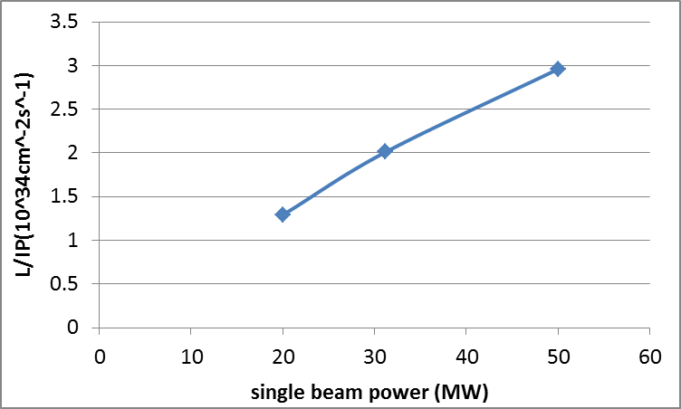
CEPC Higgs Luminosity vs beam power

Slide 14
CEPC single ring parameter-54km
 | H |  | Z
 | Pre-CDR | Low-HOM
Number of IPs | 2 | 2 | 2
Energy (GeV) | 120 | 120 | 45.5
Circumference (km) | 54 | 54 | 54
SR loss/turn (GeV) | 3.1 | 3.1 | 0.062
N_{e}/bunch (10¹¹) | 3.79 | 1.0 | 0.13
Bunch number | 50 | 187 | 4800 | 100
Beam current (mA) | 16.6 | 16.6 | 55.5 | 1.1
SR power /beam (MW) | 51.7 | 50 | 3.45 | 0.072
Bending radius (km) | 6.1 | 6.1 | 6.1
Momentum compaction (10⁻⁵) | 3.4 | 3.4 | 3.4
β_{IP} x/y (m) | 0.8/0.0012 | 0.06/0.001 | 0.4/0.0012
Emittance x/y (nm) | 6.12/0.018 | 6.13/0.018 | 0.9/0.018
Transverse σ_{IP} (um) | 69.97/0.15 | 19.2/0.13 | 18.9/0.15
ξ_{x}/IP | 0.118 | 0.031 | 0.072
ξ_{y}/IP | 0.083 | 0.074 | 0.028
V_{RF} (GV) | 6.87 | 6.87 | 0.68
f _{RF} (MHz) | 650 | 650 | 650
Nature σ_{z} (mm) | 2.14 | 2.13 | 1.5
Total σ_{z} (mm) | 2.65 | 2.4 | 1.5
HOM power/cavity (kw) | 3.6 | 1.0 | 0.55 | 0.01
Energy spread (%) | 0.13 | 0.13 | 0.05
Energy acceptance (%) | 2 | 1.5
Energy acceptance by RF (%) | 6 | 6.1 | 4.5
n_{γ} | 0.23 | 0.21 | 0.028
Life time due to beamstrahlung_cal (minute) | 47 | 46
F (hour glass) | 0.68 | 0.66 | 0.82
L_{max}/IP (10³⁴cm⁻²s⁻¹) | 2.04 | 2.1 | 1.04 | 0.022

Slide 15
parameter for CEPC PDR-88km
（wangdou20160329）
 | H-high lumi. | H-low power | W | Z
Number of IPs | 2 | 2 | 2 | 2
Energy (GeV) | 120 | 120 | 80 | 45.5
Circumference (km) | 88 | 88 | 88 | 88
SR loss/turn (GeV) | 2.0 | 2.0 | 0.4 | 0.04
Half crossing angle (mrad) | 15 | 15 | 15 | 15
Piwinski angle | 2.0 | 2.6 | 6.3 | 12.1
N_{e}/bunch (10¹¹) | 1.75 | 1.53 | 0.565 | 0.24
Bunch number | 257 | 176 | 1150 | 6600
Beam current (mA) | 24.5 | 14.7 | 35.5 | 86.5
SR power /beam (MW) | 50 | 30 | 14.3 | 3.6
Bending radius (km) | 9.0 | 9.0 | 9.0 | 9.0
Momentum compaction (10⁻⁵) | 1.9 | 1.5 | 1.9 | 1.9
β_{IP} x/y (m) | 0.36/0.0011 | 0.36/0.0011 | 0.1/0.001 | 0.1/0.001
Emittance x/y (nm) | 1.63/0.005 | 1.15 /0.0035 | 0.76/0.0023 | 0.24/0.0011
Transverse σ_{IP} (um) | 24.4/0.074 | 20.5/0.062 | 8.7/0.048 | 4.9/0.033
ξ_{x}/IP | 0.04 | 0.033 | 0.0053 | 0.0033
ξ_{y}/IP | 0.091 | 0.091 | 0.061 | 0.06
V_{RF} (GV) | 3.1 | 2.57 | 0.57 | 0.074
f _{RF} (MHz) | 650 | 650 | 650 | 650
Nature σ_{z} (mm) | 2.7 | 2.94 | 3.55 | 3.93
Total σ_{z} (mm) | 3.25 | 3.53 | 3.65 | 4.0
HOM power/cavity (kw) | 2.2 | 1.1 | 0.99 | 0.97
Energy spread (%) | 0.1 | 0.1 | 0.07 | 0.04
Energy acceptance (%) | 1.5 | 1.4
Energy acceptance by RF (%) | 3 | 2.1 | 1.4 | 0.9
n_{γ} | 0.29 | 0.31 | 0.27 | 0.2
Life time due to beamstrahlung_cal (minute) | 32 | 40
F (hour glass) | 0.78 | 0.82 | 0.94 | 0.97
L_{max}/IP (10³⁴cm⁻²s⁻¹) | 4.18 | 2.63 | 3.52 | 5.02

Slide 16
parameter for CEPC PDR-100km
（wangdou20160329）
 | H-high lumi. | H-low power | W | Z
Number of IPs | 2 | 2 | 2 | 2
Energy (GeV) | 120 | 120 | 80 | 45.5
Circumference (km) | 100 | 100 | 100 | 100
SR loss/turn (GeV) | 1.7 | 1.7 | 0.33 | 0.034
Half crossing angle (mrad) | 15 | 15 | 15 | 15
Piwinski angle | 2.0 | 2.83 | 8.65 | 15.8
N_{e}/bunch (10¹¹) | 1.43 | 1.22 | 0.42 | 0.165
Bunch number | 436 | 307 | 2400 | 15800 | 182260
Beam current (mA) | 30 | 18 | 48.7 | 125.3 | 1449.7
SR power /beam (MW) | 50 | 30 | 16.0 | 4.3 | 50
Bending radius (km) | 11 | 11 | 11 | 11
Momentum compaction (10⁻⁵) | 1.8 | 1.4 | 1.4 | 1.3
β_{IP} x/y (m) | 0.297/0.0011 | 0.3/0.0011 | 0.1/0.001 | 0.1/0.001
Emittance x/y (nm) | 1.63/0.0049 | 1.03/0.003 | 0.46/0.0014 | 0.14/0.00065
Transverse σ_{IP} (um) | 22/0.074 | 17.6/0.59 | 6.8/0.037 | 3.8/0.026
ξ_{x}/IP | 0.033 | 0.025 | 0.003 | 0.002
ξ_{y}/IP | 0.083 | 0.083 | 0.055 | 0.054
V_{RF} (GV) | 3.1 | 2.25 | 0.41 | 0.053
f _{RF} (MHz) | 650 | 650 | 650 | 650
Nature σ_{z} (mm) | 2.45 | 2.77 | 3.8 | 3.94
Total σ_{z} (mm) | 2.94 | 3.33 | 3.9 | 4.0
HOM power/cavity (kw) | 2.3 | 1.1 | 0.98 | 0.97 | 11.3
Energy spread (%) | 0.1 | 0.1 | 0.065 | 0.037
Energy acceptance (%) | 1.46 | 1.4
Energy acceptance by RF (%) | 3.5 | 2.2 | 0.9 | 0.7
n_{γ} | 0.27 | 0.28 | 0.26 | 0.18
Life time due to beamstrahlung_cal (minute) | 40 | 49
F (hour glass) | 0.8 | 0.85 | 0.96 | 0.985
L_{max}/IP (10³⁴cm⁻²s⁻¹) | 4.75 | 3.01 | 4.46 | 6.59 | 76.4

Slide 17
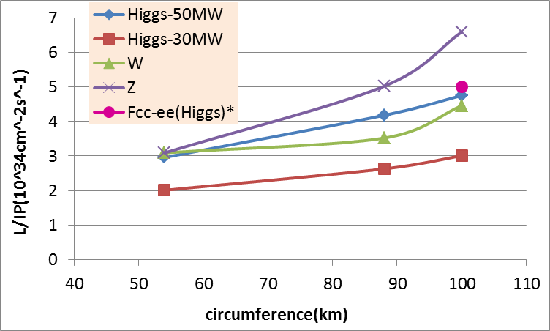
CEPC PDR Luminosity vs circumference
* Fabiola Gianotti, Future Circular ColliderDesign Study, ICFA meeting, J-PARC, 25-2-2016.

Slide 18
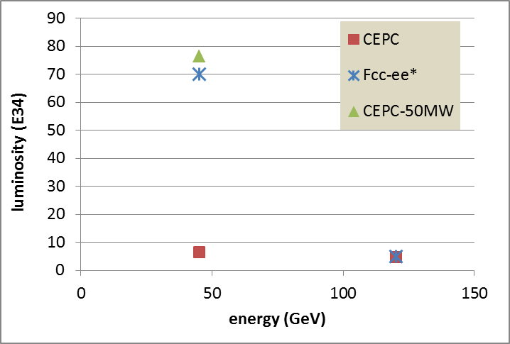
100km CEPC PDR vs Fcc-ee
P_{HOM,CEPC}=11.3 kw
The large difference of Z is due to the constraint for RF HOM power.
* Fabiola Gianotti, Future Circular ColliderDesign Study, ICFA meeting, J-PARC, 25-2-2016.

Slide 19
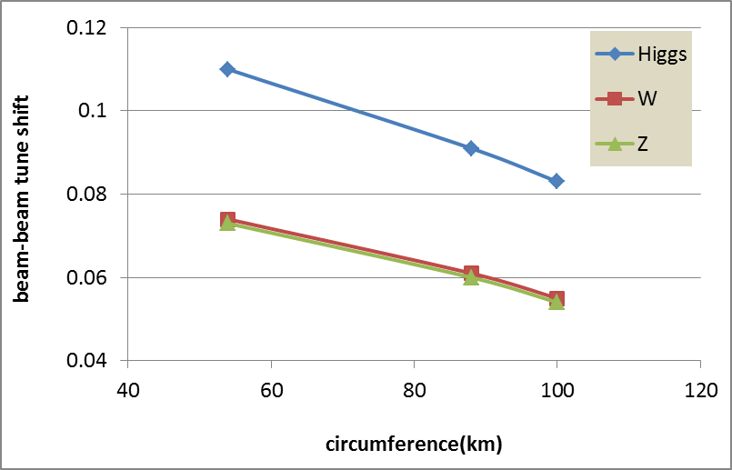
CEPC PDR ξ_{y} vs circumference (Higgs)

Slide 20
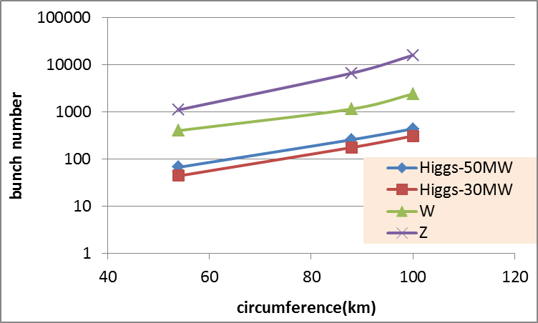
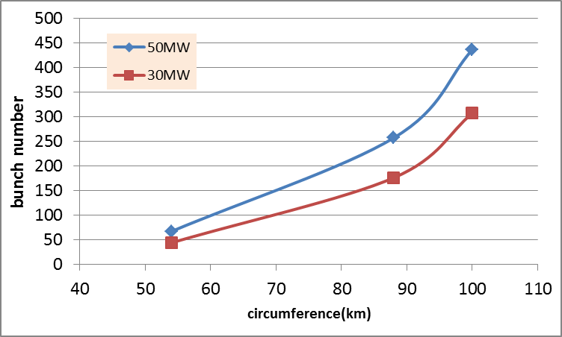
CEPC PDR bunch number vs circumference
Higgs

Slide 21
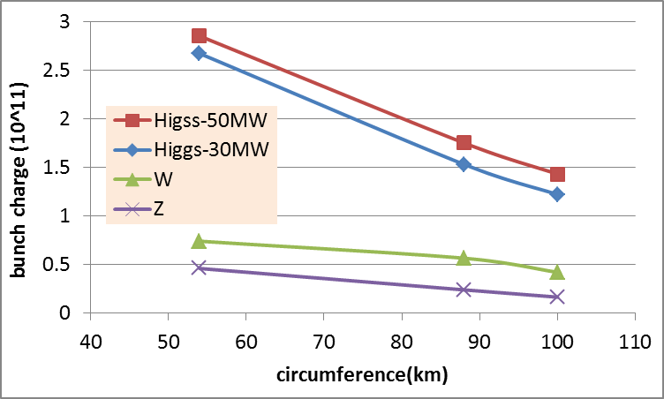
CEPC PDR bunch charge vs circumference

Slide 22
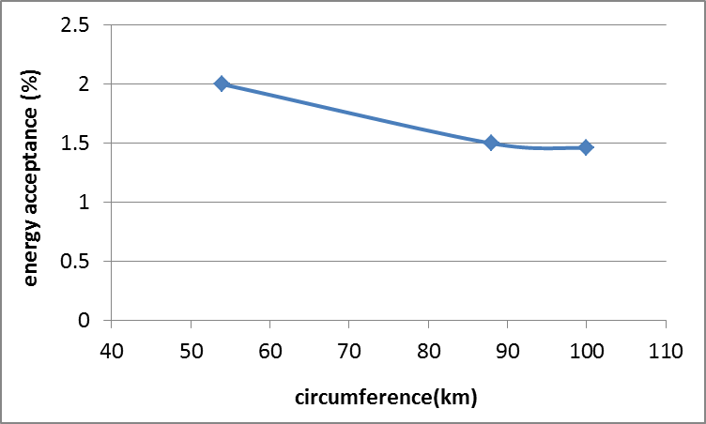
CEPC PDR energy acceptance vs circumference (Higgs)

Slide 23
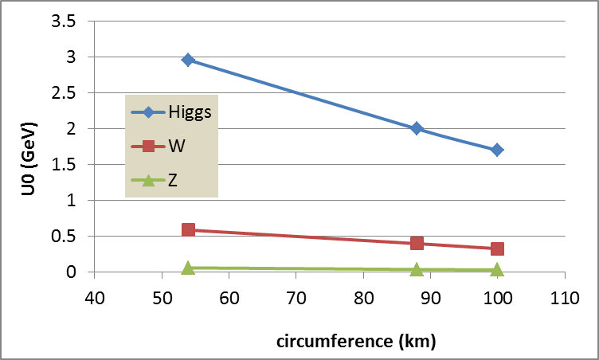
CEPC PDR SR loss vs circumference

Slide 24
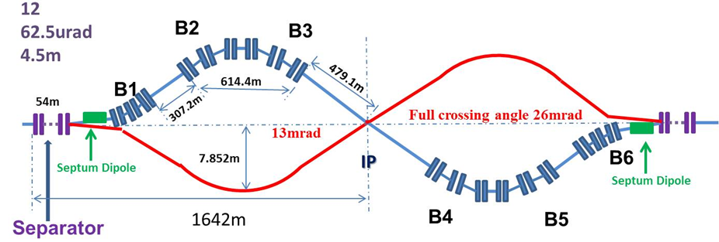
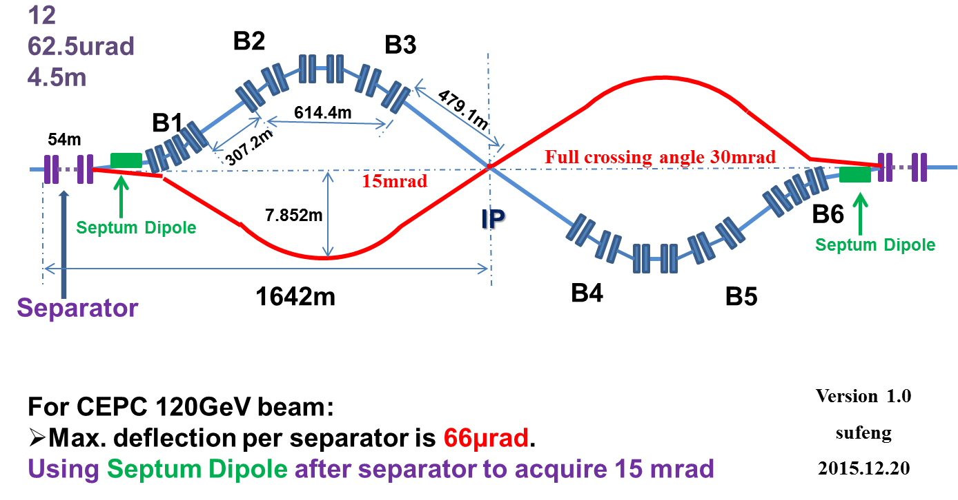
CEPC Partial Double Ring Lattice

Slide 25
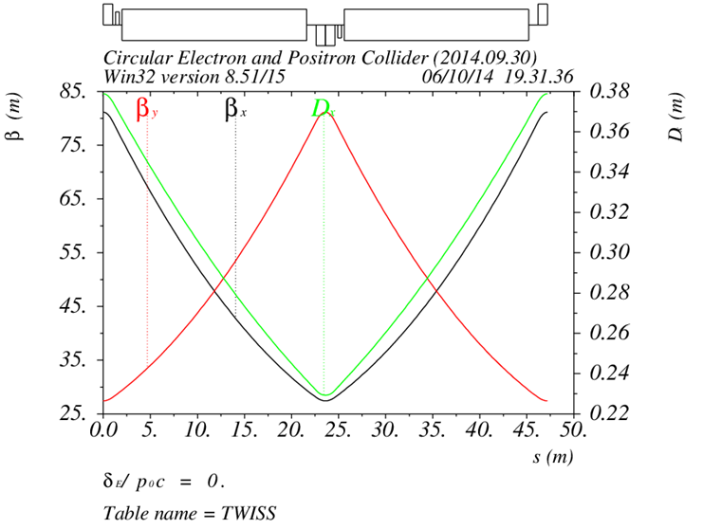
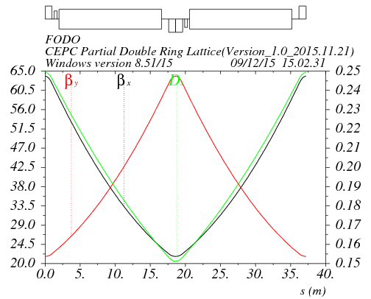
Arc redesign-lower emittance
Length of FODO cell: 47.2m
Phase advance of FODO cells: 60/60 degrees
Emittance: 7.9nm, αp=5.38E-5
Bunch length: 2.3mm
Length of FODO cell: 37.5m
Phase advance of FODO cells: 60/60 degrees
Emittance: 4.3nm , αp=2.25E-5
Bunch length: 3.3mm

Slide 26
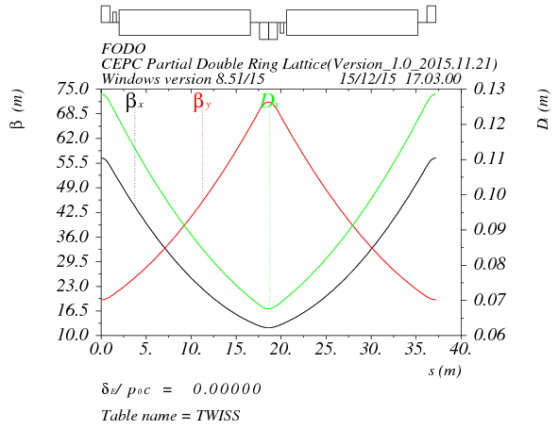
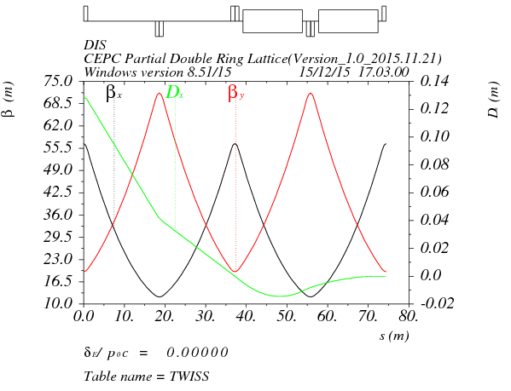
Low emittance arc – 90°/60°
Length of FODO cell: 37.5m
Phase advance of FODO cells: 90/60 degrees
Emittance: 2.3nm, αp=1.07E-5
Bunch length: 3.1mm
Dispersion supressor:
Angle(BDIS1)=3.583724E-3
Angle(BDIS2)=-8.598108E-4
Angle(B0)=2.723923E-3
BDIS1
BDIS2
B0
B0

Slide 27
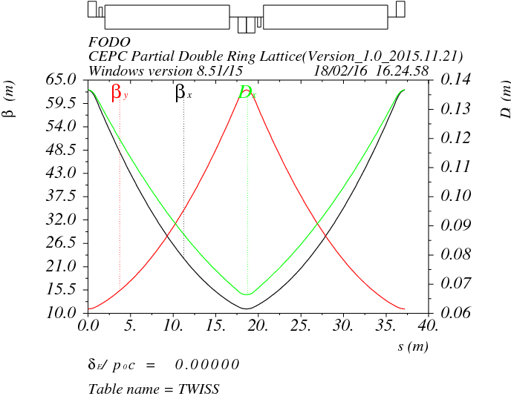
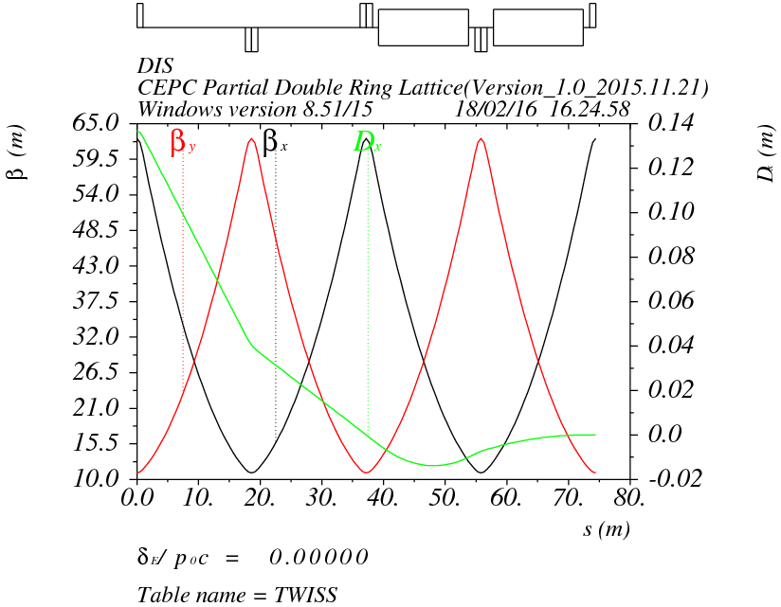
Low emittance arc – 90°/90°
Length of FODO cell: 37.5m
Phase advance of FODO cells: 90/90 degrees
Emittance: 2.3nm, αp=1.02E-5
Bunch length: 3.1mm
Dispersion supressor:
Angle(BDIS1)=3.50284406482E-3 Angle(BDIS2)=-7.78931580723E-4 Angle(B0)=2.723923E-3
BDIS1
BDIS2
B0
B0

Slide 28
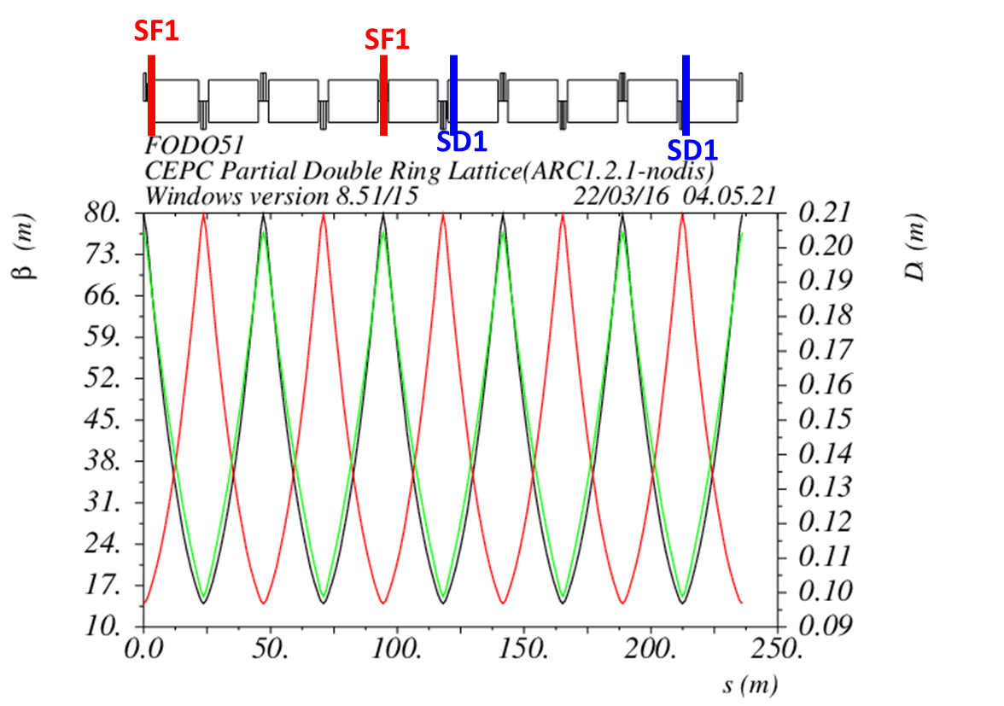
Non-interleave sextupoles in arc
(90°/90° FODO)

Slide 29
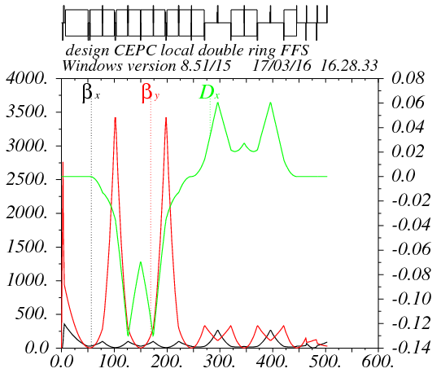
Partial double ring FFS design with crab sextupoles
Betax=0.25m
Betay=0.00136m
K2hs=26.8 m⁻³
K2vs=32.2 m⁻³
Crab sextupole
IP
Critical energy: Ec=190 keV
Dipole strength: B=0.019 T
The second FFS sextupoles of the CCS-Y section work as the crab sextupoles.

Slide 30
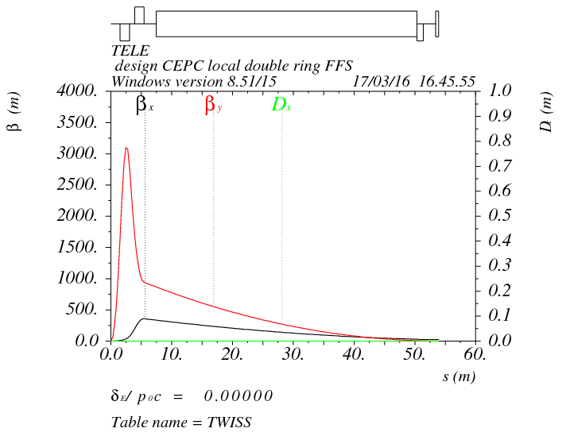
Final doublet
IP
L*=1.5m
L(QD0)=1.46m, G(QD0)=-200T/m
L(QF1)=1.29m, G(QF1)=97T/m
L₀=1.5m

Slide 31
Crab sextupole strength
Δϕ_{x}=2π, Δϕ_{y}=2.5π
The crab sextupole should be placed on both sides of the IP in phase with the IP in the horizontal plane and at π/2 in the vertical one.
13% strength of main sextupoles

Slide 32
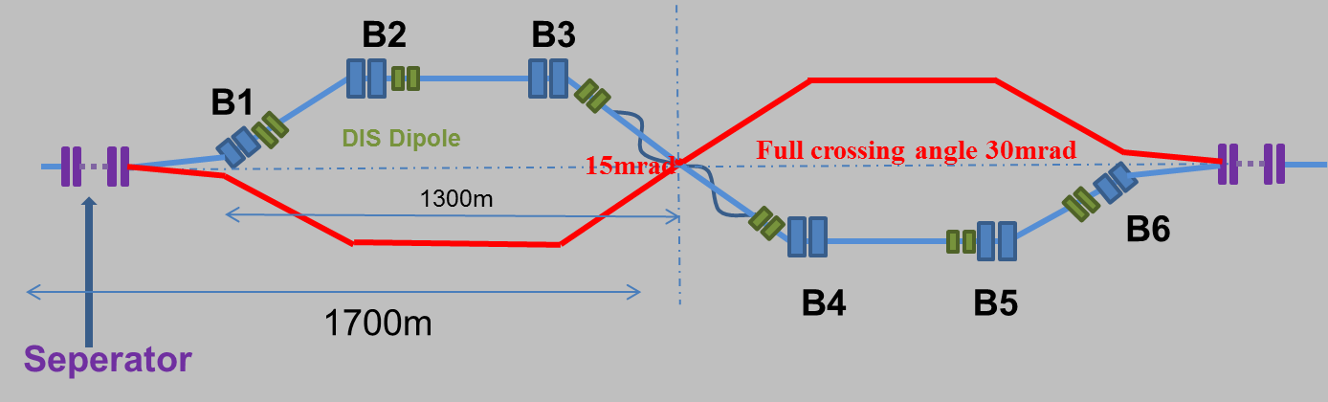
Combine with partial double ring lattice
30 mrad
10 m

Slide 33
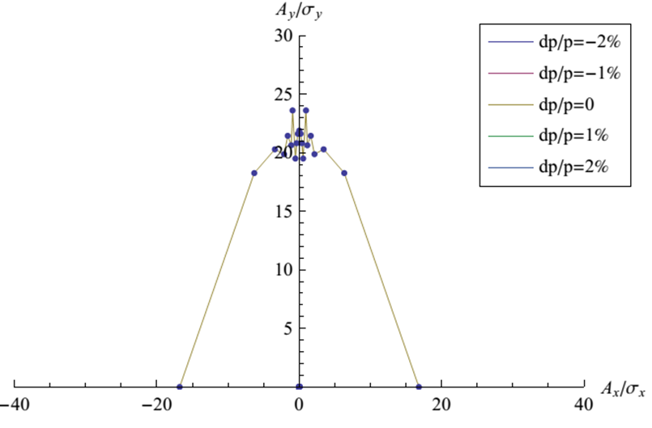
DA of the whole ring
(arc+PDR+bypass+FFS)
Su Feng 2016.03.30
Arc sextupole: 2 groups
Crab sextupoles - off

Slide 34
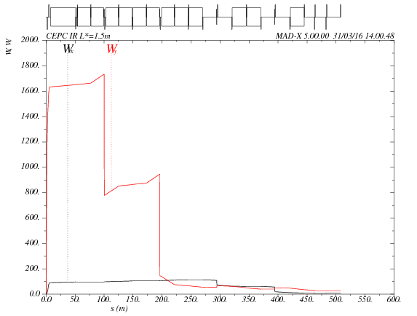
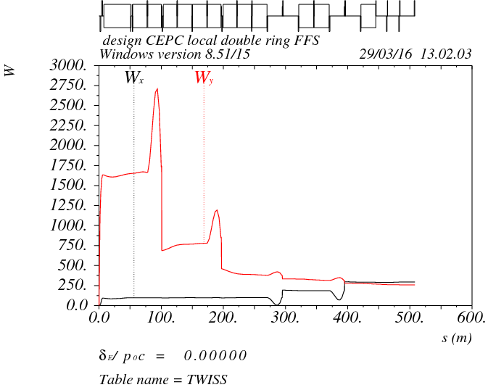
Chromaticity correction in FFS
Fine tuning the phase of main sextupoles.
Weak sextupoles are -10% of main sextupoles to correct the sextupoles’ length effect*
K2hs=-6.99 m-3
K2vs=32.16 m-3
*A. Bogomyagkov, S. Glukhov, E. Levichev and P. Piminov, “effect of the sextupole finite length on dynamic aperture in the collider final focus”, arXiv:0909.4872v1 [physics.acc-ph]

Slide 35
DA after chromaticity correction
Arc sextupole: 2 groups
Crab sextupoles - off
DA (on-momentum): 27σ_{x} × 57σ_{y}
DA (±0.5%): 2σ_{x} × 2σ_{y}

Slide 36
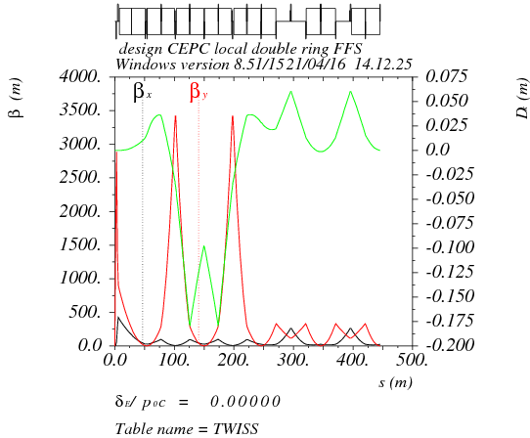
Higher order chromaticity correction in FFS
Quadrupole pair, sextupole pair, octupole pair.

Slide 37
summary
A consistent calculation method for CEPC parameter choice with carb waist scheme has been created. Larger ring has the potential to reach higher luminosity.
Based on partial double ring scheme, we can get higher luminosity (+50%) keeping Pre-CDR beam power or to reduce the beam power (30 MW) keeping same luminosity.
For “H-high lumi” mode, the HOM power per cavity can not be reduced under 1kw. The minimum value is about 2 kw.
Based on partial double ring scheme, we get a set of Z parameter with 3.1*10³⁴cm⁻²s⁻¹ luminosity using 1100 bunches.
CEPC single ring scheme is neither easy to reduce cavity HOM power for Higgs nor to accommodate more bunches for Z.
FFS with crab sextupoles and lower emittance arc has been designed. On-momentum DA of whole ring is good enough and the optimization of DA bandwidth is ongoing.

Slide 38
Thanks！

