Slide 1

LCS γ-ray and application at IHEP
__________
ICFA Mini-Workshop on
Future gamma-gamma Collider
Contributions：ZhiPeng Zheng，Jiacai Li，Tao Hu，Yongsheng Huang，Naiyan Wang.
25/4/2017

Slide 2
Cooperation teams
CIAE-China Institute of Atomic Energy:
Naiyan Wang; Bing Guo; Chuangye He
CAEP-China Academy of Engineering Physics:
Jinshui Shi; Jianjun Deng; Guojun Yang
DEP of Tsinghua University:
Chuanxiang Tang; Wei Lu

Slide 3
Outlines
Laser Inverse Compton Scattering（LCS）at IHEP
The applications：
The scaling of γ-detectors
Gamma-nuclear physics：(γ,*) reactions
CEPC γ-ray （100GeV）and possible applications (synchrotron radiation source, or LCS)

Slide 4
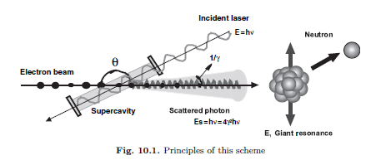
LCS γ-ray source
High brightness
The Small divergence angle: 1/γ
tunable energy in the wide MeV-GeV energy range.
Quasi-monoenergetic
Highly polarized

Slide 5
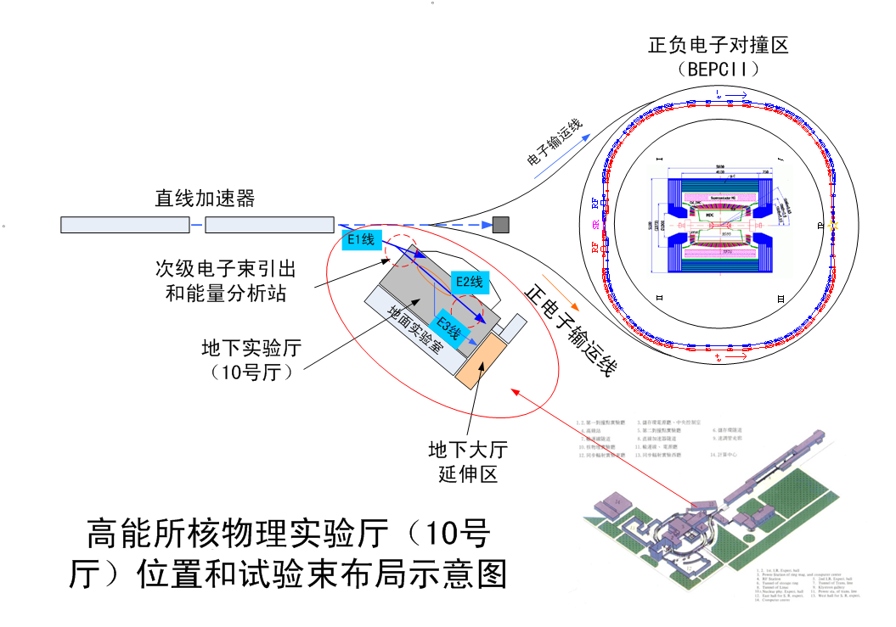
TestBeam Facility at IHEP

Slide 6
Current status /Schedule
Obtained Funds：
”The experiment study on LCS driven by intense laser pulses”, An innovative research project from CAS;
“The key technologies of LCS and applications”, An emergency management project from National Natural Fund Committee
Current status:
The basic detections of the quality of the electron beams and the laser pulses;
The synchronization scheme between the electron beams and the lasers;
The scheme of the gamma-ray detection and the related nuclear physics experimental technologies;
The plan on the technology to generate intense sub-picosecond CO2 lasers; and so on;

Slide 7
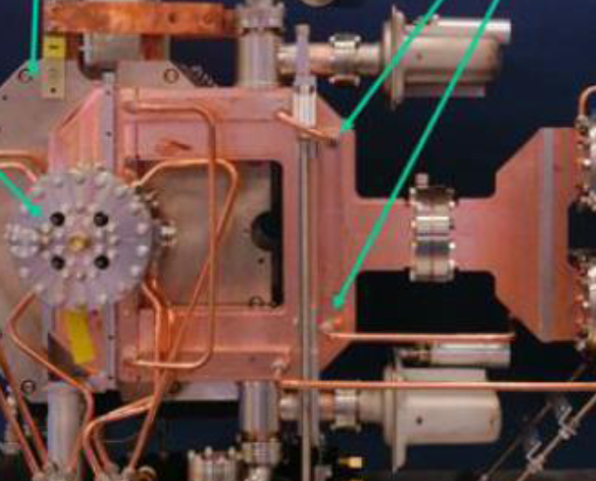
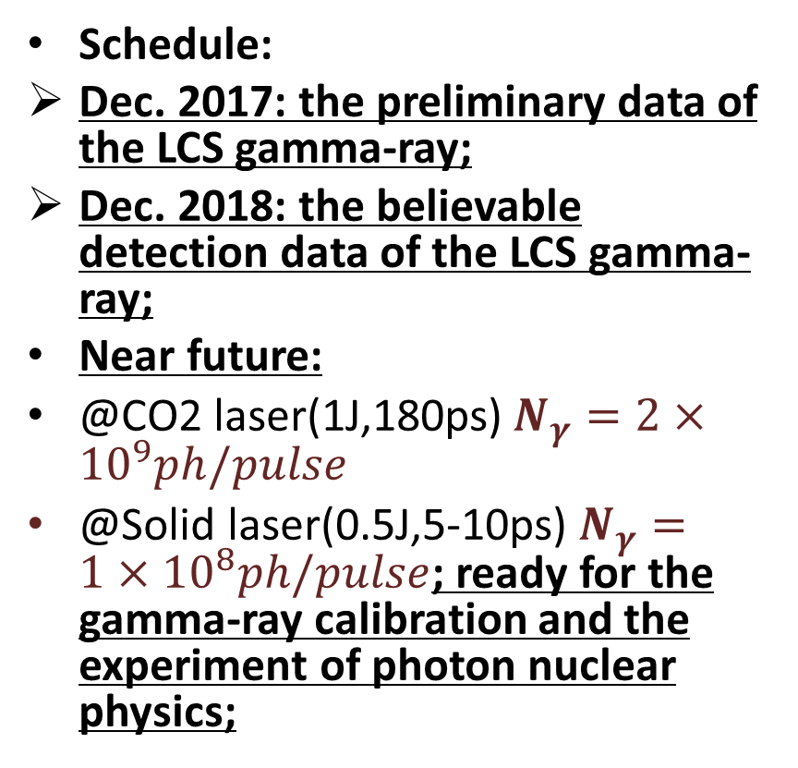
Current status /Schedule
Schedule:
Dec. 2017: the preliminary data of the LCS gamma-ray;
Dec. 2018: the believable detection data of the LCS gamma-ray;
Near future:
@CO2 laser(1J,180ps)$N_{γ}=2×{10}^{9}ph/pulse$
@Solid laser(0.5J,5-10ps)$N_{γ}=1×{10}^{8}ph/pulse$; ready for the gamma-ray calibration and the experiment of photon nuclear physics;
A Photocathode RF GUN from Tsinghua will be used to optimize the quality of the electron beam.

Slide 8
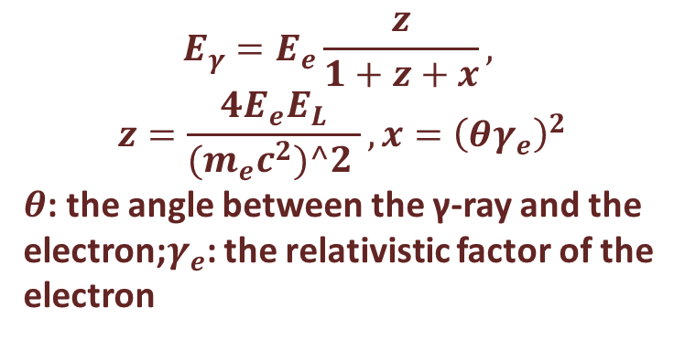
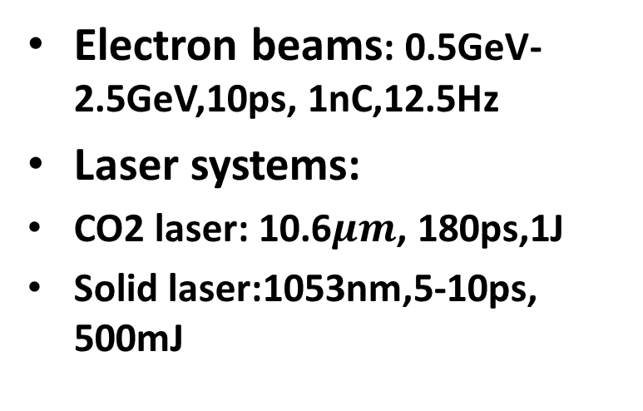
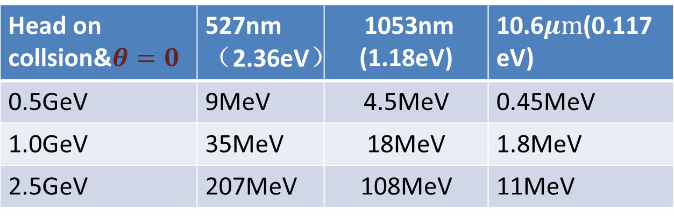
Key parameters—energy:MeV-100MeV
Electron beams: 0.5GeV-2.5GeV,10ps, 1nC,12.5Hz
Laser systems:
CO2 laser: 10.6$μm$, 180ps,1J
Solid laser:1053nm,5-10ps, 500mJ
$$E_{γ}=E_{e}\frac{z}{1+z+x},$$
$$z=\frac{4E_{e}E_{L}}{{(m}_{e}c^{2})^2 }, x={\left(θγ_{e}\right)}^{2}$$
$θ$: the angle between the γ-ray and the electron;$γ_{e}$: the relativistic factor of the electron
Head on collsion&$θ=0$ | 527nm（2.36eV） | 1053nm (1.18eV) | 10.6$μm$(0.117eV)
0.5GeV | 9MeV | 4.5MeV | 0.45MeV
1.0GeV | 35MeV | 18MeV | 1.8MeV
2.5GeV | 207MeV | 108MeV | 11MeV

Slide 9
The applications
The scaling of the γ-ray detectors：MeV-100MeV; (the wonderful source!)
Flash X-ray radiography: the measurement of the response function of the detectors to the monoenergetic x-ray;
(Different x-ray->different absorption coefficient of the matter->different inversion function; monoenergetic response function to improve the precision of the inversion )

Slide 10
The applications on photo-nuclear reaction
A energy-tunable monoenergetic γ-ray source is the best choice to (γ,n), (γ,p) and other photo-nuclear reactions!
Low-energy （1－15MeV）： nuclear resonance fluorescence; the resonant structure of the nulear; nuclear fission; p-process in the nuclear astrophysics；
Middle energy（100-200MeV）：the symmetry breaking in QCD;
High energy（>200MeV）：the resonant state of the nucleus or others

Slide 11
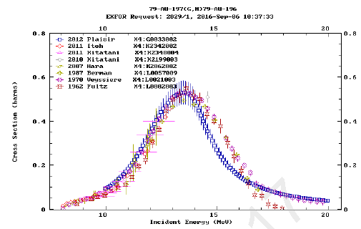
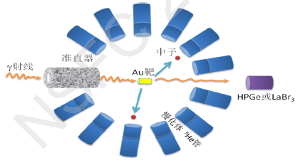
The Appications in the nuclear astrophysics
Important to the caption reactions
  (p,γ)、(α,γ) 、(n,γ) ,
  (γ, *), to generate the cross section of (*,γ) inversely by principle of detailed balance
A basic experiment ¹⁹⁷Au (γ,n)¹⁹⁶Au
Notes:
germanium lanthanum bromine(Br) aurum(Au)

Slide 12
Possible gamma-ray from CEPC
Synchrotron radiation source : MeV-100GeV gamma-ray
ICS at CEPC: 100GeV brightness gamma-ray
Gamma-ray astronomy(>GeV): important in the study of extrasolar, and especially extra-galactic astronomy.
Notes:
All GRBs observed to date have occurred well outside the Milky Way galaxy and have been harmless to Earth. However, if a GRB were to occur within the Milky Way and its emission were beamed straight towards Earth, the effects could be harmful and potentially devastating for the ecosystems. Earth's atmosphere is very effective at absorbing high energy electromagnetic radiation such as x-rays and gamma rays, so these types of radiation would not reach any dangerous levels at the surface during the burst event itself. The immediate effect on life on Earth from a GRB within a few parsecs would only be a short increase in ultraviolet radiation at ground level, lasting from less than a second to tens of seconds. This ultraviolet radiation could potentially reach dangerous levels depending on the exact nature and distance of the burst, but it seems unlikely to be able to cause a global catastrophe for life on Earth

Slide 13
Possible to be solved?
Exploration of the generation of anti-matter: Of course：e+e-；but if anti-proton or others？
Can the energetic gamma ray tear up the proton or neutron?
Why matter >> antimatter?
Can we provide reference data for gamma-ray astronomy or gamma-ray bursts?(>GeV, extrasolar or extra-galactic)
The effects of GRB on earth? Simulation
Notes:
relativistic shock wave

Slide 14
QED birefringence vanishing in a thermal relativistic pair plasma

Slide 15
Why QED? What is a vacuum?
Full of virtual electrons and particles;
Schwinger effect: vacuum breakout --→e-e+ pairs
Dynamical assisted Schwinger effect: low frequency high intense field + high frequency low intense field (PRL 101.130404)
Magnetic control of pair creation(PRL 109, 253202 (2012))
Nonlinearity: birefringence, reflection, scattering ----light-light interaction…

Slide 16
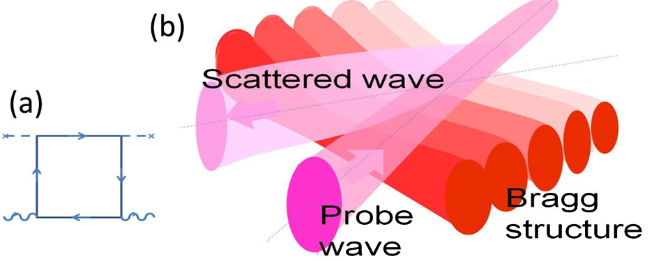
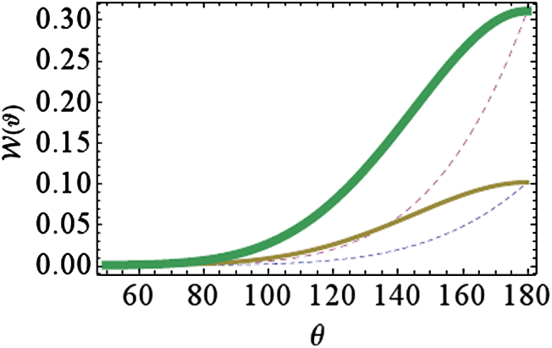
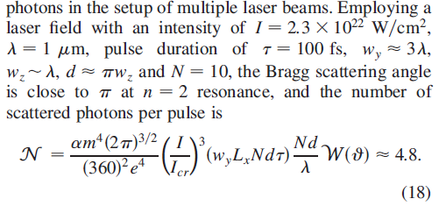
“Bragg scattering” by ultra-intense laser pulses
Gagik Yu. Kryuchkyan and Karen Z. Hatsagortsyan PRL 107, 053604 (2011)

Slide 17
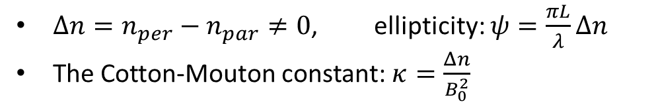
birefringence----the Cotton-Mouton effect linear polarized--→ elliptical polarized
Strong field, B₀
B₁,perpendicular polarization
E₁, parallel polarization
k of the probe wave
B₂, parallel polarization
E₂, perpendicular polarization
${Δn=n}_{per}−n_{par}≠0$, ellipticity: $ψ=\frac{πL}{λ}Δn$
The Cotton-Mouton constant: $κ=\frac{Δn}{B_{0}^{2}}$

Slide 18
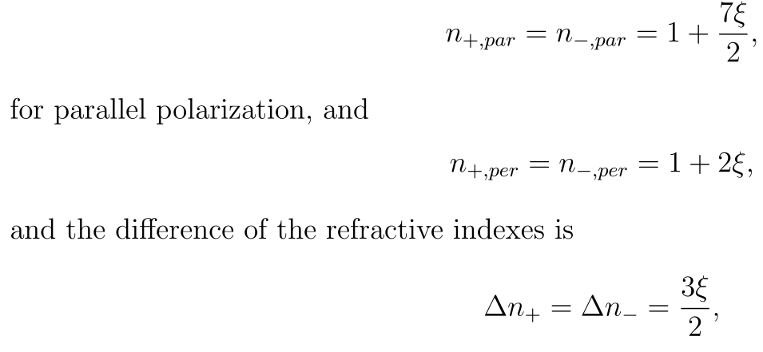
Theories about vacuum birefringence
In a homogenous magnetic field:
J. Kerr, Br. Assoc. Rep. 568 (1901); A. Cotton and H. Mouton, C. R. Hebd. S′eanc. Acad. Sci. Paris 141, 317 (1905); 142, 203 (1906); 145, 229 (1907); Ann. Chem.
Phys. 11, 145 (1907). S. Biswas and K. Melnikov, Phys. Rev. D 75, 053003 (2007). S. L. Adler, J. Phys. A: Math. Theor. 40 (2007) F143–F152; J. S Heyl and L. Hernquist, J. Phys. A: Math. Gen. 30, 6485 (1997).

Slide 19
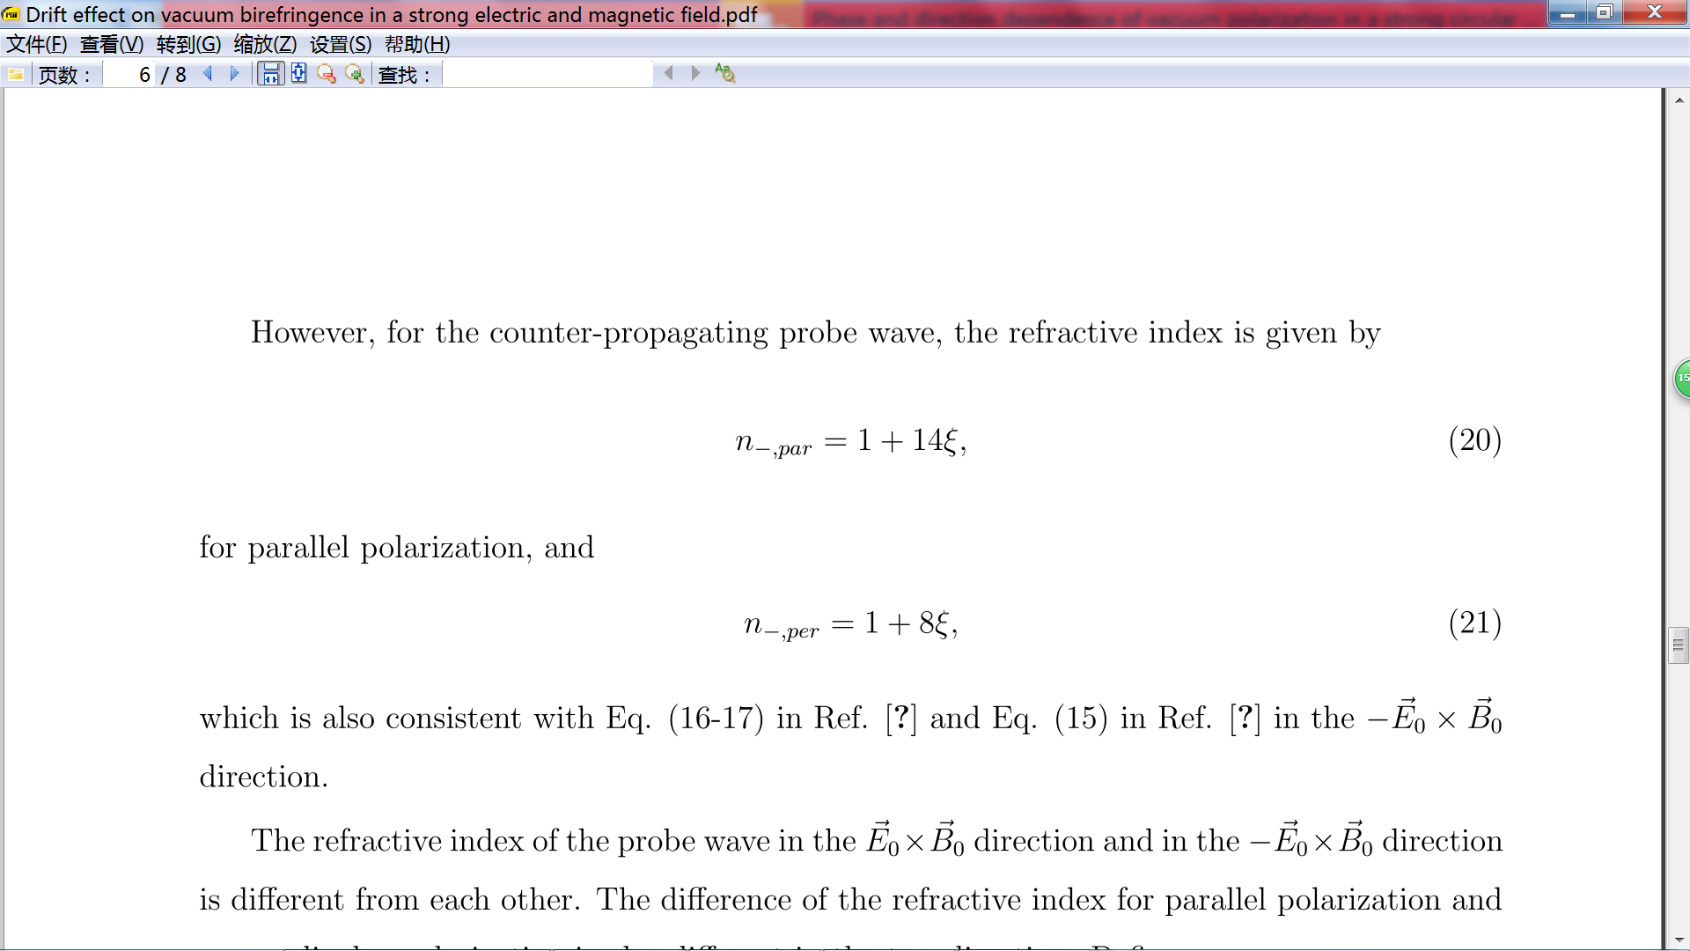

Theories about vacuum birefringence
In a crossed $E_{0}=cB_{0} field$ or in a plane wave:
No interaction in the positive z direction;
However, for the counter-propagating wave,
Thomas Heinzl, Ben Liesfeld, Kay-Uwe Amthorb, Heinrich Schwoererb, Roland Sauerbreyc, Andreas Wipfd, Optics Communications
267, 318-321 (2006). E. Brezin and C. Itzykson, Phys. Rev. D 3, 618 (1971). and so on…

Slide 20
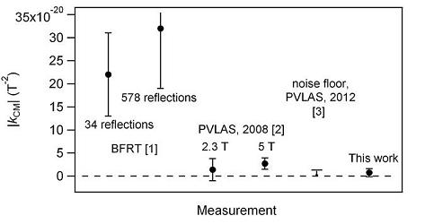
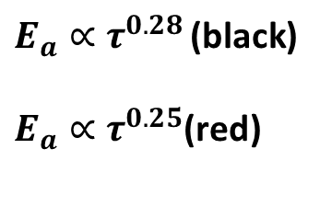
Experimental result of vacuum birefringence
BMV results: about 200 magnetic
pulses and a maximum field of 6.5 T, giving a noise floor of about 8 × 10⁻²¹ T
PVLAS 2013NJP: $Δ$n <= 4.5×10⁻²⁰
−2
at 3σ confidence level.

Slide 21
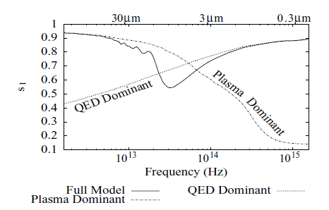
Field-induced birefringence in a plasma
Plasma collective effect
QED effect
R. M. Shannon† and J. S. Heyl,MNRAS,2006

Slide 22
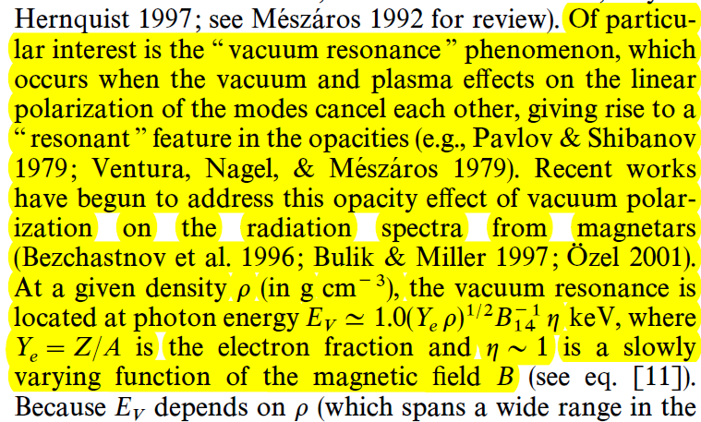
Vacuum resonance
DONG LAI AND WYNN C. G. HO,:
THE ASTROPHYSICAL JOURNAL, 566:373È377, 2002 February 10

Slide 23
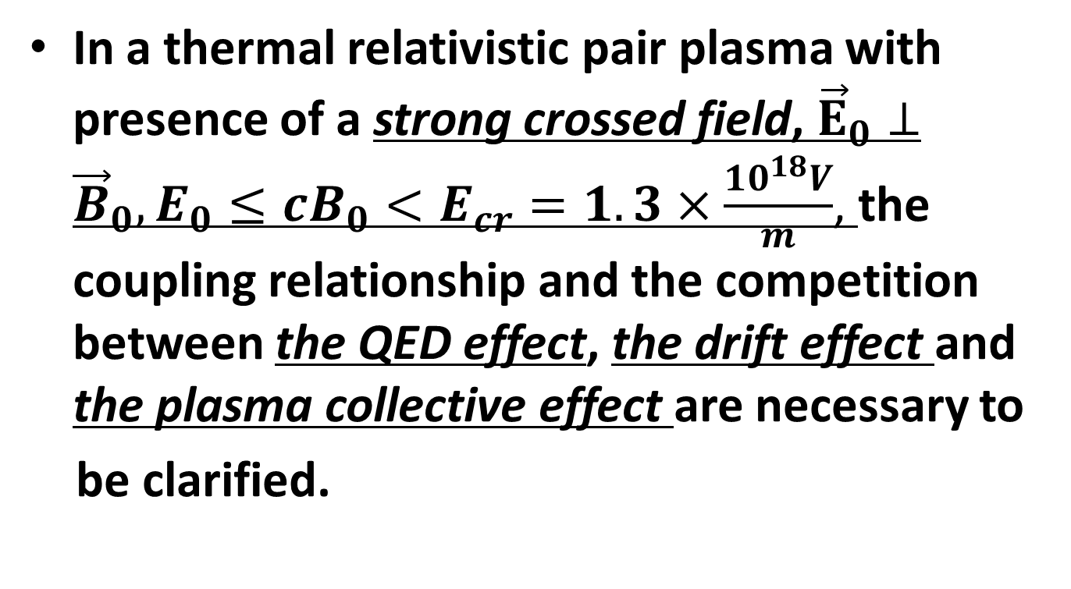
What did we do?
In a thermal relativistic pair plasma with presence of a strong crossed field, ${\vec{E}}_{0}⊥{\vec{B}}_{0}, E_{0}≤cB_{0}<E_{cr}=1.3×\frac{10^{18}V}{m}$, the coupling relationship and the competition between the QED effect, the drift effect and the plasma collective effect are necessary to
be clarified.

Slide 24
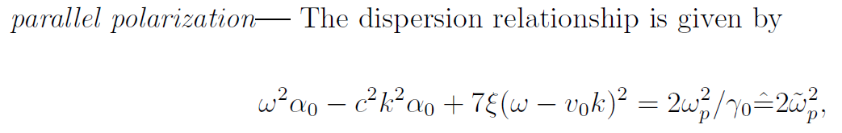
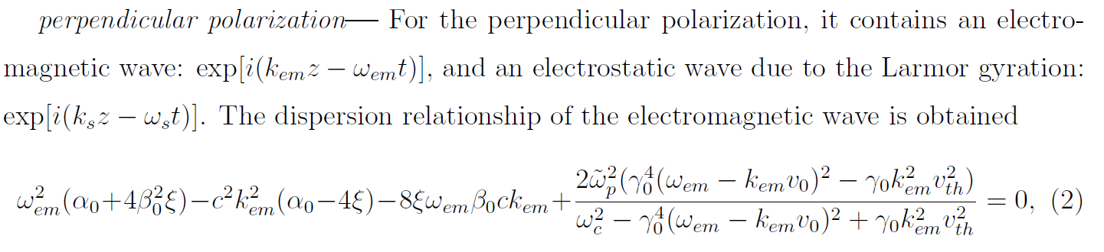
Dispersion relationship

Slide 25
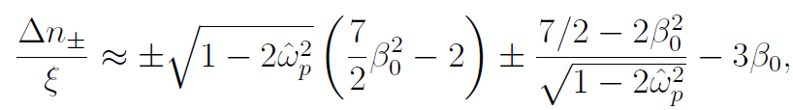
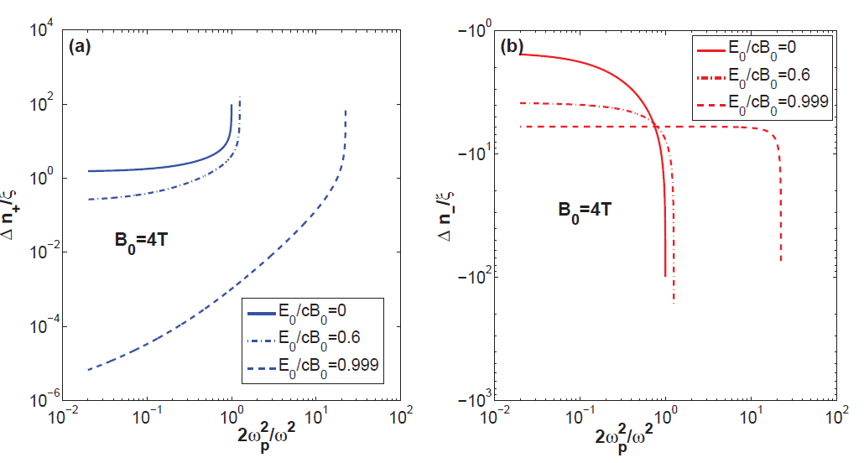

Case I: $\frac{ω_{c}^{2}}{γ_{0}^{4}}≪ω^{2}$
the low larmor frequency compared with the probe wave frequency, or the relativistic drift velocity

Slide 26

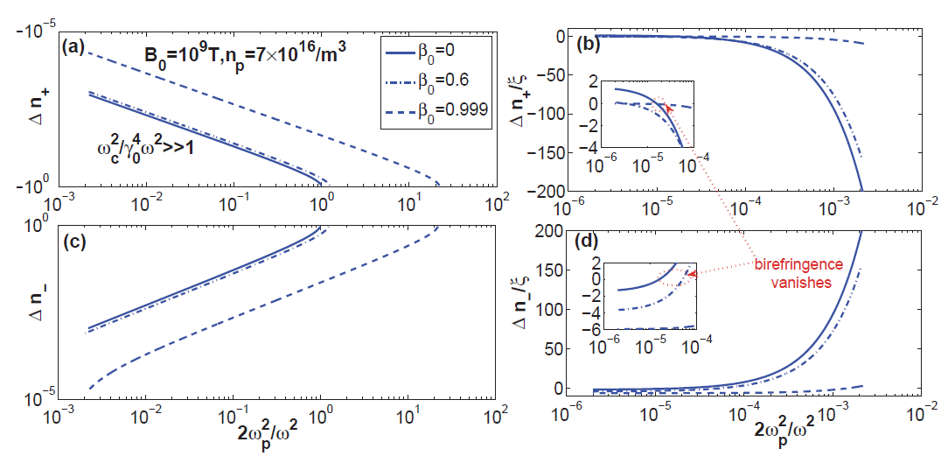

Case II: $\frac{ω_{c}^{2}}{γ_{0}^{4}}≫ω^{2}$
For the strong magnetic field, i.e., the Larmor frequency far larger than the probe wave frequency,

Slide 27
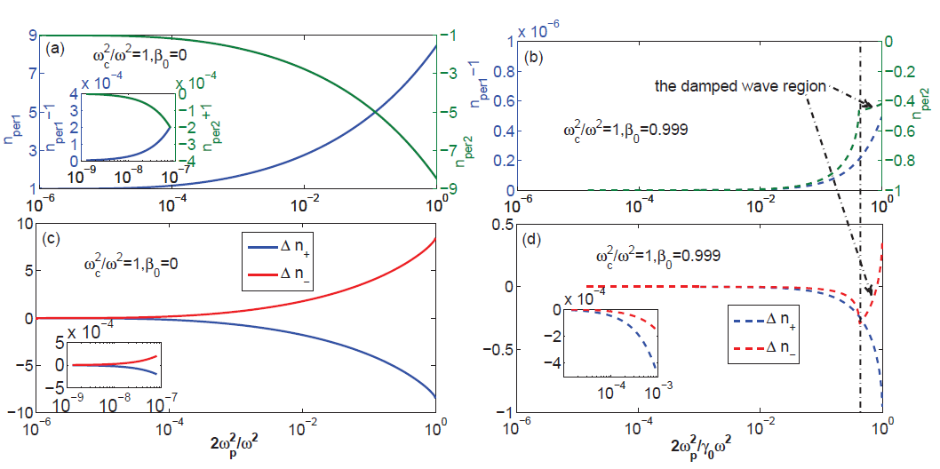

Case III: $\frac{ω_{c}^{2}}{γ_{0}^{4}}≈ω^{2}$
The QED effect and the drift effect dominate, while the collective effect is overwhelmed.

Slide 28
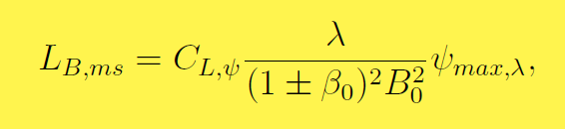
Applications- millisecond pulsar
The thickness of the magnetosphere of a millisecond pulsar could be estimated by:

Slide 29
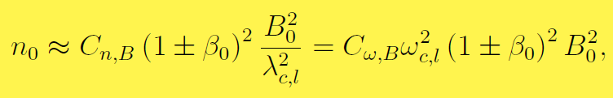
Applications-Pulsar
The relationship between the plasma density
and the magnetic field is given by:
If the dependence of the degree of elliptical polarization on the wave frequency or the wavelength is obtained, the degree of elliptical polarization should achieve a minimum value at the critical wavelength.

Slide 30
Thank you for your attentions !

