Slide 1
Argonne Dielectric Wakefield Accelerator: A technology to future e⁺e⁻ /γ γ colliders
Chunguang Jing for AWA and Euclid
April 24, 2017

Slide 2
OUTLINE
What and Why Dielectric Wakefield Acceleration
Argonne Flexible Linear Collider
Add-on for γ - γ Collider
LC R&D @Argonne Wakefield Accelerator facility
Summary

Slide 3
Main Advanced Accelerator Schemes
Pump Source
Medium
DWA
beam
Structure
DLA
PWFA
Laser
Plasma
LPWA

Slide 4
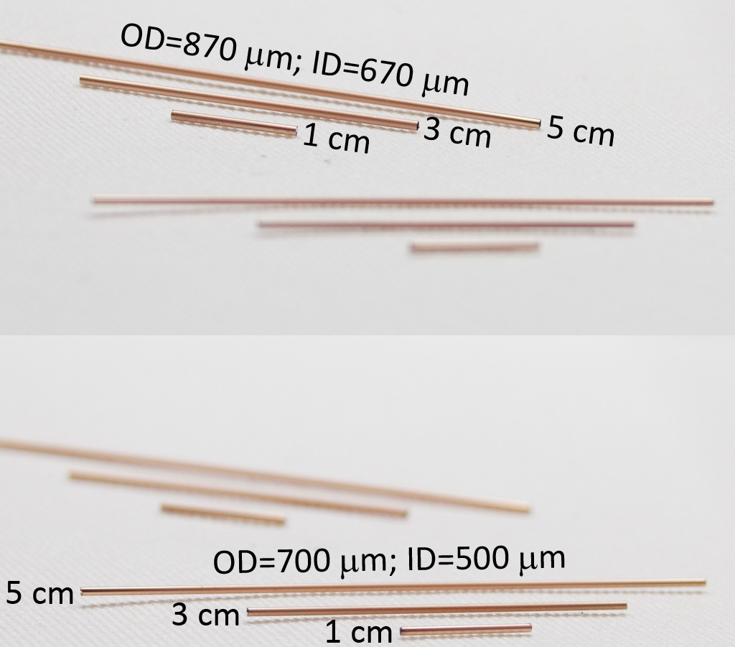
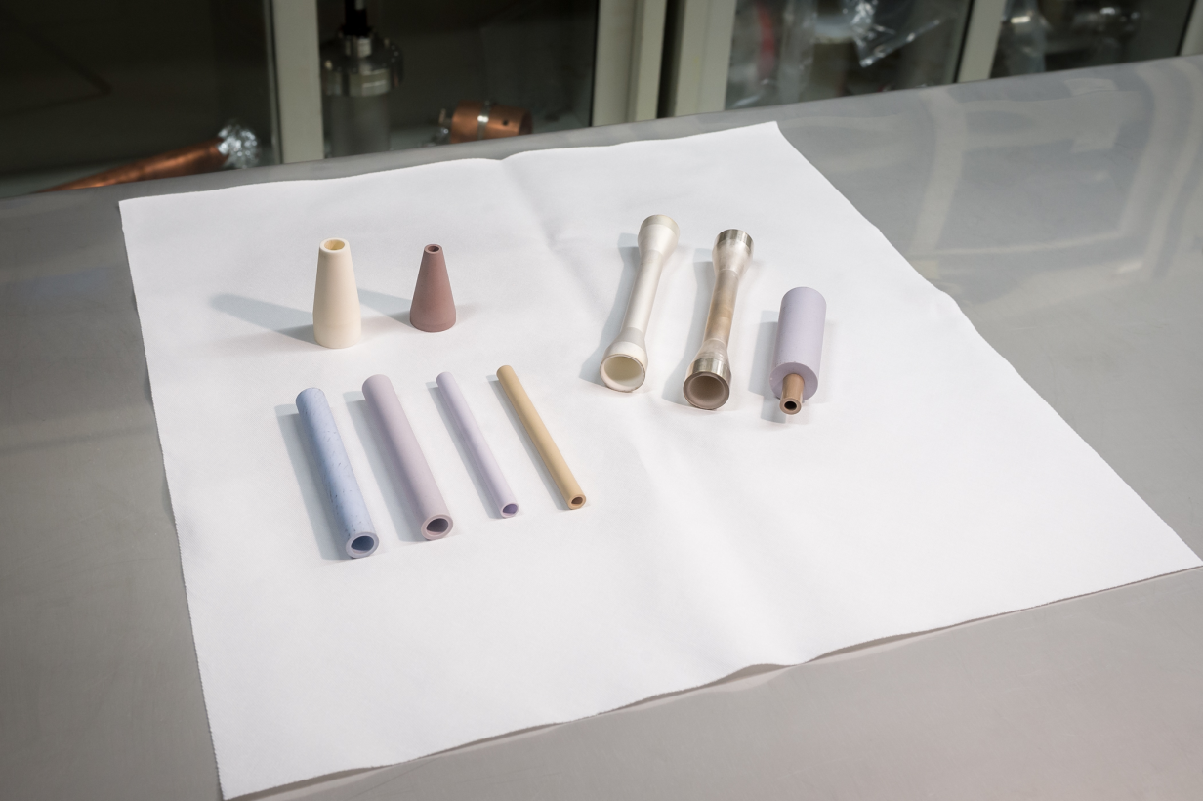
OUTLINE
What and Why Dielectric Wakefield Acceleration
Simplicity

Slide 5
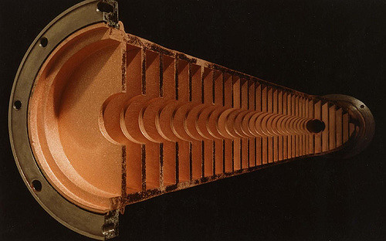
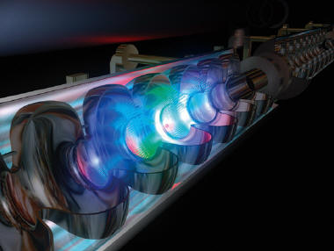
RF Driven Linear Accelerator Currently Used
Resonant linear accelerators are usually single-pass machines. Charged particles traverse each section only once; therefore, the kinetic energy of the beam is limited by the length of the accelerator. Strong accelerating electric fields are desirable to achieve the maximum kinetic energy in the shortest length.
~100MV/m for NC (~10GHz)
~30MV/m for SC (~1GHz)

Slide 6
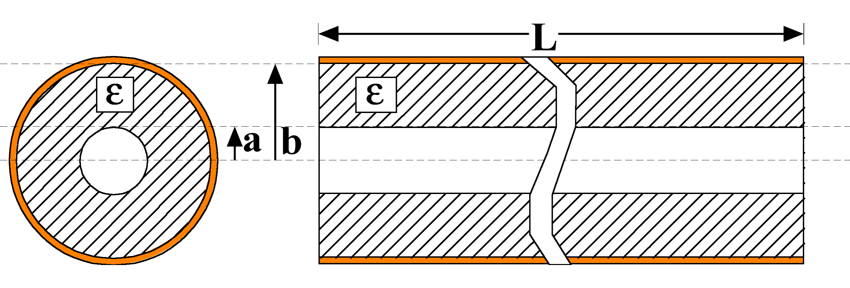
Dielectric-Loaded Accelerators
Features:
Simple geometry.
Small transverse size.
Short rf pulse, high repetition rate, preferred.
300MeV/m
5GV/m
theory
30MV/m
Tunable DLA
DWA
D. TBA
100MV/m
Staging
1951
1958
1989
2000
2006
2007
2011
2016
Geometry
Electric Field Vectors

Slide 7
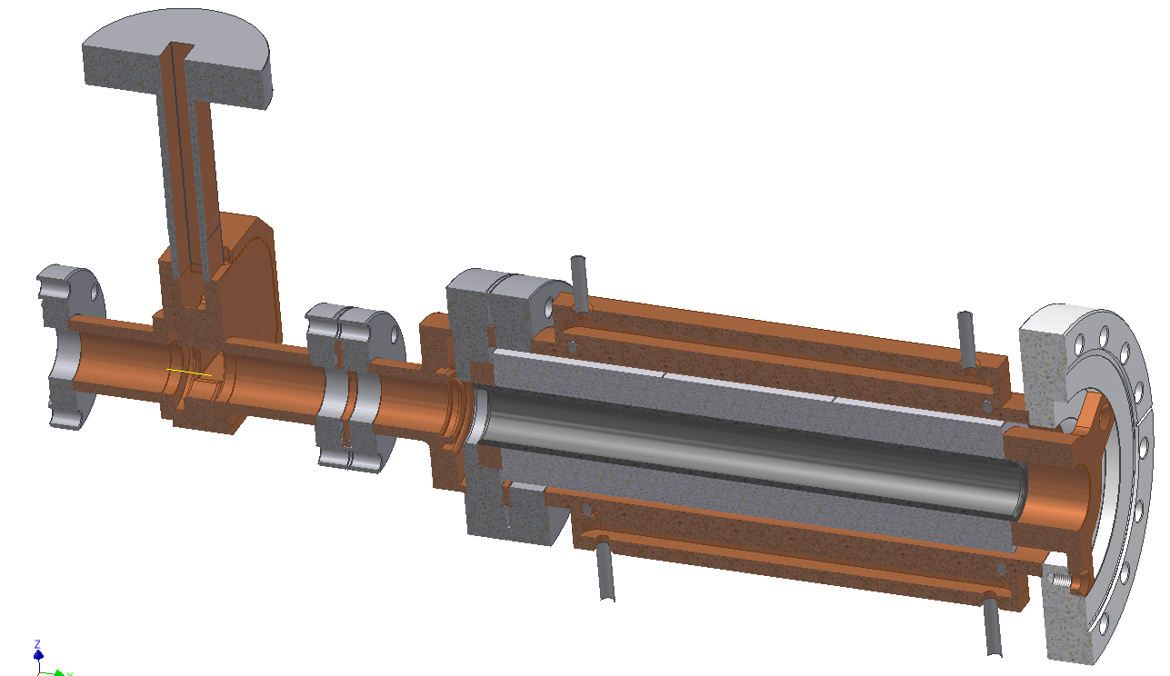
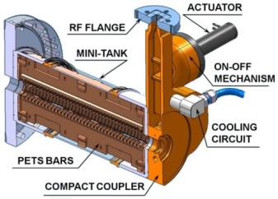
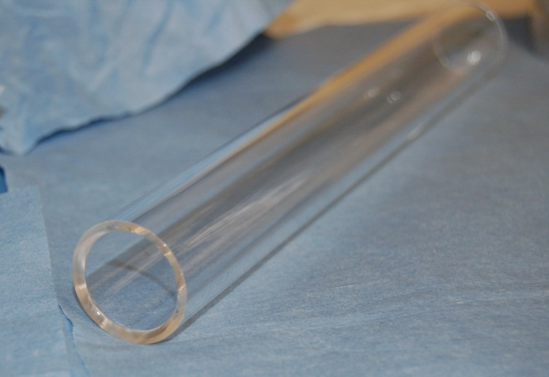

Dielectric vs. Metallic Structures
Cost saving > 50%
  more material options; easy to construct and HOM damping.
Euclid/AWA
CLIC
Quartz tube

Slide 8
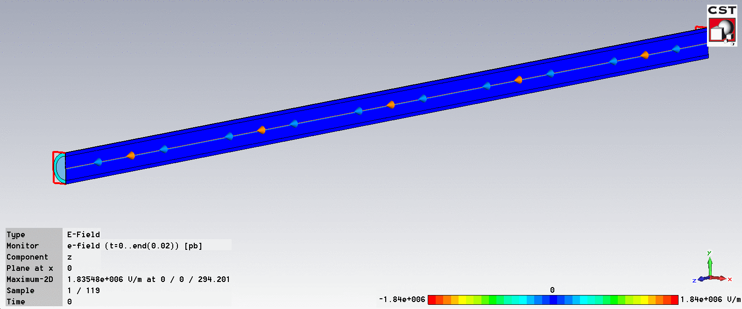
OUTLINE
What and Why Dielectric Wakefield Acceleration
Wakefield (beam→structure)

Slide 9
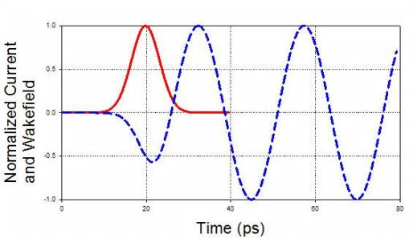
Wakefield Acceleration: High Gradient
Cu
2b
2a
Q
Dielectric
Voltage:
Wake function: structure related; favors high frequency;
Drive bunch current: bunch length related; favors shorter bunch;

Slide 10
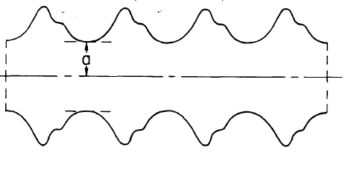
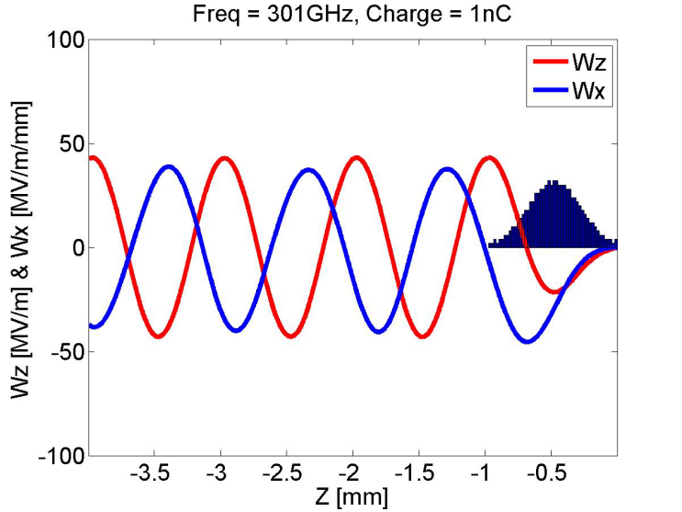
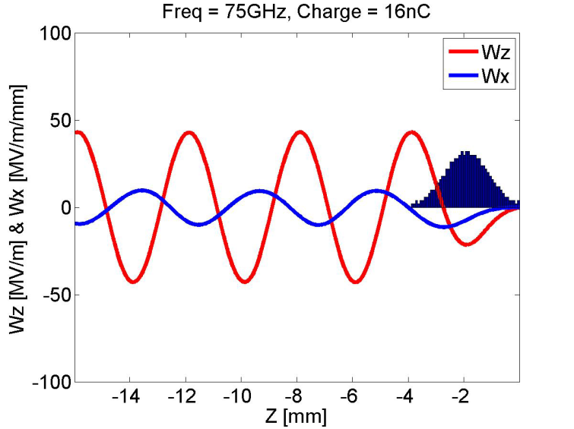
Two Types of Wakefield
W_{z} ~ Q/a^2, W⊥ ~ Q/a^3
Case I | Case II
a=0.5mm | a=2mm
Q=1nC | Q=16nC
Freq.=300GHz | Freq.=75GHz
σz/λ=0.2 | σz/λ=0.2

Slide 11
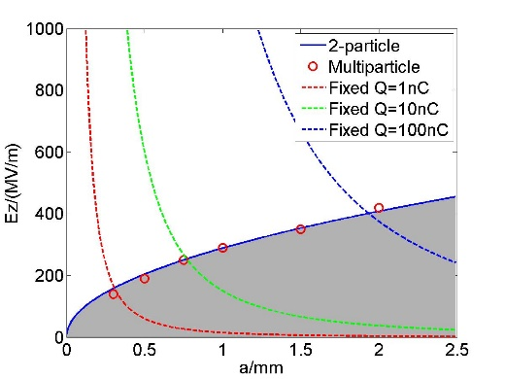
Sustainable Wakefield Gradient
Ez~Q*a⁻²
Sustainable beam acceleration area
THz
MW
Reference: C. Li, et al, Phys. Rev. ST Accel. Beams 17, 091302 (2014)

Slide 12

Two Main Formats of Wakefield Acceleration
Collinear wakefield acceleration
Two Beam Acceleration
Single bunch acceleration
low charge
high repetition rate
bunch train acceleration
high charge
low repetition rate

Slide 13
Mission of Wakefield Accelerator Technologies
High Energy e⁻ e⁺ (comp. or steppingstone γγ)Collider:
  High efficiency: ~10% (wall plug)
  High gradient: ~300MeV/m (effective)
  High luminosity (high beam power )
Technologies extended beyond HEP --- High Rep. Rate FEL
  Ultrahigh repetition rate: >100KHz
  High efficiency collinear wakefield acceleration: >10%
  Low construction and operational cost

Slide 14
OUTLINE
What and Why Dielectric Wakefield Acceleration
Argonne Flexible Linear Collider
Add-on for γ - γ Collider
LC R&D @Argonne Wakefield Accelerator facility
Summary

Slide 15
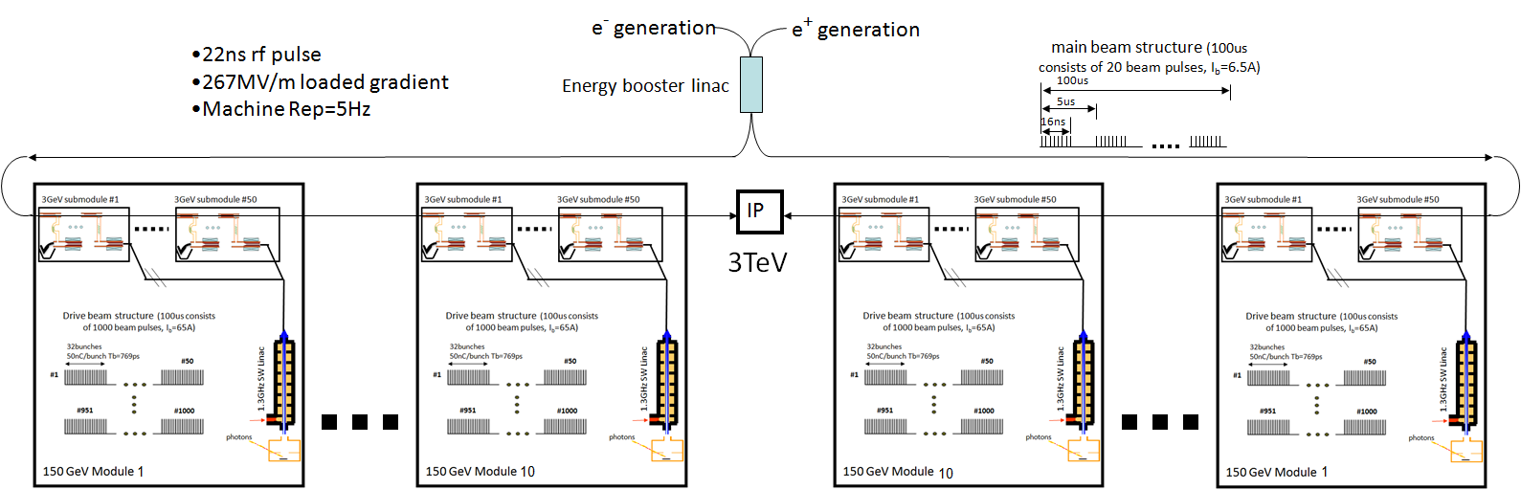
3TeV 30MW Beam Argonne Flexible Linear Collider
18km
7.5km linac
7.5km linac
Based on scientifically mature and low cost Dielectric TBA technologies
  Short rf pulse (20ns) for high gradient (e⁺ e⁻ 200MeV/m of effective gradient)
  Modular design →easily staged
  Wall plug efficiency (~10%)

Slide 16
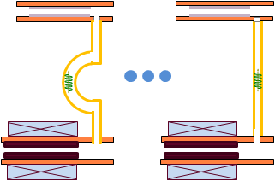
Zoom-in for each 150GeV AFLC Module
2L /c
Drive beam
Stage 2
Stage 1
photons
rf delay 1
rf delay m
rf delay 1
rf delay m
1.3GHz SW Linac
L
L
Main beam
Simplified Staging by manipulating RF instead of high energy drive beam
Notes:
Staging with high quality main beam

Slide 17
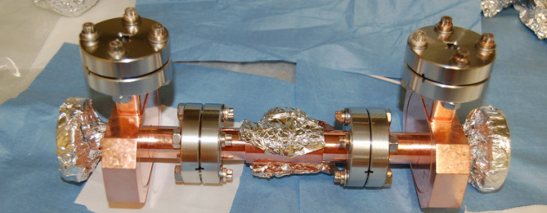
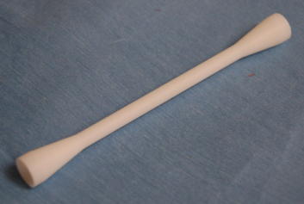
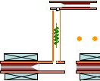
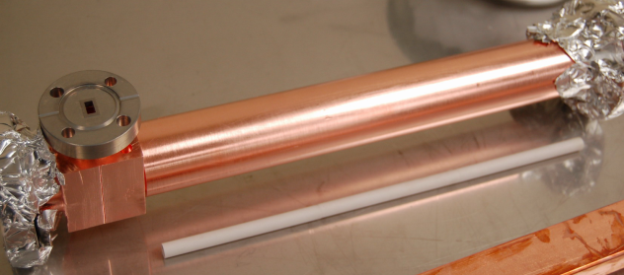
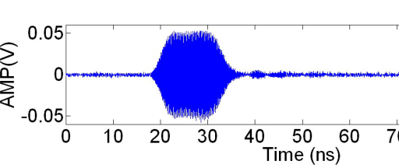
Zoom-in to AFLC Structure Level
Short pulse accelerator
~15cm
Power Extractor
30cm
Gradient needs ~300MV/m
Shorten the rf pulse length ~20ns
High group velocity accelerator (10%c) to reduce rf filling time
TBA
GW level rf power
high frequency (26GHz) to high shunt impedance
Dielectric accelerator for low cost
Notes:
Logic: high gradient in structure>short rf pulse>high power>TBA; values are achievable

Slide 18
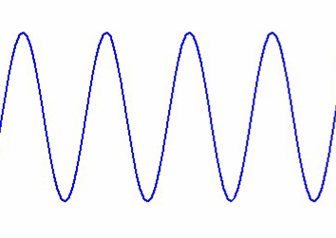
AFLC Beam Power for high luminosity:
Main Beam Structure
1s
0.5nC/bunch
200ms
100us
In pulse beam current =6.5A
Average current=10.4uA
Average beam power=15.6MW
5us
16ns
#1
#2
#20
#21
#22
#40
#81
#82
#100
AFLC RF-to-beam efficiency:
RF Structure
T_{rf}=28ns
3ns
Competitive rf-beam efficiency for the short pulse TBA
3ns
6.5A
267MV/m
0.3m
16ns
T_{f}=9ns
T_{beam}=16ns
1.264GW
25ns

Slide 19
AFLC Power and efficiency flow chart
Site Power
~400MW
291MW
η_{AC-rf}=55%
Main beam injection, magnets, services, infrastructure, and detector
Power supplies to klystrons gallery
~100MW*
160MW
* Borrowed from the CLIC design
Drive beam acceleration
η_{rf-drive}=86%
138MW
η_{total}~7.8%
Drive beam Dumps
DPETS
126MW
η_{rf-tran}=95%
120MW
η_{rf-main}=26%
Main linac
31.2MW
Main beam

Slide 20
Improved AFLC Power and efficiency
η_{AC-rf}=90% (CLIC/SLAC)
Site Power
~200MW
100MW
η_{AC-rf}=55%
Main beam injection, magnets, services, infrastructure, and detector
Power supplies to klystrons gallery
~100MW*
90MW
* Borrowed from the CLIC design
Drive beam acceleration
η_{rf-drive}=86%
η_{total}~16%
77MW
Drive beam Dumps
DPETS
65MW
η_{rf-tran}=95%
η_{rf-main}=50% (AWA bunch shaping)
62MW
η_{rf-main}=26%
Main linac
31.2MW
Main beam

Slide 21
OUTLINE
What and Why Dielectric Wakefield Acceleration
Argonne Flexible Linear Collider
Add-on for γ - γ Collider
LC R&D @Argonne Wakefield Accelerator facility
Summary

Slide 22
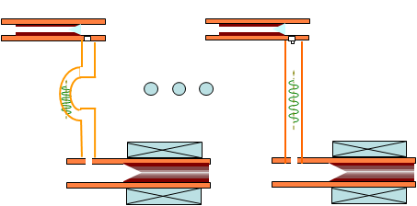

60GeV
100us
Summary of a 150 GeV Stage
5us
#20
16ns
3GeV submodule #1
3GeV submodule #50
main beam structure (100us consists of 20 beam pulses, 6.5A inside the pulse) 10.4uA w/ 50Hz of the machine rep rate.
Drive beam structure (100us consists of 1000 beam pulses, I_{b}=65A)
32bunches 50nC/bunch Tb=769ps
100us
#20
2us
#50
#1
1.3GHz SW Linac
16ns
#981
20rows
50rows
#951
#1000
main beam structure (100us consists of 50 beam pulses, 6.5A inside the pulse) 26uA w/ 50Hz of the machine rep rate.
photons
150 GeV Module

Slide 23
360GeV e⁺e⁻ Higgs Factory with the Add-on γ-γ Collider (just a straw man concept)
γγ
IP
Blue laser
Blue laser
e⁻
60GeV
Module
#1
e⁻
60GeV
Module
#2
e⁻
60GeV
Module
#3
e⁺ e⁻ IP
e⁺
60GeV
Module
#1
e⁺
60GeV
Module
#2
e⁺
60GeV
Module
#3

Slide 24
OUTLINE
What and Why Dielectric Wakefield Acceleration
Argonne Flexible Linear Collider
Add-on for γ - γ Collider
LC R&D @Argonne Wakefield Accelerator facility
Summary

Slide 25
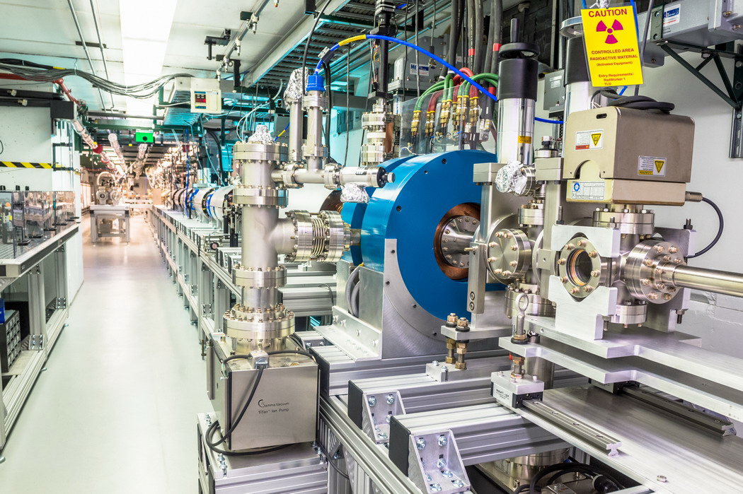
A Pathway to AFLC using the AWA facility

Slide 26
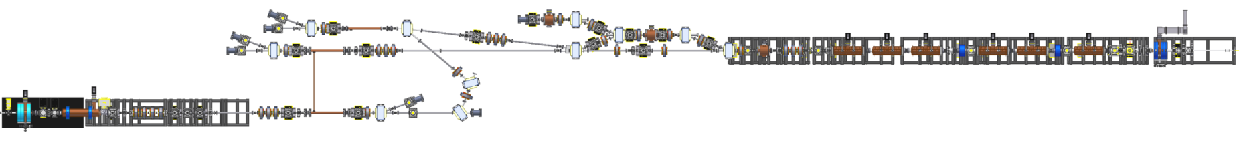
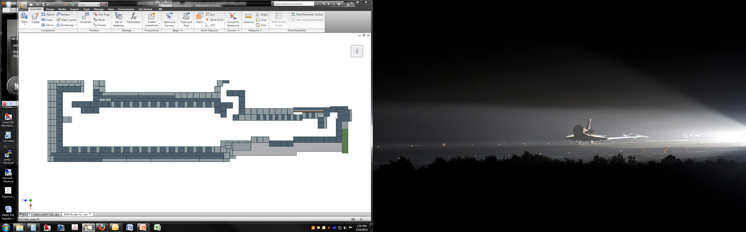
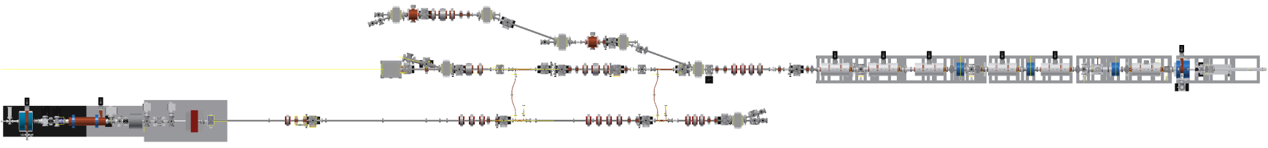
AWA facility: demonstrating critical technology elements
collinear & TBA
EEX & bunch compression
experimental area
70 MeV drive beam
15 MeV witness beam
bunch trains of up to 32 bunches
Maximum charge in single bunch 100 nC
maximum charge in bunch train 600 nC.
single bunches
bunch charge 0.05 to 60 nC
Notes:
Transformed to demonstrate CTEs

Slide 27
Demonstrate AFLC-system in high fidelity
Parameters | AFLC requirements | AWA capability
Acceleration mechanism | Dielectric TBA | Dielectric TBA
Drive beam generation | 1.3GHz Photogun | 1.3GHz Photogun
Drive beam current | 65A (32 x 50nC) | 65A (16 x 50nC)
RF Power generation | 26GHz 1GW 20ns | 26GHz 1GW 15ns
Main beam generation | CLIC like | 1.3GHz Photogun
Main beam current | 6.5A (0.5nC w/ interval of 77ps) | 0.5~10nC single bunch
Main linac structure | 26GHz DLA | 26GHz DLA
Effective Gradient | 200MeV/m | 200MeV/m
Stages | Multiple stages | >2 stages, 2 TBA units/stage
AWA can be used for AFLC-system high-fidelity demonstration.
Notes:
High fidelity

Slide 28
Report on recent experimental results @ AWA
Where we stand now
26GHz Dielectric TBA High Power RF Test
11.7GHz Metallic TBA Acceleration
Staging Demonstration
Bunch shaping

Slide 29
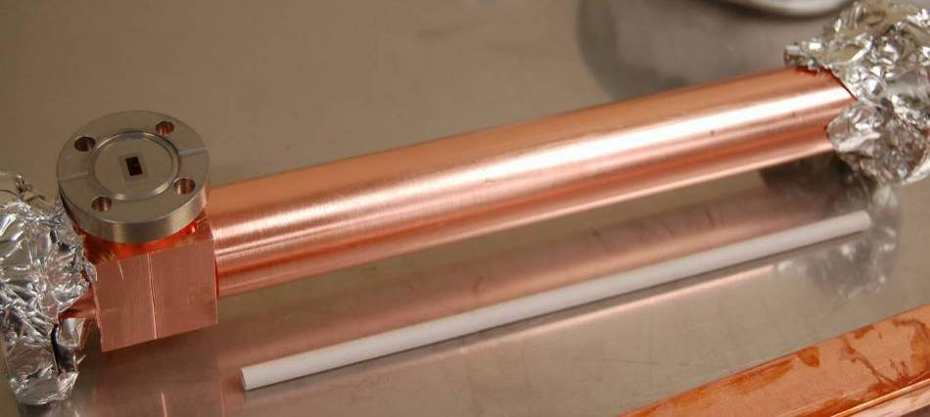
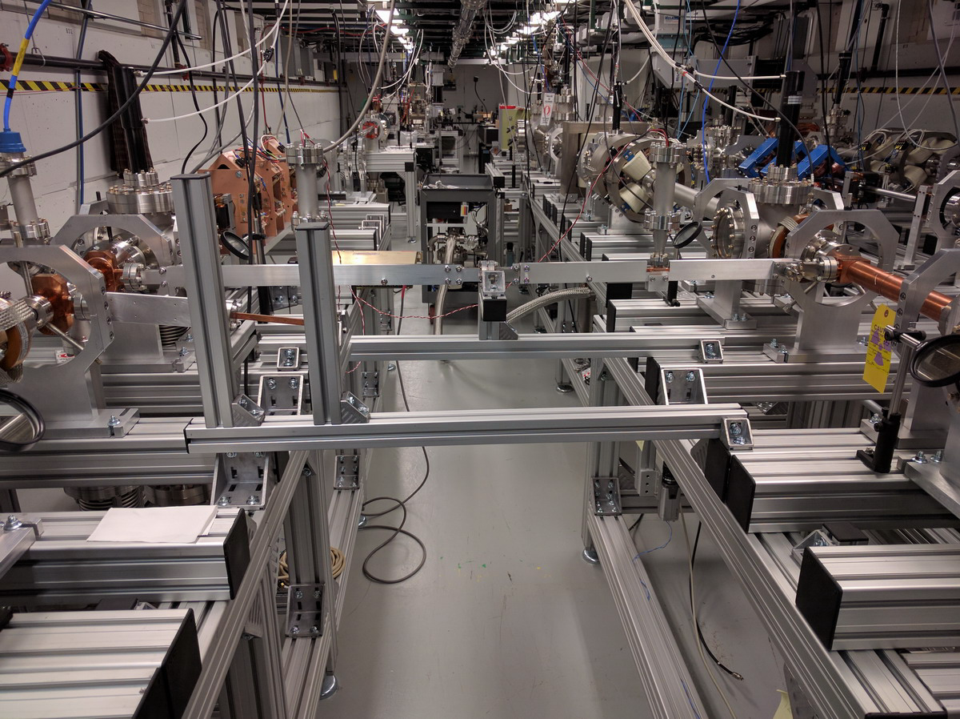


High power test of 26GHz dielectric TBA
DPETS
~4MeV deceleration was measured for each drive bunch which is aligned with ~160MW rf power output by a 4x22nC bunch train.
~1.8MeV acceleration of a 230pC witness beam transmitted through the dielectric accelerator, which is eqv. to ~50MV/m gradient.
Note: Gradient is lower than the ideal case due to the combination of RF loss in the waveguide, miss-match of the phase advance, and inefficient rf coupling, etc.
ID=7mm, L=30cm
DLA
ID=3mm, L=10cm

Slide 30
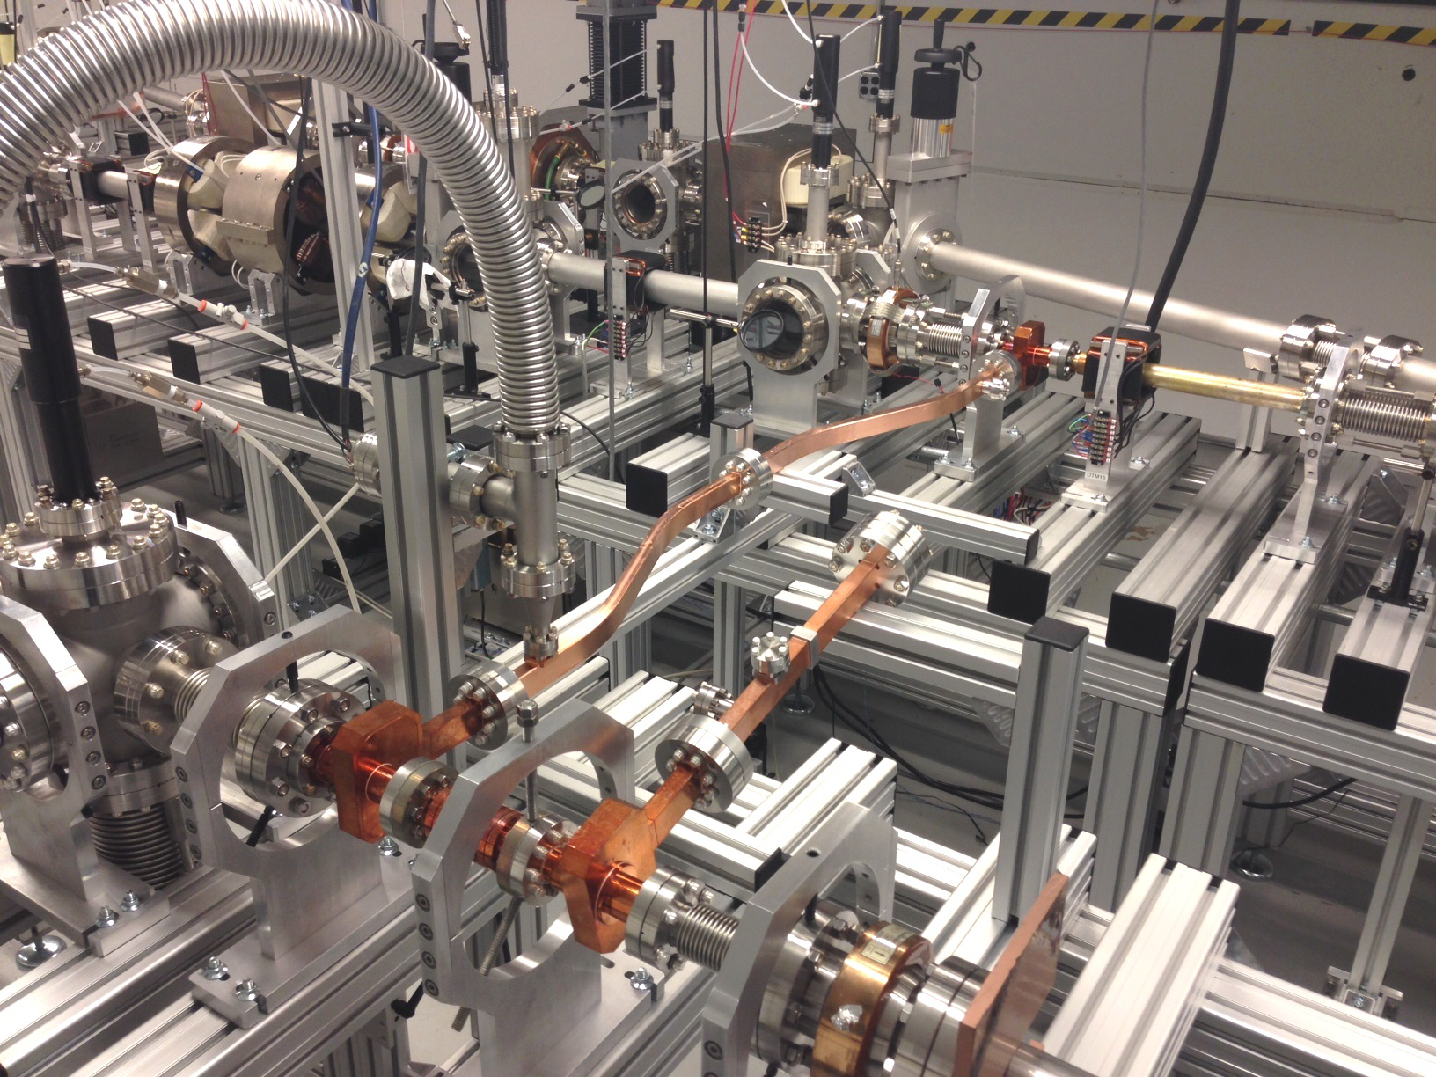
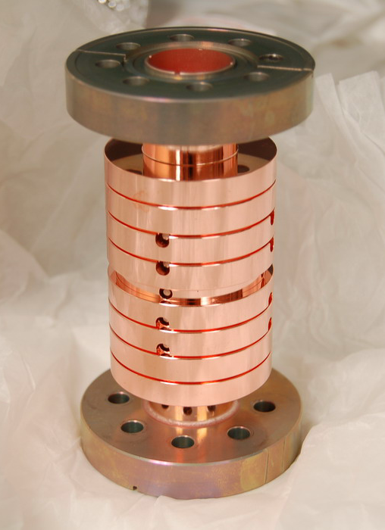
11.7GHz Metallic TBA Acceleration
Drive Beam
RF
Witness Beam

Slide 31
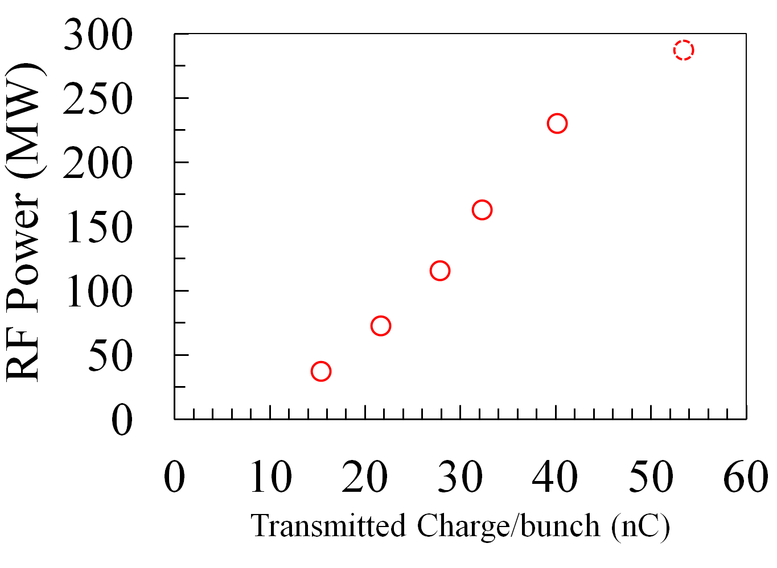
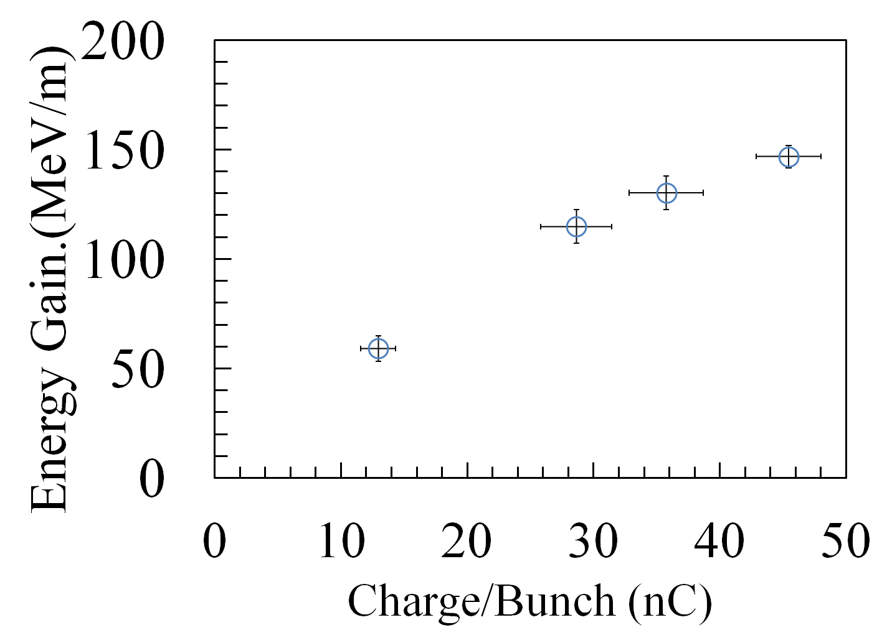
~150MeV/m Acceleration Achieved

Slide 32
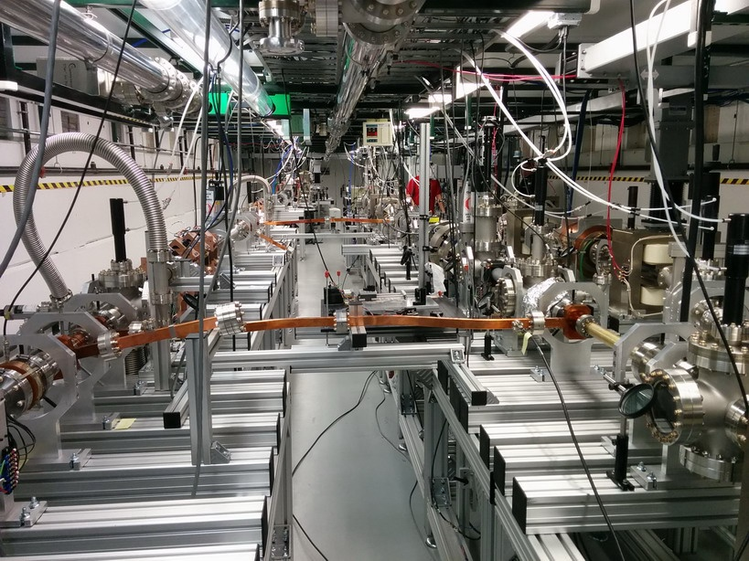
Staging Demonstration
Witness
Stage1
Stage2
Drive
Notes:
Use new picture

Slide 33
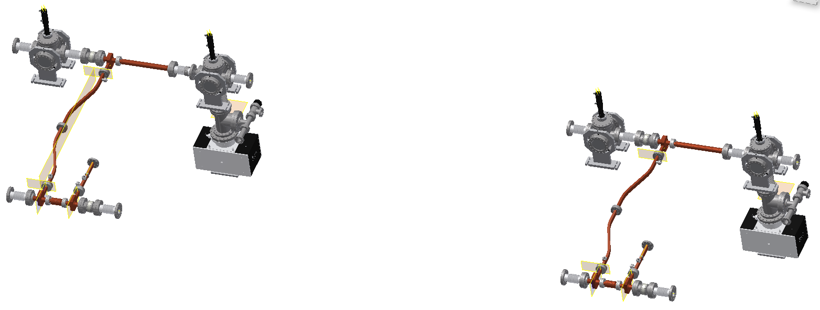
Timing Required for Staging PoP Experiment
Drive train-1
L
Drive train-2
Witness bunch
Two Drive trains to successively accelerate one witness bunch while preserving its beam quality
Stage 1
Stage 2
L =Nλ, (N ≥ 6, λ =23cm)

Slide 34
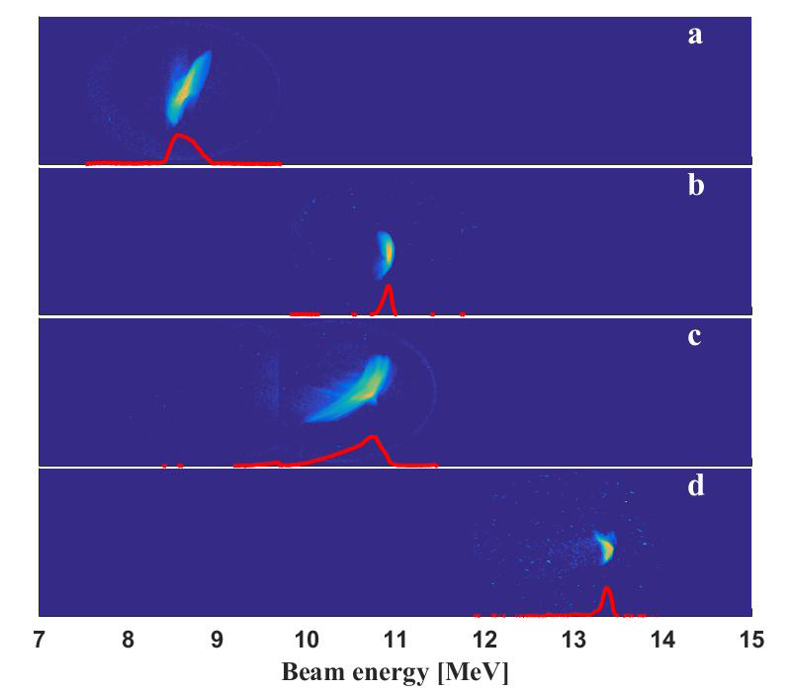
Staging Experiment at AWA
Drive beam off
Drive Train #1 on
Drive Train #2 on
Drive Train #1+2 on

Slide 35
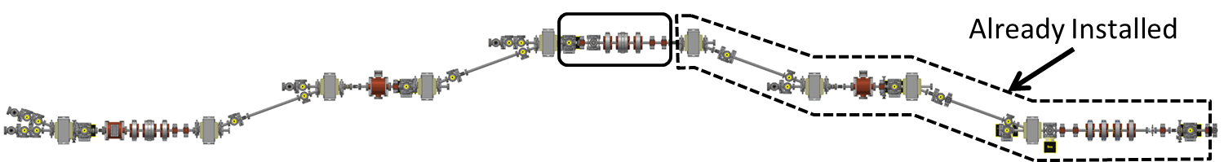
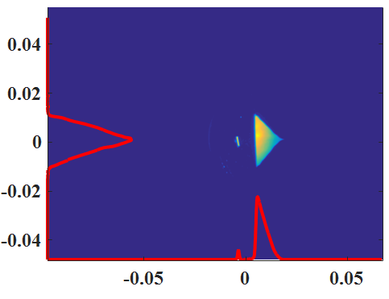
Arbitrary bunch shaper using EEX or DEEX
Under construction
Using Micro-Lens Array and mask produce the “ideal” transverse shaped bunch (Drive + witness bunches).
Using Emittance Exchanger or Double Emittance Exchanger to transform the beam transverse profile to the current temporal profile.

Slide 36
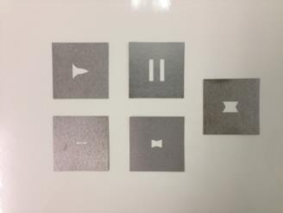
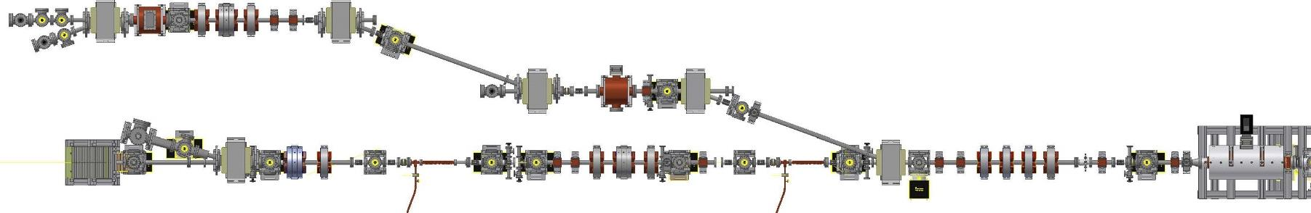
Bunch Shaping with EEX Demonstrated
Five masks on actuator
SPECT
TDC2
TQ1-3
B3
TDC1
B2
B4
B1
45 MeV
Q4
Q3
Q2
Q1
x-x’ & y-y’
beam size & slope
Linac chirp
x
tunable parameters
z

Slide 37
SUMMARY
AFLC (feasibility study)
  Preconceptual design of AFLC has been developed.
  Critical Technology Elements for AFLC have been identified. 3 of them are addressed at AWA.
    Gradient (100MV/m achieved, moving to 200MV/m)
    RF power (moving to GW)
    High quality staging demonstrated (moving to 100MeV net acceleration in stages)
  Roadmap developed
  Flexible to adapt to e+e- Higgs factory with an add-on γγ collider

