Slide 1

Reports for optimization of Calorimeter
Bing Liu
SJTU
2016.03.22

Slide 2


Calorimeter structure
I
II
III
2450mm
$≈$2540mm
$≈$2600mm
Particle gun
…
……..
…
1200,1200,0
20 layer
10 layer
40 layer
I
:Cu:0.5,W:1.4,Cu:0.5,Si:0.5,PCB:1.2,Air:0.5
II
:Cu:0.5,W:2.8,Cu:0.5,Si:0.5,PCB:1.2,Air:0.5
III
:Iron:0,RPC1:1.2,PCB:1.2,Air:0.5

Slide 3
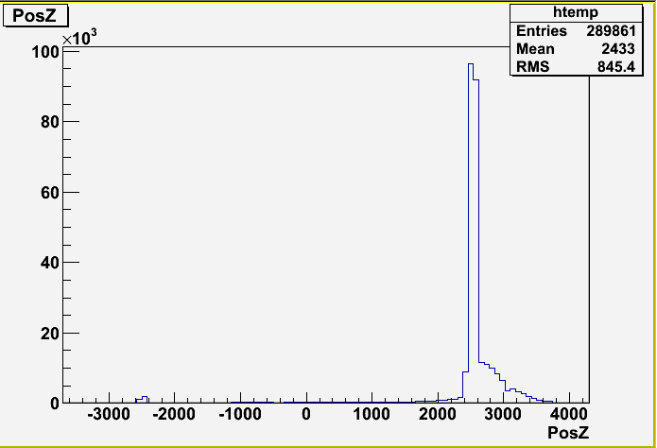
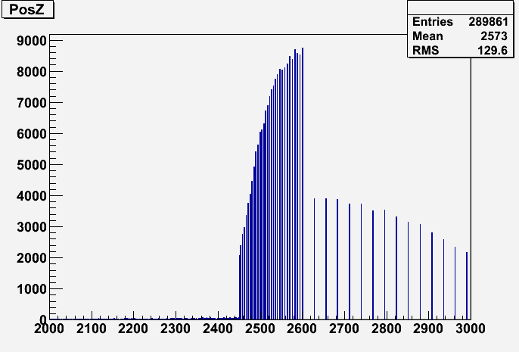
(mm)
PosZ(mm)

Slide 4
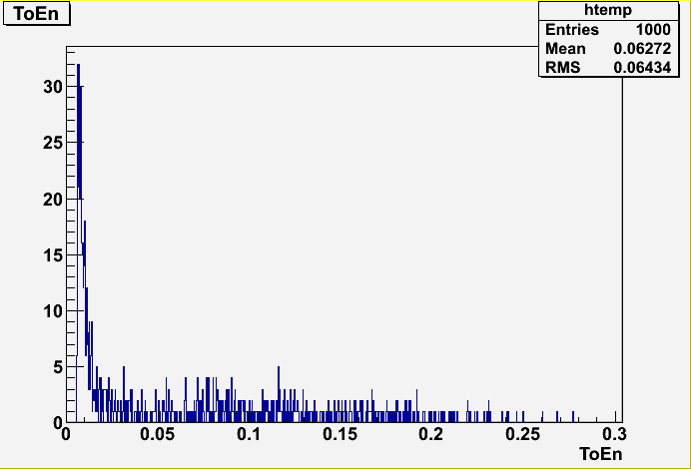
The total energy is not calibrated .
The Total energy is not like gaus distribution, The possible solution to separately calibrate different area in calorimeter

Slide 5
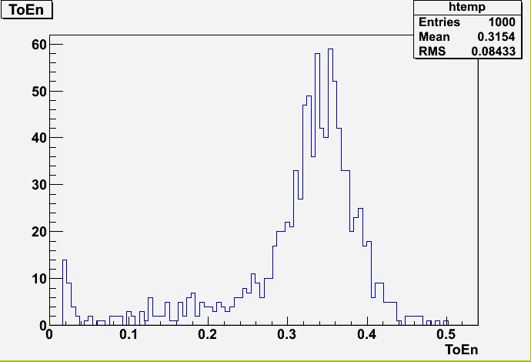
Test

