Slide 1
Overview of SRF system of Ring and Linac （1）
Zhenchao Liu, Song Jin, Dianjun Gong
2016-5-11

Slide 2
Outline
SUPER KEKB
LEPII
LEP
PEPII

Slide 3
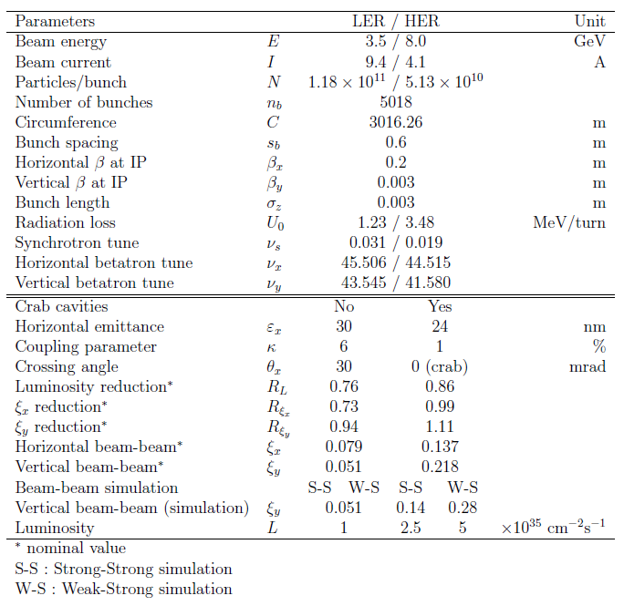
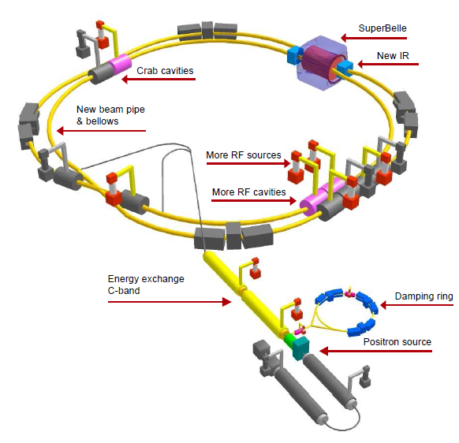
Super KEKB
Schematic layout of accelerator upgrade for SuperKEKB
Machine parameters of SuperKEKB
Notes:
One important thing to notice is that the LER and the HER will exchange electron
and positron beams after upgrade of the IR in our present strategy. This means that both
rings will have to accept both beams, and that the required beam acceptance is determined
by the beam which requires wider acceptance.

Slide 4
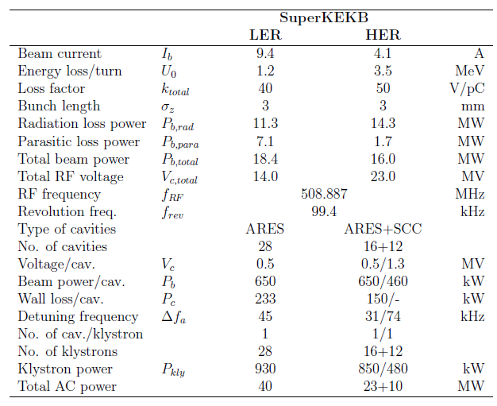
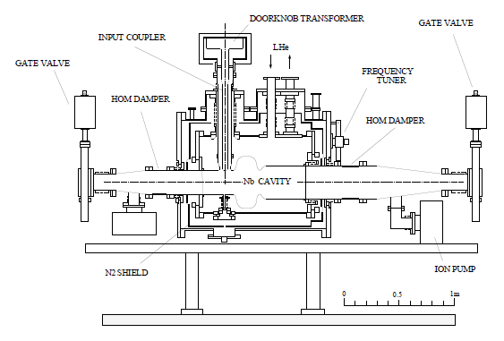
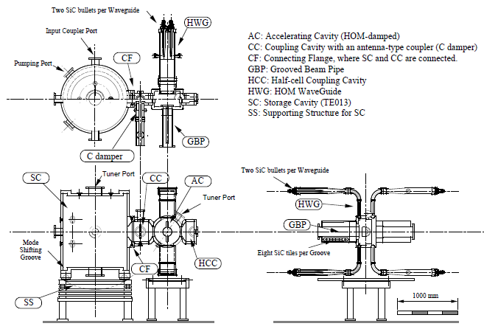
Superconducting cavity for KEKB
RF parameters of SuperKEKB
Top, front and side views of the ARES cavity for KEKB

Slide 5
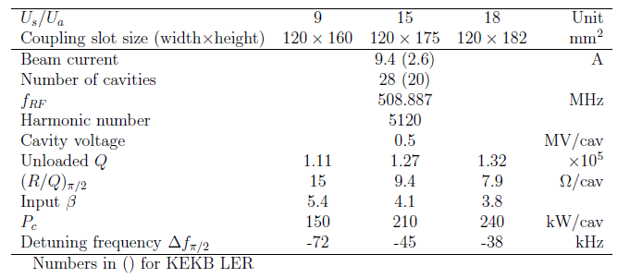
Normal Conducting Cavity
Instability due to large detuning of the accelerating mode
Δf_{a} several times the revolution frequency
The ARES cavity system can be mechanically separated into two cavity parts: the storage cavity and the accelerating cavity part with the coupling cavity brazed.

Slide 6
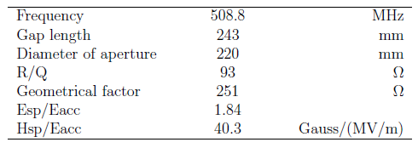
SC Cavity
The development of the SC damped cavity for KEKB began in 1991, aiming at achieving a sufficiently low higher order mode (HOM) impedance to avoid CBI and the high-power handling capability required for an ampere-class beam intensity of KEKB. Optimization of the cavity shape, the HOM damping scheme, and a several-hundred-kW input coupler were the main R&D items for the SC damped cavity system.
A single cell cavity has a beam aperture of 220 to achieve an external Q of 100 for monopole modes, and a 300 cylindrical wave guide is attached on one side to extract the lowest dipole modes of TE11 and TM11
The input coupler is a coaxial antenna type using a 152 ceramic disk, which can transfer a traveling RF of 800 kW
Cavity parameters of the KEKB superconducting cavity

Slide 7
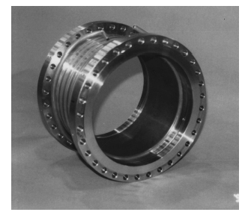
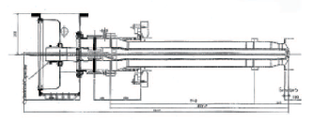
Input coupler
HOM damper

Slide 8
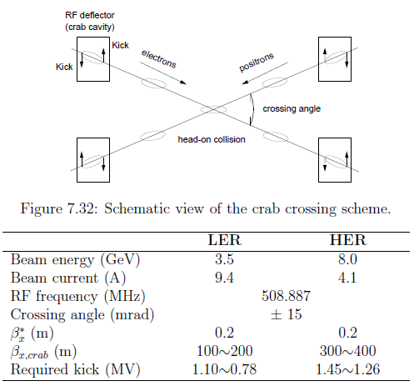
Parameters for the crab crossing in SuperKEKB

Slide 9
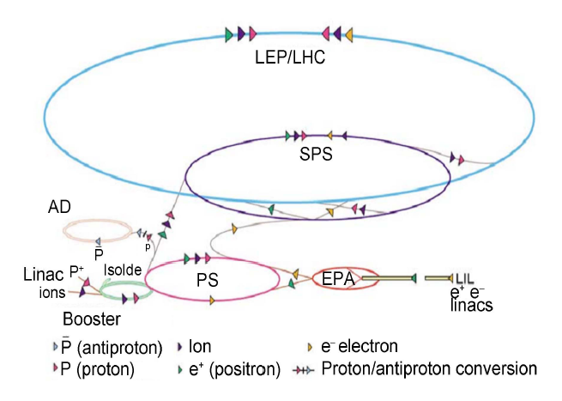
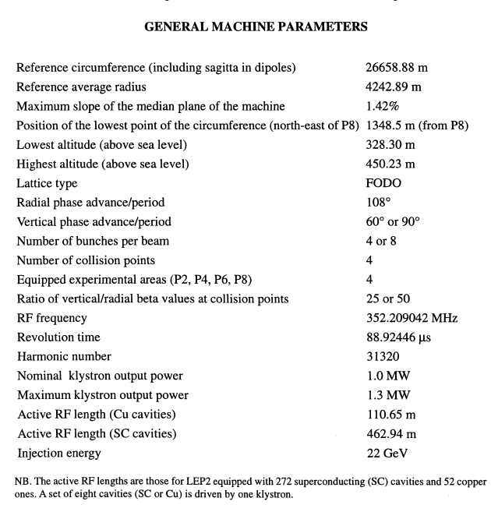
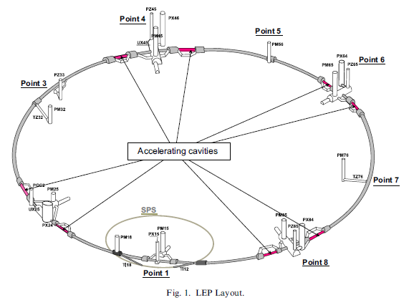
LEPII
LEP layout

Slide 10
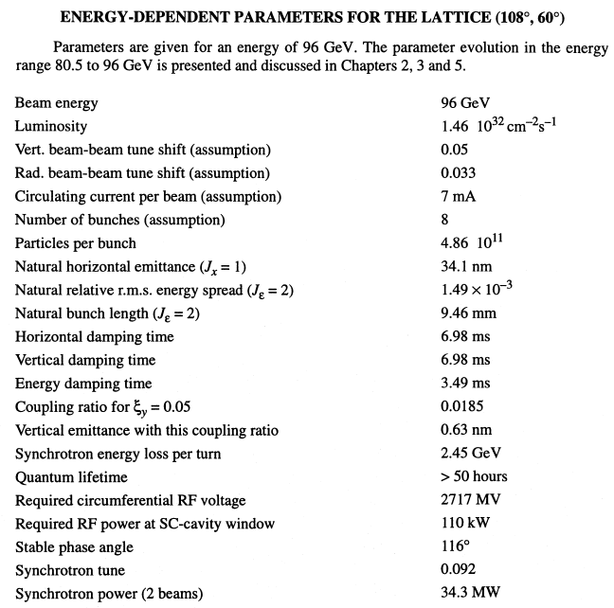

Slide 11
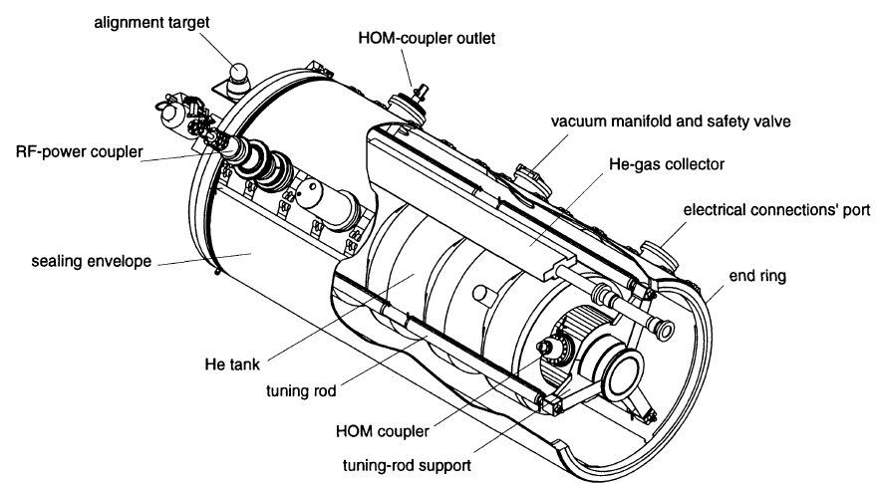
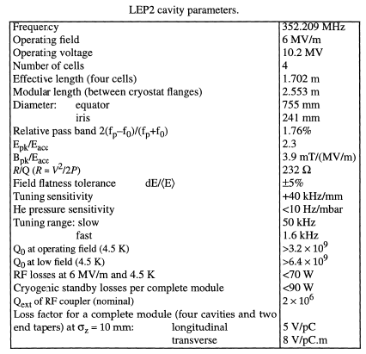
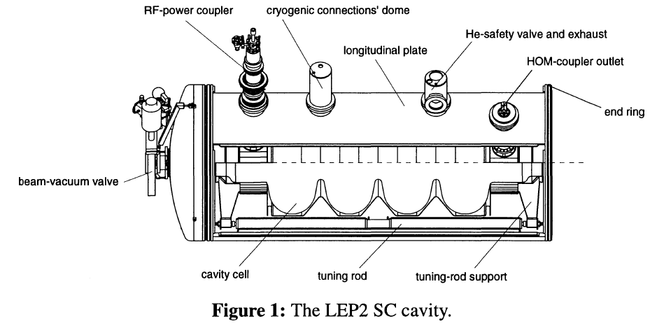
LEP II

Slide 12
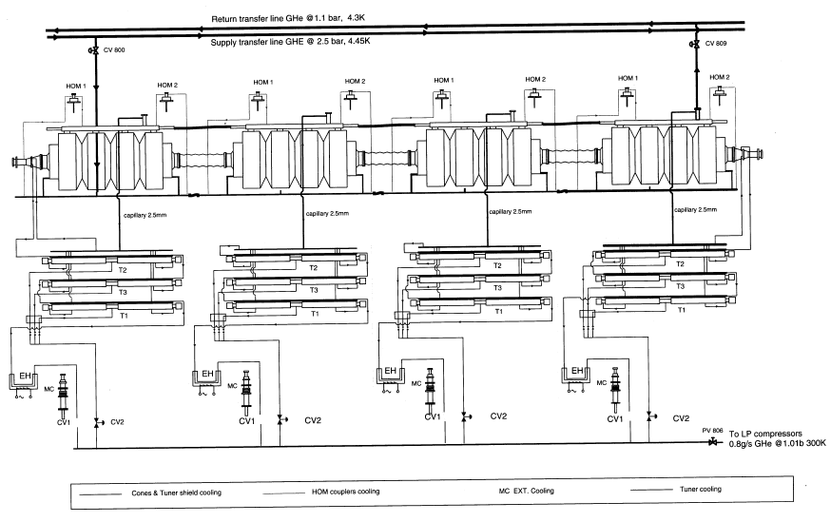
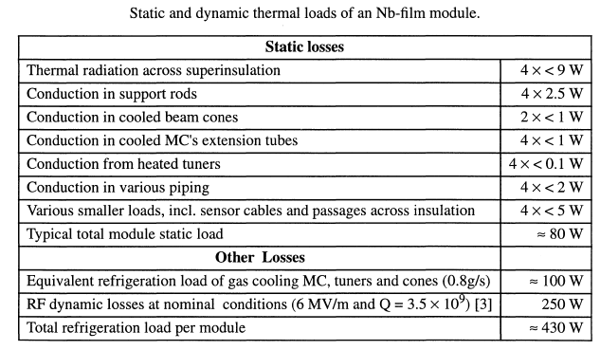
SC module with He circuits

Slide 13
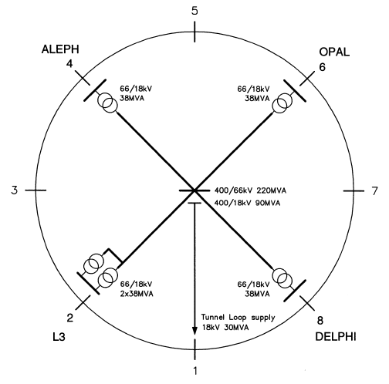
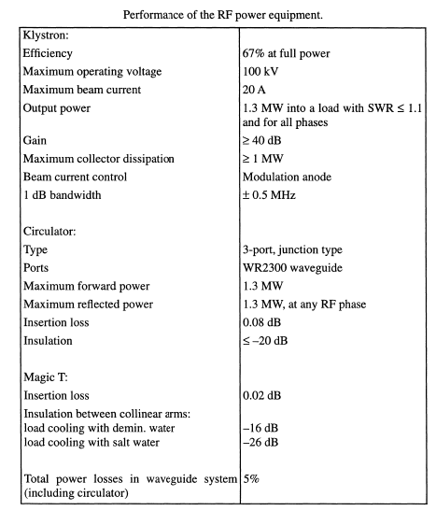
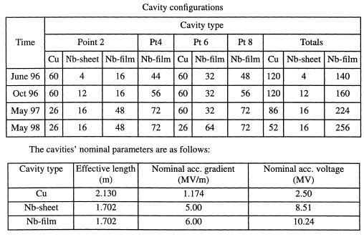

Slide 14
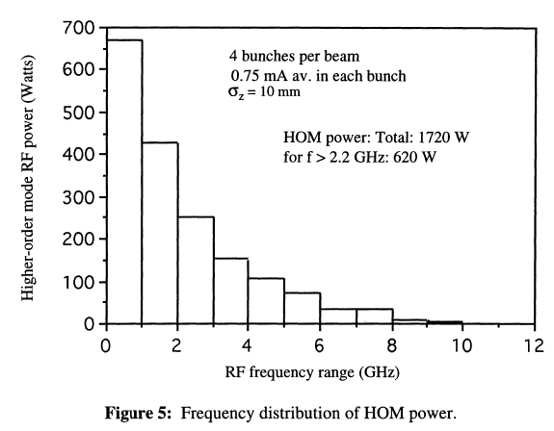

Slide 15
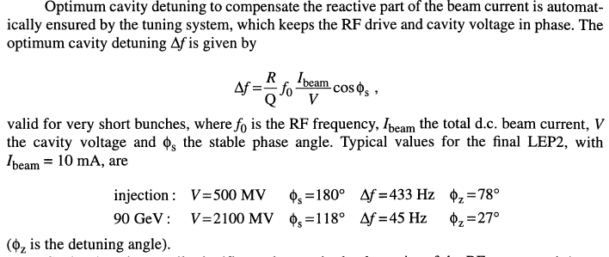

Slide 16
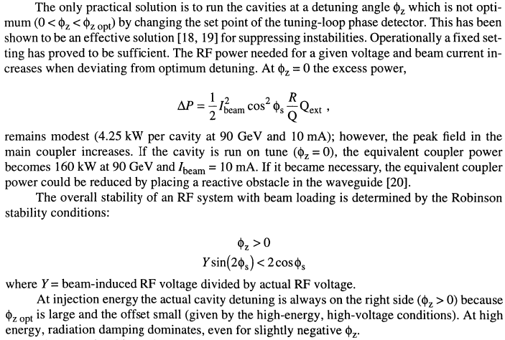

Slide 17
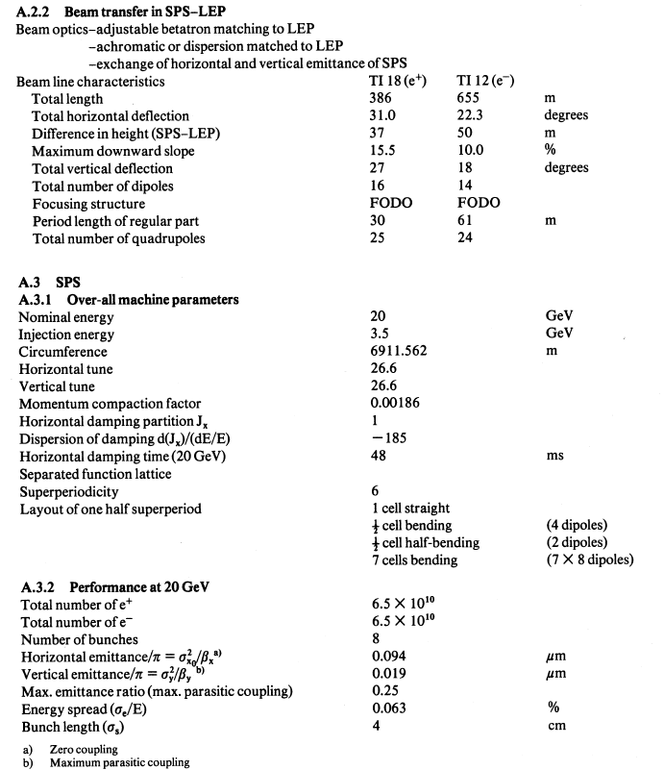
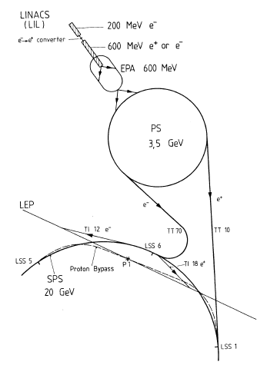
LEP

Slide 18
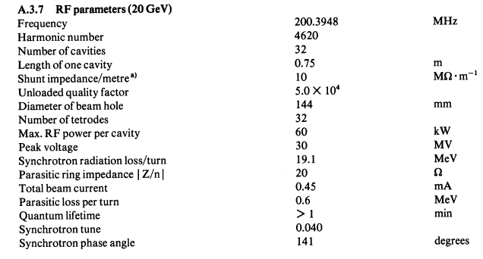
LEP
SPS ring

Slide 19
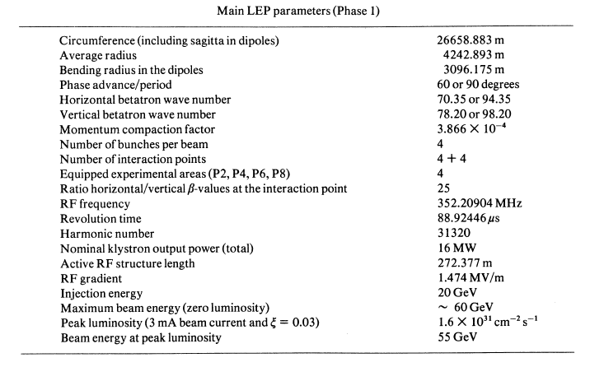
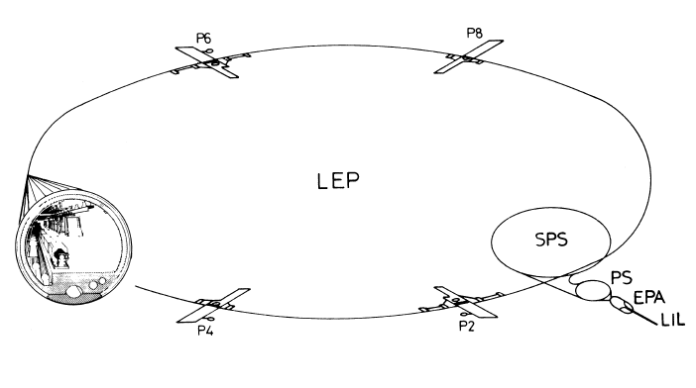
LEP main ring

Slide 20
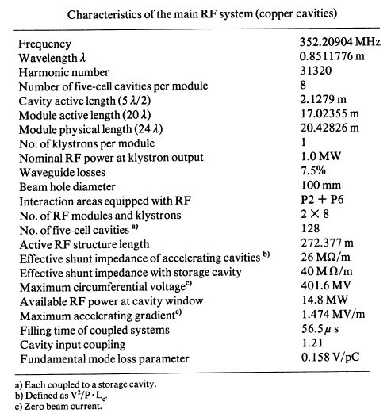

Slide 21
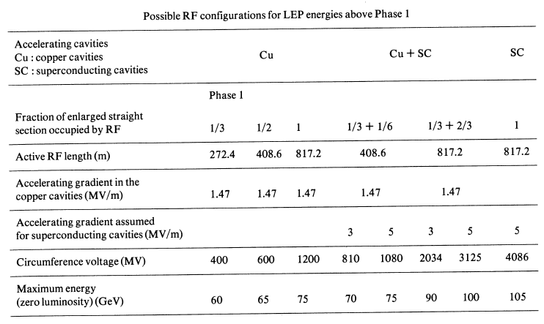

Slide 22
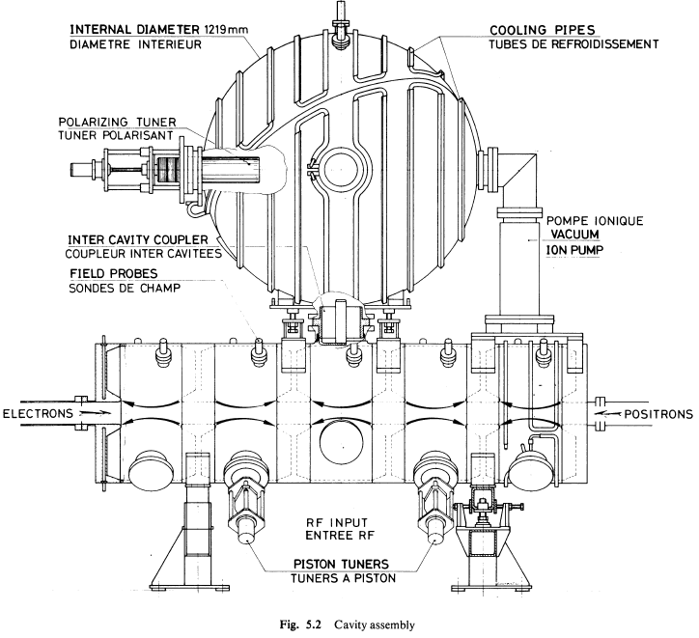

Slide 23
PEPII

Slide 24
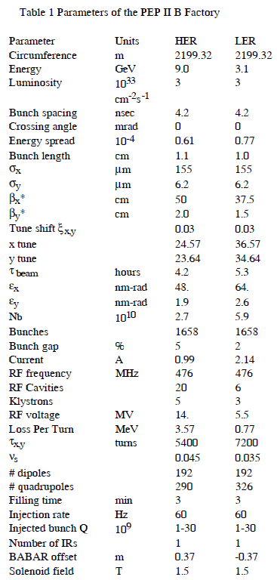
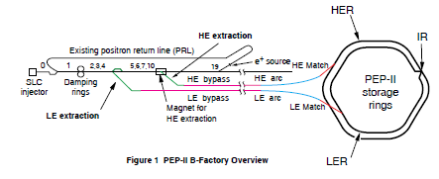
The PEP II B-Factory1 project is an e+e- colliding beam
storage ring complex to be built on the SLAC site. PEP II is
designed to provide a luminosity of 3 x 10³³ cm⁻²s⁻¹ at a
center of mass of 10.6 GeV with unequal energy beams of 3.1
and 9.0 GeV. The goal is to study CP violation in the B meson
system. The project is being built by a collaboration of the
Stanford Linear Accelerator Center, Lawrence Berkeley
Laboratory, and Lawrence Livermore National Laboratory.
DOE construction authorization was given in 1994.

Slide 25
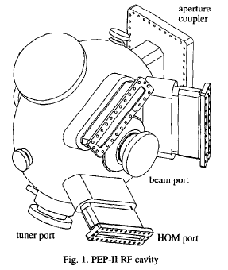
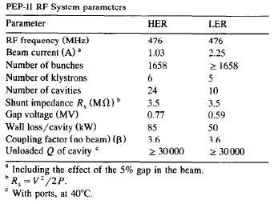
PEPII

Slide 26
